Slide 1

Controlling refractive index and reducing the GWP of Cerenkov gas radiators: challenge in an era of diminishing fluorocarbon availability
“From the Speed of Sound to the Speed of Light: and beyond!”
G. Hallewell
Aix Marseille Université, CNRS/IN2P3, CPPM, Marseille, France
With thanks to Christoph Frei, Christian Joram and Antonello di Mauro (CERN),
Helen McNamee and Andy Penman (F2 Chemicals, UK)
ECFA Detector R&D Roadmap,
Photodetectors & Particle ID (ECFA TF-4)
Meeting @ CERN May16-17th 2023
.
1
Notes:
1

Slide 2
Abstract (from meeting web pages)
COMPASS and LHCb use C₄F₁₀ and CF₄ Cherenkov gas radiators.
These Saturated FuoroCarbons (C_{n}F_{(2n+2)}) have high GWPs, however
(5000-9000*CO₂) so there is impetus to reduce their consumption.
Oxygenated fluorocarbons (C_{n}F_{2n}O) for example 3M NOVEC ® types can offer similar optical performance, with GWPs equivalent to CO₂.
Closed molecular rings with oxygen atom link have GWPs as high as SFCs:
to be avoided.
Legislation & market forces will limit FC availability, maybe leaving “holes” in the C_{n}F_{x} “spectrum”, unfilled by C_{n}F_{2n}O equivalents.
Blending low molar concentrations of heritage-stock higher-order SFCs
or 3M NOVEC®5110: C₅F₁₀O (GWPzero) with light gases, N₂, Ar, CO₂… would
reproduce C₄F₁₀ and CF₄ radiator optics but with reduced GWP “load”.
Sound velocity monitoring was used for controlling real-time blending C₅F₁₂ with N₂ in the SLD CRID. The technique could be valuable in the future operation to meet optical & low GWP constraints of future blended Cherenkov gas radiators.
Examples are explored.
G. Hallewell: GasRad GWP: ECFA TF-4 Meeting May16-17th 2023

Slide 3
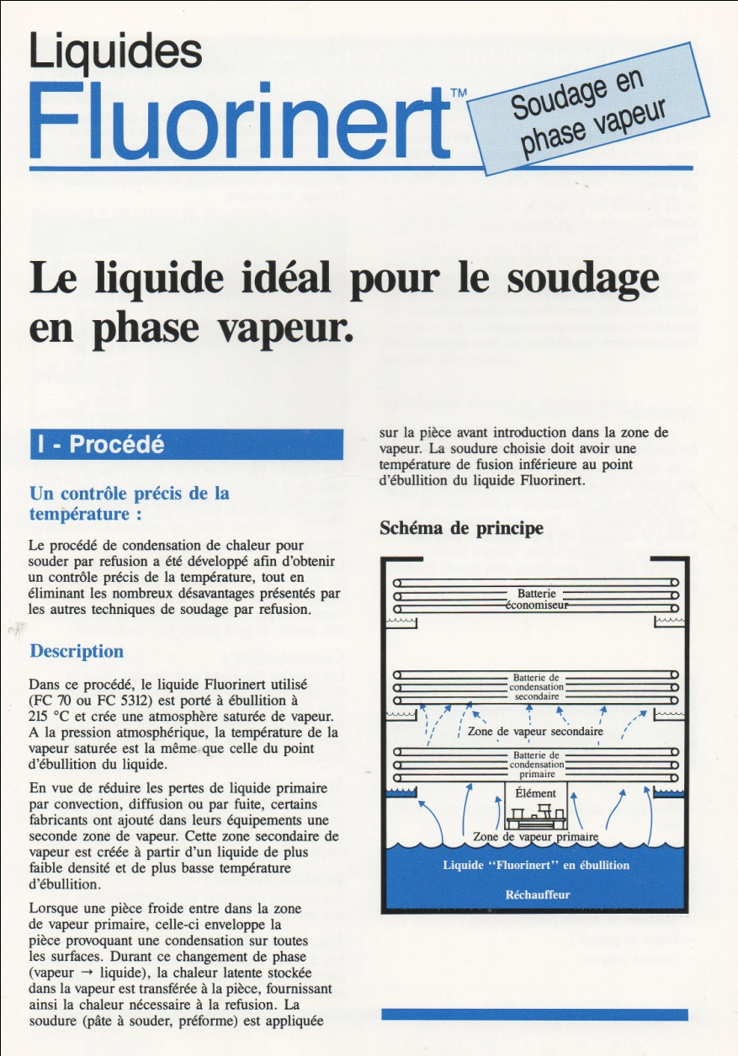
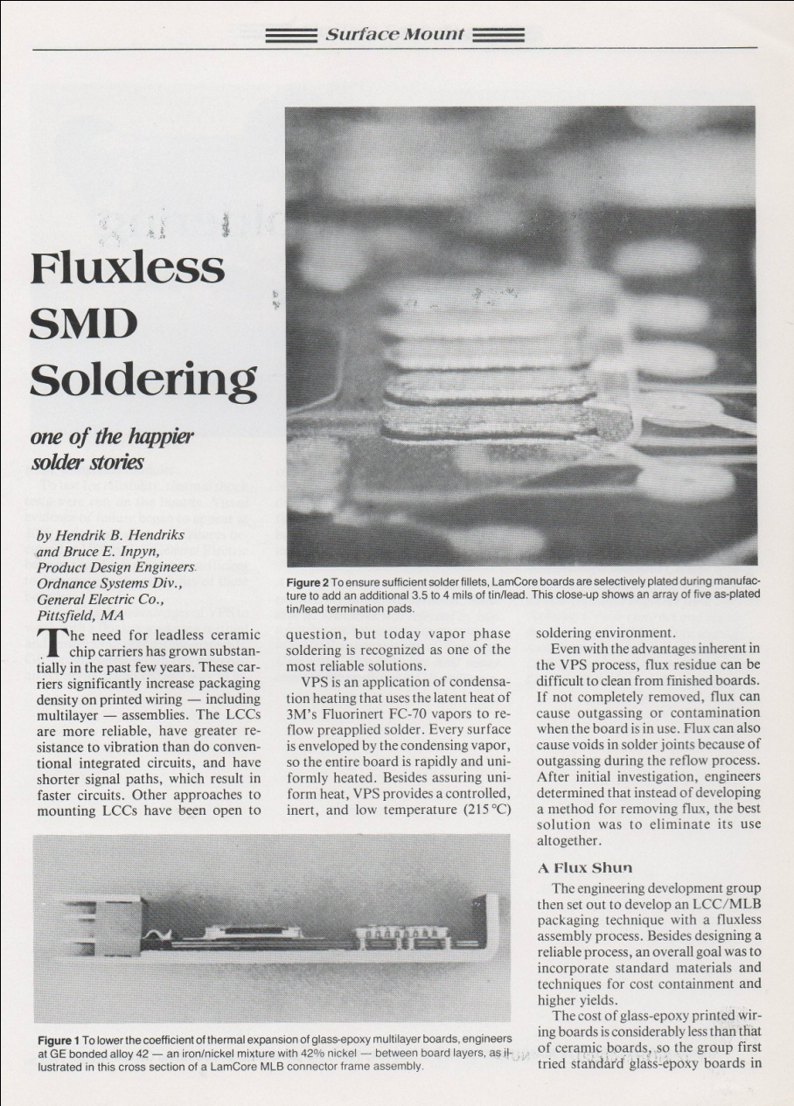
Historical - fluorocarbons: military and industrial (heat transfer) uses (3)
Vapour phase (non-contact) soldering of components on PCBs
(particularly surface mount) in high T fluorocarbon atmosphere !!!
The demand for vapour phase soldering is hardly going to “evaporate”.
New, lower GWP, transfer vapours will be needed (e.g. NOVEC)
3
G. Hallewell ECFA TF-4 Meeting May16-17th 2023

Slide 4


https://e-publishing.cern.ch/index.php/CERN_Environment_Report/issue/view/102;
Disappearing
Fluorocarbons?
4
G. Hallewell ECFA TF-4 Meeting May16-17th 2023

Slide 5
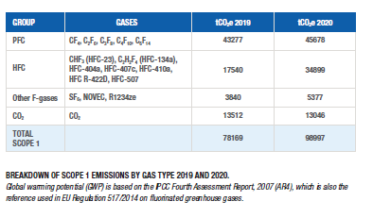
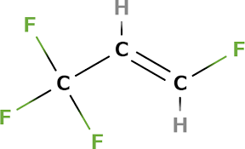
https://e-publishing.cern.ch/index.php/CERN_Environment_Report/issue/view/102;
CF₄ LHCb RICH2: GWP = ¬ 4880_{_CO2}* [16]
C₂F₆ ATLAS evap cooling (potential use): GWP = ¬ 11000_{_CO2}*
C₃F₈ F2 Chemicals , Astor, ATLAS evap cooling: GWP = ¬ 8900_{_CO2}*
C₄F₁₀ LHCb RICH1, COMPASS RICH: GWP = ¬ 8500_{_CO2}*
C₅F₁₂ PP50: GWP = ¬ 8500_{_CO2}*
C₆F₁₄ PP1, F2 Chemicals: Liquid cooling, many expts: GWP = ¬ 8000_{_CO2}*
For some perspective: SF6 GWP = ¬ 23000_{_CO2}*
See references: 100 yr (average of 2nd, 4th & 5th assessment reports; AR2,4,5)
https://www.ghgprotocol.org/sites/default/files/ghgp/Global-Warming-Potential-Values%20%28Feb%2016%202016%29_1.pdf
R1234ze
GWP=7
Which NOVEC®? What molecular structure: C₆F₁₂O (GWP = 0)?
Extremely unfair and deceptive to group NOVEC
on the same line as SF₆ (GWP = 23000)
5
G. Hallewell ECFA TF-4 Meeting May16-17th 2023

Slide 6
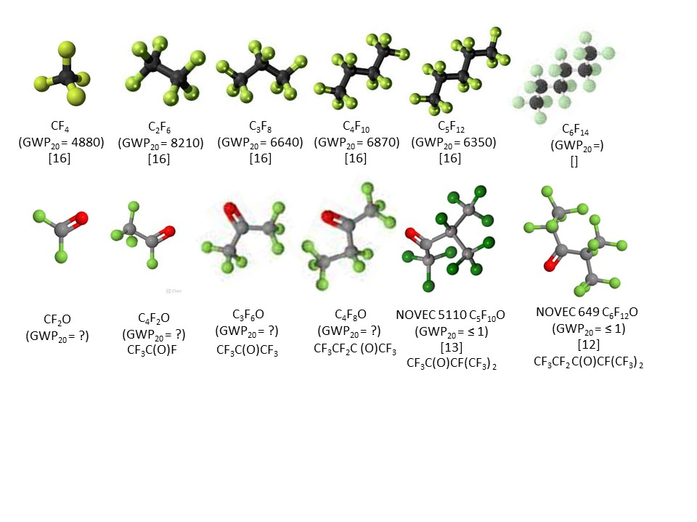
Alternatives to the saturated (C_{n}F_{(2n+2)}) molecules (“Fluoro-oygenates”: C_{n}F_{2n}O) ?
Could the solution be as “simple” as substituting an oxygen atom for 2 fluorines in the molecule?
3M NOVEC® 649 (C₆F₁₂O) & 5110 (C₅F₁₀O) GWP < 1 !!!
Can CFO’s be made over a wide C_{n} order range (n=1➔6)?
CF₂O, C₂F₄O, C₃F₆O, C₄F₈O, C₅F₁₀O, C₆F₁₂O…
Would the electronics industry be the commercial market driver for such alternatives (we are a small consumer…)?
6
G. Hallewell: RICH 2022, Edinburgh : Sept 12-16, 2022

Slide 7
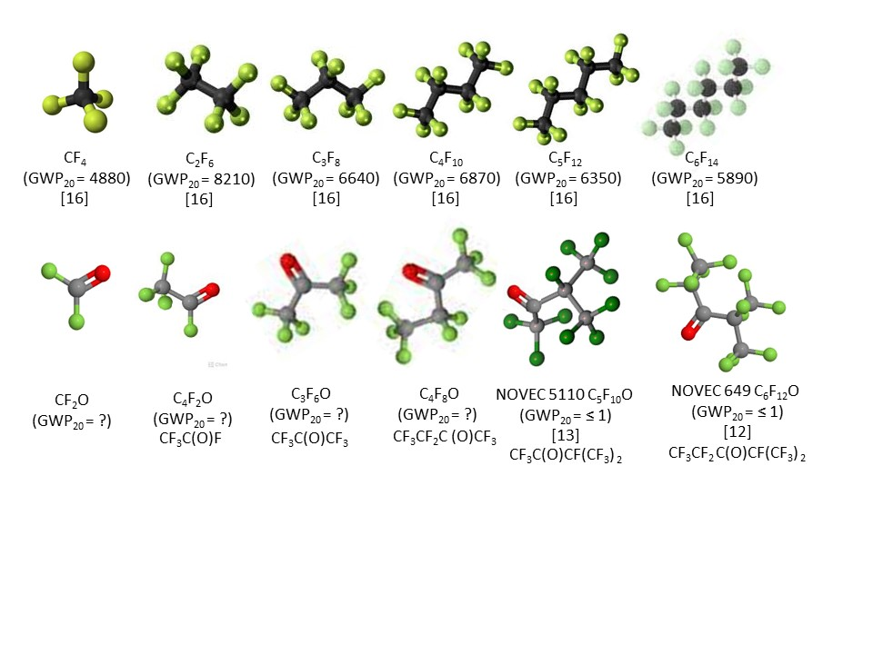
Molecular shapes and GWP (1)
Upper: molecular shapes of SFCs, including common gaseous Cherenkov radiators Lower: shapes of some non-cyclic C_{n}F_{2n}O analogues
(20-year GWPs noted where known – refs at end)
G. Hallewell: GasRad GWP: ECFA TF-4 Meeting May16-17th 2023

Slide 8
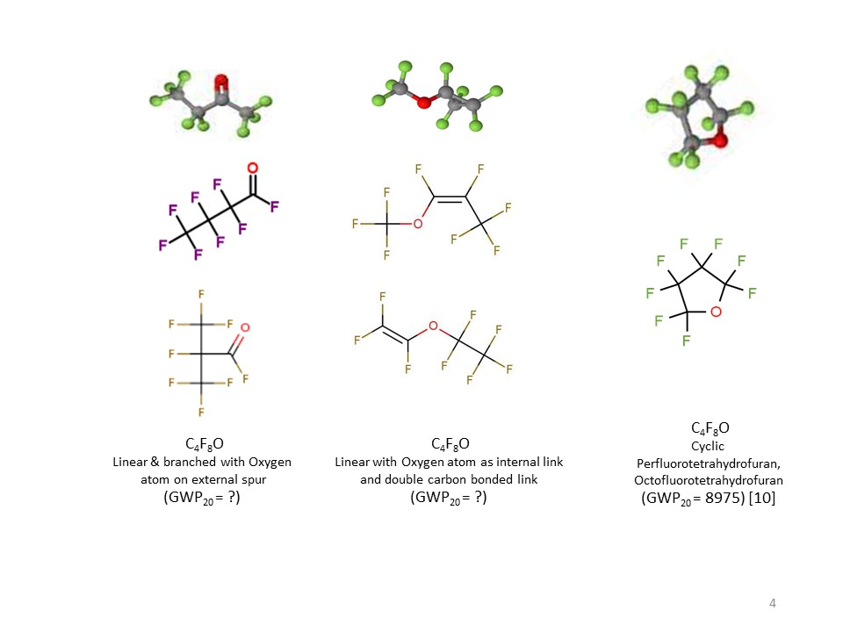
Molecular shapes and GWP (2)
☺
?
!!
Shape examples of cyclic, non-cyclic
& non-cyclic double carbon-bonded C₄F₈O isomers
refs at end.­
G. Hallewell: GasRad GWP: ECFA TF-4 Meeting May16-17th 2023

Slide 9
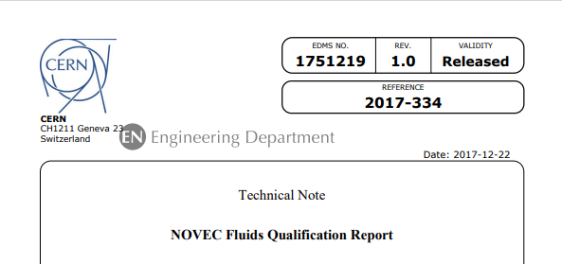
CERN has tested NOVEC 649
Equivalent radiation stability
to C₆F₁₄ used as a liquid coolant
in all LHC experiments;
(C₆F₁₂O) needs dessicants, but standard molecular sieves, activated-C OK: chosen SiPM coolant; LHCb Sci-Fi tracker
9
G. Hallewell: GasRad GWP: ECFA TF-4 Meeting May16-17th 2023

Slide 10
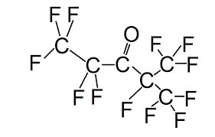
Q: But What gives NOVEC 649/1230
(a spurred-Oxygen fluoro-ketone) its low GWP?
A: Structure!: a double-bonded oxygen atom on a peripheral spur of the molecule
This fluoro-ketone configuration is:
CF₃CF₂C(O)CF(CF₃)₂
10
G. Hallewell: GasRad GWP: ECFA TF-4 Meeting May16-17th 2023

Slide 11
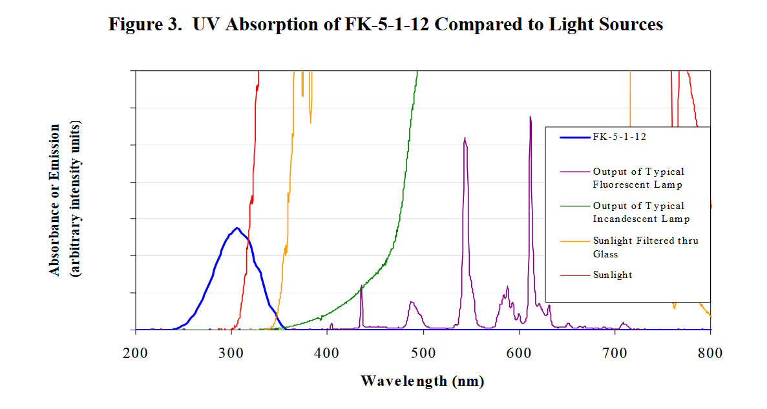
Q: What gives NOVEC 649/1230 its low GWP?
https://www.nist.gov/system/files/documents/el/fire_research/R0301570.pdf
[15]
Scission by UV photons of λ around 300 nm
In the atmosphere (low pressure, high UV): the fragments do not reassociate* into saturated fluorocarbons of the type C_{n}F_{(2n+2)} (which would have high GWP)
*The Environmental Impact of CFC Replacements HFCs and HCFCs
T. WALLINGTON et al Environ.Sci.Technol.1994(28)7 320A https://doi.org/10.1021/es00056a714
11
G. Hallewell: GasRad GWP: ECFA TF-4 Meeting May16-17th 2023

Slide 12
Positive and Negative exeriences with C₄F₈O as a substitute for C₄F₁₀
Cherenkov radiator gas
(BTeV and ALICE VHMPID)
12
G. Hallewell: GasRad GWP: ECFA TF-4 Meeting May16-17th 2023

Slide 13
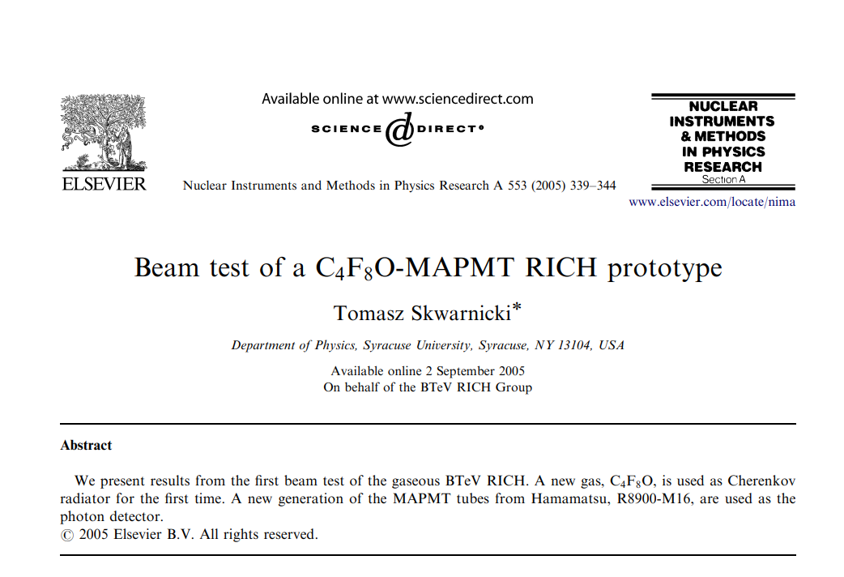
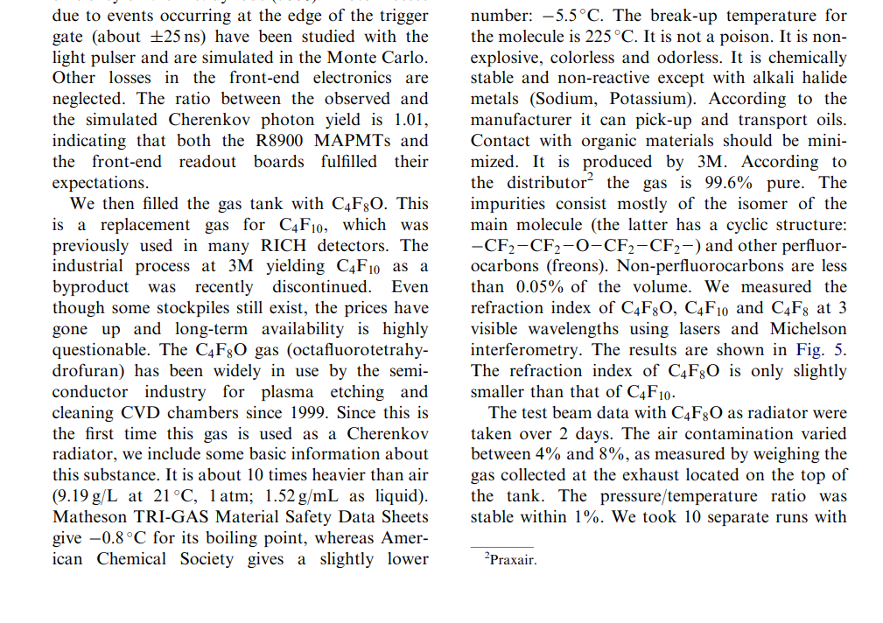
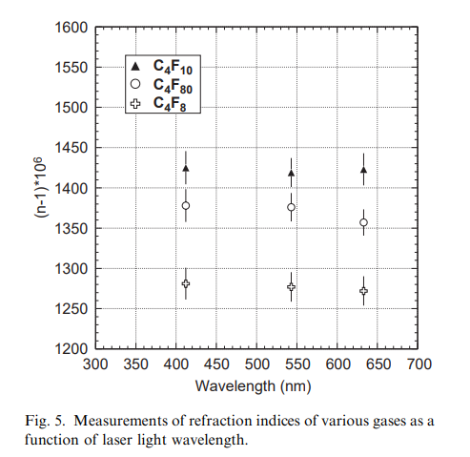
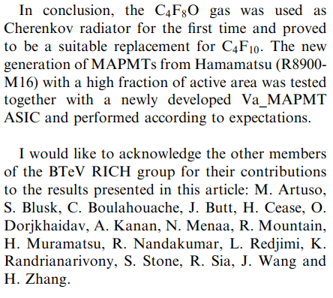
BTeV study: optics good – GWP not
G. Hallewell: GasRad GWP: ECFA TF-4 Meeting May16-17th 2023
13

Slide 14
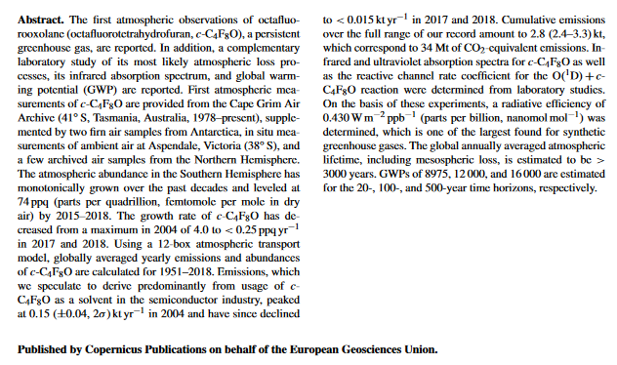
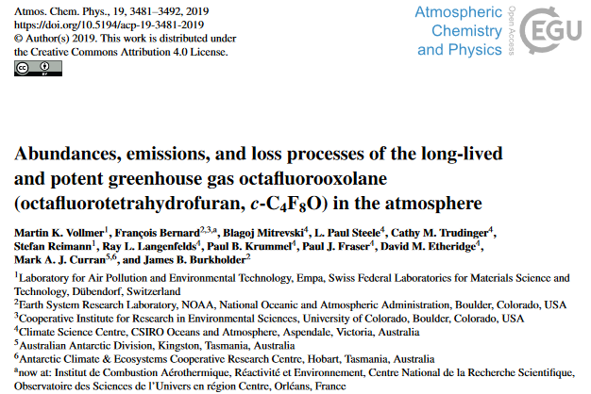
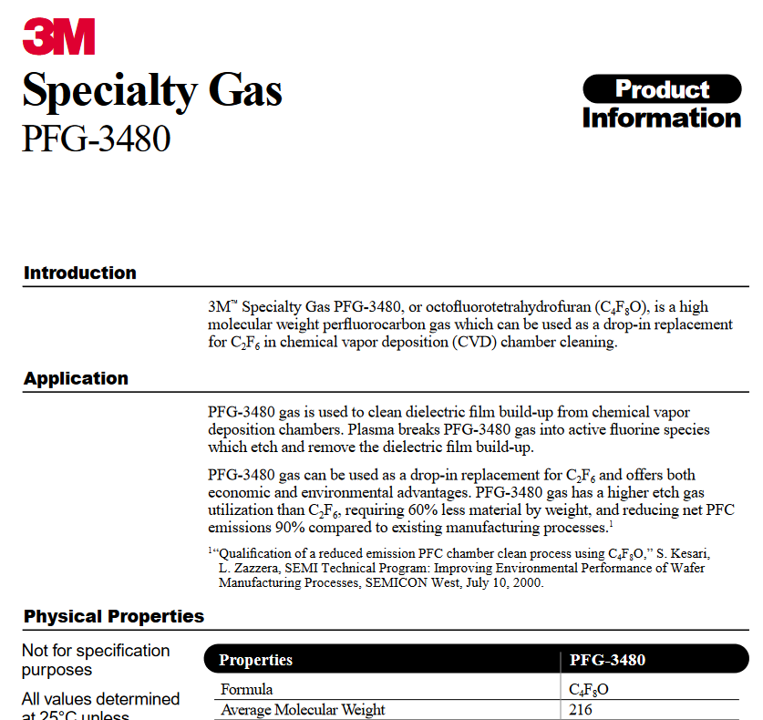
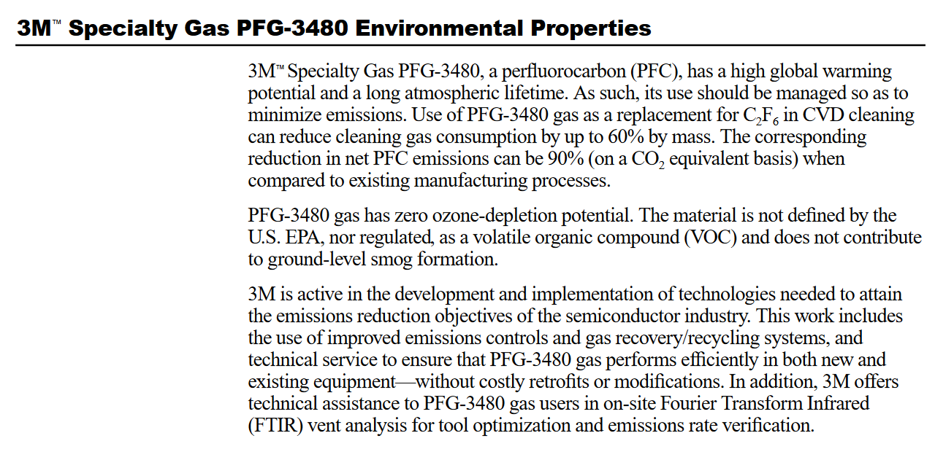
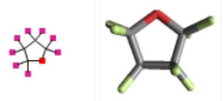
Shapes of C_{n}F_{2n}O molecules and GWP:
c-octafluorooxolane (C₄F₈O),
MW = 216: GWP = 12000 BTEV stuff?
Perfluortetrahydrofuran – The BTeV choice
From June 2000 3M datasheet
https://repository.library.noaa.gov/
044ed5ad-93ae-40e3-9420-d78
a4729ff0f
3M Specialty Gas PFG-3480 is a high-performance chamber cleaning gas that has environmental advantages and can help reduce operating costs. PFG-3480 reduces emissions of global warming compounds by 90 percent when compared to the traditional plasma enhanced chemical vapor deposition(PECVD) cleaning gas, C2F6. The replacement does not require changes to existing processes
14
G. Hallewell: GasRad GWP: ECFA TF-4 Meeting May16-17th 2023

Slide 15
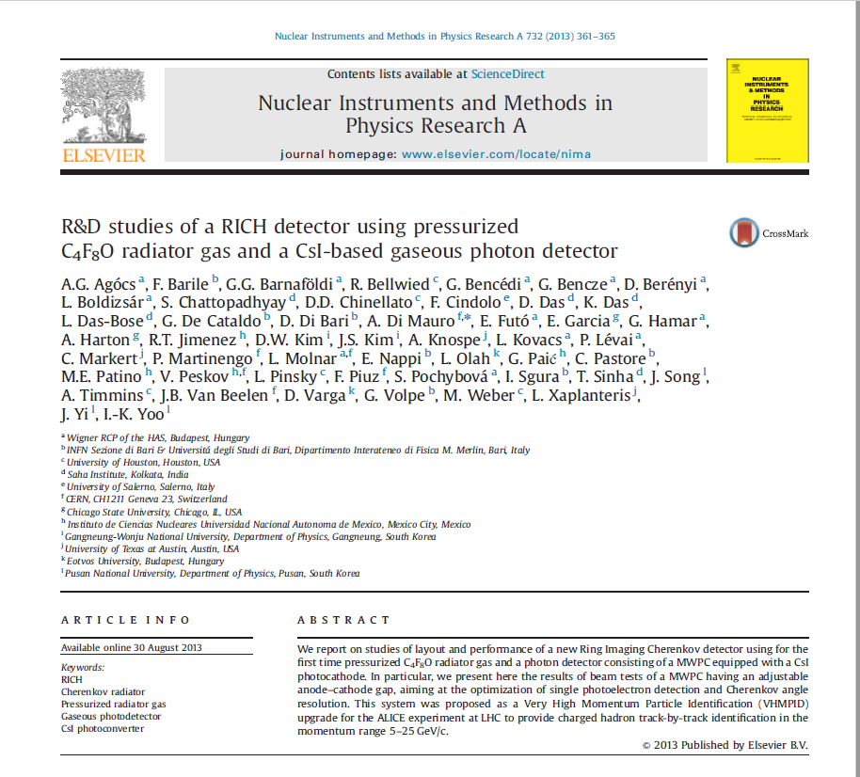
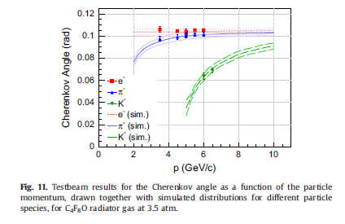
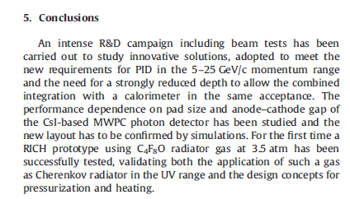
Shapes of C_{n}F_{2n}O molecules and GWP:
Octafluortetrahydrofuran – the probable ALICE VHMPID config
C₄F₈O acquired from Synquest (FL,USA) : reported by A. di Mauro:
15
G. Hallewell: GasRad GWP: ECFA TF-4 Meeting May16-17th 2023

Slide 16

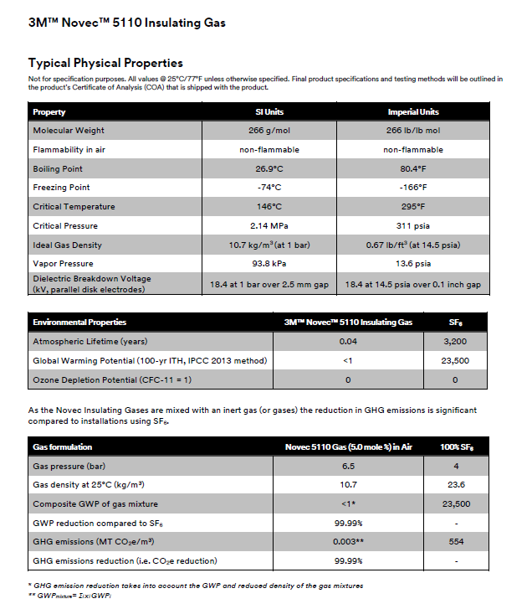
Another exciting example: Novec 5110: C₅F₁₀O MW = 282: GWP <1
Mixing potential here with currently-available
low GWP « Fluoro-oxygenate » (C_{n}F_{2n}O) :
Blend with N₂ to match C₄F₁₀ - or even CF₄ - refractivity?
16
G. Hallewell: GasRad GWP: ECFA TF-4 Meeting May16-17th 2023

Slide 17
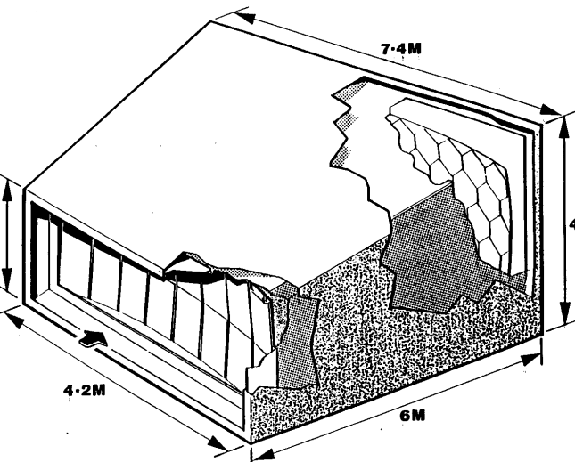
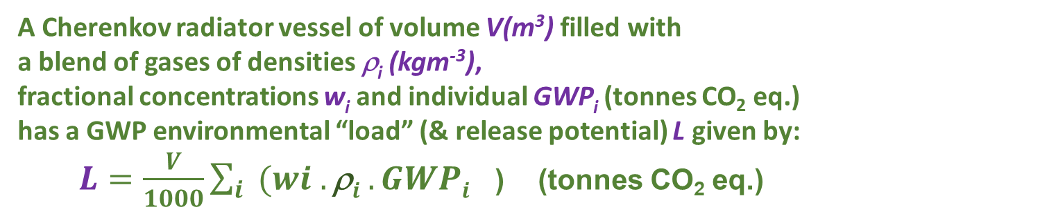
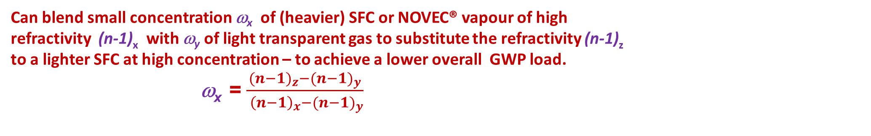
Refractive index & GWP ’load’ in a Cherenkov Gas Radiator
3 large RICH detectors currently in operation at CERN:
using saturated fluorocarbon gas volumes ˜ 50-100 m³:
C₄F₁₀ (COMPASS, LHCb RICH 1): GWP₂₀ = 4880,
CF₄ (LHCb RICH 2): GWP₂₀ = 6870
V,ρ
A Cherenkov radiator vessel of volume V(m³) filled with
a blend of gases of densities ρ_{i} (kgm⁻³),
fractional concentrations w_{i} and individual GWP_{i} (tonnes CO₂ eq.)
has a GWP environmental “load” (& release potential) L given by:
$L=\frac{V}{1000}\sum_{i}{{(wi .\text{r}i .GWPi}^{}}$) (tonnes CO₂ eq.)
(2)
Can blend small concentration of high refractivity (heavier) SFC or NOVEC vapour with light transparent gas
(or gases) for similar optical properties to a lighter SFC at high concentration, but with a lower overall
GWP load. In this context the replacement of a lighter SFC by a (GWP = 1) “NOVEC” fluoro-ketone alternative would be ideal, but the
absence of convenient NOVEC fluids blends of legacy stock heavier SFCs could be considered. Taking the case of a binary mixture of a
heavy fluoro-ketone or SFC vapour x of refractivity (n-1)_{x} a light transparent partner y of refractivity (n-1)_{y,} the molar concentration, w_{x}, necessary
to replicate the refractivity of a light SFC z with refractivity (n-1)_{z} can be expressed as:
wx=((n-1)z-n-1y)(n-1x-n-1y) (3
The corresponding radiator gas mixture refractivity is given by :
$\text{(}\text{n}\text{−1)}rad =\sum_{i}{{(wi.\text{(}\text{n}\text{−1)}i}^{}}$)
Can blend small concentration ω_{x} of (heavier) SFC or NOVEC® vapour of high
refractivity (n-1)_{x} with ω_{y} of light transparent gas to substitute the refractivity (n-1)_{z}
to a lighter SFC at high concentration – to achieve a lower overall GWP load.
ω_{x} = $\frac{{{(n−1)}_{z}−(n−1)}_{y}}{{ {\left(n−1\right)}_{x}−(n−1)}_{y}}$
G. Hallewell: GasRad GWP: ECFA TF-4 Meeting May16-17th 2023

Slide 18
GWP loads of SFCs & 3M NOVEC ® 5110 blended with N₂
((n-1) = 310.10⁻⁶) to match refractivity of CF₄ and C₄F_{10.}
Positions of presently unavailable-in-bulk C_{n}F_{2n}O fluids in red
Base fluid | Base fluid density (1bar,25˚C) kgm⁻³ | Base fluid GWP (20-yr) | Component (n-1) (*10⁶) (@ nm) | % Blend with N₂ to match (n-1) CF₄ | GWP load (100m³: t.CO₂) | % Blend with N₂ to match (n-1) C₄F₁₀ | GWP load (100m³: t.CO₂)
CF₄ | 3.56 [18] | 4880 [16] | 488 (180-310 nm) [19] | 100 | 1737 | not applicable | n/a
CF₂O | - |  |  | - |  | n/a | n/a
C₂F₆ | 5.63 [18] | 8210 [16] | 793 (180-310 nm) [19] | 38.1 | 1762 | not applicable | n/a
Lin-C₂F₄O | - |  |  | - |  | n/a | n/a
C₃F₈ | 7.75 [18] | 6640 [16] | 1180 (250 nm) [16] | 21.4 | 1099 | not applicable | n/a
Lin-C₃F₆O | - |  |  | - |  | n/a | n/a
C₄F₁₀ | 9.97 [18] | 6870 [16] | 1450 (250 nm) [16] | 16.3 | 1119 | 100 | 6849
Lin-C₄F₈O (Non-cyclic C₄F₈O)* | 9.5 (est.) | Probably < 1 (NOVEC 5110 Analogy) | 1380 @ 400nm (based on 3M PFG-3480 c-C₄F₈O [7]: linear C₄F₈O not yet measured but assumed similar) | 18.4 | 0.18 | 112.7* (>100% would imply necessity of operating C₄F₈O at slight overpressure) | 1.07
C₅F₁₂ | 11.63 [18] (BP 30 ˚C at 1 bar) | 6350 [16] | 1750 (180-310nm)[19] (40 ˚C, undiluted) | 13.0 | 957 | 79.3 | 5857
NOVEC 5110 C₅F₁₀O | 10.7 [13] (BP 27˚C at 1 bar) | <1 [13] | Not yet measured: probably around 1650 by analogy with C₄F₁₀ and C₄F₈O ratio | 13.9 | 0.149 | 85.2 | 0.91
*Made in research quantities by Synquest Inc. as isomers Heptafluorobutyryl fluoride PN: 2116-2-07 CAS: 335-42-2
Octafluoro-2-butanone PN: 2117-2-10 CAS: 337-20-2 & Heptafluoroisobutyryl fluoride PN: 2116-2-0A CAS: 677-84-9
G. Hallewell: GasRad GWP: ECFA TF-4 Meeting May16-17th 2023

Slide 19
GWP loads of SFCs & 3M NOVEC ® 5110 blended with N₂
((n-1) = 310.10⁻⁶) to match refractivity of CF₄ and C₄F_{10.}
Positions of presently unavailable-in-bulk C_{n}F_{2n}O fluids in red
Base fluid | Base fluid density (1bar,25˚C) kgm⁻³ | Base fluid GWP (20-yr) | Component (n-1) (*10⁶) (@ nm) | % Blend with N₂ to match (n-1) CF₄ | GWP load (100m³: t.CO₂) | % Blend with N₂ to match (n-1) C₄F₁₀ | GWP load (100m³: t.CO₂)
CF₄ | 3.56 [18] | 4880 [16] | 488 (180-310 nm) [19] | 100 | 1737 | not applicable | n/a
CF₂O | - |  |  | - |  | n/a | n/a
C₂F₆ | 5.63 [18] | 8210 [16] | 793 (180-310 nm) [19] | 38.1 | 1762 | not applicable | n/a
Lin-C₂F₄O | - |  |  | - |  | n/a | n/a
C₃F₈ | 7.75 [18] | 6640 [16] | 1180 (250 nm) [16] | 21.4 | 1099 | not applicable | n/a
Lin-C₃F₆O | - |  |  | - |  | n/a | n/a
C₄F₁₀ | 9.97 [18] | 6870 [16] | 1450 (250 nm) [16] | 16.3 | 1119 | 100 | 6849
Lin-C₄F₈O (Non-cyclic C₄F₈O)* | 9.5 (est.) | Probably < 1 (NOVEC 5110 Analogy) | 1380 @ 400nm (based on 3M PFG-3480 c-C₄F₈O [7]: linear C₄F₈O not yet measured but assumed similar) | 18.4 | 0.18 | 112.7* (>100% would imply necessity of operating C₄F₈O at slight overpressure) | 1.07
C₅F₁₂ | 11.63 [18] (BP 30 ˚C at 1 bar) | 6350 [16] | 1750 (180-310nm)[19] (40 ˚C, undiluted) | 13.0 | 957 | 79.3 | 5857
NOVEC 5110 C₅F₁₀O | 10.7 [13] (BP 27˚C at 1 bar) | <1 [13] | Not yet measured: probably around 1650 by analogy with C₄F₁₀ and C₄F₈O ratio | 13.9 | 0.149 | 85.2 | 0.91
!!
G. Hallewell: GasRad GWP: ECFA TF-4 Meeting May16-17th 2023

Slide 20
GWP loads of SFCs & 3M NOVEC ® 5110 blended with N₂
((n-1) = 310.10⁻⁶) to match refractivity of CF₄ and C₄F_{10.}
Positions of presently unavailable-in-bulk C_{n}F_{2n}O fluids in red
Base fluid | Base fluid density (1bar,25˚C) kgm⁻³ | Base fluid GWP (20-yr) | Component (n-1) (*10⁶) (@ nm) | % Blend with N₂ to match (n-1) CF₄ | GWP load (100m³: t.CO₂) | % Blend with N₂ to match (n-1) C₄F₁₀ | GWP load (100m³: t.CO₂)
CF₄ | 3.56 [18] | 4880 [16] | 488 (180-310 nm) [19] | 100 | 1737 | not applicable | n/a
CF₂O | - |  |  | - |  | n/a | n/a
C₂F₆ | 5.63 [18] | 8210 [16] | 793 (180-310 nm) [19] | 38.1 | 1762 | not applicable | n/a
Lin-C₂F₄O | - |  |  | - |  | n/a | n/a
C₃F₈ | 7.75 [18] | 6640 [16] | 1180 (250 nm) [16] | 21.4 | 1099 | not applicable | n/a
Lin-C₃F₆O | - |  |  | - |  | n/a | n/a
C₄F₁₀ | 9.97 [18] | 6870 [16] | 1450 (250 nm) [16] | 16.3 | 1119 | 100 | 6849
Lin-C₄F₈O (Non-cyclic C₄F₈O)* | 9.5 (est.) | Probably < 1 (NOVEC 5110 Analogy) | 1380 @ 400nm (based on 3M PFG-3480 c-C₄F₈O [7]: linear C₄F₈O not yet measured but assumed similar) | 18.4 | 0.18 | 112.7* (>100% would imply necessity of operating C₄F₈O at slight overpressure) | 1.07
C₅F₁₂ | 11.63 [18] (BP 30 ˚C at 1 bar) | 6350 [16] | 1750 (180-310nm)[19] (40 ˚C, undiluted) | 13.0 | 957 | 79.3 | 5857
NOVEC 5110 C₅F₁₀O | 10.7 [13] (BP 27˚C at 1 bar) | <1 [13] | Not yet measured: probably around 1650 by analogy with C₄F₁₀ and C₄F₈O ratio | 13.9 | 0.149 | 85.2 | 0.91

Slide 21
GWP loads of SFCs & 3M NOVEC ® 5110 blended with N₂
((n-1) = 310.10⁻⁶) to match refractivity of CF₄ and C₄F_{10.}
Positions of presently unavailable-in-bulk C_{n}F_{2n}O fluids in red
Base fluid | Base fluid density (1bar,25˚C) kgm⁻³ | Base fluid GWP (20-yr) | Component (n-1) (*10⁶) (@ nm) | % Blend with N₂ to match (n-1) CF₄ | GWP load (100m³: t.CO₂) | % Blend with N₂ to match (n-1) C₄F₁₀ | GWP load (100m³: t.CO₂)
CF₄ | 3.56 [18] | 4880 [16] | 488 (180-310 nm) [19] | 100 | 1737 | not applicable | n/a
CF₂O | - |  |  | - |  | n/a | n/a
C₂F₆ | 5.63 [18] | 8210 [16] | 793 (180-310 nm) [19] | 38.1 | 1762 | not applicable | n/a
Lin-C₂F₄O | - |  |  | - |  | n/a | n/a
C₃F₈ | 7.75 [18] | 6640 [16] | 1180 (250 nm) [16] | 21.4 | 1099 | not applicable | n/a
Lin-C₃F₆O | - |  |  | - |  | n/a | n/a
C₄F₁₀ | 9.97 [18] | 6870 [16] | 1450 (250 nm) [16] | 16.3 | 1119 | 100 | 6849
Lin-C₄F₈O (Non-cyclic C₄F₈O)* | 9.5 (est.) | Probably < 1 (NOVEC 5110 Analogy) | 1380 @ 400nm (based on 3M PFG-3480 c-C₄F₈O [7]: linear C₄F₈O not yet measured but assumed similar) | 18.4 | 0.18 | 112.7* (>100% would imply necessity of operating C₄F₈O at slight overpressure) | 1.07
C₅F₁₂ | 11.63 [18] (BP 30 ˚C at 1 bar) | 6350 [16] | 1750 (180-310nm)[19] (40 ˚C, undiluted) | 13.0 | 957 | 79.3 | 5857
NOVEC 5110 C₅F₁₀O | 10.7 [13] (BP 27˚C at 1 bar) | <1 [13] | Not yet measured: probably around 1650 by analogy with C₄F₁₀ and C₄F₈O ratio | 13.9 | 0.149 | 85.2 | 0.91
G. Hallewell: GasRad GWP: ECFA TF-4 Meeting May16-17th 2023

Slide 22
GWP loads of SFCs & 3M NOVEC ® 5110 blended with N₂
((n-1) = 310.10⁻⁶) to match refractivity of CF₄ and C₄F_{10.}
And should fantasy become reality?
Base fluid | Base fluid density (1bar,25˚C) kgm⁻³ | Base fluid GWP (20-yr) | Component (n-1) (*10⁶) (@ nm) | % Blend with N₂ to match (n-1) CF₄ | GWP load (100m³: t.CO₂) | % Blend with N₂ to match (n-1) C₄F₁₀ | GWP load (100m³: t.CO₂)
CF₄ | 3.56 [18] | 4880 [16] | 488 (180-310 nm) [19] | 100 | 1737 | not applicable | n/a
CF₂O | - |  |  | - | 0 |  | 0
C₂F₆ | 5.63 [18] | 8210 [16] | 793 (180-310 nm) [19] | 38.1 | 1762 | not applicable | n/a
Lin-C₂F₄O | - |  |  | - |  | n/a | n/a
C₃F₈ | 7.75 [18] | 6640 [16] | 1180 (250 nm) [16] | 21.4 | 1099 | not applicable | n/a
Lin-C₃F₆O | - |  |  | - |  | n/a | n/a
C₄F₁₀ | 9.97 [18] | 6870 [16] | 1450 (250 nm) [16] | 16.3 | 1119 | 100 | 6849
Lin-C₄F₈O (Non-cyclic C₄F₈O)* | 9.5 (est.) | Probably < 1 (NOVEC 5110 Analogy) | 1380 @ 400nm (based on 3M PFG-3480 c-C₄F₈O [7]: linear C₄F₈O not yet measured but assumed similar) | 18.4 | 0.18 | 112.7* (>100% would imply necessity of operating C₄F₈O at slight overpressure) | 1.07
C₅F₁₂ | 11.63 [18] (BP 30 ˚C at 1 bar) | 6350 [16] | 1750 (180-310nm)[19] (40 ˚C, undiluted) | 13.0 | 957 | 79.3 | 5857
NOVEC 5110 C₅F₁₀O | 10.7 [13] (BP 27˚C at 1 bar) | <1 [13] | Not yet measured: probably around 1650 by analogy with C₄F₁₀ and C₄F₈O ratio | 13.9 | 0.149 | 85.2 | 0.91
WOULDN’T THIS BE WONDERFUL?
AND THIS?
G. Hallewell: GasRad GWP: ECFA TF-4 Meeting May16-17th 2023

Slide 23
The ideal new radiator fluids would be the non-cyclic C_{n}F_{2n}O molecules with the same carbon order as CF₄, C₄F₁₀ if these become available.
We should NOT be considering flammable gases or high pressure (large PV stored energy) gas radiators for underground areas (this is an even bigger “fantasy”).
However in their absence we can blend NOVEC 5100
or even legacy high-order fluorocarbons
to reduce gas radiator GWP:
But how to blend?
(see aslo annex)
23
G. Hallewell: GasRad GWP: ECFA TF-4 Meeting May16-17th 2023

Slide 24
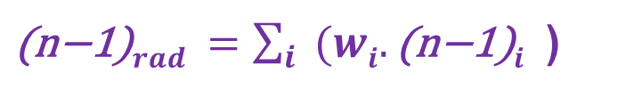
Use speed of sound measured in real-time
(traditionally also called “c” by acousticians to confuse things)
to get the molar concentrations of the gas components ω_{i}
$\text{(}\text{n}\text{−1)}rad =\sum_{i}{{(wi.\text{(}\text{n}\text{−1)}i}^{}}$)
Then use standard refractivity formula to get from calculated ω_{1,2}
to refractive index of the radiator gas in real-time along with standard relativistic expressions to get from n to Cherenkov γ thresholds for different particle species and β = 1 angle
Real-time measurement of speed of sound c takes us via the relative concentrations of the components to the speed of light β in the radiator gas (see annex for algorithms used)
24
G. Hallewell: GasRad GWP: ECFA TF-4 Meeting May16-17th 2023

Slide 25
SLD-CRID: Cherenkov threshold in C₅F₁₂/N₂ mixtures
vs. measured speed of sound in radiator gas mixture (1)
Typical mix 87%C₅F₁₂,13%N₂
C₅F₁₂ concentration (%)
25
G. Hallewell: GasRad GWP: ECFA TF-4 Meeting May16-17th 2023

Slide 26

SLD-CRID: Cherenkov threshold in C₅F₁₂/N₂ mixtures
vs. measured speed of sound in radiator gas mixture (2)
So.. from c to β…
Cherenkov Threshold (GeV/c)
β = 1/n
Measured Sound Velocity (m/s)
26
G. Hallewell: GasRad GWP: ECFA TF-4 Meeting May16-17th 2023

Slide 27
Cherenkov threshold in C₅F₁₂/N₂ mixtures
and GWP load comparison with LHCb RICH2 (new vol.?)
N₂-NOVEC5110 (C₅F₁₀O) might be very similar (MW 282 vs 288)
LHCb RICH 2: CF₄ thresholds
GWP load = (0.95 molar*4880*V.ρ)
Novec 5110 gives a huge GWP load reduction of 4636 V.ρ units
Even substituting 0.9 molar CF₄ with 0.12 molar C₅F₁₂ reduces GWP load by 3784 V.ρ units
C₅F₁₂ concentration (%)
LHCb RICH 2 with C₅F₁₀O/N₂
GWP load = (0.12 molar*1*V.ρ)
27
G. Hallewell: GasRad GWP: ECFA TF-4 Meeting May16-17th 2023

Slide 28
Situation for RICH radiators using C₄F₁₀ with N₂ passivant
Can make the same C₅F₁₀O comparison
as for a CF₄ radiator (see preceeding table)
But low GWP non-cyclic C₄F₈O
would be easier to circulate, if available.
Cherenkov Threshold (GeV/c)
C₄F₁₀ concentration in radiator gas (%)
Measured Sound Velocity (m/s)
28
G. Hallewell: GasRad GWP: ECFA TF-4 Meeting May16-17th 2023

Slide 29
Cherenkov threshold in C₅F₁₂/N₂ mixtures
and GWP load comparison with LHCb RICH1 (new vol.?)
N₂-NOVEC5110 (C₅F₁₀O) might be very similar (MW 282 vs 288)
LHCb RICH 1: C₄F₁₀ thresholds
GWP load = (6870*V.ρ)
85% Novec 5110 gives a huge GWP load reduction of 6870 V.ρ units
C₅F₁₂ concentration (%)
29
G. Hallewell: GasRad GWP: ECFA TF-4 Meeting May16-17th 2023

Slide 30
The uncertain ECHA path to prohibition
[33] ECHA/NR/23/04;
https://echa.europa.eu/-/echa-publishes-pfas-restriction-proposal]
[34] ECHA Candidate List of substances of very high concern for Authorisation;
https://echa.europa.eu/candidate-list-table
[35] Annex to the Annex XV restriction report proposal for restriction:
Per- & polyfluoroalkyl substances (PFASs);ECHA; 22/03/2023 https://echa.europa.eu/documents/10162/d2f7fce1-b089-c4fd-1101-2601f53a07d1
[36] Per- and polyfluoroalkyl substances (PFAS); ECHA
https://echa.europa.eu/hot-topics/perfluoroalkyl-chemicals-pfas
We need to clarify the 3M attitude to future NOVEC production
Electronics industry is the driver!
G. Hallewell: GasRad GWP: ECFA TF-4 Meeting May16-17th 2023

Slide 31
Conclusion
Saturated (C_{n}F_{(2n+2)}) fluorocarbons under attack for their high GWP
Reduce wastage, purification loss in present installations;
Mix smaller molar concentrations of heavy SFCs
or better C_{n}F_{2n}O with light N₂ etc. carriers for desired ref. index;
SLAC SLD CRID sonar (1990s): Cherenkov angle/β measurement
& dynamic C₅F₁₂/N₂ blend control: ultrasonic feedback to flow controllers
Refractive index can be continuously monitored by utrasound even in dynamically-varying trimixes, if 3rd component conc. known from another sensor ;
New (non-cyclic) C_{n}F_{2n}O molecules very promising (particuarly
C₅F₁₀O (3M NOVEC ® 5110)): blend studies starting (Antonello Di Mauro)
(need optical studies) ➔ potentially huge GWP savings
➔ CF₂O & lin. C₄F₈O would be ideal…
We are a small-scale users who will always ride on the
coat-tails for the semiconductor manufacturing industry.
We should nonetheless enter discussions with manufacturers!
31
G. Hallewell: GasRad GWP: ECFA TF-4 Meeting May16-17th 2023

Slide 32
Other resources:
References, Annexes
& supporting information
G. Hallewell: GasRad GWP: ECFA TF-4 Meeting May16-17th 2023

Slide 33

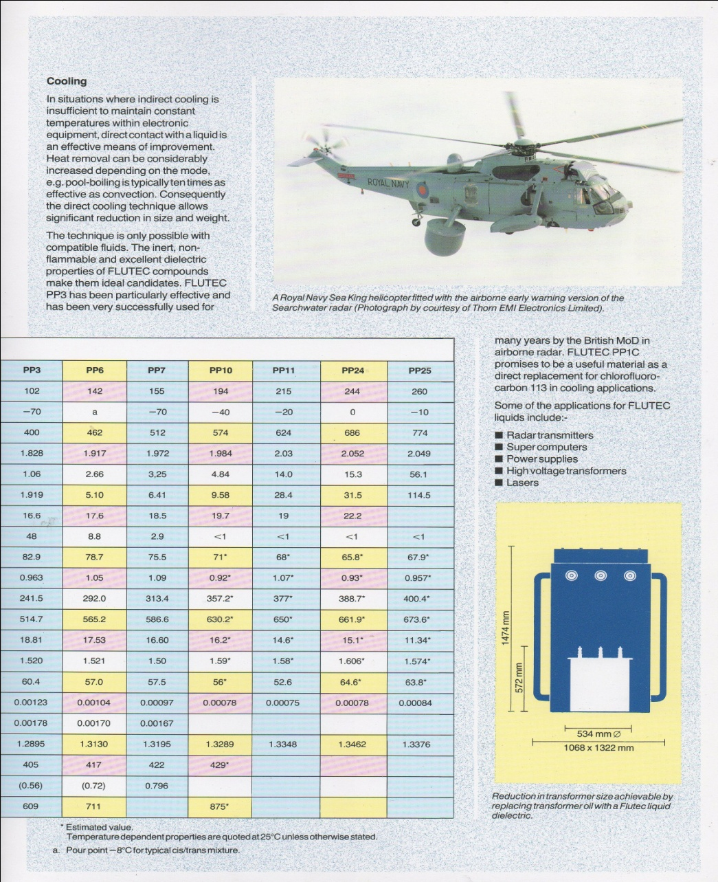
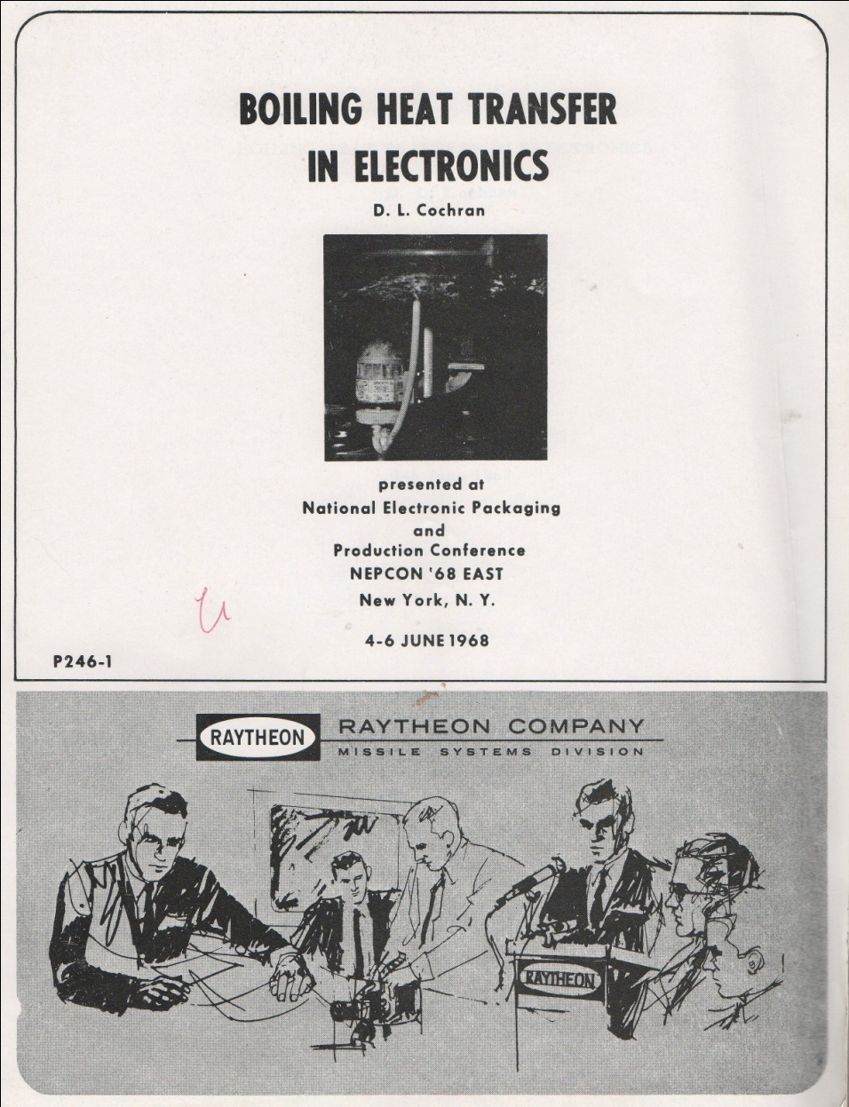
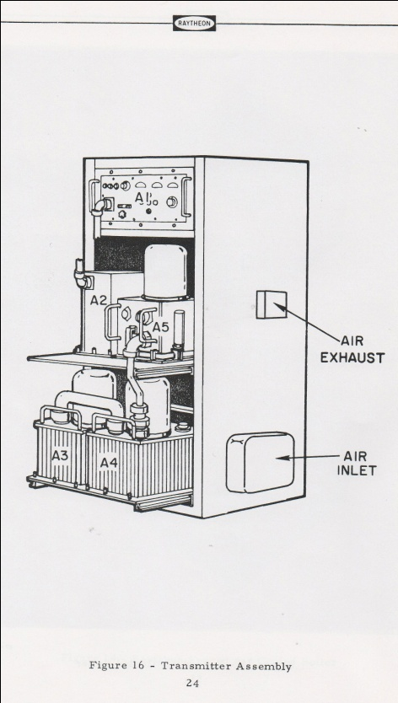
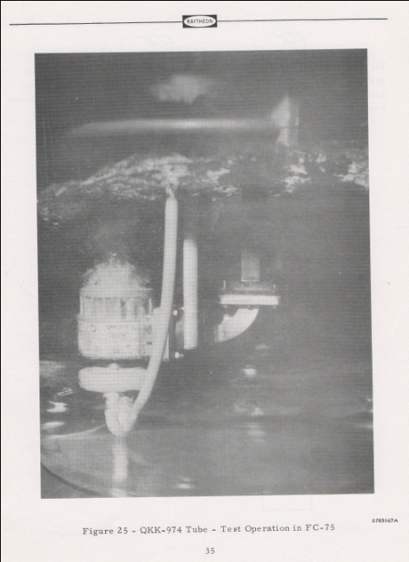
Historical: fluorocarbons: military (mainly radar) and industrial uses (1)
Radar magnetron
Direct immersion
33
G. Hallewell ECFA TF-4 Meeting May16-17th 2023

Slide 34
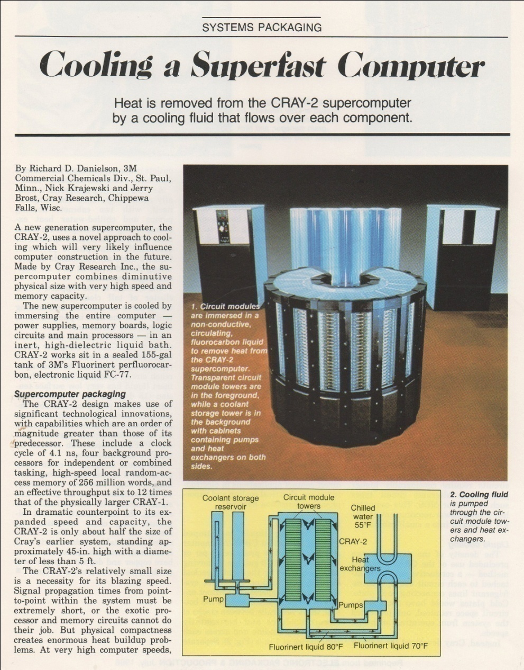
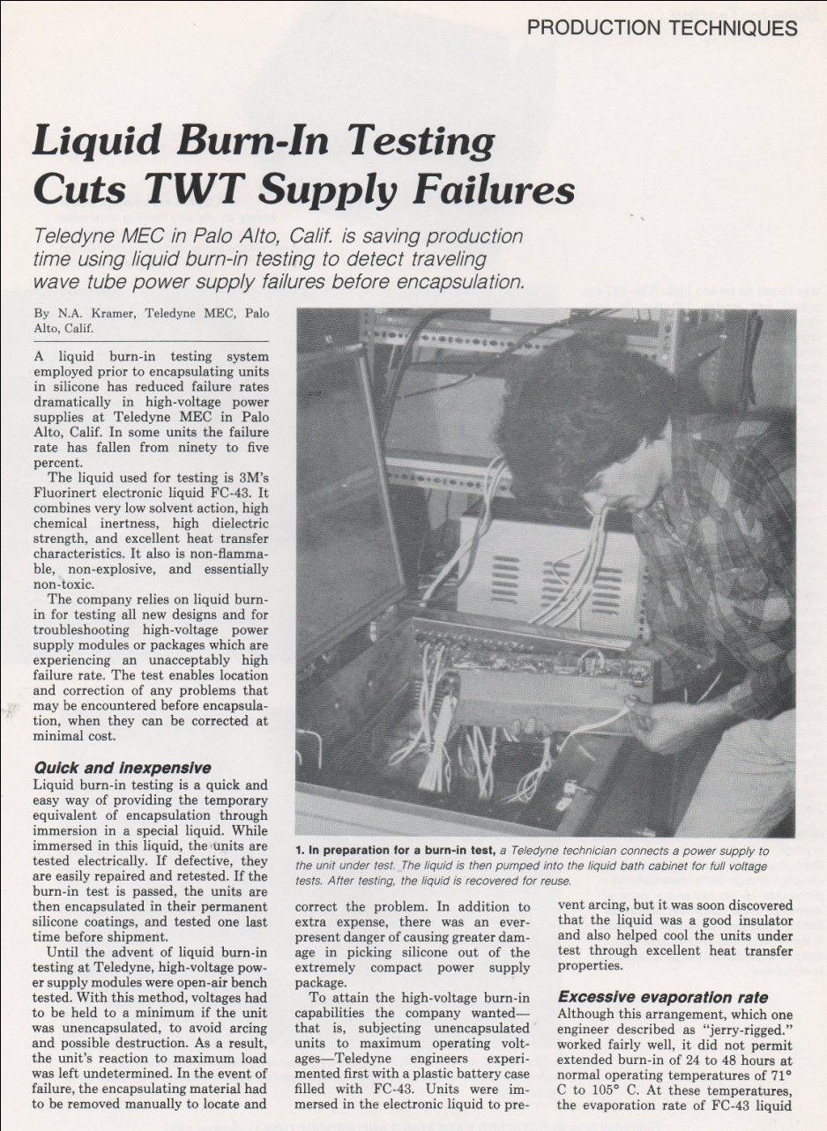
Historical: fluorocarbons - military and industrial (heat transfer) uses (2)
Saturated Liquid FC immersion for destroying
(accelerated burn-in) and preserving (cooling) electronics
34
G. Hallewell ECFA TF-4 Meeting May16-17th 2023

Slide 35
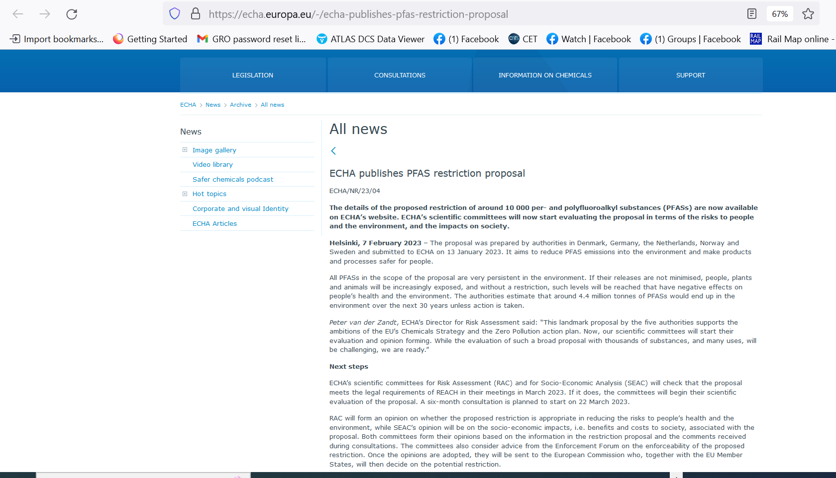
G. Hallewell: GasRad GWP: ECFA TF-4 Meeting May16-17th 2023

Slide 36
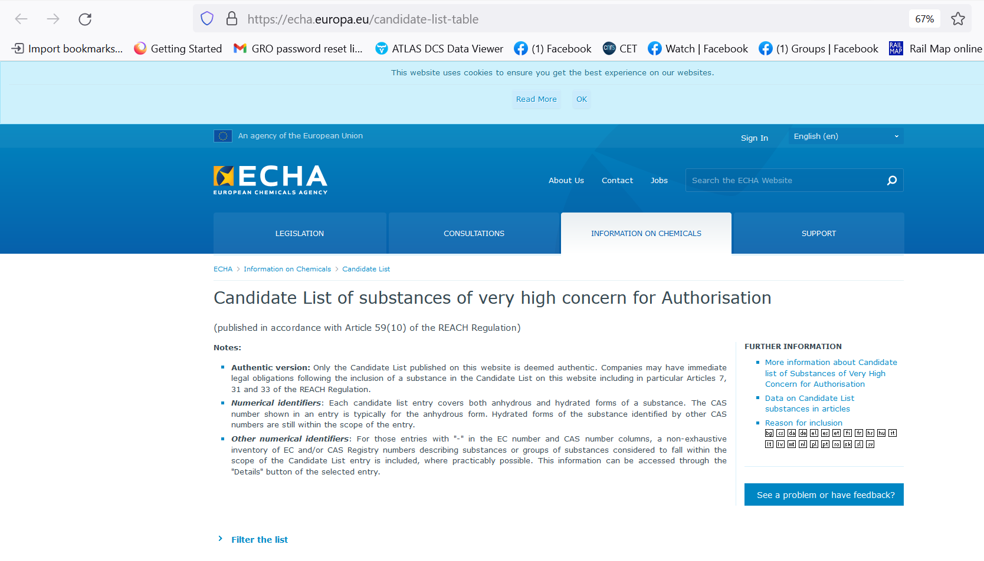
G. Hallewell: GasRad GWP: ECFA TF-4 Meeting May16-17th 2023

Slide 37
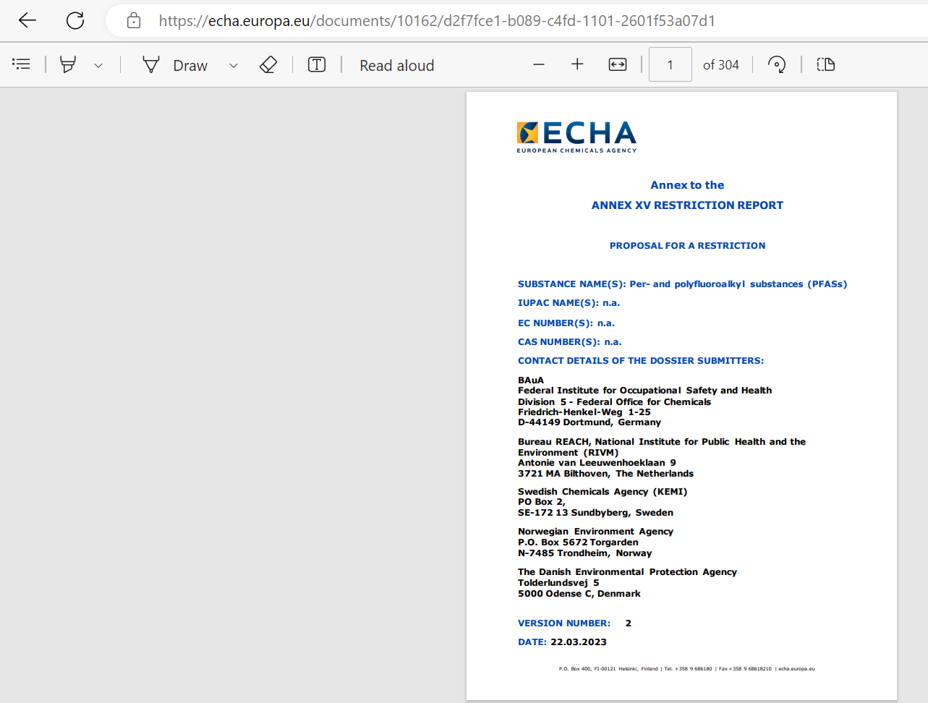
G. Hallewell: GasRad GWP: ECFA TF-4 Meeting May16-17th 2023

Slide 38
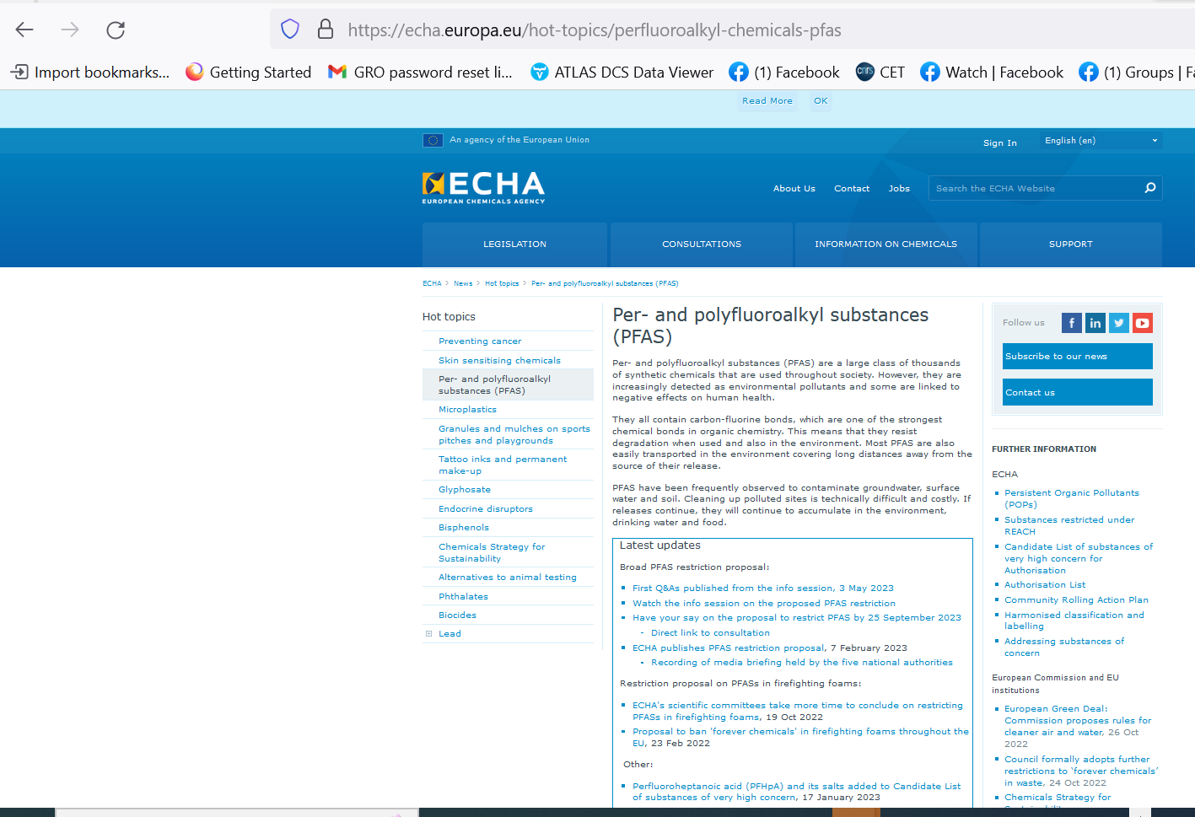
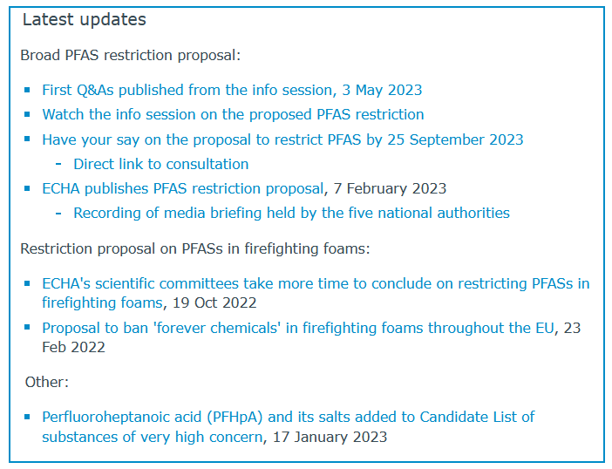
G. Hallewell: GasRad GWP: ECFA TF-4 Meeting May16-17th 2023

Slide 39
References;
(numbering from earlier slides) mainly on fluorocarbon fluids and GWP
39
G. Hallewell: GasRad GWP: ECFA TF-4 Meeting May16-17th 2023

Slide 40
References
[1] CERN Environment Report 2017–2018 https://doi.org/10.25325/CERN-Environment-2020-001
[2] Eco-gas mixtures and mitigation procedures for Green-house Gases (GHGs);
B. Mandelli ECFA Detector R&D Road-map Symposium: T.F. 1 Gaseous Detectors, 29/4/2021
https://indico.cern.ch/event/999799/contributions/4204191
/attachments/2236047/3789965/BMandelli_ECFA.pdf,
[3] R&D for the optimization of the use of greenhouse gases in particle detector systems; B. Mandelli;
Mini workshop on gas transport parameters for present and future generation of experiments:
CERN April 22, 2021
https://indico.cern.ch/event/1022051/contributions/4325947/
[4] Studies to reduce greenhouse gas emissions from detectors at the LHC;
G. Rigoletti; EP-DT Seminar May 4, 2022.pdf (cern.ch)
[5] Long term experience with C₄F₁₀ in COMPASS RICH-1;
S. Dalla Torre et al; Presentation 11th Intl. Workshop on Ring Imaging Cherenkov detectors,
Edinburgh, Scotland, Sept 12-16 2022.
https://indico.cern.ch/event/1094055/contributions/4932286/attachments/2508724/4311387/
RICH2022_C4F10_dallatorre.pdf
[6] 3M PFG-3480: c-octofluorotetrahydrofuran (C₄F₈O).
Note: fluid out of production : product reference now used for a non-fluidic product.
For historic product data sheet mentioning its high GWP see (for example):
http://static6.arrow.com/aropdfconversion/a7116f41dfdd5b79d2eb7b40afd687f8af23d8ef/
mediawebserver(563).pdf
[7] M. Artuso et al; Nucl. Instr & Meth. A Volume 558, (2006), 373-387
[8] Product #2H07-2-08 Synonyms: 2,2,3,3,4,4,5,5-octafluorotetrahydrofuran,
Perfluorotetrahydrofuran; CAS No: 773-14-8, MDL No. MFCD00465561:
SynQuest Labs Inc., 13201 Rachael Boulevard, Alachua, FL 32615, USA
https://www.synquestlabs.com/Home/ProductDetail?SearchText=Octafluorotetrahydrofuran
[9] T. Acconcia et al ; Nucl. Instr & Meth A 767 (2014) 50–60
G. Hallewell: GasRad GWP: ECFA TF-4 Meeting May16-17th 2023

Slide 41
References (cont. 1)
[10] Abundances, emissions, and loss processes of the long-lived and potent greenhouse gas
octafluorooxolane (octafluorotetrahydrofuran, c-C4F8O) in the atmosphere;
M. Vollmer et al ; Atmos. Chem. Phys., 19, 3481–3492, 2019
[11] 3M Novec® range of fluorinated fluids; https://www.3m.com/3M/en_US/p/c/b/novec/?Ntt=novec
[12] 3M Novec 649/1230 fluid (C₆F₁₂O);
https://multimedia.3m.com/mws/media/569865O/3m-novec-engineered-fluid-649.pdf,
https://multimedia.3m.com/mws/media/124688O/3m-novec-1230-fire-protection-fluid.pdf]
[13] 3M Novec 5110 fluid (C₅F₁₀O);
https://multimedia.3m.com/mws/media/1132123O/3m-novec-5110-insulating-gas.pdf
[14] CERN report EN-CV 22/12/2017, EDMS 1751219 2017-334 rev 1.0: T
echnical Note NOVEC Fluids Qualification Report: Report on the study executed for the qualification
of the NOVEC Fluid for Detector Cooling applications.
[15] Understanding the stability and environmental characteristics of a sustainable Halon alternative.
J. Owens, 3M Performance Materials 3M Center, St. Paul, MN 55144
[16] CERN Mini-workshop on gas transport parameters for present and future generation of
experiments 20/04/2021;S. Easo; LHCb-RICH detectors and their gas radiators
https://indico.cern.ch/event/1022051/contributions/4333562/attachments/2231064/3780374/
LHCb-RICH-Current-GasRadiators-April-2021.pdf,
Options for alternate radiators in LHCb-RICH system (including calculations by O. Ullaland); S. Easo,
https://indico.cern.ch/event/1022051/contributions/4319538/attachments/2231436/3781060/
LHCb-RICH-Future-Radiators.pdf
[17] S.Easo; Nucl.Inst.& Meth. A 876 (2017) 168-173
[18] E. Lemmon, M. Huber, & M. McLinden; REFPROP Standard reference database 23, version 9.0 (2010)
U.S. National Institute of Standards & Technology.
[19] E. Nappi & J. Seguinot Rivista del Nuovo Cimento Vol. 28, N. 8-9 2005 DOI 10.1393/ncr/i2006-10004-6
[20] K. Abe et al. ; IEEE Trans. Nucl. Sci. 45 (1998) 648 SLAC-PUB-7705 DOI: 10.1109/23.6826
[21] G. Hallewell et al; Nucl. Instr. & Meth A264 (1988) 219-234
[22] G. Hallewell; Nucl. Instr & Meth A 876, (2017) 50-53
G. Hallewell: GasRad GWP: ECFA TF-4 Meeting May16-17th 2023

Slide 42
References (cont. 2)
[23] G. Hallewell et al; MDPI Instruments (2021) 5(1), 6;
[24] P. Stassi et al; Ultrasonic Gas mixture analysis system in the Forward RICH of DELPHI,
DELPHI Internal Note 95-124 RICH73, 25 July 1995
[25] M.Sannino; Nucl. Instr. and Methods in Physics Research A 595 (2008) 208–211
[26] Monitoring, Alignment and Control of the RICH Detectors; C. D'Ambrosio et al;
LHCb-Memo-2000-80 RICH 6 September 2000.
[27] P. Fauland, PhD thesis; (COMPASS experiment) University of Bielefeld March 2004.
[28] Now marketed as SensComp model 600 transducer, http://www.senscomp.com/ultrasonic-sensors/
[29] T. Blake et al; Nucl. Instr. Meth A791 (2015) 27-31
[30] A. Papanestis; Nucl. Instr. Meth. A766 (2014) 14–18
[31] R. Calabrese et al; 2022 JINST 17 P07013
[32] R. Bates et al; 2013 JINST 8 P02006
[33] ECHA/NR/23/04; https://echa.europa.eu/-/echa-publishes-pfas-restriction-proposal]
[34] ECHA Candidate List of substances of very high concern for Authorisation;
https://echa.europa.eu/candidate-list-table
[35] Annex to the Annex XV restriction report proposal for restriction:
Per- & polyfluoroalkyl substances (PFASs);
ECHA; 22/03/2023 https://echa.europa.eu/documents/10162/d2f7fce1-b089-c4fd-1101-2601f53a07d1
[36] Per- and polyfluoroalkyl substances (PFAS); ECHA
https://echa.europa.eu/hot-topics/perfluoroalkyl-chemicals-pfas
G. Hallewell: GasRad GWP: ECFA TF-4 Meeting May16-17th 2023

Slide 43
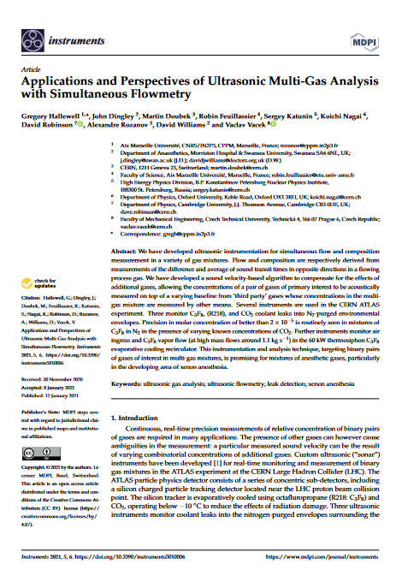
Ultrasonic gas analysis in a process environment with multiple background gases
https://www.mdpi.com/2410-390X/5/1/6
43
G. Hallewell: GasRad GWP: ECFA TF-4 Meeting May16-17th 2023

Slide 44
The ultrasonic algorithm to find ω_{i=1,2…} for radiator gas components
44
G. Hallewell: GasRad GWP: ECFA TF-4 Meeting May16-17th 2023

Slide 45
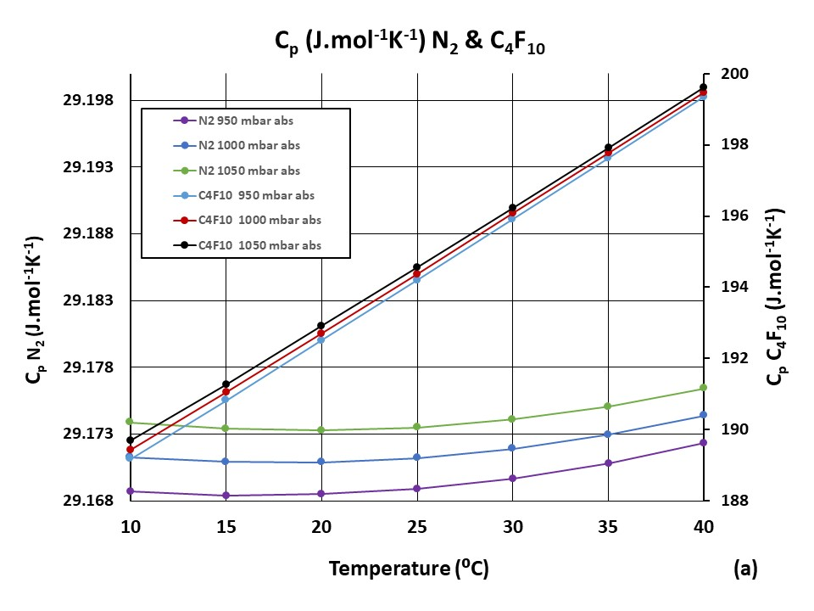
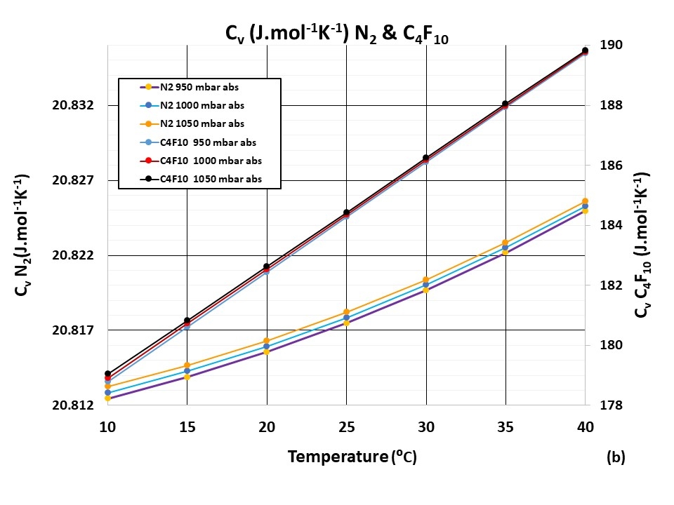
(1) Calculate data base of individual C_{Vi..n} C_{Pi..n}
over expected T, P. range:
Example here: C₃F₈: (mol. wt.) = 188 in N₂ (mol. wt. = 28)
G. Hallewell: GasRad GWP: ECFA TF-4 Meeting May16-17th 2023
45

Slide 46
(2) Calculate c_{‘theo’} as a function of concentration from component
Cp, Cv’s over the expected sonar temperature, pressure range to
make database of c_{‘theo’} vs. conc. fit equations
(example here 0- 1% C₃F₈ (m.w.= 188 in N₂ (m.w.= 28): only one pressure shown here for clarity)
46
G. Hallewell: GasRad GWP: ECFA TF-4 Meeting May16-17th 2023

Slide 47
(3) CAN UTILITY: Store these c_{‘theo’} vs. molar conc. polyfit coeffs covering expected temperature & pressure range in “cans” at P,T grid intersections
(4) Calculate component concentrations ω_{i} from measured sound velocity c_{meas} & stored fit coeffs. interpolated to correspond to the measured T, P
T_{min}
T ➔
T_{max}
P_{max}
P ➔
P_{meas}
P_{step}
P_{min}
T_{step}
T_{meas}
!! This grid can become 3-D or higher-D with known contaminant gas(es) ➔
47
G. Hallewell: GasRad GWP: ECFA TF-4 Meeting May16-17th 2023

Slide 48
Aah…but what if there are 3 gases present?
Acoustic Ambiguity ?
(2 combinations ➔ same c… so find w₃ from a different source…)
Examples: CO₂ from infra-red,
O₂ from EC cell… etc
48
G. Hallewell: GasRad GWP: ECFA TF-4 Meeting May16-17th 2023

Slide 49
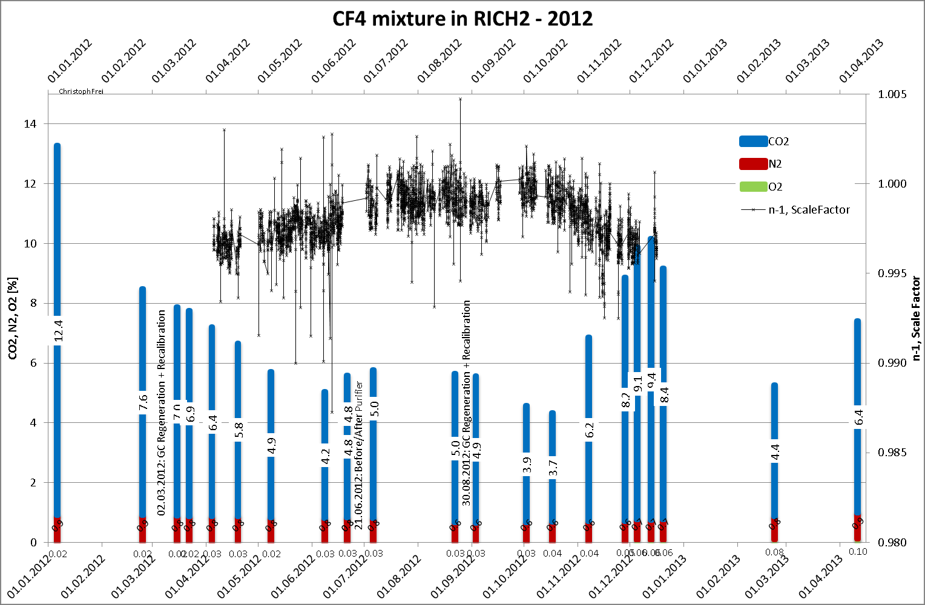
LHCb RICH 2 change in refractivity with varying CO₂ radiator addition
(From RICH2013)
Substitution of CF₄ by CO₂ under consideraton:
but we earlier saw a possible NOVEC5110
C₅F₁₀O/N₂ (or C₅F₁₀O/CO₂) GWP advantage…
Stable N2
content
49
G. Hallewell: GasRad GWP: ECFA TF-4 Meeting May16-17th 2023

Slide 50
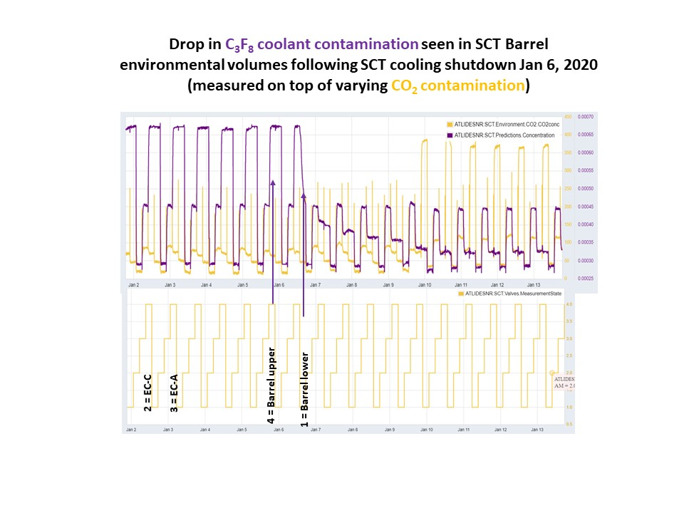
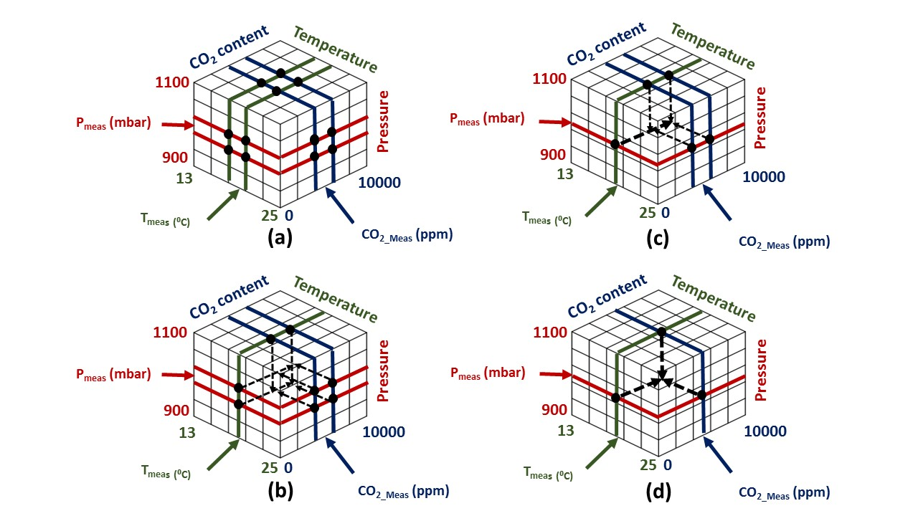
Example: Look-up tables of SoS. vs. composition for C₃F₈/N₂ (+ CO₂) (ATLAS silicon tracker cooling leak analysis)
https://www.mdpi.com/2410-390X/5/1/6
CAN UTILITY DB expanded
from 2-D to 3-D:
C₃F₈/N₂ fit coeffs
stored @{T, P, CO₂} grid
Extra interpolation step,
starting from grid cub(oid) of uncertainty
to T_{meas}, P_{meas},CO_{2 meas}
Calculate sound vel vs. conc. eqns from
C₃F₈ & N₂ AND KNOWN CONTAMINANT GAS
Cp & Cv over expected T,P, %CO₂ range.
Demonstration:
1st acoustic measurement of concentrations of binary gas pair
of interest (C₃F₈/N₂)
in known varying conc. of 3rd gas (CO₂) :
(4 envelopes cycling every 4 hours)
Algorithm: industrial & anaesthesia applications
G. Hallewell: GasRad GWP: ECFA TF-4 Meeting May16-17th 2023
50

Slide 51
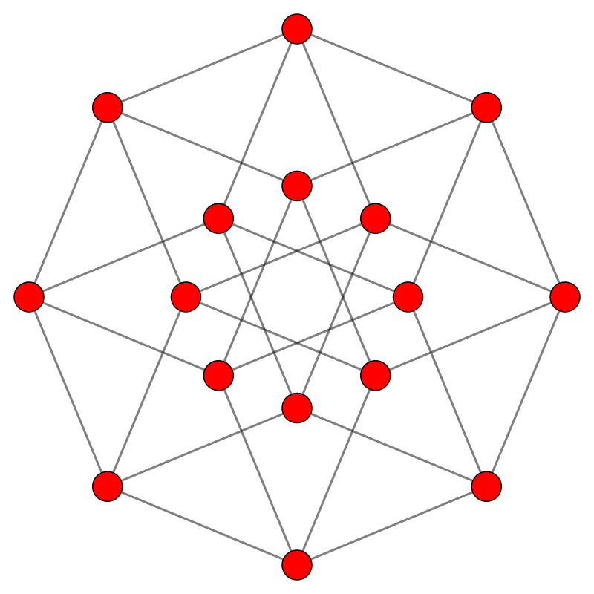
Example with a second known contaminant gas: here H₂O but could be another measurable gas : 4-D {T,P, CO₂, H₂O} Process dataspace example ‘Cans’ of c vs. conc_{1,2} fit coefficients now at corners of tesseract. (Here in Coxeter B4 projection)
8 cube faces:
2 x {T,P,CO₂} exc. H₂O
2 x {T,P, H₂O} exc. CO₂
2 x {T, CO₂, H₂O} exc. P
2 x {P, CO₂, H₂O} exc. T
T
CO2
H2O
P
CO2
T
P
H2O
P
H2O
H2O
P
CO2
T
T
P
H2O
CO2
CO2
T
T
P
P
H2O
H2O
T
CO2
P
H2O
CO2
T
Opposite cubic faces explored in the following slides
51
G. Hallewell: GasRad GWP: ECFA TF-4 Meeting May16-17th 2023

Slide 52
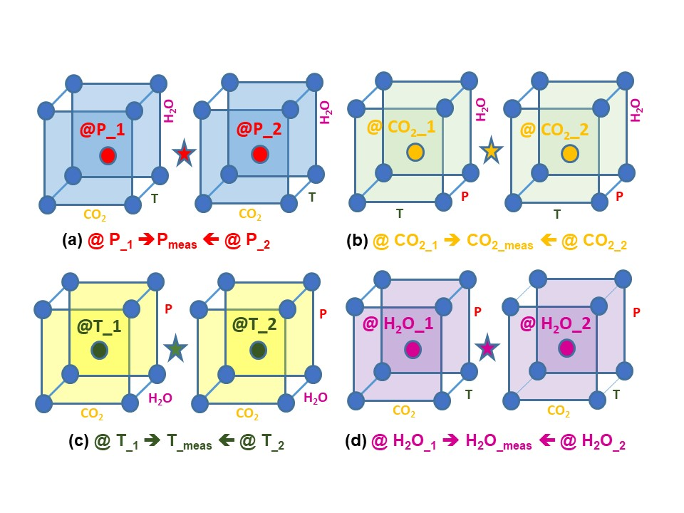
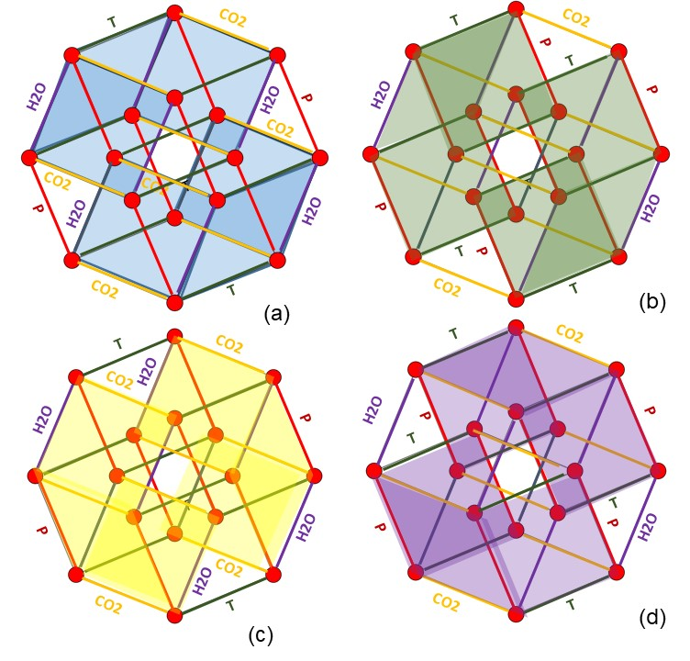
Extractio-reduction
Tessar-Action
https://www.mdpi.com/2410-390X/5/1/6
52
G. Hallewell: GasRad GWP: ECFA TF-4 Meeting May16-17th 2023

Slide 53
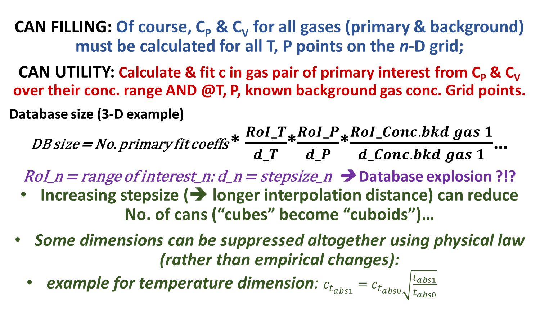
Database growth control
(important in instruments using embedded μ-controllers)
CAN FILLING: Of course, C_{P} & C_{V} for all gases (primary & background)
must be calculated for all T, P points on the n-D grid;
CAN UTILITY: Calculate & fit c in gas pair of primary interest from C_{P} & C_{V} over their conc. range AND @T, P, known background gas conc. Grid points.
Database size (3-D example)
DB size = No. primary fit coeffs * $\frac{RoI_T}{d_T}$*$\frac{RoI_P}{d_P}$*$\frac{RoI_Conc. bkd gas 1}{d_Conc. bkd gas 1}$…
RoI_n = range of interest_n: d_n = stepsize_n ➔ Database explosion ?!?
Increasing stepsize (➔ longer interpolation distance) can reduce No. of cans (“cubes” become “cuboids”)…
Some dimensions can be suppressed altogether using physical law (rather than empirical changes):
example for temperature dimension: $c_{t_{abs1}}=c_{t_{abs0}}\sqrt{\frac{t_{abs1}}{t_{abs0}}}$
53
G. Hallewell: GasRad GWP: ECFA TF-4 Meeting May16-17th 2023

Slide 54
The uncertain ECHA path to prohibition
G. Hallewell: GasRad GWP: ECFA TF-4 Meeting May16-17th 2023

Slide 55
The SLD CRID ultrasonic gas radiator control system at SLAC
G. Hallewell: GasRad GWP: ECFA TF-4 Meeting May16-17th 2023

Slide 56
SLD-CRID: Cherenkov threshold in C₅F₁₂/N₂ mixtures
and GWP load comparison with LHCb RICH2
SLD-CRID: Cherenkov threshold in C₅F₁₂/N₂ mixtures
vs. measured speed of sound in radiator gas mixture (1)
N₂-NOVEC5110 (C₅F₁₀O) might be very similar (MW 266 vs 288)
LHCb RICH 2: CF₄ thresholds
GWP load = (0.9 molar*7000*V.ρ)
Typical mix 87%C₅F₁₂,13%N₂
Novec 5110 gives a HUGE GWP load reduction of 6300 (V.ρ/1000) tonnes
Even substituting 0.9 molar CF₄ with 0.12 molar C₅F₁₂ reduces GWP load by 5300 (V.ρ/1000) tonnes
C₅F₁₂ concentration (%)
LHCb RICH 2 with C₅F₁₀O/N₂
GWP load = (0.12 molar*1*V.ρ)
56
G. Hallewell: GasRad GWP: ECFA TF-4 Meeting May16-17th 2023

Slide 57
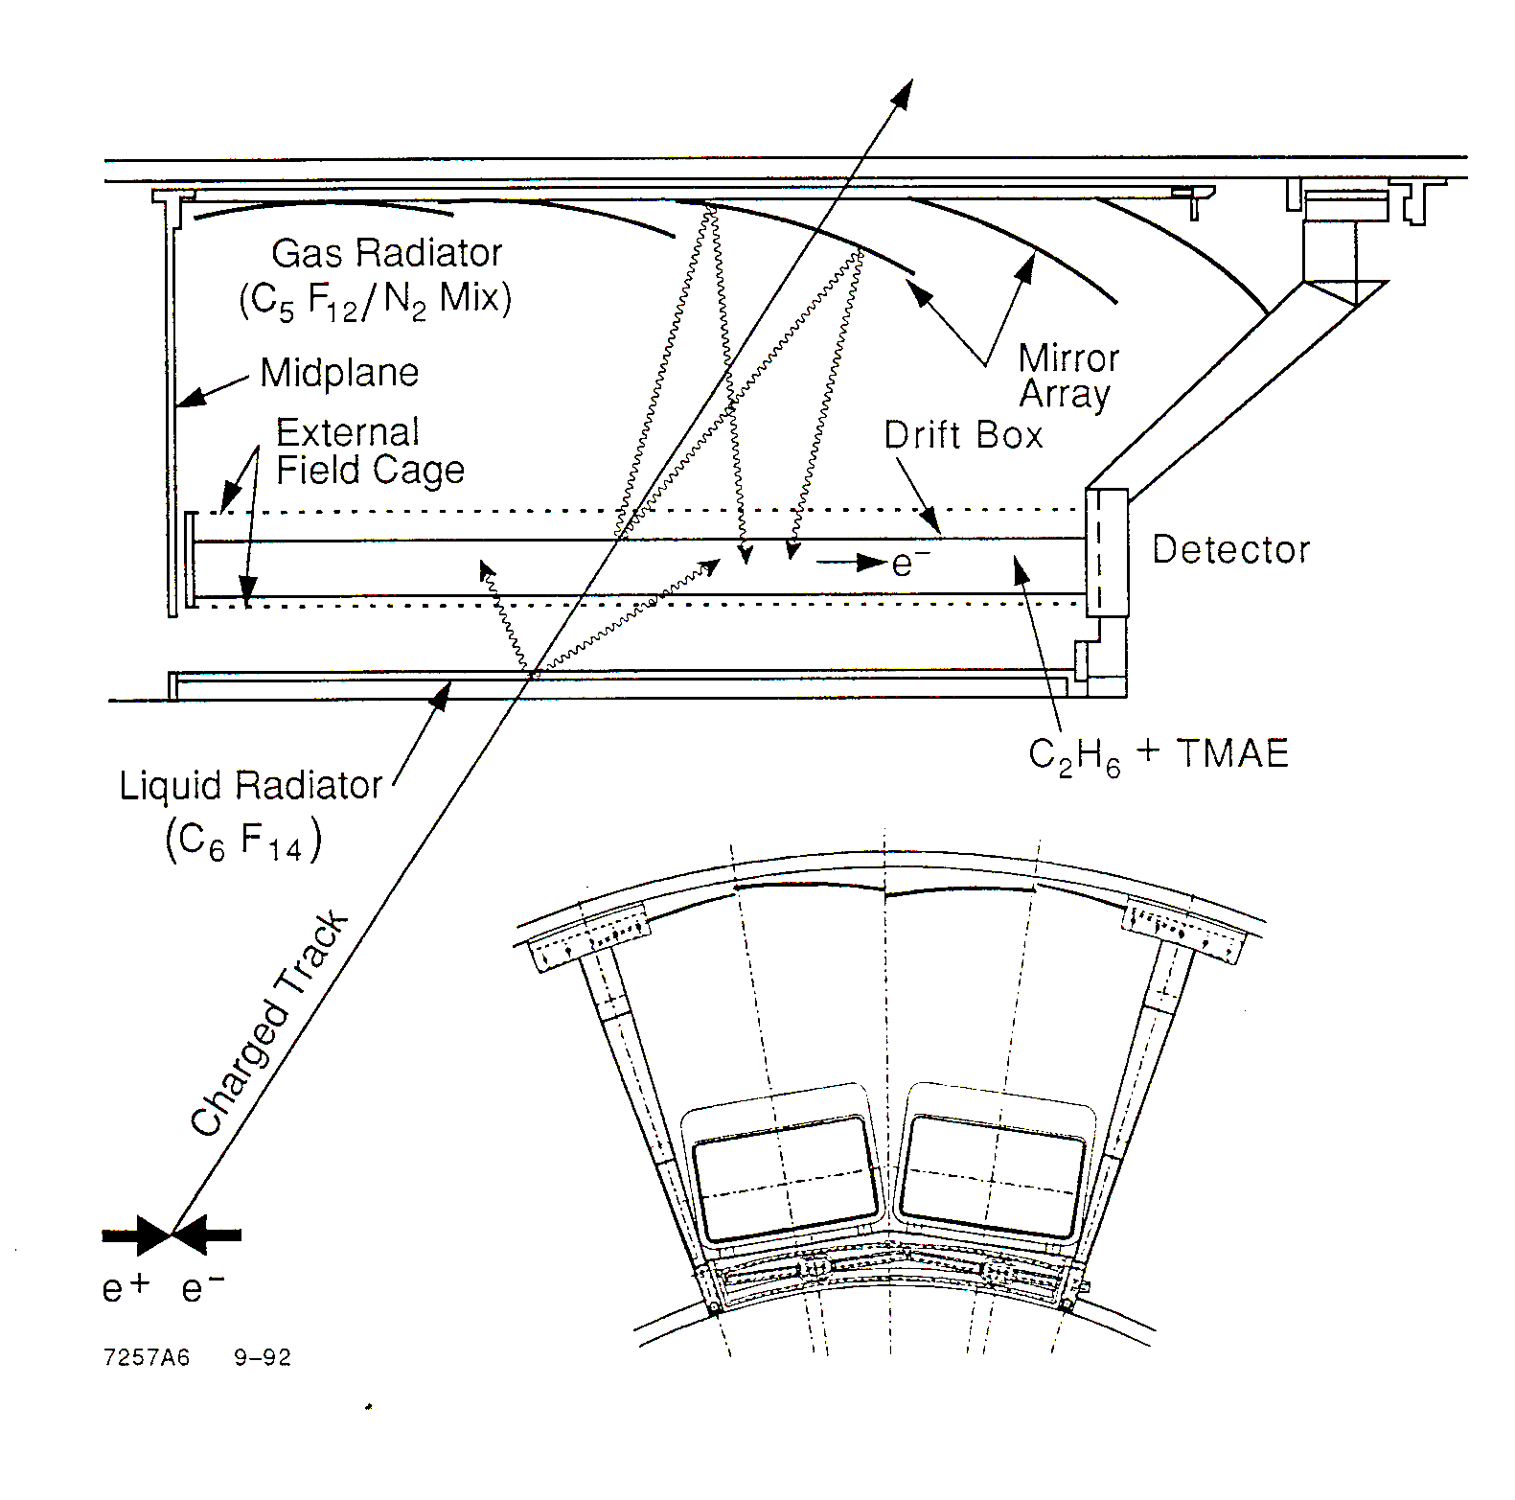
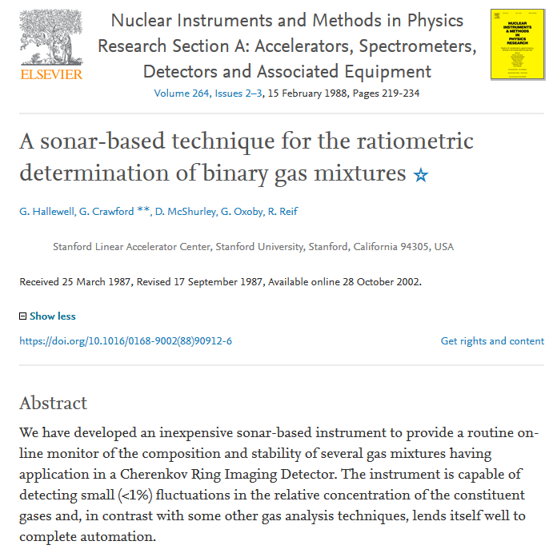


The SLD CRID experience: barrel CRID gas radiators (1990s)
87% C₅F₁₂/13%N₂
gas radiator
Sonar transducer
6 transducer pairs
@ 3 different heights
(hydrostatics)
57
G. Hallewell: GasRad GWP: ECFA TF-4 Meeting May16-17th 2023

Slide 58


Improvements in maintaining C₅F₁₂/N₂ refractive index
through sonar-based active mixture control
● Sonar
□ Inclusive Angles
Before use of flowmeter
analyzer in supply line
β = 1 Cherenkov Angle (mrad)
30400 30600 30800 31000 31200
Using the flowmeter
analyzer in supply line
to modify the blend by
hardwired 4-20mA link to mass flow controllers
● Sonar
□ Inclusive Angles
0,3 mrad rms
With active mixture control: δr/r ~ 0.2%
33500 34000 34500 35000 35500
Note: before and after
blend stabilization sonar
interpreted β=1 radius
agreed well with
reconstructed radii!!
Run Number
β = 1 Cherenkov angle comparison (1995-6 runs) between reconstructed ring data (□) in the SLD barrel CRID and angles from sonar-deduced refractive index corrected for atmospheric pressure (●)
58
G. Hallewell: GasRad GWP: ECFA TF-4 Meeting May16-17th 2023

Slide 59

Polaroid Capacitative transducer components
Capacitative 350V activation/ bias ➔ rapid response
37mm diameter determines 50 kHz dominant frequency: can operate over wide pressure range (50mbar ➔>35 bar…)
59
G. Hallewell: GasRad GWP: ECFA TF-4 Meeting May16-17th 2023

Slide 60

SLD Barrel CRID C₅F₁₂/N₂ gas radiator: continuous thermodynamic recirculation
Low temperature (-80°C)
N₂ gas-induced condensation (B):
of C₅F₁₂ fromC₅F₁₂/N₂ radiator gas (flow~1m³/hr, negligible C₅F₁₂ loss)
followed by (C) electric re-evaporation
(1-1.5m below condenser liq. level)
Cold N₂ gas (‘conditioned’ by
counter-flow with boil-off LN₂
from liquid argon calorimeter: (A))
Ultrasonic (speed of sound) – aided
“on-the fly” mixing of typical
17%N₂ /83%C₅F₁₂ (molar) radiator gas mixture (D)
A
B
D
C
G. Hallewell: GasRad GWP: ECFA TF-4 Meeting May16-17th 2023

Slide 61
Shapes of C_{n}F_{2n}O molecules and GWP:
Octafluortetrahydrofuran – the probable ALICE VHMPID config
C₄F₈O acquired from Synquest (FL,USA) : reported by A. di Mauro:
61
G. Hallewell: GasRad GWP: ECFA TF-4 Meeting May16-17th 2023

Slide 62

SynQuest Labs Inc.,
13201 Rachael Boulevard Rt 2054, Alachua, FL 32615, USA
62
G. Hallewell: GasRad GWP: ECFA TF-4 Meeting May16-17th 2023

Slide 63



SynQuest Labs, Inc. Can manufacture different C₄F₈O configurations
The cyclic molecule seems to be cheaper for SynQuest to manufacture:
whereas 3M make NOVEC 649, 5110 which are non-cyclic
63
G. Hallewell: GasRad GWP: ECFA TF-4 Meeting May16-17th 2023

Slide 64

Another linear all single-bonded geometry C₄F₁₀O..? TO BEWARE???
Bis(pentafluoroethyl)ether /
Perfluoroethyl ether
GWP = ??
Unfriendly (not nice to mice) & lachrygene
https://pubchem.ncbi.nlm.nih.gov/compound/Bis_pentafluoroethyl_-ether
https://www.govinfo.gov/content/pkg/CFR-2017-title40-
vol23/xml/CFR-2017-title40-vol23-part98-subpartA-appA.xml
64
G. Hallewell: GasRad GWP: ECFA TF-4 Meeting May16-17th 2023

