Slide 1

Development of RICH software using GPUs
ECFA - DRD4 Workshop
From Y.Li, A.Pointer, K.Evans, L.Girardey, A.Davis, M.Gersabeck, E.Gersabeck, N.Nandakumar, S.Easo,
C.Jones, M.Bartolini and many others
S.Easo
16-05-2023

Slide 2
Introduction
Graphics Processing Units (GPUs) are already used for various applications in HEP in recent years.
In this context, I focus on the usefulness of GPUs for the software related to Cherenkov detectors.
In the coming years experiments need to simulate and reconstruct billions of events which have RICH data.
This is specially important for experiments at the LHC.
If one uses the standard CPUs, the cost of running these programs will become prohibitively expensive.
Simulation:
RICH simulation requires single photon transport.
Until recently, RICH simulation consumed ~30% of the CPU time of LHCb simulations.
GPUs are used efficiently by the industry for ray tracing optical photons.
Example: OptiX from NVIDIA is used in video games.
Optical photon simulation is well suited for GPUs
We would like to reduce the fraction of time taken up by the RICH
Reconstruction:
The parallelization offered by the GPUs can be useful for various parts of the particle identification
procedure in the context of large number of track-hit combinations.

Slide 3
Outline
Pioneering work in JUNO for using GPUs
General structure of the program for simulation using GPUs
Proof-of-principle implementation in LHCb.
RICH reconstruction: usefulness of GPUs
Prospects

Slide 4
JUNO Simulation
The Dayabay and JUNO neutrino experiments have large water Cherenkov detectors.
The detector simulation is based on the GEANT4 package.
GEANT4 is used for the simulation of all the particles other than optical photons
The OptiX package from NVIDIA is used for optical photon simulation.
An interface package named Opticks was developed to provide the interface between GEANT4 and OptiX
Simon Blyth is author and maintainer of this interface package.
This was the first attempt to use the OptiX for simulating optical photons in a HEP experiment.
At present many HEP groups are starting to use this method for photon simulation.

Slide 5
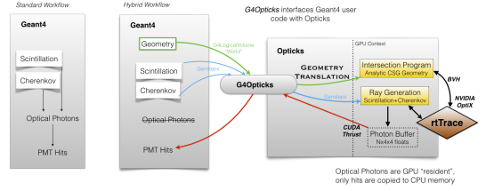
General structure
Ref: S.Blyth,
EPJ Web Conf, 251 (03009) , 2021
Recently this structure is modified with OptiX7. See backup slide
Optical processes: For the creation and transport of optical photons in the standard GEANT4 workflow
Hybrid Workflow:
Instead of using GEANT4 optical processes, the corresponding methods in OptiX are used
All other particles are tracked by GEANT4 as in the standard workflow.
Opticks
This enables to translate the required parts of geometry and optical properties, into a format needed by OptiX
This also facilitates copying the information on the ‘hits’ in photon detectors, back into GEANT4.

Slide 6
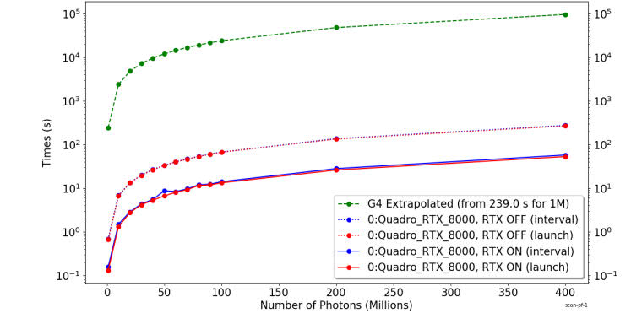
Performance in JUNO
Simulation time versus number of photons
Ref: S.Blyth,
EPJ Web Conf, 251 (03009) , 2021
Green: GEANT4 alone
Solid Red: GPU with RTX option
Dotted Red: GPU without RTX option
Red: Without overhead for upload/download each event
Blue: With overhead for upload/download each event
(Difference between Red and Blue is small on the
scale of these plots, with log scale along the vertical axis)
In this illustration, for 400 million photons
Time taken by GEANT4 : 95600 seconds ( Using GEANT4 version 10.4.2 in single threaded mode)
Time taken by OptiX (with Opticks) : 58 seconds ( Using a single GPU )

Slide 7
Goals in LHCb
We would like to eventually achieve similar success in LHCb and other experiments which use RICH detectors.
To this end we started an R&D program within the scope of LHCb
Goals of the R&D project :
Use the Opticks and OptiX in a simple RICH system as proof-of-principle
Compare the results from the new system with those from running GEANT4 alone.
Transform the full LHCb-RICH simulation to be able to use the GPUs
Integration into the LHCb software framework, which uses DD4HEP and Gaussino

Slide 8
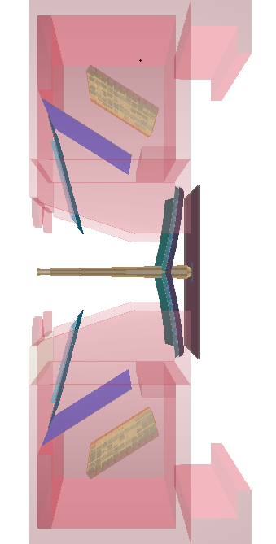
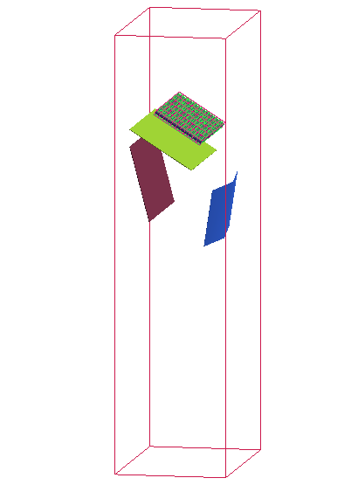
Full and simplified RICH
Simplified RICH description :
It has the same optical geometry, radiator and
photon detector system as that of LHCb-RICH1
The optical properties (Mirror reflectivities, QE etc )
are same as those used for LHCb-RICH1
However there is only a single set of spherical and ‘flat’ mirrors
in the top half, without their supports.
There is no beam pipe, exit window and magnetic shielding
Simplified RICH
LHCb-RICH1

Slide 9
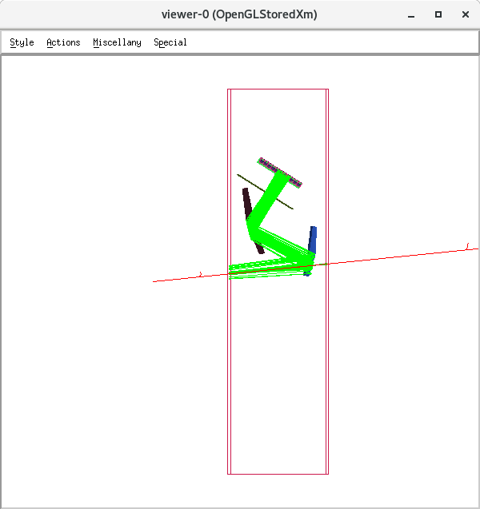
Simplified RICH
Many issues were solved in translating the geometry from the GEANT4 into Opticks.
This enables CSG (constructive solid geometry) → BREP (Boundary representation)
Work flow:
Data for detector description
in C++ files
GEANT4 geometry
Opticks
GEANT4 simulation
OptiX simulation
Y
X
Z
Particle gun used in simplified RICH
GEANT4 : OpenGL graphics

Slide 10
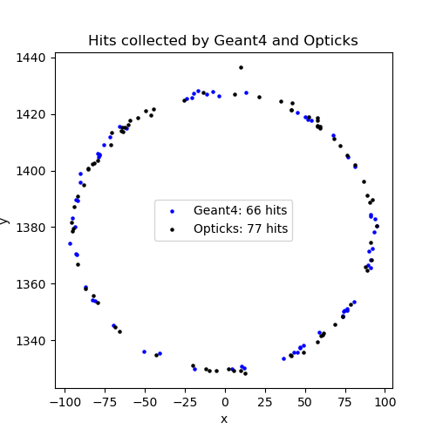
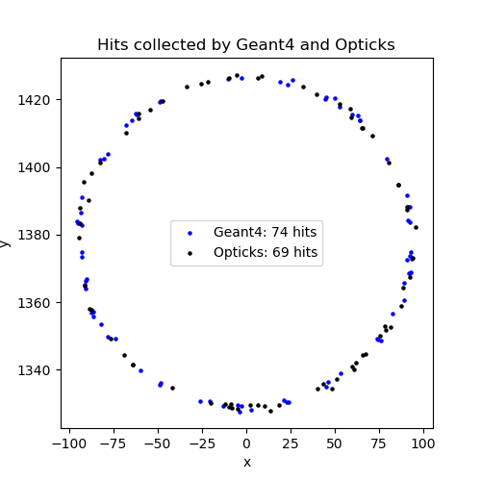
Simplified RICH
Comparison between GEANT4 and Opticks+OptiX simulations
Detailed comparisons of the various steps of the simulation were done
A few problems in using Opticks were solved, along the way
Example Event 1
Example Event 2
XY coordinates of hits on the
detector plane from single events
from GEANT4 simulation and
Opticks+OptiX simulation
Hit distributions obtained from the two
simulations are similar to each other
Hits obtained from using a particle gun with 4 GeV/c electron

Slide 11
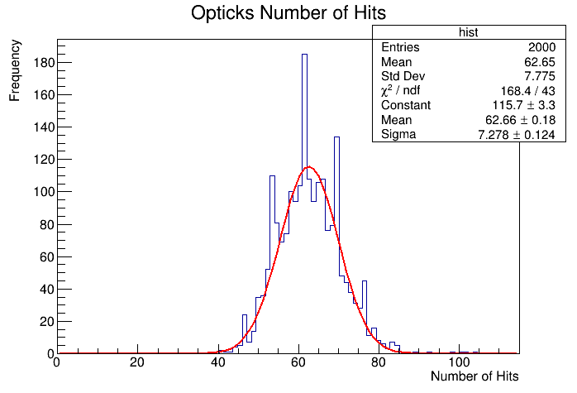
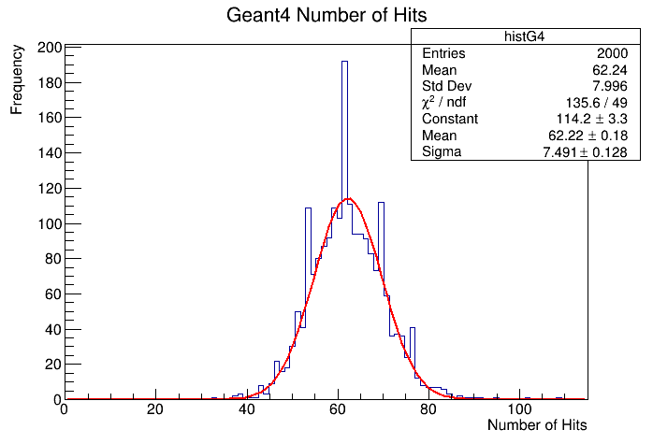
Simplified RICH
Yield comparison between GEANT4 and Opticks+OptiX simulations
Yield obtained from running 2000 events with particle gun
 | Simplified RICH: GEANT4 | Simplified RICH: Opticks+OptiX
Mean yield | 62.2 | 62.7
Opticks+OptiX produces a yield
similar to that from GEANT4 for the
Simplified RICH configuration.
This is also same as the simulated mean yield obtained for the full LHCb-RICH1

Slide 12
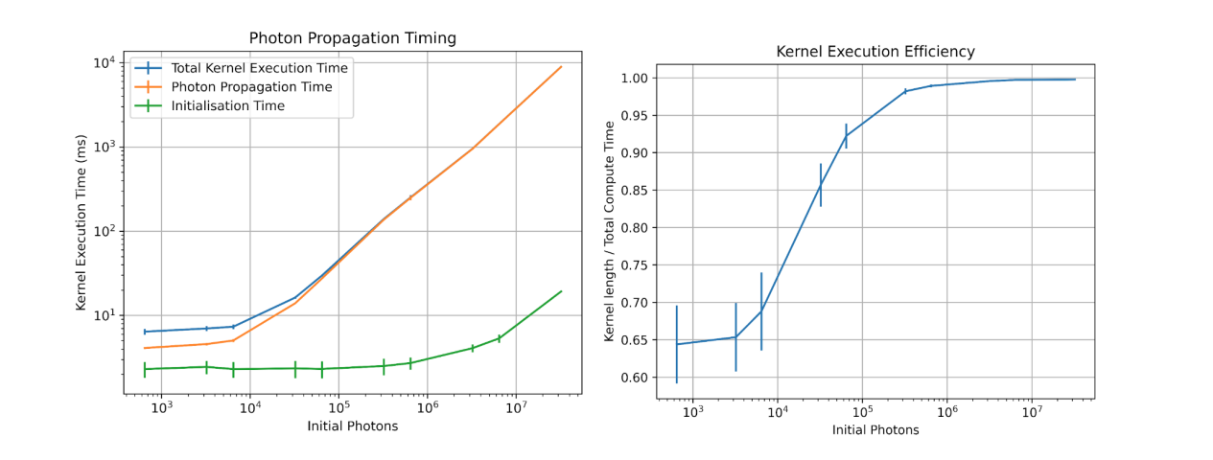
Profiling : initial studies
K.Evans
Effectively, re-sample single events to generate very large events with lot of photons
Plot the ‘execution time’ as function of the number of photons
Using Simplied RICH geometry, for now
Further details in
SwiftHep workshop-March-2022

Slide 13
Simulation - prospects
The initial goal of creating a program as proof-of-principle is achieved.
Based on this, in LHCb efforts are underway to use the full RICH system with Opticks.
Most of the software developed for this purpose would be useful for different experiments.
For this, eventually the Opticks would need to be maintained within the CERN-LCG similar to the way
GEANT4 software is maintained.
Geometry integration using Opticks:
Helps to run OptiX and GEANT4 during simulation.
It can also help to provide the programs in the GPUs with the information needed during reconstruction.

Slide 14
GPUs for data reconstruction
Example of GPU usage:
The starting point of the PID algorithm procedure is to reconstruct the Cherenkov angle
When using optical geometry similar to that in LHCb, this will involve solving a quartic equation.
For ‘N’ number of charged tracks and ‘M’ number of photon detector hits in the appropriate
regions of the detector plane, the reconstruction is done for N x M photon combinations.
This is best done in the GPU threads.
LHCb has a prototype implementation of this.
Performance in terms of the ratio of number of photon combinations processed per second.
Scalar (CPU) : SIMD (CPU) : Device (GPU)
1 : 7.1 : 35.9

Slide 15
GPUs for data reconstruction
The algorithm used for PID involves summing likelihood over a matrix of tracks and hits,
for different mass hypothesis and get a scalar number.
This is a ‘data reduction’ problem and it is efficient to implement this the GPU rather than in a CPU.
LHCb has a prototype implementation of this. (Using CUDA, Thrust etc)
Example performance :
For an example of 100 tracks and 50000 hit pixels in LHCb upgrade2
Time taken to calculate the likelihood for one mass hypothesis :
CPU | GPU | Ratio
4. 5 ms | 0.61 ms (0.3 ms using an LHCb implementation ) | 7.4
LHCb-Allen project aims to implement LHCb reconstruction software in GPUs
LHCb plans to create a version of the PID algorithm that can run in the GPU

Slide 16
Prospects
In LHCb, it is planned to integrate the usage of Opticks into the software framework.
However, one needs to address issues related to program maintenance at the LCG level.
At present, there is only one expert. We need an organization (within LCG) to acquire the expertise for this.
Alternatives to Opticks are being explored, however they will have the same issues regarding program maintenance.
The OptiX is made by NVIDIA. It can update according to the needs of the industry.
In this case the Opticks interface package need to be adapting accordingly.
A continued engagement between representatives of the industry and HEP software people would be
be needed.
Some other projects beginning to use the GPUs for optical photon simulation using OptiX / Opticks:
LUX-ZEPLIN for liquid xenon TPC
IceCube experiment in Antartica
Fermilab Calorimeter Tracker simulation (CaTs) project

Slide 17
Prospects
Once GPU based programs are available for RICH detectors:
Different HEP experiments which have RICH detectors may access the Opticks and configure their simulation
programs. This thus becomes useful for them also.
Using GPUs, the cost of running programs at the computer centers can be reduced in the HL-LHC era.
Resources :
Eventually acquire GPUs at the computer centers
Human resources needed to
Implement the updates needed
Use this technology in different experiments

Slide 18
Summary
The usage of GPUs would be needed to simulate the RICH detectors in the future
They will be useful for the reconstruction of the RICH data collected .
This will require significant investment in human resources in the coming years.
This development would be useful for many experiments using Cherenkov detectors.
Prototypes were developed in LHCb to compare the performance between GPU and CPU
It is useful for all detectors which make use of optical photons
Simulation of the RICH
Some aspects of reconstruction and particle identification
We would be happy to integrate future efforts towards DRD4

Slide 19
Extra pages

Slide 20
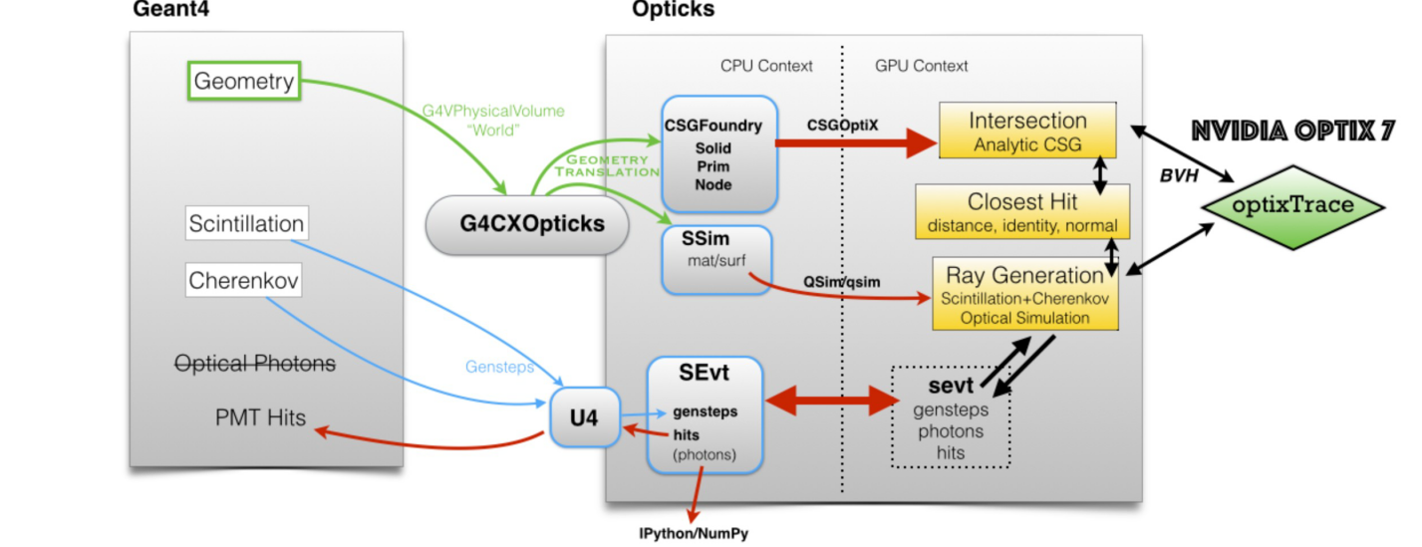
General structure with OptiX7
Ref:
S.Blyth, CHEP conference
Presented on 08-05-2023
at Norfolk,VA,USA

