Slide 1
Combining Cherenkov Angle and Timing Measurements in One Detector
E. Nappi
on behalf of INFN-BARI/CERN/UNAM teams

Slide 2
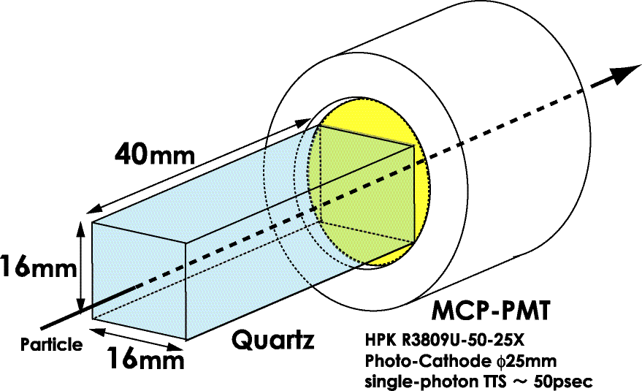
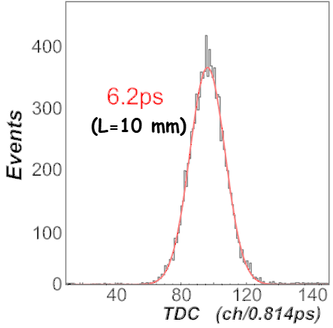
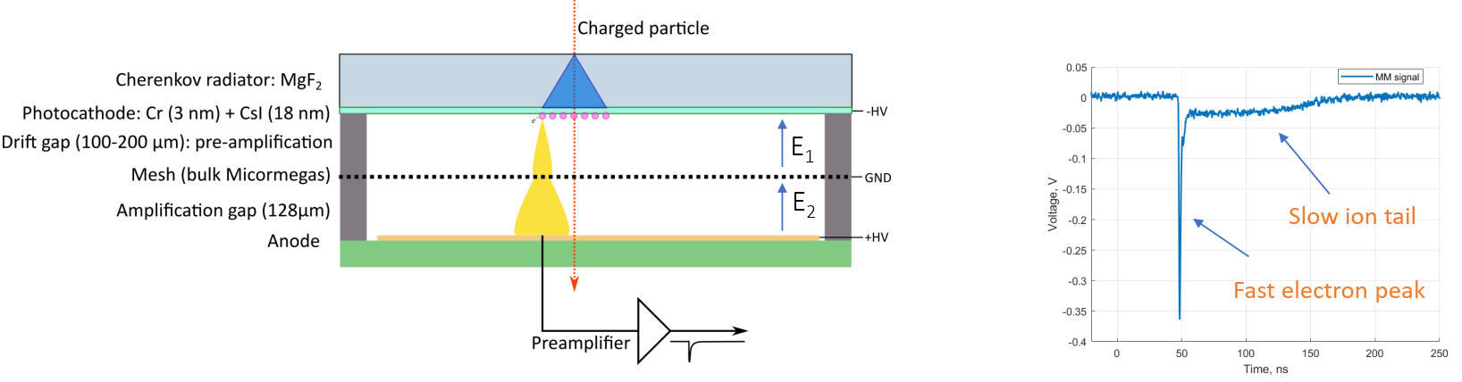
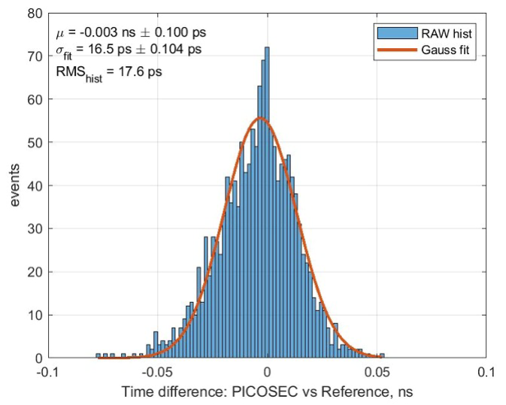
TOF DETECTORS BASED ON CHERENKOV LIGHT
Why Cherenkov light for TOF devices?
  Produced promptly
  Almost no time jitter (directionality)
  Single photoelectron statistics
Conventional TOF with scintillators
  Long decay time O(ns) in photon emission
  Time jitter due to photon paths
Y.Enari NIM A547 (2005) 490
K.Inami NIM A560 (2006) 303
RD51 Picosec Micromegas Collaboration
Time resolution of a 100-channel
prototype (10x10 cm²)
M. Lisowska et al.
NIM A1046 (2023) 167687

Slide 3
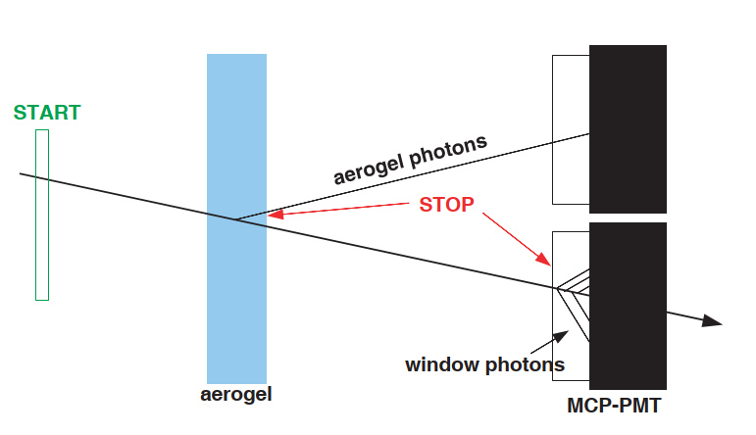
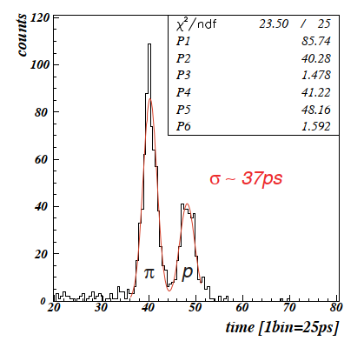
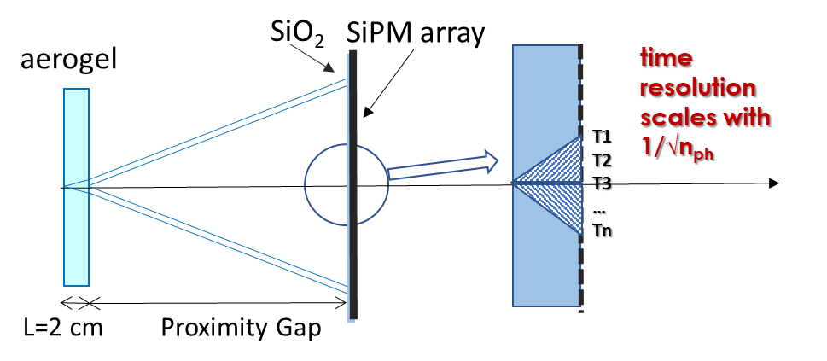
Proximity focusing RICH detector with TOF capabilities
2 GeV/c pions and protons
P. Krizan et al.,
Nuclear Physics B (Proc. Suppl.) 172 (2007) 227–230
Belle II Technical Design Report
Vacuum Photon Detectors (MCPs, LAPPDs)
Main limitation:
Sensitivity to B (no gain at all for a barrel geometry
PID system embedded in a solenoidal magnetic field)
Gaseous Photon detectors (i.e. PICOSEC MM)
Main Limitation:
Unable to detect visible photons
(cannot be used aerogel as Cherenkov radiator)
Both gaseous and vacuum photon detectors
are bulky (large X0)
SiPMs

Slide 4
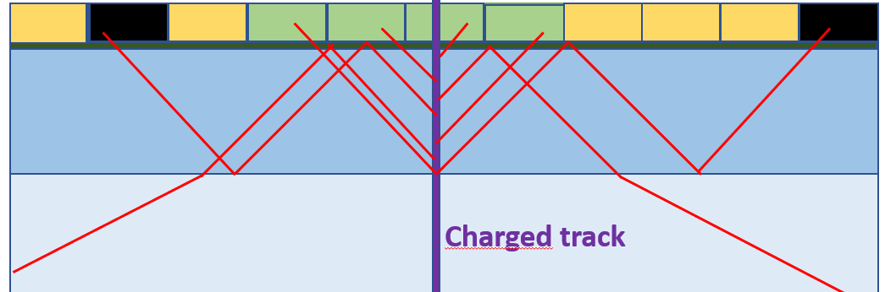
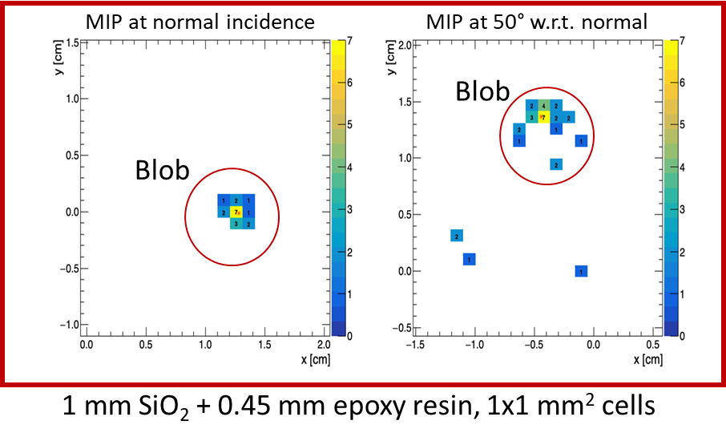
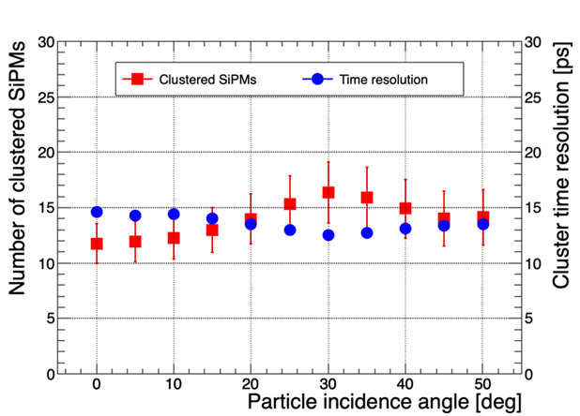
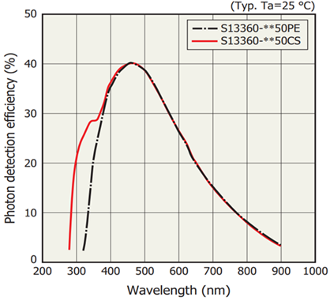
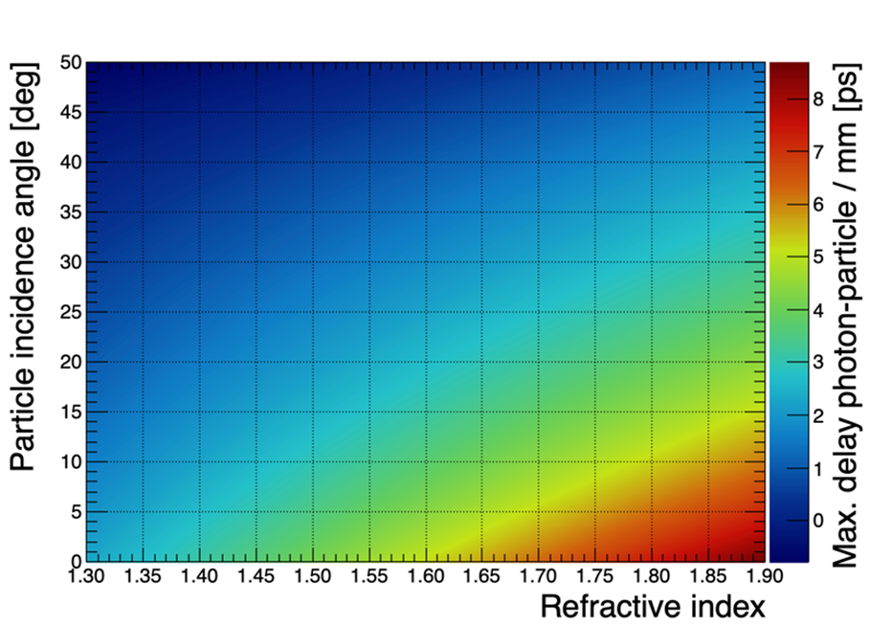
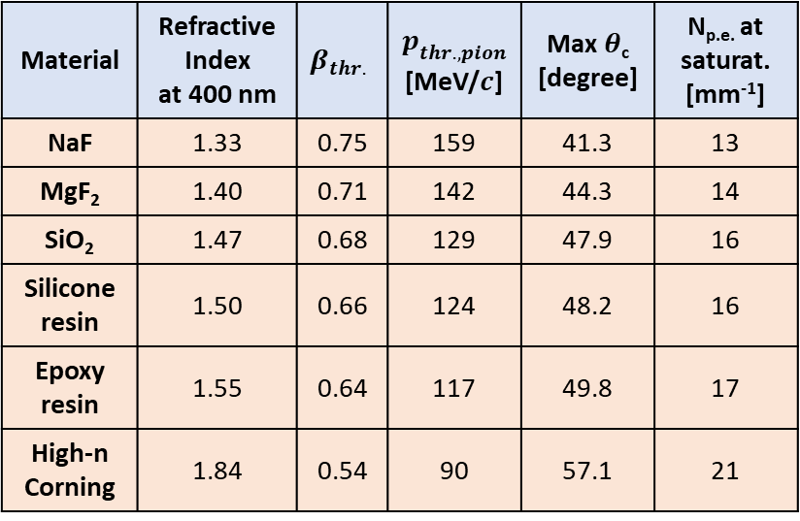
TOF Measurements by SiPMs
Material | Refractive Index at 400 nm | $$β_{thr.}$$ | $$p_{thr.,{pion}^{} }$$ [MeV/$c$] | Max $θ$_{c} [degree] | N_{p.e.} at saturat. [mm⁻¹]
NaF | 1.33 | 0.75 | 159 | 41.3 | 13
MgF₂ | 1.40 | 0.71 | 142 | 44.3 | 14
SiO₂ | 1.47 | 0.68 | 129 | 47.9 | 16
Silicone resin | 1.50 | 0.66 | 124 | 48.2 | 16
Epoxy resin | 1.55 | 0.64 | 117 | 49.8 | 17
High-n Corning | 1.84 | 0.54 | 90 | 57.1 | 21
Reflection
Cluster
Reflection
SiPMs
Resin/Epoxy
Window
Charged track
Gas
a
Fresnel reflection between
  Window and resin/epoxy
  Resin/epoxy and silicon
  Window and gas
Window chromatic dispersion
SiPM Fill Factor 90%, SPTR=50 ps
Dark count rate ~ 50 kHz/mm²
@ room temperature
Window: 2 mm SiO₂
1 GeV/c pion

Slide 5
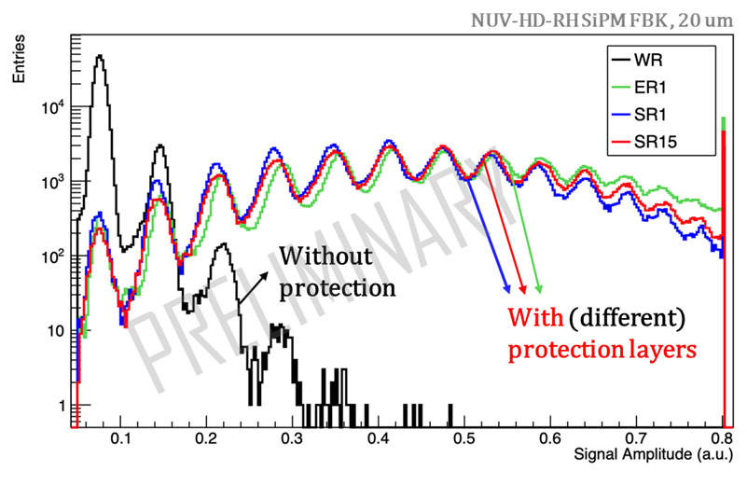
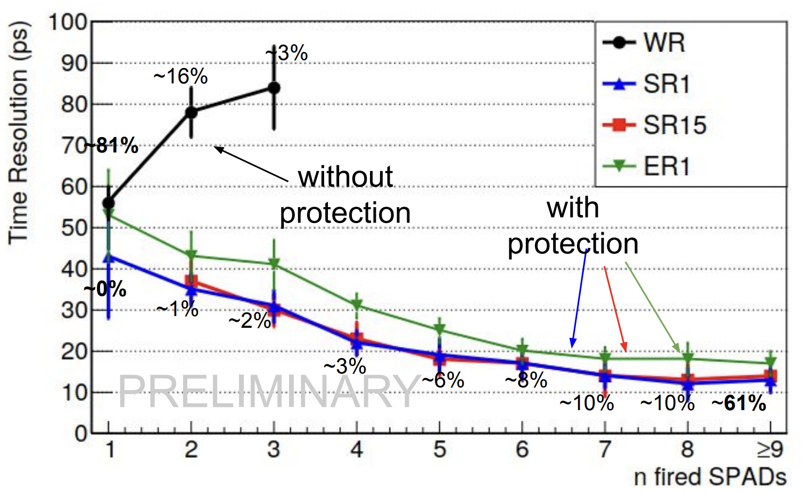
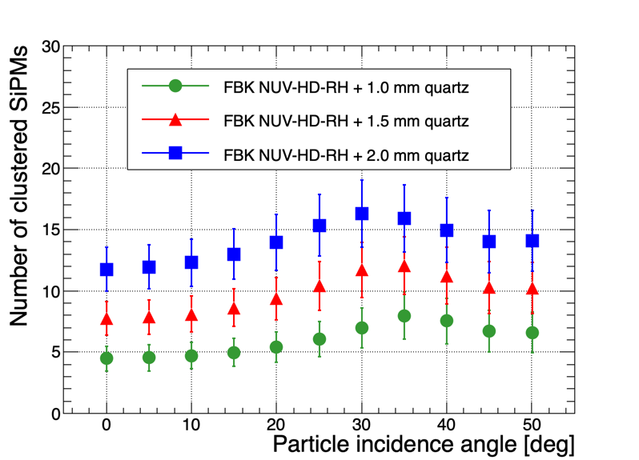
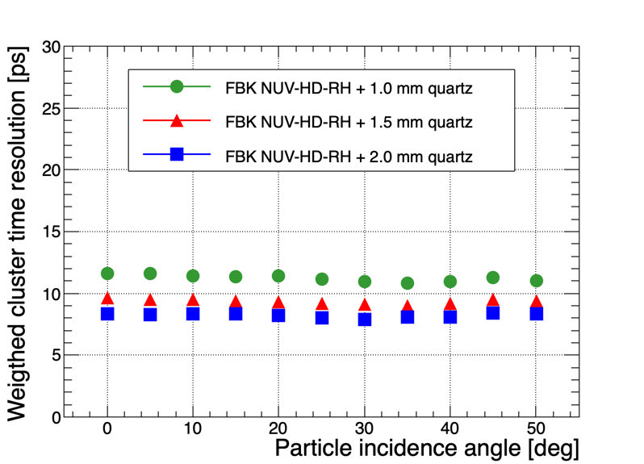
More on TOF Resolution Simulation
F. Carnesecchi, et al., Understanding the direct detection of charged particles with SiPMs
https://dx.doi.org/10.1088/1748-0221/17/06/P06007
https://doi.org/10.48550/arXiv.2210.13244
Talk by P. Antonioli tomorrow
Bianca Sabiu, Alice Upgrade Week, 05/2023
FBK NUV-HD-RH SiPM (1x1 mm², 20 μm SPADs, 72% Fill Factor)
Simulation for 5 GeV/c pions
Protection Layers:
SR1 – 1 mm silicone resin (n=1.5)
SR15 – 1.5 mm silicone resin (n=1.5)
ER1 – 1 mm epoxy resin (n=1.53)
WR – without protection layer

Slide 6
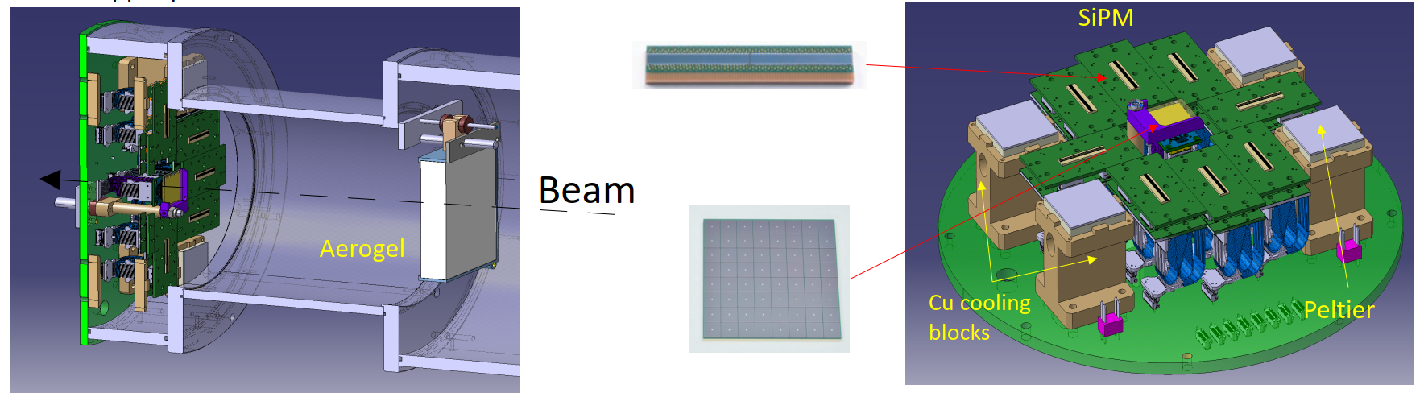
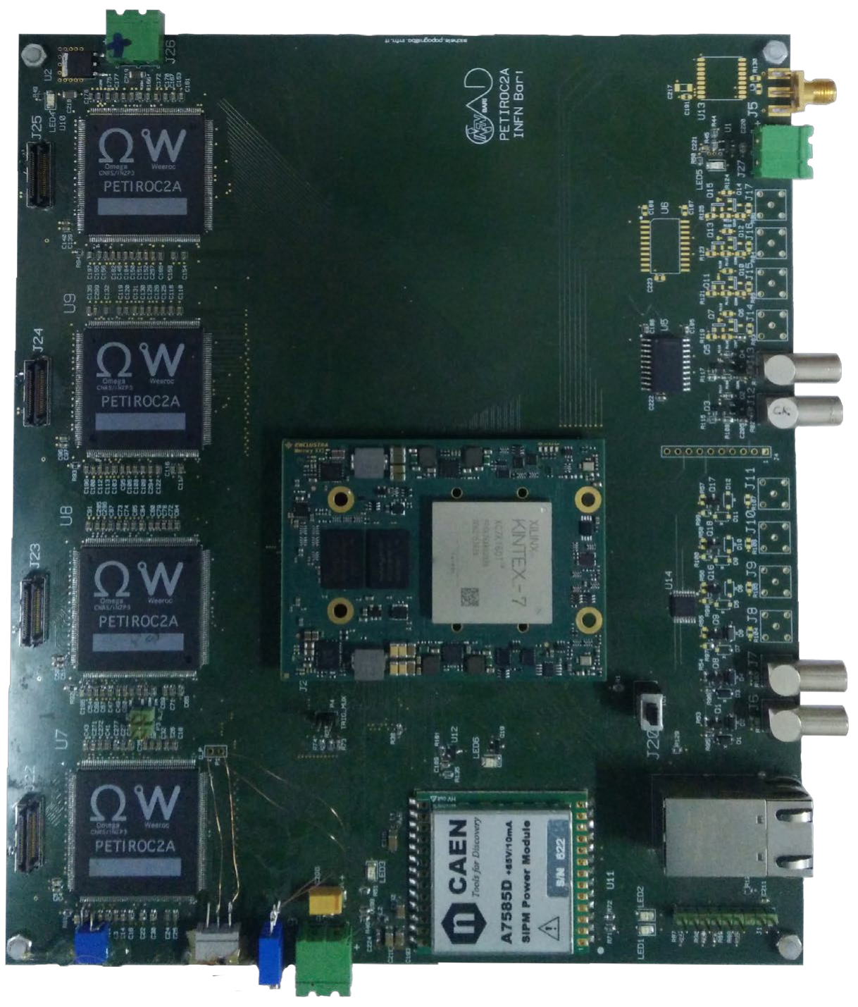
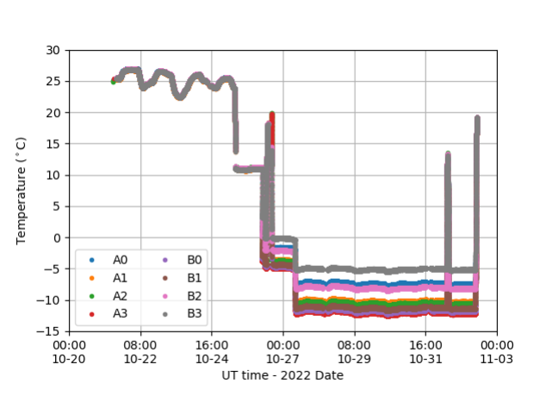
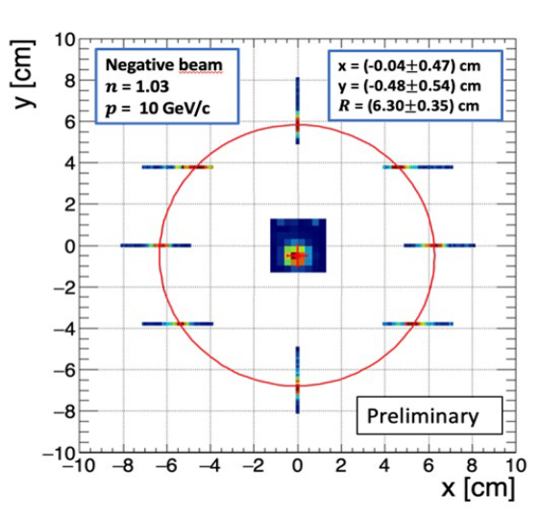
2022 Beam Test Campaign @ PS T10
8 HPK S13552 SiPM arrays for detecting Cherenkov light from aerogel
8x8 HPK S13361 SiPM matrix 3x3 mm² pixel with a NaF radiatior , 3 mm thick (n = 1.3319 @ 400 nm), for charged particles
Front-End: Four PETIROC 2A ASICs
Ref. M.N. Mazziotta et al “A light tracker based on scintillating fibers with SiPM readout”, NIMA 1039 (2022) 167040
https://doi.org/10.1016/j.nima.2022.167040

Slide 7
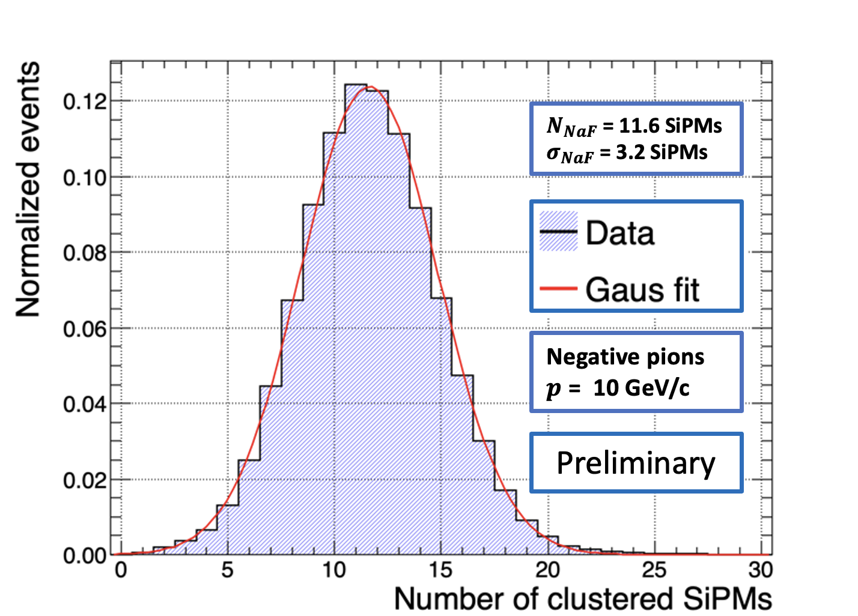
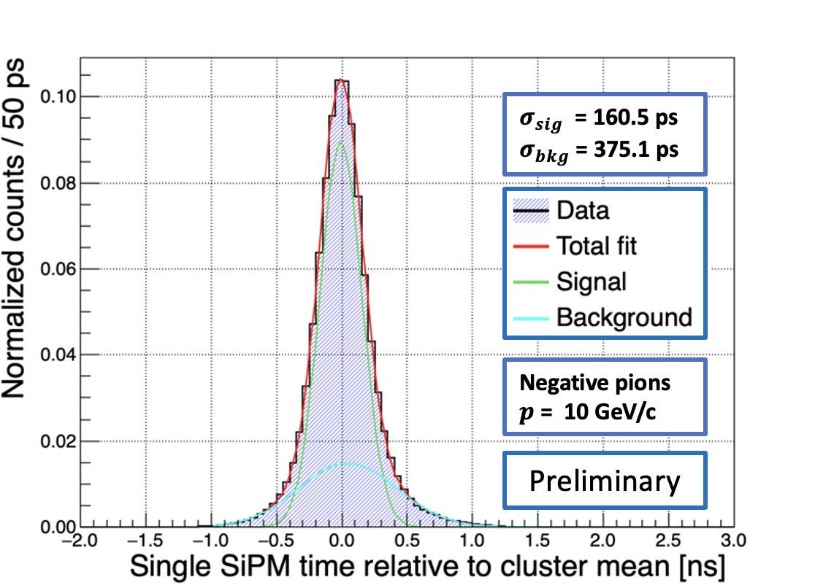
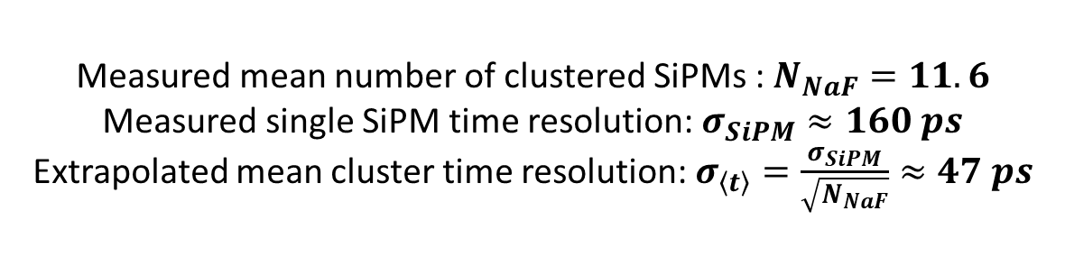
Test Beam Results on Time Resolution
Measured mean number of clustered SiPMs : $N_{NaF}=11.6$
Measured single SiPM time resolution: $σ_{SiPM}≈160 ps$
Extrapolated mean cluster time resolution: $σ_{\left\langle t\right\rangle }=\frac{σ_{SiPM}}{\sqrt{N_{NaF}}}≈47 ps$
Planned 2023 beam test:
• R/O Board synchronization
• External tracking detector:
Two X-Y upstream/downstream fiber trackers
Two ALPIDE pixel modules
• Photon yield and timing studies with 1 mm
SiO₂ radiator glued on the SiPM matrix

Slide 8
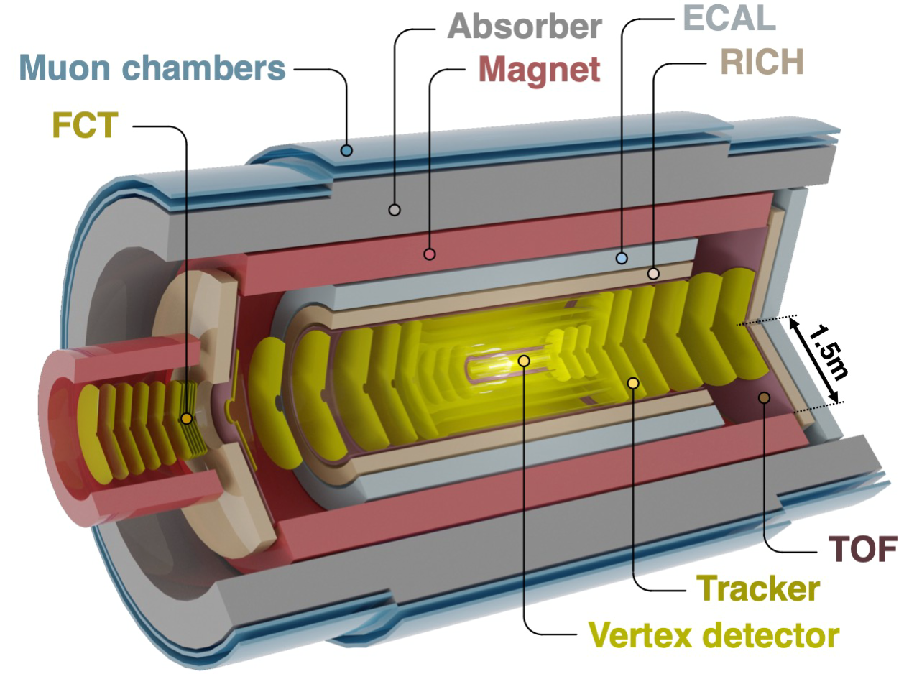
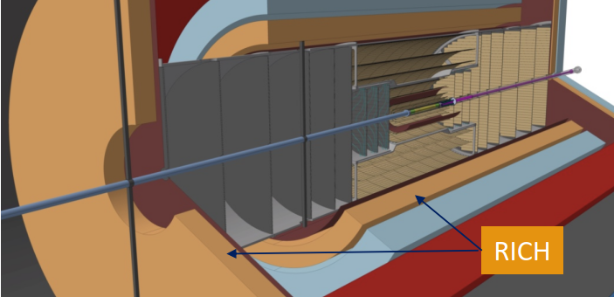
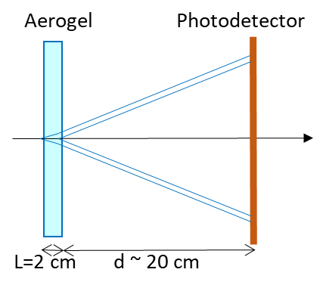
ALICE 3 LOI LAYOUT
Barrel RICH: proximity focusing configuration with an aerogel radiator (2 cm, n=1.03),
20 cm expansion gap and SiPM array as photodetector (magnetic field up to 2 T and
strong Rayleigh scattering from aerogel below 300 nm)
Forward RICHs: same configuration, but aerogel with a lower n
Total Photon Sensitive surface ~ 30 m2
The TOF/RICH approach, if successful, would bring a remarkable cost saving
Baseline scheme: no TOF

Slide 9
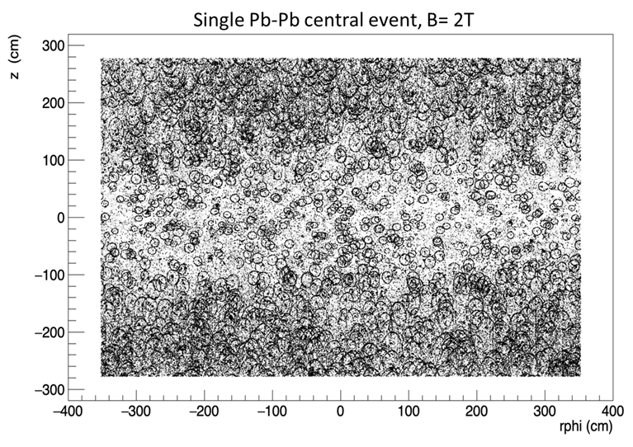
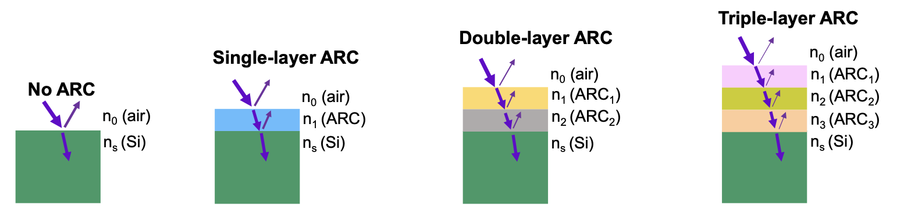
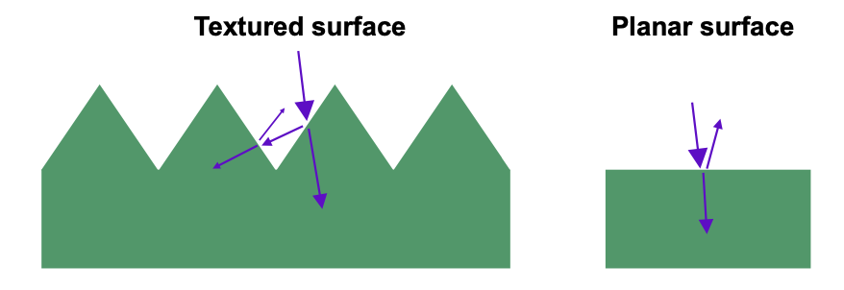
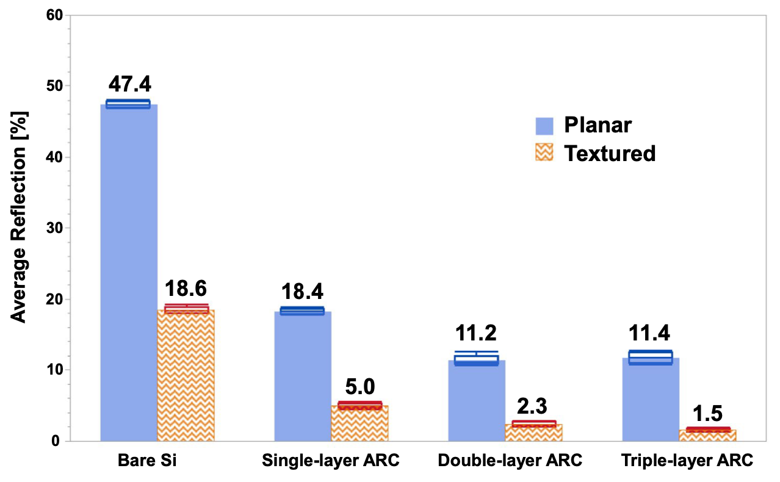
R&D TOPICS FOR THE TOF/RICH DETECTOR
SiPM Anti Reflective Coating
Yuguo Tao at al. doi: 10.1038/s41598-022-18280-y
ALICE 3 RICH Photon Detector hit map
Direct and indirect optical crosstalk is a severe drawback
Secondary photons detected by surrounding SiPMs increase
the rate of accidentals
R&D studies:
• Conventional single-layer antireflection coating (ARC)
• (Multi-layer) ARC: double-layer ARC and triple-layer ARC
• Textured Si surface with upright random nano/micro pyramids
formed by anisotropic etching.
Additional benefits:
• The PDE increase allows operation at lower V_{OV} hence smaller DCR
Textured Si surface: upright random nano‐micro pyramids made by anisotropic etching

Slide 10
Involvement in DRD4
R&D Project
SiPM-based TOF/RICH detector
Fields of Interest
CMOS SPAD development
Textured anti-reflective coating (increase PDE, operate at lower Vov and decrease DCR)
SiPM Module integration
  System design incorporating cooling/annealing
  Power, clock and control signal distribution
  Local Intelligence

