Slide 1
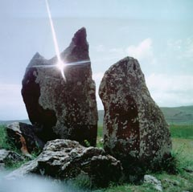

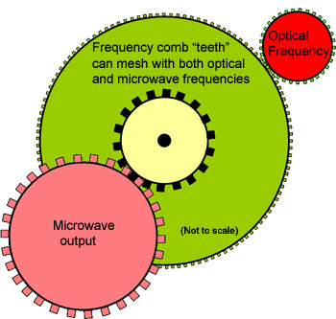
Zorats qarer - 10000 BC?
Zvartnots - 7 Century
Optical Frequency Comb - 21 Century
Advanced RF Timer of Electrons, Photons and Heavy Ions
Amur Margaryan
Alikhanyan National Science Laboratory, Armenia
Notes:
1
1
A. Margaryan, YerPhI RICH-2007 October 20

Slide 2
Outline
Introduction
Regular timing technique
RF timing technique
Advanced RF timing technique
Test studies
Spiral scanning
RFPMT
RFPMT based Cherenkov detectors
RF Timer, Spiral Scanning and TPX3Cam
RFPMT and Optical Frequency Comb
RF Timer based Heavy Ion Detector
Applications
Expectations
Notes:
2

Slide 3
Introduction
20th century was century of first-generation Quantum Technologies (lasers, nanosecond electronics, atomic clock….)
21st century will be century of second-generation Quantum Technologies: PHOTONICS, NANOTECHNOLOGIES
(more than 7 Nobel Prizes of this century is related to PHOTONICs)
Single Photon Detection and Timing is a crucial part of PHOTONICS

Slide 4
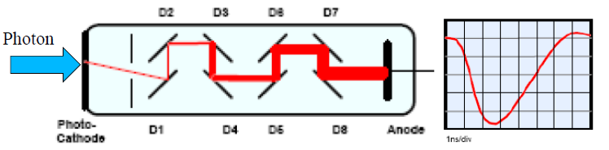
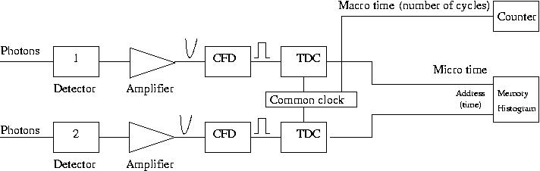

Regular Timing Technique
Gain ~ 10⁶ -10⁷
Fast ~ns output pulse
The timing jitter
of the regular
timing electronics
is ~ 1 ps.
Rate ~ 1 MHz
Vacuum PMT; SiPMT; APD; HPD: typical time resolution ~ few tens ps
Single photon detection with less than 10 ps resolution is possible by means:
SNSPDs- Superconducting Nanowire Single-Photon Detectors

Slide 5
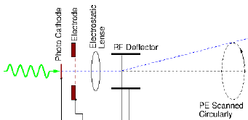
Radio Frequency Time Measuring Technique or Streak Principle
Passing through RF deflector, electrons deflected and fixed the phase of the RF field on the position sensitive detector as a point.
Time (X,Y)
Position Sensitive
Detector, e.g. CCD
Slow readout
few kHz
- HV
Schematic of the RF timing technique
Timing jitter of the commercial Streak Cameras ~ 0.2 ps
Theoretical prediction of the timing jitter is less than 0.1 ps
Notes:
5

Slide 6
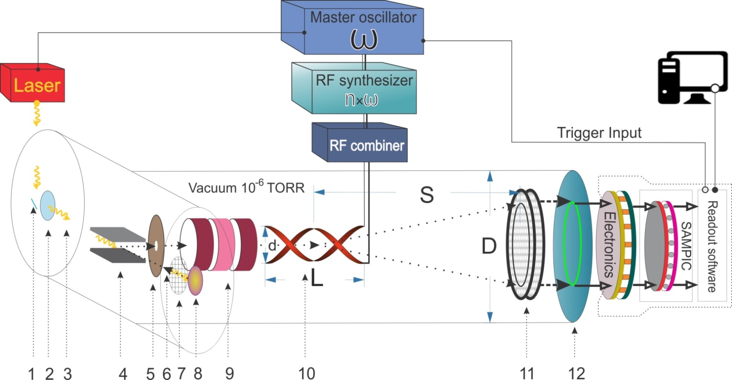

Advanced RF Timing Technique
500 MHz
Pulsed, 100 Hz, 258 nm photon beam, bunch length 0.45 ps
500,
1000
MHz
Schematic of the technique
1-mirror; 2-quartz window; 3-ultrafast laser photon pulse; 4-magnet; 5-collimator; 6-photoelectron; 7-accelerating electrode; 8-photocathode; 9-electrostatic lens;10-RF deflector; 11-MCP detector; 12- delay line anode

Slide 7
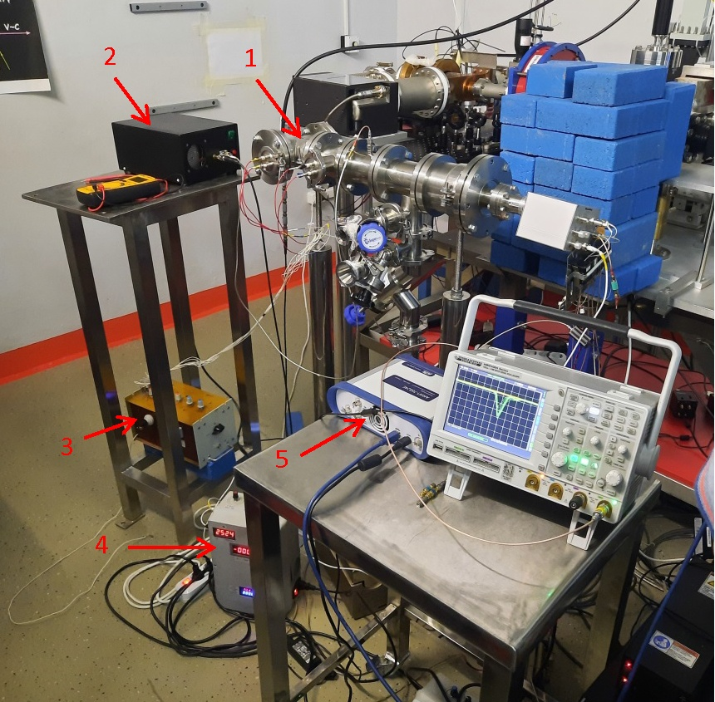
General view of the setup at the CANDLE Institute
1-RF Timer prototype; 2-RF amplifier; 3-power supply for electrostatic lens; 4-power supply accelerating electrode and MCP detector, 5-PICOSCOPE.

Slide 8
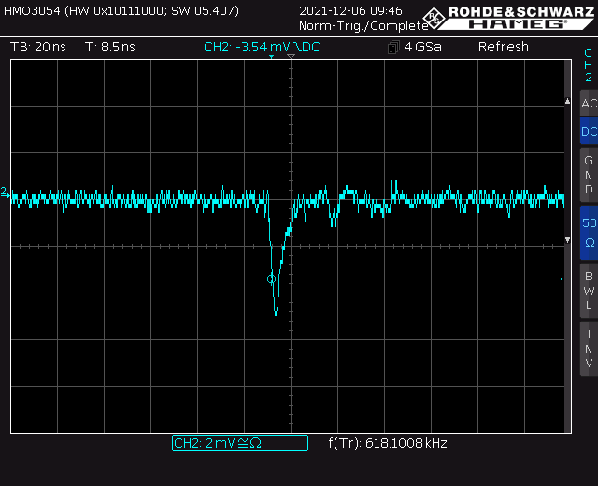
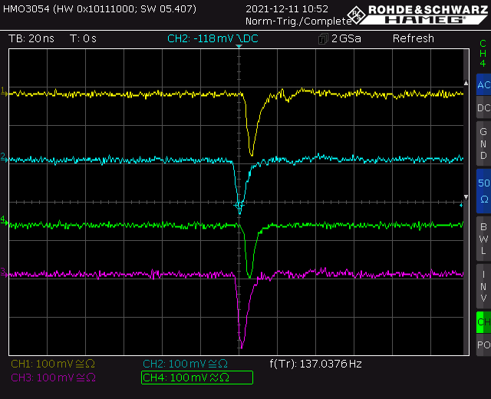
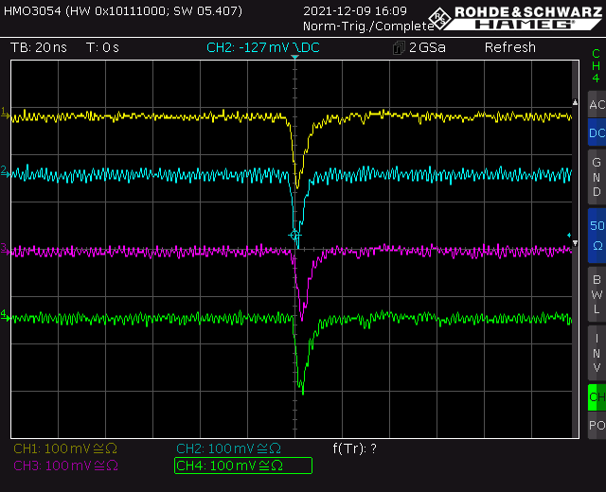
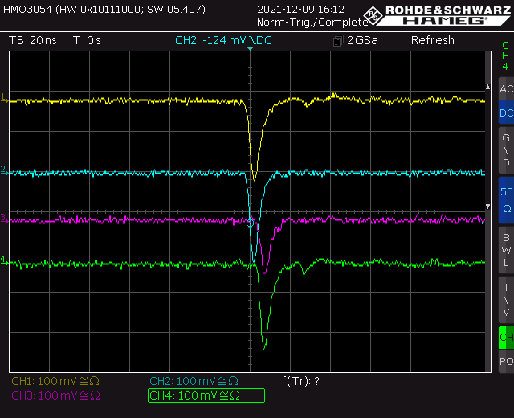
The signals from the position sensitive anode
a
b
c
d
(a) typical raw signal; (b) typical amplified signals, RF off; (c) typical signals with 500 MHz RF on; (d) typical signals with 1000 MHz RF on.

Slide 9
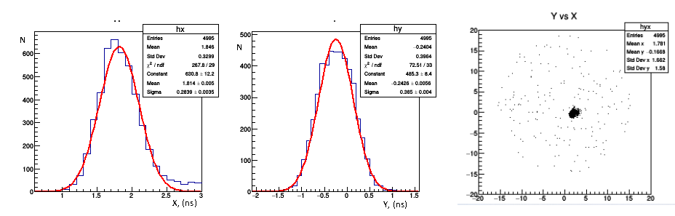
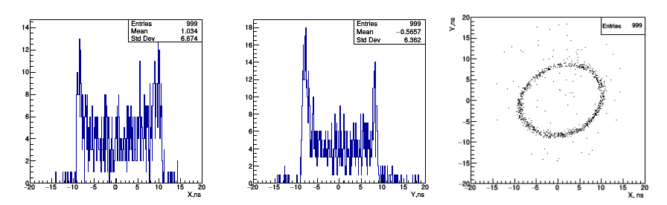
RF timer of keV electrons: test with thermo-electrons
a
b
c
Distribution of time intervals between signals of x (a) and y (b)
directions and 2D image (c) of the 2.5 keV electrons (RF off).
a
b
c
Distribution of time intervals between signals of x (a) and y (b)
directions and 2D image (c) of the 2.5 keV electrons (500 MHz RF on).

Slide 10
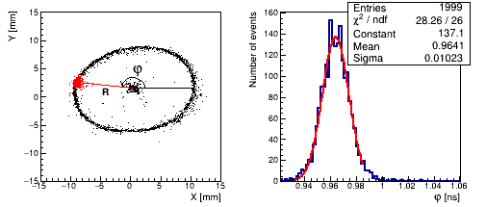
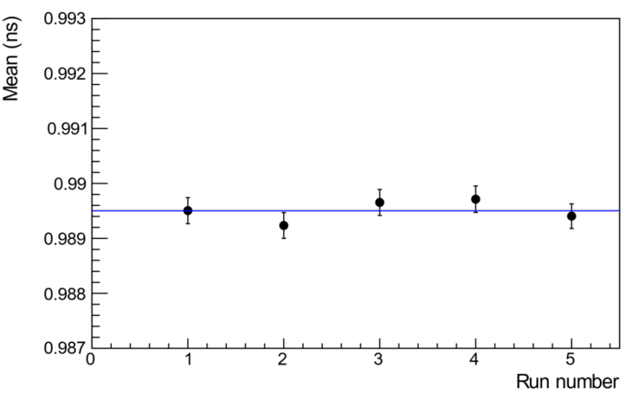
RFPMT: test with femtosecond pulsed laser
Left: 2D image of anode hit positions. The point in the center of the circle is an image of electrons with RF turned OFF. The circle is an image of the scanned electrons when the 500 MHz RF is ON but not synchronized with the laser. The red spot on the circle corresponds to phase distributions of RF-synchronized photoelectrons for a fixed phase;
Middle: Distribution of phase (φ) of the electrons in the case of RF synchronized laser;
Right: The mean values of sequentially measured time distributions in a one-hour period.
HIGH RESOLUTION (≤ 10 ps), HIGH RATE (~MHz), HIGHLY STABLE (≤ 0.5 ps, FWHM) timing technique for single electrons and photons.
A. Margaryan et al., Nucl. Instr. & Meth. A1038, 166926 (2022)

Slide 11
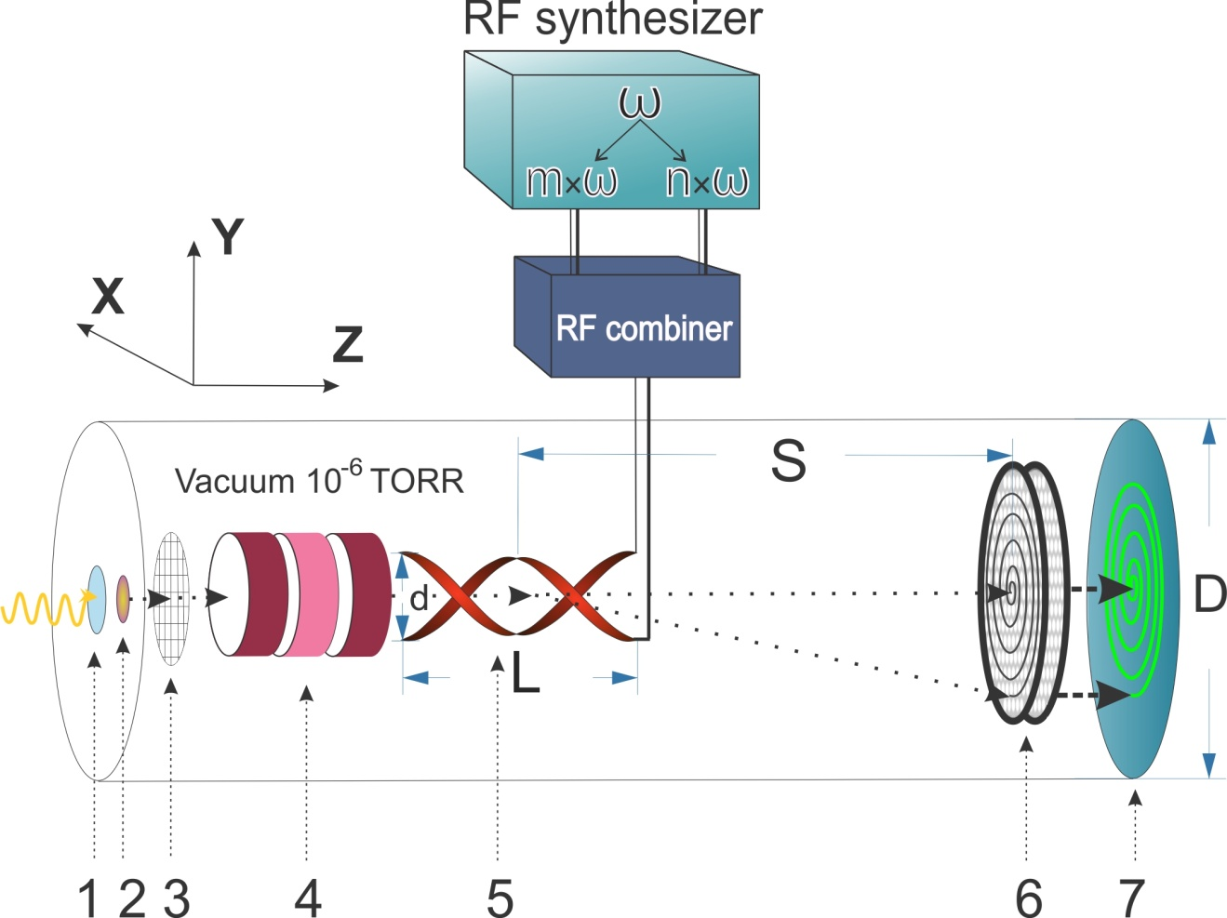
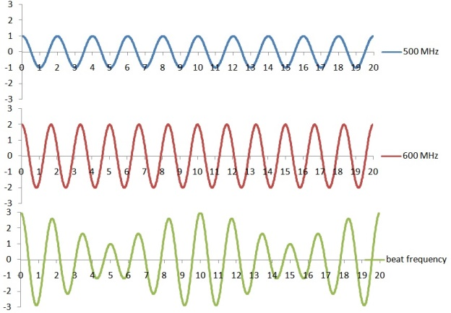
The Radio Frequency Photomultiplier Tube-RFPMT
Schematic of the technique
1-quartz window; 2-photocathode; 3-accelerating electrode; 4-electrostatic lens; 5-RF deflector; 6-MCP detector; 7-position sensitive anode
Schematic of the RFPMT. 1. glass-window, 2. photo-cathode, 3. accelerating electrode, 4. electrostatic lens, 5. RF deflector, 6. microchannel plate base electron detector, 7. position sensitive readout system.

Slide 12
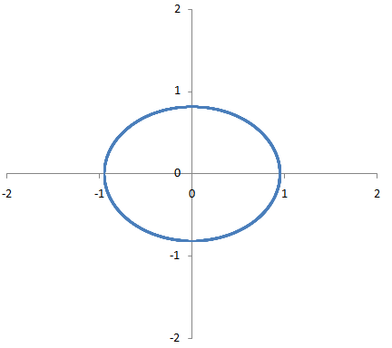

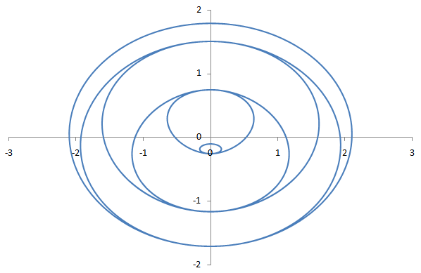

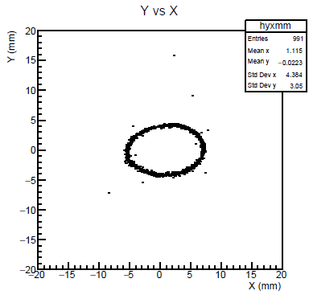
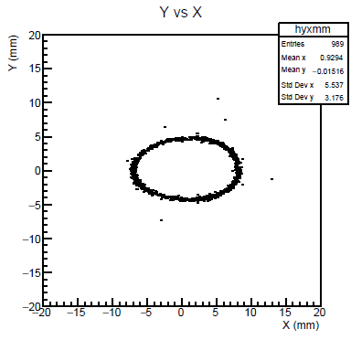
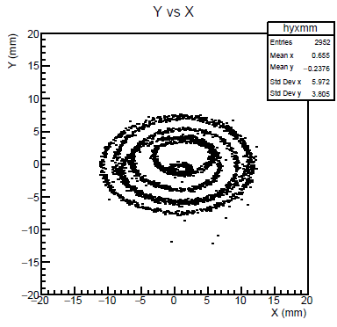
Spiral Scanning RF Timer with DL anode
Theory
Circular/elliptical scanning
Spiral scanning
500MHz
600MHz
f₁ = 500 MHz
f₂ = 600 MHz
500 & 600 MHz
500&600 MHz = Beat Frequency
Experiment
Spiral scanning RF Timer is a Doorway into the High Resolution, High Rate and Highly Stable Continues Timing Technology
f₁=500MHz, f₂=600MHz, a=1.36,

Slide 13
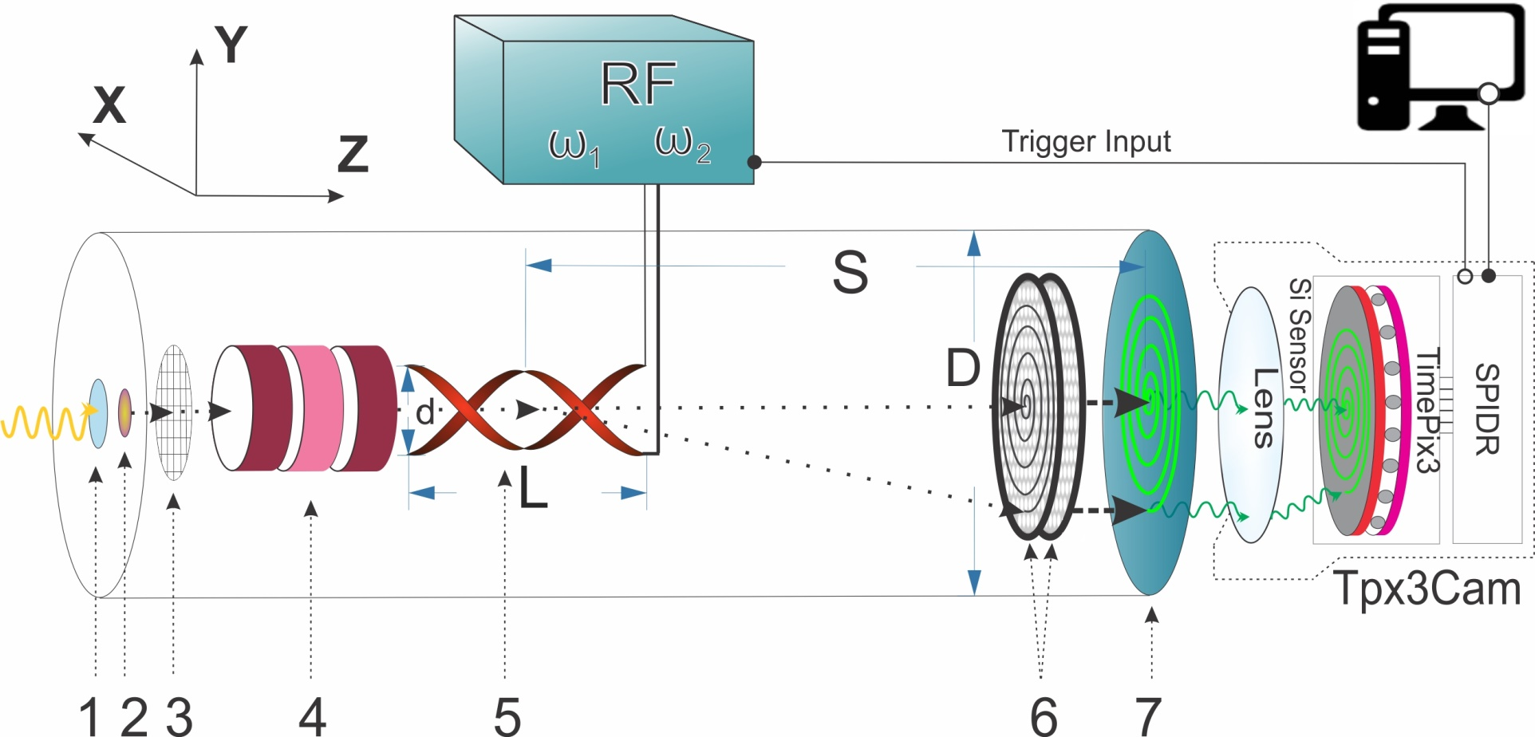
RF Timer with spiral scanning and fast pixelated detector
Schematic of the technique
1-quartz window; 2-photocathode; 3-accelerating electrode; 4-electrostatic lens; 5-RF deflector; 6-MCP detector; 7-phosphor screen
Spiral scanning RF Timer with a fast pixelated detector, e. g. TPX3Cam is a Doorway into the High Resolution, High Rate, Highly Stable and Dead Time free Continues Timing Technology

Slide 14
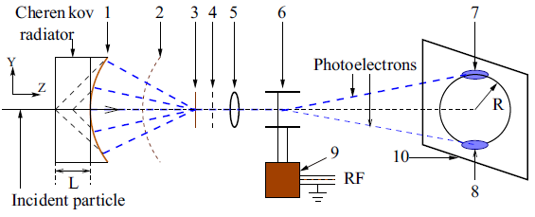
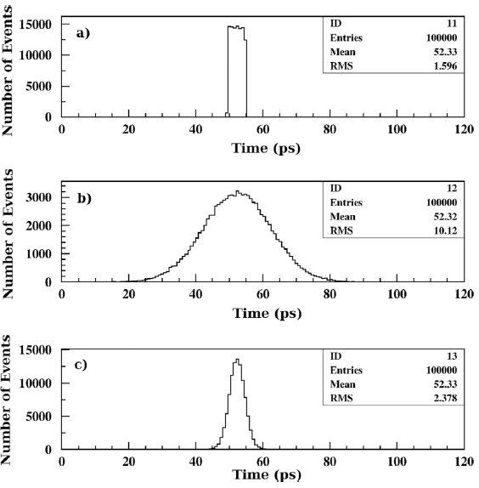
A schematic layout of the Cherenkov TOF detector with large size photocathode RFPMT
1- photocathode, 2- electron transparent accelerating electrode,
3- transmission dynode, 4- accelerating electrode, 5- electrostatic lens,
6- RF deflection electrodes, 7- image of PE's from electron,
8- image of PE's from pion, 9- RF coaxial cavity, 10- SE detector.
A. Margaryan, J.R.M. Annand, P. Achenbach et al., 2017
MC simulated time distributions of
single Cherenkov photons;
PE's for tracks of p = 133 MeV/c pions;
(c) the mean time of 20 PE's.
A. Margaryan, O. Hashimoto et al., Nucl. Instr. & Meth., 2008
A. Margaryan, 2011
A. Margaryan et al. 2014

Slide 15
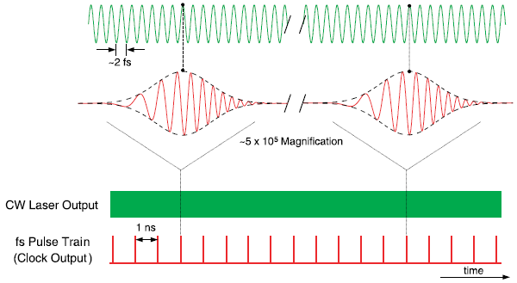
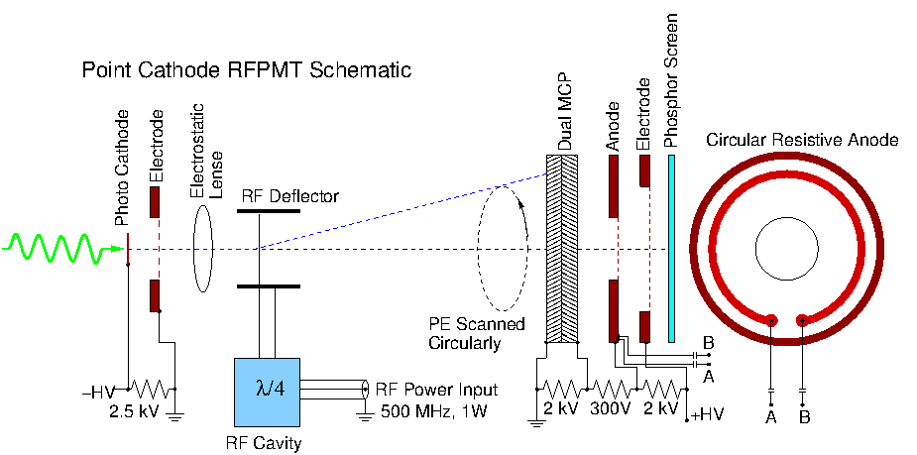
The RFPMT and Optical Frequency Comb
S. Diddams et al, Science, 2001
J. L. Hall, Nobel lecture, 2005
The fs Pulse Train as a Reference Beam
RFPMT + OFC Results:
High Resolution
High Rate
Highly Stable
Time Correlated Single Photon
Counting Technique
RF synchronous with the OFC
A. Margaryan, 2010, Nucl. Instr. Meth. A652 (1) 504–507.
15
Notes:
15

Slide 16
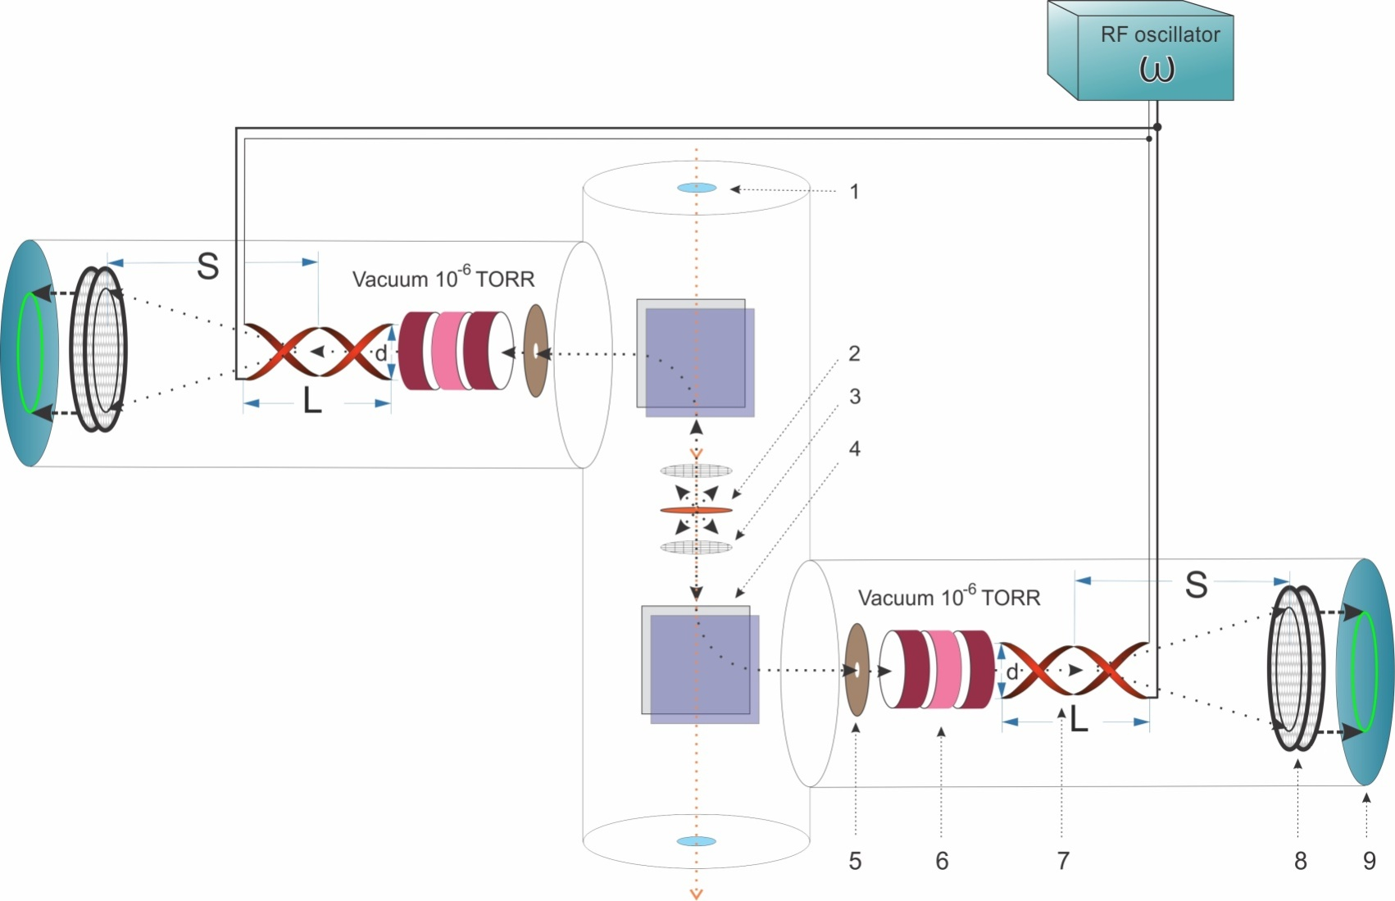
RF Timer based Heavy Ion Detector
Window
Target
Accelerating electrode
Magnet
Collimator
Electrostatic lens
RF deflector
MCP detector
Readout electronics
Schematic of the RF Timer based Heavy Ion Detector
Expected time resolution ≤ 10 ps, time stability ≤ 0.2 ps
Notes:
16
16

Slide 17
Applications
Fundamental Studies - Comparison of Clocks
Astrophysics - Brown -Twiss experiments
High Energy and Nuclear Physics - Cherenkov TOF
Heavy Ion precise timing
FLIM - Fluorescence Lifetime Imaging
FRET - Foster Resonance Energy Transfer
STED - Stimulated Emission Depletion super resolution microscope
DOI - Diffuse Optical Imaging
TOF - PET - 10 ps Challenge
PALS - Positronium Annihilation Lifetime Spectroscopy
LIDAR - Laser Imaging Detection & Ranging

Slide 18
Expectations
We can start developing and producing prototype vacuum sealed RFPMTs and RFHIDs and scientific devices based on them.
Preliminary discussions with Photek Ltd. inspire hope that with adequate funding, the RFPMT prototypes could be ready in a few years.

Slide 19
Advanced RAdio Frequency Timing AppaRATus
Amur Margaryanª, Ani Aprahamian^{a,i,1,8}, Vahe Gurzadyan^{a,6}, Armen Allahverdyan^{a,7},Vanik Kakoyan^{a,1,2}, Simon Zhamkochyan^{a,1,2}, Sergey Abrahamyan^{a,4,5}, Hayk Elbakyan^{a,2}, Samvel Mayilyan^{a,3,5}, Garnik Ayvazyan^{a,3,5}, Hasmik Rostomyan^{a,2,5,8,10}, Anna Safaryan^{a,2,5,10}, Arpine Piloyan^{a,2,9}, Bagrat Grigoryan^{b,1,5}, John Annand^{c,2,3,5}, Kenneth Livingston^{c,2,3,5}, Rachel Montgomery^{c,2,3,5}, Patrick Achenbach^{d,1,2,5,8}, Josef Pochodzalla^{e,5,8}, Dimiter L. Balabanski^{f,5,8}, Satoshi N. Nakamura^{g,2,5,8}, Viatcheslav Sharyy^{h,2,5,9}, Dominique Yvon^{h,2,5,9}, Khachatur Manukyan^{i,2}, Maxime Brodeur^{i,2,3,5,8}
a) A.I. Alikhanyan National Science Laboratory, b) CANDLE Synchrotron Research Institute, c) School of Physics & Astronomy, University of Glasgow, d) Thomas Jefferson National Accelerator Facility, e) Institut für Kernphysik, Johannes Gutenberg-Universität Mainz, f) Extreme Light Infrastructure- Nuclear Physics (ELI-NP), g) Department of Physics, Graduate School of Science, the University of Tokyo, h) Département de Physique des Particules Centre de Saclay, i) Department of Physics and Astronomy, University of Notre Dame
Activities: 1 management, 2 R&D, 3 hardware, 4 software, 5 test studies, 6 fundamental studies, 7 quantum technologies, 8 nuclear physics, 9 imaging, 10 material science
Thank you for your attention

