Slide 1
Organisation of DRD4
Peter Krizan and Christian Joram
JSI Ljubljana CERN
Community Meeting
16 and 17 May 2023

Slide 2
Tentative Programme for Community Meeting
Tue, 16/05, morning, 0.5h
Introduction, the Roadmap, purpose of the meeting, timeline, results of survey
Session Photodetection,
SiPM, SPAD, PMT, MCP 12 talks
Session Technologies
Materials
Software
Session Particle ID
RICH/DIRC
TOF/TORCH
Social dinner
Wed, 17/05
Session ‘blue sky’, special, etc.
Session Organisation 1
Introduction
Presentation of groups and their interests
Session Organisation 2
Structure of DRD4
Which WPs? Scopes ?
Financial
Common projects
Session Organisation 3
Proposal, content, timeline, signatories
Contributors
3 talks
3 talks
6 talks

Slide 3
Draft structure of DRD4
(For discussion only)
Board of
Institutes
Coordinator
JP leaders
WG leaders
Joint projects
DRDT 4.1
DRDT 4.2
DRDT 4.3
DRDT 4.4
Enhance the timing resolution and spectral range of photon detectors
Develop photosensors for extreme environments
Develop RICH and imaging detectors with low mass and high timing resolution
Develop compact high performance time-of-flight detectors
Other JP
…
Project 1.1
Project 2.1
Project 1.2
Project 2.2
Project 1.3
Project 2.3
Working Groups
Photodetector R&D
Solid state
Gaseous
Vacuum
Particle ID
RICH
DIRC
TOP
TORCH
TOF
Technologies
Radiators
Optical elements
Readout
Cooling
software
Future
ideas,
concepts,
blue sky
…
Other WG
…

Slide 4
Vote: Scope and Structure of DRD4.
Voting procedure:
Open vote
Persons present in room and by zoom
Every person has 1 vote
Aim for absolute majority
Scope: Photodetectors (single photon sensitive), Particle ID *RICH, TOF, TOP, TORCH, Scifi tracking
In favour
Against
Abstention
Alternative proposal
Structure: Working groups and Joint Projects (names may still change)
In favour
Against
Abstention
Alternative proposal

Slide 5
Vote: Working groups, their scope, modus operandi
Working groups
1. Photodetectors
2. Particle ID
3. Technological
4. Software
5. Future (incl. SciFi, may be split at a later stage)
Forum-like mode
Loose cooperation without agreed milestones, commitments, budgets
A convenor (+ deputy) organises meetings (few per year), stimulates activities
Joining/leaving without formalities
Vote
In favour
Against
Abstention
Alternative proposal
Photodetector R&D
Solid state
Gaseous
Vacuum
Particle ID
RICH
DIRC
TOP
TORCH
TOF
Technologies
Radiators
Optical elements
Readout
Cooling
software
Future
blue sky
SciFi
…

Slide 6
Vote: Joint projects, their scope, modus operandi
Joint Projects in 4 themes (4 themes should/must follow Roadmap)
Enhance the timing resolution and spectral range of photon detectors => High Performance Photodetectors
Develop photosensors for extreme environments => High Longevity Photodetectors
Develop RICH and imaging detectors with low mass and high timing resolution => Fast Imaging Cherenkov
Develop compact high performance time-of-flight detectors => High Performance TOF
Project mode
Cooperation with agreed goals, milestones, commitments, budgets
A convenor (+ deputy) organises (more frequent) meetings, tracks progress, stimulates activities
Procedure/approval for joining/leaving
Vote
In favour
Against
Abstention
Alternative proposal

Slide 7
Financial
Financial arguments are often used to motivate the formation of DRDs
Funding Agencies (FA) should have heard of this European-wide effort and hopefully react favourably to your requests
‘DRD’ shall be a kind of R&D quality label, telling the FA that this is highly relevant and monitored R&D.
Still, at least in the initial phase, resources will be tight and we depend on already financed R&D which the groups continue to perform, but now under the umbrella of the ECFA roadmap.
The groups remain responsible and in control of their resources. Contributions will not be mutualised.
We propose to create a small Common Fund based on a small member fee (e.g. 1000 CHF per institute). This will allow to organise meetings (coffee breaks, dinner?), send someone to a conference to give a DRD4 talk (in case no other funding is available), etc.
DRD4 shouldn’t require huge funds (compared to DRD3 or DRD7 which need to pay expensive Si/ASICs submissions).
For specific financial questions, please contact Phil Allport or Karl Jakobs.

Slide 8
DRD4 Timeline
31.07.2023
Official deadline for
proposal submission
today
Feb Mar Apr Mai June Jul Aug Sep Oct Nov Dec Jan 2024
Low efficiency !
Many people absent!
We’ll ask for a few weeks extra, if needed.
Community meeting =>
Proposal completed =>
Start of activities =>
Constitution meeting =>
24/02 Send invitation =>
questionnaire returned =>
Start proposal writing=>
Send out questionnaire =>
08/03 Small zoom meeting =>

Slide 9
Next steps
We aim for proposal submission by the end of June
We will contact all groups next week and ask
    Which WG do you want to join (at least 1) ? What is your main contributions and interests (mention one per WG)?
    Which project do you propose in which of the 4 themes ? Provide a few lines of justification
    Provide answer by 28 May
Based on the answers we will draft a work plan. For every proposed projects we will ask the involved groups to prepare a description of the project and fill the resource table (As far as information is available)

Slide 10
Next steps
Proposal writing. Try to limit effort. Recommended length 20 pages. Motivation, goals … refer to Roadmap. Need to fill WG and more importantly JP with life and substance.
Outline/template available. ECFA DRDC panel should update it.
We must start now. We need your help!
Are there volunteers who are prepared to describe one of the Working Group activities?
Are there volunteers willing to organise the proposals of one theme ?

Slide 11
DRD4 Collaboration Proposal – layout following a suggested template
Abstract
Introduction (objectives of the DRD4 collaboration)
(make use of the introduction of the TF4 chapter in the RD Roadmap, shortened)
Scope of the DRD4 Research Work
Planning technology area 1: DRDT 4.1 - Enhance timing resolution and spectral range of photon detectors
(including a task/deliverable synoptic, resources and list of contributing institutes)
Planning technology area 2: DRDT 4.2 - Develop photosensors for extreme environments:
(including a task/deliverable synoptic, resources and list of contributing institutes)

Slide 12
DRD4 Collaboration Proposal – layout 2
Planning technology area 3: DRDT 4.3 - Develop RICH and imaging detectors with low mass and high resolution timing.
(including a task/deliverable synoptic, resources and list of contributing institutes)
Planning technology area 4: DRDT 4.4 - Develop compact high performance time-of-fight detectors.
(including a task/deliverable synoptic, resources and list of contributing institutes)
Common simulation tools and test facilities
Partnerships (industrial, other research areas, other applications)
Networking and training
Proposal for the collaboration structure

Slide 13
Table 1: timeline

Slide 14
Table 2: institutional involvement

Slide 15
Table 3: available and requested resources - confidential

Slide 16
Table 4: community input estimates

Slide 17
Next steps
MoU writing. Try to limit effort. Not clear whether ECFA DRDC will provide a template. In the meantime, we use the RD50 MoU as a model.
Idea (by DRD1): Lightweight MoU plus Annexes for Joint Projects
It seems that we can submit the R&D proposal end of July and the MoU lster in autumn.
Should we have a DRD4 constitution meeting in 1 month from now?
Proposal June 15. By zoom ?
=> Finalise proposal and MoU
=> Constitue proto-collaboration

Slide 18
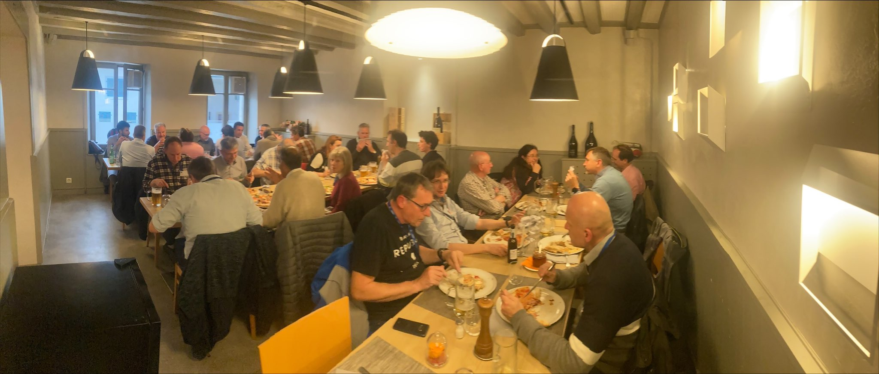
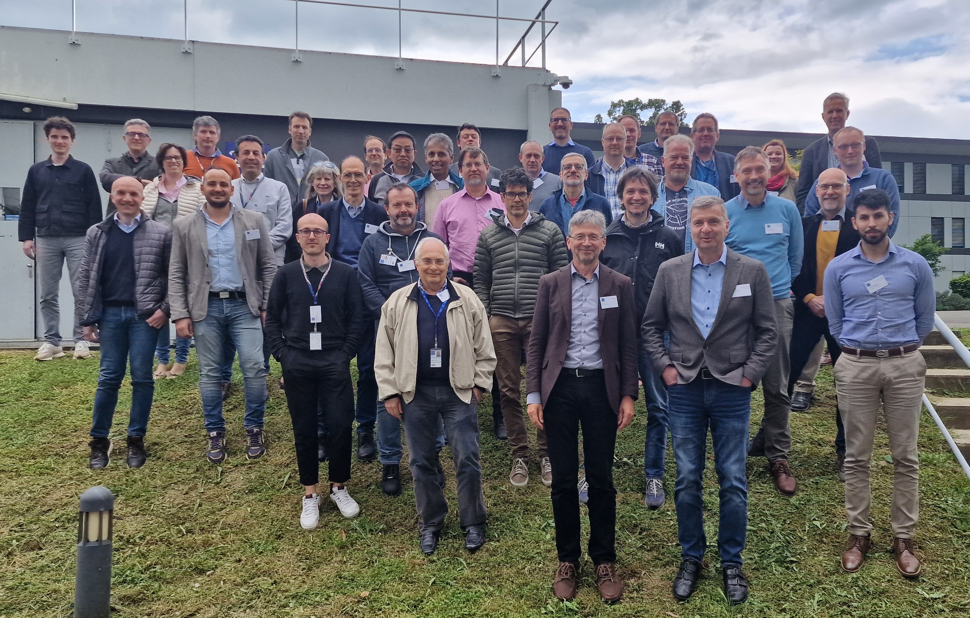
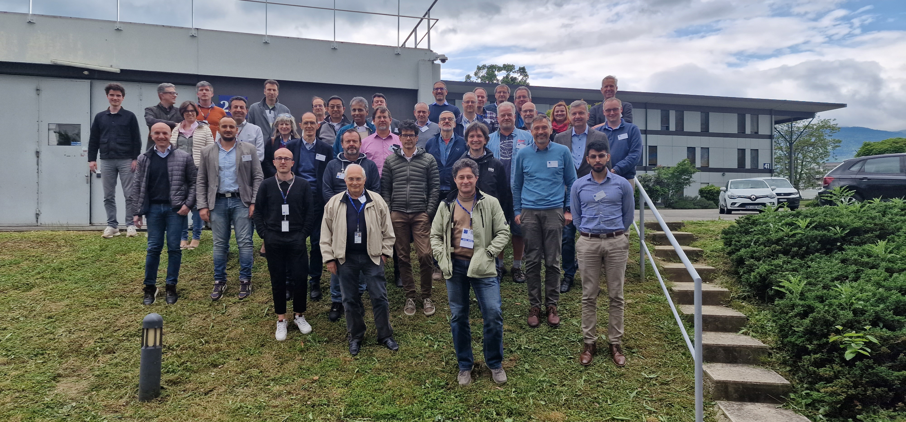
A very productive meeting
Lots of useful discussions
A big step towards forming the DRD4 Collaboration

Slide 19
A tight schedule ahead
DRD4 internal proposal deadline end of June
DRD4 Collaboration constitutional meeting: June 15 via zoom
Groups submit their interest in Working groups and propose projects: deadline May 28

Slide 20
Thanks
… to the colleagues at CERN for their support!
Safe trip back home!

Slide 21
SPARE SLIDES

Slide 22
Tentative participation to Working Groups
Working groups
1. Photodetectors
2. Particle ID
3. Technological
4. Future (incl. SciFi, may be split at a later stage)
Photodetector R&D
Solid state
Gaseous
Vacuum
Particle ID
RICH
DIRC
TOP
TORCH
TOF
Photodetector | Particle ID | Techno | Future
Technologies
Radiators
Optical elements
Readout
Cooling
software
Future
blue sky
SciFi
…

Slide 23
Tentative participation to Joint Projects
Working groups
High Performance Photodetectors
High Longevity Photodetectors
Fast Imaging Cherenkov
High Performance TOF
High Performance Photodetectors | High Longevity Photodetectors | Fast Imaging Cherenkov | High Performance TOF

Slide 24
Organisation of Detector R&D Roadmap
https://indico.cern.ch/e/ECFADetectorRDRoadmap

Slide 25
Facility requirements : Particle Identification
Projects | Timescale | RICH (high and low momentum PID) | Time of flight and DIRC | RPC technologies | TRD & dE/dx
Panda/CBM (Fair/GSI) | 2025 | ✓ | ✓ | ✓
NA62/KLEVER/TauFV | 2025 | ✓ | ✓
ALICE | 2026-27 (LS3) – 2031 (LS4) | ✓ | ✓ | ✓ | ✓
Belle-II | 2026 | ✓ | ✓
Neutrino long baseline | 2027
LHCb | 2031 (LS4) | ✓ | ✓
ATLAS-CMS | 2031 (LS4) - 2035 (LS5)
Non accelerator & particle astro | --
EIC | 2031 | ✓ | ✓
ILC | 2035
CLIC | 2035
FCC-ee | 2040 | ✓ | ✓ |  | ✓
Muon-collider | > 2045
FCC-hh | > 2050

Slide 26
Facility requirements : Photon Detectors
Projects | Timescale | SiPM technology | MCP-PMT technology | Large diameter PMT technology | Scintillating fibres & new scintillating materials | CCDs & superconducting devices
Panda/CBM (Fair/GSI) | 2025 | ✓ | ✓
NA62/KLEVER/TauFV | 2025 | ✓ | ✓
ALICE | 2026-27 (LS3) – 2031 (LS4) | ✓ | ✓
Belle-II | 2026 |  | ✓
Neutrino long baseline | 2027 | ✓ |  | ✓ | ✓
LHCb | 2031 (LS4) | ✓ | ✓ |  | ✓
ATLAS-CMS | 2031 (LS4) - 2035 (LS5) | ✓
Non accelerator & particle astro | -- | ✓ |  | ✓ | ✓ | ✓
EIC | 2031 | ✓ | ✓ |  | ✓
ILC | 2035 | ✓ |  |  | ✓
CLIC | 2035 | ✓ |  |  | ✓
FCC-ee | 2040 | ✓ | ✓ |  | ✓
Muon-collider | > 2045 | ✓
FCC-hh | > 2050 | ✓

Slide 27
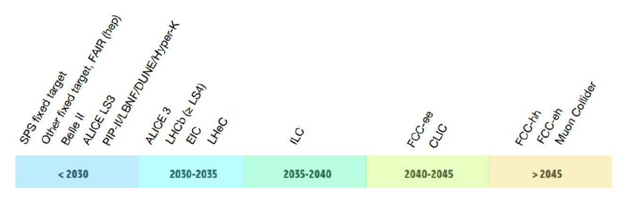
Large accelerator-based facility/experiment earliest feasible start dates

Slide 28
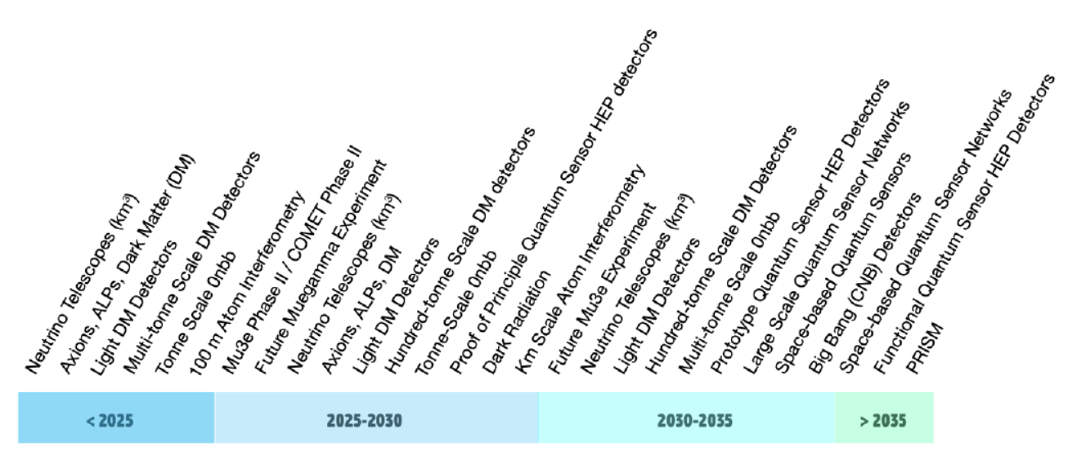
Smaller accelerator and non-accelerator-based experiments start dates

Slide 29
Family of vacuum-based photodetectors
A number of photon detector types have evolved from the classic photomultiplier concept :
Micro-channel plate detectors (MCP-PMTs)
  Several suppliers : eg. LAPPD (large area) and Photonis/ Hamamatsu/ Photek (compact, tunable granularity) – see next slide
  Photo-multipliers (including large areas)
  Improvements needed to increase radio-purity (factor 5-10), UV response & QE
  Multianode (MaPMTs)
  Hybrid avalanche photon detectors (HAPDs)
  Hybrid HPDs, V-SiPMT …. etc

Slide 30
Gas-based photodetectors
Gaseous Photon Detectors (GPDs) represent an effective solution for instrumenting large imaging surfaces (up to several square metres) in high magnetic felds.
Need to develop GPDs based on Micro Pattern Gaseous Detector (MPGD) structures which allow photon conversions at few 10’s of micron level.
  Further R&D to improve the photocathode lifetime (GHz rates for EIC), the PDE, radiation hardness and time resolution in the few ps range (PICOSEC-Micromegas Detector Development); challenging extension to the visible spectral range.
Search for UV-sensitive materials more radiation-hard and chemically inert than CsI.
  Carbon based photocathodes
  Develop compact GPD systems with integrated electronics for imaging applications
  InGrid - Micromegas integrated in a Timepix
  R&D for alternative hydrocarbon-free gas mixtures
  GPDs for cryogenic applications
  Detection of both scintillator light and ionization

Slide 31
SiPMs : R&D technology requirements
A non-exhaustive list – different applications, different requirements:
  Improved radiation hardness (1x10¹⁴ n cm⁻² eq @ CMS ; 10¹⁷-10¹⁸@ FCC-hh !)
  Improved dark count rates towards 1 Hz mm⁻² (driven by low light-level experiments) and reduced after pulsing
  Improved timing characteristics (aspire to 10 ps or below for time resolution)
  Increasing photon detection efficiency for single-photons : fill factor and spectral range into the UV & IR
  Cryogenic operation of SiPMs : improved cooling systems (to reduce dark noise), @ -50 °C
  Optimised SiPM systems - large-area integration with cooling
  Optimised optical couplings. development of micro-lenses/filters.
  New materials for SiPMTs (eg SiC, GaN, InGaN, AlGaN)
  Improved dynamic range (driven by calorimetry)
  Improved cross talk
  Cheaper solutions for SiPMs (eg CMOS) for large area applications and high pixel density. Analogue vs. Digital
  Improving pulse shape discrimination (neutrinos and non-accelerator); development of corresponding r/o electronics
  High radioactive-purity for underground experiments, better than a few Bq/kg depending on material
  Cell size, dynamic range, fill factor.

Slide 32
PID with dE/dx, TRD
dE/dx resolution around 5% is routinely reached, in excellent conditions and with accurate calibration. Possible improvements
  dE/dx resolution ~ 5.4% (LP)^{-0.37} with L length in m, P pressure in bar; the interest in the P term is renewed where excellent PID is needed together with a large mass of the gas (TPC-as-a-target). R&D topics: suitable gas mixtures for high-P operation, light pressure-containment vessels.
  Cluster counting: dN_{cl}/dx resolution is potentially better than dE/dx (by a factor of 2). Cluster counting requires fast electronics and sophisticated counting algorithms, or alternative readout methods. It has the potential of being less dependent on other parameters. Cluster counting in time, cluster counting in space; R&D topics: wave-form sampling FEE with FPGA processing, 2D micropattern read-out.
TRD: employed in several experiments, ATLAS, ALICE, AMS, CBM, EIC
  Gas TRDs a mature instrument for PID at high energies. Due to the overlapping of the TR signal with the ionization, a precise knowledge (and simulation) of dE/dx is a must.
  GEMs are making their way in the technique
  An attempt has been made to improve cluster counting by means of a GridPix. Some improvement is possible, although not drastic. Potential improvement may be reached by differentiating the response to X-ray photons and to particle ionization→ Extensive R&D required!
  TRD imaging (e.g., with Timepix3)? (for hadron PID at very high energies)

Slide 33
Superconducting photodetectors
  Single photon detection technologies with superconductors
  Superconducting detectors for UV-midIR photons
    TES: Transition Edge Sensor
    SNSPD: Superconducting Nanowire Single Photon Detector
    MKID: Microwave Kinetic Inductance Detector
  Example: nanowire detectors for dark matter detection; dark photons
  Work in progress relevant to HEP applications

Slide 34
Novel optical materials for fiber trackers
Scintillating fibres:
  A cost-effective way of instrumenting large areas for charged particle tracking at relatively low material budget. With the availability of small-pitch SiPM arrays, high resolutions are possible (LHCb SciFi tracker upgrade)
Further advances in the technology, e.g. for a second upgrade of the tracker envisaged for the High-Luminosity LHC:
  Optimize photo-sensor and optical fibers need to be optimised for a higher light yield, allowing for smaller diameters and thus higher precision and improved radiation tolerance.
Open issues:
  Radiation tolerance, speed, emission spectrum
Innovative materials: Nanostructured-Organo-silicon-Luminophores (NOL) scintillators:
  Exhibit stronger and faster light output than presently achieved.
  Decay time: NOL fibres are almost a factor 2 (6) faster than the best blue (green) standard fibres, which makes them very interesting for time critical applications
  Radiation hardness (X-rays to a dose of 1 kGy): damage is as expected on a level comparable to reference fibres

Slide 35
Proposed implementation timeline
Starting now : the R&D Roadmap Task Forces will organise open meetings to establish the scope and scale of the communities wishing to participate in the new DRD activities. DRD conveners and team of experts identified. Where the R&D area has a DRDT already in operation, these need to be involved from the beginning.
Q4 2022 : Outline structure and review mechanisms agreed by CERN Council.
Through 2023 : mechanisms to be agreed with funding agencies, preparing for DRD collaboration funding requests.
By Spring 2023 : the DRDC mandate to be formally defined with CERN management; Core DRDC membership appointed.
Through early Summer 2023 : Conveners and experts prepare DRD proposals with work package structure which are then submitted.
Q4 2023 : DRD collaborations receive formal approval from CERN Research Board.
Q1 2024 : The new DRDs come into existence and operational for ongoing review of DRDs. R&D programmes underway.
Through 2024 : collection of MoU signatures to take place, with defined areas of interest per institute.
2024-2026 : Ramp up of new strategic funding and R&D activities in parallel to completion of current deliverables.

