Slide 1


Latest LHCb UPC Results
Cesar Luiz da Silva for the LHCb Collaboration
Los Alamos National Lab

Slide 2
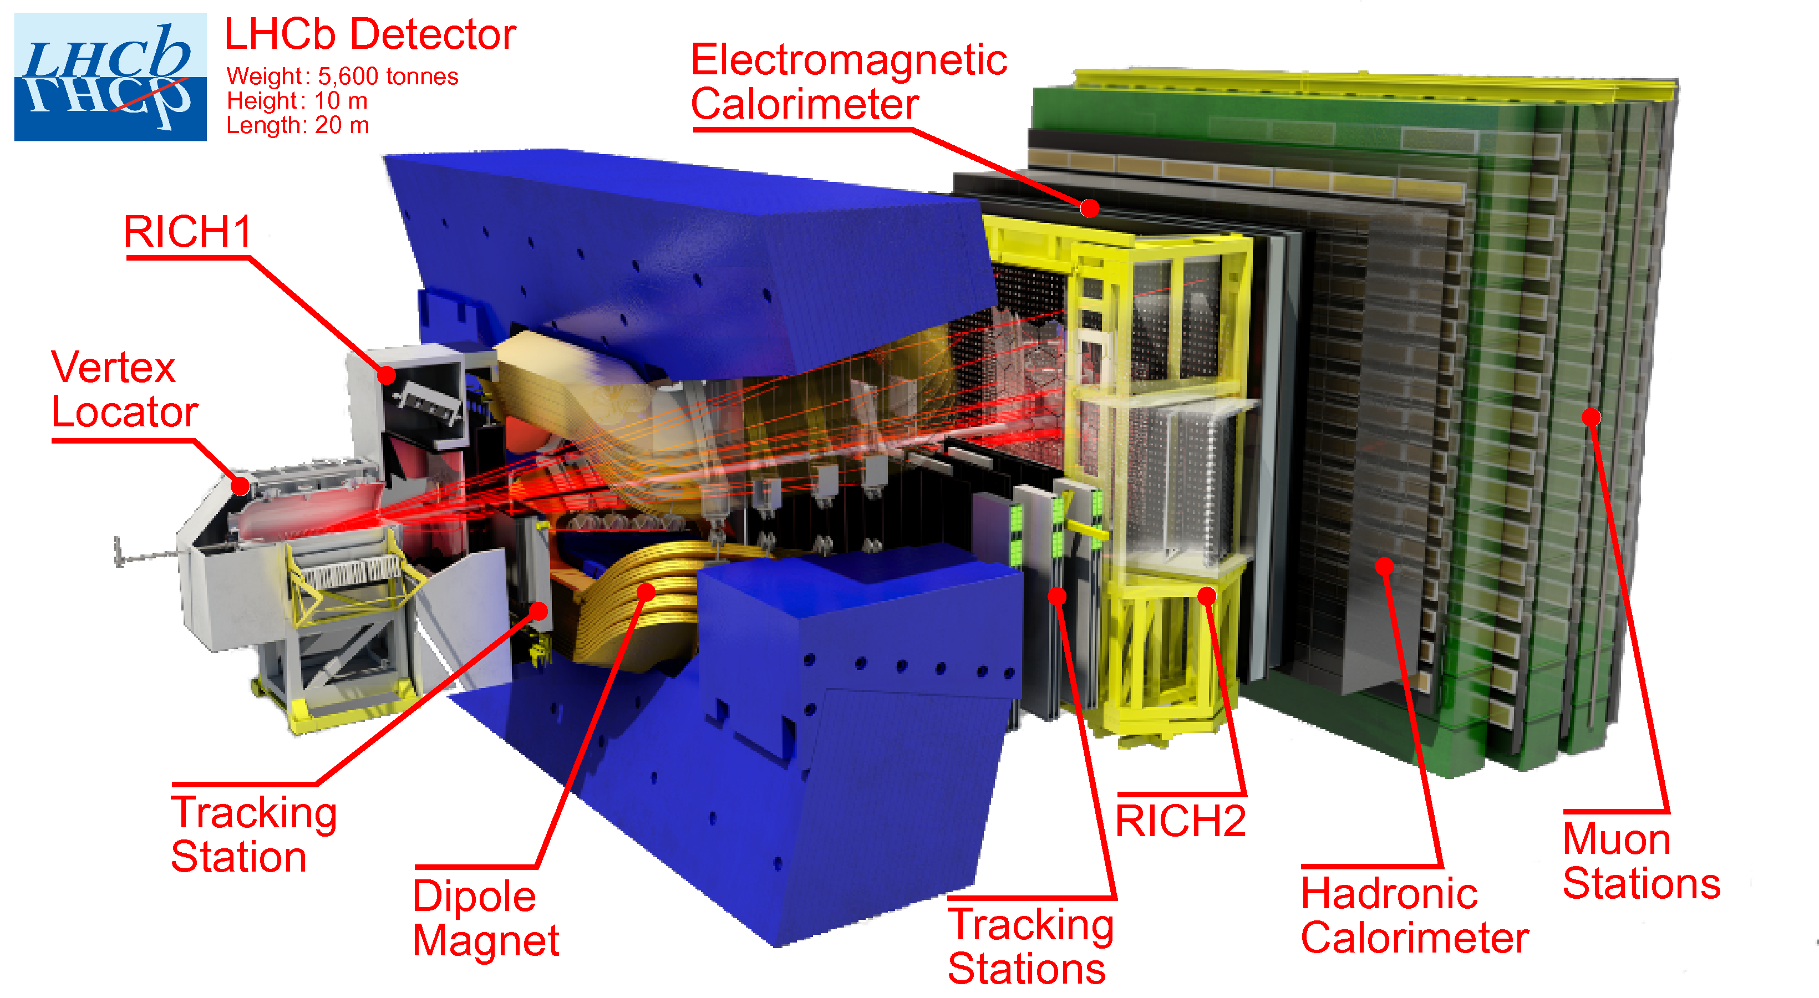


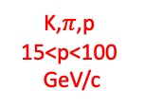


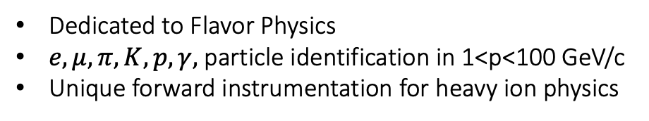
The LHC beauty detector Runs 1 & 2
Converts stopping e,$γ$ energy in scintillating signal.
J. of Instr.,3(08):S08005, 2008
Kaon,$π$,proton
1<p<60 GeV/c
$$\left\langle δIP\right\rangle =15+\frac{29}{pt}\frac{μm}{GeV}$$
K,$π$,p
15<p<100
GeV/c
$$\frac{δp}{p}<0.5−1\%$$
Converts stopping hadron energy in scintillating signal.
Dedicated to Flavor Physics
$e,μ,π,K,p,γ,$ particle identification in 1<p<100 GeV/c
Unique forward instrumentation for heavy ion physics

Slide 3
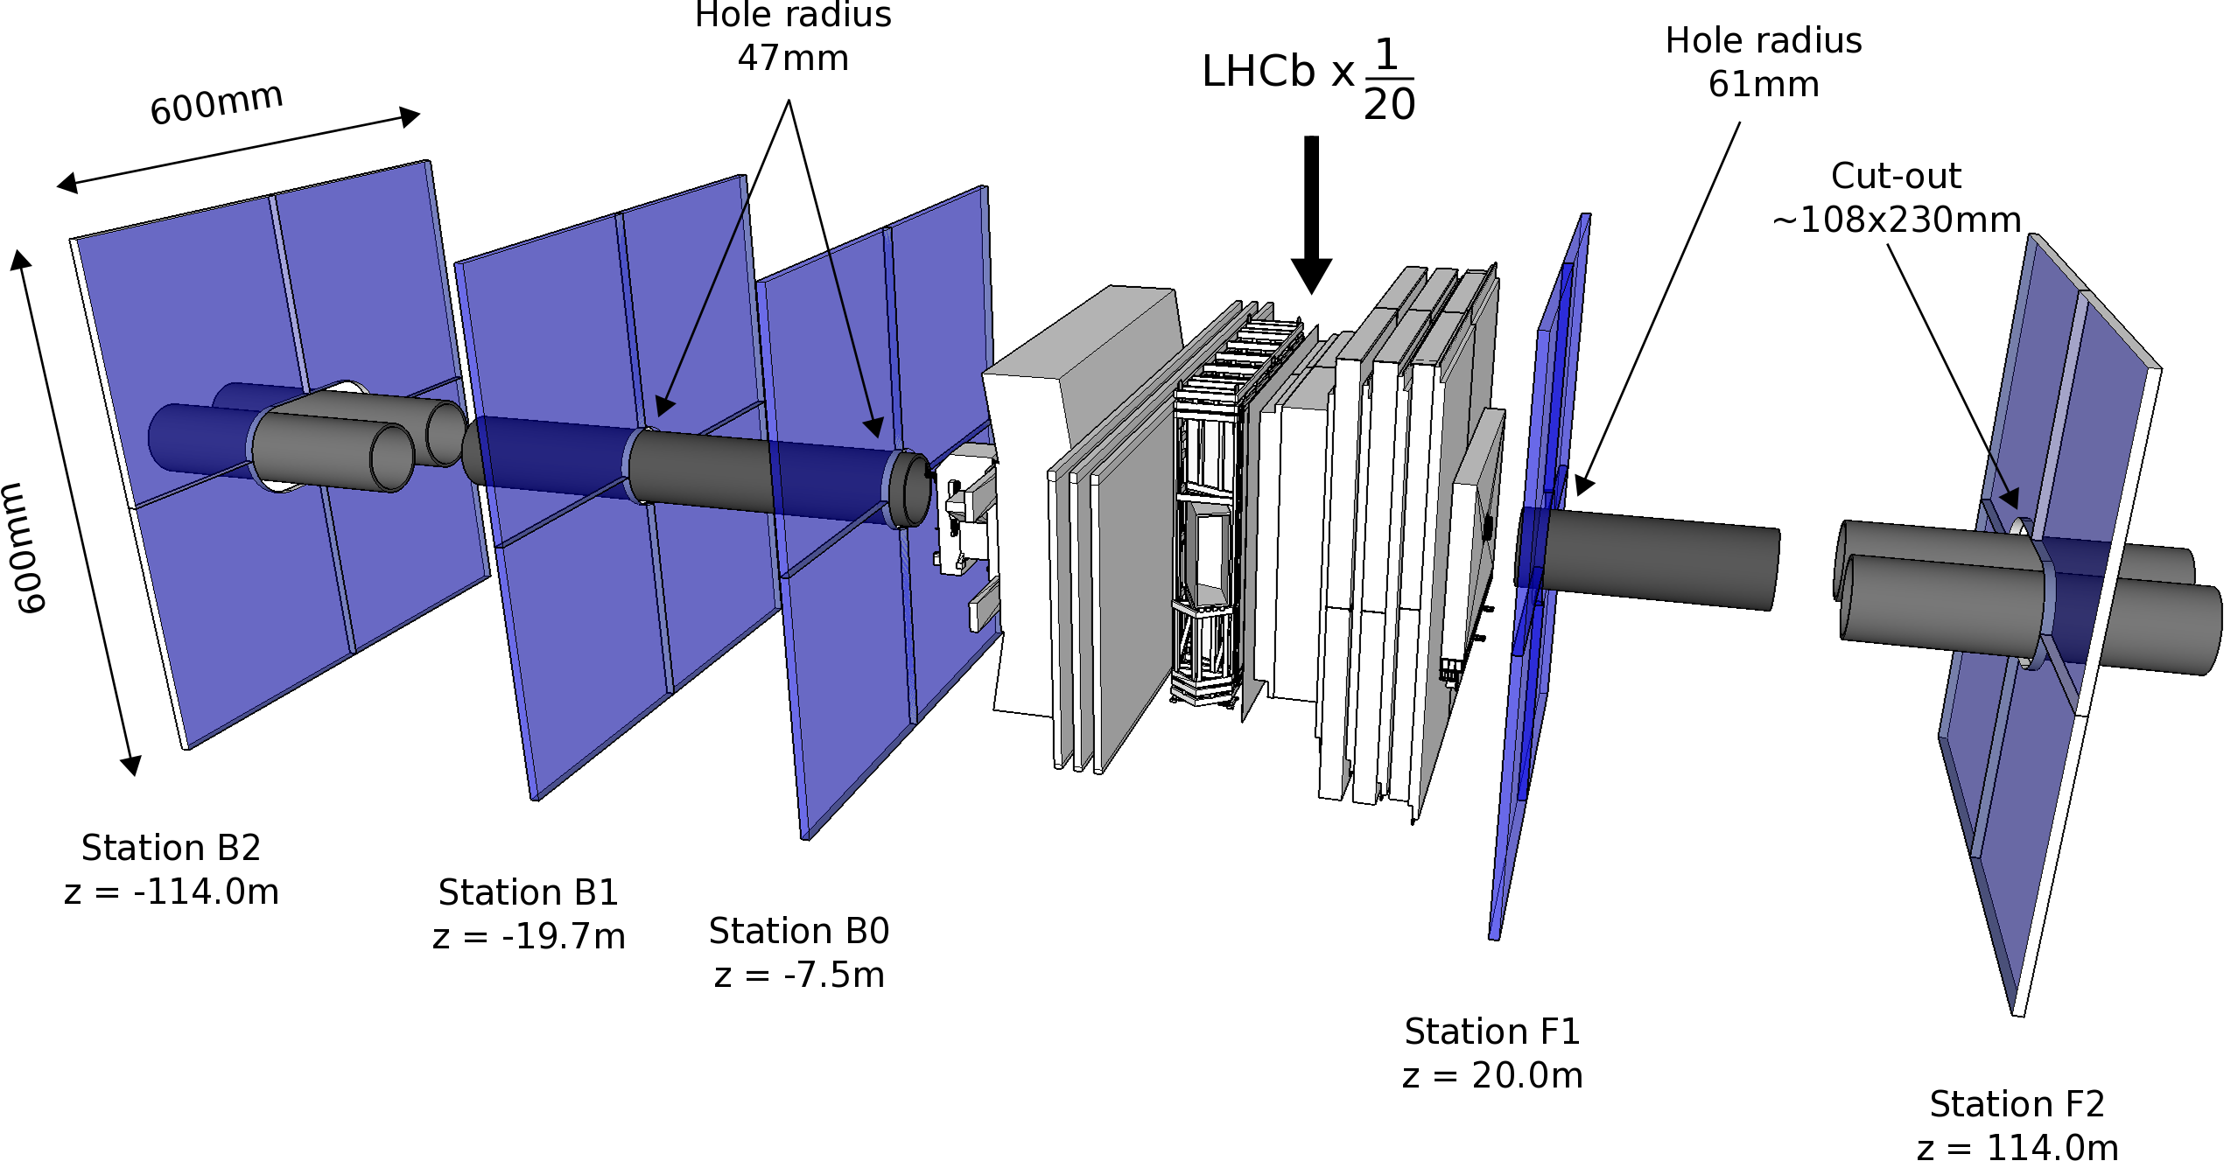

HeRSCheL detector: high-rapidity shower counters for LHCb
$$5<\left|η\right|<9$$
K. Carvalho Akiba et al 2018 JINST 13 P04017

Slide 4
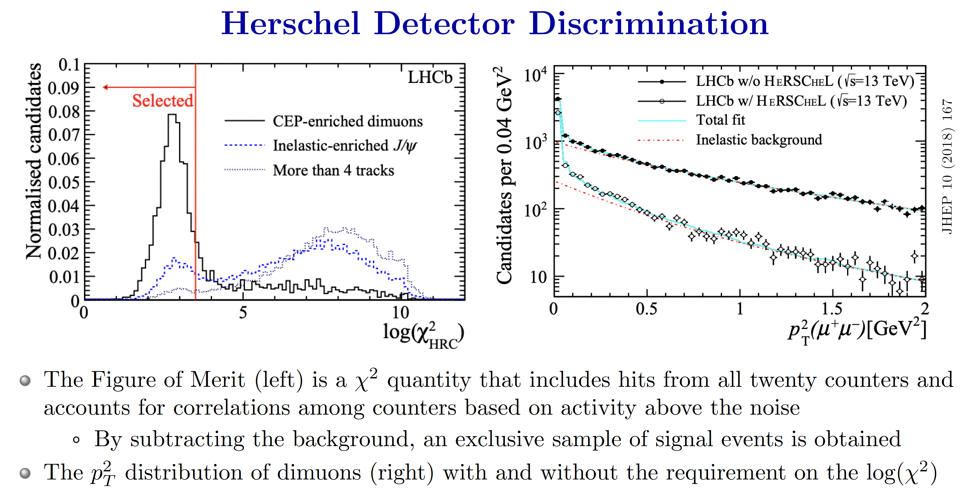
CEP

Slide 5
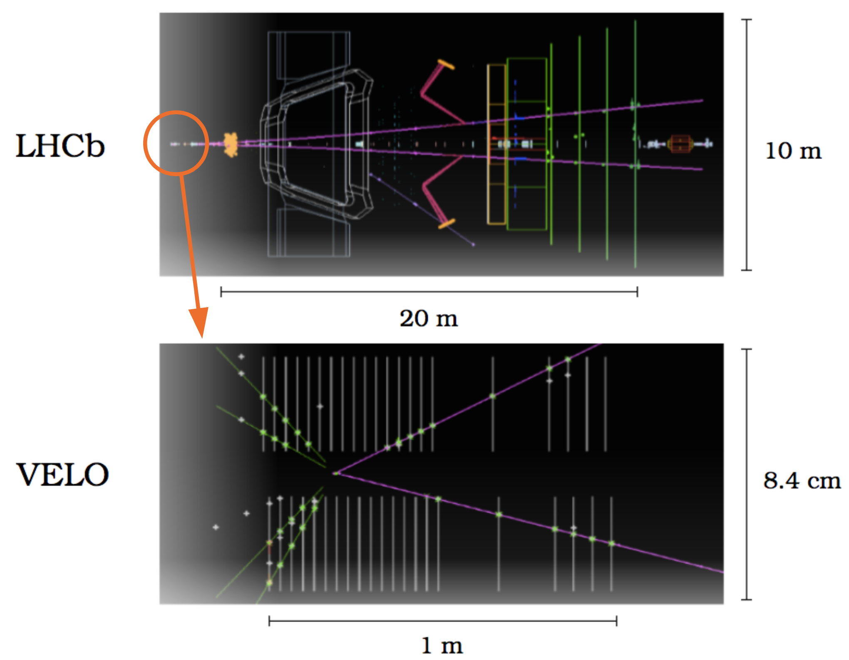
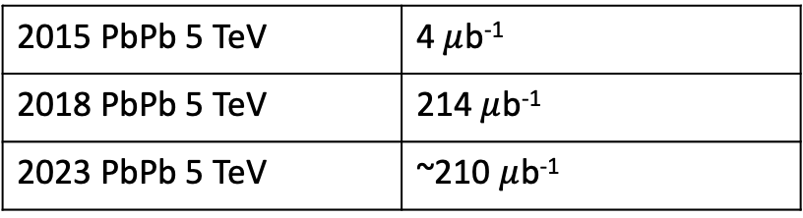
Trigger Conditions for UPC events
long track (tracks with hits in all tracking detectors) [1,20]
SPD hits (ECAL raw hits) < 2000
Event selected by software
NO pre-scale
Data sets
2015 PbPb 5 TeV | 4 $μ$b⁻¹
2018 PbPb 5 TeV | 214 $μ$b⁻¹
2023 PbPb 5 TeV | ~210 $μ$b⁻¹

Slide 6
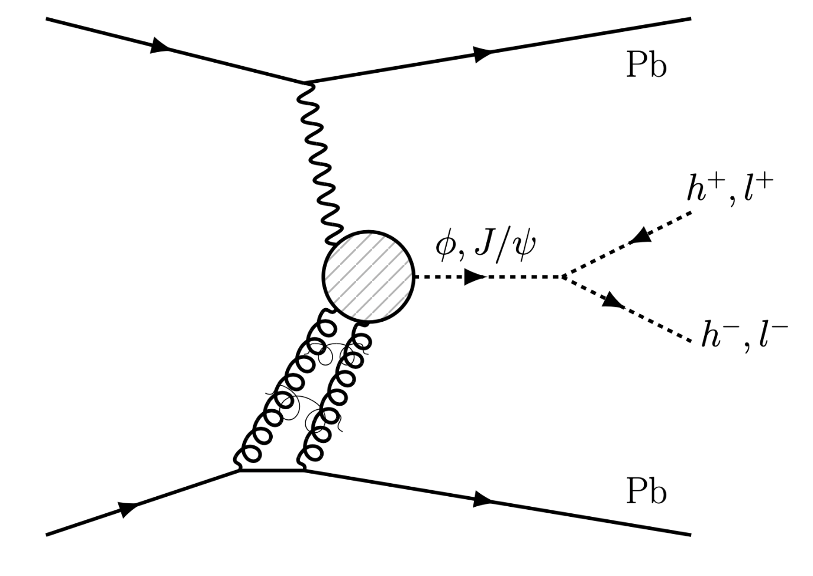
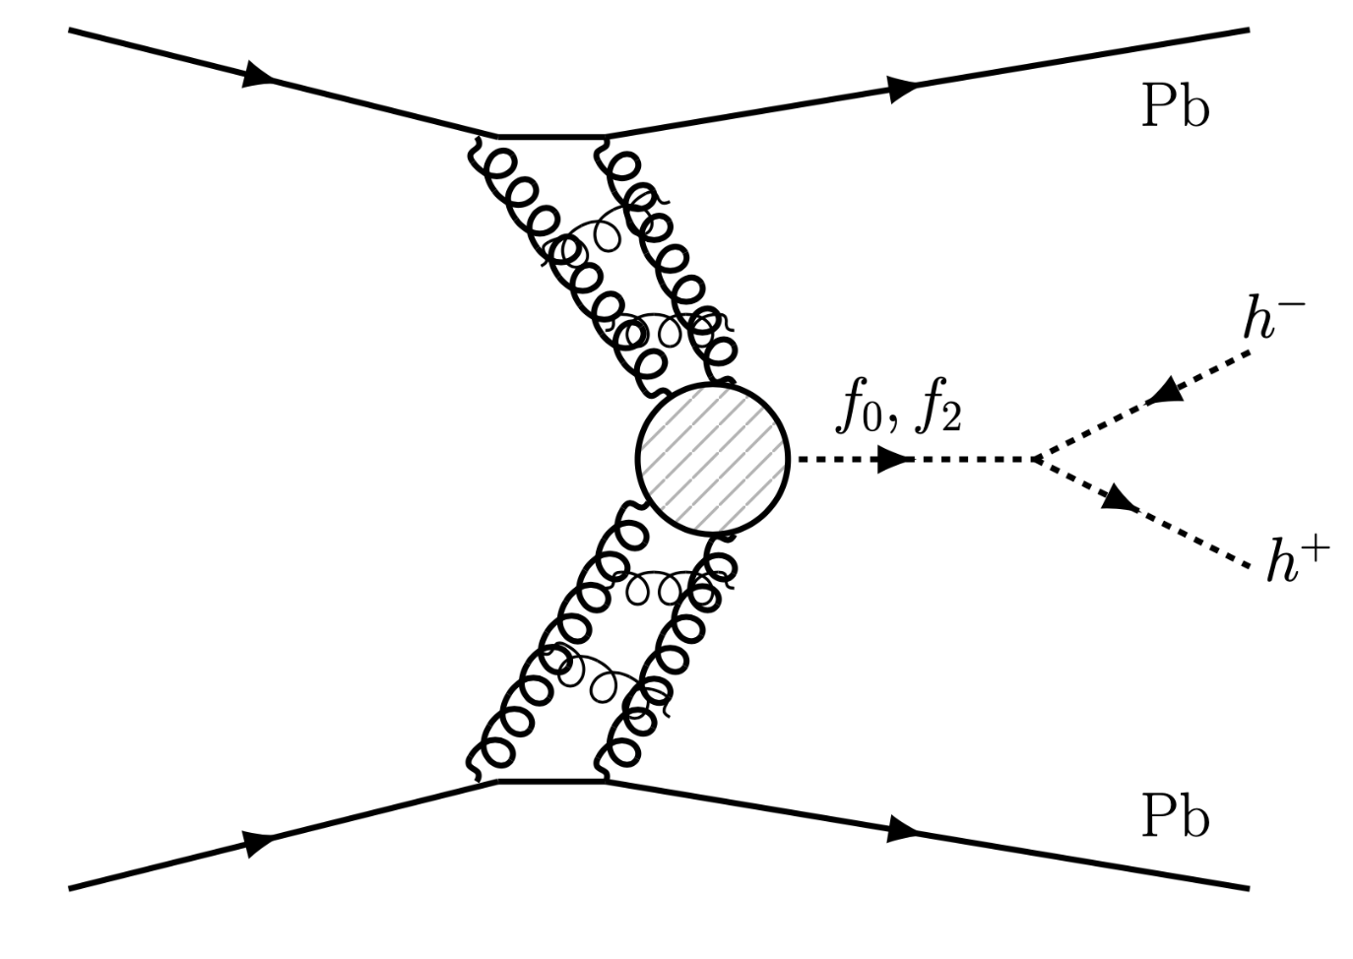
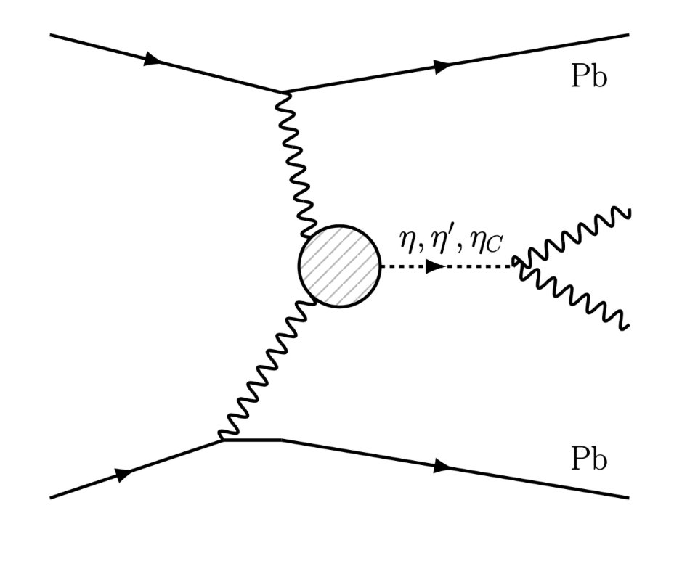
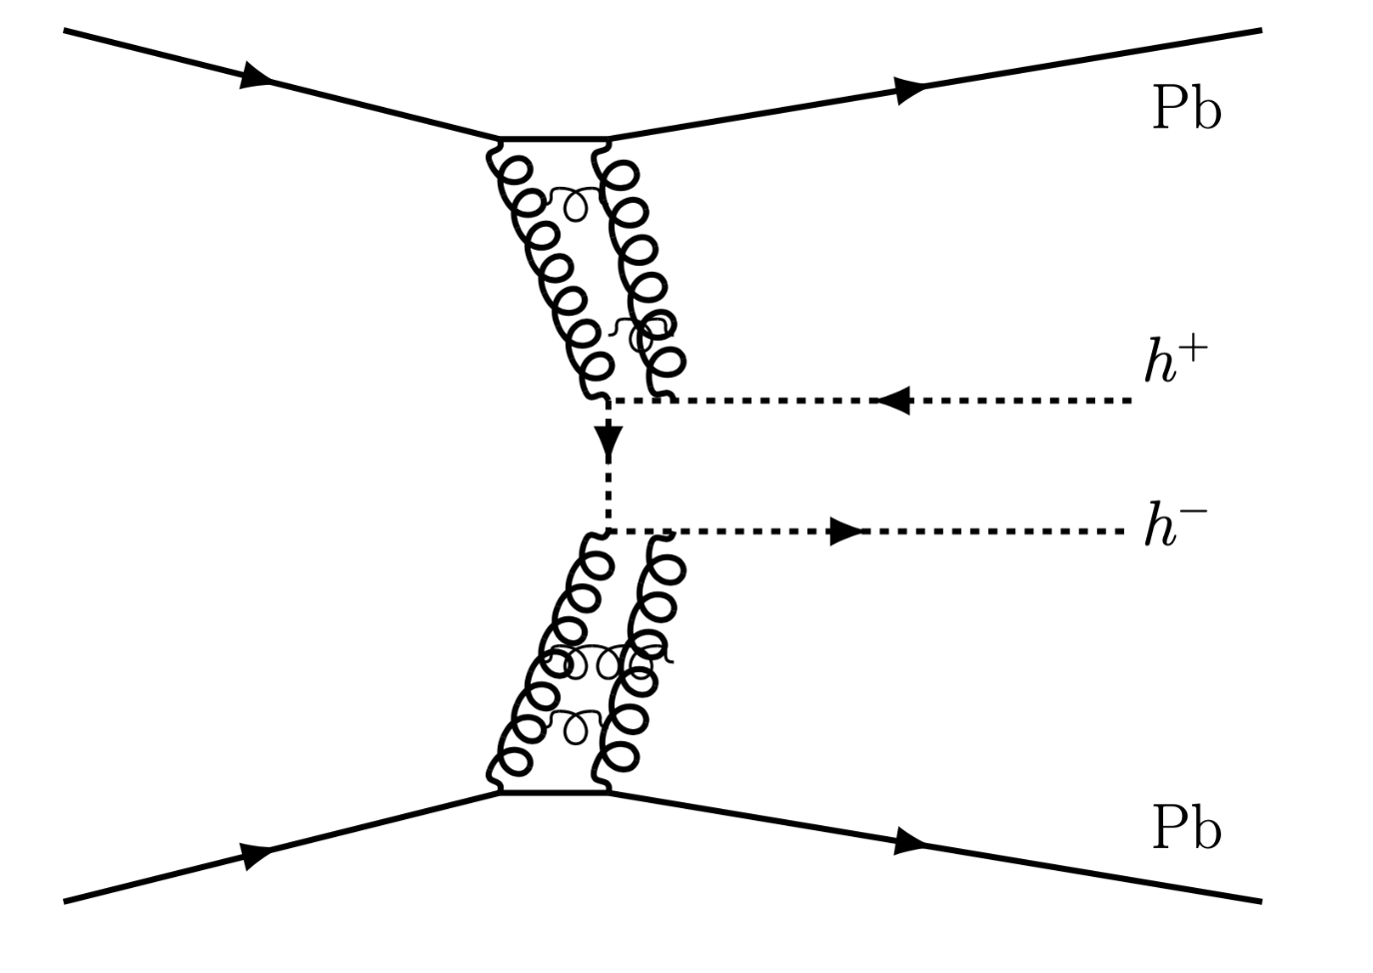
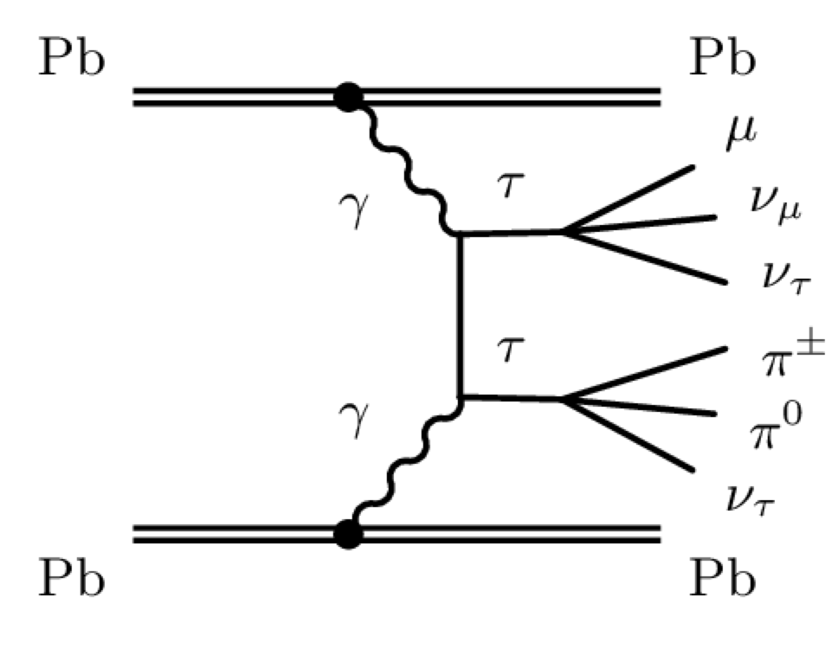
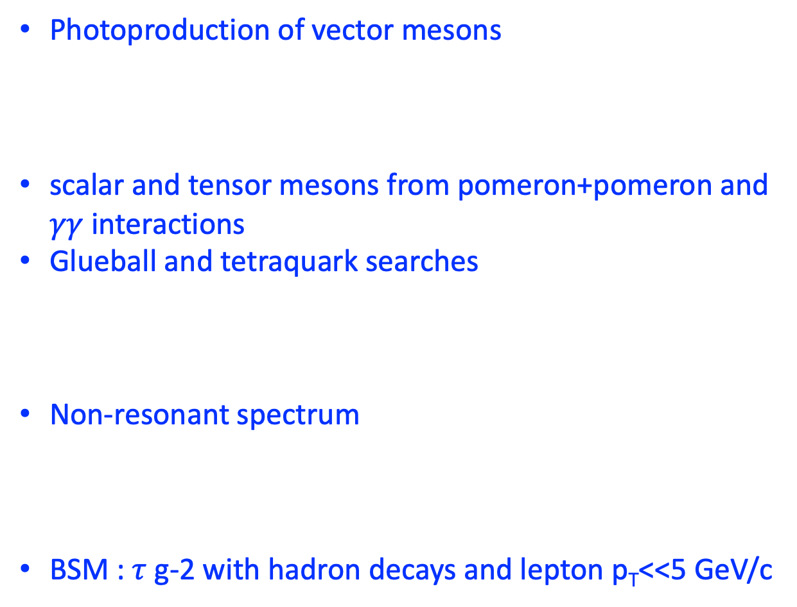
LHCb has detector coverage and particle identification for an entire UPC program
Photoproduction of vector mesons
scalar and tensor mesons from pomeron+pomeron and $γγ$ interactions
Glueball and tetraquark searches
Non-resonant spectrum
BSM : $τ$ g-2 with hadron decays and lepton p_{T}<<5 GeV/c

Slide 7
Rapidity coverage
Not in LHCb
inelastic
p,Pb
single diffraction
double diffraction
CEP+UPC elastic
CEP+UPC inelastic
Elastic

Slide 8
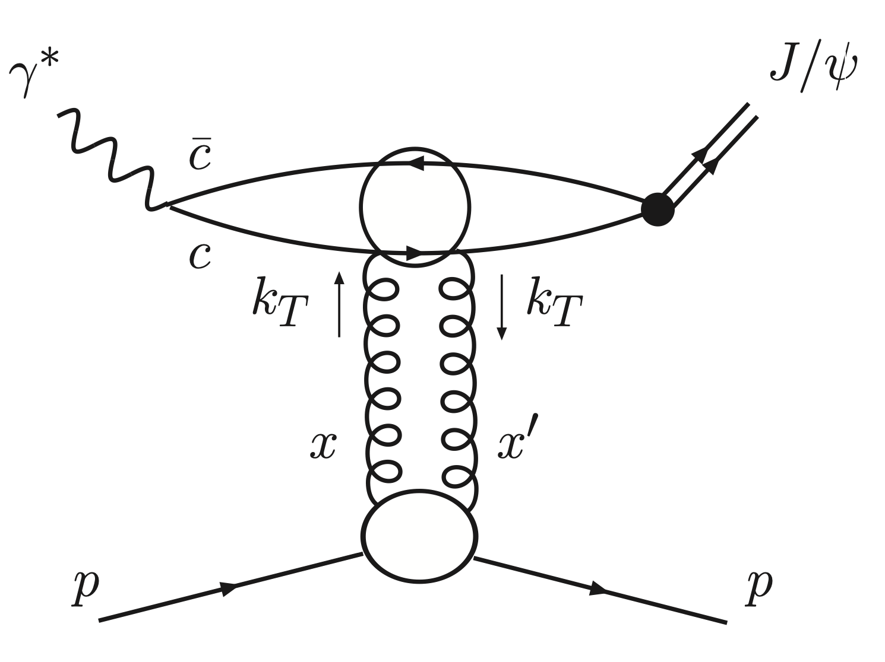
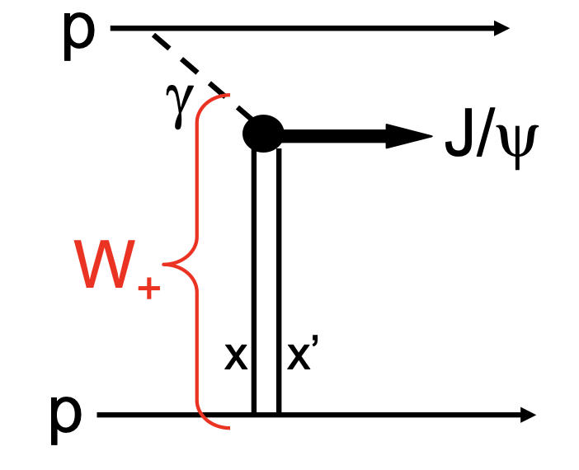
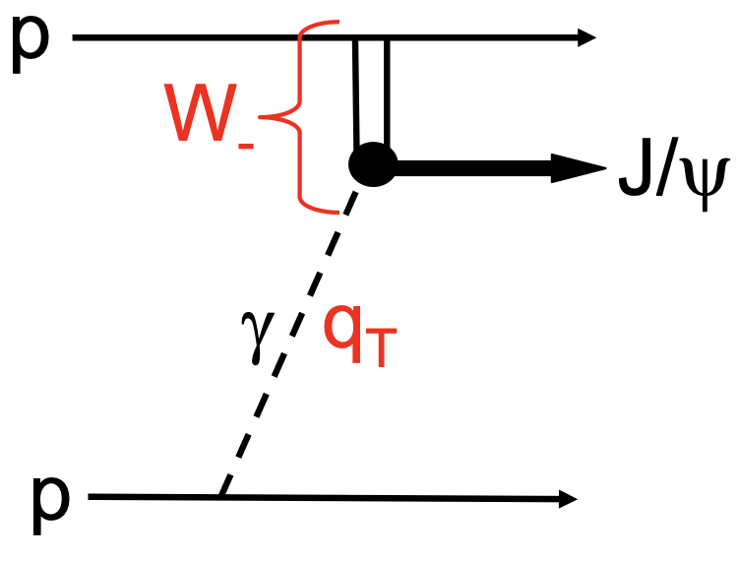

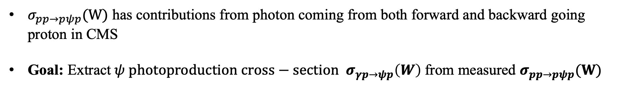



J/$ψ, ψ$(2S) Photo-production cross-section in CEP
photon energy
Invariant mass of the photon-proton system
$$k_{±}≡{(M}_{ψ}/2)e^{{±y}_{ψ}}$$
$$External inputs$$
Photoproduction result from H1(HERA)
parametrization = $a{\left(\frac{W}{90 GeV}\right)}^{δ}$
gap survivor
photon flux
$$σ_{pp→pψp}=r\left(W_{+}\right){\left(\frac{dn}{dk_{+}}\right)k_{+}σ}_{γp→ψp}\left(W_{+}\right)+{r\left(W_{−}\right)\left(\frac{dn}{dk_{−}}\right)k_{−} σ}_{γp→ψp}\left(W_{−}\right)$$
JHEP11(2013)085
$σ_{pp→pψp}(W)$ has contributions from photon coming from both forward and backward going proton in CMS
Goal: Extract$ψ photoproduction cross−section σ_{γp→ψp}\left(W\right)$from measured $σ_{pp→pψp}(W)$
$$W^{2}≡2k\sqrt{s}$$

Slide 9





J/$ψ, ψ$(2S) Photo-production cross-section in CEP
photon energy
Invariant mass of the photon-proton system
$$k_{±}≡{(M}_{ψ}/2)e^{{±y}_{ψ}}$$
$$External inputs$$
Photoproduction result from H1(HERA)
parametrization = $a{\left(\frac{W}{90 GeV}\right)}^{δ}$
gap survivor
photon flux
$$σ_{pp→pψp}=r\left(W_{+}\right){\left(\frac{dn}{dk_{+}}\right)k_{+}σ}_{γp→ψp}\left(W_{+}\right)+{r\left(W_{−}\right)\left(\frac{dn}{dk_{−}}\right)k_{−} σ}_{γp→ψp}\left(W_{−}\right)$$
JHEP11(2013)085
LHCb
LHCb
JHEP 10 (2018) 167
$$W^{2}≡2k\sqrt{s}$$
HeRSCheL sel.

Slide 10





Bottomonia photo-production cross-section in CEP
$$Υ$$
$ℒ=2.9$fb⁻¹
pp $\sqrt{s}$=7 TeV + 8 TeV
JHEP 1509 (2015) 084
pp $\sqrt{s}$=7 TeV + 8 TeV
pp $\sqrt{s}$=7 TeV + 8 TeV
LO,NLO: JHEP 09 (2015) 084

Slide 11
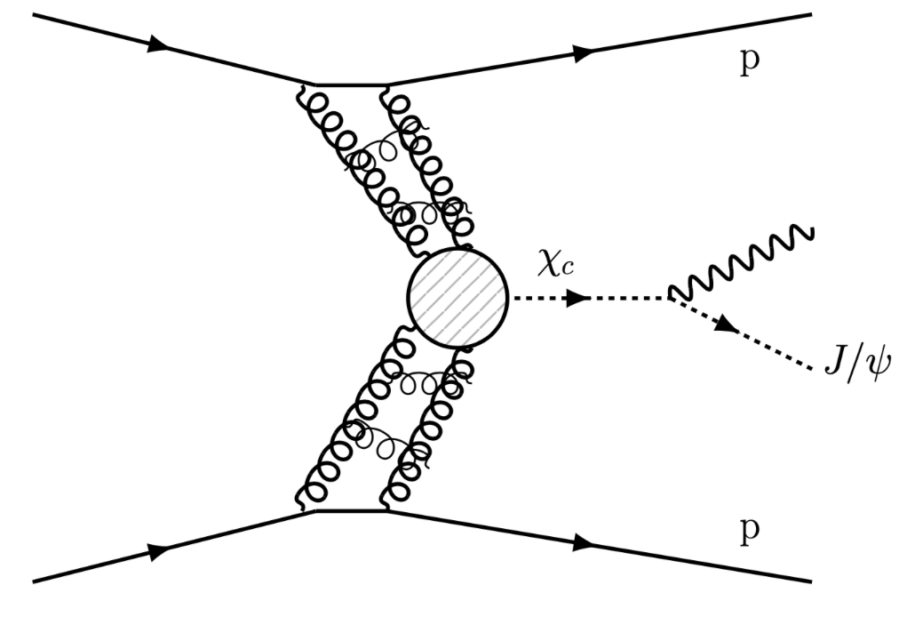

P-wave charmonia
LHCb-CONF-2011-022
Data Result
(factor 2 uncertainty)
Discrepancy for $σ_{χc2}$ can come from inelastic contamination.
New measurement using HeRSCheL on target.
arXiv:hep-ph/0909.4748

Slide 12
Double J/ψ production
J.Phys.G41 (2014)115002
Double pomeron exchange

Slide 13
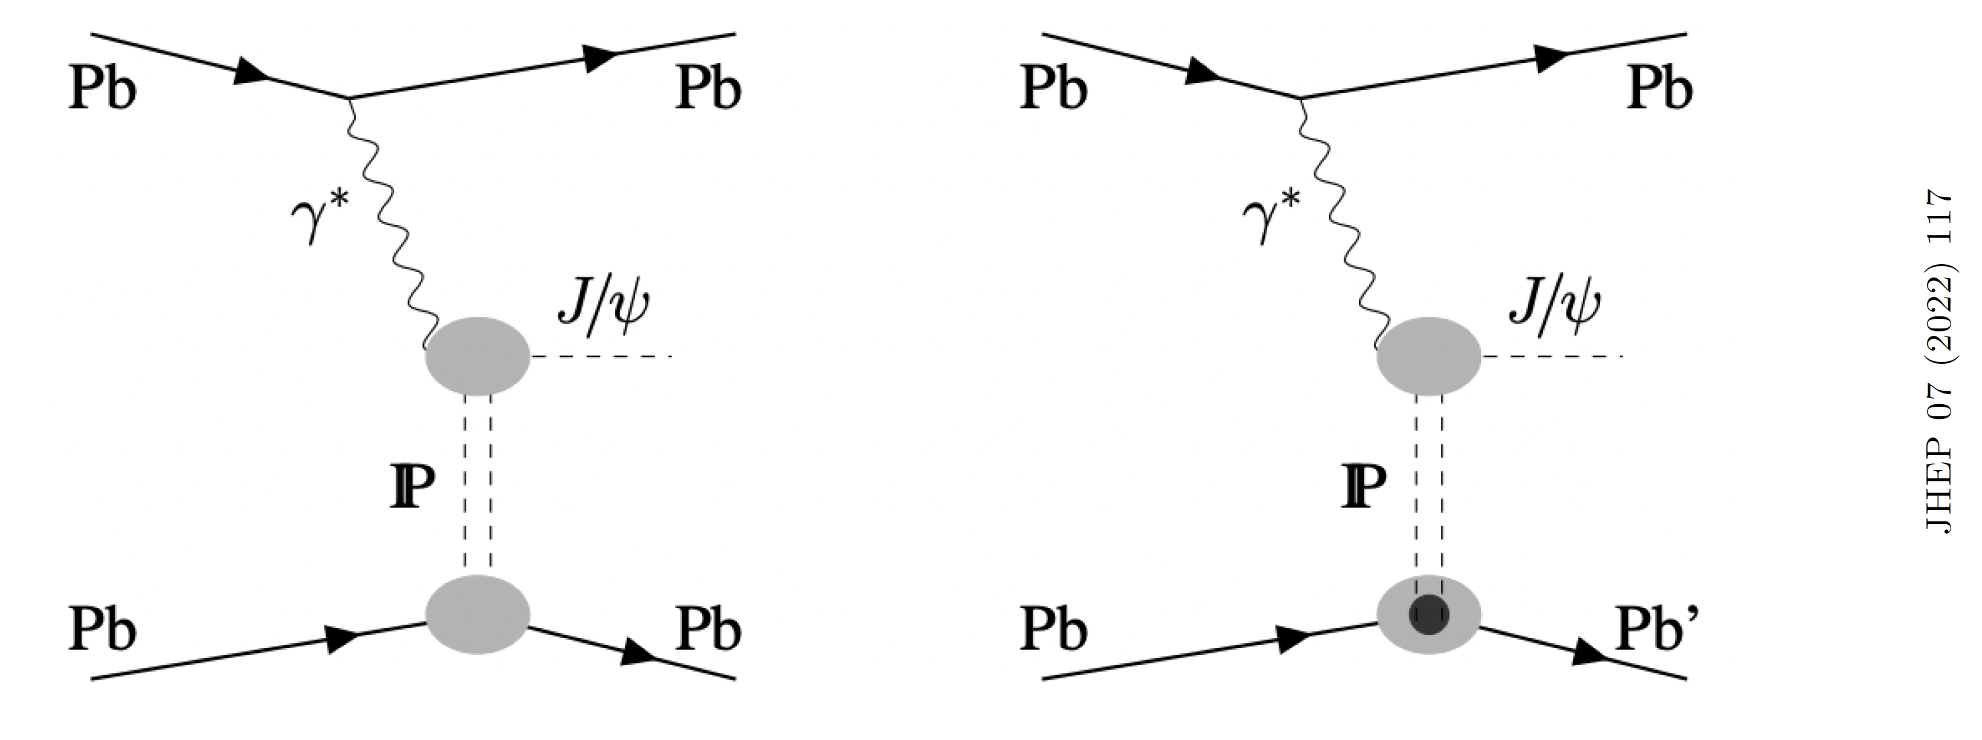
Photo-production in PbPb UPC
Coherent
Incoherent

Slide 14
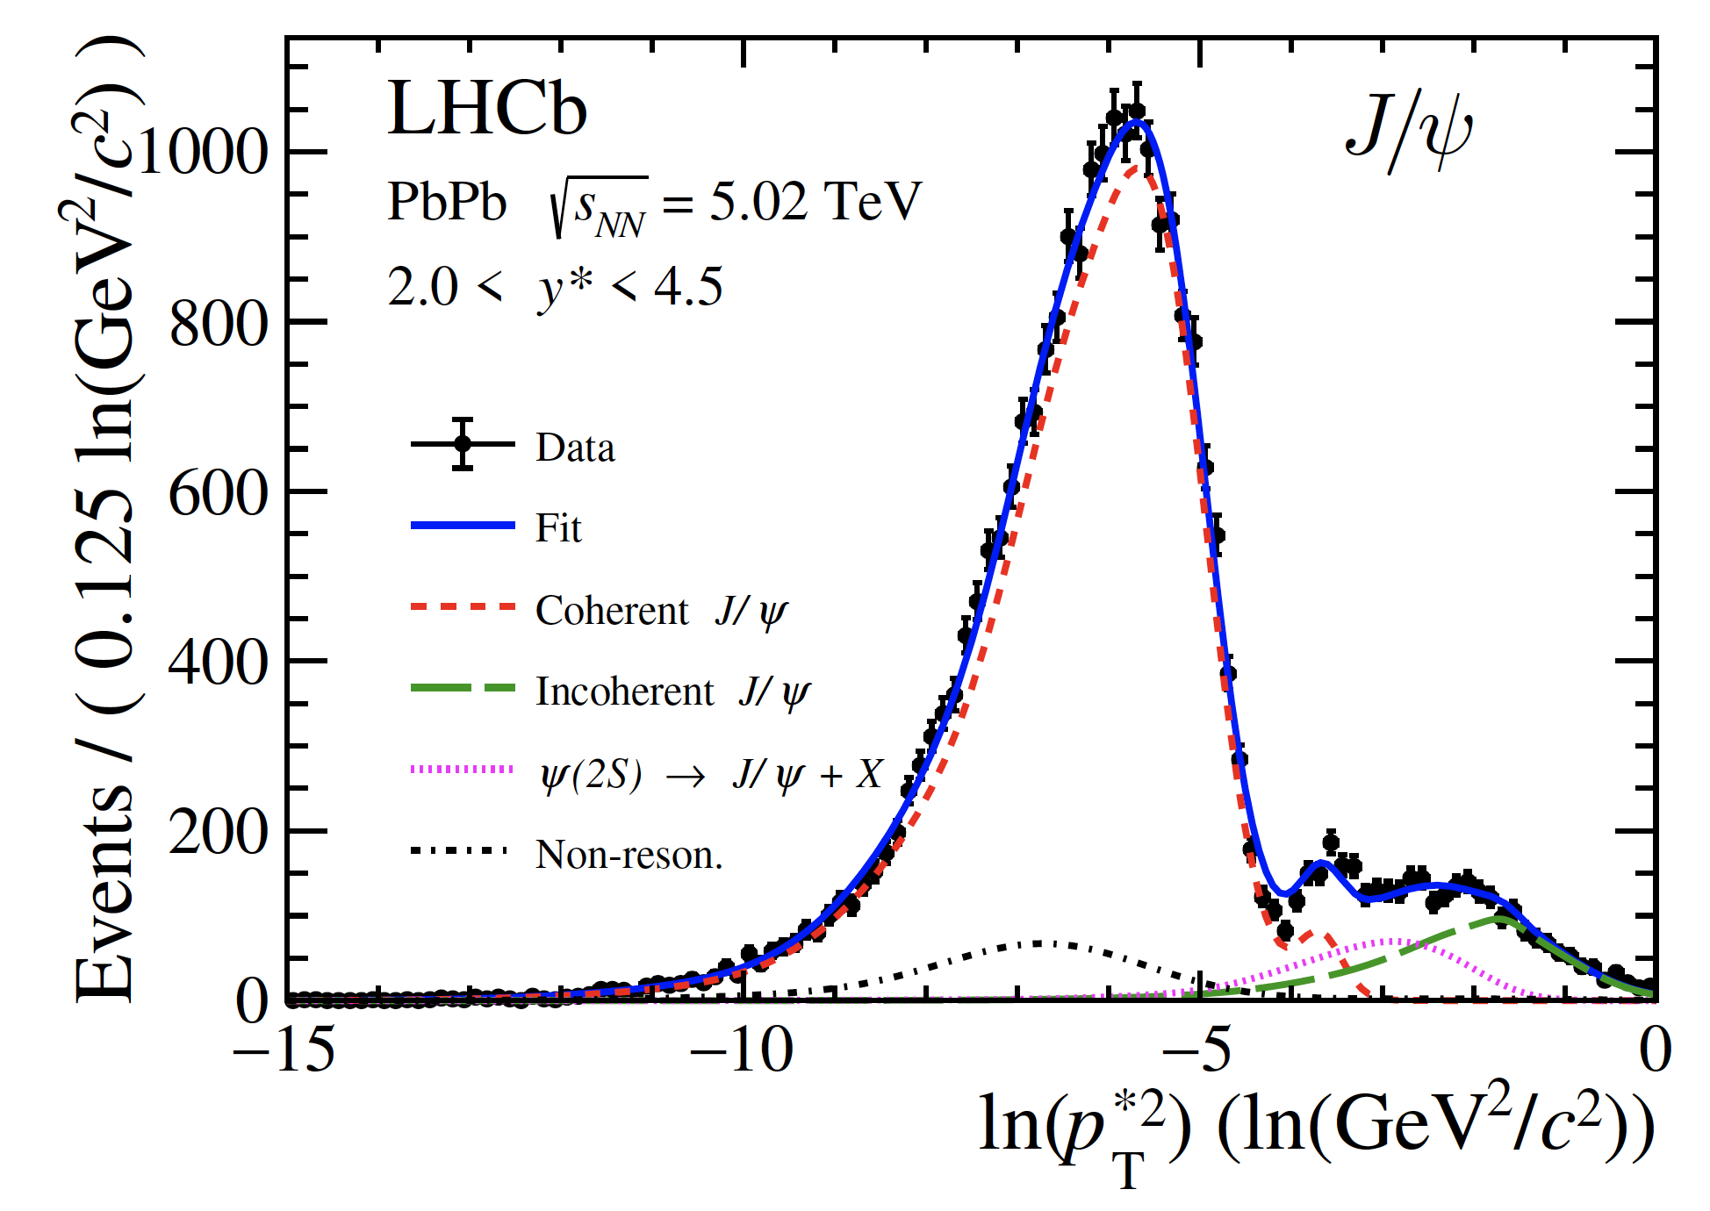
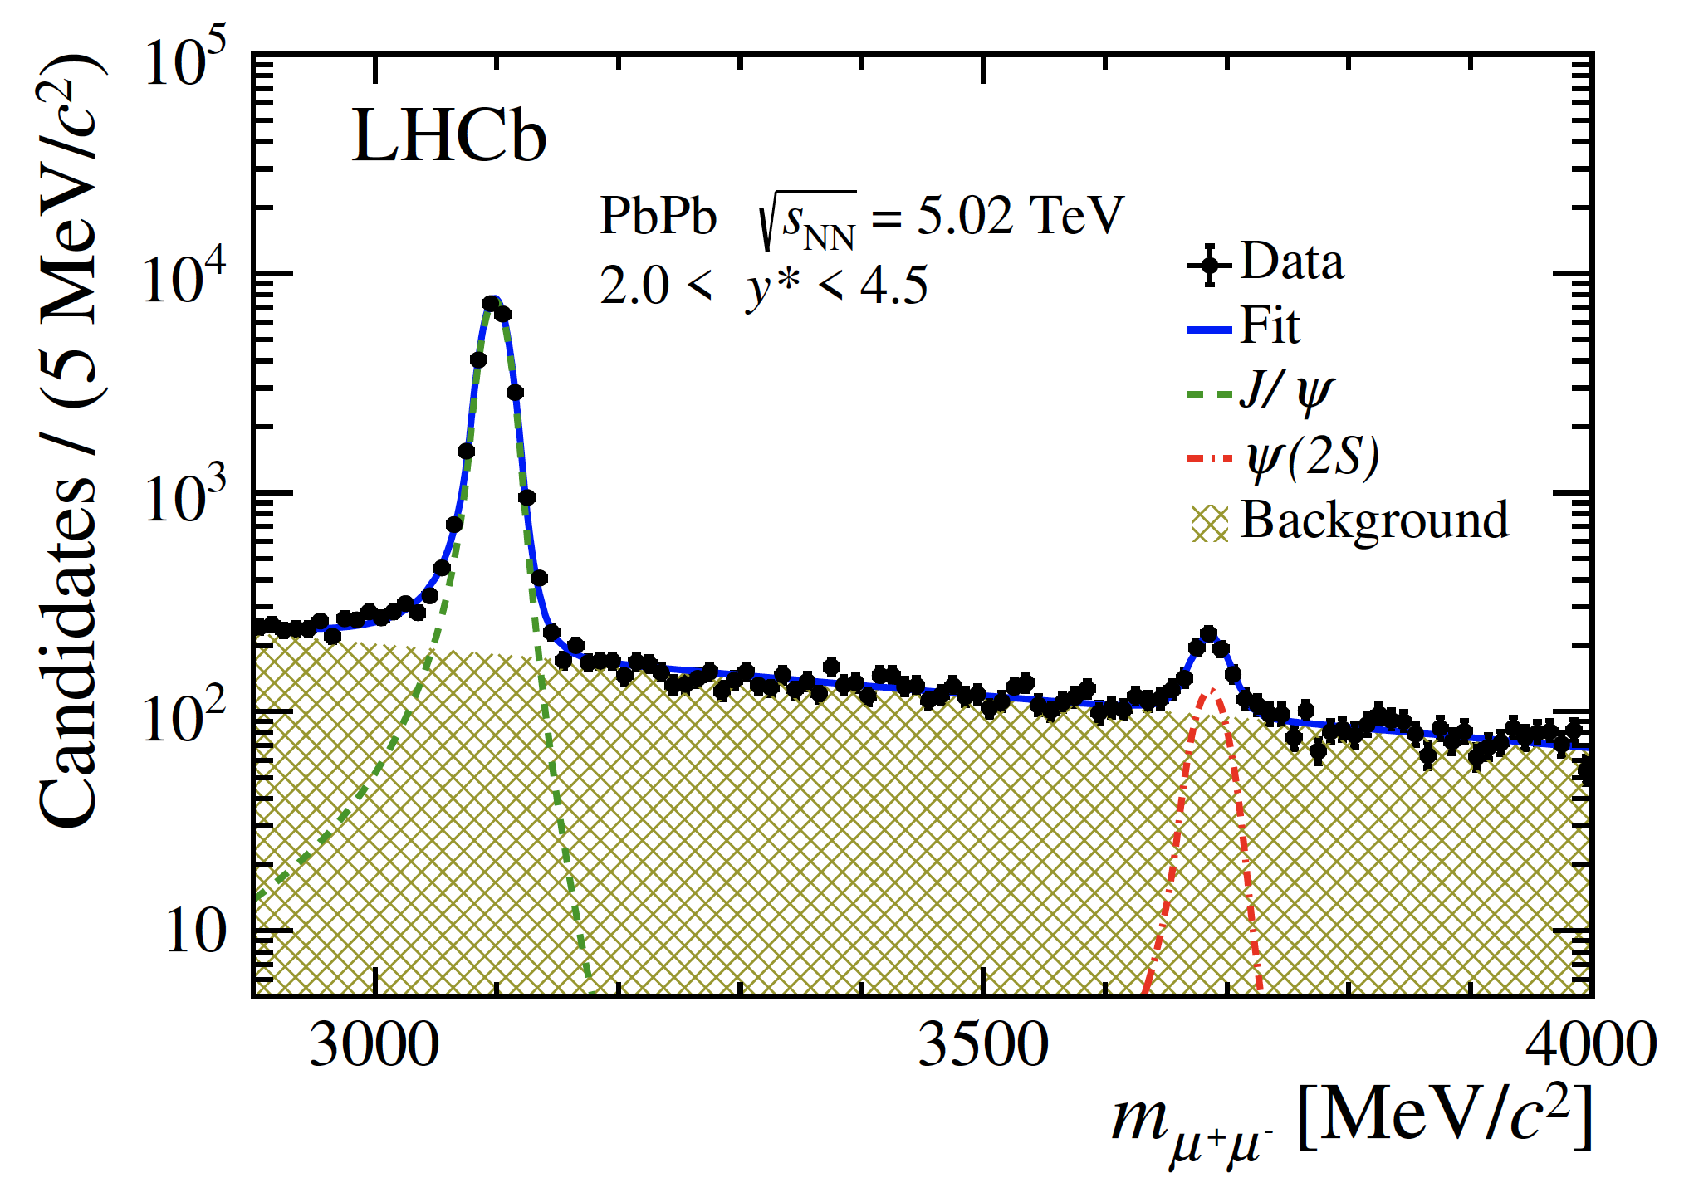
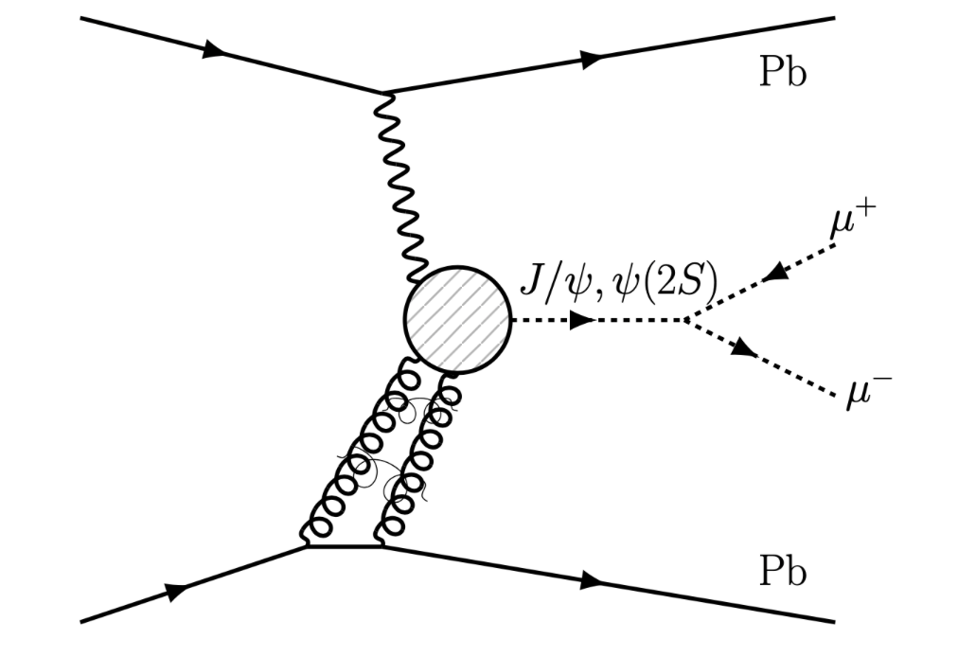
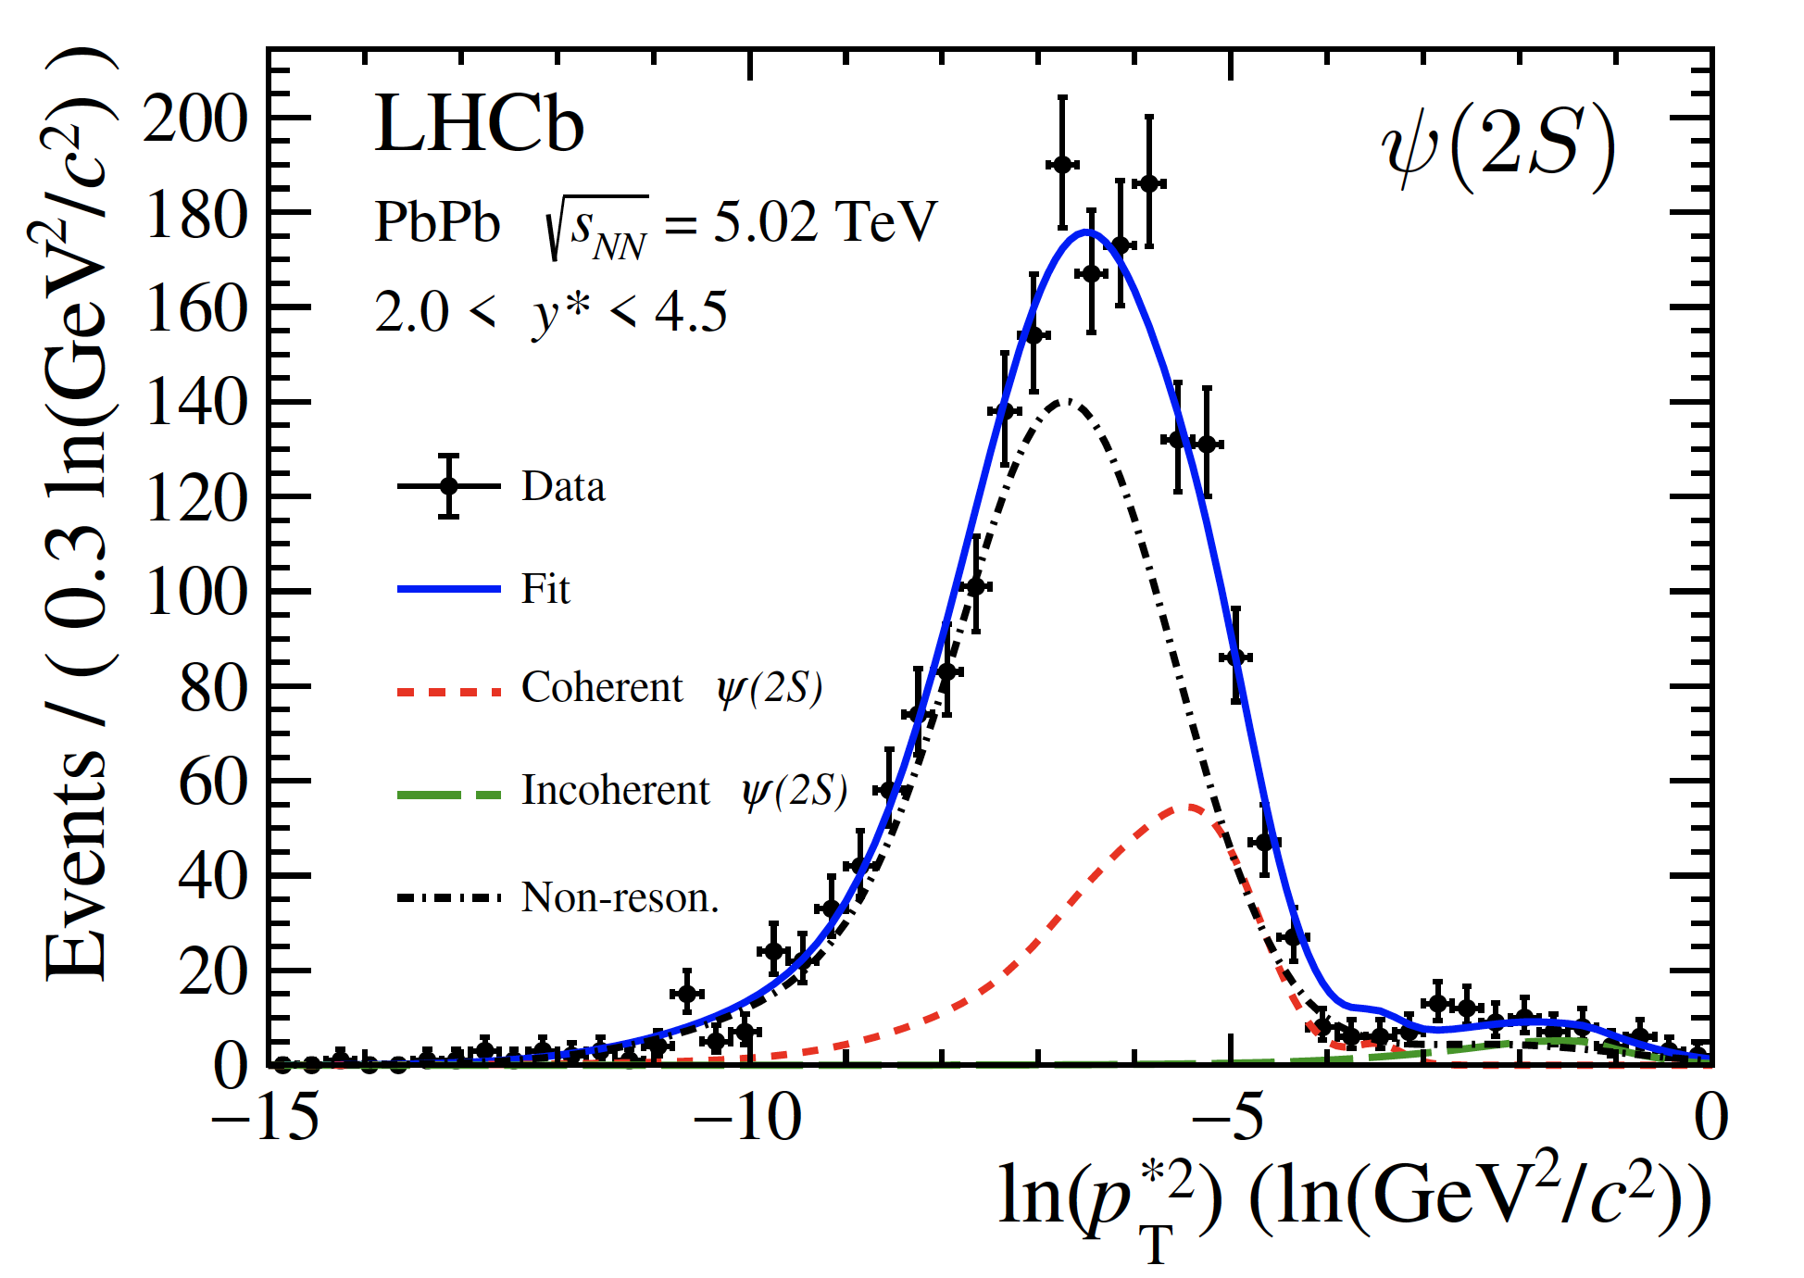

J/ψ, $ψ\left(2S\right)$ photoproduction in UPC
JHEP06(2023)146
Excellent separation between coherent and incoherent components, thanks to
  HeRSCHeL
  High p_{T} resolution

Slide 15
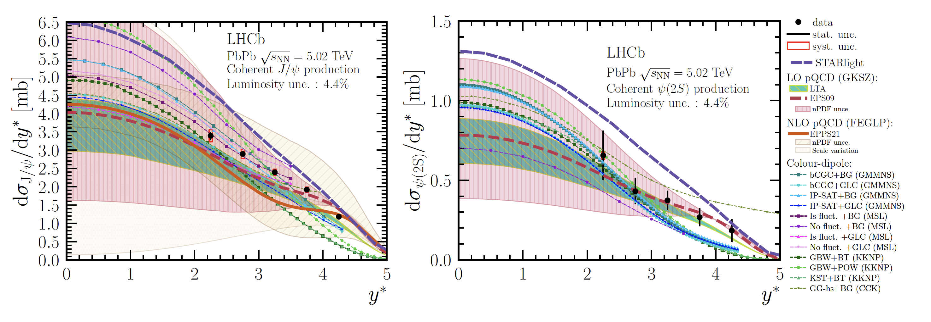
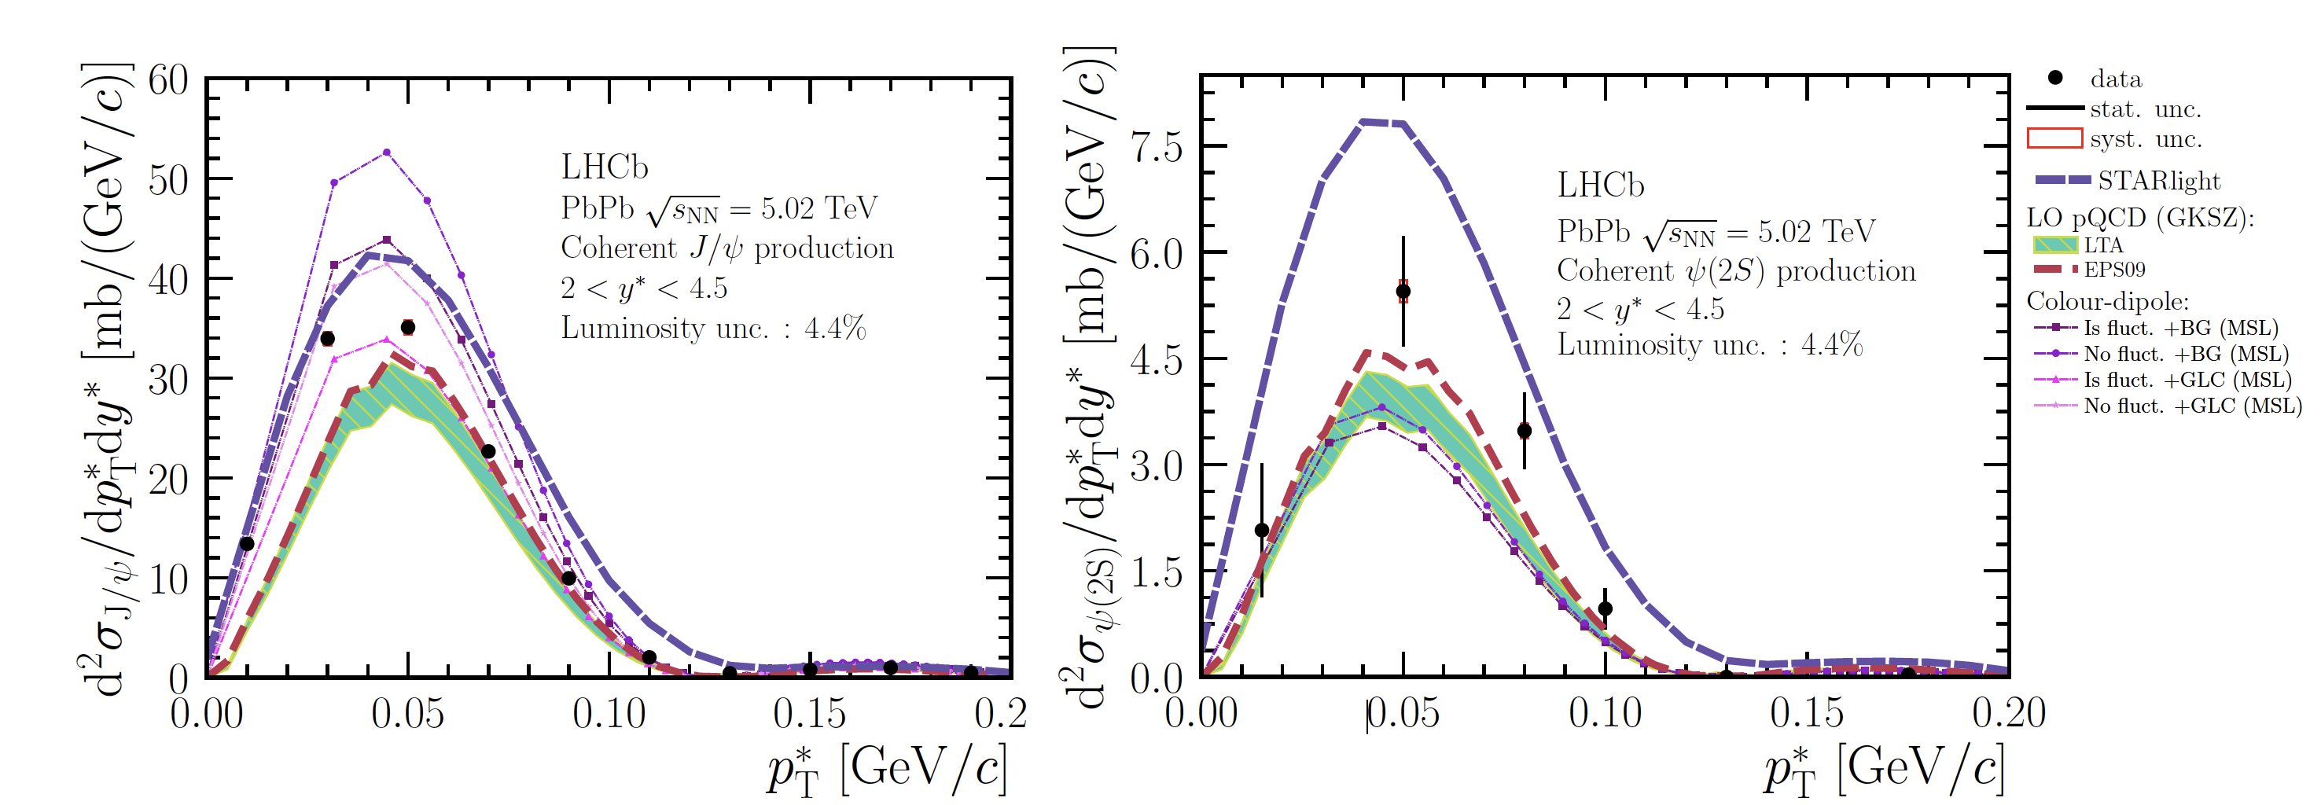


Comparison with theoretical models
$$J/ψ$$
$$ψ(2S)$$
JHEP06(2023)146

Slide 16
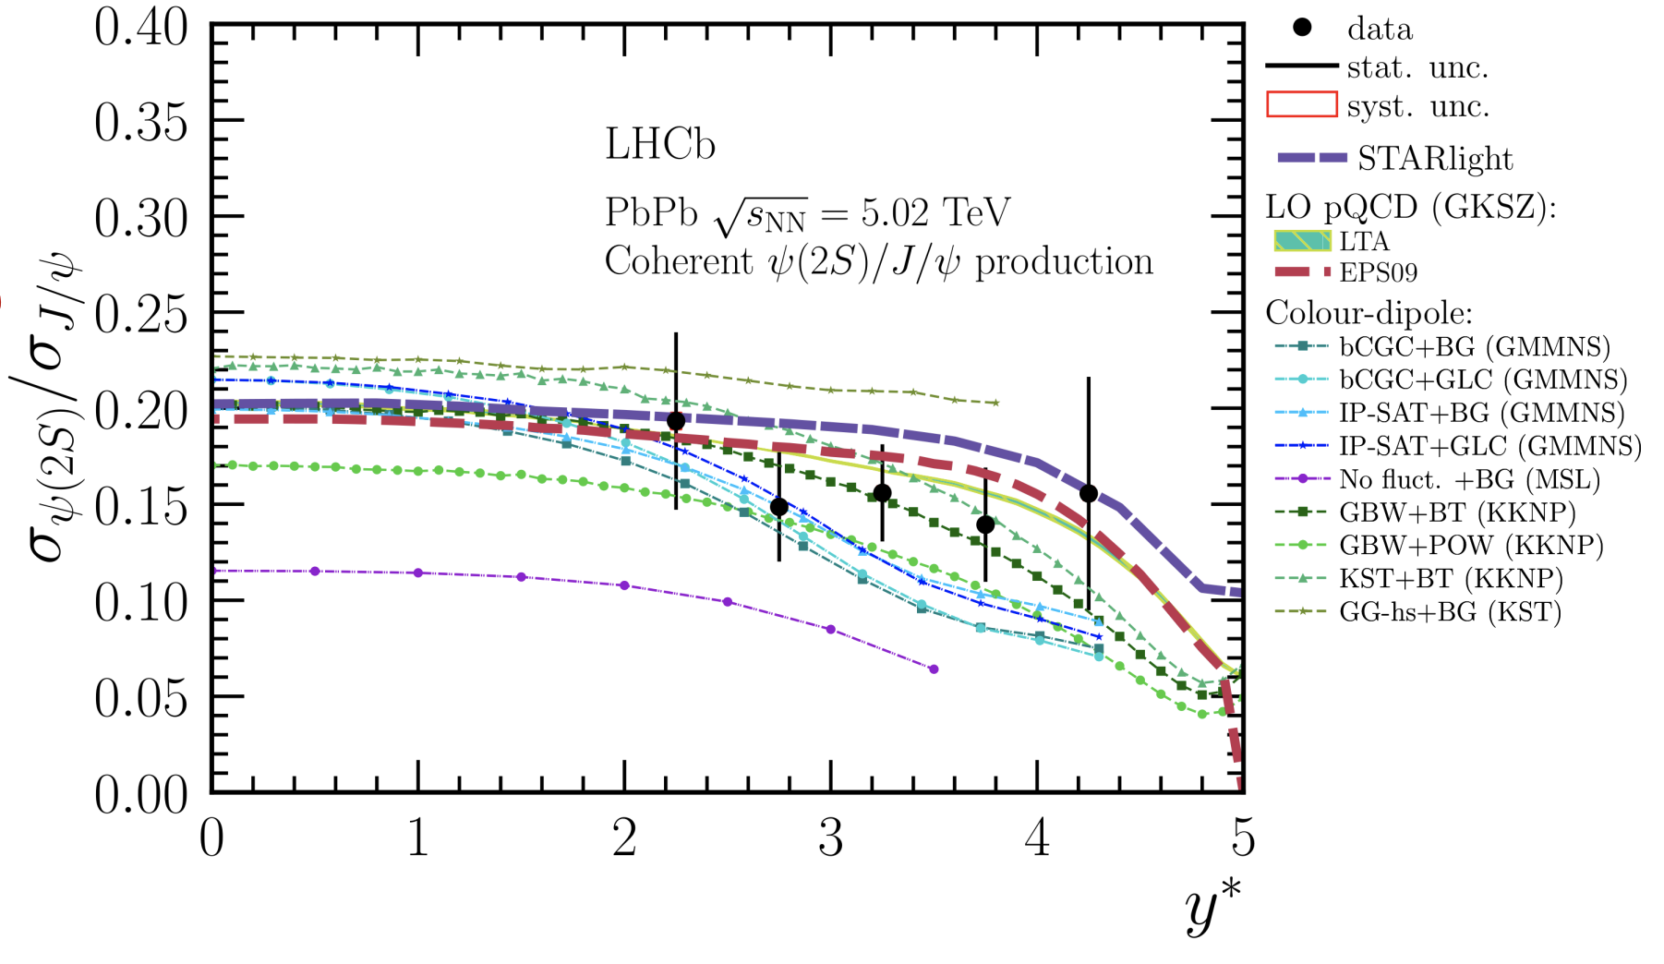
Comparison with theoretical models
JHEP06(2023)146

Slide 17
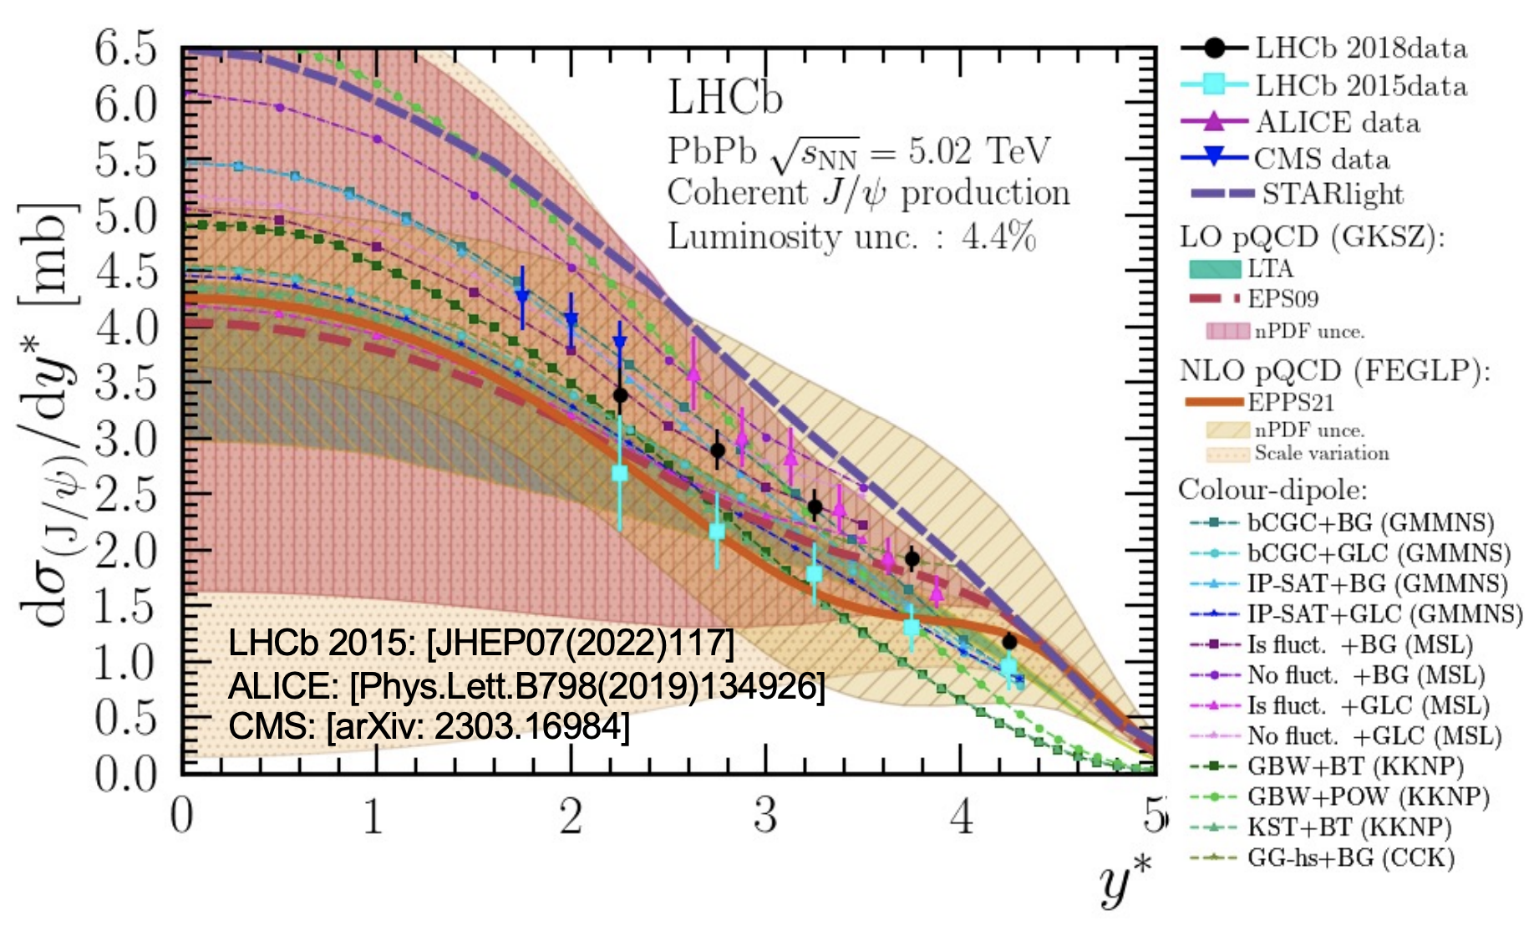
Comparison with previous results
JHEP06(2023)146
Luminosity unc. 2015 : 13%

Slide 18
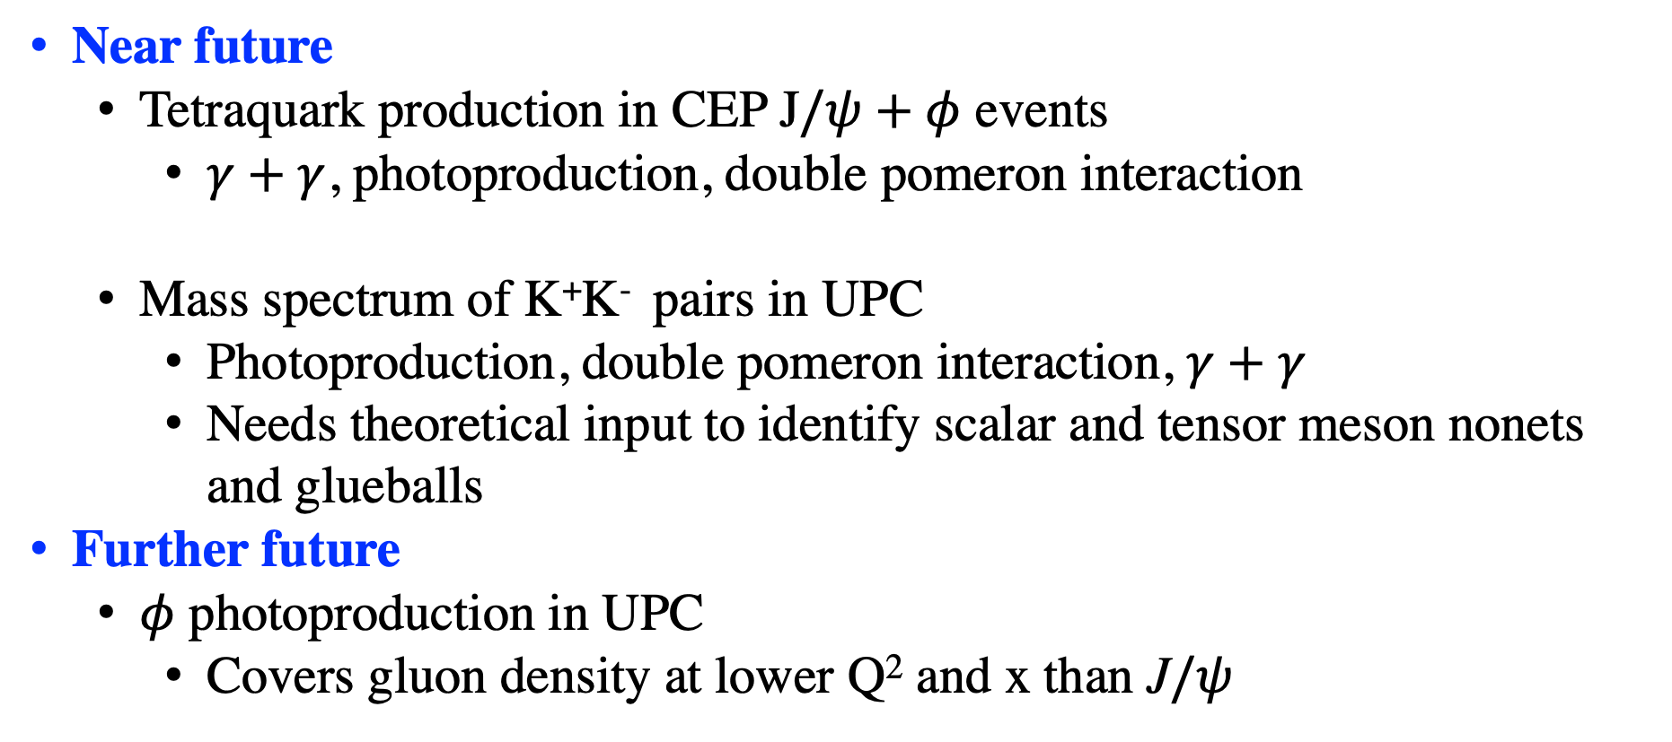
Results coming up
Near future
  Tetraquark production in CEP J$/ψ+φ$ events
    $γ+γ$, photoproduction, double pomeron interaction
  Mass spectrum of K⁺K⁻ pairs in UPC
    Photoproduction, double pomeron interaction, $γ+γ$
    Needs theoretical input to identify scalar and tensor meson nonets and glueballs
Further future
  $φ$ photoproduction in UPC
    Covers gluon density at lower Q² and x than J$/ψ$

Slide 19
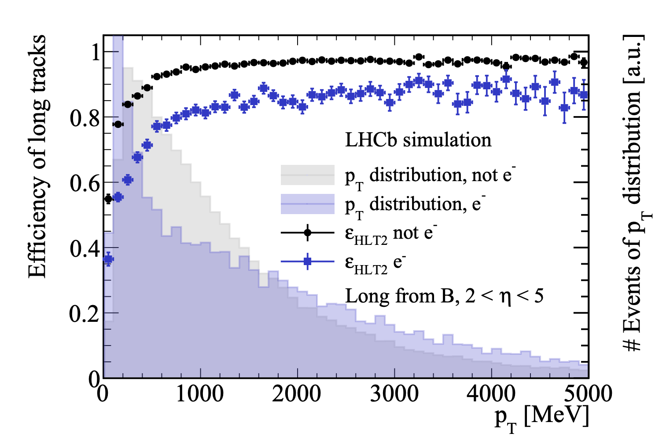
The LHCb Upgrade I
arXiv:2305.10515
40 MHz data acquisition
No hardware trigger
Real time data reconstruction

Slide 20
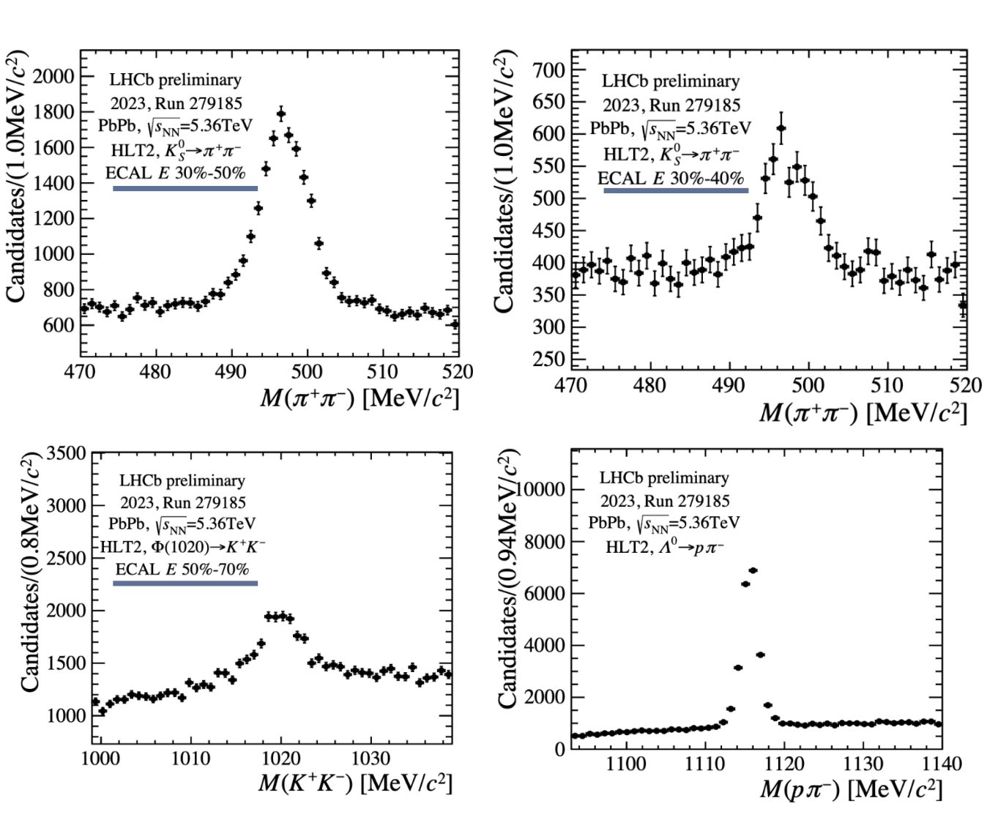
Detector performance in 2023 PbPb run
LHCb can for the first time take PbPb data up to 30% centrality !!
Full centrality in fixed target mode (SMOG)
Peaks from 40 minutes of data taking.
<<1% of the entire data set
Very promising for new UPC results.

Slide 21
Future Upgrades : New HeRSCheL
Replace radiation damaged scintillators.
Add another station

Slide 22
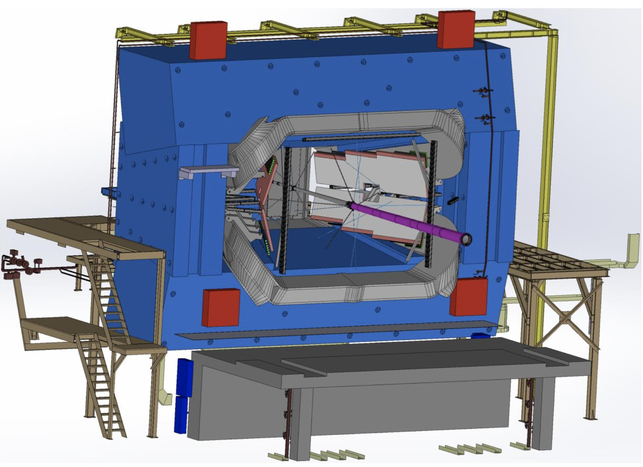
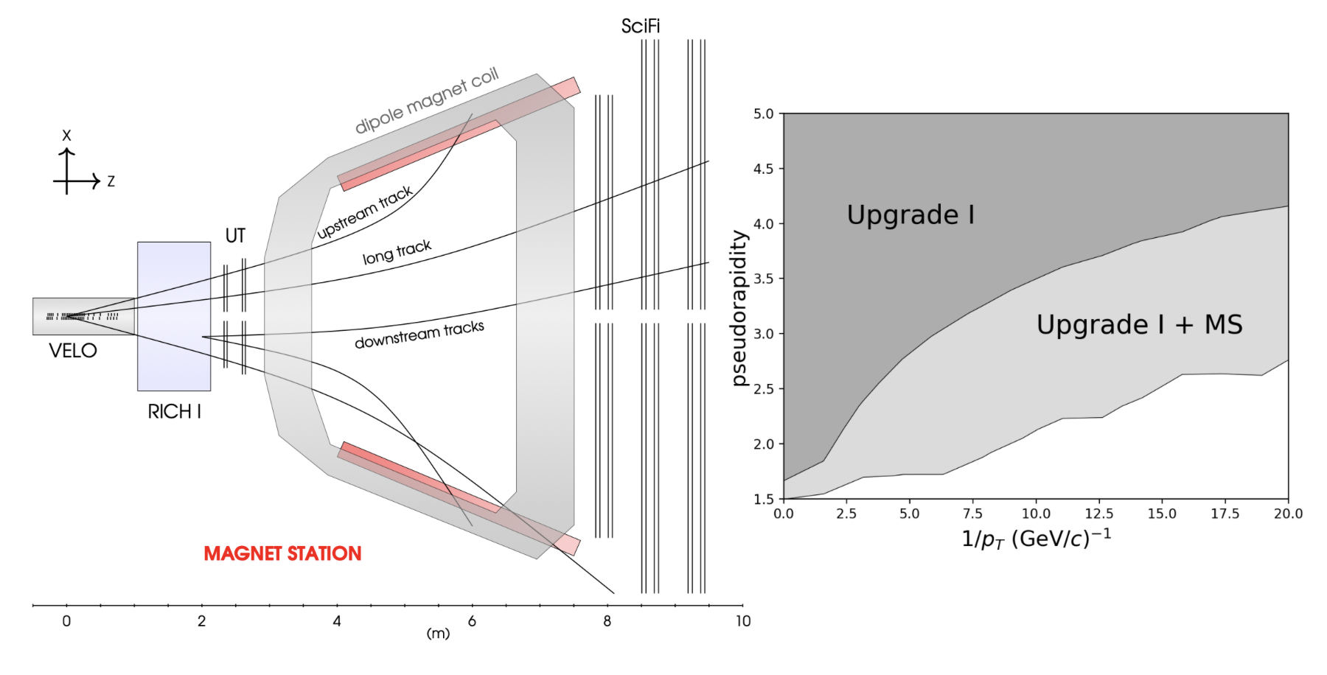
Future Upgrades : Magnet Station
Instrument the internal magnet walls with a scintillator-based soft particle tracker
tracking p_{T}>50 MeV/c
  Essential to complete the UPC program
  high-statistics low-mass vector, scalar and tensor mesons
  Exotic hadrons with multiple decay products
  Low-mass dielectrons and photon conversions
Looking for US institutions to join a DOE proposal, installation starting during LS3

Slide 23
Take away
LHCb is ideal for UPC studies. The sky is the limit, thanks to
  Software-based trigger
  Excellent particle identification
  Low-p_{T} tracking
Results limited to quarkonia photoproduction so far, but other measurements are very close to be released
LHCb is a new detector now and ready for Run3
Future upgrades dedicated to UPC
LHCb heavy ion is a good example of a high data/people ratio
  Heartbreaking opportunities missing because of the lack of people to do analysis
  Upgrade 1b and II are very good opportunities to be part of the LHCb HI program and make UPC physics as one of the most relevant in particle physics

