Slide 1
EFT Searches in
Multiboson Final States:
ATLAS and CMS
Michael Schmitt (Northwestern University)
for the ATLAS and CMS collaborations
MBI2023 – San Diego
August 29, 2023

Slide 2
apology:
I cannot cover > 30 papers even though they are all interesting.
I did not choose to simply review the most recent papers from ATLAS & CMS.
Rather, I have tried to identify some interesting themes and topics for discussion.
I’ll bring in a variety of analyses as illustrations and explanation.
I apologize if a new result or two is neglected.

Slide 3
searching for new physics (beyond the standard model)
No overt sign of new physics (physics beyond the standard model) – unfortunately.
(Let me set aside the hints of flavor anomalies.)
Must hope to falsify the SM by comparing a prediction to precise measurements.
(g-2)_{μ} is the current best example of this, but of course there are many others.
Old approach: think of something you can measure very precisely with a minimum dependence
on theory modeling. (LEP)
See whether the SM predicts the value that you measure.
30 years ago, people were certain that the SM would be falsified.
Nowadays, we know otherwise, and expect that falsifying the SM will be a major challenge.

Slide 4
Why EFTs?
New way (EFT) is better.
It is model-agnostic but still incorporates sensible, ”loose” theory prejudice.
Furthermore, a variety of measurements can be organized together and combined
ultimately leading to a more stringent / precise result.
Finally, even without particle theory, nice idea:
- SM is a dim-4 EFT – fully validated
- new physics should show up at dim-6
- tidy scheme based on an expansion in 1/Λ
Potentially very powerful.
Drawbacks:
- fundamentally invalid – at least at energies too close to L or above (unitarity)
- too much freedom!
- power of the data is dilute, at least in a realistic/serious treatment
Our task is to let Nature show us which Wilson Coefficients are significant – and what the pattern is.
Like hitting the right notes on a keyboard to make a beautiful chord.

Slide 5
topics:
dim-6 and the impact of differential cross sections
trying to deal with unitarity violation
dealing with dim-8 when dim-6 is unknown
global combined fits

Slide 6
1. dim-6 and the impact of differential cross sections
CMS WW (2020)
- use M(eμ) (clean and simple)
- decent results
ATLAS WW+1j (2021)
- demanding 1 jet enhances dim-6 signal
- better results
ATLAS Z+jj (2021)
- not true multiboson, but
- use of signed azimuthal jet angle → enhancement
CMS Wg (2022)
- interference resurrection
- major enhancement

Slide 7
CMS PRD 102 (2020) 092001
CMS WW 2020

Slide 8
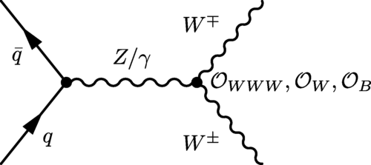
CMS PRD 102 (2020) 092001
relatively simple “cut-based” analysis
  require one e and one μ, opposite signs
  p_{T}^{miss}, avoid DY and apply b-veto
pay attention to N_{jets}
  separate events with N_{jets} = 0 and N_{jets} = 1
many thousands of evets; sample purity around 45%
cross section measurement precise to 6%
  (in agreement with the SM, a minor issue back then)
measure differential cross sections, including jet multiplicity
use M(eμ) distribution for a dim-6 EFT study

Slide 9
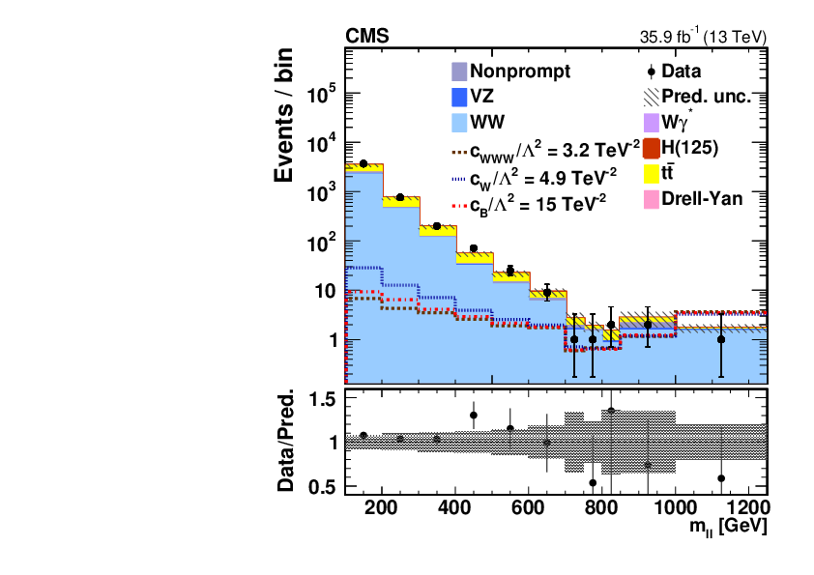
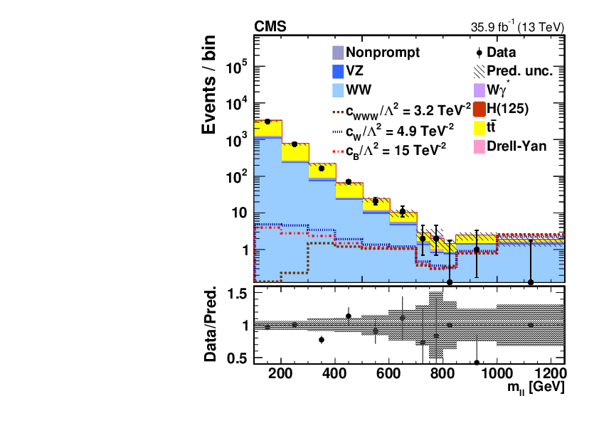
CMS PRD 102 (2020) 092001
zero jets
one jet
M_{eμ}
M_{eμ}

Slide 10
Downward fluctuation leads to
tighter constraints than expected.

Slide 11
ATLAS JHEP06 (2021) 003
ATLAS WW+j (2021)

Slide 12
ATLAS JHEP06 (2021) 003
This ATLAS analysis is similar to the CMS one:
Look at eμ final states.
There is a greater emphasis on the impact of jets
on the interference term.
Analysis uses m_{eμ} separating events with
zero jets, or at least one jet (p_{T} > 200 GeV).
The latter shows enhanced sensitivity.

Slide 13
ATLAS JHEP06 (2021) 003
at least one jet p_{T} > 200 GeV
comparison to SM
illustrate potential NP
M_{eμ}
M_{eμ}

Slide 14
ATLAS JHEP06 (2021) 003
Requiring the jet reduces the
suppression of the interference effects
between SM and dim-8 operators.
Reduced suppression means
greater sensitivity.

Slide 15
ATLAS Eur. Phys. J. C (2021) 81
ATLAS Z+jj (2021)

Slide 16
ATLAS Eur. Phys. J. C (2021) 81
-> jet
A different kind of process.
These jets are special – they are not ISR.
The two tagging jets change everything
This is not just plain Drell-Yan production.
The two energetic, high-mass, well-separated jets
enable ATLAS to study triple gauge couplings.
Event samples are large, enable detailed studies of this process.
Differential cross sections are measured, including the jet-jet signed azimuthal angle Δφ_{jj}.
-> jet

Slide 17
ATLAS Eur. Phys. J. C (2021) 81
m_{jj}
|Δy|_{jj}
p_{T,ll}
Δφ_{jj}

Slide 18
ATLAS Eur. Phys. J. C (2021) 81
It turns out that these differential
cross sections show tremendous
sensitivity
Mainly through interference terms
(which are linear in the W.C.)
Most interesting is angle Δφ_{jj}.
Δφ_{jj} = φ_{f} – φ_{b} is signed according to y_{f} > y_{b}.

Slide 19
ATLAS Eur. Phys. J. C (2021) 81
Bounds are very good even though there
is only one boson in the final state.

Slide 20
CMS PRD 105 (2022) 052003
CMS Wy (2022)

Slide 21
CMS PRD 105 (2022) 052003
Not VBF – just Wγ production.
Similar to W⁺W⁻ production though jets play no special role.
As indicated in the ATLAS Zjj analysis,
use of angular distributions greatly increases
the sensitivity of the interference term.
“interference resurrection” - potent
lepton azimuthal angle in the Wγ rest frame

Slide 22
CMS PRD 105 (2022) 052003
Δφ
tour de force paper
several interesting
measurements
focus on EFT part
fit to p_{T}^{γ} , Δφ grid
p_{T}^{γ}
Exceptionally strong limits, thanks to the boosted sensitivity of the interference term:
Expect [-0.066,0.065] Observe [-0.062,0.052] at 95% CL
We will say more about these limits later.

Slide 23
Summary and Comparison of dim-6 bounds
CMS WW 0/1 jet (2020)
cW exp [-5.3,4.2] obs [-3.6,2.8] baseline
ATLAS WW+1j (2021)
cW exp [-0.39,0.38] obs [-0.33,0.33] +1 jet reduces the reduction
ATLAS Z+jj (2021)
cW exp [-0.31,0.29] obs [-0.19,0.41] Δφ_{jj} makes a big differene
CMS Wγ (2022)
c3W exp [-0.066,0.065] obs [-0.062,0.052] interference resurrection

Slide 24
2. attempts to deal with unitarity violation
Common viewpoint: the Wilson expansion used in EFTs is similar in spirit to a Taylor expansion (in s).
New physics (think: new resonances) at a higher energy scale Lambda.
Below Lambda, hope to see indirect evidence of New Physics in relevant kinematic distributions.
The expansion will be accurate only over a limited range of s and is best when the
differential cross section does not vary rapidly.
Clearly, not a good approach at the scale Λ, where one expects peaking structures!
A truncated EFT expansion is not renormalizable and violates unitarity at some energy scale.
What action should we take?
Do nothing.
Report the unitarity bound
Clipping: zero-out the NP contribution above cutoff Ec (but keep SM contribution).
Censor data at high energy.

Slide 25
CMS 2212.12592
CMS Wγ+2j (2023)

Slide 26
CMS 2212.12592
This new analysis is sensitive to quartic couplings.
Hence, the focus is on dim-8 operators and coefficients.
(We’ll return to the question of dim-6 operators.)
This pair of jets is special: m_{jj} is high, and they are
separated in rapidity.
The presence of the two jets is crucial (similar to Zjj)
this is vector boson scattering, not just Wy production.
Use m_{Wy} as the sensitive variable.
m_{Wy}

Slide 27
CMS 2212.12592
Example: reporting the unitary bound
This approach is simple and straight forward.
U_{bound} is like a warning: above this energy
the theory is in trouble.
It does not tell us about any impact on W.C.
nice constraints on f_{T,I} for i=0,1,2,5,6,7.

Slide 28
ATLAS Eur. Phys. J. C 83 (2023) 539
ATLAS Zγγ (2021)

Slide 29
ATLAS Eur. Phys. J. C 83 (2023) 539
Example of ”clipping”
Choose an arbitrary energy cutoff E_{c.}
Above that cutoff, zero-out the non-SM contribution (both the pure BSM quadratic part and the
interference term)
and retain the SM part only.
High-energy data are not discarded but
they do not contribute to the bounds.
Compute bounds as a function of E_{c}.

Slide 30
ATLAS Eur. Phys. J. C 83 (2023) 539
Example of ”clipping”
Naturally, bounds on W.C. weaken when
much of the NP at high energies is zeroed out.
Several analyses in ATLAS and CMS use this technique. This is a recent example.

Slide 31
CMS PRD 105 (2022) 052003
CMS Wy (2022)
discussed earlier

Slide 32
CMS PRD 105 (2022) 052003
Example of “dropping the quadratic term”.
The interference term is linear in the W.C.
and is the leading 1/Λ² term.
Trouble enters with the quadratic term,
especially when the W.C. “c” is not small.
The growth at high s is associated with the
quadratic term (b/c the linear term cannot be large
where the SM term vanishes).
Approach: remove the quadratic terms from the likelihood (i.e., set the “pure BSM” term to zero, by hand) and derive new bounds on the W.C.
Several analyses in ATLAS and CMS use this
technique. This is one example.

Slide 33
CMS PRD 105 (2022) 052003
Another approach: censor data which is too high in energy.
These data cannot be explained by the theory (because it breaks down at those energies)
so remove them from the analysis.
p_{T}^{γ} cutoff is an
upper bound

Slide 34
CMS PRD 105 (2022) 052003
This paper shows both the impact of
- dropping the quadratic term
- censoring data

Slide 35
Summary:
Unitarity violation is a conundrum.
It occurs at relatively “low” energies – typically between 1 and 2 TeV.
Events above this energy cannot really be understood on the basis
of a simple EFT.
Dropping the quadratic term provides a sense of the problem:
  Analyses which rely mainly on the interference term are OK
  Analyses which rely mainly on the quadratic, “pure BSM” term are not
Of course, we don’t want to prohibit analyses that could discover new physics
at high mass scales – this is the essence of the LHC!
Censoring data may seem logical, but it is hard to stomach.
Is it time to bring back dipole form factors?
  study how W.C. bounds change as a function of the dipole parameter

Slide 36
3. setting bounds on dim-8 when dim-6 is unknown
What should we do with quartic couplings (cf. VBS, VVV production)?
These are uniquely impacted by dim-8 operators.
Naturally, analyses seek to place bounds on dim-8 W.C.
But dim-6 operators can impact these same processes, and
generally one expects dim-6 terms (∼1/Λ²) to be larger than dim-8 (∼1/Λ⁴).
So far, analyzers evoke existing bounds on dim-6 W.C. coming from VV production, etc.,
and set dim-6 terms to zero. (We saw this in the CMS Wγ analysis above, but it is common).
Furthermore, VBS and VVV production tend to have limited sensitivity to dim-6 operators
(so they cannot themselves rule out dim-6 terms).
I suspect individual analysis are insufficient to constrain dim-6 and dim-8 simultaneously.

Slide 37
Is there a better way?
Perhaps dim-6 terms could be constrained by a prior tuned with a parameter α.
One would study how the derived bounds on dim-8 depended on α.
This is somewhat similar to clipping that we discussed earlier.
(Comment: this problem seems to me to be morally equivalent to the practice of
deriving 1D bounds, ie, setting all coefficients to zero but one, and allowing that
one coefficient alone to be constrained by the data.)
On the longer term, a better way is to build a global combined analysis that
takes all experimental results into account.
Let VV production constrain dim-6 while VBS, VVV production constrain dim-8.

Slide 38
ATL-PHYS-PUB-2023-002
ATLAS combined ssWWjj & WZjj reinterpretation (2023)

Slide 39
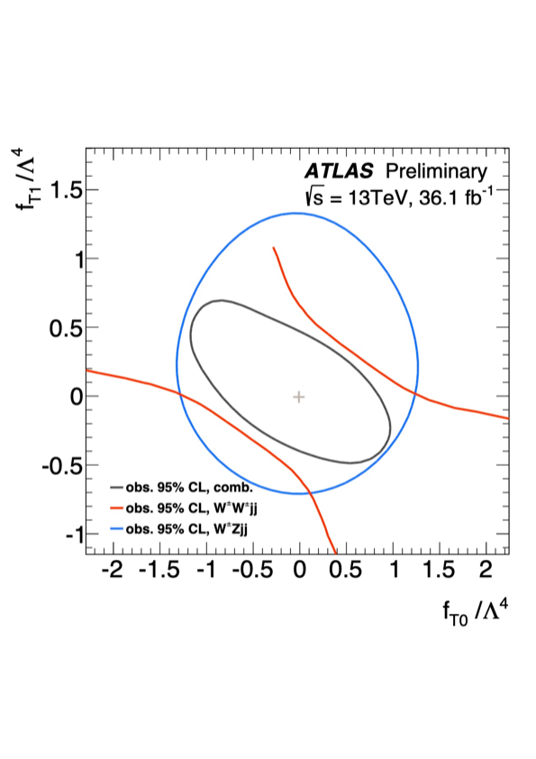
ATL-PHYS-PUB-2023-002
WZ helps to close off flat directions.
(no unitarization applied)
Fit to m_{ll} in WWjj channel
fit to m_{T}(WZ) in WZjj channel.

Slide 40
ATL-PHYS-PUB-2023-002
no unitarization
energy cutoff at 1 TeV
significant loss of sensitivity
(or was it overestimated without unitarization?)

Slide 41
ATL-PHYS-PUB-2022-027
4. progress toward global combined fits
ATLAS have released several combined fits.
Their most global fit includes Higgs, EW, and EWPO.
- Higgs production and decay (STXS)
* reparametrize STXS in terms of W.C.
- certain gauge boson cross section measurements (WW, WZ, ZZ, Zjj)
* reparametrize binned distributions in terms of W.C.
- precision Z pole observables measured at LEP and SLC
* use theoretical predictions for EWPO values as functions of W.C.
Sensitive to operators that affect Higgs couplings, weak boson self-couplings,
vector boson – fermion couplings, and four-fermion couplings.
Build individual likelihoods for Higgs, EW, EWPO.
- consider “ATLAS-only” data: combine Higgs & EW
- “global” data: include EWPO on top of Higgs & EW

Slide 42
Higgs data
ATL-PHYS-PUB-2022-027
Z pole data
EW data

Slide 43
ATL-PHYS-PUB-2022-027
Great care was taken to get details right.
  consider indirect impact of operators on Higgs BF
  consider impact of certain operators such as C_{Hl}⁽³⁾ and C_{ll} which modify G_{F}.
  take propagator effects into account (i.e., when total width is modified)
  handle acceptance effects in certain Higgs decay kinematics
Unitarization: drop quadratic part and compare.
  attitude favors pure-linear part
  do not consider dim-8
  neglect cross terms
  (i.e. interference from two different dim-6)
  neglect double-insertions
m_{Z2}

Slide 44
The complementarity of these data sets is key.
Tight EWPO constraints allow Vff to be distinguished from H-only and V-self interactions.
Example: compare two 1D scans. EWPO dominates c_{Hq}⁽¹⁾ while Higgs+EW dominates c_{W}.
ATL-PHYS-PUB-2022-027
c_{Hq}⁽¹⁾
c_{W}
Even so, these data are insufficient to determine all 28 W.C.
There are flat directions, even with all these measurements. → principal component analysis

Slide 45
PCA: ATLAS-only
Some eigenvectors are determined by one or two W.C.
Others depend on several.
ATL-PHYS-PUB-2022-027

Slide 46
ATL-PHYS-PUB-2022-027
PCA: ATLAS-only
Restructure the PCA: form physics-motivated groups of W.C.
A pleasing and sensible/interpretable structure emerges.

Slide 47
ATL-PHYS-PUB-2022-027
linear is
stronger
than quad
offset due to
A_{FB}^{b} & A_{FB}^{c}

Slide 48
ATL-PHYS-PUB-2022-027
ATLAS developed a
so-called “simplified NLL”
which delivers results that
are very close to those of the
“full NLL”.
Will be very useful as the
global analysis grows.
  easy to test out other schemes
  much faster to execute
Look forward to future developments!

Slide 49
Summary and Conclusion:
This presentation could not include several interesting analyses, unfortunately.
Main ideas:
  Proper development of interference terms (e.g. angular or jet variables)
  can lead to much greater sensitivity
  Dealing with unitarity violation is hard.
  What is the best way to handle dim-8 constraints?
  Global combined analyses are getting more inclusive, and more powerful.
  They will help solve many of these problems.

Slide 50
BACKUP

Slide 51
CMS WZ differential 2022

Slide 52
CMS JHEP07 (2022) 032
CMS WZ detailed differential cross sections
Use M(WZ) – not just the fiducial cross section
(look also at pTZ but do not use it in the fit)
Consider linear term only - compare
early example of “clipping”

Slide 53
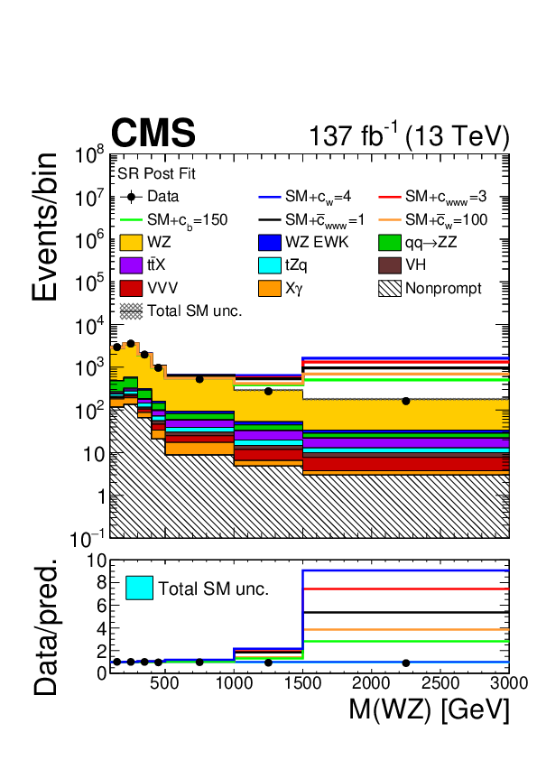
CMS JHEP07 (2022) 032

Slide 54
CMS JHEP07 (2022) 032

Slide 56
CMS JHEP07 (2022) 032

Slide 57
CMS JHEP07 (2022) 032
linear + quadratic
linear only

Slide 58
ATLAS ZZjj 2023

Slide 59
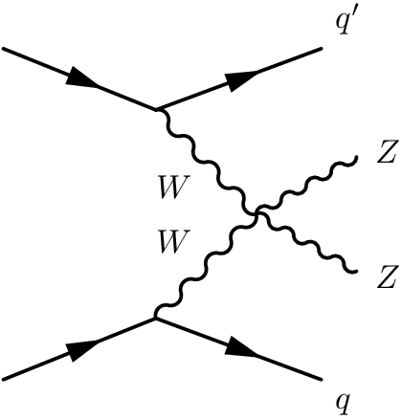
ATLAS ZZ+2j just published 2308.12324
4 leptons, 2 jets
vector boson scattering
quartic coupling: dimension 8 as well as dim-6
cuts to enhance or suppress VBS
measure differential cross sections in both cases
careful comparison to theory
  EW: MadGraph5 at LO (which is adequate)
  QCD: Sherpa, MG5_NLO (Sherpa is better)
interesting kinematic quantities
  m4l
  mjj
  costheta*
  dphi
Use m4l and mjj for EFT analysis

Slide 63
backup

Slide 64
ATL-PHYS-PUB-2022-027
ATLAS combined H, EW, EWPO 2023

Slide 65
ATL-PHYS-PUB-2022-027

