Slide 1


Discussion input for longitudinal emittance & synchronous phase studies
F. Batsch, I. Karpov, H. Damerau
HEMAC meeting #17
14/3/2023

Slide 2
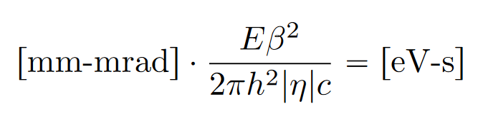
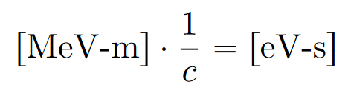

Longitudinal emittance definitions (1)
Different definitions of the longitudinal emittance and different units co-exist:
  Encircling, 1σ, 4σ, FWHM,…
  [eV-s], [MeV-m], [mrad-m], the conversion can be found under Unit conversion for longitudinal emittances (F. Batsch, April 2022):
2σ_{E}
The ellipse area with half axis lengths (a,b) equals π∗a∗b
With 1σ_{t}, 1σ_{E} the emittance ε_{L} = π ∗ σ_{t} ∗ σ_{E}
With 2σ_{t}, 2σ_{E} the emittance ε_{L} = 4π ∗ σ_{t} ∗ σ_{E}
1σ_{E}
1σ_{t}
2σ_{t}

Slide 3
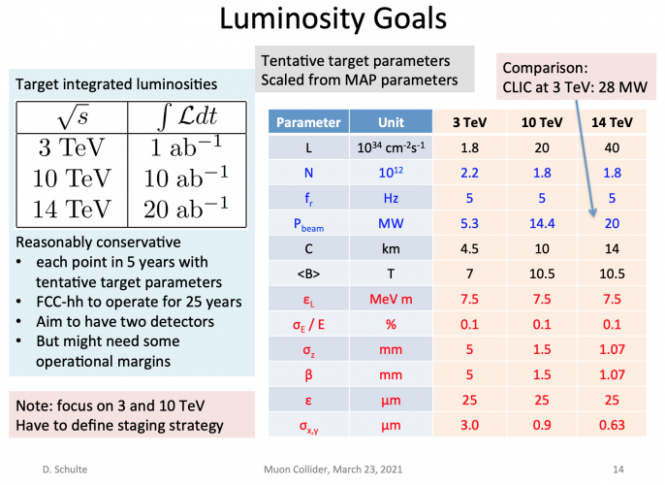
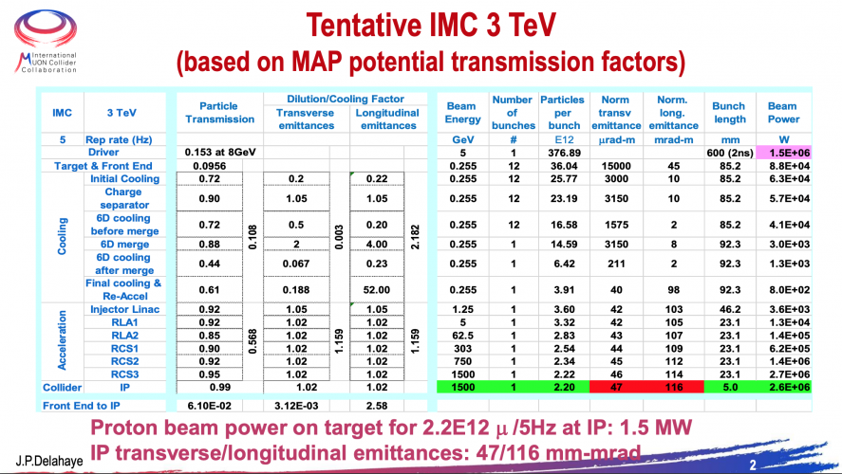
Longitudinal emittance definitions (2)
2σ_{E}
After the accelerator design meeting on 27/2, we realized that different definitions are used with the muon collider collaboration:
The general parameter tables on the webpage are based on MAP:
1σ_{E}
1σ_{t}
2σ_{t}
ε_{L} = 7.5 MeVm ≙ 0.025 eVs ≙ σ_{t}*σ_{E}!
109 mrad m @(63GeV, h=25975) ≙ 0.058 eVs
109 mrad m @(303GeV, h=25975) ≙ 0.28 eVs
[70 mrad m @(63GeV, h=25975) ≙ 0.038 eVs]
Definitions not specified!
Definition of ε_{L} unclear

Slide 4
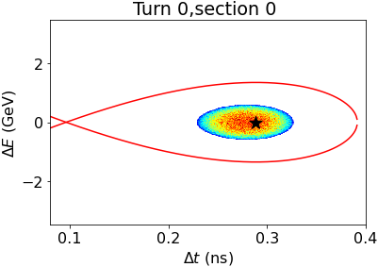
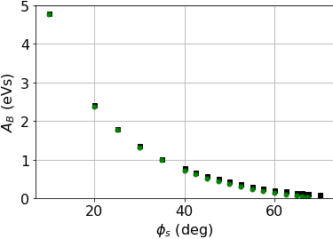
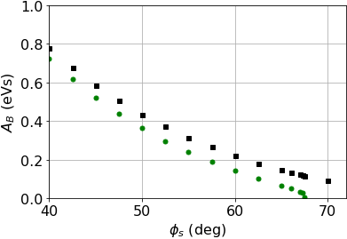
Longitudinal emittance definitions (3)
2σ_{E}
The baseline value of 7.5 MeV-m or 0.025 eV-s corresponds to the square, we assumed to the ellipse and used 4*0.025 eVs = 0.1 eVs in our simulations.
Do the parameter tables mean 7.5 π-MeV-m = 23.56 MeV-m?
The emittance in our simulations differs by a factor of π.
A larger emittance in simulation lead to smaller φ_{s,max} , but also to smaller P_{HOM} due to the longer bunches
1σ_{E}
1σ_{t}
2σ_{t}
No intensity effects
With intensity effects
No intensity effects
With intensity effects
Plots from accelerator design meeting for 0.1 eVs

Slide 5
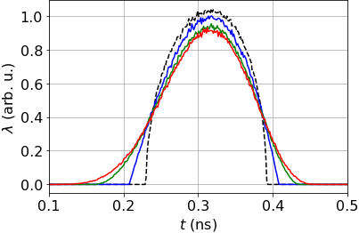
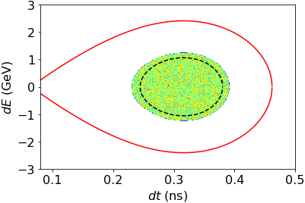
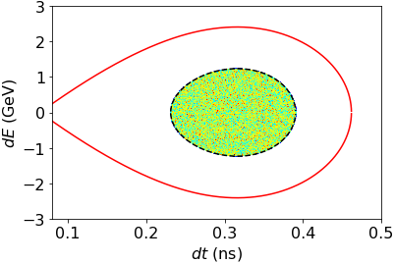

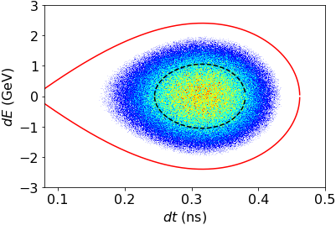
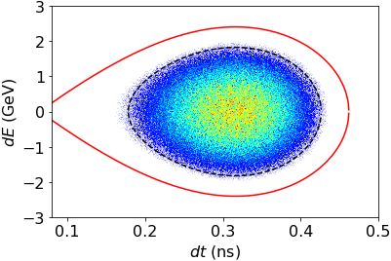

Discussion:
Which emittance definition / value / bunch length should be the baseline value?
Which tails are assumed? Equal bunch lengths in simulation but different tail definitions give different encircling emittances:
Tails increase ε_{L} by factor of 2
Agreement on definition essential
Simulations might have to be re-run
ε_{L} = 0.22 eVs
ε_{L} = 0.31 eVs, 4σ_{L} = 0.16ps
µ = 0.5, τ_{L} = 4 σ_{t}
µ = 1 (parabolic)
µ = 2
µ = 3
FWHM,
µ = 1
Encircling ,
µ = 1
$$λ(τ)=λ_{0}{\left[1−{\left(\frac{τ}{τ_{l }}\right)}^{2}\right]}^{μ}$$
(^^{(µ+1/2)} in BLonD)
ε_{L} = 0.22 eVs
φ_{s} = 30°
ε_{L} = 0.69 eVs , 4σ_{L} = 0.20ps
FWHM,
µ = 2
4σ,
µ = 2

Slide 6


Slide 7
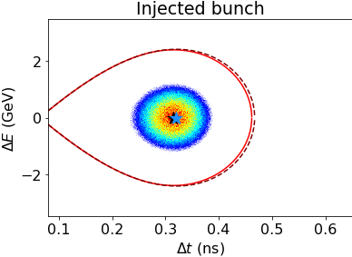
Extra:
Generating the bunch with fixed emittance of 0.31 eVs:
ε_{L} = 0.31 eVs, 4σ_{L} = 0.16ps
Encircling ,
µ = 1
µ = 0.5, τ_{L} = 4 σ_{t}
µ = 1 (parabolic)
µ = 2
µ = 3
ε_{L} = 0.31 eVs
FWHM,
µ = 2

Slide 8
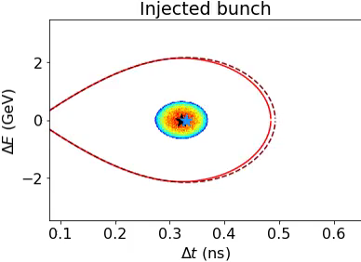
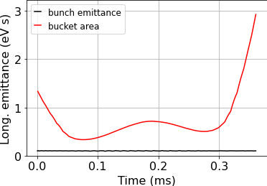
Extra:
Simulations with nonlinear ramping, for RCS 1, φ_{s} = 50°, input emittance 0.1 eVs:
→ 54% of the bunch lost

Slide 9
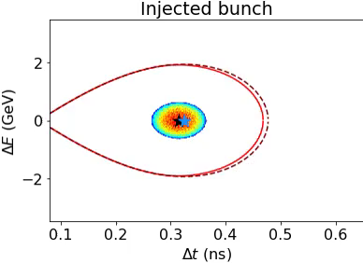
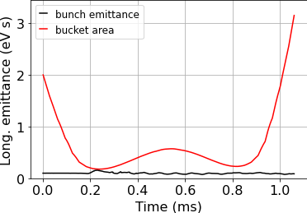
Extra:
Simulations with nonlinear ramping, for RCS 1, φ_{s} = 57.5°, input emittance 0.1 eVs:
→ 54% of the bunch lost

Slide 10
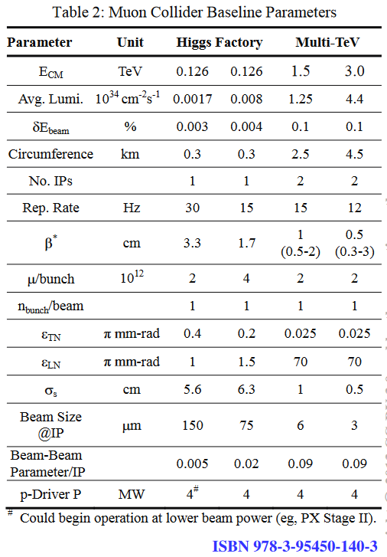
Extra:
MAP parameter, from here:

