Slide 1
8th BCD ISHEP Cargèse School
NEUTRINO MASS HIERARCHY MEASUREMENT WITH DUNE
In collaboration with: prof.Marumi Kado
Giulia Lupi

Slide 2

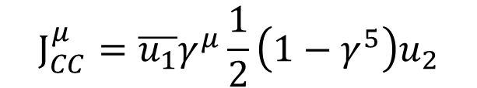



NEUTRINO IN THE STANDARD MODEL
Two notable facts about neutrino
Neutrino are emitted with negative helicity
From massless Dirac’s equation energy solutions
Antineutrino are emitted with positive helicity
Direction of the motion
NEUTRINO $≠$ ANTINEUTRINO
$$ν$$
$$\overline{ν}$$
Spin
From the V-A structure of the CC processes
ONLY $ν_{L}$ AND $\overline{ν_{R}}$ ENTER IN WEAK INTERACTIONS
$$J_{CC}^{μ}=\overline{u_{1}}γ^{μ}\frac{1}{2}\left(1−γ^{5}\right)u_{2}$$
Extract only the left –handed component of fermions and right-handed component of anti-fermions
Notes:
Neutrino are neutral charged fundamental particel with spin 1/2 as we know they are organized in three families related to the corresponding charged lepton. Some of the fundamental assumption in the SM that seems to be break due to the neutrino oscillation and are not adaptable with the non zero mass state are related to the chirality of neutrino. In standard model is in fact possible to have a clear distinction between what is a particle what an antiparticle by the measure of the helicity. Solving the dirac eqaution for a massless particle the solution for the two energy value gives that neutrino are emitted with a negative helicity and antinetirno with a negative one. In addiciton neutrino can only interact weakly, in the standard model only the left handend fermions can enter in V-A current interaction violating the parity means that only left neutrino and right handed neutrino.
If neutrinos were massless and traveled at the speed of light, as scientists initially thought and as the Standard Model predict

Slide 3
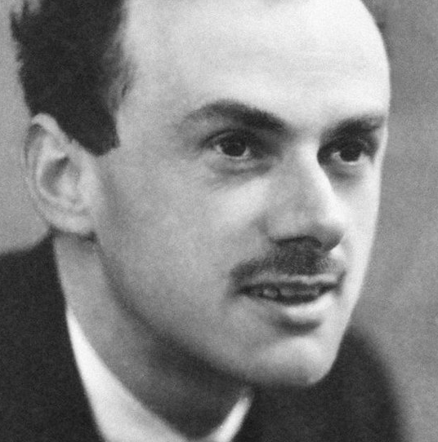
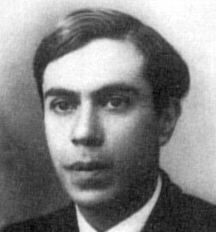
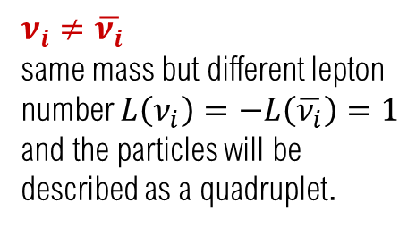
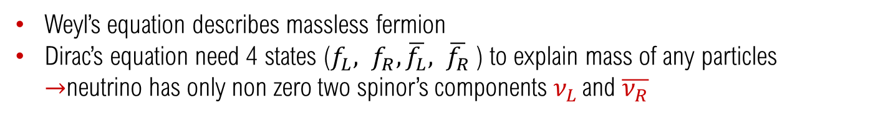
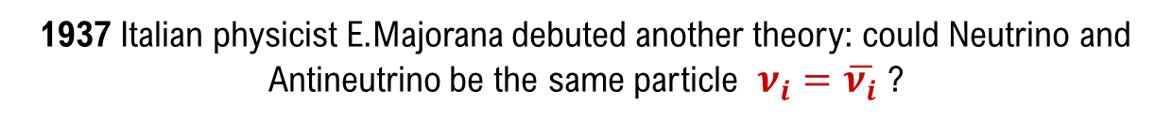
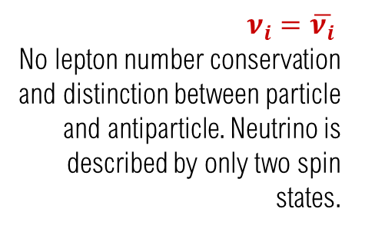
DIRAC OR MAJORANA NEUTRINO?
In SM particles can de described either by Dirac or Weyl’s equation but massive neutrinos can’t:
Weyl’s equation describes massless fermion
Dirac’s equation need 4 states ($f_{L}, f_{R}, \overline{f_{L}}, \overline{f_{R}}$) to explain mass of any particles $→$neutrino has only non zero two spinor’s components $ν_{L }$and $\overline{ν_{R}}$
1937 Italian physicist E.Majorana debuted another theory: could Neutrino and Antineutrino be the same particle $ν_{i}=\overline{ν_{i}}$ ?
DIRAC FERMIONS
MAJORANA FERMIONS
$ν_{i}≠\overline{ν_{i}}$
same mass but different lepton number $L\left(ν_{i}\right)=−L\left(\overline{ν_{i}}\right)=1$ and the particles will be described as a quadruplet.
$ν_{i}=\overline{ν_{i}}$
No lepton number conservation and distinction between particle and antiparticle. Neutrino is described by only two spin states.
Notes:
Since we have understood that sm reprentation are not compatible with the neutrino mass state in fact weyl describes massless particle, dirac equation require additional chiral state that are not observed in neuritno so two main possible new representation had been presented by majo and dirac.Understand wich type neutrino is D or M will be fundamnetal in the understanding of the massa acquisition mechanism. Other particles in the SM get their mass through the interaction with the Higg's boson. The observation of only one state of helicity of the neutrino excluded the possibilities of the same mechanism for this particle. . If the left-handed neutrino instead are majorana particle it could be possible to have a non zero mass term. DI LA DIFFERENZA
Number of relevant parmaeters for the lepton mixing as we will see depending on the nature of neutrino. With three majorana neutrino number of independet parameters will be six instead of four as for dirac neutrino ->PMNS matrixSi

Slide 4
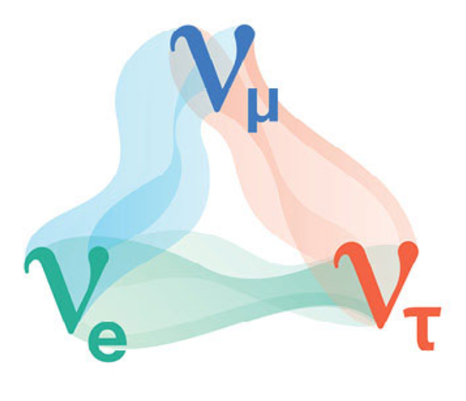
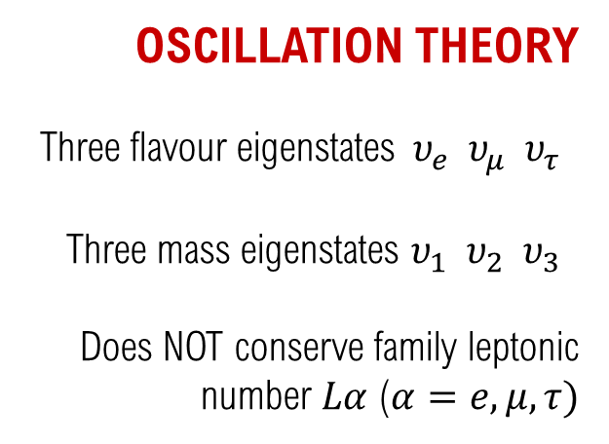

NEUTRINO OSCILLATIONS
STANDARD MODEL
Three flavour eigenstates $υ_{e} υ_{μ} υ_{τ}$
One zero-mass state $m_{υ}≃0$
Does conserve familiy’s leptonic number $Lα$ ($α=e, μ, τ$)
OSCILLATION THEORY
Three flavour eigenstates$υ_{e} υ_{μ} υ_{τ}$
Three mass eigenstates $υ_{1} υ_{2} υ_{3}$
Does NOT conserve family leptonic number $Lα$ ($α=e, μ, τ)$
Experimental observation of flavour changing in propagating neutrino can only be explained by assuming different neutrino mass eigenstates
Notes:
o overall we have a net distinction between standard model and possible model introduced by the oscillation theory. So far the flavour chaning has been confirmed so we know that neutrino comes in the three flavour but their propagation in time brought the non zero probability to observe them in different flavour state respect to the intial one.
If neutrino are massless, different flavour neutrino states are degenerate and we could always find a basis in wich the Hamiltonian and the lepton flavours are simoultaneously diagonal. If instead are massive particles is no longer true and automatic that the mass matrices of the lepton and neutrinos are concurrently diagonalisable and phenomenon of the neutrino mixing can occur with the violation of
the lepton number conservation

Slide 5
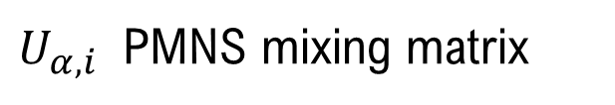


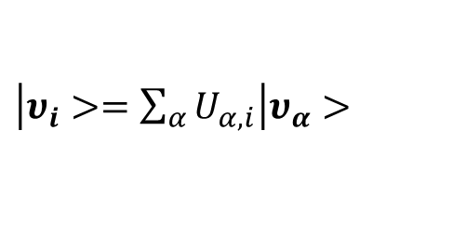
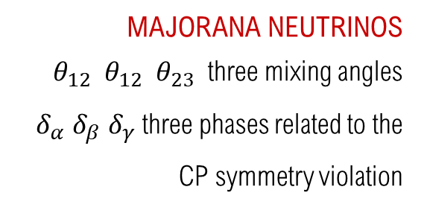

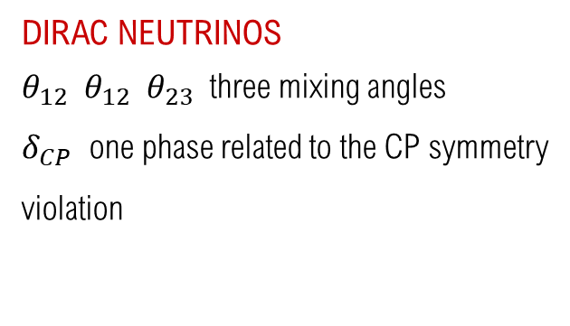
NEUTRINO OSCILLATIONS
Neutrino with a definite flavour can be expressed as a linear combination of the three mass eigenstate and viceverse
$\left|υ_{α}>=\sum_{i}{U_{α,i}^{∗}} \right|υ_{i}>$
$α=e, μ, τ$ FLAVOUR
$\left|υ_{i}>=\sum_{α}{U_{α,i}}\right|υ_{α}>$
$$i=1, 2, 3$$
MASS
$U_{α,i}$ PMNS mixing matrix
Unitary matrix that assumes 3x3 form for three neutrino families → 9 degrees of freedom
DIRAC NEUTRINOS
$θ_{12} θ_{12} θ_{23}$ three mixing angles
$δ_{CP}$ one phase related to the CP symmetry violation
MAJORANA NEUTRINOS
$θ_{12} θ_{12} θ_{23}$ three mixing angles
$δ_{α}$ $δ_{β}$ $δ_{γ}$ three phases related to the CP symmetry violation
Notes:
The formalism if neutrino oscillation is quite simple is it can be done in the hilber space expressing flavour state as a supersposition of the mass eigenstate and viceverse. The flavour changing is described b the pmns matrix wich due the presence of three flaovour will have nine degrees of fredoom. As we have seen depending on dirac or majorana particle diffferent parameters can be aboserbed and in dirac we will end up with 4 independent param while in majo..

Slide 6





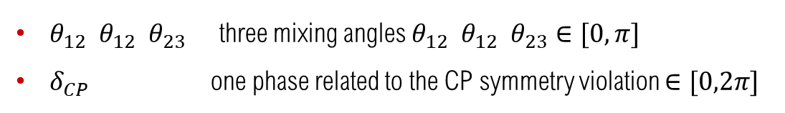
NEUTRINO OSCILLATIONS
Using Dirac parametrization for the PMNS matrix
(observation of oscillation does not distinguish between Majorana and Dirac neutrino!)
$θ_{12} θ_{12} θ_{23}$ three mixing angles $θ_{12} θ_{12} θ_{23}∈[0,π]$
$δ_{CP}$ one phase related to the CP symmetry violation $∈[0,2π]$
$$U_{α,i}=$$
Atmospheric
Accelerated
Solar
$$υ_{μ}→υ_{τ}$$
$$υ_{μ}→υ_{e}$$
$$υ_{e}→υ_{α}$$
With sij = sin θij , cij = cos θij, ij = 12, 13, 23
Notes:
Since the experimentla observation is not sensible to dirac or majorana neutrino for the discussion we will assume dirac parametrixation for a simplified notation. Diffferent parameter are then related to each mass state transition wich can de detected from different sources. he knowledge of these parameters toghether with the observation of solar and atmospheric neutrinos allowed to estabilish how each neutrino in a specific mass eigenstate
has or not the probability to interact with

Slide 7
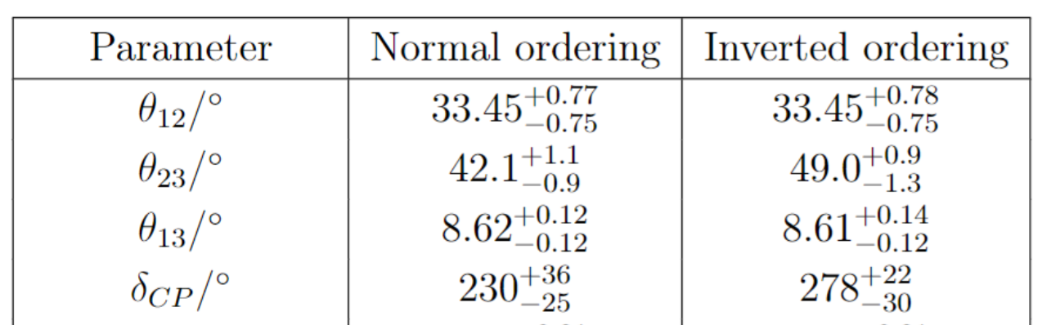
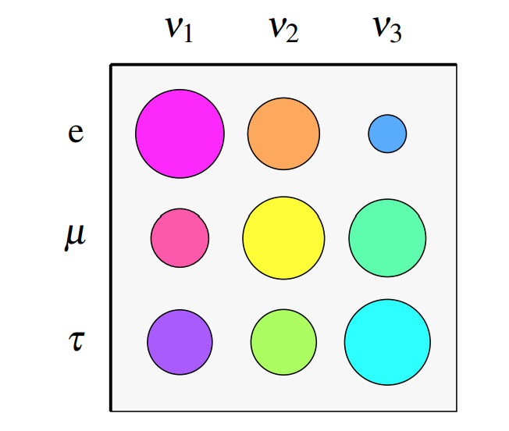
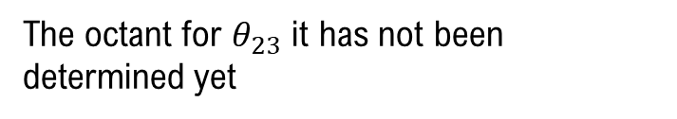
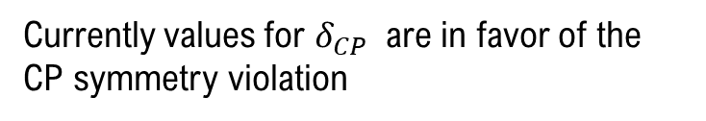
NEUTRINO OSCILLATIONS
Respect to CKM matrix parameters the mixing is enhanced
The octant for $θ_{23}$ it has not been determined yet
Currently values for $δ_{CP}$ are in favor of the CP symmetry violation

Slide 8


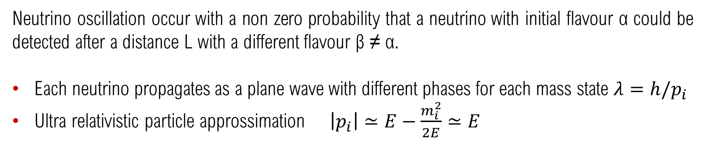

NEUTRINO OSCILLATIONS
Neutrino oscillation occur with a non zero probability that a neutrino with initial flavour α could be detected after a distance L with a different flavour β ≠ α.
Each neutrino propagates as a plane wave with different phases for each mass state $λ=h/p_{i}$
Ultra relativistic particle approssimation $\left|p_{i}\right|≃E−\frac{m_{i}^{2}}{2E}≃E$
PROBABILITY OF OSCILLATION
$$P_{α→β}=\sum_{i}{{\left|U_{α,i}\right|}^{2}{\left|U_{β,i}\right|}^{2}}+2Re\sum_{i>j}{{U_{α,i}^{∗}U}_{β,i}U_{α,j}U_{β,j}^{∗}e^{−i\frac{Δm_{ij}^{2}L }{2E}}}$$
${Δm}_{ij}^{2}=m_{i}^{2}−m_{j}^{2}$
Observation of a flavour’s transition implies the existance of different non zero mass states
Notes:
So what is the realtion between the observed oscillation and the existance of mass state? Using the particle wave dualitiy formalism a general neutrino state can be treated as a plane wave propagating with different frequencies therefhore the flavour oscillation is due to the ohase changing.
This phase in proportional to the mass squared difference. Since they are very light particle the ultra relativistic approsismation it has been used giving the following result of the transition probability

Slide 9





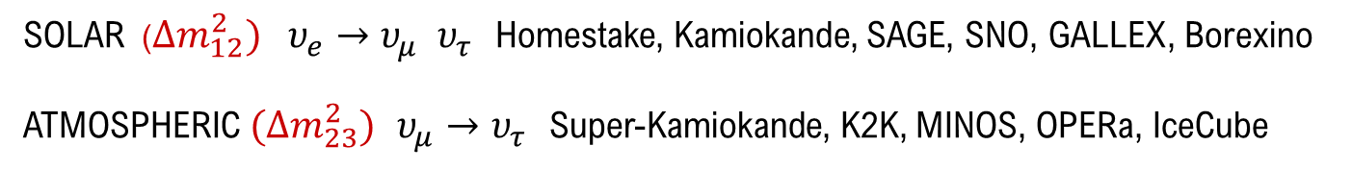

MASS HIERACHY
$P_{α→β} ∝Δm_{ij}^{2}$ does not give any information about the absolute mass values!
Any massive state has different probabilities to interact as a neutrino with a given flavour
$$υ_{1 }$$
$${66\% υ}_{e} 17\% υ_{μ} 17\% υ_{τ}$$
$$υ_{2 }$$
$${33\% υ}_{e} 33\% υ_{μ} 33\% υ_{τ}$$
$$υ_{3 }$$
$${10\% υ}_{e} 45\% υ_{μ} 45\% υ_{τ}$$
The measureable quantity is $Δm_{ij}^{2}$ → studies on solar and atmospheric neutrinos first measured
SOLAR ($Δm_{12}^{2})$ $υ_{e}→υ_{μ} υ_{τ}$ Homestake, Kamiokande, SAGE, SNO, GALLEX, Borexino
ATMOSPHERIC $(Δm_{23}^{2})$ $υ_{μ}→υ_{τ}$ Super-Kamiokande, K2K, MINOS, OPERa, IceCube

Slide 10
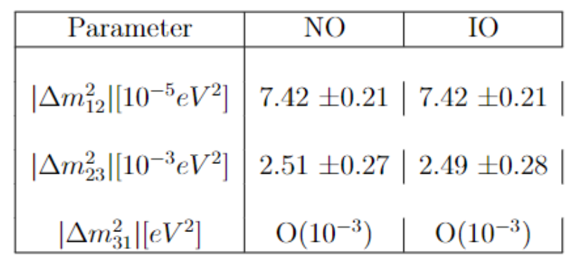

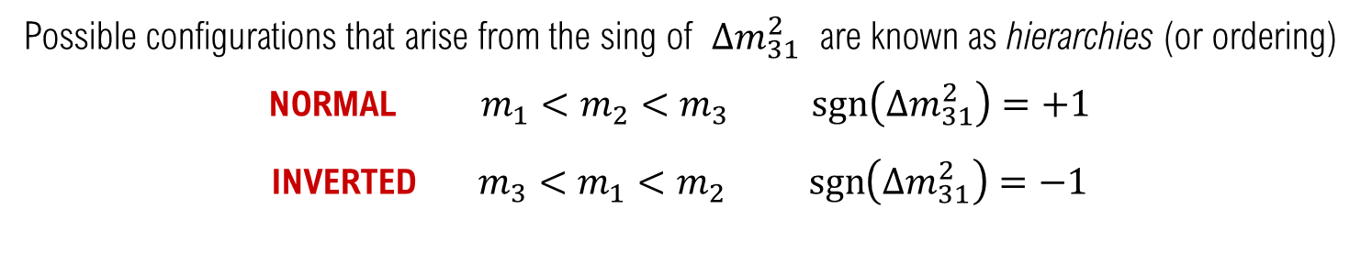

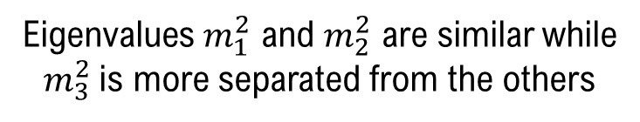
MASS HIERACHY
Eigenvalues $m_{1}^{2}$ and $m_{2}^{2}$ are similar while $m_{3}^{2}$is more separated from the others
$$\left|Δm_{12}^{2}\right|≪|Δm_{23}^{2}|$$
What is the sing of $Δm_{31}^{2}$?
Possible configurations that arise from the sing of $Δm_{31}^{2}$ are known as hierarchies (or ordering)
NORMAL $m_{1}<m_{2}<m_{3} \operatorname{sgn}\left(Δm_{31}^{2}\right)=+1$
INVERTED $m_{3}<m_{1}<m_{2} \operatorname{sgn}\left(Δm_{31}^{2}\right)=−1$

Slide 11
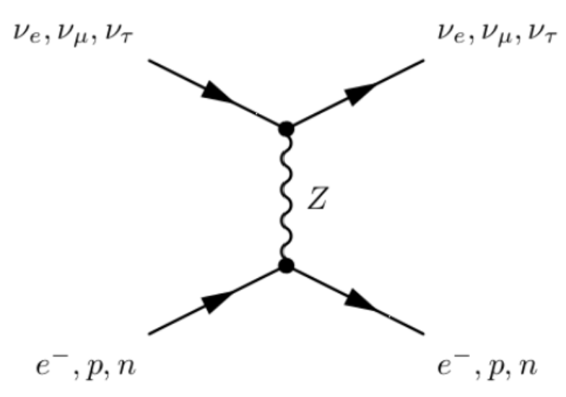
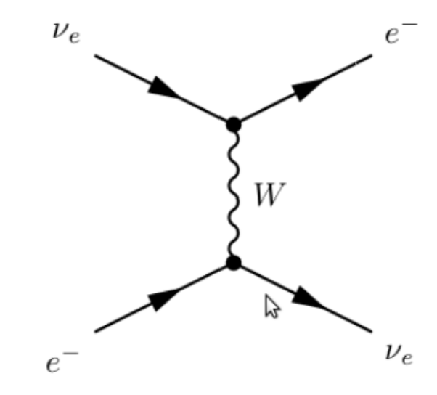
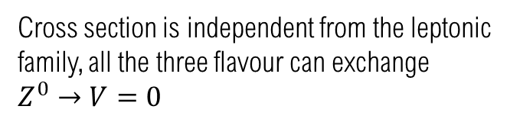
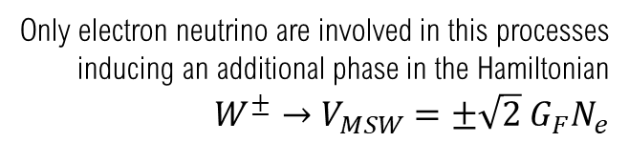




MSW EFFECT
Neutrino interaction with matter can modifies the probability of oscillation
Propagation is alterated due to the elastic scatterin event with the medium’s particles
Increase for $υ_{e}$
$$H→H_{effecctive}=H+V_{MSW}$$
$$Δm^{2}→Δm_{M}^{2}$$
Decrease for $\overline{υ_{e}}$
NEUTRAL CURRENT WEAK INTERACTION (CN)
CHARGED CURRENT WEAK INTERACTION (CN)
Cross section is independent from the leptonic family, all the three flavour can exchange $Z^{0}→V=0$
Only electron neutrino are involved in this processes inducing an additional phase in the Hamiltonian $W^{±}→V_{MSW}=±\sqrt{2} G_{F}N_{e}$
Notes:
resence of matter can modify propagation of neutrinos due to the forward difussion processes of them with the particles of the media. As a consequence the effective neutrino mass can results to be bigger and different for each eigenstate υi with the result that the squared mass difference ∆m2 it is different in a medium respect to the measured vacuum
Value
The hamiltonian will be the modified with a differential potential term that raise from the different interaction that affected neutrino families in fact nc and CC.
The matrix element obtianed depend on the electron density of the media that as we will see is the key to control neutrino oscillation in experiments

Slide 12
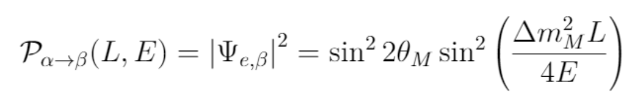
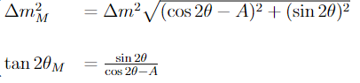
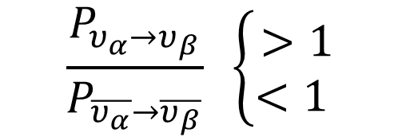
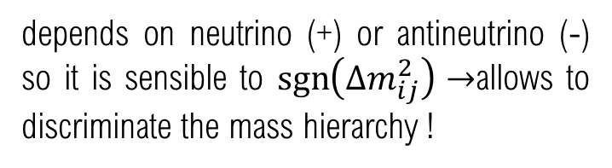
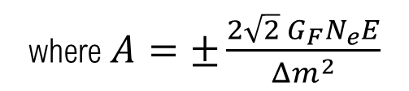
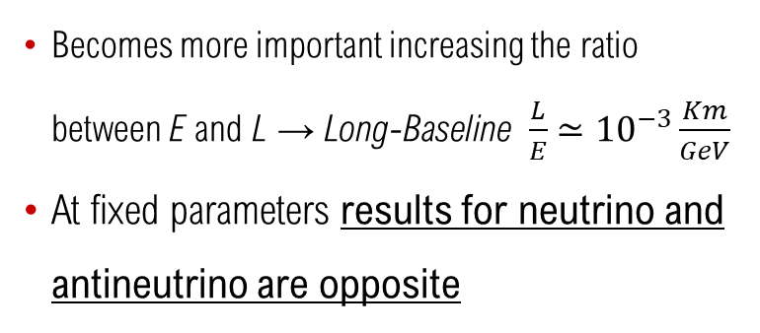
MSW EFFECT
Matter effect modifies the probability of oscillation
where $A=±\frac{2\sqrt{2} G_{F}N_{e}E}{Δm^{2}}$
depends on neutrino (+) or antineutrino (-) so it is sensible to $\operatorname{sgn}\left(Δm_{ij}^{2}\right)→$allows to discriminate the mass hierarchy !
Becomes more important increasing the ratio between E and L → Long-Baseline$\frac{L}{E}≃{10}^{−3}\frac{Km}{GeV}$
At fixed parameters results for neutrino and antineutrino are opposite
$$\frac{P_{υ_{α}→υ_{β}}}{P_{\overline{υ_{α}}→\overline{υ_{β}}}} \left\{\begin{aligned}>1 \\ <1 \end{aligned}\right.$$
NORMAL (NH)
INVERTED (IH)
Notes:
s a consequence the parameters that describes the propagation will be different but more important are sensible to the sing of the difference mass squared allowing the determination of mass hierarchy. The A parameter from wich the effective mass difference depends is affected from the difference between matter and natimmater with the result the the probability that an oscillation occur could be anhanced or not for a neurtrino or antineutrino respectively

Slide 13
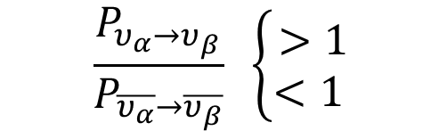
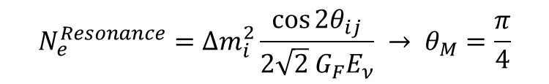
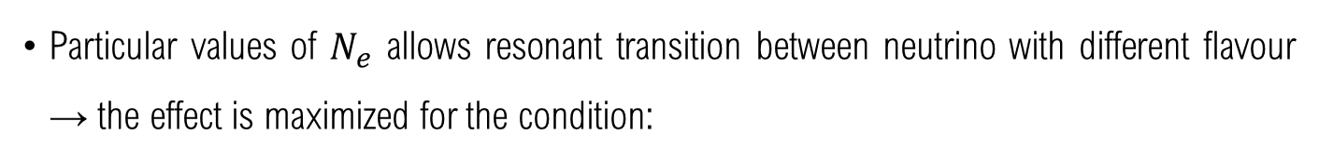

MSW EFFECT
How to measure $\operatorname{sgn}\left(Δm_{13}^{2}\right)$
Particular values of $N_{e}$ allows resonant transition between neutrino with different flavour → the effect is maximized for the condition:
$$N_{e}^{Resonance}=Δm_{i}^{2}\frac{\cos{{2θ}_{ij}}}{2\sqrt{2} G_{F}E_{ν}} → θ_{M}=\frac{π}{4}$$
MAXIMAL MIXING
Using different effects between neutrino and neutrino due to the presence of matter is an efficient tool for the ordering discrimination
$$\frac{P_{υ_{α}→υ_{β}}}{P_{\overline{υ_{α}}→\overline{υ_{β}}}} \left\{\begin{aligned}>1 \\ <1 \end{aligned}\right.$$
NORMAL (NH)
INVERTED (IH)
Notes:
For particular value of the electron sendisty of the medium then a resonance effect can be observed for wich the mixing in maximized then the comparison between neutrino and antineutrino allowed to estabilished wich mass ordering respect the observed value. So since the delta m 13 is the missing one in case of NO one would expect that for deltam grather than zero only neutrino progatation will be enanched

Slide 14
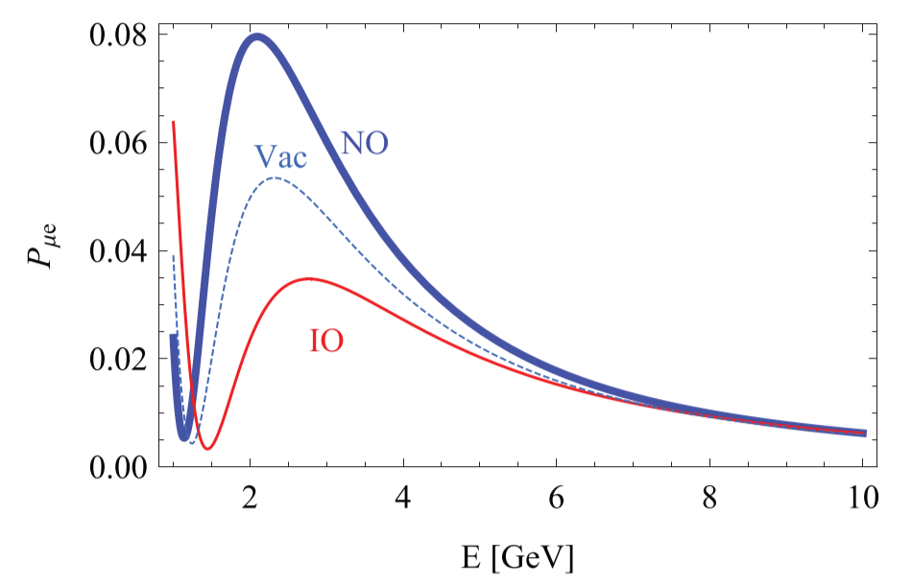

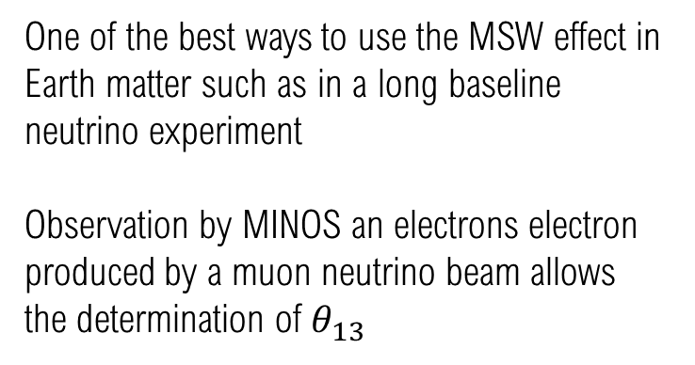


MSW EFFECT
Example: appereance events for transition $υ_{μ }→υ_{e}$ and $\overline{υ_{μ}}→\overline{υ_{e}}$ (with neutrino beam)
One of the best ways to use the MSW effect in Earth matter such as in a long baseline neutrino experiment
Observation by MINOS an electrons electron produced by a muon neutrino beam allows the determination of $θ_{13}$
$$P_{υ_{μ}→υ_{e}}$$
Amplified for NH
$$P_{\overline{υ_{μ}}→\overline{υ_{e}}}$$
Amplified for IH
Suppressed for IH
Suppressed for NH

Slide 15
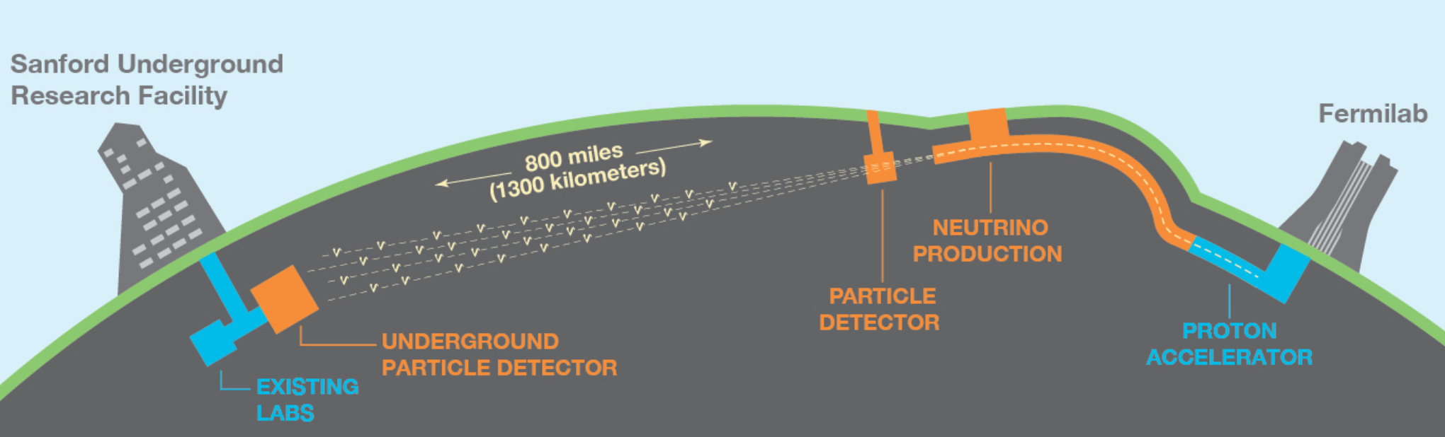
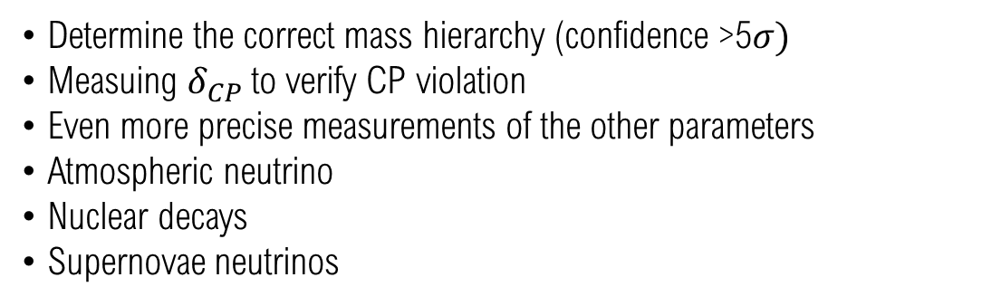
DUNE
Deep Underground Neutrino Experiment
Determine the correct mass hierarchy (confidence >5$σ)$
Measuing $δ_{CP}$to verify CP violation
Even more precise measurements of the other parameters
Atmospheric neutrino
Nuclear decays
Supernovae neutrinos
PRIMARY GOALS
SECONDARY GOALS
Notes:
s a consequence the parameters that describes the propagation will be different but more important are sensible to the sing of the difference mass squared allowing the determination of mass hierarchy. The A parameter from wich the effective mass difference depends is affected from the difference between matter and natimmater with the result the the probability that an oscillation occur could be anhanced or not for a neurtrino or antineutrino respectively

Slide 16
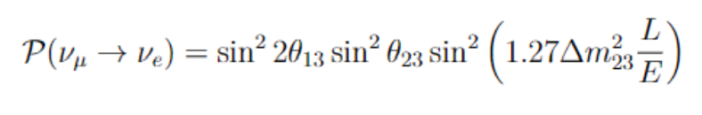


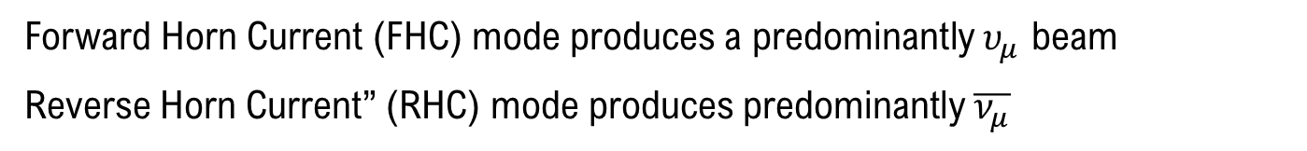

DUNE
Deep Underground Neutrino Experiment
ACCELERATOR
An effective way to access neutrino oscillation is by making intense neutrino beams using particle accelerators
Disappereance channels $\left|Δm_{31}^{2}\right| and\sin^{2}{(2θ_{23})}$
Appereance channels $Δm_{31}^{2} θ_{23} θ_{13} δ_{CP }$
$$p+C→π^{+}+π^{−}+n$$
$$π^{+}→μ^{+}+υ_{μ}$$
$$υ_{e}+{}_{}^{40}{Ar}→{}_{}^{40}{K^{∗}}+e^{−}$$
Forward Horn Current (FHC) mode produces a predominantly $υ_{μ}$ beam
Reverse Horn Current” (RHC) mode produces predominantly $\overline{ν_{μ}}$

Slide 17
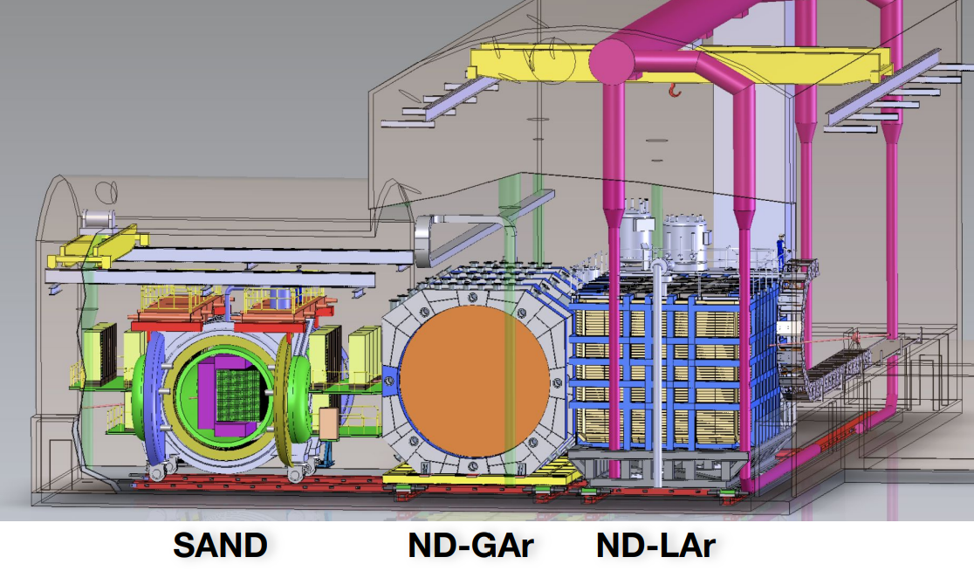
DUNE
The Near Detector
3 SUBSYSTEM
SAND tracker surrounded by ECAL and magnet On-axis monitor of beam spectrum
ND-Gar high-pressure GArTPC surrounded by ECAL and magnet muon spectrometer Constraint nuclear Interaction model
ND-Lar modular pixelated LarTPC, primary target similar to FR
Higher number of interactions with pure neutrino beam
Information about the intial beam composition
Smaller sistematic errors on the final measures
600 m away from the Fermilab base
ArgonCube Liquid Argon detector.
Array of 5x7 ArgonCube modules (5 along and 7 transverse to the beam direction) sharing a common cryostat
Minimal amount of inactive material

Slide 18
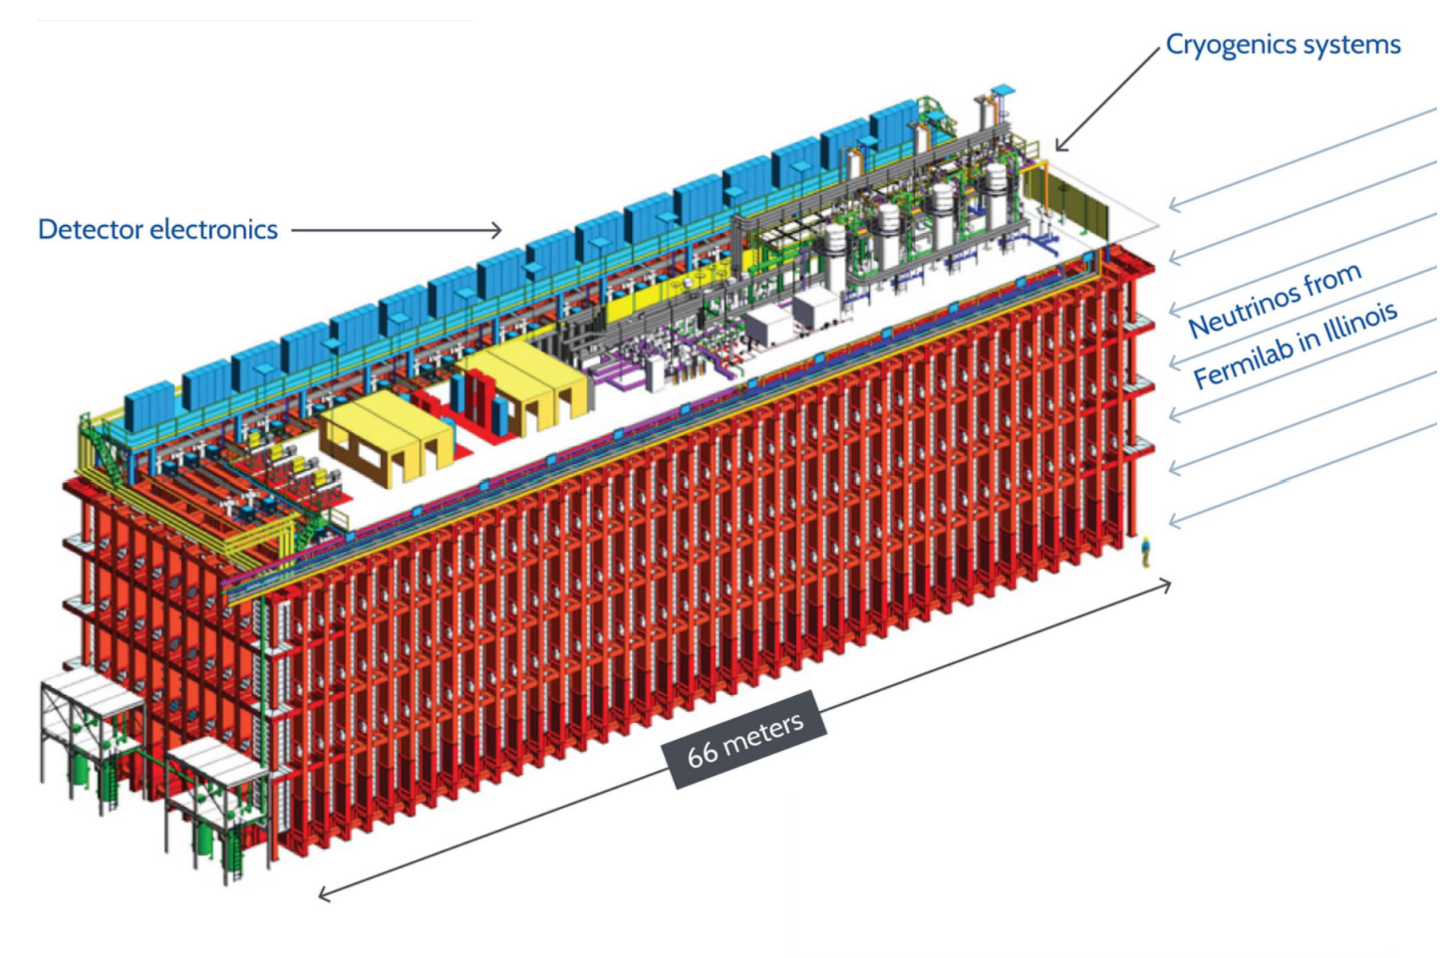


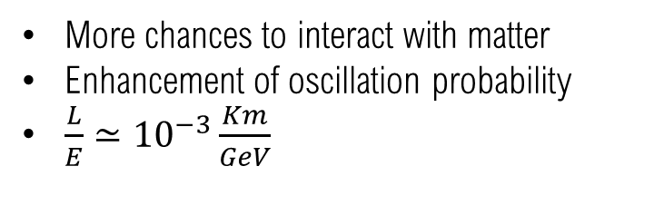
DUNE
Far Detector
More chances to interact with matter
Enhancement of oscillation probability
$\frac{L}{E}≃{10}^{−3}\frac{Km}{GeV}$
1300 km far from Fermilab
1.5 km underground
4 modules, filled with liquid Argon at -184 each with a total (fiducial) mass of 17 kt (10 kt)
$$υ_{e}+{}_{}^{40}{Ar}→{}_{}^{40}{K^{∗}}+e^{−}$$
$$υ_{μ}+{}_{}^{40}{Ar}→{}_{}^{40}{K^{∗}}+μ^{−}$$

Slide 19
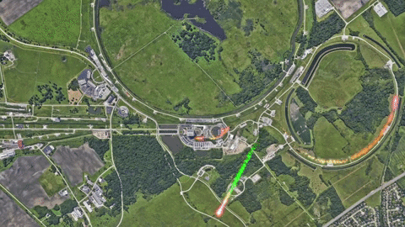
DUNE
Deep Underground Neutrino Experiment
2018
Construction begin
2021
Far-Detecor installation
2025
Start ! (maybe..)

Slide 20
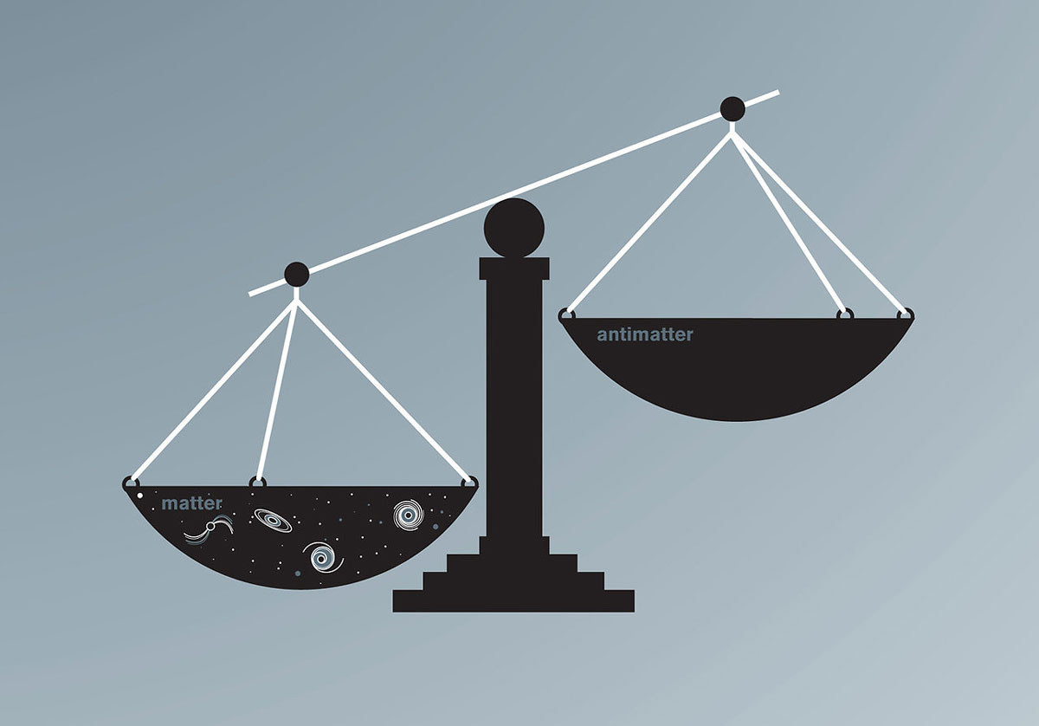

CONCLUSION
Still a lot of questions!
What is the right mechanism through wich neutrino acquire their mass?
Are neutrino Majorana or Dirac fermions?
Do they violate CP symmetry?
Could be the explanation of the discrepancies between matter and antimatter in our universe?
Are new beyond Standard Model thories necessary? (YES!)

Slide 21
8th BCD ISHEP Cargèse School
University of Bologna
a.a 2022-2023
Ajó
THANKS FOR YOUR ATTENTION!
Giulia Lupi

