Slide 1
Machine learning techniques for top-top event search with the ATLAS experiment at the LHC
Alma Mater Studiorum – Università di Bologna
Supervisor: Prof. Maximiliano Sioli
Co-supervisor: Dott.ssa Noemi Cavalli
Presented by: Virginia Mazza
Alma Mater Studiorum Università di Bologna – Virginia Mazza
29 March 2023

Slide 2
Introduction
It was analyzed the production process of quark top same-sign following proton-proton collisions taking place in the Large Hadron Collider at CERN in Ginevra using data collected by the ATLAS detector.
Process strongly suppressed by the Standard Model → BSM physics research
Analysis conducted with an EFT-type approach
The thesis work is part of an ongoing analysis, using an alternative approach for signal/background discrimination
Three sets of variables of different reconstruction levels were chosen to be presented to a neural network optimized for signal-from-background discrimination to verify its performance.
Alma Mater Studiorum Università di Bologna – Virginia Mazza

Slide 3
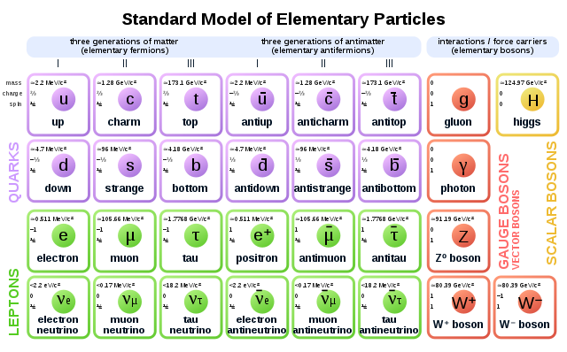
Standard Model (SM)
It describes almost all experimental observations:
Twelve FUNDAMENTAL PARTICLES divided into bosons and fermions
Three of the four FUNDAMENTAL FORCES present in nature (quantized field theories): electromagnetic, weak and strong (NO gravity)
It leaves open some question marks, both on the experimental and theoretical side
Alma Mater Studiorum Università di Bologna – Virginia Mazza

Slide 4
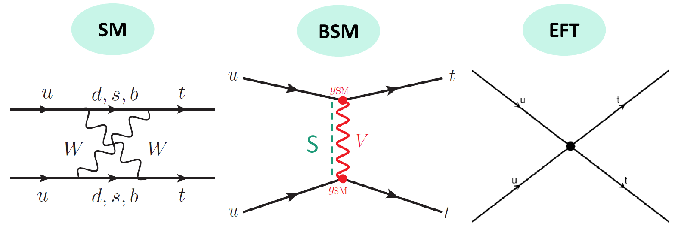
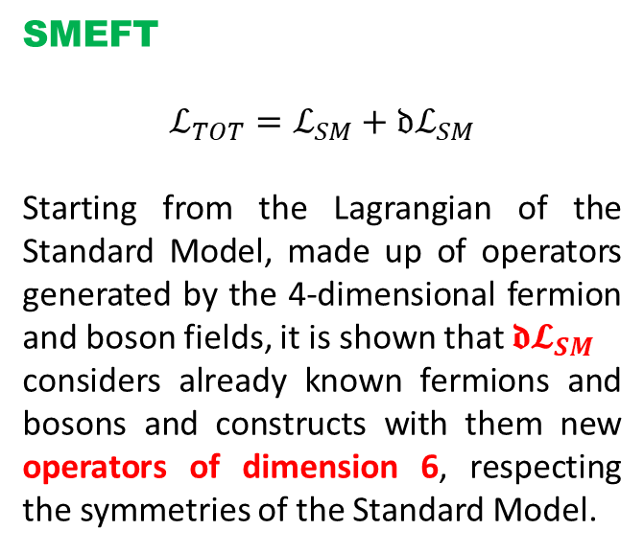
Effective Field Theories (EFT) and SMEFT
Effective Field Theories (EFT)
Approach to investigate «physics beyond the Standard Model», which applies to an already existing and verified model
Understand the behavior of a theory at lower energies and then derive what is assumed to be a simpler model at higher energies
SMEFT
$$ℒ_{TOT}=ℒ_{SM}+{𝔡ℒ}_{SM}$$
Starting from the Lagrangian of the Standard Model, made up of operators generated by the 4-dimensional fermion and boson fields, it is shown that ${𝖉𝓛}_{SM}$
considers already known fermions and bosons and constructs with them new operators of dimension 6, respecting the symmetries of the Standard Model.
Alma Mater Studiorum Università di Bologna – Virginia Mazza

Slide 5
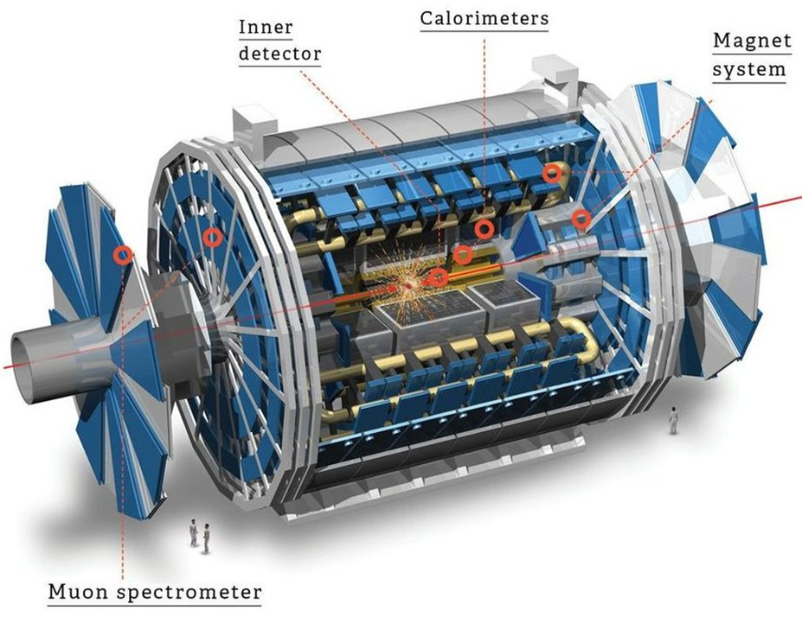
ATLAS detector
Where it is
ATLAS is one of the four large detectors present at the LHC in CERN in Ginevra.
Components
Internal detector: measures direction, momentum and charge of particles produced in collisions
Calorimeter: contains all particles except neutrinos and muons and measures their energy
Muon spectrometer: measures the momentum of muons
Magnet system: deflects the trajectories of charged particles to measure their momentum and charge
Trigger and data acquisition
For each collision the goal is to count, track and characterize all the particles produced. Two trigger levels:
Hardware: calorimeter and muon spectrometer information, it decides which data to keep and sends them to the second level
Software: it examines, selects and sends data to an offline storage system
Alma Mater Studiorum Università di Bologna – Virginia Mazza

Slide 6
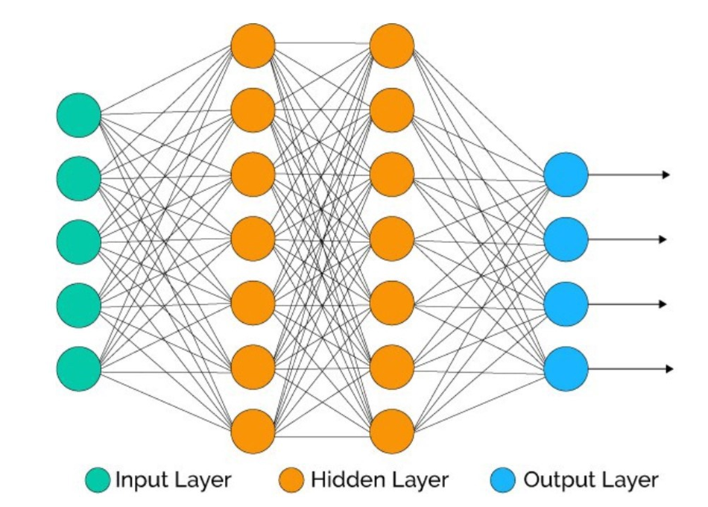
Artificial Neural Network
How it works
A network is made up of nodes (artificial neurons) whose connections are regulated by numbers called weights which activate them (positive value) or suppress them (negative value) through an input function.
An activation function and a threshold value compute the output value of the neuron: an algorithm is thus modeled to produce a result for each input.
Structure
Made up of different levels:
Input layer: receives information from the outside
Hidden layers: nodes receive information from input layer or other hidden layers and process them
Output level: the final result of all data processing, can have one or more nodes based on the problem studied
Training
The network needs to be trained: new data are presented and for each training iteration the weights are modified so that it provides increasingly precise results.
Alma Mater Studiorum Università di Bologna – Virginia Mazza

Slide 7
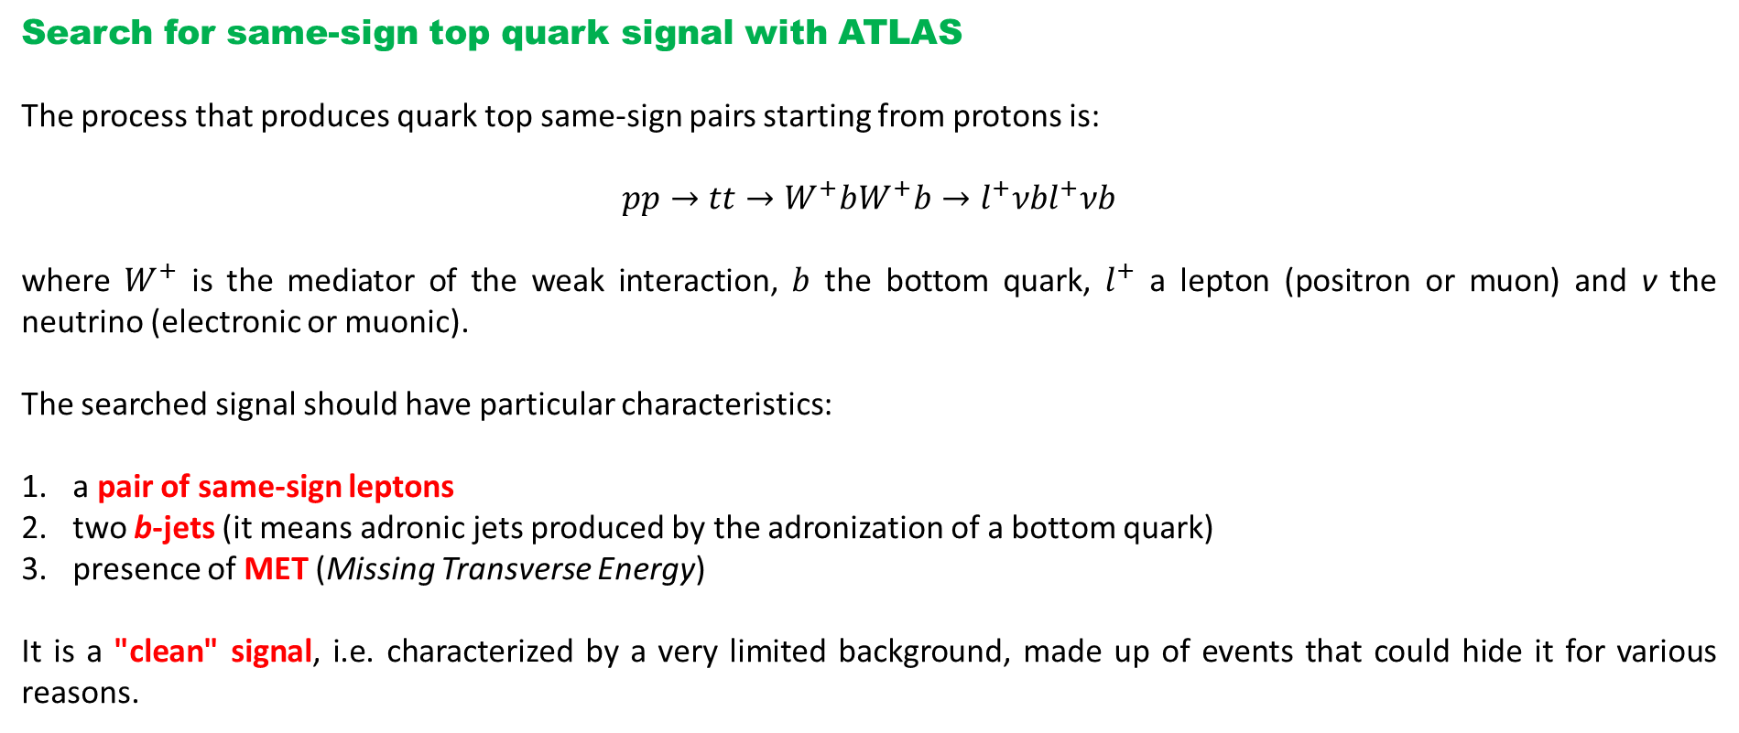
Data analysis
Search for same-sign top quark signal with ATLAS
The process that produces quark top same-sign pairs starting from protons is:
$$pp→tt→W^{+}bW^{+}b→l^{+}νbl^{+}νb$$
where $W^{+}$ is the mediator of the weak interaction, $b$ the bottom quark, $l^{+}$ a lepton (positron or muon) and ν the neutrino (electronic or muonic).
The searched signal should have particular characteristics:
a pair of same-sign leptons
two b-jets (it means adronic jets produced by the adronization of a bottom quark)
presence of MET (Missing Transverse Energy)
It is a "clean" signal, i.e. characterized by a very limited background, made up of events that could hide it for various reasons.
Alma Mater Studiorum Università di Bologna – Virginia Mazza

Slide 8
Data analysis
Choice of samples for analysis
Three sets of data have been proposed to the neural network:
high level (invariant masses, lepton angles, Ht and b-tagging)
strictly low-level (two-lepton and leading jet quadrivectors, number of jets and METs)
copy of the second case with the addition of two b-tagging variables (sumPsbtag and sumPsbtag77)
GOAL: understand how the neural network behaves when you give it low-level or high-level variables as input.
The neural network used was built using the keras and tensorflow python packages, it is composed of 5 hidden levels consisting of 128, 64, 32, 16 and 8 nodes respectively and has a single node in the output level since it is a classifier.
Alma Mater Studiorum Università di Bologna – Virginia Mazza

Slide 9
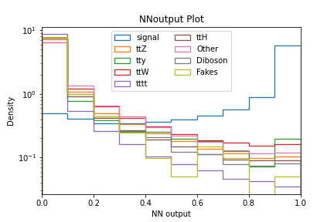
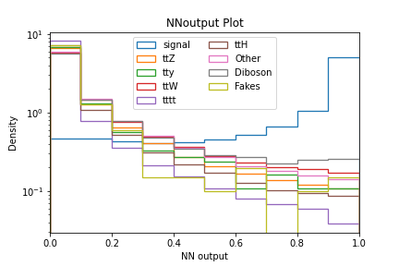
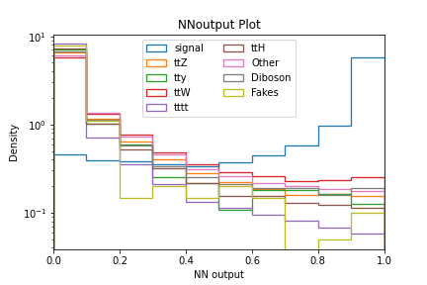
Data analysis
Comparisons between the different levels – Trend of the outputs of the NN
It is assumed that the second set of variables has a higher VV background (di-boson category) than the other two.
SIGNAL → similar behaviour
BACKGROUNDS → similar trend, small difference in the last two columns of the histograms:
→ second and third case higher values ​​assumed respectively by the VV and ttW backgrounds
→ di-boson background smaller in the third case wrt the second one
Alma Mater Studiorum Università di Bologna – Virginia Mazza

Slide 10
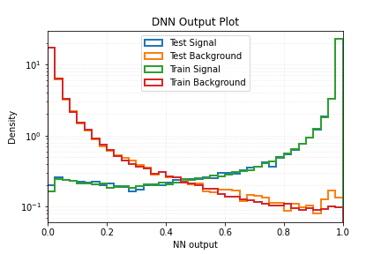
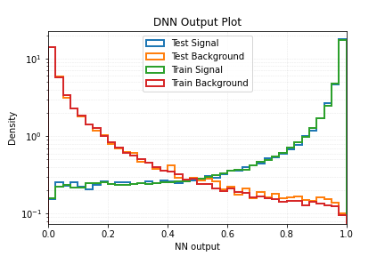
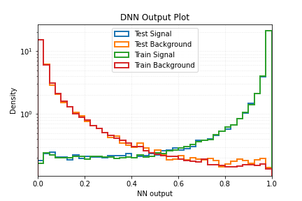
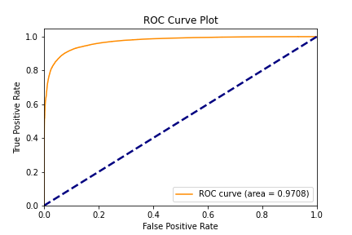
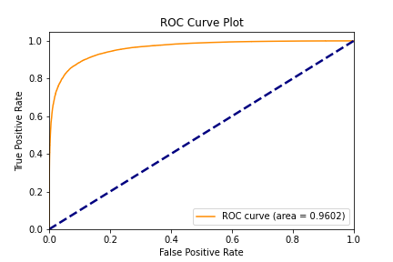

Data analysis
Comparisons between the different levels – Output behaviours and ROC curves
Similar behaviours althought high level variables show a better performance wrt the ones of low level while the latter appear to be more performant if are added b-tagging variables to them.
Areas under ROC curves, computed for each dataset, have the values 0.971 in the first case, 0.960 in the second and 0.964 in the third.
Alma Mater Studiorum Università di Bologna – Virginia Mazza

Slide 11
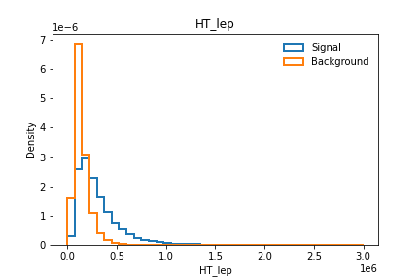
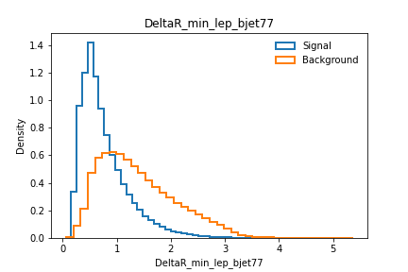
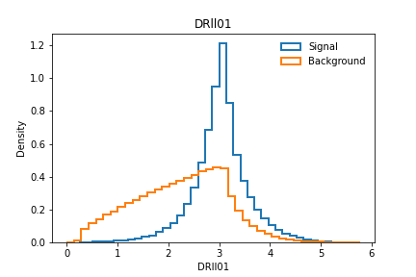
Data analysis
Comparisons between the different levels – Variables’ behaviour
The trends of the most important variables considered by the neural network for the analysis were compared: HT_lep, DeltaR_min_lep_bjet77 and DRll01 for HIGH LEVEL; lep_Phi_1, lep_Phi_0 and njets_OR for the LOW LEVEL, even after the introduction of the two b-tagging variables.
HIGH LEVEL
The network exploits the strong discriminating power of the input variables.
Alma Mater Studiorum Università di Bologna – Virginia Mazza

Slide 12
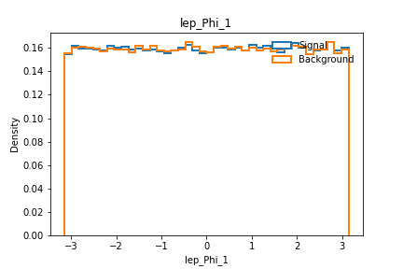
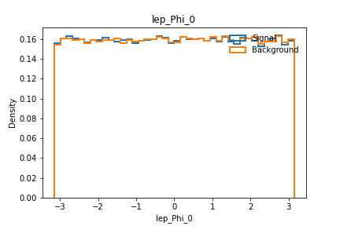
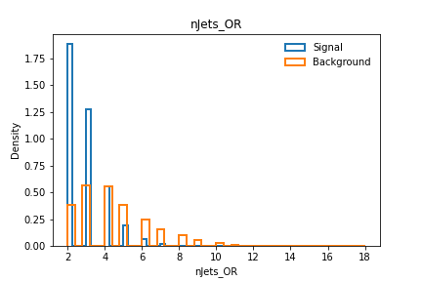
Data analysis
Comparisons between the different levels – Variables’ behaviour
The trends of the most important variables considered by the neural network for the analysis were compared: HT_lep, DeltaR_min_lep_bjet77 and DRll01 for HIGH LEVEL; lep_Phi_1, lep_Phi_0 and njets_OR for the LOW LEVEL, even after the introduction of the two b-tagging variables.
LOW LEVEL
The network reconstructs and exploits the strong correlations existing between the low-level variables for signal and background discrimination.
Alma Mater Studiorum Università di Bologna – Virginia Mazza

Slide 13
Conclusions
A study on the performance of an artificial neural network was conducted in the context of the search for same-sign top quarks with the ATLAS experiment at the LHC.
Use of an artificial neural network for signal/background discrimination
Using three datasets with different levels of reconstruction
Performance study for the various levels of reconstruction
Comparable results for the various levels of reconstruction: the neural network is able to exploit the correlations between the low-level variables, providing a high discriminating power between the signal and background hypotheses.
The results presented here are a starting point for a more in-depth study that can be used in the comprehensive analyses of the ATLAS collaboration.
Alma Mater Studiorum Università di Bologna – Virginia Mazza

Slide 14
Thanks for the attention
Alma Mater Studiorum Università di Bologna – Virginia Mazza

