Slide 1
CIBFX deployment in the SPS and North Area
Meeting with SY-EPC
10th March 2023
I. Romera on behalf of the BIS team

Slide 2
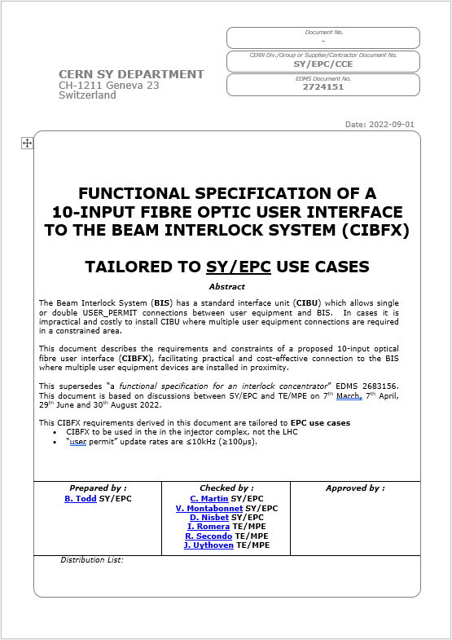
Context
Consolidation of the obsolete Power Converter Controls (MUGEF) in the SPS TLs with modern FGC controls required a new interface to merge interlocks to the BIS after LS2
In LS2, SY-EPC developed a custom interface (EPIC CIBU) that is currently deployed in the SPS TLs
TE-MPE accepted the responsibility for developing a 10-input optical fibre user interface (CIBFX) to connect the Power Converter Controls to the BIS that will be available in LS3 (18th CTTB meeting)
CIBFX hardware design is based on the functional requirements written by SY-EPC (EDMS 2724151)
The CIBFX will be deployed in the SPS (including SPS to LHC TLs and NA) in LS3

Slide 3
CIBFX deployment in the SPS Ring and TLs

Slide 4
CIBFX deployment in the SPS North Area
Engineering Specification of the Beam Interlock System for the SPS Slow Extraction and the North Area (EDMS 2810115) defines the interlocking requirements for the Power Converters
20x CIBFX will be deployed between LS3 and LS4 to interlock the Power Converters involved in the SPS Slow Extraction and the NA beam lines
Figure on the left shows the proposed connection layout between the PCs and the BICs:
  BICs in BA2 receiving inputs from 6 CIBFX
  BICs in BA80 receiving inputs from 10 CIBFX
  BIC in BA81 receiving inputs from 4 CIBFX

Slide 5
User Interface responsibilities
Collimators
PXIe controls
Vacuum
PLC controls
Power Converters
FGC controls
Beam Interlock Controller
VME controls
Cables and fibres between
BIC and User Interface
responsibility of TE-MPE
Beam Loss Monitors
VME controls
TE-MPE
Cables between User Interface
and Users
responsibility of Users
User Interface
Installed in user’s rack
Hardware maintained by TE-MPE
User Systems

Slide 6
CIBFX responsibilities – A proposal 1/4
Fibres between
BIC and CIBFX
responsibility of TE-MPE
Power Converters
FGC controls
Power Converters
FGC controls
CIBFX
Power Converters
FGC controls
Beam Interlock Controller
VME controls
TE-MPE
Power Converters
FGC controls
User Systems
Who is responsible for cabling between the BIC and the CIBFX?
TE-MPE is responsible for fibre optic installation and maintenance

Slide 7
CIBFX responsibilities – A proposal 2/4
Fibres between
BIC and CIBFX
responsibility of TE-MPE
Power Converters
FGC controls
Power Converters
FGC controls
Power Converters
FGC controls
Beam Interlock Controller
VME controls
CIBFX
TE-MPE
Power Converters
FGC controls
User Systems
Where to install the CIBFX?
TE-MPE proposes to install the CIBFX in user’s rack (same strategy as CIBU)
Optimise cable lengths and cabling cost: Installing the CIBFX as close as possible to the user helps to minimise cable lengths and therefore cost
Reusing present infrastructure: EPIC CIBUs are already installed in some SPS installations therefore space and infrastructure can be reused (plug-and-play)
Insufficient space on WIC’s rack: Installing CIBFX on WIC racks is not always possible due to space required for hardware and cabling (i.e. up to 10x cables per CIBFX)
TE-MPE will continue to be responsible for the maintenance of the CIBFX hardware (i.e. redundant power supplies, SFP transceivers, etc)
Does SY-EPC agree with this approach?

Slide 8
CIBFX responsibilities – A proposal 3/4
Fibres between
BIC and CIBFX
responsibility of TE-MPE
Power Converters
FGC controls
1
2
Power Converters
FGC controls
3
Power Converters
FGC controls
Beam Interlock Controller
VME controls
CIBFX
10
TE-MPE
Cables between
CIBFX and Users
responsibility of Users
Power Converters
FGC controls
User Systems
Who is responsible for cabling between the CIBFX and the Power Converters?
TE-MPE proposes that cables between the CIBFX and the User are managed by the Users (same strategy as CIBU)
Safety constraints: TE-MPE cannot be responsible of cables installed in user’s rack due to safety concerns (e.g. high voltage presence or other risks)
Lack of expertise: What users connect to the CIBFX is the sole responsibility of the users (TE-MPE does not know what is behind the CIBFX)
Reusing present cabling: Present cables used for the EPIC CIBU in some SPS installations could be reused for CIBFX
Connectors’ convention: Connectors on user´s side are not standardized and this is better managed by users
Does SY-EPC agree with this approach?

Slide 9

CIBFX responsibilities – A proposal 4/4
Fibres between
BIC and CIBFX
responsibility of TE-MPE
Power Converters
FGC controls
1
2
Power Converters
FGC controls
3
Power Converters
FGC controls
Beam Interlock Controller
VME controls
CIBFX
10
TE-MPE
Cables between
CIBFX and Users
responsibility of Users
Power Converters
FGC controls
User Systems
Who is responsible for enabling/disabling inputs on the CIBFX?
The responsibility of what is connected to the CIBFX relies on the users and therefore it is their responsibility to enable/disable inputs accordingly
TE-MPE does not have the knowledge to change Power Converters interlocks
The CIBFX will be equipped with key switches and users will be able to allow enabling/disabling inputs individually by turning a physical key (procedure to be defined)
TE-MPE will provide a reference database and the software tools to the users to ensure that the reference database matches the hardware configuration
TE-MPE proposes that inputs on the CIBFX are enabled/disabled by the Users. Does SY-EPC agree with this approach?

