Slide 1



Conceptual designs and R&D challenges for muon detectors
G. Aielli

Slide 2
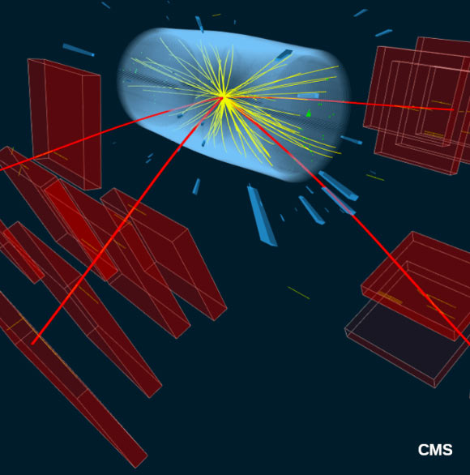
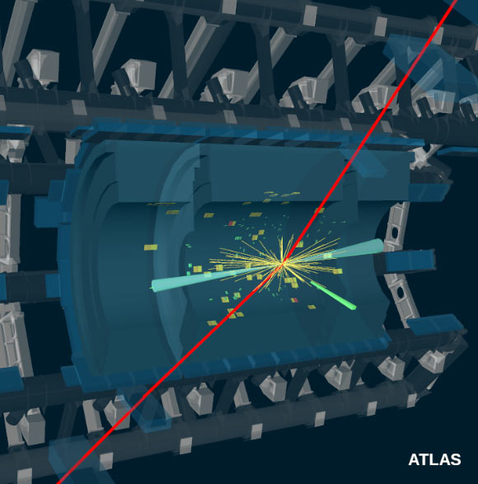
Introduction on muon systems
Typical features for HL-LHC
measure of track curvature → thousands of m^2 instrumented surface
Particle rate << than innermost detectors
Typical tracking precision ⁓ 100 μm (with B ⁓1T and R=5m)
Typical trigger detector resolution < 5 ns
How this will evolve in FFC scenarios and what are the consequences on the muon detector design?
Muon systems is whatever comes after the hadronic calorimeter, wrapping all the other detectors
It is designed to provide a primary trigger on muons and measure their momentum spectrum
It is done by measuring the muon trajectory deflection in a magnetic field

Slide 3
Constraints from the new Accelerators
Main Cases at study
pp-collider (FCC-hh)
→ main emphasis, defining infrastructure requirements
~16 T ⇒ 100 TeV pp in 100 km
~100 km tunnel infrastructure in Geneva area, site specific
e⁺e⁻ collider (FCC-ee) as potential first step
p-e (FCC-he) option, integration one IP, e from ERL
HE-LHC with FCC-hh technology (LHC Ring 8→16T, 14→28TeV)
LHC
HE-LHC
PS
SPS
FCC
photo: J. Wenninger

Slide 4
FFC-hh parameters and constraints
parameter | FCC-hh |  |  | HE-LHC | HL-LHC | LHC
collision energy cms [TeV] | 100 |  |  | 27 | 14 | 14
dipole field [T] | 16 |  |  | 16 | 8.33 | 8.33
circumference [km] | 97.75 |  |  | 26.7 | 26.7 | 26.7
beam current [A] | 0.5 |  |  | 1.12 | 1.12 | 0.58
bunch intensity [10¹¹] | 1 |  | 1 (0.2) | 2.2 (0.44) | 2.2 | 1.15
bunch spacing [ns] | 25 |  | 25 (5) | 25 (5) | 25 | 25
synchr. rad. power / ring [kW] | 2400 |  |  | 101 | 7.3 | 3.6
SR power / length [W/m/ap.] | 28.4 |  |  | 4.6 | 0.33 | 0.17
long. emit. damping time [h] | 0.54 |  |  | 1.8 | 12.9 | 12.9
beta* [m] | 1.1 | 0.3 |  | 0.25 | 0.20 | 0.55
normalized emittance [μm] | 2.2 (0.4) |  |  | 2.5 (0.5) | 2.5 | 3.75
peak luminosity [10³⁴ cm⁻²s⁻¹] | 5 |  | 30 | 25 | 5 | 1
events/bunch crossing | 170 |  | 1000 (200) | ~800 (160) | 135 | 27
stored energy/beam [GJ] | 8.4 |  |  | 1.3 | 0.7 | 0.36
Highlighted in red → drivers for muon systems
A factor 6 higher average rate w.r.t HL-LHC
Physics boosted in the forward regions → muon precision |η|~4
Combined muon tracking
Stand-alone muon trigger
X10 pileup → option to lower at 5 ns the BC to reduce the bunch intensity
Constraints given by FCC-ee are less challenging for that concern the background rate and similar for the rest

Slide 5
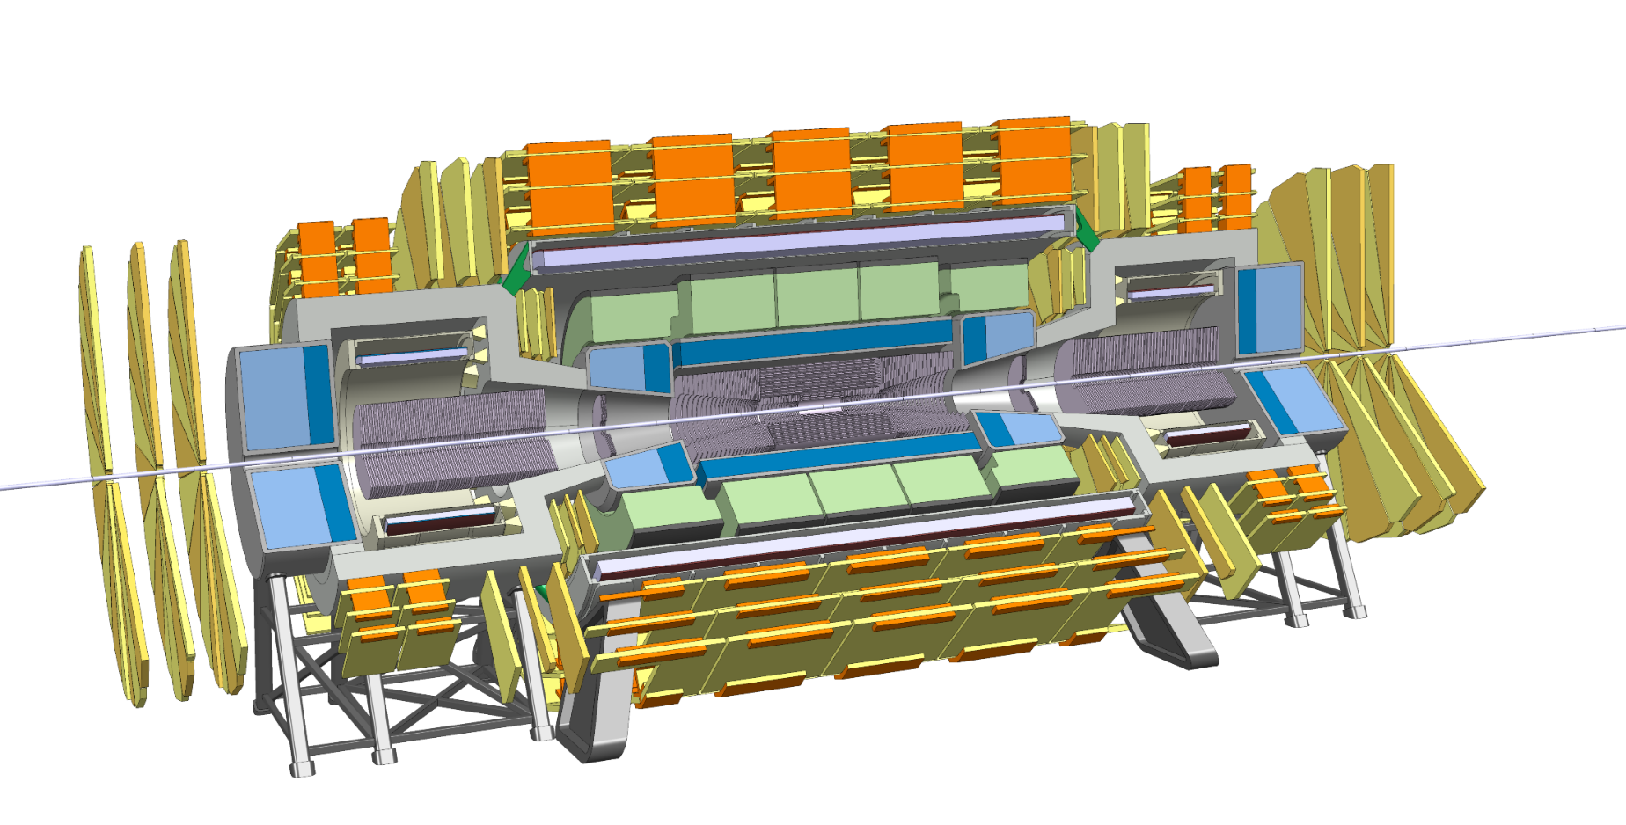
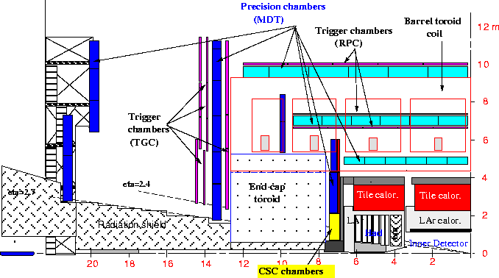
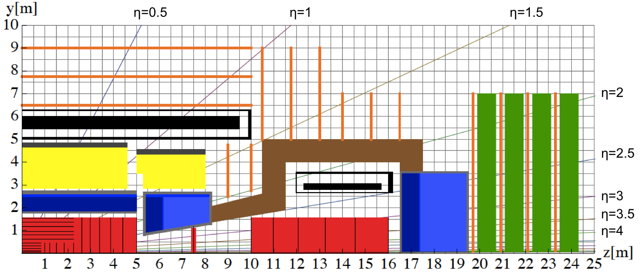
FFC-hh reference detector
4T 10m solenoid
Forward solenoids
Silicon tracker
Barrel ECAL Lar
Barrel HCAL Fe/Sci
Endcap HCAL/ECAL LAr
Forward HCAL/ECAL Lar
MUONS?
  Barrel
  Encap
  Forward
Various gaseous detectors

Slide 6
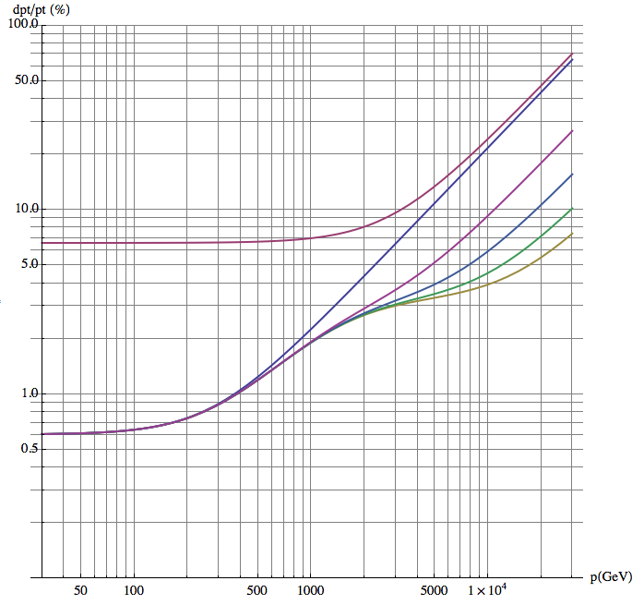
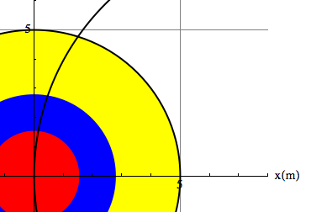
Muon tracking performance
Three methods for the muon momentum measurement
Tracker only with identification in the muon system
Muon system only by measuring the muon angle where it exits the coil
Tracker combined with the position of the muon where it exists the coil
70 µrad muon detector angular resolution:
  < 10% standalone momentum resolution up to 3 TeV, equal to tracker resolution
50 µm muon detector spatial resolution:
  < 10% combined momentum resolution up to 20 TeV.
Multiple scattering limit for track combination (infinite muon detector resolution)
L₁
Analytical calculation, Werner Riegler, FCC Week 2017
L_{Calo}
L₀

Slide 7
Muon system contribution
Tracking
Improvement by muon system for p_{T} > 1 TeV and |η| < 2.5.
Muon and Barrel endcap fully included
Forward is meant principally for muon identification
Trigger
Momentum resolution at pT < 100 GeV dominated by multiple scattering, independent of detector resolution.
For 200 X0 of scattering material in front of the muon system and perfect chamber resolution 5 - 25% standalone pT resolution from η =0 up to | η | = 2.5 for 1st level muon trigger.
Solenoidal B field in forward direction (|η| > 2.5) not suitable for precise standalone momentum measurement for trigger (p_{T} resolution > 80%).

Slide 8
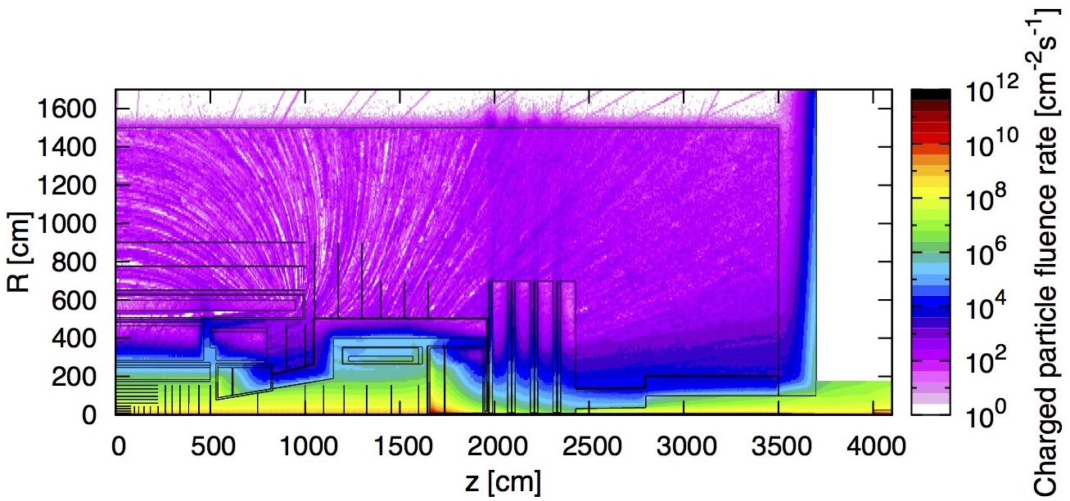
Particle Fluence @ L=30x10³⁴cm⁻²s⁻¹
  Barrel muon chambers: ~300 cm⁻²s⁻¹ to ~500 cm⁻²s⁻¹
Charged rates
  Up to 500 cm⁻²s⁻¹ (R>3m |η|<1.5)
  up to 10⁴ cm⁻²s⁻¹ (R>1m 1.5<|η|<3.5)
  ~ 5x10⁵ cm⁻²s⁻¹ (R<1m |η|>4)
photon rates
  ~ 5x10⁶⁻⁸ cm⁻²s⁻¹
N fluence
  Up to10¹⁴ cm⁻² (shielding to mitigate the effect)
Charged particles Fluence
|η|=1.5
|η|=4
  Endcap Muon Chambers: 10⁴ cm⁻²s⁻¹
  Forward Muon Chambers: 5x10⁵ cm⁻²s⁻¹
Present muon detectors close to fully satisfy this requirement → further R&D needed for completing

Slide 9

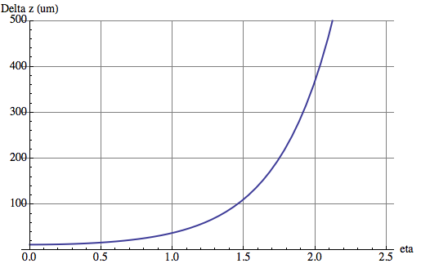

Pileup of 1000 (25ns Bunchcrossing)
HL-LHC average distance between vertices at z=0 is
≈ 1mm in space and 3ps in time.
For 6 times higher luminosity at FCC-hh (an HE-LHC) this would become
≈ 170μm in space and 0.5ps in time.
x=0.8mm, X₀=35.28cm (Be), p=1GeV
θ₀
Beampipe
η
r = 2.5cm
Beam
Δz
Even having a perfect tracking detector, the error due to multiple scattering in the beampipe for η > 1.7 is already larger than the average vertex distance !
Timing, very clever new ideas needed …
W. Riegler; FCC-hh Accelerator and Detectors, Nov. 21 2017

Slide 10
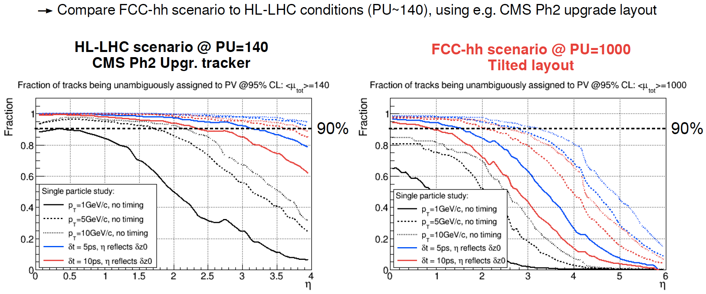
Vertexing at Pileup of 1000, Timing
W. Riegler; FCC-hh Accelerator and Detectors, Nov. 21 2017

Slide 11
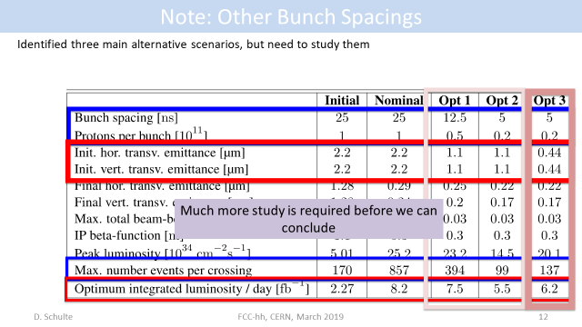
Pileup mitigation - consequences
Shorter BC spacing proposal:12.5 and 5 ns
Correspondingly lower bunch intensity
Pileup reduction
Most of internal detector are developing at least sub ns timing
The BC id. Will require sub-ns timing in the muon system too
At the moment just RPCs can provide this performance among the classical muon detectors → drive of new R&D effort

Slide 12
Constraints from LLP and DM searches

Slide 13
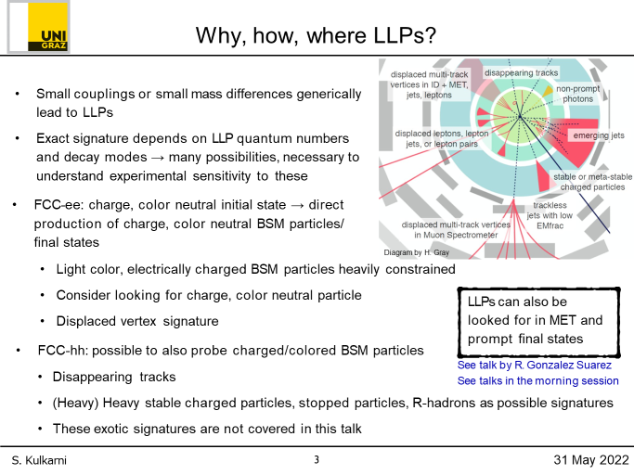
Beyond the muon detector: LLPs
Detector for long-lived particles at high energy of 100 TeV
Has ca 500 times more sensitivity; 150 due to increased cross section and luminosity and factor 3-4 due to moving detector closer to IP
Impact on the muon system
Local vertex identification
3D tracking
~ 100 ps ToF capabilities

Slide 14

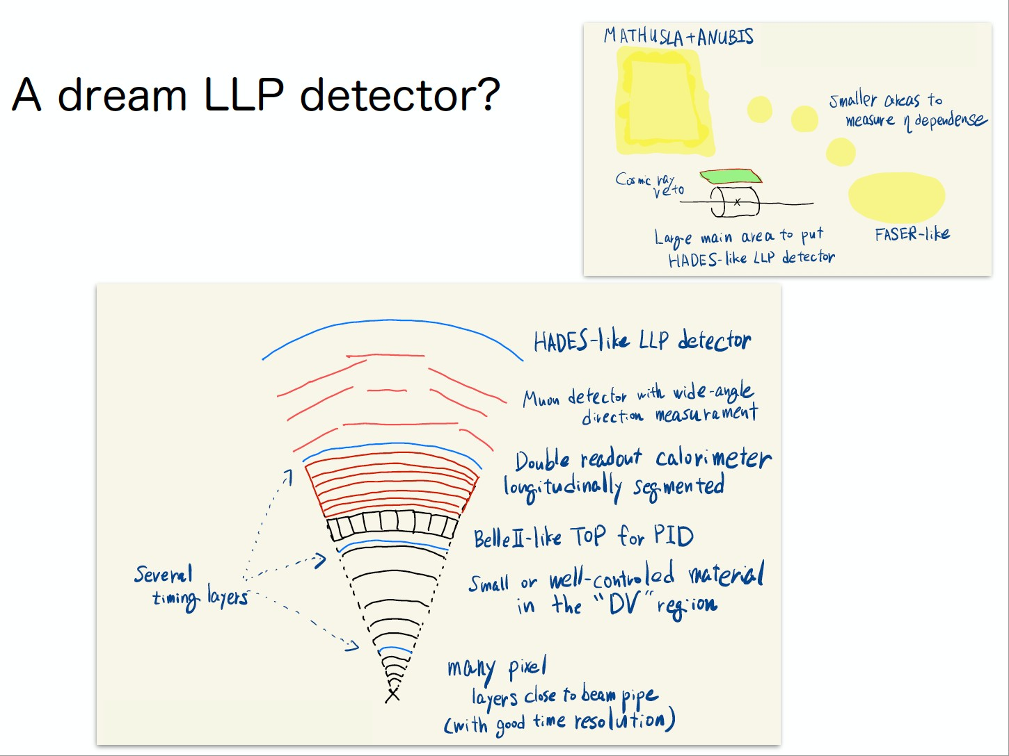
A dream LLP detector?
Adding a good timing and tracking layer extending the muon system...
Ryu Sawada’s first example at the LLP workshop in November-2020

Slide 15
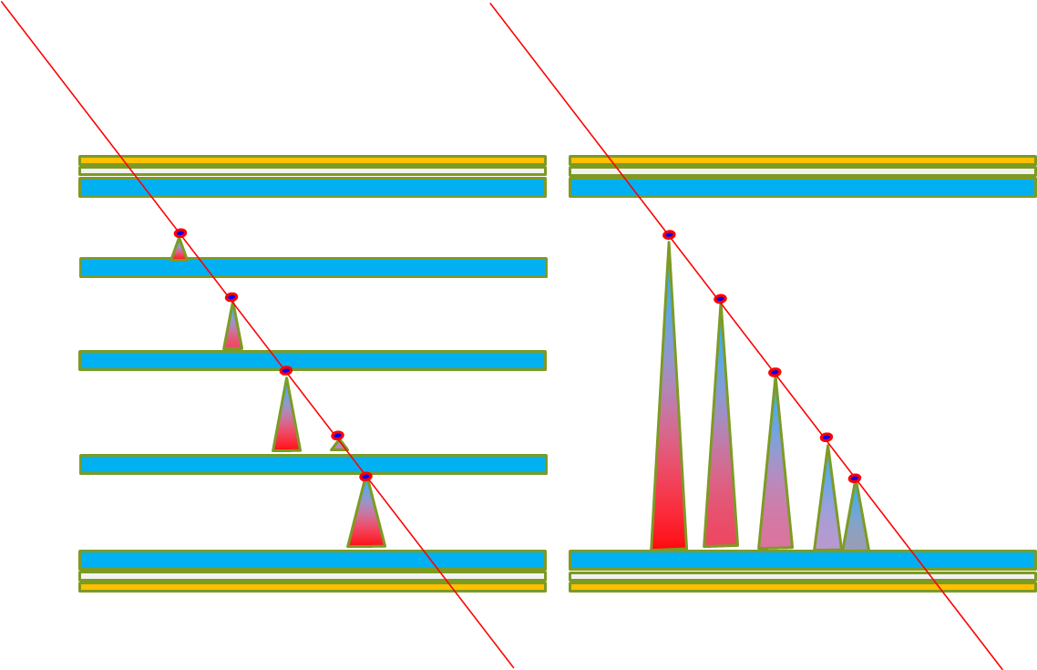
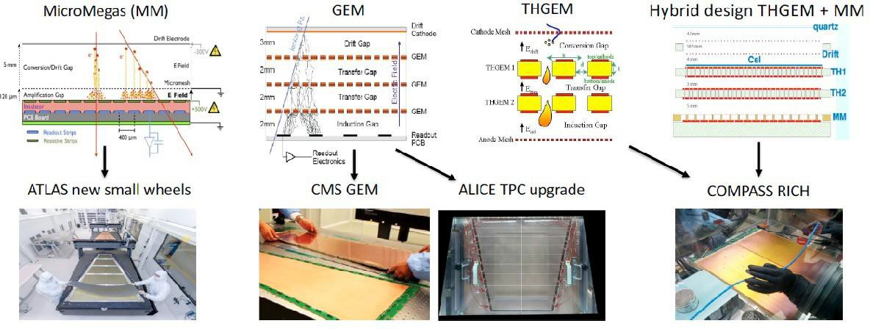
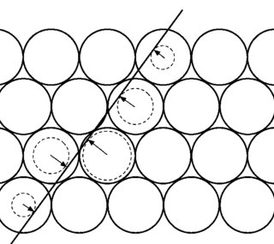
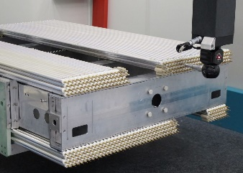
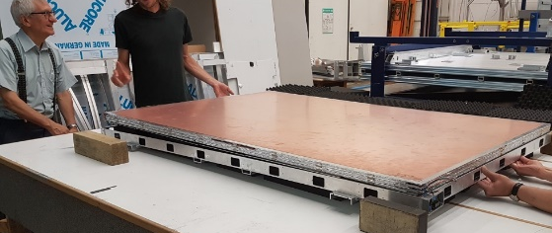
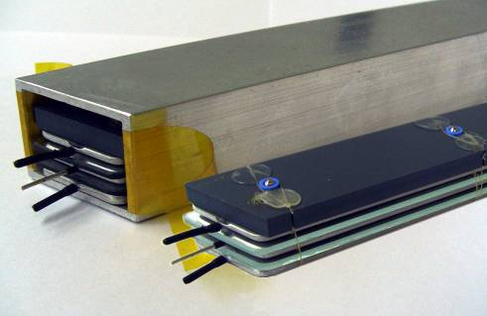
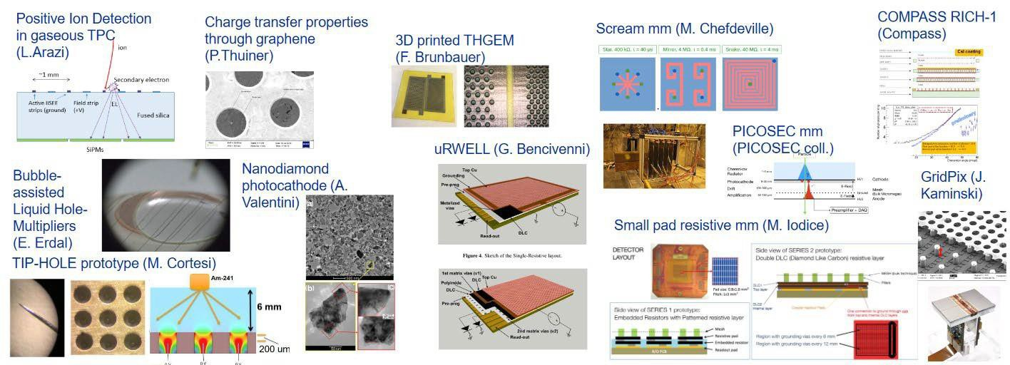

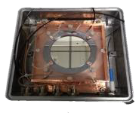



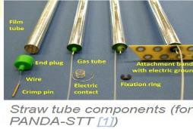
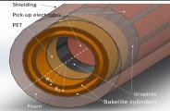
Muon detector technologies
sMDT
RPC
ATLAS Ph1 + Ph2 upgrade and CMS RE3/1 & RE4/1
Several experiments at GSI and RICH
ATLAS Ph1 + Ph2 upgrade
,
And new ideas
sRPC (Bencivenni
single gap semi-conductor
R. Cardarelli
RCC Cardarelli

Slide 16




Basic principles of muon detectors
All gaseous detectors designed for muons share the same base principle:
  A gaseous target thick enough for a MIP to release a sufficient primary ionization
  An electric field sufficiently strong to start an avalanche multiplication
  A segmented pick-up electrode to readout the signal and extact a space-time information
Wire chamber
MPGD
RPC
drift
$$E1$$
$$E=constant$$
$$E≈\frac{1}{r}$$
$$E2≫E1$$
avalanche
Pick-up strips
Resistive electrode

Slide 17
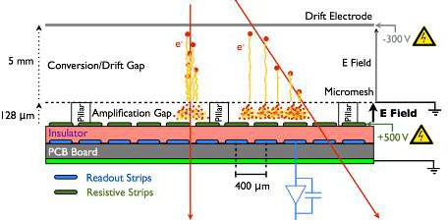
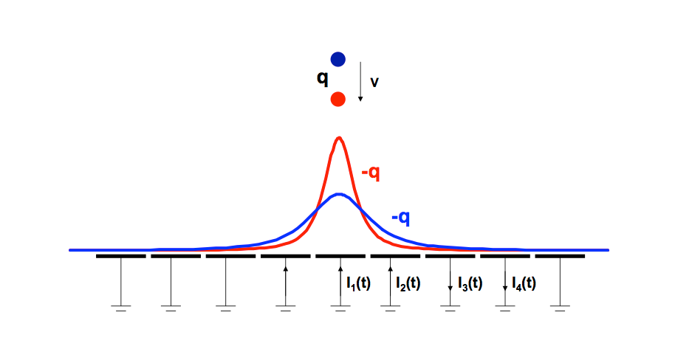

Space resolution principles
MPGD
Space resolution is driven by 2 factors
  Intrinsic localization of the event
  Precision of the chamber geometry
RPCs
Wire chamber
$$E≈\frac{1}{r}$$
Tubes and MWPC exploit the R-t relation of the ions drifting in the gas and rely on their metallic bulks which can be easily machined to offer a precise reference frame. Can obtain high precision with low channel density
RPCs and MPGD exploit electrostatic induction of the moving charges to calculate the charge centroid. The resolution is driven by the readout system segmentation and mechanical precision preserving it on large multi-layer chambers made of composite materials. Can obtain high precision with high channel density

Slide 18
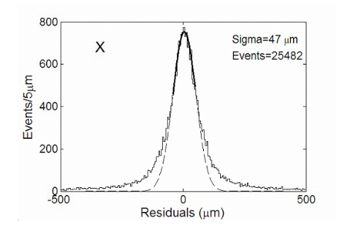
Space resolution performance
RPCs and MPGDs
ATLAS MMGAS
  resolution ~ 100μm with 0.4 mm strips
The drift gap is large → impact angle worsen resolution corrections needed (micro-TCP method)
Affected by the B field
A lot of care needed in construction
Proof of principle on a small MRPC
  resolution ~ 50μm with 4 mm strips
  RPC less sensitive to the angle → smaller gas gaps and a single dominant cluster
1m2 1mm gas gap ATLAS prototype reaching 1mm space resolution with 2.7cm strip pitch! Up to 10 kHz/cm^2 at GIF++
Space resolution is not a classic RPCs performance, though physics is not preventing it...
MMGAS
MRPC
Planar technologies need further R&D for a simple and reliable structures to emulate DTs
Atlas upgrade prototype
Space resolution

Slide 19
Space resolution performance
Drift tubes (ATLAS case – CMS is similar)
Examples: ATLAS and CMS DT systems
Great improvement by reducing the drift length
Wire accuracy 20μm, resolution < 80μm
Angular resolution independent on the track angle
Self calibrating
Angular resolution < 70 mrad with 2x4 tube layers
Mechanically stable over large areas
Drift tubes are at the moment a more reliable and simpler tracking technology with respect to planar detectors

Slide 20
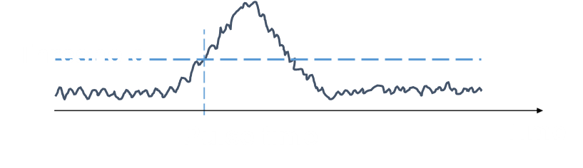

Time resolution principles
Time resolution is driven by
  Avalanche statistical fluctuations
  Drift time (velocity x gap size)
  Electronics noise
Wire chamber
MPGD
$$E≈\frac{1}{r}$$
MWPC and MPGD work on similar principles: the separation of the drift and multiplication introduces irreducible uncertainty on the time resolution, dependent on the drift width
RPCs and MRPCs drift and multiplication space coincide. The multi-micro gap RPC segments the gas gap to further reduce the drift time

Slide 21
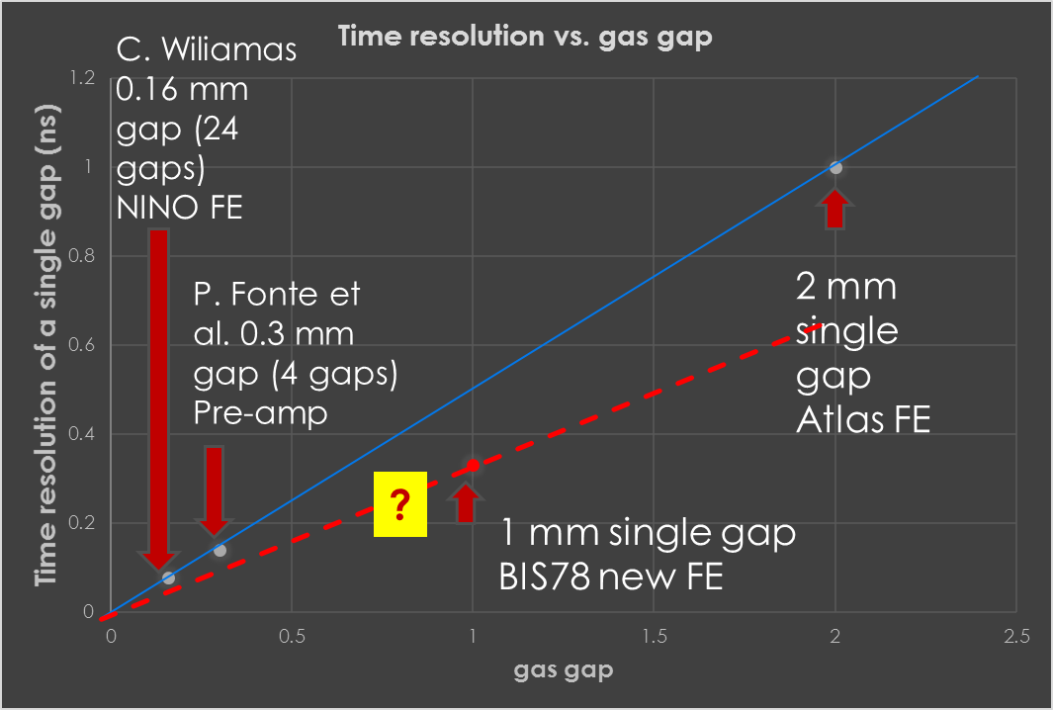
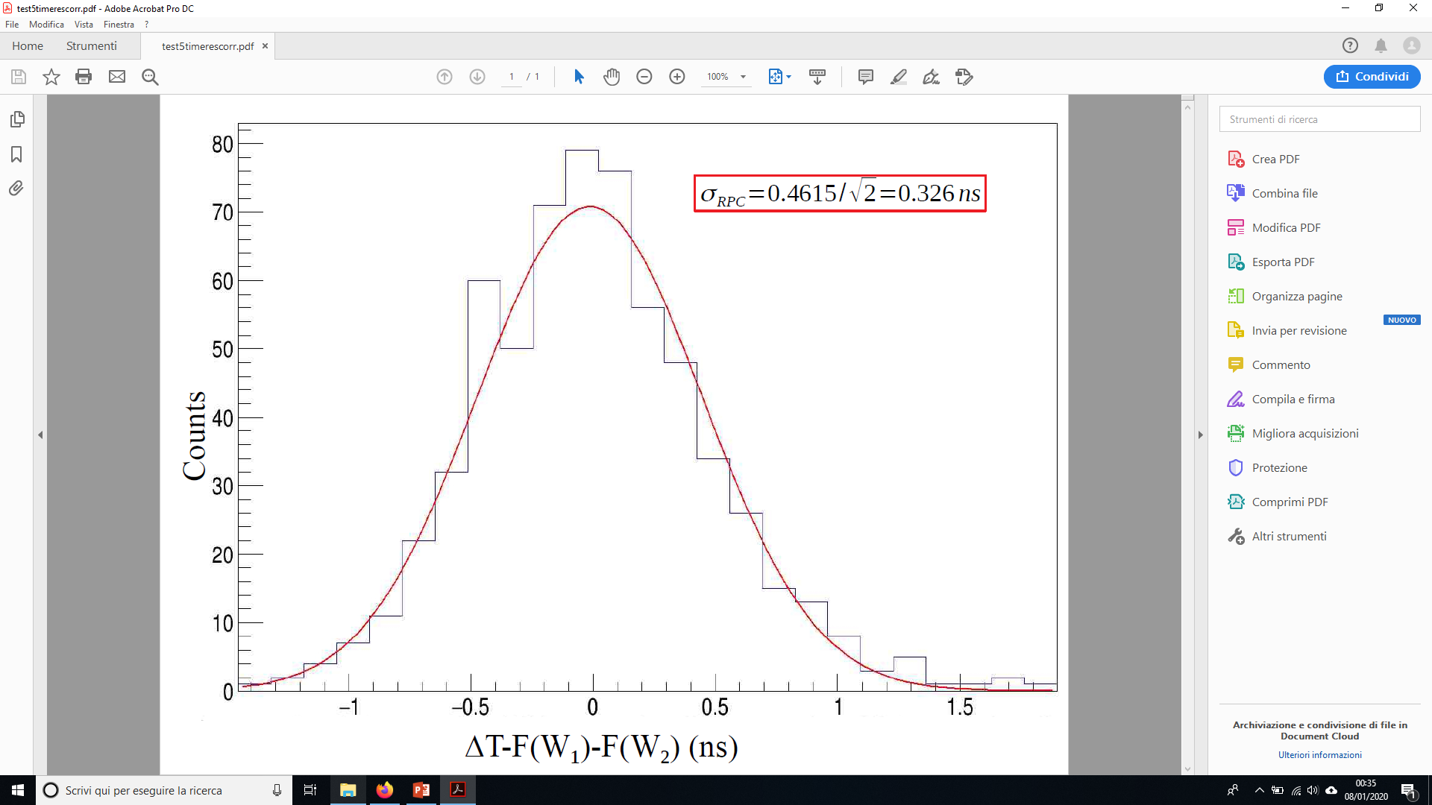
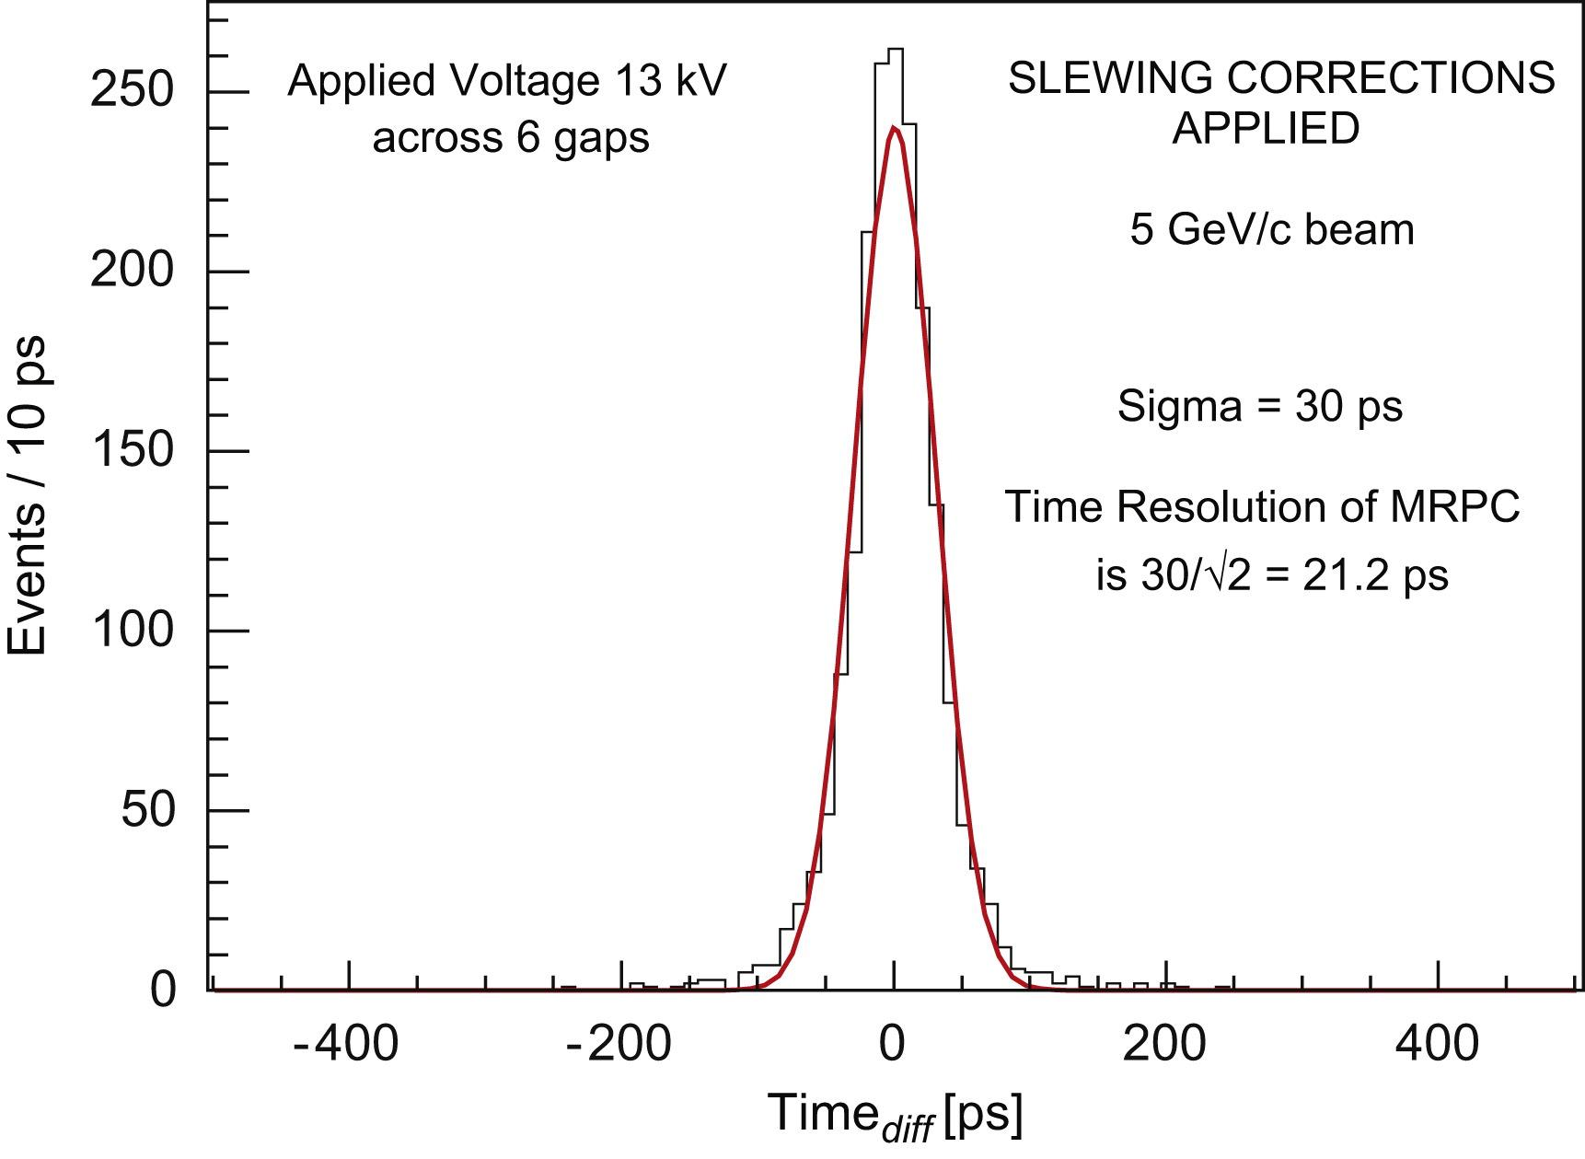
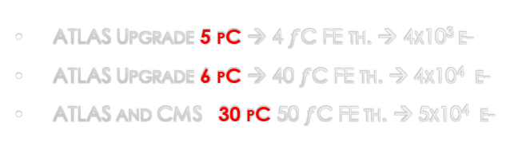
RPC time resolution
Time resolution is one of the main RPC features
Golden standards: MRPCs ~50 ps -- RPCs ~500 ps
complex physics behind: cluster statistics, multiplication dynamics, electronic noise
Empirically smaller gas gaps → higher resolution
  Smaller gas gaps can be operated at higher electric field and have a faster multiplication dynamics compressing noise fluctuations
As one learn from other detectors the electronics noise plays a role
ATLAS Upgrade 5 pC → 4 $f$C FE th. → 4x10³ e-
ATLAS Upgrade 6 pC → 40 $f$C FE th. → 4x10⁴ e-
ATLAS and CMS 30 pC 50 $f$C FE th. → 5x10⁴ e-
Challenge: resolution beyond 50 ps
with more and thinner gas gaps, e.g, 20 ps with 24, 0.16 mm gaps [10.1016/j.nima.2008.06.013]
Thinner electrodes → higher signal
Low noise high resolution FEE (picoTDC) https://kt.cern/technologies/picotdc
Innovative approach →
going beyond the gas gap width law
extract hidden information beyond discr. and slew correction
Promising the use of DNN to filter the complex avalanche dynamics → 16 ps achieved! [arXiv:2005.03903v1 [physics.ins-det] 8 May 2020]

Slide 22
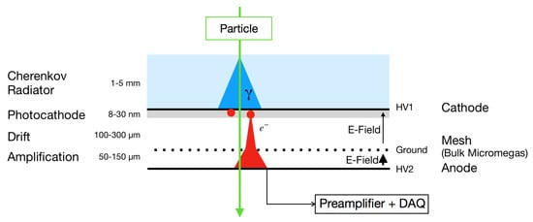
Drift based detectors time resolution
Atlas MMGAS
DT drift spectrum is by construction unsuitable for timing as a long drift time is used for high space accuracy
ATLAS Thin gap chambers → 6-7 ns
Typical Micromegas, GEM, μRWELL 10 ns
A proposal to get rid of the drift variations is to hybridize a MMGAS with a photo-cathode and a Cherenkov radiator. Resolution ~ 50 ps driven just by the single avalanche process, like in MRPC
Atlas sMDT
Drift detectors and limited in time resolution and an optimal strategy is combining a drift detector with an RPC to have a combined performance.
MPGD have a barely sufficient resolution for identifying the BC at 25 ns but it can be improved by using multiple layers for the 5ns scenario
The idea to combine a Cherenkov and a MMGAS can provide a good timing in the very high rate regions

Slide 23
Present limits – rate and longevity
Rate capability [RPCs and MPGDs]
Electrode resistivity to prevent discharges in RPCs and MPGDs but limits rate capability:
  ΔV = <Q> x freq. x R
<Q> is very favorable in MPGDs
Longevity: Bulk materials insensitive to radiation, but
  radicals produced in RPC avalanches affect the electrodes
  High ionization may induce discharges in MPGDs progressively damaging the detector
Rate capability(drift chambers)
Limited by the space-charge effect
Effect reduced with R^3 → R=1/2 → rate = 8x (drift time x cross section)
Longevity: Bulk materials insensitive to radiation, but
  Gas purity is very important to avoid ageing
  no discharges possible (geometrical quenching)
  No observed ageing in such conditions
Reduction of <Q> improves rate capability and longevity at the same time
  by improving the S/N on the FE electronics
  by improving the signal collection efficiency
Lowering R improves rate capability only
  Lower resistivity materials
  Thinner electrodes
Achieving high rate by brute force reduction of R (without reducing at the same time the E field) may lead to instable detectors
Keeping the gas clean is the key to preserve the electrode longevity

Slide 24
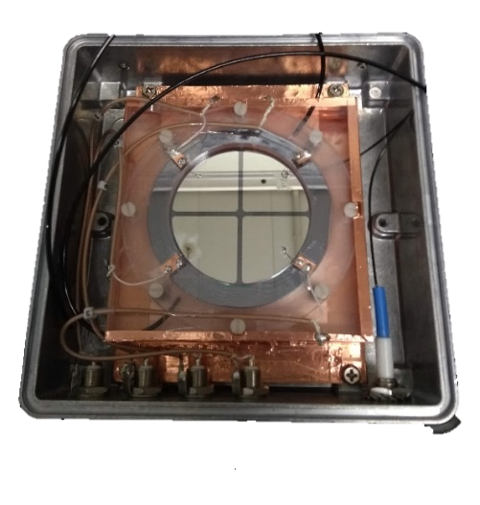
High rate for single gap RPCs
limited by Ramo theorem (~1/20 of <Q> is usable)
low resistivity electrodes made of HPL (~10¹⁰ Ω cm)
SiGe FE tech. with 4k e- noise to reduce <Q>
Reaching up to 10 kHz/cm² in production chambers
Suitable for safe operation with eco-gas mixture
Up to~10 kHz/cm²
FFC full TARGET → improve by a further order of magnitude by increasing S/N and lowering R:
Last generation SiGe etero-junction technologies (fT 0.7 THz) announce a further x 10 leap in the FE → 500 e- noise reduction
A new device: single gap semi-conductor RPC
[electronic carriers can not be depleted]
  0.6 mm GaAs electrodes
  Resistivity 1.4×10^8 Ωcm
  Tested up to > 40 kHz/cm²
  > 1 MHz/cm² is possible
  Active area 6.25 cm²
  10.1088/1748-0221/15/12/C12004
LHC → 30pC
For further exploiting the electronics:
Faster avalanche
Very efficient grounding
1mm gas gap
HL-LHC → 5pC
FFC → 1-2 pC

Slide 25

The μ-RWELL technology
The µ-RWELL detector is composed of two elements: the cathode and the µ-RWELL_PCB .
The µ-RWELL_PCB is realized by coupling:
Drift/cathode PCB
a “suitable WELL patterned kapton foil as “amplification stage”
a “resistive stage” for the discharge suppression & current evacuation
gas gap 4-7 mm
Copper top layer (5µm)
Well pitch: 140 µm
Well diameter: 70-50 µm Kapton thickness: 50 µm
i. “Low particle rate” (LR) ~ 100 kHz/cm²:
DLC layer (0.1-0.2 µm) R 1̴ 0 -200 MΩ/□
single resistive layer ➔ surface resistivity
1
~100 MΩ/☐ (CMS-phase2 upgrade - SHIP)
ii. “High particle rate” (HR) > 1 MHz/cm²: more sophisticated resistive scheme must be implemented (MPDG_NEXT- LNF & LHCb- muon upgrade)
3. a standard readout PCB
2
3
Rigid PCB readout electrode
µ-RWELL
G. Bencivenni et al., 2015_JINST_10_P02008
Major advantages wrt. GEM
•
•
•
1 kapton foil instead of 3 No stretching
Spark safe
Collaboration of INFN, CERN, Eltos
FCC 2018 week - A Muon detector based on the μ-RWELL technology - Paolo Giacomelli
13

Slide 26
sMDT Rate Capability
15 mm tube diameter, optimum for aluminum drift tube technology at high rates:
• Effect of space charge fluctuations eliminated for drift radii r < 7.1 mm (linear r-t relation). • Gain loss suppressed proportional to r³, i.e. by factor 8 compared to MDTs. • 4 x shorter max. drift time, 2 x smaller tube cross section, i.e. 8 x lower occupancy.
MDT
Space-to-drift time relation in Ar:CO₂ (93:7), 3 bar
sMDT
Gas gain
185 ns
MDT
700 ns
Measurements performed at the CERN Gamma Irradiation Facility.
26

Slide 27
Conclusion block (spoiler...)
Most of the FFC-hh requirements on muon detectors are fulfil
In the regions with higher radiation a substantial improvement is needed
Potential competitor: new generation of Si detectors
Fine timing is needed in the 5 ns BC scenario and for the LLP searches
Muon detector community is sparling new ideas

Slide 28
R&D summary
Time resolution: sub-ns

Slide 29
Technology state of the art evaluation
(my personal view)
Useless = *
Poor = **
Sufficient = ***
Good = ****
Excellent = *****
Incremental R&D = *
Disruptive R&D = *
State of the art | Rate capability | Longevity (hadrons) | Space resolution | Time Resolution | Cost | Industrialization | Scalability
DT | *** | **** | **** | * | *** | **** | ****
sTGC | **** | *** | *** | *** | *** | ** | ****
RPC | *** | *** | *** | ***** | ***** | **** | ****
MPGD | **** | *** | *** | *** | ** | *** | ***
R&D potential | Rate capability | Longevity (hadrons) | Space resolution | Time Resolution | Cost | Industrialization | Scalability
DT | *** | **** | **** | ** | *** | **** | ****
sTGC | **** | *** | **** | *** | *** | *** | *****
RPC | ***** | **** | **** | ***** | ***** | **** | *****
MPGD | ***** | **** | **** | **** | ** | **** | ****

Slide 30
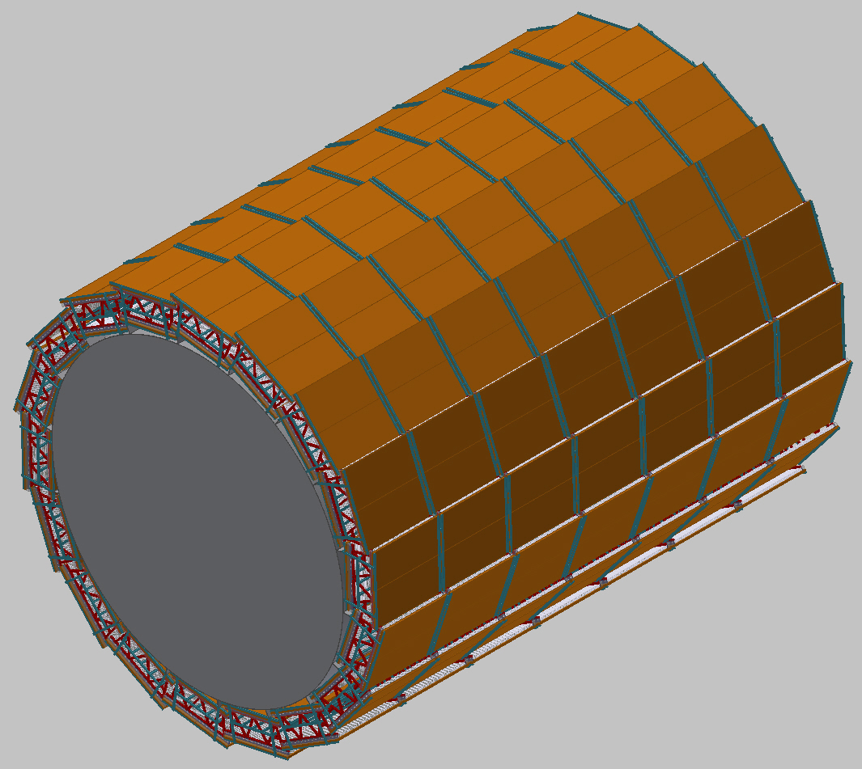
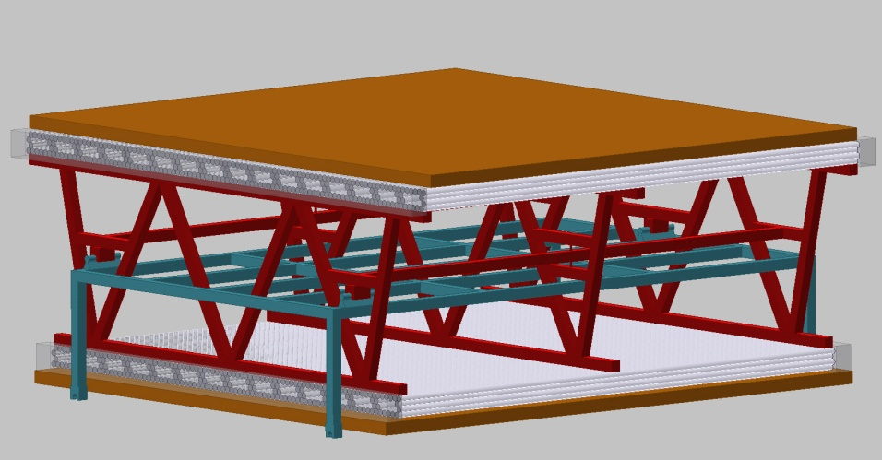
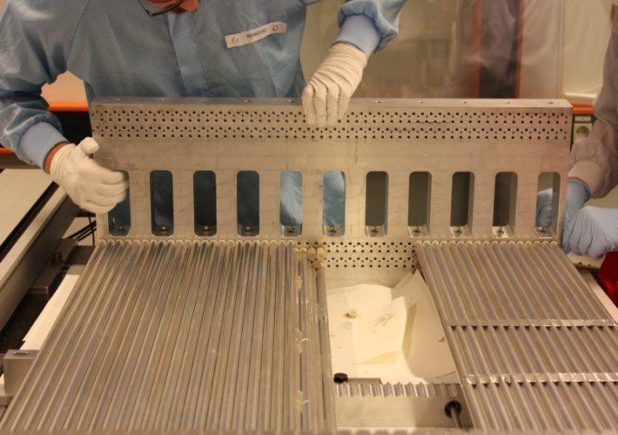
A working proposal (doable now)
Barrel and outer endcaps of FFC-hh:
2 x 4 layers of 2.8 m long drift tubes (axial in barrel, radial in outer endcaps) with 1.4 m multilayer distance provide 40 µm spatial resolution, 60 µrad angular resolution, 100% tracking efficiency up to the maximum background rates.
Monolithic sMDT construction, no optical alignment of multilayers needed. Chambers well accessible.
Embedded new RPCs for trigger, timing, and second coordinate

Slide 31
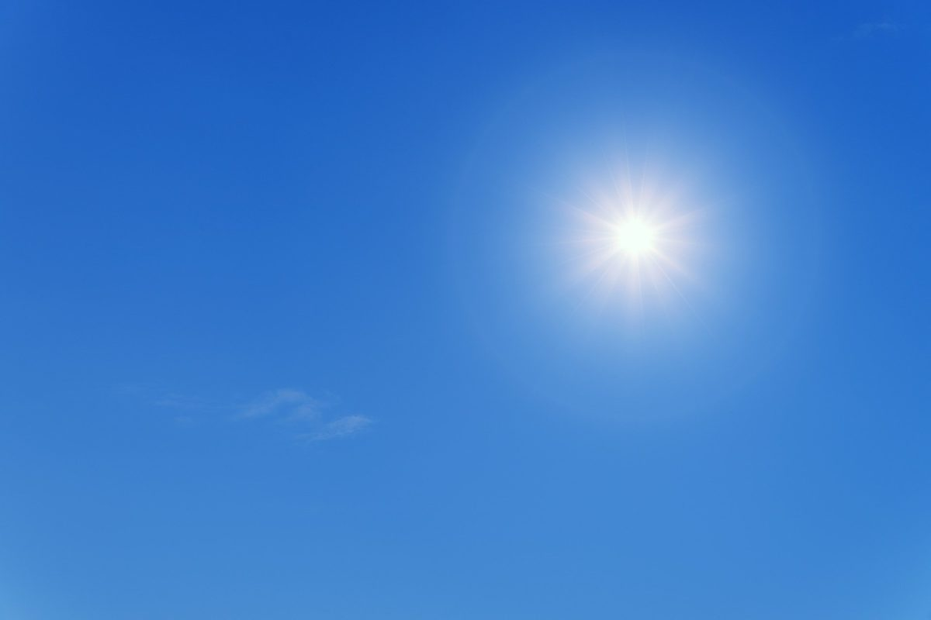
New Ideas

Slide 32

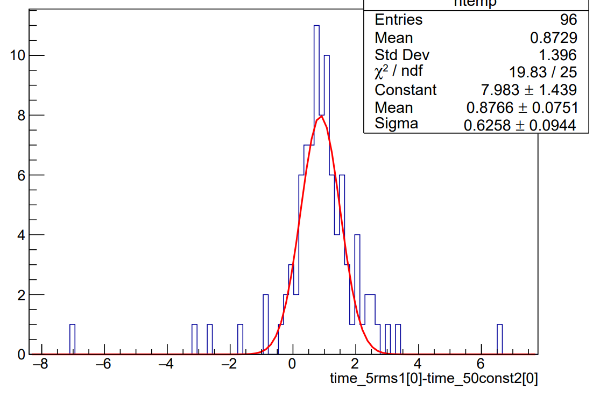
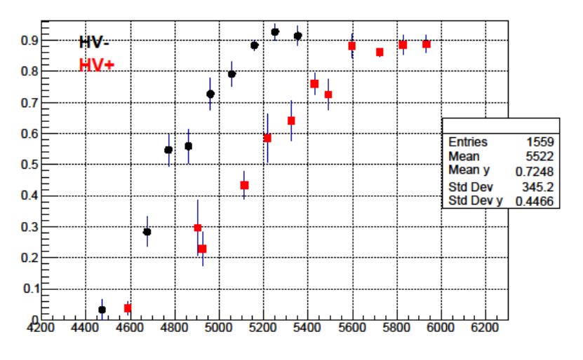

The Resistive Cylindrical Chamber (RCC)
R. Cardarelli “Future RPC developments”, RPC2020 Roma 10-14 /02/2020 proceeding on JINST
Geometry defined by two concentric pipes spaced by a gas gap
The radial field introduce the concept of geometrical quenching, can be tuned by playing with R1 and R2
No need of expensive and high GWP electronegative gases to keep the avalanche stable
No chemical driven ageing effects
Cylindrical geometry supports high pressure operation i.e.
  Full efficiency in a single micro gap even with light gases
  Time resolution proportional to pressure
  Can exploit large experience in MDT chambers…
Aiming to a fully efficient sparkles ~5 ps resolution detector…
Can be combined with a sMDT tube by adding a wire…
First test in Roma2 lab
$$E\left(r\right)=−\frac{V}{rlog\frac{R_{1}}{R_{2}}}$$

