Slide 1
Follow-up of outstanding EN-IM support issues for BE-CEM
Eve Fortescue, Cedric Charrondiere, Ioan Kozsar
17th March 2023
Notes:
Notes 6/2/2023
Slide 3: Set egroup as FP responsible. Publish from layout is implemented in new gui – won’t retrofit to current version, Issue can be closed on infor side.
Slide 4: Migration of Functional positions from Buildings to Rooms. Action: Create a ticket with examples – cannot be just CCIB positions, as they are linked to racks, which also need to be moved
Slide 6: Rename of functional positions in Infor from Layout. In progress on Layout-side (progress expected in February)
Slide 7: Prefill Part creation form from Naming. Action Lukasz – Discuss with David, no clear answer yet
Slide 8: Mutually exclusive Active/Deprecated/Out of Service states Action Lukasz – Discuss with David, no clear answer yet
Slide 9: Set up Stock level notifications. Action CMMS: Organise meeting to discuss field requirements for thresholds.
Slide 10: barcode issues with Kiosk interface – Was probably done in Jan sprint. But no demo/release yet. Should have news by 20th Feb
Slide 11: Kiosk Return button hidden by keyboard – Was probably done in Jan sprint. But no demo/release yet. Should have news by 20th Feb
Slide 12: Employee ID vs phone number issue - Should have news by 20th Feb
Slide 13: Add link to GIS in Kiosk header bar – Not done, no further sprint on kiosk planned in near future
Slide 14: transfer assets from one store to another without changing status – Not done, no further sprint on kiosk planned in near future
Slide 15: Generate automatic work orders by calculating next date, taking into account a dust factor. - Infor can’t calculate a maintenance date. Every asset would have to be downloaded, date updated and uploaded again. Checklist cannot be defined at part level – only at asset level. Dust factor can be stored a CF on location
Slide 16: Generate WO from SNOW: everything done on SNOW-side.
Kind Regards
Eve

Slide 2
RQF1879029
Move a set of assets e.g. a crate and its modules from one parent position to another. i.e. in the case of expired functional positions or during dismantling.
First step: “Dismantle Equipment” button to detach all assets from a Functional Position structure and place in a “buffer location”
As a second step the same process could be applied when triggered by an action in Layout i.e. Expire of positions in Layout -> detach all assets and set positions “Hors Service” in InforEAM
  Feedback from meeting (Feb’ 23):
    No real solution for this at the moment
Notes:
Reply from meeting 01/09/22
David to look into this – further internal discussions required
Goran asked if we want functionality to detach only part of a tree – this is more complicated
Reply from meeting 23/09
Leverage equipment tree to allow manipulation
No real solution for this at the moment

Slide 3
RQF2228393
Update locations of functional positions to be at the room level instead of the building level, using the data in the temporary field that was completed during publication from Layout.
Feedback from last meeting (Feb’ 22):
  Ticket created
  Discussion with Sonia – suggested to do in batches by criteria
  Not possible because are hierarchies are mixed, not easy to identify controls equipment
  New Layout publication tool has serious bugs when publishing hierarchies
  Will republish rack positions and update the egroups and department codes using uploader
Notes:
For locations: Current version supports publishing to room. Data should be migrated.
Reply after meeting: 01/09/22
A new responsible field is available that supports egroups
CMMS will migrate the data for everyone to this new field
Constraints will be relaxed on existing field to allow publication of egroups without change to Layout
During this period the two fields will be synchronised
Finally the old field will be removed and Layout requested to point to the new field
CMMS have an internal task to transfer the FPs from the buildings to the rooms. Have to check that the data is still valid in the temp field.
Reply after meeting 23/09
Constraint on egroups is now disabled in test and with be on prod by Monday – in original field
Egroup autocomplete only In EAM light – not EAM
Layout has been informed, as they need to remove the check on their side
What happens to suggested department code in layout – is there a mapping between egroups and dept code
Can we still attach assets to positions which aren’t CCIB?
Constraint disabled on original field
Autocomplete works on original field in infor
Service unit not linked to person in infor
Shouldn’t be a problem to attach assets to non-ccib position
Lukasz to follow up on location migration
Egroup can be added to eam, but no autocomplete
Responsible not linked to service unit
Test publishing from layout with an egroup – still doesn’t work in current version – there is an internal check on the layout side before pushing to infor. Will be implemented in new version of layout

Slide 4
RQF1879050
Expire Functional Positions in InforEAM from Layout
Prerequisite: Must detach any assets first and put in buffer, as per request #2
  Feedback from last meeting (Feb’ 23):
    Several ideas/discussions on how to implement this
    Intermediate solution is to have an expiry date field
    No decision reached
Notes:
When layout functional position are cloned/evolved… would be interesting to be able to transfer assets structure from one parent position to another in InforEAM.
=> Complicated due to different use cases (structure of functional positions superposed with structure of assets with some variations..)
Not a problem on the layout side. Infor should find out how to detach all assets from their side. Expiry is trivial.
Reply form meeting:
First stage for CMMS is to have a field containing the expiry, and then potentially a report sent to users that positions should be out of service
Reply from meeting 23/09
Several ideas how to implement this
To be discussed with Layout on 6.10
Haven’t reached an decision with Layout
Still up in the air
Having a field is an intermediate solution

Slide 5
RQF1879067
Rename Functional Positions in InforEAM from Layout
  Feedback from last meeting (Feb’ 23):
    Webservice exposed to Layout
    Access to the function should be limited to layout admins
    Action: In progress on the Layout-side, should have news in february
Notes:
Users requesting to be able to rename functional position from layout UI. Possible ? Can this be pushed forward with EN-EL ? (LAYOUT-3766)
=> First need to discuss this in parallel with Eric Van Uytvinck from EN-EL
But InforEAM API is supporting rename
Reply from meeting
Rename does exist
Worried about who should use it – would need to be restricted to admins in layout
Need to provide API to Layout - september
Reply from meeting 23/09
Webservice exposed to Layout
Can it be done from eAM light
Access to the function should be limited to layout admins
Nov 22
Rename coming only from layout.
Shouldn’t rename in light
Sonia to discuss with Pascal but didn’t manage yet – to be followed this week

Slide 6
RQF1879063
Generate part in InforEAM from Naming Interface
Feedback from last meeting (Feb’ 23):
  Intermediate solution proposed: launch create part page with data pre-filled from naming
    Internal discussion required
    Development not scheduled
  Action: To be rediscussed with David
Notes:
Reply from meeting
Equipment generator might help reduce inconsistencies at least between parts and assets
May not help with part
Functionality exists to create part from edms item – may not be helpful to us
Should see some progress on this
Reply from meeting 23/09
Equipment generator not good for our needs – we don’t have items
Need to go back to original proposal – link from naming
More internal discussions required – mixed opinions
PLM section very busy
Naming tool not top priority
To be checked with David - dates

Slide 7
RQF1879073
Add "Deprecated" status to Parts: CCI Parts have 3 mutually exclusive states: Active, Deprecated or Out of Service
  “Tracking Method” drop-down list reconfigured for this usage
  Not an ideal solution:
    “Out of Service” status is a checkbox and “Deprecated” is part of a drop-down list
    The two fields could potentially contradict each other (even though HS overrides deprecated)
  We would have preferred one mutually exclusive status field
  Action: To be rediscussed with David
Notes:
Results of meeting:
David understood problem and will try to come up with a better solution.
Argument is that if a part is out of service, then this overrides everything and it disappears, so it doesn’t matter that the tracking method is deprecated
Not mentioned at meeting 23/09 – to be revisited
To be discussed with David again

Slide 8
RQF1879074 / RQF2231250
Set up stock-level notifications
For assets: Raise an alert when the number of assets "in stock" is less than 10% of the number of installed assets
For parts not tracked by asset: set a threshold of 10 units
  Done 27/02/2023
Notes:
Do we really want to continue with this?

Slide 9
RQF2139577 (5)
EAM Inventory QR/barcode issues with Kiosk interface
  “Return” button hidden by keyboard
    Was treated in January sprint. But not released yet
    Should have news by 20th Feb

Slide 10
INC3317639
KIOSK ISSUE/RETURN from search engine
Search for a part or asset, without scanning a QR code
Tick the box “Choose”
Click ISSUE or RETURN ,Employee, NEXT
The Part Description is displayed but the “Part” is empty
If I click “ISSUE” / “RETURN” then I have an error message “PartID is a required field”
Also if clicking anywhere on the line containing the description, the entire page becomes blank
KIOSK does not copy the Part ID at the same time as the description.
    Was treated in January sprint. But not released yet
    Should have news by 20th Feb

Slide 11
INC3327338
Employee ID vs phone number issue
Kiosk not keeping employee ID in memory when employee ID is the same as a CERN phone number
    Was treated in January sprint. But not released yet
    Should have news by 20th Feb
    Done 21/02/2023

Slide 12
RQF2183001
Add link to store in GIS in header bar of kiosk
  Not done in January sprint
  No further kiosk sprints planned

Slide 13
RQF2216482
Is there a way of transferring assets from one store to another without changing status to “Installed and Maintained”?
  Assets automatically get put into the status “Installed and Maintained”, when they are just being moved between stores
  Skewing our installation statistics.
  Bin2bin between stores will likely be supported soon in kiosk
  Alternatively, ability to change to another status that is not “Installed and Maintained”
  This will be necessary for new workflow
  Might be deployed Friday 24th feb

Slide 14
INC3387647
Kiosk phone Letters are being written into form backwards when screen tilted

Slide 15
RQF2255626
Update of CCI state Machines
  Update state machines for CCI-ADM, MRO, MTA, IN, CR so that workflow is coherent and better defined
  Requires 3 new custom states:
    In Acceptance Testing
    In Testing and Maintenance
    Exchanged
  Requires possibility to move from “In store” to “Testing & Maintenance” and “Out of Service” (See request for user to choose a new status when issuing in RQF2216482)
  Requires EAM-light “Replace Equipment” tool to temporarily switch status of old asset to “Exchanged”, before the new state selected by the user and fix RQF2260564

Slide 16
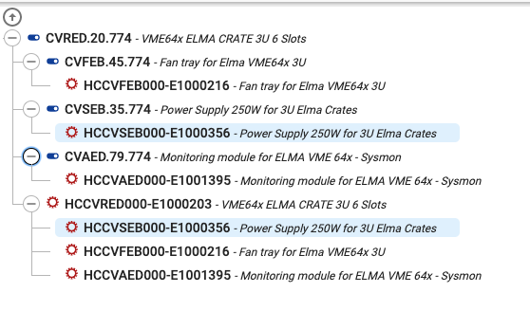
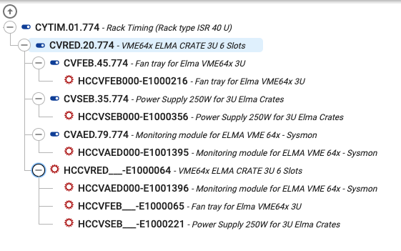
RQF2260564
Assets still attached to positions after "Replace Equipment” action
Tested ”Replace equipment tool” after concerns from team members about feasibility of implementing “Exchanged” status (see RQF2255626)
When replacing a hierarchy of assets, old assets are not detached from their secondary parent positions

