Slide 1
2023 PS and SPS User Schedule
Eva Barbara Holzer
SPS and PS Physics Coordinator
Notes:
LHCb Upgrade I : now for Run3

Slide 2
Injector Schedule

Slide 3
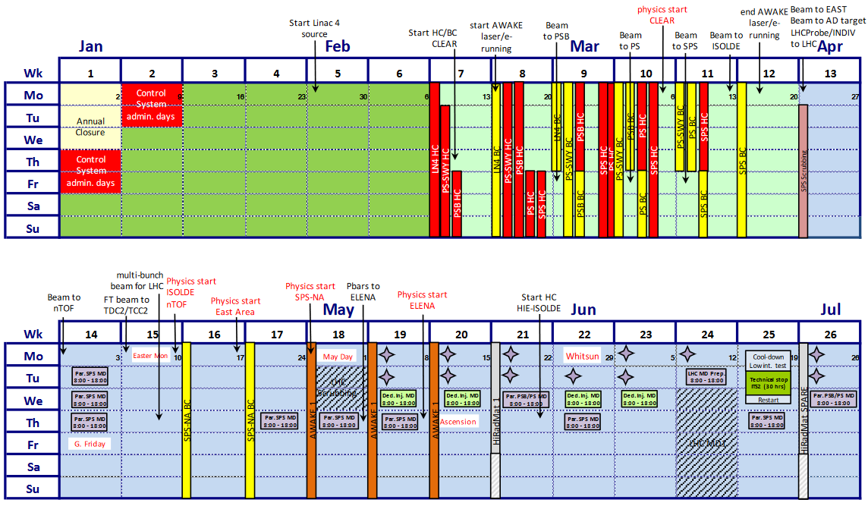
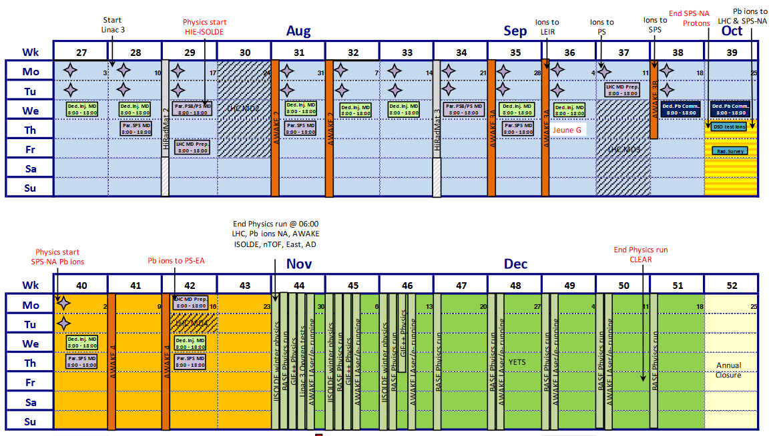
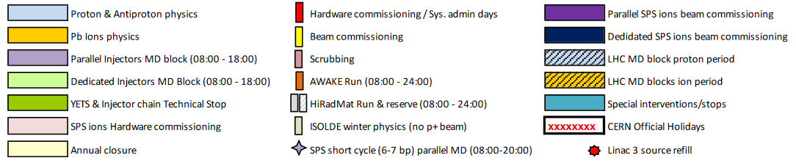
Injector Schedule v1.0 – approved by RB December 2022
Changes since approval (not shown above):
  PS EA and SPS EHN1 physics starts one week earlier
  Recent request to add approximately 72 hours of ion commissioning during the last 4 weeks of proton beam → impact on the test beam users and the physics experiments

Slide 4
Physics Accounting 2023
Not subtracting for: ion commissioning, MDs, LHC MD preparations, technical stop etc.
AWAKE: 9.5 weeks (11 in 2022) 86%
HiRadMat: 3 weeks + 1 spare week (4 in 2022) 75% / 100%
 | ISOLDE | nTOF | AD/ELENA | PS EA FT | SPS EHN1 | SPS EHN2 & ECN3
p (p-) start | April 10th | April 10th | May 11th | April 7th | April 24th | May 1st
p (p-) end | October 30th | October 30th | October 30th | October 30th | September 28th | September 28th
Pb ion start |  |  |  | October 16th | October 2nd | October 2nd
Pb ion end |  |  |  | October 30th | October 30th | October 30th
Weeks 2023 (weeks 2022) % wrt 2022 | 29 (35 in 2022) 83% | 29 (35 in 2022) 83% | 24.4 p- (30.5 in 2022) 80% of the shortened 2022 run | 29.5 p (35 in 2022) 83% 2 Pb (5 days in 2022) | 22.5 p (29 in 2022) 78% 4 Pb (2 in 2022) | 21.5 p (29 in 2022) 74% 4 Pb (2 in 2022)

Slide 5
User Beam Requests

Slide 6
Multi-user lines PS East Area and SPS North Area beam time requests
Average overbooking of the SPS EHN1 lines about the same as in 2021 (and much more than in 2022!)
  2021 we had only 18 weeks protons in EHN1 (2023 22 weeks) and had the first beam since 2018
More calorimeter and exclusive main user requests now compared to 2021
 |  | Weeks requested by SPSC related user | Weeks requested for LHC experiments R&D | Weeks requested by other users | Total Requested | Weeks available
PS T9 & T10 | protons | 8 main 0 parasitic | 22 main 0 parasitic | 19 main 0 parasitic | 49 main 85% | 58
SPS H2, H4 | protons | 28 main 0 parasitic | 28 main 1 parasitic | 13 main 7 parasitic | 69 main 157% | 44
SPS H6, H8 | protons | 0 main 0 parasitic | 64 main 22 parasitic | 24 main 18 parasitic | 88 main 200% | 44

Slide 7
User Schedules

Slide 8
Main / Parallel / Parasitic Users
Very high requests for beam time → parallel running required, in particular in the SPS H6 and H8 beam lines
The priority level of each user will only be defined after the beam line meetings! At the moment, it is only an indication!
Up to 3 levels of priority within the same beam line at the same time:
  Main user (only one at a time per line): Controls the beam and the access. Coordinates with the parallel users so that they as well get the conditions they require.
  Parallel user(s): Have to agree to the run conditions like: beam parameters, installation and de-installation schedule, access frequency
  Parasitic user(s): No influence on beam parameters nor zone access. Lowest priority for infrastructure support.
Additional parasitic beam time might also be granted on a short notice during the year.
Safety rules (for example ISIEC) apply to parasitic users exactly the same way!

Slide 9
Update User Requests based on the current meeting
If during the annual beam-line preparation meeting, a user group discovers some incompatibilities (for example with the other users of the same beam line or the beam line sharing the same primary target):
  Please use the ‘Comment’ tab of your run(s) provided in the user beam time request tool – you should have received the link per email, or find it after you log in to the tool – to request changes like:
    Different beam slot and/or with or without certain other user groups (for example because of incompatibilities with respect to the beam intensity or the access frequency)
    Particular week where you would like to be the main user
    Etc.
  https://ps-sps-users.web.cern.ch/
If you need to add additional users to your activity → please contact Martin Schwinzerl for technical user support

Slide 10
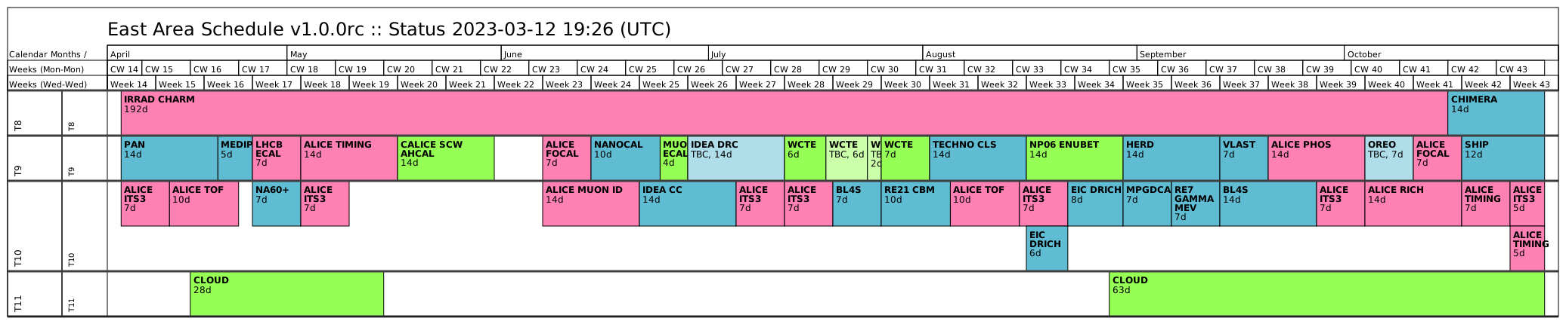
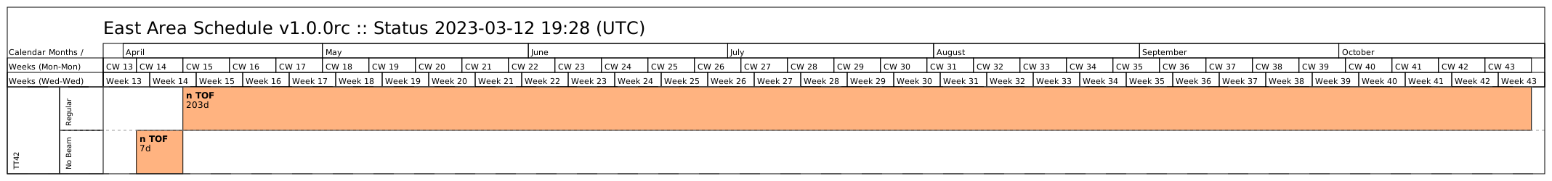
PS East Area
Schedule settled for most users. Waiting for feed-back from a few users.
CHIMERA in week 42 and 43 will take Pb ions. All the other users take proton beam.
PS schedule inter-linked with SPS EHN1 schedule
  Several users have beam time in both locations (e.g. ALICE ITS3)
  SPSC recommendations in May 2023 for NA65 versus NP04 in EHN1 will have a small impact on the PS schedule
Free slots could accommodate additional beam requests or will be used to ease the beam sharing between all Booster and PS users (ISOLDE, nTOF, AD, IRRAD, T9 and T10 test beam users)

Slide 11
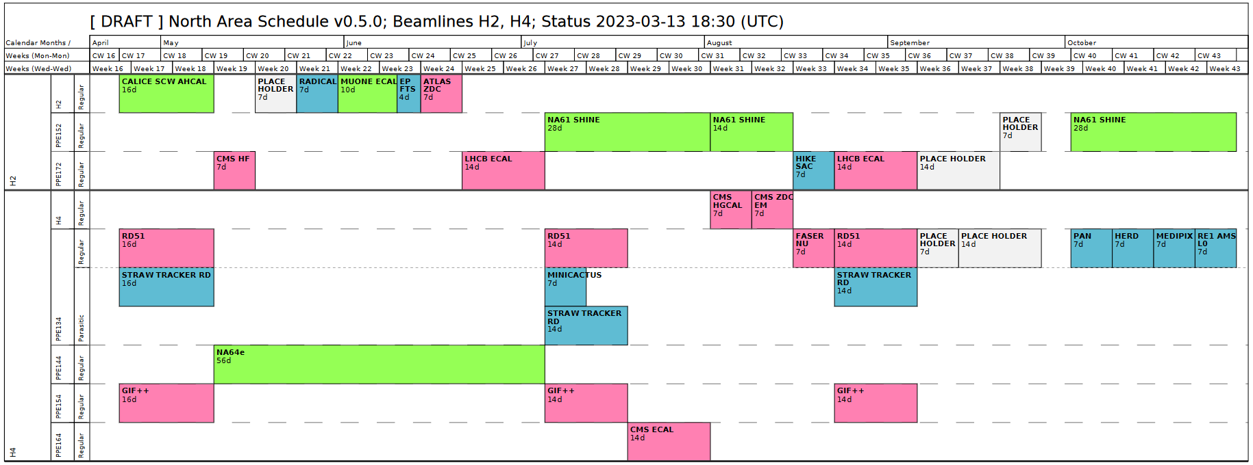
DRAFT: SPS North Area T2 Target — H2 and H4
High request of high energy high purity electron beams, which are only available in H2 and H4.
4 weeks in October are Pb ion beams preceded by a beam set-up period of 4 days (no user beams to NA)
Question of compatibility of beam in H2 and H4 strongly limits the scheduling options – as they share the same target the possible beam configurations are coupled
Over-requested in the second half of the run → Not all of the SPSC/LHCC requests can be scheduled (fully)
Very few not CERN related activities schedule in earlier weeks – only in weeks without requests from LHCC / SPSC reviewed activities
Pb Ions
H2
H4

Slide 12
SPS North Area T4 Target — H6 and H8
H6 high intensity weeks (as high as radiation protection allows):
  Weeks: 20, 23, 27, 30, 34 (starting on the Wednesday of that week)
Standard setting for H6 and H8 are:
  Positive polarity 120 GeV/c for H6 and 180 GeV/c for H8: most weeks will run in these conditions
  Some users require a scan in energy. If the energy is requested to go higher than 180 GeV/c in H8, there is the option for:
    Negative polarity in both lines → the users in H6 have to agree to the different run condition
  Primary protons are not available due to incompatibility with ECN3 users

Slide 13
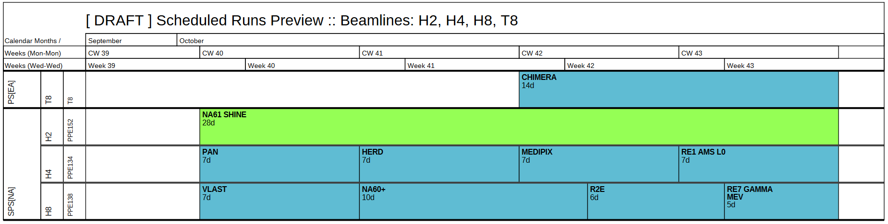
DRAFT: Ion User Schedule

Slide 14
Weekly User Meetings
The weekly user meetings from April onwards will be held in person again in 2023.
As before COVID, attendance is strictly expected from one representative of each user group
  The week before the first beam day
  During beam time
  The meeting following the last day of beam time
  → for a one week slot, users need to attend three of the weekly user meetings
  When the run responsible is not able to attend
    Notify the Physics Coordinator the day before (email) and
    Send / nominate a representative (could be a co-user of your beam line or your beam line physicist, if they agree) and
    Fill the template of the minutes at least the day before the meeting
All main and parallel users are requested to
  Fill the template of the minutes before the weekly user meeting
  Give a short statement about their progress and/or difficulties encountered
Parasitic users are requested to attend the meeting the same way as main/parallel users. But reporting in the minutes and/or during the meeting is optional for them.
More users means that the time during the meetings is getting tight → please try to be brief

Slide 15
SPS and PS Physics Coordination
Please contact the SP and PS Physics Coordinator (Eva Barbara Holzer)
      mailto: Sps Coordinator <Sps.Coordinator@cern.ch>
      Tel.: +41 22 767 29 19
  For all questions regarding sharing of CERN resources (beam, consumables, infrastructure related) amongst the user groups of the SPS and PS machines (AD, nTOF, AWAKE, PS East Area, SPS North Area)
  For all questions concerning the sharing of CERN resources between the user groups and other activities of the injector complex (machine related activities, users of the Booster and the LHC related).
During the run, at days when the Physics Coordinator is unavailable for urgent requests (e.g. away on a workshop), an acting Physics Coordinator ensures the continuity of the service.
The SPS and PS Physics Coordinator is a physicist from the Experimental Physics (EP) Department. The physicists replacing the Physics Coordinator in case of absence are members of the EP Department as well and highly experienced with CERN test beams.

Slide 16
END

