Slide 1


T9 and T10 Beams in the East Area
D. Banerjee, J. Bernhard, M. Van Dijk, L. Nevay, B. Rae, E. Giulia Perozzi on behalf of BE-EA
20/03/2023

Slide 2
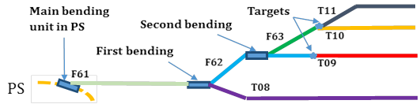
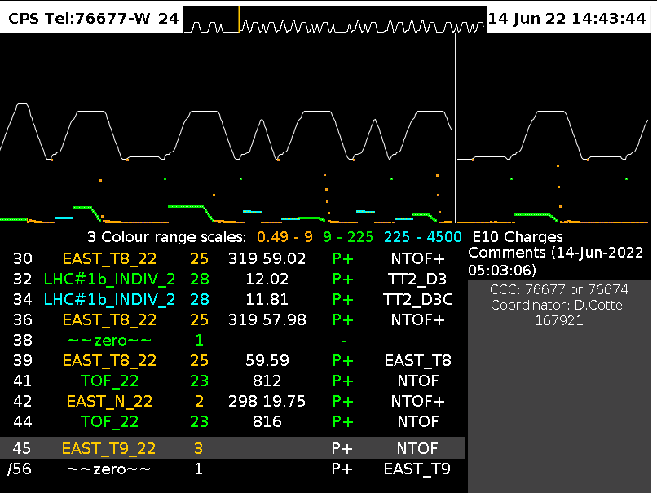
East Area Secondary Beamlines
PS beam @ 24 GeV/c
Spill duration: 0.4 second flat top
Usually : 1-2 cycles per minute per East Destination
Max 6 East cycles / 40 seconds → RP Limit
Super-cycle structure dependent on all users (SPS, nTOF …)

Slide 3
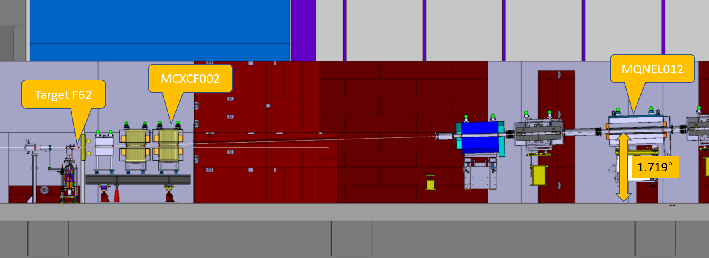
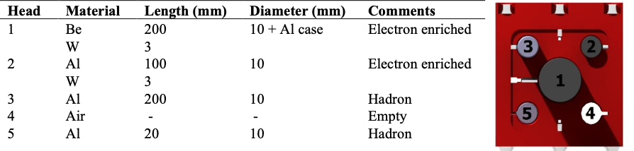
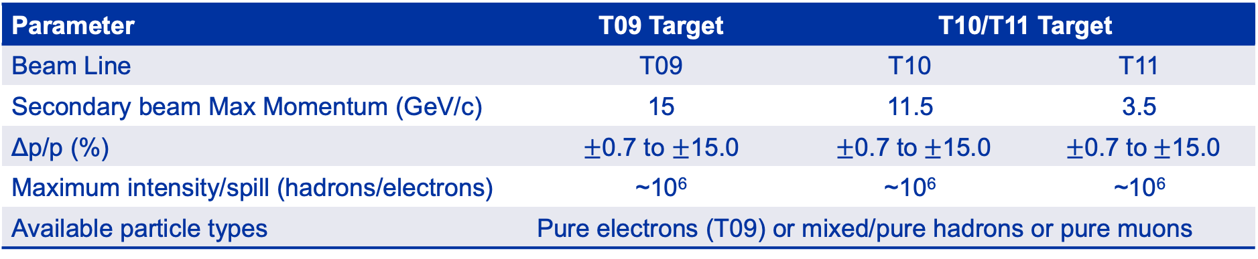
Characteristics of the Secondary Beams
Parameter | T09 Target | T10/T11 Target
Beam Line | T09 | T10 | T11
Secondary beam Max Momentum (GeV/c) | 15 | 11.5 | 3.5
Δp/p (%) | $±$0.7 to $±$15.0 | $±$0.7 to$±$15.0 | $±$0.7 to$±$15.0
Maximum intensity/spill (hadrons/electrons) | ~10⁶ | ~10⁶ | ~10⁶
Available particle types | Pure electrons (T09) or mixed/pure hadrons or pure muons
T11 serves the CLOUD experiment which is a permanent installation.
30-35 mrad vertical production angle
Multi-target configuration

Slide 4
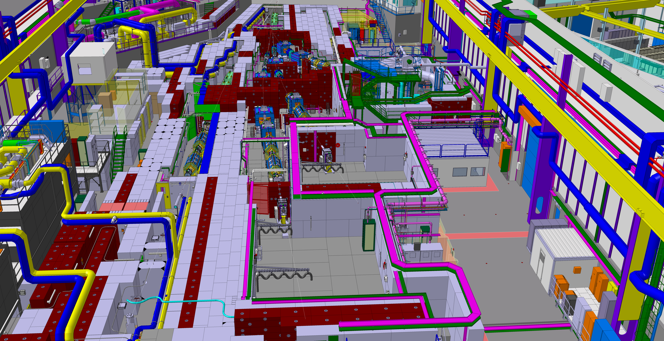
Current Layout
T11
T10
T08
T09
D. Brethoux, M. Lazzaroni

Slide 5
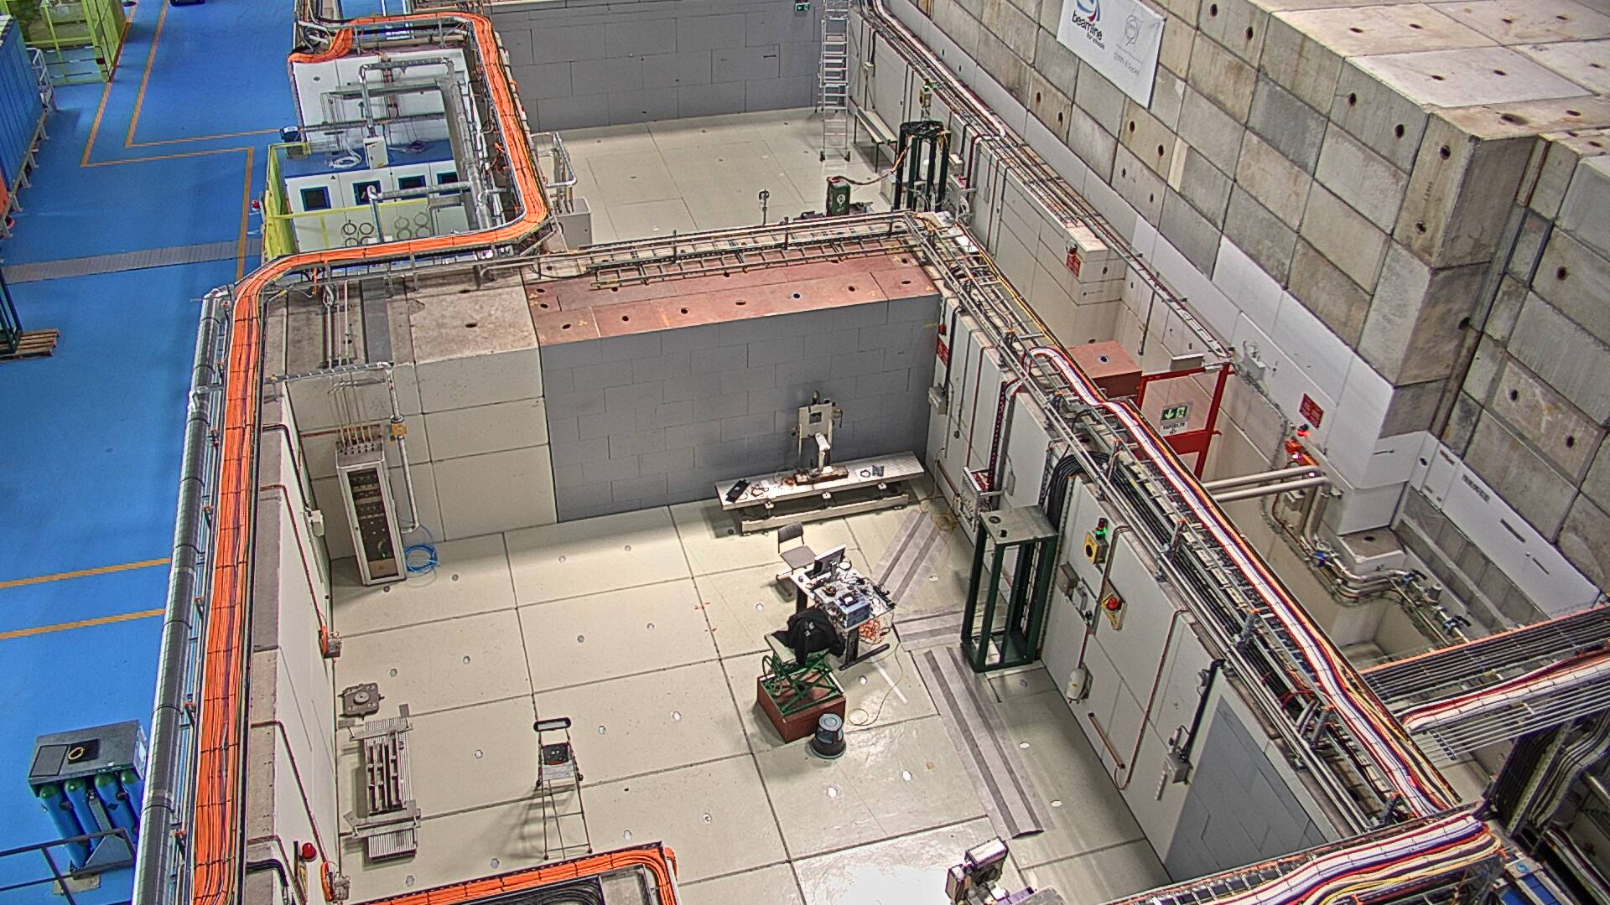
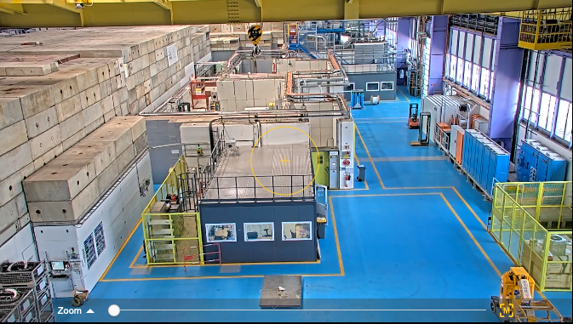
Current Layout
Beam
T09
T11
T10
T09
T10
T08
Beam

Slide 6
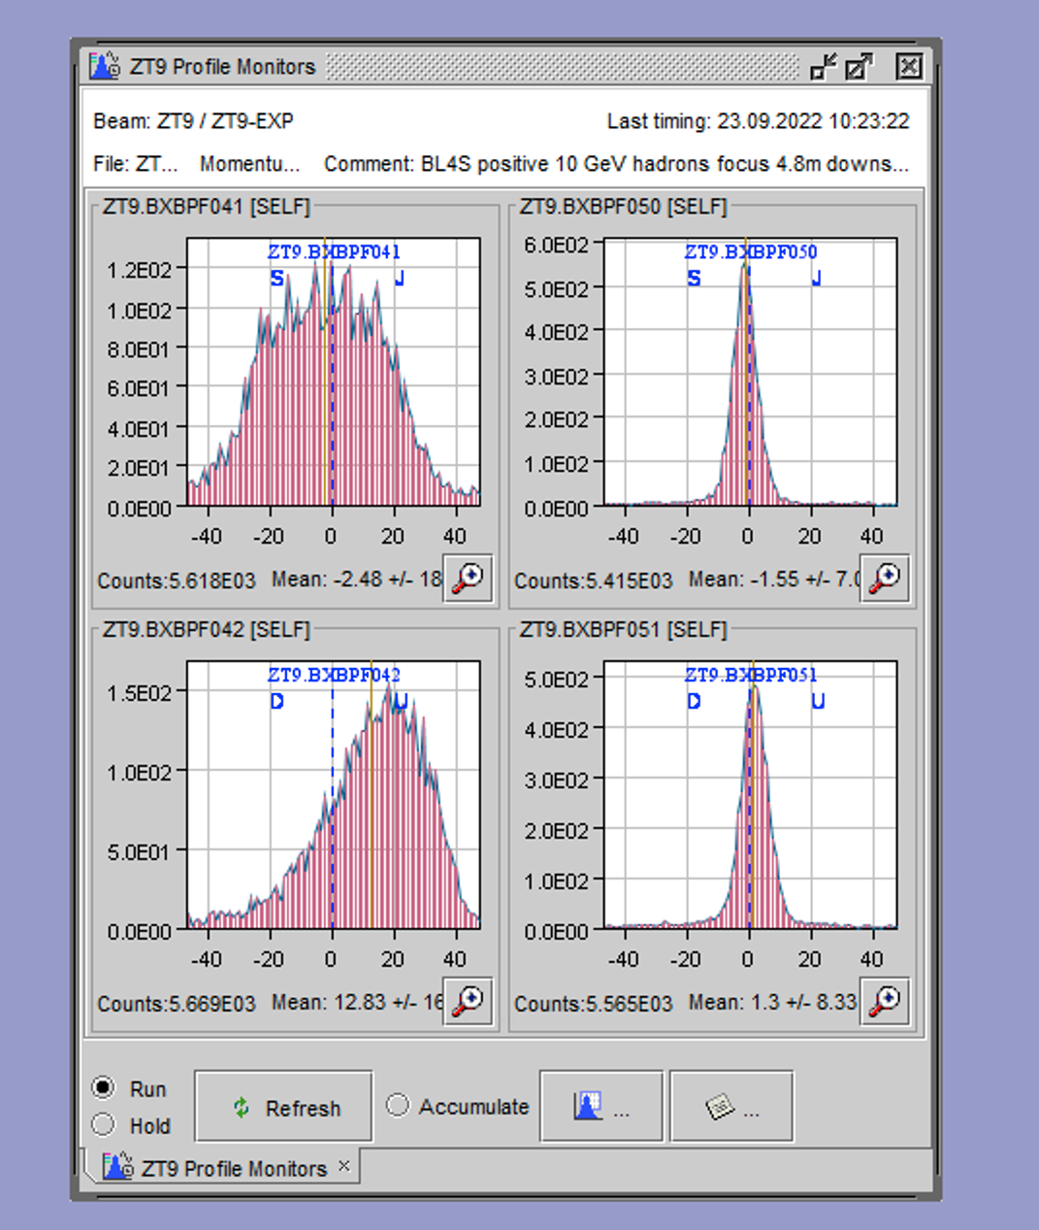
Beam Instrumentations available
Beam profile & intensity monitors:
Scintillators (XSCI) give the beam intensity and scintillating fibre hodoscopes (XBPF) are used as X/Y profile monitors.
In T09 there are two XSCIs and two XBPFs ~ 9.5 m apart and in T10 there is one XBPF just upstream of the user zone and two scintillators ~ 8 m apart.
Analogue and discriminated XSCI signals are available in the
control room and the zone.
Timestamped data of the XBPF can be accessed offline (on request).
PID: Threshold Cherenkov Detector
Two threshold Cherenkov detectors available.
High pressure < 15 bars (relative);
Low pressure < 3.5 bars (relative)
Analogue and discriminated signals are available in the
control room and the zone.
Beam data available in the control rooms (Online: CESAR, Offline: Timber)

Slide 7
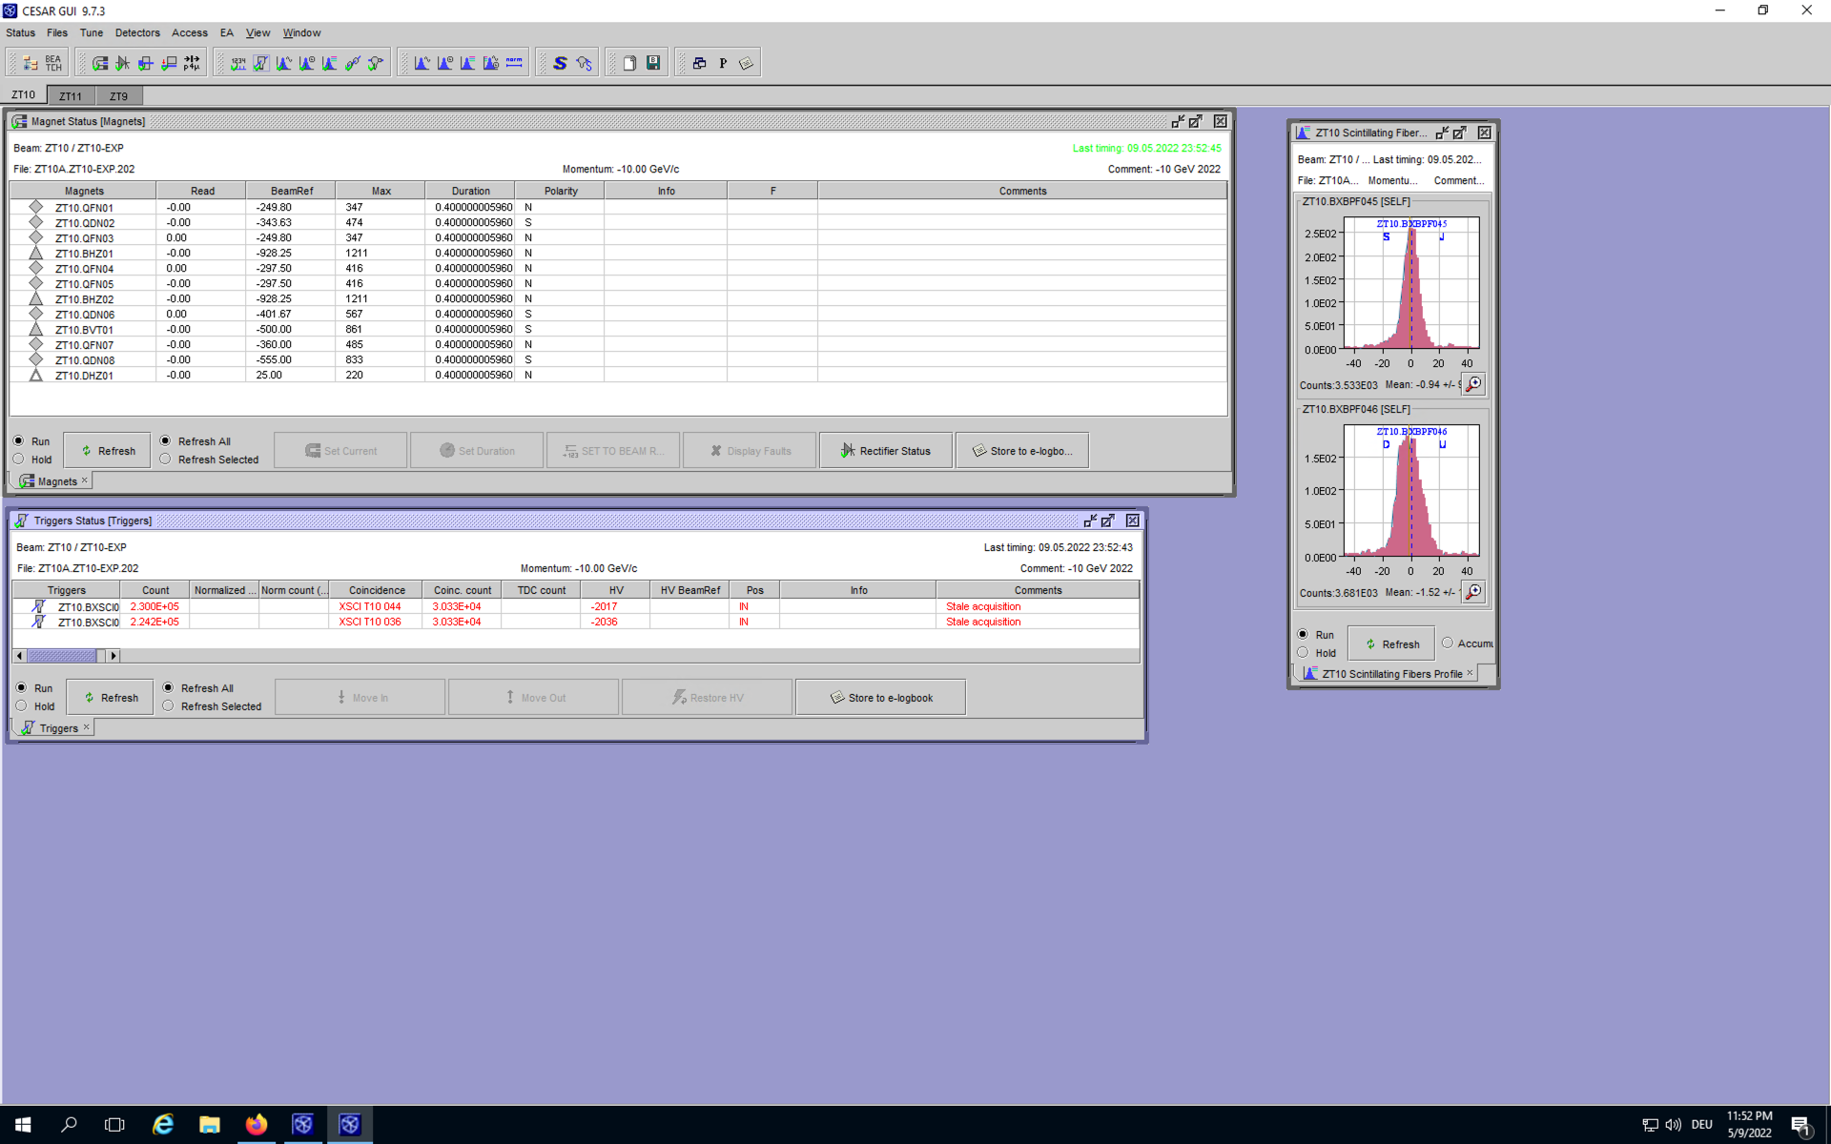
Access and Beam Control Software
The beam can be controlled using the CESAR interface from the control room
Magnet currents can be changed, Threshold Cherenkov pressure can be set, beam files can be loaded, beam profiles and trigger information can be accessed etc.,
A training will be given before the beam time to use the software.
The zone can be accessed with a dosimeter without any other special access request.
2-3 members from each group are given the patrol rights following an on-site training to be able to close the zone for beam.
Access to the control rooms 157/R-F30 (T09) and 157/R-C21 (T10) should be requested in adams.

Slide 8
Contact Persons for T9
Responsible liaison physicist → D. Banerjee (64582/164065)
Beam composition, intensity, spot-size, PID, Cherenkov gases, general layout possibilities, beam tuning
In the event of absence:
Deputy beam physicist : M. Van Dijk (67631/166972)
Operational support:
CESAR training, patrol rights training: B. Rae (63625/167388)
files creation, steering etc., : E. Giulia Parozzi (65791)
Technical support → A. Ebn Rahmoun!
“I want help with transport”, “I need a special table”, “I need racks/fixed support”…..

Slide 9
Contact Persons for T10
Responsible liaison physicist → M. Van Dijk (67631/166972)
Beam composition, intensity, spot-size, PID, Cherenkov gases, general layout possibilities, beam tuning
In the event of absence :
Deputy beam physicist : L. Nevay (67277/167401)
Operational support:
CESAR training, patrol rights training: B. Rae (63625/167388)
files creation, steering etc., : E. Giulia Parozzi (65791)
Technical support → A. Ebn Rahmoun!
“I want help with transport”, “I need a special table”, “I need racks/fixed support”…..

Slide 10
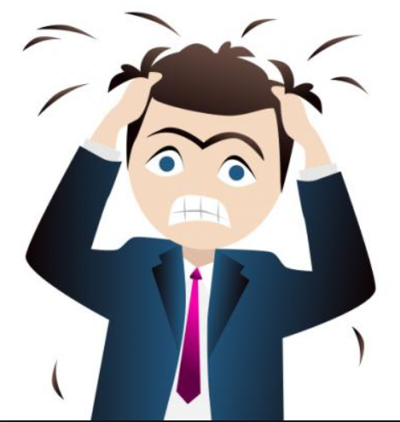
What about after hours?
At weekends or nights, we always check our e-mails and there is a high probability to pick-up the telephone also.
However, most of the times, the CCC can help you solve most of the issues like any equipment/magnetic element failure, beam got switched OFF due to RP alarms, access to the zone etc., If they cannot help, and if the need is imperative, they will give us a call.
To call the CCC → 76677/76674

Slide 11
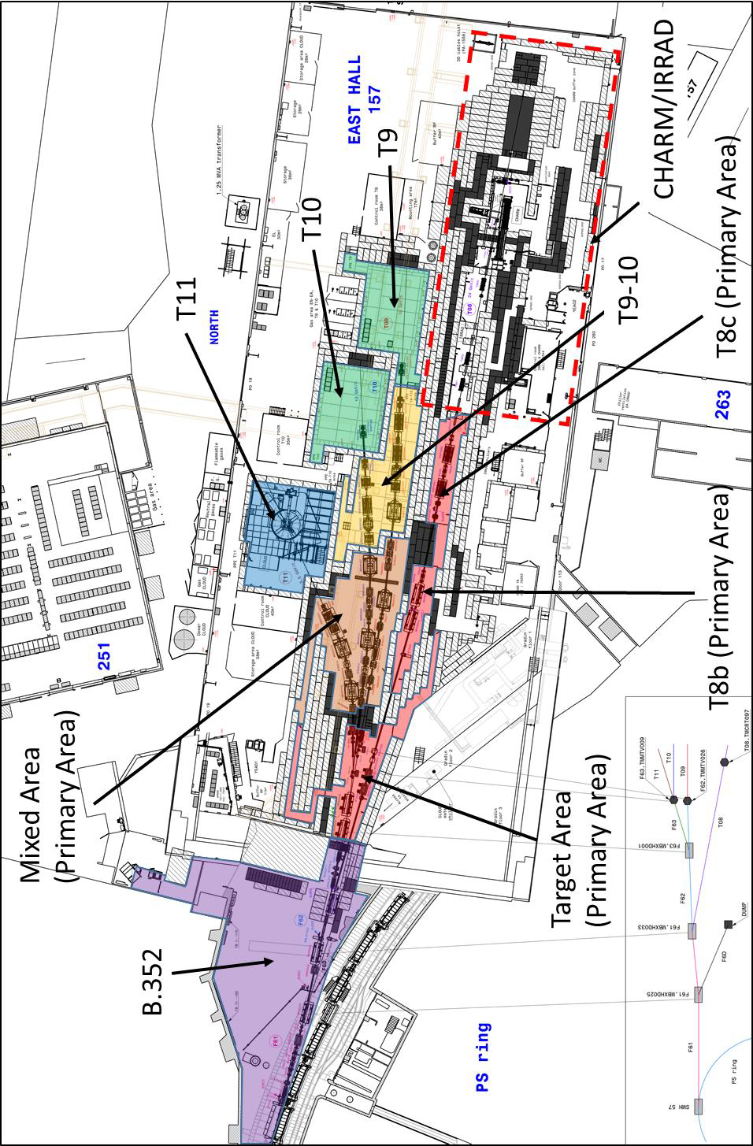
Summary
Communicate with us all your requests for beam and infrastructure as early as possible and also your worries, issues, any details so that we can identify and mitigate showstoppers if any.

