Slide 1

Muon ID
Beam test requirements
Solangel Rojas Torres*, Antonio Ortiz Velásquez**
(on behalf of the Muon ID group)
*Czech Technical University in Prague
**Universidad Nacional Autónoma de México
20/March/2023

Slide 2
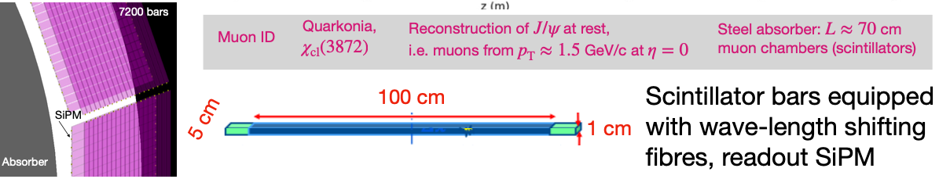
MID: muon identification detector for ALICE 3
Goal: MID is a large area detector for low momentum muon identification that could operate in the LHC run 5. Given the low particle fluence that is expected in the MID region, three technologies are considered
Scintillator bars equipped with WLS fibers and SiPM for readout
Resistive Plate Chambers
Multi Wire Proportional Chambers
Test beam: 1) Study the performance of plastic scintillator produced by the group, and other commercial options (time and spacial resolution, light collection). 2) Test the performance of MWPC

Slide 3
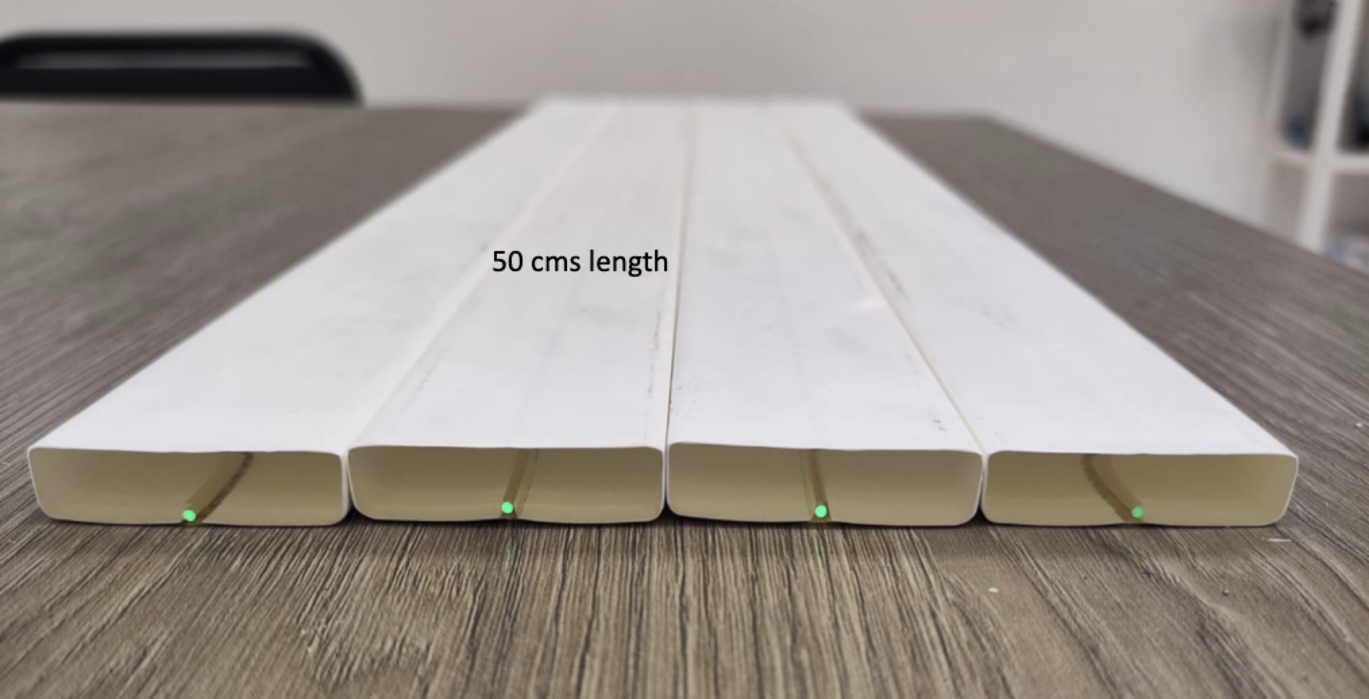
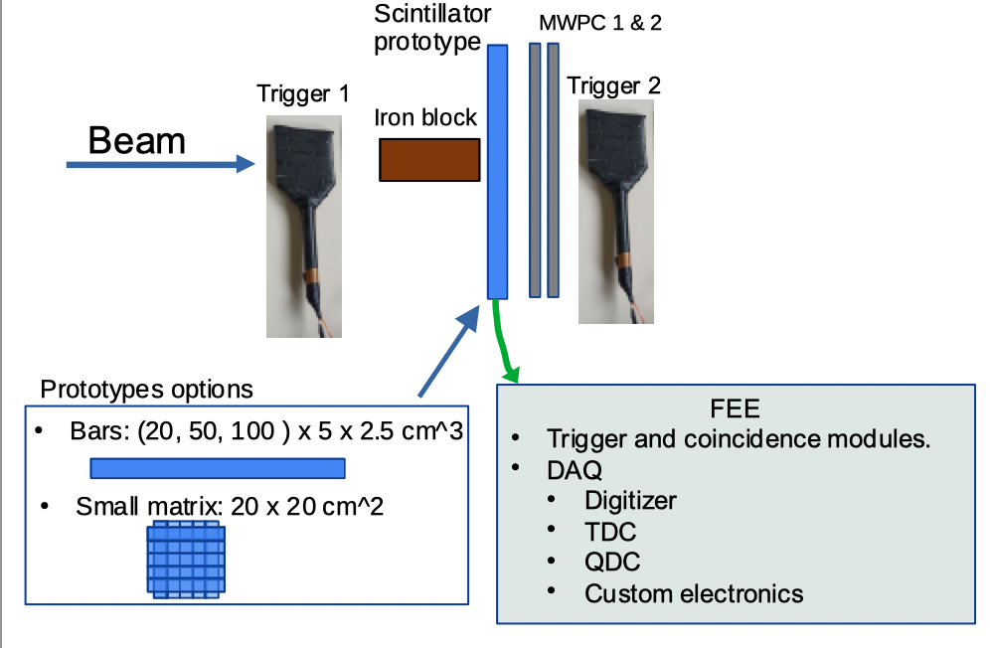
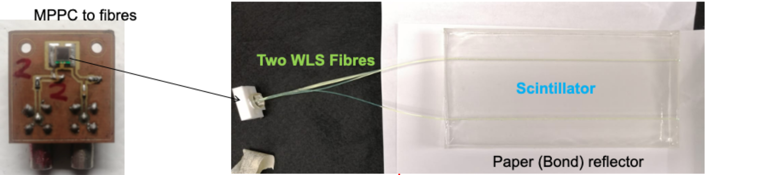
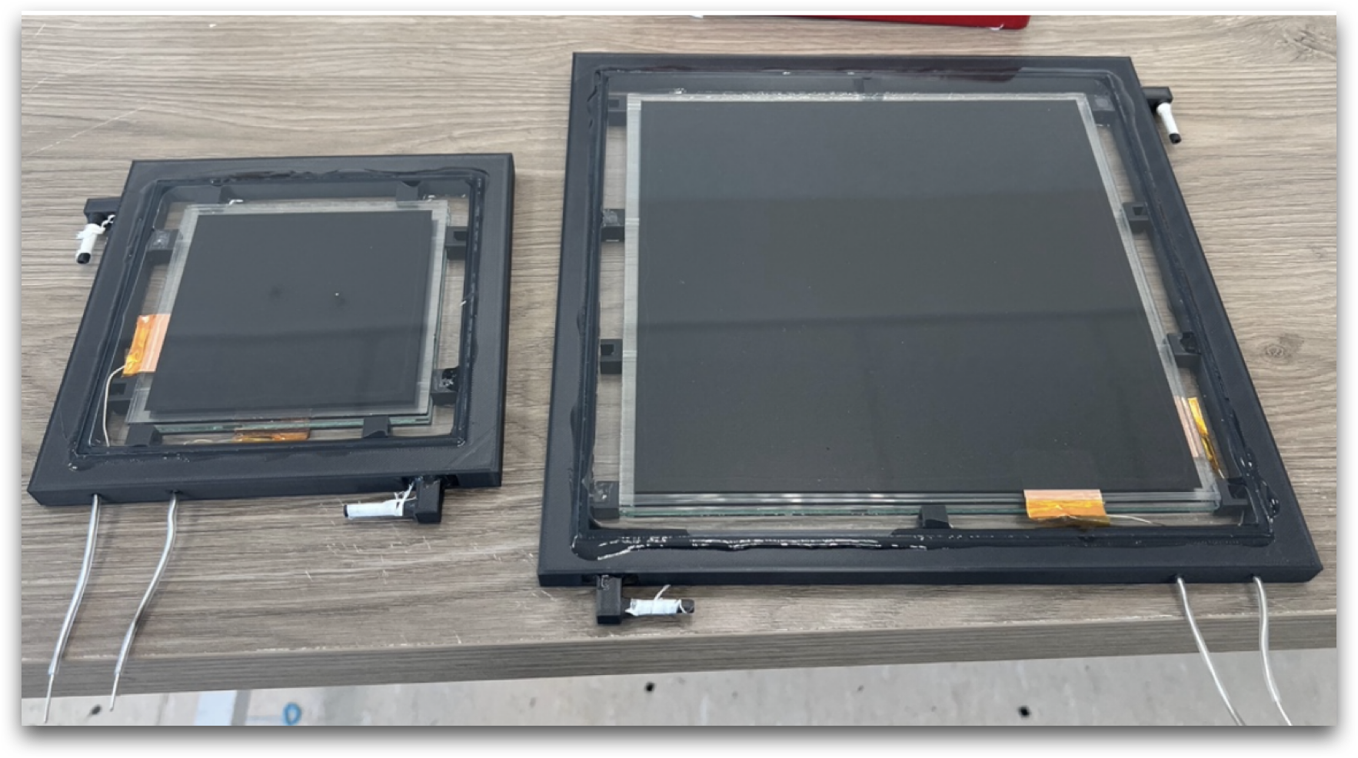
Beam test concept

Slide 4
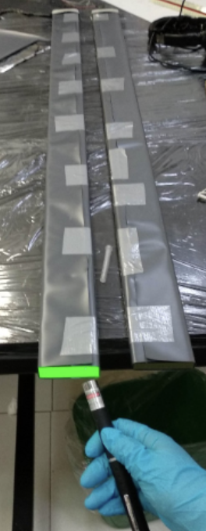
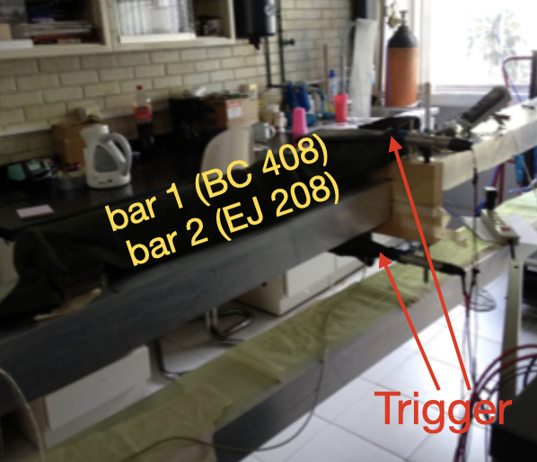
Prototypes
To test several prototypes of Scintillators, RPCs and MWPC
MINOS scintillator
Mexican plastic scintillator
EJ-208 (comercial scintillator)
RPCs

Slide 5
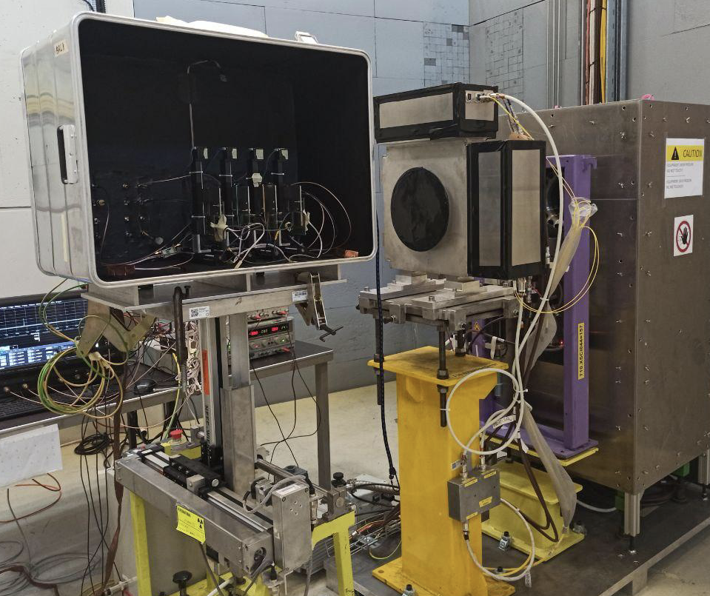
Requirements
Beam type: 1-5 GeV muons
Intensity: 1000 particles/spill
Beam divergence: as small as possible (1mm?)
Movable table
With platform to place the prototypes
To make homogeneity scans
Crates: inside the beam and counting room area
Gas
MWPC (80x80 cm^2): Mixture 80:20 of Ar:CO2
~100 litres/day
RPC (35x35 cm^2): Freon (no humidity)
~100 litres/day
Optional - R134A 95.4%, Iso-butane 4.3% and SF6 0.3%.
Fixing supports
Large standard table to place and fix several detector modules.
To place some modules 1m length on the downstream
Iron block - 70 cm thick
Scintillator triggers
Movable table

Slide 6
Backup

Slide 7
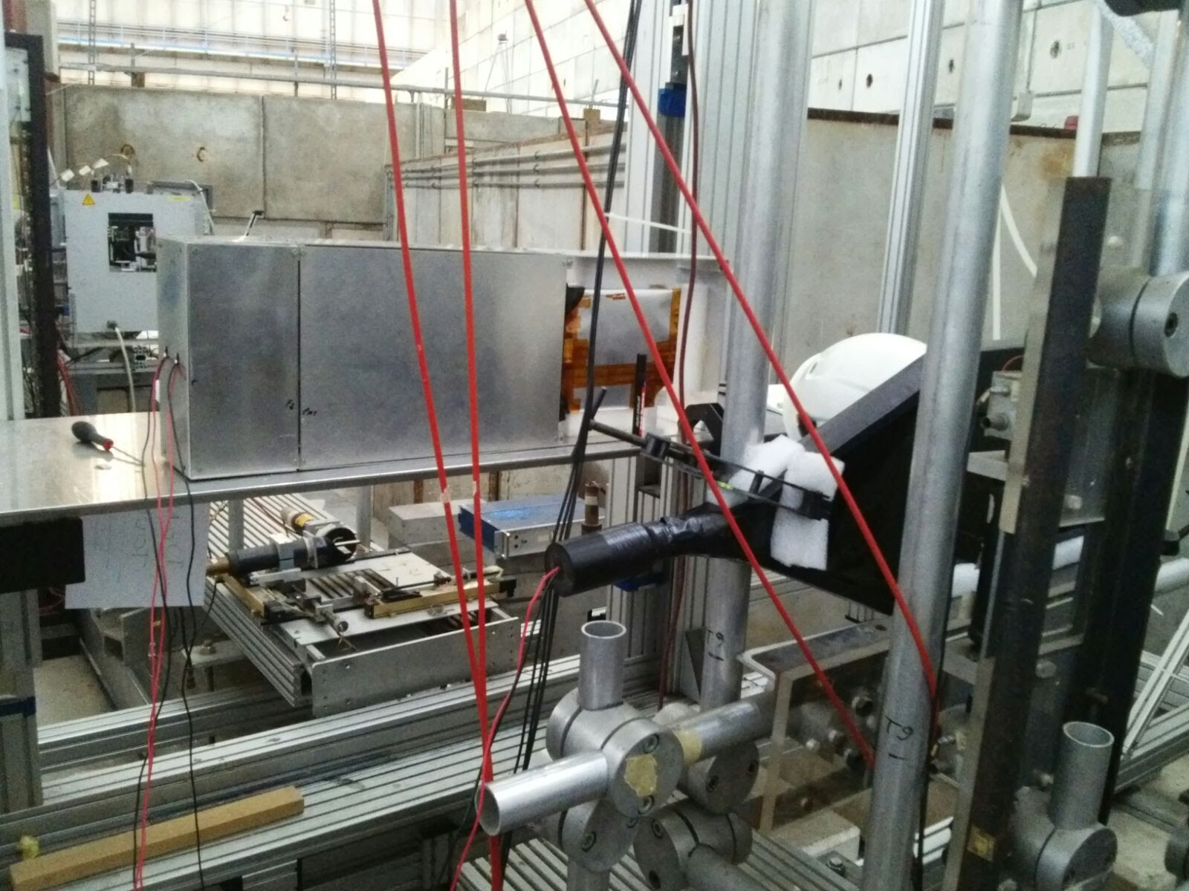
Old beam area
Beam output
Large standard table

Slide 8
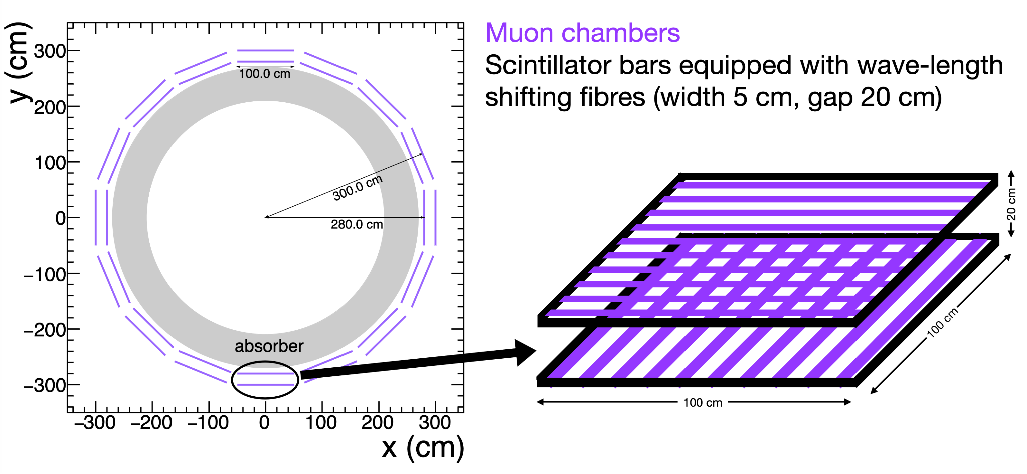
MuonID activities
Beam test: 7 to 20 of June
Muon chamber baseline option
Identification of muons crossing absorber
1 m long, 5 cm wide scintillator bars around absorber
Should cover an area of ~360 m^2
Iron absorber
Readout in both sides of the bar: 13440 channels

