Slide 1



Beamline for Schools A Physics competition for
high-schools students

Slide 2
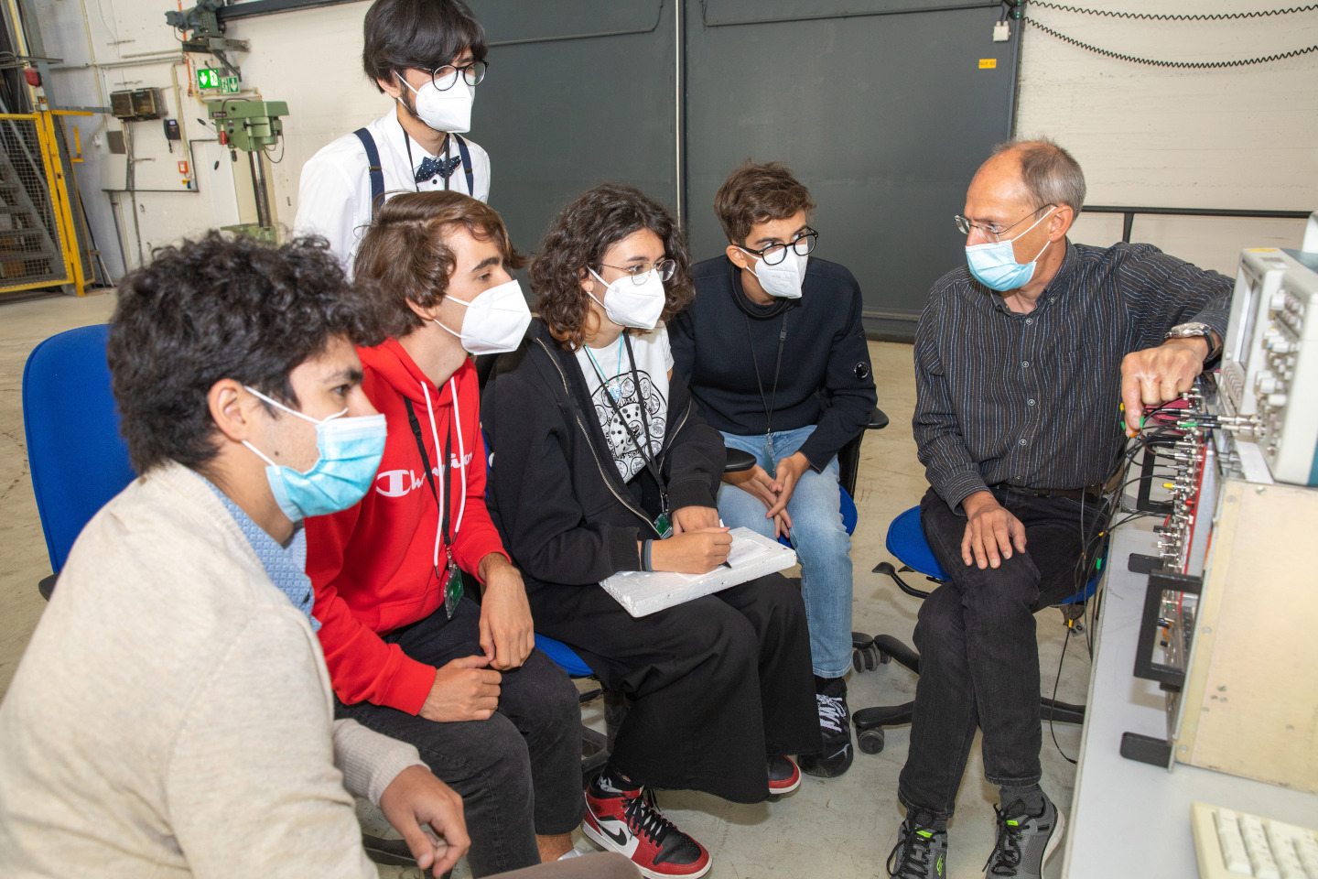
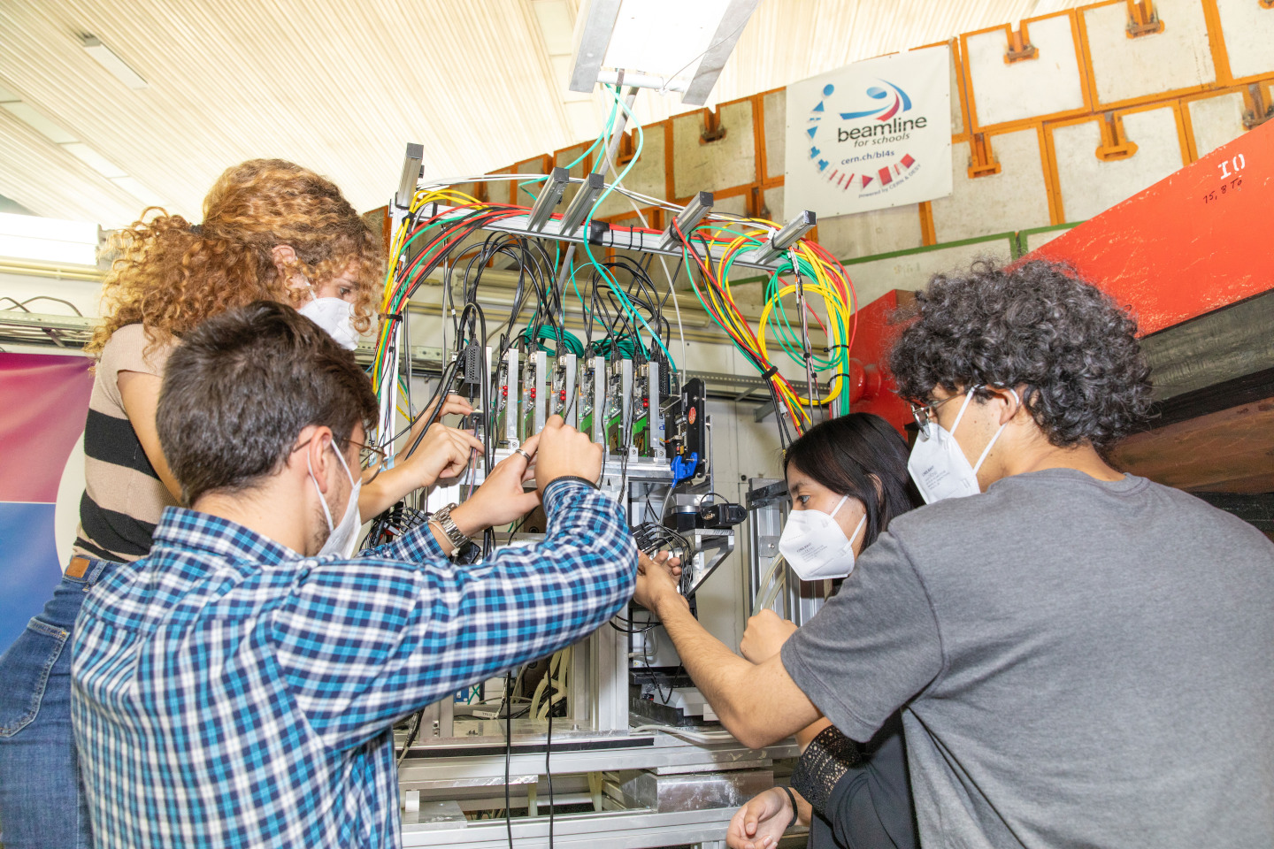
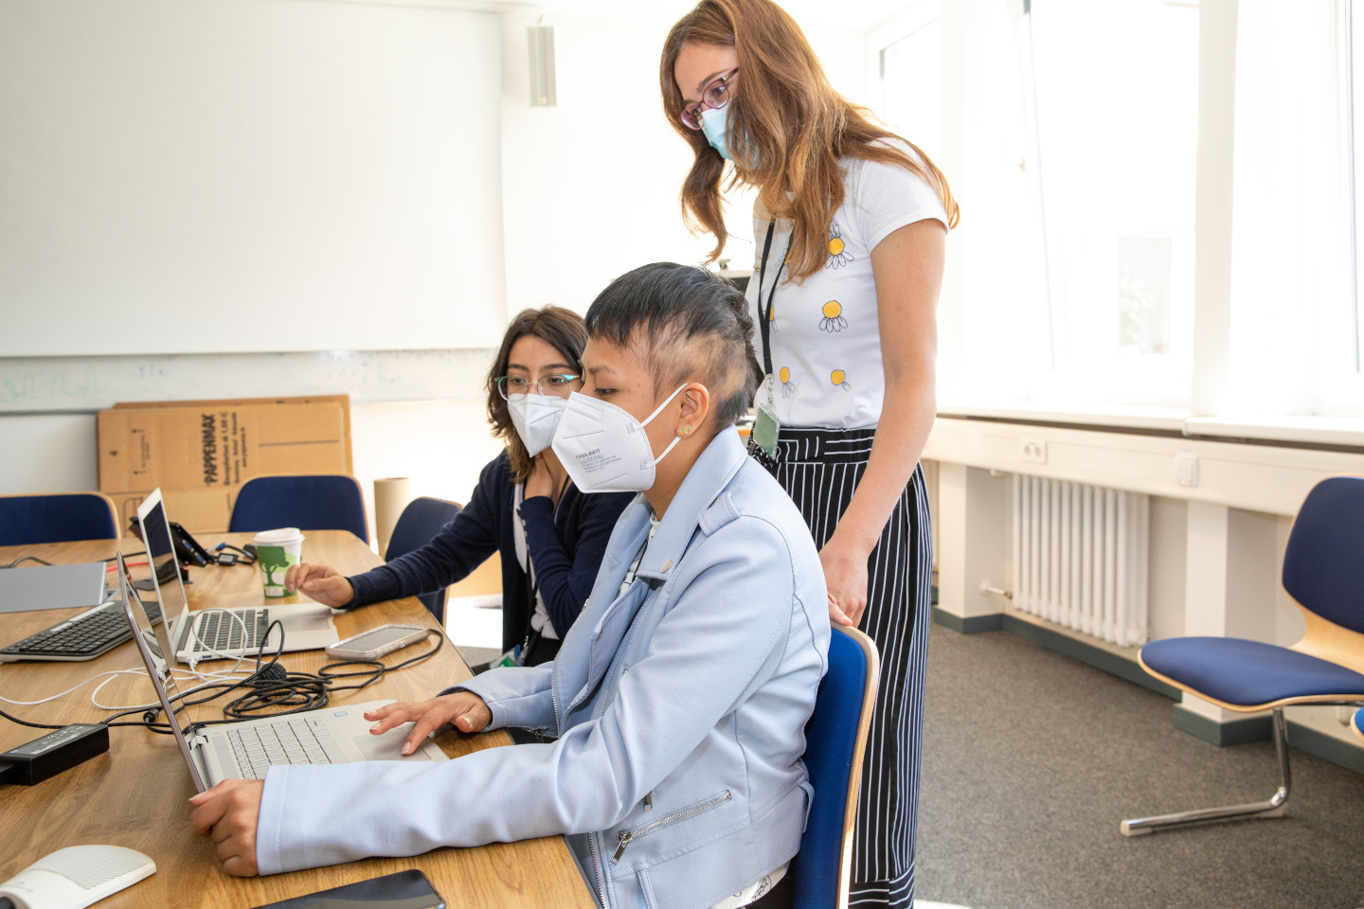
Beamline for Schools – About it
Teams of high-school students can propose an experiment to be performed at the test-beam facility of a particle accelerator.
It is a great opportunity to get in touch with the world of physics research.
They can interact with scientists from CERN, DESY and many other institutions around the world.
Two teams will perform their experiments at CERN and one at DESY.
M. Boselli | BL4S

Slide 3
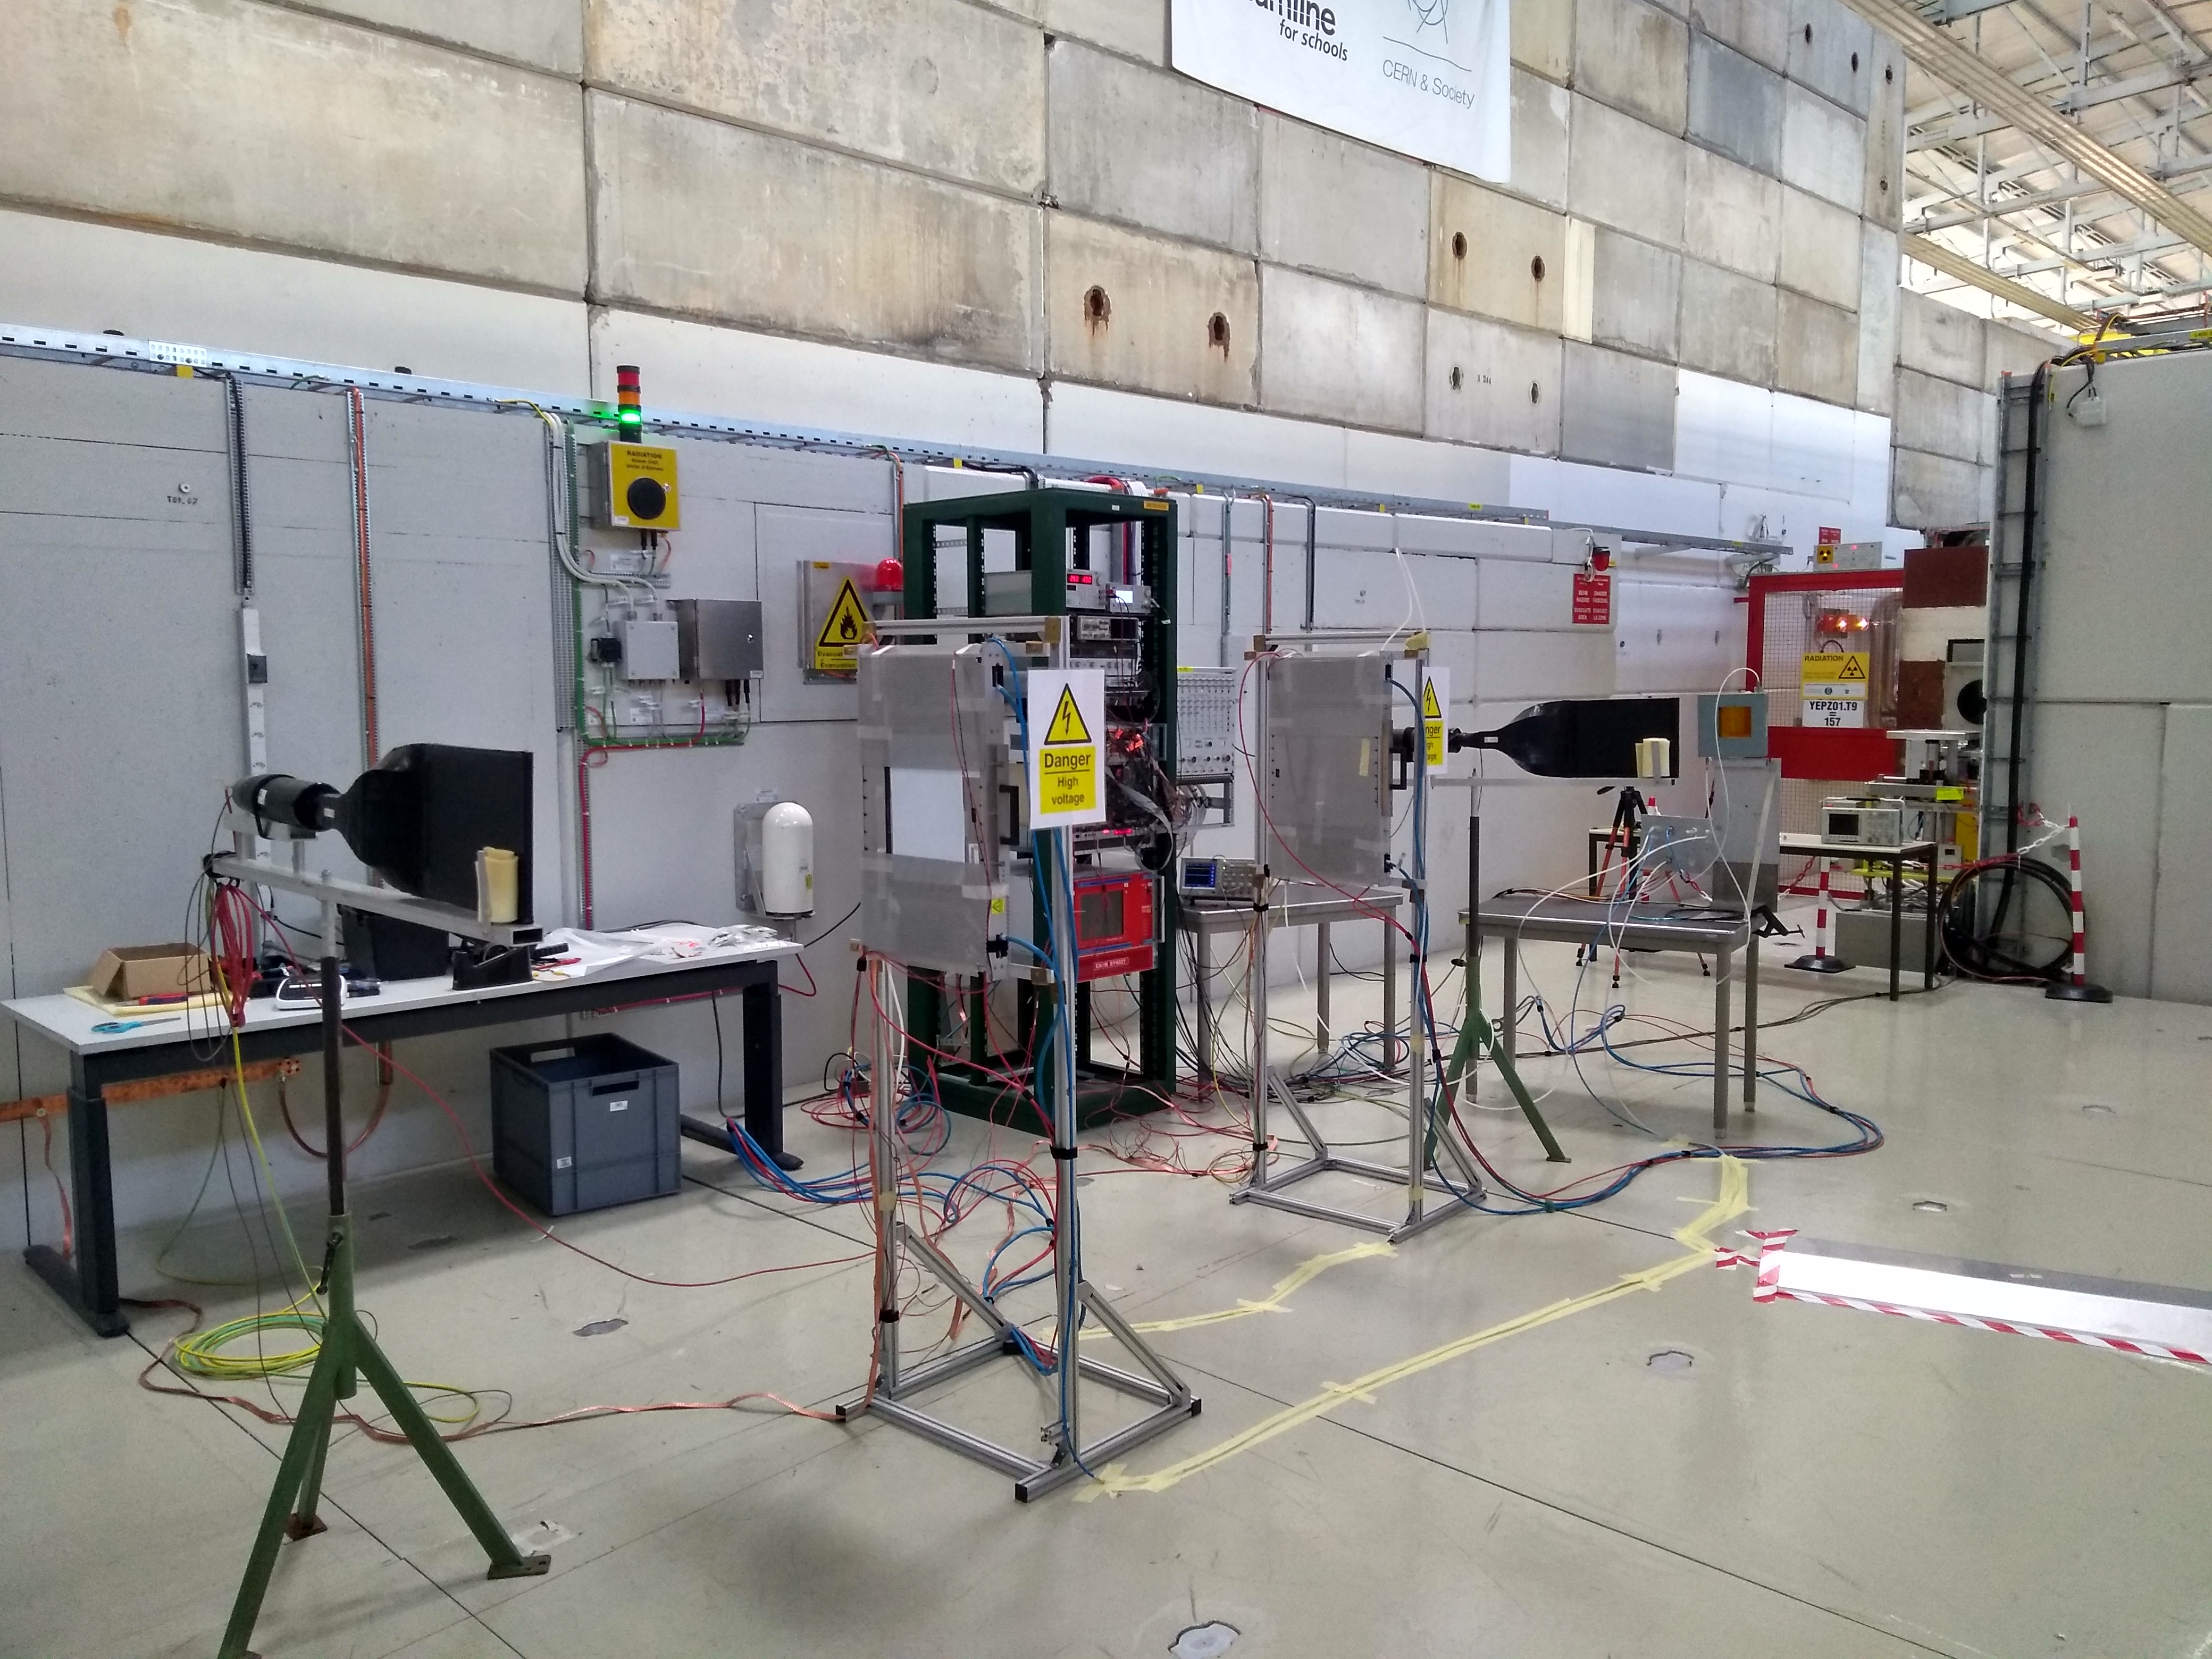
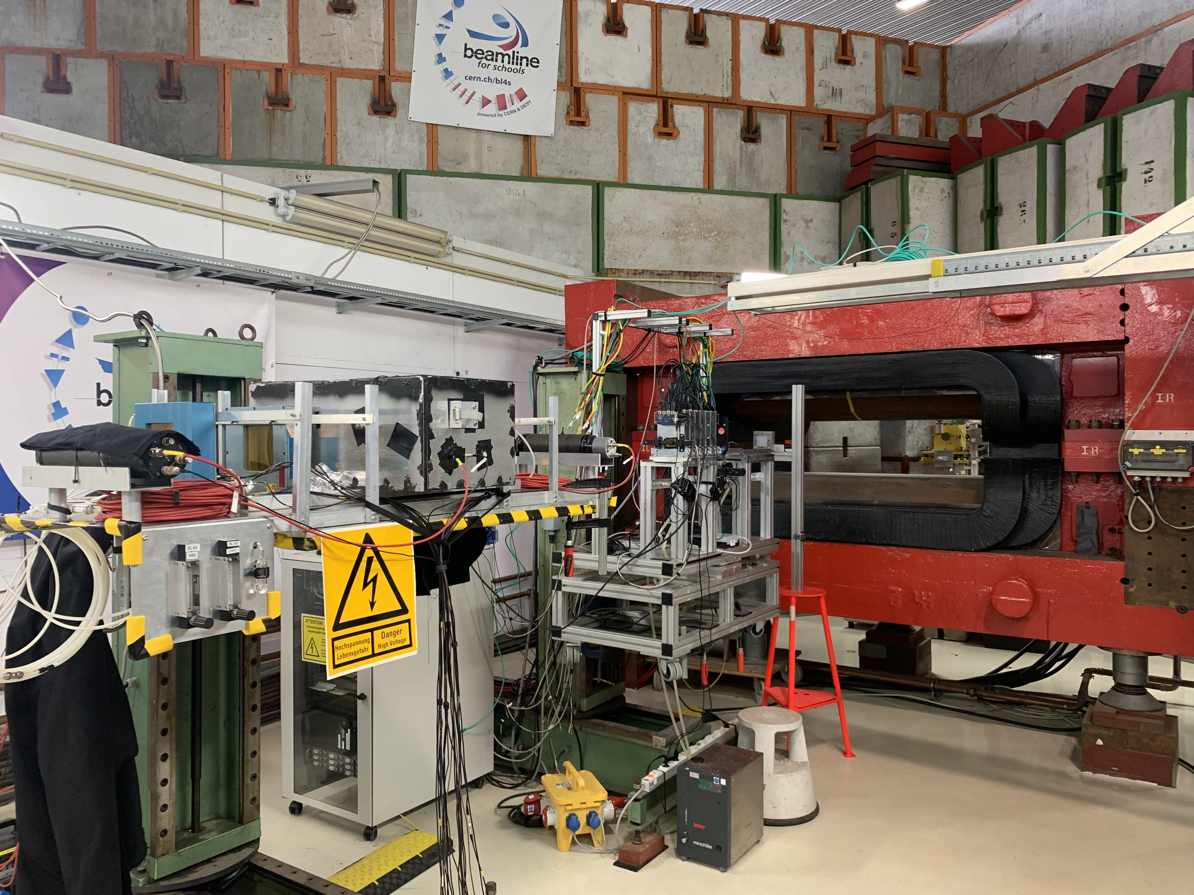
BL4S Beamtime - PS T10
Two experiment sessions: Week 29 for the concept validation, weeks 37 and 38 with students.
We don’t have an overview of the experiments yet.
Mixed hadrons, Energy range: 0.5 - 10 GeV, possible use of gases (MRPCs, DWCs, Micromegas).
Magnet?
M. Boselli | BL4S

