Slide 1
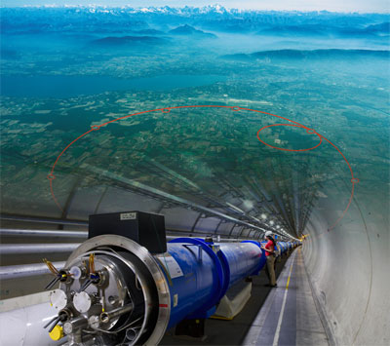

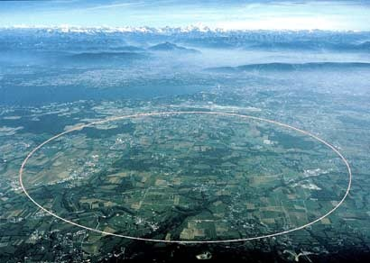
STEM Education Programmes and Opportunities for Bulgarian Students and Teachers at CERN
Svejina Dimitrova
Astronomical Observatory and Planetarium ”Nicolaus Copernicus” – Varna

Slide 2
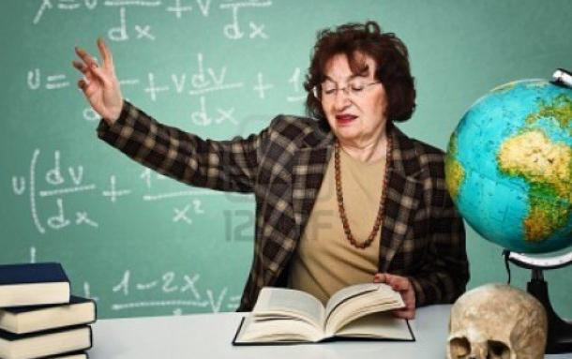

Slide 3
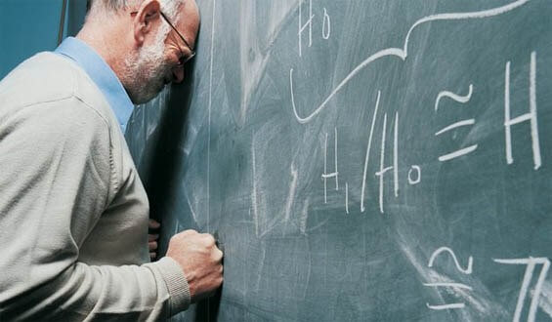

Slide 4


Slide 5
Cooperation between CERN and the Bulgarian educational system
13 Bulgarian Physics teachers programs
1 program for directors of MG and PMG
7 programs for engineering and IT teachers
Program - "From Galileo to CERN" - over 4200 students on visits to CERN
Video conferences with CERN Virtual visits
TEDxCERN 2016
International master classes.
Translation of materials from CERN
Exhibition at BAS – Sofia
2 Regional Scientific and Practical Conferences "CERN for Science and Society“
Festival "Science through art“
3 National conferences with international participation "Europe territory of knowledge "
Exhibition "Feeling of the Universe“
Sci Art Master Class at Science Festival 2017
CERN master classes Bulgarian internship program and many others

Slide 6
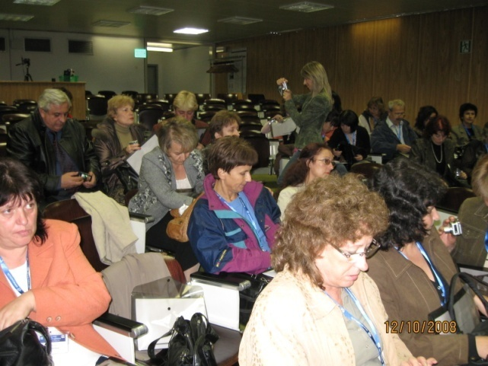
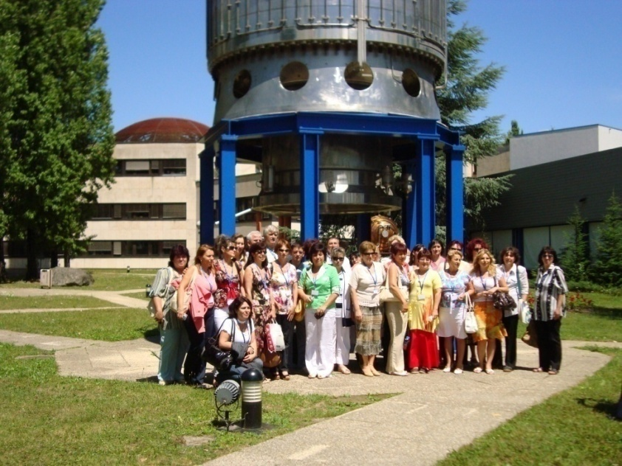
Bulgarian Physics and Science Teachers Programmes 2008 – 2022
12 – 18.10.2008
19 – 25.07.2009
http://teacher-programmes.web.cern.ch/ntp/bulgaria

Slide 7
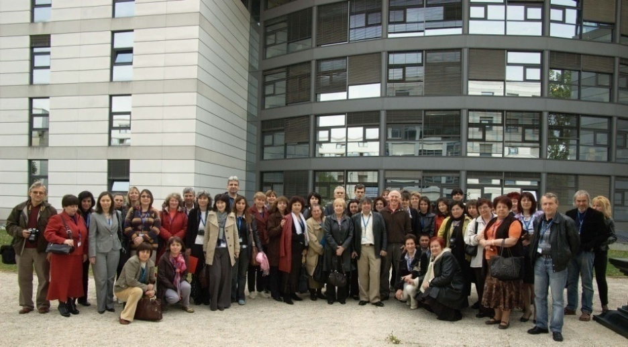
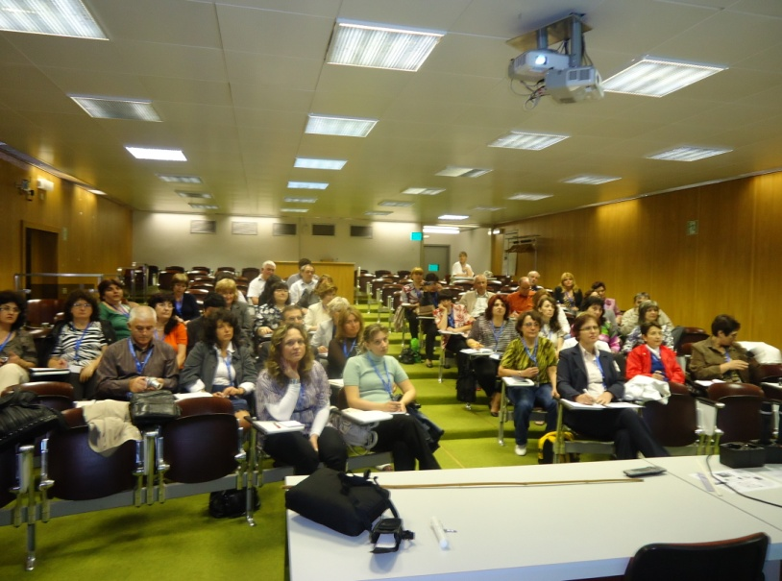
Bulgarian Physics and Science Teachers Programmes 2008 – 2022
24 – 30.07. 2011г
02 - 08.05. 2010г.
III Национална конференция с международно участие "Европа-територия на знанието" – 10 – 11.10.2019г.

Slide 8
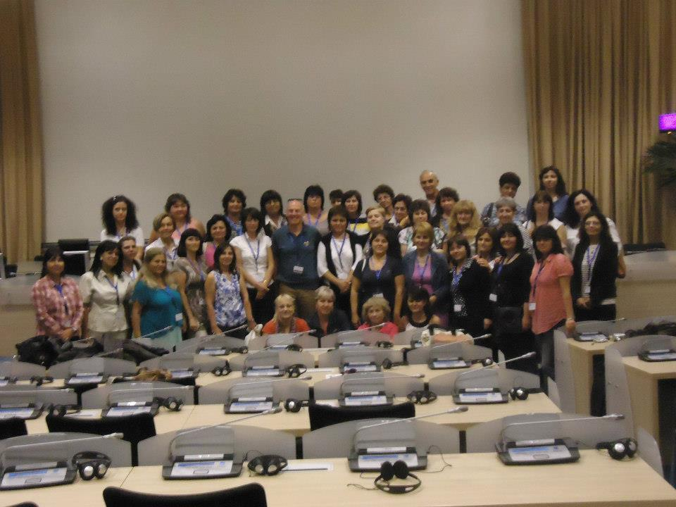
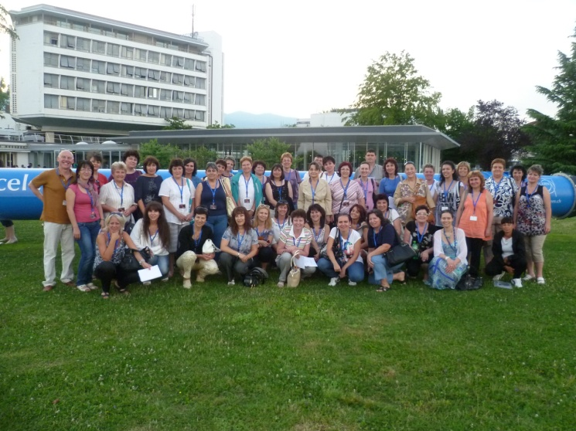
Bulgarian Physics and Science Teachers Programmes 2008 – 2022
16 – 22.09.2012
21- 27.07.2013

Slide 9
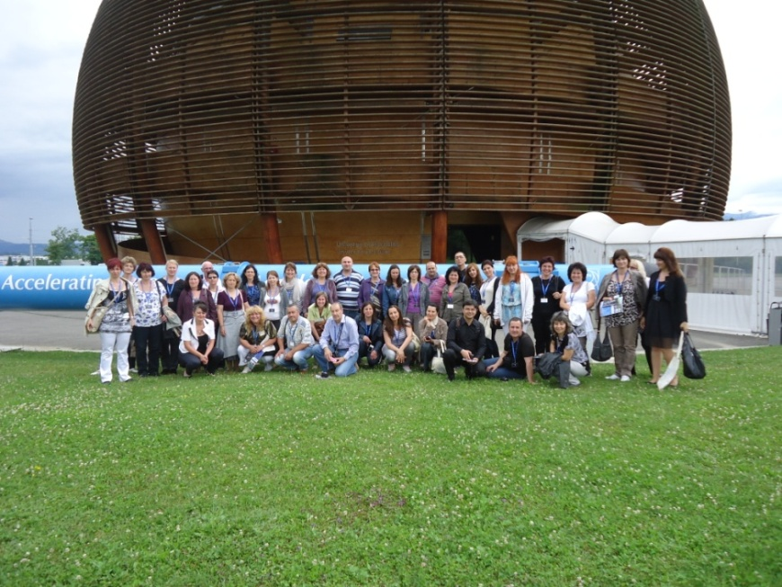
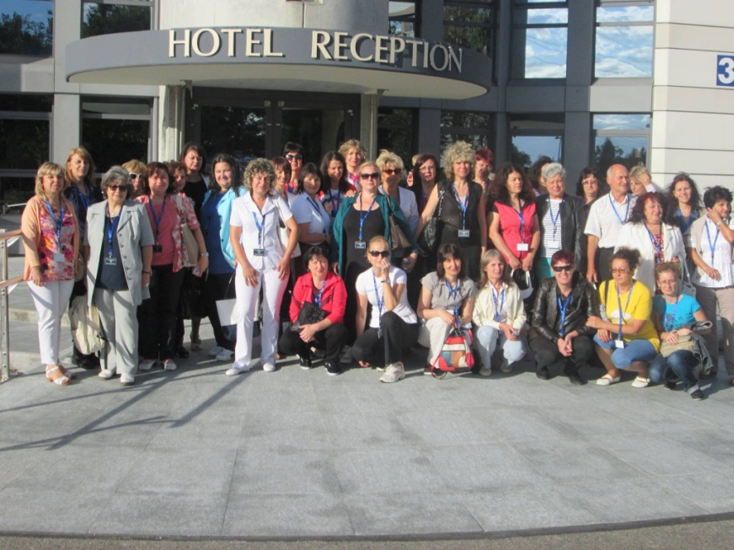
Bulgarian Physics and Science Teachers Programmes 2008 – 2022
27.07. – 02.08.2014
26.07. – 01.08.2015

Slide 10
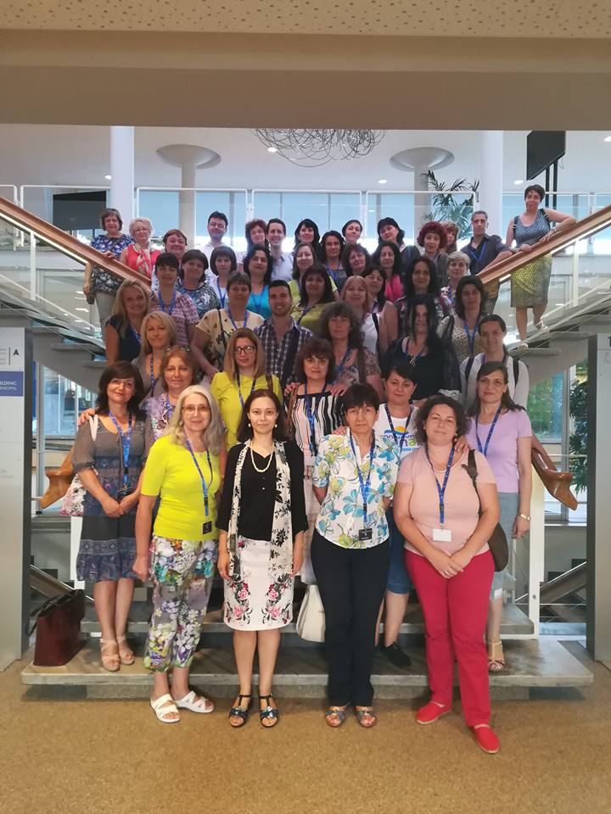
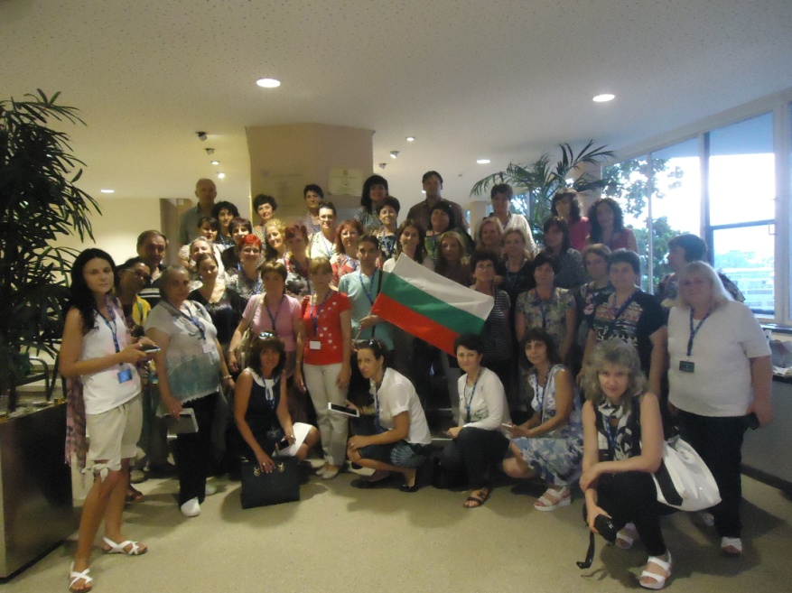
Bulgarian Physics and Science Teachers Programmes 2008 – 2022
24.07. – 30.07.2016
23.07. – 29.07.2017

Slide 11
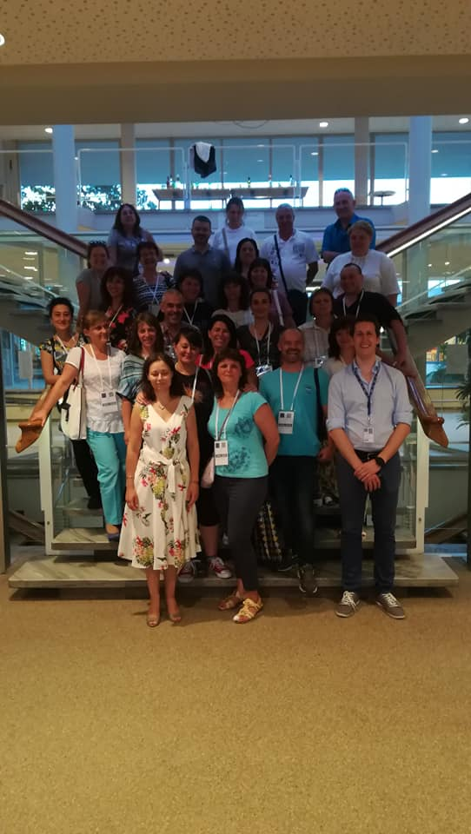
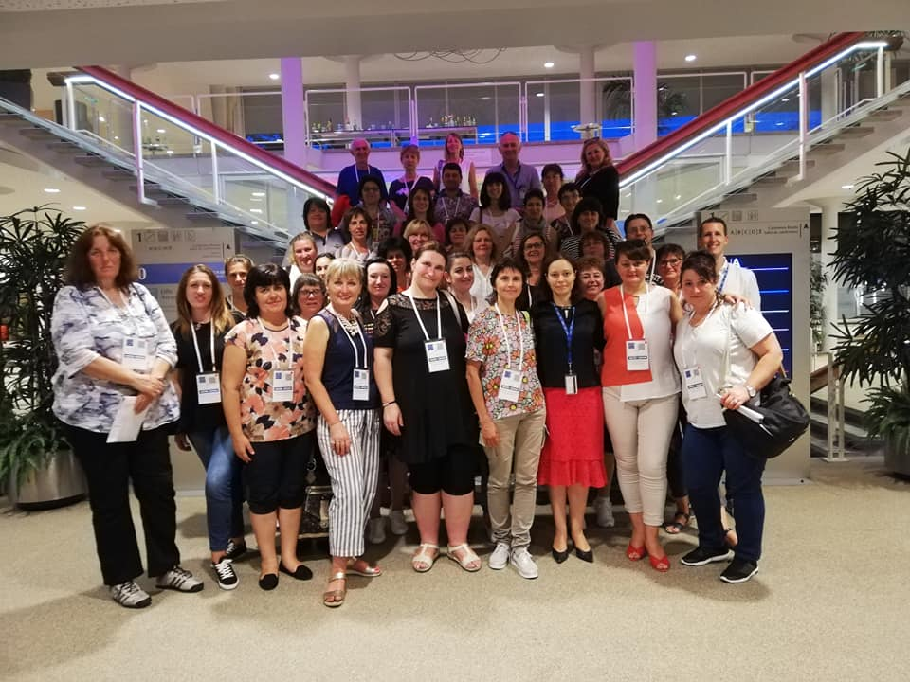
Bulgarian Physics and Science Teachers Programmes 2008 – 2022
22.07. – 28.07.2018
21.07. – 27.07.2019

Slide 12
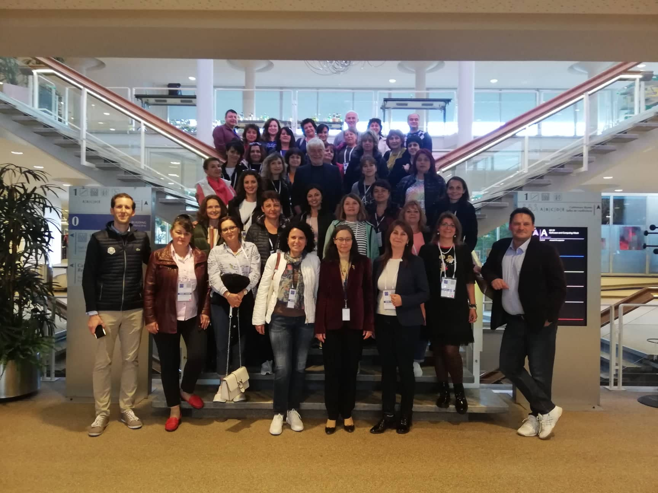
02.10. – 08.10.2022
Bulgarian Physics and Science Teachers Programmes 2008 – 2022

Slide 13
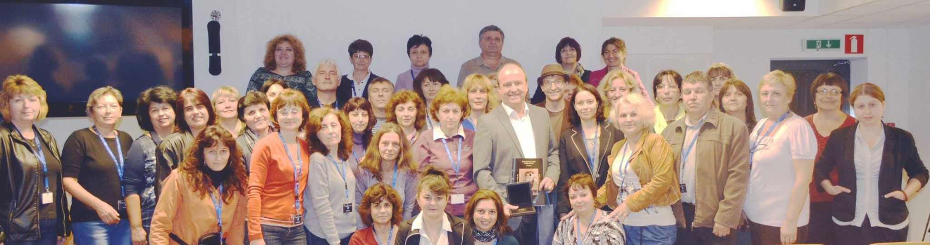
Bulgarian Engineering Teacher Programmes
2014 – 2022
2014
25th IPPOG meeting public events in Sofia

Slide 14
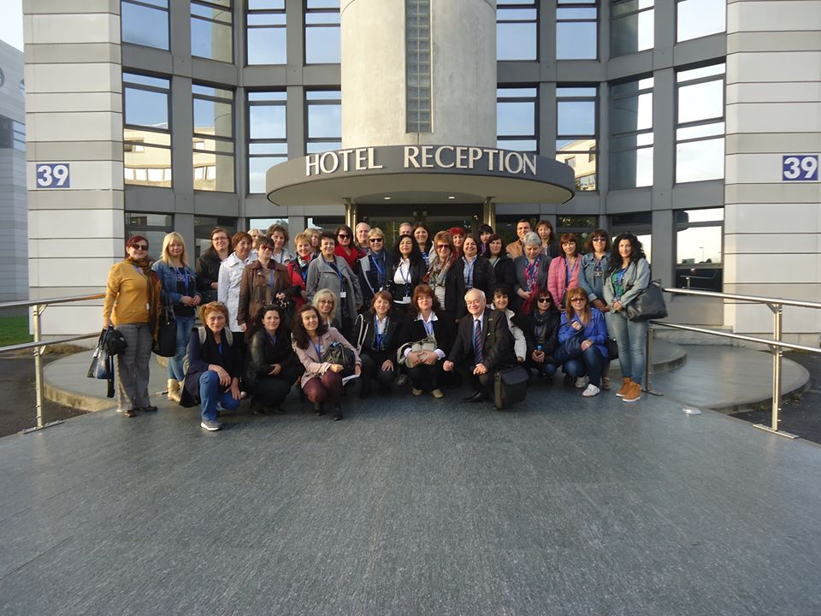
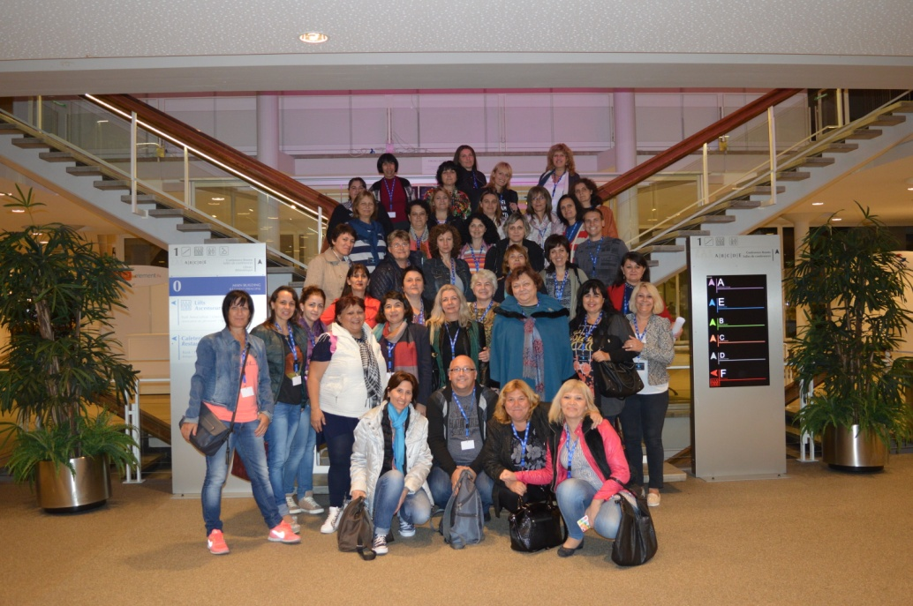
Bulgarian Engineering Teacher Programmes
2014 – 2022
2015
2016
25th IPPOG meeting public events in Sofia

Slide 15
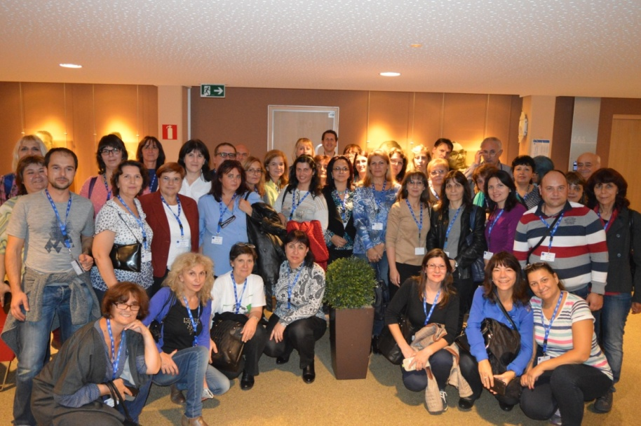
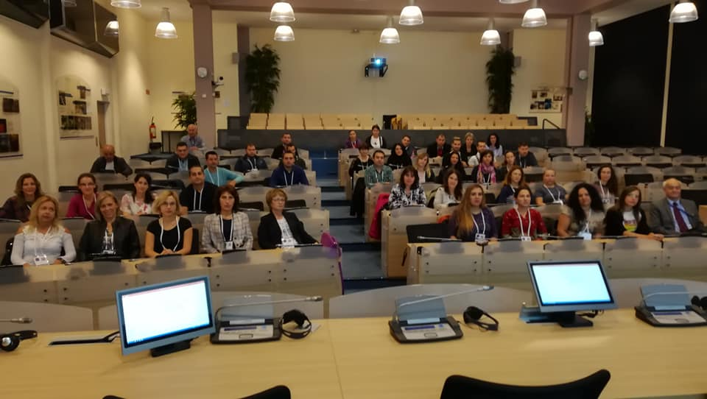
Bulgarian Engineering Teacher Programmes
2014 – 2022
2017
2018

Slide 16
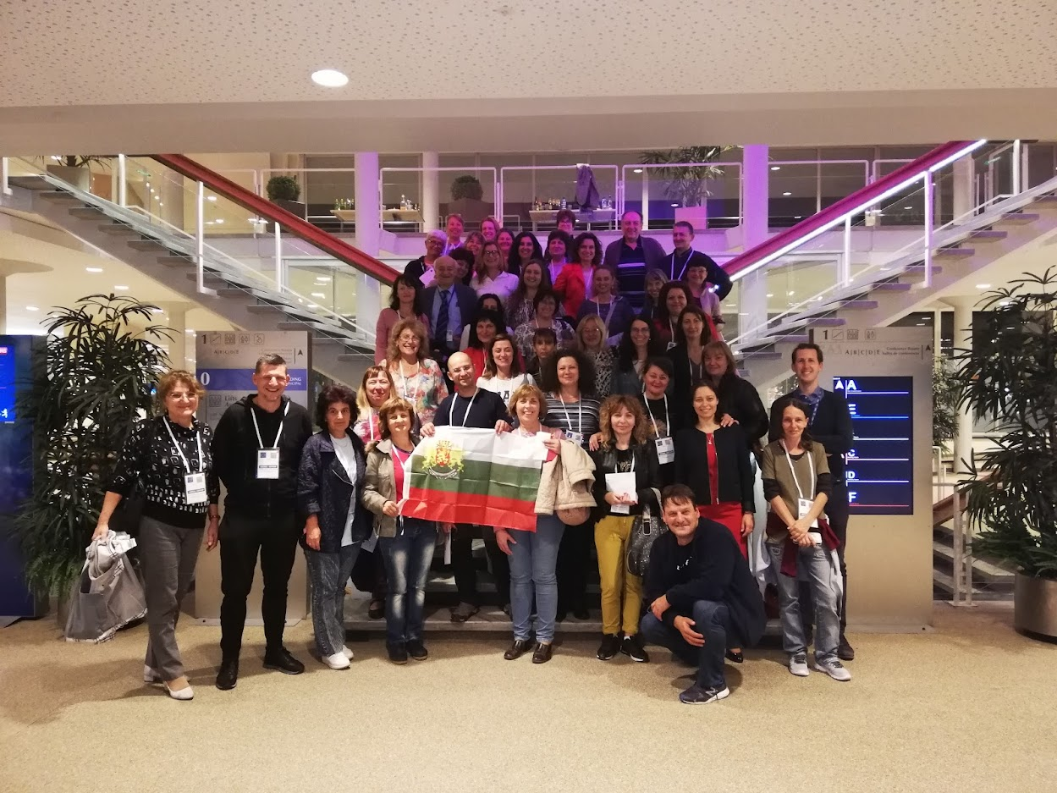
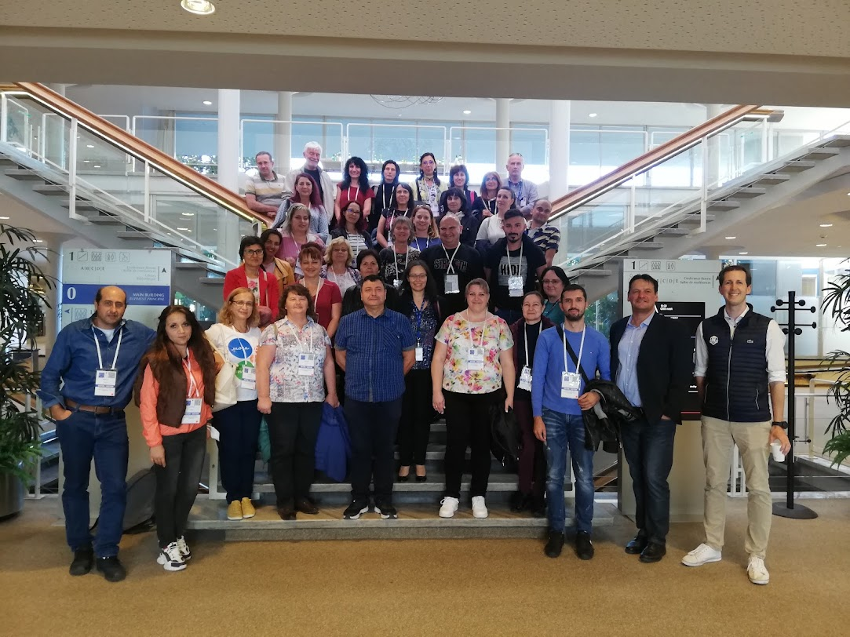
Bulgarian Engineering Teacher Programmes
2014 – 2022
2019
2022

Slide 17
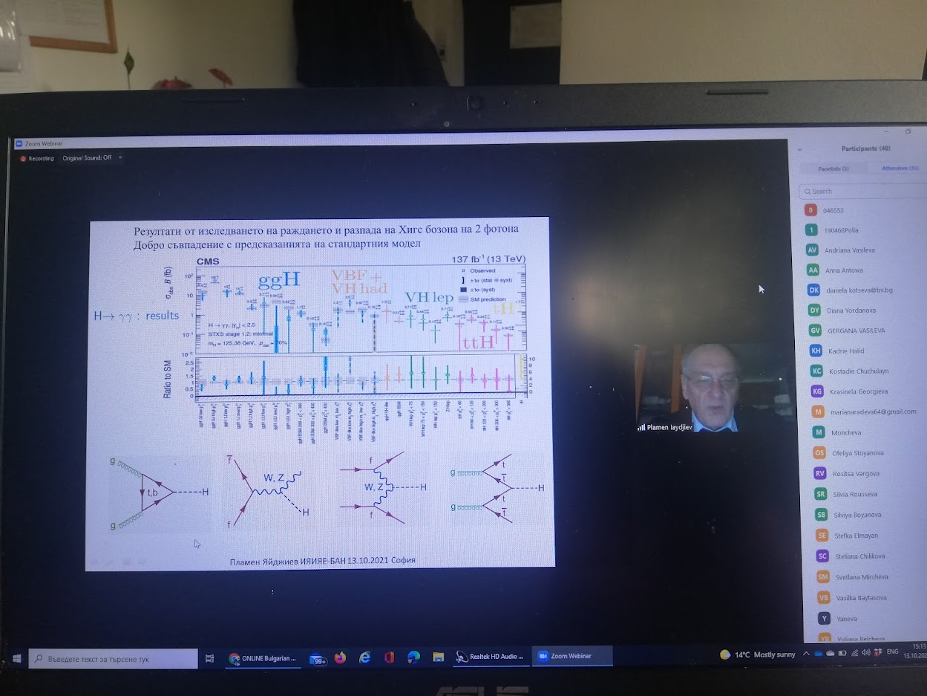
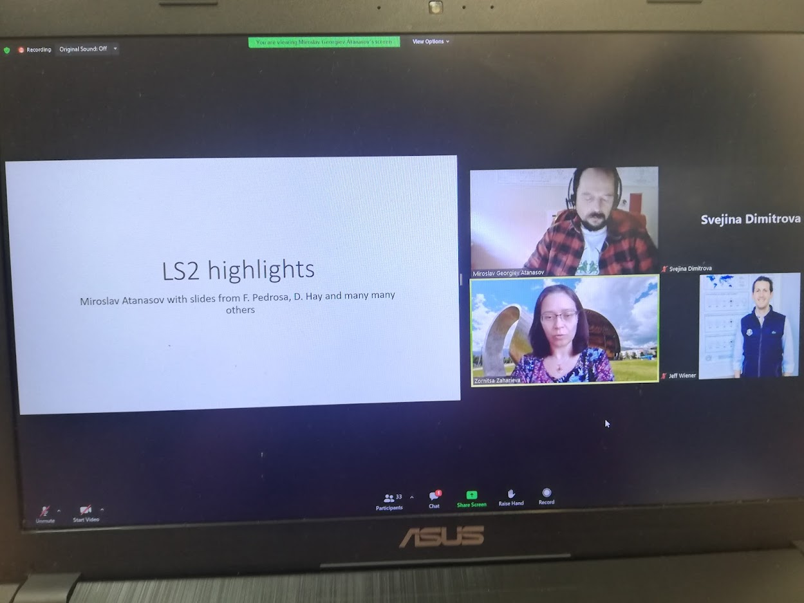
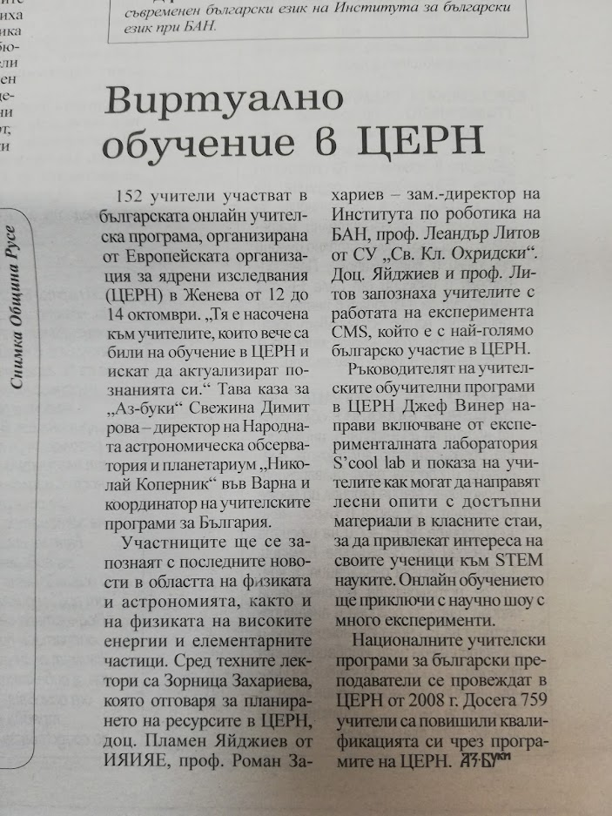
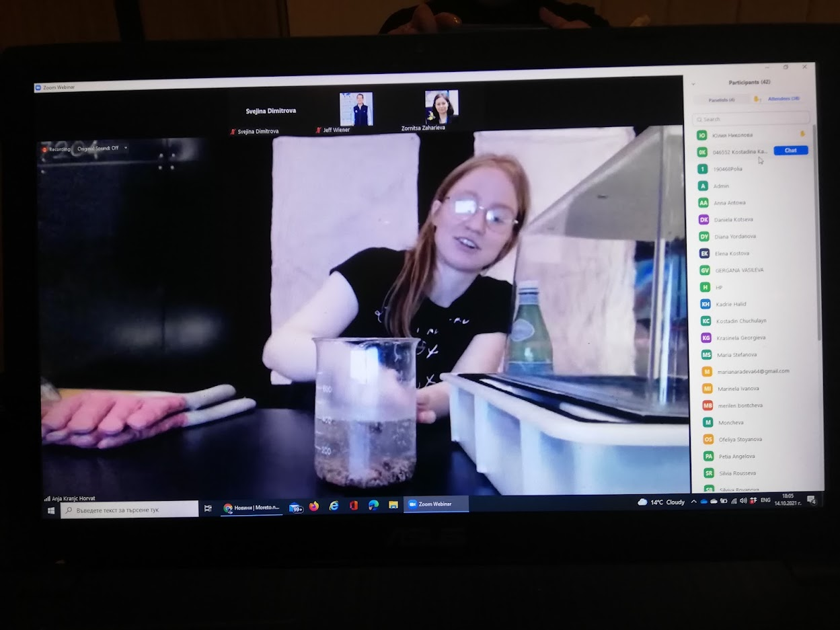
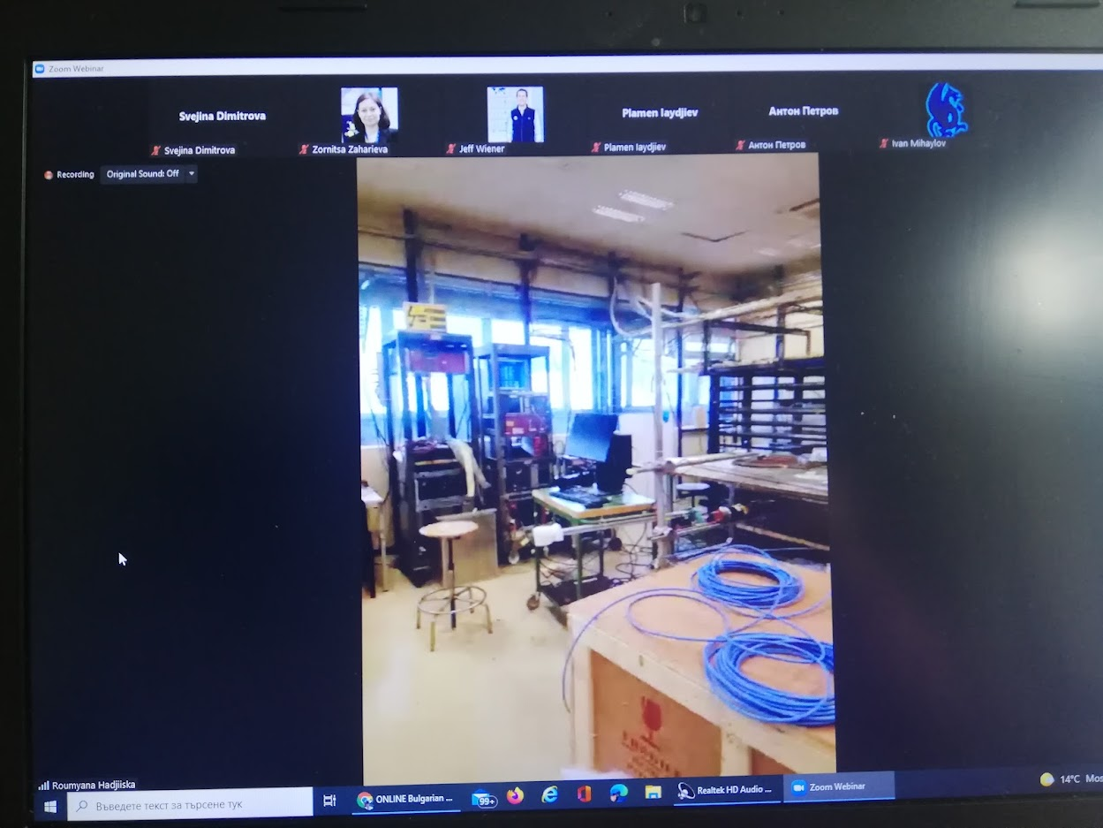
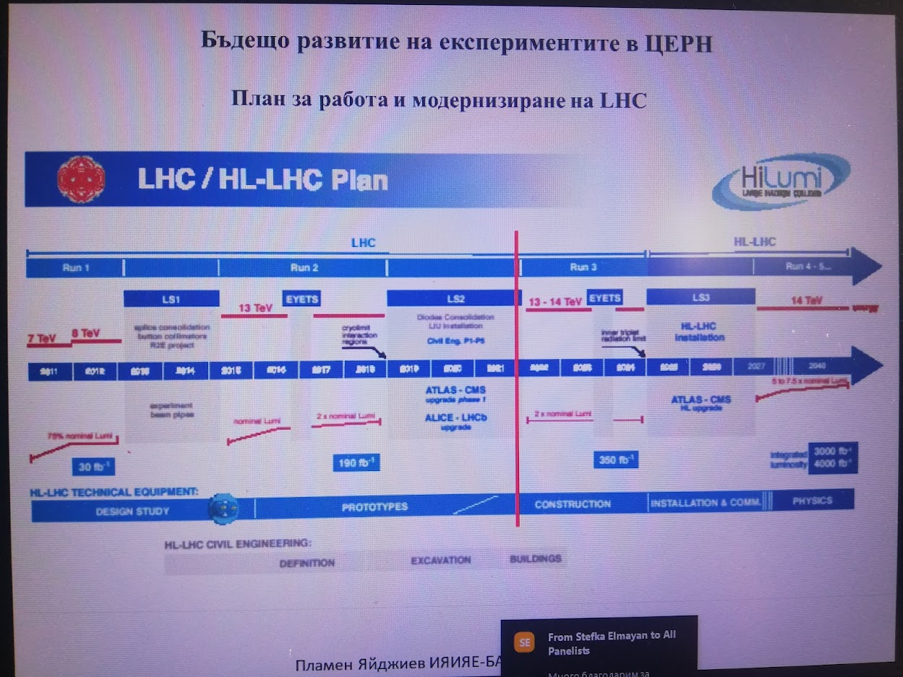
Virtual Programme

Slide 18
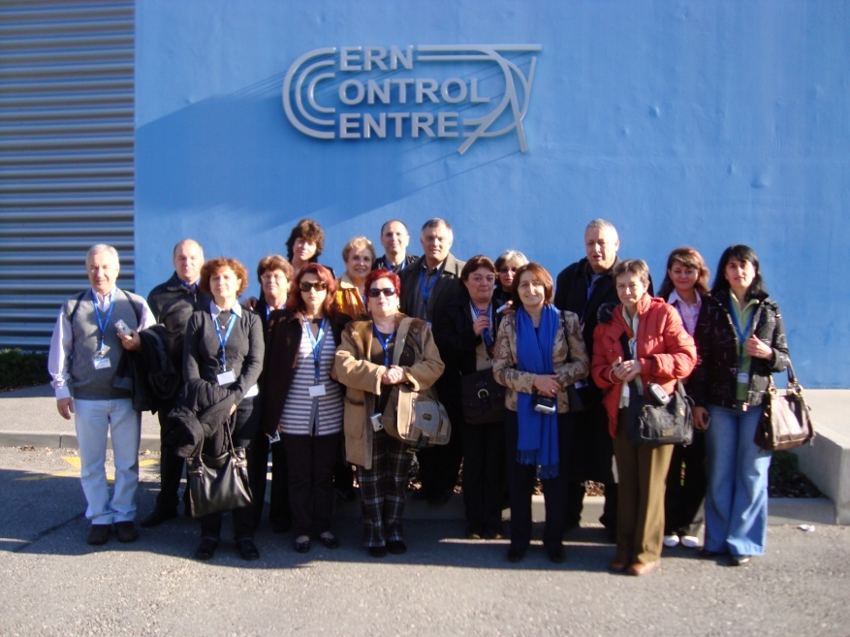
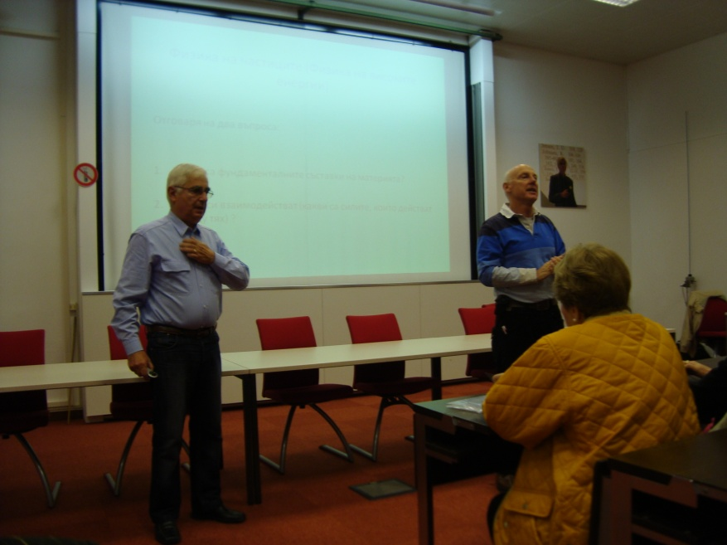
Programme for directors of Mathematics High Schools and Natural Sciences and Mathematics High Schools

Slide 19
Exhibitions for CERN and the Teacher programmes – 105
Presentations of teachers to their colleagues and students
Participation with the CERN theme in the national competitions for Internet lessons - "Physics in my eyes" and "Celestial Treasure Hunters" and every physics conference
"Friends of CERN" clubs
Making posters, brochures and drawings
Preparation of a scientific theater for the scientific-practical conference "CERN for science and society" Making crosswords
Preparation for quizzes, competitions and school conferences
Making models
Student visits in CERN
Scientific and practical conferences "CERN for science and society"
Communication of science and technology and relations with the public and the media on the subject of CERN and the Bulgarian participation
Participation with models in the national competition "Cosmos - present and future of humanity“
Visited the "Feeling of the Universe" exhibition and many others. etc.
Activities after the Teachers Programmes
Notes:
19

Slide 20
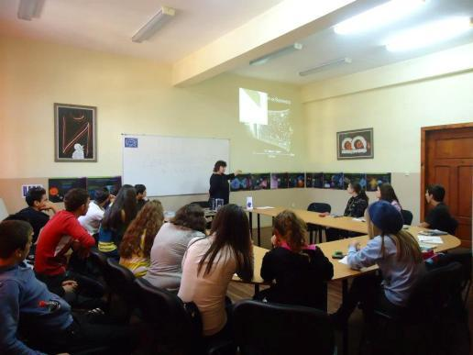
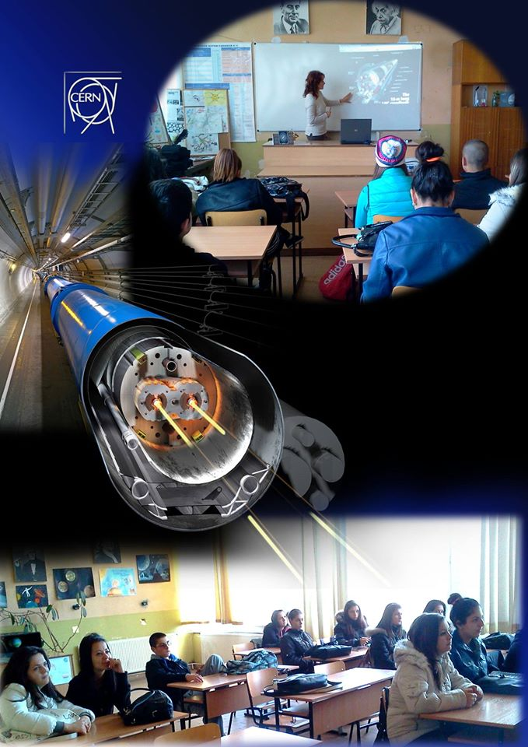
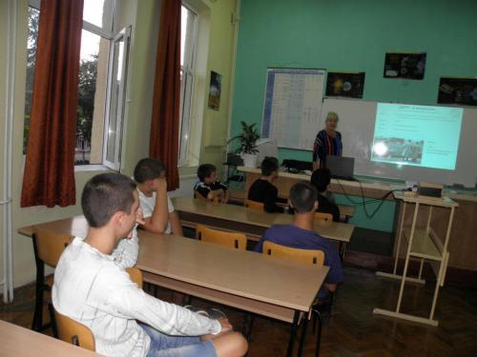
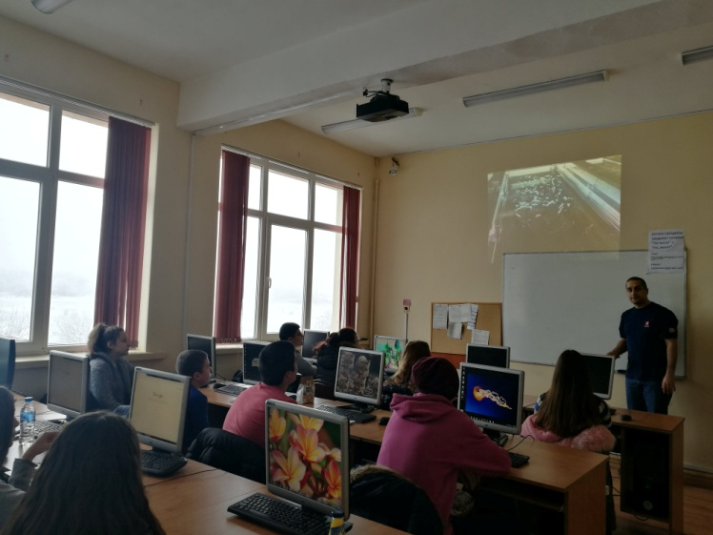
Activities after the Teachers Programmes
In the classroom

Slide 21
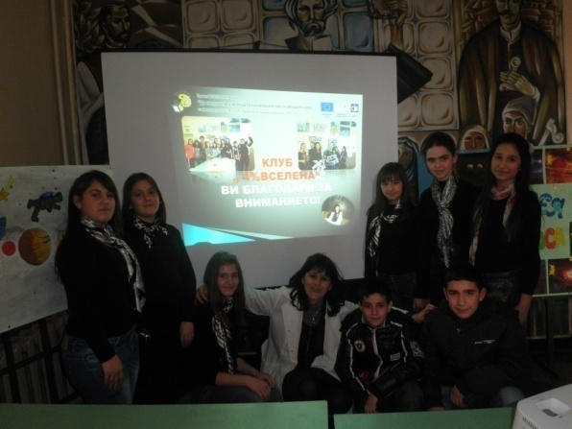
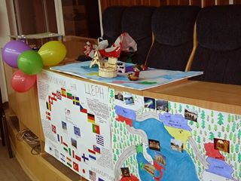
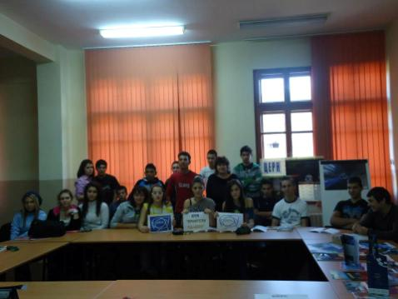
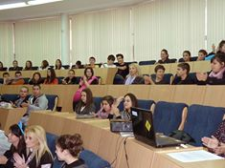
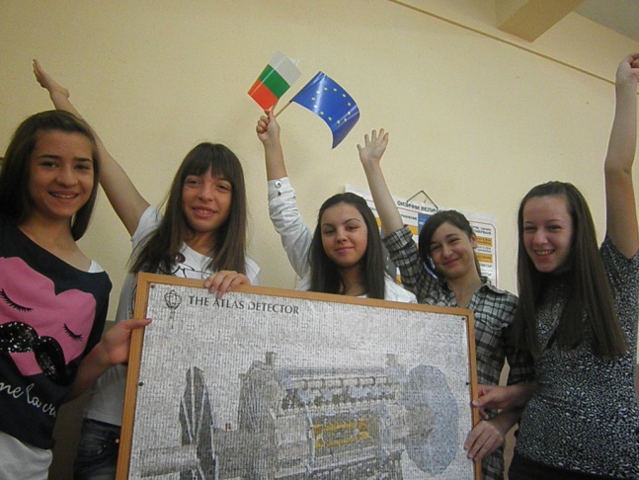
Clubs „CERN friends”

Slide 22
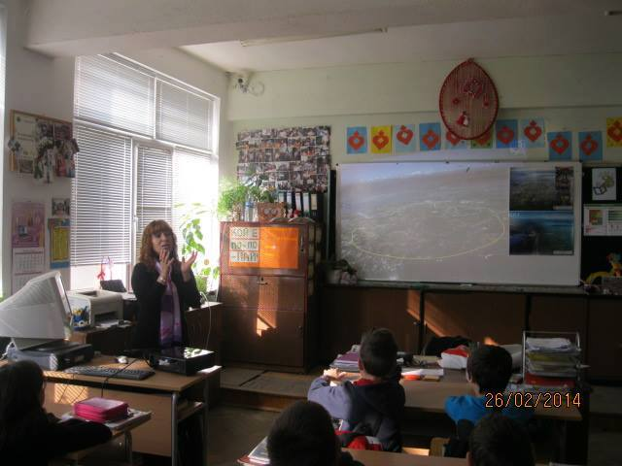
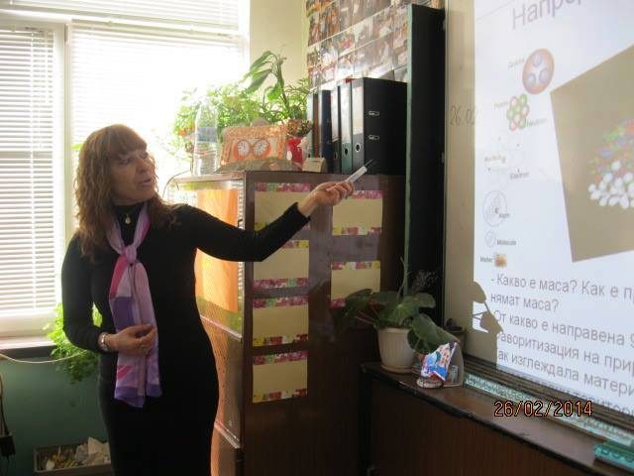
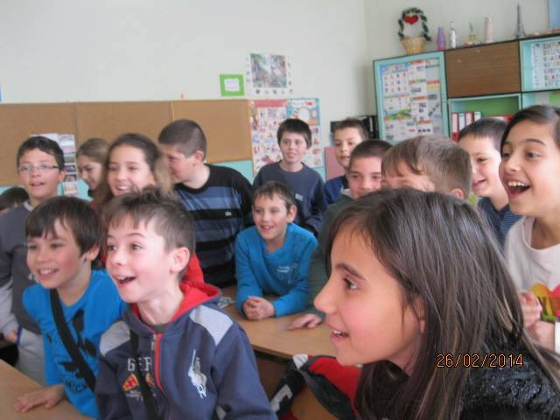
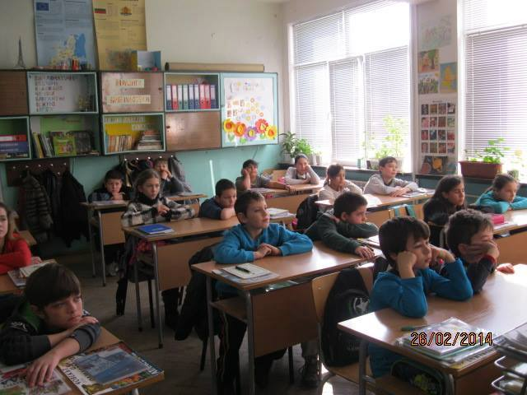
Once upon a time........... in 4th grade
(10 years old children)

Slide 23
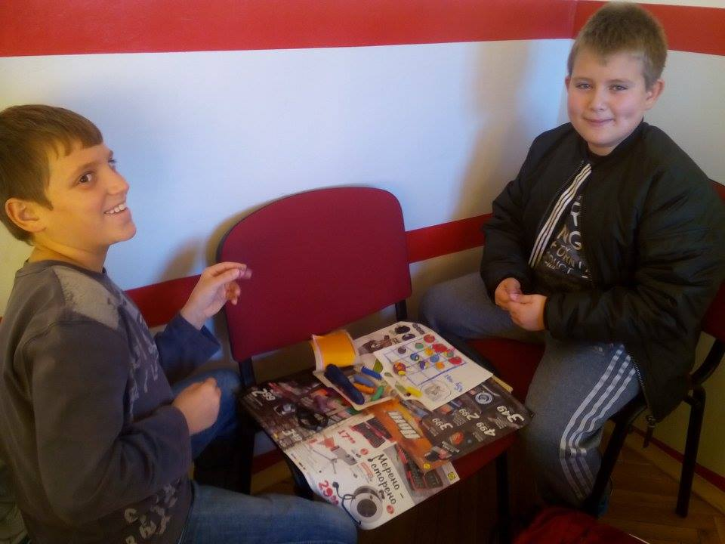
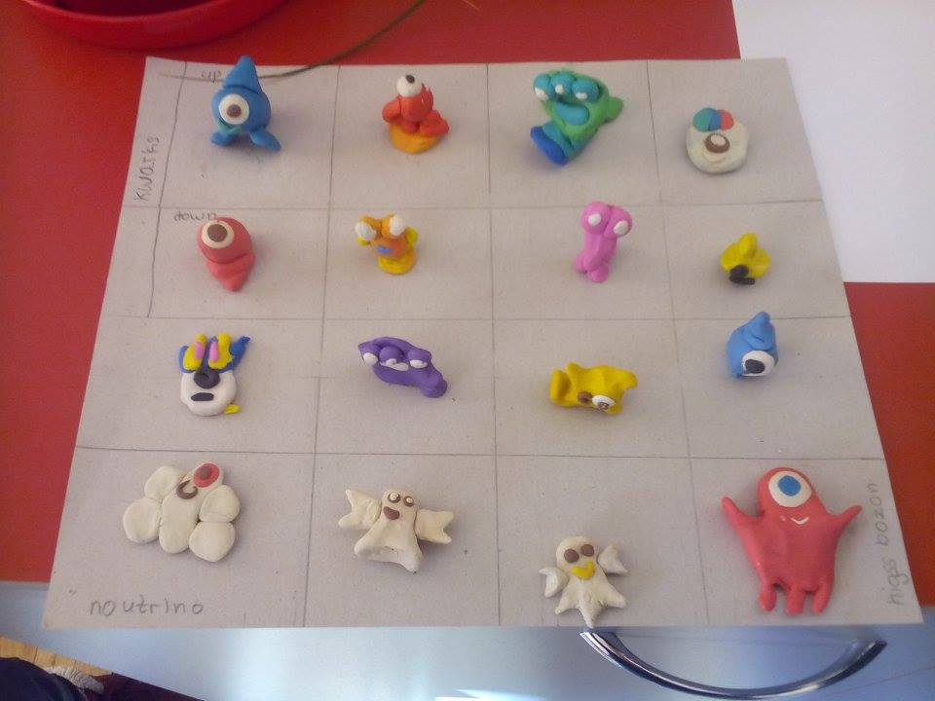
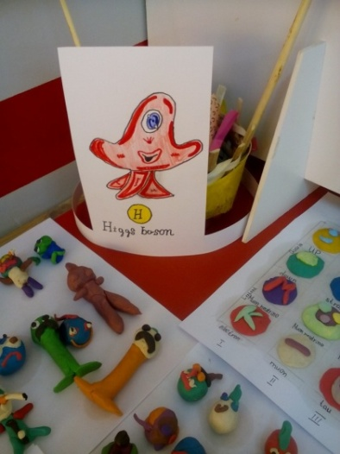
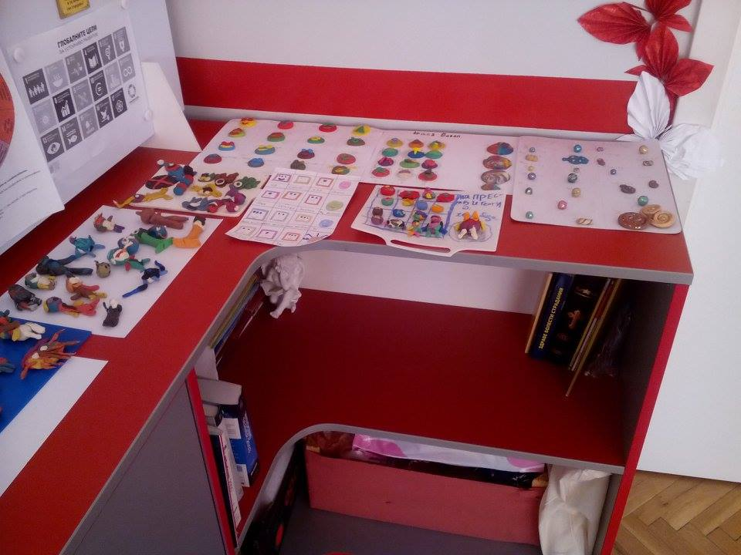
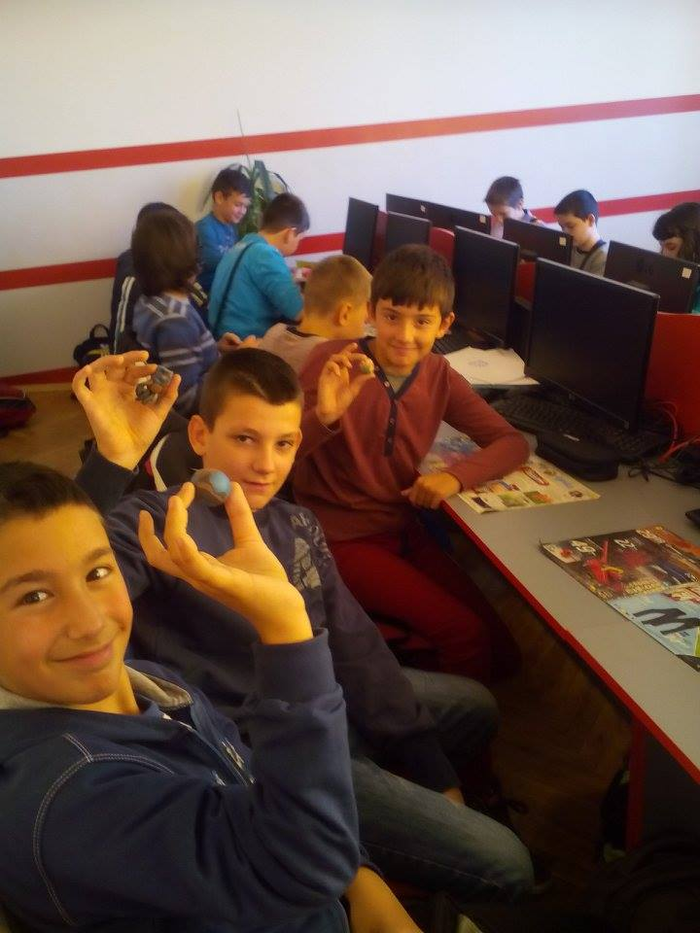

In the world of particles

Slide 24




Face to face with colleagues

Slide 25





Teachers train teachers

Slide 26





Slide 27




Conferences

Slide 28



Virtual excursion to CERN
Ученици от 11 б клас ни „отведоха” в ЦЕРН
Последните часове по физика на учениците от гимназиален курс в нашето училище бяха проведени по начин, различен от типичния. Учениците на г-жа Семова от 11 б клас ни заведоха на виртуална екскурзия до най-голямата лаборатория по физика на елементарните частици – ЦЕРН. Екскурзиите се проведоха от 18 февруари /седмицата, в която е роден италианският физик и астроном Галилео Галилей/ в часовете по физика на 9, 10 и 11 клас.
Началото на всяка екскурзията бе дадено от туроператора Ивана Бобекова, която приветства „пътниците”. Екскурзоводът Милица Тильовска запозна „туристите” с по-големите забележителности на държавите, през които минава пътят до ЦЕРН. Част от тези забележителности бяха Плитвишките езера в Хърватия, също така и едни от най-красивите градове в Европа – Рим и Венеция в Италия. След дългия, изтощителен път, най-накрая автобусът достигна до Женева, града, в който се намира крайната цел – Европейската организация за ядрени изследвания /ЦЕРН/. Любознателните туристи бяха посрещнати от Мария Недева, който разказа за района на лабораторията, общежитията и начина на живот на работещите там. За следващата спирка, а именно посетителският център „Глобус на науката и иновациите”, в който са показани изследванията, провеждани в ЦЕРН, ни каза повече Йоана Ботева. Цветомир Михлюзов заведе „посетителите” под земята, където се намират ускорителите и където се провеждат експериментите, свързани с елементарните частици. Работата на ускорителя ALICE и експеримента LHCb бе представена от Жана Загарьова. С Големия Адронен Колайдер (LHC) ни запознаха Катя Шаркова и Нелина Петришка. Благодарение на видеото, съпроводено с интересните разкази на екипа, което бе изготвено от тях, учениците почувстваха атмосферата на ЦЕРН. След като изязоха от лабораторията, екскурзоводът Ивана разведе „туристите” из красотите на Женева. В края на екскурзията, г-жа Радка Семова разказа за своето преживяване в лабораторията, което стана лятото на миналата година, и показа снимки от него. Шофьорът на автобуса, Теодор Куртев, ни показа интересни сувенири, които г-жа Семова бе донесла от своето посещение.
Йоана Ботева

Slide 29





Physics and astronomy competition - "The world of CERN"

Slide 30

School sites

Slide 31







Media publications over 400
https://dobrichonline.com/novini/49170/priklyuchenie-vdkhnovenie-chudoto-tsern?fbclid=IwAR2JSvWxwUtKX5AWfmWUvy_qkMmGZZP5u5kb4-10IkMDNzo_jKT1mP6V7zc

Slide 32




Pressconferences
https://www.facebook.com/eratv.bg/videos/666758853479029/

Slide 33








School exhibitions- 105

Slide 34









Slide 35




Meeting with Bulgarian scientists at school

Slide 36





Virtual visits and videoconferences

Slide 37

TEDxCERN – Live streaming
5.11.2016, 14:30–19:30ч.

Slide 38





On December 15, 2016 - students and teachers from 18 Bulgarian schools on a virtual visit!

Slide 39

Virtual visit in CERN
The event was a gift from the scientists at CERN and IPPOG for the participation of students from SU "Antim I" in the International Competition "Particles4u" and their ranking at the final stage.

Slide 40

CERN International Masterclass
40

Slide 41

First International Masterclass 26.03.2018

Slide 42






Slide 43





High school "Hristo Botev" in Dupnitsa and SU "Nikolai Katranov" - Svishtov were part of W2D2- 18. A 24-hour period from 0.00 a.m. to 12.00 a.m. midnight, in which students from 19 countries around the world analyzed real data from Large Hadron Collider and then shared their results via an extended video conference with moderator physicists around the world.
15 November 2018 World Wide Data Day 2018

Slide 44
World Wide Data Day
World Wide Data Day or the world day for data analysis from experiments at CERN
https://quarknet.org/content/world-wide-data-day
The event consists of a video conference with moderator physicists and other students from around the world.

Slide 45






Integrated science lesson

Slide 46




First school visit in CERN–
29.03 – 08.04.2010
Issue No. 21-22/2010 - Monday 24 May 2010
150 Bulgarian students visit CERN
Between 27 March and 8 April 2010, 150 Bulgarian students from the Astronomical Observatory in Varna visited CERN as part of the “From Galileo to CERN” programme.

Slide 47


Students for visits

Slide 48






Students and teachers in CERN

Slide 49







Scientific practical conference
”CERN for science and comunity”

Slide 50








Slide 51




CERN anniversary - 60th years

Slide 52



Slide 53


Workshop - 12 May 2018
Art@CMS
Art @ CMS is an innovative program created in collaboration between CERN scientists, artists, arts and science teachers.

Slide 54






20 years Bulgaria in CERN

Slide 55


Hello Space– 13th September 2022
Sofia Teh Park

Slide 56


Facebook groups

Slide 57



Second International forum of education, Varna
7 – 9 September 2022

Slide 58

Under the patronage of the Minister of Education and Science
Participants: deputy minister of education, MP, experts from the Ministry of Education and Science, representatives of the education office at CERN, of the INIAE, representatives of universities and research laboratories and 200 teachers
The main goal – exchange of experience and knowledge in the field of natural sciences.
Providing the opportunity for teachers, lecturers, scientists and researchers to exchange ideas and find partners for future joint work.
Presentation of reports and presentation of good practices.
Discussions and debates in the following areas:
Interdisciplinary connections - presentation of good pedagogical practices
Teaching of natural sciences and the connection between secondary and higher education
Memorandum for the Ministry of Education and Science

Slide 59




http://www.zonaznanie.com

Slide 60



SECOND NATIONAL CONFERENCE WITH INTERNATIONAL PARTICIPATION "EUROPE - TERRITORY OF KNOWLEDGE", VARNA OCTOBER 05 - 07, 2017

Slide 61




III National Conference with international participation 10 - 11. 10. 2019

Slide 62
Student programs at CERN
Bulgarian High-School Student Internship Programme - 3 - 16 September 2017
Beamline for schools – cern.ch/BL4S
S’Cool LAB day - cern.ch/scool-lab
CERN visits with students

Slide 63

Bulgarian High-School Student Internship Programme 2017

Slide 64


Bulgarian High-School Student Internship Programme - 3 - 16 September 2017

Slide 65

https://beamline-for-schools.web.cern.ch/sites/beamline-for-schools.web.cern.ch/files

Slide 66
Outcomes of the programs for teachers and students
  Motivating students to focus and develop their abilities in physics, mathematics, informatics, etc.;
  Enrichment of the school program with the latest achievements in the field of physics, engineering developments and information technologies;
  Organization in schools - exhibitions, presentations, quizzes, poster sessions, 'Friends of CERN' clubs and many other assets;
  Encouraging students' curiosity and creativity;
  An opportunity to touch the modern science that is being developed at CERN;
  Motivating students to continue their education in physics, engineering disciplines, mathematics and informatics;
  Developing and upgrading the qualifications of teachers;
  Building professional networks between the teachers participating in the programs and between teachers and scientists.

Slide 67


As CERN ambassadors, the teachers are:
Motivated and Confident
Inspirational and motivating
Sharing experiences with your students!
Sharing experience with colleagues!
Sharing experiences with the general public!
Acting as ambassadors for CERN and high energy physics
Organizing various activities
Promoting CERN programs

Slide 68
Thank you for your attention

Slide 69
The aim of the Programme?
STIMULATE AND SUPPORT THE INTEREST OF STUDENTS AND TEACHERS IN MODERN SCIENCE AND EDUCATION
Motivating them for deeper study and teaching of physics, chemistry, informatics and engineering disciplines;
Supporting the creative understanding and transformation (development) of the world;
Increasing scientific and technological culture
Inspire A DESIRE TO DISCOVER THE UNKNOWN AND A SENSE OF DISCOVERY
Motivating students to study physics and natural sciences, informatics and technical disciplines at universities and to choose the profession of researchers, and teachers to continuously develop their qualifications
Training the future generation of physicists, chemists, engineers - researchers and teachers

