Slide 1
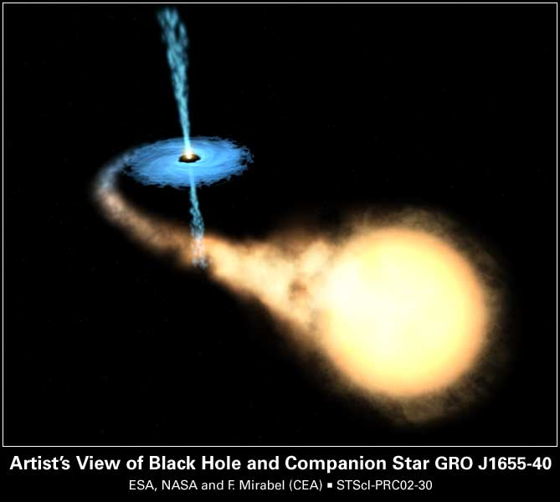
BLACK HOLES:
The Most Extreme Laboratories of the Universe
Maxim TITOV, CEA Saclay, France
(maxim.titov@cea.fr)
3rd ONLINE CERN – UKRAINE
Teachers Program
APRIL 24-28, 2023

Slide 2
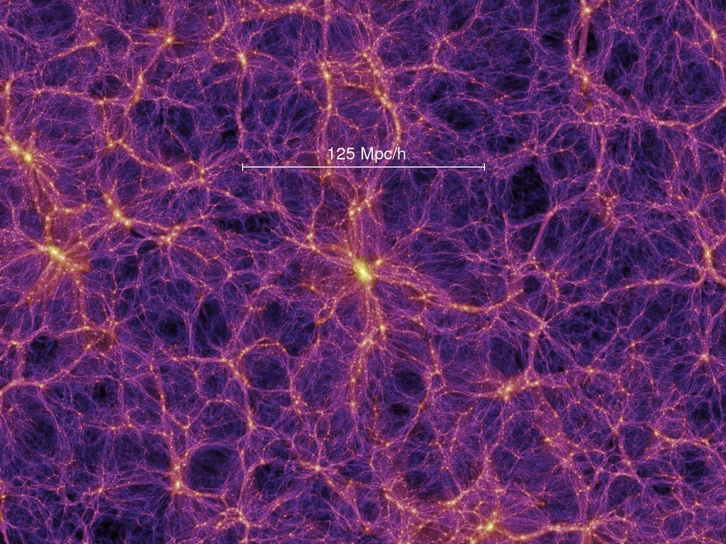
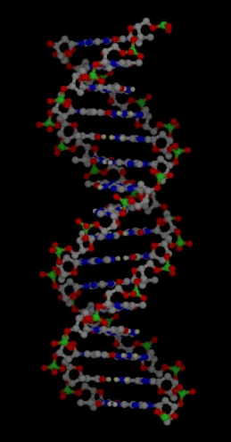

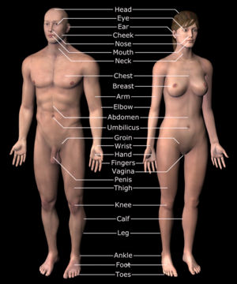
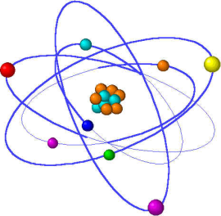

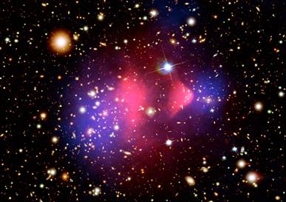
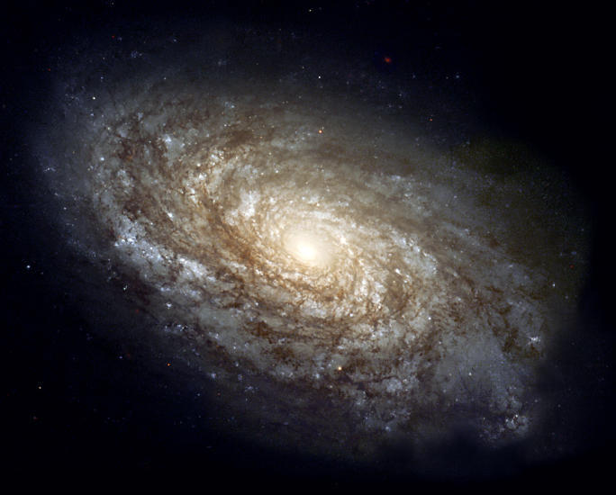
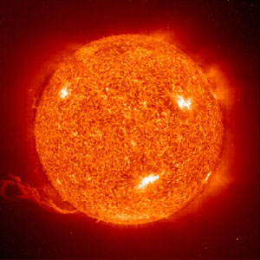
What is everything made of ? What holds it all together ?
Where did we come from?
Why do we exist?
Colliding galaxies reveal dark matter

Slide 3
What is Particle Physics ?
Particle Physics = Study of
Fundamental Laws of Nature
governed by still-mysterious union of
Quantum Mechanics + Spacetime
We are about to take a journey into the world of Black Holes:
They allow us to probe extreme conditions and fundamental physics
They are influential for formation and evolution of galaxies

Slide 4
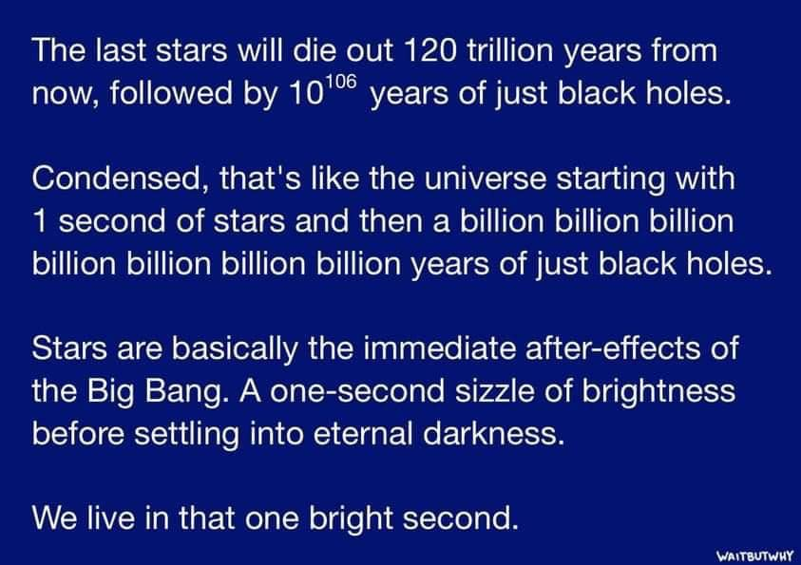
What is everything made of ? What holds it all together ?

Slide 5
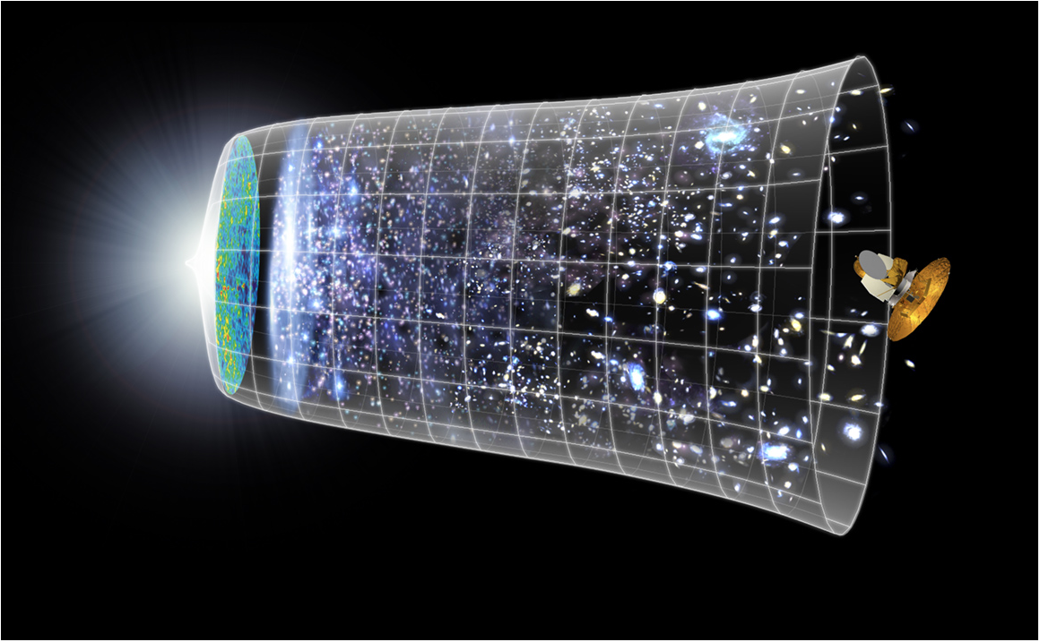
Today’s Scientific Challenge
to understand the very first moments of our Universe after the Big Bang
What
happened then ?
Big Bang
WMAP
How particle collider
and telescopes relate?
13.7 Billion Years,
10²⁸ cm
Today
What is Universe made of ?

Slide 6
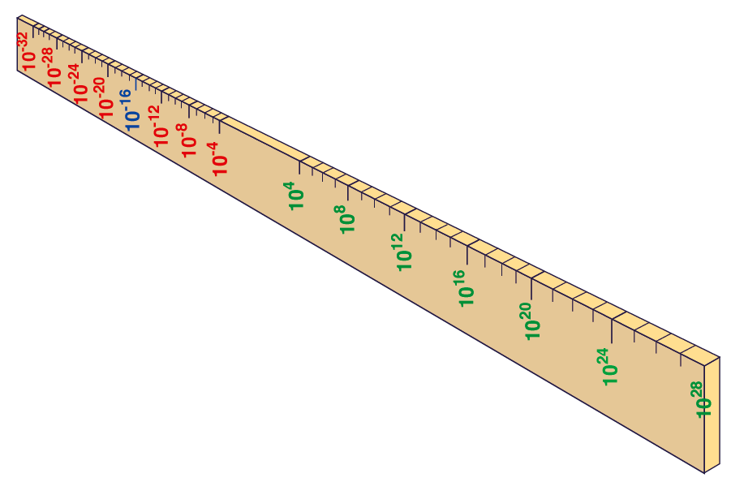
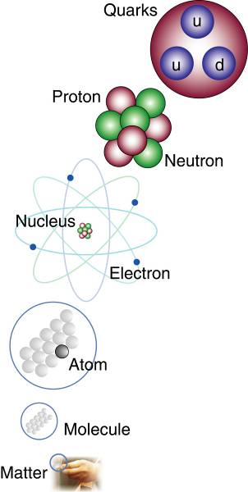
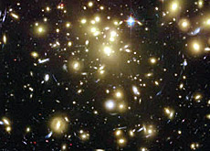


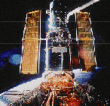
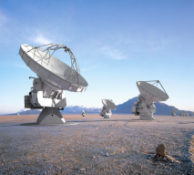
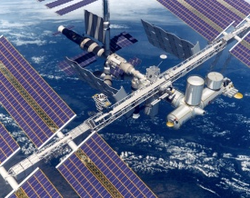
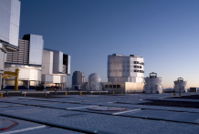
PHYSICS OF TWO INFINITIES
Big Bang
Proton
Atom
Radius of Earth
Earth to Sun
Radius of Galaxies
Universe
LHC
Super-Microscope
Hubble
ALMA
cm
We are entering a golden age of synergy between studies of the very small and the very big.
Extra dimensions may solve many known fundamental problems.
AMS
VLT

Slide 7
Brief History of Our Universe and Physics at LHC
Electro-weak phase
transition (Higgs,…)
QCD phase transition
(quark gluon plasma)
LHC studies the first
10⁻¹⁰ - 10⁻⁵ seconds…

Slide 8
Matter Content of Our Universe
→ We know only 5% of it ...
Dark Matter (27%) → Can be detected only from its gravitational effects
Dark Energy (68%) → Expansion of Universe is faster than “expected” (Big-Bang + relativity)

Slide 9
If, in some cataclysm, all of scientific knowledge
were to be destroyed, and only one sentence
passed on to the next generation of creatures,
what statement would contain the most
information in the fewest words? I believe it is
the atomic hypothesis that all things are made
of atoms —little particles that move around in
perpetual motion, attracting each other when
they are a little distance apart, but repelling
upon being squeezed into one another.
In that one sentence, you will see, there is an
enormous amount of information about the
world, if just a little imagination and thinking
are applied.
– Richard Feynman

Slide 10
RICHARD FEYNMAN
There’s Plenty of Room at the Bottom (1959)
“The principles of physics do not speak against the possibility of maneuvering things atom by atom.”

Slide 11
The Quantum World of Particle Physics
Квантовый мир физики элементарных частиц очень далек от нашего, поэтому его законы часто кажутся нам странными и контр-интуитивными. У человека существует, видимо, глубокая психологическая потребность сводить все явления окружающего мира к простым, понятным образам. Удивительный факт заключается в том, что предсказания квантовой физики подтверждены экспериментально гораздо точнее, чем классической механики и теории относительности Эйнштейна. В 1959 году величайший физик XX века Ричард Фейнман выступил с докладом «Внизу полным-полно места: приглашение в новый мир физики» («There’s Plenty of Room at the Bottom: An Invitation to Enter a New Field of Physics»), где была обрисована перспектива прямого манипулирования индивидуальными атомами и фотонами. Однако реальные очертания эти идеи стали приобретать к началу 80-х, прежде всего, в связи с изобретением сканирующего туннельного микроскопа, отмеченного уже в 1986 г. Нобелевской премией. В этом мире атомы ведут себя совсем не так, как объекты макромира, поскольку они подчиняются законам квантовой физики. Наверное, эти идеи тогда и самому Фейнману казались слишком смелыми, но сегодня квантовые сенсоры, универсальные квантовые компьютеры, квантовые коммуникации (криптография) и даже квантовая телепортация (передача квантового состояния частицы из одного места в другое, без использования прямого переноса квантовой частицы в пространстве) постепенно приоткрывают дверь в нашу жизнь. Это должно стать краеугольным камнем для технологий квантовой связи. При этом конфиденциальность информации, передаваемой с помощью квантовых коммуникаций, гарантируется фундаментальными законами физики. Пока это фантастика… Возможно, фантастикой это останется совсем недолго…

Slide 12
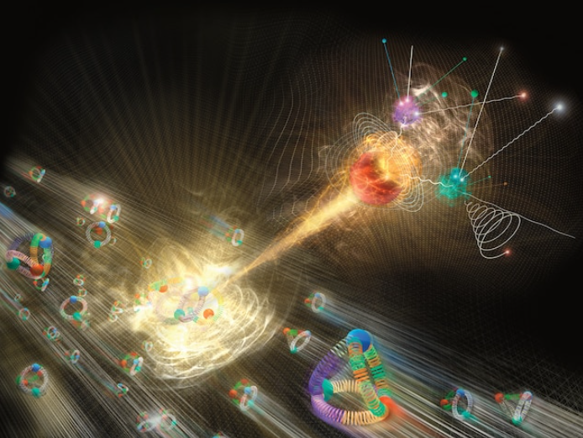
5* Scientific Discoveries of the Last Decade
In Fundamental Physics
Higgs Boson
Gravitational Waves
Black Hole Event Horizon
Image Credit:
National Geographic

Slide 13
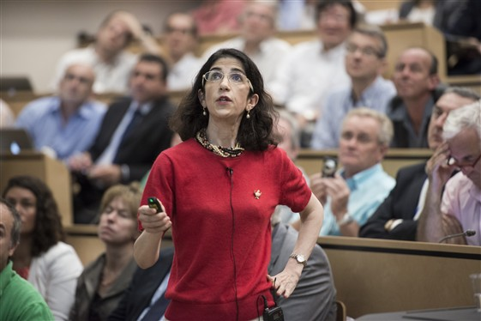
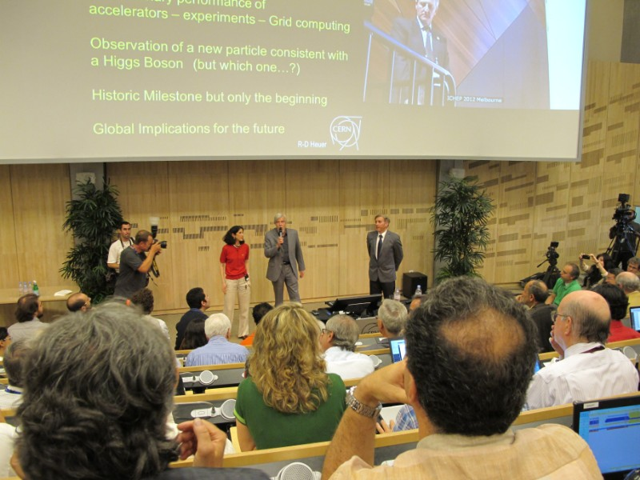
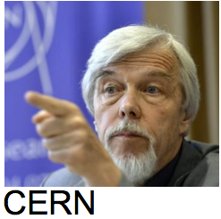

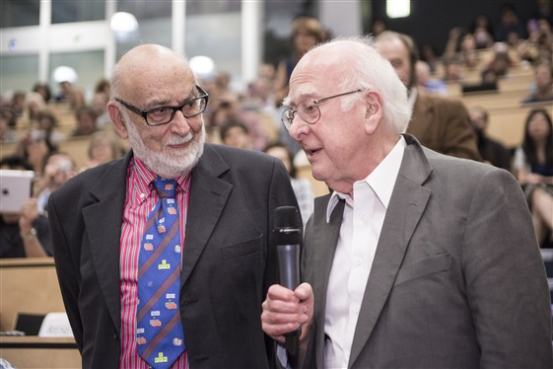
I. Higgs Discovery at Large Hadron Collider @ CERN (2012)
“As a layman I would now say… I think we have it –
It is a Discovery” (Rolf-Dieter Heuer, CERN DG)
Both ATLAS and CMS Collaborations have reported observation of a
narrow resonance ~ 125 GeV consistent with long-sought Higgs boson
What did we know on that day: it is most probably “A HIGGS BOSON”
→ had to establish if it is “THE HIGGS BOSON” of the Standard Model

Slide 14

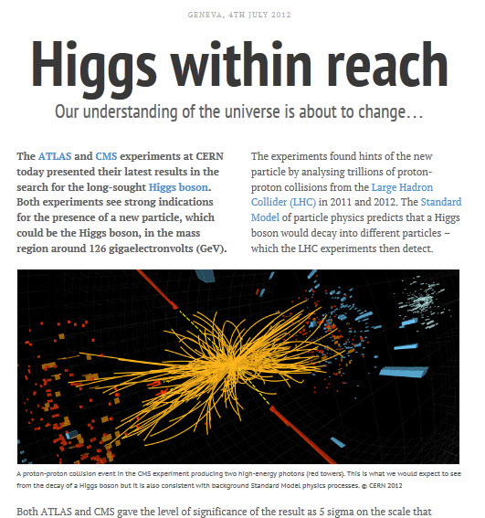
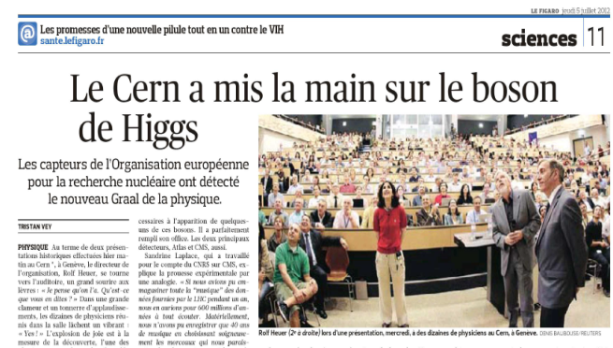
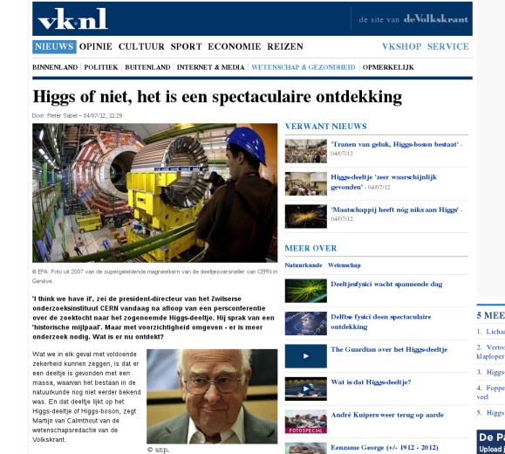


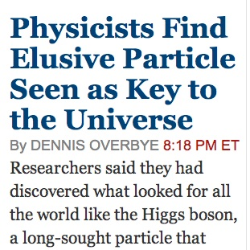
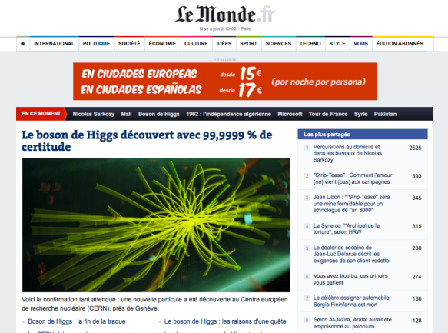
Abour 50 years and Billion(s) of Dollars –
The “God Particle” is no Longer a Theory

Slide 15

Determine Higgs properties as precisely as
possible to address fundamentl questions:
… is it “THE Higgs Boson” (of the Standard Model) ? or one of several ?
… its properties could give information on Dark Matter
… its properties could give first hints on Dark Energy

Slide 16
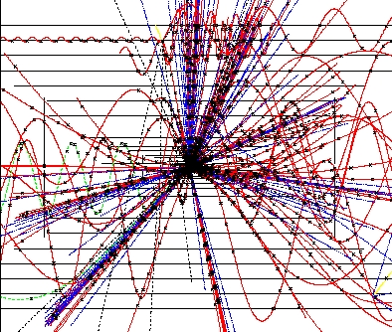
2000x: Fear and Loathing… Are They Going to End the World?
Has the new CERN project –
the LHC - the potential to
create a black hole
that swallows our
planet earth?
Micro black holes @ LHC:
Mass: M_{BH} ~ 1000 M_{proton}
Size: 10⁻¹⁸ m
Temperature: 10¹⁶ K
Lifetime: 10⁻²⁷ s
https://www.forbes.com/sites/startswithabang/2016/03/11/could-the-lhc-make-an-earth-killing-black-hole/#2fe64fd02ed5

Slide 17
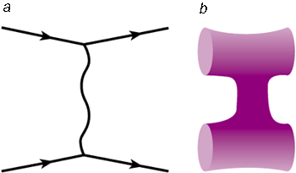
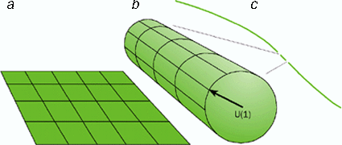
Large Extra Dimensions – A Little Bit of History …
Once upon a time (1921), Theodor Kaluza in the hope of unifying gravitation and electromagnetism extended general relativity by including the U(1) symmetry of electromagnetism by adding a 4th spatial dimension.
In 1926, Oskar Klein proposed that the fourth spatial dimension is curled up (compactified) in a circle of very small radius “R”, therefore a particle moving a short distance along that axis would return where it began.
In the 1970’s and 1980’s there’s been renewed interest in (multiple) extra dimensions: SUSY and string theory.
From 1998 onwards, new models have surfaced (ADD, RS, etc.) which address the hierarchy problem by exploiting the geometry of spacetime.
Gravity is automatically included in string theory; there is a vibration mode with the properties of the graviton.

Slide 18



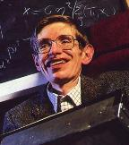
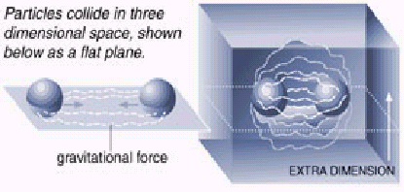
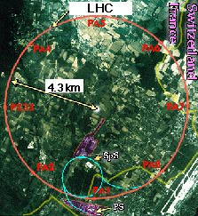
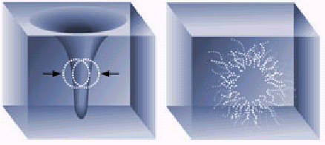
One Day at CERN in 2035 …
November 17, 20XX
APRIL 9, 2007
Higher-dimensional Black Holes Radiate Higgs!
Most Exotic Object of Cosmology Gives Birth to the Most Wanted Object of Particle Physics...
Hawking's "luminous" victory!
Breakthrough to the Extra Dimensions...
Stephen Hawking’s black hole radiation theory is proven experimentally at CERN after 34 years.
Detecting black holes at CERN proves that spacetime has seven dimensions.
CAMBRIDGE, 17 November: The Sweedish Royal Academy has announced that the Nobel Price in Physics for this year will go to Stephan W. Hawking for his theory of particle creation by black holes, which is also named “Hawking radiation” after its founder. Hawking’s theory of black hole decay was proved recently by the famous black hole production experiment at the LArge Hadron Collider (LHC) of CERN (European Center for Nuclear REsearch.
Black holes are such objects from which even light cannot escape. Since lightspeed is the ultimate speed in universe, black holes are objects from which no escape is possible. However this idea was completely changed by a revolutionary paper by Hawking published in 1975 which suggested that black holes could emit radiation via a
particles from which objects of our daily encounter are made of are not able to penetrate the world of extra dimensions unless they reach very high energies.
Theories also pointed out that existence of extra dimensions strengthened the gravitational interactions, which means, in the presence of extra dimensions, force of gravitational attractions would be stronger. Such an enhancement of the gravitational force was the phenomena which enabled the production of black holes on Earth.
Black holes produced at the LHC live in extra dimensions and any data coming from them gives direct information on the structure of spacetime. Once formed, the extra-dimensional black holes decay through a quantum mechanical process called Hawking radiation abd the decay products could be studied
complicated quantum mechanical process. Briefly this idea states that spacetime near a black hole is not a classical vacuum. Energy fluctuations near a black hole creates particle-antiparticle pairs among which the antiparticle with negative energy enters the black hole while the particle with positive energy flies off to infinity. Negative energy of the antiparticle falling into the black hole reduces the mass of the black hole, therefore black hole seems to evaporate and emit particles.
This phenomena was finaly observed in CERN after 33 years of its proposal in an experiment which created miniature black holes through high energy proton collisions. These black holes decayed immediately after their production, emitting a spectrum of high multiplicity of particle species.
GENEVA, JULY 26: An ultimate physics experiment done at the Large Hadron Collider (LHC) of CERN (European Center for Nuclear Research) which produced first Earth-made black holes revaled important facts about the true structure of spacetime in small distance scales. Direct experimental information coming from the mass and decay temperature of black holes showed that spacetime has more then the four dimensions (length, width, height and time) that we perceive in everyday life.
In recent years, many theoretical assumptions predicted the possibility for the existence of extra dimensions in spacetime, but till now these extra dimensions were not observed since firstly they open up at only very small distance scales and secondly, the
GENEVA, JULY 13: Latest data coming from CERN (European Center for Nuclear REsearch) gives the good news that the long-hunted Higgs particle is finally observed. This discovery was through a most unusual experiment since the observed Higgs particles were formed via emissions from miniature extra-dimensional black holes produced in tunnels of the Large Hadron Collider (LHC) by high energetic proton-proton collisions.
Higgs particle is very important for physics since it is the particle which is responsible for the masses of other particles. Yet despite all the prescise theoretical evidence Higgs particle was not observed until now since the earlier generation of particle accelerators did not have the sufficient collision energies to create the Higgs mass. Now this problem is solved with the completion of Large Hadron Collider which, with its 14 TeV center of mass energy, has initiated a new era of high energy physics experiments.
It was again this high center of mass energy which enabled the production of black holes that live in higher dimensions of spacetime. Once formed, these black holes can decay through a quantum mechnical process, emitting all sorts of particles from the known Standard Model spectrum. As had already been predicted by the theory, almost one percent of the black hole decay products were found to be Higgs bosons. Although the signature of Higgs is quite clear among the data, physicists are still examining the marks of this curious particle to bring its properties to daylight.
S. W. Hawking
Who Knows …

Slide 19
II. Gravitational Waves – LIGO Observatory (2016)

Slide 20
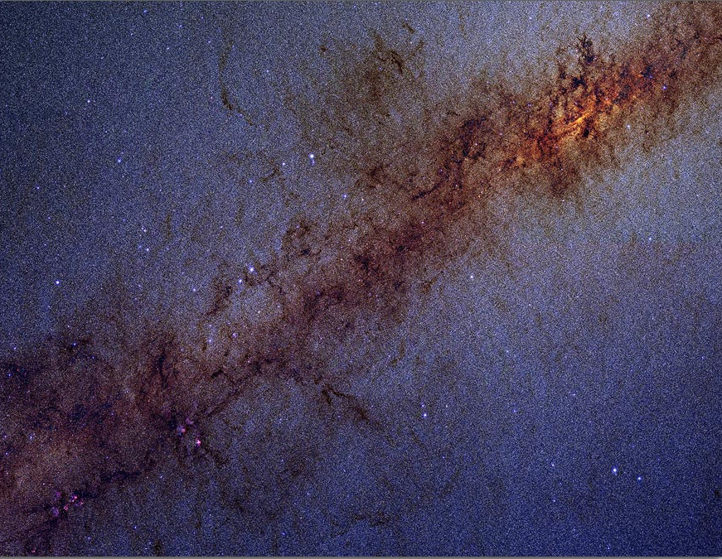
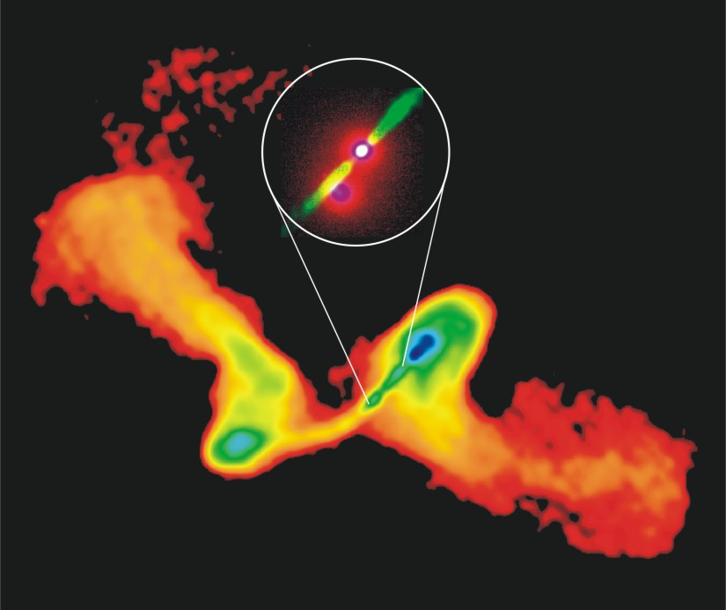
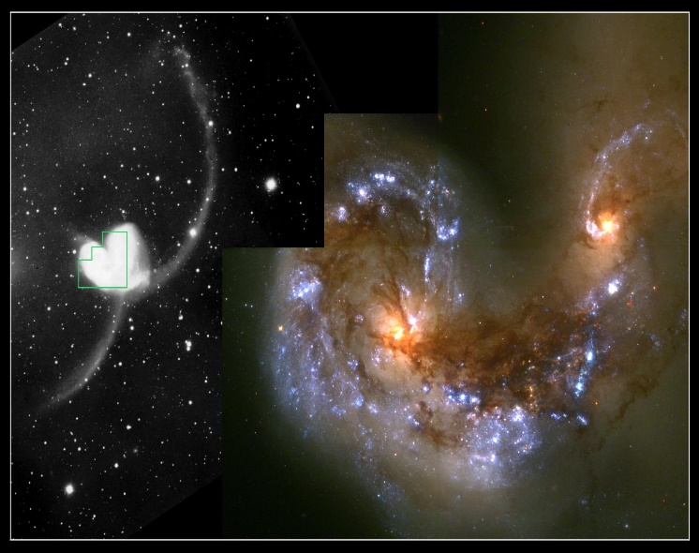
Gravitational Waves Encode Dynamics of Massive Objects
MBHs are found at the centers of most galaxies
Most galaxies merge one or more times → Massive Black Hole (MBH) binaries*
Final merger of MBHs occurs in the arena of very strong gravity (strong GW sources)
Observing gravitational waves allows direct tests of GR and probe early stages of structure formation:
→ Requires numerical
relativity to calculate
dynamics & waveforms
→ Waveforms scale w/
masses, spins → apply
to ground-based & LISA

Slide 21
III. M87 Black Hole – Event Horizon Telescope (2019)

Slide 22
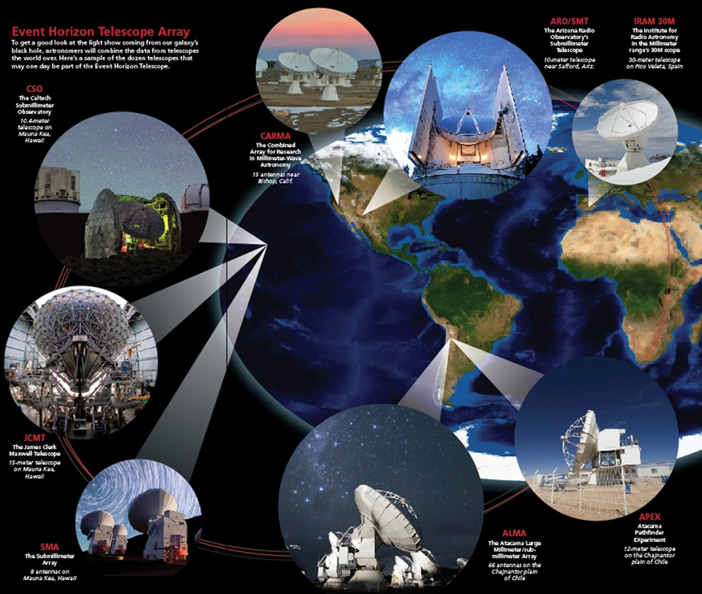
Event Horizon Telescope (EHT)
8 telescope array at radio frequency around the Earth

Slide 23
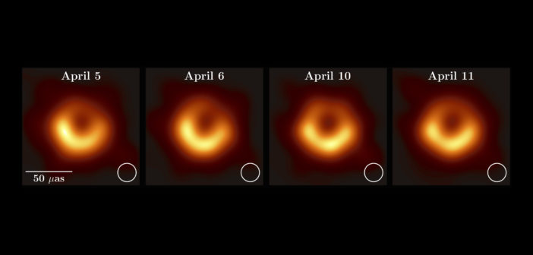
EHT: What the Real Image of Black Hole is (M87) ?
Watch the history and the importance of the M87 black hole picture:
https://www.youtube.com/watch?v=omz77qrDjsU
Image of the supermassive black hole at the center of the elliptical galaxy M87, for four different days.
It was found in a galaxy called M87 and is larger than the size of our entire Solar System.
The black hole is 500 million trillion km away and it was captured by the Event Horizon Telescope (EHT), a network of eight linked telescopes around the world.
"It has a mass 6.5 billion times that of the Sun. And it is one of the heaviest black holes that we think exists. It is an absolute monster, the heavy weight champion of black holes in the Universe”

Slide 24
EHT: What the Real Image of Black Hole is (M87) ?
Watch the history and the importance of the M87 black hole picture:
https://www.youtube.com/watch?v=omz77qrDjsU
Image of the supermassive black hole at the center of the elliptical galaxy M87, for four different days.
What Are We Seeing in This image ?
The first DIRECT evidence for black holes!!
Black holes are REALLY BLACK, consistent with GR predictions
The bright ring comes from emission of the accreting materials
It was found in a galaxy called M87 and is larger than the size of our entire Solar System.
The black hole is 500 million trillion km away and it was captured by the Event Horizon Telescope (EHT), a network of eight linked telescopes around the world.
"It has a mass 6.5 billion times that of the Sun. And it is one of the heaviest black holes that we think exists. It is an absolute monster, the heavy weight champion of black holes in the Universe”

Slide 25
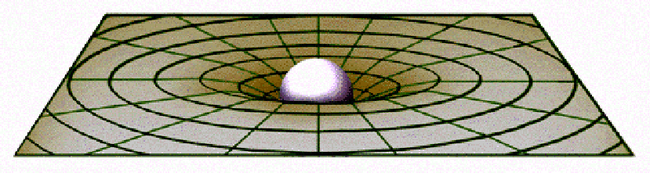
Einstein’s General Theory of Relativity Warping of Spacetime Produces the Effects of Gravitational Force
Space-time gets curved by masses (mass distorts space). Objects traveling in curved space-time have their paths deflected, as if a force has acted on them.
“Curvature” of time means that the time flows with a different rate in different points in space
Objects and light moving near the massive object are forced to take a curved path around the object. (Just like the Moon orbiting Earth).
"Matter tells spacetime how to bend and spacetime returns the compliment by telling matter how to move."

Slide 26
A. Einstein (1915): Spacetime is an active player: curves, expands, shrinks, …
Aristotle: there are absolute space and absolute time. There is absolute rest different from motion for all observers.
Galileo-Newton: there are absolute space and absolute time. Motion and rest are relative to an observer. Laws of physics are the same for all uniformly moving observers. Acceleration is absolute.
Einstein (Special relativity): space and time are relative to an observer. Laws of physics are the same for all uniformly moving observers. Space-time is a fixed flat background.
Einstein (General relativity):
→ ALL kinds of motion are unified, including accelerated motion
→ Gravity and acceleration are unified and depend on the observer
→ Space-time is not a fixed background anymore. Space-time and
matter interact with each other and affect each other.
Describes curvature of space-time
Mass-energy density of matter

Slide 27
Thinking in Terms of Einstein’s Theory of General Relativity
- Newton’s gravity works well in most situations (planetary orbits, binary stars) but fails when:
→ Gravity becomes extremely intense
→ Large masses move rapidly.
→ Light is effected by a large mass.
- Einstein’s theory says
that the presence of matter warps space and time. Gravity is replaced by warping of space-time.
GR remains one of the most accurate theories in physics:
  Precession of the perihelion of Mercury
  Light will be bent when passing near large objects
  Time will slow down near a large mass
  Gravitational redshift of light
  Gravitational Waves
  Massive objects will collapse to a singularity (black hole)
  → existence of Black Hole Event Horizon (no one believed in 1915)

Slide 28
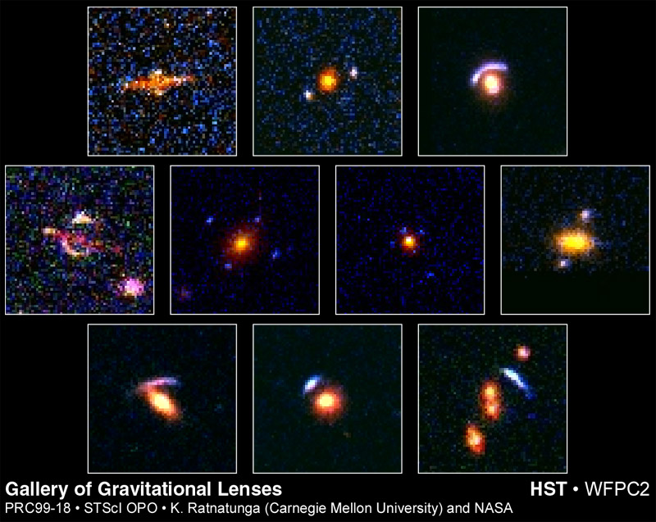
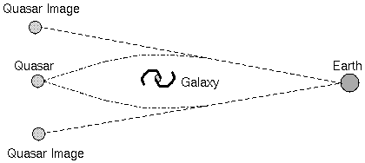
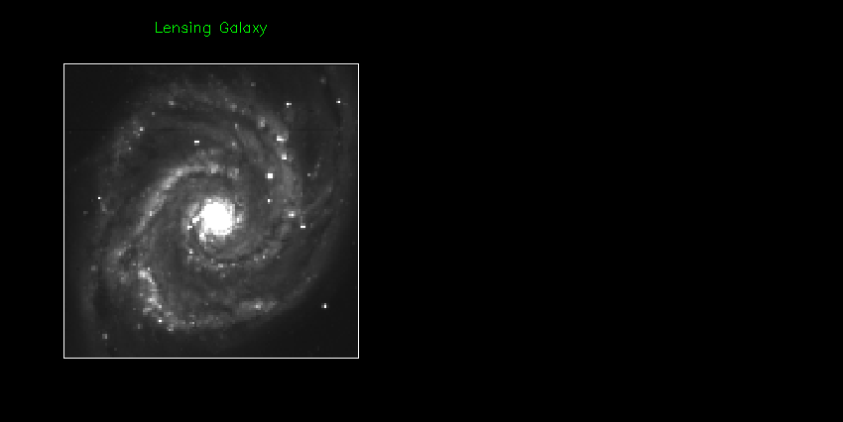
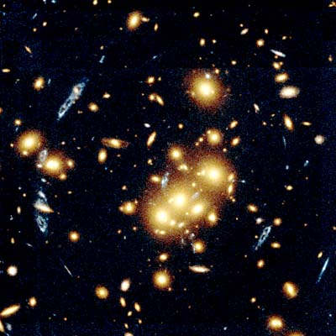
Gravitational Lensing is Now a Tool
Gravitational lens - gravity can bend light
around a very heavy obstacle (triumph of GR)
Can be used to estimate the mass of intermediate galaxy

Slide 29
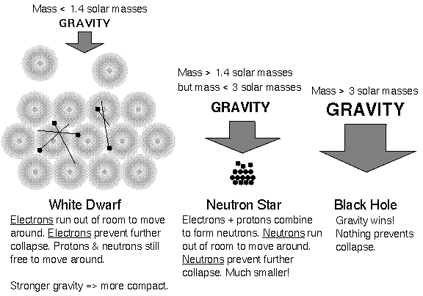
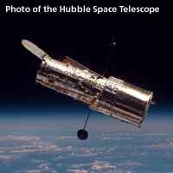
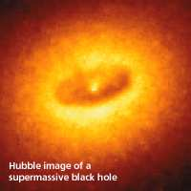
Gravity’s Final Victory
Black holes are the evolutionary
endpoints of stars at least 10 to
15 times as massive as the Sun.
A star more massive than about 18 M_{sun} leaves behind a core larger than 3 M_{sun}
Neutron degeneracy pressure fails
Nothing can stop its gravitational collapse.
Core collapses to a singularity:
  → zero radius
  → infinite density
Near the singularity gravity is so strong that not even light can escape.

Slide 30
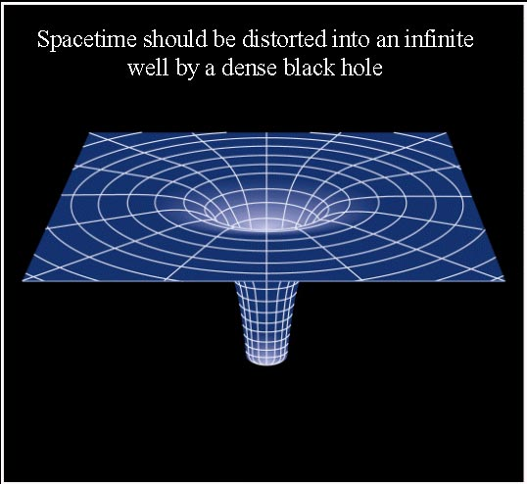
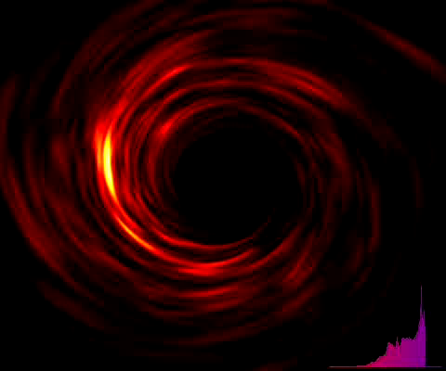
Black Hole: A Theoretical Definition (I)
A black hole is a region of space-time from which nothing can escape, even light:
A black hole is a true "hole" in space: Anything that crosses the edge of the hole - called the “event horizon" - is swallowed forever
As you get closer to a black hole, the flow of time slows down, compared to flow of time far from the hole.
At the event horizon, time actually appears to stop. An object falling into the hole would appear frozen in time at the edge of the black hole!
Our laws of physics break down at the very center of the black hole . Time itself seems to come to an abrupt end there. For this reason, a black hole is sometimes described as the "reverse of creation."
Einstein’s theory of gravity allows the possibility of a black hole forming a link - or wormhole - to another universe, or another part of our universe.

Slide 31
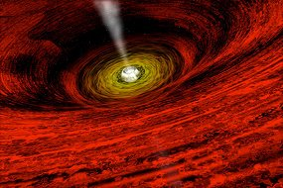

Black Hole: A Theoretical Definition (II)
The black hole is surrounded by an “event horizon” which is the sphere from which light cannot escape;
The distance between the black hole and its event horizon is the Schwarzschild radius (R_{Sch}= 2GM/c²);
The center of the black hole is a point of infinite density and zero volume, called a singularity;
The “event horizon” hides the singularity from the outside universe:
→ Events occurring inside are
invisible to the outside universe.
→ Anything closer to the singularity
can never leave the black hole
→ The important thing is this area
can be of any size;

Slide 32


Some Unresolved Problems: What is the Singularity
Singularities Clothed and Naked
The singularity is the point of infinite density thought to exist at the center of a black hole. We have no way of understanding what would happen in the vicinity of a singularity, since in essence nature divides our equations by zero at such a point. There is an hypothesis, called the "Law of Cosmic Censorship" that all singularities in the Universe are contained inside event horizons and therefore are in principle not observable (because no information about the singularity can make it past the event horizon to the outside world). However, this is an hypothesis, not proven, so it is conceivable that so-called "Naked Singularities" might exist, not clothed by an event horizon.
General relativity
breaks down
at Planck scale:

Slide 33


Black Holes: “Where God Divided by Zero”
Recipe for a black hole:
Just squeeze a body of mass M
below its Schwarzschild’s radius
Geometry of the spacetime near a BH can be found by solving Einstein’s equations for different conditions (spin, charge):
Schwazschild radius

Slide 34


Gravitational Redshift of Light
Frequency of light is shifted in the accelerated frame.
→ It should be also shifted in the gravitational field!
Photons always travel at the speed of light, but they lose energy when traveling out of a gravitational field and appear to be redder to an external observer. The stronger the gravitational field, the more energy the photons lose because of this gravitational redshift. The extreme case is for photons emitted at event horizon of black hole, gravitational redshift is infinite. The observed frequency is zero, i.e. the photons loose all their energy are never observed.

Slide 35
A Plunge into a Black Hole
Modern physics has two basic sets of laws for the universe:
  → General relativity -- macro-scale
  Quantum field theory -- micro-scale
The two are not compatible!
Most problems fall into one category only.
Black holes need both:
  → micro-size and macro-mass
→ the study of black holes helps understand how to combine the two theories.
Black holes are “simple” objects – their structure is defined by three parameters:
→ Mass (as measured by the black hole’s effect on orbiting bodies, such as
another star)
→ Total electric charge (as measured by the strength of the electric force)
→ Spin = angular momentum (how fast the black hole is spinning)
Black holes have no hair → All event horizons are spherical, no matter what the mass looked like before collapse
Black holes have no magnetic field (internal).
Black holes have entropy (a measure of disorder) that is proportional to the size of the event horizon.
Black holes have a temperature → black body (The heavier a BH, the cooler it is! )

Slide 36

Evaporating Black Holes
BHs can decay via a quantum mechanical process near event horizon of a BH
Black Holes evaporate slowly by emitting “Hawking radiation” → particles falling into the BH have negative energy, BH looses mass and energy is conserved.
The smaller the mass, the faster the evaporation
Hawking radiation is equivalent to black body radiation → Each particle carries off a little of the black hole's mass
Most properties of matter vanish when matter enters a black hole, such as chemical composition, texture, color, shape, size, distinctions between protons and electrons, etc
Questions Remain about Black Holes:
  Is the information that falls into a Black Hole lost forever? → this contradicts the laws of quantum mechanics, and scientists have been trying to deal with this paradox for decades)
  What is inside a black hole?
  Can wormholes be produced to travel in time and/or space?

Slide 37





Black Hole Galore
NASA/CXC/U.Amsterdam/S.Migliari et al.
NASA/CXC/SAO/H.Marshall et al.
NASA/CXC/MIT/F.K.Baganoff et al.
NASA/UMD/A.Wilson et al.
X-ray: NASA/CXC/MIT/UCSB/P. Ogle et al. Optical: NASA/STScI/A.Capetti et al
From the formation of galaxies to the deaths of stars,
black holes are an integral part of our universe’s history.

Slide 38
A Galaxy Full of Black Holes
There are 200 billion stars in our galaxy, the Milky Way
There are also millions of black holes
Including one giant black hole at the very center.
How have we survived?

Slide 39


So How Do we Survive amid All These Black Holes ?
Great distances between the stars
Everything is orbiting fast enough!
Far away from a black hole:
  Gravity is the same as for a star of the same mass.
  If the Sun became a Black Hole, all the planets would continue in the same orbits.
  It would however be darker and MUCH colder
Close to a black hole:
  R < 3 R_{S}, there are no stable orbits - all matter eventually gets sucked in.
39

Slide 40
What a Strange Object a Black Hole is ?
We cannot see black holes directly, but their influence
on the matter around them reveals their presence.

Slide 41
Black Holes as Laboratories of Fundamental Physics
Binary Systems with one Black hole and visible giant star orbit around a center of mass :
Motion of visible companion betrays black hole:
  → Kepler's 3rd law ⇒ total mass of the system;
  → If the mass of the unseen object is too big for a neutron star or a white dwarf, then it is very likely a black hole!
Orbits depend on masses of
two obejects:

Slide 42


Black Holes: X-Ray Emission
Visible star in a binary system loses some of its gas to the black hole
Gas material forms an accretion disk as it spirals onto the black hole
Material in Disk gains energy as it falls into black hole:
Gravitational energy is converted into kinetic energy (up to 40% of the mass of infalling material is converted into energy)
Gas particles in the disk rub against each and heat up from friction (up to 10⁷ K)
Near event horizon, emitting thermal radiation peaking in X-Ray
Black Hole are efficient « Power
Factories » when they accrete!

Slide 43

Radio Jets from Black Holes
Radio tells us about motions of particles in magnetic fields:
Magnetic field from surrounding disk funnels material into the jet
MANY BLACK HOLES EMIT JETS:
Magnetic fields surrounding the black hole produce spectacular jets of high-energy particles (B-field comes from the disk of hot gas around the BH, and not BH itself)
  Material in jet moving at 0.9c.
  Jet likely composed of electrons and positrons.
  Interaction of jet material with magnetic field gives rise to Radio emission.

Slide 44





How Do We Know Black Hole is There ?
Jets of
glowing gas
Hot material falling into the black hole.
“Weird” motions of objects nearby
“Weird” motions of objects nearby
Hot material falling into the black hole.
Jets of
glowing gas
One month

Slide 45



Where do Black Holes Come From ?
Primordial – can be any size, including very small (If <1014 g, they would still exist) → cannot be described only with GR,because they emit Hawking radiation and evaporate
“Stellar-mass” black holes – must be at least 3 Mo to 20 Mo (~1034 g) – many examples are known
Mid-mass black holes – range from 100 to 1000 Mo - located in normal galaxies – many seen
Massive black holes – about 106 Mo – such as in the center of the Milky Way – many seen
Supermassive black holes – about 109-10 Mo - located in Active Galactic Nuclei, often accompanied by jets – many seen

Slide 46


Where do Supermassive Black Holes Come From ?
Cores of many other galaxies show compact objects in the centers and accretion disks with possible black holes ;
Following the orbits of individual stars near the center of the Milky Way, the mass of the central BH is ~ 2.6 million solar masses;
We don’t know which comes first, the galaxy or the black hole
Our Milky
Way Galaxy:
Super-Massive Black Hole Theories:
From “Lumps” in the early universe (lumps in early Universe could have formed and of matter dense enough that a black hole formed)
The “Stellar Seed” Model (giant black hole could result in an initial “stellar seed” of 10 mass of sun produced during a supernova)
Collapse of a whole star cluster (stars from a tight cluster in early Universe could form a few Black Holes, causing smaller stars to be absorbed, and black holes to combine)

Slide 47

Where do Stellar-mass Black Holes Come From ?
Stellar-mass black holes are made when a massive star, manty (3 – 20) times the mass of our Sun, dies
Most of the star’s atmosphere is blown into space as a supernova explosion.
The star’s spent core collapses under its own weight.
If the remaining mass is more than the mass of 3 Suns, it will collapse into a black hole.
Credit: European Southern Observatory

Slide 48

Where do Mid-Mass Black Holes Come From ?
Star cluster, called M15,
in our Galaxy:
Optical and X-ray images of NGC 253
Black Holes with masses a few hundred to a few thousand times the mass of the sun have been found outside the central regions of a number of galaxies
Often found in Starburst galaxies (in centers of large, dense star clusters)
May be precursors to Active Galaxies
Image Credit: NASA and The Hubble Heritage Team (STScI/AURA)

Slide 49
A New Golden Age for Gravitation
Gravitational physics is entering a new golden age
A wealth of data, from gravitational waves to EHT observations, is opening new doors for potential discoveries.
In the coming years, especially with LISA and 3G detectors, we will be doing “precision gravitational-wave physics”.
Plenty of room for unexpected discoveries
Gravitational wave detection (interferometer):
Changes of the arm length (4 km)
are ~ 1/10 of the atomic nuclei size !!!
Event Horizon Telescope -
First real image of Black Hole:

