Slide 1
WP3: Monte Carlo simulations - UniPD
24.03.2023
M. Bagatin,
S. Gerardin,
A. Paccagnella

Slide 2

WP3: Monte Carlo simulations, Tasks 3.4/3.5
UniPD is involved in the following tasks and deliverables:
Task 3.4
Assessment of energy deposition variability and uncertainty related to beam transport across degraders, printed circuit boards and packages. Memories and/or logic devices with state- of-the- art feature size will be modeled and used to quantify the energy deposition variability and uncertainties caused by the materials and structures interposed between the beam and the sensitive volumes. Results will be compared to the experimental tests performed in WP5.
[Deliverable 3.4: Demonstration of LET uncertainty reduction from simulations as a complement to experimental measurements]
Task 3.5
Differences between energy deposition events caused by very-high-energy and standard-energy heavy ions will be simulated using benchmark components, such as memories, or simplified sensitive volumes. Monte Carlo techniques will be adopted for the purpose, using existing codes based on Geant4, with a particular focus on the production of highly-energetic secondary electrons. Results will be compared to the experimental tests performed in WP5.
[Deliverable 3.5: Modelling of medium-complexity devices and response to different ion beams]
2
2

Slide 3
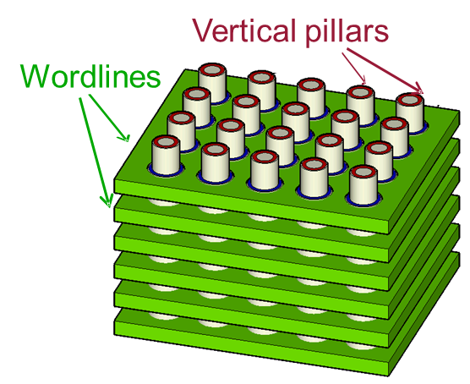
WP3: Monte Carlo simulations, Tasks 3.4/3.5
Tentative list of memories that will be simulated (and experimentally tested) by UniPD during HEARTS:
Floating Gate 3D NAND Flash Memories
  GDML Model already available
  Details are under NDA with the manufacturer
Charge Trap 3D NAND Flash Memories
  Working with the manufacturer to create the GDML model
  Details will be under NDA with the manufacturer
SRAM Cell
  Discussing with the manufacturer for the GDML model and experiments
https://g4see.web.cern.ch

Slide 4
WP3: Monte Carlo simulations, Tasks 3.4/3.5
We will make use also of Simplified Sensitive Volumes
  Array of parallelipeds to understand and clarify physical mechanisms
We’ve been using GRAS from ESA (contact G. Santin) for Geant4 based simulations in the last years
GRAS and python scripts to automate the simulations are already available at UniPD
https://g4see.web.cern.ch

Slide 5
WP3: Monte Carlo simulations, resources
Involved WP members and task distribution:
Name | Partner | Project time | Tasks involved
L. Esposito (WP leader) | CERN | M1 - M36 | 3.1 | Physicist
A. Waets | CERN | M1 - M36 | 3.1 | Physicist (PhD student)
L. Bocchini | TAS-I | M1 - M36 | 3.2 | Physicist
C. Cipriani | TAS-I | M1 - M36 | 3.2 | Nuclear engineer
C. Schuy | GSI | M1 - M36 | 3.2, 3.3 | Physicist
D. Lucsanyi | CERN | M1 - M36 | 3.4 | Physicist (PhD student)
M. Bagatin | UNIPD | M12 - M36 | 3.4, 3.5 | Associate Professor
S. Gerardin | UNIPD | M12 - M36 | 3.4, 3.5 | Associate Professor
A. Paccagnella | UNIPD | M12 - M36 | 3.4, 3.5 | Full Professor

