Slide 1
CERN IPMC: Update
On behalf of the CERN xTCA/IPMC Team

Slide 2
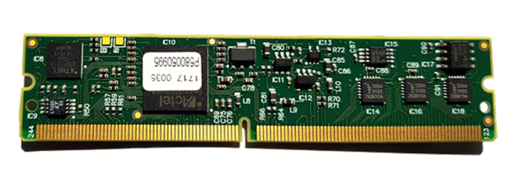
IPMC Cards
IPMC:
Current availability:
IPMC Version V3 (two UARTs): 74
IPMC Version V4 (three UARTs): 30
New production:
500 cards (V4) available in June 2023 (late because of lead time of components).
Purchasing procedure:
Send an email to epesebe-ipmc-purchase@cern.ch, containing number and version of IPMCs, and budget code: 1 IPMC = 200 CHF.

Slide 3
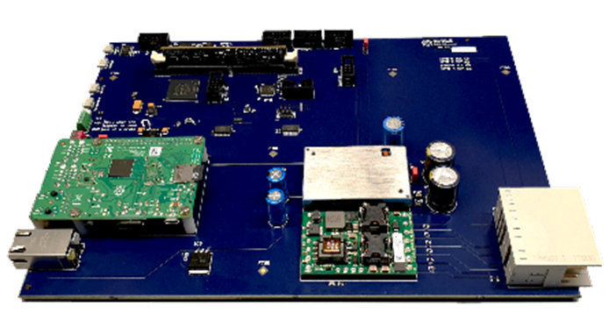
IPMC Tester
IPMC Tester:
For desk-top testing
(this is how we test the IPMC cards)
For in-shelf tests
As a development kit
Current availability:
CERN has 11 IPMC Testers.
You can buy one for 1500 CHF (we do not have the Raspberry Pis!)
Three IPMC Testers were sold: feedback welcome!
New production to be launched:
Build ten more IPMC Testers; they will become available end of 2023 due to lead time of the components.
Plan to run full-crate tests: stress tests of IPMC software and ShelfManager, investigate system aspects.

Slide 4
IPMC Support
Web site (https://cern-ipmc.web.cern.ch):
Documentation, software, remote compilation (requires login), link to Discourse
Discourse forum (https://cern-ipmc-forum.web.cern.ch):
Check/read the existing topics.
If you cannot find anything on your issue, create a new topic.
Alternatively, send an email to cernipmc.webapp@cern.ch:
The email will also create a new topic in Discourse.
Support team: Markus Joos, Stefan Haas, Ralf Spiwoks
CERN has a support contract with PigeonPoint Systems (PPS):
We escalate issues to PPS, if we cannot solve them ourselves.

Slide 5
Questions?
Contact: epesebe-xtca-support@cern.ch

