Slide 1
Design of the experiment for testing FCC-hh beam screen
C. Petrone
On behalf of the TM team
17 03 2023

Slide 2
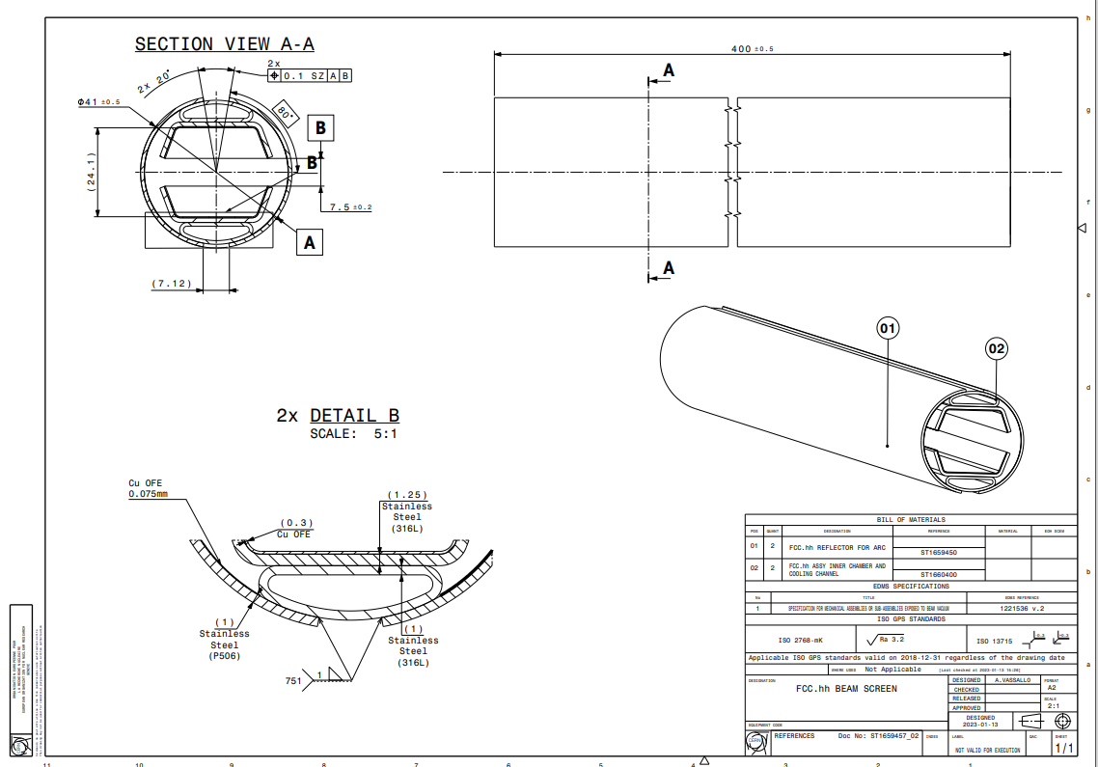
Beam screen: requirements and dimentions

Slide 3
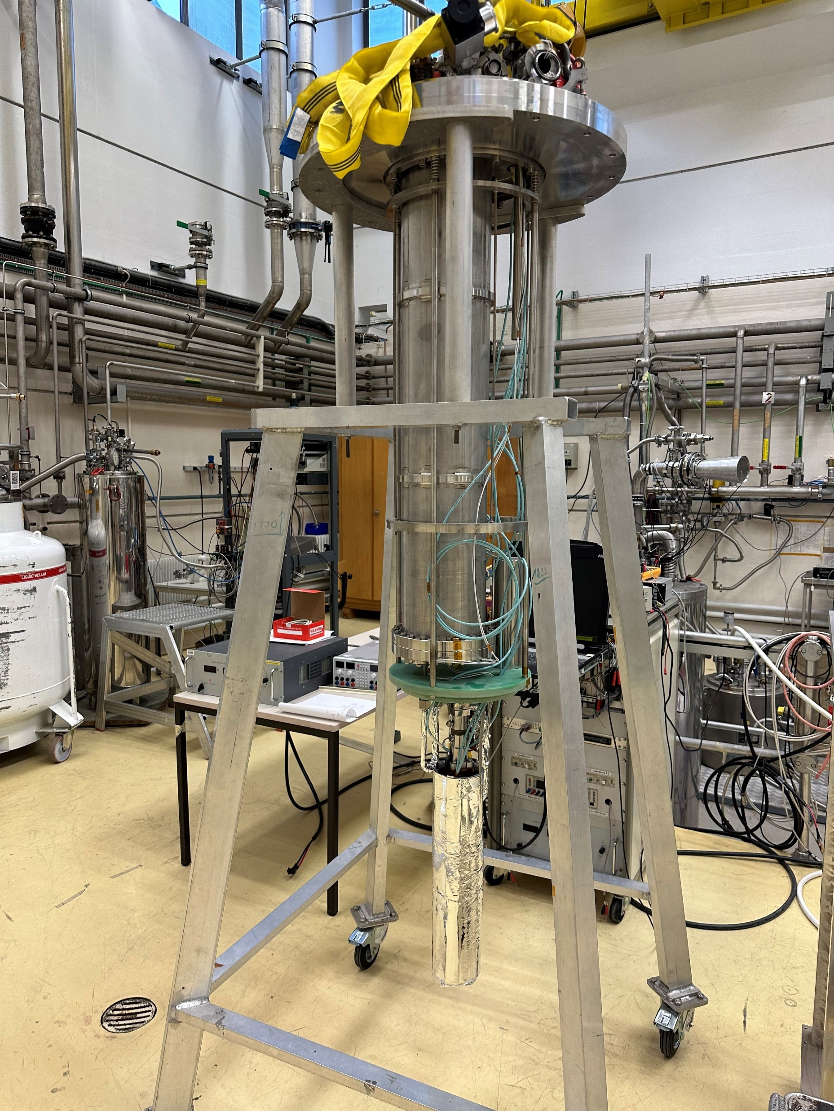
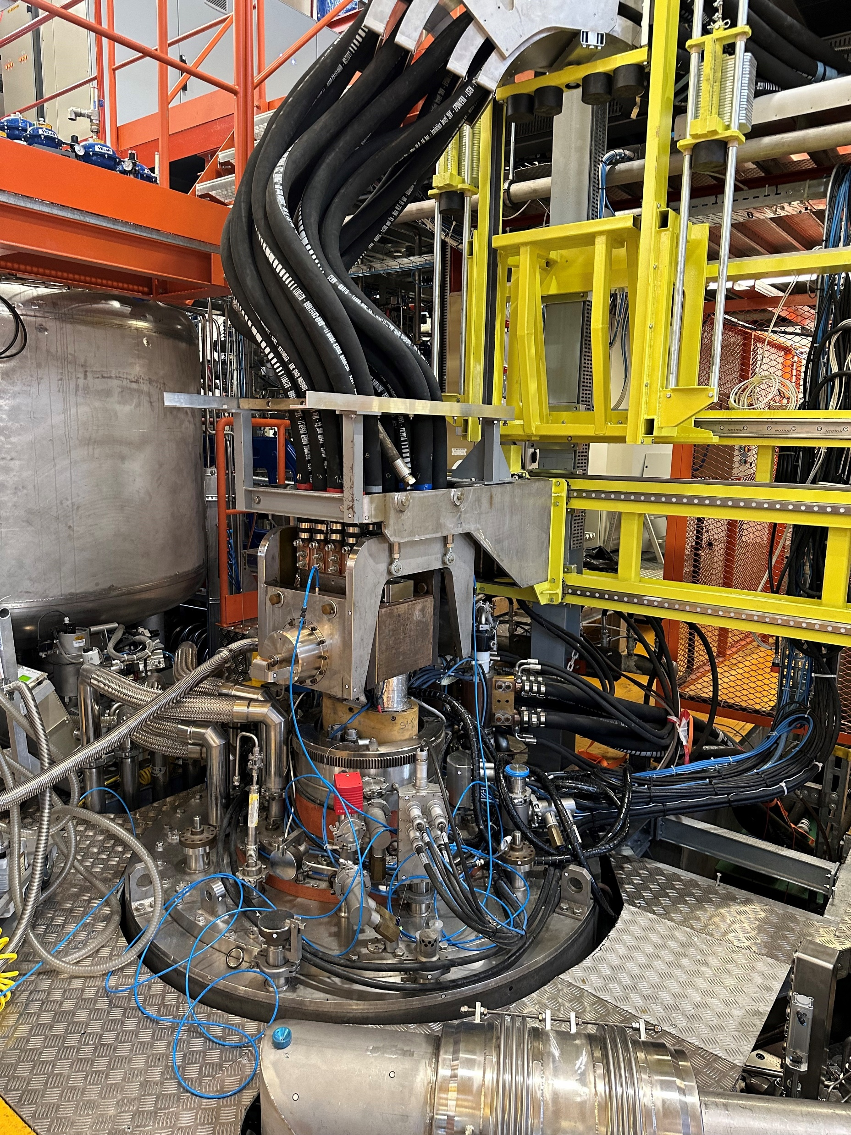
Tests foreseen in Cryolab and 163
2472678 v.1 "FRESCA1 INSERT GENERAL ASSEMBLY" by Nadine FAVRE in status: In Work
FRESCA1 INSERT GENERAL ASSEMBLY
Link: https://edms.cern.ch/document/2472678/1/approvalAndComments
The insert is not designed to welcome any rotating coil
Insert in the CryoLab
FRESCA1 - 163

Slide 4
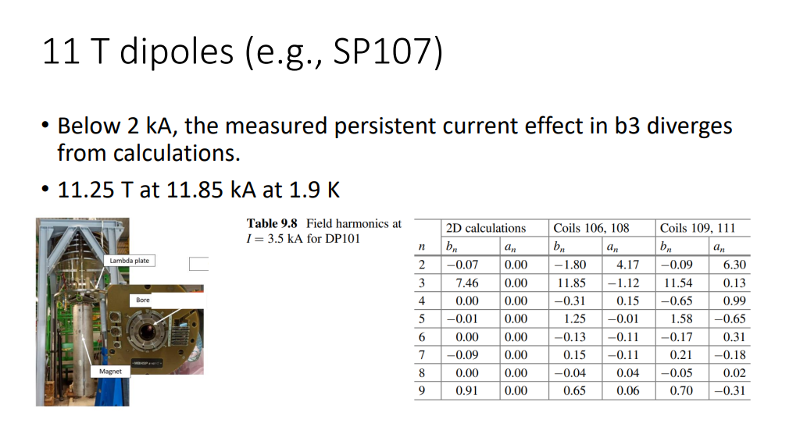
Test in SM18

Slide 5
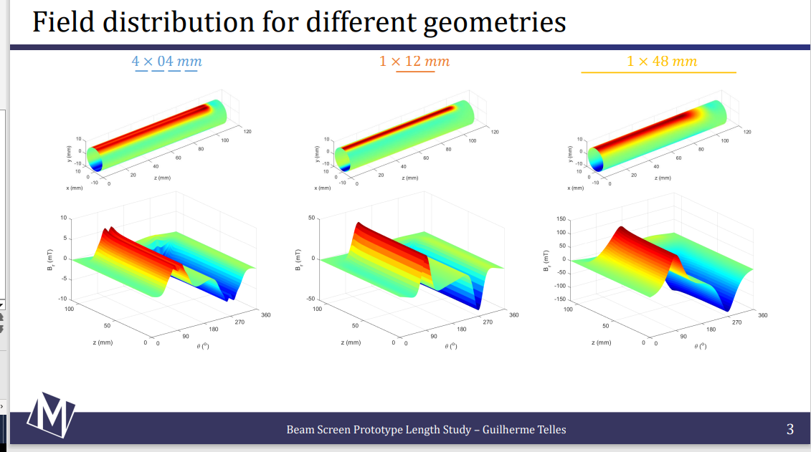
Beam screen simulations

Slide 6
Rotating coil and beam support design:

Slide 7
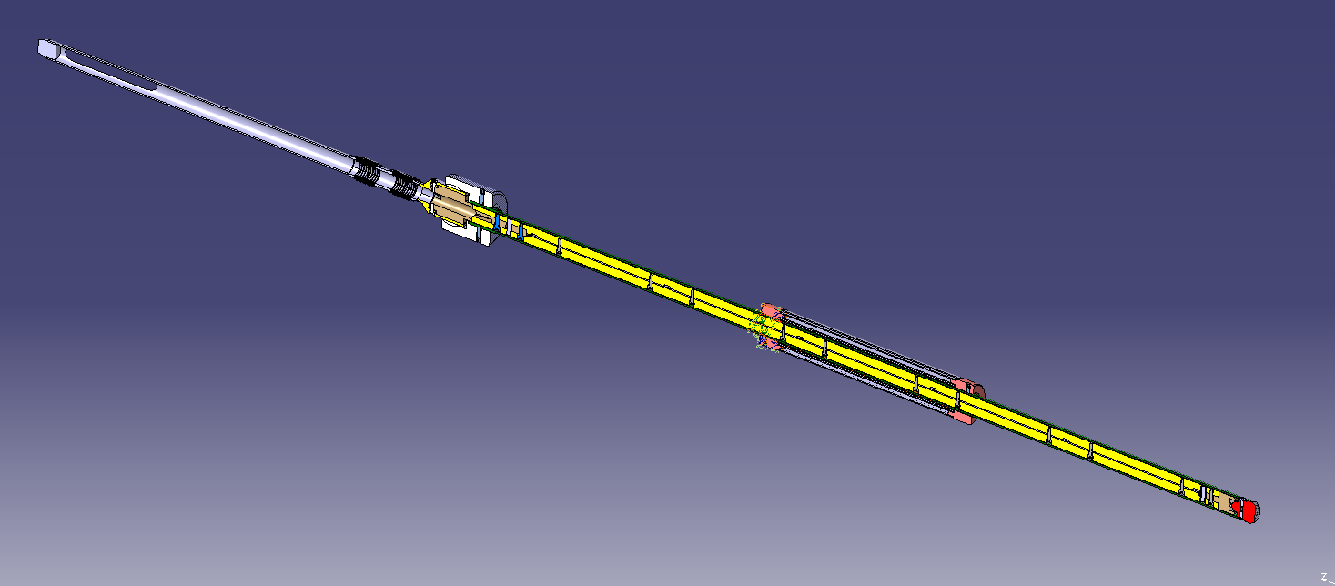

Slide 8
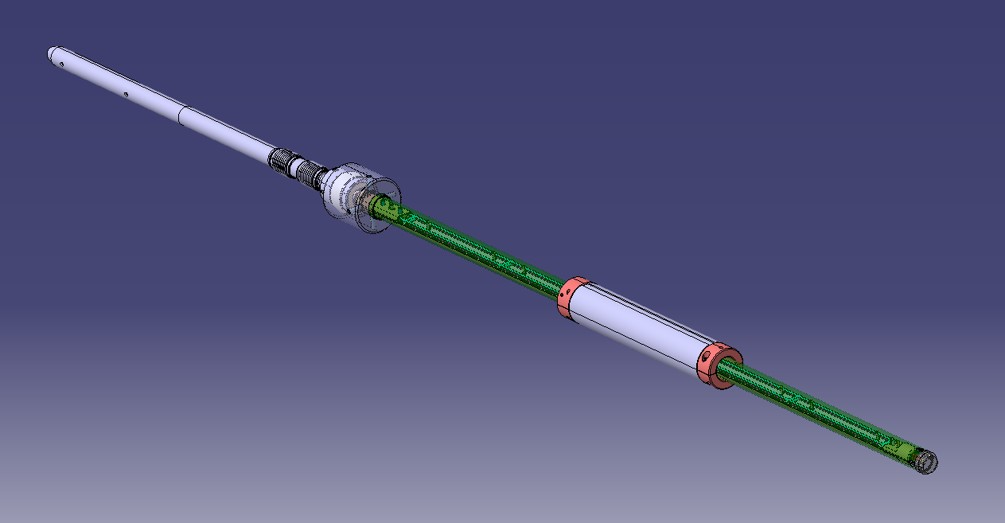

Slide 9
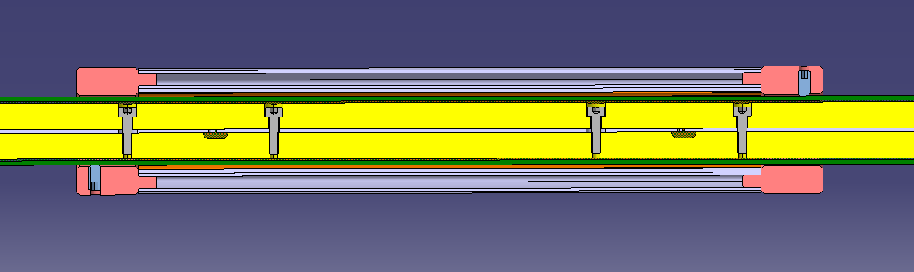

Slide 10
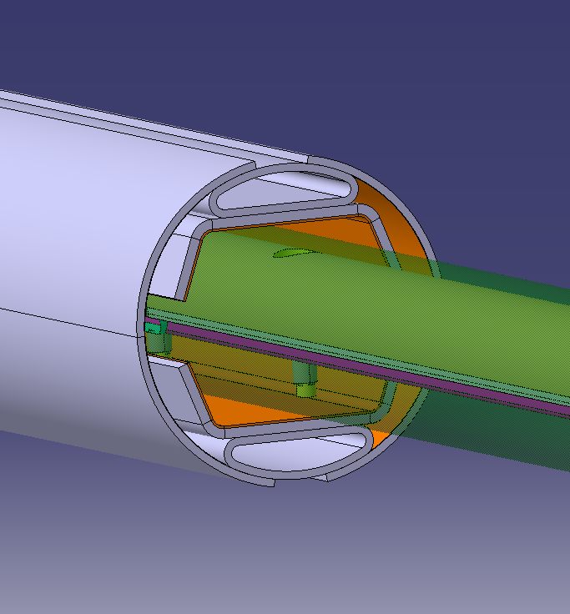

Slide 11
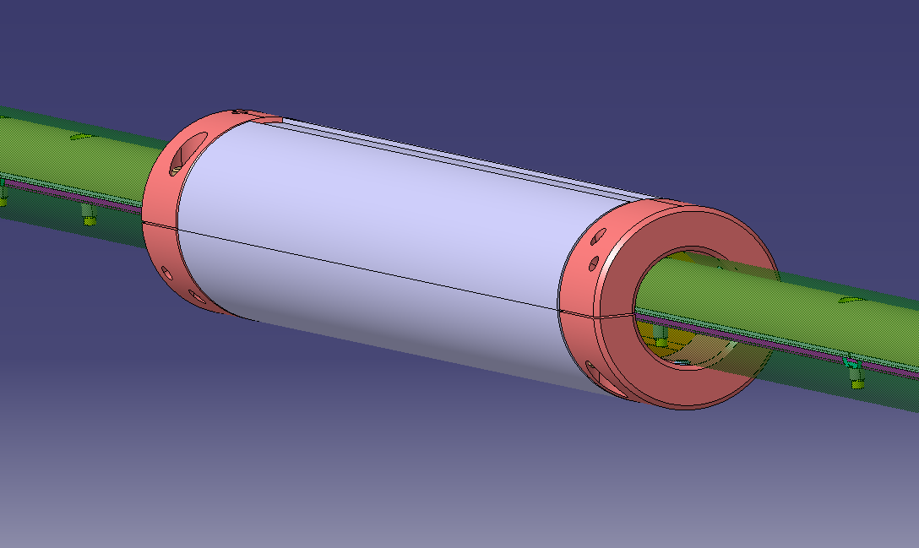

Slide 12
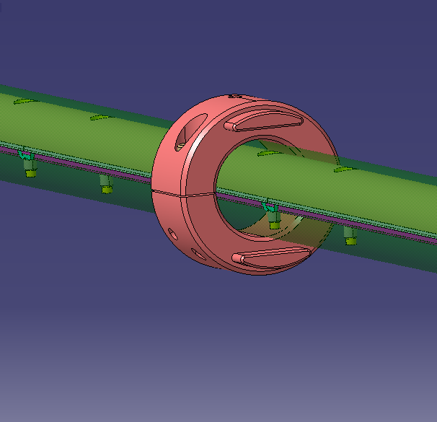

Slide 13
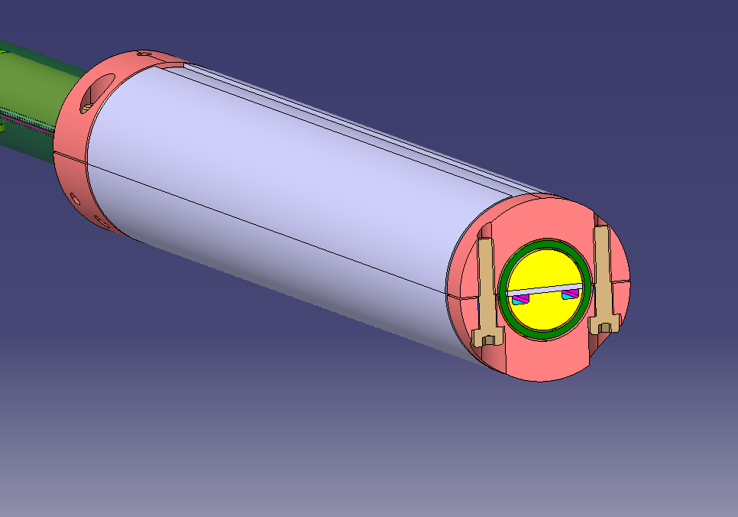

Slide 14
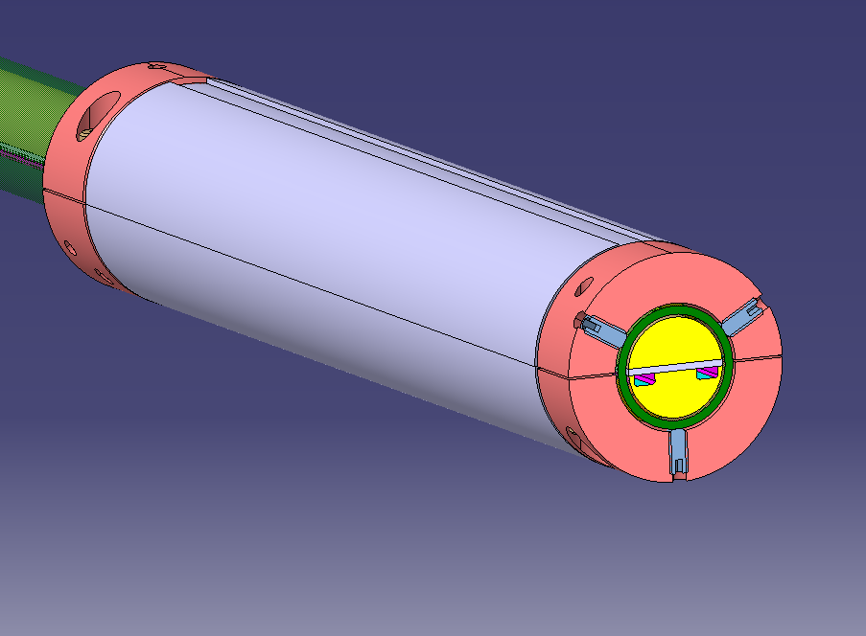

Slide 15
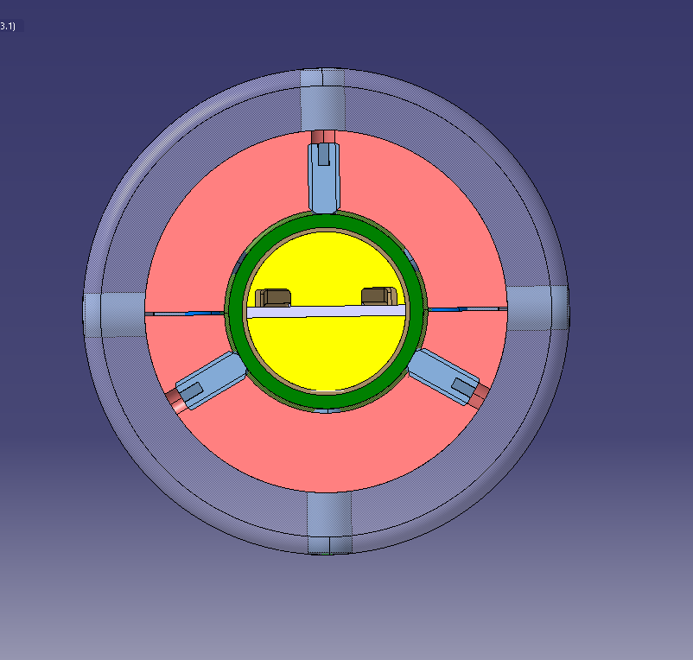

Slide 16
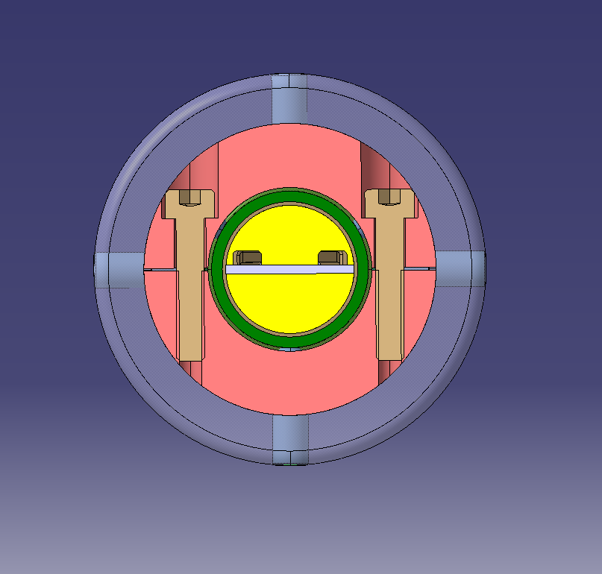

Slide 17
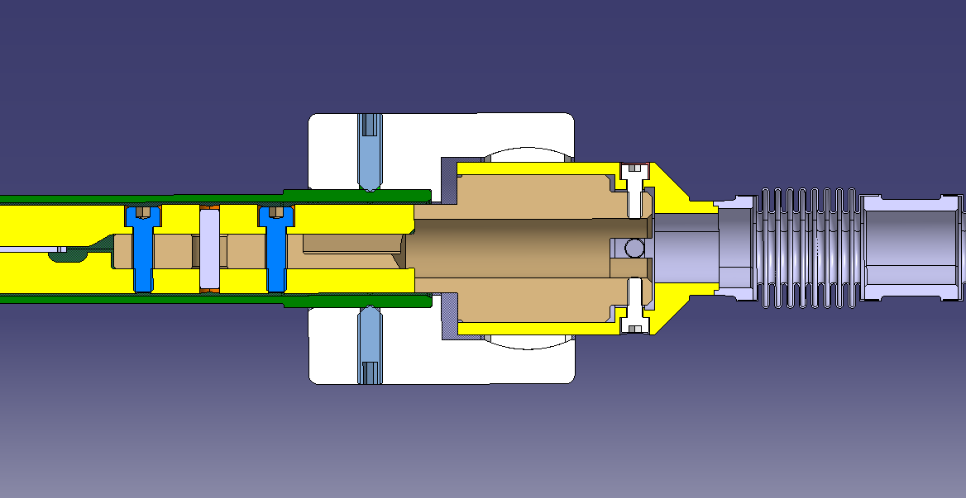

Slide 18
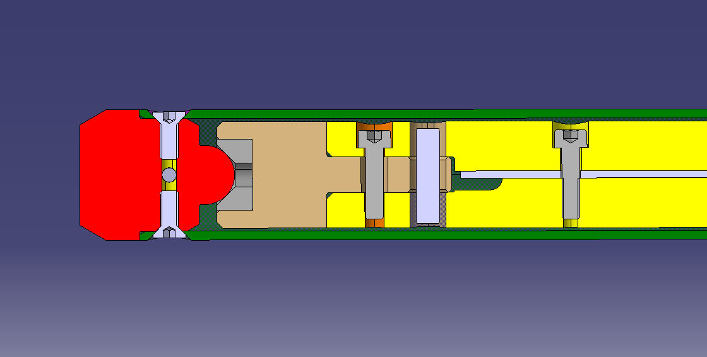

Slide 19
