Slide 1
HEARTS Project Office Meeting #1
30 March 2023
https://indico.cern.ch/event/1266637/
Pablo Lopez
CERN, WP1

Slide 2
Agenda
Open actions from Kick-off meeting and 1st Meeting of the WP Leaders
Milestones and deliverables status and outlook
Event organization
AoBs

Slide 3
Open actions from Kick-off meeting and 1st Meeting of the WP Leaders
Advisory Panel mandate and NDA (Mandy)
Website updates (David and Antoine)
HEARTS Promotional video (Antoine)
Amendment for (i) financial changes for update on equipment costs, and (ii) D2.1 description update to include the HEARTS video, and (iii) WP8.3 description and deliverables to include CBM vault at GSI (Cloé)
Digital collaboration tools (e-groups, Indico, EDMS, CERNbox, Mattermost, Zenodo) (Pablo)

Slide 4
2. Milestones and deliverables status and outlook
Achieved milestones:
MS1: Consortium Agreement signed (M1)
MS2: HEARTS Kick-off meeting (M2)
MS3: Forming of official bodies required by governance (M3)
MS9: Project website launched, with update and maintenance plan (M2)
MS10: Project social media launched (M3)

Slide 5
2. Milestones and deliverables status and outlook
Upcoming milestones:
MS4: Appointment of the Advisory Panel (M6)
Work in progress (Rubén and Marco)
MS5: 1st HEARTS annual meeting (M12)
No other milestones are foreseen in 2023.

Slide 6
2. Milestones and deliverables status and outlook
Achieved deliverables:
No deliverables are yet achieved.

Slide 7
2. Milestones and deliverables status and outlook
Upcoming deliverables:
D2.1: Communication and dissemination plan (M6)
Work in progress (Antoine)
D5.1: Finalized list of beam parameter requirements concurring to establish a TRL 6-7 for the CHARM facility (M6)
Work in progress (Simone)
D2.2: Exploitation and data management plan (M12)
D4.1: Beam instrumentation for high-energy low intensity heavy ion beam characterization (M12)
D7.1: Definition of extraction methodology for parallel use of the heavy ion beamline for different energies (M12)

Slide 8
3. Event Organisation
1st HEARTS Annual Meeting, December 2023 (TBC)
HEARTS presence in RADNEXT booth at NSREC (July 2023) and RADECS (September 2023)

Slide 9
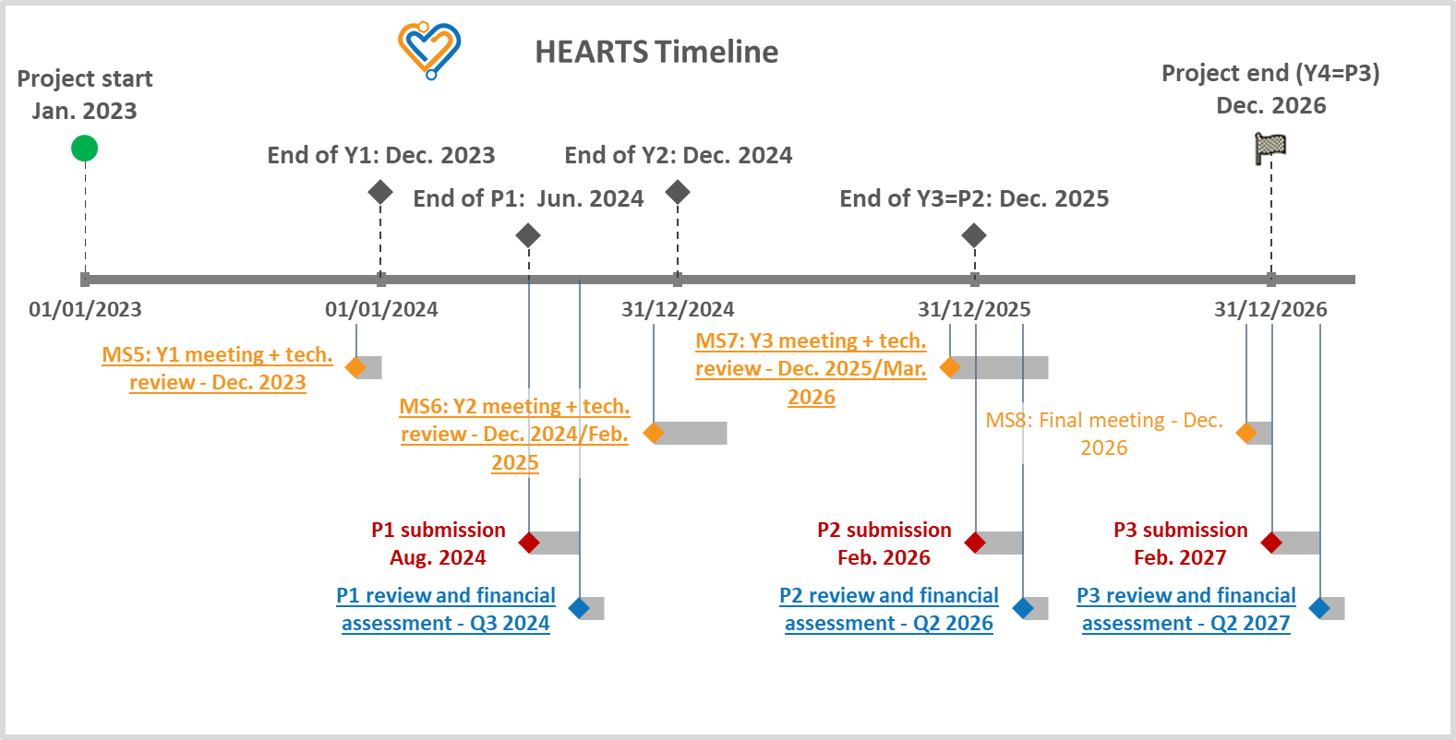
4. AoBs
Naming of infrastructures: HEARTS@CERN & HEARTS@GSI agreed with PO
To be approved by GSI (Rubén, Marco)
and inform GB (Rubén, Pablo)
HEARTS Timeline: uploaded on EDMS
TRL definition: work in progress (Andrea)

