Slide 1
Symmetry in
Standard Model
Seongmin Kim

Slide 2
Review
Electroweak + Higgs
SU(2) YM interaction for All left-handed fermion
Higgs gives fermions & gauge bosons mass
-> Yukawa interaction
Strong interaction
SU(3) YM interaction for only quarks
Problems and topics in two "sectors"

Slide 3
Role of Symmetry in QM
Poincaré group
All particle are a irrep of Poincaré group : m, j
other symmetry : charge, C, P, T, ...
Action should be invariant under all the symmetrys
finding All symmetry-preseving possible term
pick relevant & marginal terms (renormalization)

Slide 4




Why Higgs should come out?
weak interactions : SU(2) symmetry, only for left-handed fermion
left handed fermion : doublet
right handed fermion : singlet
mass term : left x right coupling
-> can't put SU(2) invariant term without aditional SU(2) doublet
symmetry tells us there is a SU(2)-doublet scalar field
$$\left({u_{L} \atop d_{L}}\right) \left({e_{L} \atop ν_{e}}\right)$$
$$u_{R}, d_{R}, e_{R}$$
$$m \overline{f_{R}} f_{L}+m \overline{f_{L}} f_{R}$$
$$\left({φ_{+} \atop φ_{0}}\right)$$

Slide 5

mass term by higgs field
mass term with
SU(2) symmetry!
$\left({u_{L} \atop d_{L}}\right)$ 와 $\left({φ_{+} \atop φ_{0}}\right)$ 내적
$g_{d}\left(\begin{matrix}\overline{u_{L}} & \overline{d_{L}}\end{matrix}\right)\left({φ_{+} \atop φ_{0}}\right)d_{R}$
$g_{u}\left(\begin{matrix}\overline{u_{L}} & \overline{d_{L}}\end{matrix}\right)\left(\begin{matrix}0 & 1 \\ −1 & 0\end{matrix}\right)\left({φ_{+} \atop φ_{0}}\right)u_{R}$
$g_{d}v \overline{d_{L}}d_{R}$ , $g_{u}v \overline{u_{L}}u_{R}$

Slide 6
symmetry in SM
SU(2)xSU(3)xU(1) : gauge symmetry
SU(2)xU(1): broken by Higgs , U(1) "electric" charge left
SU(3) : only scalar (simplest) left by "confinement"
Baryon number
Lepton number
CPT, Poincaré group

Slide 7
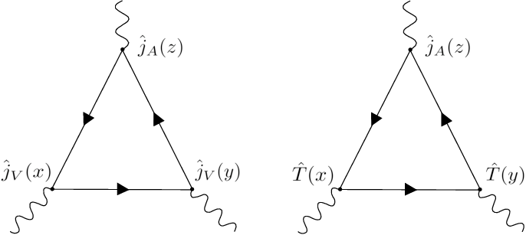
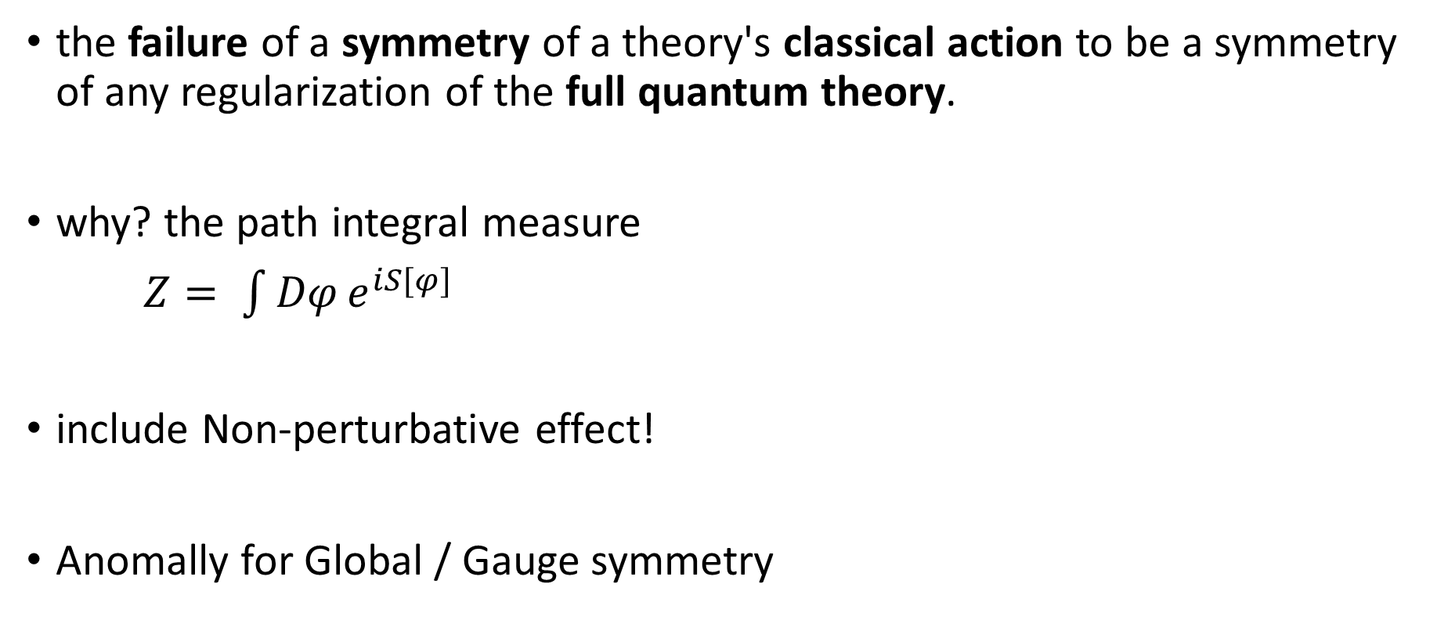
Anomally
the failure of a symmetry of a theory's classical action to be a symmetry of any regularization of the full quantum theory.
why? the path integral measure
$Z= \int{Dφ}e^{iS[φ]}$
include Non-perturbative effect!
Anomally for Global / Gauge symmetry

Slide 8
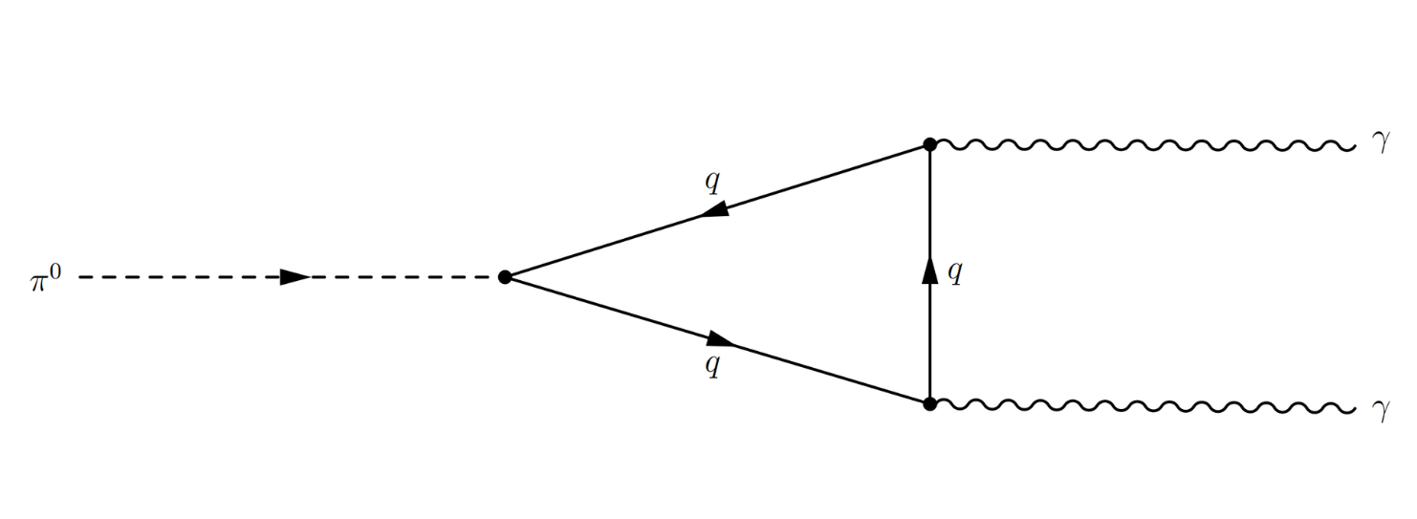
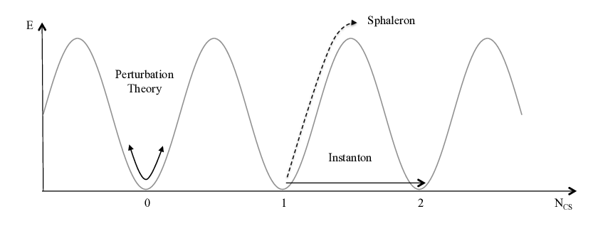
Global anomally in SM
newtral pion decay
B,L non-conservation
B-L is only exact symmetry
Why anomalous? : 가능한 vacuum 간의 양자 터널링
axial current non-censervation
B

Slide 9
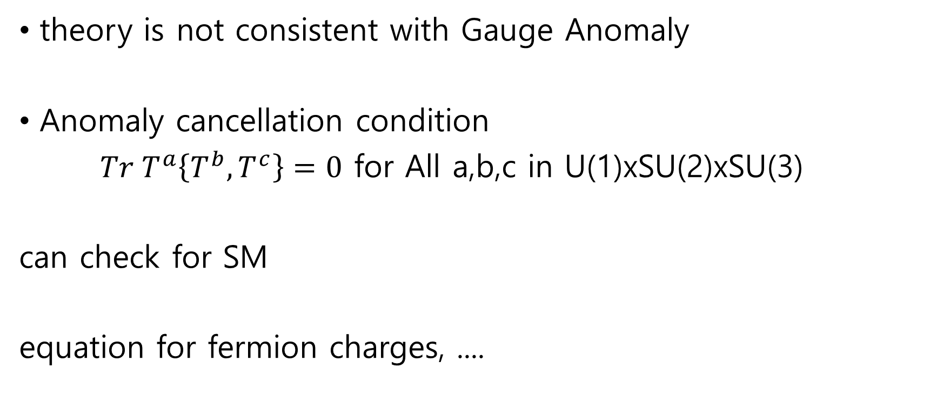
Gauge Anomaly Cancellation
theory is not consistent with Gauge Anomaly
Anomaly cancellation condition
$Tr T^{a}\left\{T^{b},T^{c}\right\}=0$ for All a,b,c in U(1)xSU(2)xSU(3)
can check for SM
equation for fermion charges, ....

Slide 10
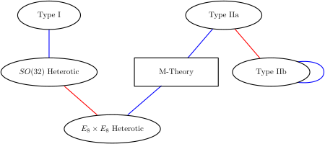
Anomaly cancelation of GUT, String, ...
constrain the gauge group
one of a "signpost" beyond GUT
10-dim spacetime
SO(32)
E8 x E8

