Slide 1
PERLE Collaboration Meeting
INTODUCTION

Slide 2
PERLE Timeline for TDR phase and beyond
The current phase of the project:
Technical Design phase (→ 2023)
Prepare to Build phase (P2B) (→ 2025)
Machine design (Injector, 250MeV and 500 MeV configurations)
Beam dynamics studies
Main systems design (Buncher, Magnets, HOM couplers, full dressed cavity, power couplers, new CM, IP, dump…)
In-Kind adaptation and/or upgrade studies (DC-Gun, Booster, SPL CM) *
Definition of the needs (Diags, Cryogenics, CC, LLRF, Shielding, machine interlock system, infrastructure…)
Experiments with PERLE beam and their specific needs
Prototyping and tests (HOM couplers, Single cell booster cavity, B-COM magnet, 5-cells Nb Cavity) *
PERLE administrative regime (Dossier ASN)
Infrastructure (site investigations and work)
And also:
DC-Gun reinstallation and test
Equipment specifications and procurement (for DC gun)
In-Kind adaptation and/or upgrade work (DC-Gun, ESS CM)
* Design of some systems could continue after TDR publication
* Prototyping results could be included in the TDR phase if available

Slide 3
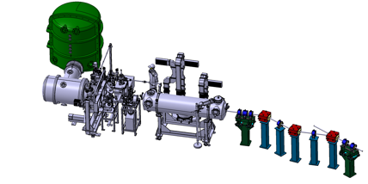
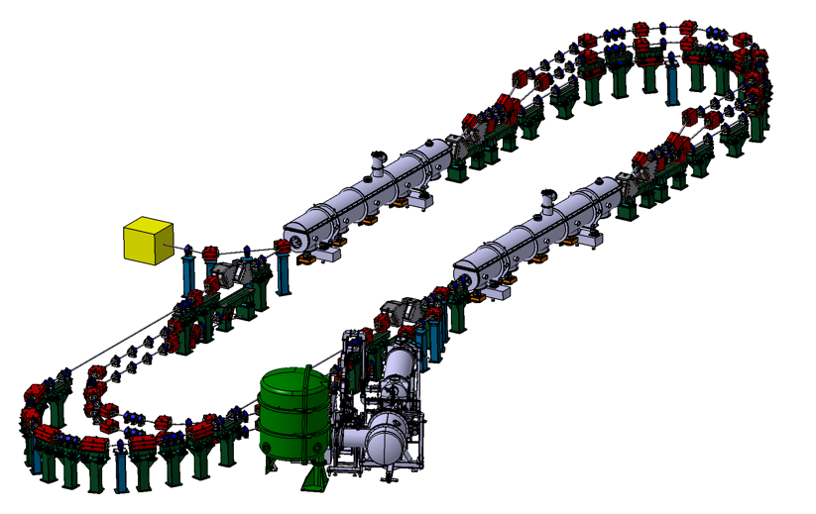
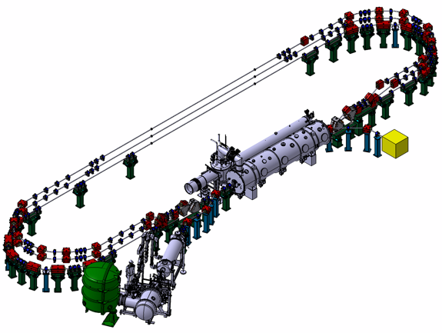
PERLE Timeline for TDR phase and beyond
Technical Design phase (TDR)
Prepare to Build phase (P2B)
Installation phases
Phase 1: Installation of the injection line
Phase 2: PERLE 250 MeV version
Phase 3: PERLE 500 MeV version
2020
2021
2022
2023
2024
2025
2026
2027
2028
2029
2030
2031

Slide 4
Hightlighst on results of recent months
which will be discussed in details during this collaboration meeting
with some comments on important discussion which could take place.

Slide 5
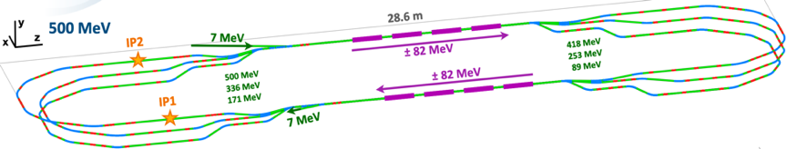
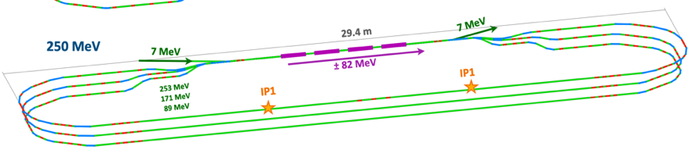
PERLE Lattice optimization
Lattices and optics for the 500 MeV and 250MeV PERLE versions were studied and optimised:
A full 1st order calculation were finished and a complete 250 and 500 MeV lattice is now available.
The stability of the lattice was crosscheck with different codes (OPTIM6, MADX & BMAD).
First specifications of quadrupoles and dipoles in switchyards & arc sections are obtained.
→ Further studies are ongoing/to be done: correction of nonlinear aberrations with multipoles, momentum acceptance, longitudinal match…
→ In addition to beam dynamics studies: Start to end simulations with CSR and microbunching, Multiparticle tracking, BBU, Impedance analysis and Wakefield effect mitigation …

Slide 6
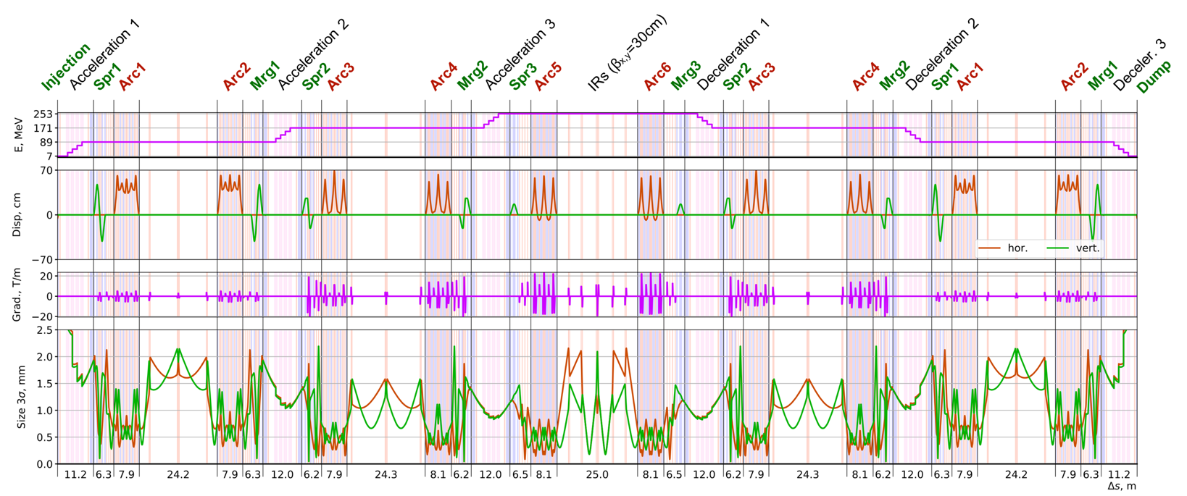
Lattice optimization of the 250 MeV version of PERLE
Transverse beam size (3$σ radius)<2,2 mm$($after the 2nd RF cavity),\text{Dispersion}\text{ < 70 }\text{cm}$ and Low beta function @ the 2 IRs
(more details in Alex, Alex, Rasha, Julien, Coline talks)

Slide 7
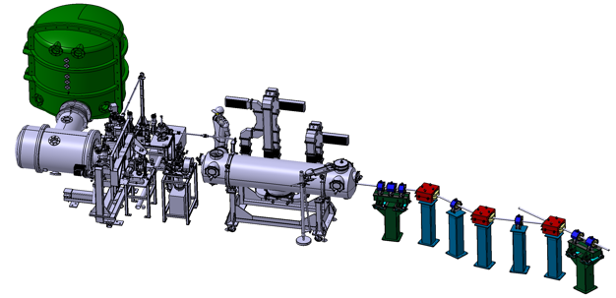
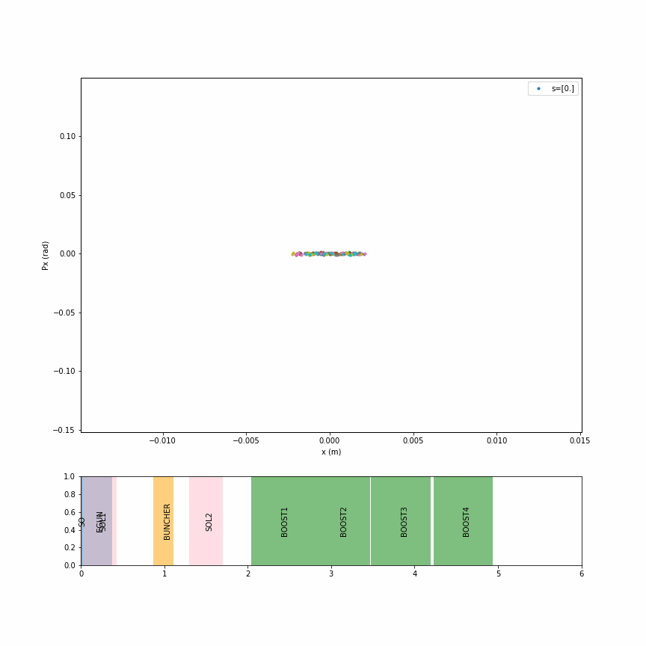
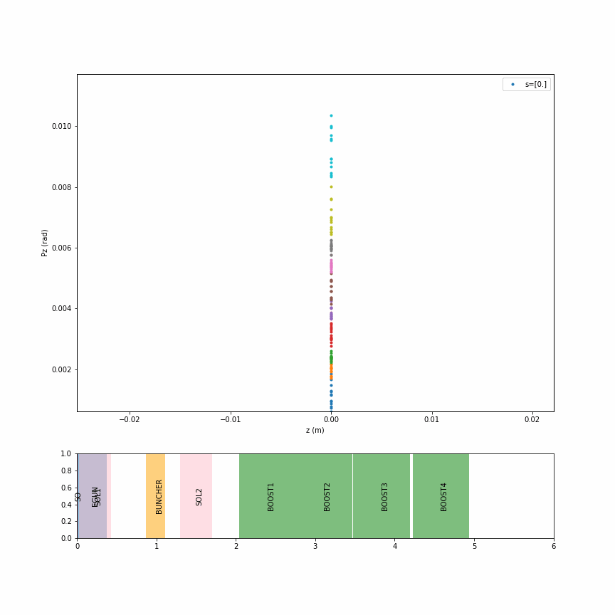
Injection line optimisation
A conceptual design of the PERLE injector was made within a collaboration between AsTeC-Daresbury, UoL and IJCLab. This included the DC gun cathode shape optimisation, a buncher cavity and the merger conceptual designs, besides a complete beam dynamic studies of space charge effects, phase space and bunch distributions, and emittance. Further studies and design optimisation of the injector are currently undertaken.
HV tank
Photocathodes loading chamber (Sb-based photocathodes)
Buncher
350 kV
DC gun
Merger
Light box
Green laser 40 MHz
Booster: 5 single-cell cavities (802MHz) individually powered
Solenoids focus beam in transverse plans
Buncher focus beam in longitudinal
M shape in z-pz axis at the end of injector : Might be a problem
More details in Raphael’s talk
+diagnostics Mohamed
B. Hounsell et al. “Conceptual design of the PERLE injector” LINAC’22- Liverpool, UK- THPOJO26
Transverse phase space (x-px)
Longitudinal phase space (z-pz)

Slide 8
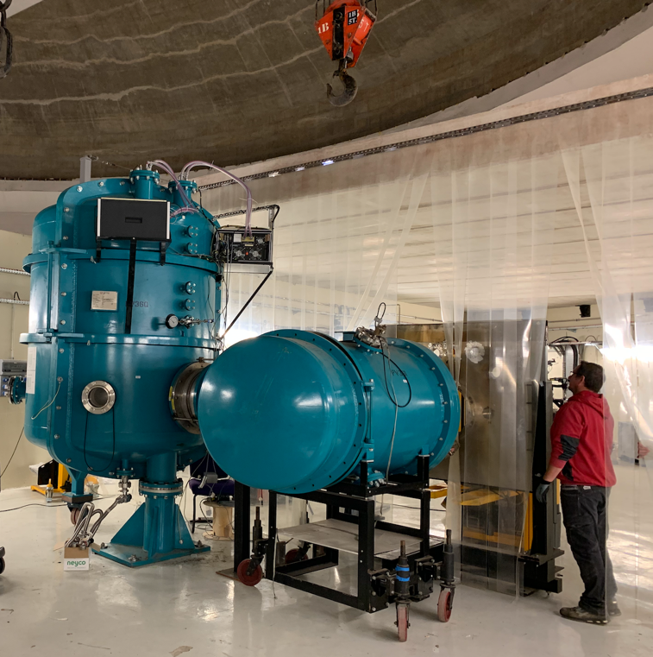
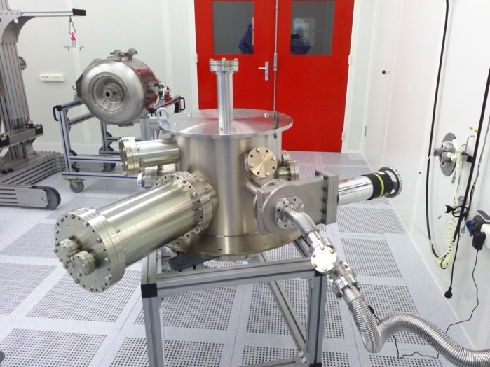
PERLE e- Source
Vacuum pumping of gun new chamber after ultrasonic cleaning (December 2023)
Installation of the gun vessel (November 22)

Slide 9
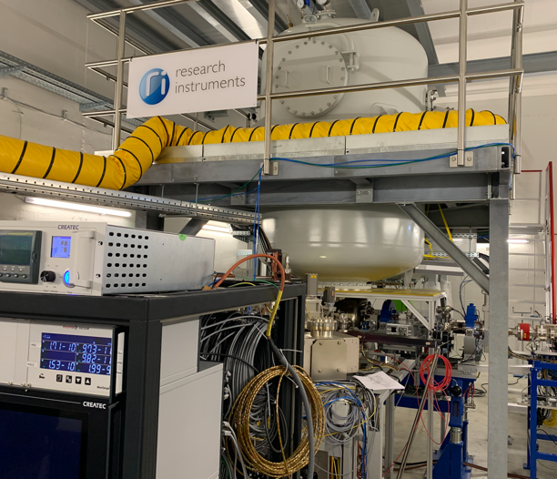
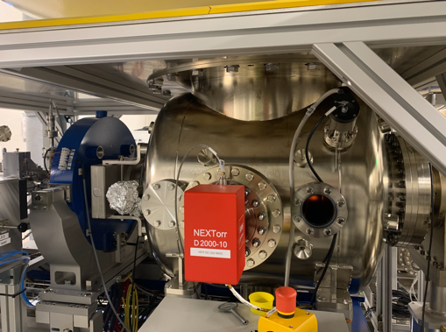
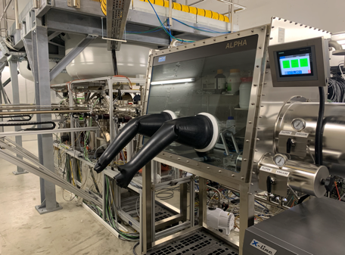
PERLE e- Source
A new opportunity of a DC gun acquisition raised early in 2023: Ongoing discussions with Research Instruments GmbH (RI)
→ A Gun with Cornell design (400 pC, 50 MHz demonstrated), fully equipped (all pumps) in load-lock version
Equipped with a Photocathode preparation facility
HV power supply suited for high bunch charge (designed for 40 mA, 450 kV)
The gun was commissioned and tested at high rep rate, at a limited bunch charge
(more details in Maud & Raphael talks)

Slide 10
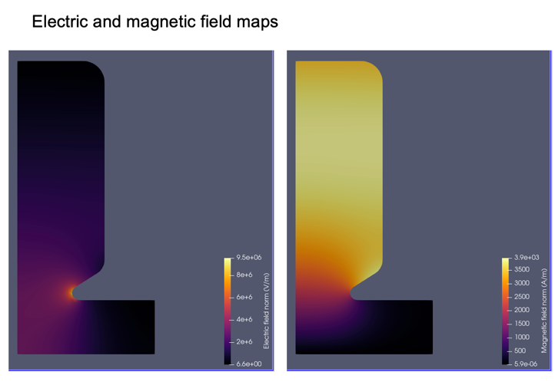
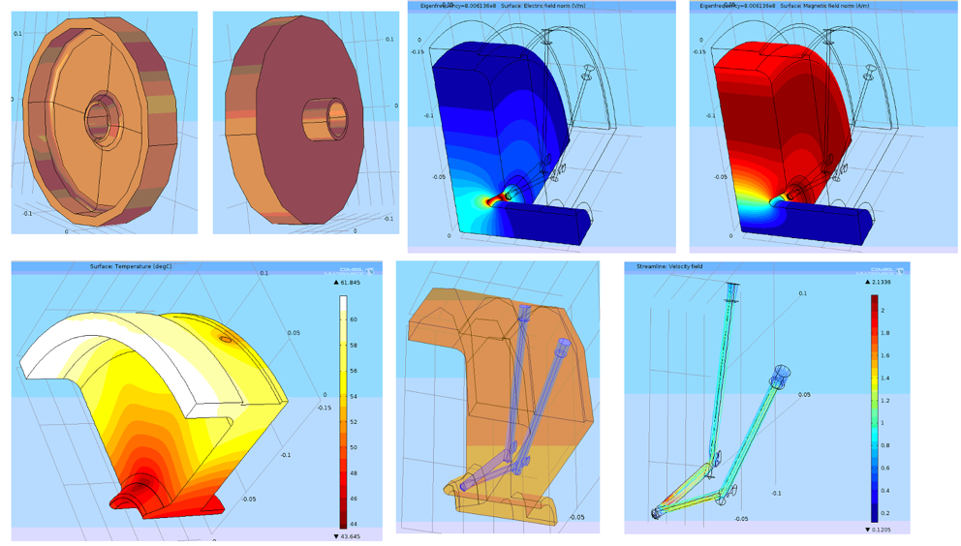
First simulation of Buncher cavity :
Courtesy to Juan Luis Munoz- ESS- Bilbao
First results of the buncher cavity design (more details in Juan Luis’s talk)

Slide 11
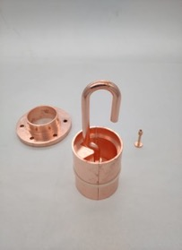
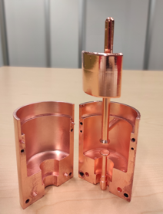
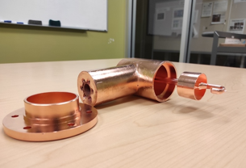
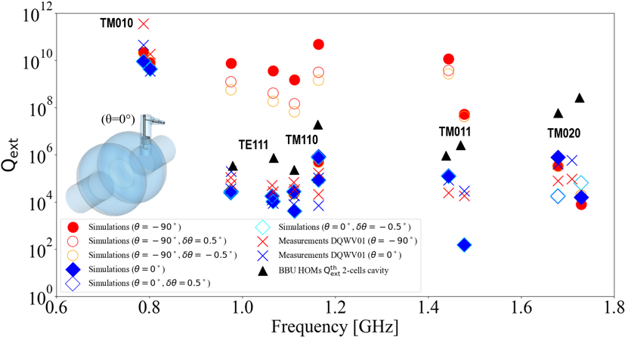
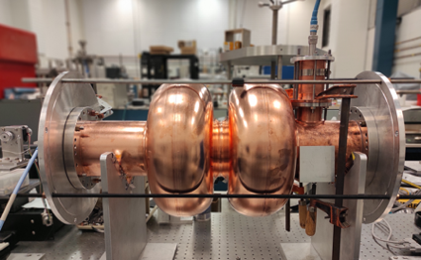

Status of HOM studies :
From RF design to performance measurements: collaborative effort between IJCLab, Jefferson Lab & CERN
(more details in Carmelo talk)
Probe coupler
DQW coupler
Hook coupler
3D-printed prototype (Epoxy Accura 48) copper-coated @CERN
Measurements are made as a function of rotation angle of HOM coupler hook.
Good rejection of Fundamental Mode, Q_{ext} > 1E+09.
Measured Q_{ext} for HOMs are below BBU limit thresholds.
Good agreement between measured and simulated Q_{ext} → could be improved with more appropriate boundary conditions at beam pipe apertures.
Installation in a double-cell Cu cavity and test of performances (S12, $β_{1},β_{2},$Q_{L} and Q_{ext}) @JLab
C. Barbagallo et al. “First RF measurements of coaxial HOM coupler prototypes in a copper cavity for the PERLE project”- IPAC’23- MOPA025

Slide 12
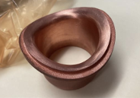
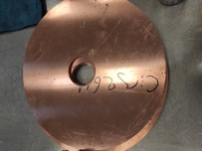
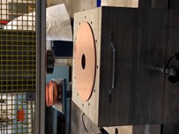
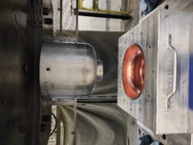
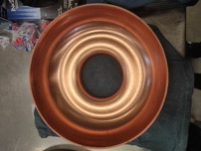
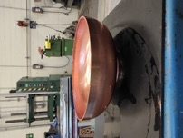
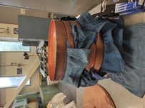
Plans on HOMs and cavity activities :
IJCLab- JLab- CERN Collaboration
(more details in Bob & Haipeng talks)
A 5-Cell copper cavity under fabrication @Jlab (same design as the 1st Nb 5-cell cavity fabricated in 2017) to allow end group design optimisation and to test several HOM couplers combinations to assess the best HOM damping scheme.
Copper half-Cells production at Jlab for the 5-Cell “clamped” cavity
3D-printed HOM port to beam transition- France
Ultimately, we aim to produce Nb HOM couplers with optimised design and and install them on a new Nb 5-cell PERLE cavity with optimised end groups. The Production of 4 cavity scheduled within the ISAS program (Starting from 2024).
→ A global technical review (HOM dumping scheme + cavity end cell design) to be settled before moving to fabrication

Slide 13
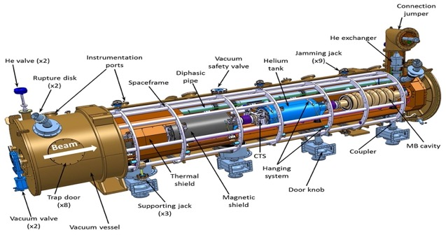
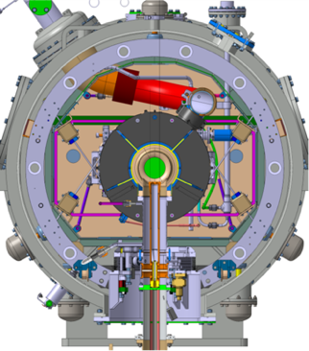
Cryomodule design:
(more details in Gilles talk)
ESS Cryomodule design was selected:
Intermediate supporting structure (spaceframe)
Cavity string hung by rods
Insertion of the cavity string by the extremity (rollers)
Trap doors for tuner access
Connexion to the valve box on the top of the vacuum vessel
Important space available inside
Design validated: series fab. & tests ongoing (Qty 30)
1st Cryomodule: Foreseen for 2027
Adapted from ESS design, it will be optimised for efficient high current ERL operation within the European Infra-Tech program iSAS*. It will host cavities equipped with HOM couplers and FPC optimised and developed within the same program.
2nd Cryomodule: Foreseen for 2030
May include some/all the technologies studied within iSAS program to improve the efficiency of Cryomodules: Fast Reactive Tuner (FRT) for microphonics mitigation, LLRF managed by AI and 4.2 K Cavities operating.
* More information on iSAS program: https://indico.ijclab.in2p3.fr/event/9521/
(more details in Nick talk)

Slide 14
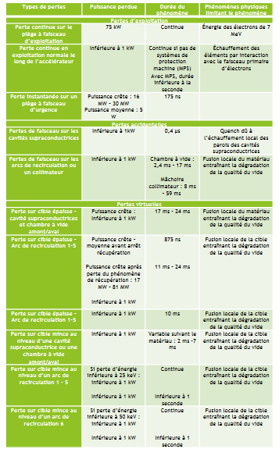
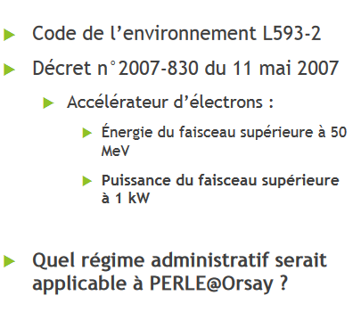
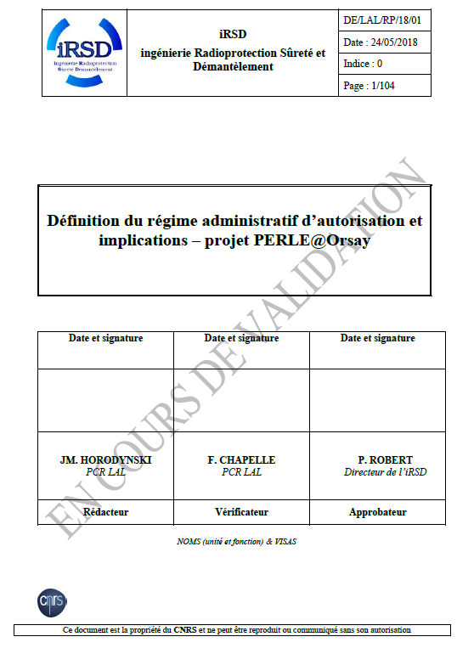
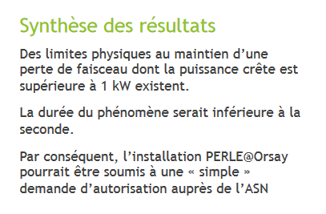
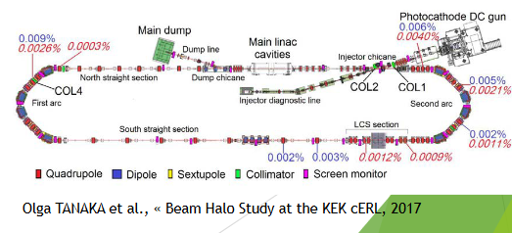
Administrative Classification of PERLE
(more details in Walid talk)
A study was ordered to IRSD in 2018 and released in 2019.
Preliminary conclusions.
~100 pages document
Today, a task-force is formed to:
Continue and complement these studies to have a preliminary discussion with ASN by Summer 2023.
Start the required studies and the draft of the ASN document for PERLE in the upcoming years
Some benchmarking with cERL and JLab former ERLs.

Slide 15
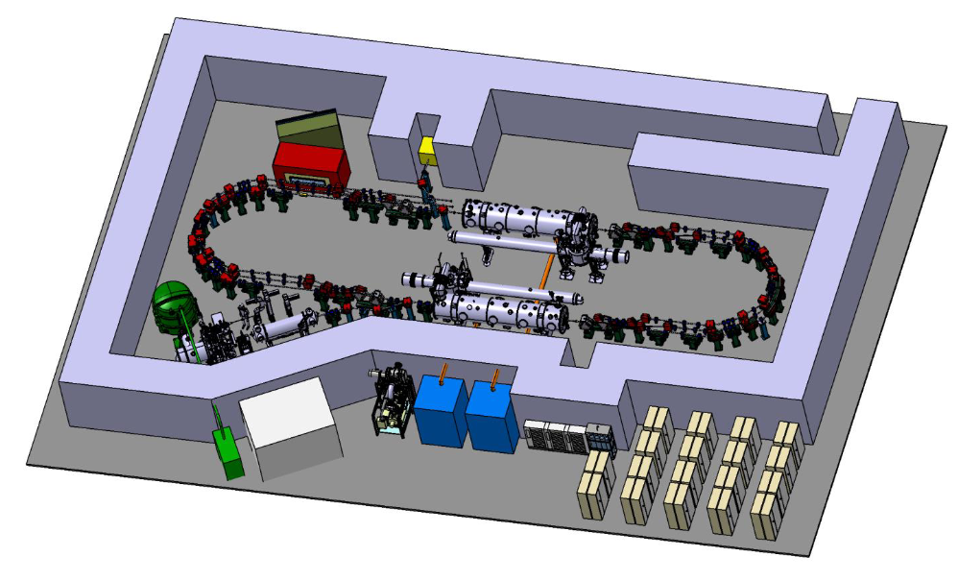
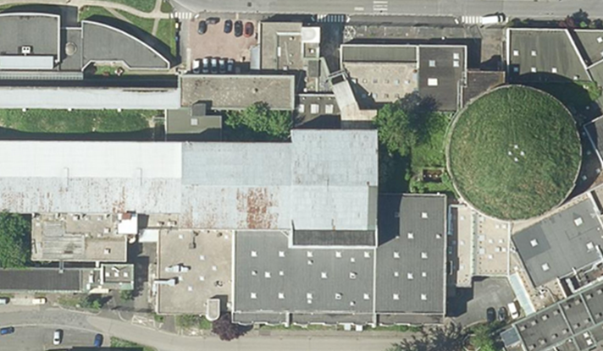
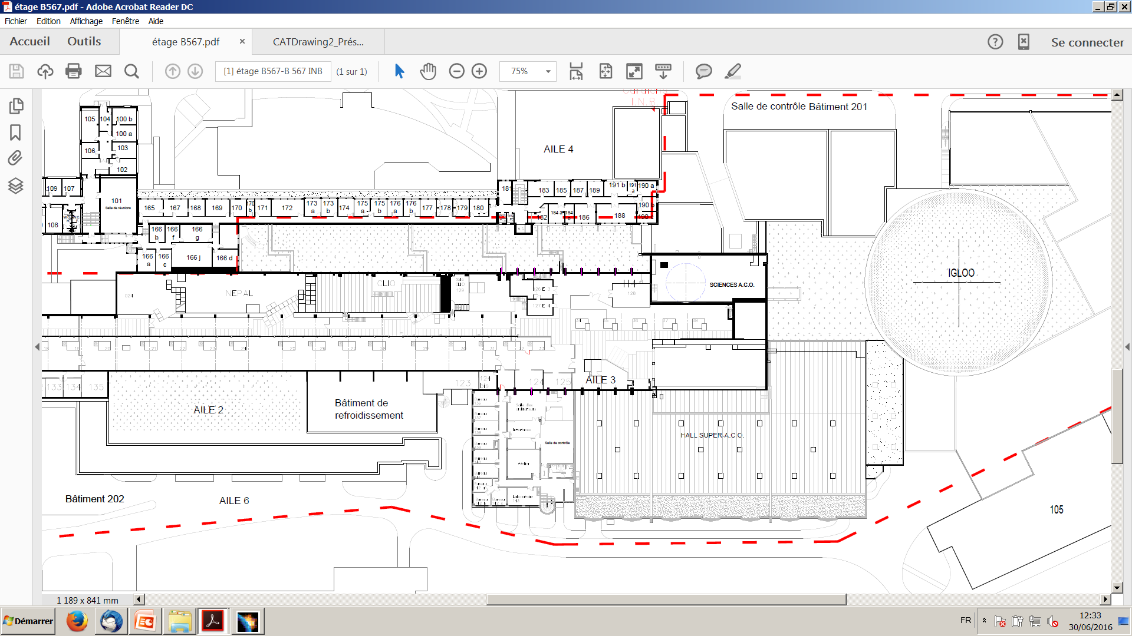
PERLE Footprint and site studies
Two sites are currently considered and will be studied in details within the CPER program for possibly host PERLE: The Super ACO hall and the IGLOO.
36 m
IGLOO
PERLE feature a total footprint of:
30 meters long, 15 meters wide and 3.4 meters high.
Super ACO Hall
37 m
55 m

Slide 16
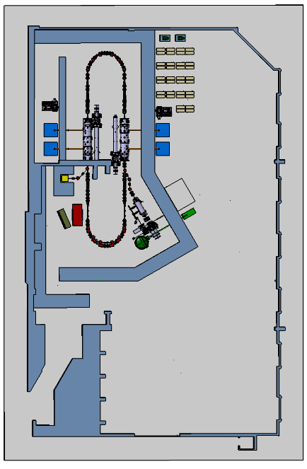
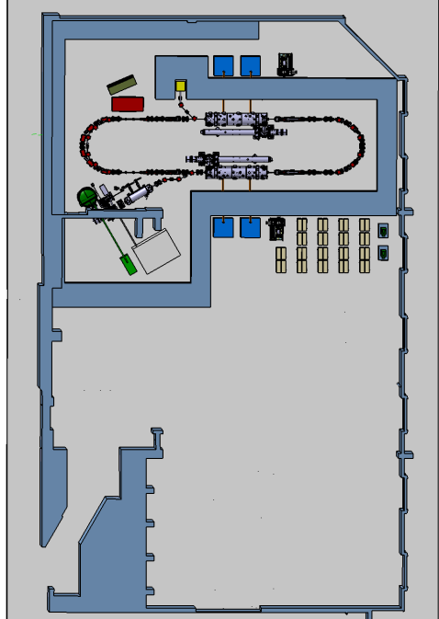
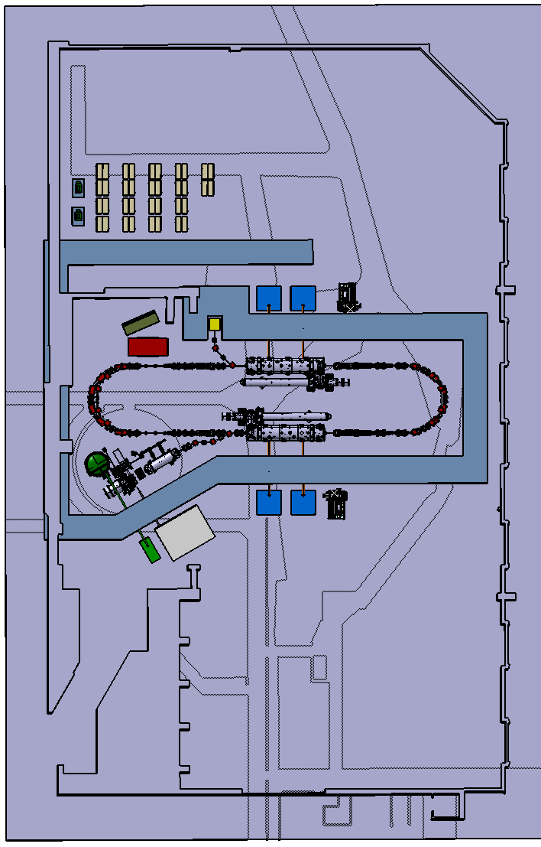
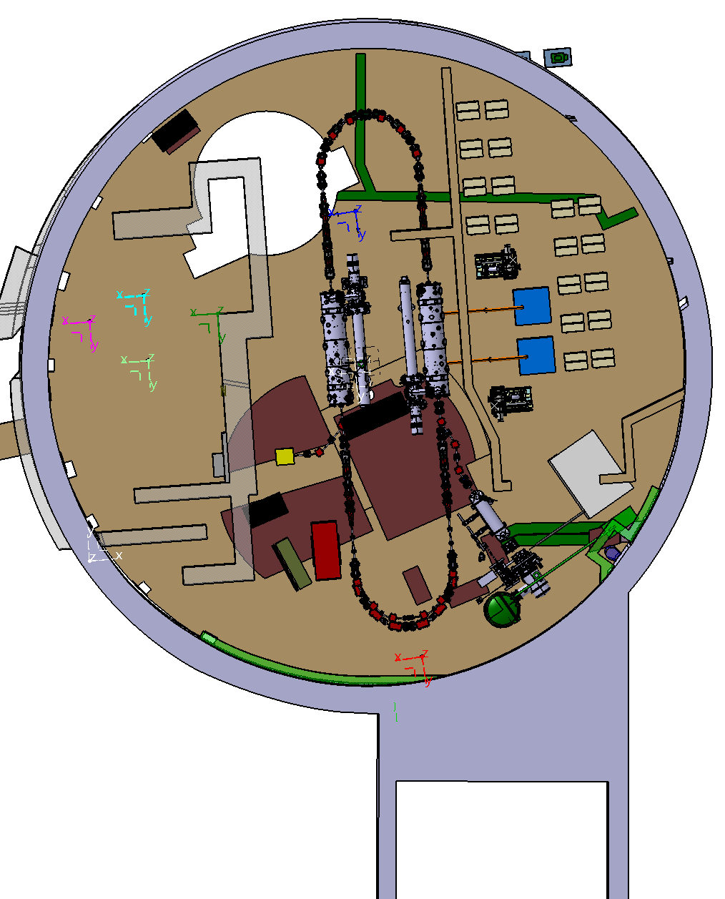
PERLE Footprint and site studies
(more details in Walid talk)

Slide 17
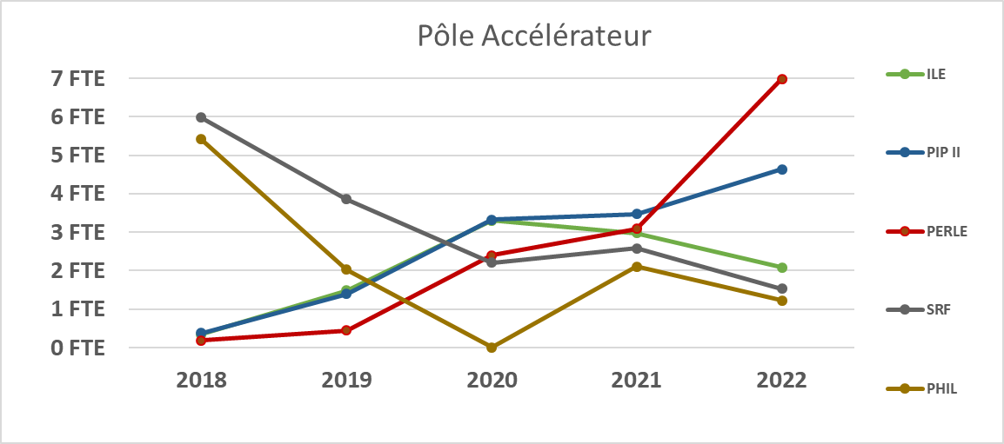
HR involvement and projection - French level mostly
Significant increase in 2022 of the forces contributing to PERLE that will continue in the coming years according to the phasing strategy.
Up to 20 FTE secured.
IJCLab/ France has to increase that.
BUT
We need similar exercise from the other partners.
Action on going.
→ Here the evolution of IJCLab manpower implication on the project in the past three years and an estimation for the 3 upcoming ones:
Year | 2020 | 2021 | 2022 | 2023 | 2024 | 2025
FTEs | 1,9 | 3 | 7 | 16 | 18 | 20
* For the past years, the table do not include other French lab involvements (LPSC + GANIL) + a split site PhD with Liverpool University.

Slide 18
Financial resources- Budget Estimation and spending profile
The global cost of the full machine ~27 MEuros.
(This estimation did not include manpower cost)
The following table presents an Ideal Spending Profile splitted in P2B phase, Construction, Construction-Infra (infrastructure equipment installation) and Upgrade to 500 MeV.
 | 2022 | 2023 | 2024 | 2025 | 2026 | 2027 | 2028 | 2029 | 2030 | 2031 | Total (k€)
P2B (k€) | 168,5 | 630 | 610 | 218 | 0 | 0 | 0 | 0 | 0 | 0 | 1626,5
Construction (k€) | 0 | 0 | 0 | 2970 | 7300 | 6200 | 1050 | 0 | 0 | 0 | 17520
Constr.-Infra (k€) | 0 |  | 100 | 500 | 1100 | 1600 | 500 | 0 | 0 | 0 | 3800
Upgrade 500 MeV (k€) | 0 | 0 | 0 | 0 | 0 | 0 | 350 | 1600 | 1830 | 550 | 4330

Slide 19
Budget – Spending profile in graphs
Ideal Spending Profile in k€ splitted in P2B phase, CONSTRUCTION, CONSTRUCION-INFRA and UPGRADE to 500 MeV.
Focus on P2B phase
We are trying to secure it
Spending Profile in k€ for P2B phase detailing the cost for TDR + Prototyping and the installation of the DC-Gun.

Slide 20
Search for financial support
We are actively looking at different possibilities to get extra funds for the P2B phase and beyond.
Beyond PERLE, but really PERLE and bERLinPro oriented, we are about signing an MoU CNRS/HZB
iSAS: European INFRA-TECH project 11 research partners (CNRS, CERN, ESS, DESY, VUB, CEA, HZB, INFN, UKRI, UL, EPFL) Asked 5M€. Financial support for the construction of the full cryomodule of a cost of about 3M€. The IN2P3 has guarantee the matching funds at the level of 1.0M€ complemented by the lab.
Possibility of having ESS and INFN-LASA-Milano in PERLE Coll.
Contribution ESS vessel cryomodule
France 2030 will propose new project oriented calls (current 2023) ~5M€. Call in fall.
Important role played by ERL panel with a mandate by the CERN Council in the ESPP Roadmap has as a main task to guarantee that the ERL RoadMap and so PERLE could get the sufficient financial support to success the ESPP strategy.
In-Kind contributions:
  Approved: DC gun from Daresbury, CM vessel ESS (around 700k€).
  Potential in-Kind Contributions under discussions: CBETA equipment, Booster (Jlab ?), Buncher (ESS-Bilbao?)

Slide 21
ISAS: Innovate for Sustainable Accelerating Systems
EU call HORIZON-INFRA-2023-TECH-01-01: New technologies and solutions for reducing the environmental and climate footprint of RIs. Project submitted to EU on March 9, 2023
The objective of iSAS is to innovate those technologies that have been identified as being a common core of SRF accelerating systems and that have the largest leverage for energy savings with a view to minimizing the intrinsic energy consumption in all phases of operation
Project lead by CNRS
  Scientific coordinator : J. D’Hondt (VUB)
  Project coordinator : A. Stocchi
International consortium :
  11 research partners (CNRS, CERN, ESS, DESY, VUB, CEA, HZB, INFN, UKRI, UL, EPFL)
  6 industrial partners

Slide 22
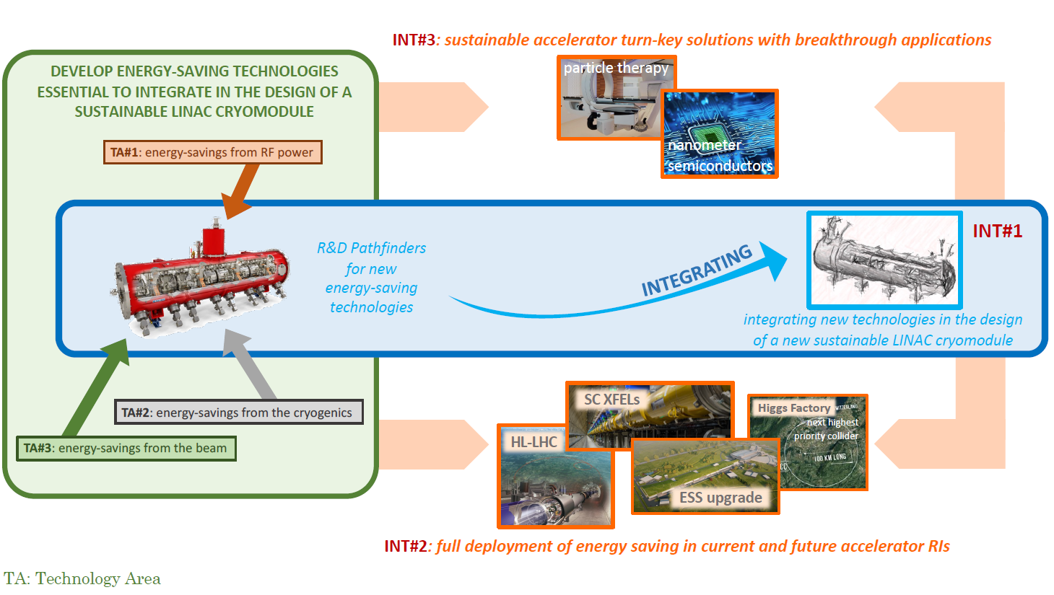
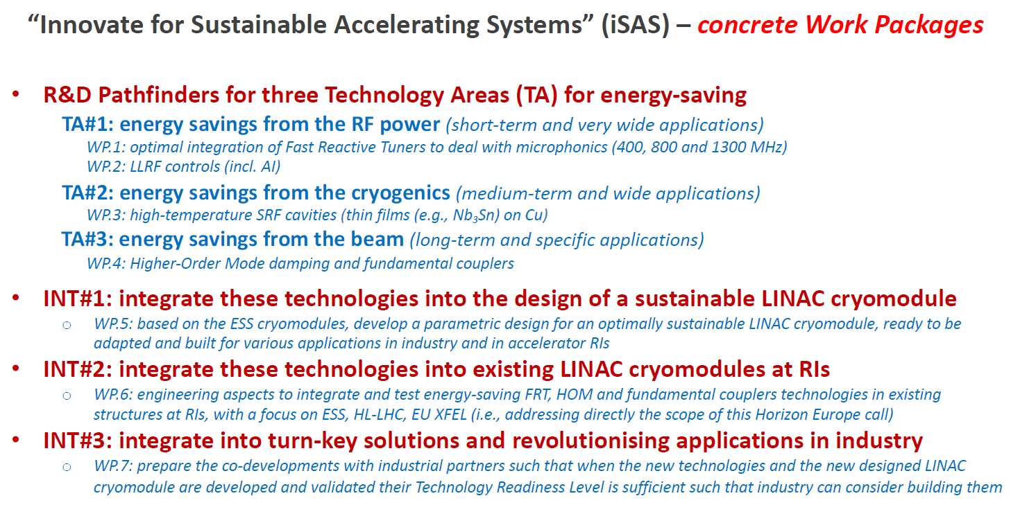
ISAS: Innovate for Sustainable Accelerating Systems

Slide 23
Very nice progress on the project in the last few months (DC-gun, injection, cryomodules, HOM, beam dynamics..)
The success of some very promising initiative could be a game changer for PERLE (iSAS, Recovery plan projects..). Still not enough for the full PERLE construction
Manpower largely not sufficient as soon as we enter in the next phase. Action on going at IJCLab and more clear discussions to be made with partners
I wish us a fruitfull meeting !

