Slide 1
Optics Misalignment and Correction
PERLE Collaboration Meeting
Presented by
Rasha ABUKESHEK
Supervisors
Achille STOCCHI & Hadil ABUALROB
June 2023
rasha.abukeshek@ijclab.in2p3.fr

Slide 2
Outline
Introducing errors to the PERLE lattice
Misalignment errors:
  Dispersion function
  Beta function
  Alfa function
Field errors
  B-com magnet

Slide 3
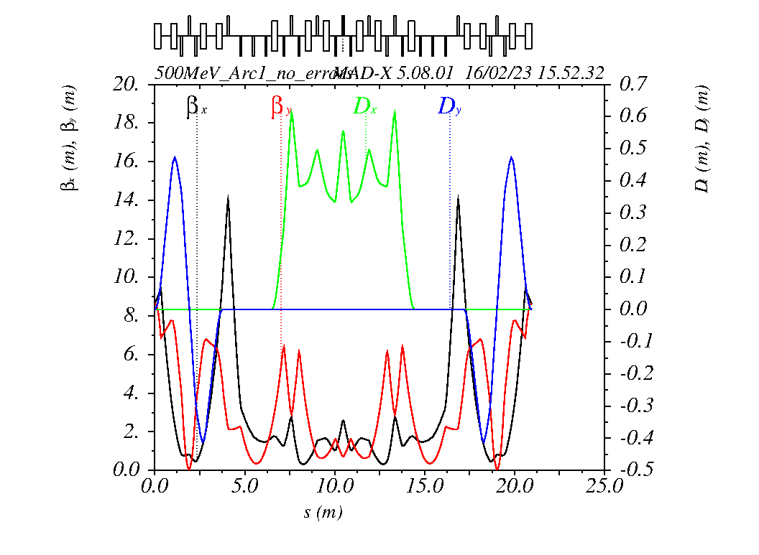
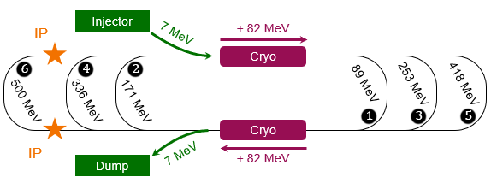
500 MeV PERLE Lattice
Reproduction of the PERLE 500 MeV machine using MADX.
The optics are perfect elements.
The dipoles (bends) are defined by an angle and tilt.
The quadrupoles are defined by K1.
Arc1 refers to the spreader section after the first LINAC, the circulating arc, and the merger section before the second LINAC

Slide 4
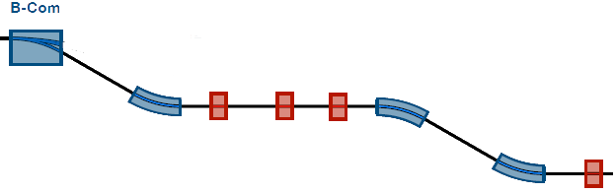
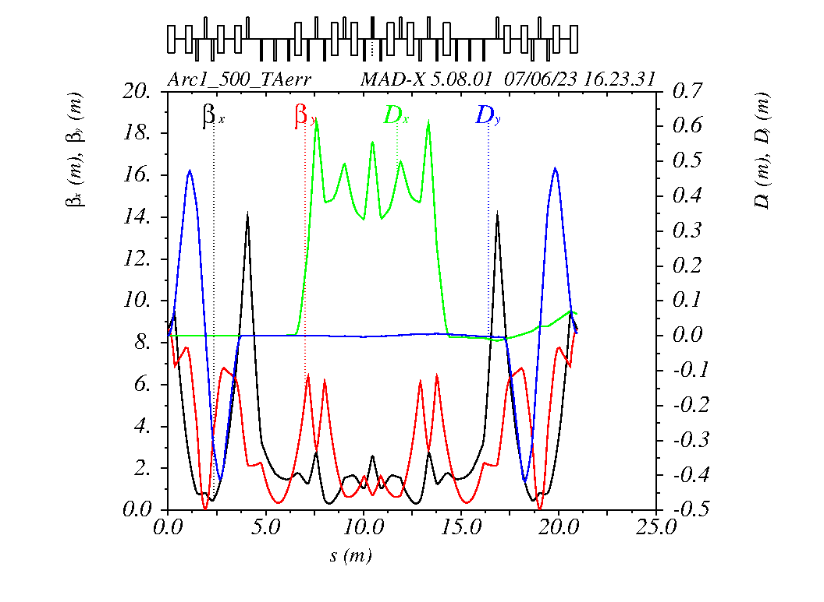
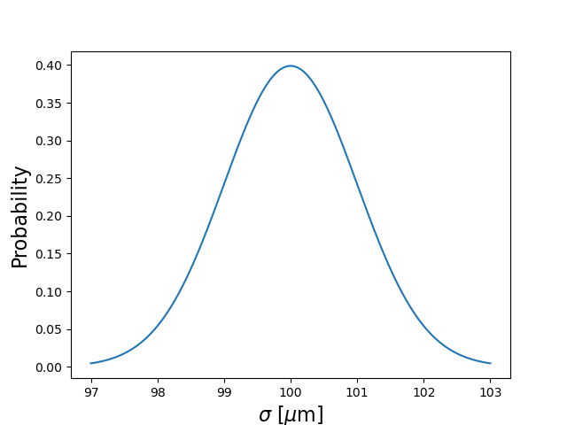
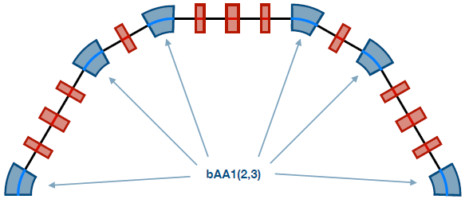
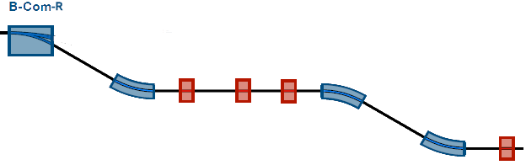
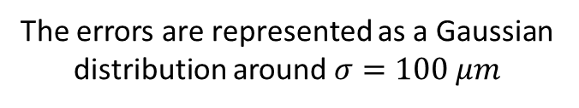
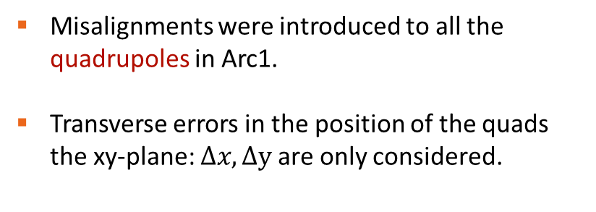
Introducing Misalignments
Misalignments were introduced to all the quadrupoles in Arc1.
Transverse errors in the position of the quads the xy-plane: $Δx,Δy$are only considered.
The errors are represented as a Gaussian distribution around $σ=100 μm$

Slide 5
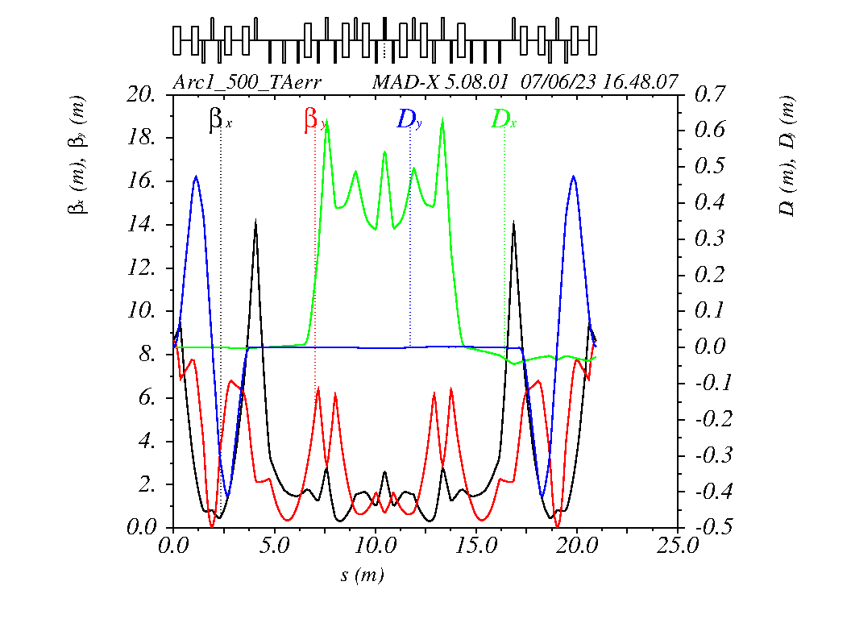



Different Possibilities
Since the distribution is Gaussian → different seeds generate different values to each element.
$D_{x}$ is negative at Arc1 end
$D_{x}$ is positive at Arc1 end
1000 simulations were performed to deduce:
  Dispersion DX, DY at the exit of the Arc.
  The difference in BETX, BETY between the arc's entrance and exit.
  The difference in the ALFX, ALFY between the arc's entrance and exit.

Slide 6
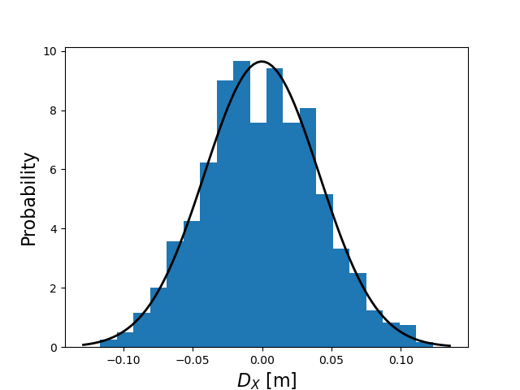
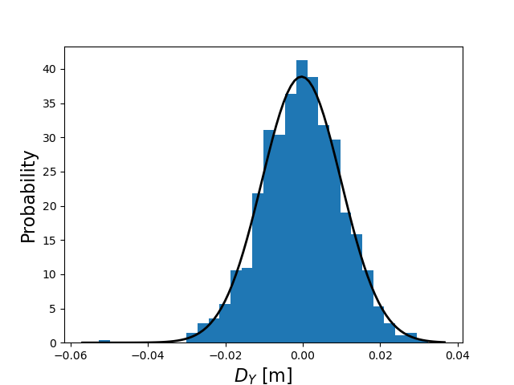


Dispersion DX and DY
The lattice is tuned so that the Dispersion function is Zero at the exit of each arc
Mean value = 0.00
Standard deviation $σ\sim 40 mm$
Mean value = 0.00
Standard deviation $σ\sim 10 mm$

Slide 7
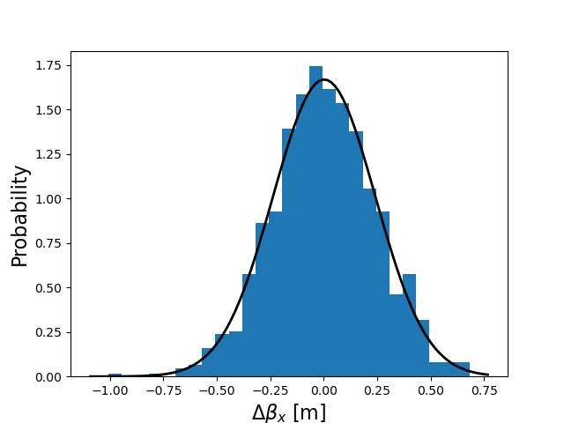
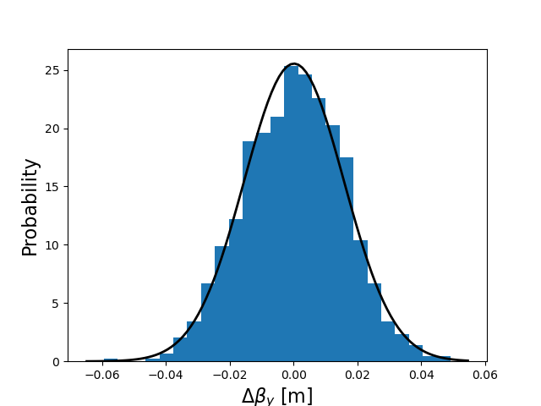
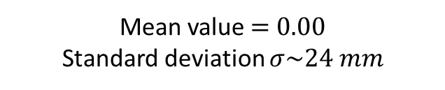
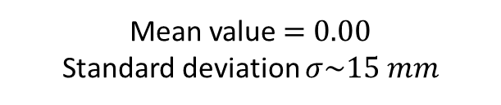
Difference in BETX and BETY
The lattice is tuned so that the Beta function is the same at the entrance and exit of each arc
Mean value = 0.00
Standard deviation $σ\sim 24 mm$
Mean value = 0.00
Standard deviation $σ\sim 15 mm$

Slide 8
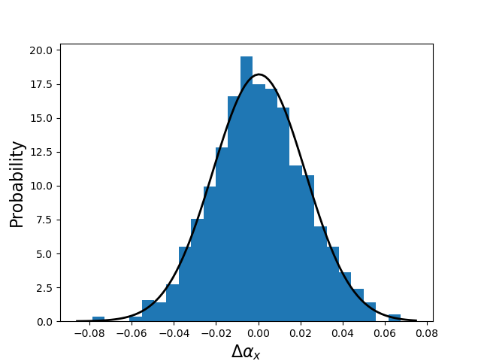
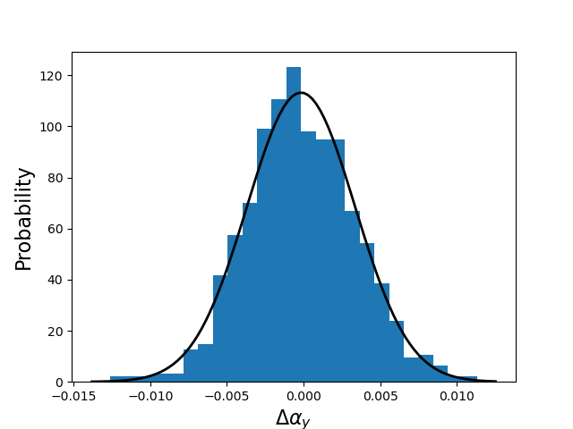

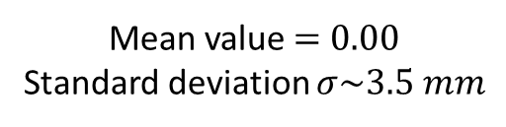
Difference in ALFX and ALFY
The lattice is tuned so that the ALFA function changes sign between the entrance and exit of each arc
Mean value = 0.00
Standard deviation $σ\sim 22 mm$
Mean value = 0.00
Standard deviation $σ\sim 3.5 mm$

Slide 9
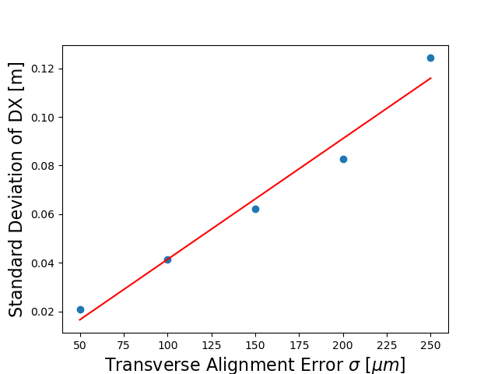
Introducing Different Values of Errors
Different values of the transverse alignment errors were introduced.
Each time, the standard deviation of DX at the exit of the Arc is extracted.

Slide 10
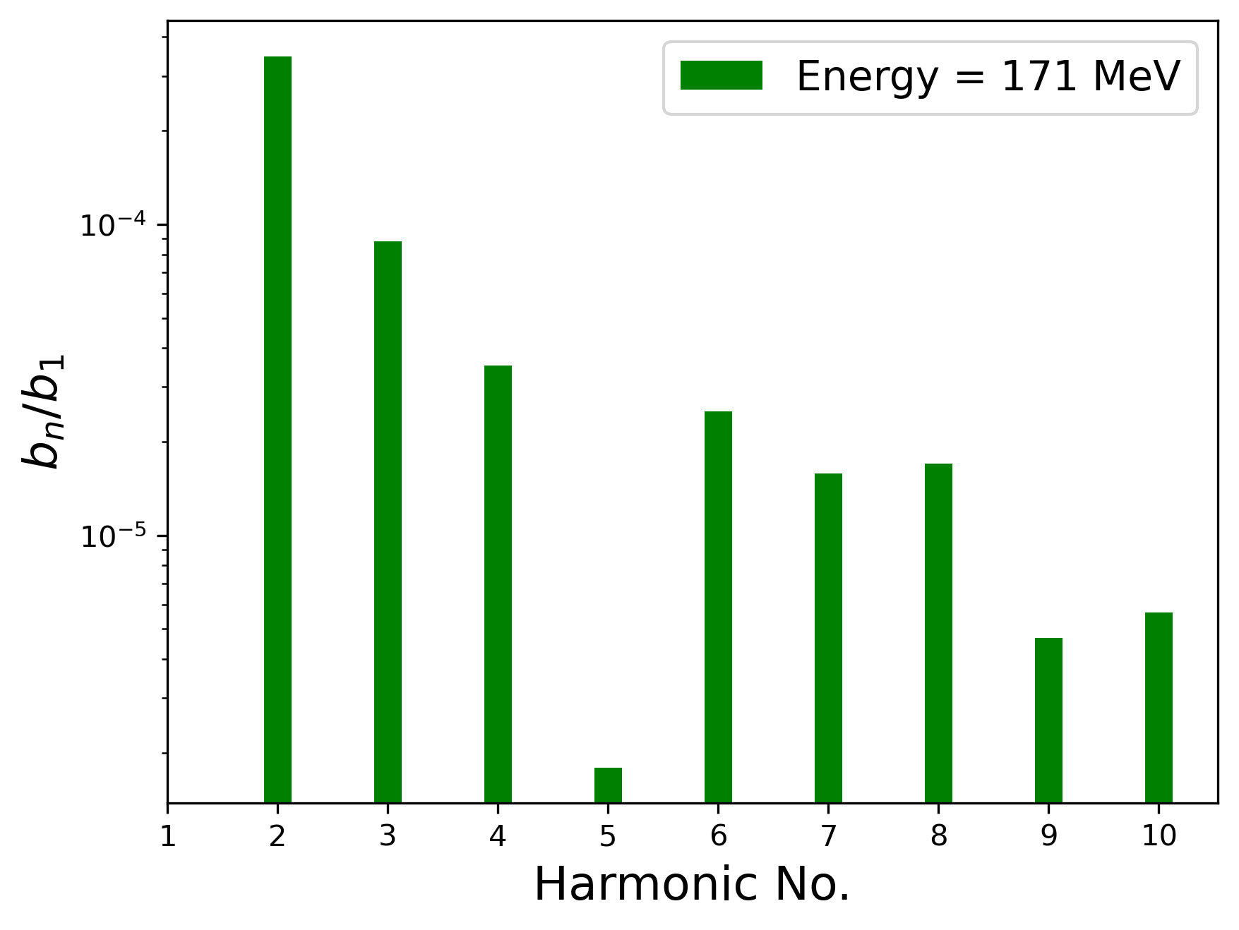
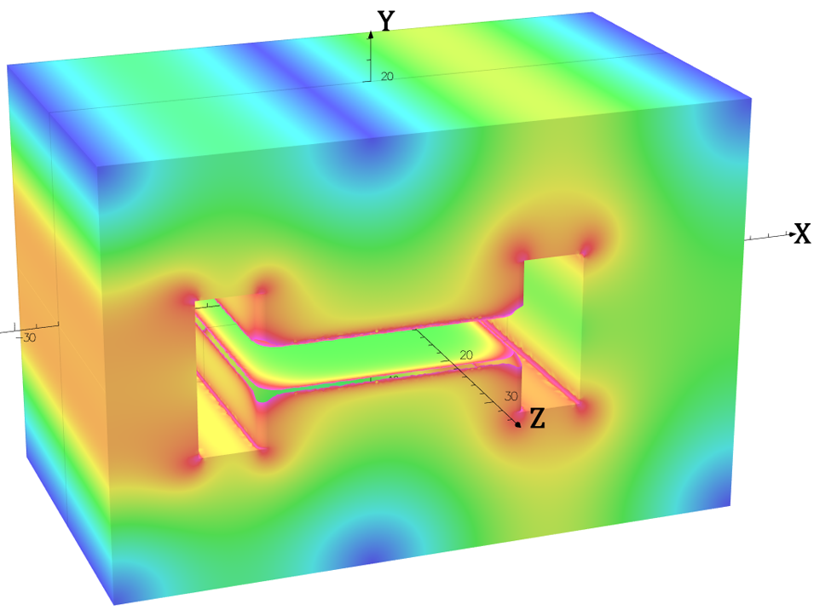
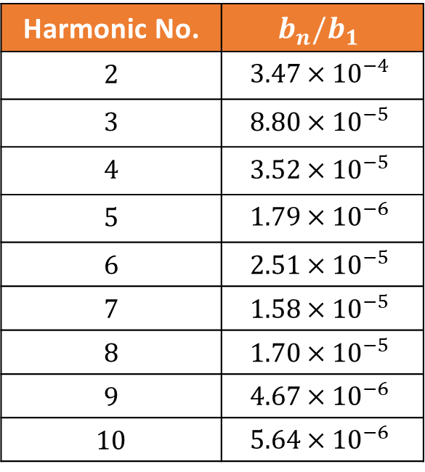
Introducing Field Errors to B-com Magnet
The B-com magnet was designed using Opera 3D.
Harmonic No. | $$b_{n}/b_{1}$$
2 | $$3.47×{10}^{−4}$$
3 | $$8.80×{10}^{−5}$$
4 | $$3.52×{10}^{−5}$$
5 | $$1.79×{10}^{−6}$$
6 | $$2.51×{10}^{−5}$$
7 | $$1.58×{10}^{−5}$$
8 | $$1.70×{10}^{−5}$$
9 | $$4.67×{10}^{−6}$$
10 | $$5.64×{10}^{−6}$$
The values of the first relative four higher harmonics were considered to introduce field errors
(see tomorrow’s talk: Magnet Specifications, Design and Prototyping)

Slide 11

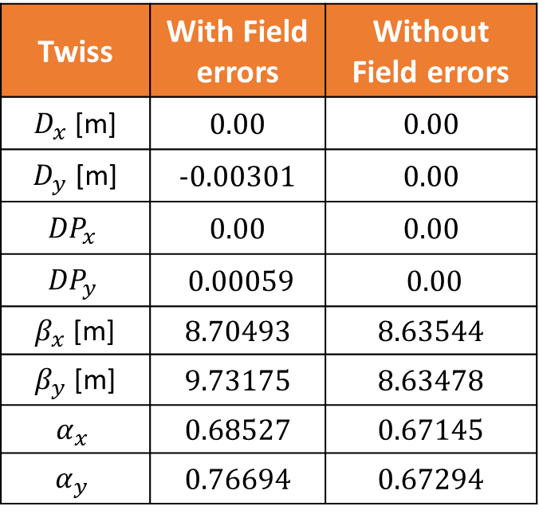
Introducing Field Errors
Relative field errors were introduced to the first B-com in the spreader and the B-com-R in the merger section.
Increase in the BETY function is noticed at the exit.
Twiss functions at the exit of Arc1
Twiss | With Field errors | Without Field errors
$D_{x}$ [m] | 0.00 | 0.00
$D_{y}$ [m] | -0.00301 | 0.00
$${DP}_{x}$$ | 0.00 | 0.00
$${DP}_{y}$$ | 0.00059 | 0.00
$β_{x}$ [m] | 8.70493 | 8.63544
$β_{y}$ [m] | 9.73175 | 8.63478
$$α_{x}$$ | 0.68527 | 0.67145
$$α_{y}$$ | 0.76694 | 0.67294
Further investigation is to be done

Slide 12
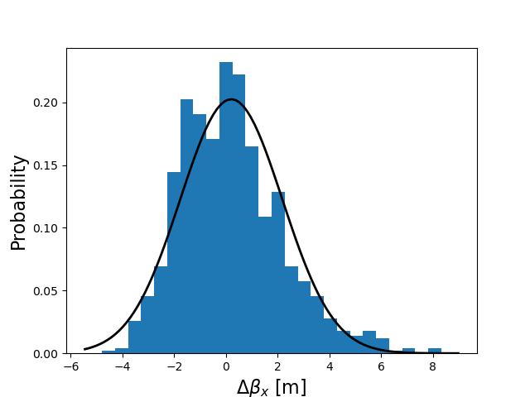
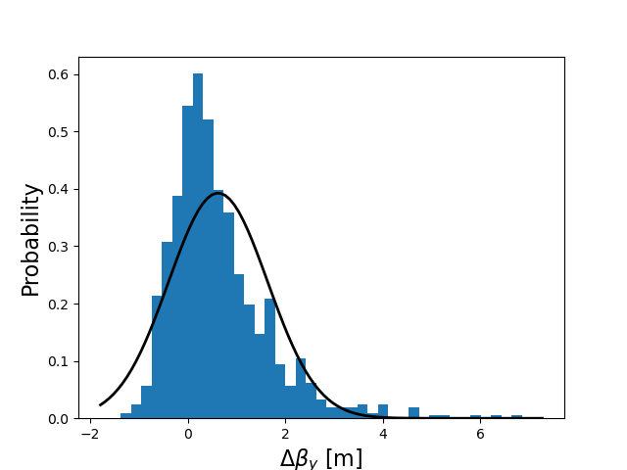
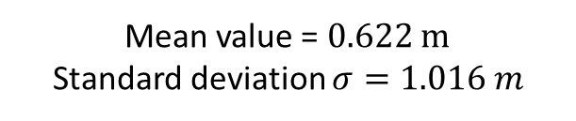
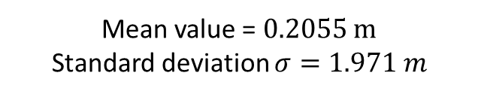
Difference in BETX and BETY
The lattice is tuned so that the Beta function is the same at the entrance and exit of each arc
Mean value = 0.2055 m
Standard deviation $σ=1.971 m$
Mean value = 0.622 m
Standard deviation $σ=1.016 m$
Truncated Gaussian to limit the value of field errors.

Slide 13
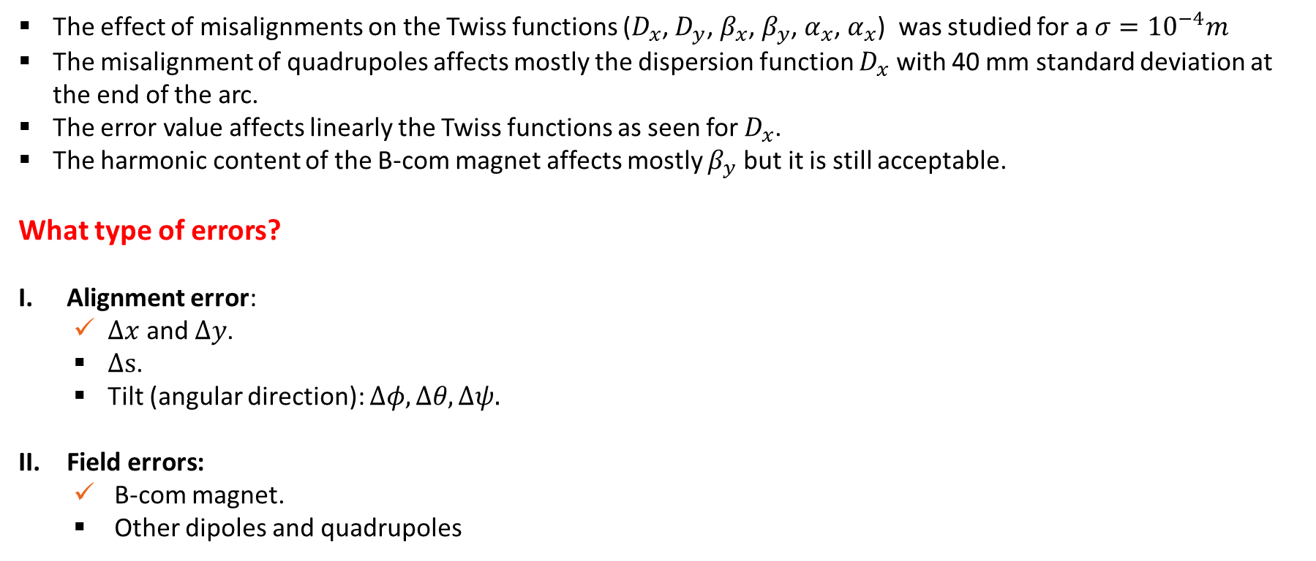
Conclusion and Outlook
The effect of misalignments on the Twiss functions ($D_{x}$, $D_{y}$, $β_{x}$, $β_{y}$, $α_{x}$, $α_{x}$) was studied for a ${σ=10}^{−4}m$
The misalignment of quadrupoles affects mostly the dispersion function $D_{x}$ with 40 mm standard deviation at the end of the arc.
The error value affects linearly the Twiss functions as seen for $D_{x}$.
The harmonic content of the B-com magnet affects mostly $β_{y}$ but it is still acceptable.
What type of errors?
Alignment error:
  $Δx$ and $Δy$.
  $Δs$.
  Tilt (angular direction): $Δφ, Δθ, Δψ.$
Field errors:
  B-com magnet.
  Other dipoles and quadrupoles
Next Steps:
Perform the errors study to the full PERLE machine (500 MeV and 250 MeV)
Check if corrections are needed and where.

Slide 14
Thank You!

Slide 15
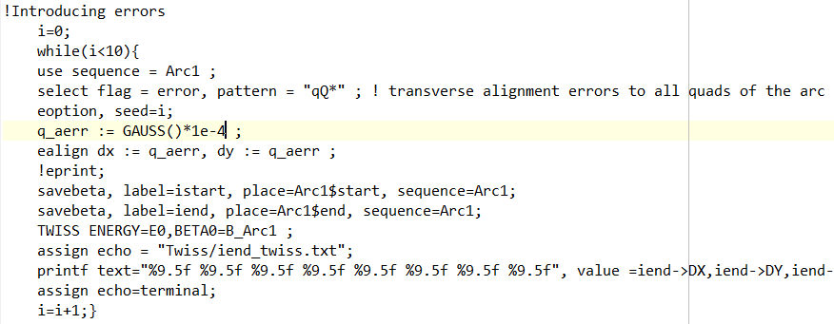
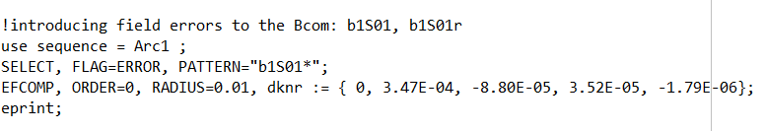
The MADX code for introducing Errors
Alignment Errors
In xy plane only
Field Errors

Slide 16
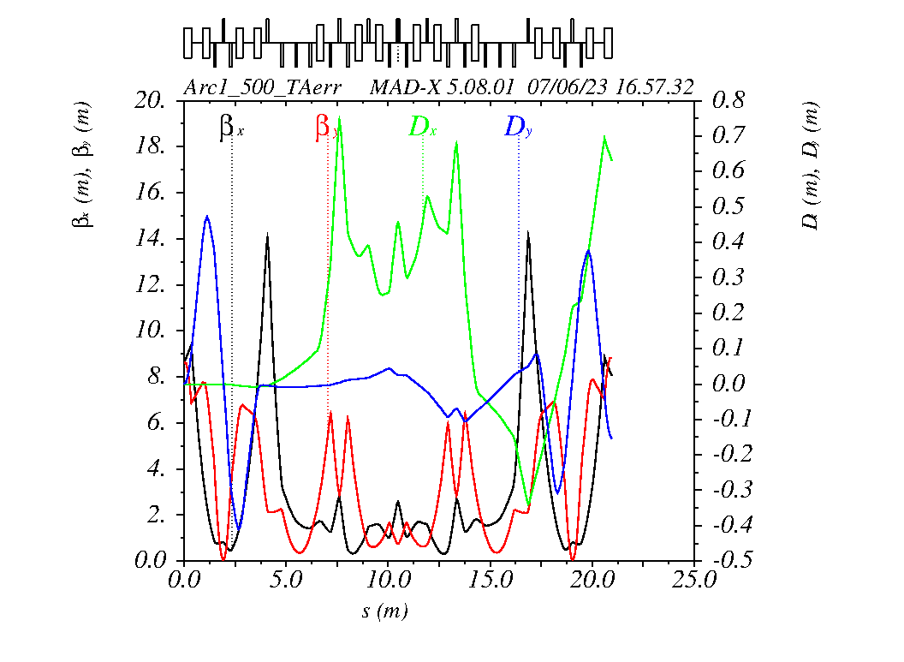
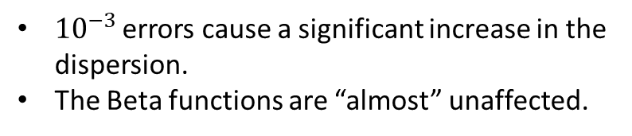
Different possibilities
${10}^{−3 }$errors cause a significant increase in the dispersion.
The Beta functions are “almost” unaffected.

Slide 17
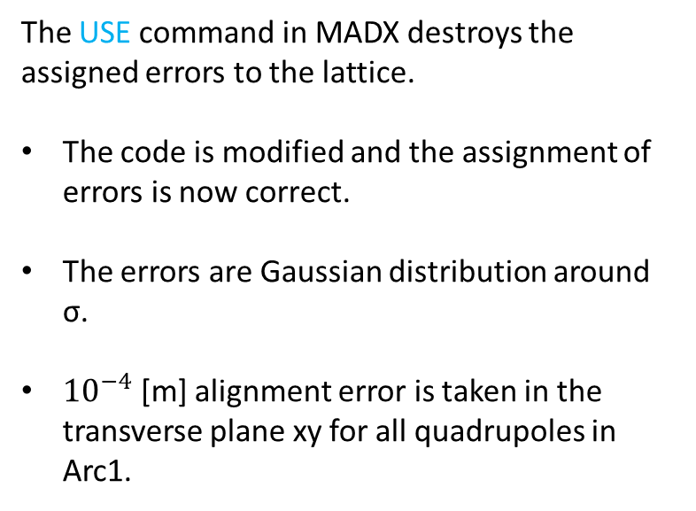
MADX code problem solved
The USE command in MADX destroys the assigned errors to the lattice.
The code is modified and the assignment of errors is now correct.
The errors are Gaussian distribution around σ.
${10}^{−4}$ [m] alignment error is taken in the transverse plane xy for all quadrupoles in Arc1.

