Slide 1
Jlab Booster and Alternatives
R. Rimmer, J. Henry JLab
F. Hannon, Phasespacetech
J. Rathke et. al, (formerly AES)

Slide 2
Outline
Jlab/AES 748.5 MHz booster prototype
Comparison of parameters
Cavity Modifications needed
Path forward
JLEIC booster(s)
EIC cooler booster
Conclusions

Slide 3
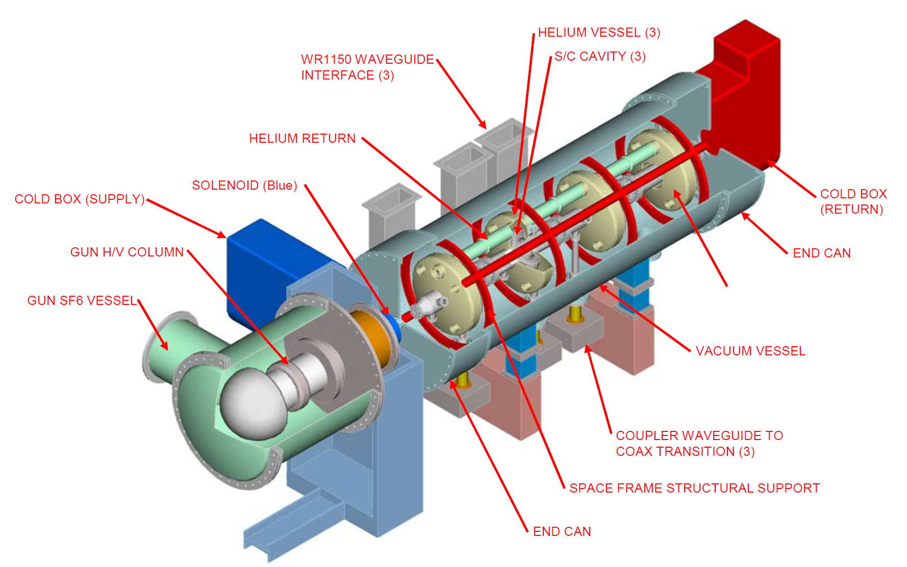
Jlab booster
A collaboration between JLab and Advanced Energy Systems, that began in 2002, had the goal to design, fabricate and test a prototype high-current electron beam injector for a 100kW free-electron laser (FEL)
Module is based on SNS type cryostat
4 single-cell cavities with the same He tank
  1 third harmonic (not needed for PERLE?)
  Replace with 802.5 MHz cavities
  β-match to beam?
  Salvage He tanks?
SNS type couplers (FPC and HOM)
Mated to DC gun similar to Alice gun
Custom end cans to allow close proximity
A.Todd et al., “High-Power Electron Beam Injectors for 100 kW Free-Electron Lasers”, Proceedings of the 2003 Particle Accelerator Conference, p 997-999
J. Rathke et al., “Design and Fabrication of an FEL Injector Cryomodule”, Proceedings of 2005 Particle Accelerator Conference, p 3724-3726

Slide 4
Jlab vs. PERLE comparison
Comparison of design parameters from the JLab/AES injector and PERLE
 | JLab/AES Booster | PERLE
Booster exit energy | 7MeV | 7MeV
Bunch charge | 133pC | 500pC
Bunch repetition rate | 748.5MHz | 40.1MHz
Cavity Fundamental Frequency | 748.5MHz | 802MHz
Average current | 100mA | 20mA
RMS bunch length | 3mm | 3mm
Emittance | <5mm mrad | <6mm mrad
Uncorrelated energy spread |  | < 10keV

Slide 5
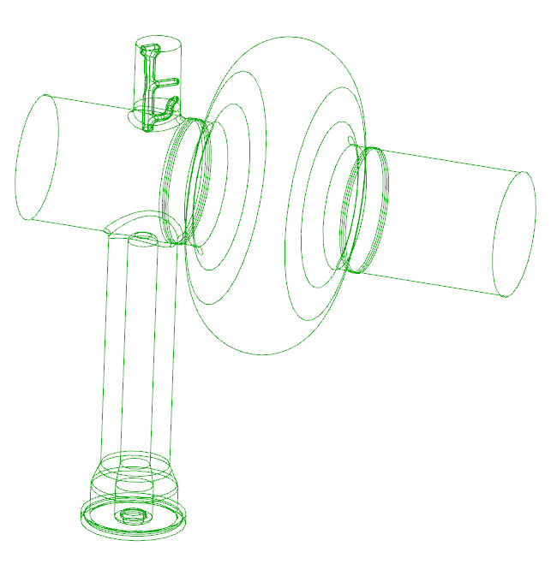
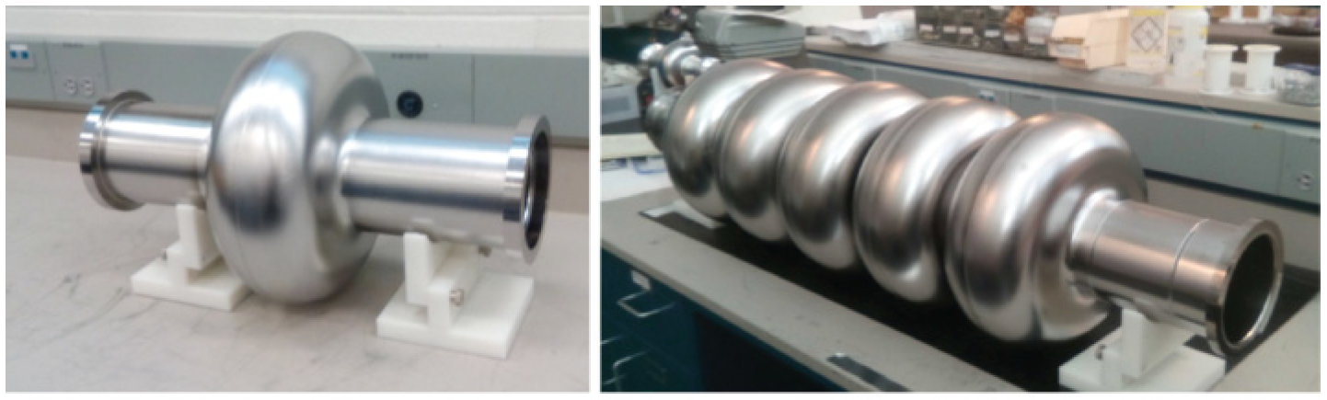
Jlab booster cavities
The fundamental frequency cavities installed were scaled from SNS, as were the couplers and HOM dampers on either end of each cavity. Replace with 802.5 MHz.
These components would be redesigned for PERLE, based upon recent advances in coupler design and cavity shapes for high current operation and HOM removal.
It may be advantageous for beam performance to beta-match new cavities to improve capture efficiency and 6D emittance.
Wire drawing of the AES single cell cavity with coupler and HOM damper shown
802MHz Single cell and 5-cell cavities manufactured at JLab

Slide 6
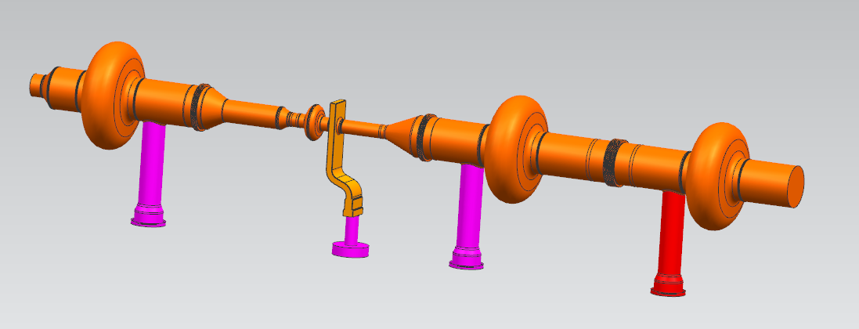
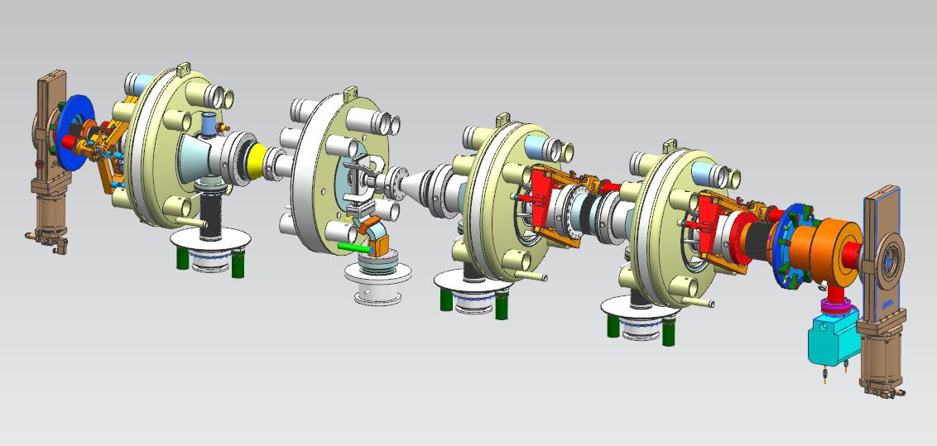
JLab/AES booster cold mass

Slide 7
Booster path forward
The work associated with developing the booster to completion is estimated
to take approximately three years. The expected high-level work packages
are:
1) Perform beam dynamics simulations to verify that the key parameters
of the PERLE injector can be met. Determine the cavity shape and whether a
3rd harmonic is required.
2) Cavity and power system design: simulate the cavity performance with
HOM dampers and couplers scaled to 802MHz. Generate the mechanical model and
drawings for manufacture.
3) Manufacture: Cavities, HOMs and couplers could be manufactured
in-house at Jlab or procured from industry. Vertical testing of the cavities will be performed at this
stage, prior to installation in the cryomodule.
4) Cryomodule assembly: The 748.5MHz cavities string inside the module
must first be removed before the new cavities can be installed. The new
components are fitted and leak checked.
5) Testing: Horizontal RF conditioning and testing will be performed
with the cryomodule test facility; a shielded bunker

Slide 8
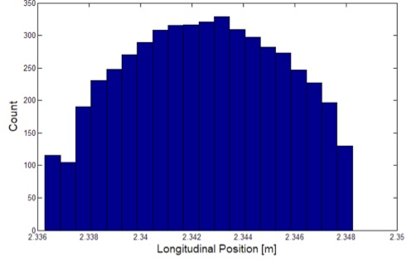
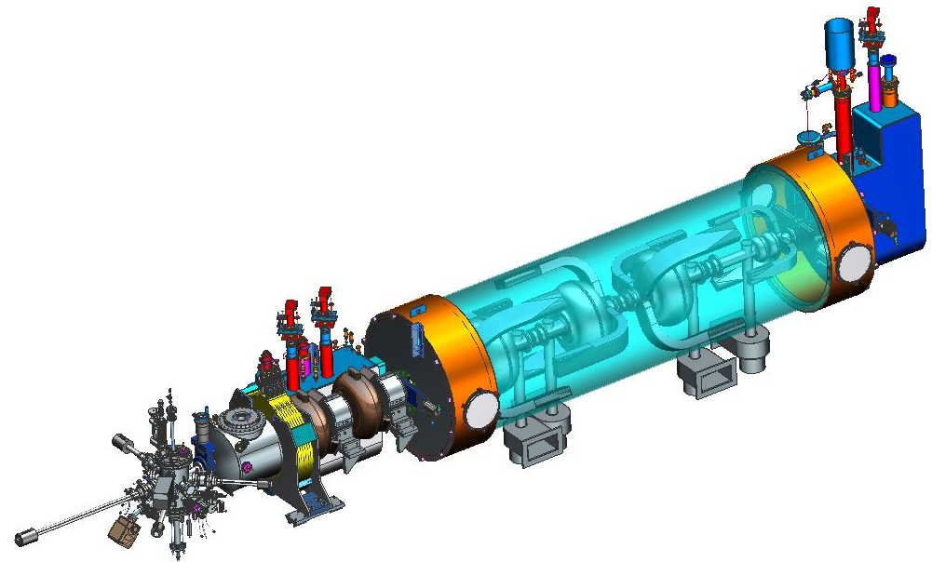
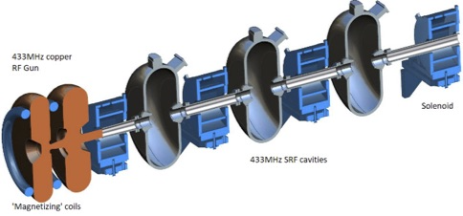
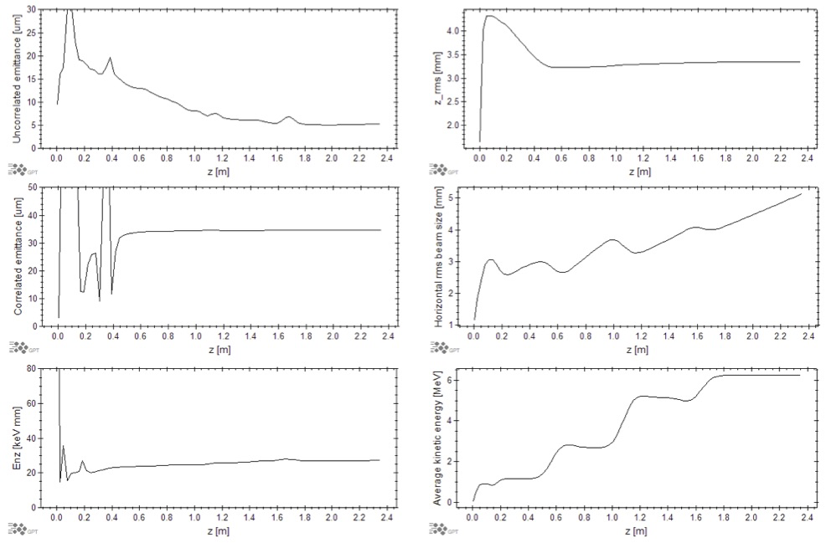
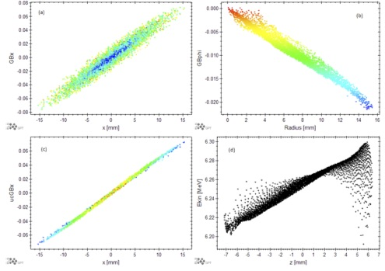
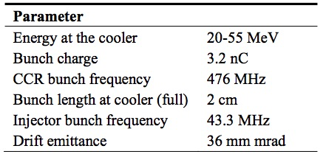
JLEIC ERL injector(s)
F. Hannon
Magnetized DC gun or RF gun
NC capture and buncher
433 MHz SRF booster
High-current non energy recovered
1299 MHz 3rd harmonic linearization
DC gun version
A Normal Conducting RF Gun as an Electron Source for JLEIC Cooling, F. Hannon, IPAC19, Melbourne

Slide 9
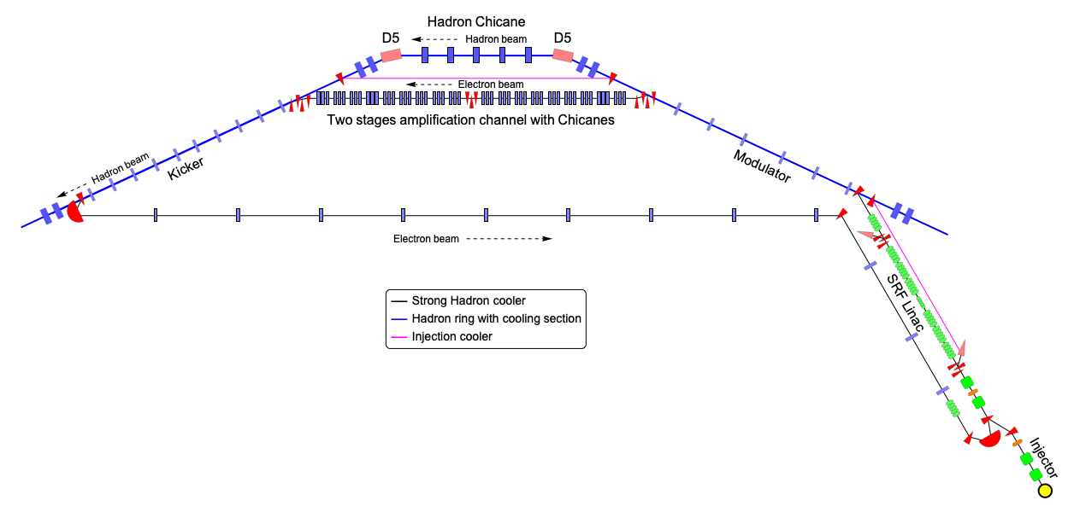
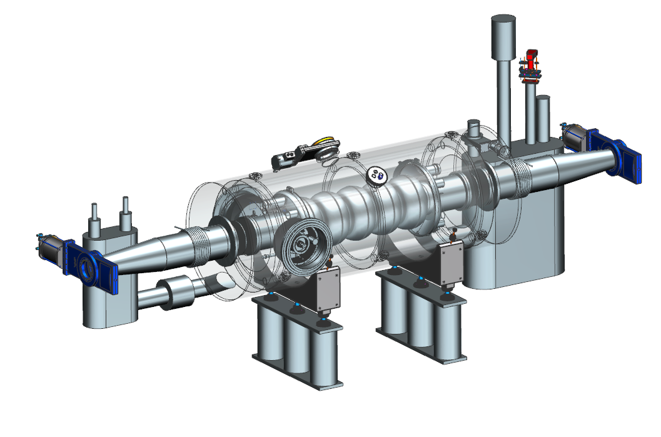
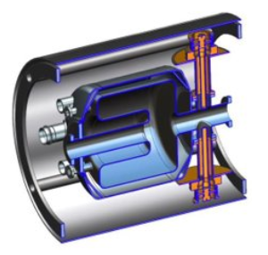
EIC Strong Hadron Cooler ERL layout
591 MHz 5-cells +
1773 MHz 5 cells
197 MHz QWR
400-500kV DC gun for 100 mA of beam and 5.6 MV SRF injector
Dogleg ERL merger
149 MeV Superconducting Energy Recovery LINAC
Electron and hadron overlapped cooling sections.
Amplification section with chicanes and triplets for electrons
Hadron chicane path length matching & R₅₆ adjust
Return transport of electron beam to ERL
Possibility to include injection pre-cooler in the same location

Slide 10
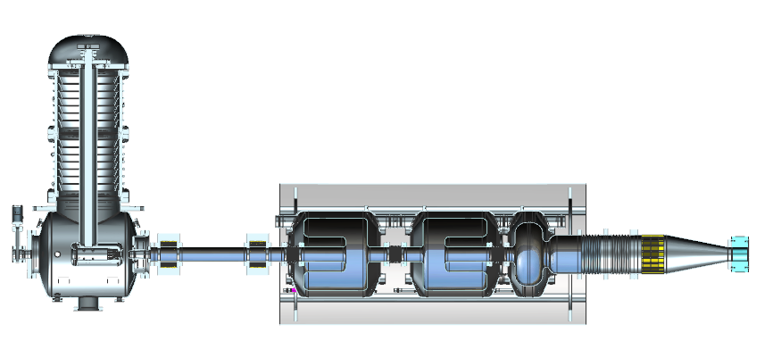
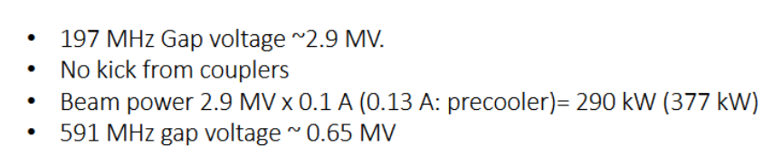
EIC cooler injector preliminary concept
197 MHz QWR
with FPC’s
and HOMs
DC gun
197 MHz QWRs
591 MHz single cell

Slide 11
Conclusions
JLab/AES FEL booster is still available
  New cavities needed
  3 SNS type couplers may be OK
  Labor to disassemble and reassemble
JLEIC options were promising
  DC gun with NC booster and SRF + 3rd harmonic
  NCRF gun with SRF booster, no 3rd harmonic
  Designs not completed
EIC booster going for long bunches, low frequency
  197 MHz QWR’s, 591 MHz 3rd harmonic
  Similar requirements to PERLE except bunch length.

