Slide 1
From Cu to Nb: towards the fabrication of the dressed cavity
H. Wang, R. Rimmer, G. Park, J. Henry, S. Soloman
JLab
C. Barbagallo, IJCLab

Slide 2
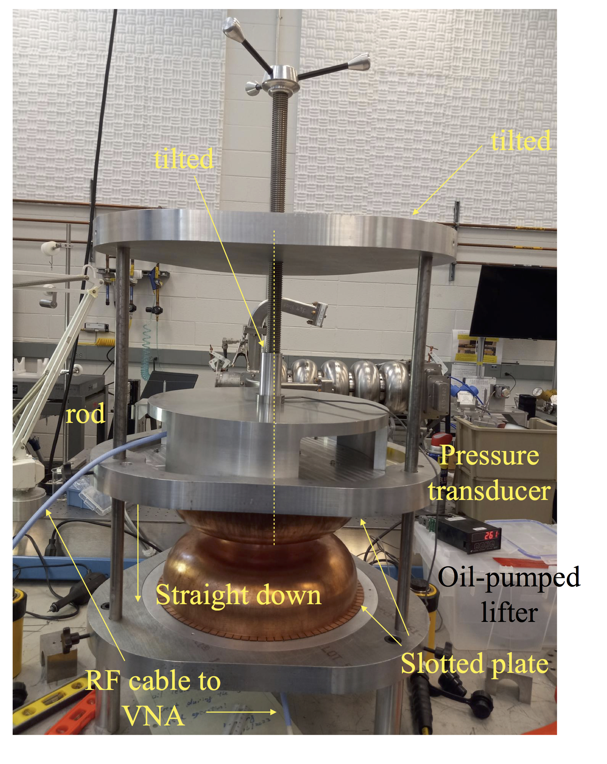
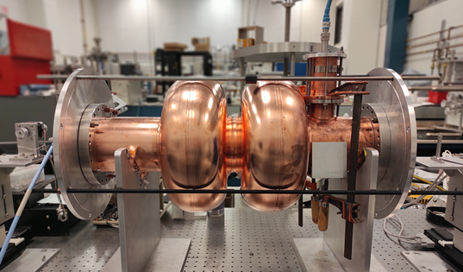
Progress on copper cavity
2-cell copper model
Do we need BLA’s?
Dumbbell tuning for copper 5-cell
Thermal study

Slide 3


PERLE HOM study: Carmelo
Other suitable HOM-damping schemes :
Rectangular waveguide dampers (A)
JLab-Type coaxial couplers (B)
TESLA-Type coaxial couplers (C)
Add absorbers in cavity-interconnecting beam tubes (D)
Coupling through Fundamental Power Coupler (E)
HOM-damping studies of a 5-Cell Elliptical Superconducting Cavity for PERLE , Carmelo Barbagallo , PERLE SRF Meeting, 03 December 2021

Slide 4
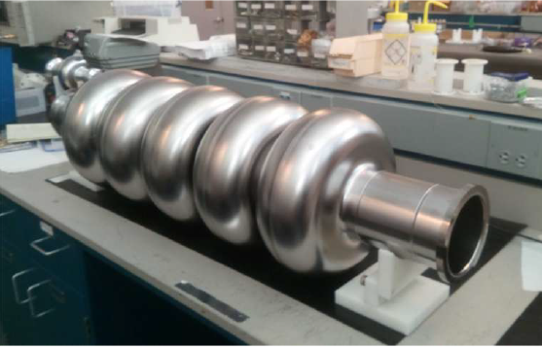
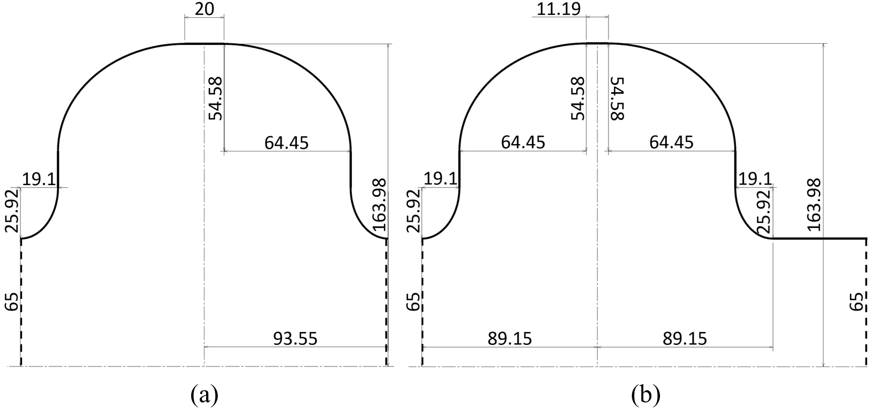

The 5-cell SRF cavity for PERLE
International Workshop on Energy Recovery Linacs (ERL 22), Cornell University,
3-6 October 2022
  The first 801.58 MHz 5-cell elliptical Nb cavity has already been fabricated and successfully tested at JLab in October 2017 [1].
Cavity Parameters | Unit | Value
Frequency | [MHz] | 801.58
Temperature | [K] | 2.0
Cavity active length | [mm] | 917.9
R/Q | [Ω] | 523.9
Geometry Factor (G) | [Ω] | 274.6
$B_{pk}{/E}_{acc}$ (mid-cell) | [$mT/(MV/m)$] | 4.20
$E_{pk}{/E}_{acc}$ (mid-cell) | [-] | 2.26
Cell-to-cell coupling k_{cc} | [%] | 3.21
Iris radius | [mm] | 65
Beam Pipe radius | [mm] | 65
Mid-cell equator diameter | [mm] | 328
End-cell equator diameter | [mm] | 328
Wall angle | [degree] | 0
Cutoff TE₁₁ | [GHz] | 1.35
Cutoff TM₀₁ | [GHz] | 1.77
  Courtesy of F. Marhauser
Mid-cell
End-cell

Slide 5
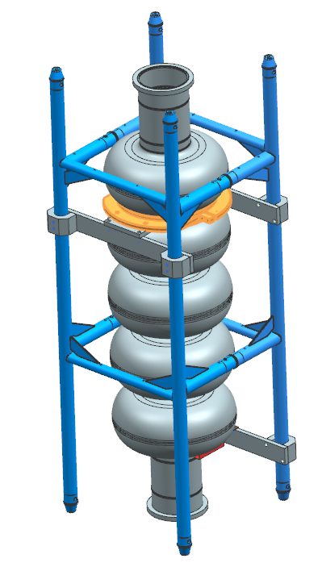
Cavity is now at FNAL for more tests

Slide 6
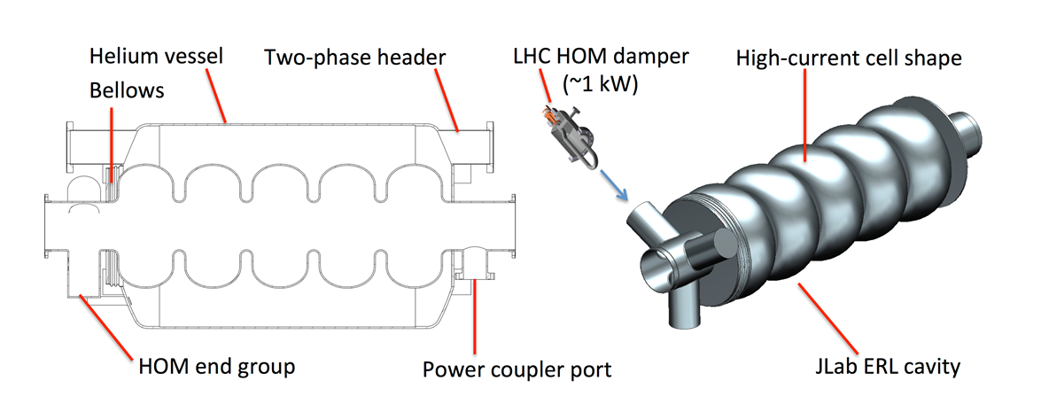
ERL roadmap/path forward
Develop firm requirements for PERLE
  BBU thresholds
  Bunch parameters
  Fill pattern
Complete HOM study
  Carmelo visits to Jlab
  Determine if new end cells needed
Use Cu models to verify design
Finalize FPC interface
Modify Jlab prototype cavity
Fabricate prototype HOM couplers
Vertical test at Jlab or CERN
Integrate into He tank and SPL module
Build or procure 4 production cavities
New

Slide 7
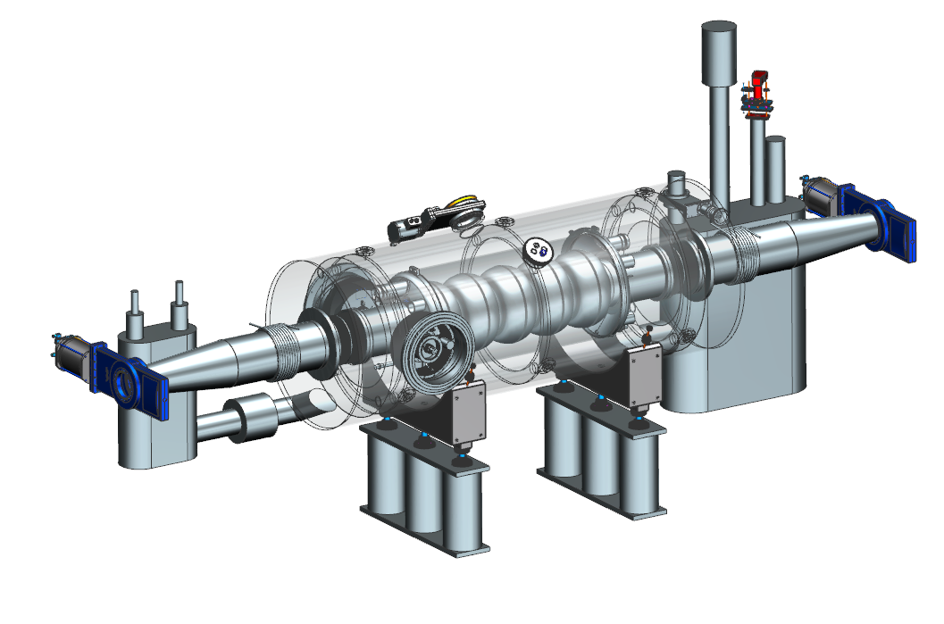
EIC Cooler 591 MHz 5-cell
In CDR common design assumed for HSR, RCA and cooler ERL
Baseline scaled from ESR 1-cell
  Warm BLA HOM dampers
  Symmetric FPC’s
  Long tapers
ERL has the most 5-cell cavities
  Lower HOM power
  Tight space constraints
  Evaluating other HOM options
591 MHz 5-cellcavity

Slide 8
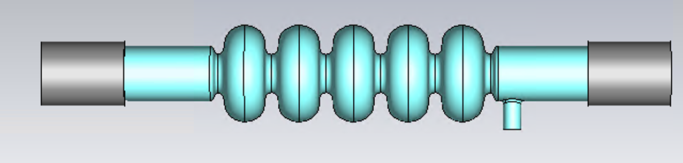
EIC SRF cavity: 5-cell 591 MHz SRF cavity
RCS requirements for 5-cell 591 MHz SRF cavity.
  Total voltage 60 MV for 3 cavities.
  Ramping of electron bunch energy requires cavity resonant frequency fast tuning up to 4 kHz in ~ 100 ms.
  Couple bunch instability requires longitudinal impedance < 1.6 M Ω (bunch merging at 1 GeV).
  Transversal bunch instability requires impedance < 12 MΩ/m.
Scaled from the high current 650 MHz SRF linac cavity design for eRHIC (previous BNL version of EIC).
A Copper 650 MHz cavity was built for HOM study.
A 650 MHz Nb cavity was prototyped, processed and tested vertically up to 18.2 MV, limited by radiation.
The 650 MHz Nb cavity serves as a practicing cavity for EIC, and we are reprocessing the cavity and retesting the cavity soon.
SiC HOM damper
SiC HOM damper
Frequency | 591 MHz
R/Q | 502 Ω
Geometry factor | 273
Epk/Eacc | 2.27
Bpk/Eacc | 4.42 mT/(MV/m)
Coupling factor | 2.8
Wall thickness | 4.4 mm
Tuning range | +/- 174 kHz (+/-2mm)
Lorentz detuning factor | 0077 Hz/(MV)^2
First modal frequency | > 107 Hz

Slide 9
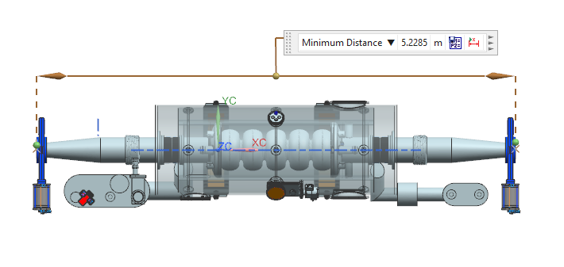
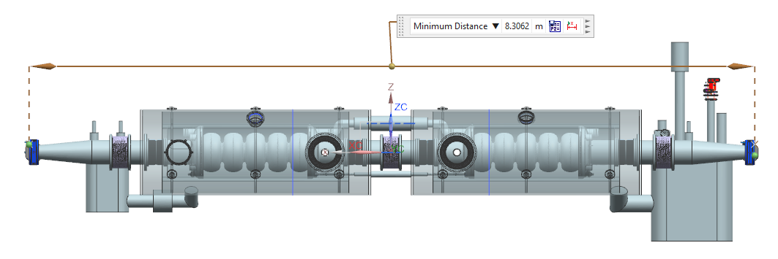
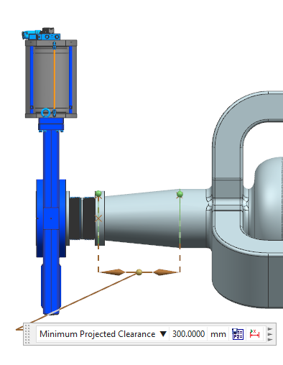
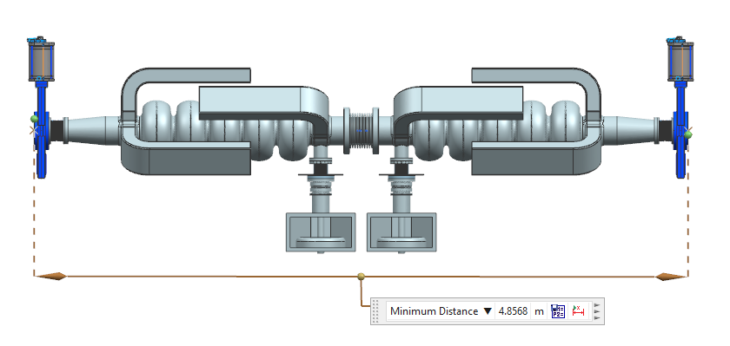
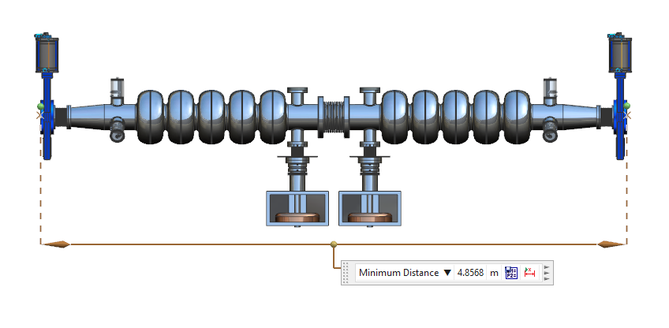
Compact 5-cell options
For 100 mA HSR cavity may be overkill
Standard 5-cell
Two per string
Compact end groups
  Waveguide
    JLab, HZB
  Coaxial
    HERA, LHC,
    TESLA, C100
    PERLE
Need more analysis
150mm
DIA
210mm
DIA
WAVEGUIDE END GROUPS
COAXIAL END GROUPS

Slide 10
Conclusions
Good progress on copper model measurements
Open questions:
  Do we need beam line absorbers?
  How much space is needed for helium tank attachment?
  Do we need active cooling of antennas?
Next steps:
  Validate HOMS on 5-cell copper cavity
  Prepare for implementing ports on Nb 5-cell
  Plan for four production cavities
Strong synergy with EIC cooler ERL

Slide 11
Back up

Slide 12
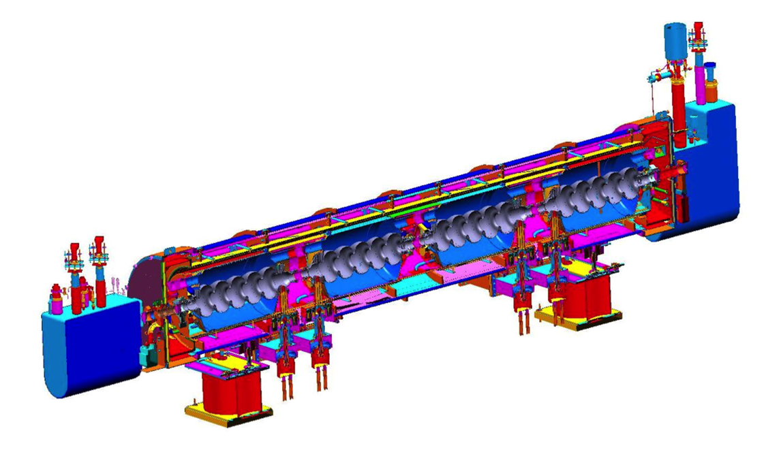
PERLE CM concept based on SNS cryostat

Slide 13
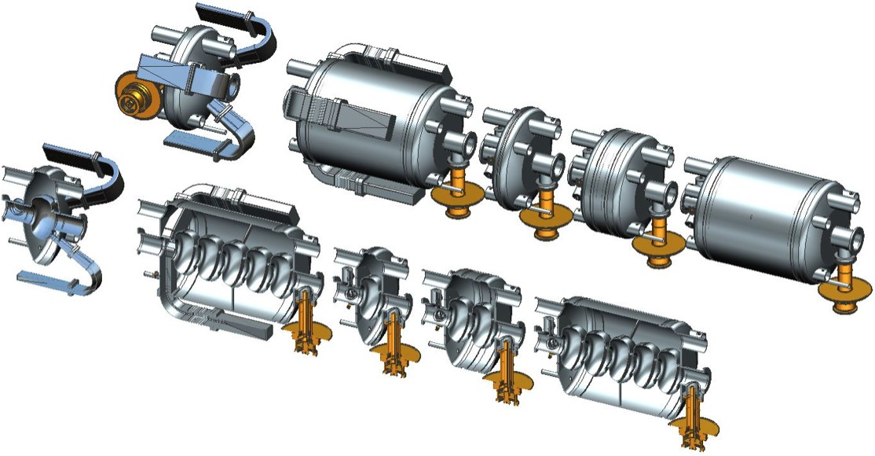
Jlab modular cryostat
Dimensions loosely based on SNS cryomodule

Slide 15
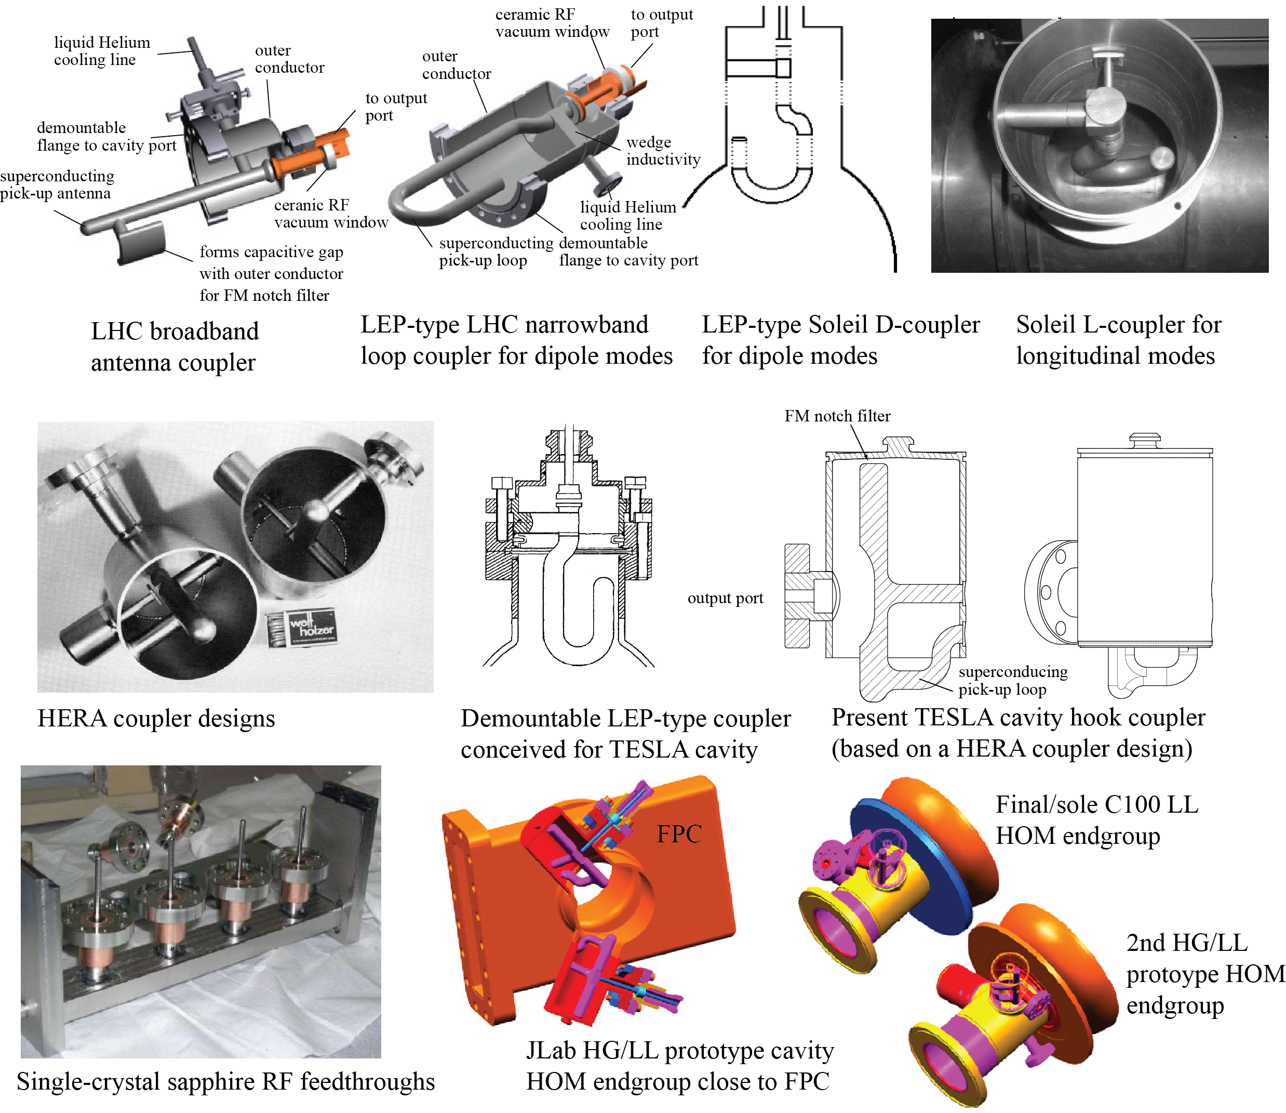
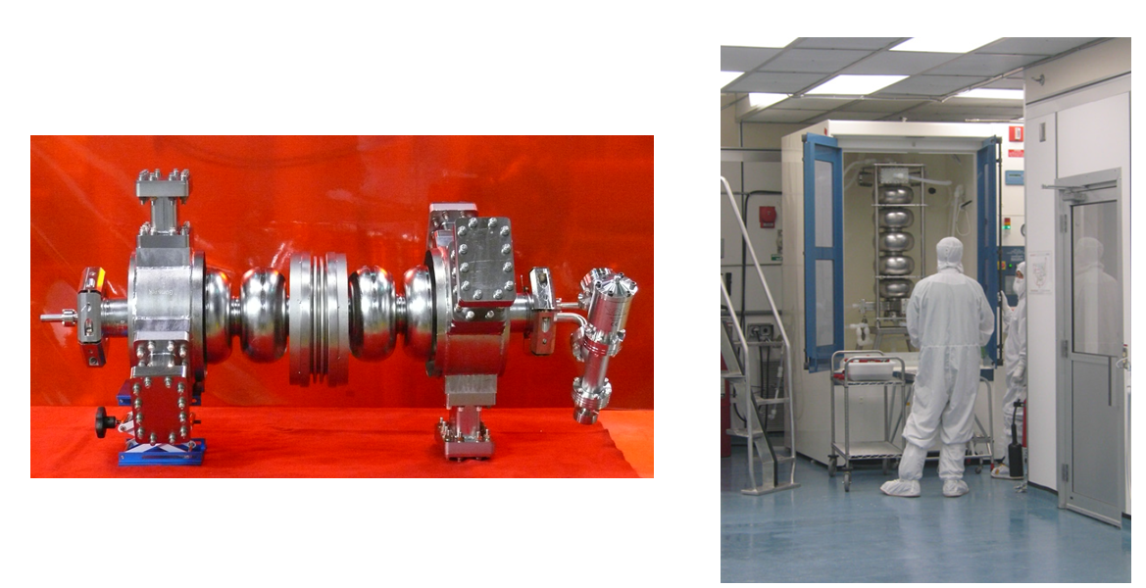
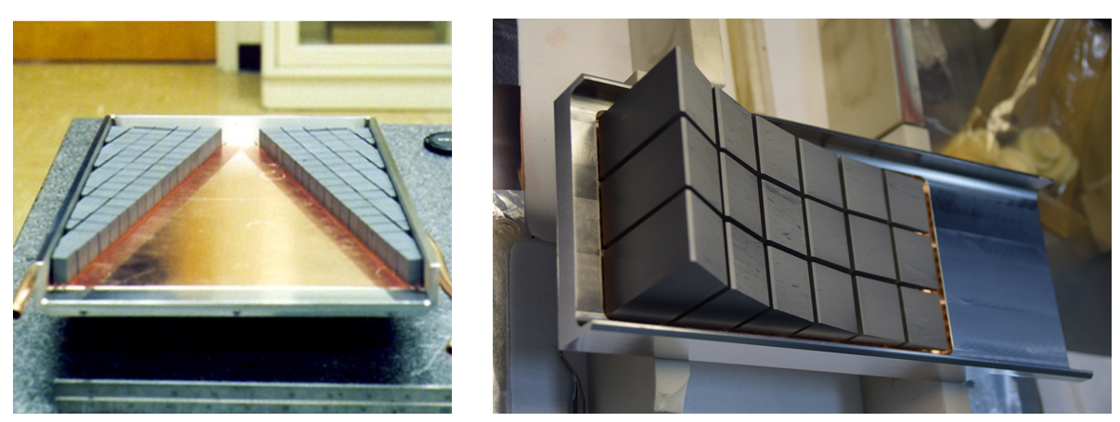
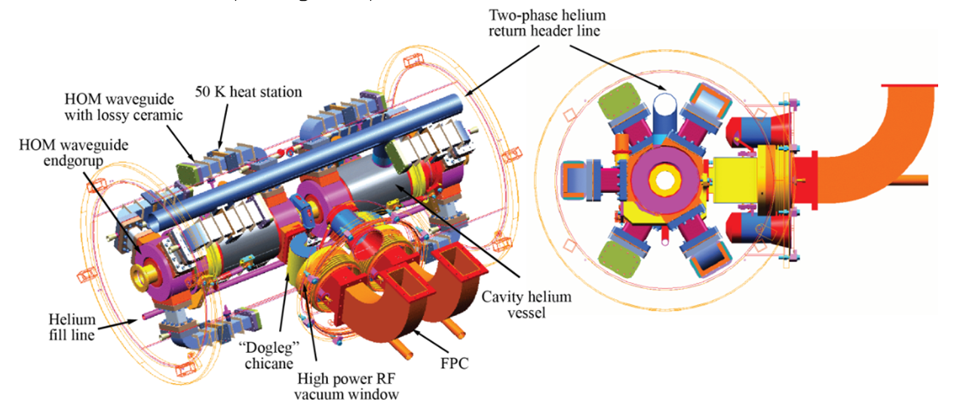
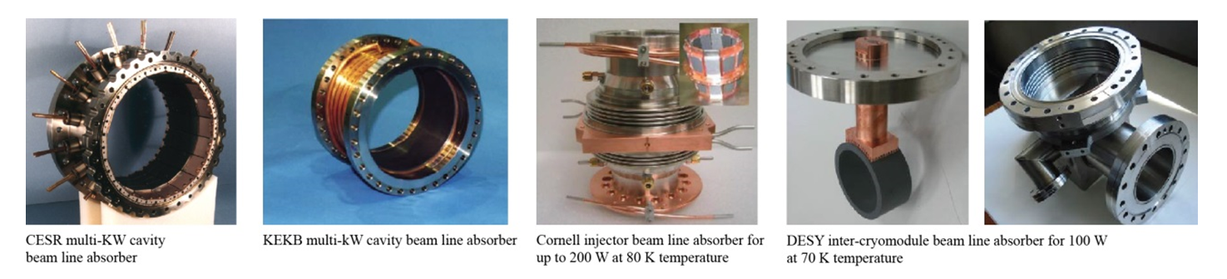
HOM damping options
HZB

Slide 16
New Jlab variants
F. Marhauser
Modified end cell profiles
Reduction of TM011 and TM012 modes
Some increases in dipole modes

Slide 17
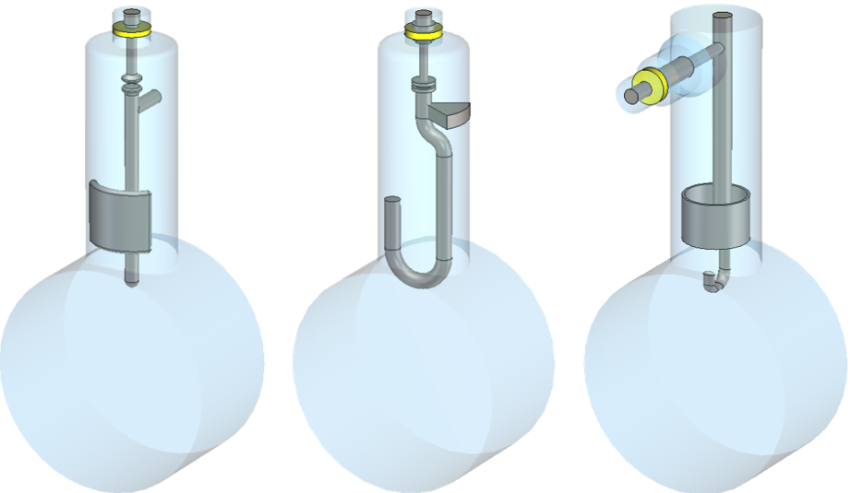
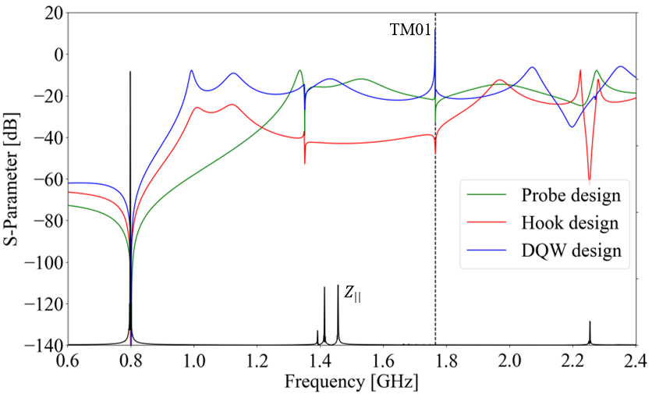
HOM coupler optimization
International Workshop on Energy Recovery Linacs (ERL 22), Cornell University,
3-6 October 2022
P_{ext}
Monopole transmission
Port 2 (Output)
TM010
Port 1 (Cavity side)
Optimized region
TM011
Port 3 (Rear-side)
HOM field
TM012
Probe design
Hook design
DQW design
Dipole transmission
HOM couplers are geometrically optimized according to the HOM spectrum ($Z_{||}$and $Z_{⊥}$)
The S-parameters between the beam pipe port 1 and port 2 at the coaxial output of the coupler are studied.
The DQW coupler exhibits a better monopole coupling for TM010 mode than the probe design.
The hook coupler provides higher damping of the first two dipole passbands (TE111 and TM110)
Optimized region
TM110
TE111
TM111

Slide 18
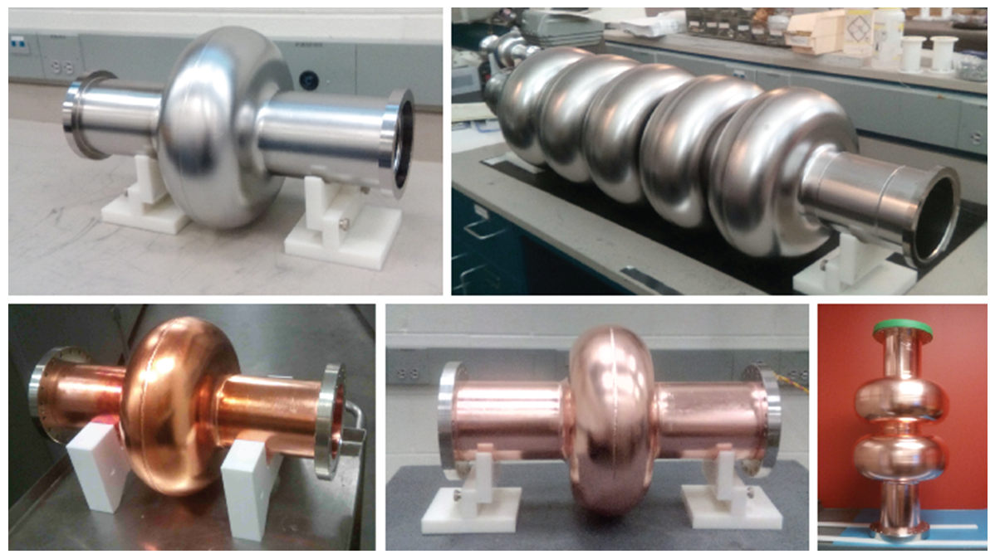
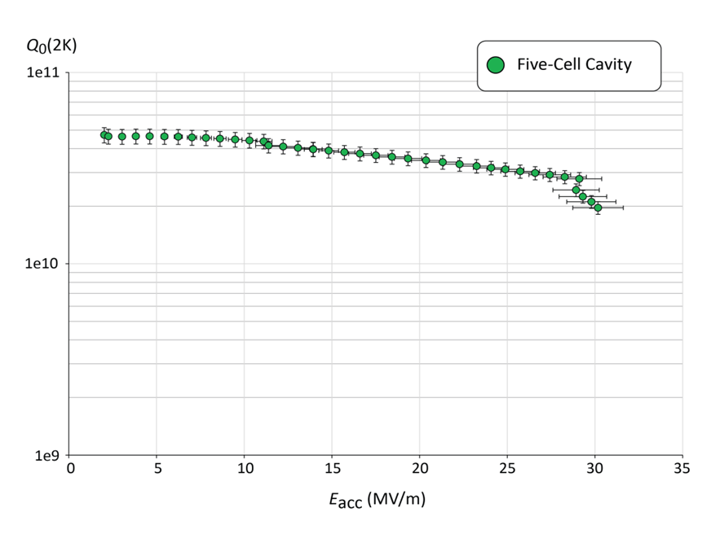
Jlab 802.5 MHz prototype (F. Marhauser et. al.)
Shared DNA with Jlab FEL, JLEIC cooler and CEBAF “C75” cavities
1-cell and 5-cell Nb prototypes
2x Cu 1-cells for thin film coating
2-cell Cu “kit” for further HOM development
End group design was to come from CERN
Most parts available for PERLE if useful
Dies and fixtures available at Jlab.
R. Rimmer et al. The JLab Ampere-Class Cryomodule. Proceedings of the 12th Workshop on RF Superconductivity (SRF’05), 2005.
[193] R.A. Rimmer, W. Clemens, D. Forehand, J. Henry, P. Kneisel, K. Macha, F. Marhauser, L. Turlington, and H. Wang. Recent Progress on High-Current SRF Cavities at JLab. Pro- ceedings of the International Particle Accelerator Conference (IPAC’10), 2010.

