Slide 1
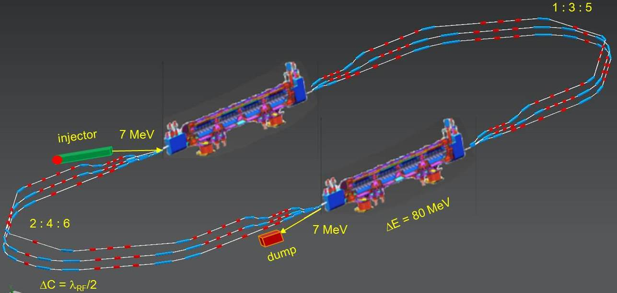
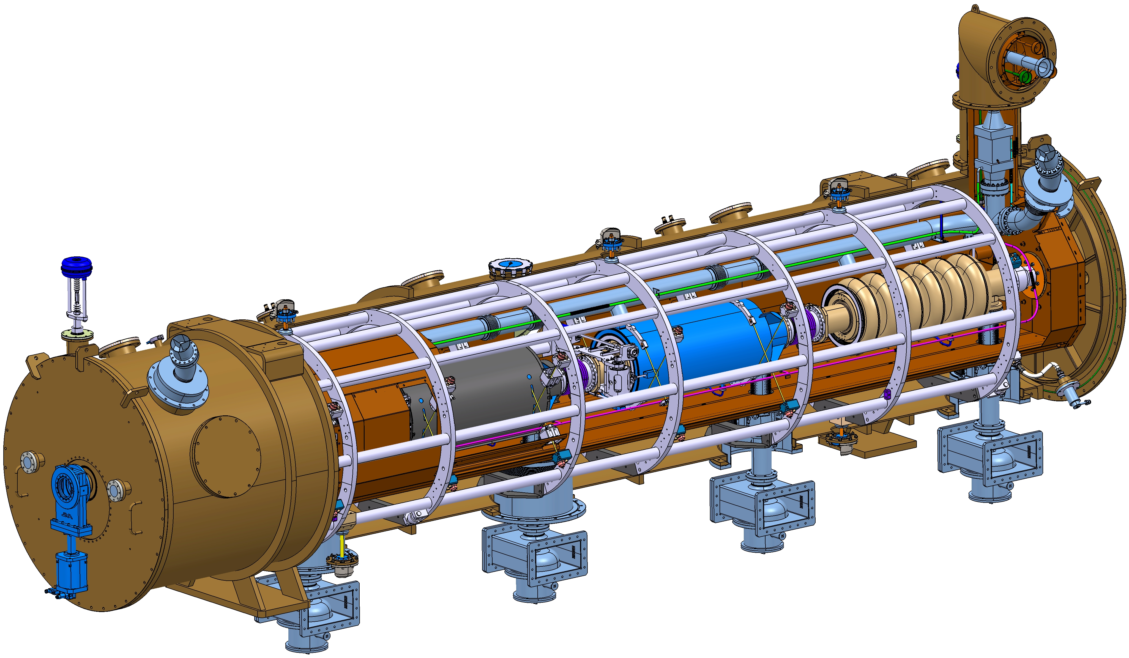
CRYOMODULE FOR PERLE @ ORSAY
CRYOMODULE FOR PERLE @ ORSAY
PERLE COLLABORATION MEETING
CERN
June 22, 2023

Slide 2
CRYOMODULE FOR PERLE @ ORSAY
SUMMARY
Program general considerations
Genesis of a choice
ESS elliptical cryomodule presentation
Components to be reused, modified, not reused
Cavity, Cold Tuning System & HOM couplers
Cryogenic and thermal aspects

Slide 3
CRYOMODULE FOR PERLE @ ORSAY
SUMMARY
Program general considerations
Genesis of a choice
ESS elliptical cryomodule presentation
Components to be reused, modified, not reused
Cavity, Cold Tuning System & HOM couplers
Cryogenic and thermal aspects

Slide 4
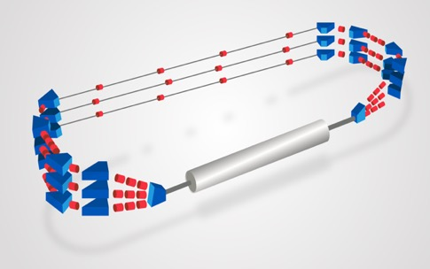
CRYOMODULE FOR PERLE @ ORSAY
PERLE @ ORSAY
5 cells elliptical cavities at 801,58MHz
2 cryomodules composed of 4 superconducting cavities
FIRST MILESTONE
1 cryomodule prototype
Complete cryomodule ready for test
Limited cryogenic plant
Full RF power on one cavity
SECOND MILESTONE
Integration of the cryomodule in the PERLE phase 1 layout
Operation at 250MeV
THIRD MILESTONE
Integration of the second cryomodule
Final PERLE layout (phase 2)
Operation at 500MeV

Slide 5
CRYOMODULE FOR PERLE @ ORSAY
SUMMARY
Program general considerations
Genesis of a choice
ESS elliptical cryomodule presentation
Components to be reused, modified, not reused
Cavity, Cold Tuning System & HOM couplers
Cryogenic and thermal aspects

Slide 6
DESIGN OF THE CRYOMODULE
WICH DESIGN?
Recently, several projects worldwide have designed cryomodules for elliptical cavities with a cavity configuration (number, length and diameter) which is very close to the one required for PERLE
PROJECT | Number of cavities | Number of cells | Frequency (MHz) | β
PERLE à Orsay | 4 | 5 | 802 | 1
ESS | 4 | 6 5 | 704 | 0,67 0,85
SPL | 4 | 5 | 704 | 1
Design performed at IJCLab.
Design performed at IJCLab & CERN
Some components available
Opportunity to reuse the design and the components

Slide 7
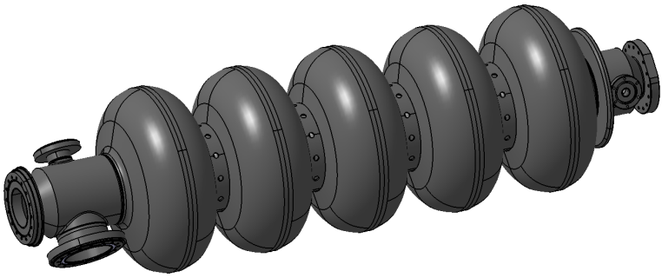
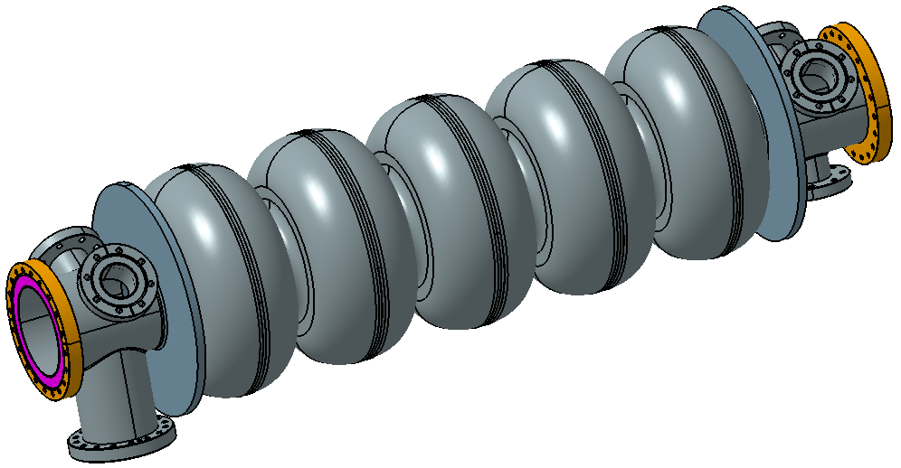
MAIN DIMENSIONAL CHARACTERISTICS OF THE CAVITIES
CHARACTERISTICS | ESS (704MHz) | SPL (704MHz) | PERLE / JLAB (802MHz)
Coupler to coupler length (mm) | 1500 | 1490,5 | -
Length flange to flange (mm) | 1258,8 (Mβ) / 1316,3 (Hβ) | 1397,3 | 1292,5
Coupler to flange dimension (mm) | 115 (Mβ) / 130 (Hβ) | 116,4 | 96,7
Cells external diameter (mm) | 378,9 (Mβ) / 385,7 (Hβ) | 386,5 | 335
Beam port internal diameter (mm) | 135,8 (Mβ) / 139,8 (Hβ) | 129,8 / 139,8 (coupler side) | 130
Flanges internal diameter (mm) | 135,8 (Mβ) / 139,8 (Hβ) | 79,7 (CF100) | 130 (CF160)
Vacuum valve diameter | CF100 | CF63 | tbd
Coupler internal diameter (mm) | 100 | 100 | 100
Coupler flange | D100 | CF100 | CF100
Beam axis to ext. coupler flange | 374,25 | 403 | tbd
SIMILAR FEATURES

Slide 8
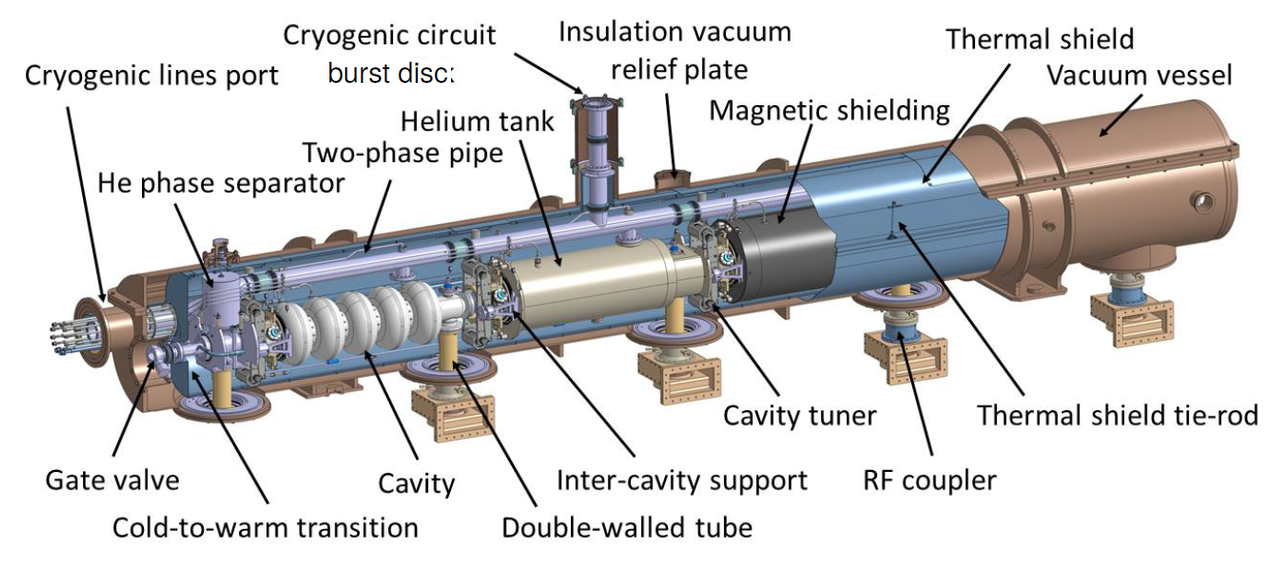
Potential REUSE of the SPL/HG CRYOMODULE DESIGN and components
CERN proposed to re-use the existing SPL short cryomodule prototype either as it is or replacing the 704 MHz cavities by the perle referenced 802 MHz cavities
Design of the cryomodule performed by IPNO and updated by CERN.
Vacuum vessel and parts of cryogenic lines (not welded) delivered.
2 innovative points:
the cavity string directly supported by the power coupler and with dedicated inter-cavity support features.
integrates a full length demountable top lid, enabling the cavity string assembly from the cryomodule top

Slide 9
Potential REUSE of the SPL/HG CRYOMODULE DESIGN and components
MAIN ISSUES
Beam vacuum valve not compatible with beam vacuum (vatterfly valve instead of all metal gate valve)
Second bursting disk needed
Internal space very crowded. Difficulties to find additional space for HOM couplers and their cooling
Cryogenic lines to be adapted. Potentially important refurbishing for HOM active cooling
Uneasy access to cold tuning system (top cover to be removed)
New cover needed (second bursting disk, new feedthroughs and instrumentation for HOM, connection to valve box?)
Is the valve box location compatible with beam spreaders?
Reuse of the SPL cryomodule very difficult
Heavy constraints from the beginning, inducing bad compromises

Slide 10
2nd OPTION: ESS CRYOMODULE (ELLIPTICAL CAVITIES)
More transversal space between cavities
No supporting system between cavities
More space between tank and thermal shield
Easy access to Cold Tuning System (trap doors)
Blocking system for transportation
Design performed at IJCLab
Design validated (prototypes and ongoing series)
Ø800
Ø1200
537
886

Slide 11
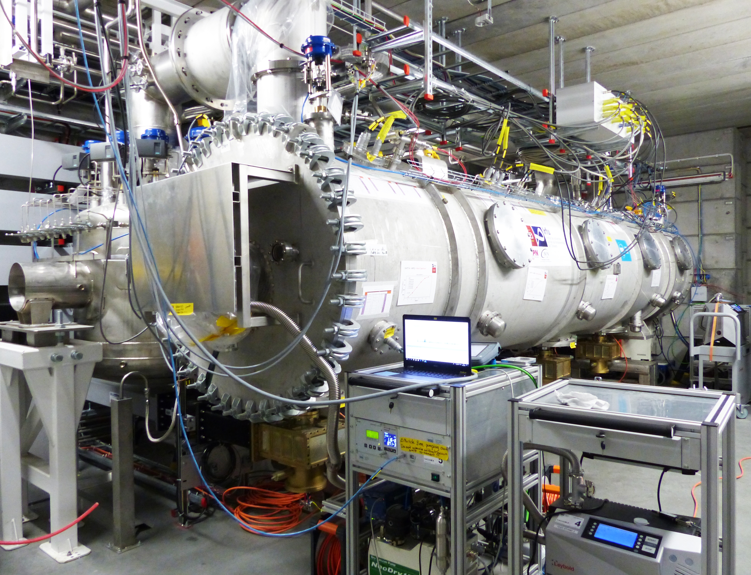

ESS CRYOMODULE FOR ELLIPTICAL CAVITIES
CEA in charge of the In-kind contribution for medium and high beta section (elliptical cavities)
Design of the cryomodule (common for Mβ and Hβ) by IJCLab (excepted cavities string)
Components of the Mβ prototype purchased and delivered by IJCLab
Assembled and tested at CEA Saclay
Tested at ESS Lund
ESS has agreed to provide the cryomodule components to IJCLab for its first Perle cryomodule
ESS prototype cryomodule in LUND test stand

Slide 12
CRYOMODULE FOR PERLE @ ORSAY
SUMMARY
Program general considerations
Genesis of a choice
ESS elliptical cryomodule presentation
Components to be reused, modified, not reused
Cavity, Cold Tuning System & HOM couplers
Cryogenic and thermal aspects

Slide 13
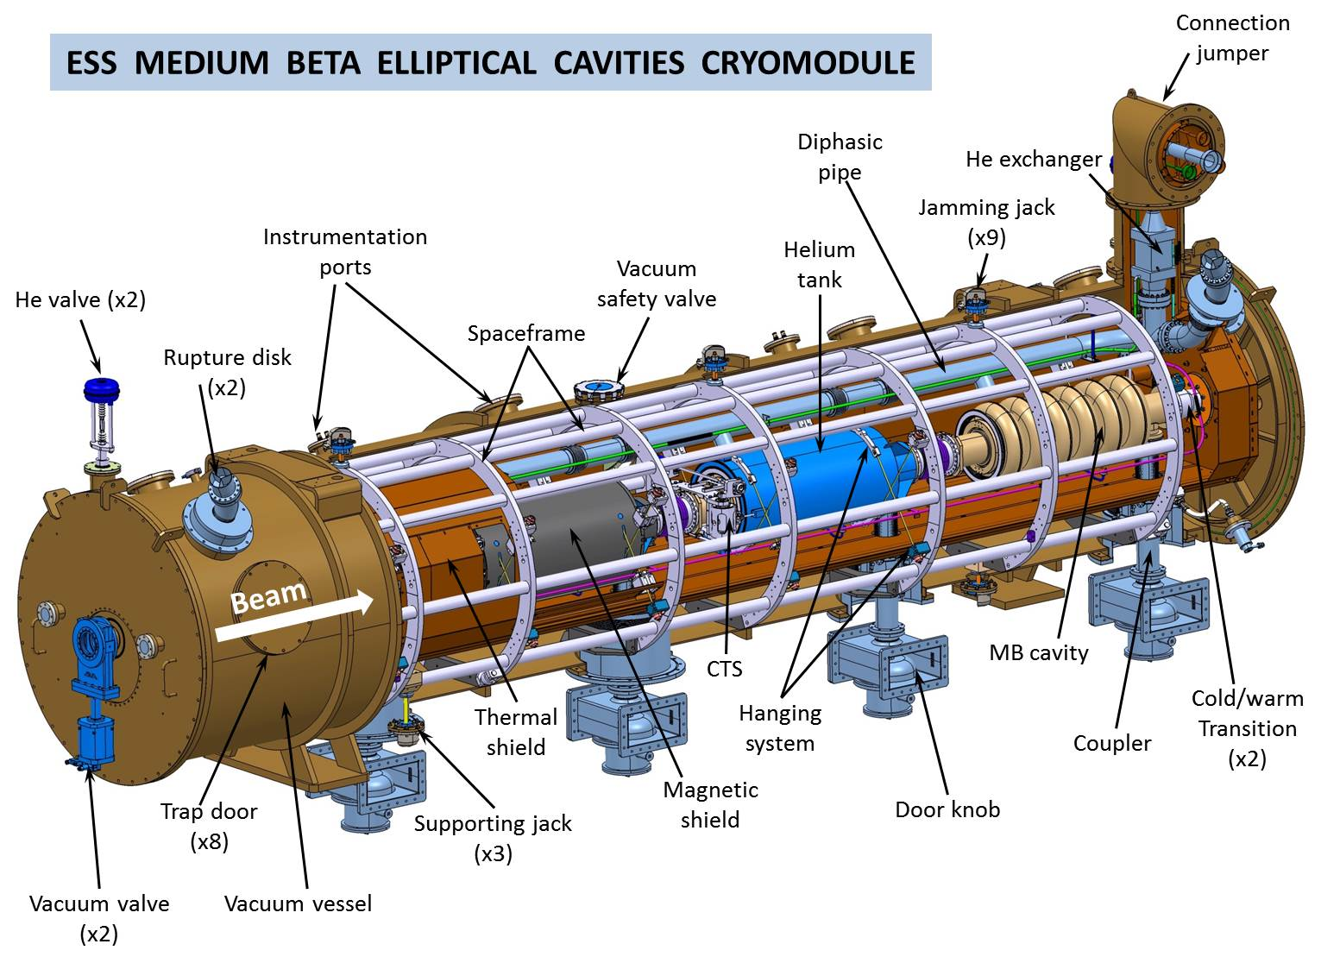
ESS CRYOMODULE FOR ELLIPTICAL CAVITIES

Slide 14
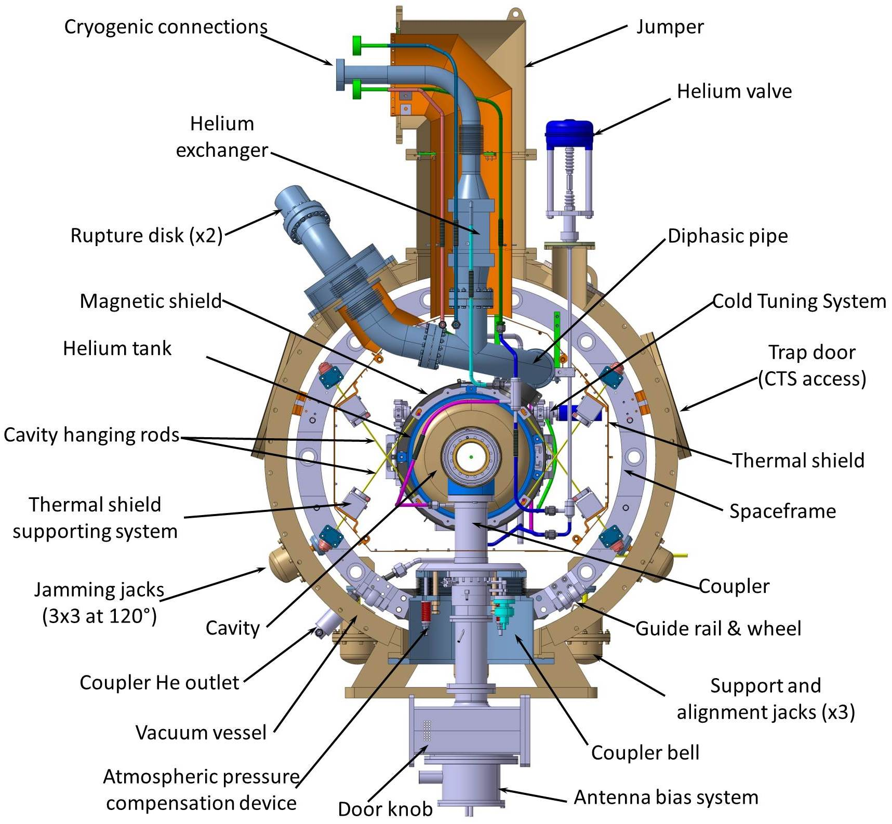
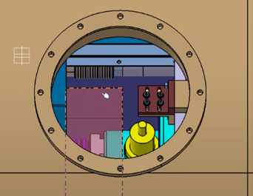
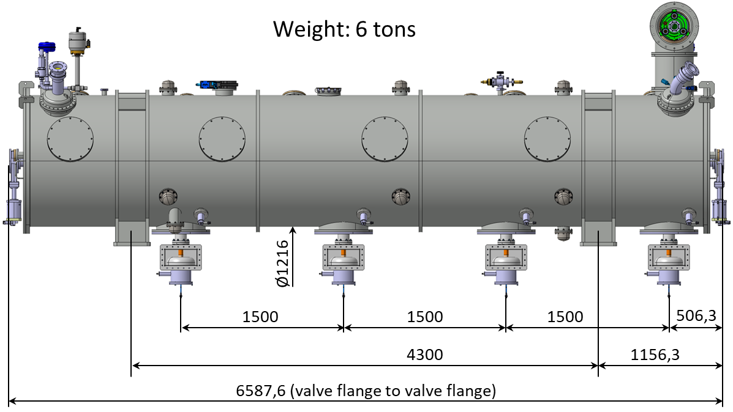
ESS CRYOMODULE FOR ELLIPTICAL CAVITIES
Access to CTS
Blocking of cavities, spaceframe & thermal shield for transportation
2 helium valve inside the cryomodule:
JT valve
Cooling down
Main dimensions

Slide 15
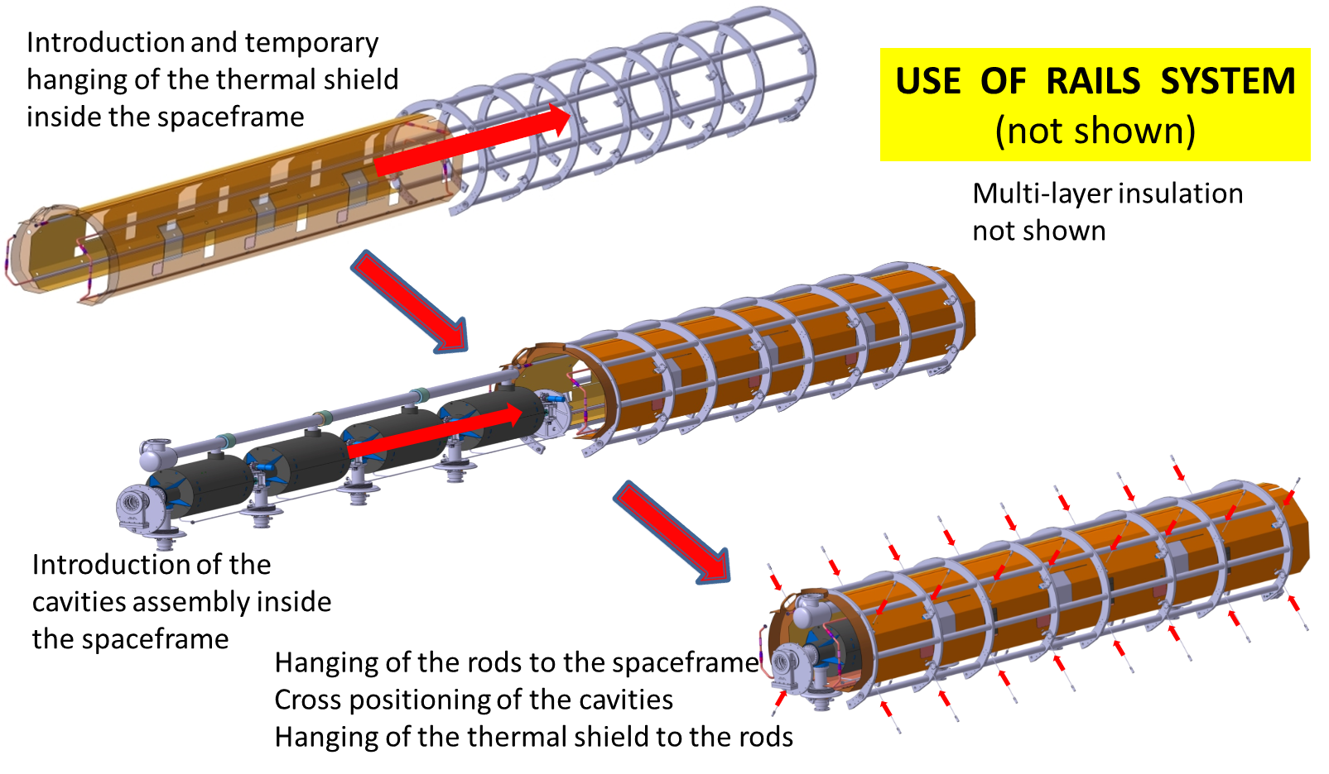
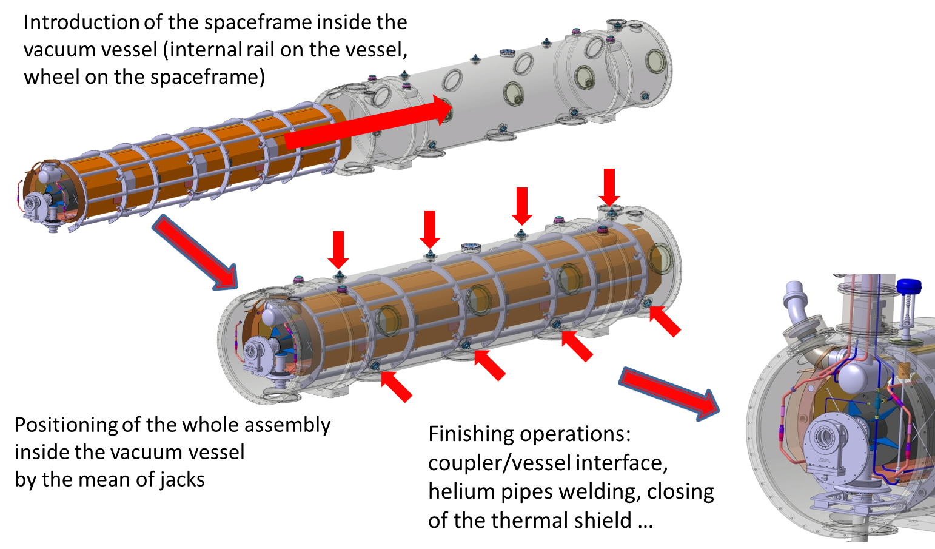
ESS CRYOMODULE FOR ELLIPTICAL CAVITIES
ASSEMBLY PROCESS
No means at IJCLab for the cryomodule assembly (clean rooms size)

Slide 16
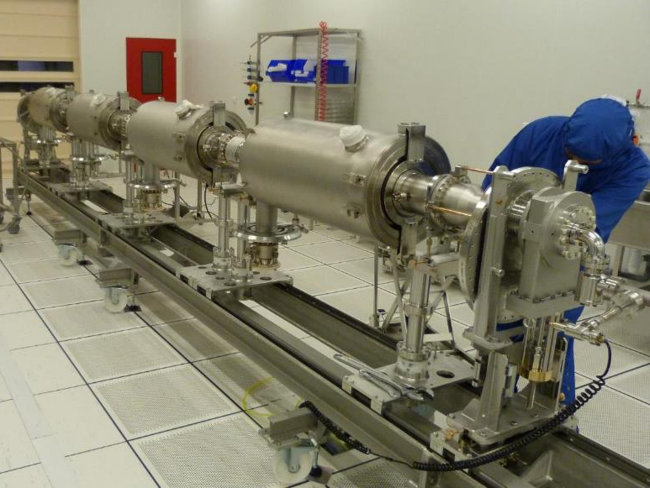
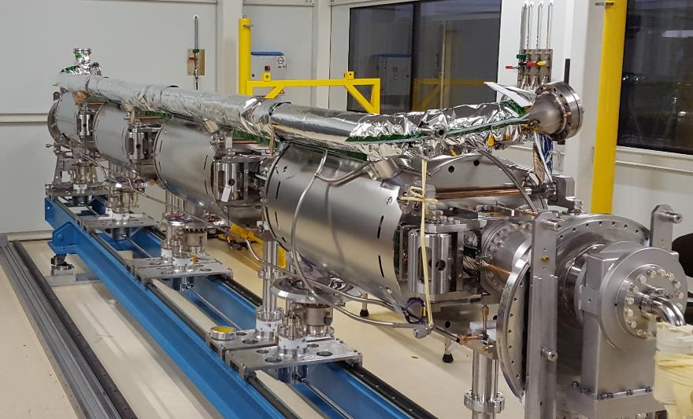
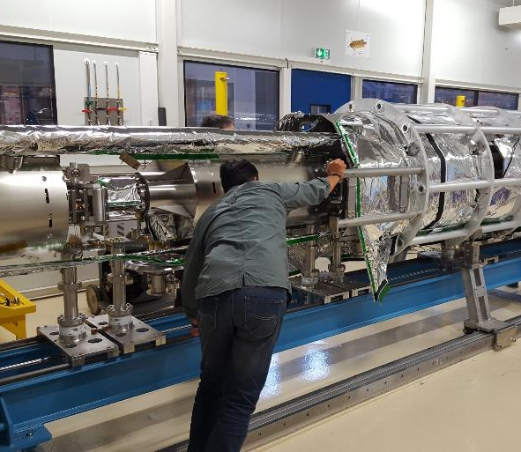
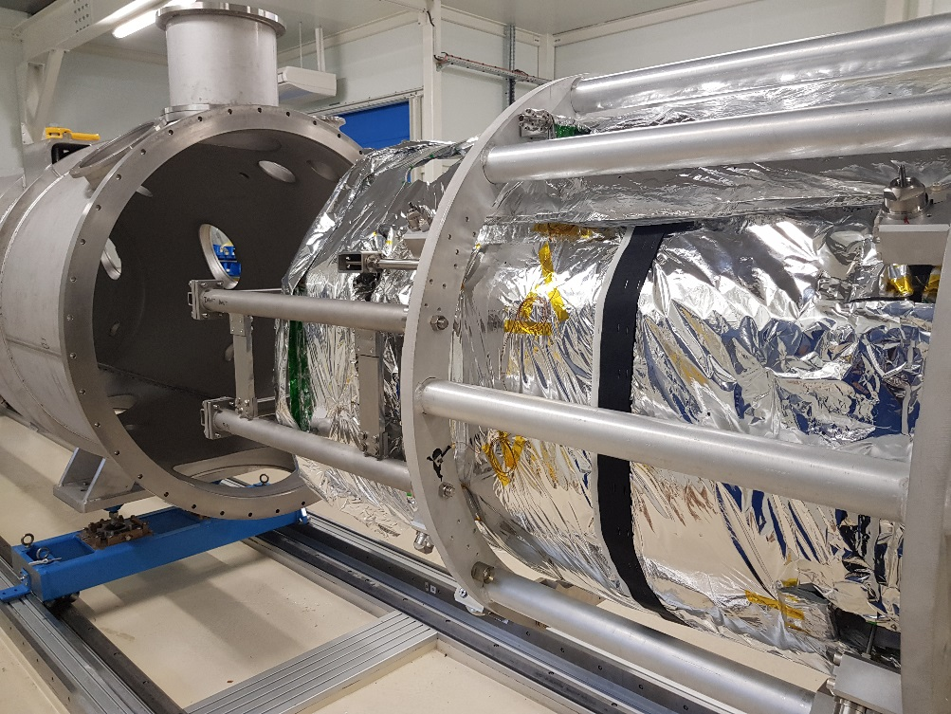

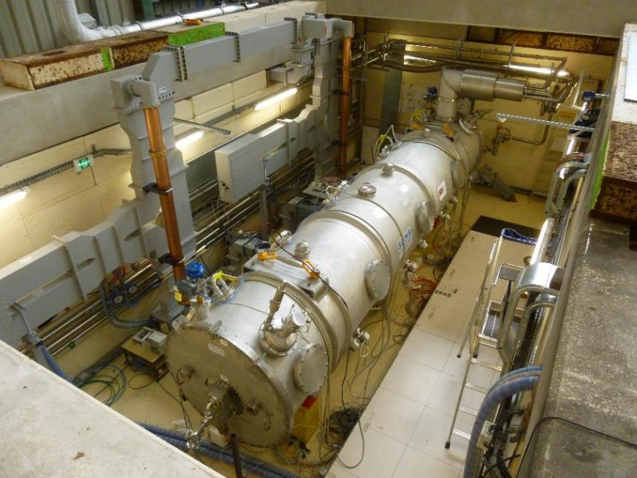

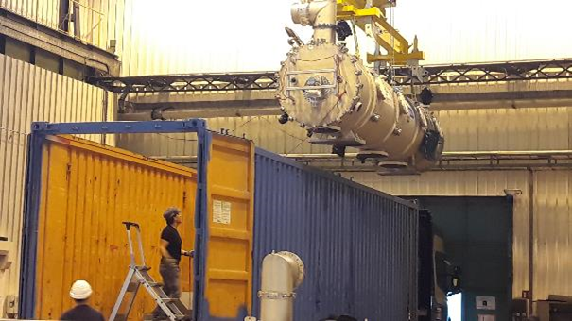
ESS CRYOMODULE FOR ELLIPTICAL CAVITIES
2017-2018
2018
2019-2020

Slide 17
CRYOMODULE FOR PERLE @ ORSAY
SUMMARY
Program general considerations
Genesis of a choice
ESS elliptical cryomodule presentation
Components to be reused, modified, not reused
Cavity, Cold Tuning System & HOM couplers
Cryogenic and thermal aspects

Slide 18
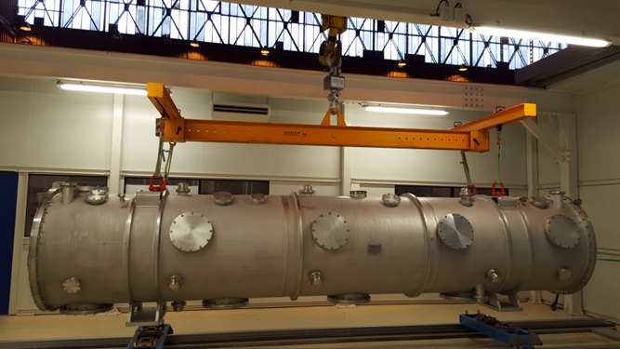
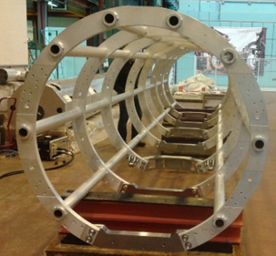
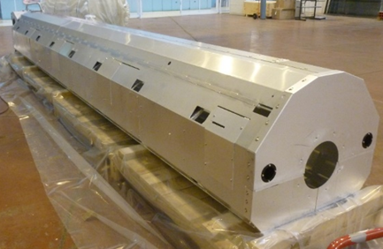
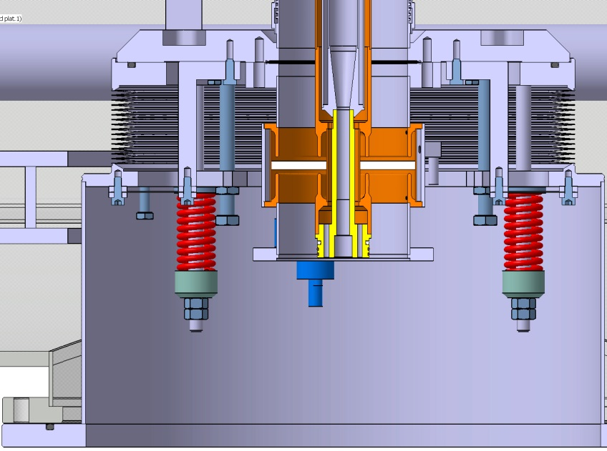
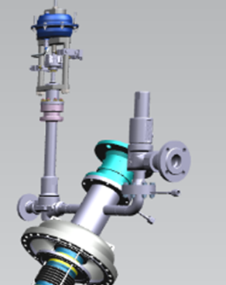
COMPONENTS TO BE REUSED
Thermal shield
Coupler « bell » & Patm compensation (x4)
Vacuum vessel
Spaceframe
And also:
2 UHV all metal gate valves (???)
2 helium valves
Angle vacuum valves
Thermal shield multi layer insulation + parts of cold mass
Instrumentation (temperature gauges, level gauges, pressure gauges)
Wiring and connectors
Pressure safety devices:
Bursting disks (x2)
Controlled valve
Safety valve

Slide 19
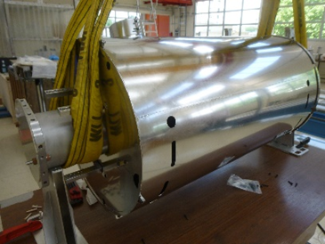
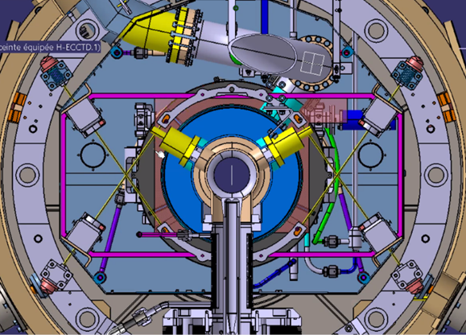
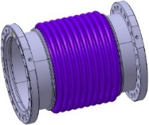
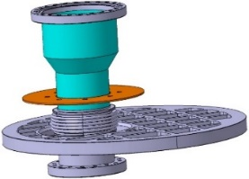
COMPONENTS NOT REUSED OR MODIFIED
Magnetic shield
(not reused)
Supporting system to be adapted to Perle cavity.
Perle tank diameter < ESS diameter
Inter cavities bellows
& Cold/warm transitions
(not reused)

Slide 20
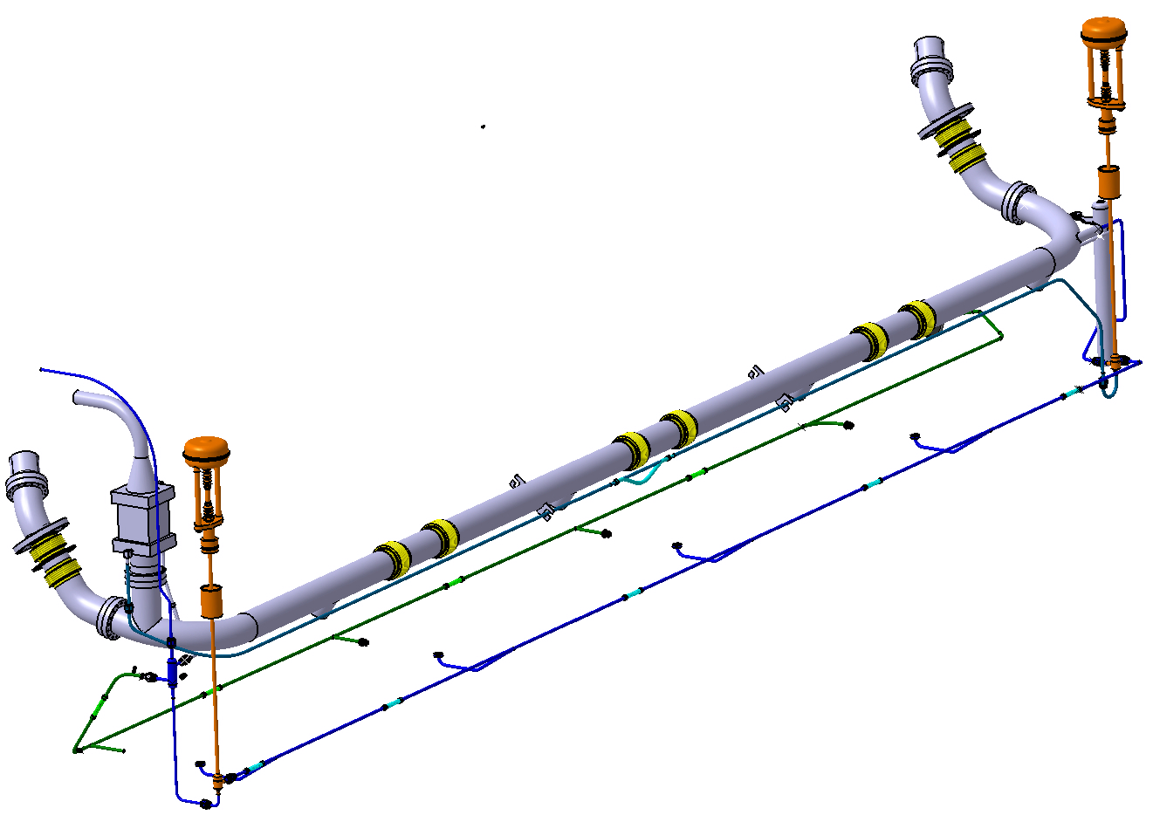
CRYOGENIC LINES
Mainly all welded circuits
Bursting disk
JT valve
Ti diphasic line
Not reused or deeply modified
He Exchanger
Cooling down valve
Cavities filling
The configuration and the dimensioning of the Cryogenic circuits strongly depends on:
the characteristics of the HOM couplers cooling
The power to be dissipated by the low pressure circuit (see related slide)
Cooling down
Bursting disk
Couplers cooling

Slide 21
CRYOMODULE FOR PERLE @ ORSAY
SUMMARY
Program general considerations
Genesis of a choice
ESS elliptical cryomodule presentation
Components to be reused, modified, not reused
Cavity, Cold Tuning System & HOM couplers
Cryogenic and thermal aspects

Slide 22
CAVITY
First draft
Design Jlab
2+2 HOM couplers
HOM coupler basis cooled by Lhe
Compatibility with ESS Cryomodule: positions of main coupler & helium ports, link to the supporting system…
Bellows
D368
HOM Coupler (bulk) (2+2)

Slide 23
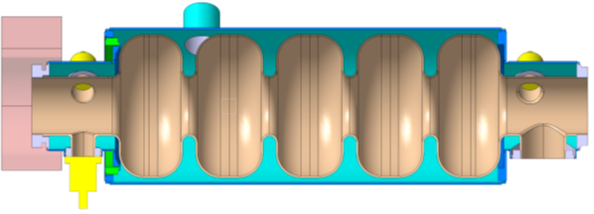
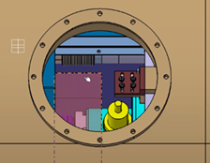
COLD TUNING SYSTEM
Compact design
Allows enough space for HOM couplers
Moved back from the helium tank
Need of adaptation for flange and tank interfaces
Need of adaptation for bigger beam pipe
Pay attention to the overall stiffness
Designed, tested and validated at IJCLab
Tuner for:
ESS double spoke
Myrrha single spoke
Maximum bulk of the tuner
Easy access via the trap doors
Gilles OLIVIER
23

Slide 24
HOM POWER EXTRACTION / DISSIPATION
Tens of Watt to be extracted.
RF losses (<10mW @ 2K) on the coupler port (antenna & cylinder)
What about HOM power not extracted (beam pipe absorbers)?
Thermal loads due to RF cable:
Static conduction through the RF cable
Dynamic loads in the RF cable
Intermediate thermalizations needed à 2 & 50K
RF coax cable thermal behaviour to be analysed.
Cooling possibilities:
Thermalization 2/4K of the antenna
Thermalization 2/4K of the coupler sleeve
Active cooling 2/4K of the antenna
Active cooling 2/4K of the coupler sleeve
2K thermalization
(linked to diphasic pipe)
(Courtesy of CERN/HG team)
Loop coupling with active cooling (Courtesy of CERN/HG team)

Slide 25
CRYOMODULE FOR PERLE @ ORSAY
SUMMARY
Program general considerations
Genesis of a choice
ESS elliptical cryomodule presentation
Components to be reused, modified, not reused
Cavity, Cold Tuning System & HOM couplers
Cryogenic and thermal aspects

Slide 26
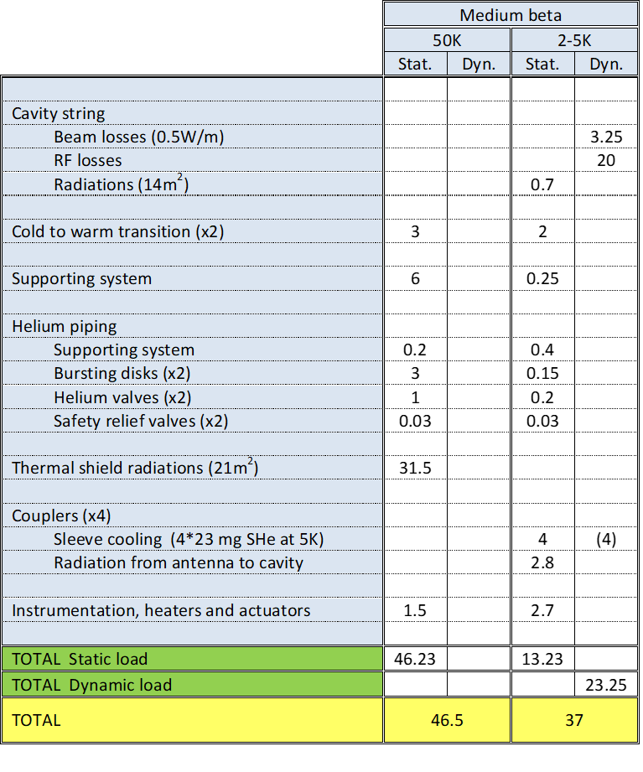
HEAT LOSSES FOR CRYOGENIC LINES
Calculated
Measured
MB cryom.
ESS medium beta
Heat balance
Static & Dynamic 2/4K heat loads for 4 cavities
CIRCUIT | Heat load ESS Ell. (W) | Heat load PERLE (W)
RF losses | 40 | 260 (Q0 1.E+10)
Beam losses | 3,25 | ??
HOM ports |  | 10 mW à 2K
HOM beam pipes |  | 20/40 W
Static losses | 20 | 20
24 to 40
(HB: 24,4)
70 to 80
Preliminary estimate
Heavy figures for helium consumption at 2K.
Dimensioning of the low pressure circuit to be assessed
16 to 20
(HB: 27,65)
(HB: 41)

Slide 27
CRYOMODULE FOR PERLE@ORSAY
THANK YOU FOR YOUR ATTENTION

