Slide 1
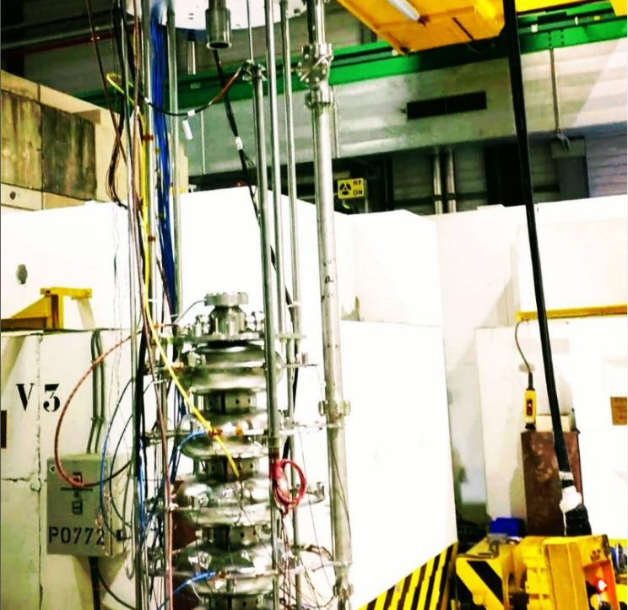




Ferro-Electric Fast Reactive Tuners (FRTs)
N. Shipman on behalf of:
I. Ben-Zvi, J. Bastard, G. Burt, M. Coly, A. Edwards, C. Jing, A. Kanareykin, A. Macpherson, N. Stapley, H. Timko
Acknowledgements
M. Barnes, D. Barrientos, A. Castilla, F. Gerigk, W. Hofle, P. Kohler, E. Montesinos, G. Pechaud, P. Schneider, D. Smekens, D. Valuch, W. Venturini
Presented at:
PERLE Collaboration Meeting

Slide 2
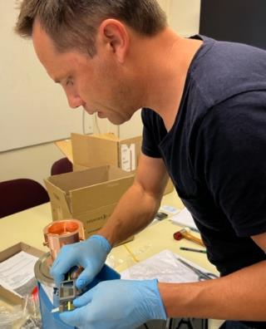
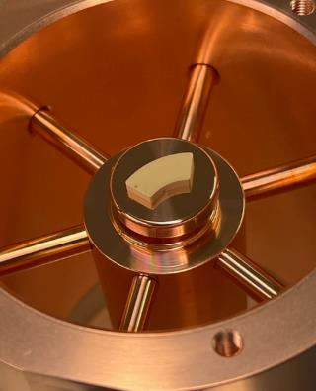
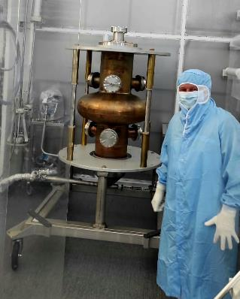
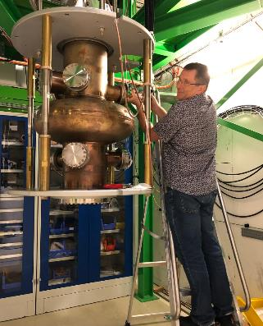
Introduction
FRTs are a new type of extremely fast non-mechanical tuner
CERN/Lancaster are developing and testing improved FRT designs
Research focus at CERN is now “transient detuning” for HL-LHC
  Compensation of transient beam loading using an FRT
Microphonics suppression with prototype FRT already demonstrated
  PERLE is an ideal use case!

Slide 3

FRTs
Introduction to Ferro-Electric Fast Reactive Tuners

Slide 4
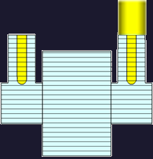
FRT Concept
Circulator
HV Line
FRT
RF Amplifier
FPC
FRT Antenna
Load
An FRT is a shorted co-axial structure containing a ferro-electric element
RF power flows into the FRT and is reflected back to the cavity
Voltage applied to the ferro-electric changes its permittivity
Permittivity change → Phase change of the reflected power → Cavity frequency change
Usually, the FRT would require its own port, although other arrangements have been proposed
Operates outside cryomodule at room temperature
Tunes cavity without mechanical deformation
Tuning speed measured at less than 600ns, limited by HV circuit

Slide 5

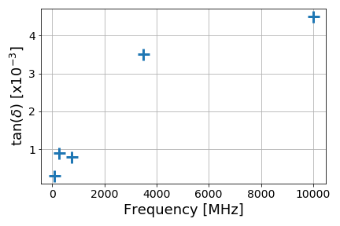

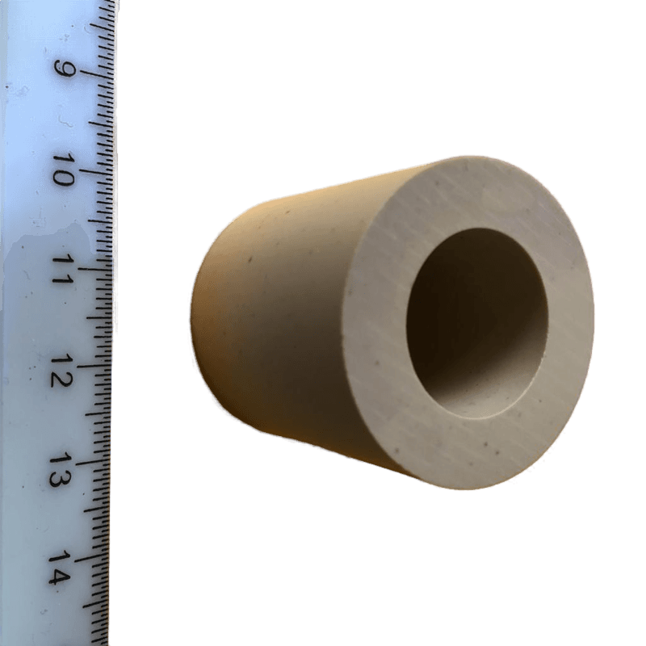
Figure of Merit and Ferro-Electric (FE) Material
Parameter | Value
Relative Permittivity | 160
Tunability | 1.4
Tuning Field | 8 Vµm⁻¹
Breakdown Strength | 20 Vµm⁻¹
Thermal Conductivity | 7.02 Wm⁻¹K⁻¹
FoM allows:
  Comparison of FE-FRT designs
  Estimation of benefit e.g. power reduction
FoM is ~tuning range divided by increase in bandwidth
  Subscripts 1 and 2 refer to the two extreme high voltage ‘end’ states
Material FoM is FoM of a FE capacitor with only dielectric losses
  Material FoM is a theoretical upper limit of FoM
  Would allow comparison of different ferro-electric materials
FE is BaTiO₃-SrTiO₃ with Mg based additives
  Loss tangent roughly ~ frequency
FE material parameters
30 mm
33 mm
Loss tangent vs RF frequency
(Courtesy Euclid TechLabs)
A BST(M) Ferroelectric Sample

Slide 6
Transient Detuning
Overview of Transient Detuning Concept

Slide 7
Use cases: transient detuning
RF power required for cavity with beam
Can change
Fixed
will change so either:
  or must change
Normally, choice between:
  Increased RF power
  Cavity phase errors
Simplifying assumptions
Recently we proposed a new scheme “Transient detuning”
Transient detuning uses FE-FRT to change
  Reduced average RF power (by up to FoM/2)
  Increased phase stability
  Fixed RF bucket position → ideal for injection
In the future, we hope to apply this to HL-LHC, project underway!
Notation | Meaning
 | RF power
 | Cavity phase derivative
 | Detuning
 | Beam Current

Slide 8
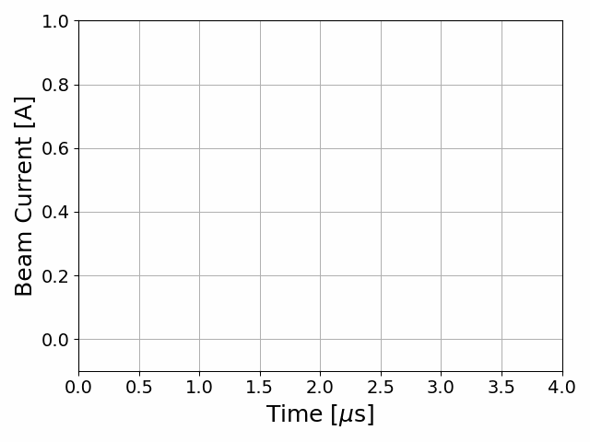
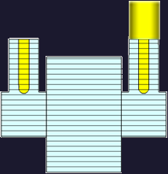
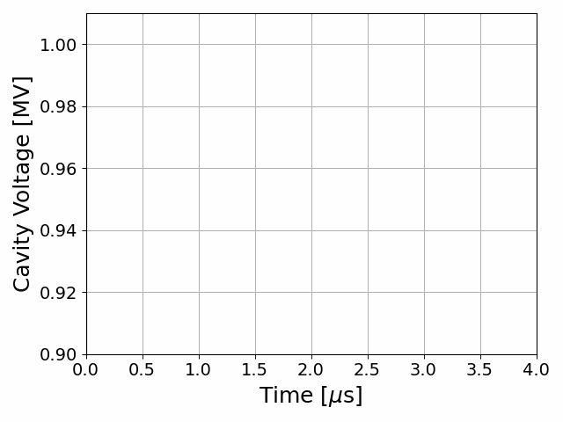
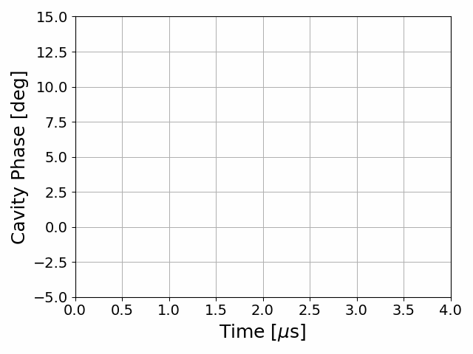
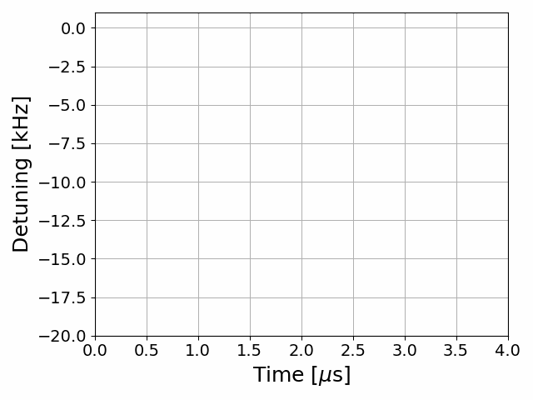
Use cases: transient detuning
Beam + fixed detuning
Circulator
HV Line
FRT
RF Amplifier
FPC
FRT Antenna
Load

Slide 9
Use cases: transient detuning
Beam + transient detuning
Circulator
HV Line
FRT
RF Amplifier
FPC
FRT Antenna
Load

Slide 10
Transient Detuning Project
Overview of transient detuning research at CERN

Slide 11
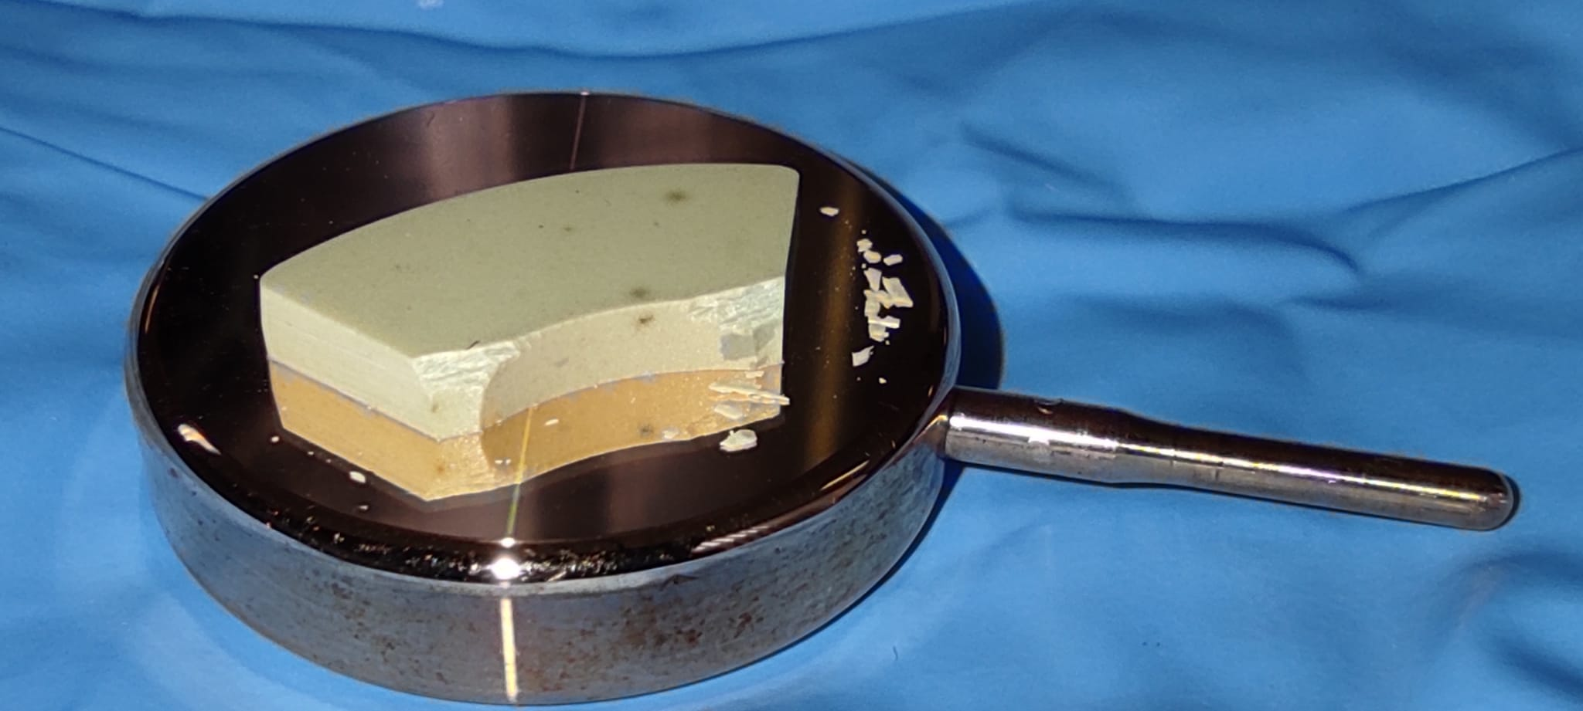
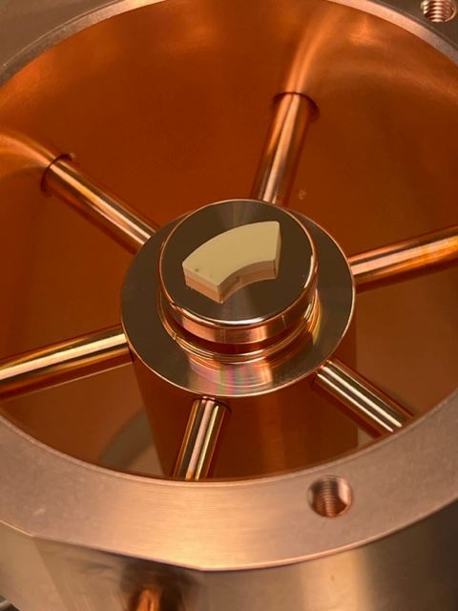
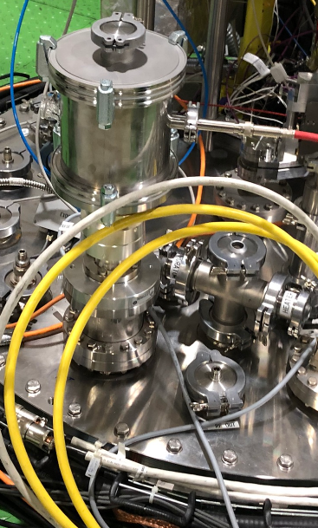
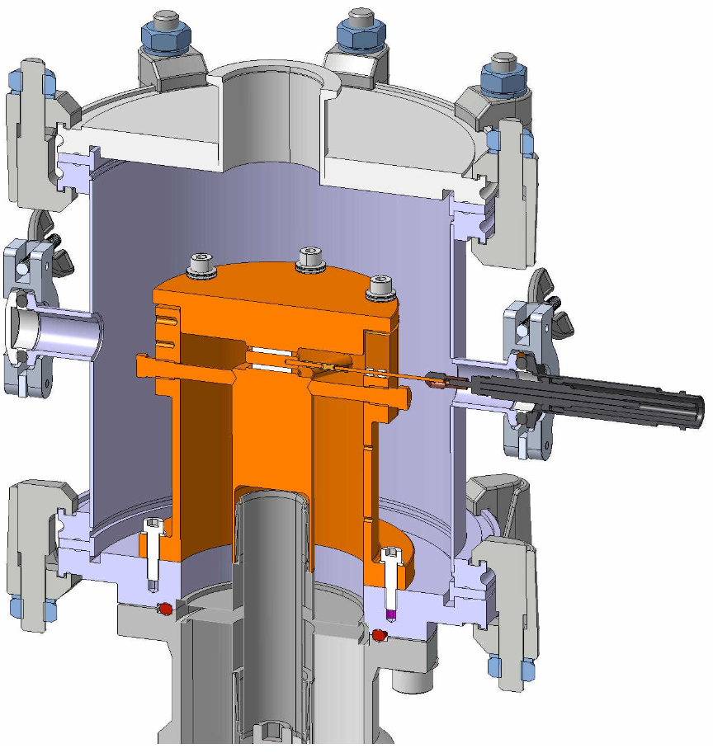
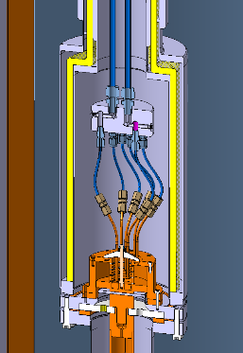
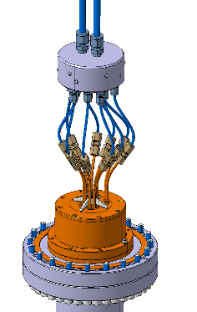
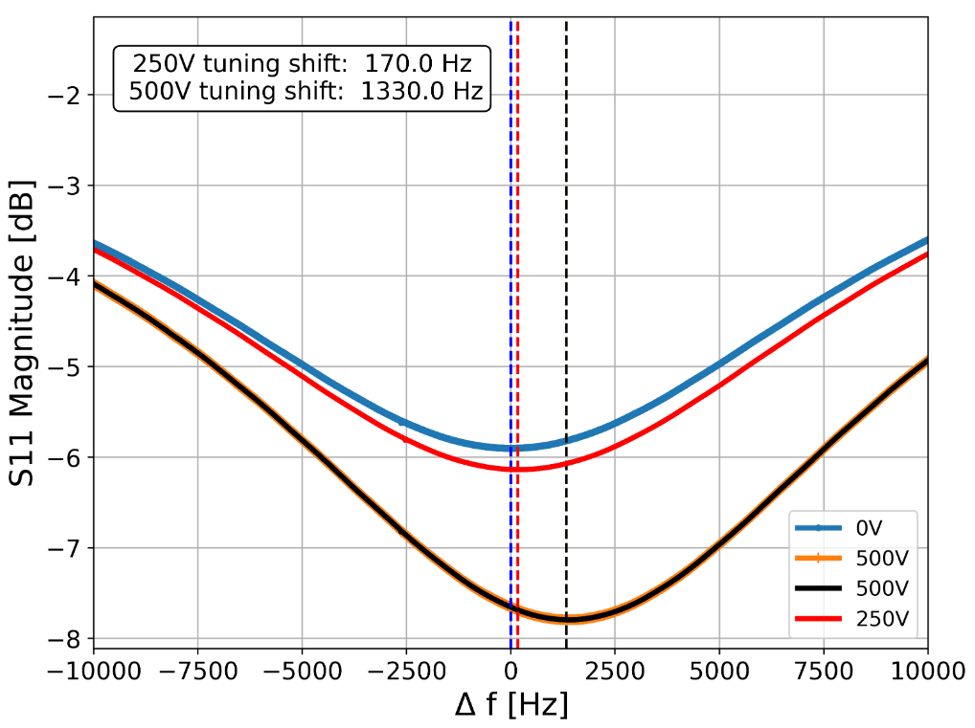
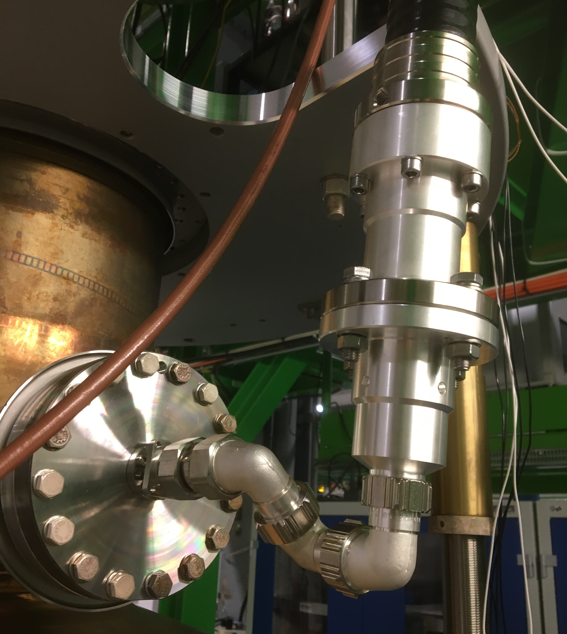
Transient Detuning Demonstrators
Brazeless (compression fit) thin wafers of ferro-electric in vacuum
  Aim: reduced losses + higher biasing electric fields
  + greater change in permittivity at reduced voltage
First prototype TDD0 (Transient Detuning Demonstrator) built and tested on cold LHC cavity
  Test cut short due to cavity vacuum leak
1.3kHz tuning shift observed with 500V
  TDD0 designed for 10-16kV, voltage limited due to vacuum leak on TDD0
Lessons learned:
  Very sensitive to air gap/compression force in FerroElectrtic stack
  Care must be taken to apply compression evenly
  Rigid line from top plate causes to much mechanical stress on vacuum feedthroughs
    Move FRT inside cryostat for next test → anti-cryostat
Parts of TDD1 already in workshop
  Mechanical design ~1 week away from being finished
  High performance, high power (100s kW) design
  4 doughnut shaped wafers with cooling lines
Left: TDD1 in anticryostat.
Right: TDD1 with cooling lines.
TDD0 produced reproducible 1.3kHz frequency shift on cold LHC cavity with 500V applied across FerroElectric.
Left: TDD 0 during assembly, shape of ferro-electric dictated by geometry of samples in stock.
Right: TDD0 installed on top plate.
TDD 0 design, ferro-electric wafers shown in white.
Top: uneven compression force cracked ceramic.
Left: Large diam. rigid line caused vacuum leak.
Right: Breakdown through ceramic near cracks?

Slide 12
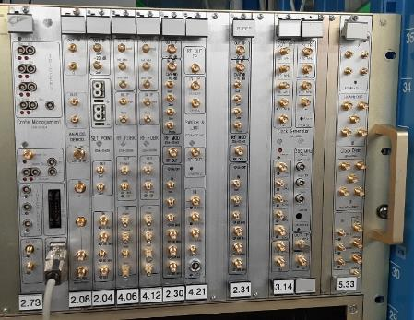
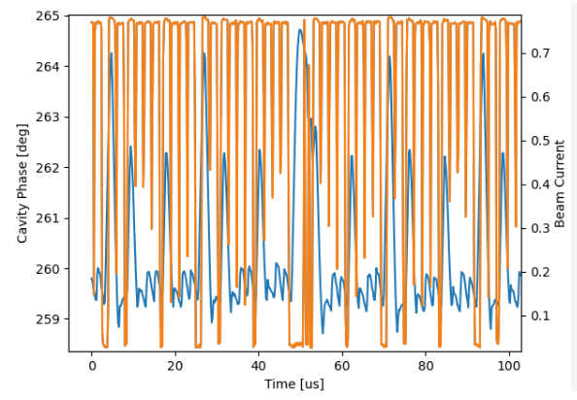
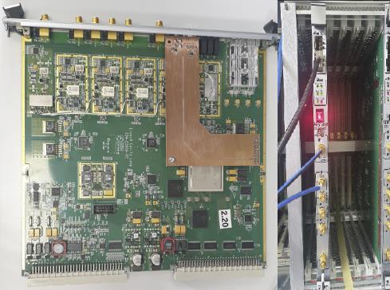
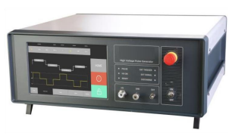
Transient Detuning Project: Peripherals 1
LHC LLRF System
  LHC LLRF system is complex and will not be redesigned for HL-LHC
  Transient detuning must work with existing LLRF system
  LHC LLRF system replicated in cavity cold testing area
  No One Turn Feedback Module in last test now installed, waiting to be tested
BLEEP
  Beam Loading Electronic Emulation Project
  Testing with cryomodule with real beam not feasible in initial project timescale
  BLEEP adds correct RF power and phase to input coupler to replicate beam pattern
High Voltage Pulser for biasing FE ceramic
  Prototype HVP capable of running ~10ms:
    Procured, received, tested, broken and sent back for diagnosis and repair
  Final HVP design more challenging as would need to run continuously
Pulse generator
  Programmable pulsed optical output to drive high voltage pulser
  Triggered with same signal as BLEEP
  Implemented as daughter board of new “Universal Cavity Controller”
Parameter | Value | Parameter | Value
Total Capacitance | 2 nF | Rise, Fall Time | 100ns
High Voltage | 7 kV | Power Supply Rating | 14.4 kW
Energy per pulse | 49mJ | (Dis)charge current | 140 A
Burst Pulse Rate | ~146 kHz | Burst Duration | 10ms
High Voltage Pulser specification.
BLEEP and replicated LHC LLRF system in control room of SM18 cavity cold test area.
BLEEP replicated beam pattern causes several degrees of uncorrected phase error if One Turn Feedback Module (OTFB) absent from LLRF.
Orange: LHC beam pattern replicated with BLEEP
Blue: Cavity phase controlled with LLRF without OTFB
Green: Target phase for LLRF
UCC module with pulse generator daughter board and optical output.
High Voltage Pulser for transient detuning tests.

Slide 13
Microphonics Suppression with FRT
Benefits of suppressing microphonics with an FRT

Slide 14

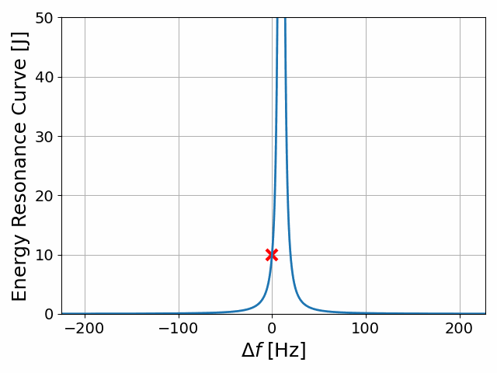
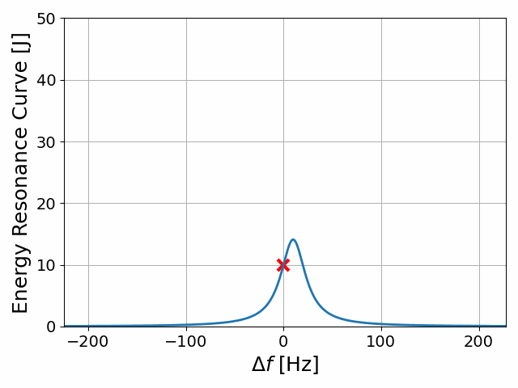
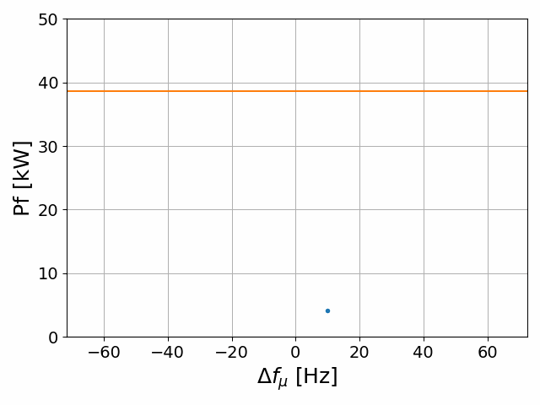
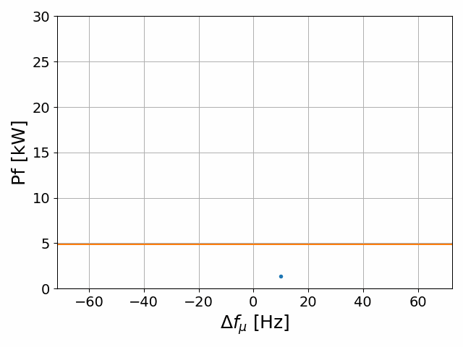
Use cases: microphonics suppression
For low beam loading machines RF power is dominated by microphonics
The effect of microphonics can be reduced passively or actively
  Stiffening of cavity
  Isolation of noise sources
  Active feedback e.g. piezo tuners
Residual microphonics require over-coupled FPC
Typically, RF power required is still many times larger than for critical coupling case
Decreasing Q_{L}

Slide 15
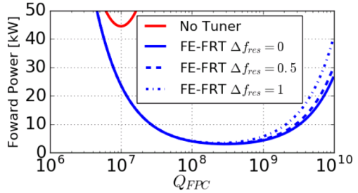


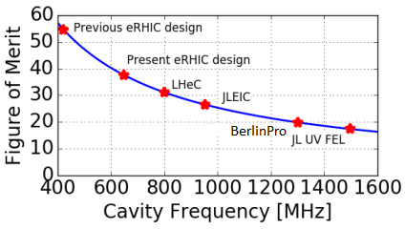
Use cases: microphonics suppression
FRTs are an excellent tool for microphonics suppression
  High Tuning speed
    ~600ns measured limited by external HV circuit
  No excitation of mechanical modes
  Simple transfer function/negligible phase delay at frequencies of interest
Peak and average RF power reduced by and respectively
  Increased dielectric and conductor losses at higher RF frequencies reduce effectiveness
FRTs can be combined with other suppression technologies
  E.g. piezo tuners
PERLE power savings: 732 kW
LHeC power savings: 22 MW!!
  ~150GWh per year, ~50,000 tons of C0₂
Case study: RF power for PERLE vs QL with and without FRT
Estimated FRT FoM vs RF frequency

Slide 16
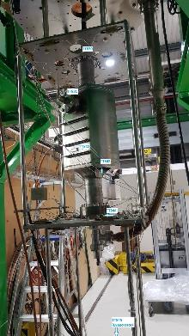
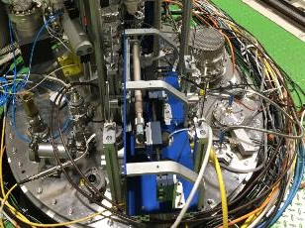
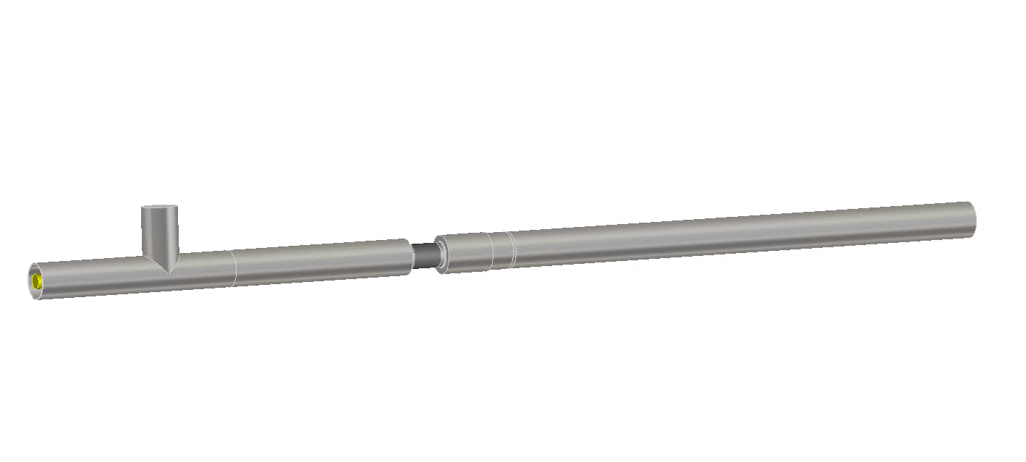
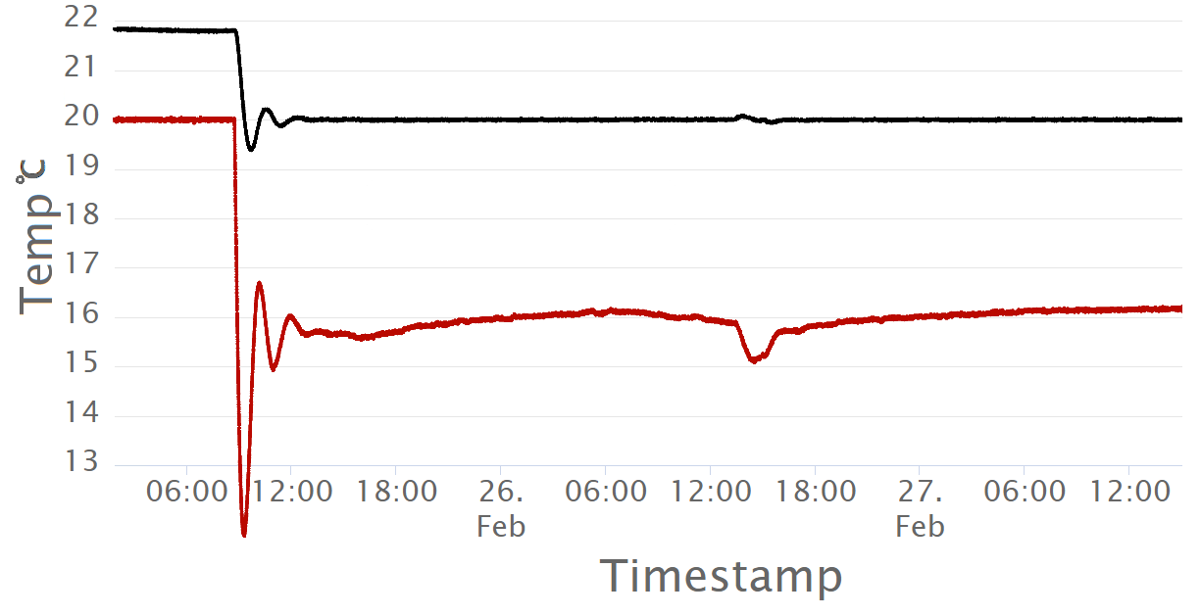
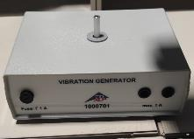
Microphonics suppression results
Lower order Mode of UK4R crab cavity at 374MHz
  Very stiff → very low levels of microphonics → used vibration generator
Euclid designed prototype FRT
No slow tuner → operated in SEL mode
Chiller, phase shifter, vibration generator
Deliberately simple purely integral feedback used
  More performant solutions surely possible
Phase shifter on top plate
FE-FRT temp.
UK4R on insert
regulation on
Bath temp.
bunker opened
Euclid FE-FRT prototype
Temperature regulation with chiller
Vibration generator

Slide 17
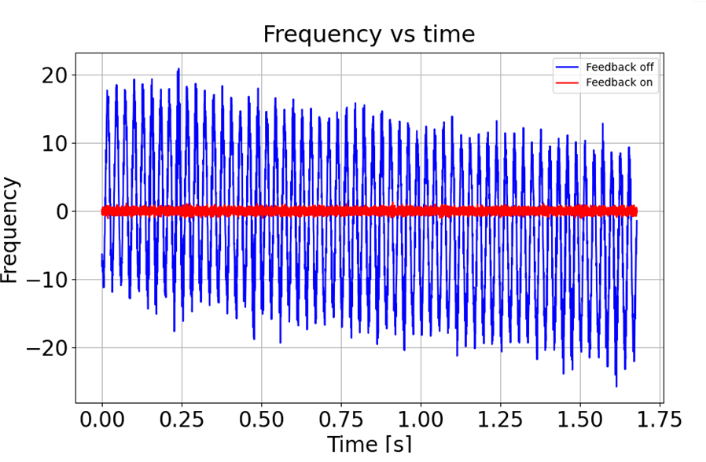
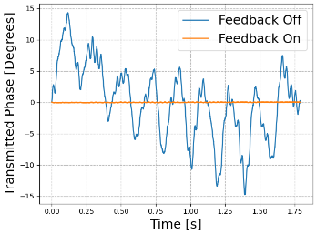
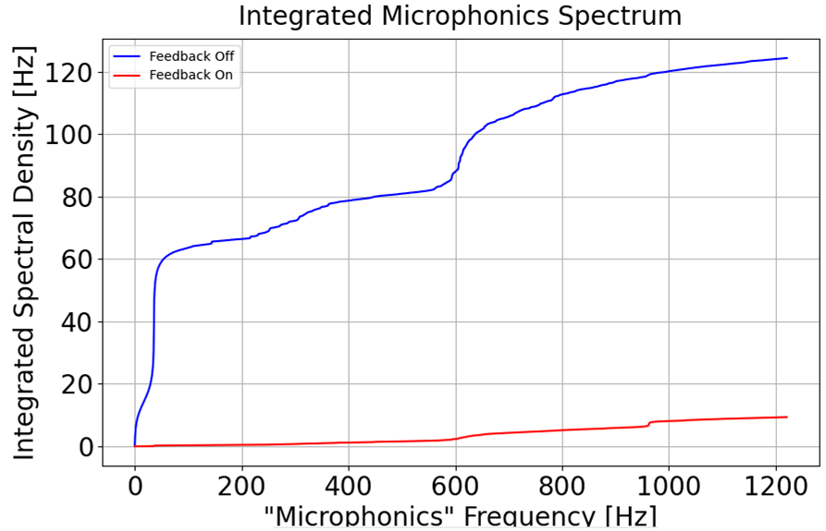
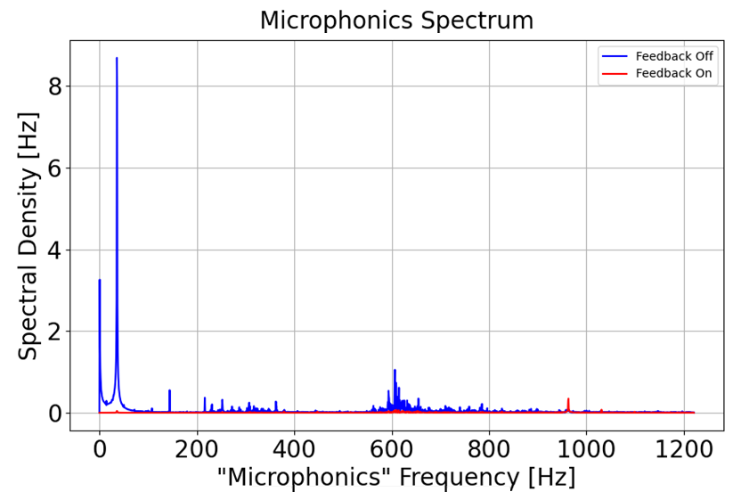
Microphonics suppression results
Test of prototype FRT with UK4R cavity
  UK4R very stiff, used vibration generator to create microphonics
Microphonics ~completely eliminated
  ~20x reduction in integrated microphonics spectrum up to 1kHz
  Order of magnitude better than other technologies
Deliberately simple purely integral feedback algorithm
F
No correction
With correction

Slide 18
Other Use Cases and FRT Projects
Overview of current FRT Landscape

Slide 19
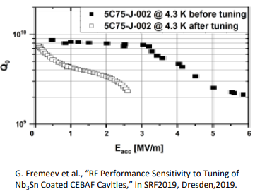
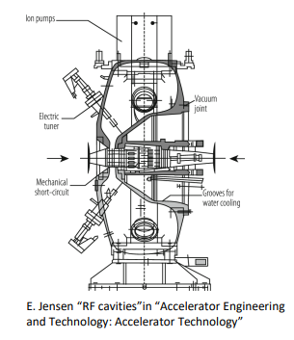
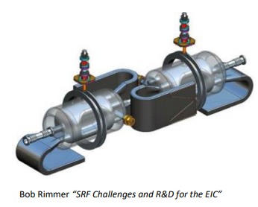
Other Use Cases
Nb₃Sn Cavities
CERN PS 80MHz cavities
EIC 197 MHz hadron crab cavities
Nb₃Sn could double or quadruple carnot efficiency
  Would reduce required cooling power by factor 2-4
Nb₃Sn performance degraded with mechanical tuning
There may be a material science solution
FE-FRTs can provide an alternate solution
Cavity should be off during ramp
Large frequency sweep ~930kHz must not excite resonances.
Elegant idea:
  Use FE-FRT to jump cavity resonance over revolution lines during abort gaps.
  Only 10-100 Hz Tuning required
FE-FRTs could provide fast 230kHz frequency switching
This would allow parallel operation with both protons and ions

Slide 20
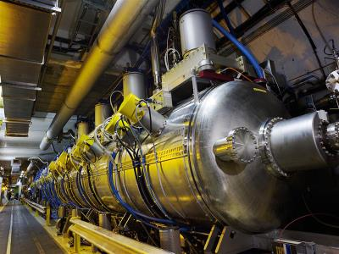
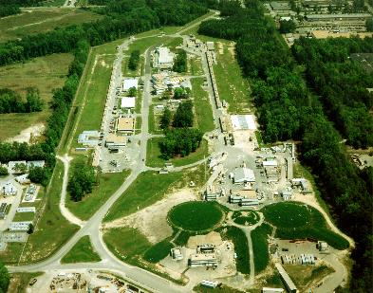
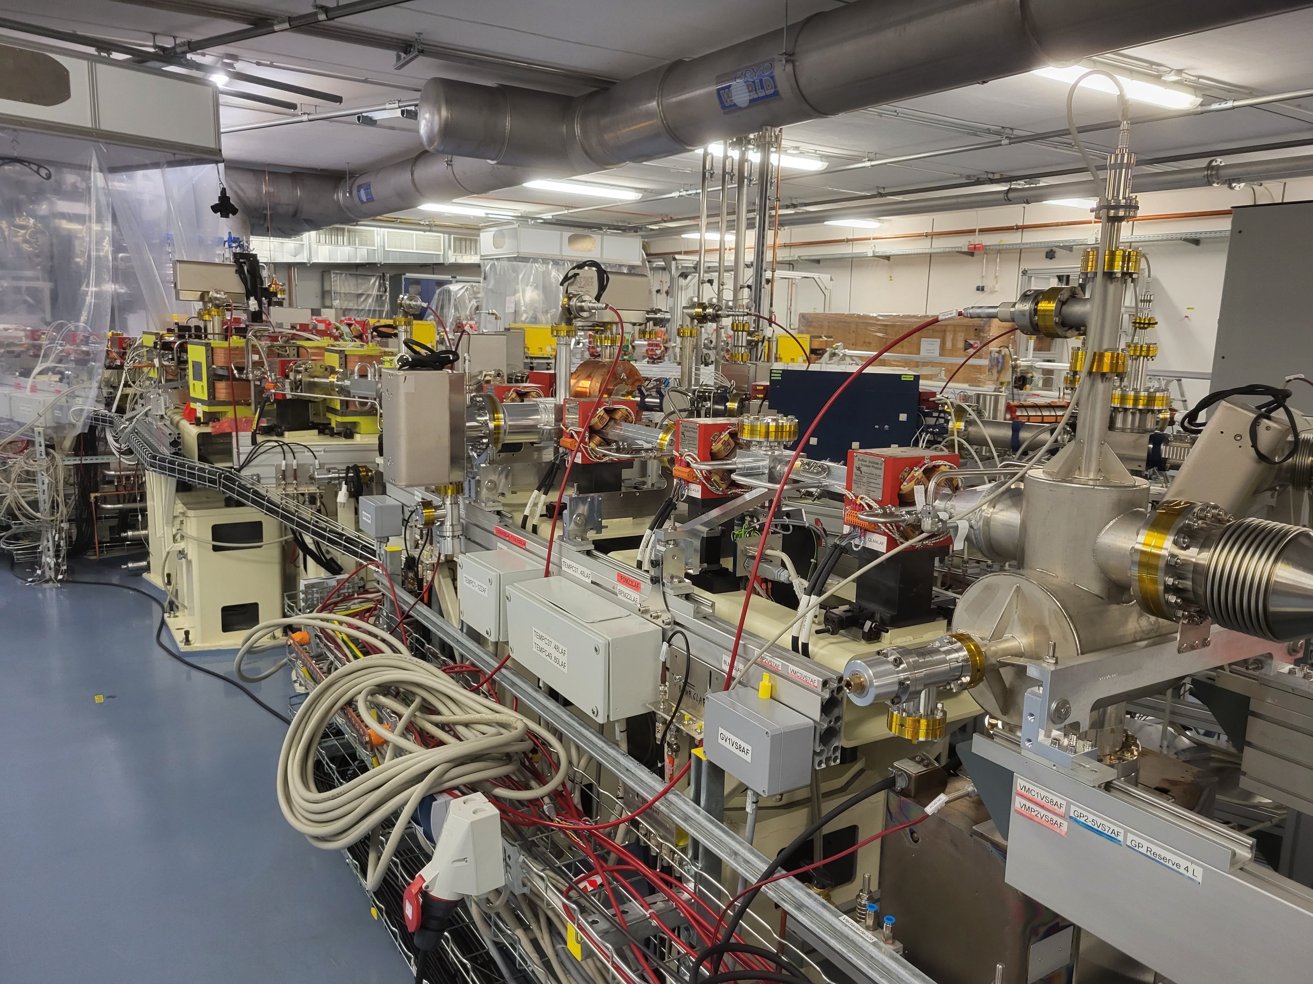
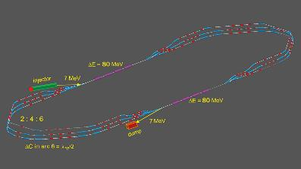
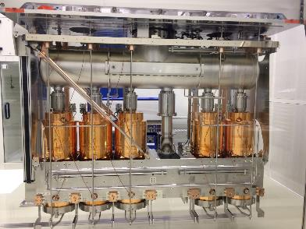
FRT projects
HL-LHC
  FRTs being seriously studied to reduce power at injection
CEBAF
  Aiming to reduce power due to microphonics with combined FRT/FPC port
  Exciting but challenging
bERLinPro
  Plan to start dedicated R&D from Jan 23
PERLE
  Plan to integrate FRT in 2nd cryomodule to be installed in beam ~2030
HIE-ISOLDE
  Investigating FRTs for microphonics compensation
  Ideal test case: low frequency, low beam loading, low power
  Could be first FRT in working machine
LHC Cryomodule
CEBAF facility
bERLinPro Hall
PERLE Layout
HIE-ISOLDE Cavities

Slide 21
FRTs for PERLE
Parameter | Value
Tuning Range | ~80 Hz
Peak Reactive Power | ~14 kVar
Dissipated Power | <240 W
FoM (estimated) | >30
PERLE is an excellent use case for an FRT
  Small Tuning Range
  Relatively low power handling requirements
  RF frequency is not too high → high FoM
FRTs need their own port
  FRTs could potentially have impact on HoMs and coupler kick
  End group should be designed to accommodate an FRT
Cryomodule design/adaptation needs to be considered
  If FRT is inside cryomodule volume need: space, “anti-cryostat”, HV feedthrough
  If FRT outside cryomodule → space for transmission line, RF feedthrough
Some mechanical, thermal and RF design consideration can take place without finalized FRT design
Estimated parameters of a PERLE FRT

Slide 22
Summary

Slide 23
Summary
CERN research currently focused on transient detuning for HL-LHC
FRTs are perfect for Microphonics suppression for low beam loading machines
PERLE is an excellent use case for FRTs
FRTs need there own port
Preliminary mechanical, integration, thermal, RF work could start without final FRT design
  Additional cost would be small and could pay off later!

Slide 24
Thank you for your attention
N. Shipman
nicholas.shipman@cern.ch

