Slide 1
PERLE INJECTOR DIAGNOSTICS
Mohammed Ben Abdillah
sidi-mohammed.ben-abdillah@ijclab.in2p3.fr

Slide 2
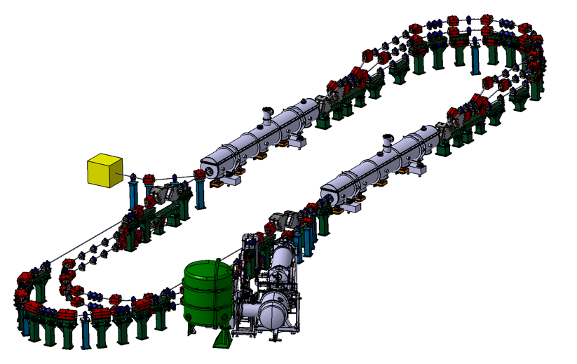
PERLE Genesis
PERLE: A testbed to explore and validate a broad range of accelerator phenomena & technical choices on the pathway to the LHeC and other new frontier machines realisation.
Main challenges: Multi-turn, high bunch charge, high power energy recovery, …
2 Linacs (Four 5-Cell 801.58 MHz SC cavities)
3 turns (164 MeV/turn)
Max. beam energy 500 MeV
I = 20mA
Injector Parameters | Unit | Value
Injection energy | MeV | 7
Normalised Emittance γε_{x,y} | mm mrad | 6
Average beam current | mA | 20
Bunch charge | pC | 500
Bunch length | mm | 3
Bunch spacing | ns | 25
Duty factor |  | CW
Injector

Slide 3
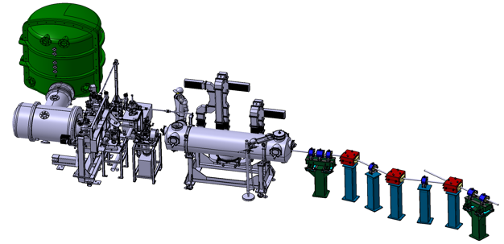
PERLE Injector scheme
HV tank
Buncher
Merger
DC gun
Light box
Green laser 40 MHz
Booster:

Slide 4

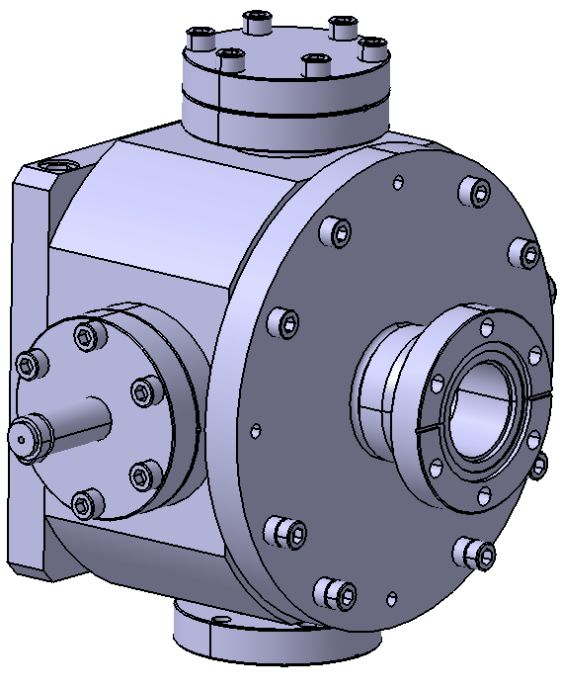
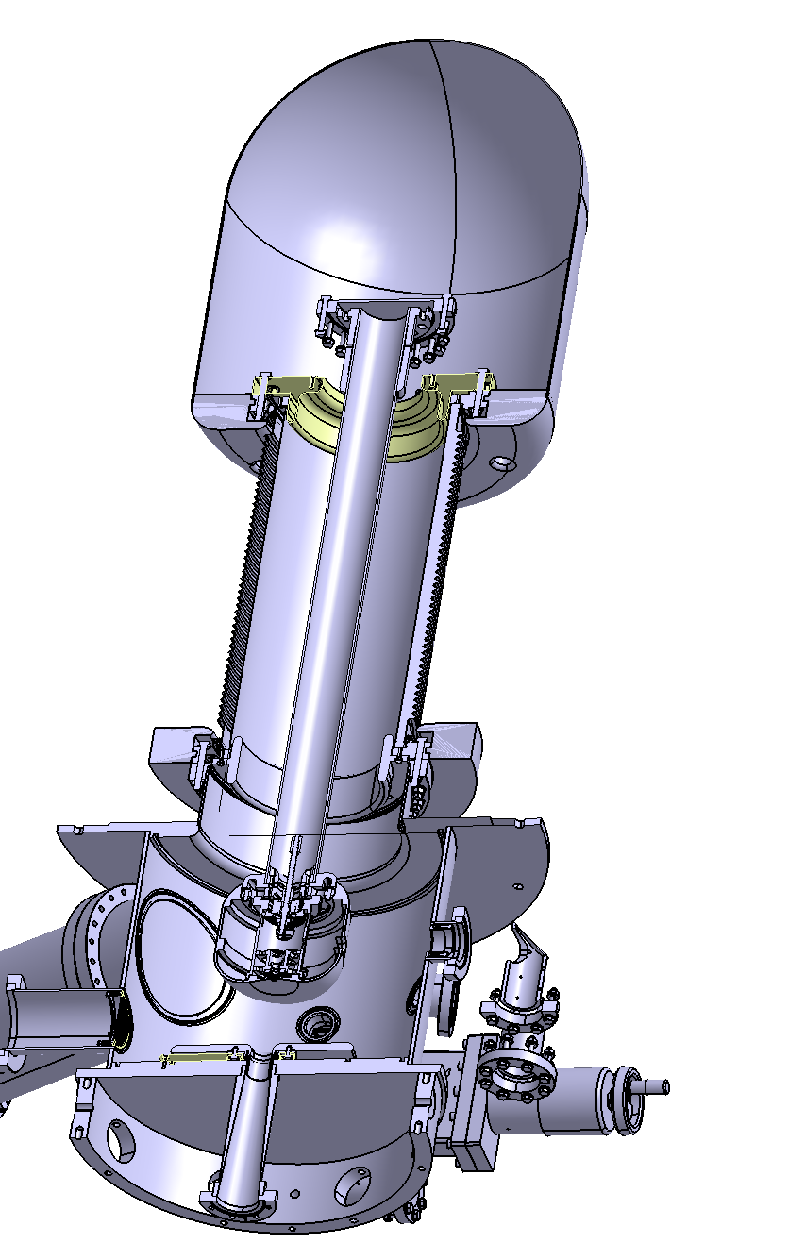
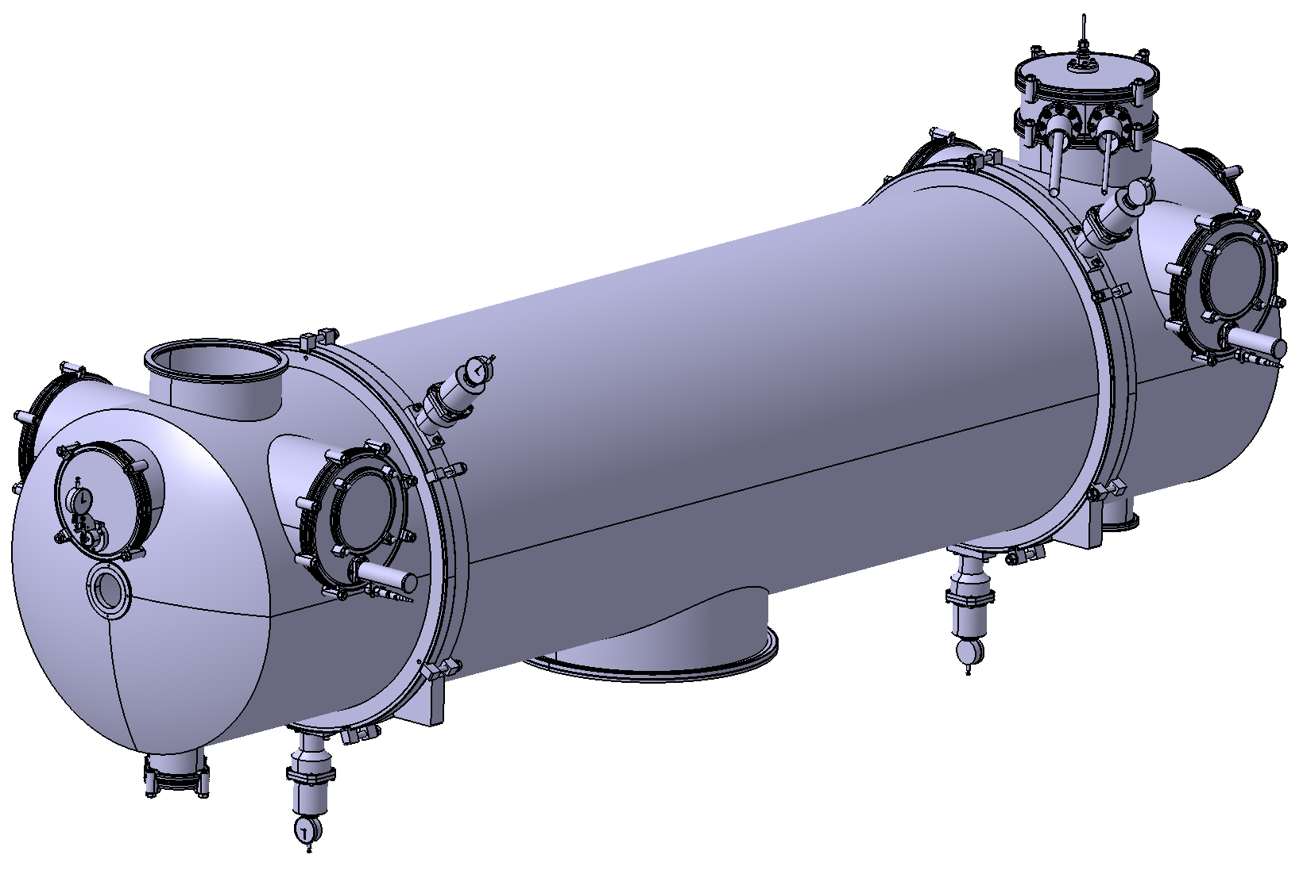
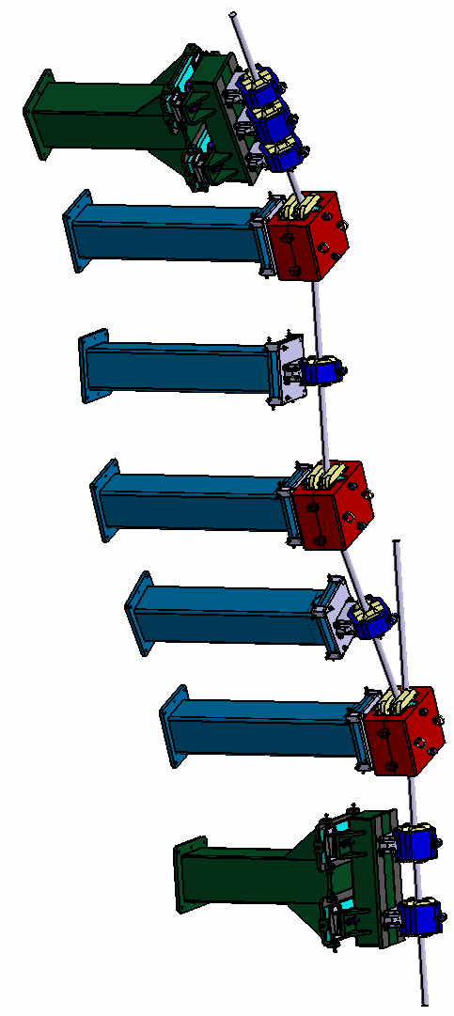
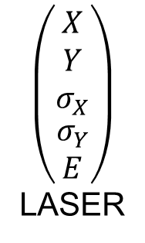

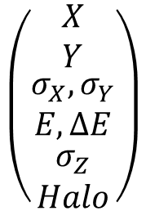


PERLE injector: what should be monitored?
Laser
Cathode
Buncher
Booster
Merger
ERL
$$\left(\begin{matrix}\begin{matrix}X \\ Y \\ σ_{X}\end{matrix} \\ \begin{matrix}σ_{Y} \\ E\end{matrix}\end{matrix}\right)$$
LASER
$$\left(\begin{matrix}\begin{matrix}X \\ Y \\ σ_{X}\end{matrix} \\ \begin{matrix}σ_{Y} \\ \begin{aligned}Q \\ E\end{aligned}\end{matrix}\end{matrix}\right)$$
$$\left(\begin{matrix}\begin{matrix}X \\ Y \\ σ_{X} \end{matrix} \\ \begin{matrix}σ_{Y} \\ \begin{aligned}Q \\ E\end{aligned}\end{matrix}\end{matrix}\right)$$
$$\left(\begin{matrix}\begin{matrix}X \\ Y \\ σ_{X} \end{matrix} \\ \begin{aligned}\begin{matrix}σ_{Y} \\ Q\end{matrix} \\ E\end{aligned}\end{matrix}\right)$$
$$\left(\begin{matrix}\begin{matrix}X \\ Y\end{matrix} \\ \begin{matrix}σ_{X},σ_{Y} \\ E,∆E\end{matrix} \\ \begin{matrix}σ_{Z} \\ Halo\end{matrix}\end{matrix}\right)$$
BEAM LOSS

Slide 5
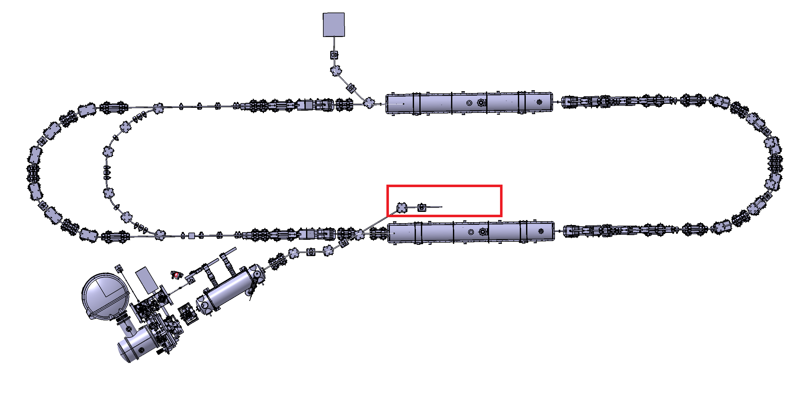
PERLE injector: where should it be monitored?
Diagnostics along the injector: Beam manipulation constraints available space for diagnostics
Position, charge
Transverse profile
Loss
Laser parameters (might be optional)
Diagnostics beyond the Merger: Footprint issues
Energy and Energy dispersion
Transverse profile
Halo
Longitudinal profile
Unsure how much space would be dedicated to post merger diagnostics

Slide 6
PERLE injector: monitors to be used
BEAM
ORBIT
PROFILE
ENERGY
CHARGE
LOSSES
BPM
View screens
View screens
(transverse)
+ deflecting cavity (longitudinal)
Dipole + View screen
BCM (BPM)
ICT
Faraday cup
PMT
Fiber
LASER
GUN (optional)
Power meters
CCD Cameras
Virtual cathode
High voltage Ripple monitor
GOAL: injector with necessary diags and not a diag station

Slide 7
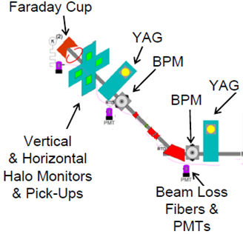
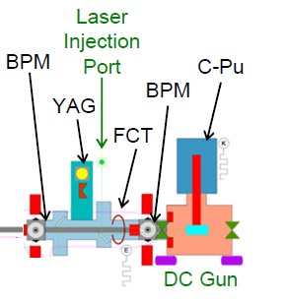


PERLE Injector : example with diag positions
Booster
MERGER
BUNCHER

Slide 8
Readout hardware and interface issues
Commissioning schemes
Beam Manipulation
Acquisition systems
Injector Components
Machine Protection

Slide 9



Task force and partners
Needs: Task force for many diagnostics yet to be studied

Slide 10
Conclusions
PERLE@Orsay is a key ERL project for HEP and Nuclear Physics communities
Diagnostics are crucial devices for PERLE success.
PERLE injector diagnostics quite challenging: commission schemes, CW operation, large dynamic ranges, broad range diagnostics, beam dynamics...
Collaborations on diagnostics under construction and still opened to new comers.

Slide 11
Thank you for your attention!

