Slide 1


Beam Monitoring and Diagnostics Options for Future ERLs
Joseph Wolfenden, Angus Jones, and Carsten Welsch
23/06/2023

Slide 2
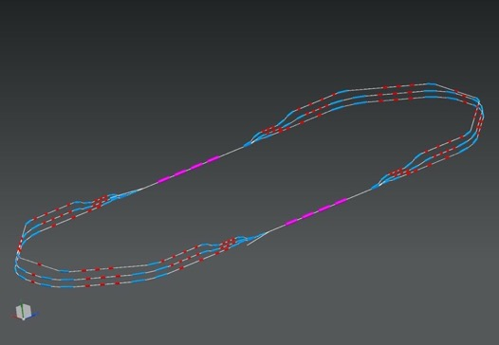

Overview
Injector beamline
Space charge
Recirculation arcs
Standardisation of diagnostics
1 : 3 : 5
DE = 82.2 MeV
injector
7 MeV
Injection “point”
Efficiency
Common beamlines
Different energies
DE = 82.2 MeV
2 : 4 : 6
7 MeV
dump
[1]
J. Wolfenden (joseph.wolfenden@cockcroft.ac.uk)
PERLE collaboration meeting 23/06/2023
1

Slide 3
Overview
Single-shot emittance measurements
Halo imaging with DMD-masking
Optical-fibre beam loss monitor
Virtual diagnostics
J. Wolfenden (joseph.wolfenden@cockcroft.ac.uk)
PERLE collaboration meeting 23/06/2023
2

Slide 4
Single-shot emittance measurements
J. Wolfenden (joseph.wolfenden@cockcroft.ac.uk)
PERLE collaboration meeting 23/06/2023
3

Slide 5
Single-shot emittance measurements
Standard emittance diagnostics difficult due to space charge effects
Optical versions of slit/pinhole scans and pepper-pot avoid this issue
Focusing on OTR – Optical Transition Radiation
  Could investigate other types of radiation, e.g. synchrotron or diffraction radiation
Two methods under investigation:
  DMD – Digital Micro-mirror Device
  MLA – Micro Lens Array
J. Wolfenden (joseph.wolfenden@cockcroft.ac.uk)
PERLE collaboration meeting 23/06/2023
4

Slide 6
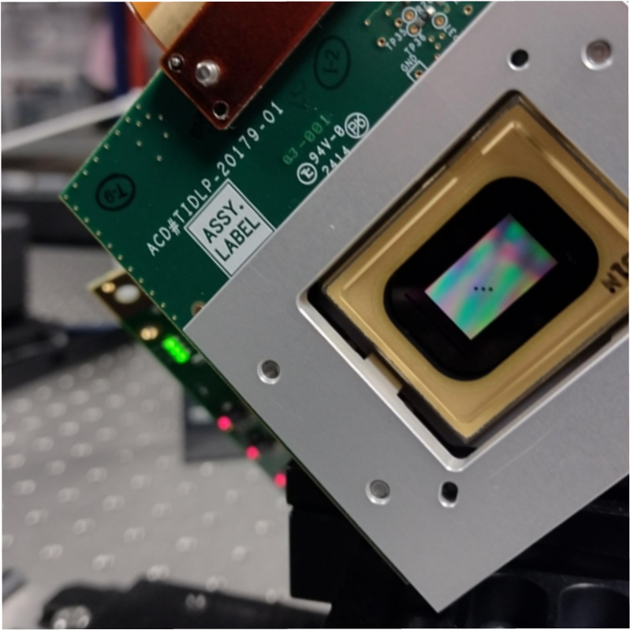
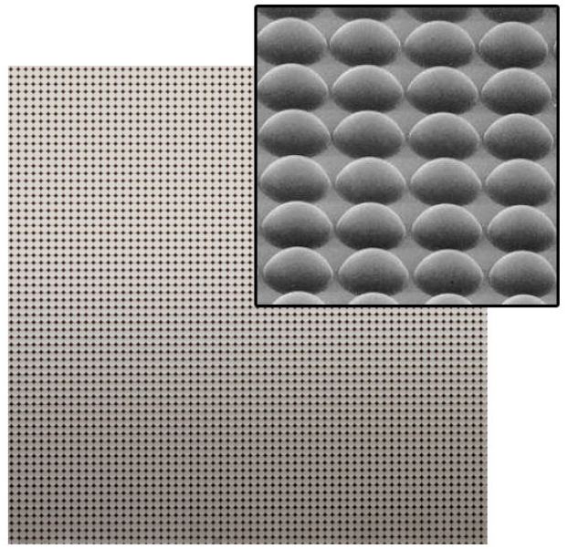
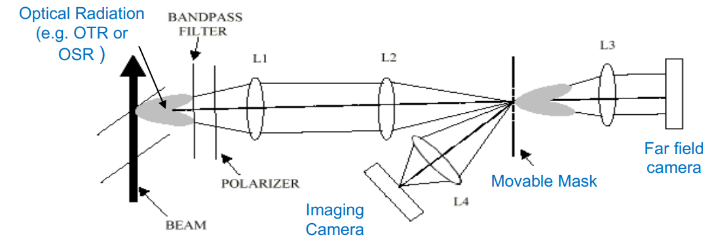
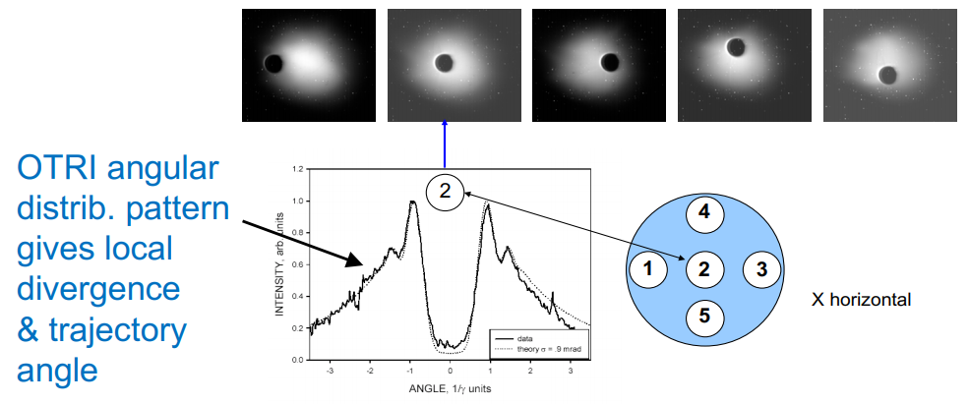


Single-shot emittance measurements
Screen
Mask
j^{th} beamlet intensity
n_{j}
Beam
σ_{j}
Beamlets
x_{j}
[4]
0
Analysis based on existing pinhole/slit beam-based methods [5]
Optical version provides two main benefits:
  Subset of measured particles is much larger
  Space-charge contribution is completely avoided
Non-invasive if radiation can be produced non-invasively (e.g. OSR)
[2, 3]
J. Wolfenden (joseph.wolfenden@cockcroft.ac.uk)
PERLE collaboration meeting 23/06/2023
5

Slide 7
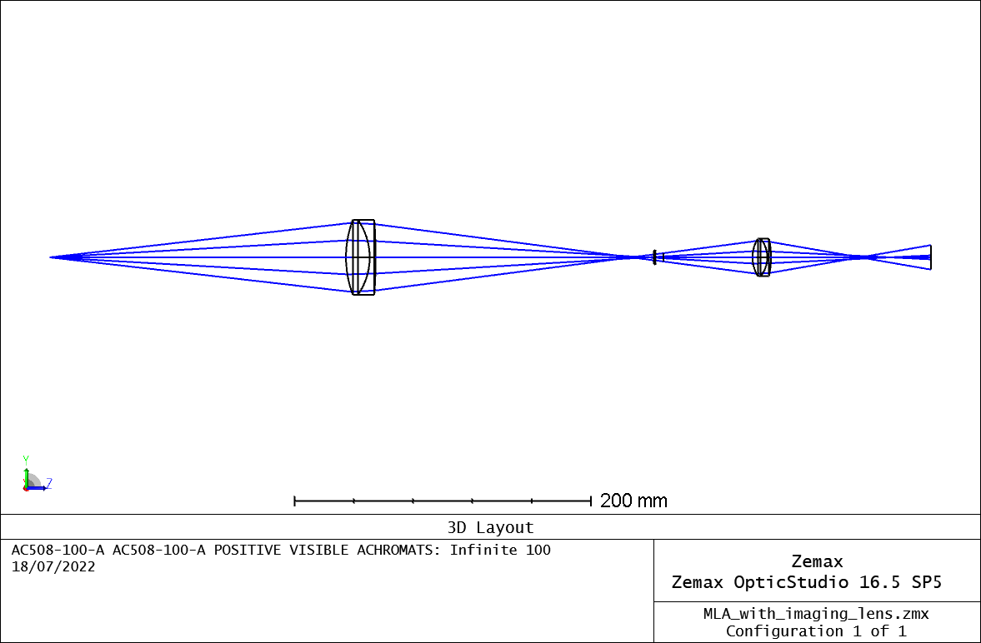
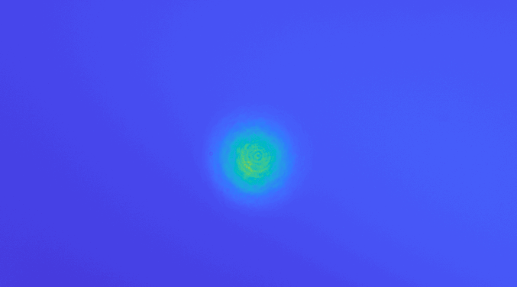
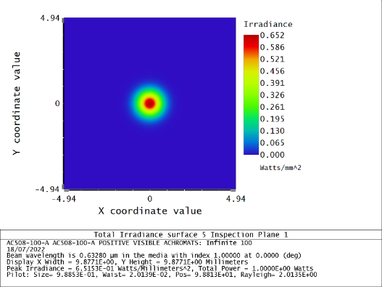
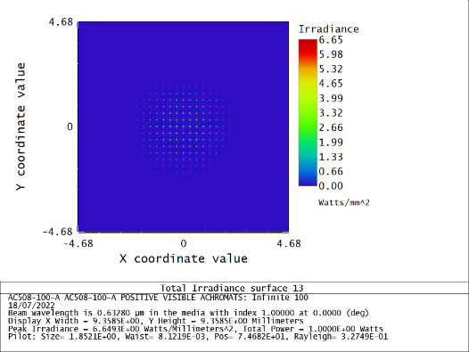

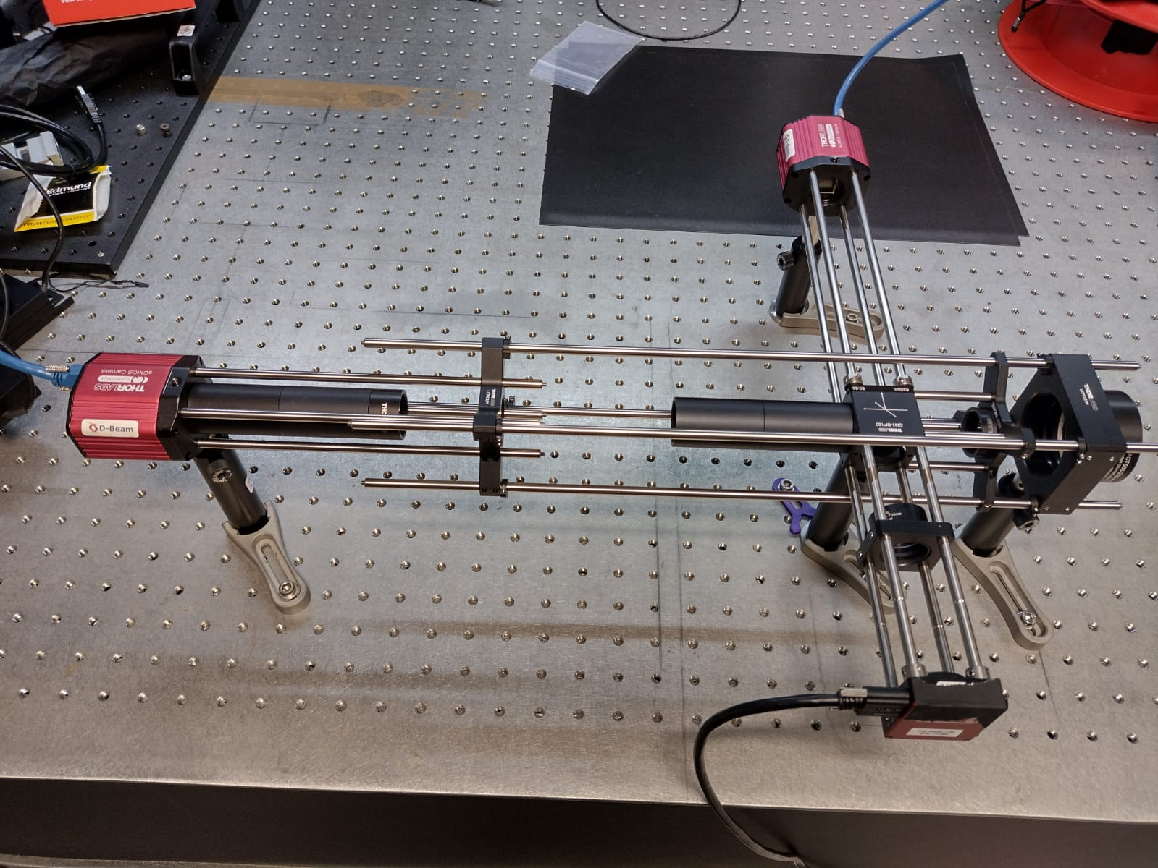

Single-shot emittance measurements
I1
L1
L2
L1
L2
I1
I1
Next steps:
Simulation of OTR source
PoC measurements (CLEAR)
ML-based image-to-phase space analysis
I2 - collimated
I2
I2
Micro-Lens Array
Micro-Lens Array
I1
I1
L1
L1
I2 - diverging
L2
I2
L2
I2
Pellicle Beamsplitter
Pellicle Beamsplitter
[6]
J. Wolfenden (joseph.wolfenden@cockcroft.ac.uk)
PERLE collaboration meeting 23/06/2023
6

Slide 8
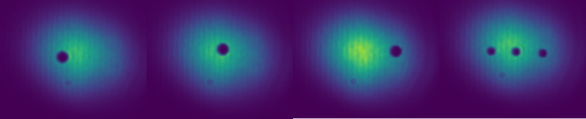
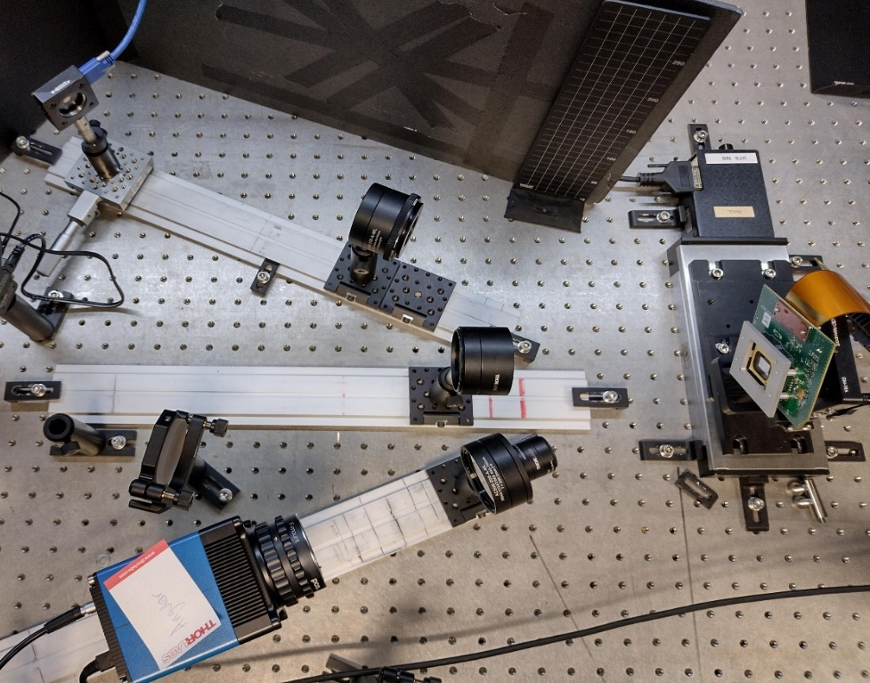
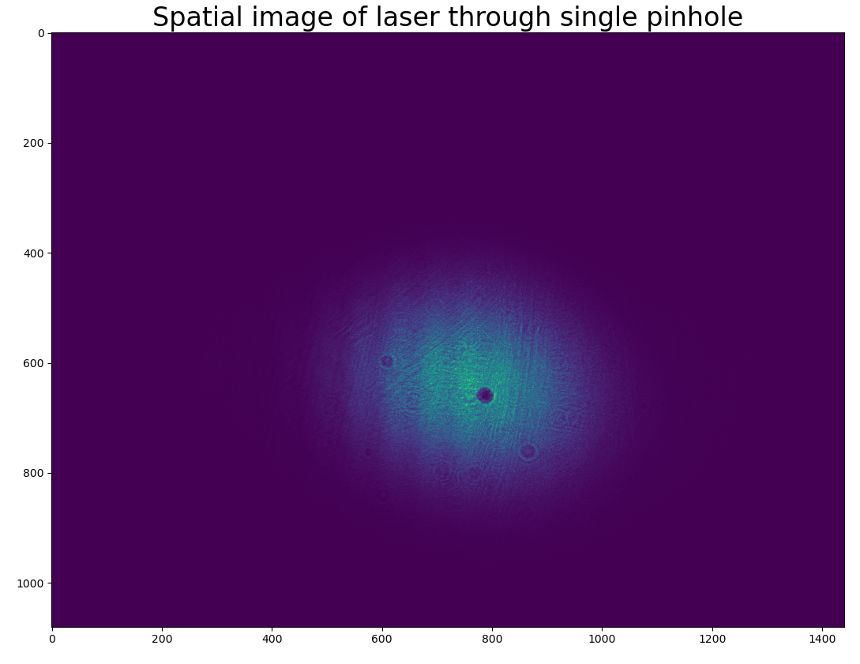
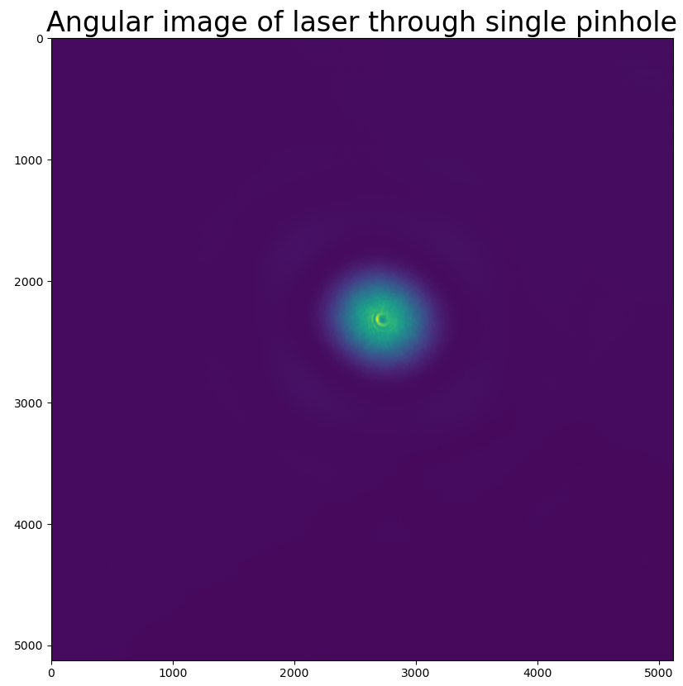
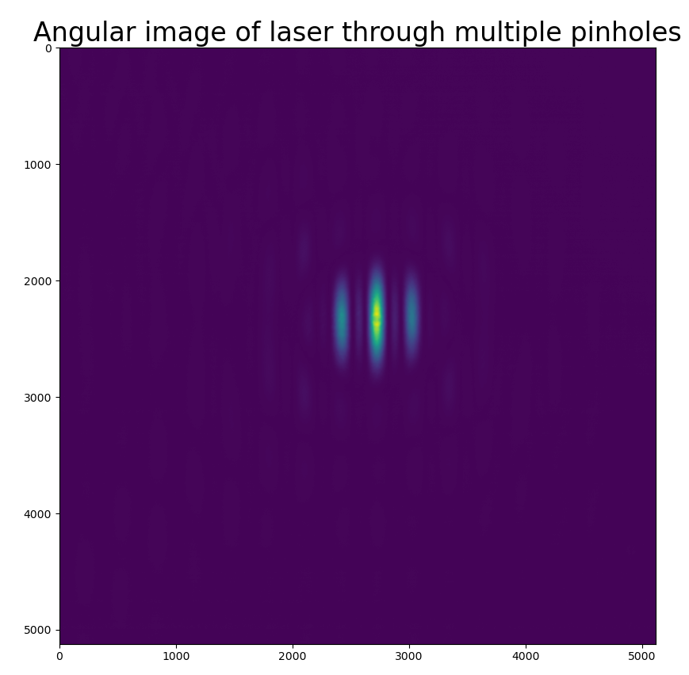
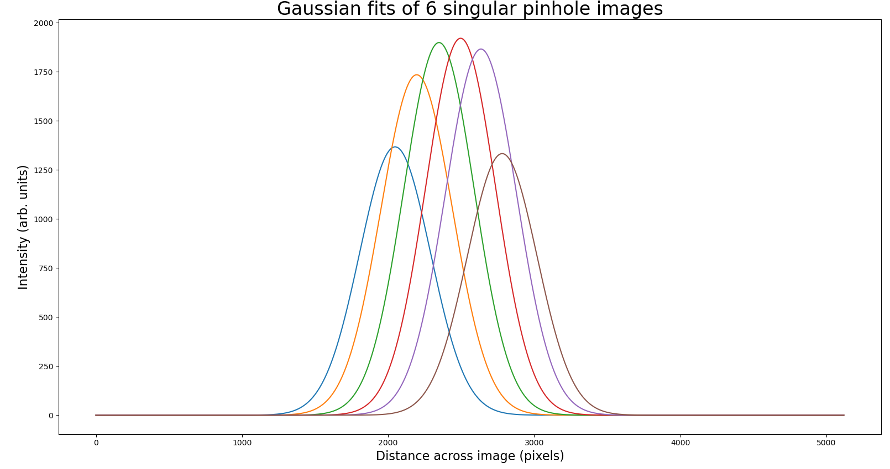
Single-shot emittance measurements
Spatial camera
DMD
Angular camera
Next steps:
Quantify resolution improvement
Simulate OTR source
PoC measurements (CLEAR)
ML-based image-to-phase space analysis
J. Wolfenden (joseph.wolfenden@cockcroft.ac.uk)
PERLE collaboration meeting 23/06/2023
7

Slide 9
Single-shot emittance measurements
Possible implementation options:
Recirculation/common beamlines
  Using OSR, could be applied on dipoles/spreader/recombiner magnets non-invasively
  Would provide full 4D characterisation including coupling
  Beamsplitter would enable streak camera (>5ps) to be placed at the same locations
  Need to assess divergence resolution/requirements
Injection diagnostic station
  Divergence resolution from low energy beam would need to be studied
  Technique resolution scales with beam energy
  Options to improve resolution, e.g. OTRI?
  High resolution multi-shot measurement?
J. Wolfenden (joseph.wolfenden@cockcroft.ac.uk)
PERLE collaboration meeting 23/06/2023
8

Slide 10
Halo imaging with DMD-masking
J. Wolfenden (joseph.wolfenden@cockcroft.ac.uk)
PERLE collaboration meeting 23/06/2023
9

Slide 11
Halo imaging with DMD-masking
Beam halo will be an important factor to monitor at PERLE
DMD masking has been used many times to separate light from core and halo
Example:
Existing halo monitor at AWAKE used fixed masks, proposed DMD as a flexible alternative
Cleared to install mid-2021 alongside existing system
  New system couldn’t prevent existing system operating!
J. Wolfenden (joseph.wolfenden@cockcroft.ac.uk)
PERLE collaboration meeting 23/06/2023
10

Slide 12
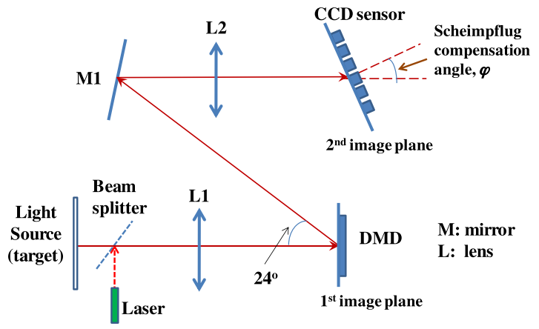
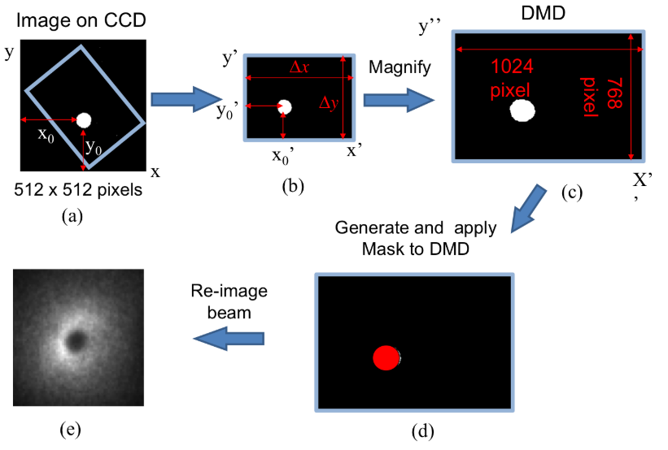
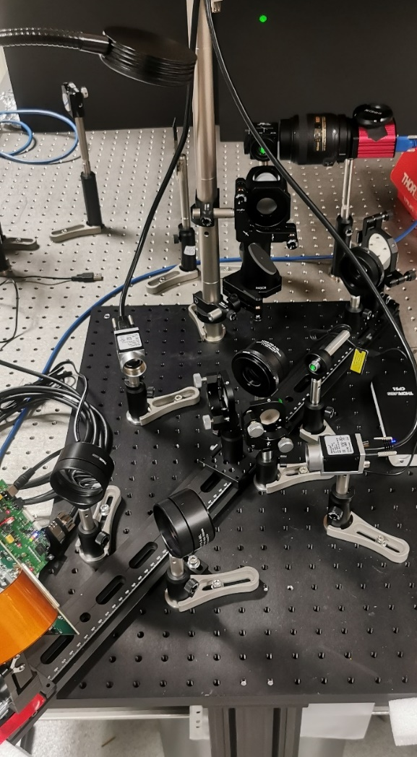
Halo imaging with DMD-masking
Beamsplitter
Core
Halo
Core of beam selected and binary mask is defined
Mask is displayed on DMD
Two cameras can be used to image two paths
Simultaneous imaging of core and halo
DMD
J. Wolfenden (joseph.wolfenden@cockcroft.ac.uk)
PERLE collaboration meeting 23/06/2023
11

Slide 13
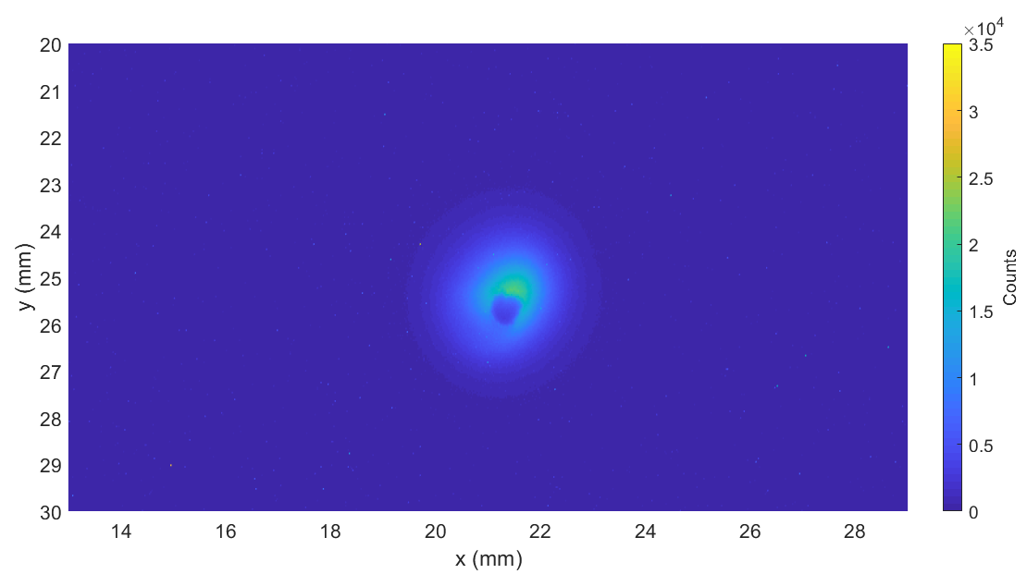
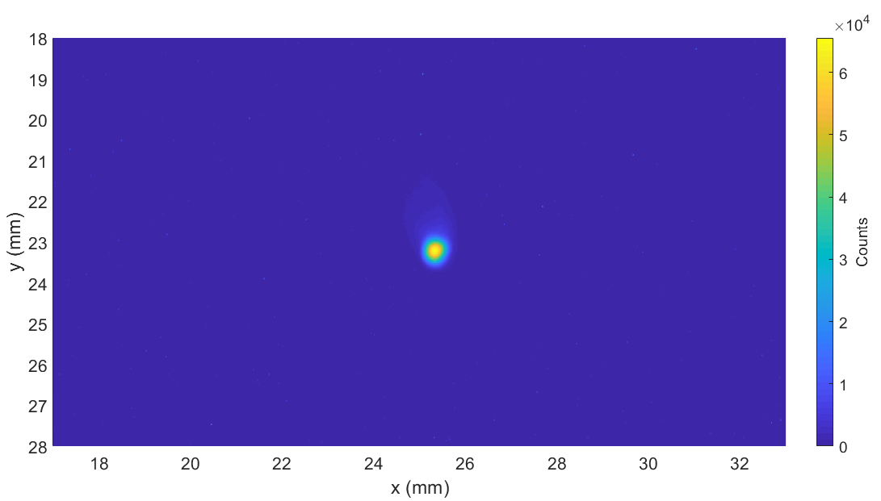
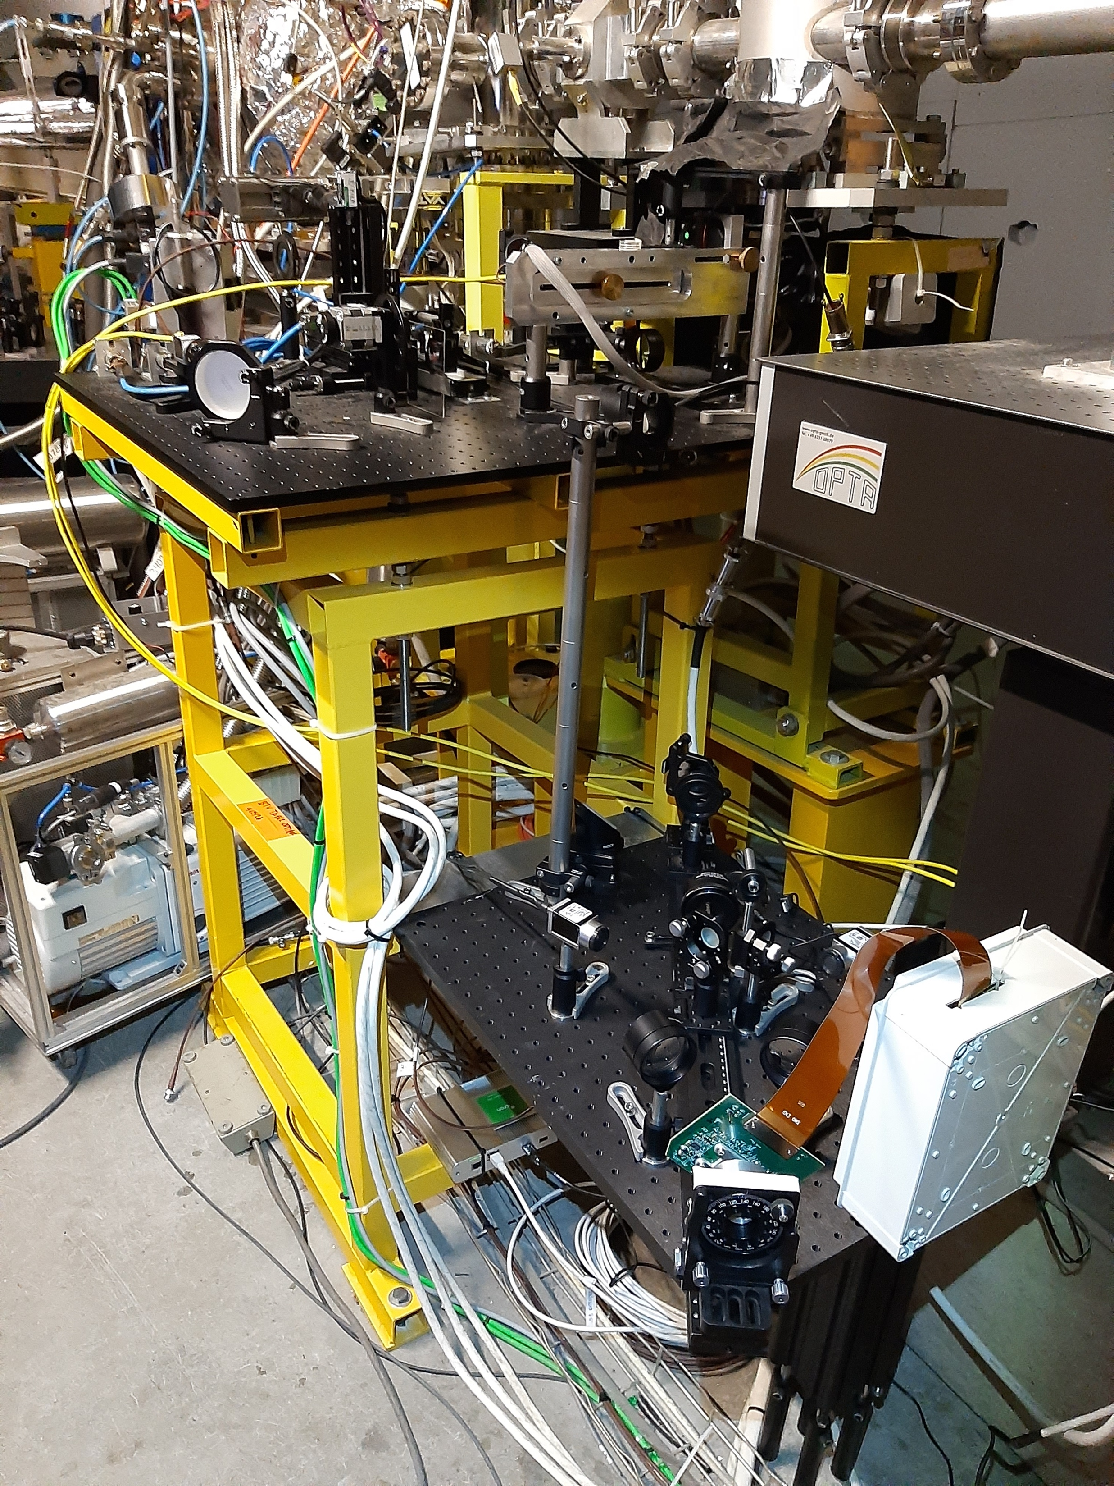
Halo imaging with DMD-masking
Existing Halo
Periscope
HALO
CORE
Camera
Light generated using scintillation screen
Halo image captured at longer exposure, taking into account scintillation decay
Halo imaging demonstrated at AWAKE late 2021
Showed dynamic range ~10⁶
Lens
DMD
J. Wolfenden (joseph.wolfenden@cockcroft.ac.uk)
PERLE collaboration meeting 23/06/2023
12

Slide 14
Halo imaging with DMD-masking
Possible implementation options:
Arcs/common beamlines
  Using OSR, could be applied on dipoles/spreader/recombiner magnets non-invasively
  Operation with beamsplitter with other diagnostics demonstrated
Injection diagnostic station
  Simple to implement with OTR
J. Wolfenden (joseph.wolfenden@cockcroft.ac.uk)
PERLE collaboration meeting 23/06/2023
13

Slide 15
Optical fibre beam loss monitor
J. Wolfenden (joseph.wolfenden@cockcroft.ac.uk)
PERLE collaboration meeting 23/06/2023
14

Slide 16
Optical fibre beam loss monitor
Beam loss monitoring will be critical at PERLE
Typical systems give absolute values of loss at discrete locations
BLM based on optical fibre provides continuous coverage at ~10cm loss location resolution
Example:
Optical fibre BLM (OBLM) installed at CLARA
Demonstrated beam loss measurements and RF breakdown detection
J. Wolfenden (joseph.wolfenden@cockcroft.ac.uk)
PERLE collaboration meeting 23/06/2023
15

Slide 17
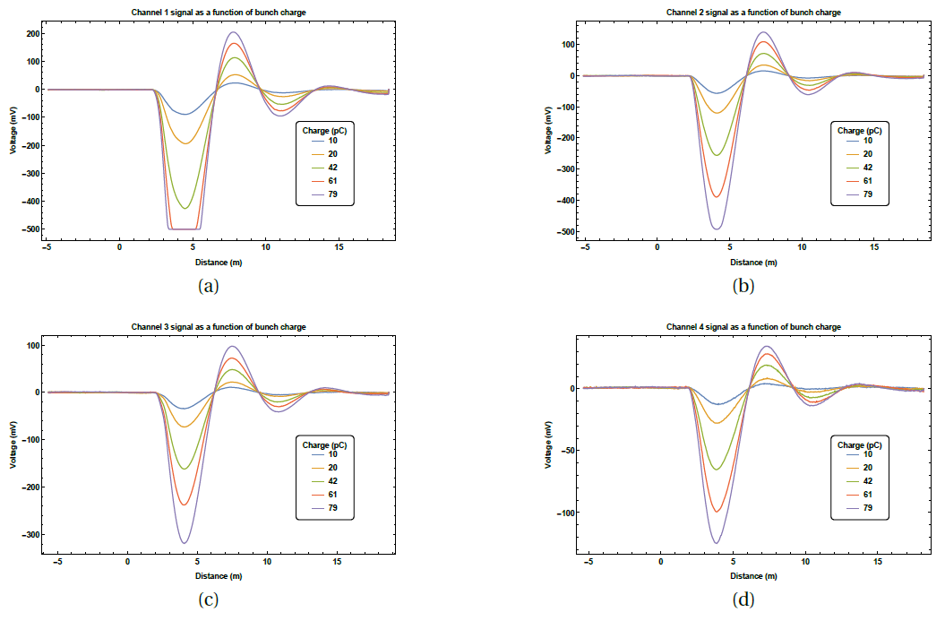

Optical fibre beam loss monitor
Particle bunch
Loss
v
Beam pipe
[7, 8, 9, 10]
Sensor Unit
Optical-fibre
Charge shower
Cherenkov radiation
  * J. Wolfenden et al. Sensors 23(4), 2248 (2023); https://doi.org/10.3390/s23042248
Improved loss location resolution, <10cm, and applications of RF breakdown detection – New paper*
Two new PhD students working in this area – one dedicated to applications to ERLs
Beginning simulation studies to study novel applications
J. Wolfenden (joseph.wolfenden@cockcroft.ac.uk)
PERLE collaboration meeting 23/06/2023
16

Slide 18
Optical fibre beam loss monitor
Possible implementation options:
Everywhere
  Completely non-invasive
  Layout of fibres would need some thought, but could be easily adapted
  Coverage of up to ~100m per fibre
  Would need to consider “cross-talk” of signals on arcs
J. Wolfenden (joseph.wolfenden@cockcroft.ac.uk)
PERLE collaboration meeting 23/06/2023
17

Slide 19
Virtual diagnostics
J. Wolfenden (joseph.wolfenden@cockcroft.ac.uk)
PERLE collaboration meeting 23/06/2023
18

Slide 20
Virtual diagnostics
Ideally beam characteristics at key locations (IP, injection, etc.) would be monitored online
Can be difficult to integrate non-invasive diagnostics in these locations
Virtual diagnostics (VD) can take data away from an IP and infer properties at an IP
Example:
  Simulation study on profile measurements at the FEBE on CLARA user IP
  Upstream and downstream X-Y measurements to infer IP measurements
J. Wolfenden (joseph.wolfenden@cockcroft.ac.uk)
PERLE collaboration meeting 23/06/2023
19

Slide 21
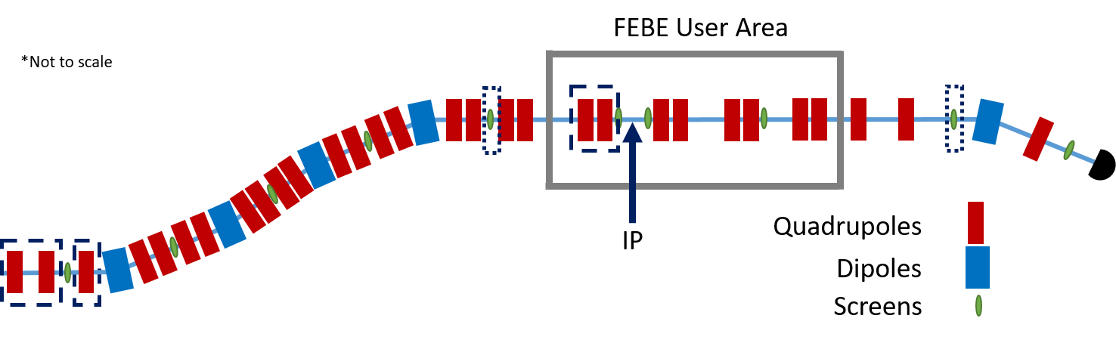
Virtual diagnostics
Initial simple demonstration – existing planned profile measurement points
Quadrupoles were varied and profiles at screens were simulated
J. Wolfenden (joseph.wolfenden@cockcroft.ac.uk)
PERLE collaboration meeting 23/06/2023
20

Slide 22
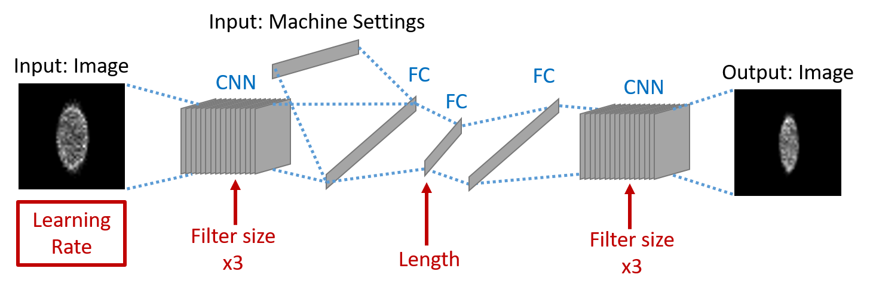
Virtual diagnostics
Convolutional Neural Network (CNN) used with tuneable hyperparameters
Upstream and downstream versions of the diagnostic were tested
J. Wolfenden (joseph.wolfenden@cockcroft.ac.uk)
PERLE collaboration meeting 23/06/2023
21

Slide 23
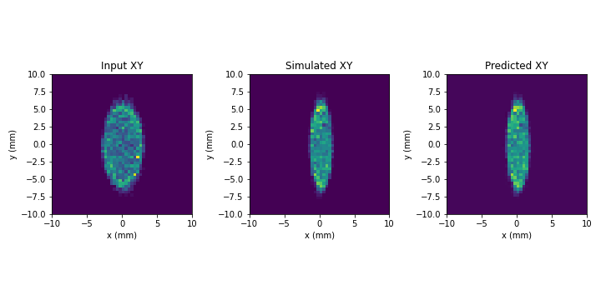
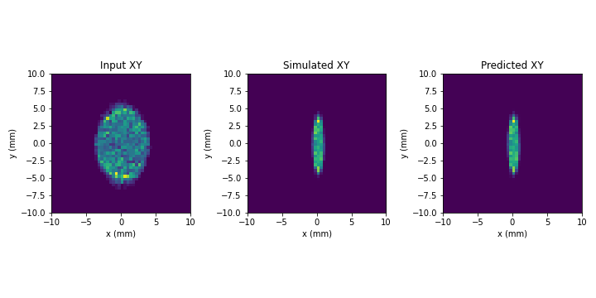
Virtual diagnostics
Upstream
Downstream
Can infer X-Y beam profile away from the IP – no other beam parameters needed
Either via non-invasive pre-IP measurements or invasive post-IP measurements
J. Wolfenden (joseph.wolfenden@cockcroft.ac.uk)
PERLE collaboration meeting 23/06/2023
22

Slide 24
Virtual diagnostics
Possible implementation options:
Everywhere
  Main limitation is the accumulation of training data – case-by-case basis
  In principle, any existing diagnostic could be used
  Example: injection
Measurement
1 : 3 : 5
Machine settings
DE = 82.2 MeV
injector
7 MeV
Inference
DE = 82.2 MeV
2 : 4 : 6
7 MeV
dump
J. Wolfenden (joseph.wolfenden@cockcroft.ac.uk)
PERLE collaboration meeting 23/06/2023
23

Slide 25
Summary
J. Wolfenden (joseph.wolfenden@cockcroft.ac.uk)
PERLE collaboration meeting 23/06/2023
24

Slide 26
Summary
Single-shot emittance measurements
  Both MLA and DMD systems currently being tested and benchmarked at CI
  Plans in place to test both systems at CLEAR (Oct 23) and FEBE on CLARA
Halo imaging with DMD-masking
  Core/halo imaging demonstrated many times in the past
  Straightforward to apply to PERLE
Optical fibre beam loss monitor
  Two new PhD students started recently focused solely on OBLM (ERL and SPS/LHC)
  Test new prototype in research and industrial setting, concentrating on novel applications
Virtual diagnostics
  Simple case demonstrated for transverse profile measurements
  Going to extend to more complex models and diagnostics
J. Wolfenden (joseph.wolfenden@cockcroft.ac.uk)
PERLE collaboration meeting 23/06/2023
25

Slide 27
Thank you for your attention!
Questions?
References:
[1] W. Kaabi, French-Ukrainian Workshop, 27/10/2021
[2] G. Le Sage et al., PRAB (1999)
[3] R. Fiorito et al., AIP Conf. Proc. 648, (2002)
[4] Thorlabs Inc., https://www.thorlabs.com/newgrouppage9.cfm?objectgroup_id=2861
[5] M. Zhang, FERMILAB·TM-1988
[6] J. Wolfenden et al., Proc. IPAC2023, THPA009
[7] M. Kastriotou et al., Proc. IBIC2016, WEPG20
[8] A. Alexandrova et al., Proc. IBIC2017, WEPWC01.
[9] A. Alexandrova et al., Proc. IPAC2018, THPML090.
[10] J. Wolfenden et al., Sensors 23(4), 2248 (2023)
J. Wolfenden (joseph.wolfenden@cockcroft.ac.uk)

