Slide 1
PERLE Magnets Design
PERLE Collaboration Meeting
Presented by
Rasha ABUKESHEK
Supervisors
Achille STOCCHI & Hadil ABUALROB
June 2023
rasha.abukeshek@ijclab.in2p3.fr

Slide 2
Outline
Introduction to PERLE optics
  General specification of PERLE dipoles
B-com magnet
  Specification and design
  Field calculation and Harmonic content
  Cooling system calculation
Spreader/Recombiner sections concerns

Slide 3
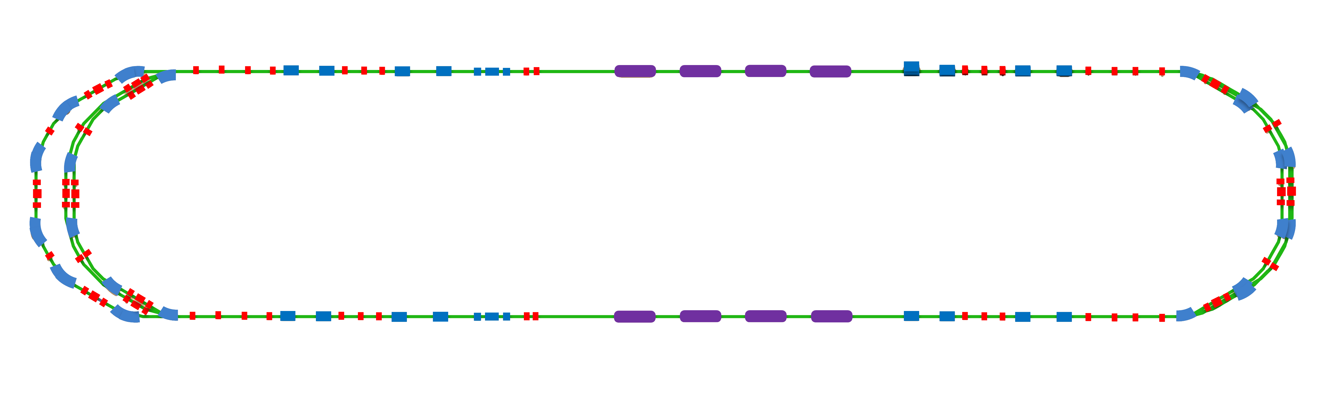
PERLE Optics
Racetrack footprint: 29 m × 5.5 m × 0.9 m
7 MeV
2 : 4 : 6
1 : 3 : 5
ΔE = 82.2 MeV
5.5 m
Top view
Dipole
Quadrupole
29 m
RF cavity
ΔE = 82.2 MeV
10 m
7 MeV
10 m
9 m
Sections:
LINAC
  Two cryomodules with four 5-cell SRF cavities.
Arcs
  6 arcs for three-turn configuration.
Spreader/Recombiner
  Connect LINAC to arcs section.
  One common dipole magnet for the three arcs at each side called the B-com magnet.
Chicane magnets for injection and dump

Slide 4
PERLE Dipole Magnets
Type | Name | Number |  | Geometry | L, cm | |B|, T |  | I, mA
1 | Chicane 15cm | 4 |  | R-Bend | 15 | 0.040 |  | 100 | 120
2 | Chicane 30cm | 2 |  | R-Bend | 30 | 0.040 |  | 100 | 120
3 | B-Com 3-lines | 2 | 4 | R-Bend | 33 | 0.451 | 0.866 | 100 | 120
4 | B-Com 2-lines | 2 | 4 | R-Bend | 33 | 0.451 | 0.866 | 60 | 80
5 | R-Bend 33cm | 8 | 16 | R-Bend | 33 | 0.451 | 0.873 | 20 | 40
6 | S-Bend 33cm | 6 | 12 | S-Bend | 33 | 0.472 | 0.907 | 40
 |  | 18 |  |  |  | 0.472 | 1.342 | 20 | 40
7 | S-Bend 66cm | 18 |  | S-Bend | 66 | 0.453 | 1.323 | 20 | 40
Total number of dipole (ERL only):
  60 dipoles for 250 MeV version
  78 dipoles for 500 MeV version
R-Bend 33 cm is used in the spreaders for Arcs 3, 4, 5, and 6.
S-Bend 33 cm is used in the spreader of Arcs 1, and 2 (vertical) and in Arcs 1, 2, and 3 (horizontal).
250 MeV
500 MeV
Courtesy to Alex Fomin

Slide 5
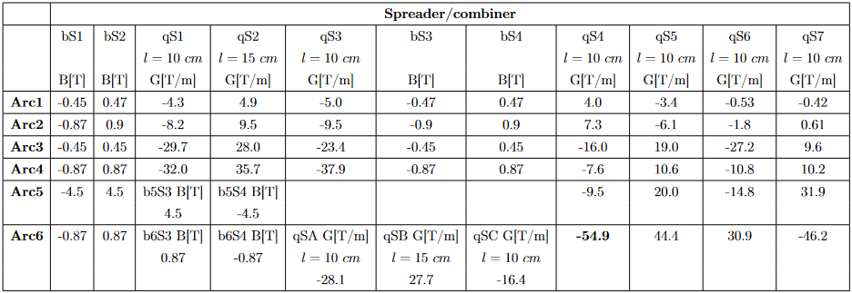
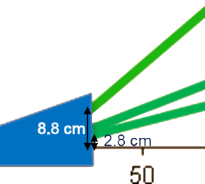
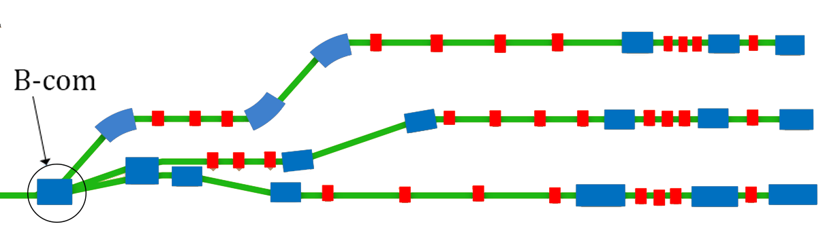
PERLE Optics
Spreader/Recombiner sections
B-com magnet
Common between three arcs.
Vertical beam split at three different energies.
30° bending angle (8.8 cm exit point).
45 cm
45 cm

Slide 6
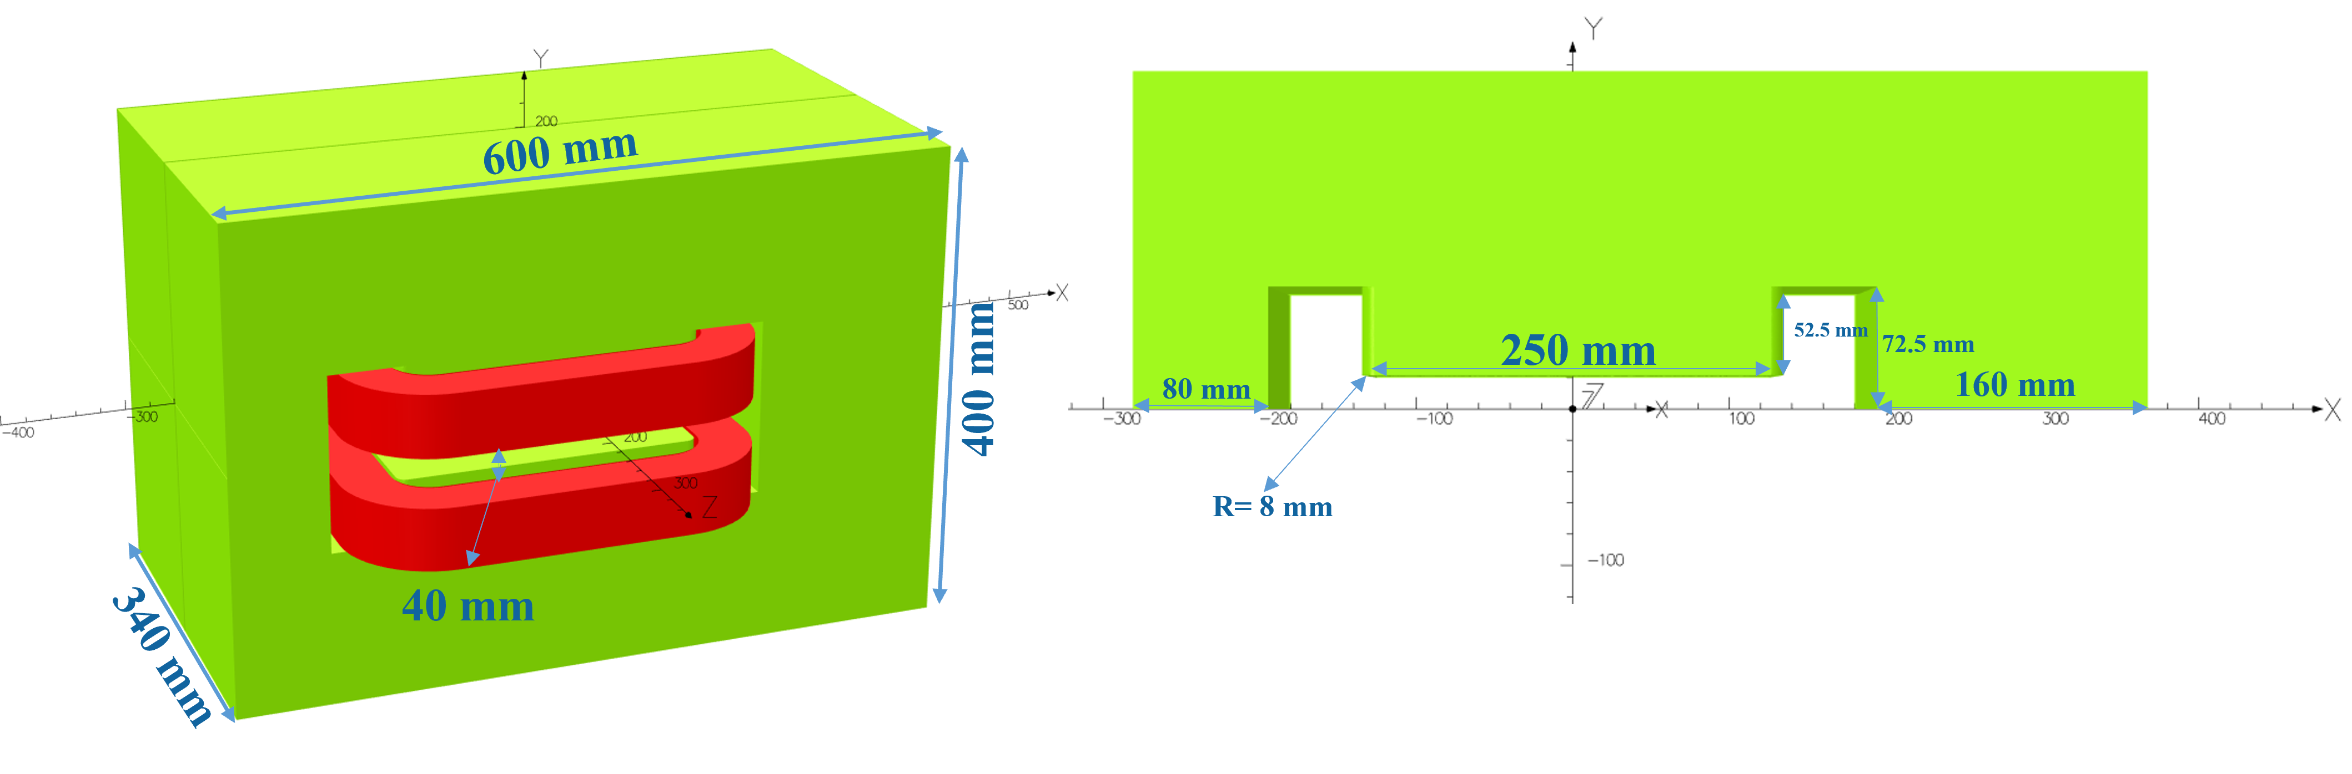
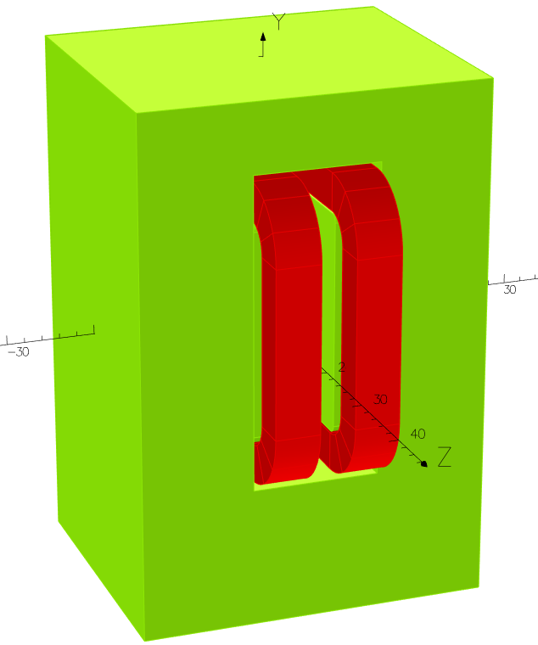
B-com Magnet
Design parameters
Optimized aperture of 40 mm.
Pole blend radius modified for lower harmonic content.
Magnet geometry | *Old design | New design
Width | 400 mm | 400 mm
Height | 570 mm | 600 mm
Length | 340 mm | 340 mm
Aperture | 36 mm | 40 mm
Pole width | 220 mm | 250 mm
Pole height | 52.5 mm | 52.5 mm
Pole blend radius | 24 mm | 8 mm
Coil
Yoke
90° clock-wise rotation around z-axis.
Yoke material: standard steel (C content < 0.1%)
* Courtesy to Jay Benesch.
This work is in collaboration with Jay Benesch from JLab.
Tool: Opera 3D

Slide 7
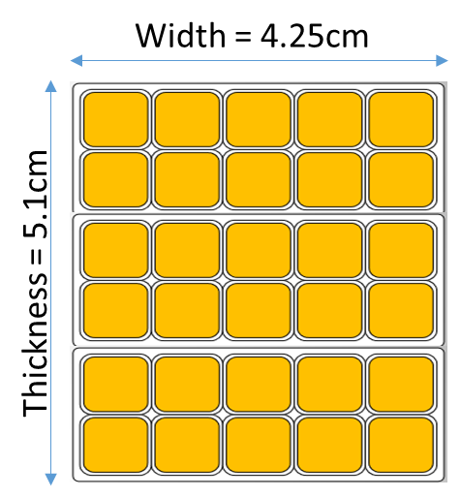
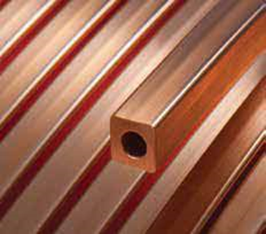
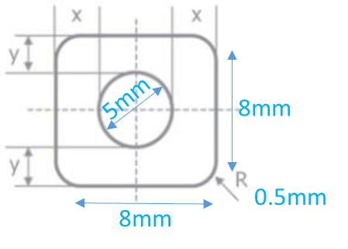
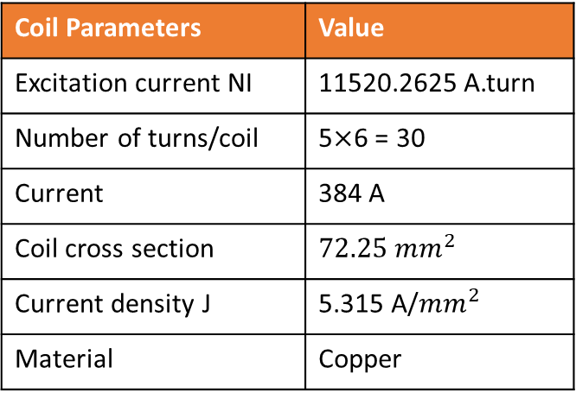
B-com Magnet
Design parameters
Coil Parameters | Value
Excitation current NI | 11520.2625 A.turn
Number of turns/coil | 5$×$6 = 30
Current | 384 A
Coil cross section | $$72.25{ mm}^{2}$$
Current density J | 5.315 A/${mm}^{2}$
Material | Copper
Excitation current calculated for B = 0.87 T
Hollow copper conductor from Luvata company https://www.luvata.com/products/hollow-conductors .

Slide 8
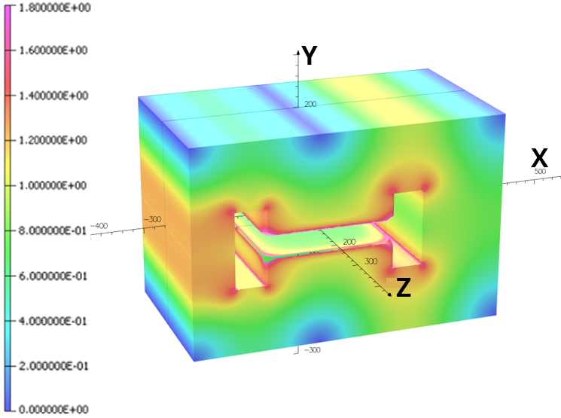
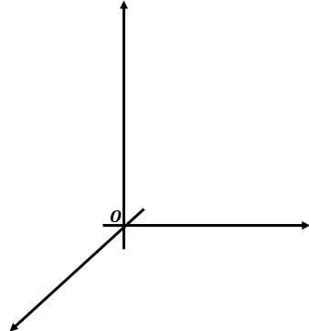

B-com Magnet
Field calculations
Edges with field larger than 1.8 T are not displayed.
No chamfer or shims is added to the pole.
Only a blend radius of 8 mm is used.
Y
$$\vec{B}$$
x
e-
z

Slide 9
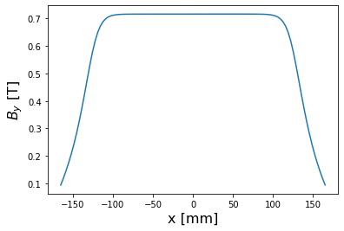
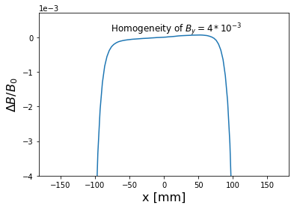
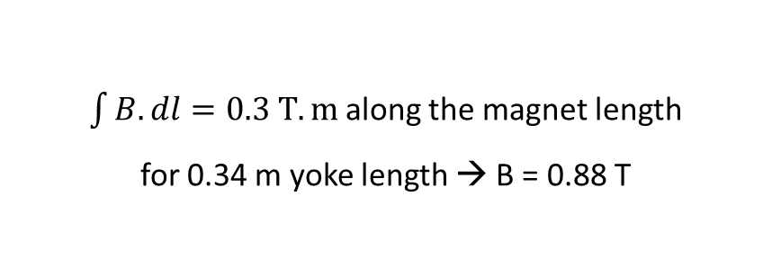

B-com Magnet
Field calculations
$$By (0, 0, 0) = 0.716382 T$$
$$\frac{ΔB}{B_{0}}=\frac{B\left(x\right)−B_{0}}{B_{0}}$$
$\int{B.dl}=0.3 T.m$along the magnet length
for 0.34 m yoke length → B = 0.88 T

Slide 10
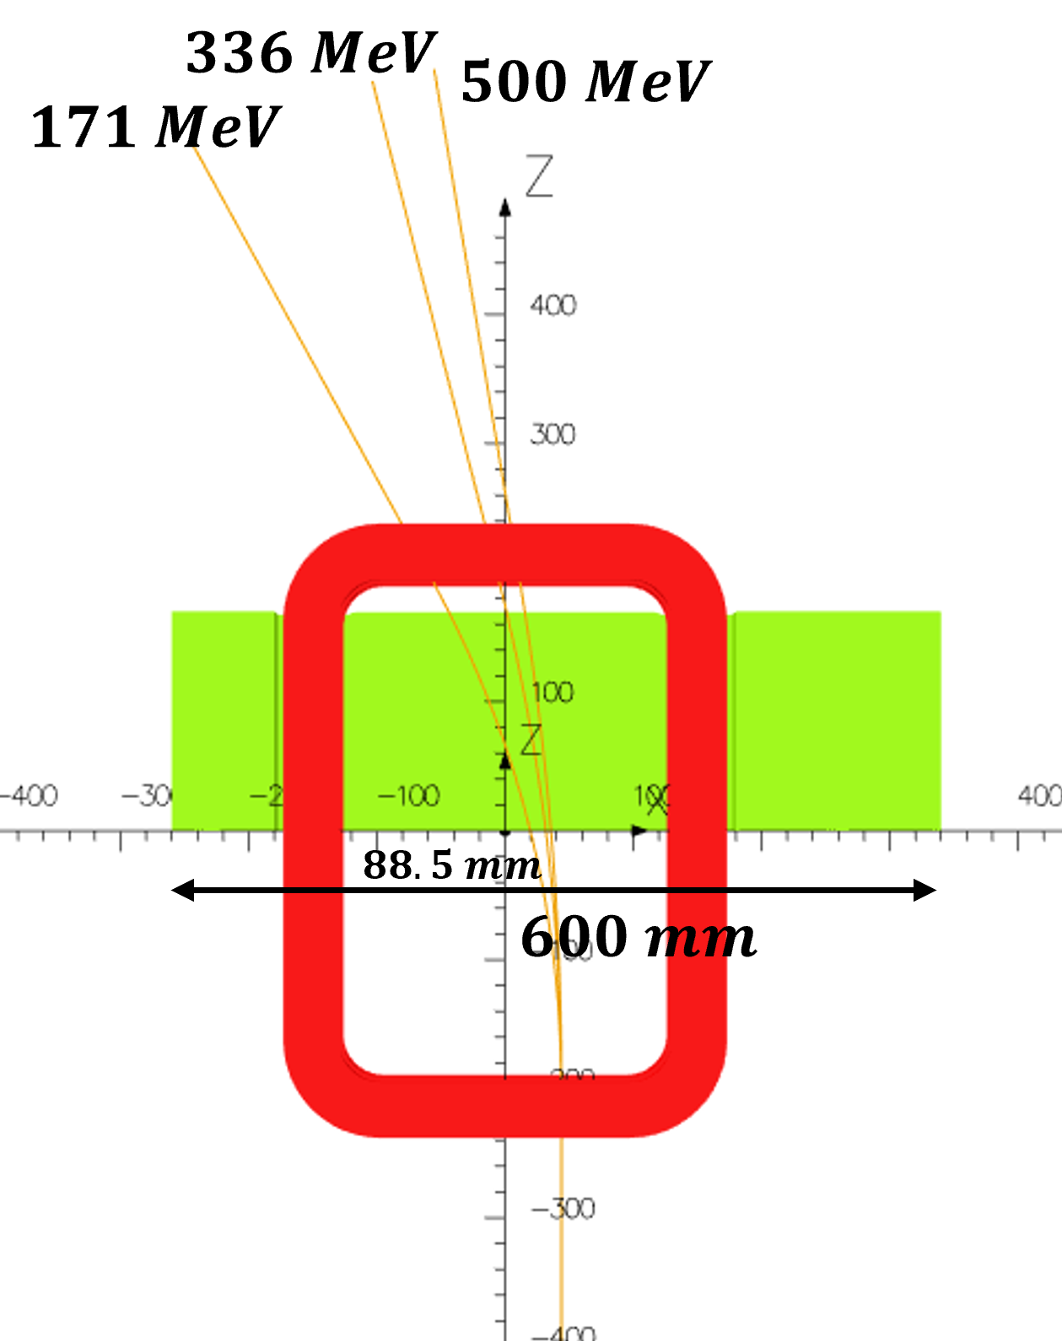
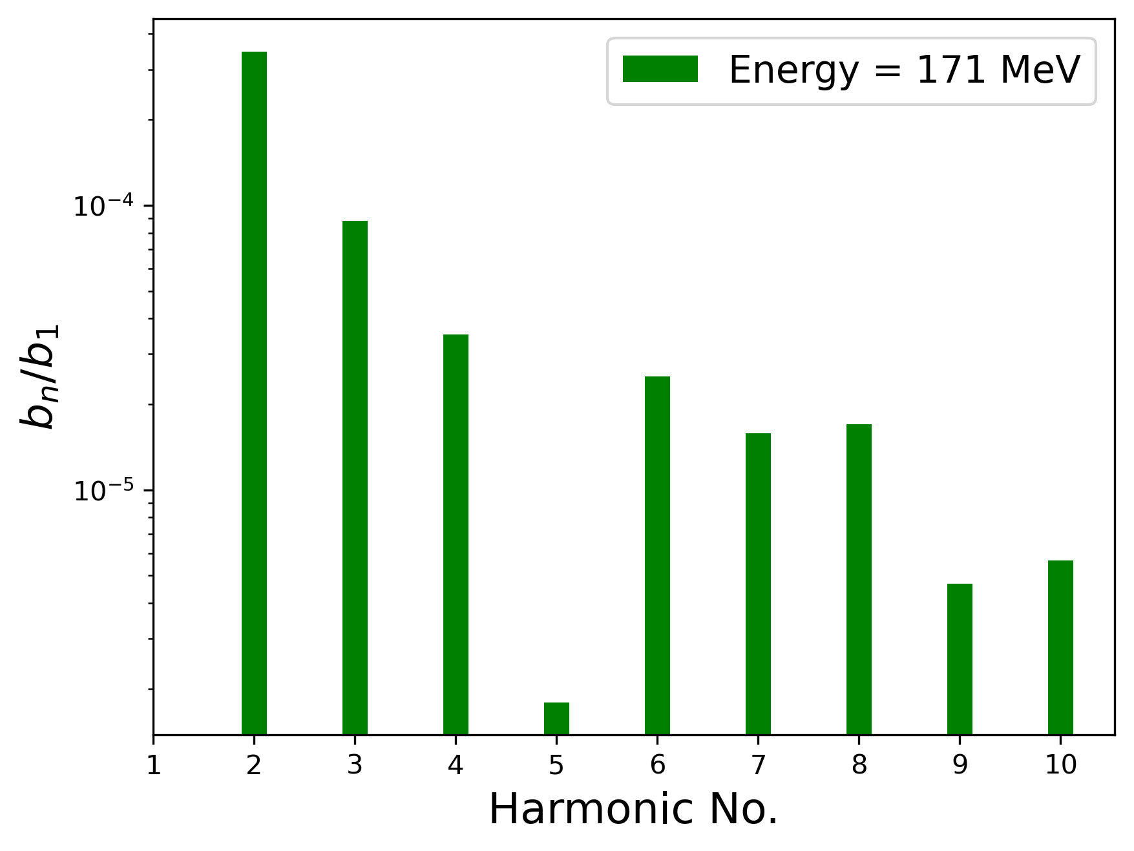
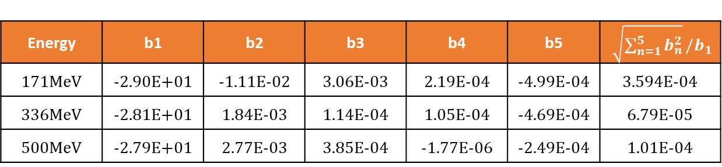
B-com Magnet
Harmonic content
Energy | b1 | b2 | b3 | b4 | b5 | $\sqrt{\sum_{n=1}^{5}{b_{n}^{2}}}/b_{1}$
171MeV | -2.90E+01 | -1.11E-02 | 3.06E-03 | 2.19E-04 | -4.99E-04 | 3.594E-04
336MeV | -2.81E+01 | 1.84E-03 | 1.14E-04 | 1.05E-04 | -4.69E-04 | 6.79E-05
500MeV | -2.79E+01 | 2.77E-03 | 3.85E-04 | -1.77E-06 | -2.49E-04 | 1.01E-04
0.036% field homogeneity along the beam path.
Quadrupole and sextupole components can be dealt with in the lattice.
Initial design: 0.1% field quality
Improvement by one order of magnitude!
Energy | Exit point [mm] |  |  | Angle[°] | Vertical Shift [mm]
 | x | y | z
171MeV | -44.64 | 0.00 | 170.95 | 27.41 | 88.64
336MeV | 1.13 | 0.00 | 169.17 | 14.22 | 42.87
500MeV | 15.11 | 0.00 | 170.99 | 9.59 | 28.89

Slide 11
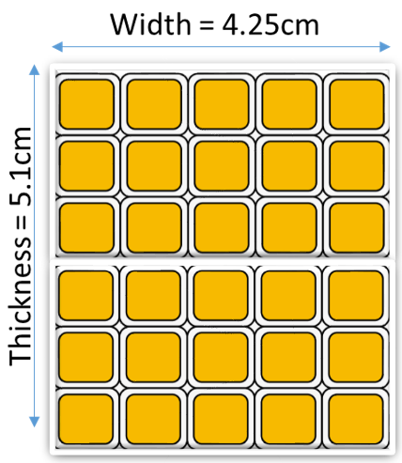
Cooling and Electrical Calculations: 8X8 conductor 2 vs. 3 Pancakes
Magnetic Field (T) | 0.866
NI Coil ( AT) | 11 520
Diameter | 5 |  | 5
Conductor | 8x8 |  | 8x8
I (A) | 384 |  | 384
Number of turns | 30 |  | 30
Section Cu | 44.15 |  | 44.15
Number of pancake | 3 |  | 2
One turn length | 1211 |  | 1211
Coil turns (m×n) | 5 | 6 | 5 | 6
Layer length (mm) | 6055 |  | 6055
Pancake length (mm) | 12110 |  | 18165
Coil length (mm) | 36330 |  | 36330
Copper mass (kg) | 14.275 |  | 14.275
J (A/mm2) | 8.698 |  | 8.698
Coil resistance (Ω) | 0.014 |  | 0.014
Disputed coil power (KW) | 2.222 |  | 2.196
R cable (Ω) 20m with r/km = 0.554 | 0.022 |  | 0.022
Voltage drop U2 (V) | 8.509 |  | 8.509
U1+U2 | 14.295 |  | 14.228
CHARACTERISTICS | 384A - 15V |  | 384A - 15V
Resistance per pancake | 0.005 |  | 0.007
Flow rate per pancake q (L/min) | 0.663 |  | 0.982
Pressure for one pancake (bars) | 1.988 |  | 1.965
Water velocity in a pancake (m/s) | 0.169 |  | 0.505
Reynolds number (water 30 ° C) | 0.562 |  | 0.834
Fluid dynamics | 3511.909 |  | 5206.609
Resistance per pancake | CB laminar or Turbulent |  | Turbulent
 | CB Accepted |  | Accepted
Initial design with 3 pancakes of 10 turns each.
Investigation of 2 pancakes of 15 turns each showed the feasibility of such fabrication.
For reducing the needed current, smaller conductors are needed.
Courtesy to Abd-alrahman Marshoud,An-Najah, Palestine.

Slide 12
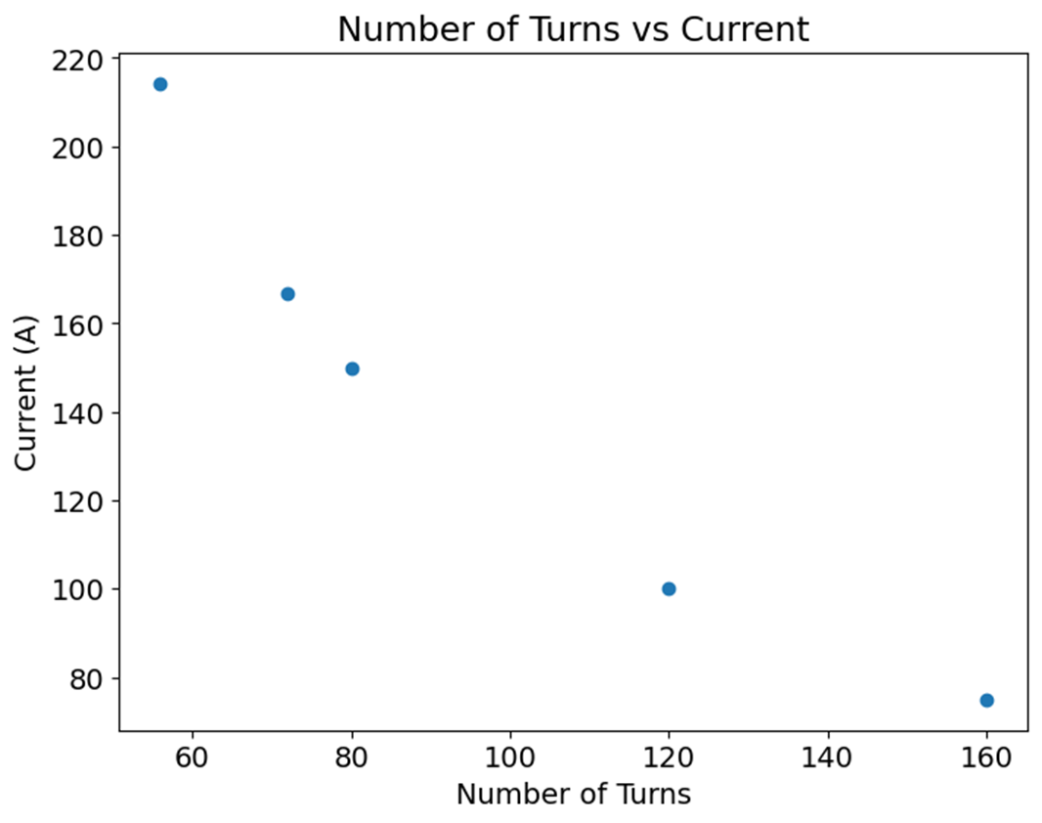
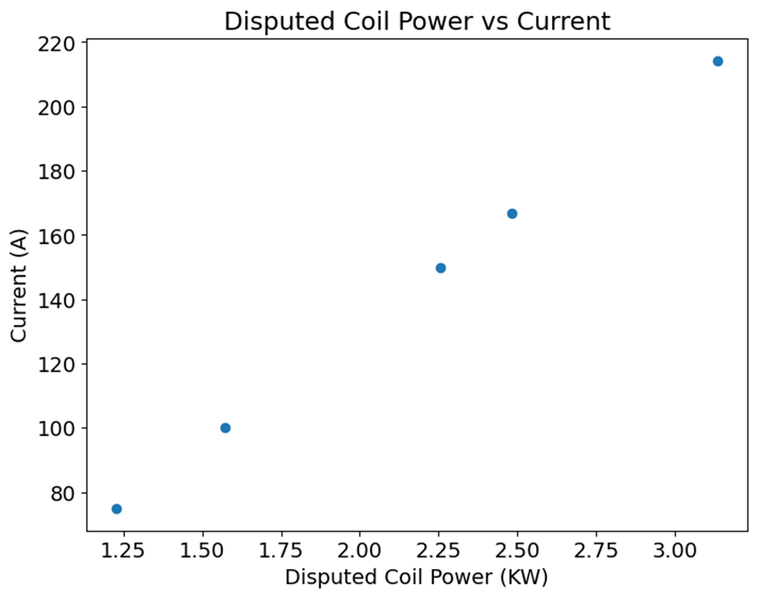
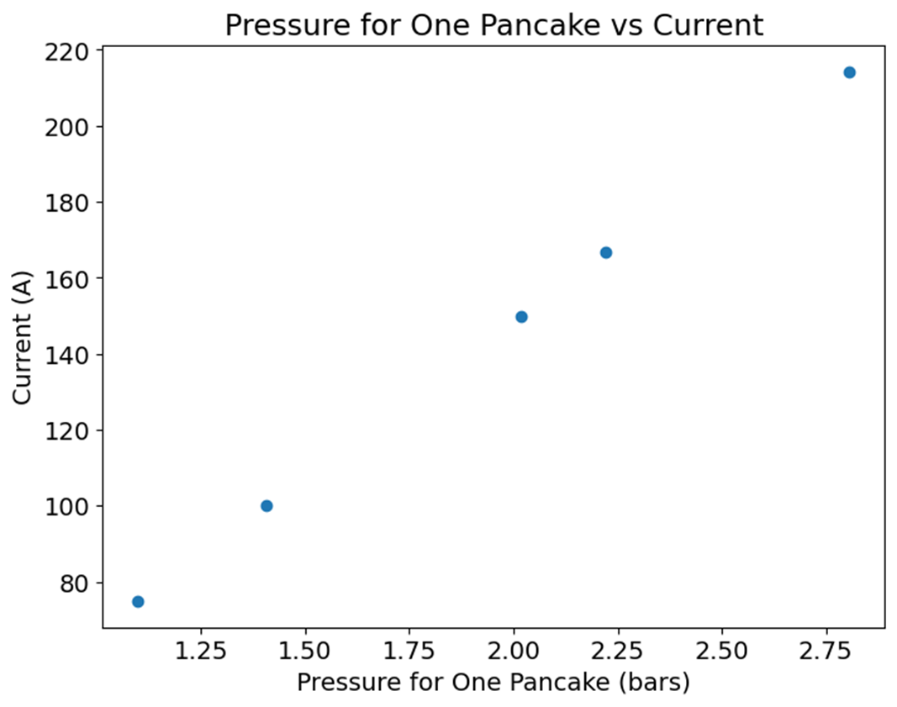
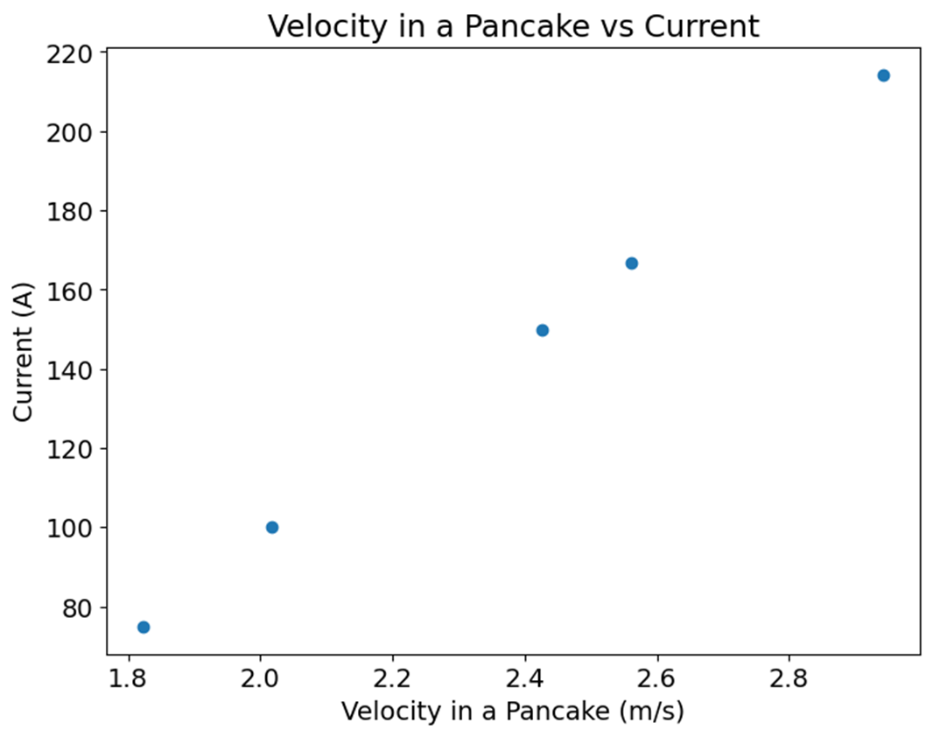
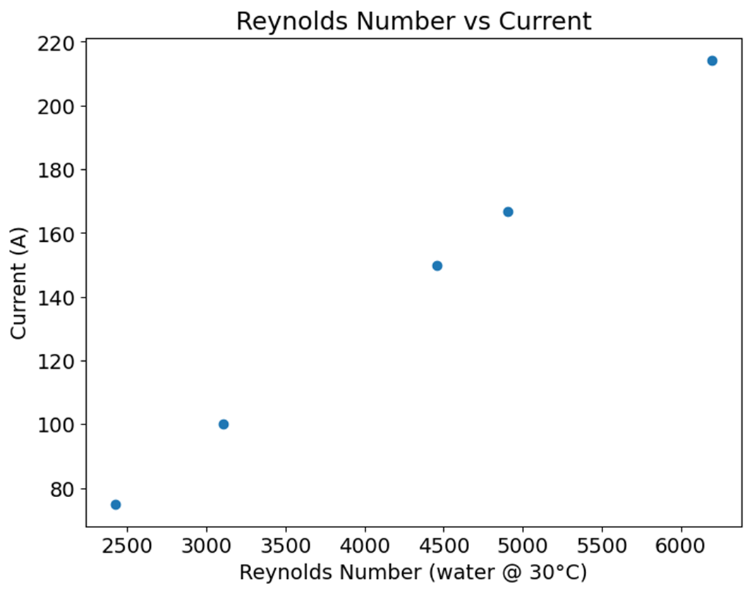
Cooling and Electrical Calculations: 5X5 conductor in 4 Pancakes

Slide 13
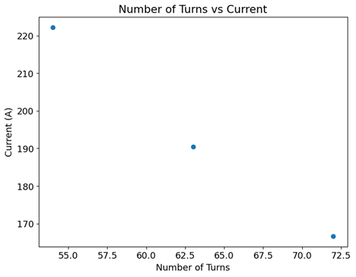
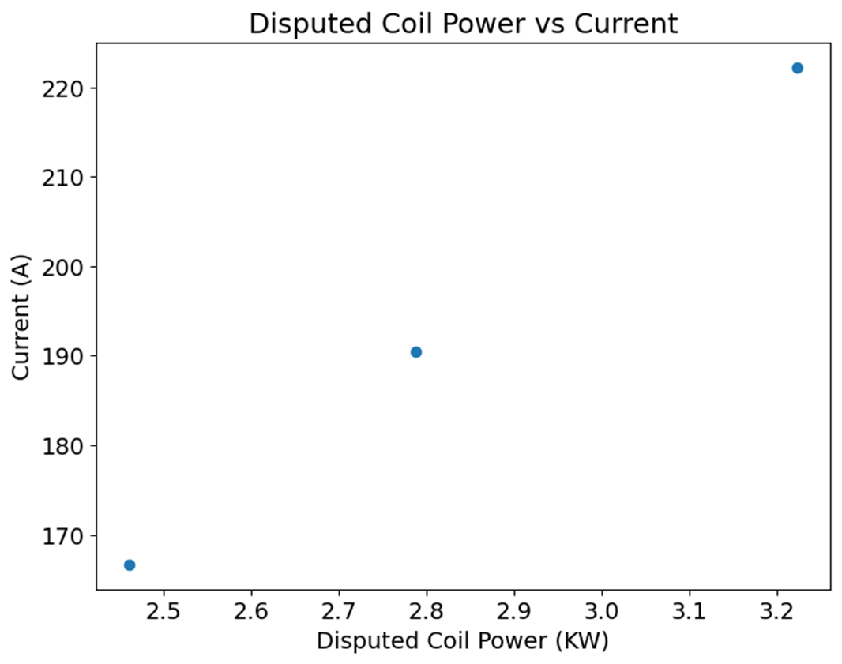
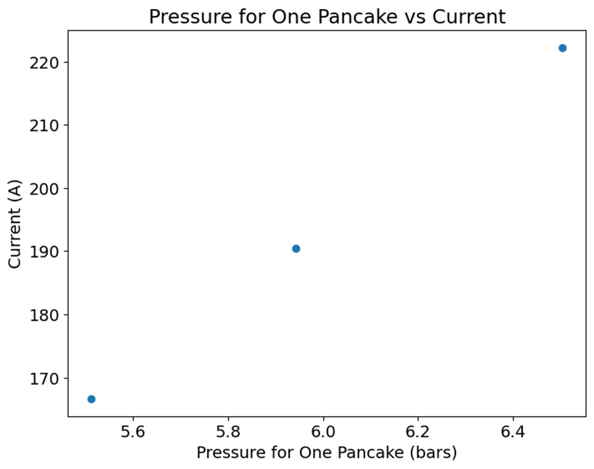
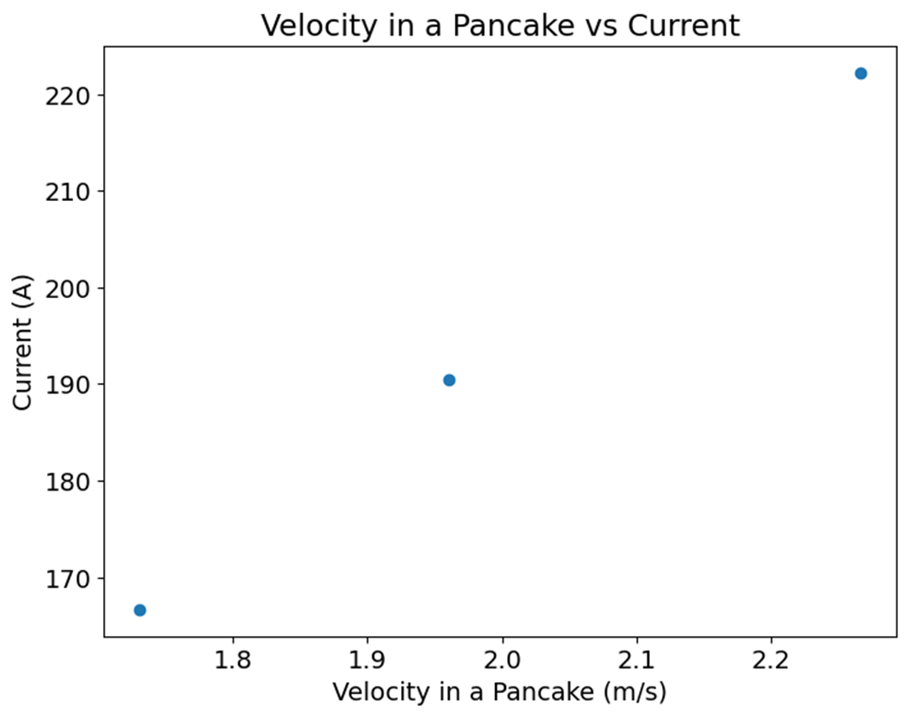
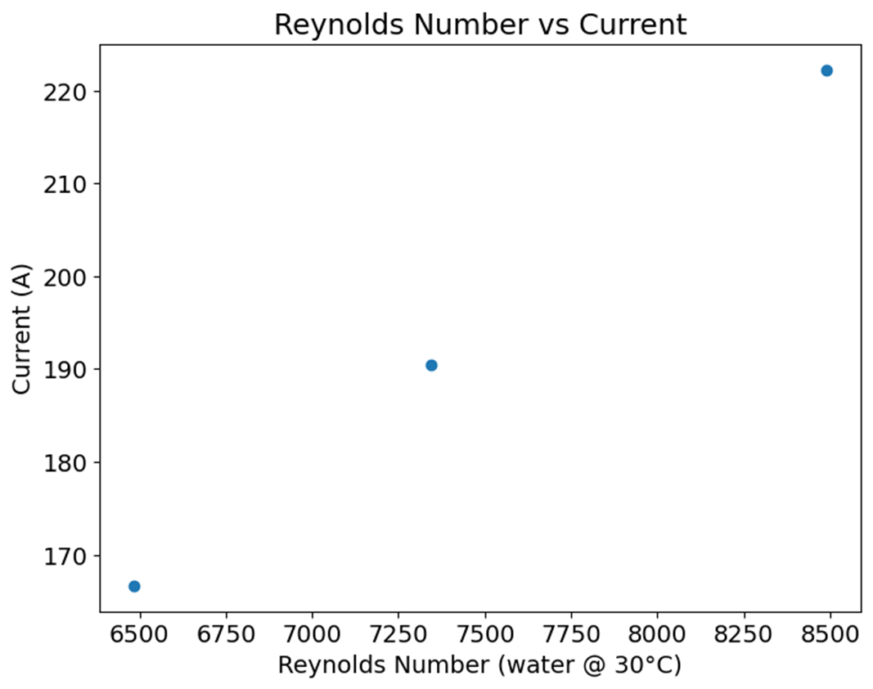
Cooling and Electrical Calculations: 5X5 conductor in 3 Pancakes

Slide 14
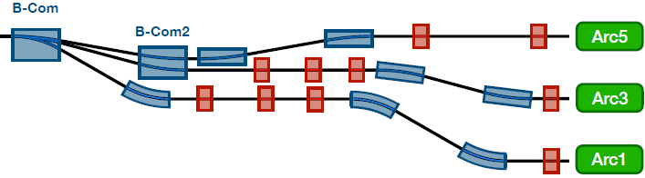
Space Constraints in Spreader/Recombiner Sections
Space between the Arcs = 45 cm.
In spreaders, the separation is around 20 cm.
Current design of quadrupoles: height of 25 cm. Impossible to fit two quads on top of each other.
Design of dipoles (S-Bends) is ongoing “Internship 2 months – Thiab Dubeik from An-Najah in Palestine”.
See Alex Fomin presentation

Slide 15
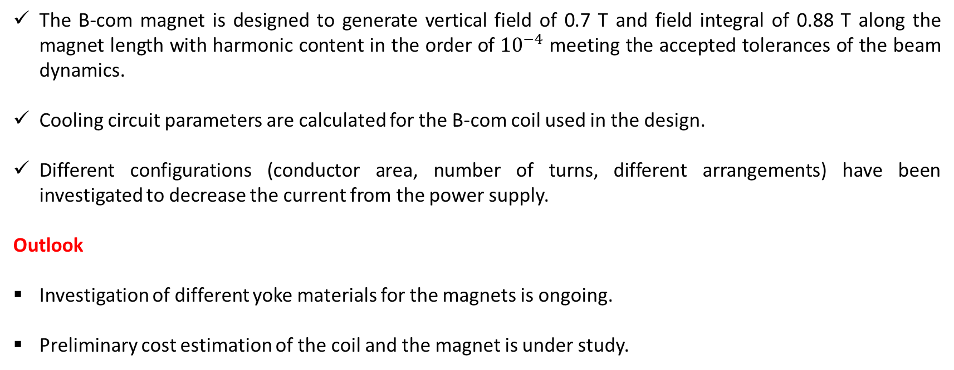
Conclusion and Outlook
The B-com magnet is designed to generate vertical field of 0.7 T and field integral of 0.88 T along the magnet length with harmonic content in the order of ${10}^{−4}$ meeting the accepted tolerances of the beam dynamics.
Cooling circuit parameters are calculated for the B-com coil used in the design.
Different configurations (conductor area, number of turns, different arrangements) have been investigated to decrease the current from the power supply.
Outlook
Investigation of different yoke materials for the magnets is ongoing.
Preliminary cost estimation of the coil and the magnet is under study.

Slide 16
Thank You!

Slide 17
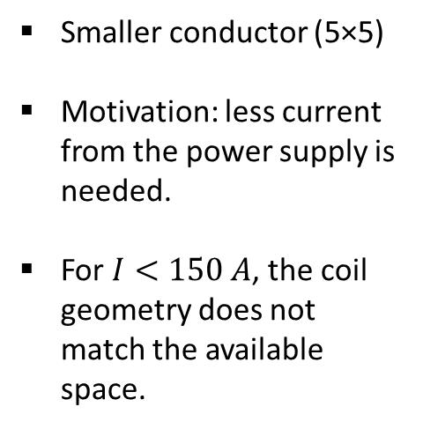
Cooling and Electrical Calculations
Magnetic Field (T) | 0.866
NI Bobine ( AT) | 12 000
Dia: | 3 |  | 3 |  | 3 |  | 3 |  | 3 |  | 3 |  | 3
Conducteur | 5x5 |  | 5x5 |  | 5x5 |  | 5x5 |  | 5x5 |  | 5x5 |  | 5x5
I (A) | 75 |  | 100 |  | 150 |  | 166.6666667 |  | 166.6666667 |  | 190.4761905 |  | 214.2857143
Number of turns | 160 |  | 120 |  | 80 |  | 72 |  | 72 |  | 63 |  | 56
Section Cu | 17.85 |  | 17.85 |  | 17.85 |  | 17.85 |  | 17.85 |  | 17.85 |  | 17.85
number of pancake | 4 |  | 4 |  | 4 |  | 4 |  | 3 |  | 3 |  | 4
one turn length | 1346 |  | 1291 |  | 1236 |  | 1225 |  | 1214 |  | 1203 |  | 1203
Coil section (xxy conductors) | 20 | 8 | 15 | 8 | 10 | 8 | 9 | 8 | 8 | 9 | 7 | 9 | 7 | 8
pancake length (mm) | 53840 |  | 38730 |  | 24720 |  | 22050 |  | 29136 |  | 25263 |  | 16842
Copper length (mm) | 215360 |  | 154920 |  | 98880 |  | 88200 |  | 87408 |  | 75789 |  | 67368
Copper mass (kg) | 34.2131664 |  | 24.6113658 |  | 15.7085712 |  | 14.011893 |  | 13.88607192 |  | 12.04021949 |  | 10.70241732
I/S (a/mm2) | 4.201680672 |  | 5.602240896 |  | 8.403361345 |  | 9.337068161 |  | 9.337068161 |  | 10.67093504 |  | 12.00480192
Coil resistance (Ω) | 0.205104762 |  | 0.147542857 |  | 0.094171429 |  | 0.084 |  | 0.083245714 |  | 0.07218 |  | 0.06416
Disputed coil power (KW) | 1.228128857 |  | 1.570593714 |  | 2.255523429 |  | 2.483833333 |  | 2.461529524 |  | 2.787686531 |  | 3.136147347
CHARACTERISTICS | 75A - 20V |  | 100A - 20V |  | 125A - 20V |  | 125A - 20V |  | 167A - 20V |  | 191A - 20V |  | 215A - 20V
Resistance per pancake | 0.05127619 |  | 0.036885714 |  | 0.023542857 |  | 0.021 |  | 0.027748571 |  | 0.02406 |  | 0.01604
Flow rate per pancake q (L/min) | 0.274693878 |  | 0.351292517 |  | 0.504489796 |  | 0.555555556 |  | 0.734089191 |  | 0.831357305 |  | 0.701457726
Pressure for one pancake(bars) | 1.823543201 |  | 2.017406243 |  | 2.425858322 |  | 2.561574553 |  | 5.512082012 |  | 5.942083051 |  | 2.942534637
speed in a pancake (m/s) | 0.647719621 |  | 0.82833683 |  | 1.18957125 |  | 1.309982723 |  | 1.730959484 |  | 1.960314671 |  | 1.654015503
Reynolds number (water 30 ° C) | 2426.754846 |  | 3103.457658 |  | 4456.863283 |  | 4907.998491 |  | 6485.235557 |  | 7344.540715 |  | 6196.956229
Fluid dynamics | CB laminar or Turbulent |  | CB laminar or Turbulent |  | Turbulent |  | Turbulent |  | Turbulent |  | Turbulent |  | Turbulent
 | Not Accepted |  | Not Accepted |  | Not Accepted |  | Accepted |  | Accepted |  | Accepted |  | Accepted
Smaller conductor (5×5)
Motivation: less current from the power supply is needed.
For $I<150 A$, the coil geometry does not match the available space.

Slide 18
Preliminary Cost Estimation: Coil
Magnetic Field (T) | 0.866
Diameter | 5.00 |  | 5.00
Conductor | 8x8 |  | 8x8
I (A) | 384.00
Number of turns | 30.00
Number of pancake | 3.00 |  | 2.00
Copper mass (kg) | 14.28 |  | 14.28
Estimation range cost (€) | 428.26 | 713.77 | 428.26 | 713.77
Average Estimation cost (€) | 571.01 |  | 571.01
Magnetic Field (T) | 0.866
Diameter | 3.00 |  | 3.00 |  | 3.00 |  | 3.00 |  | 3.00 |  | 3.00 |  | 3.00 |  | 3.00
Conductor | 5x5 |  | 5x5 |  | 5x5 |  | 5x5 |  | 5x5 |  | 5x5 |  | 5x5 |  | 5x5
I (A) | 150.00 |  | 166.67 |  | 214.29 |  | 166.67 |  | 190.48 |  | 166.67 |  | 190.47 |  | 222.22
Number of turns | 80.00 |  | 72.00 |  | 56.00 |  | 72.00 |  | 63.00 |  | 72 |  | 63 |  | 54
Number of pancake | 4.00 |  | 4.00 |  | 4.00 |  | 3.00 |  | 3.00 |  | 3.00 |  | 3.00 |  | 3.00
Copper mass (kg) | 15.71 |  | 14.01 |  | 10.70 |  | 13.89 |  | 12.04 |  | 13.89 |  | 12.04 |  | 10.23
Estimation range cost (€) | 342.13 | 513.20 | 246.11 | 369.17 | 157.09 | 235.63 | 140.12 | 210.18 | 107.02 | 160.54 | 416.58 | 694.30 | 361.21 | 602.01 | 306.77 | 511.29
Average Estimation cost (€) | 427.66 |  | 307.64 |  | 196.36 |  | 175.15 |  | 133.78 |  | 555.44 |  | 481.61 |  | 409.03

Slide 19
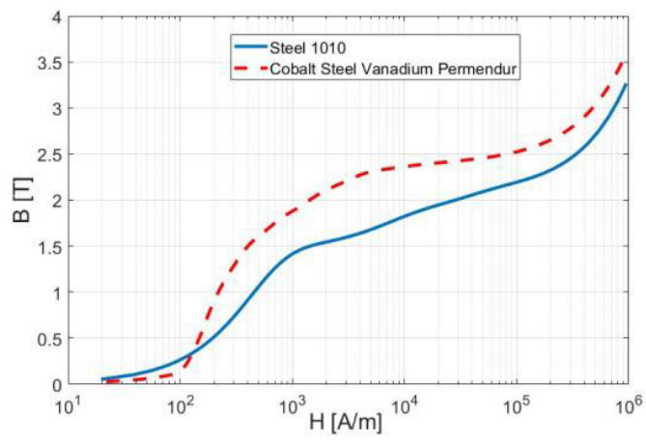
Recommended materials for the magnets manufacture
Low Carbon Steel (AISI M1010 or AISI 1010 ):
There are slight differences in composition and mechanical properties between AISI M1010 and AISI 1010, which are both types of low carbon steel.
Cobalt Steel Vanadium Permendur:
(provides high field).
Martial | cost | Cost - 10% | Cost + 10% | The estimated value of the cost (€)
 |  |  |  | from | to
Low Carbon Steel (AISI 1010) | 1.116 | 1.0044 | 1.2276 | 602.64 | 736.56
Vanadium Permendur | 128.5 | 115.65 | 141.35 | 69390 | 84810

Slide 20
Low Carbon Steel (AISI M1010)
Mechanical Properties:
Properties |  | T (°C) | Treatment
Density (×1000 kg/m3) | 7.7-8.03 | 25
Poisson's Ratio | 0.27-0.30 | 25
Elastic Modulus (GPa) | 190-210 | 25
Tensile Strength (Mpa) | 1158 | 25 | oil quenched, fine grained, tempered at 425°C
Yield Strength (Mpa) | 1034
Elongation (%) | 15
Reduction in Area (%) | 53
Hardness (HB) | 335 | 25 | oil quenched, fine grained, tempered at 425°C

Slide 21
Cobalt Steel Vanadium Permendur
Mechanical Properties:
Physical Data
Density (lb / cu. in.) | 0.292
Mean Coeff Thermal Expansion | 9.8
Mechanical Data
Form | Strip
Condition | Annealed
Temper | 70
Tensile Strength | 175
Yield Strength | 185
Elongation | 1
Brinnell | 35

Slide 22
Preliminary Cost Estimation: B-com magnet
Item | Cost indication (€) |  | Approximate amount (kg) | Cost Estimation for the B-com(€)
Production-specific tooling | 5000 – 15 000 |  | - | 5000 | 15 000
Steel sheets | 1.0-1.5 / kg |  | 600 | 600 | 900
Vanadium Permendur | 110-150/kg |  | 600 | 6000 | 9000
Copper conductor | 10-15/kg |  | 10-15 | 100 | 225
Yoke manufacture | 6-10/kg |  | 600 | 3600 | 6000
Coil manufacture | 30-50/kg |  | 10-15 | 300 | 750
Total |  | Steel sheets |  | 15000 | 30975
Contingency | 10-20% |  |  | 1500 | 6195
Total + Contingency |  |  |  | 16500 | 37170
Total |  | Vanadium Permendur |  | 9600 | 22875
Contingency | 10-20% |  |  | 960 | 4575
Total + Contingency |  |  |  | 10560 | 27450

Slide 23
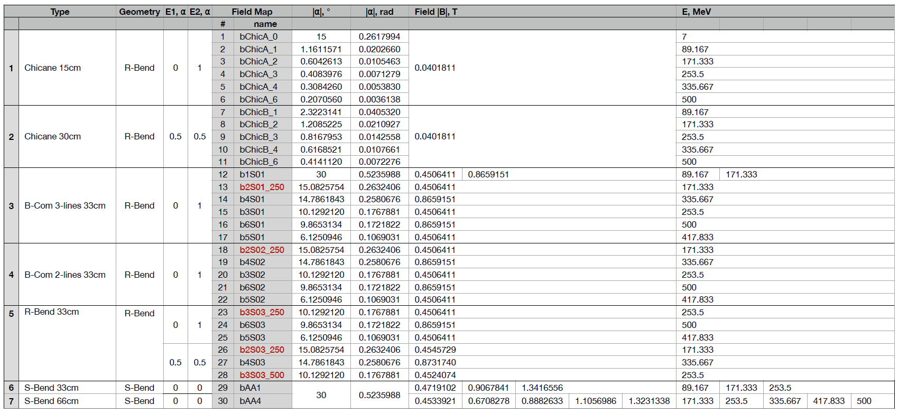
PERLE Dipole Magnets: Summary

