Slide 1
3D printing of HOM couplers
Sébastien Clément PER PERLE collaboration meeting
TE-MSC-SMT
Polymer laboratory 2023/06/23

Slide 2
Table of content
3D printing at CERN Polymer Lab
Development of HOM couplers prototype for PERLE experiment
Additive Manufacturing of NIOBIUM
PERLE collaboration meeting
TE-MSC-SMT 2023/06/23

Slide 3
3D printed polymer component requirements:
- Radiation resistance
- High voltage insulation
- Compatible with cryogenic applications
- Accuracy
Stereolithography 3D printing process (SLA)
Epoxy resins (Accura 25 and 48)
TE-MSC-SMT 2023/06/23

Slide 4
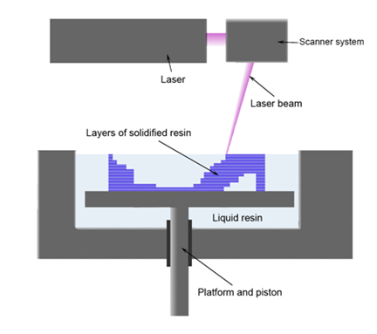



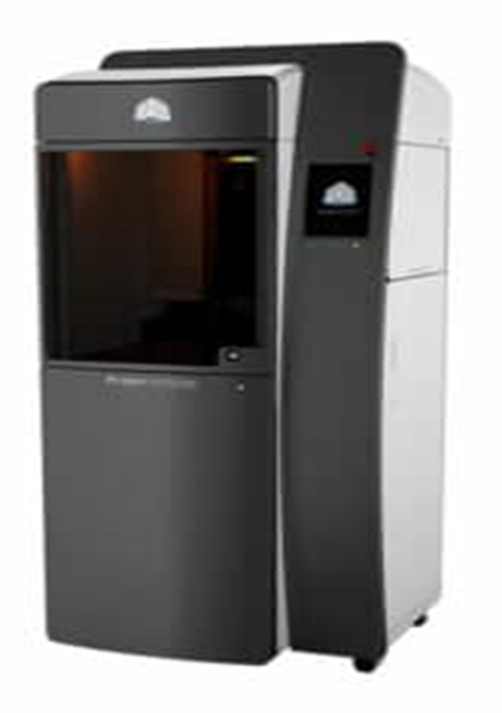
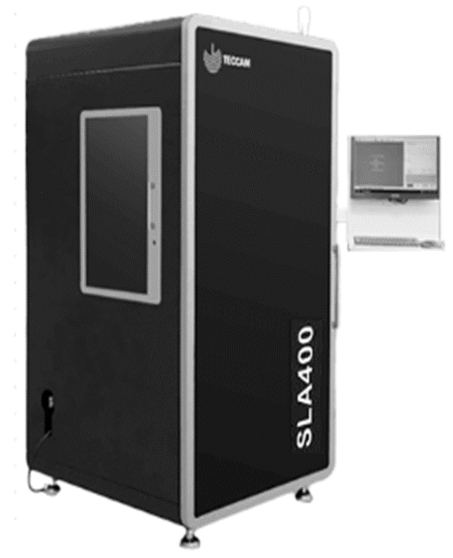
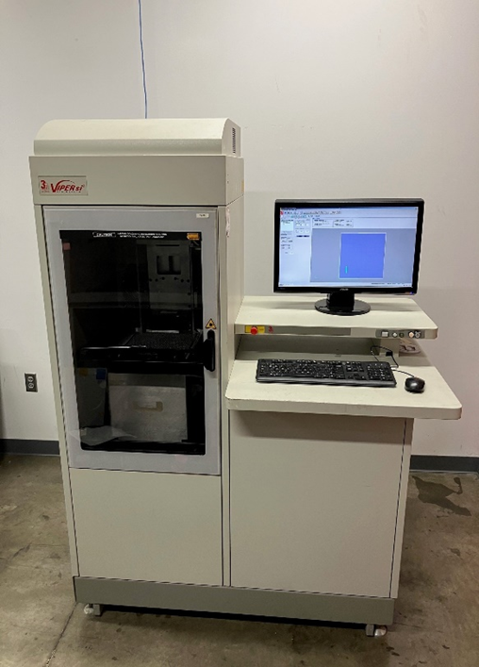



3D printing at Polymer lab
Stereolithography process
Support grid dipped into liquid resin 0.1 mm
Laser curing
Postprocessing
TE-MSC-SMT 2023/06/23

Slide 5
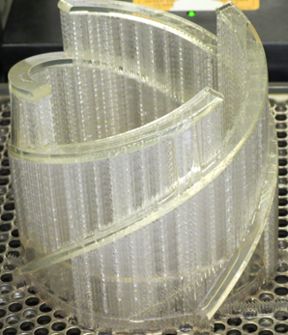
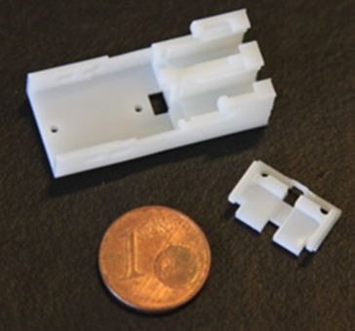
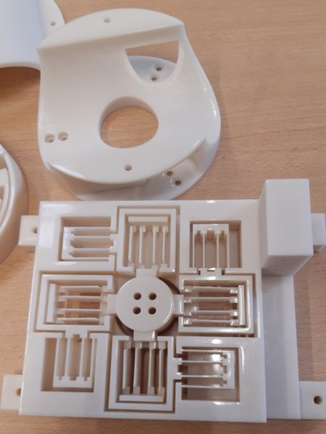
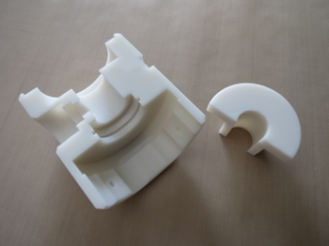
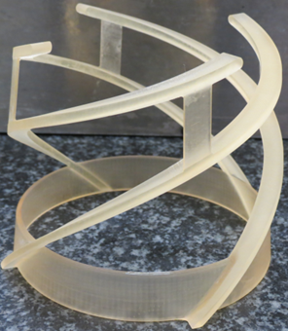
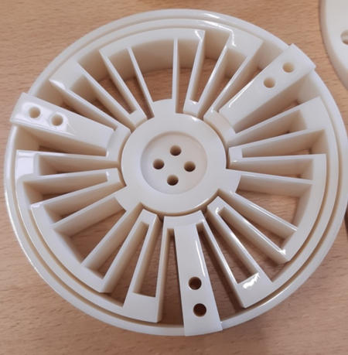
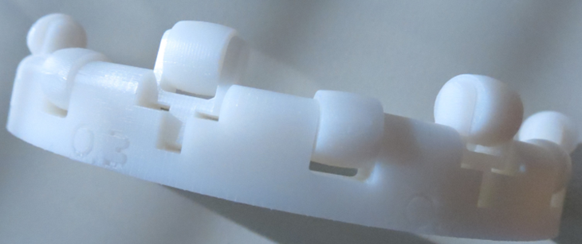
Functional parts for detectors and experiments printed in 3D
Irremovable plug (Atlas)
HV Connectors (NP02)
Ring with rolls systems in one parts for magnetics measurement (TE-MSC-MM)
Electronics cards Supports and instrumentations (FSI target)
Electric insulation(Alice)
TE-MSC-SMT 2023/06/23

Slide 6
What drives the development of metalized 3D printed parts
Row material shortage and long lead time
Price increase of row materials
Light weight
Short manufacturing time
Highly complex geometries
TE-MSC-SMT 2023/06/23

Slide 7
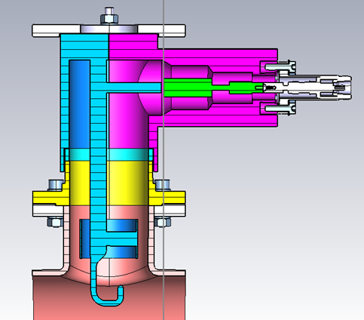
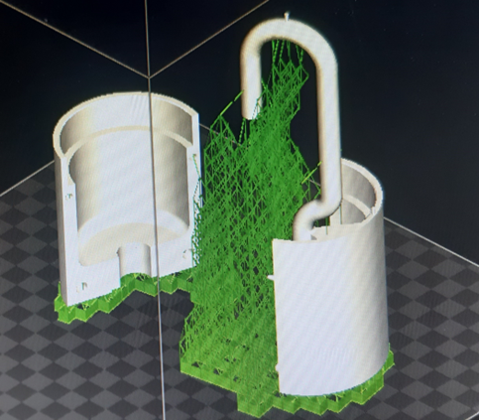
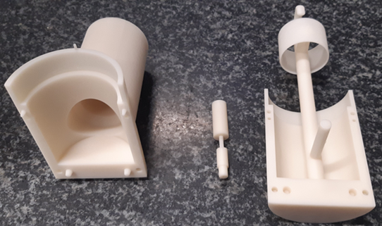
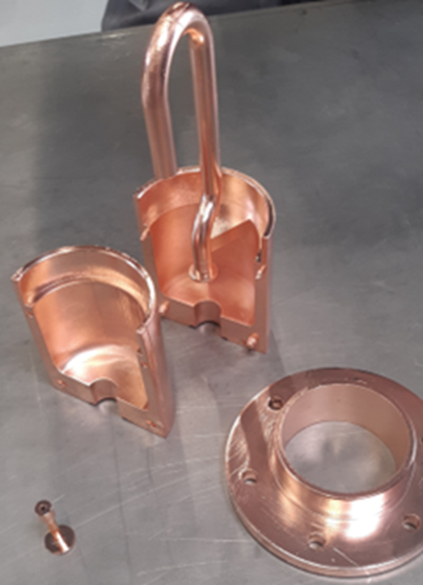
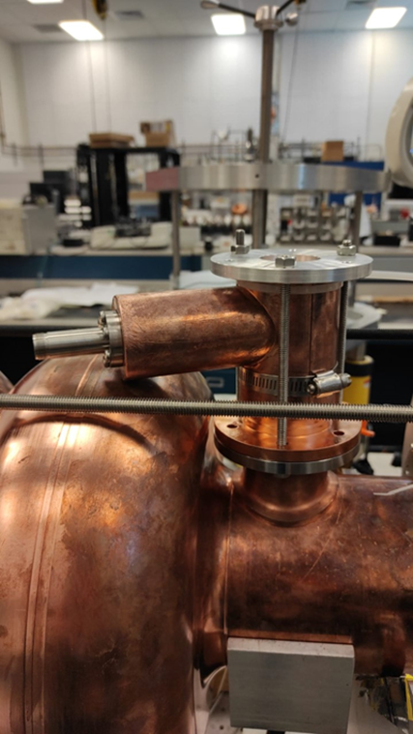

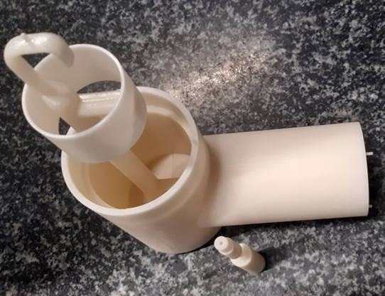
RF coupler for PERLE Experiment in 5 steps
Coupler HOM for PERLE experiment (Powerful Energy Recovery Linac for Experiment )
This project consists of the development of a prototype RF coupler with copper coating
Interaction with different groups (TE-VSC-SCC), (EN-MME-FW) and external laboratories IJCLAB (FR), JLAB (USA)
We are investigating with the polymerlab team and the surface coating team the use of this technique to other applications
Design of the assembly
3D printing plateform preparation
Parts 3D printed
Parts with copper deposition by electroplated
Part tested in Jlab
TE-MSC-SMT 2023/06/23

Slide 8

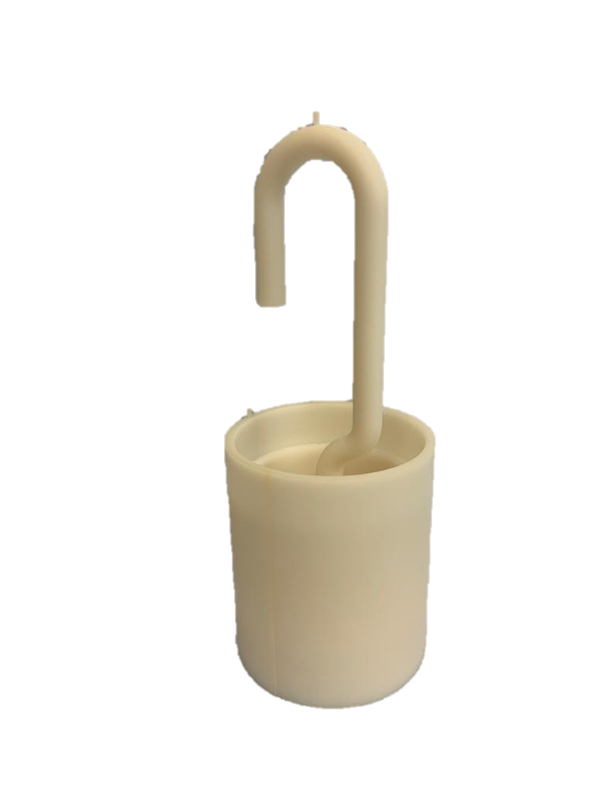
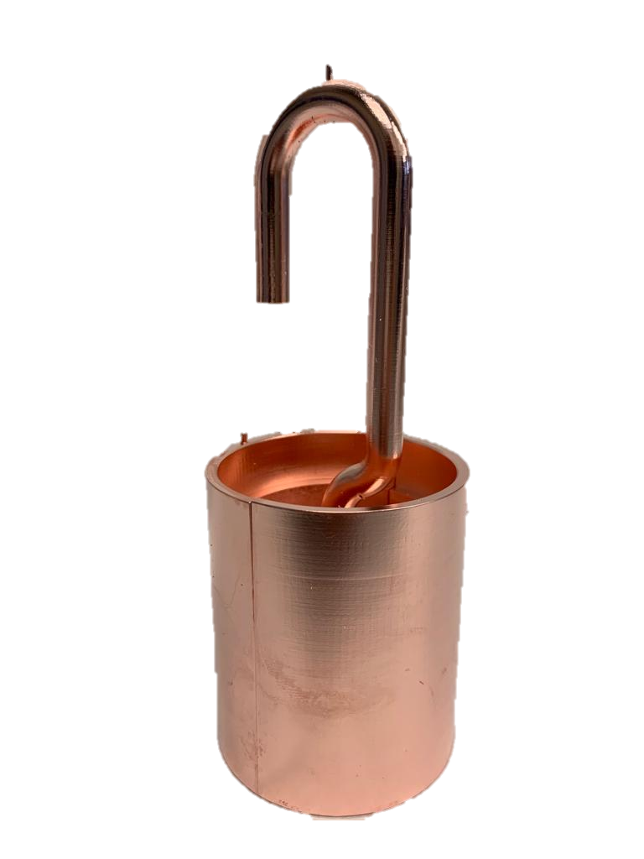
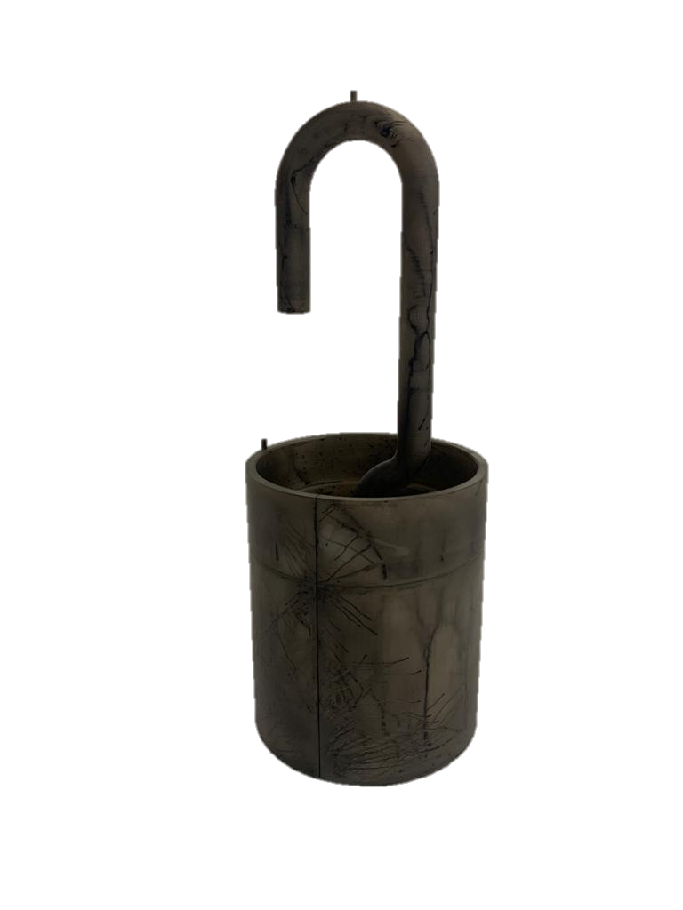
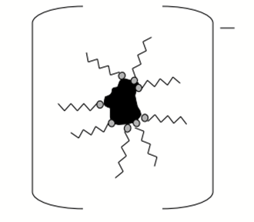
ELECTROLYTIC COPPER PLATING ON EPOXY
Sandblasting
Carbon coating
Electrolytic copper-plating
Cu 2+
Cu 2+
Cu 2+
Cu 2+
Blackhole SP Replenisher is composed of miscible carbon particles in aqueous solution, giving them a negative charge
Negatively charged particles are electrostatically absorbed on the surface
The electrical charge imparted to the epoxy enables electrolytic copper plating.
Copper plating is carried out in an electrolytic bath based on copper and sulfate
Sandblasting creates microporosities on the epoxy surface and improves adhesion
Courtesy of Pierre Maurin TE/VSC/SCC
PERLE collaboration meeting
2023/06/23

Slide 9
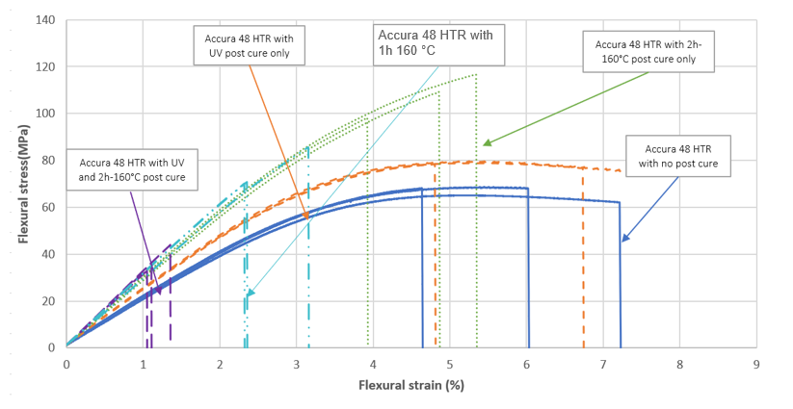
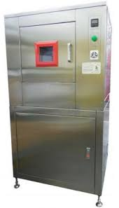
Optimization of Accura 48 post processing
Comparison of RT flexural stress vs flexural strain curves for the four types of post cure Accura 48 HTR (J.-S. Rigaud, EDMS No. 2864019).
UV post processing chamber
TE-MSC-SMT 2023/06/23

Slide 10
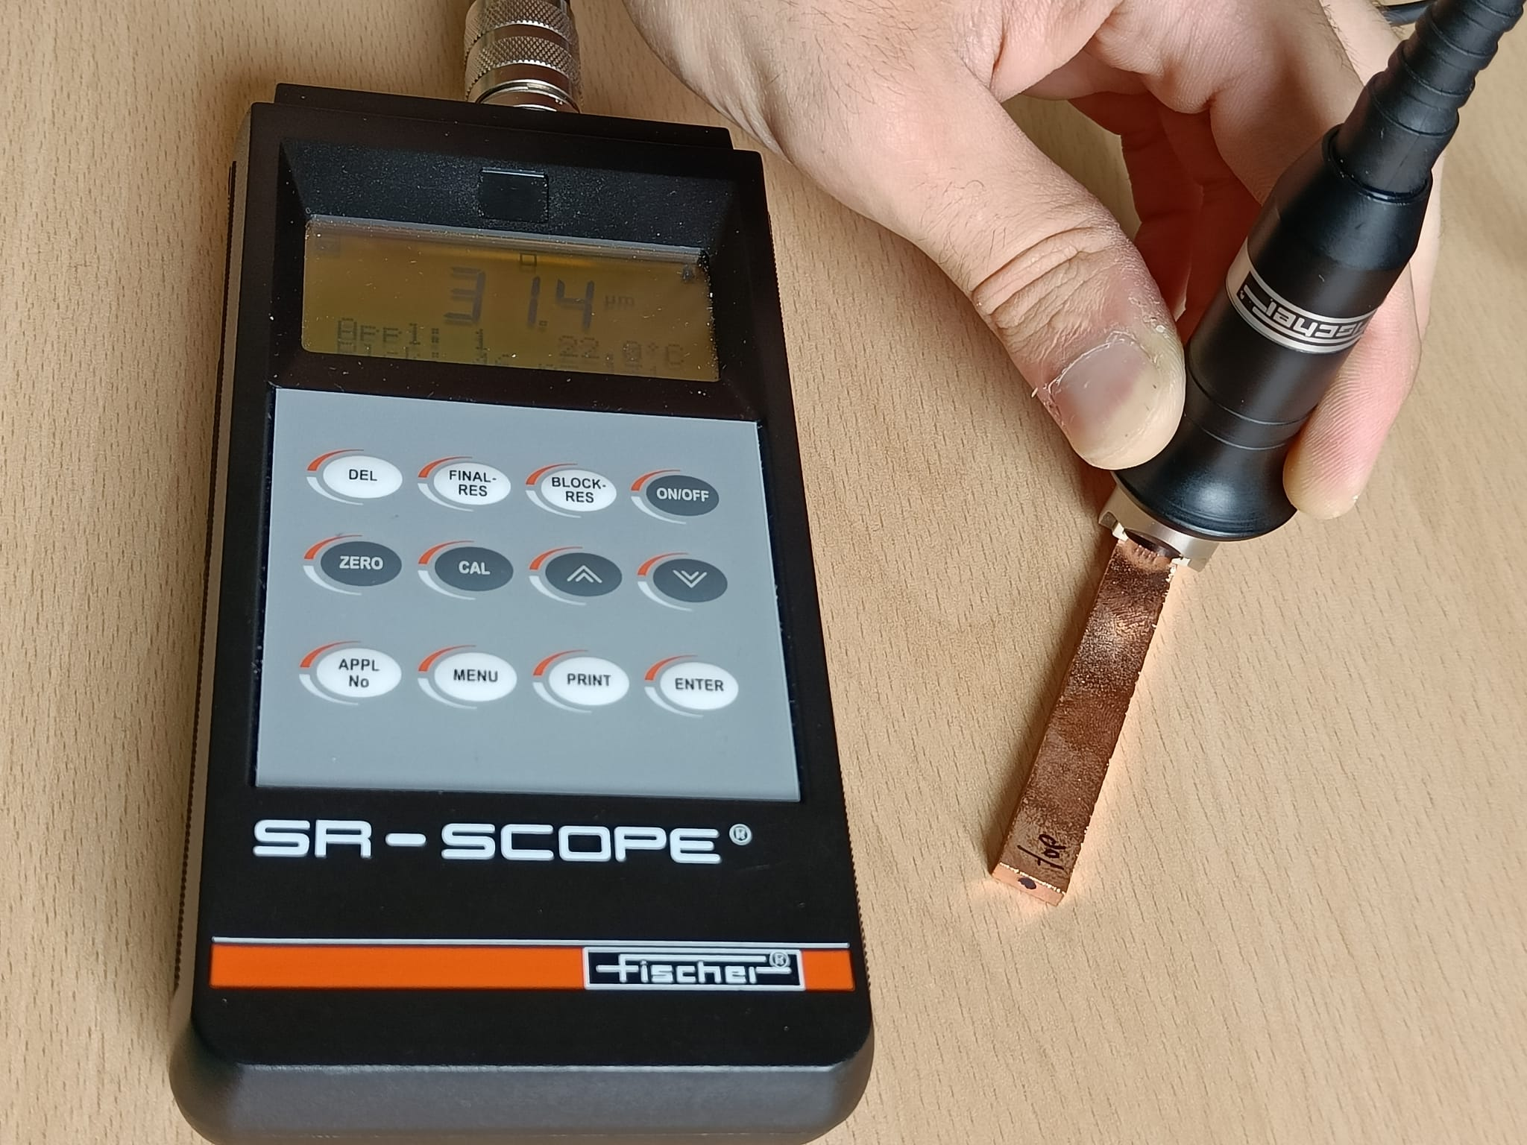
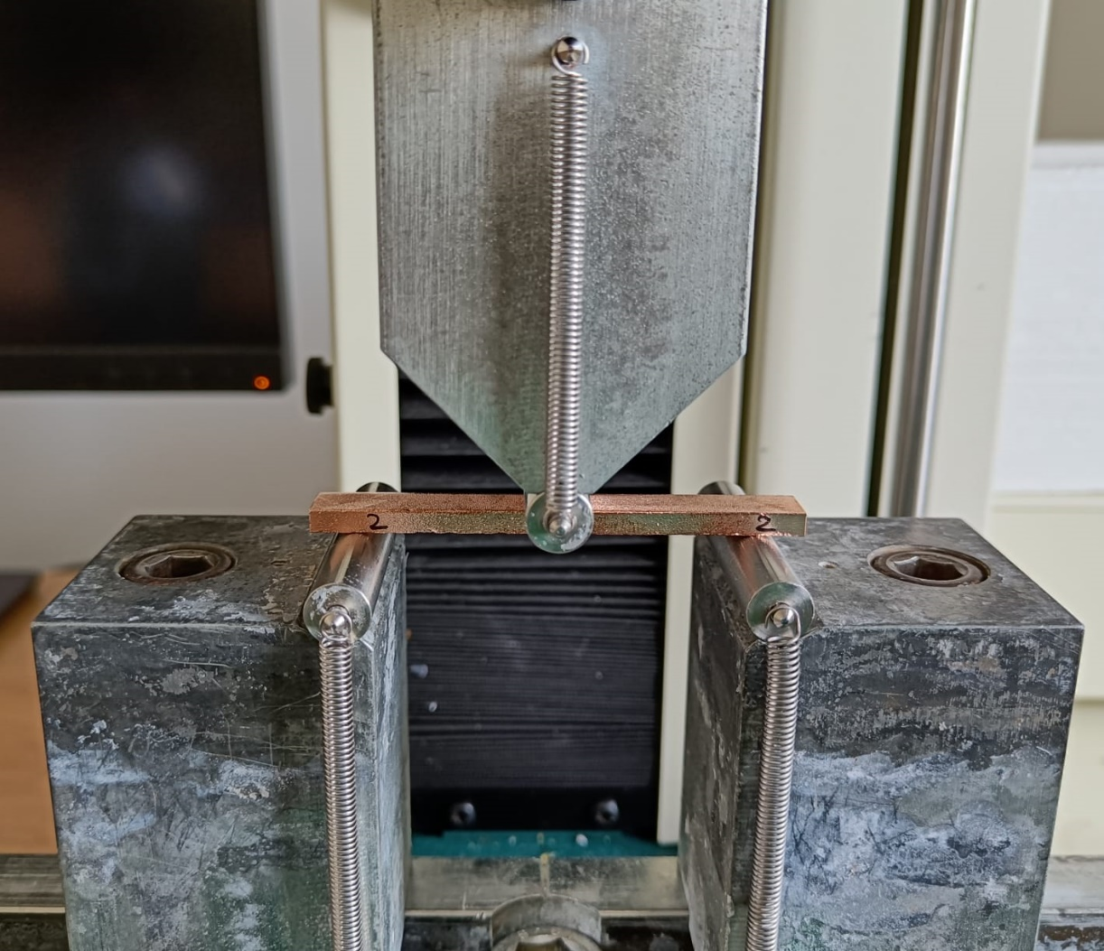
Planned coating characterization
Metrology and Cu coating thickness distribution
Cu coating adhesion tests in accordance with ASTM D4541
Tensile tests and flexural tests of Cu coated samples at RT and at 77K (effect of Cu coating thickness on mechanical properties)
Thermal shock tests in liquid nitrogen
Residual Resistivity Ratio (RRR) measurements of the Cu coating
Tests of alternative coatings (nickel, silver and gold)
TE-MSC-SMT 2023/06/23

Slide 11
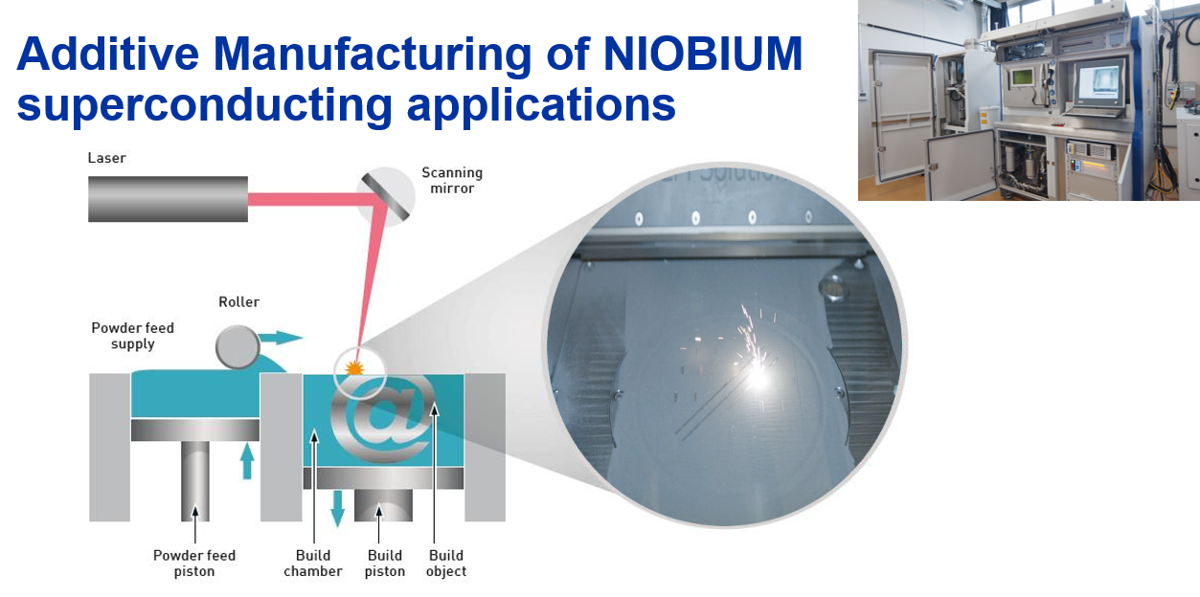
SLM solutions 280 HL
Information and contact: Romain.Gerard@cern.ch – EN/MME
Courtesy of Romain Gerard EN/MME
TE-MSC-SMT 2023/06/23
11

Slide 12
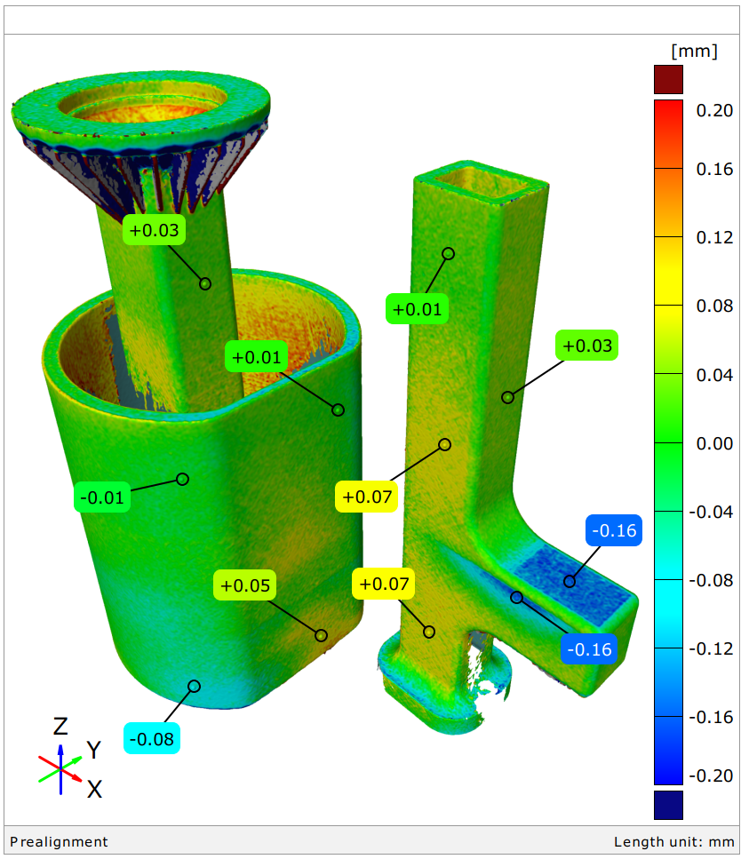
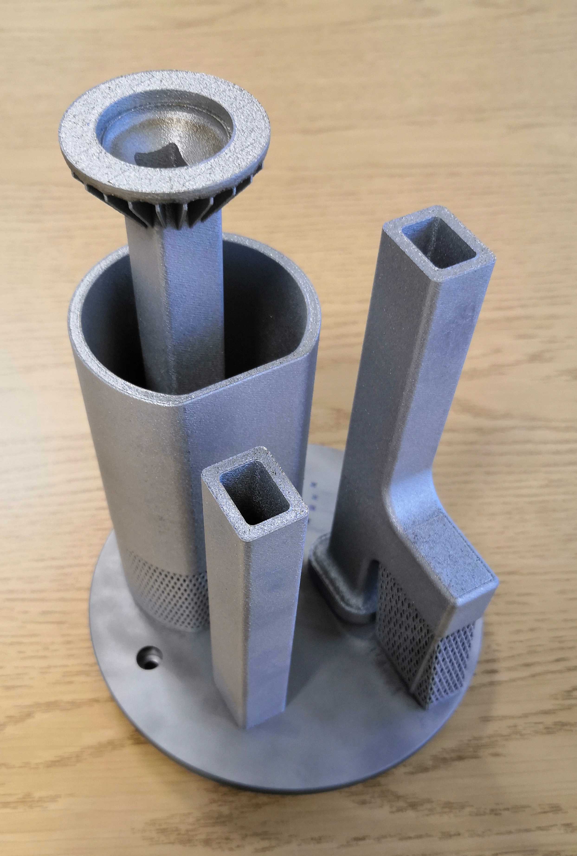
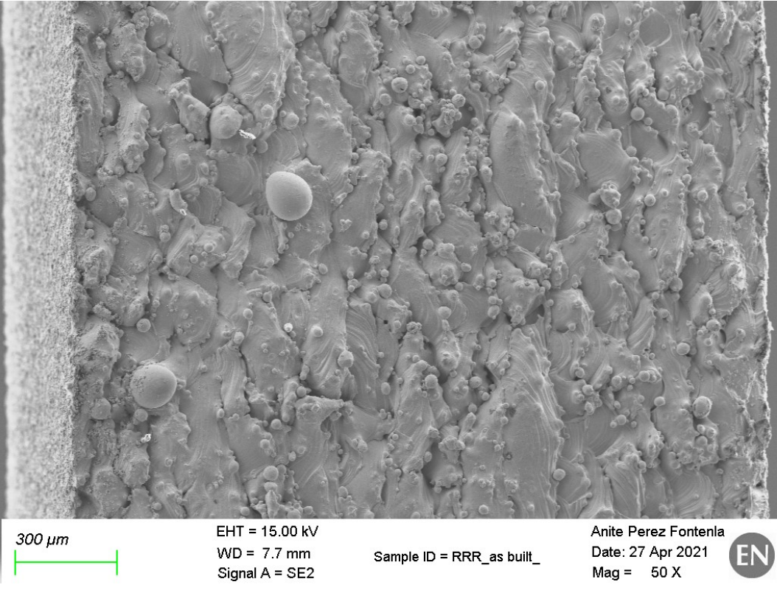
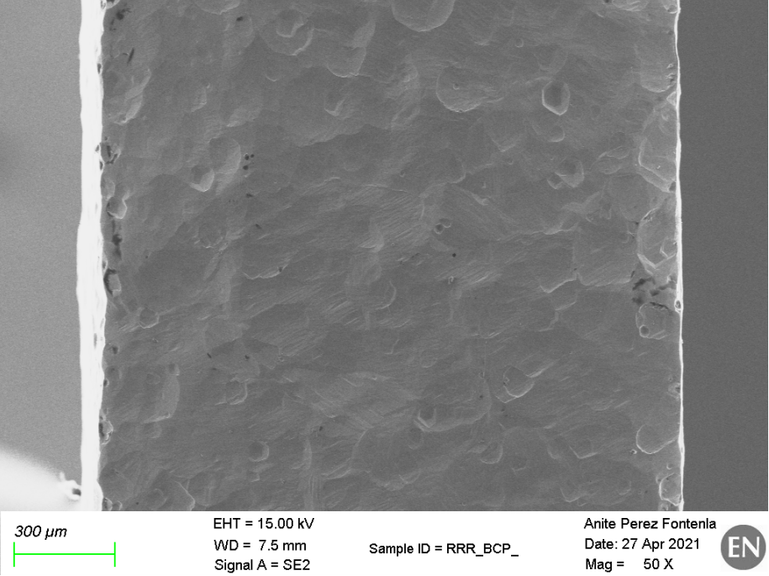

Additive Manufacturing of NIOBIUM superconducting applications
Additive Manufacturing opens the door to design freedom, bringing the cooling as close to the high field surfaces.
In EN/MME, this material was developed
from the raw metal powder, to the process and post-manufacturing treatment.
It meets the strict requirements of UHV.
Build volume with niobium: Ø125 x H275 mm³
Geometry:
High precision 3D Scanning metrology.
Precision of +-0.2mm are readily achievable
Material purity:
Raw material improvement (Nb Powder)
Titanium Gettering TTH purification of the components
Surface: Chemical polishing and mechanical polishing studies
As built:
Ra= 21 µm
Rz = 127 µm
Rt = 166 µm
After BCP 100µm:
Ra= 7 µm
Rz = 33 µm
Rt = 44 µm
RRR ≈260
Information and contact: Romain.Gerard@cern.ch – EN/MME
TE-MSC-SMT 2023/06/23
12

Slide 13
Thank you
Carmelo Barbagallo, Patricia Duchesne, Walid Kaabi, Gilles Olivier, Guillaume Olry, Samuel Roset, Fabian Zomer (IJCLAB).
James Henry, Sarah Overstreet, Gunn Park, Robert Alan Rimmer, Haipeng Wang (Jlab)
Franck Gerigk SY-RF, Simon Barriere EN-MME, Romain Gerard EN-MME, Pierre Maurin TE-VSC, Mauro Taborelli TE-VSC, Ahmed Cherif EN-MME, Jean-Phillipe Rigaud EN-MME, Olivier Choisnet FSU ,Roland Piccin TE-MSC (CERN).
TE-MSC-SMT 2023/06/23

Slide 14
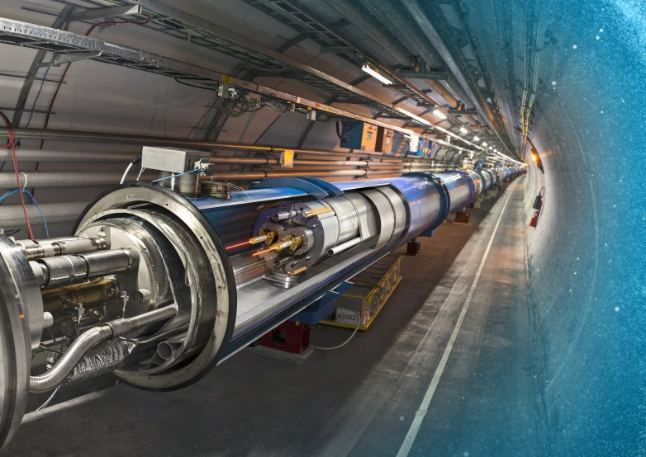
Thank you for your attention

