Slide 1

PERLE Collaboration Meeting
Setting up of PERLE
CERN, June 23rd 2023
Walid KAABI

Slide 2
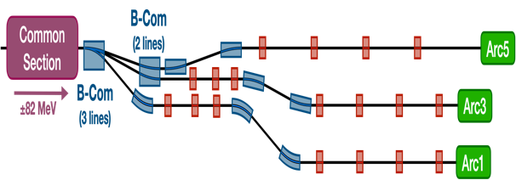
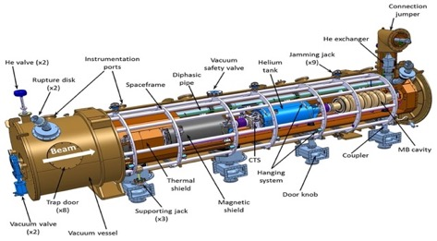
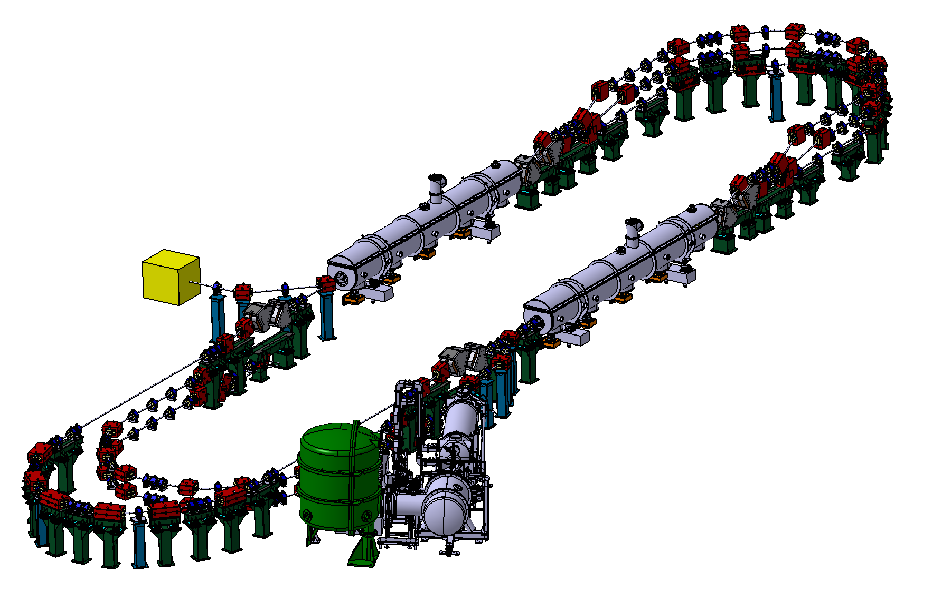
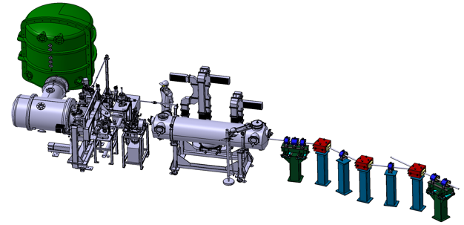
PERLE Configuration
PERLE: first multi-turn ERL, based on SRF technology, designed to operate at 10MW (20 mA, 500 MeV) power regime
→ A hub to explore a broad range of accelerator phenomena and to validate technical choices improving accelerators efficiency in an unexplored operational power regime on the pathway of the ERL technology development for future energy and intensity frontier machines.
Cryomodule with 4 five-Cell cavities
Total gradient 82 MeV
3 acc & 3 decc beams at different energies travelling in the CM.
Switchyard: vertical separation/recombination of beams at different energies
3 staked isochronous recirculation arcs for beams at different energies (Arcs 1, 3, 5).
Target Parameter | Unit | Value
Injection energy | MeV | 7
Electron beam energy | MeV | 500
Normalised Emittance γε_{x,y} | mm mrad | 6
Average beam current | mA | 20
Bunch charge | pC | 500
Bunch length | mm | 3
Bunch spacing | ns | 25
RF frequency | MHz | 801.58
Duty factor |  | CW
Beam dump
Interaction Points
HV tank
Photocathodes loading chamber (Sb-based photocathodes)
Buncher
350-500 kV
DC gun
Merger
3 staked (& inversed) isochronous recirculation arcs for beams at different energies (Arcs 2, 4, 6)
Injection line delivering 500pC bunches at 7 MeV.
Light box
Green laser 40 MHz
Booster: 5 single-cell cavities (802MHz) individually powered

Slide 3
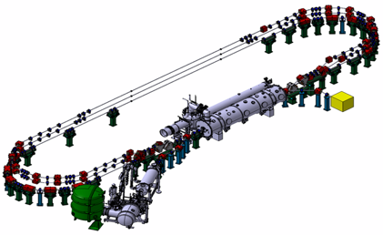
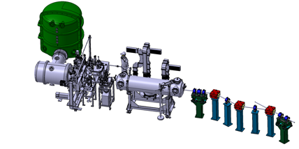
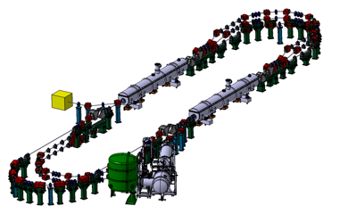
PERLE Phasing Strategy
Technical Design phase (TDR)
Prepare to Build phase (P2B)
Installation phases
Phase 1: Installation of the injection line
Phase 2: PERLE 250 MeV version
Phase 3: PERLE 500 MeV version
2020
2021
2022
2023
2024
2025
2026
2027
2028
2029
2030
2031

Slide 4
PERLE Timeline for TDR phase and beyond
The current phase of the project:
Technical Design phase (→ 2023)
Prepare to Build phase (P2B) (→ 2025)
Machine design (Injector, 250MeV and 500 MeV configurations)
Beam dynamics studies
Main systems design (Buncher, Magnets, HOM couplers, full dressed cavity, power couplers, new CM, IP, dump…)
In-Kind adaptation and/or upgrade studies (DC-Gun, Booster, SPL and ESS CM) *
Definition of the needs (Diags, Cryogenics, CC, LLRF, Shielding, machine interlock system, infrastructure…)
Experiments with PERLE beam and their specific needs
Prototyping and tests (HOM couplers, Single cell booster cavity, B-COM magnet, 5-cells Nb Cavity) *
PERLE administrative regime (Dossier ASN)
Infrastructure (site investigations and work)
And also:
DC-Gun reinstallation and test
Equipment specifications and procurement (for DC gun)
In-Kind adaptation and/or upgrade work (DC-Gun, ESS CM)
* Design of some systems could continue after TDR publication
* Prototyping results could be included in the TDR phase if available

Slide 5
Administrative Classification of PERLE
French regulations define administrative classifications for accelerator facilities as the following:
Authorization to own/use a particle accelerator under the Public Health Code
  → The process to obtain authorization relatively easy to follow,
Classification as Basis Nuclear Facility (INB)
→ Creation of INB is a long and complex process (same classification as a Nuclear Power Plant):
      5-8 years min. for files, 3-5 years instructions by French regulatory,
      HR: Specialized/Dedicated collaborators ⇒ Project management, RP, OH&S, PS.
Electron accelerator classified as INB if:
    E ≥ 50 MeV
    P ≥ 1 kW
How to calculate P?: Number of electrons passing through a virtual target per time unit.
Risks: Unit time not defined ⇒ how to assess power for pulsed accelerator? Mean Power? Peak Power? Mean Power for sustainable beam losses?
⇒ Beam losses in PERLE facility need to be identified.

Slide 6
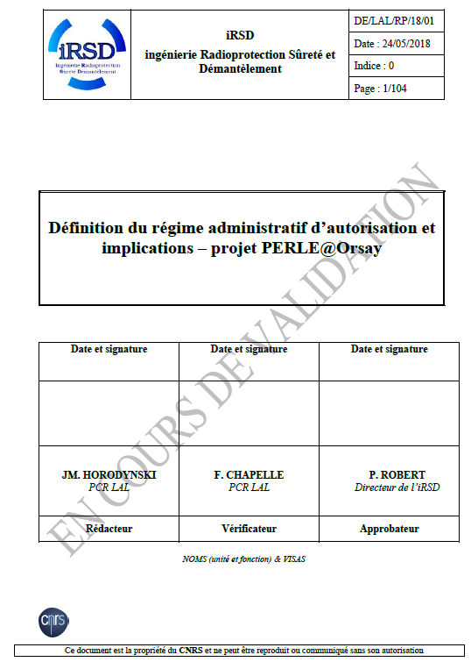
Administrative Classification of PERLE
Operational beam losses:
  Continuous losses on the operational beam dump
  Continuous losses along the accelerator
Failure scenarios:
  Beam losses on SC systems
  Beam losses on recirculation arcs or on a collimator
Virtual beam losses:
  Beam losses on a virtual thick target
  Beam losses on a virtual thin target
All these scenario have to be investigated and demonstration should be made that a beam loss higher than 1 kW pick could not be sustained in the machine for more than 1s (also due to physical limitations).
In addition a very fast MPS interlocks and MPS automation need to be developed (Exp: bERLinPro MPS: time reaction in the order of 100 μs).

Slide 7
Administrative Classification of PERLE
Today, a task-force is formed at IJCLab to:
Continue and complement the preliminary studies to prepare a document to be presented to ASN by beginning 2024
→ The aim is to receive the green light to initiate the process (complete studies and ASN document) in the upcoming years to obtain the authorization to own/use a particle accelerator under the Public Health Code.
A preliminary discussion with ASN is scheduled beginning of July 2023.

Slide 8
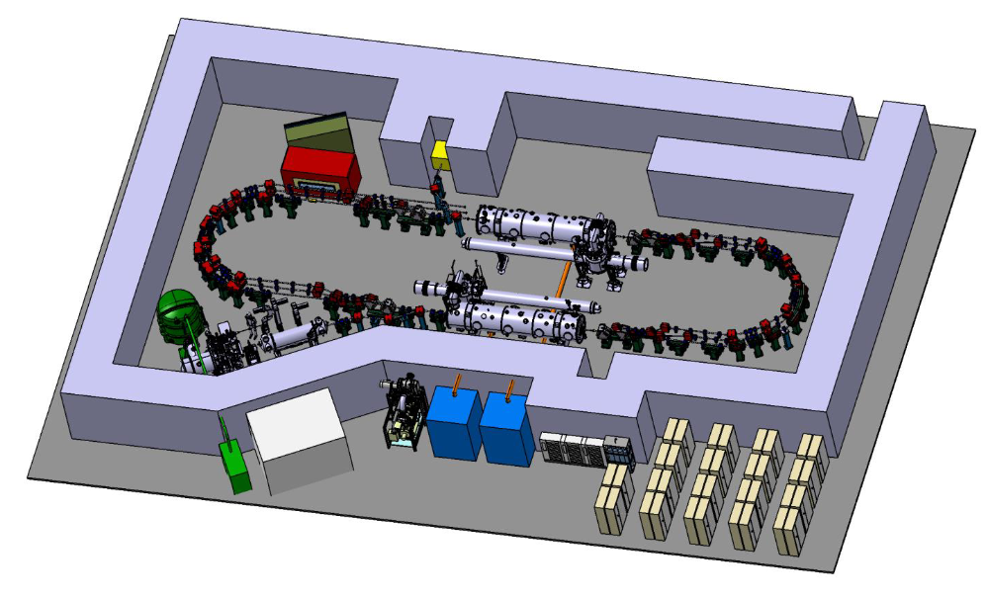
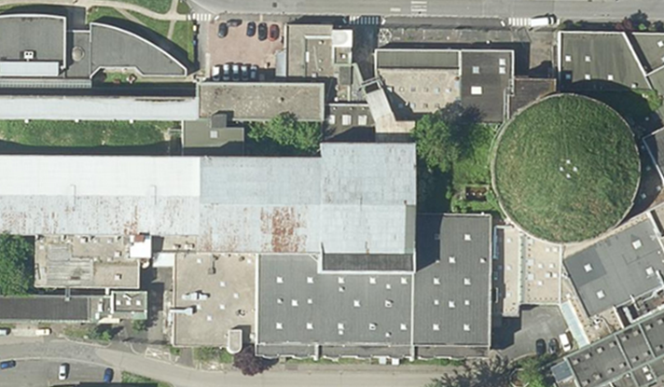
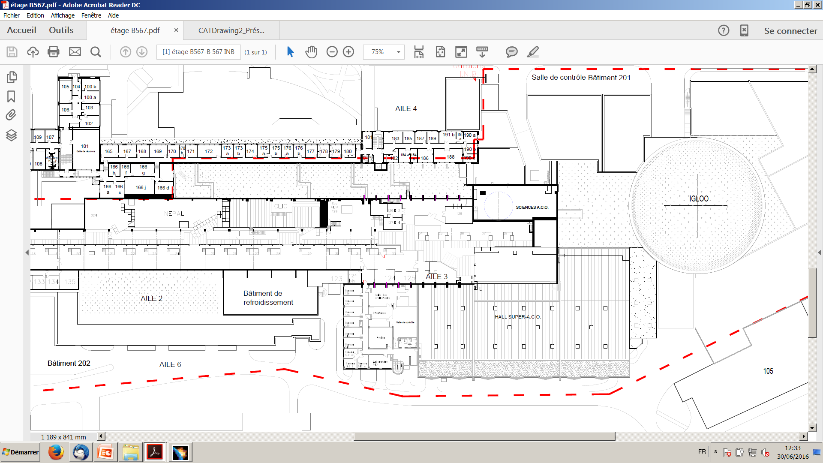
PERLE Footprint and site studies
Two sites are currently considered and will be studied in details within the CPER program for possibly host PERLE: The Super ACO hall and the IGLOO.
36 m
IGLOO
PERLE feature a total footprint of:
30 meters long, 15 meters wide and 3.4 meters high.
Super ACO Hall
37 m
55 m

Slide 9
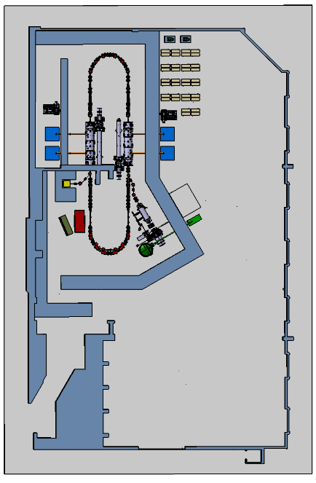
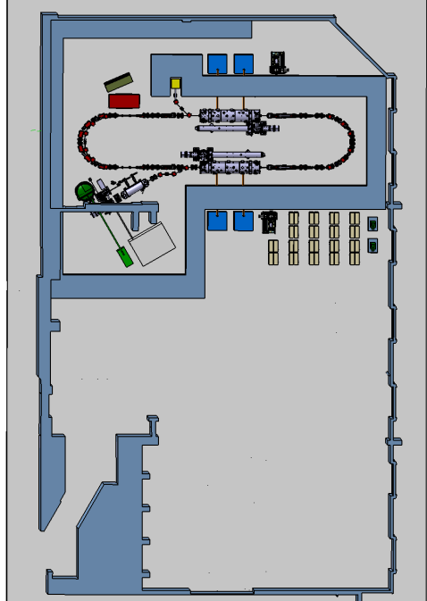
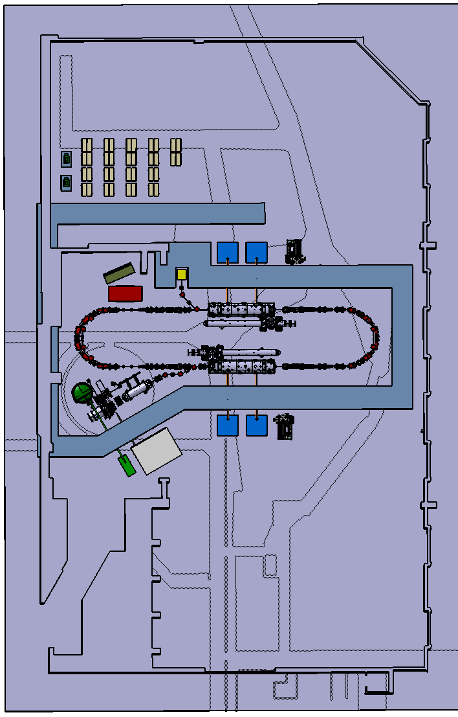
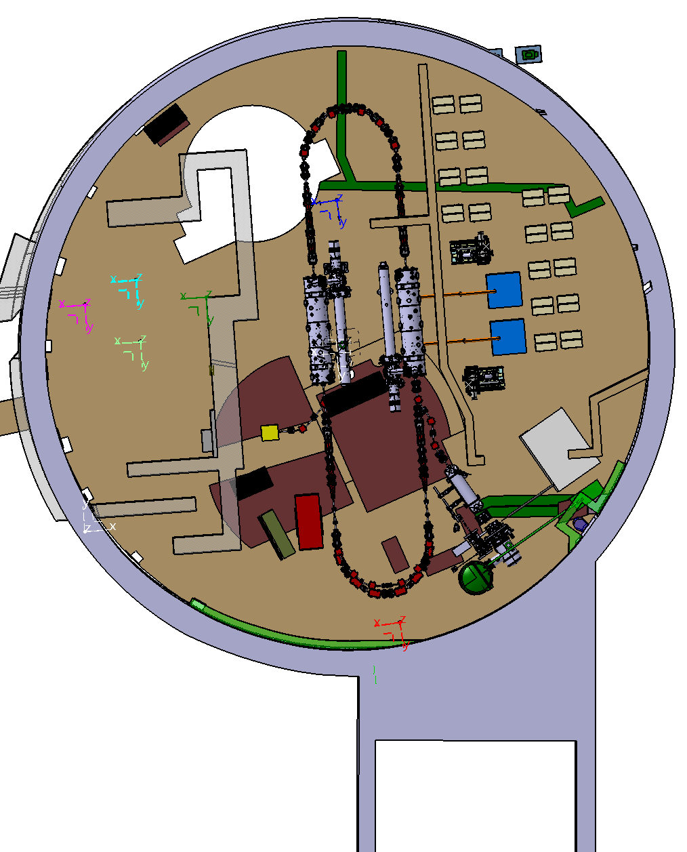
PERLE Footprint and site studies
Studies of special and structural feasibility in the two sites just started.
Several scenario of PERLE implantation will be proposed with solutions to deal with constrains of each site. Costing of each scenario will also be provided.
Limited space for the machine and ancillaries installation
High ground charge capability
Important available space for the machine and ancillaries installation
Low ground charge capability

Slide 10
PERLE Phasing Strategy
Phase 1: Injection line installation (mid 2022- 2027)
The opportunity:
Availability of an electron source ready for installation: The Alice DC Gun as in-kind contribution and now the RI Gun.
The motivation:
Acquire experience on DC gun operation, photocathodes production, booster operation and control...
Qualification of the injection line at the nominal beam parameters with a perfect mastery and control of beam quality before injection into the ERL loop.
HV tank
Photocathodes loading chamber (Sb-based photocathodes)
Buncher
350-500 kV
DC gun
Merger
Light box
Green laser 40 MHz
Booster: 5 single-cell cavities (802MHz) individually powered
Authorisation for this first important phase could be obtained relatively easily from the security authorities.
The critical issues:
The booster design and fabrication tasks still not assigned

Slide 11
PERLE Phasing Strategy
Phase 2: PERLE 250 MeV version (2024- 2030)
The opportunity:
Funding of the first cryomodule within iSAS project + matching fund from own resources.
The motivation:
Demonstration of the multi-turn, high-current operation in a reasonable time schedule.
More time for commissioning and acquiring experience on ERL operation in an unexplored power regime (5MW).
Test of the SRF system with beam + REX for further improvements before the 2nd CM fabrication → Important achievement toward the synergy with other project (FCCee, EIC, ESS upgrade…)
The critical issues:
Administrative classification of PERLE + authorisation in due time.
Identification of the site + infrastructure work schedule
Footprint and ancillaries dimensioning at the final configuration of PERLE (Shielding, Cryoplant/cryo distribution, water cooling, Electrical power…)

Slide 12
PERLE Phasing Strategy
Phase 3: PERLE 500 MeV version (2028- 2031 and beyond)
The opportunity:
Possibility to implement new efficacy-enhancing technologies, currently under development when reaching the required TRL (FRT, LLRF and machine control by AI, 4.2K cavities…).
The motivation:
Improve the efficiency of the machine acting on the 2nd CM design.
Reaching the 10 MW power regime.
Increase the machine dynamic range may (may not) bring new phenomenon to be explored.
The critical issues:
Mange the transition between the two versions (optics, beam dump, 2nd CM installation, additional diags…)
When to deal with experiment implementation? 250 MeV or 500 MeV version?

Slide 13
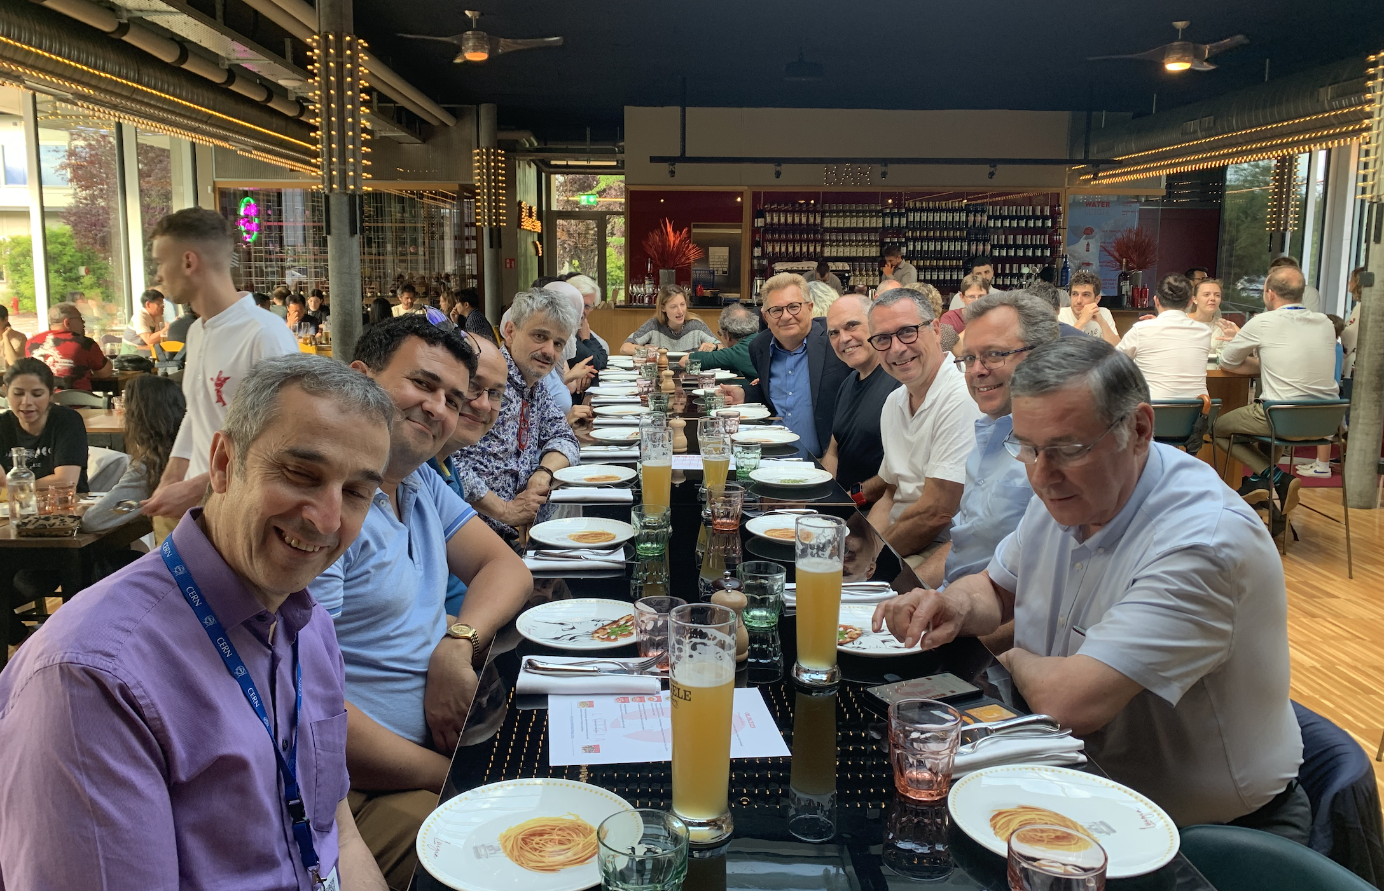
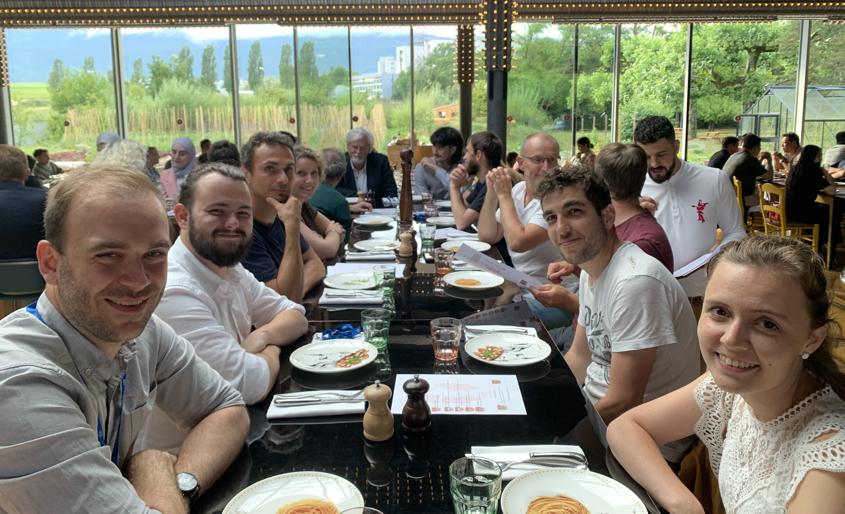
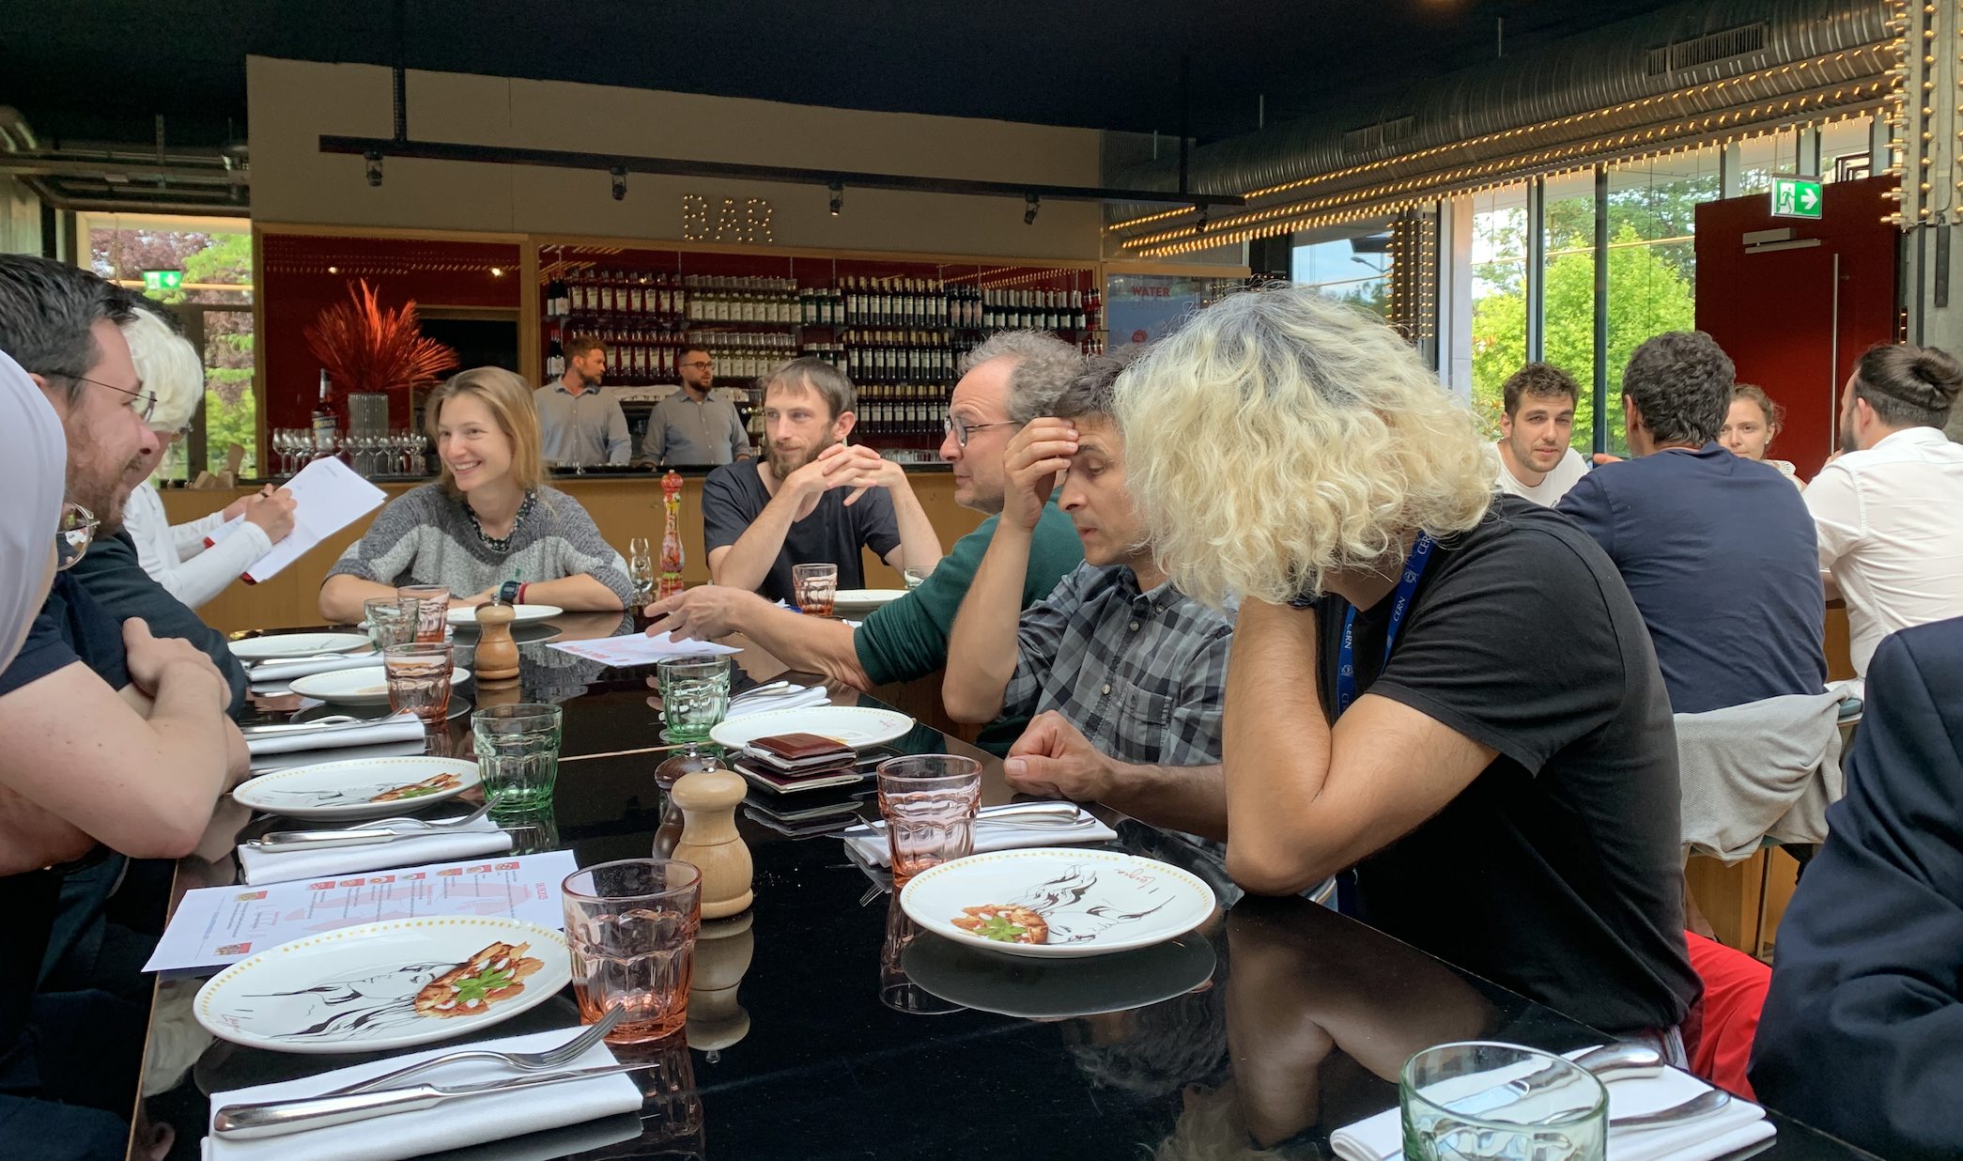
Thank you for your attention!

