Slide 1


800 MHz developments at CERN
R. Calaga, S. Udongwo, S. G. Zadeh
CERN, Rostock University
Jun 23, 2023
A short history of (11+ yrs..)
Present status for FCC
Special thanks: U. Van-Rienen & E. Jensen

Slide 2
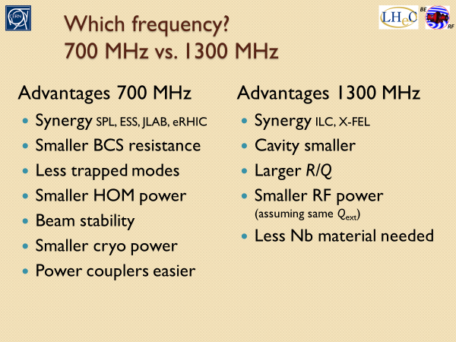
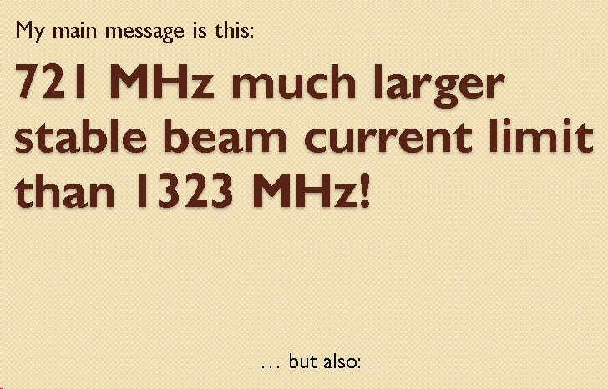
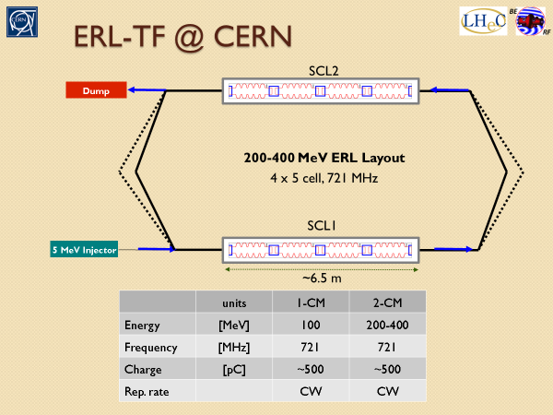
2012-15, LHeC Workshop
In the context of the LHeC studies, the frequency choice of 800 MHz was identified as best compromise (2012-15) with a proposal to build a test facility for ERL demonstration similar to LHeC
https://indico.cern.ch/event/183282/contributions/318618/attachments/249525/348968/ERL_and_Frequency_Choice1.pptx

Slide 3
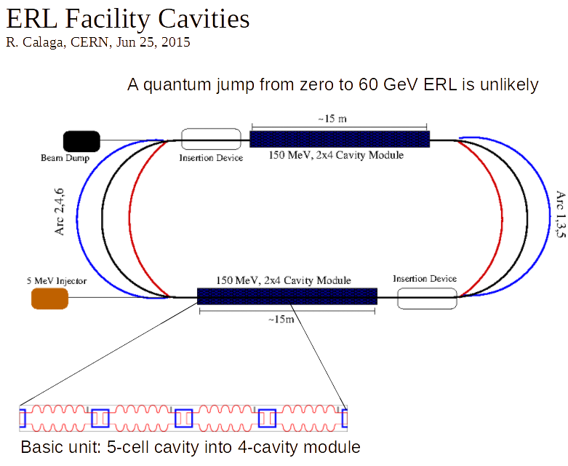
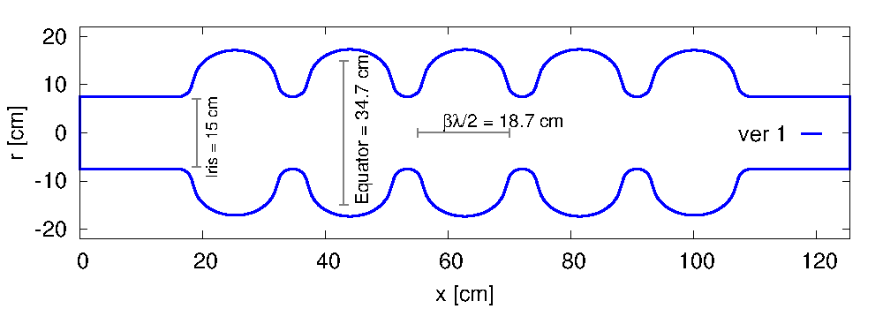
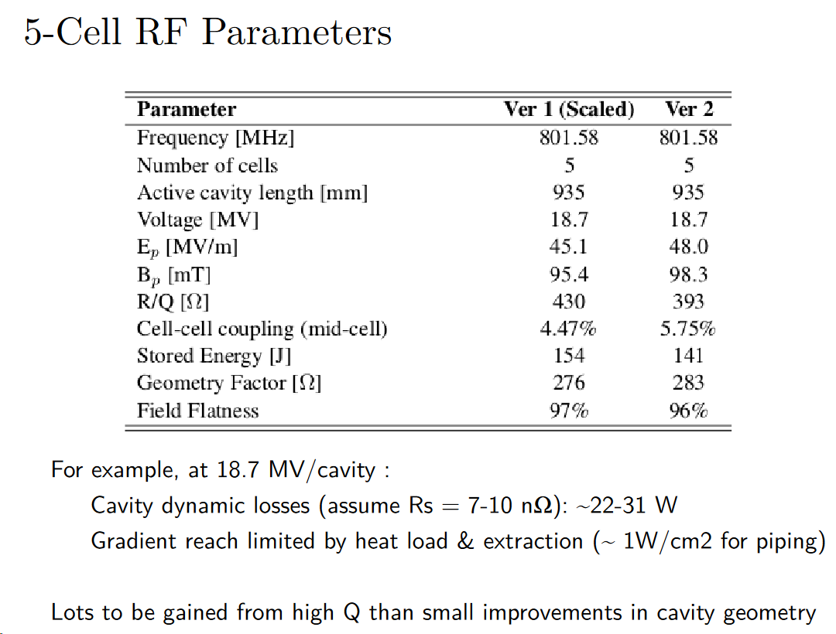
2012-15, LHeC Workshops
5-cell 801.58 MHz, v2
https://cds.cern.ch/record/1519112?ln=en
http://cds.cern.ch/record/2020926?ln=en

Slide 4
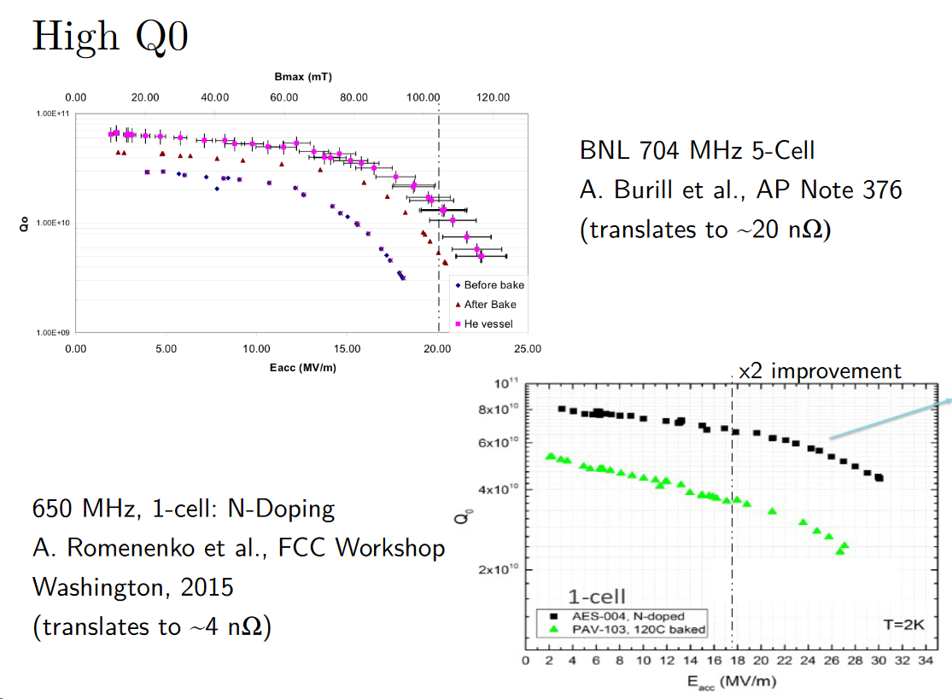
2015, LHeC Workshop

Slide 5
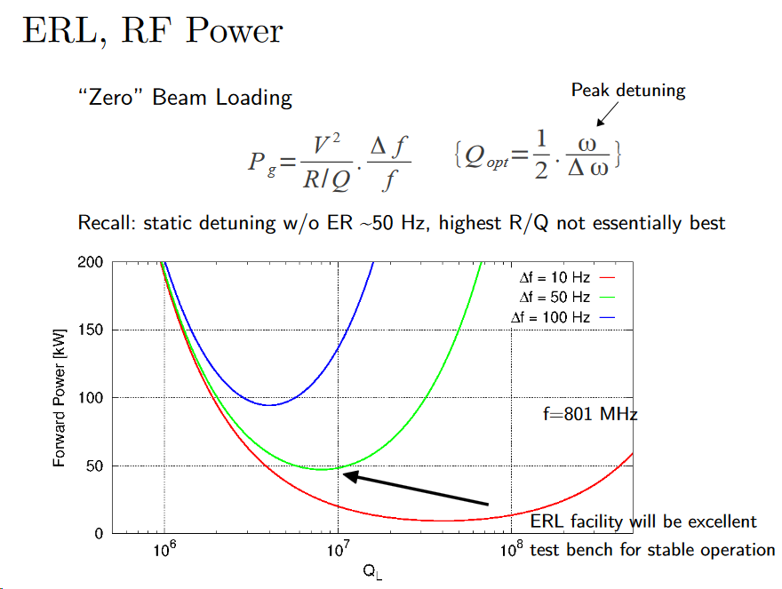
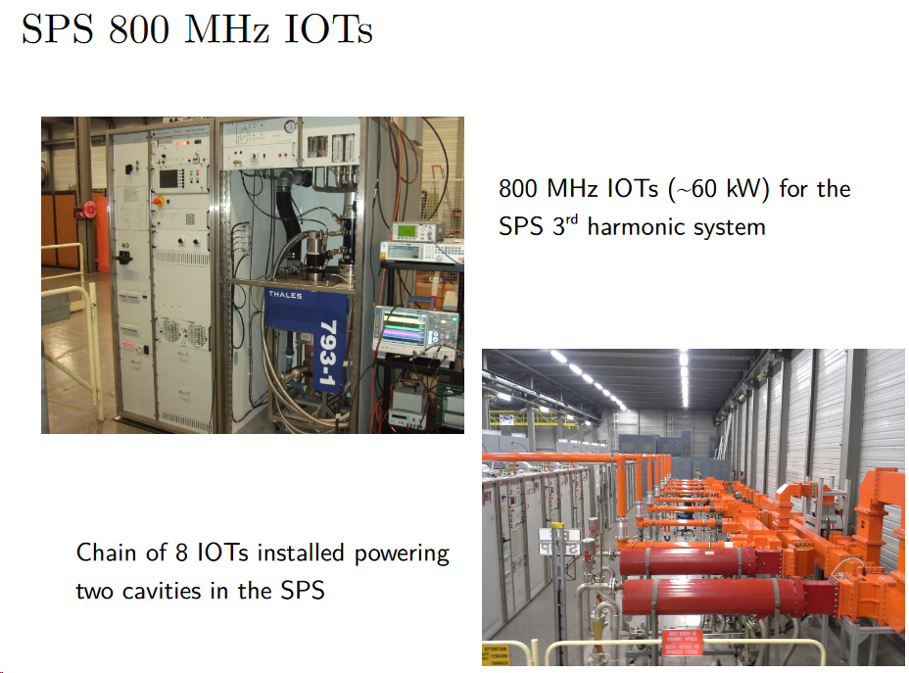
2015, LHeC Workshop
RF powering, proper dimensioning & appropriate bandwidth is key for a robust ERL

Slide 6
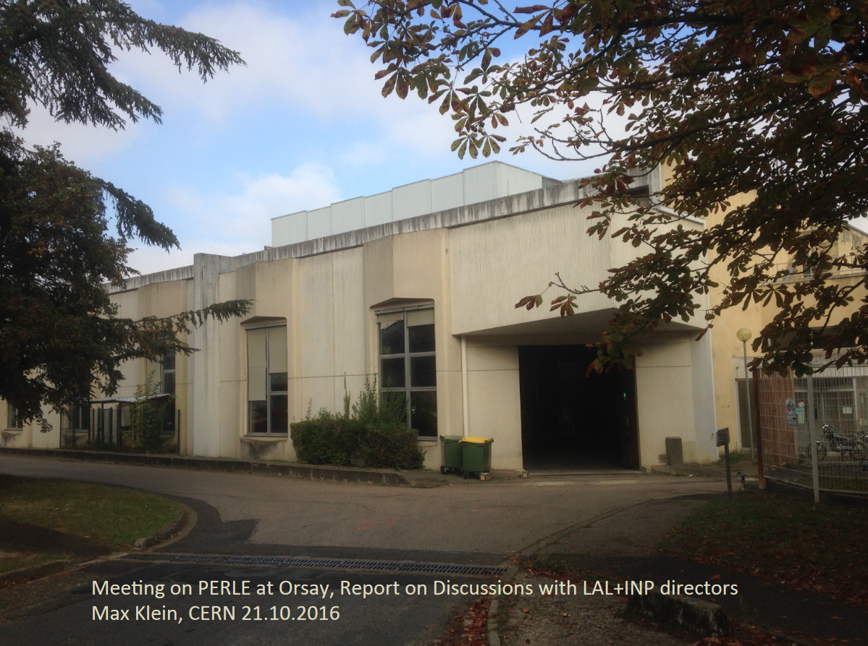
2016, LHeC/PERLE Workshop

Slide 7
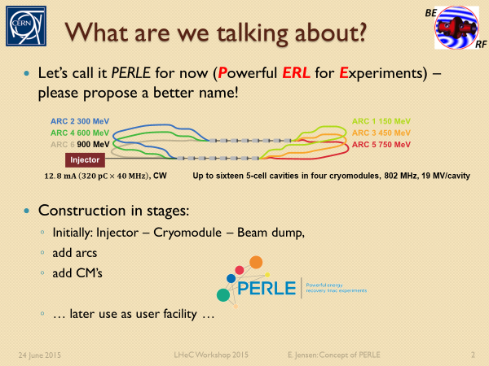
2016, LHeC Workshop

Slide 8
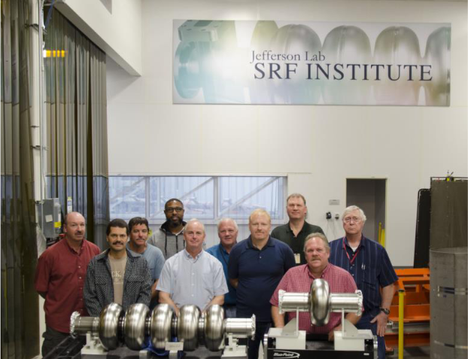
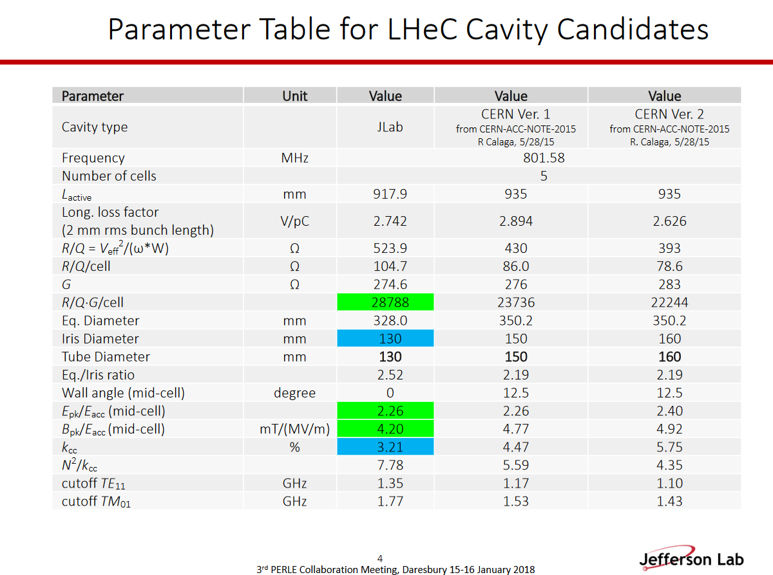
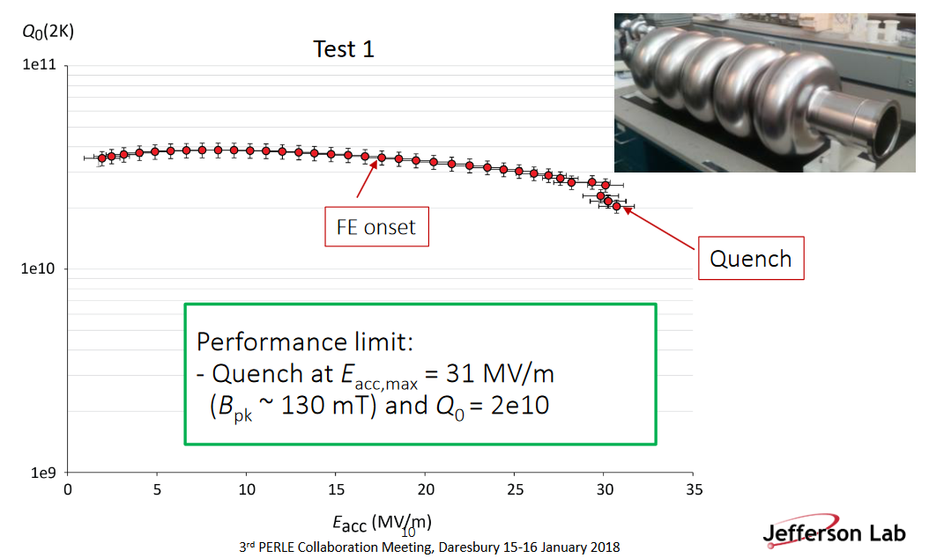
2017-18
A new Jlab design built under FCC-collaboration
and adopted for PERLE

Slide 9
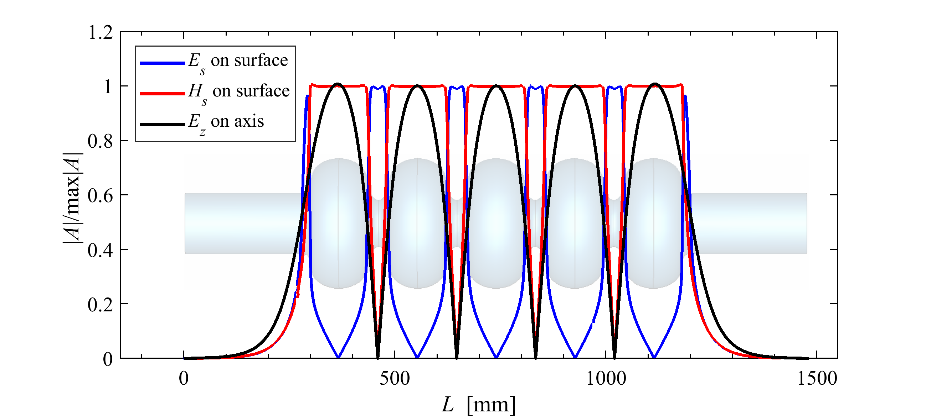
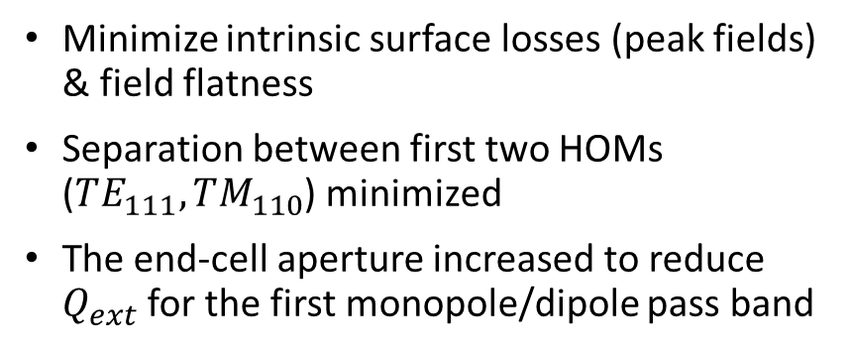
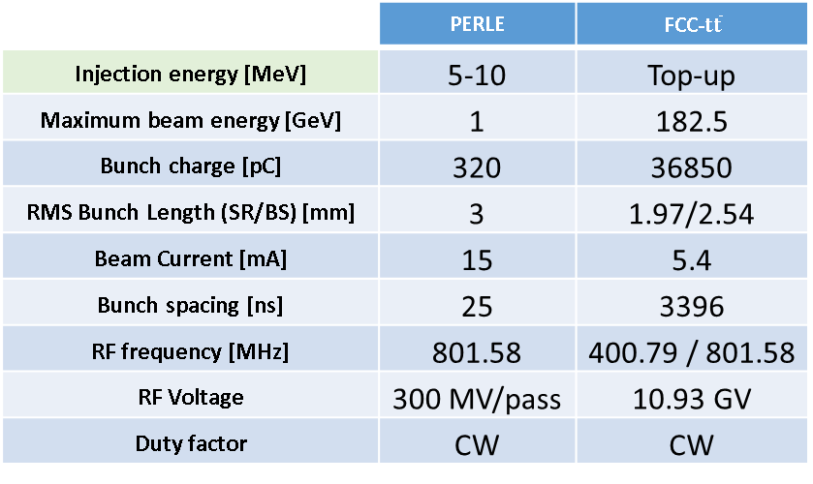
$t\overline{t}$ of FCC-ee studies, 2017-19
UROS, 5-cell 801.58 MHz
Minimize intrinsic surface losses (peak fields) & field flatness
Separation between first two HOMs ($TE_{111}, TM_{110}$) minimized
The end-cell aperture increased to reduce $Q_{ext}$ for the first monopole/dipole pass band
 | PERLE | FCC-$t\overline{t}$
Injection energy [MeV] | 5-10 | Top-up
Maximum beam energy [GeV] | 1 | 182.5
Bunch charge [pC] | 320 | 36850
RMS Bunch Length (SR/BS) [mm] | 3 | 1.97/2.54
Beam Current [mA] | 15 | 5.4
Bunch spacing [ns] | 25 | 3396
RF frequency [MHz] | 801.58 | 400.79 / 801.58
RF Voltage | 300 MV/pass | 10.93 GV
Duty factor | CW | CW
https://cds.cern.ch/record/2776785 (S. G. Zadeh thesis)

Slide 10
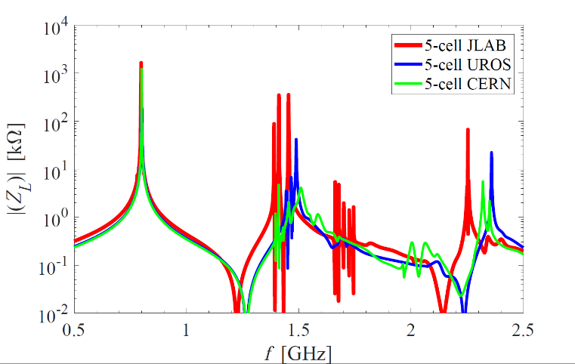
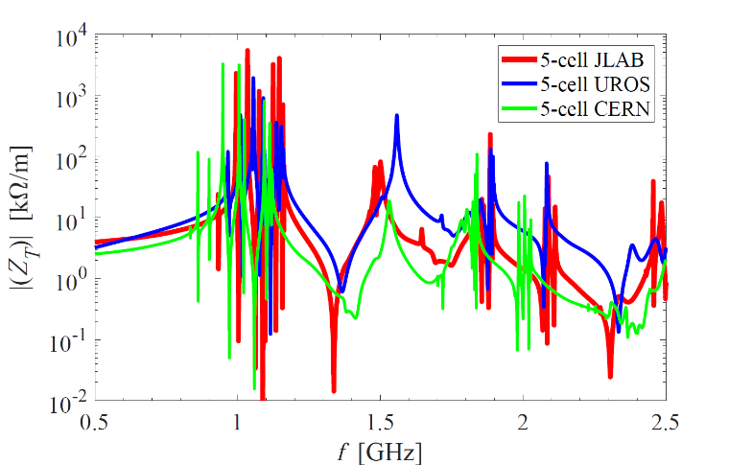
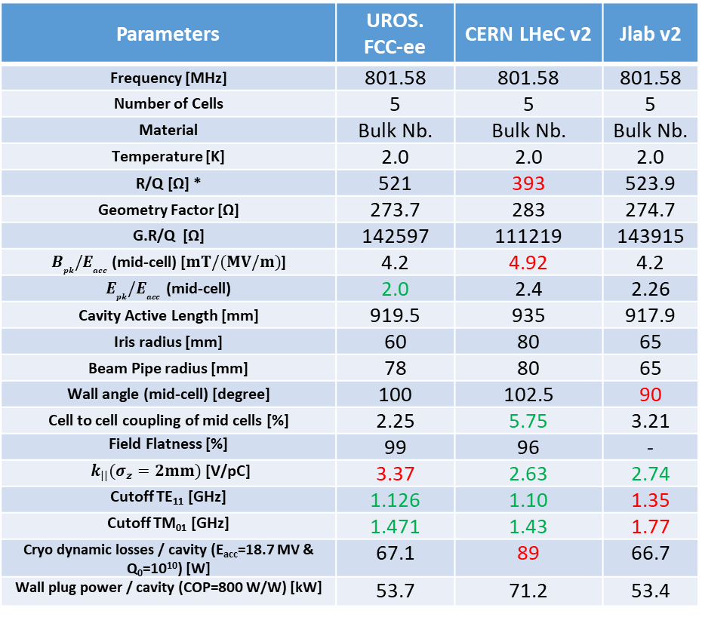
Cavity Comparisons (2018-19)
Parameters | UROS. FCC-ee | CERN LHeC v2 | Jlab v2
Frequency [MHz] | 801.58 | 801.58 | 801.58
Number of Cells | 5 | 5 | 5
Material | Bulk Nb. | Bulk Nb. | Bulk Nb.
Temperature [K] | 2.0 | 2.0 | 2.0
R/Q [Ω] * | 521 | 393 | 523.9
Geometry Factor [Ω] | 273.7 | 283 | 274.7
G.R/Q [Ω] | 142597 | 111219 | 143915
$B_{pk}{/E}_{acc}$ (mid-cell) [$mT/(MV/m)$] | 4.2 | 4.92 | 4.2
$E_{pk}{/E}_{acc}$ (mid-cell) | 2.0 | 2.4 | 2.26
Cavity Active Length [mm] | 919.5 | 935 | 917.9
Iris radius [mm] | 60 | 80 | 65
Beam Pipe radius [mm] | 78 | 80 | 65
Wall angle (mid-cell) [degree] | 100 | 102.5 | 90
Cell to cell coupling of mid cells [%] | 2.25 | 5.75 | 3.21
Field Flatness [%] | 99 | 96 | -
$k_{||}(σ_{z}=2mm)$ [V/pC] | 3.37 | 2.63 | 2.74
Cutoff TE₁₁ [GHz] | 1.126 | 1.10 | 1.35
Cutoff TM₀₁ [GHz] | 1.471 | 1.43 | 1.77
Cryo dynamic losses / cavity (E_{acc}=18.7 MV & Q₀=10¹⁰) [W] | 67.1 | 89 | 66.7
Wall plug power / cavity (COP=800 W/W) [kW] | 53.7 | 71.2 | 53.4
Monopole
Dipole
Note: Impedances are for bare cavity and the peaks are not fully resolved.
*Note: Input power not to be forgotten ($Qe \sim 8×{10}^{6}$ → 40-60 kW, detuning $\sim 50 Hz$)

Slide 11
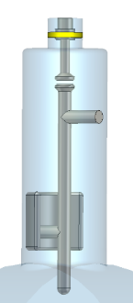
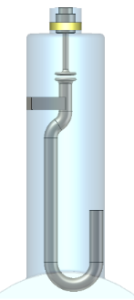
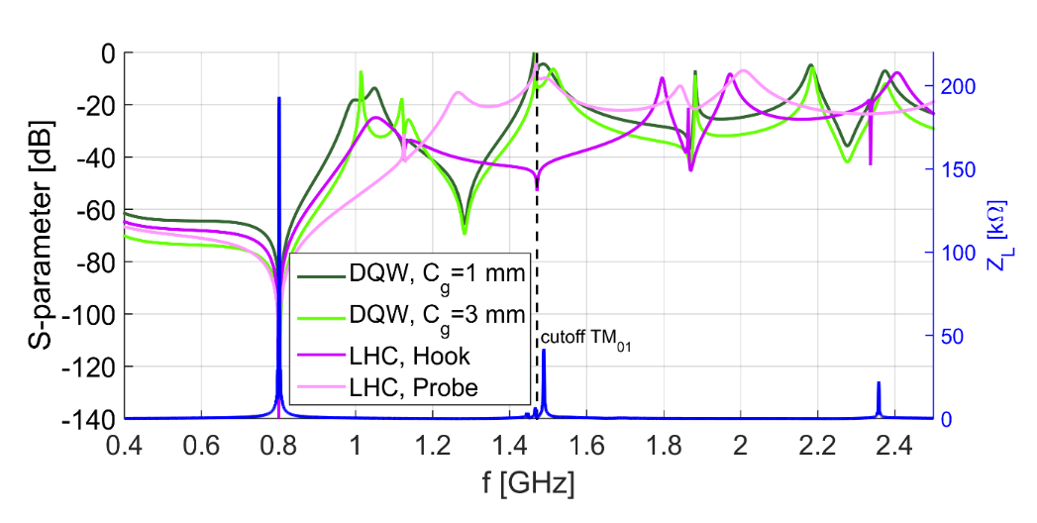
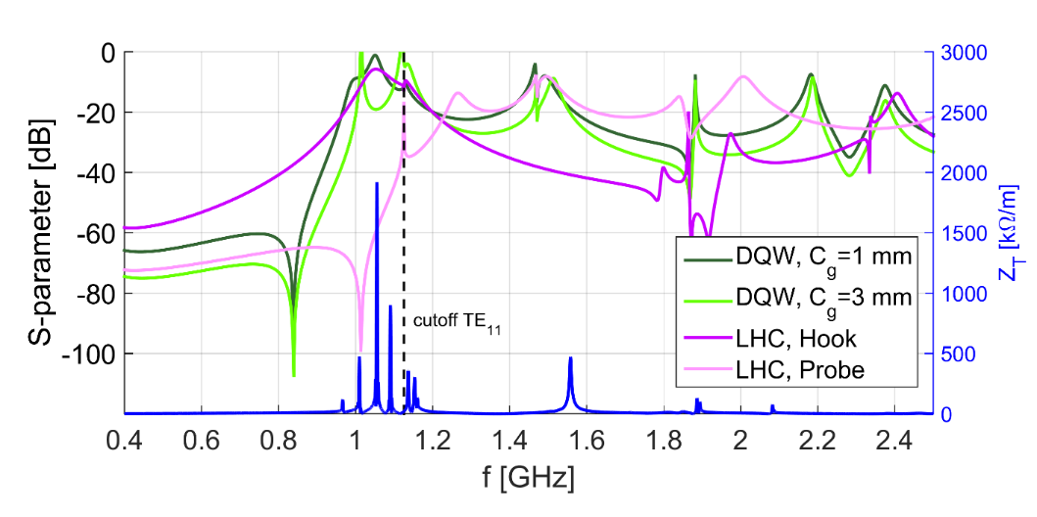
Coaxial HOM Couplers
The notch effect of all couplers is tuned to 801.58 MHz for the monopole coupling.
The DQW HOM coupler can deliver a high value of transmission at both first higher order dipole and monopole band.
LHC Probe-type
LHC Hook-type
DQW HOM Coupler
TM01-TEM transmission (Monopole coupling)
TE11-TEM transmission (Dipole coupling)
TE11-TEM transmission (Dipole coupling)
Impedances are for bare cavity and the peaks are not fully resolved.
https://cds.cern.ch/record/2776785 (S. G. Zadeh thesis)

Slide 12
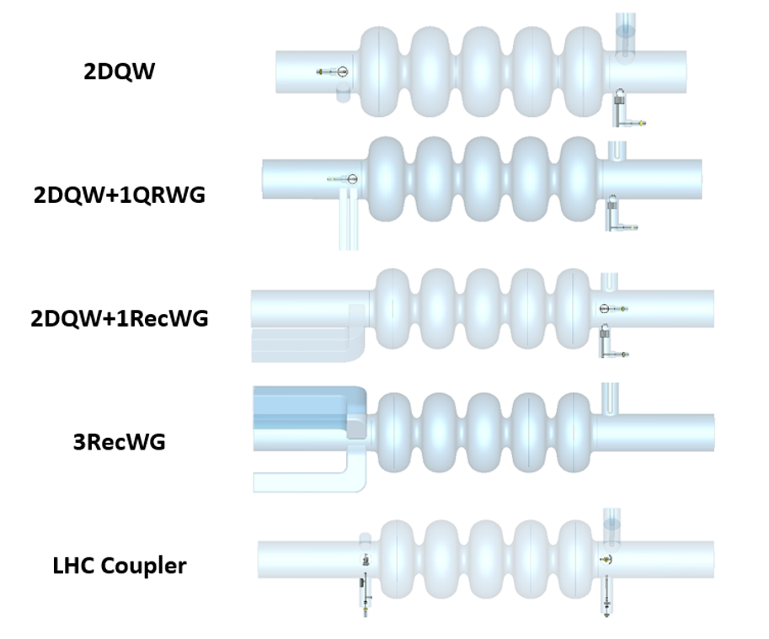

Damping schemes for the $t\overline{t}$ running
Five damping schemes are compared in the following slides. An extra “high freq” waveguide in addition to co-axial couplers is very effective for high power extraction with short bunches
7.7 m
https://cds.cern.ch/record/2776785 (S. G. Zadeh thesis)

Slide 13
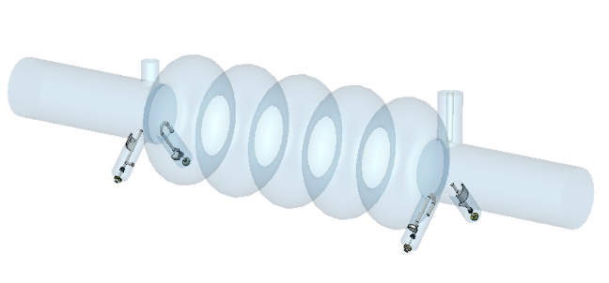
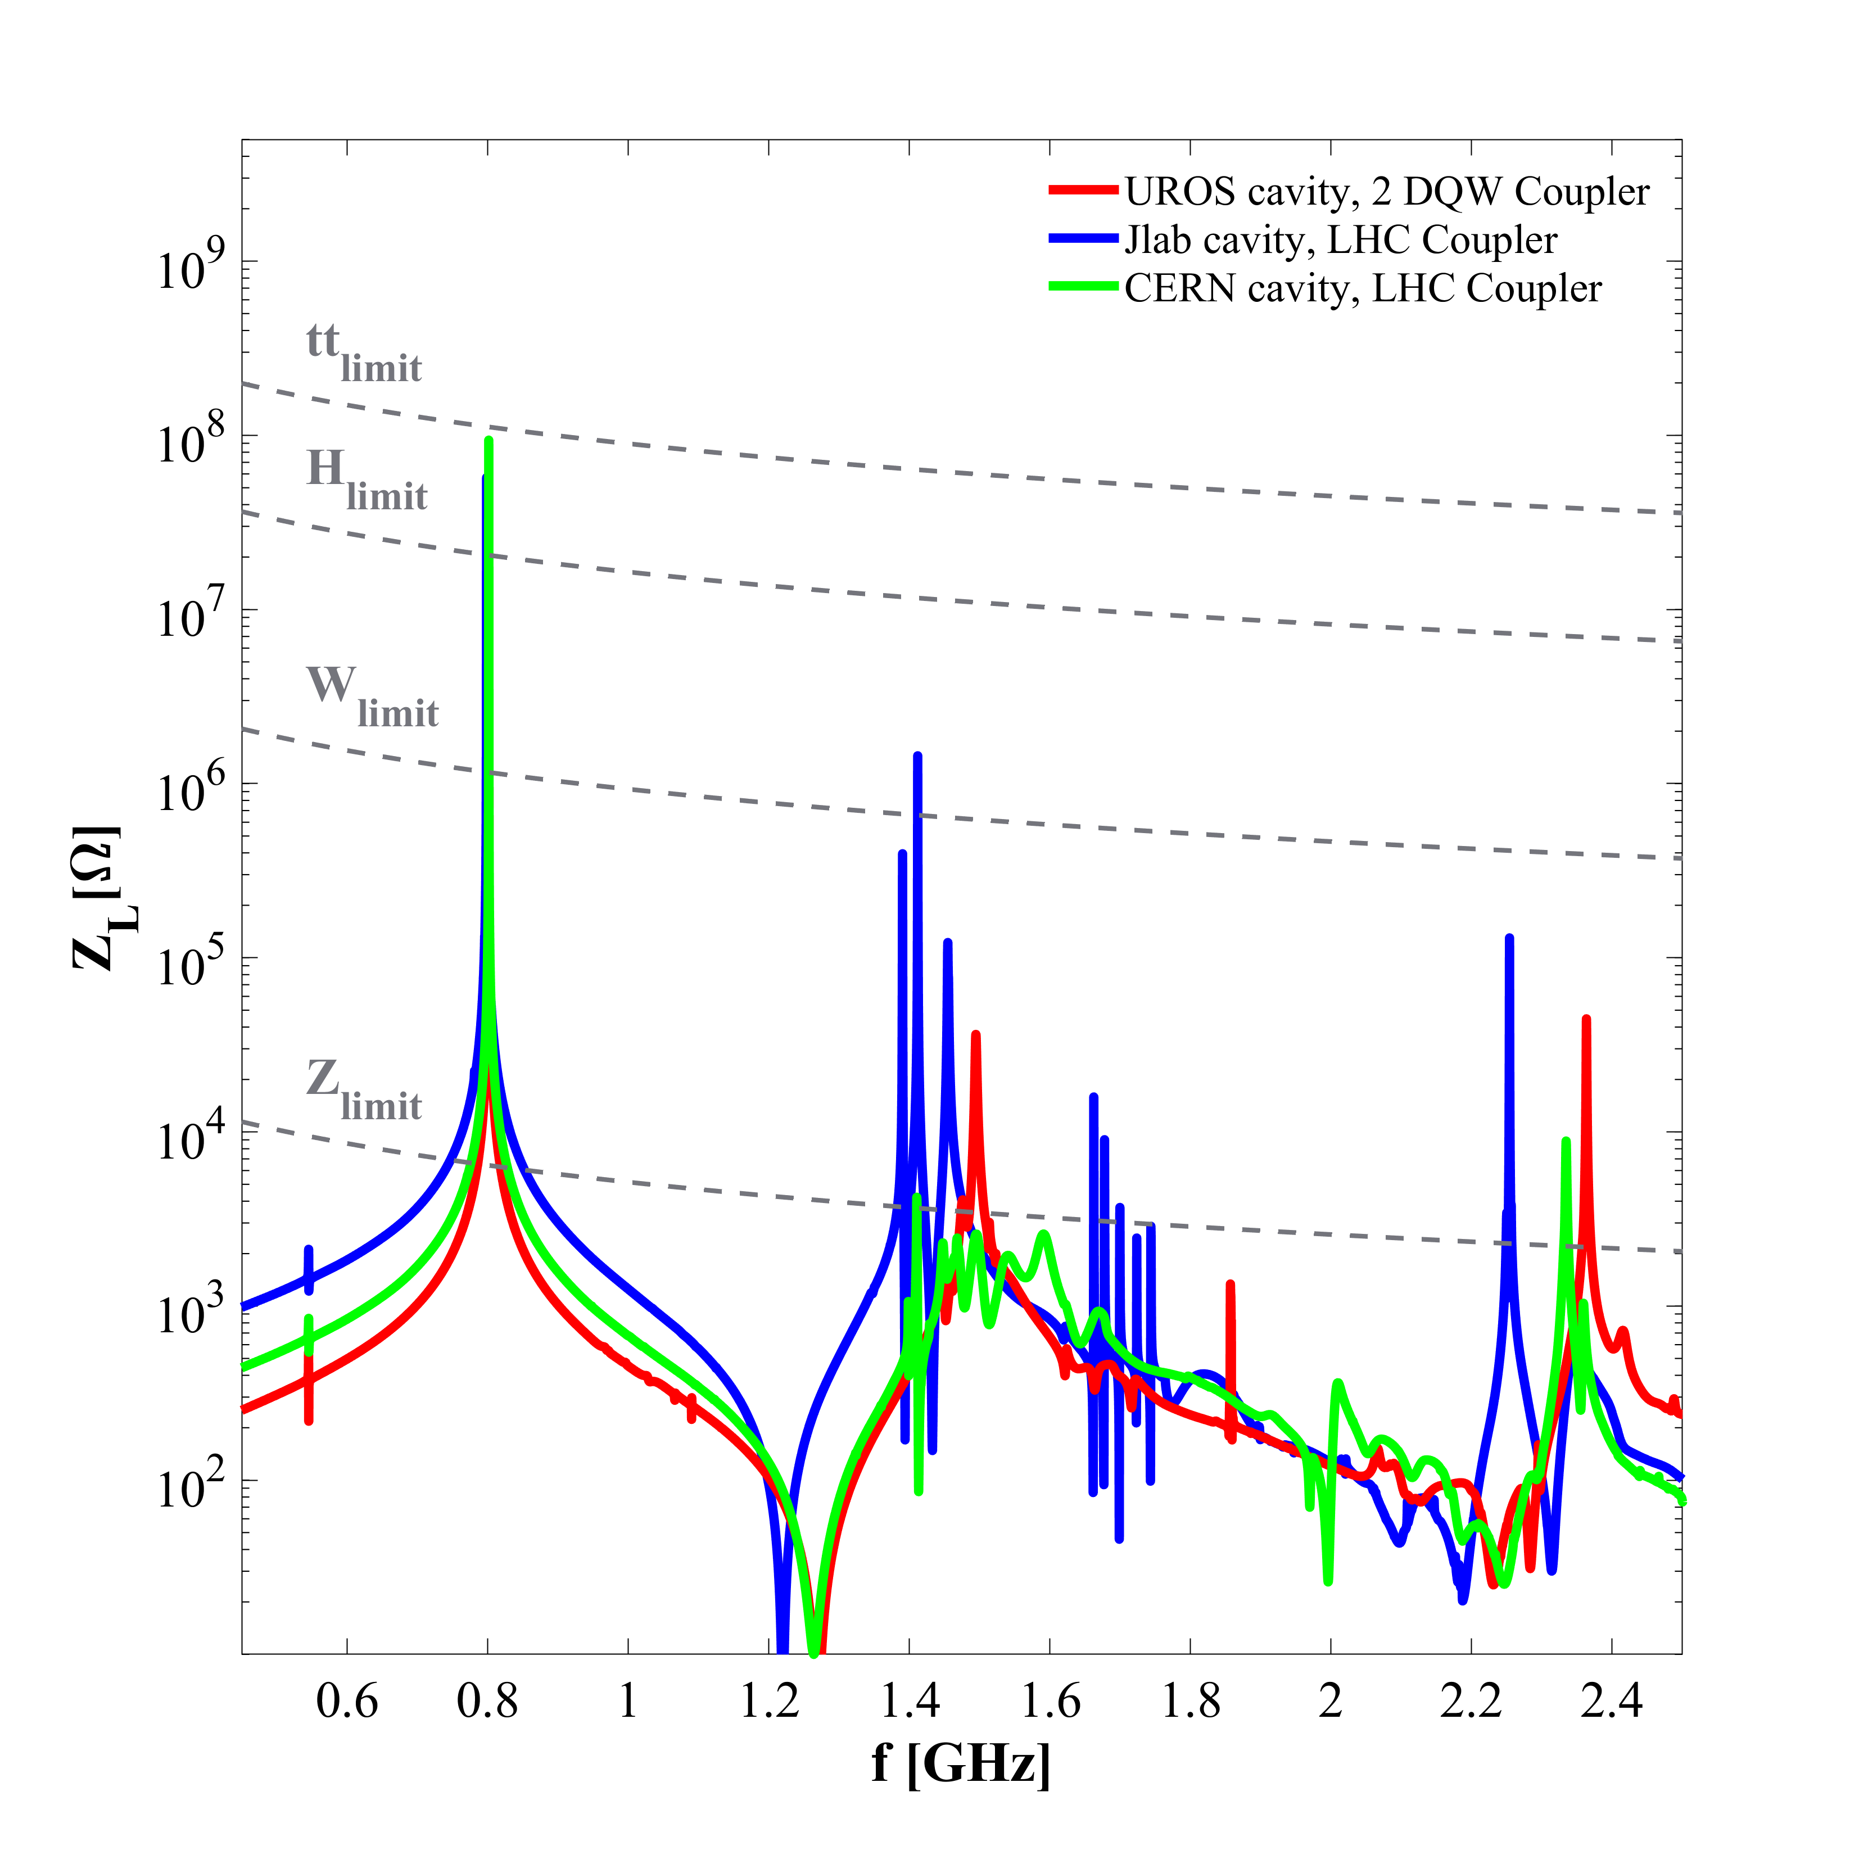
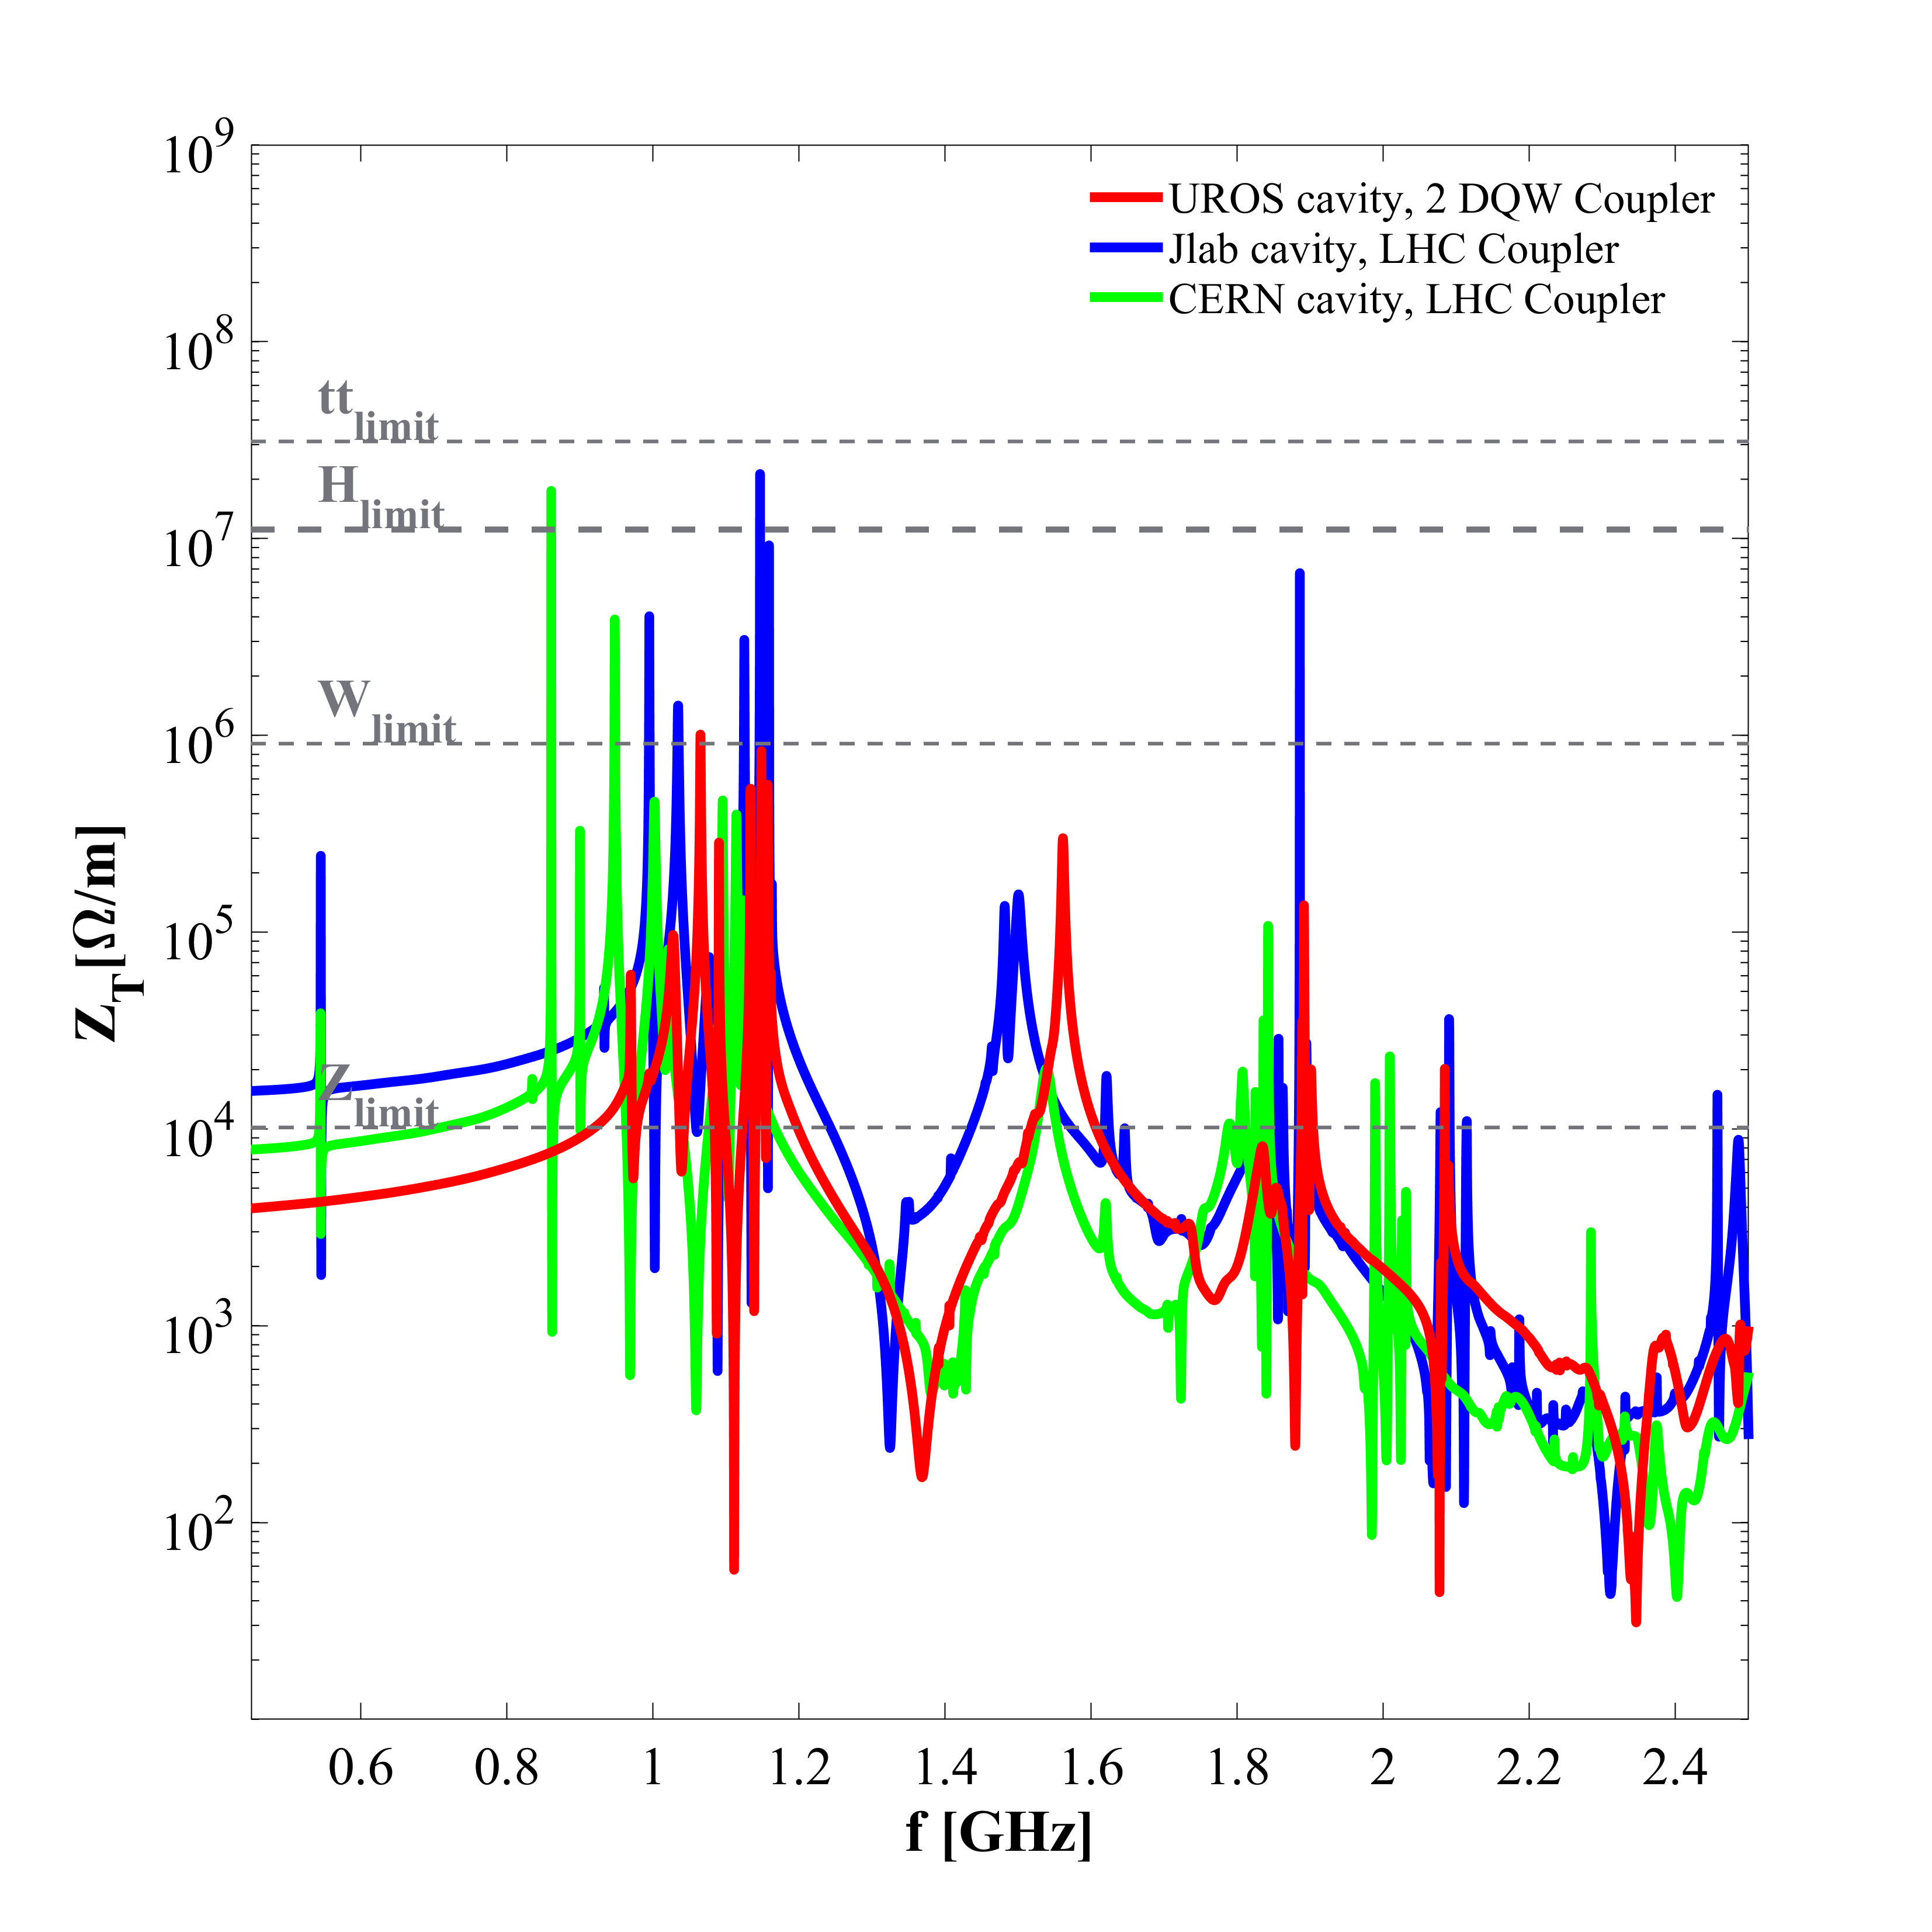
Cernv2, Jlab and UROS cavity impedance with coaxial HOM coupler
*There are different versions of Jlab cavity. For further information see “Next Generation HOM damping” by F. Marhauser
https://indico.in2p3.fr/event/19904/ (PERLE HOM meeting)

Slide 14
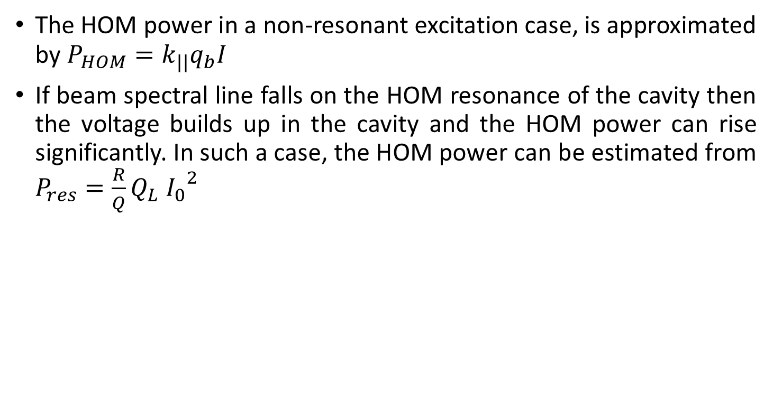
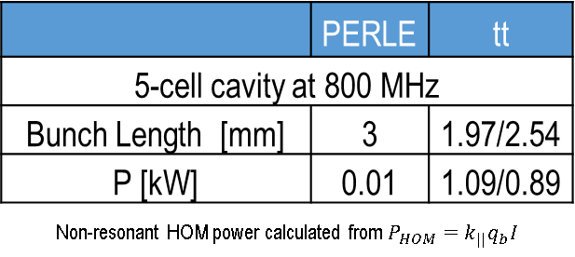
HOM power, UROS Cavity (2019)
The HOM power in a non-resonant excitation case, is approximated by $P_{HOM}=k_{||}q_{b}I$
If beam spectral line falls on the HOM resonance of the cavity then the voltage builds up in the cavity and the HOM power can rise significantly. In such a case, the HOM power can be estimated from $P_{res}=\frac{R}{Q}Q_{L}{ I_{0}}^{2}$
 | PERLE | tt
5-cell cavity at 800 MHz
f* [GHz] | P_{res} [W]
1.49 | 16 | 8
2.36 | 20 | 10
* Resonance excitation power of two monopole modes with the highest longitudinal impedance
 | PERLE | tt
5-cell cavity at 800 MHz
Bunch Length [mm] | 3 | 1.97/2.54
P [kW] | 0.01 | 1.09/0.89
Non-resonant HOM power calculated from $P_{HOM}=k_{||}q_{b}I$
https://indico.in2p3.fr/event/19904/ (PERLE HOM meeting)

Slide 15
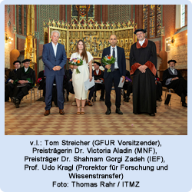
Joachim-Jungius-Förderpreis 2022 (01.07.2022)
Dr.-Ing. Shahnam Gorgi Zadeh (Institut für Allgemeine Elektrotechnik, Betreuerin Prof. Dr. rer. nat. habil. Ursula van Rienen) wird am 1. Juli 2022 mit dem Joachim-Jungius-Förderpreis 2022 der Gesellschaft der Förderer der Universität Rostock e.V. (GFUR) für seine Dissertation „Accelerating cavity and higher order mode coupler design for the Future Circular Collider“ ausgezeichnet. Die weiteren Preisträger sind Dr. Victoria Aladin und Dr. Lukas Kölsch (beide Mathematisch-Naturwissenschaftliche Fakultät).
Thesis completed with a special mention of summa cum laude!

Slide 16
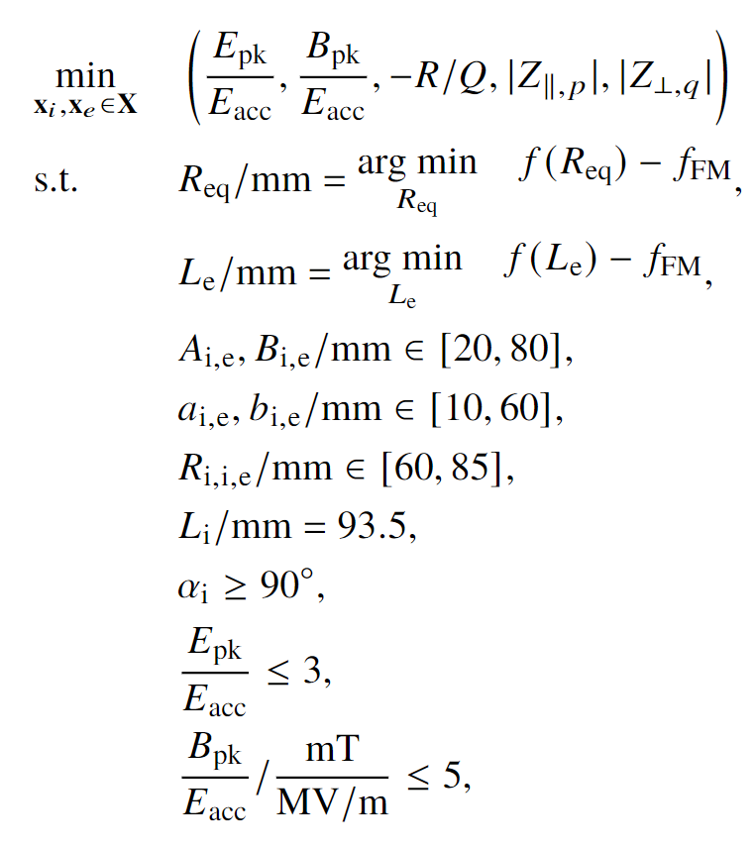
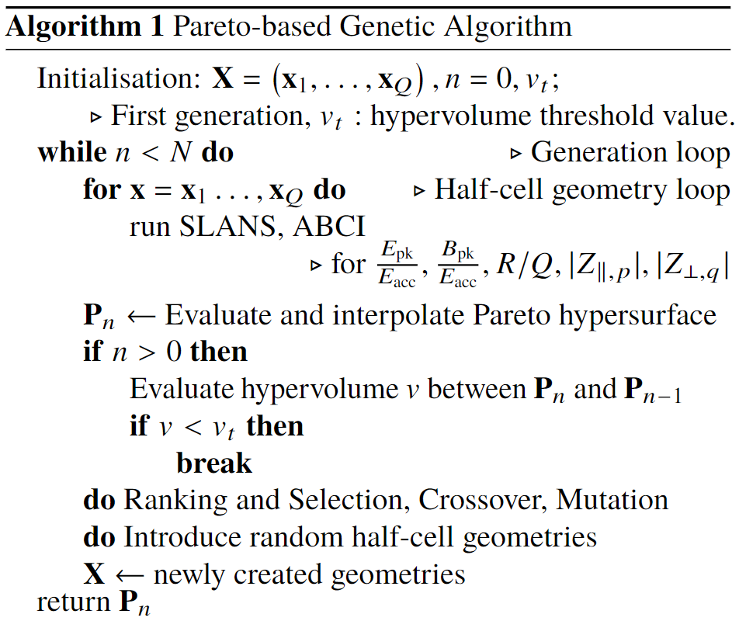
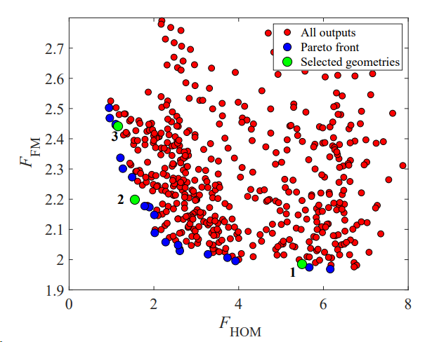
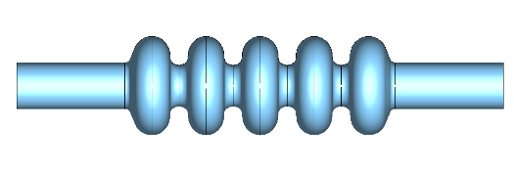

Can we improve further the UROS 5-cell design for ttbar and full energy booster ? (Thesis subject of S. Udongwo)
FCC-ee $t\overline{t}$studies, 2021-23
Objective function
Multi-objective optimisation algorithm
Cavity Designs
C3795
https://zenodo.org/record/7661145

Slide 17
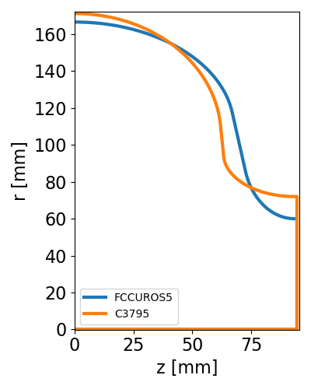
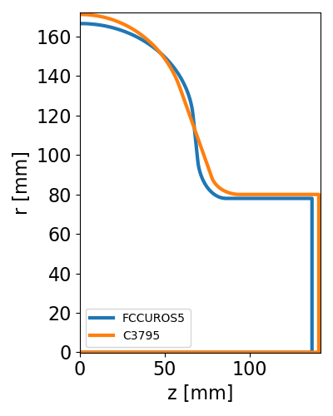
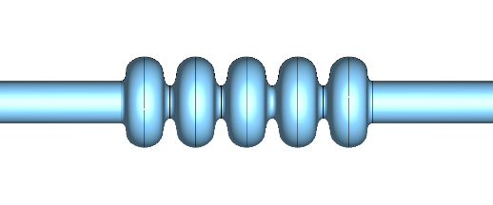
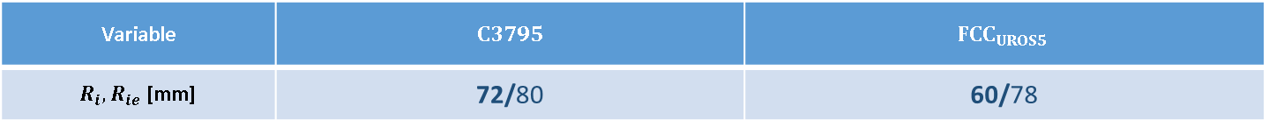


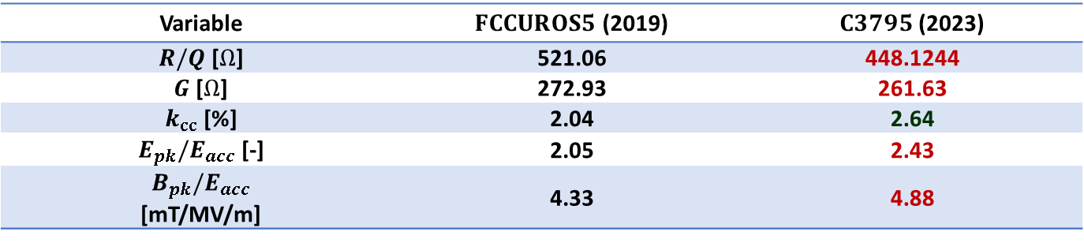
FCC-ee $t\overline{t}$studies, 2021-23
Variable | $$C3795$$ | $$FCC_{UROS5}$$
$R_{i}, R_{ie}$ [mm] | 72/80 | 60/78
$$C3795$$
Mid half-cell contour
End half-cell contour
$$FCCUROS5$$
Variable | $FCCUROS5$ (2019) | $C3795$ (2023)
$R/Q$ [$Ω$] | 521.06 | 448.1244
$G$ [$Ω$] | 272.93 | 261.63
$k_{cc}$ [%] | 2.04 | 2.64
$E_{pk}/E_{acc}$ [-] | 2.05 | 2.43
$$B_{pk}/E_{acc}$$ [mT/MV/m] | 4.33 | 4.88

Slide 18
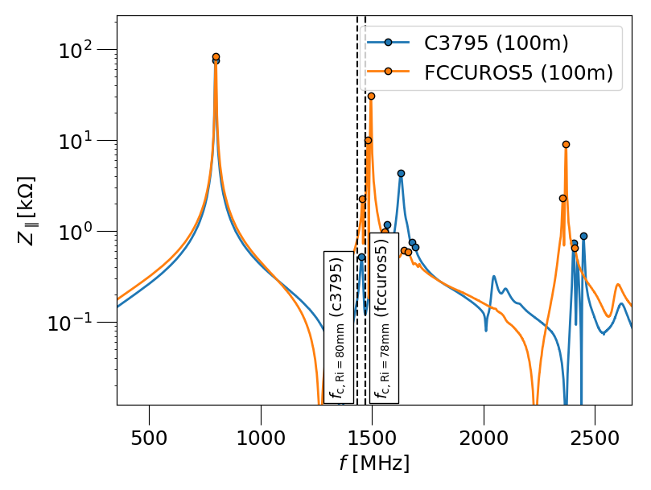
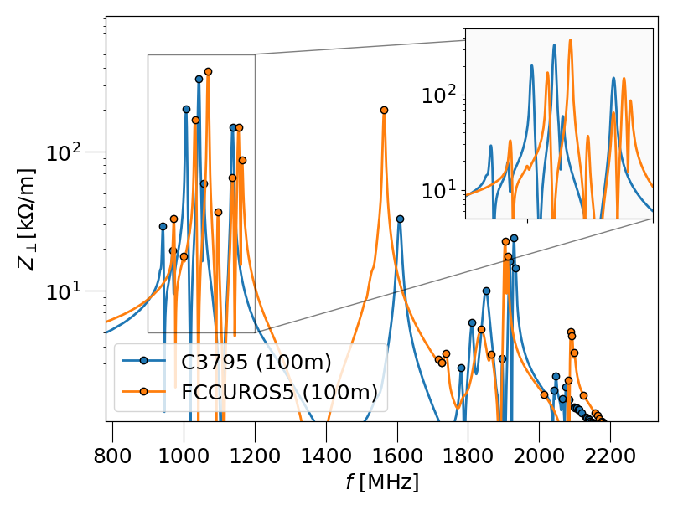
FCC-ee $t\overline{t}$studies, 2021-23
Compromise the fundamental mode performance for HOM improvement. The goal is longitudinal “HOM free” multi-cell cavity which should also reduce the overall HOM power for short e-bunches
Longitudinal impedance
Transverse impedance

Slide 19
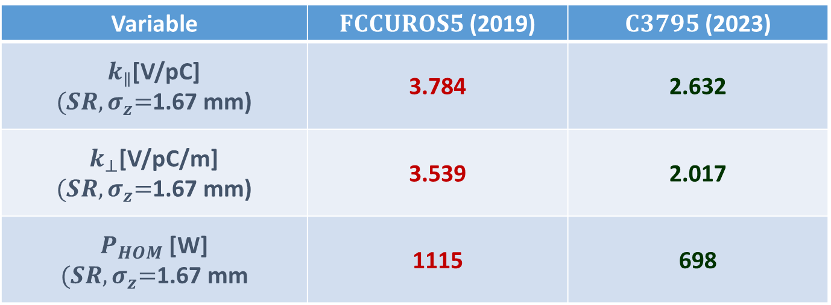
HOM Figures of Merit Comparison
FCC-ee $t\overline{t}$studies, 2021-23
Variable | $FCCUROS5$ (2019) | $C3795$ (2023)
$k_{∥}$[V/pC] ${(SR,σ}_{z}=$1.67 mm) | 3.784 | 2.632
$k_{⊥}$[V/pC/m] ${(SR,σ}_{z}=$1.67 mm) | 3.539 | 2.017
$P_{HOM}$ [W] ${(SR,σ}_{z}=$1.67 mm | 1115 | 698
Beam Current [mA] = 10mA, Bunch Intensity $N_{b}$ [$10^{11}$] = 2.26

Slide 20
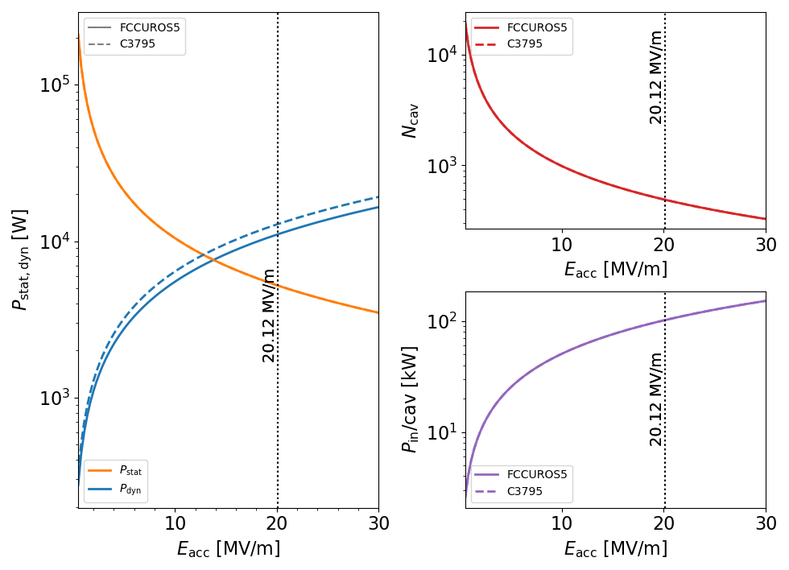
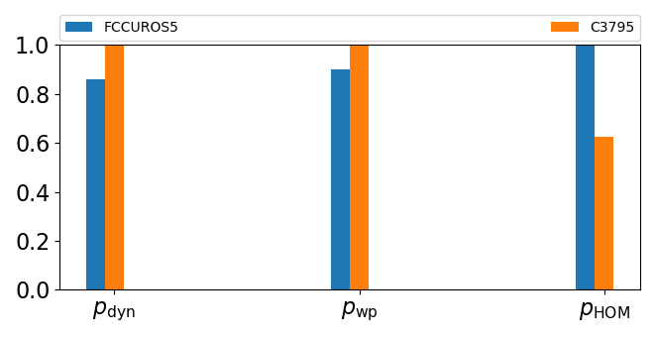
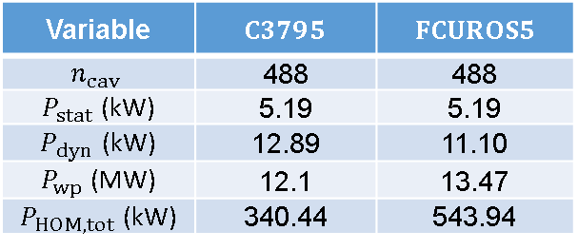


Power Comparison
FCC-ee $t\overline{t}$studies, 2023
Assumed $Q_{0}=$ $3.0E10$
Variable | $$C3795$$ | $$FCUROS5$$
$$n_{cav}$$ | 488 | 488
$P_{stat}$ (kW) | 5.19 | 5.19
$P_{dyn}$ (kW) | 12.89 | 11.10
$P_{wp}$ (MW) | 12.1 | 13.47
$P_{HOM, tot}$ (kW) | 340.44 | 543.94
Bar plot summary dynamic, wall and HOM power comparison.
Plot of static and dynamic power loss, no of cav and input power ($P_{in})$ vs $E_{acc}$

Slide 21
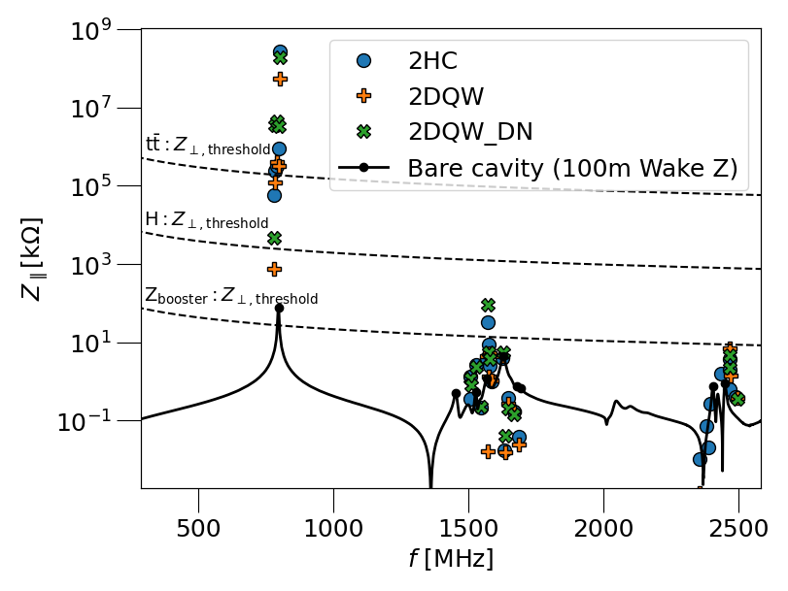
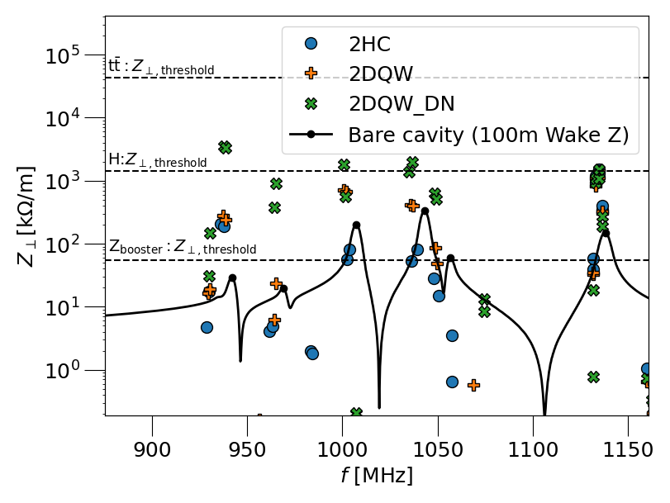
C3795 HOM performance, FCC-ee
*
*
Cavity + HOM coupler assembly longitudinal impedance plot
Cavity + HOM coupler assembly transverse impedance plot showing first dipole passband modes
*Assumed current for Z-booster operating point is 128mA

Slide 22
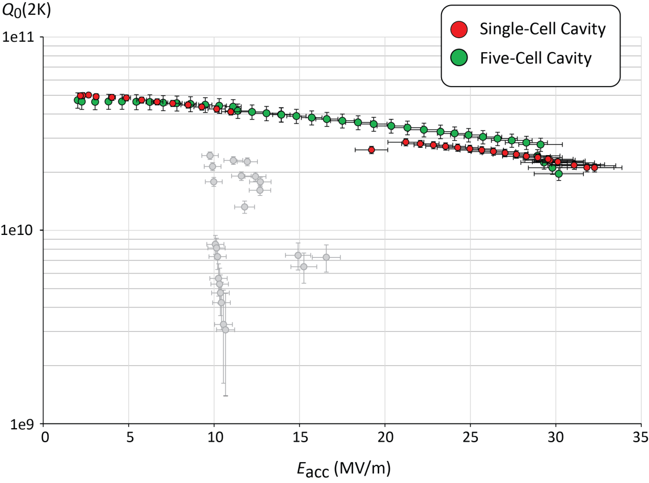
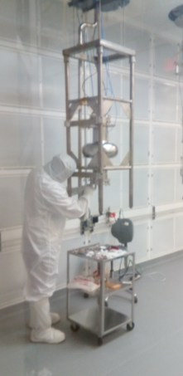




Jlab Cavity at FNAL (high $Q_{0}$)
FCC Week 2018
defect at equator weld, likely worsened by EP
FCC Week 2023
17 MV/m
S. Posen, FCC Week 2023

Slide 23



Next Steps, Prototype
5-cell cavity at FNAL for testing (S. Posen)
  Test cavity as received
  with mid-T bake, EP, mid-T bake → test
  $Nb_{3}Sn$ coating trials (tbc)
Single cell copper cavities at CERN for Nb-Coating
  Nb coating on Cu single cell in preparation
  Recent studies on 1.3 GHz seamless cavities shows promising results & Q-slope mitigation with HIPIMS coating

Slide 24
Final Comments
It took more than a decade to convince the accelerator community that 800 MHz (and nearby frequencies) are optimum for high current machines CW machines
PERLE made the step forward to embark on this journey & will likely set the standard for such technology
In my personal opinion, this will be a necessary step to implement an eventual FCC-ee/eh with 800 MHz

Slide 25

https://accelconf.web.cern.ch/SRF2015/papers/frba04.pdf

