Slide 1


Module assembly validation studies of ITkPix
21.04.23
Marianne Brekkum

Slide 2


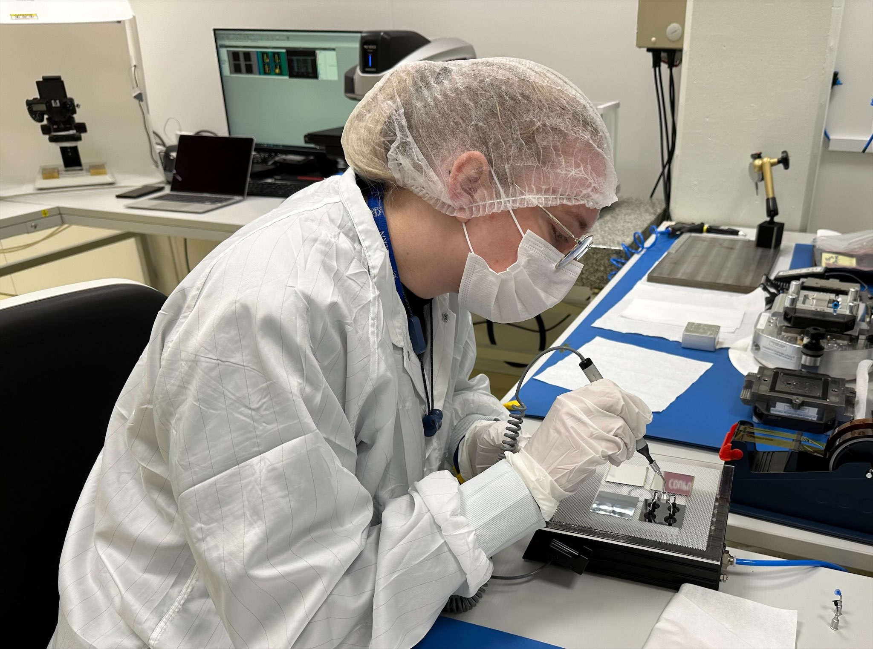
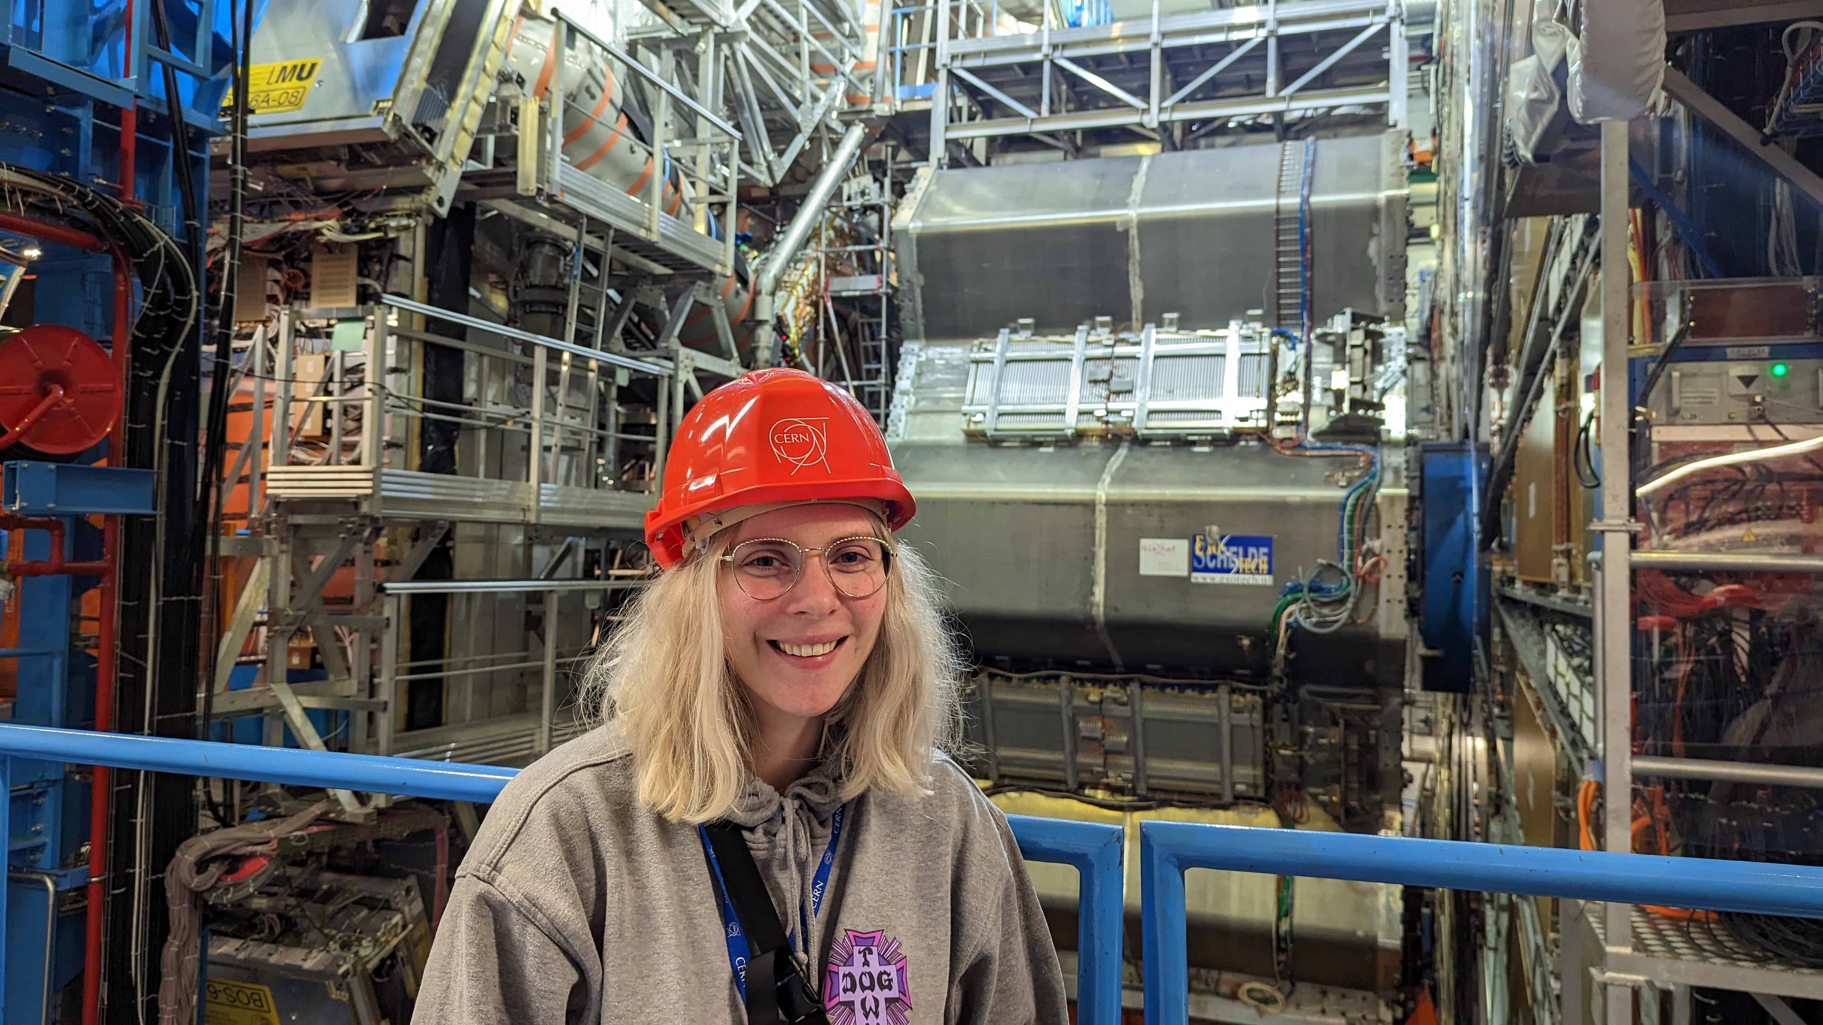
A bit about me
Marianne Brekkum, 26 years old from Oslo
Hight school studies: Electro (Etterstad VGS),
Computer electronics (Kuben VGS/Bournemouth and Poole college),
Space technology (Andøy VGS)
Pre-course in engineering at UiT in Bodø
Worked in costumer service for ~2 years at Komplett.no
BCs in Micro- and nano technology with electronics
(Electronic systems design) at USN Bakkenteigen
Bachelor thesis with the ALICE experiment at CERN in May 2022
Technical student with the ATLAS experiment from 1. September 2022
(EP-ADE-TK)

Slide 3
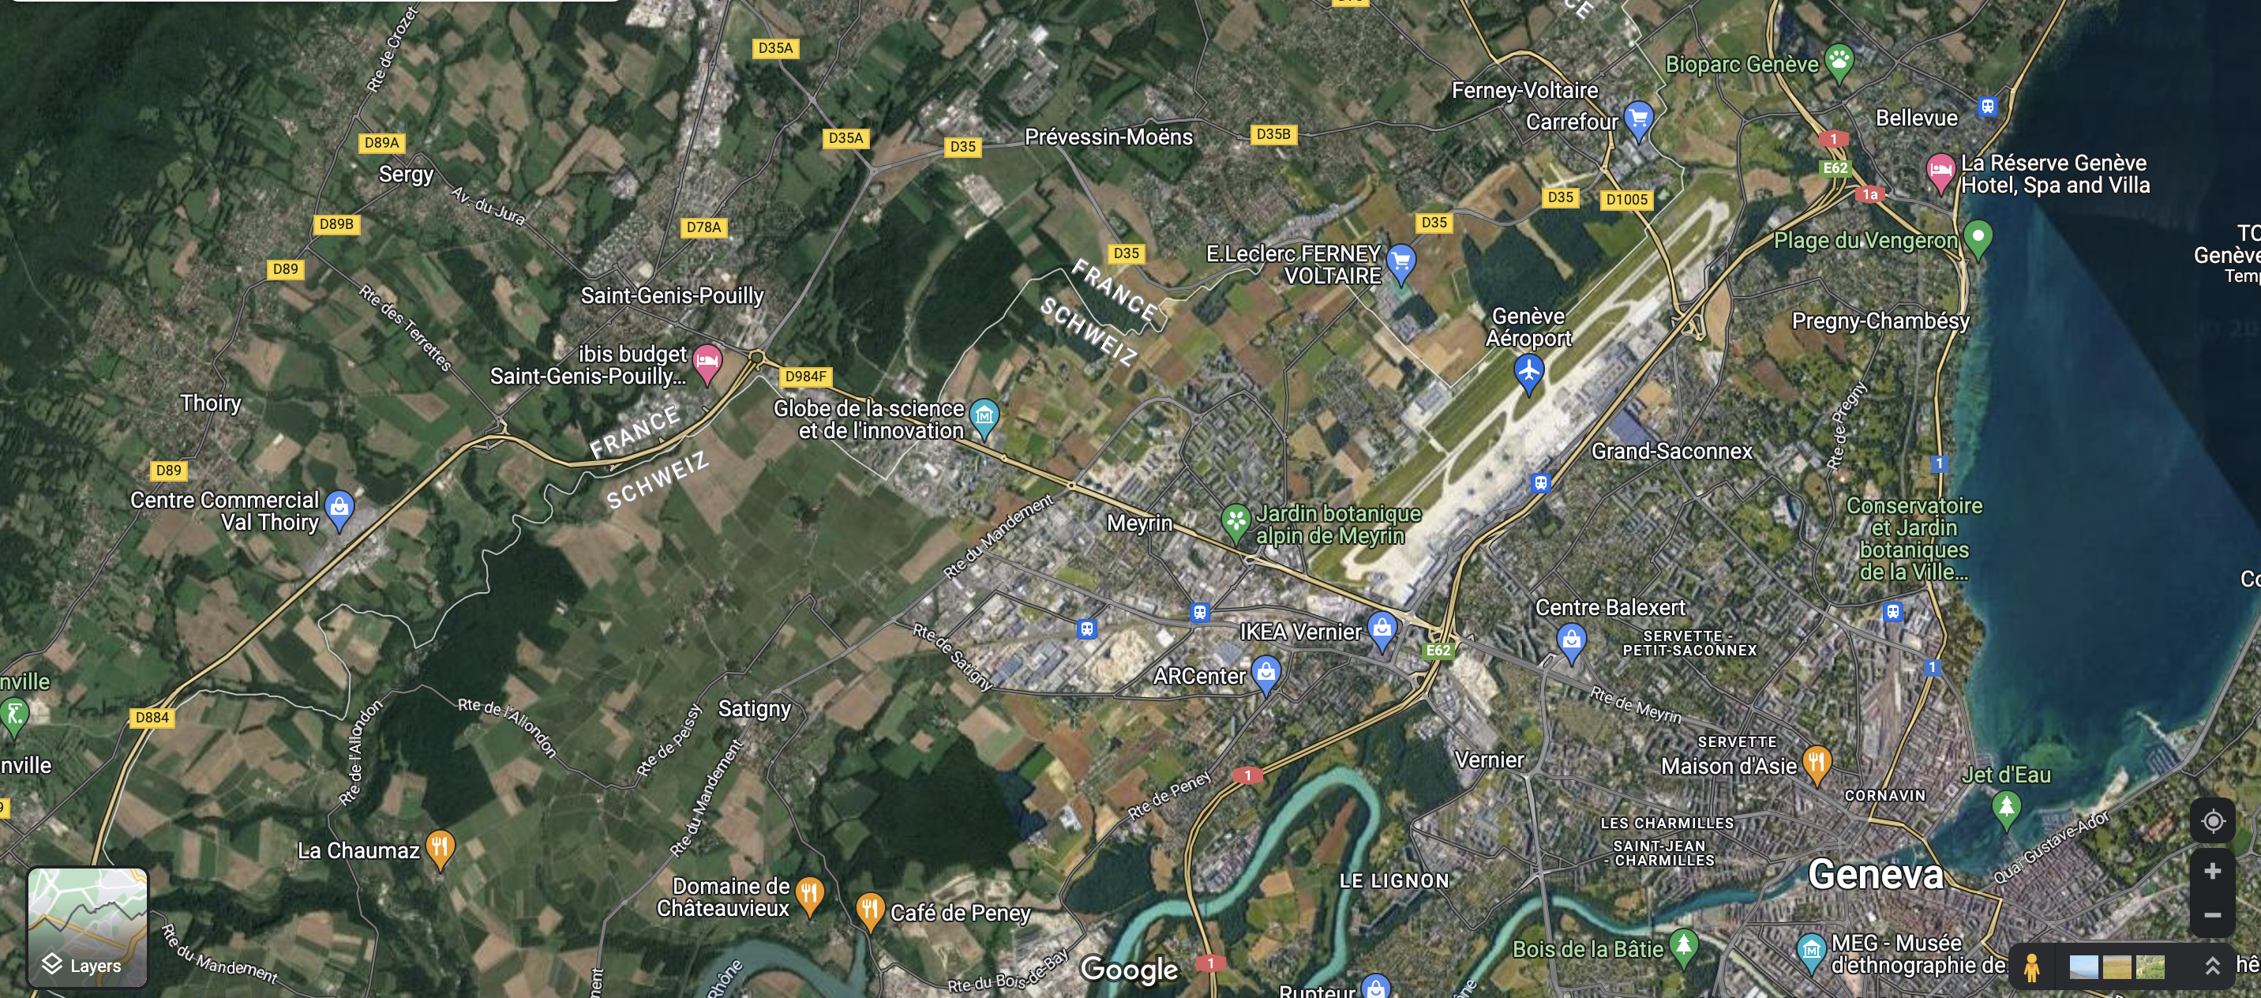
Locations
ALICE
CERN Prevessin site
LHCb
ATLAS
LHC
CERN Meyrin site

Slide 4
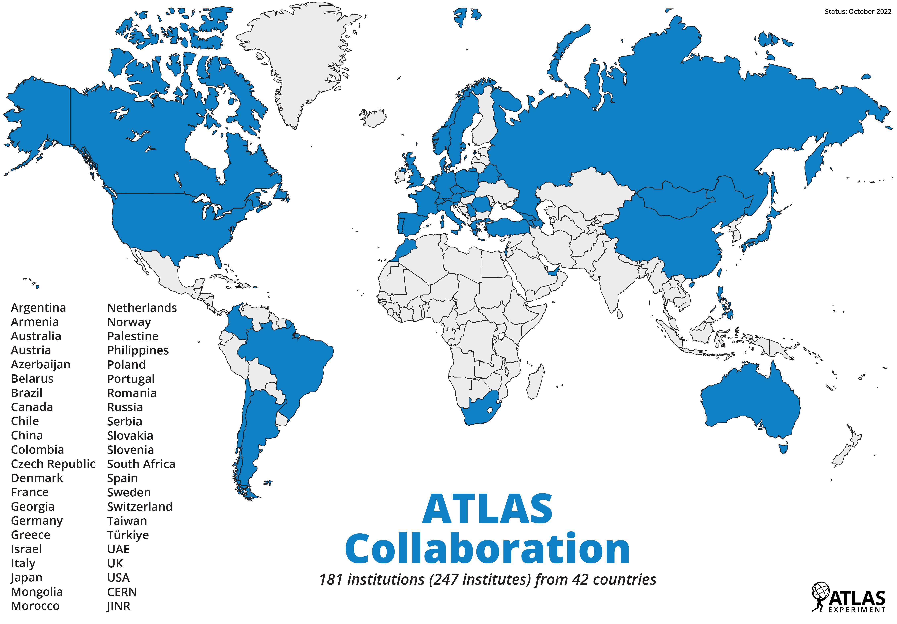
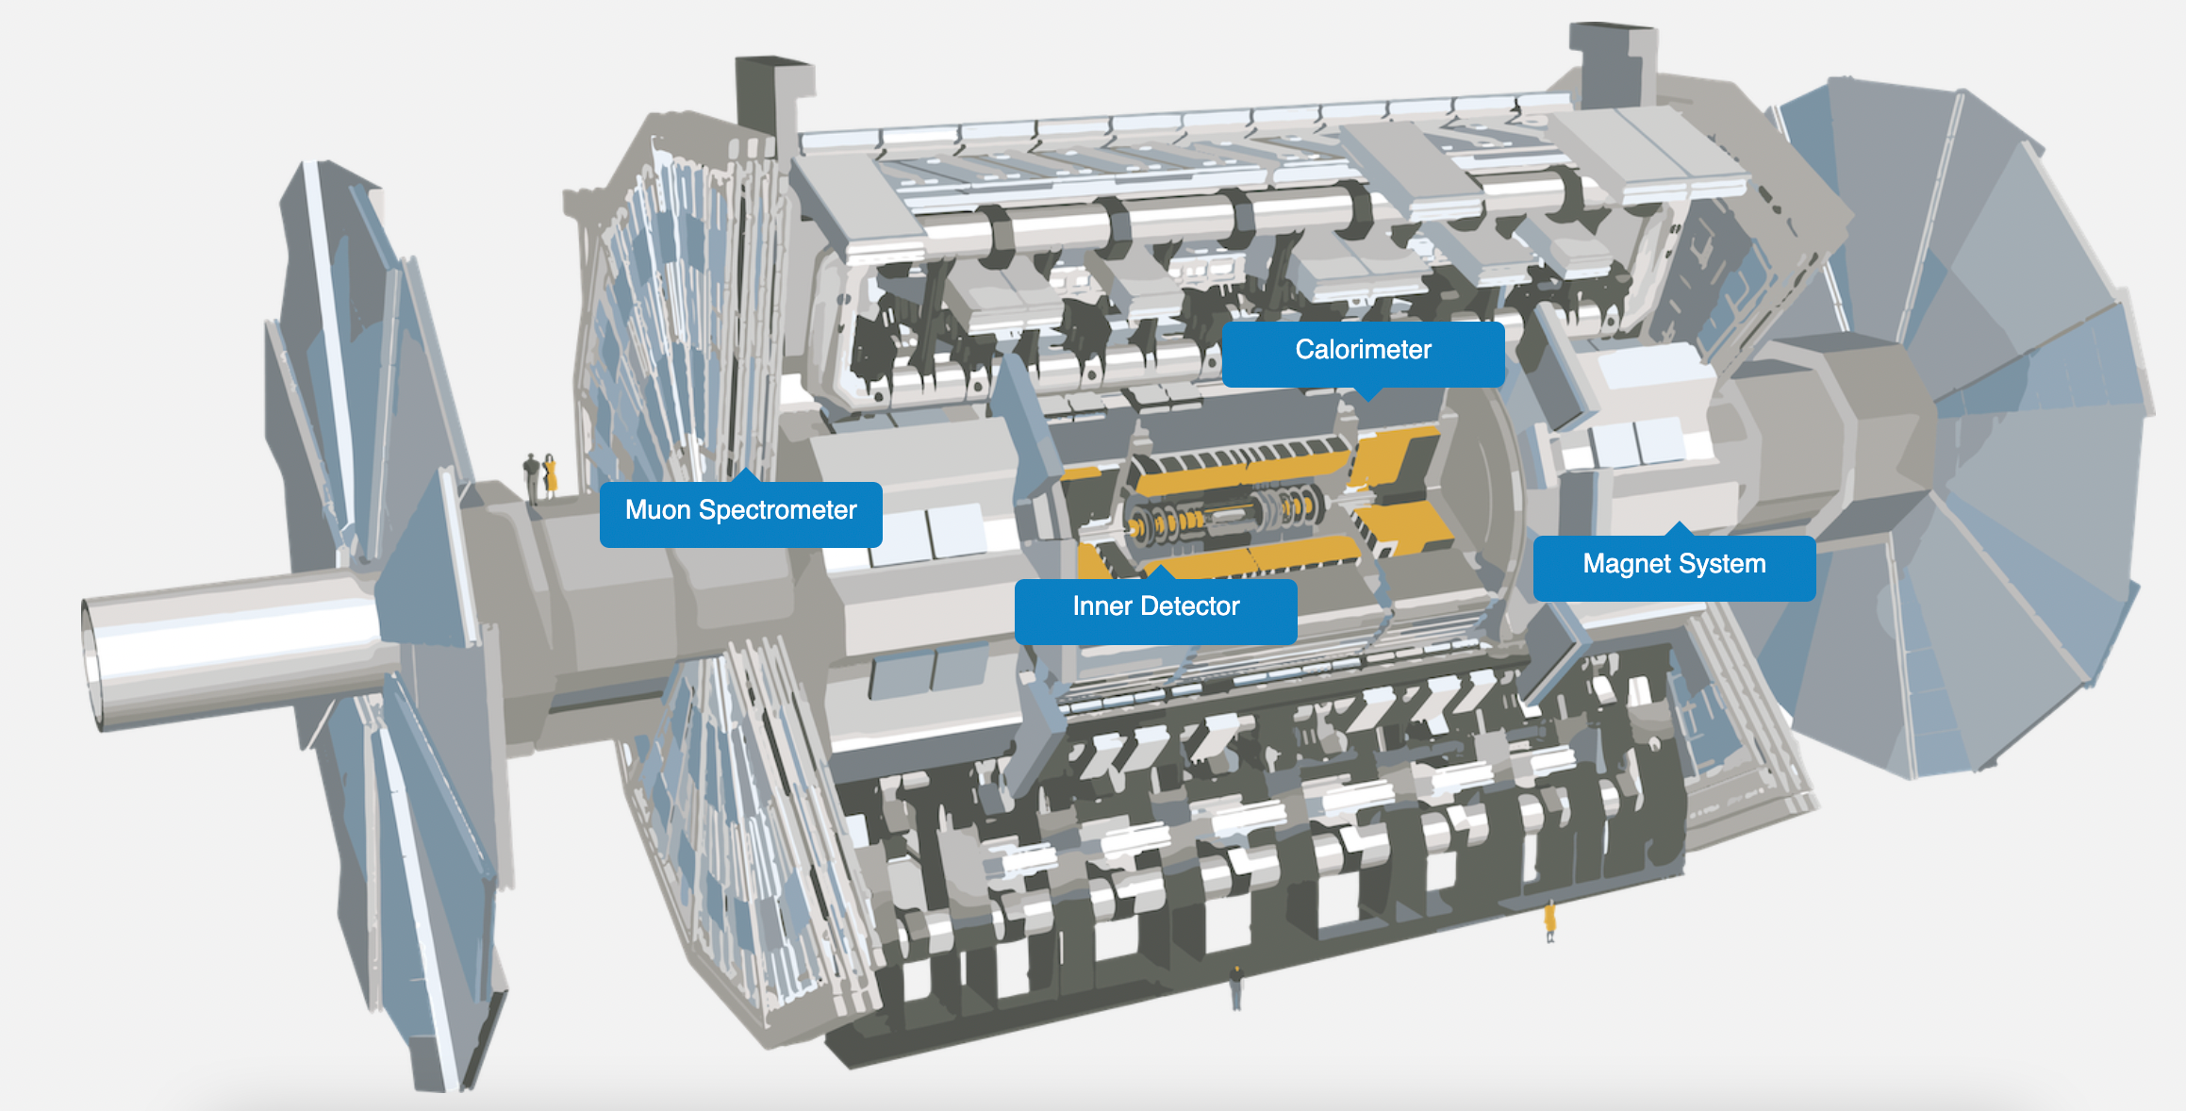
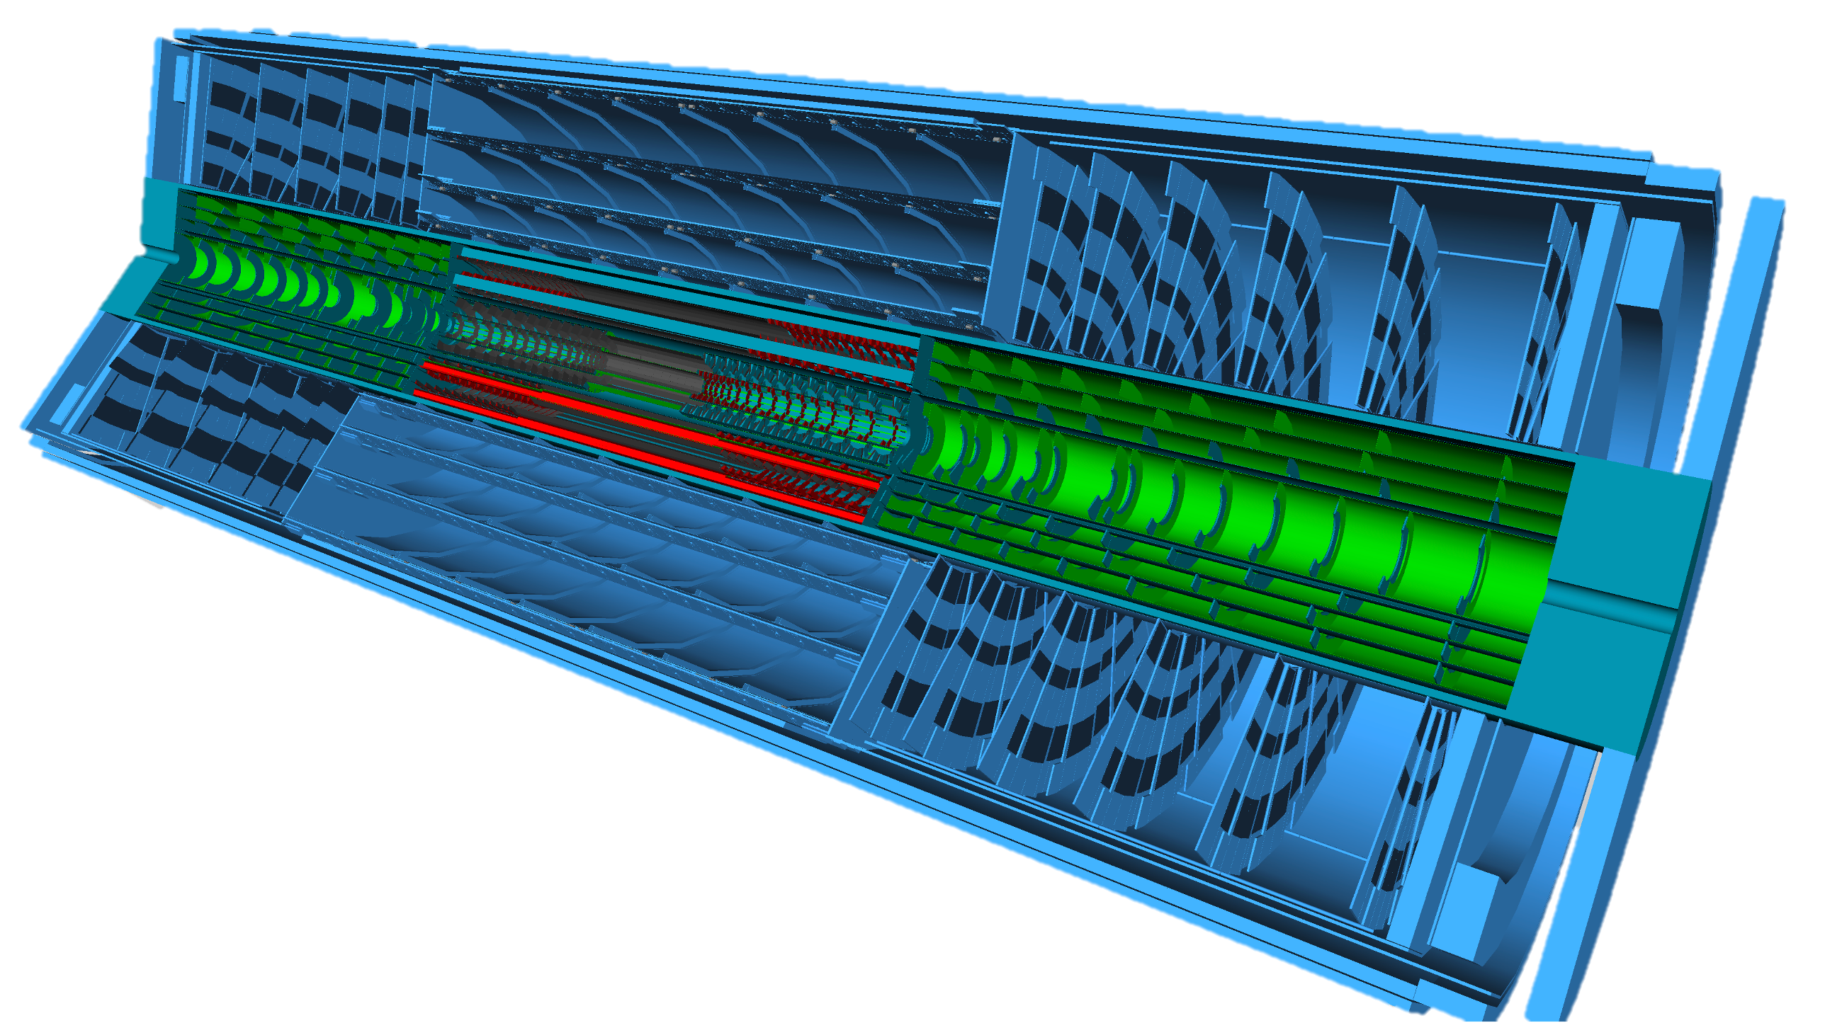
The ATLAS experiment
A Toroidal LHC Apparatus (ATLAS)
46m x 25m, 100m underground, 7000 tonnes
My work focusses on the production of modules (ITkPix) that will be placed within the new pixel inner tracker
Current ATLAS experiment
Planned upgrade of the Inner Tracker (after 2025)
Technical Design Report ATLAS Inner Tracker Pixel Detector,
CERN, ATLAS Collaboration, 2017
https://atlas.cern/Discover/Detector

Slide 5
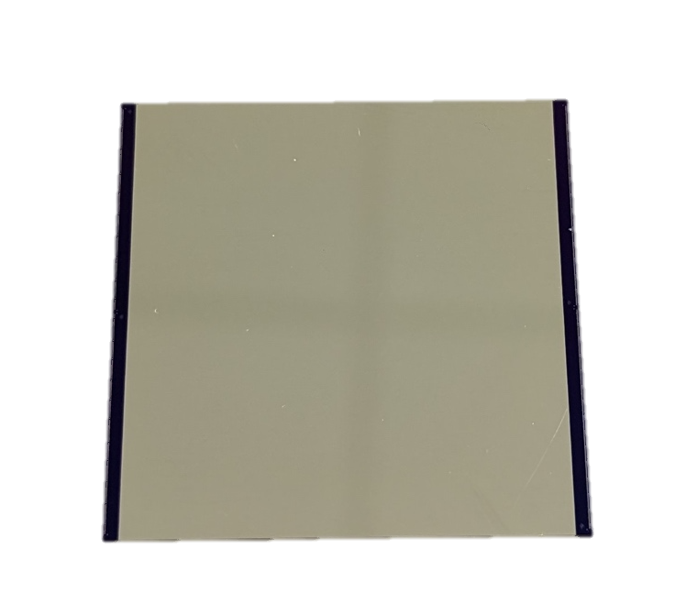
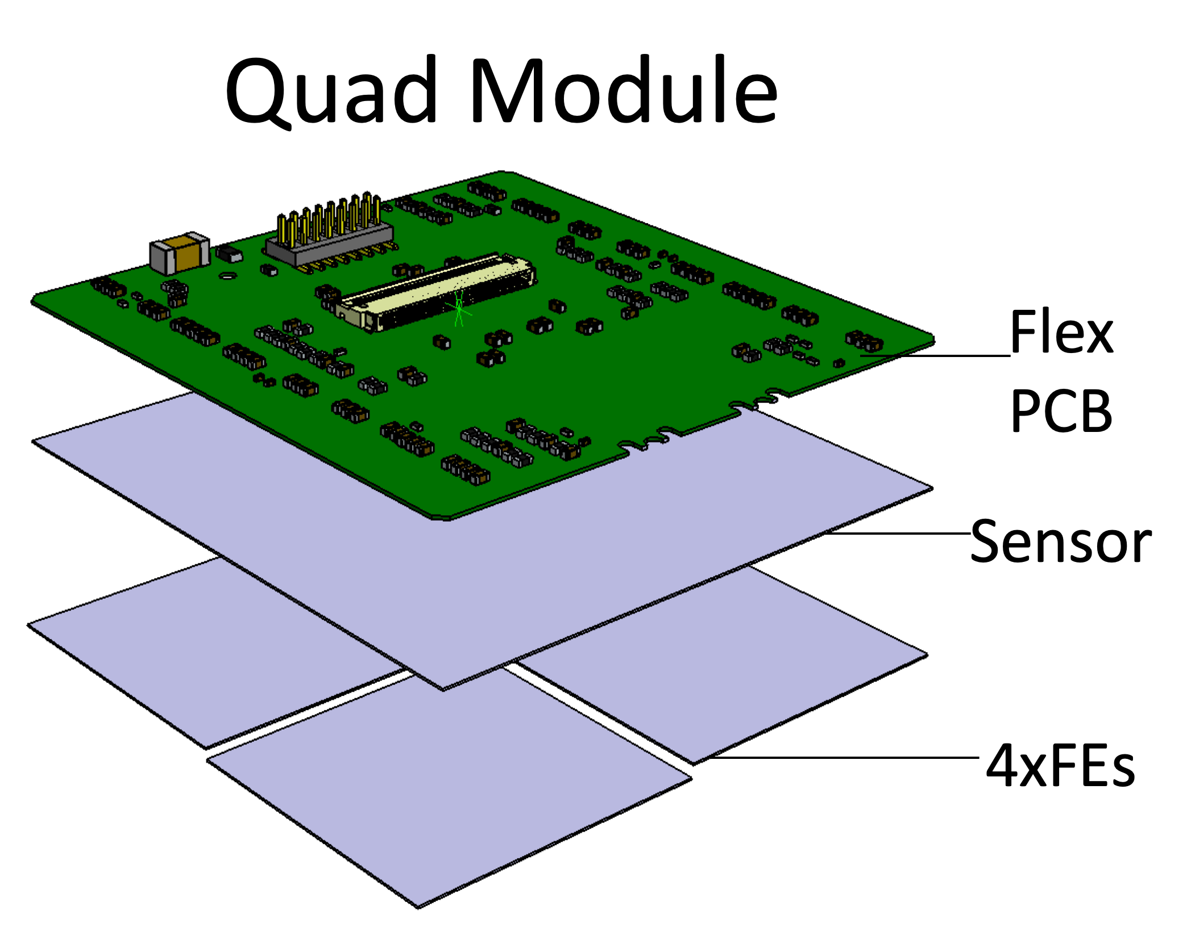
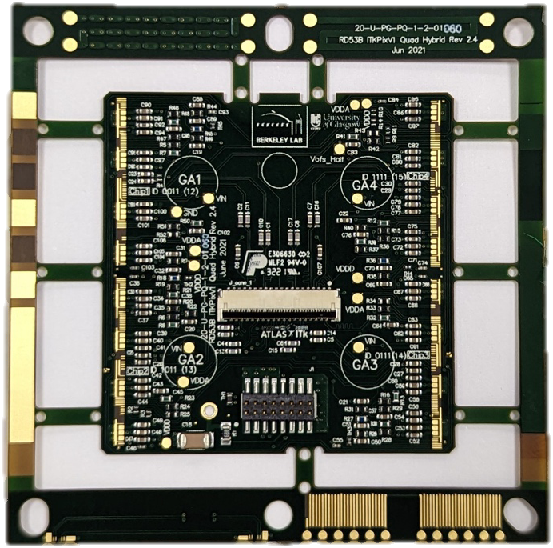
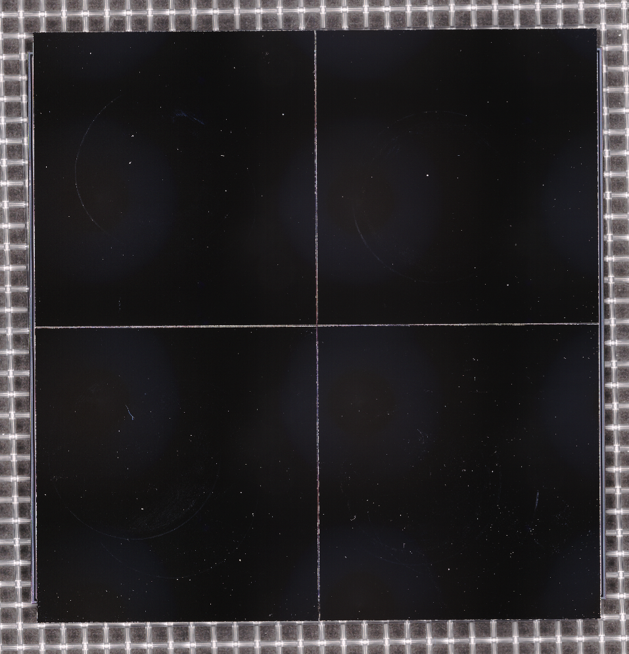
ITkPix Quad module
A module comprises of a flexible PCB glued onto a bump-bonded assembly of 1, 2, 3 or 4 front-end chips (single, dual, triplet & quad module) and a sensor
Each of these bare components requires careful assessments to ensure they meet all specifications

Slide 6
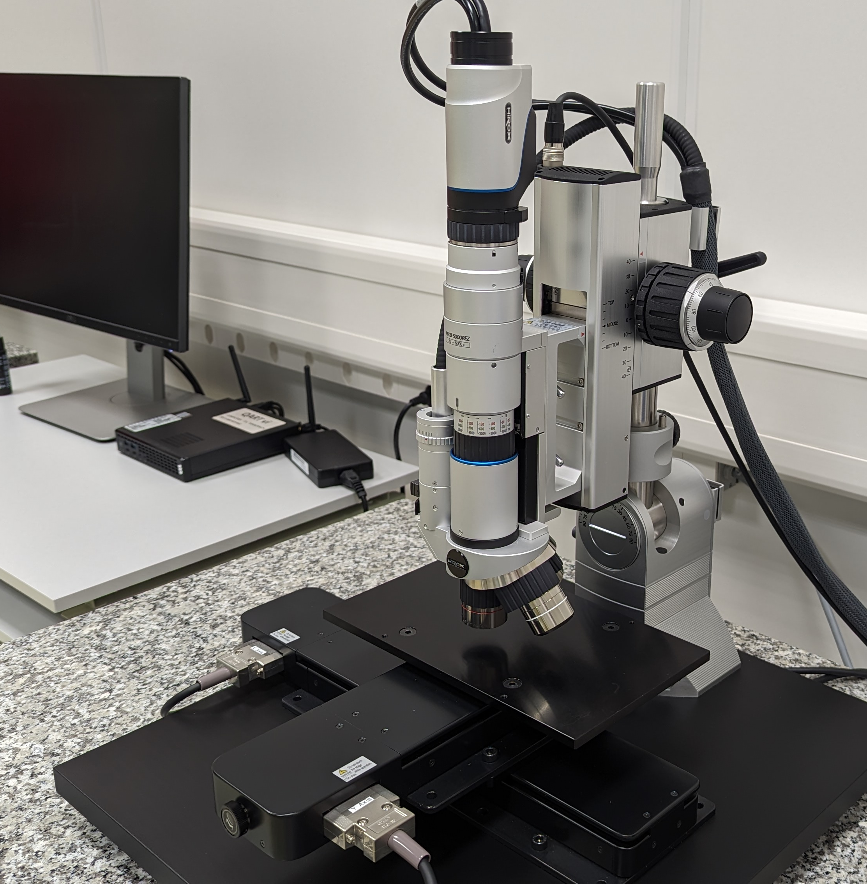
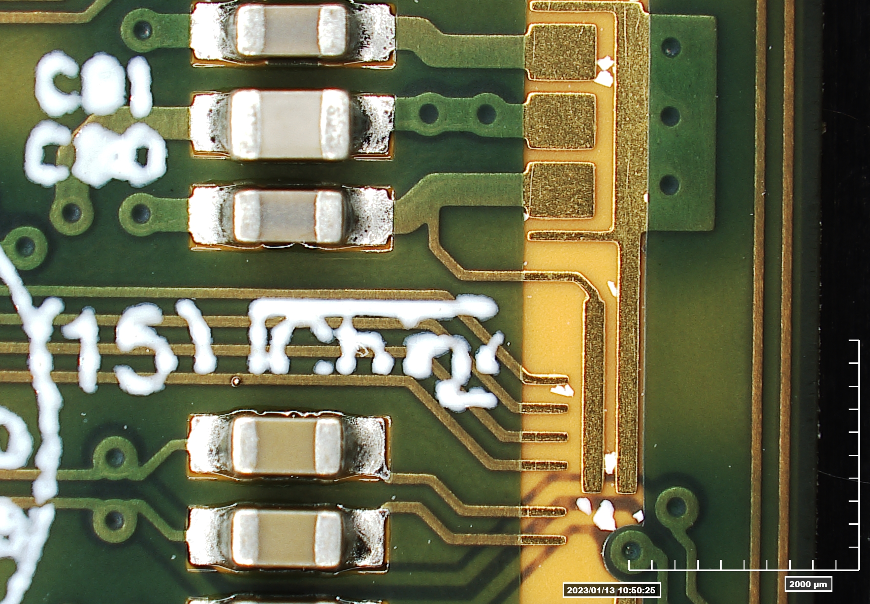
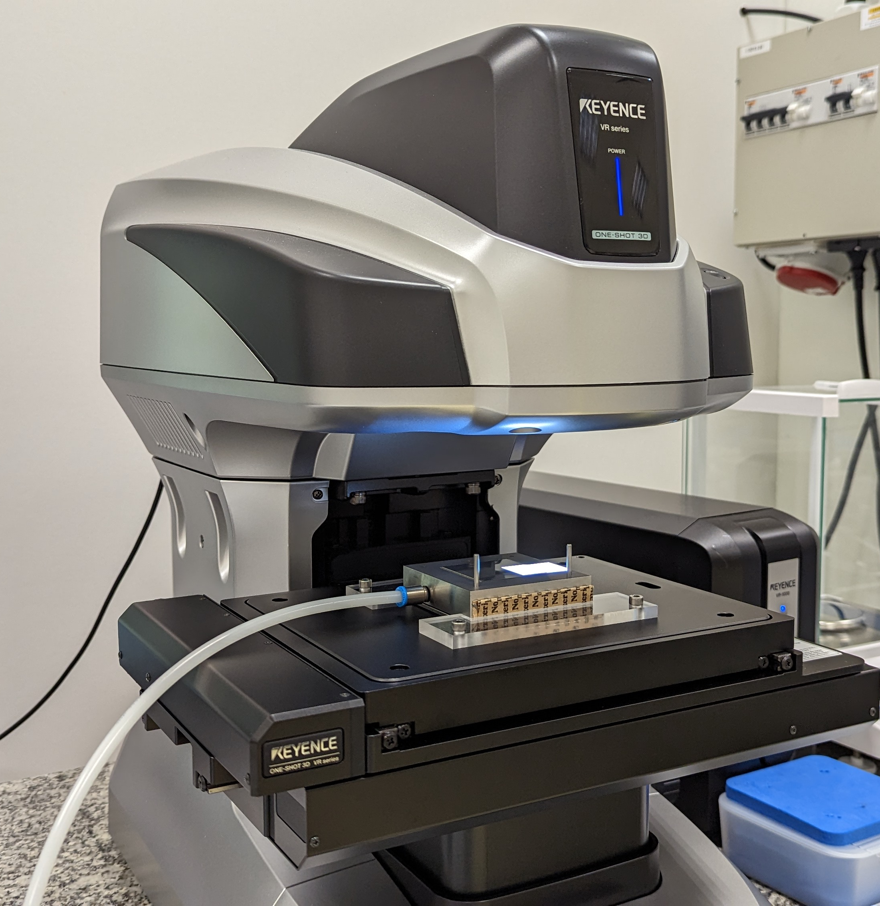
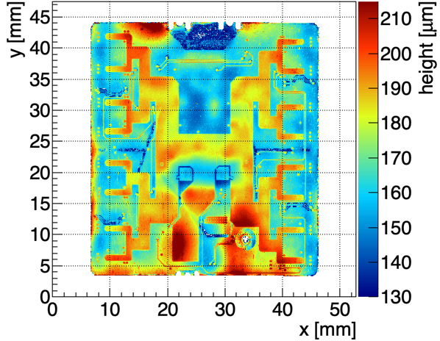
My work as a technical student
Visual Inspection
Metrology
Assessments of flex production quality & wire-bondability tests
Use of Hirox MXB-50000REZ microscope
High-precision module envelop measurements (±2 µm)
Use of Keyence VR5200 metrology system

Slide 7
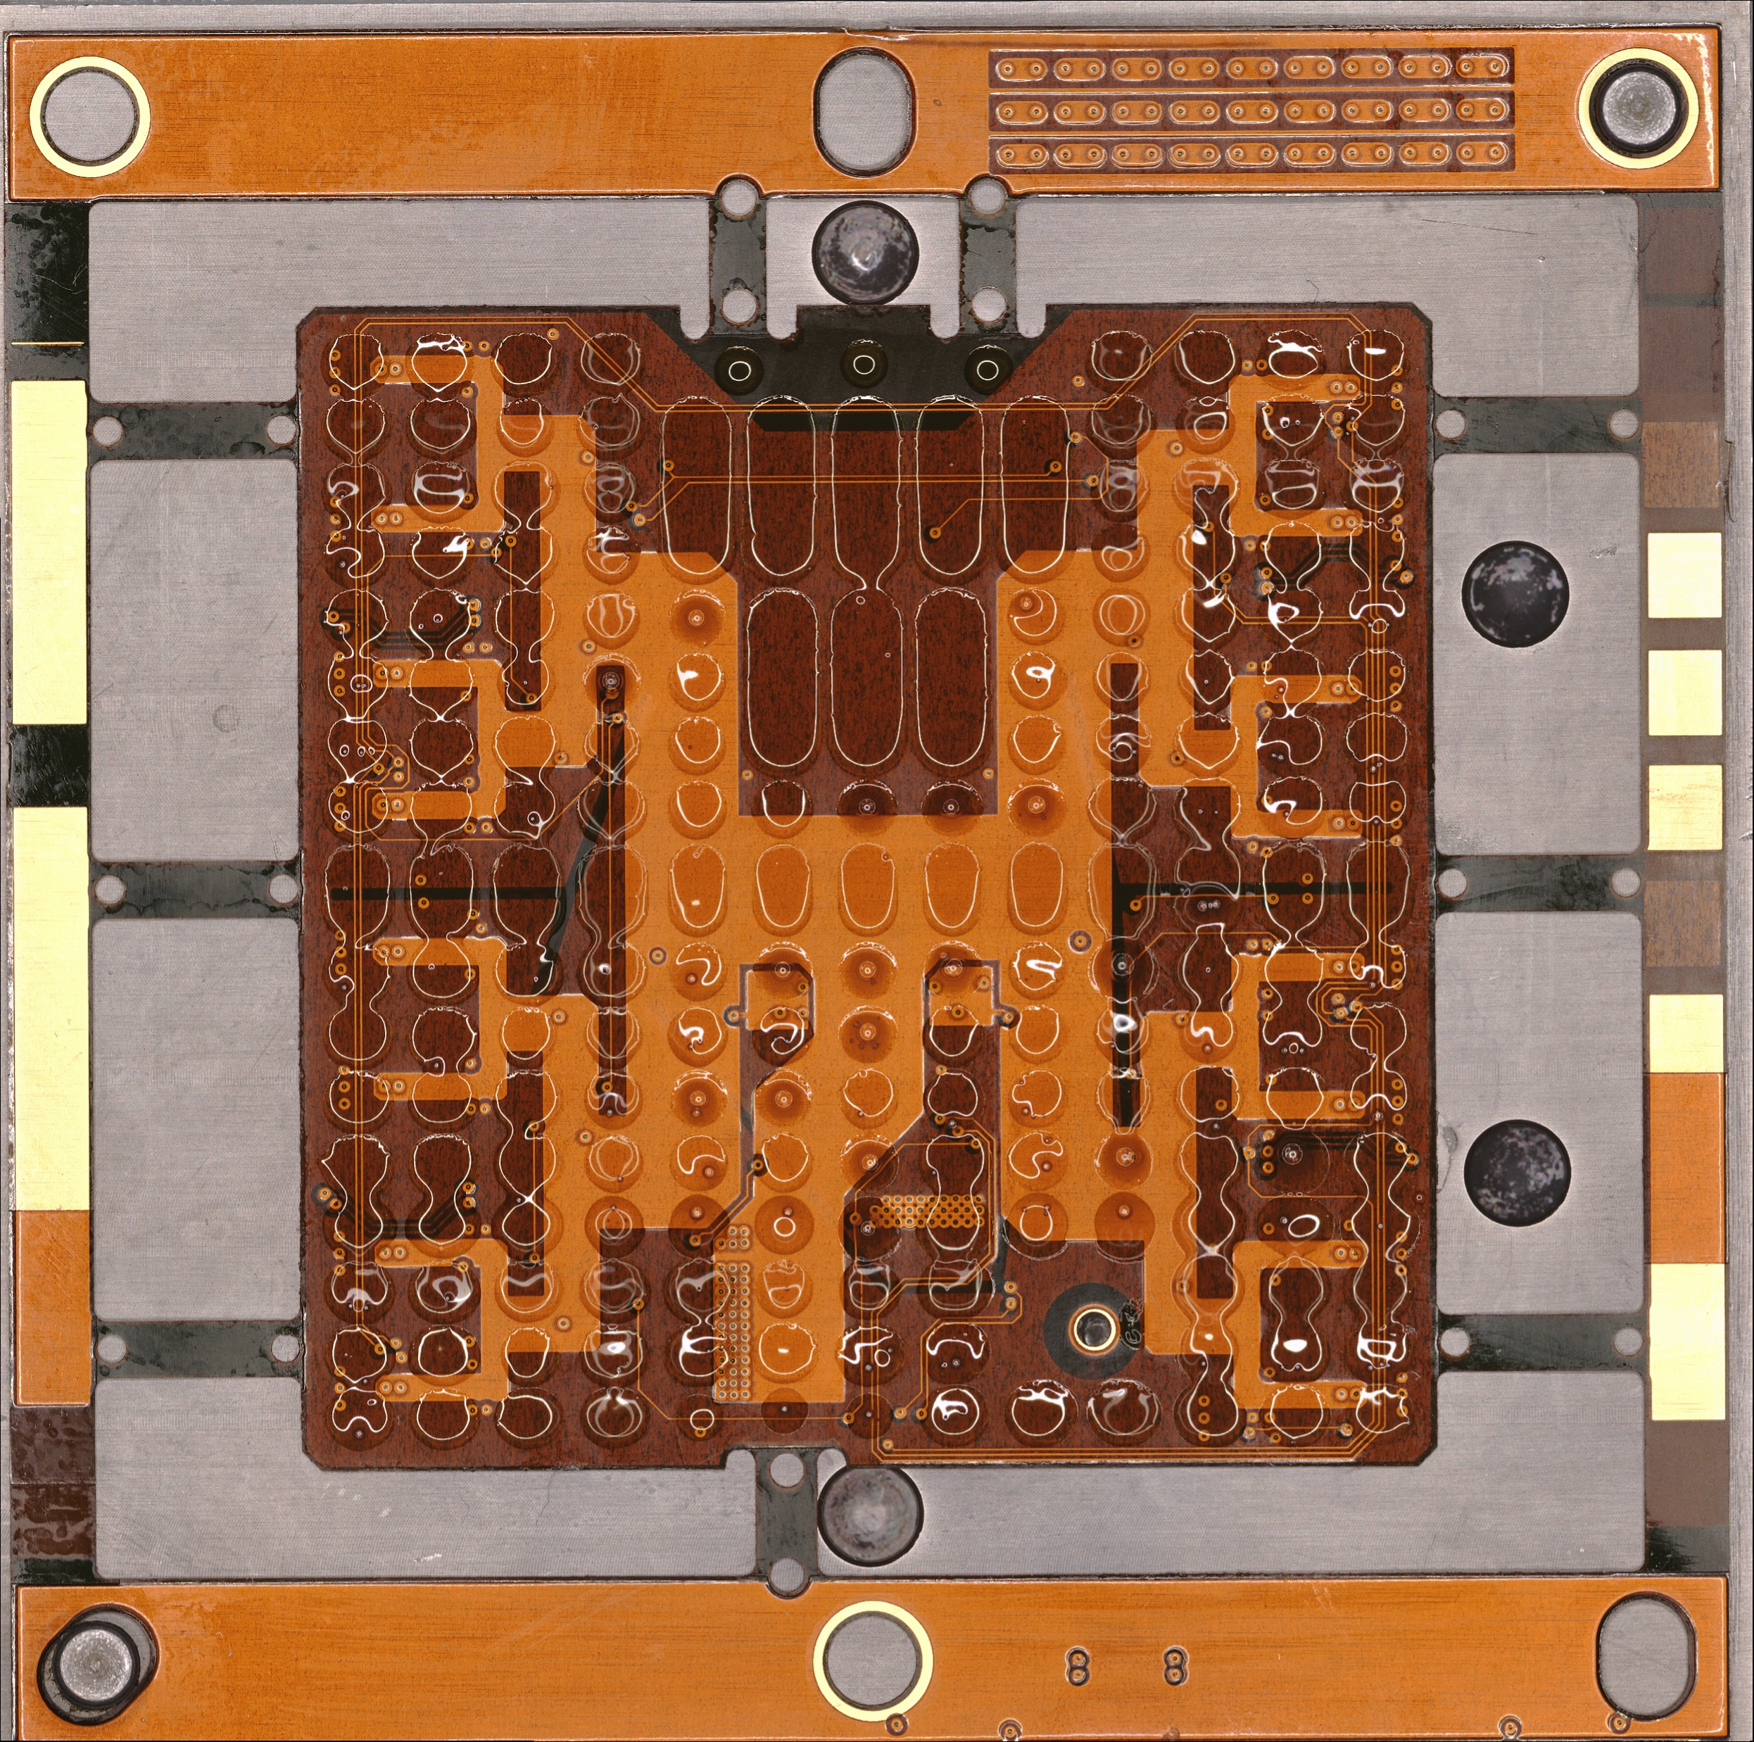
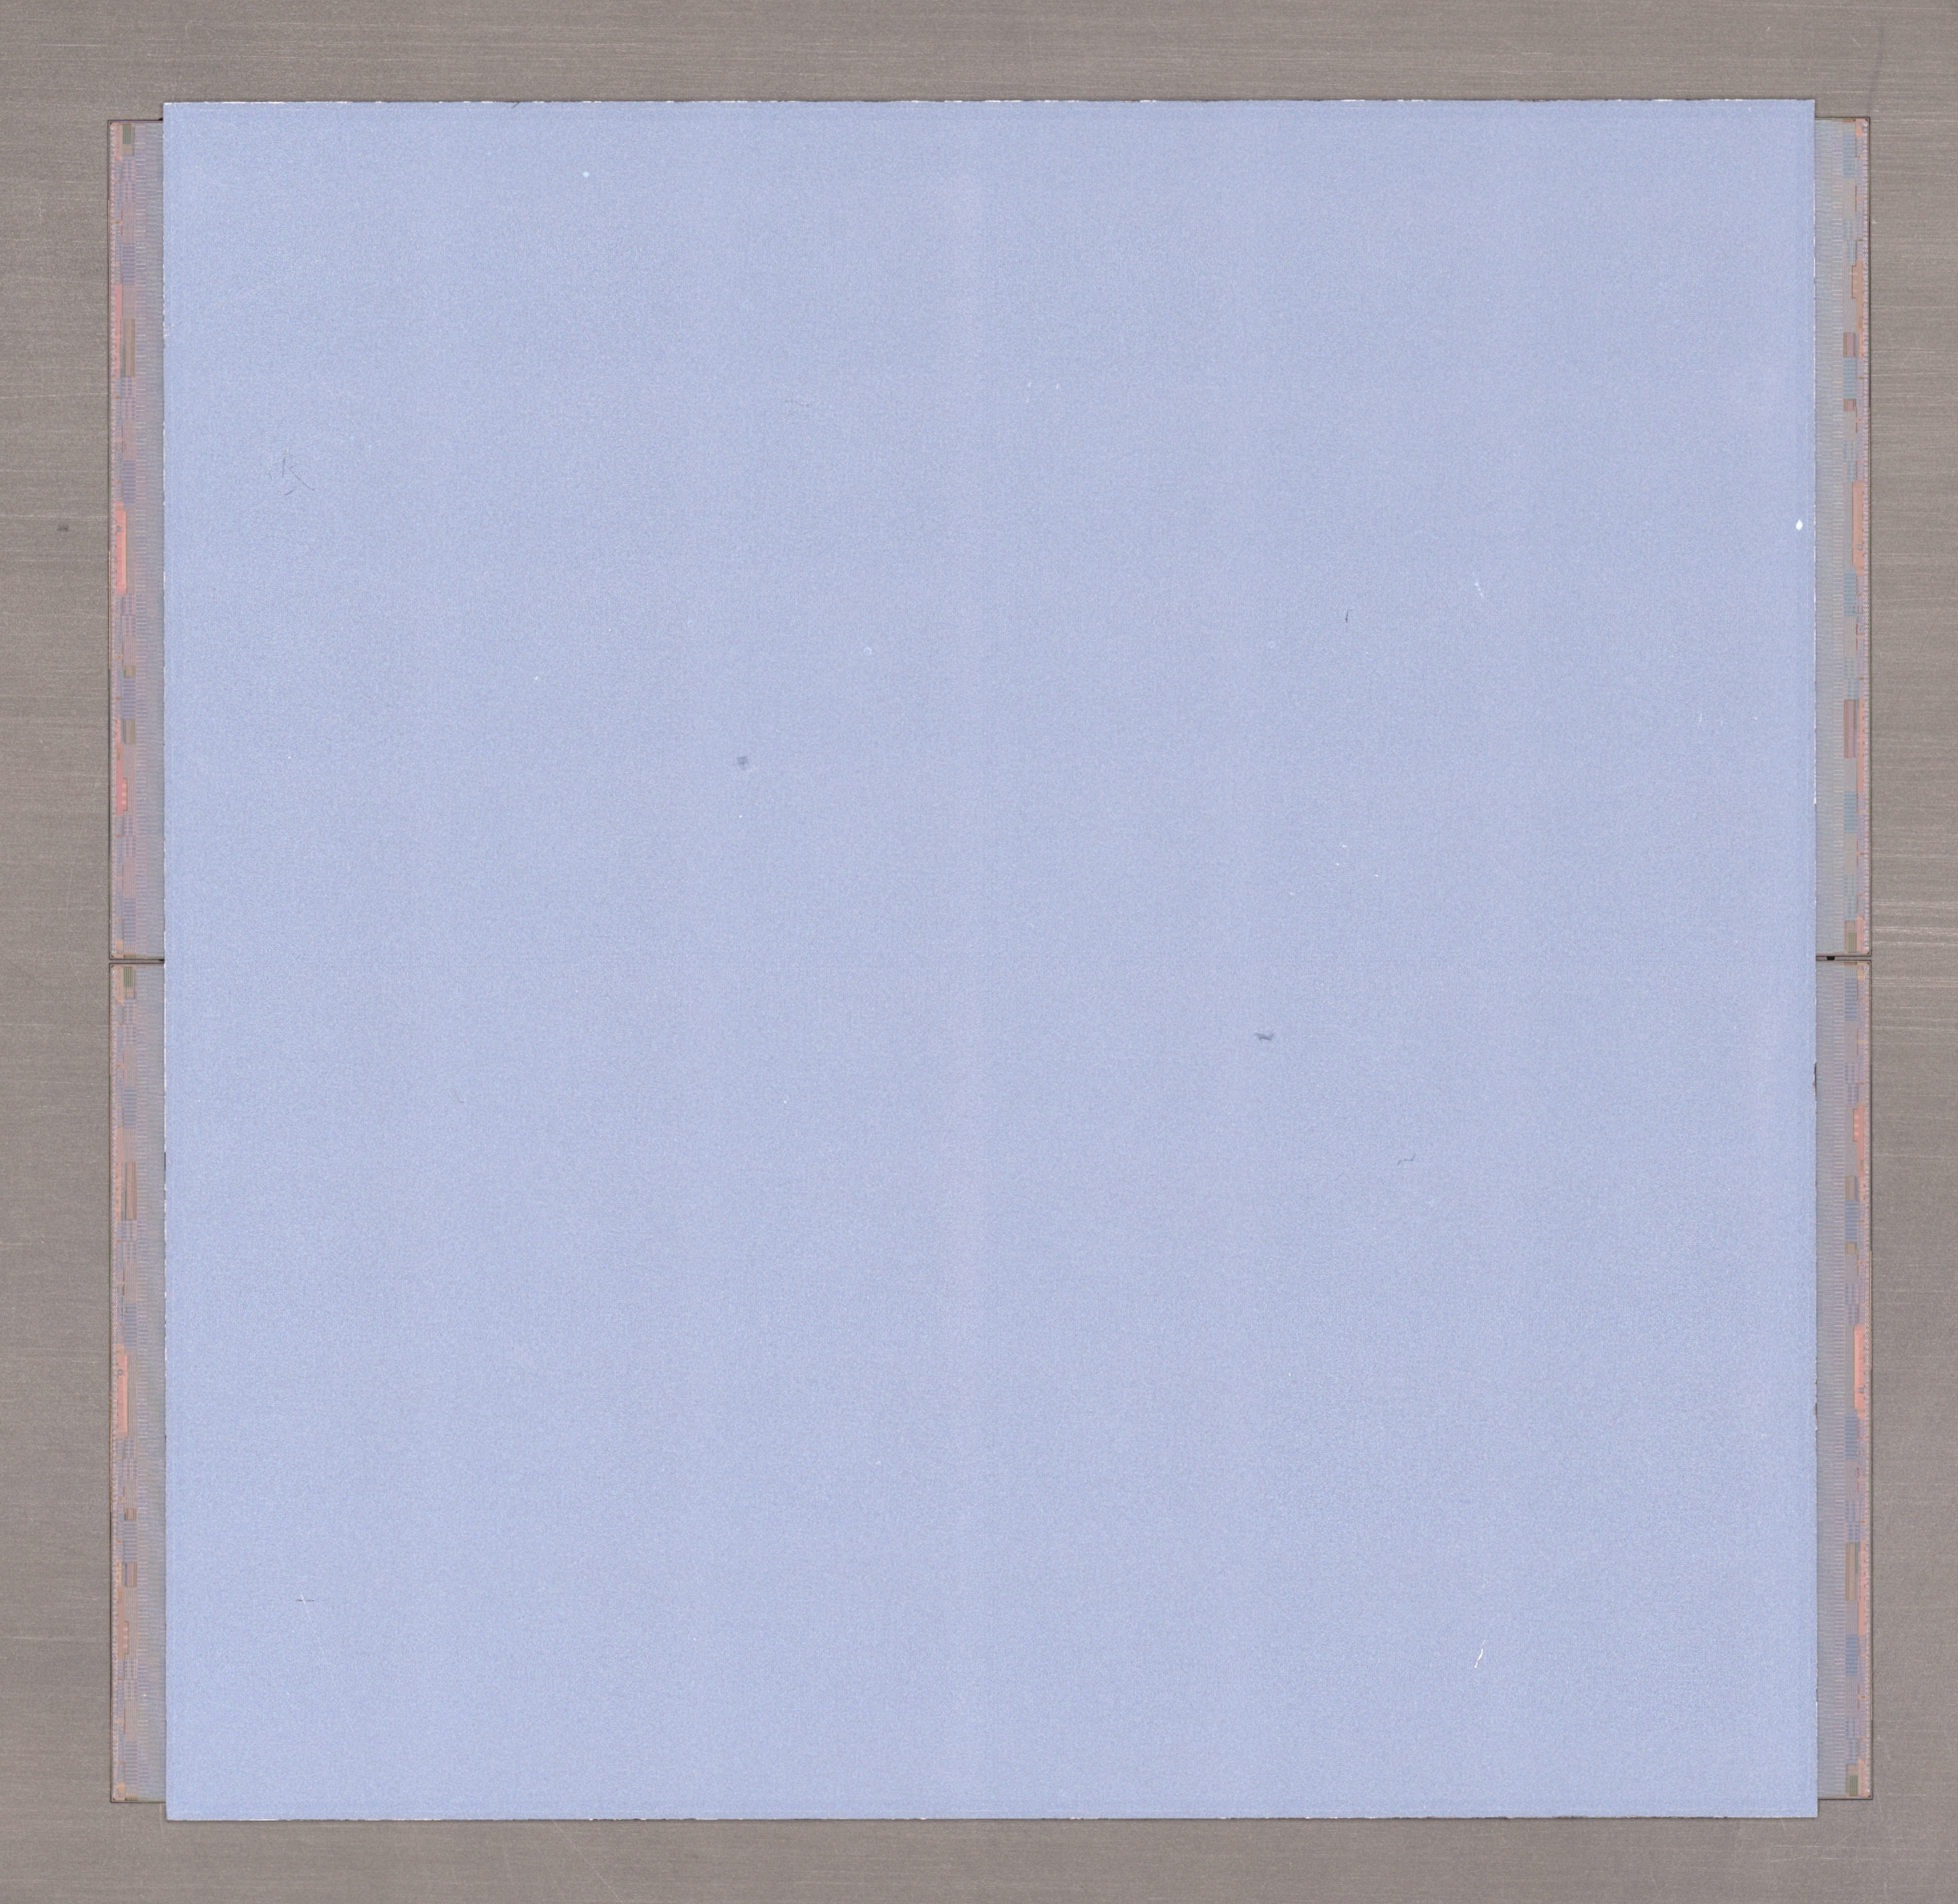
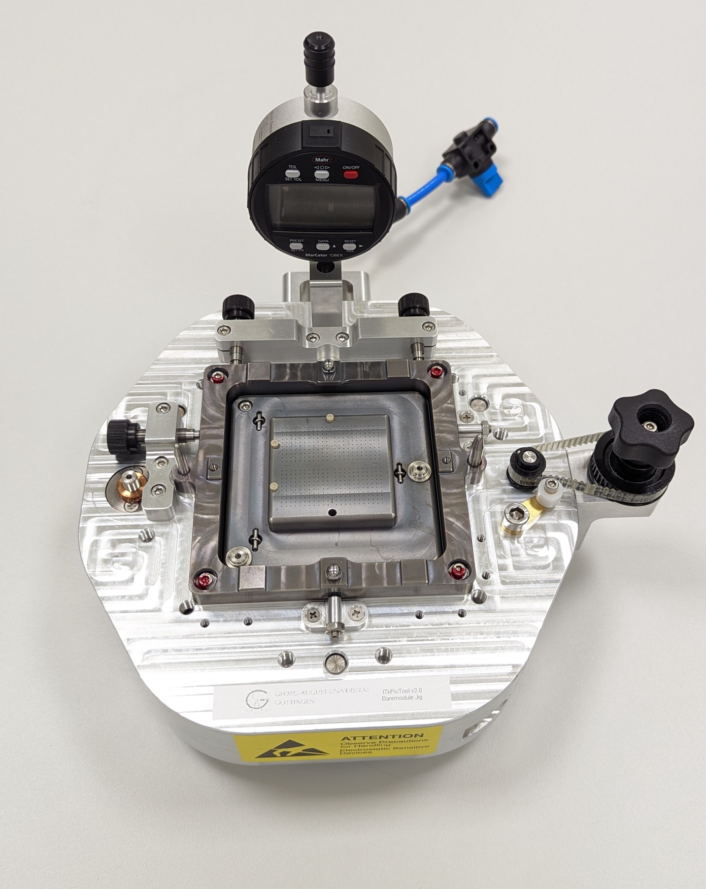
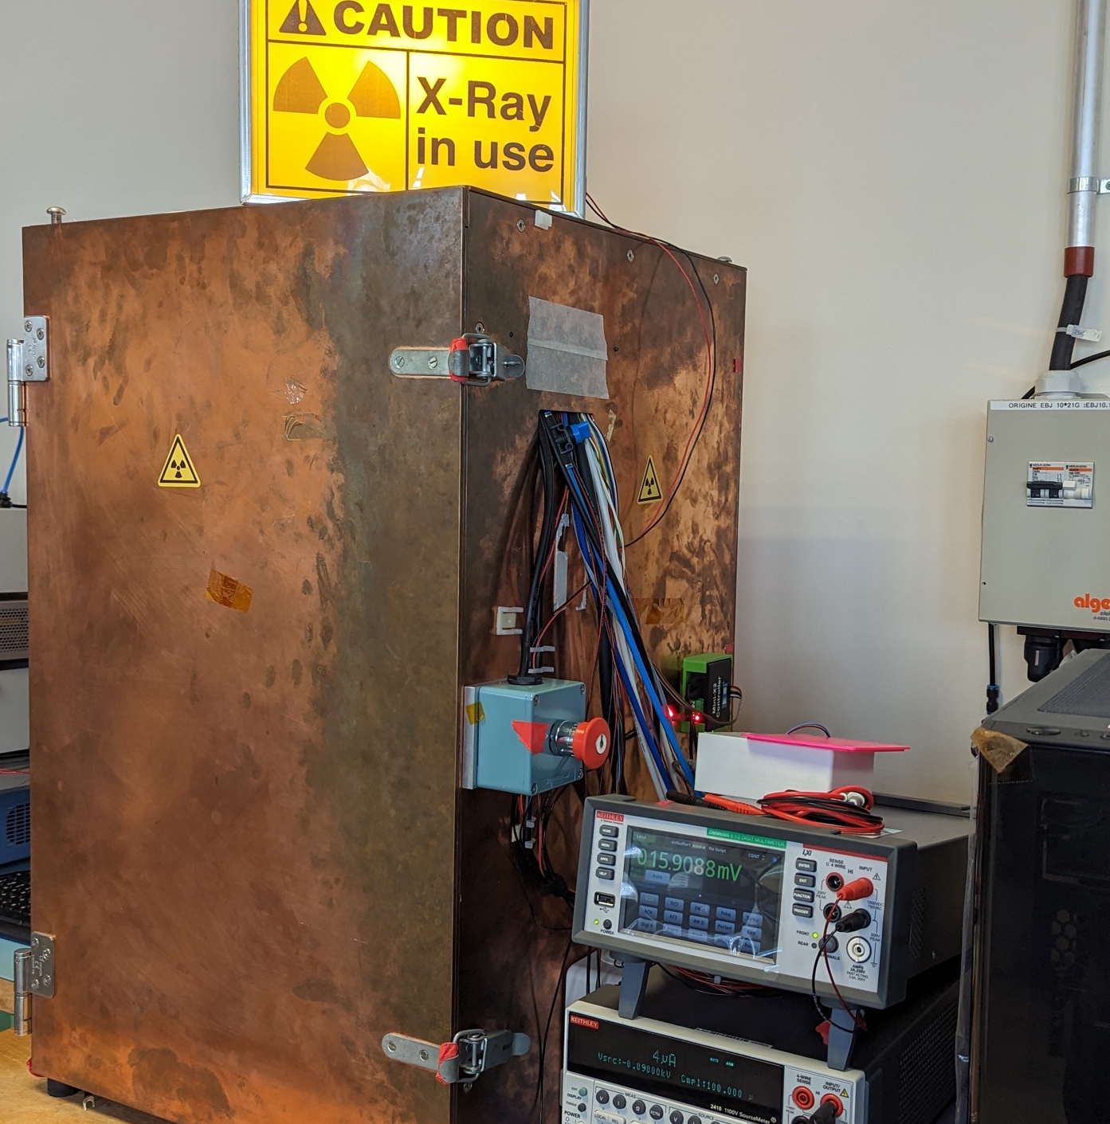
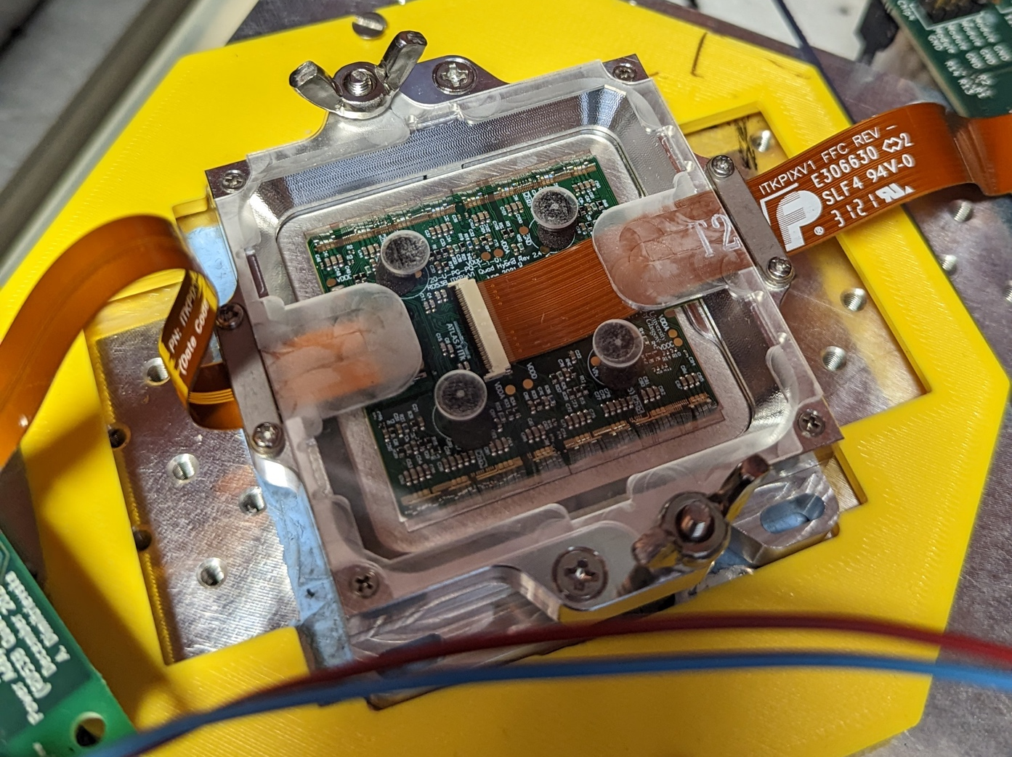
My work as a technical student
Module assembly
Electrical QC testing
Validation studies looking into planarity and alignment of bare components
Gluing procedure of flex onto bare module
  Assemble finished module into carrier
  Conduct electrical Quality Control testing with and without irradiation chamber

Slide 8
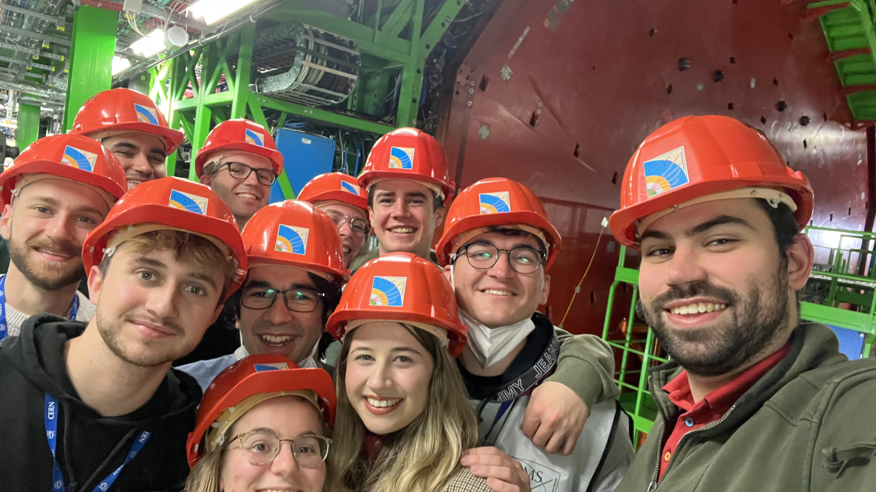
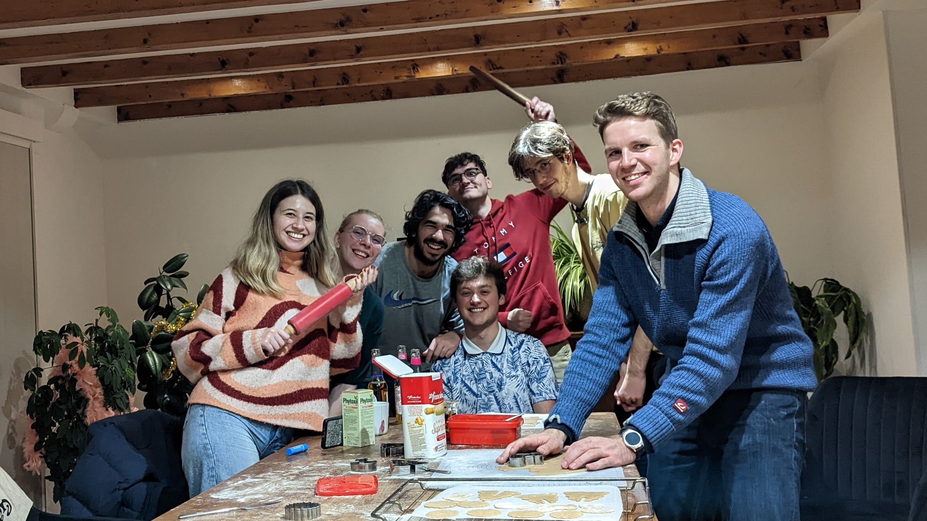
How it is to be a technical student
Many opportunities to contribute to the scientific community
  Presentations for the teams and community
  Get feedback and discuss
Ability to grow as a person
  Live abroad for a year
  Learn another language
  Take a guide course
  Learning by doing
Be part of a social and international group
  Clubs for all kinds of different hobbies and sports
  Everyone is very inclusive
Easy opportunity to go abroad

Slide 9
Thank you!
Further questions can be sent to Marianne.Brekkum@cern.ch

Slide 10
Backup slides

Slide 11
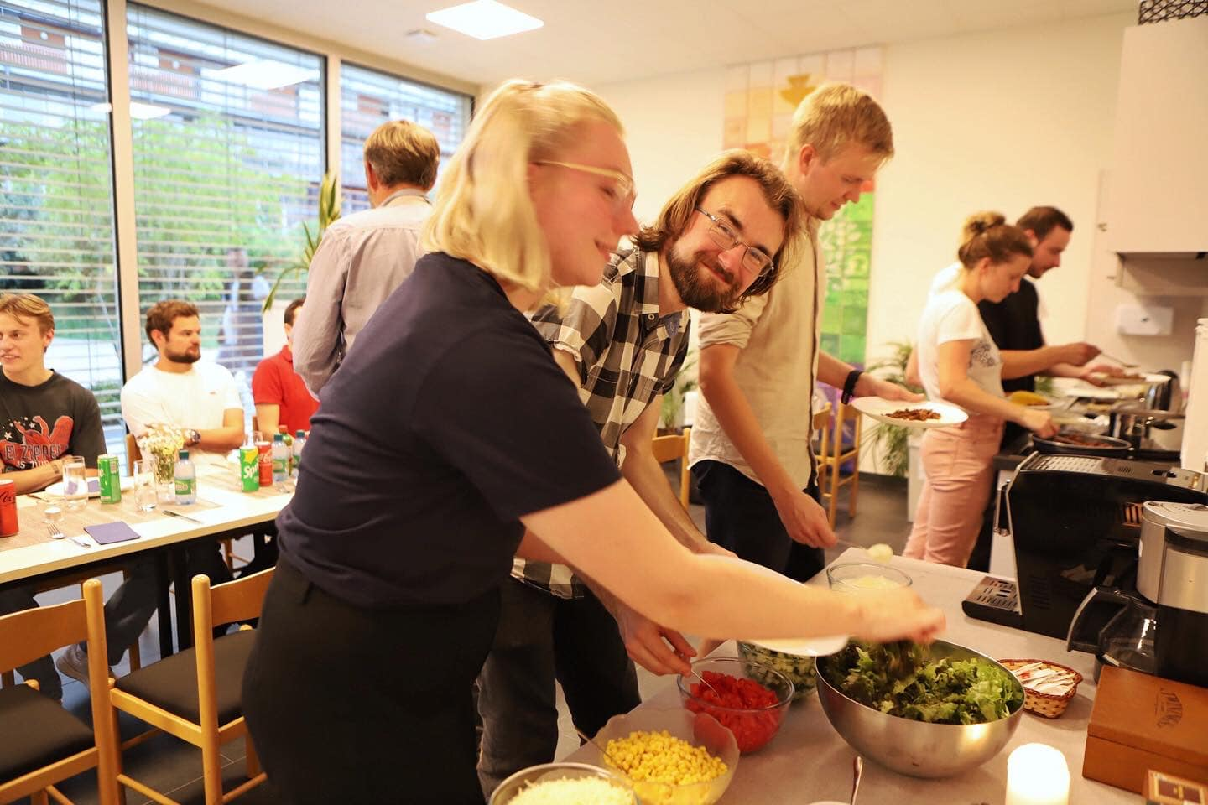
Social life @ CERN
Large social groups, Young@CERN, GIA (Geneva Interns Association)
  Often hosts social gatherings, parties, wine and cheese evenings, Beach access
Sjømannskirken arranges Taco Tuesday for People under the age of 30 once a month
  Waffle gatherings at CERN
  Christmas market
CERN clubs https://indico.cern.ch/category/426/
Close approximation to the Alps and Juras for skiing
  There is also a ski club
Taco Tuesday, picture taken from Sjømannskirken

Slide 12
What my fellow students do
(In their own words)
Reverse engineering old beamline equipment that no one remember to document before it was forgotten
Integration, manufactoring of electronics in High Granularity Calorimeter
Making sure the electronic document system breaks regularly
Creating services for accessing equiment on the technical network from the general purpose network
Transporting measurement data out from the experiment
Make reels (admin student)
In charge of the purchasing of the bare PCBs with our external suppliers (admin student)

