Slide 1
Persistent current magnetization effects in the EuroCirCol designs for the FCC-hh 16 T magnets
Susana Izquierdo Bermudez
Acknowledgments: Ezio Todesco, Davide Tommasini, Stefania Farinon (INFN), Clement Lorin (CEA), Fernando Toral (CIEMAT)
27-04-2023

Slide 2
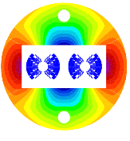
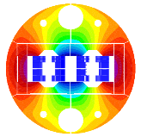
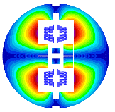
Introduction
Within EuroCirCol Program, WP5, three different magnet design options were explored [1].
16 T operating field, different coil configuration:
  Cos-theta (INFN), [2]
  Block (CEA), [3]
  Common-coil (CIEMAT), [4]
In 2018, the persistent currents effects at injection for the different coil configurations were explored EDMS 2036614
  Here we summarize the outcome of the study performed at the time
Magnetic cross section of the cosθ [2], block [3] and common-coil [4] designs.
[1] Tommasini, Status of the 16 T Dipole Development Program for a Future Hadron Collider, IEEE Transactions on Applied Superconductivity ( Volume: 28, Issue: 3, April 2018 )
[2] V. Marinozzi et al. "Conceptual design of a 16 T cosθ bending dipole for the future circular collider" IEEE Transactions on Applied Superconductivity ( Volume: 28, Issue: 3, April 2018)
[3] C. Lorin M. Durante H. Felice M. Segreti " Design of a Nb 3 Sn 16 T block dipole for the future circular collider " IEEE Transactions on Applied Superconductivity ( Volume: 28, Issue: 3, April 2018 )
[4] 10. F. Toral J. Munilla "Magnetic and mechanical design of a 16 T common coil dipole for FCC" IEEE Transactions on Applied Superconductivity (Volume: 28, Issue: 3, April 2018 )

Slide 3
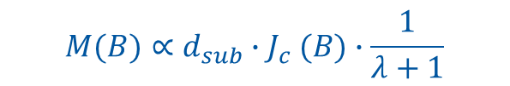
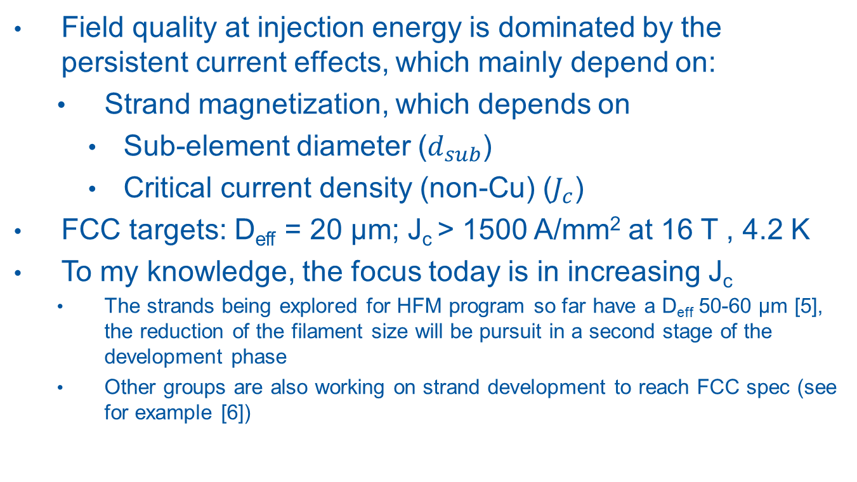
Field quality at injection
Field quality at injection energy is dominated by the persistent current effects, which mainly depend on:
  Strand magnetization, which depends on
    Sub-element diameter ($d_{sub}$)
    Critical current density (non-Cu) ($J_{c}$)
FCC targets: D_{eff} = 20 μm; J_{c} > 1500 A/mm² at 16 T , 4.2 K
To my knowledge, the focus today is in increasing J_{c}
  The strands being explored for HFM program so far have a D_{eff} 50-60 μm [5], the reduction of the filament size will be pursuit in a second stage of the development phase
  Other groups are also working on strand development to reach FCC spec (see for example [6])
$$M(B)∝d_{sub}{∙J}_{c}(B)∙\frac{1}{λ+1}$$
[5] S. C. Hopkins, et al., "Design Optimization, Cabling and Stability of Large-Diameter High Jc Nb3Sn Wires," in IEEE Transactions on Applied Superconductivity, vol. 33, no. 5, pp. 1-9, Aug. 2023, Art no. 6000609, doi: 10.1109/TASC.2023.3254497.
[6] Xingchen Xu, et al., "High critical current density in internally-oxidized Nb3Sn superconductors and its origin ," Scripta Materialia,Volume 186,2020,Pages 317-320,
ISSN 1359-6462, https://doi.org/10.1016/j.scriptamat.2020.05.043.

Slide 4
Cases considered for strand magnetization
Cases considered for strand magnetization:
  D_{eff} = 50 μm, grain boundary pinning (state of the art technology)
  D_{eff} = 20 μm, grain boundary pinning
  D_{eff} = 20 μm, artificial pinning to reduce magnetization at low field
    Remark: today this is an ‘academic case’, and we are reducing the current margin at low field
  D_{eff} = 20 μm, half of the artificial pinning efficiency
Pinning method | Grain Boundary | Grain Boundary | Point Pinning
Effective filament diameter, D_{eff} [µm] | 50 | 20 | 20
p [--] | 0.5 | 0.5 | 1
q [--] | 2 | 2 | 2
T_{c0} [K] | 16 | 16 | 16
B_{c20}[T] | 29.38 | 29.38 | 29.38
α | 0.96 | 0.96 | 0.96
C₀[A/mm²T] | 1.03*267845 | 1.03*267845 | 1.03*338485
Cabling degradation [%] | 3 | 3 | 3

Slide 5

Critical Current Density
Today, the strands available for HFM are:
  halfway between HiLumi and FCC targets in terms of Jc (consistent with EuroCircol choice for models construction)
  Similar to HiLumi in terms of Deff (≈ 50 μm )
$$B_{c2}\left(T\right)=B_{c20}∙\left(1−t^{1.52}\right); J_{C}=\frac{C\left(t\right)}{B_{p}}∙b^{0.5}∙{\left(1−b\right)}^{2}; C\left(t\right)=C_{0}∙{(1−t^{1.52})}^{α}∙{(1−t^{2})}^{α}$$
 | Hi-Lumi | FCC models | FCC target | HFM
T_{c0} (K) | 16 | 16 | 16 | 16
B_{c20} (T) | 29.38 | 28.8 | 29.38 | 29.38
α | 0.96 | 0.96 | 0.96 | 0.96
C₀(A/mm²T) | 188870 | 255230 | 275880 | 214462
J_{c} at 4.2 K | Hi-Lumi | FCC models | FCC target | HFM
12 T | 2450 | 2880 | 3600 | 2800
16 T | 1058 | 1236 | 1545 | 1200

Slide 6
Cases considered for injection energy
0.45 TeV, HE-LHC (13.5 TeVx2 collision energy)
0.90 TeV , HE-LHC (13.5 TeVx2 collision energy)
1.30 TeV , HE-LHC (13.5 TeVx2 collision energy)
3.30 TeV , FCC (50 TeVx2 collision energy)
1.30 TeV , FCC (50 TeVx2 collision energy)
Today, I focus on cases 4 and 5

Slide 7
Sensitivity to coil design
Assumed strand magnetization: D_{eff} = 50 μm, FCC target J_{c}
Coil geometry plays a role in strand magnetization
  Strand magnetization effects in the block coil geometry are about a factor two smaller than in the cos-theta and common coil design.
  The only harmonic where the persistent current effects are significant lower for the cos-theta design is b₇.
Today we are far from having a reference magnet cross-section, so we should talk more about a range than an actual number

Slide 8
Sensitivity to coil design – zoom at injection

Slide 9
Sensitivity to coil design – zoom at injection

Slide 10
Sensitivity to coil design – zoom at injection

Slide 11
Sensitivity to coil design – zoom at injection

Slide 12
Sensitivity to filament size
From now on, we will focus on the cos-theta magnet
The reduction of the filament size from 50 to 20 μm reduces the width of the hysterics loop and the penetration field
Field errors at injection for the cos-theta magnet, for three different injection energies. 1.3 TeV (and 3.3 TeV) injection in the FCC (B_{inj} = 0.4 T (and B_{inj} = 1 T)) and 1.3 TeV injection in the HL-LHC machine (B_{inj} = 1.5 T).
Strand Technology | Jc | D_{eff}, µm | B1, T | b3 | b5 | b7 | b9 | b11
Grain Boundary | Nominal | 50 | 0.416 | 209.4 | -41.9 | 6.0 | -13.2 | 0.7
 |  |  | 1.056 | -55.0 | 12.8 | -0.3 | 5.2 | 0.9
 |  |  | 1.541 | -65.4 | 11.7 | 0.1 | 5.3 | 1.0
Grain Boundary | Nominal | 20 | 0.416 | 14.6 | -1.2 | 1.2 | 0.5 | 0.8
 |  |  | 1.056 | -56.8 | 8.6 | 0.6 | 4.3 | 1.0
 |  |  | 1.541 | -39.8 | 4.1 | 1.1 | 2.9 | 1.0

Slide 13
Sensitivity to J_{c}
When injecting in the very steep region, very sensitive to the different parameters affecting magnetization
Field errors at injection for the cos-theta magnet, for three different injection energies. 1.3 TeV (and 3.3 TeV) injection in the FCC (B_{inj} = 0.4 T (and B_{inj} = 1 T)) and 1.3 TeV injection in the HL-LHC machine (B_{inj} = 1.5 T).
Strand Technology | Jc | D_{eff}, µm | B1, T | b3 | b5 | b7 | b9 | b11
Grain Boundary | Nominal | 50 | 0.416 | 209.4 | -41.9 | 6.0 | -13.2 | 0.7
 |  |  | 1.056 | -55.0 | 12.8 | -0.3 | 5.2 | 0.9
 |  |  | 1.541 | -65.4 | 11.7 | 0.1 | 5.3 | 1.0
Grain Boundary | + 10 % | 50 | 0.416 | 216.0 | -42.9 | 6.1 | -13.6 | 0.7
 |  |  | 1.056 | -49.3 | 12.0 | -0.3 | 4.9 | 0.8
 |  |  | 1.541 | -66.7 | 12.6 | 0.0 | 5.4 | 0.9
Grain Boundary | - 10 % | 50 | 0.416 | 160.4 | -31.2 | 4.7 | -9.7 | 0.7
 |  |  | 1.056 | -59.4 | 13.2 | -0.3 | 5.4 | 0.9
 |  |  | 1.541 | -63.2 | 10.9 | 0.3 | 4.9 | 1.0

Slide 14
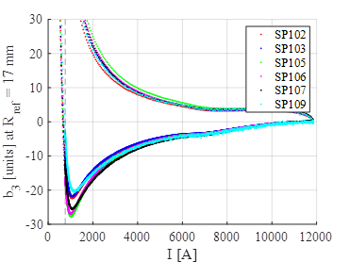
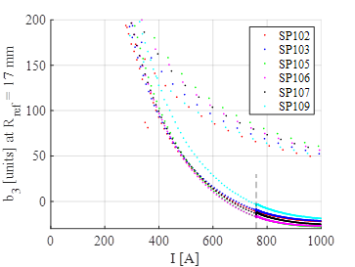
Reproducibility – 11 T
In the 11 T short model programs (different conductors were explored, in a series production one expect to haver more uniform parameters):
  Spread at 1.3 TeV eq. energy ≈ 50 units
  Spread at 3.3 TeV eq. energy ≈ 15 units
b₃ swing for the 11 T short models
1.3 TeV
3.3 TeV

Slide 15
Sensitivity to strand magnetization
We can drastically reduce the field errors are injection, reducing Jc at low field, what we ‘called’ point pinning
  Please, keep in mind that this is an academic case for the moment, today we don’t have the wire technology, but it was one of the cases explored during EuroCirCol design phase.
Field errors at injection for the cos-theta magnet, for three different injection energies. 1.3 TeV (and 3.3 TeV) injection in the FCC (B_{inj} = 0.4 T (and B_{inj} = 1 T)) and 1.3 TeV injection in the HL-LHC machine (B_{inj} = 1.5 T).
Strand Technology | Jc | D_{eff}, µm | B1, T | b3 | b5 | b7 | b9 | b11
Grain Boundary | Nominal | 20 | 0.416 | 14.6 | -1.2 | 1.2 | 0.5 | 0.8
 |  |  | 1.056 | -56.8 | 8.6 | 0.6 | 4.3 | 1.0
 |  |  | 1.541 | -39.8 | 4.1 | 1.1 | 2.9 | 1.0
Point Pinning | Nominal | 20 | 0.416 | -42.9 | 5.1 | 0.9 | 3.2 | 1.0
 |  |  | 1.056 | -27.3 | 1.4 | 1.4 | 2.0 | 1.0
 |  |  | 1.541 | -24.0 | 0.7 | 1.4 | 1.8 | 1.0

Slide 16
Conclusion
Today we don’t the element to prove that a 1.3 TeV injection is viable
  From the magnet perspective, it will be driven by the conductor development, but the final choice in terms of magnet cross-section/field will also play a role
  Smaller filaments mean higher price and lower current density, so today they are contradictory requirements

