Slide 1






Progress towards an improved measurement of the proton and antiproton magnetic moments
Gilbertas Umbrazunas
PhD student, ETH Zuerich
Baryon-Antibaryon Symmetry Experiment at CERN
2023/06/15
Lithuanian Particle Physics Meeting 2023

Slide 2


Slide 3
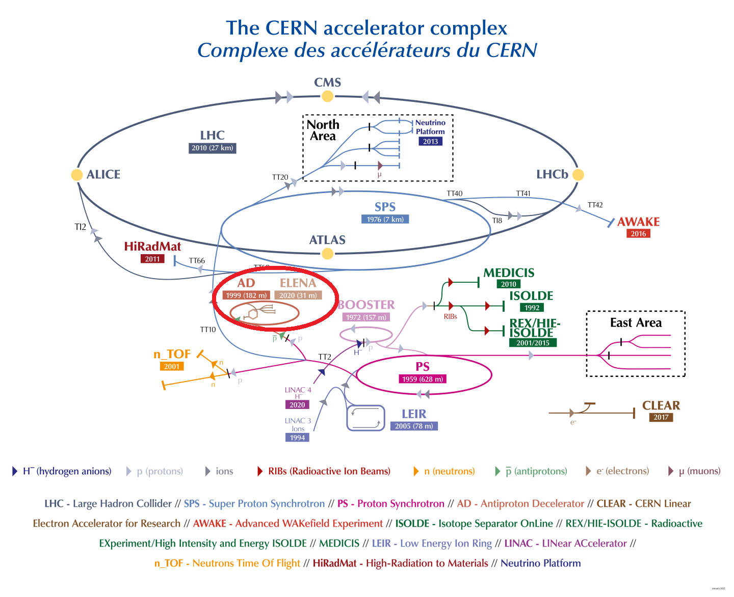
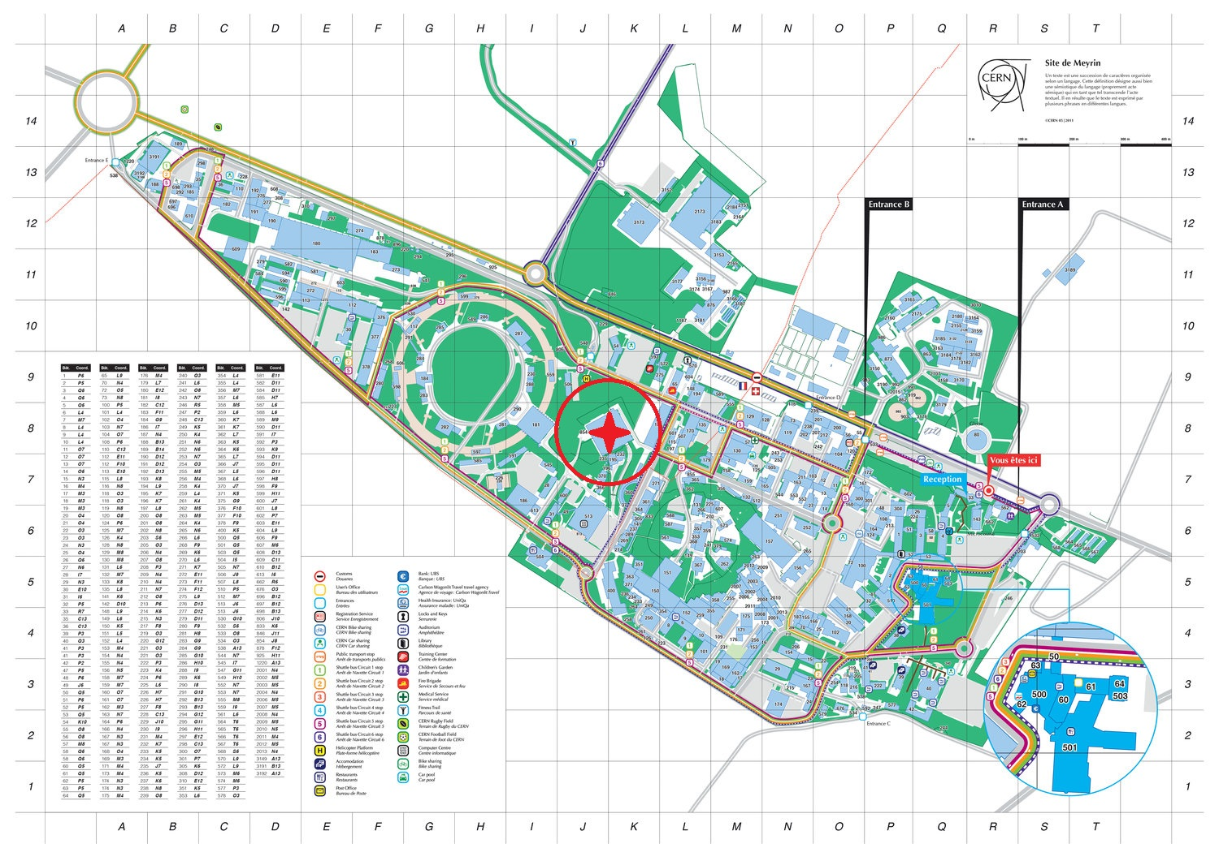

Antiproton Decelerator

Slide 4
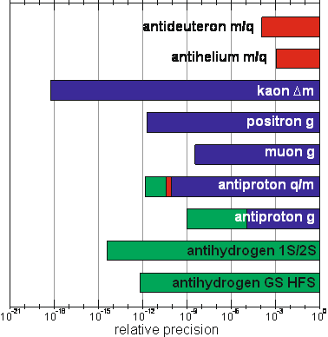
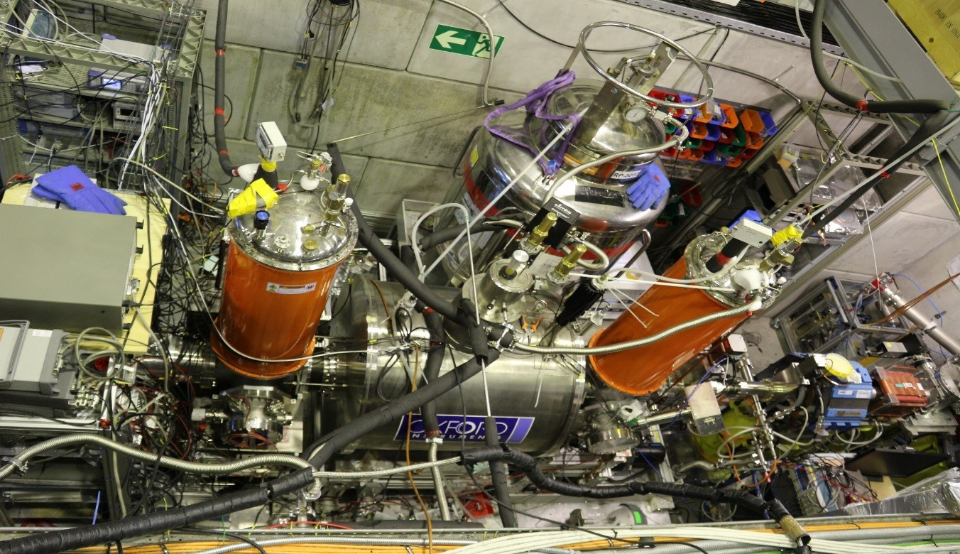
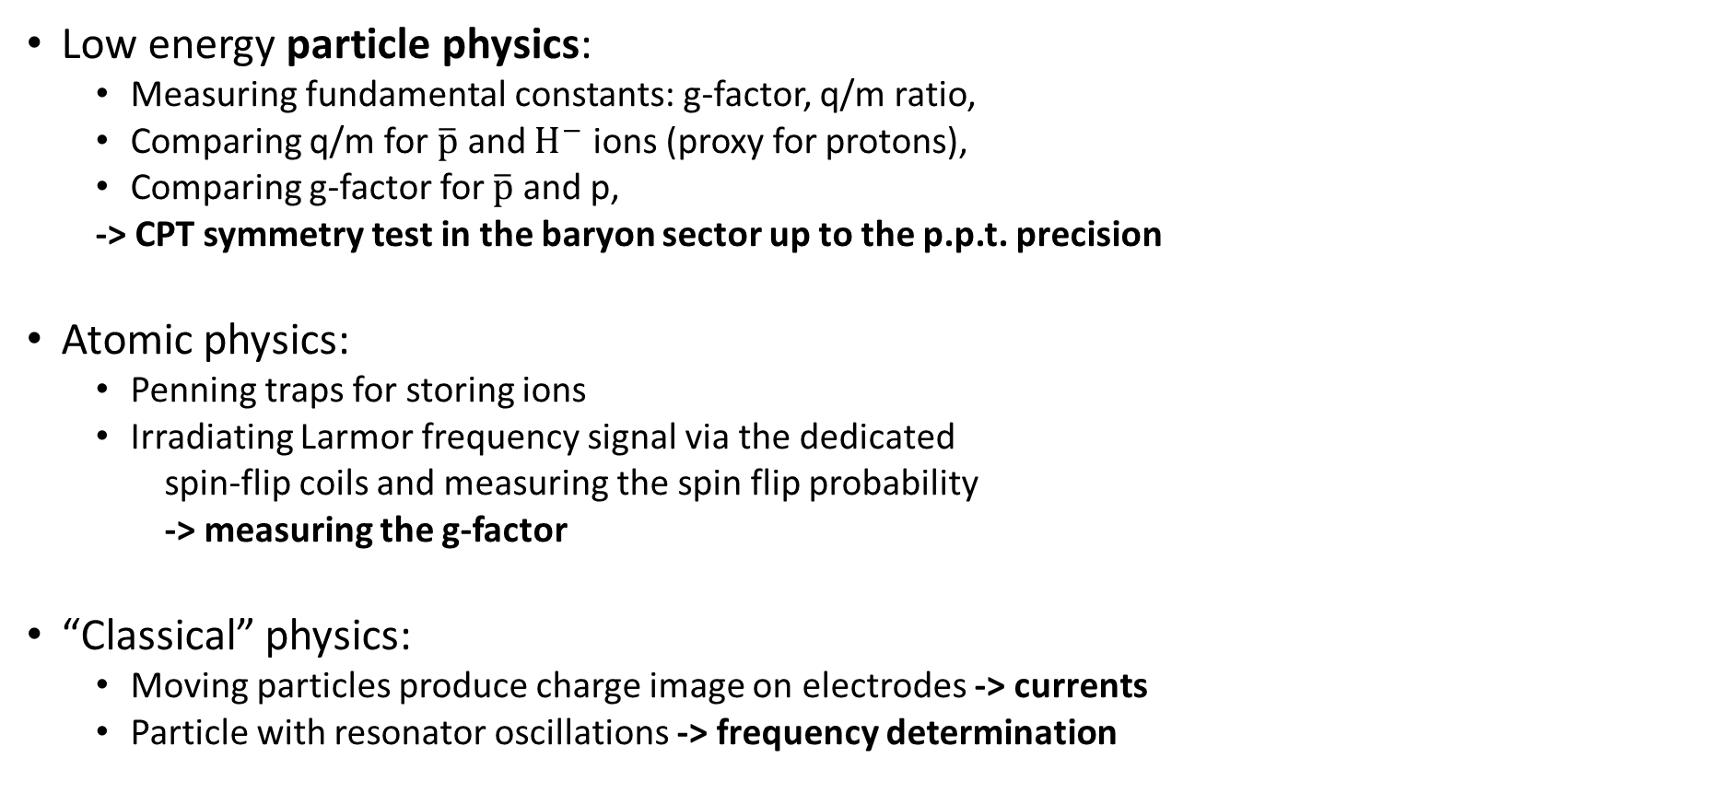
BASE – overview
(a) Precision of selected constants
Low energy particle physics:
  Measuring fundamental constants: g-factor, q/m ratio,
  Comparing q/m for $\overline{p}$ and $H^{−}$ ions (proxy for protons),
  Comparing g-factor for $\overline{p}$ and p,
  -> CPT symmetry test in the baryon sector up to the p.p.t. precision
Atomic physics:
  Penning traps for storing ions
  Irradiating Larmor frequency signal via the dedicated
  spin-flip coils and measuring the spin flip probability
  -> measuring the g-factor
“Classical” physics:
  Moving particles produce charge image on electrodes -> currents
  Particle with resonator oscillations -> frequency determination
(b) Experiment setup

Slide 5
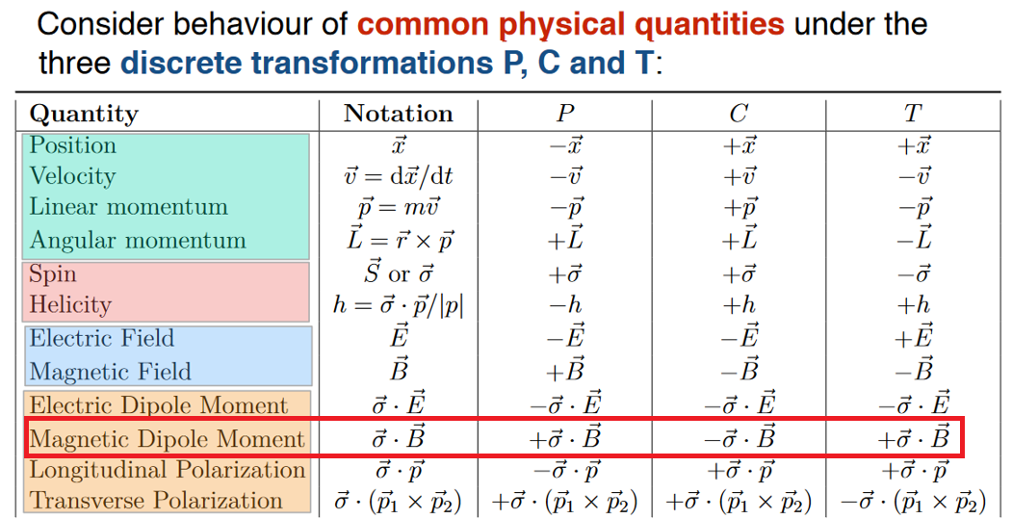
Motivation – CPT symmetry test

Slide 6
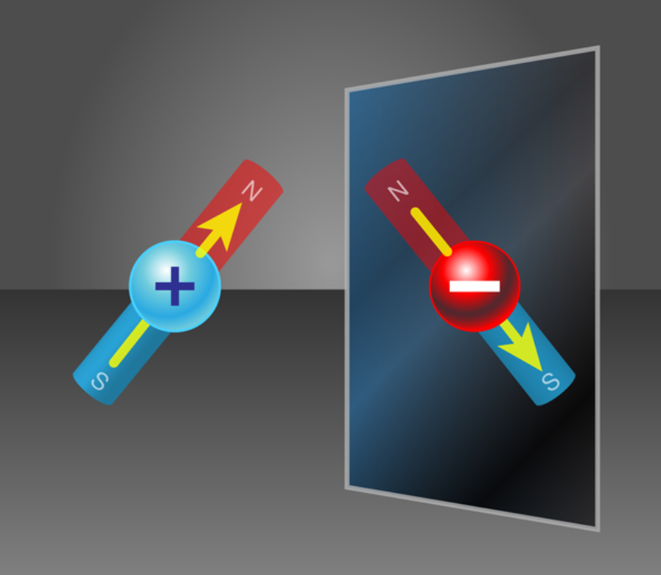
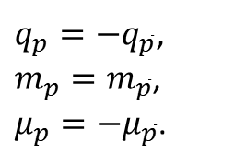
Recent upgrades and expectations
Two particle – triple trap method is an upgrade on the measurement algorithm for the proton and/or antiproton magnetic moment. Using two particles in the trap stack simultaneously, a single repetitive measurement cycle time can be decreased significantly.
Combined with the recent apparatus upgrade, a newly installed cooling trap, this opens prospects towards the measurements of the proton/antiproton magnetic moments with less than 100 ppt fractional precision (current values: 300 ppt for proton, 1500 ppt for antiproton).
Comparing the newly measured proton and antiproton g-factors, we aim at a 15-fold improved test of the CPT invariance in the baryon sector.
A prospect for more precise and fast cyclotron frequency determination is foreseen when the phase-sensitive methods will be implemented and integrated to the experiment.
[1]
CPT invariance predicts:
$q_{p}=−q_{\overline{p}}$,
$m_{p}=m_{\overline{p}}$,
$μ_{p}=−μ_{\overline{p}}$.

Slide 7
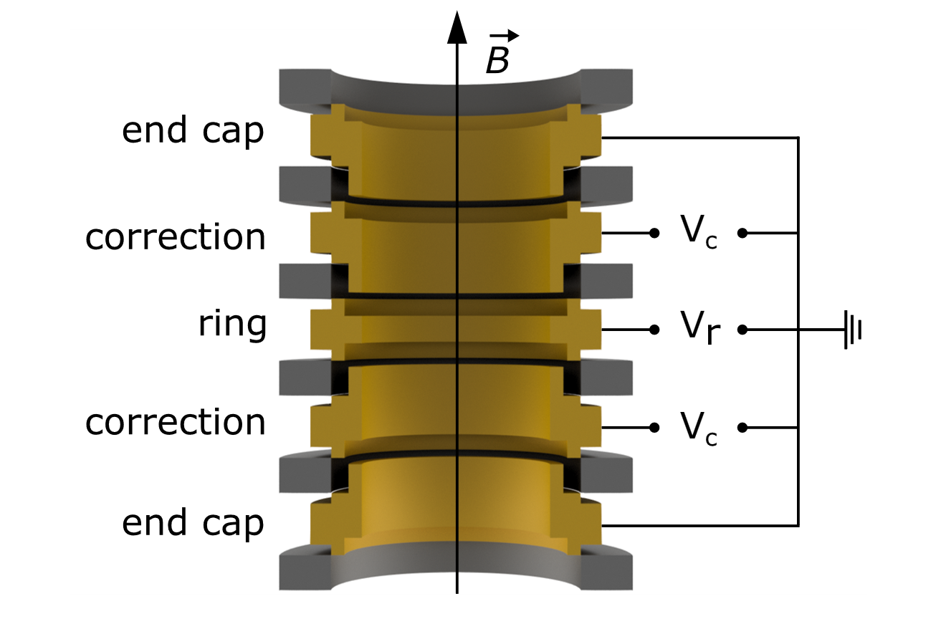
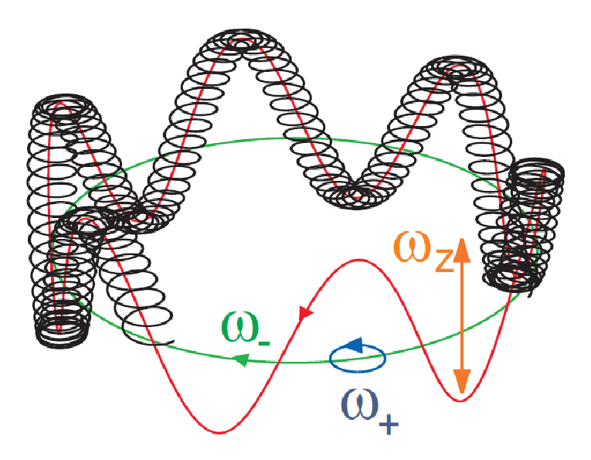
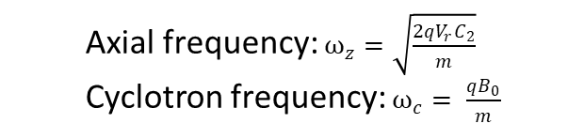
Penning traps
Trapping condition – E&B fields:
Static quadratic electric potential:
Φ(z,ρ) = C2 Vr (z² − ρ²/2)
Static uniform axial B-field
Trajectory – 3 orthogonal motions:
Harmonic axial
Circular planar modified cyclotron
Circular planar magnetron
Penning traps are used:
to trap charged particles,
to manipulate charged particles:
  to park, move along the axis,
  to excite axially/radially,
  to “cool” axially/radially,
  to split a cloud of particles,
  …
to measure the cyclotron frequency.
Physics topics include:
-> ion spectra
-> quantum computers
-> atomic clocks
-> fundamental properties: g-factor, q/m ratio
  Axial frequency: $ω_{z}=\sqrt{\frac{2qV_{r}C_{2}}{m}}$
  Cyclotron frequency: $ω_{c}= \frac{qB_{0}}{m}$
[2]
fz = 650 000 Hz
f+ = 29 000 000 Hz
f- = 7 000 Hz
[3]

Slide 8
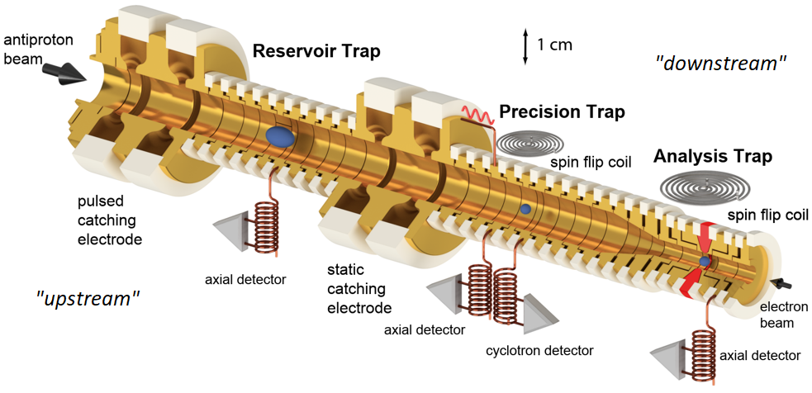
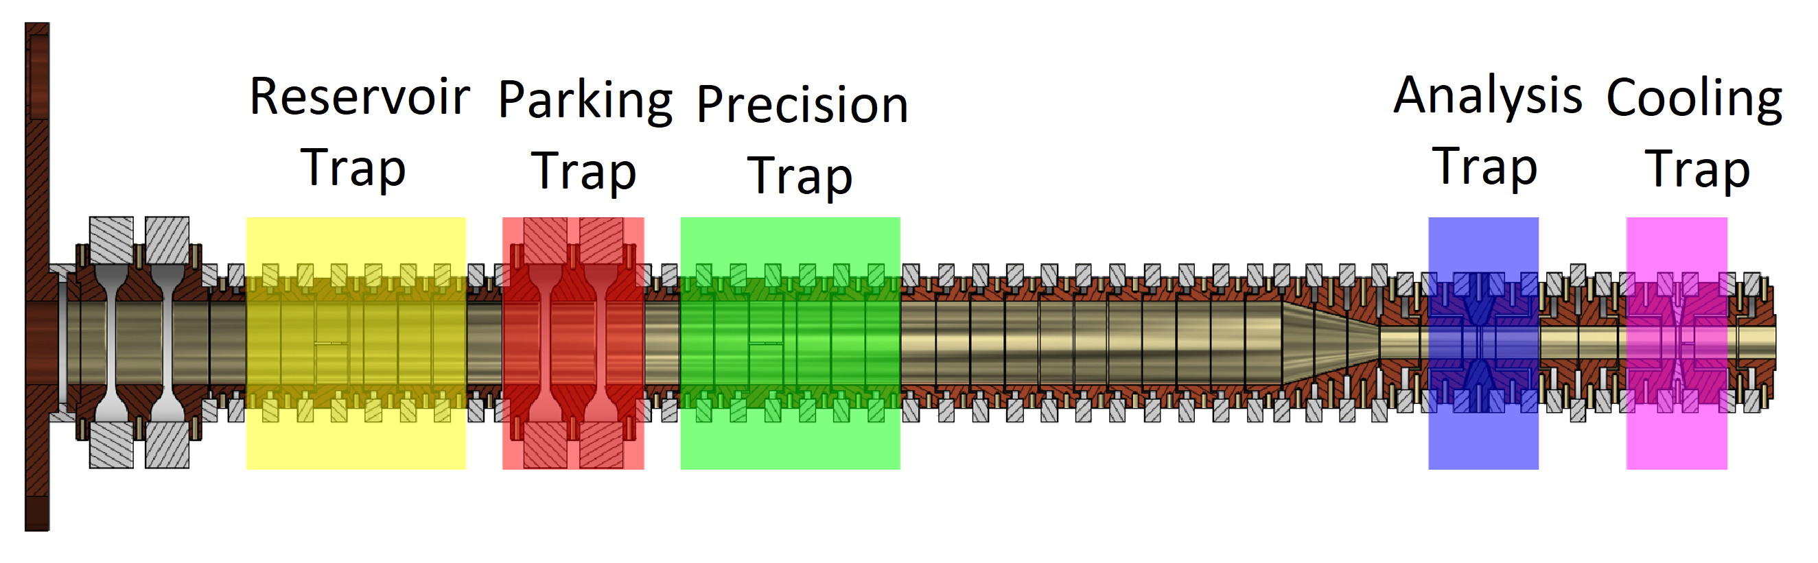
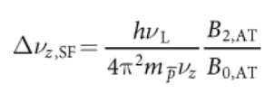
BASE Penning trap stack
Four Penning traps are used in BASE at CERN:
a) Reservoir Trap -> long storage of particles
            -> stable 4.5 mm radius trap
b) Precision Trap -> frequency measurements
-> stable magnetic field
c) Analysis Trap -> spin-state determination
-> large magnetic “bottle”
Cooling Trap -> low orbit particle preparation
-> magnetic “bottle” term
-> new cyclotron detector
Two-trap method:
Particle is initialized with low cyclotron orbit in the PT,
Particle cyclotron frequency is measured in the PT,
Particle spin is flipped in the PT,
Transports: PT -> AT -> PT,
Particle spin-state measured in the AT
  -> ~172(8) mHz axial frequency difference for ↑ and ↓ states
ELENA
beam
Recently implemented
dedicated Cooling Trap

Slide 9
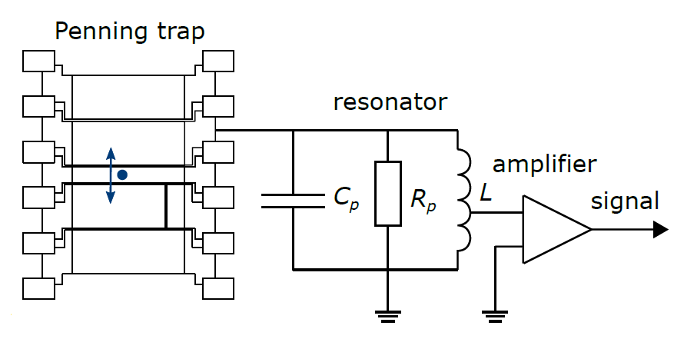
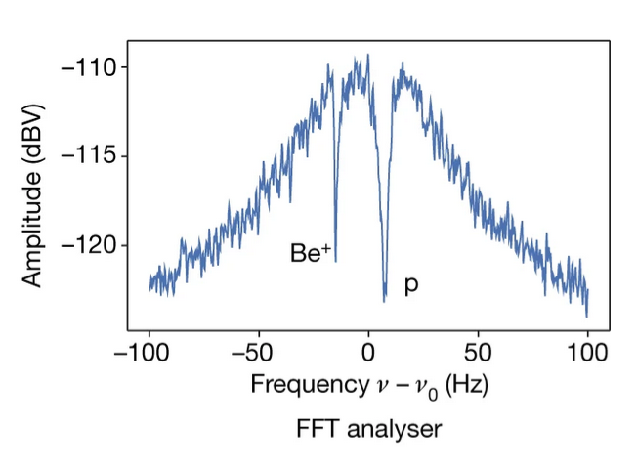
Frequency measurement technique
A charged particle induces image charge on the electrodes.
An oscillating charge induces current.
The full circuit consists of particle-electrode system and in parallel connected resonator.
The resonator Nyquist-Johnson noise is measured at the FFT analyser.
The oscillating particle effectively shorts the resonator Nyquist-Johnson noise at its oscillation frequency.
This can be seen as a dip in the noise FFT profile.
The temperature of the particle undergoes Boltzmann statistics while it is interacting with the resonator:
  -> particle in thermal equilibrium with a reservoir
Two particle sympathetic cooling (BASE Mainz)

Slide 10
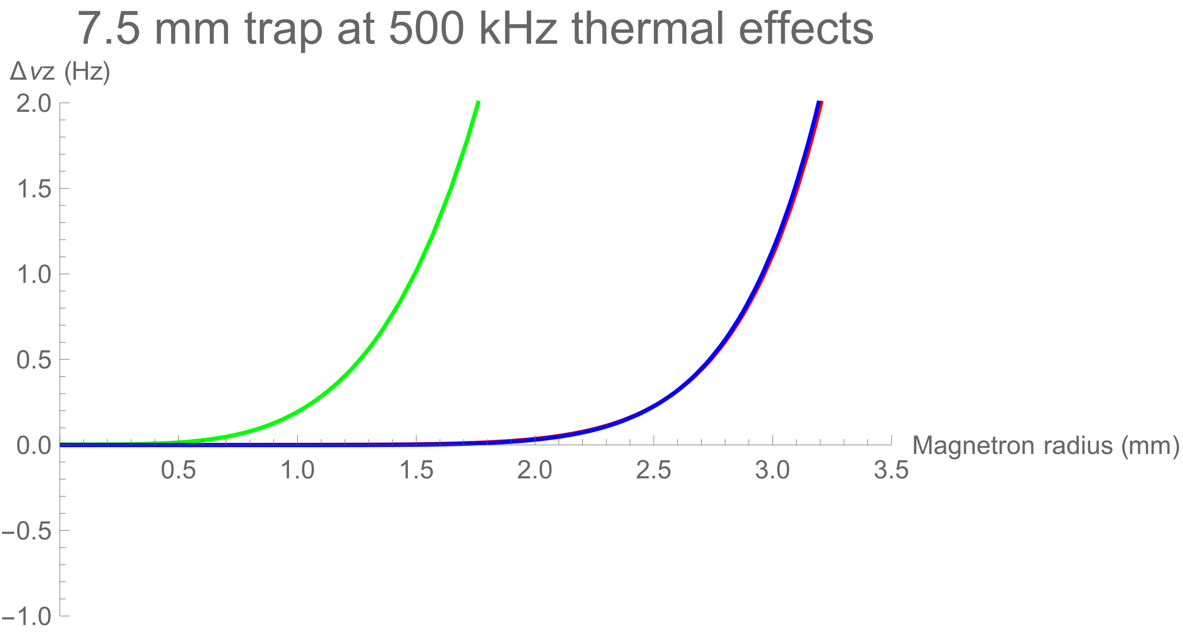
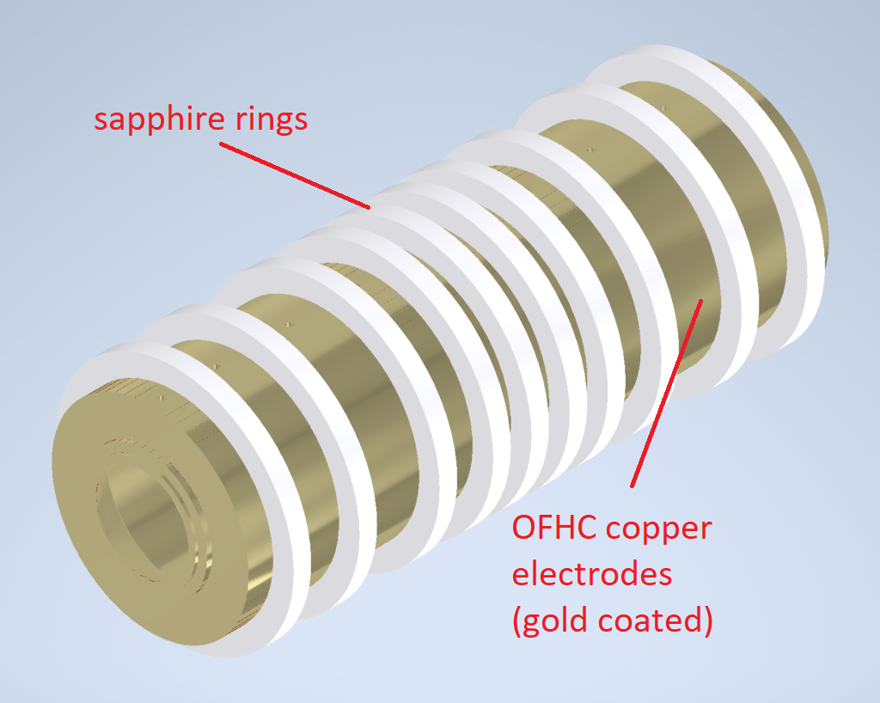
PhD projects: New seven-electrode trap design
(a) Thermal expansion vs. harmonicity:
Advantages over the five-electrode traps:
Better E-field harmonicity at low z (C4=C6=C8=C10=0):
  symmetric field expansion Φ(z) = Vr (C0 + C2 z² + C4 z⁴ + …)
Larger (factor of ~3) stable magnetron region:
  lower Δν_{z} (from Duffing equations):
  Δν_{z} = ν_{z} (3/4 C4/C2² (kB Tz/qVr) + 15/16 C6/C2³ (kB Tz/qVr)² + …)
  similar frequency shift dependence in the other modes
  -> More precise cyclotron frequency measurement
Already implemented in other Penning trap experiments:
  LIONTRAP (Mainz, Germany)
  ALPHATRAP (Heidelberg, Germany)
(b) New trap design:

Slide 11
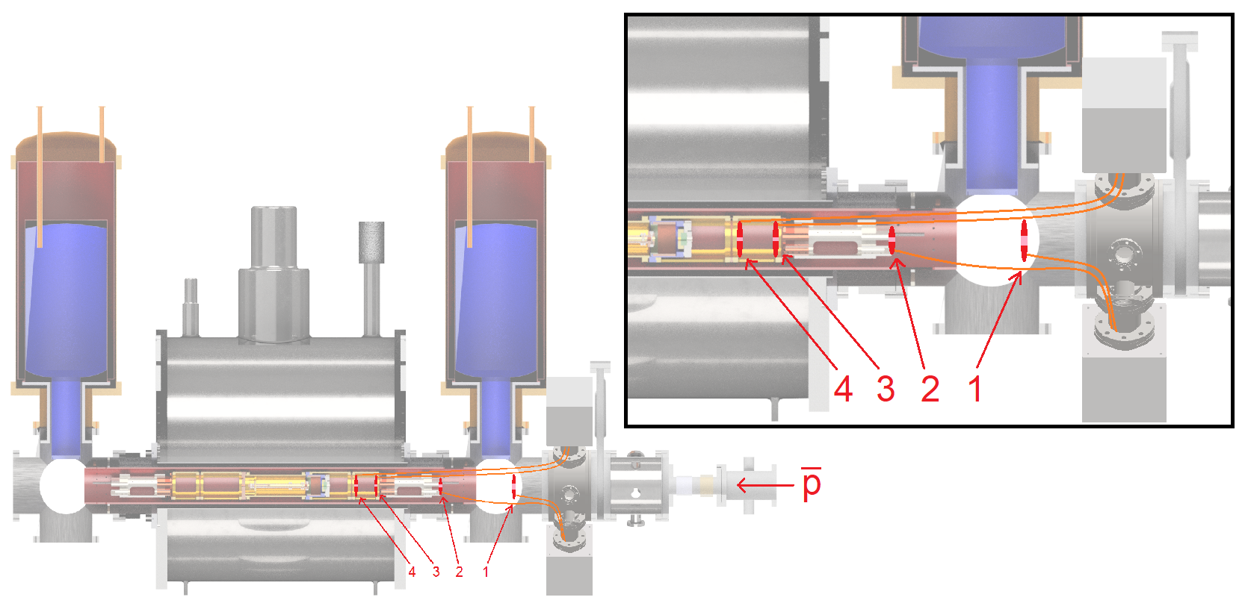
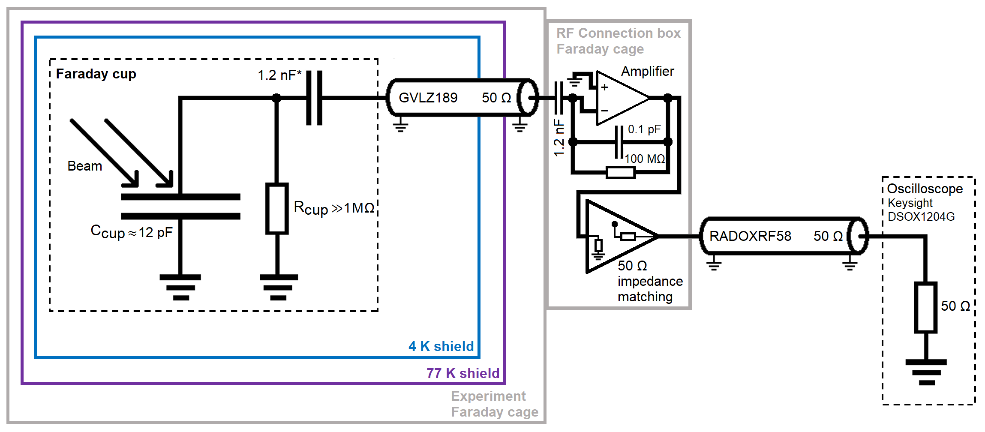
PhD projects: Antiproton beam monitors (1)
Four new antiproton beam monitors were installed in 2022 (marked 1-4), to have better antiproton beam tracking along the experiment axis.
Antiprotons are registered using Faraday cups, which consist of a capacitor, onto which the charge is distributed, and an amplification stage.

Slide 12
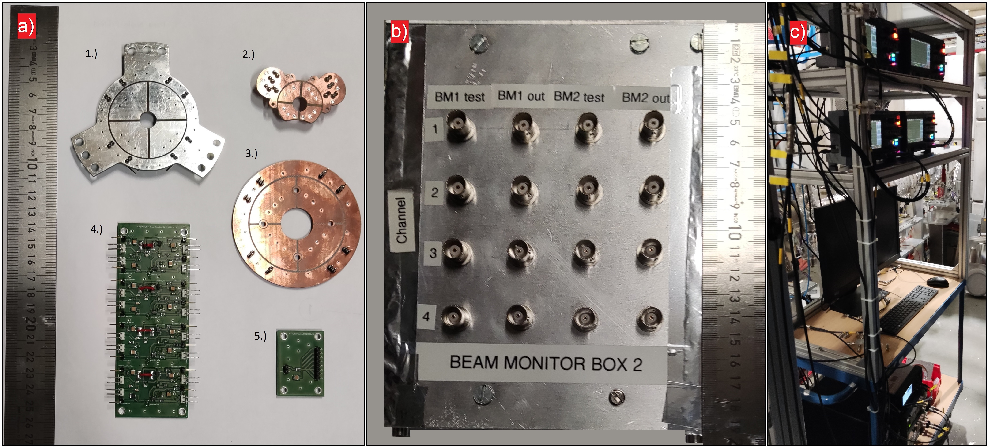
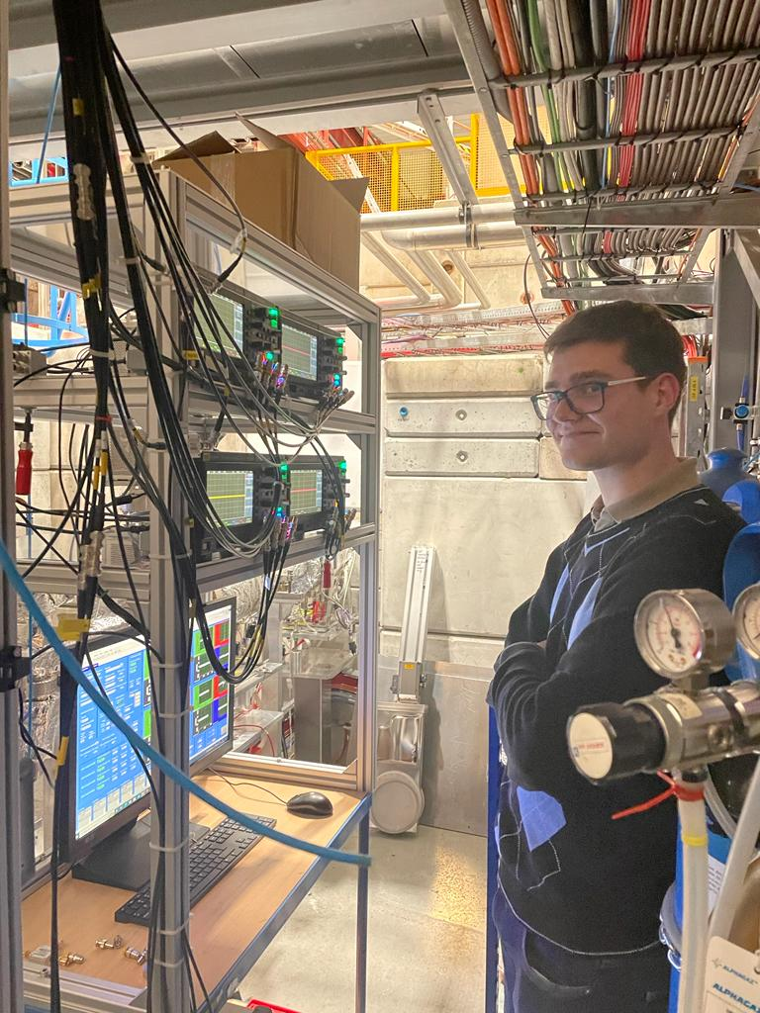
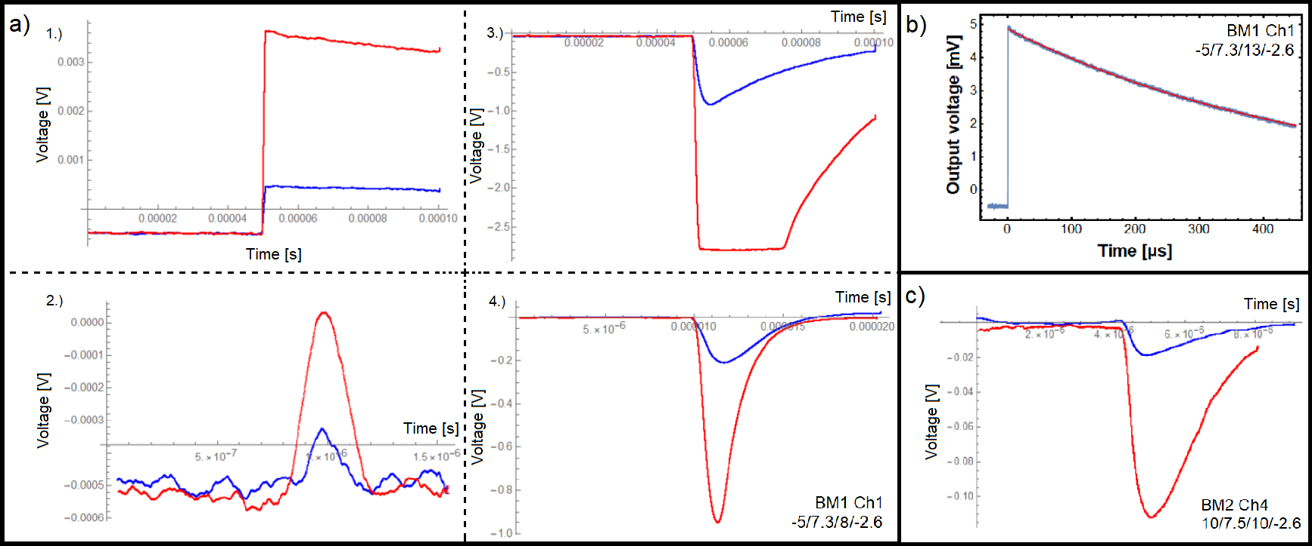
PhD projects: Antiproton beam monitors (2)
Beam monitors and amplifier PCBs;
Faraday cage for amplifying and connecting the hot lines to the coaxial outputs;
Data readout rack: four oscilloscopes.
Signals of the antiproton annihilation and H- ion deposition + charge liberation from the board;
Different signal shape depends on the oscilloscope input resistance and whether the amplifier stage is used or not.

Slide 13
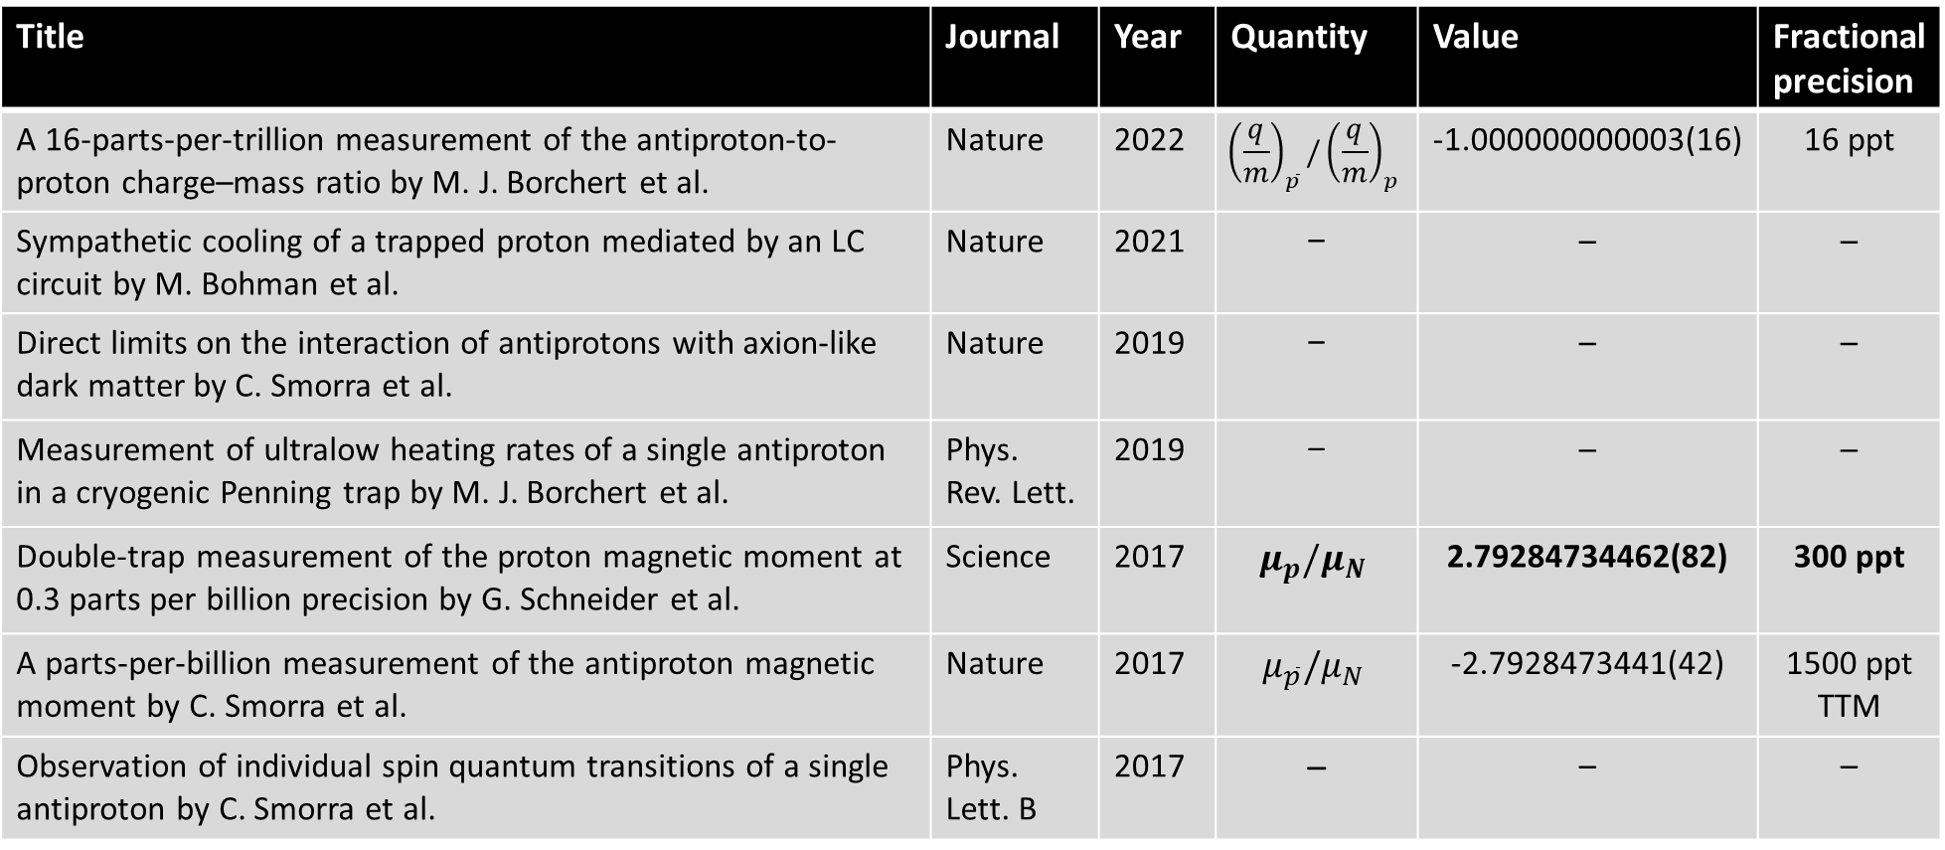
Key publications by BASE
Title | Journal | Year | Quantity | Value | Fractional precision
A 16-parts-per-trillion measurement of the antiproton-to-proton charge–mass ratio by M. J. Borchert et al. | Nature | 2022 | $${\left(\frac{q}{m}\right)}_{\overline{p}}/{\left(\frac{q}{m}\right)}_{p}$$ | -1.000000000003(16) | 16 ppt
Sympathetic cooling of a trapped proton mediated by an LC circuit by M. Bohman et al. | Nature | 2021 | – | – | –
Direct limits on the interaction of antiprotons with axion-like dark matter by C. Smorra et al. | Nature | 2019 | – | – | –
Measurement of ultralow heating rates of a single antiproton in a cryogenic Penning trap by M. J. Borchert et al. | Phys. Rev. Lett. | 2019 | – | – | –
Double-trap measurement of the proton magnetic moment at 0.3 parts per billion precision by G. Schneider et al. | Science | 2017 | $$μ_{p}/μ_{N}$$ | 2.79284734462(82) | 300 ppt
A parts-per-billion measurement of the antiproton magnetic moment by C. Smorra et al. | Nature | 2017 | $$μ_{\overline{p}}/μ_{N}$$ | -2.7928473441(42) | 1500 ppt TTM
Observation of individual spin quantum transitions of a single antiproton by C. Smorra et al. | Phys. Lett. B | 2017 | – | – | –

Slide 14
References
[1] American Physical Society: Alan Stonebraker
[2] Matthias Borchert PhD thesis, University of Hannover, Germany
[3] Onsets of nuclear deformation from measurments with the ISOLTRAP mass spectrometer by S. Naimi, 2010
… and publications by BASE

