Slide 1
H->bB update
/cern.ch/grid/ilc/user/c/cgrefe/clic_sid_cdr/ee_h_bb/fullReco/
p_{T} bug fixed, latest PandoraPFA

Slide 2
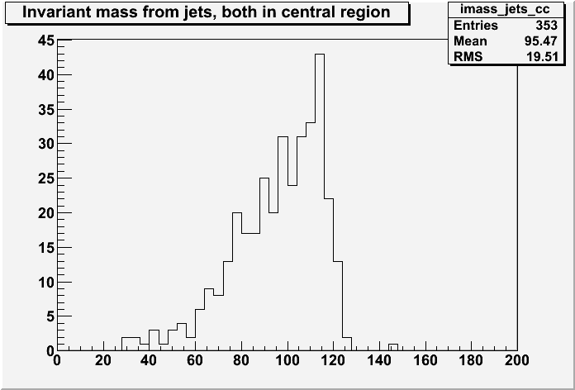
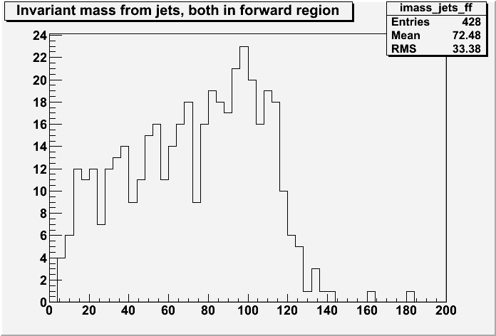
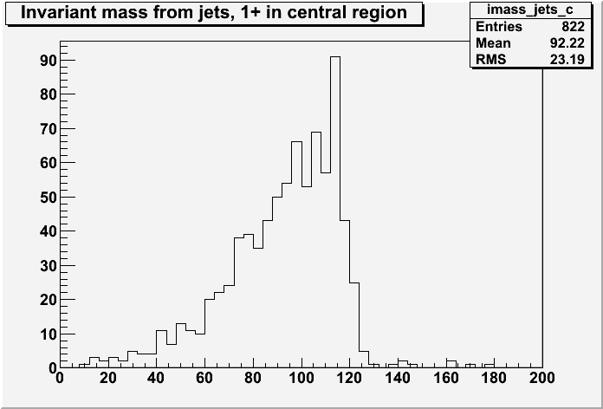
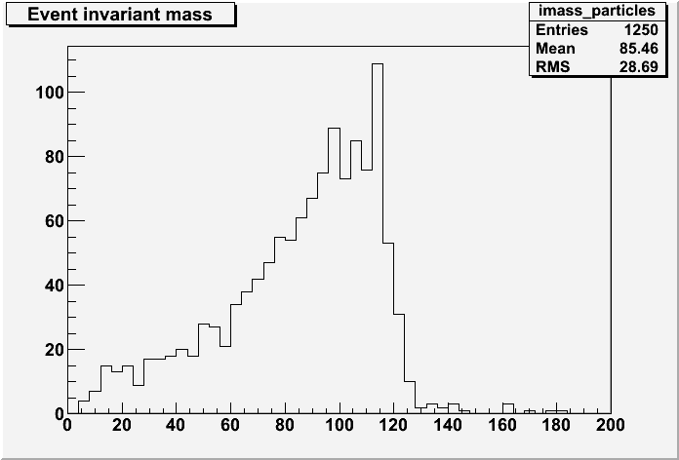
CC
FF
C+
Particles
(no anti-ISR cuts)

Slide 3
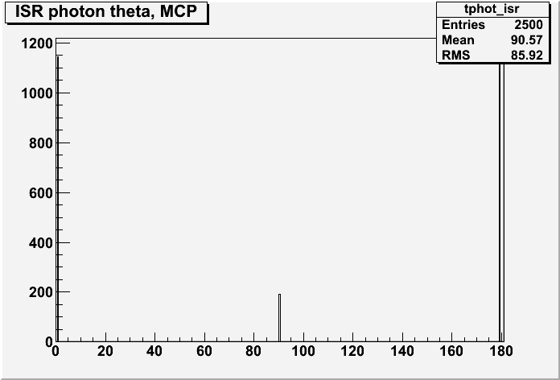
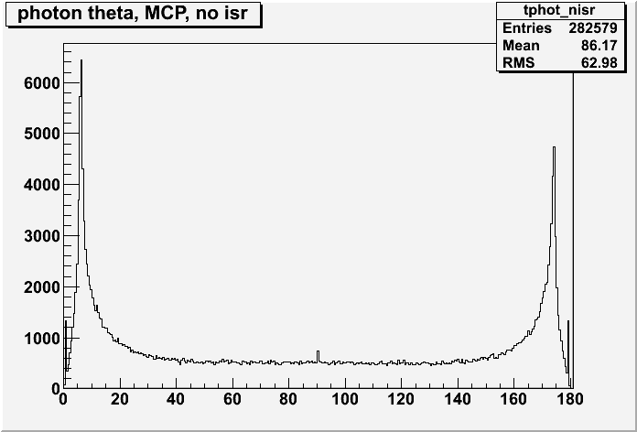
ISR Photons
(there are 2 parents, both |pid| = 11)
non-ISR Photons

Slide 4
Summary
ISR photon peak @ 90°
  No ISR radiation but MCParticle formally present with [0,0,0,0] four-momentum
Other peaks
  ISR photons always radiated parallel to the beams
    no anti-ISR cuts effective since photons disappear in the beampipe
Higgs Mass
  Separate effect of acceptance and energy resolution
  Consistent with Marcel’s Z-peak (?)
  Where is the long tail coming from?

