Slide 1
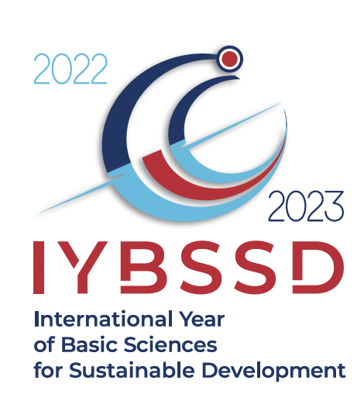
Sciences for Sustainability: from the International Year of Basic Sciences for Sustainable Development in 2022/2023, to the International Decade of (all) Sciences for Sustainable Development 2024 - 2033 proclaimed by UN and under the auspices of UNESCO
Michel Spiro
President of IUPAP
Chair of the
International Year of Basic Sciences
for Sustainable Development in 2022/2023 (IYBSSD)
https://www.iybssd2022.org/en/home/
/2023

Slide 2
International Year of Basic Sciences for Sustainable Development in 2022/2023, under the auspices of UNESCO
Proclaimed by the United Nations General Assembly on December 2nd, 2021
Opening July 8th, 2022 at UNESCO, closing December 15^{th,} 2023 at CERN
Resolution brought up by Honduras with the support of Armenia, Azerbaijan, Bahrain, Bolivia, Brasil, Burkina Faso, Chad, Chile, Colombia, Cuba, Dominican Republic, Ecuador, El Salvador, Fiji, Georgia, Guatemala, India, Indonesia, Israel, Japan, Jordan, Kyrgyzstan, Malawi, Nicaragua, Panama, Paraguay, Peru, Philippines, Qatar, Russian Federation, Saudi Arabia, Serbia, Spain, South Africa, Thailand, Vietnam
https://www.iybssd2022.org/en/home/
/2023

Slide 3

/2023

Slide 4
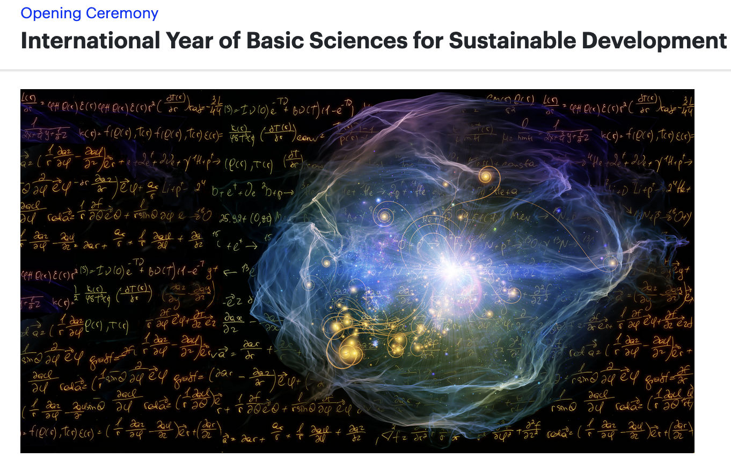
Rationale
Curiosity-driven sciences construct the pool of knowledge which future generations will use for their development
Basic sciences are not always and everywhere considered as they deserve, in the discussions concerning the societal, environmental and economic development
Curiosity-driven sciences re-enchant our world and make it worth to be sustainable
Basic sciences explore
the soul of the Universe!!
/2023

Slide 5
Examples
Vaccines and treatments against COVID-19 are full of basic biology (DNA, RNA, etc.)
The WEB was born at CERN from the needs of fundamental science
Google research engine comes from a brilliant mathematical idea
Artificial intelligence relies on statistical methods
Cellular phones are full of transistors, integrated circuits, WiFi, code, etc.
GPS relies on Einstein theory of Relativity and on quantum atomic clocks
The Genome Project has opened the way to gene therapies
PET scan and MRI are based on antimatter physics and fundamental atomic magnetism
Generation and storage of renewable energy depends on advances in physics, chemistry and materials science
Reduction in pollution and green chemistry rely on basic advances in chemistry
The second quantum revolution is having now applications!!
The science of plate tectonics has revolutionized the knowledge about our planet
/2023

Slide 6
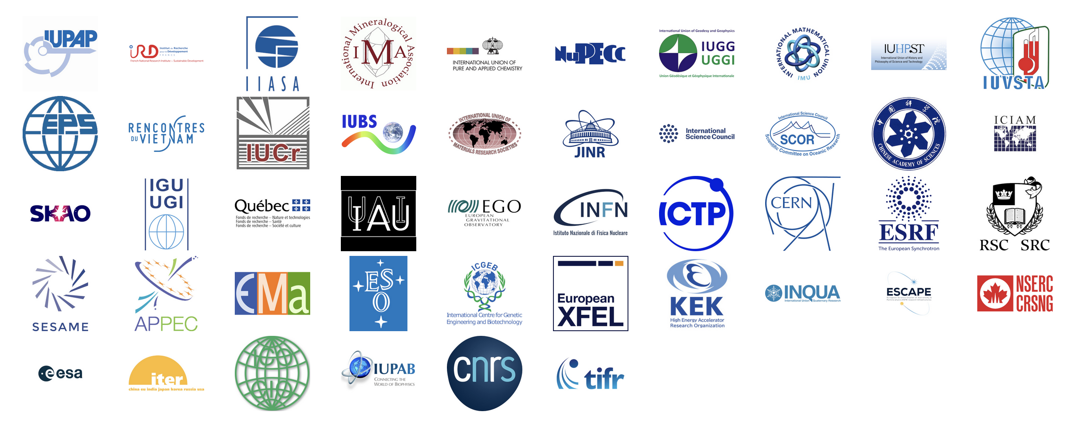
Leading Union

Slide 7

Support
50 International Unions and Organizations
110 science academies, scientific networks and learned societies International Advisory Committee
31 Nobel laureates and Fields Medalists
UNESCO, World Science Forum, Club of Rome, Inter Parliamentary Union. These unions, organizations, academies, networks and associations are the foundations for the success of the year and for further initiatives beyond this International Year. A real asset!!

Slide 8
Statement of the International Year!
Basic sciences are curiosity and inquiry driven They are the foundations of education and the sources of discoveries which turn into applications: they can then serve an inclusive sustainable development (improving global equity and well-being together with a healthy and lively planet). All together (education, discoveries, applications, and inclusive sustainable development) can boost collaborative and open Basic Sciences. This is the virtuous circle that we want to promote during the International Year of Basics Sciences for Sustainable Development and after.
To achieve this goal, we shall need you, teachers, scientists, entrepreneurs and society at large to share this vision, and act accordingly. A decade of sciences for sustainability might be necessary.
/2023

Slide 9
Science, Ethics and Human Development (Quy-Nhon, Vietnam conference)
Scientific knowledge, technology and innovation shape our lifes, our imagination, our hopes, our fears. But beyond, it is a common universal heritage.
Business as usual is no more an option. Every scientist through his/her institution, especially when supported by public funds, and even if his research is curiosity and inquiry driven, must try to best connect to the society and should have in mind how his or her activity and findings could impact the world (responsibility), and might be of interest for contributing to make it better and not worse.
However, scientists must be given the necessary funding and freedom and the right to collaborate with the other scientists in their field to conduct their research (science for peace) and be listened to at all levels of decision making and inspire that way the decision makers and the society at large.
It is a balancing act (responsibility and freedom) to ensure societies trust their scientists and the knowledge they provide
Doctoral education should include in priority ethics, integrity and sustainability

Slide 10
Plead for Basic and Applied Sustainability Science (Serbia, Belgrade conference)
Sustainability Sciences education of young people, which is multidisciplinary and integrative should be implemented in addition to the standard STEM education.
Sustainability Science must be co-constructed and open (publishing, data, software, hardware)
It goes from very basic (understanding the planet habitability, gaiaology) to the 17 interconnected SDGs and beyond (interplay between curiosity driven science, applied sciences and traditional knowledge)
Reduce poverty. Improve well being beyond just consuming, target global equity and a lively and healthy planet.
Circular economy fuelled by decarbonated energy could be the application target of Sustainability Science, with a lot of innovations and new practices needed
It could benefit for their organisation from models of organisation in Big Basic Sciences and from the IPCC and IPBES model of interaction between scientists and decision makers
A decade of actions might be necessary to implement that!

Slide 11
International Decade of Sciences for Sustainable Development 2024 - 2033
Proclaimed by consensus the UN General Assembly on August 25th
Resolution brought up by Serbia with the supporting countries: Argentina, Cuba, Equatorial Guinea, Guatemala, Honduras, Hungary, Serbia, South Africa, Spain and Viet Nam.

Slide 12
Rationale and Goals
Basic sciences, although essential for sustainability are not enough. We need to embark all sciences (basic, applied, social and human) and all knowledge (including traditional).
Equitable, peaceful and planet friendly circular economy fuelled by decarbonated energy should be the application target of Sustainability Sciences, with a lot of innovations and new practices needed.
Sciences for sustainability are rising but are very fragmented thematically, geographically, organizationally.
We need to educate, to mobilize, to interconnect, to structure in order to co-transform efficiently
We need to create the spirit for Sustainability Sciences which presided to the creation of the CERN International Organization after World War II

Slide 13
Global challenges
Global challenges approaches (from components to system, from local to global, from short term to long-term, involving open science and the society at large) are a unique opportunity to cooperate and build a better world.
Following further the international mobilization, laws and treaties should be enacted towards these goals, based on a dialog between all stakeholders, including scientists.

Slide 14
Thank You
We count on you and YES WE CAN, YES WE MUST!
/2023

