Slide 1
LHCb optical system status
Overview of system
Running experience
On behalf of all the LHCb sub-systems

Slide 2
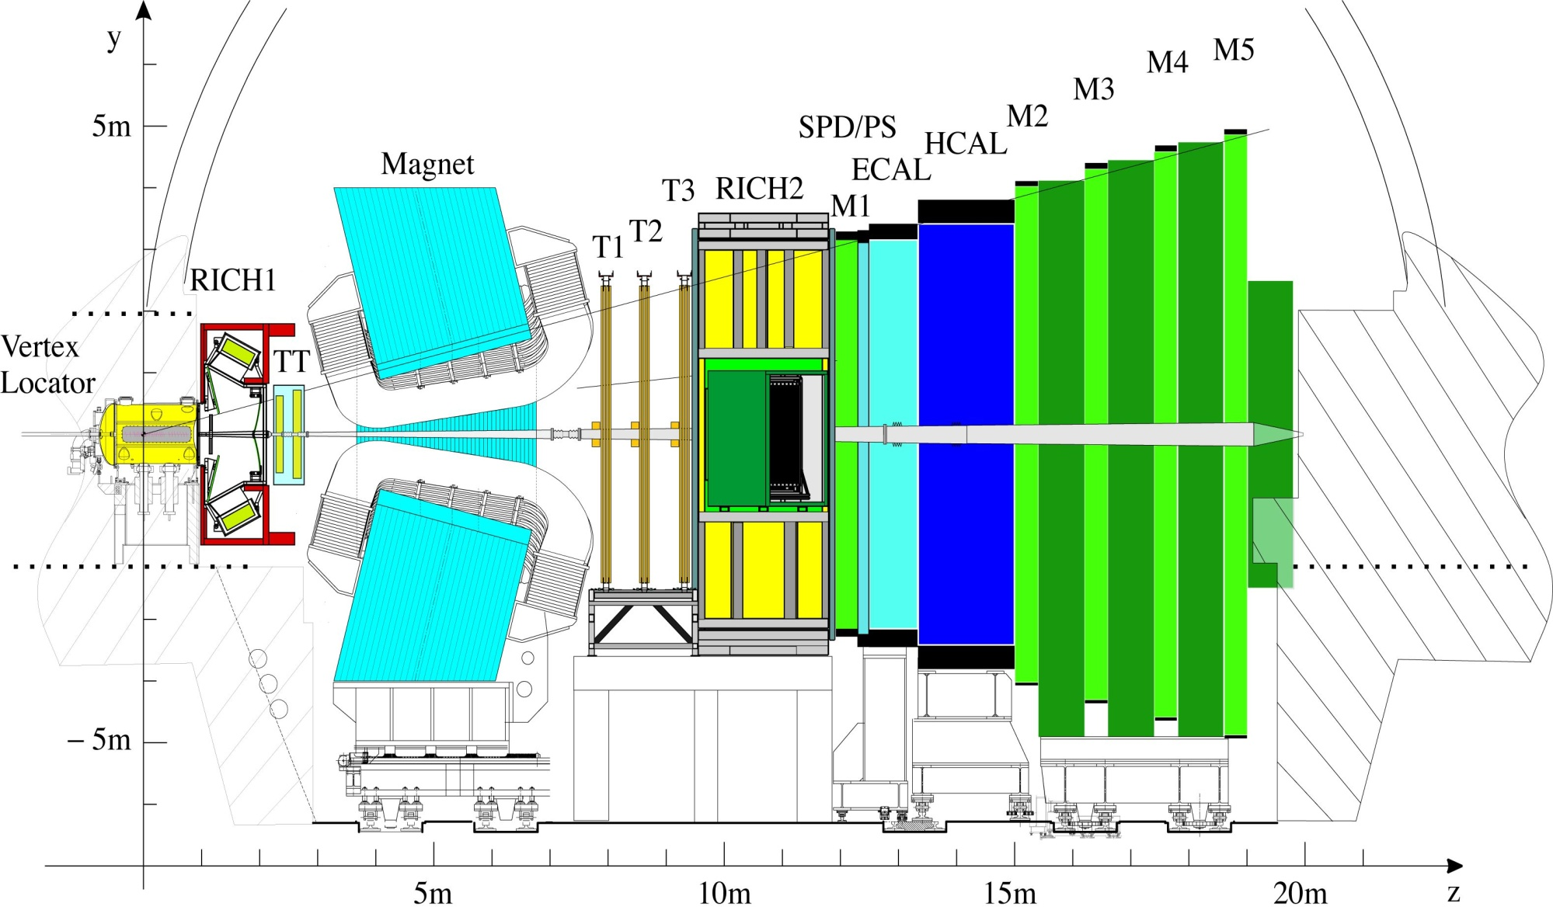
LHCb sub-systems
VELO 5000
Cu links
Silicon Tracker
2016
optical links
Outer Tracker
432
optical links
Muon
152 + 152 x 12-way optical links
RICH
484
optical links
Calo
82 x 12-way optical links

Slide 3
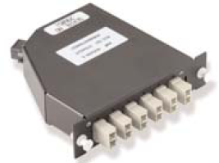
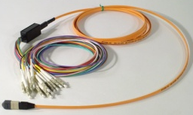
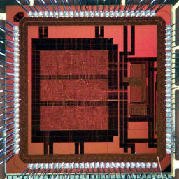

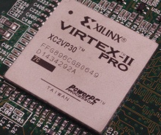
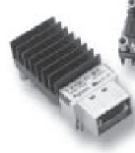
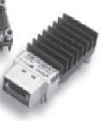
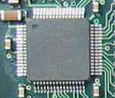
Standardised optical link
Cassette
Fibre
Breakout
VCSEL-SMA
GOL
XILINX FPGA
12-way MTP/MPO
~ 100m
Agilent HFBR-7XX
Agilent HFBR-7XX
TLK 2501
System summary | Radiation environment (10 years)
1.6 Gbit/s serial data, 8b/10b
3084 single-channel VCSELs | 24krad 3.4 x 10¹² n_{eq} 3.1 x 10¹¹ hadrons >20MeV
234 12-channel TXs | 2.2krad 3.4 x 10¹¹ n_{eq} 1.9 x 10¹⁰ hadrons >20MeV
850nm, multi-mode 50/125

Slide 4
VCSEL problems
All 3084 from same vendor
Oxide-confined, 850nm, 6mW, 1mA threshold
Packaging (2 steps): TO-46
SMA
Burn-in after TO-46 packaging (48h at 100degC, 15mA)
Vendor promises:
good handling (ESD) procedures (but LHCb can’t!)
good hermetic sealing
wafer position tracing (all from one wafer)
Bias currents 1.5 – 3 mA, modulation current = 10mA (fixed)
They are ALWAYS biased above threshold

Slide 5
Timeline
Before spring 2010:
RICH2 early deaths (2007-2008)
RICH1 (3): 2009(2), 2010(1)
All of Muon deaths
Rate is slow (or zero) except Silicon Tracker (biggest user)
Since spring 2010:
All deaths in OT
Most in ST
RICH2 (2)
Lots of downtime

Slide 6
Statistics

Slide 7
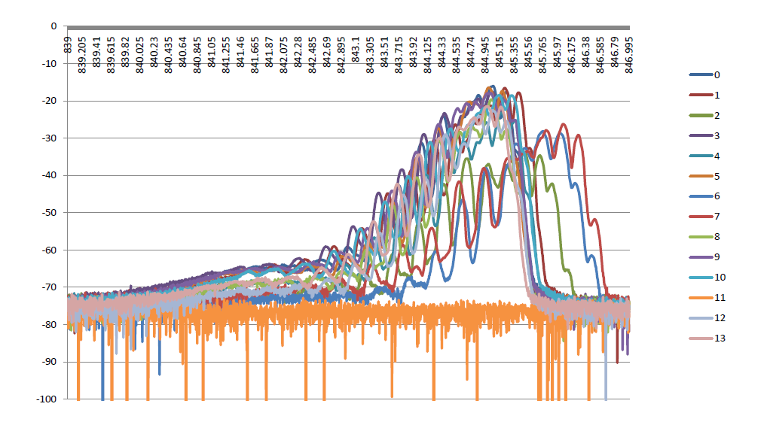
Optical Spectrum Analysis
Higher bias
Dead VCSEL

Slide 8
Optical Spectrum Analysis
Results inconclusive:
Two dead VCSELs had normal spectrum before death
One with clear shift: will send for analysis

Slide 9
Failure analysis by vendor
Vendor admits failure rate is much higher than normal
Observations:
LIV curves: downward shift in diode-turn-on voltage
Only light output from spontaneous emission
-> electro-luminescence images

Slide 10
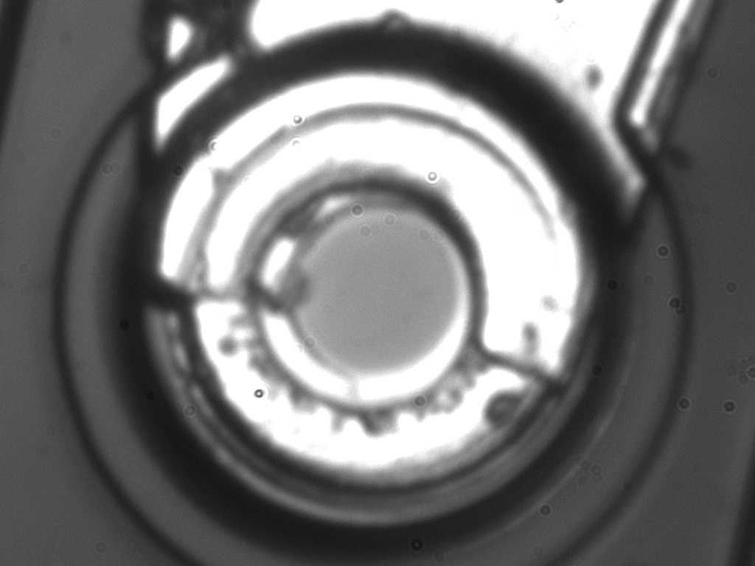
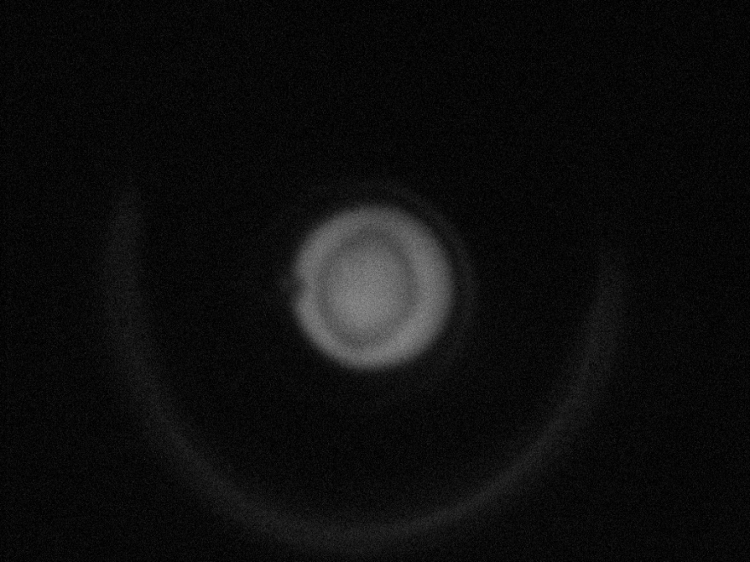
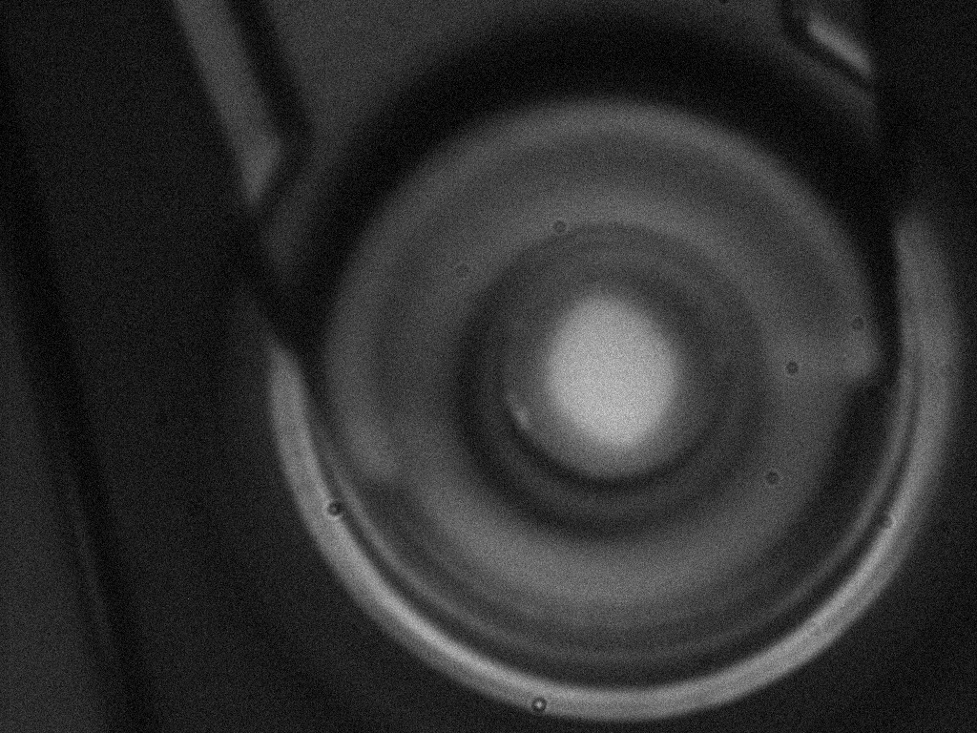
Failure analysis by vendor
Dead VCSEL
New devices from same wafer with very small bias current
Current aperture?

Slide 11
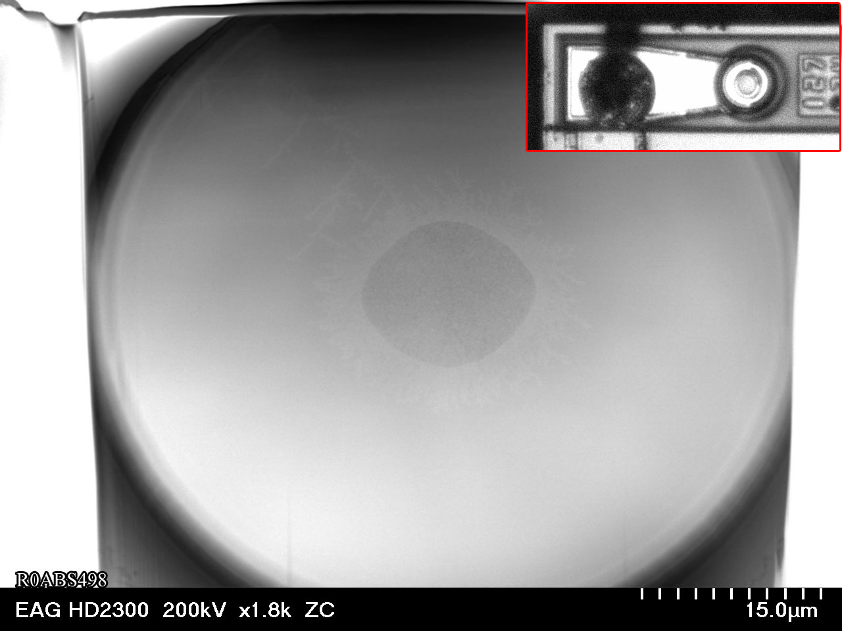
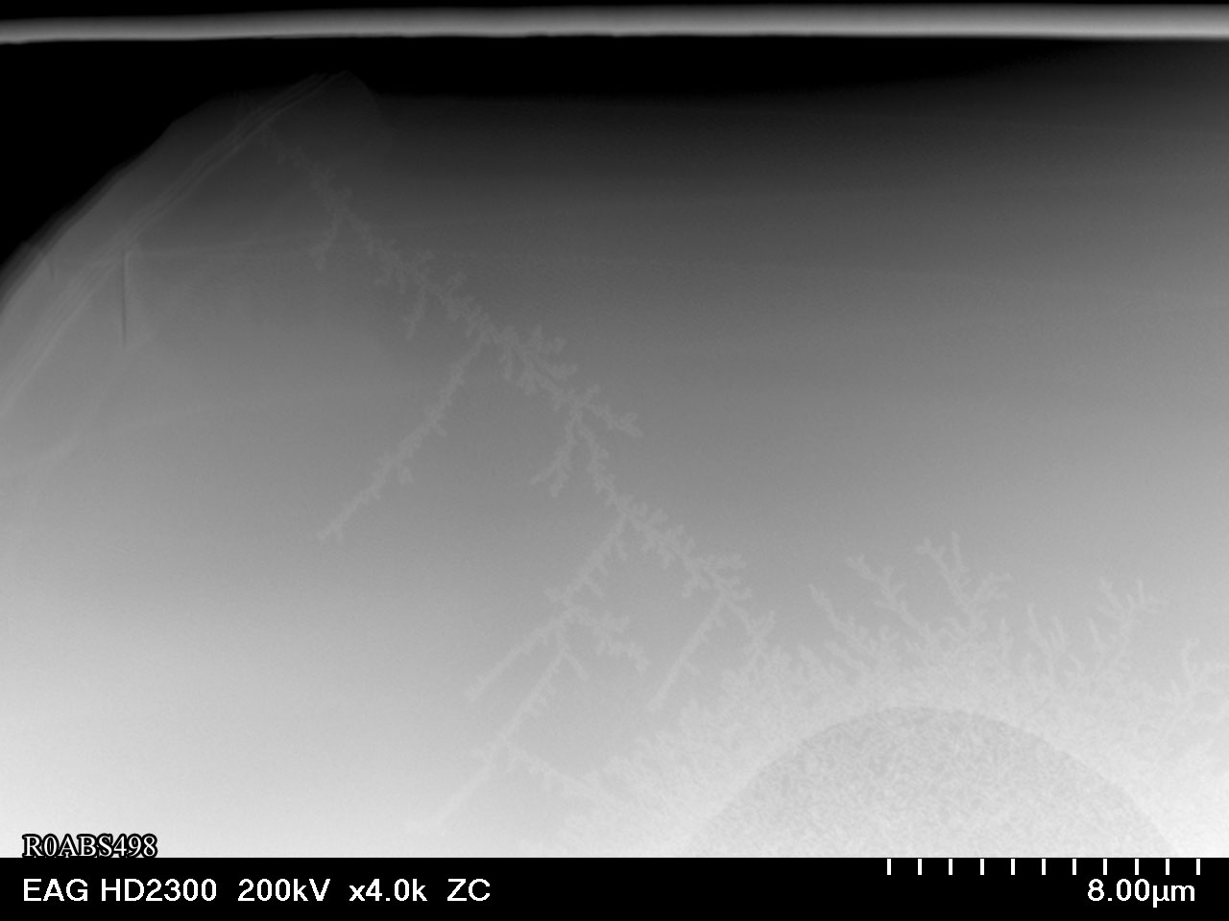
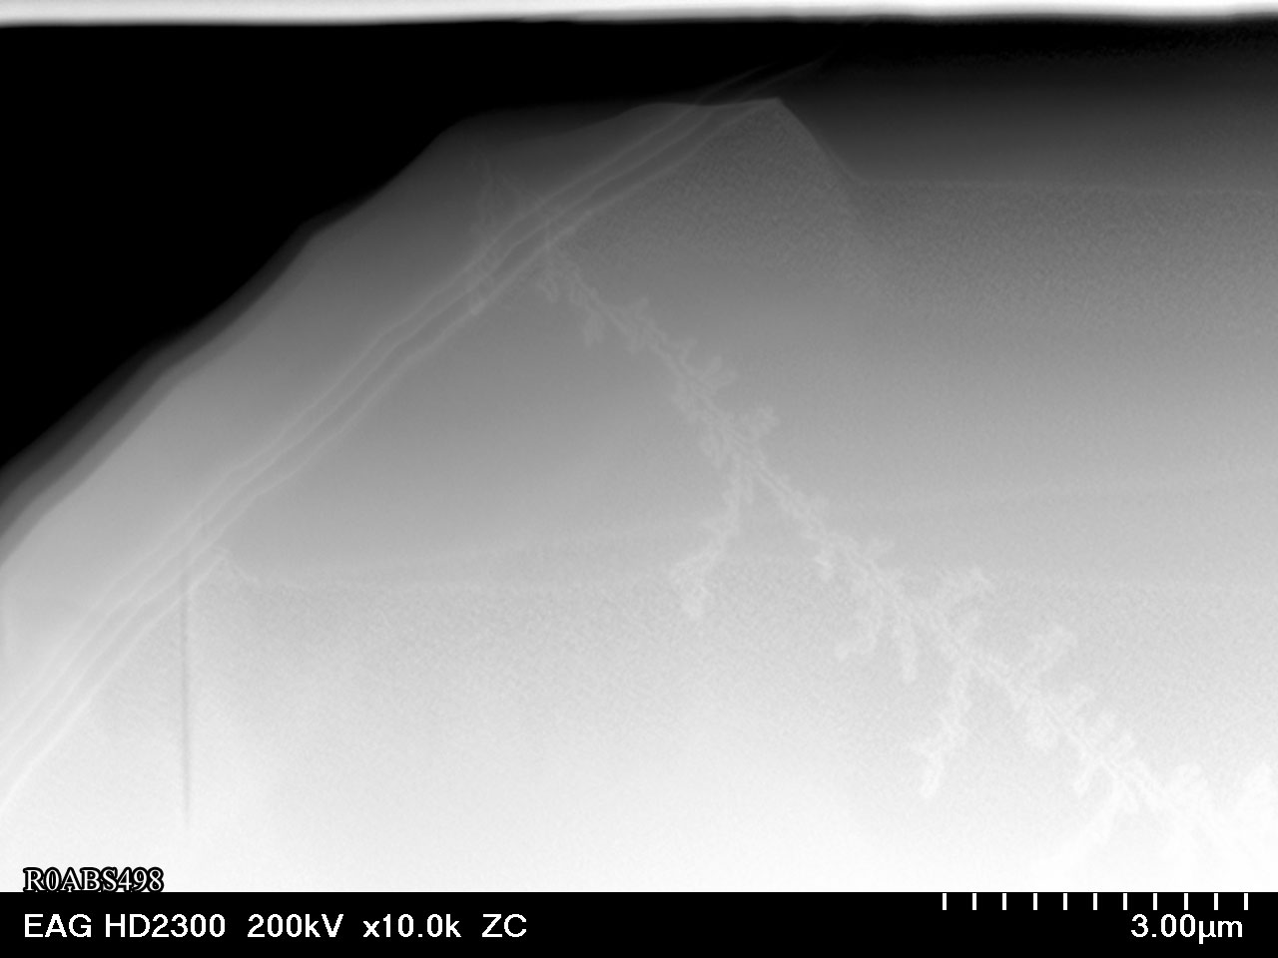
Failure analysis by vendor
Vendor sent samples to contractor for TEM imaging
Images shows cracks:
Recognised failure mode of oxide-confined VCSELs: manufacturing defect
Defect on edge plus mechanical stress between layers create cracks

Slide 12
Mitigation Plans
Short-term:
Replaced failed devices during winter shutdown
Additional spares purchased (Same device, but from different wafer)
Extended burn-in of samples already in progress
Longer term:
Manufacturer proposes new device
- design modifications to mitigate this effect
Radiation resistance unknown…… to be checked by LHCb
Make decision in 2011
- possible replacement in long shutdown

