Slide 1
ATLAS optical system status, VCSEL failures, analysis and mitigation
T. Flick, University of Wuppertal
Opto Working Group mini-workshop
CERN, March 8, 2011

Slide 2
Overview
Pixel statistics
SCT statistics
Larg statistics
Failure investigations
  Humidity investigation
  Usage of different VCSEL types
Getting new plugins
  Spares
  Old-style
  New desing

Slide 3
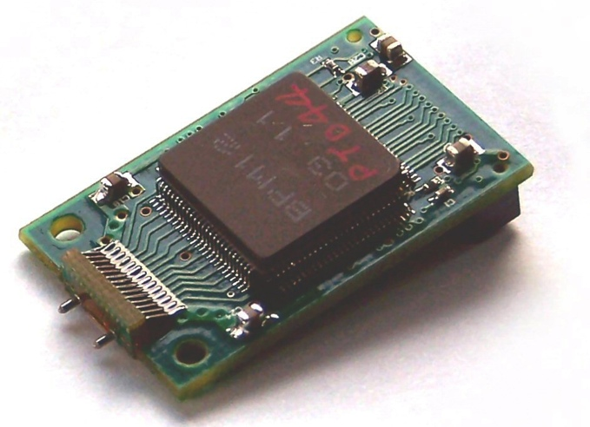
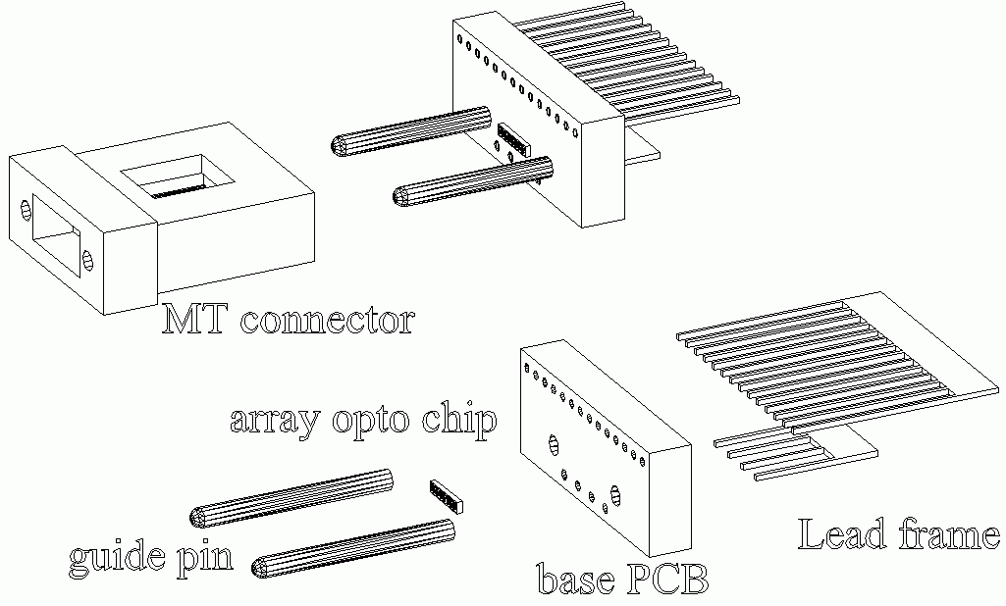
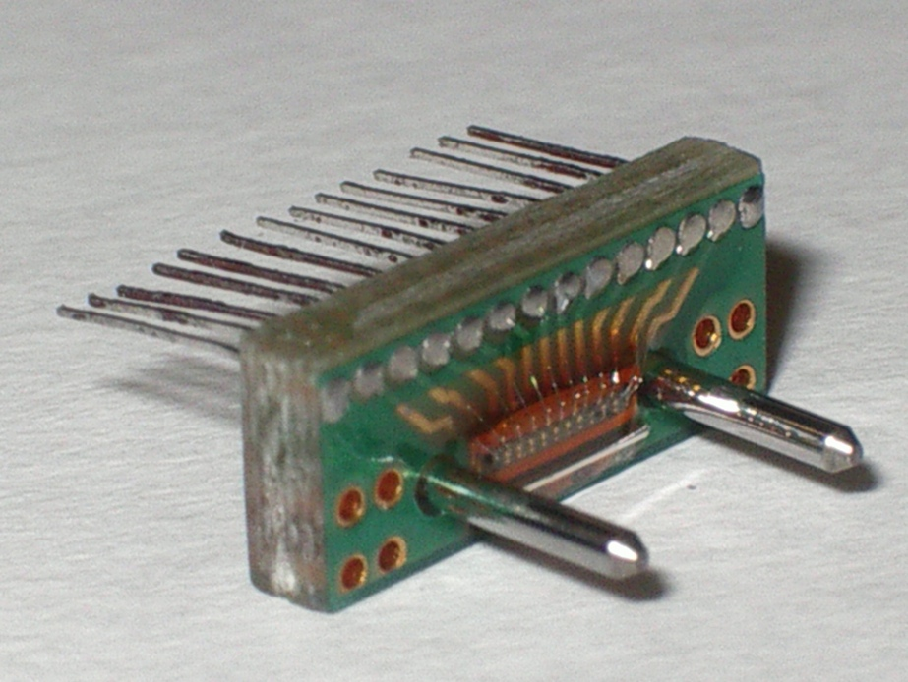
The SCT / Pixel Off-detector Optical Device
Epoxy Epo-Tek 353ND over active surface of VCSEL
Jig used for precision placement of array wrt guide pins ➔ purely passive alignment
SCT uses 12 channels,
Pixel uses 8 channels

Slide 4
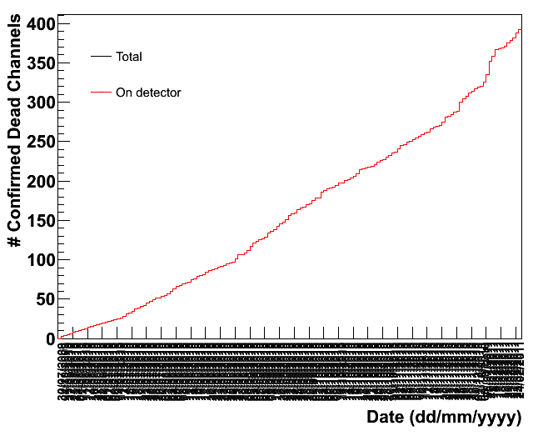
VCSEL failures SCT
Laser failures still going on
Replacement of devices for which redundant channel cannot be used
Need more plugins to keep detector (replacement) going
^
01/2010
07/2010
01/2011
Date

Slide 5
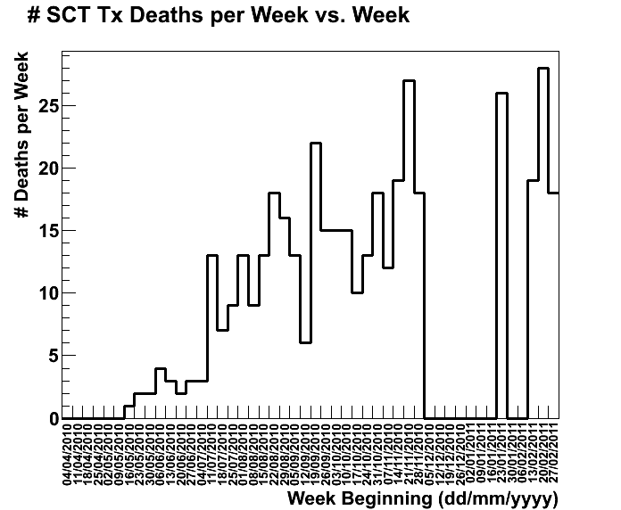
SCT Weekly
Faillure rate per week after shutdown same order as before shutdown.
~20/week

Slide 6
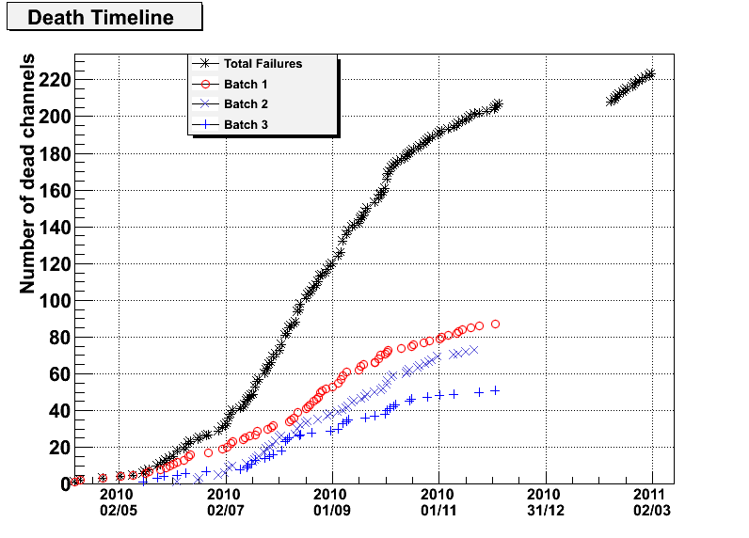
Pixel Statistics
Normally, single channel failures per plugin
Plugins have been replaced a.s.a.p. after failure to keep the detector going
  No redundancy
Started to replace with plugins which have been extracted in 2009
at global replacement.

Slide 7
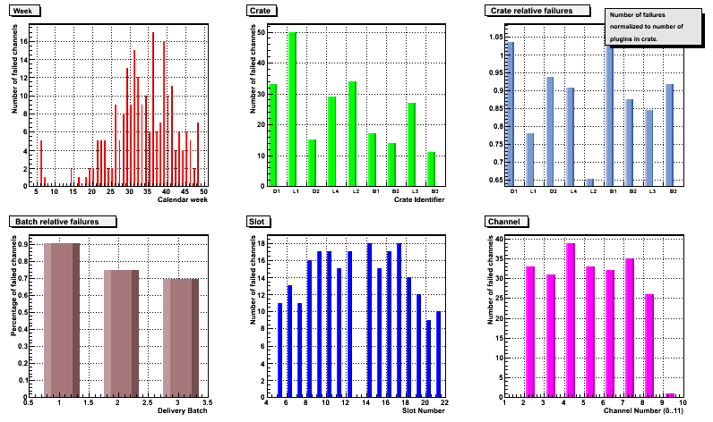
Pixel Weekly
2011
2010

Slide 8
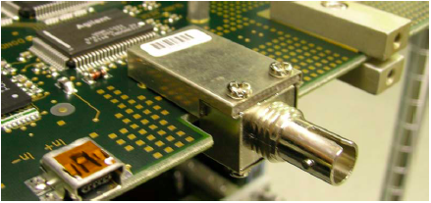
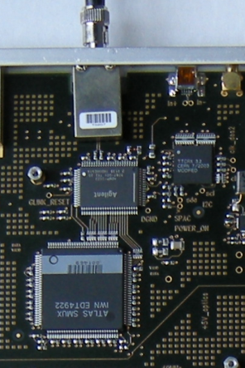
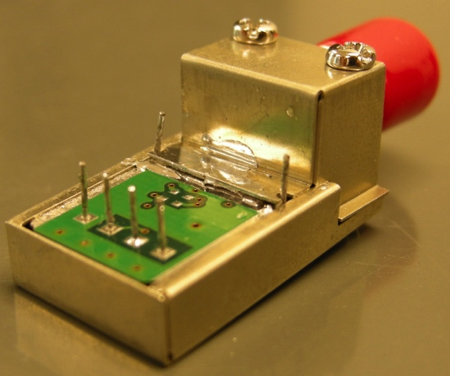
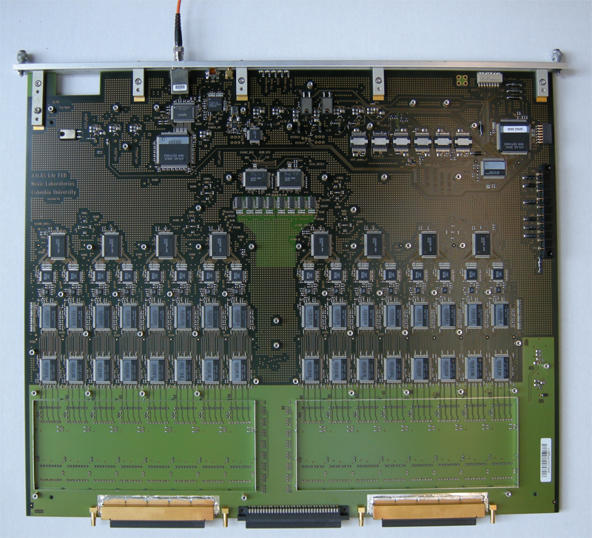
LAr optical links
OTX
G-link TX
FEB
SMUX
present
Single channels devices serving
128 detector channels each
Not pluggable → soldering needed
~ 400 mm

Slide 9
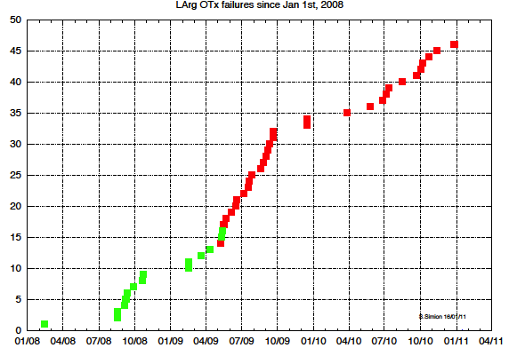
VCSEL failures in LArg
OTx failures in LArg detector was first observed failure (2008)
Devices are single channel TO cans
Green: OTx replaced in 2009
Red: OTx replaced in last shutdown

Slide 10
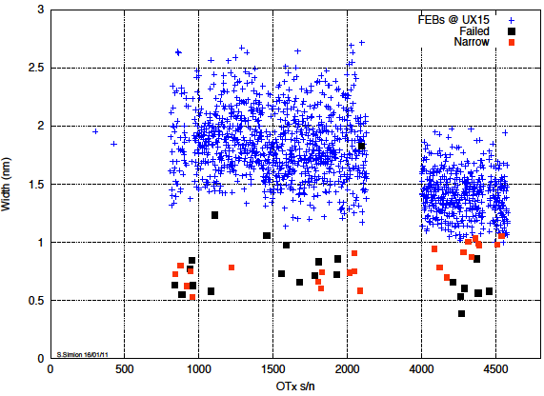
Optical Spectra (Larg OTx)
Optical spectra have been measured several times and are rather stable
Clear separation in the distribution
VCSEL failing devices show narrow spectrum
  Failures with normal spectrum developed short circuit, not due to VCSEL
Optical spectrum width as indicator!?

Slide 11
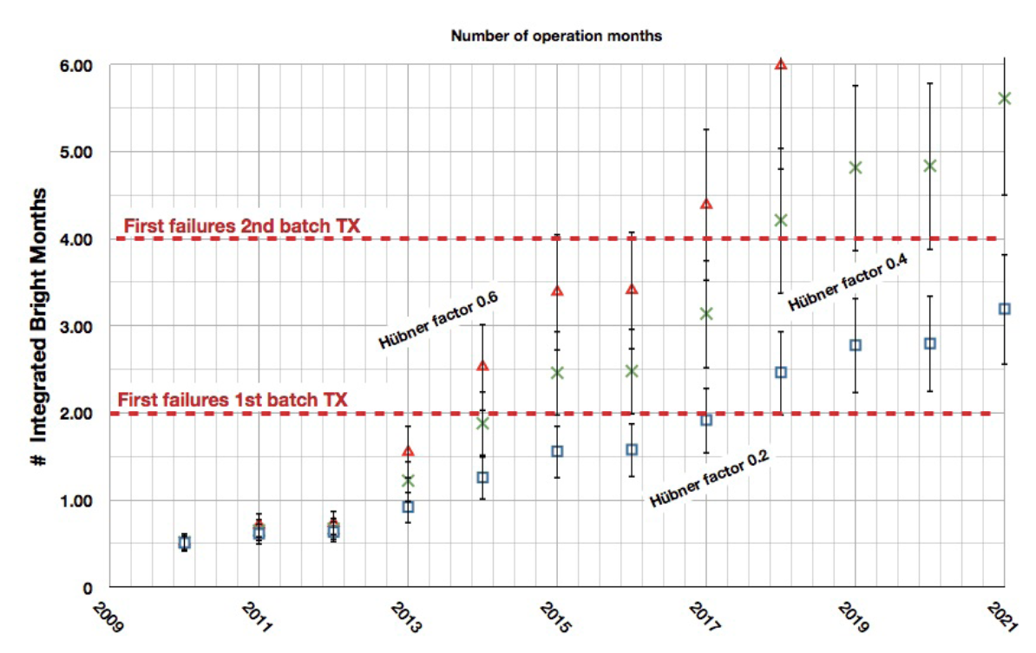
Pixel on-detector fear
Pixel has the same optical package on-detector as it is off-detector
Did a „what would be if“ calculation
Ingredients:
  Expected bright time before failure
  Luminosity profile
  Occupancy with this
  Hübner factor
  ...
No failures in the detector package still
Will differences in the off- and on-detector
operation help to survive?

Slide 12
Post-Mortem Studies
Use range of techniques
  Electroluminescence
    Dark areas sensitive to damage.
  EBIC
    Electron Beam Induced Current
    Beam energy gives depth.
    2D scan of beam and measure induced currents ➔ sensitive to defects
    Select where to cut device with FIB
  STEM
    See defects in active region and DBR mirror.

Slide 13
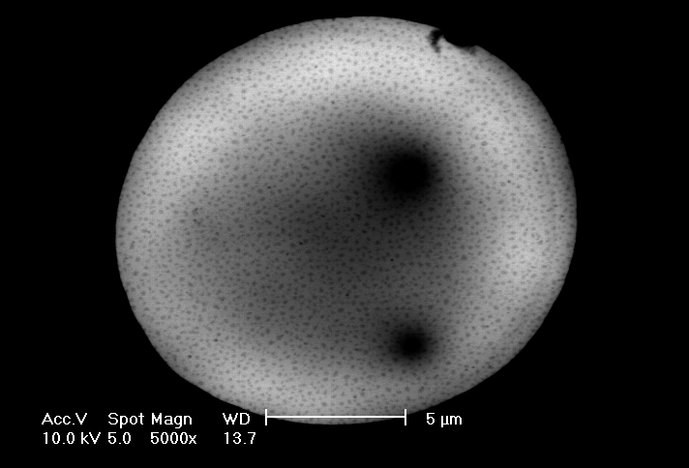
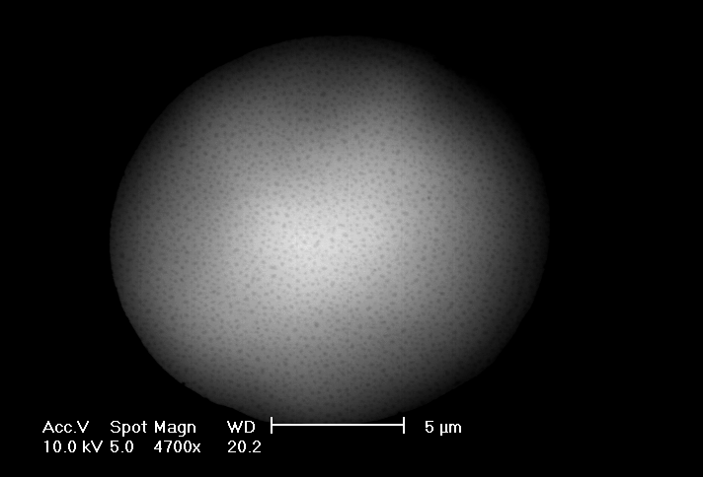
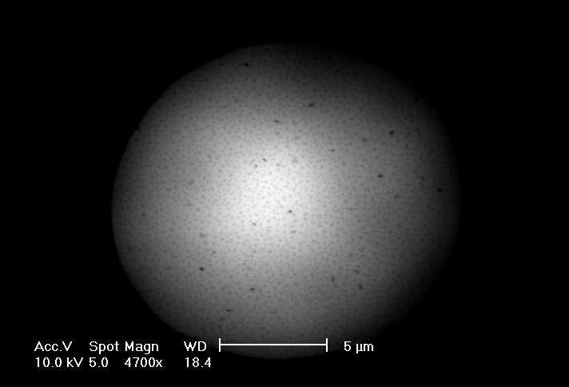
EBIC comparison
Ch 06
Ch 08
Ch 10
All taken with same SEM settings: 10KV spot 5 (roughly same mag 4700X and 5000x)
Original Image LUTs stretched to accentuate EBIC changes across VCSELs
Only Ch 10 shows distinct EBIC minima (dark spots) within the emission region
Ch 06 & 08 show some inhomogeneity but no distinct minima
Small dark speckles are surface topography

Slide 14
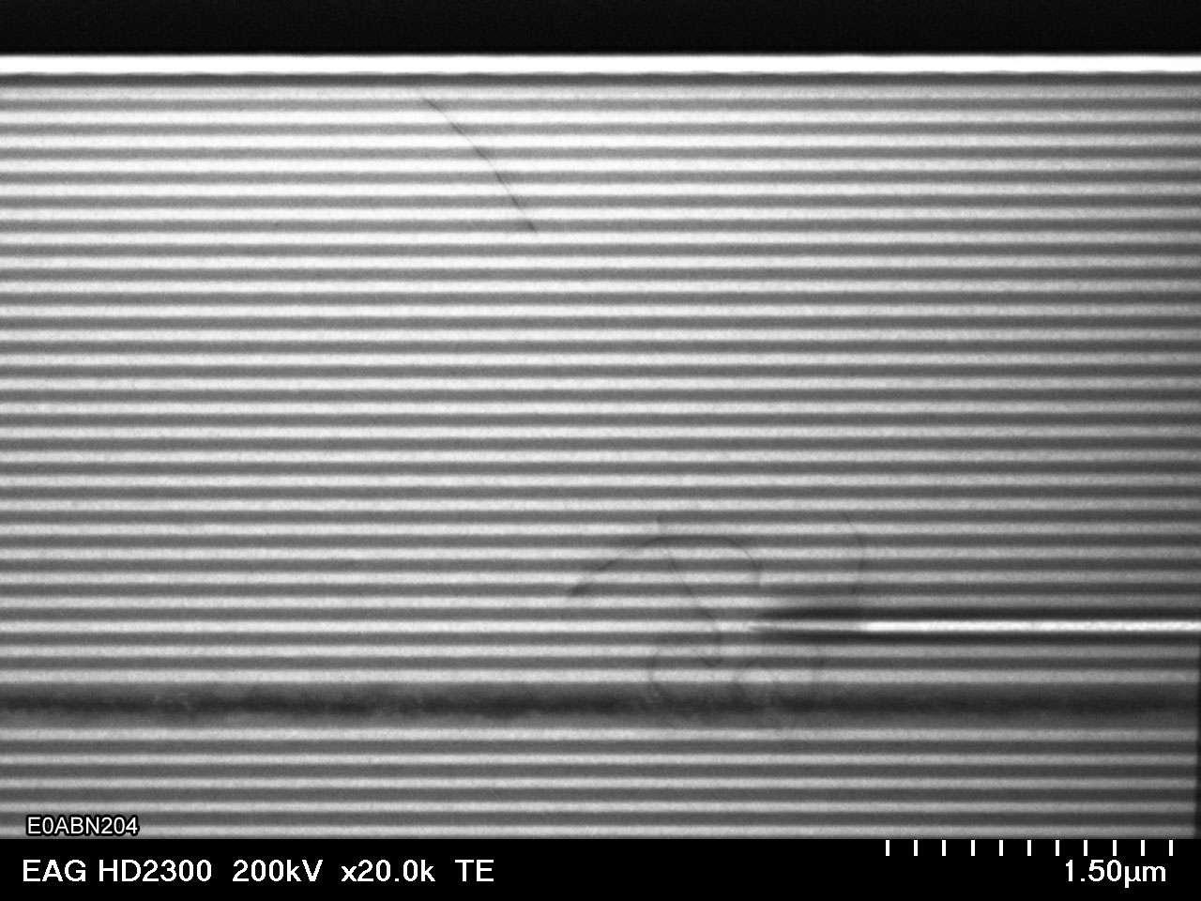
STEM Failed Channel after FIB cut
DBR
Oxide
MQW

Slide 15
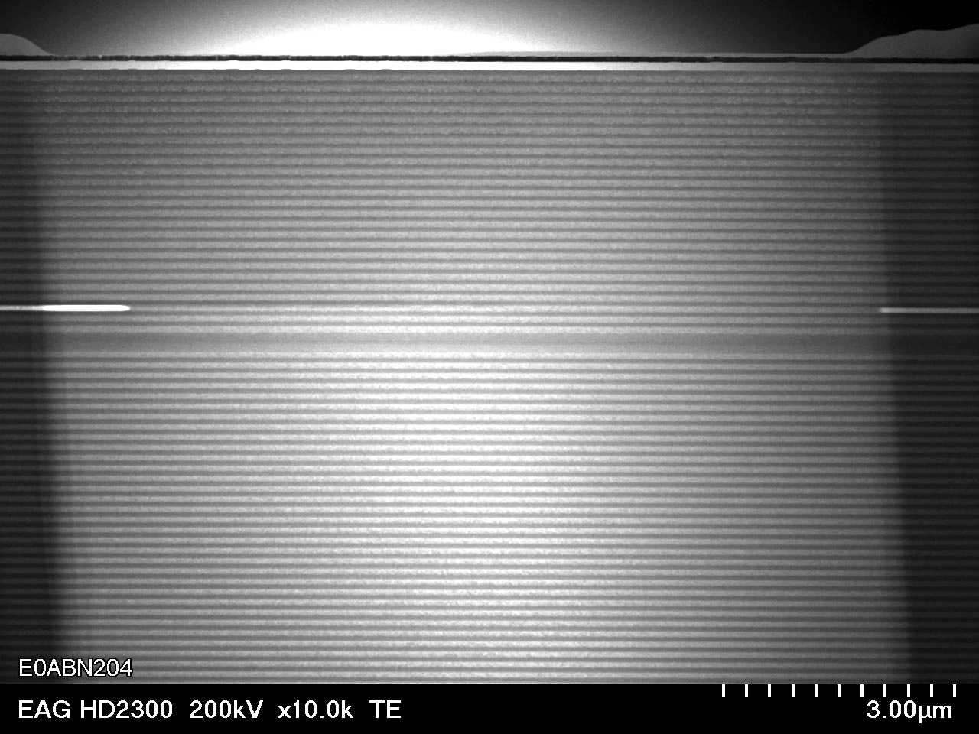
STEM Unused Channel

Slide 16
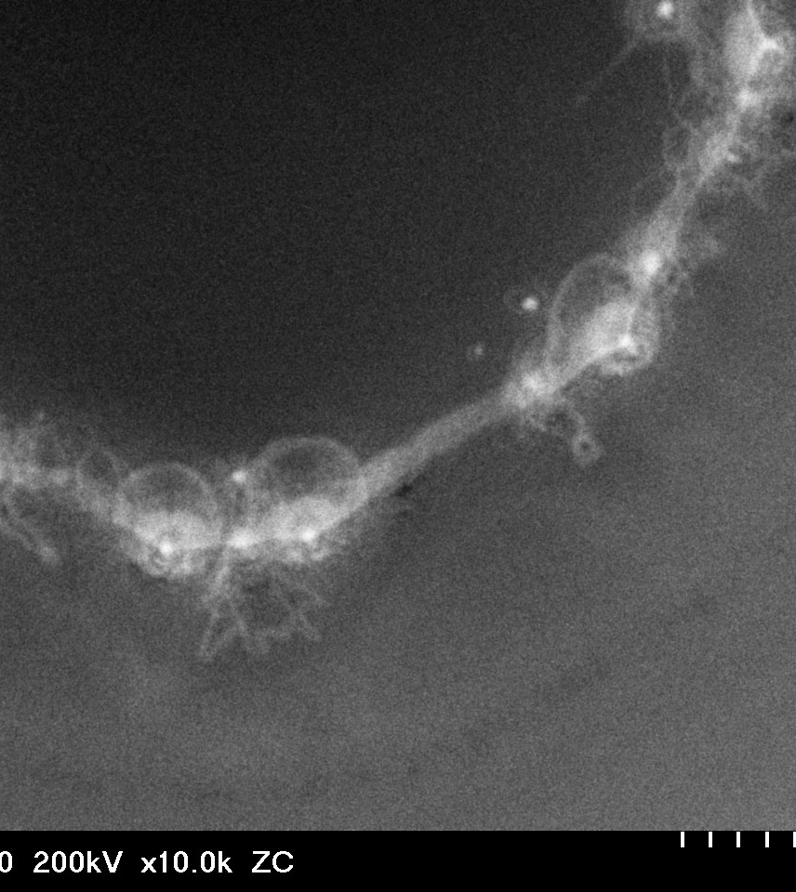
Used Working Channel Plan View SEM
Dislocations starting to form on edge of aperture
Further investigations needed as well as discussion with experts about what is to be seen here.

Slide 17
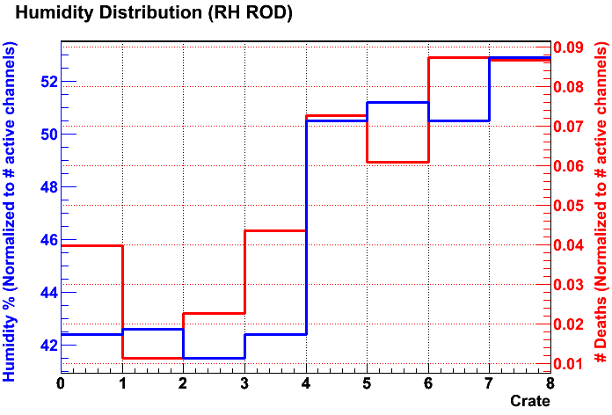
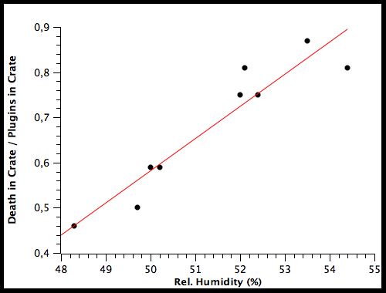
Understanding the Reason
Investigation about the failure reason is ongoing
Found a correlation between the humidity in the different crates and the failure rates
SCT very clear indication
Pixel also the same correlation, but not as strong

Slide 18
Humidity
Damp heat tests:
  85°C/85%RH
TEM picture for failed device
  Dislocation network covers full active region.
  This failure mode not seen in p implant VCSELs
    dislocation growth related to the oxide.
  Corrosive reaction between moisture and oxide during operation
  (electrolytic process)
    point defects

Slide 19
Humidity
All oxide VCSELs use steam to grow the oxide layer.
  If this created defects would be seen in poor reliability in dry operation.
    Verified by damp storage + dry heat tests.
  Accumulation of point defects
  ➔ dislocation networks which grow through “climb“
  (absorption of interstitial point-defects).

Slide 20
Humidity (3)
Oxide VCSELs vulnerable to stress during damp heat.
Can lead to semiconductor cracking
Moisture builds up stress in porous oxide layer.
Moisture absorption the oxide
Cracks in the aperture
Dislocation growth leads to device failure.

Slide 21

Aging Factors
Accelerated aging model
From data at 85/85, 85/60, and 85/30
A_{RH}=0.058 (with RH in %).

Slide 22
Tests for our Optopackages
U-L-M photonics is doing a industrial standard
85°C/85% rel. humidity test (damp heat)
SCT has a setup at SR1 to compare plugin in dry(N₂) and humid (air) environment
Testing Truelight VCSEL as well as AOC lasers to check for a more reliable laser device
  First plugins have been assembled with AOC lasers
  Light coupling to the fibres still to be inproved but ok for the first go

Slide 23
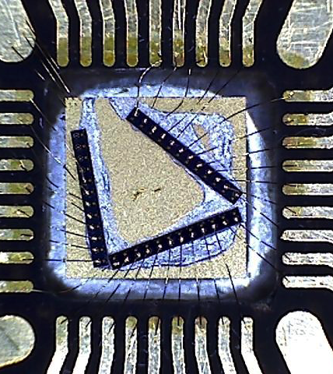
U-L-M photonics testing
U-L-M photonics got several VCSEL arrays
Bonded onto test card
Card is kept in a climate chamber being able to operate the device and do regular measurements

Slide 24
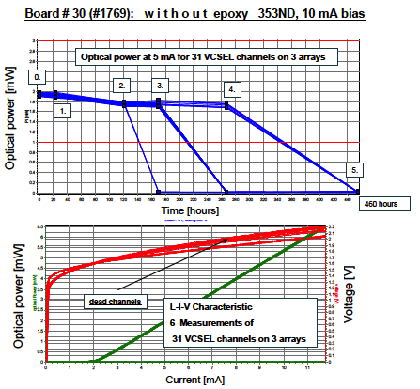
VCSELs without Epoxy
Around 30 channels have been under test
Some with and some without epoxy
VCSELs without epoxy start to dye after 120 hours already
All dead after 460h
Test was to run up to 1000 h in the first go.
Standard aim would be 4000h

Slide 25
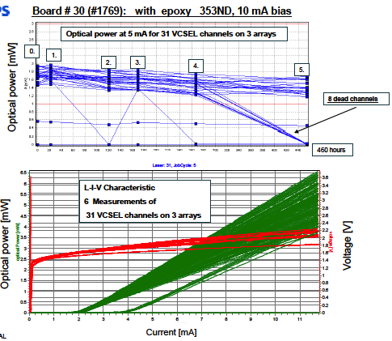
VCSELs with Epoxy
VCSELs being potted with epoxy (same as used in the detector)
Dying (8 channels) in between 300 and 400h of operation
Epoxy helps to prevent from humidity.... At least a bit...

Slide 26
U-L-M photonics Plans
2 soaked TrueLight arrays (22 channels active) and 3 virgin TrueLight arrays as reference under operation
  with 10mA driving current
  85°C / 0% R.H. conditions for initial 1000 h
  both samples without epoxy
  L-I-V measurements will be taken ones a week
3 virgin TrueLight arrays
  covered with optical epoxy
  to be inserted in 85C - 85% R.H. environmental chamber for 1000 h for STORAGE (no operation) → will epoxy trap the humidity?
Will test with AOC devices too
testing if humidity only
causes the failure
testing if epoxy traps
Humidity

Slide 27
CERN: Optical Spectra of TXs in Air and N2
Running 8 TXs (92 VCSELs) in SR1: 4 In Nitrogen and 4 in air (1% and 50% RH at 20ºC).
4 new units were added around day 62 (2 N₂ + 2 Air) and these were virgin units from Minglee (each new TX has 1 dead channel)
Max. operational time is now 115 days, newer samples 50 days, one unit added at day 21 (94 days operation)
To date there are no VCSEL failures (would not expect any for another 2-3 months).
Key to plots shown below (old = red, new = blue)

Slide 28
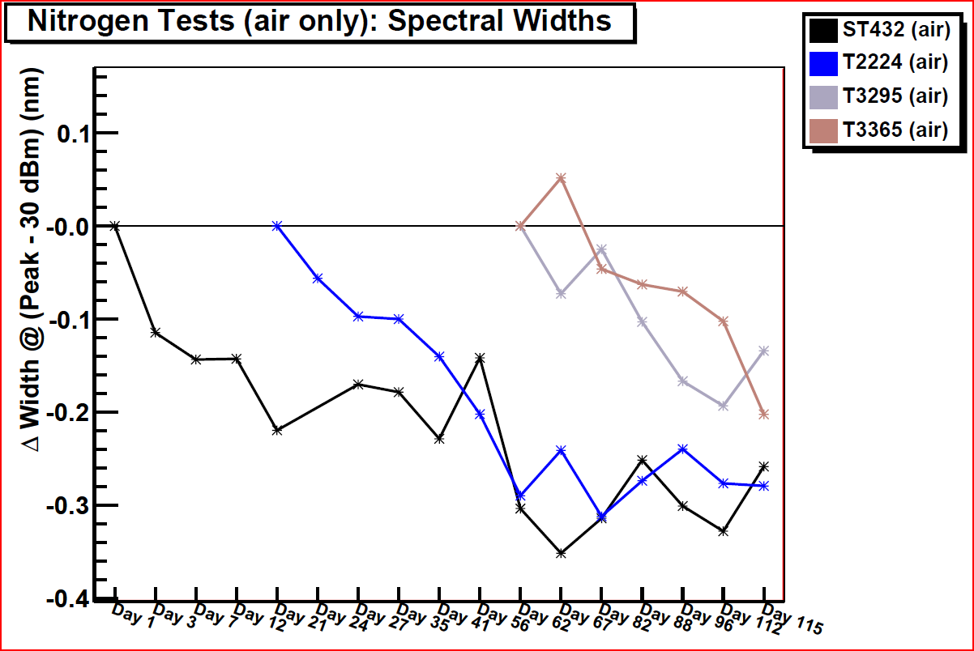

Slide 29
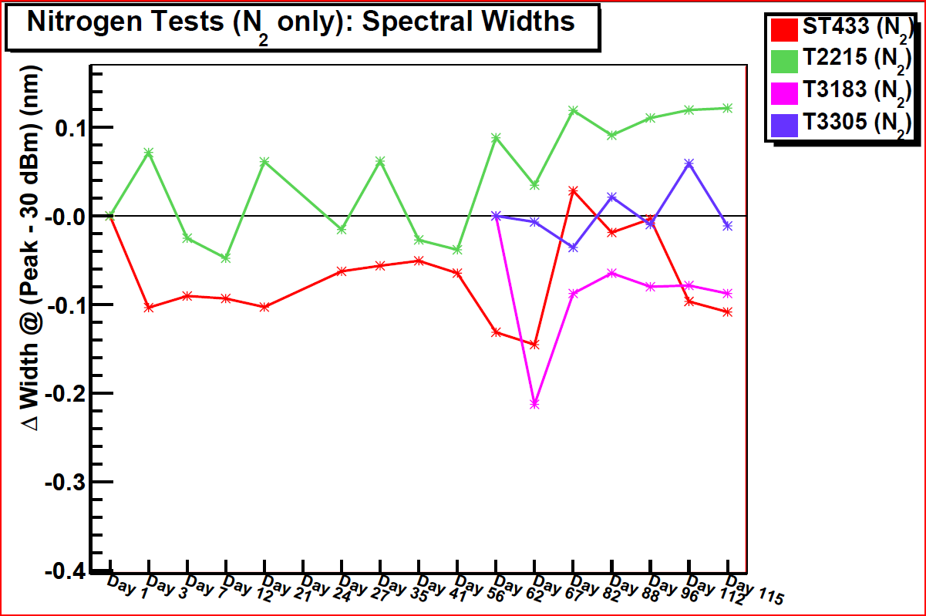

Slide 30
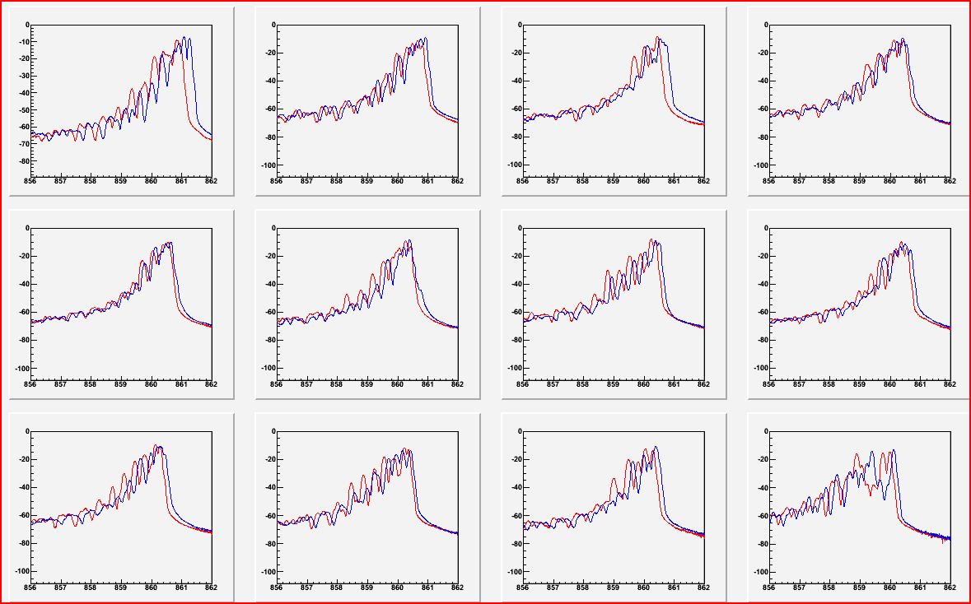
An example ST432 running in Air

Slide 31
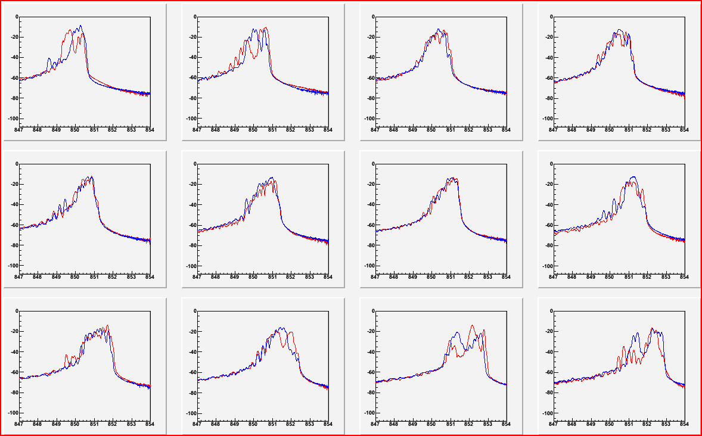
T224 running in air after 91 days

Slide 32
N₂ vs. Air testing
Changes are occurring in the samples operating in air and we continue to monitor at regular (but less frequent) intervals.
We may increase the frequency again as we get closer to what we believe will be the onset of failures. It is even possible that we will automate the process and take much more frequent measurements.

Slide 33
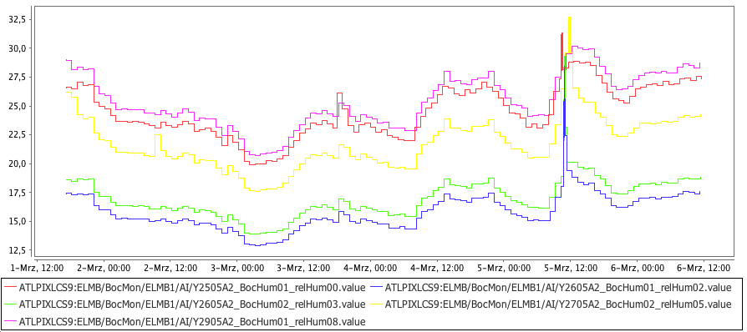
Pixel Crate relative Humidity
Normally 40-50% rel. humidity in the USA15 racks. We did a good sealing
and flowing dry air though it.
Preventing the danger of oil or dirt in the air by appropriate filtering

Slide 34
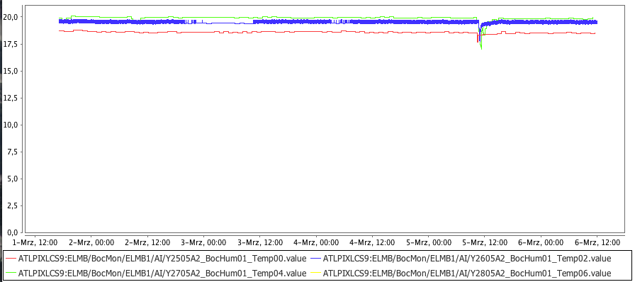
Pixel Crates Temperature

Slide 35
How to get out?
New plugins to replace the existing ones are needed urgently
  Taiwan is doing more plugins old style (AOC instead of Truelight VCSELs)
  BPM chips are reworked from plugins failing in the pit
  New BPM chips have been produced (old process redone)
  BGA housing
  New plugin layout needed
  New producers for plugins are under evaluation.
  XLOOM will do prototype now (to be delivered mid of April to start damp heat test)
    They will use a better epoxy to optimise the humidity resistance.
    Semi hermetic package
    Will use ULM VCSELs which are optimised to survive the damp heat tests.
    Interest in iFlame has also been expressed for Pixel on-detector and LAr

Slide 36
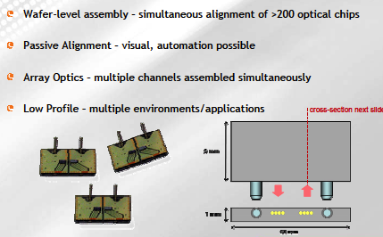
XLOOM

Slide 37
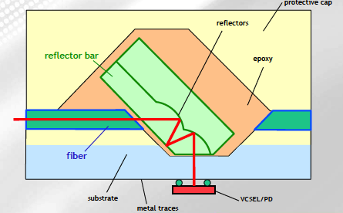
XLOOM

Slide 38
Integration of iFlame
Aim: find mounting arrangement for iFlame which is backward compatible with ATLAS.
  Electrical connector Samtec QTE 40 way.
  Location screw holes on BOC.
  Ensure that MT guide pins are in correct position for Infineon SMCs.
Tx Plugin has to be modified to integrate iFlame package
PCB will hold BPM driver chip and passive components
Connection to iFlame by wirebonds

Slide 39
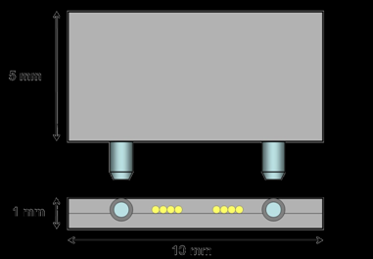
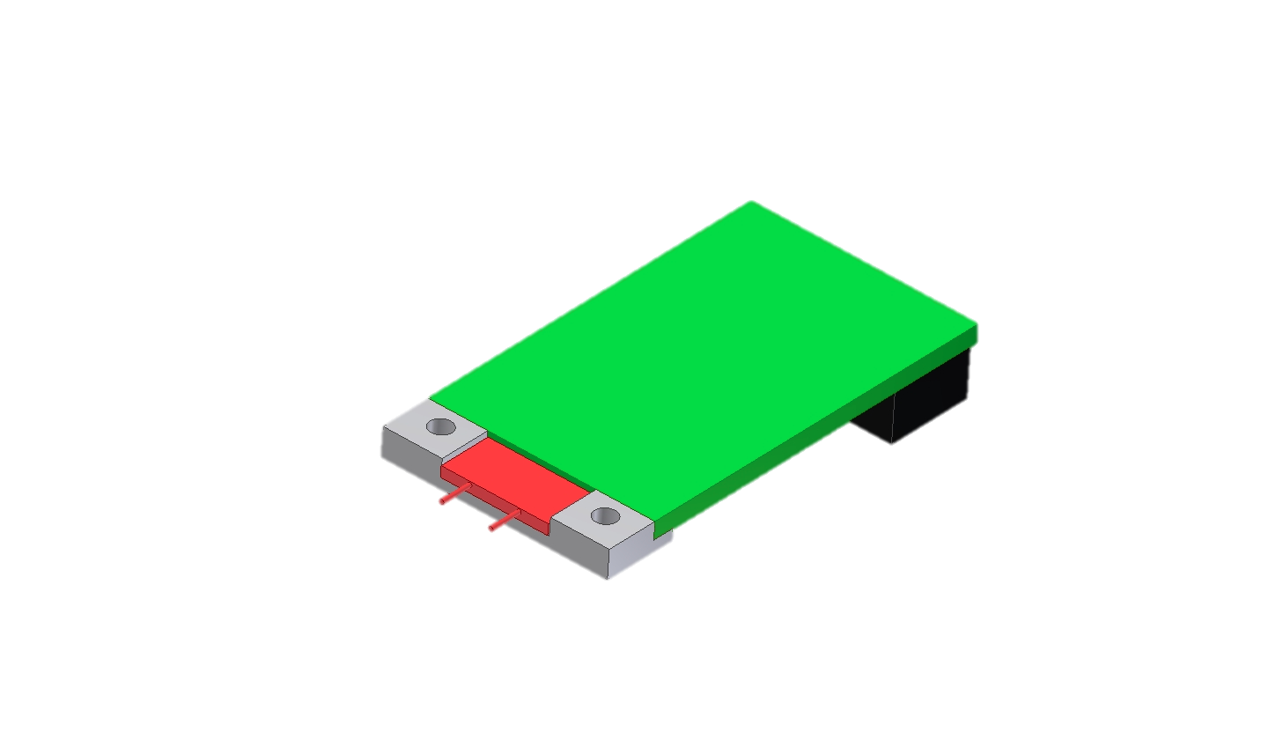
iFlame Integration into a Plugin
TX PCB
Samtec QTE
iFlame OSA
Plastic support with screw holes for location

Slide 40
Summary
ATLAS subdetector still suffering from dying lasers
A very good candidate as cause of failure is humidity
Detailed studies on this going on (in the labs and in industry)
Old style spares and replacement plugins as well as a new design of the plugin is under production to keep the detectors alife for data taking

Slide 41
Backup

Slide 42
Laser Reliability
Semiconductor lasers have very high minority carrier concentrations
➔ high recombination rates.
➔ dislocations can grow at relatively low T and low I.
GaAs-based lasers vulnerable to climb dislocations
➔DLD.
  Electrical and optical recombination from dangling bonds
InGaAsP are not vulnerable to the growth of climb dislocations.
Dislocations can start from ESD or mechanical stress.
Very slow growth until within 1 diffusion length of active region, followed by “rapid” growth ~ 1 μm/minute
Deliberate damage of stripe laser with scribe at edge

Slide 43
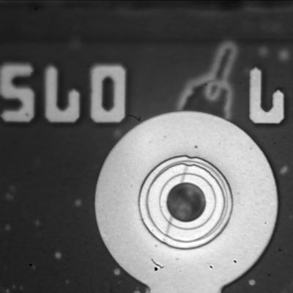
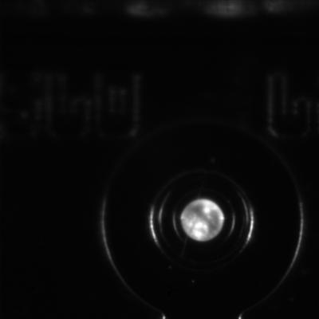
Sandia: Electroluminescence
Overlay: Optical and Emission
Low Level Emission Image
Possible scratch on surface
Speckled emission pattern

Slide 44
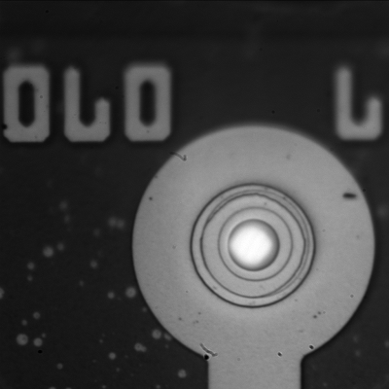
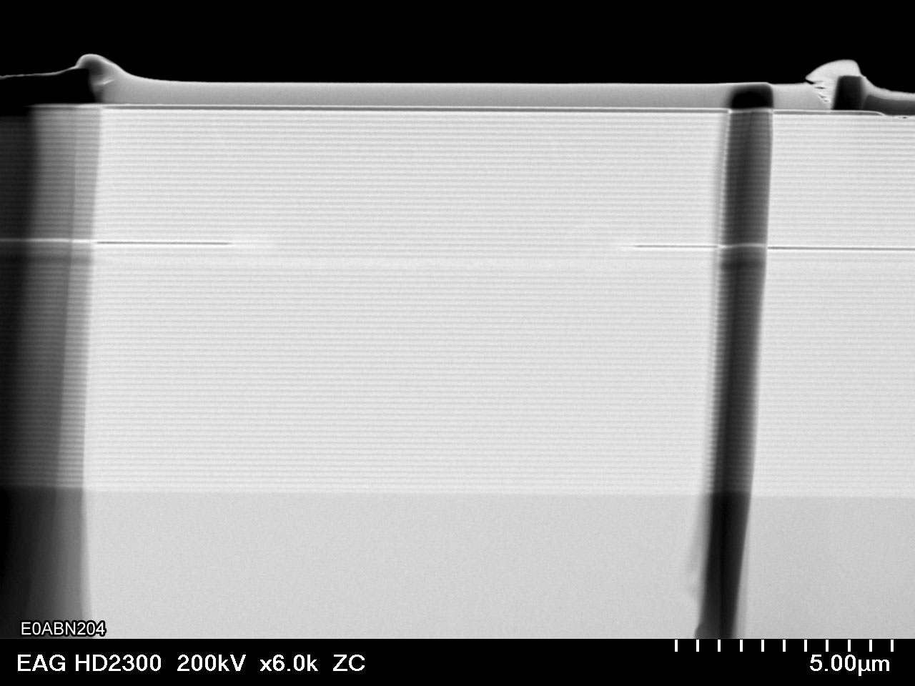

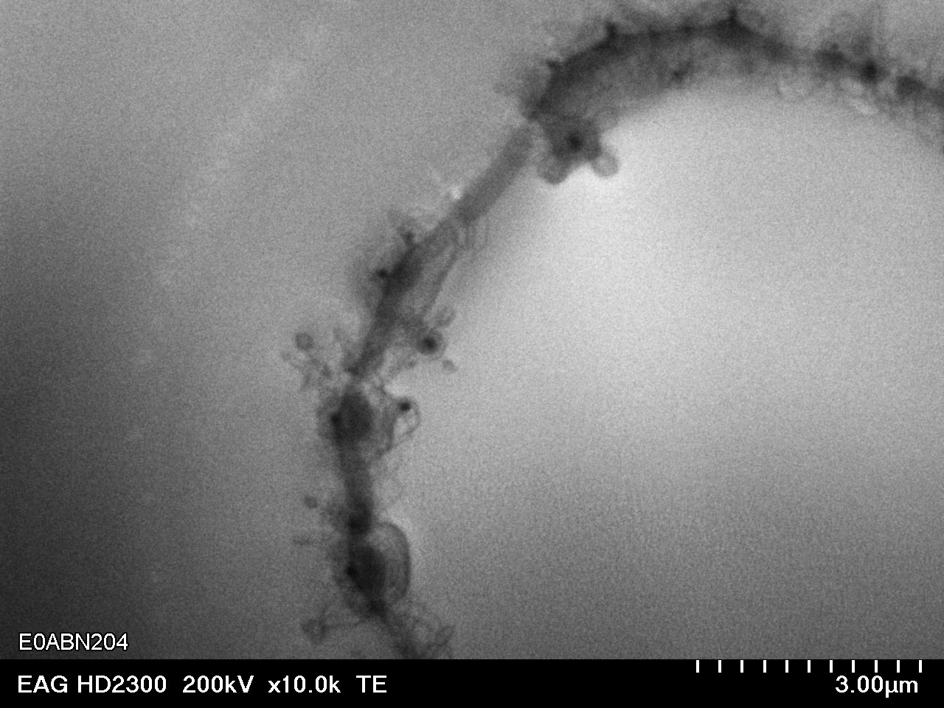
Destructive insight
Laser Bulk investigations show defects
inside the bulk and the aperture
opening → kind of short?
There is clearly a defect in the bulk in the
region of the aperture, growing from there?
Further investigations needed as well as discussion with experts about what is to be seen here.

