Slide 1
Failure of triplet higher order correctors: impact on performance and mitigation measures
T. Persson
Many thanks to E. Maclean
Also thanks to X. Buffat and R. Tomas

Slide 2
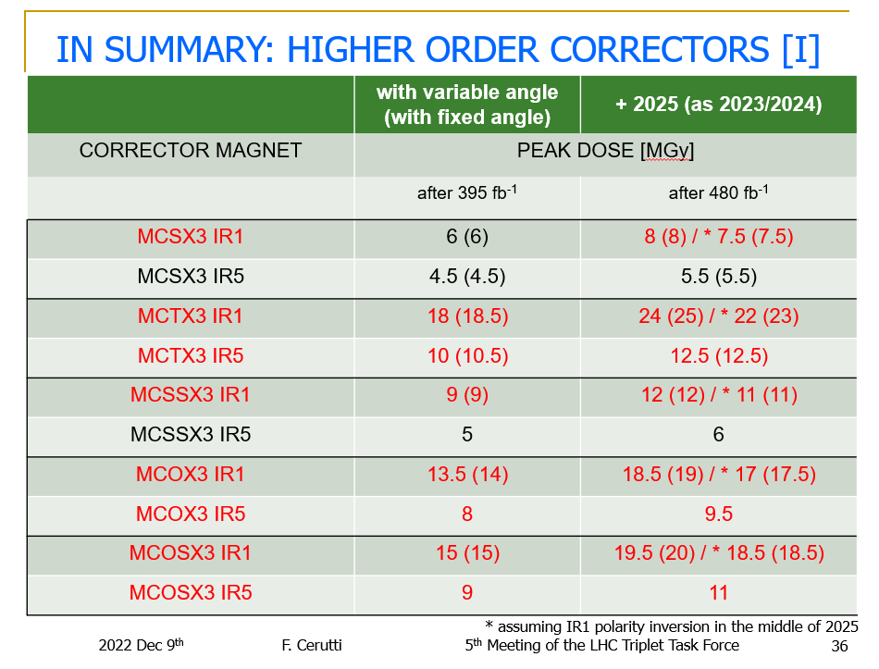
Francesco said that the impact of changing to the RP optics is not likely to change these numbers more than 30% (in the good direction)
Sextupole (b3)
Dodecapole (b6)
Skew sextupole (a3)
Octupole (b4)
Skew Octupole (a4)

Slide 3
Introduction and Background
The LHC was operated in 2016 at β* = 40cm without any nonlinear correctors powered
The following study is an extension to previous work by E. Maclean (most plots and work is from him!) (LMC 4th of April 2018)
  The focus is down to β* = 30 cm and potential mitigation method in case of failure for the different correctors

Slide 4
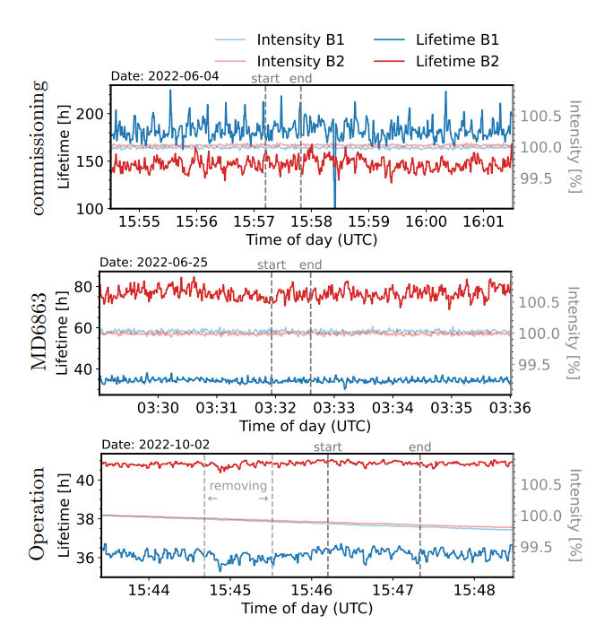
MCTX3 (Dodecapole, b6)
Used for first time in operation in 2022
Main motivation was to gain experience in the correction and operation of it in view of HL-LHC
Test of removing it in operation didn’t show any detrimental effect
No impact to operation if they would fail
-> Mitigation: No mitigation needed
J. Dilly

Slide 5
MCOSX3 (octupole corrector, a4)
Used in operation in 2018 but not in 2022 due to lack of time in commissioning
  Only 3 out of 4 working (Left of IP1 is broken)
Correction calculated in MD in 2022
  To be implemented in this commissioning
If they break we can expect a change in |C-| of 1-2*10⁻³ at 30cm
  If needed can be corrected with a global correction
  No significant impact on beam size at IP
The impact of DA has not been studied but the good performance in 2022 shows that even without it the performance remains good
-> Mitigation: If any stability issue is observed perform a global coupling

Slide 6
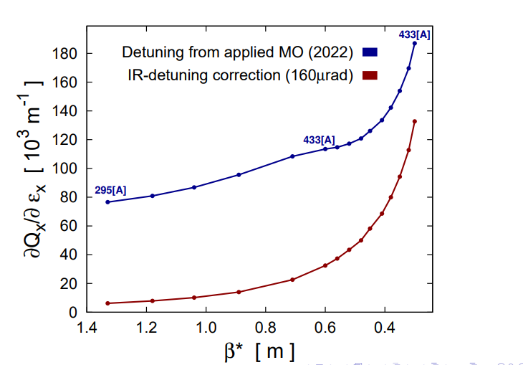
MCOX (octupole correctors, b4)
The impact on β-beat is around 1%
At lower β* they have a strong impact on the amplitude detuning
IR1 and IR5 generate significant detuning by end-of-squeeze ≡ 310[A] of MO at 30cm with 160 µrad crossing-scheme
E. Maclean

Slide 7
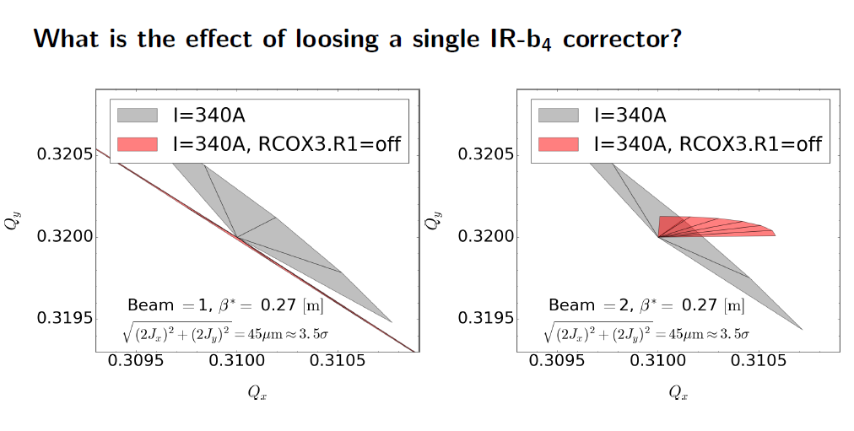
Single b4 corrector (or single IR failure)
Losing 1 has a big impact on the footprint
  In this case for stability in one case and the DA for the other beam
Note that these currents are pre-ATS so the amps are no longer correct. These are at ATS factor = 1
E. Maclean

Slide 8
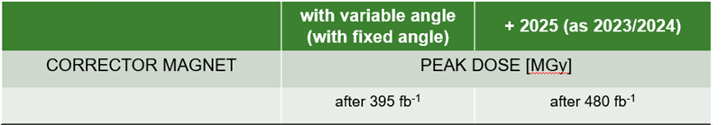
Single b4 (MCOX) corrector (or single IR failure)
IR1 b4 correctors will pass the integrated dose value significantly before IR5
Potential Mitigation: Transfer the correction to the other IR
  It will restore the footprint
    Not directly possible for flat optics
  The correction no longer local, might have implication on DA
    Proposed to study this in end of fill in 2023
F. Cerutti

Slide 9
All b4 (MCOX) (1)
We start colliding at 1.2 m where the impact of the b4 errors in the IR have a small impact
  The beam-beam effect will stabilize the bunches colliding in IP1 and IP5
Bunches colliding in IP2 and IP8 (“witness bunches”)
  Only significant beam-beam from IP8 and this depends on the separation, if less than around 1 sigma it should be sufficient for stabilizing without lattice detuning
    The separation at IP8 at 30cm depends on intensity (these bunches don’t have the same burn off), and their requested luminosity
Mitigation: Change the MO powering depending on β* and per beam

Slide 10
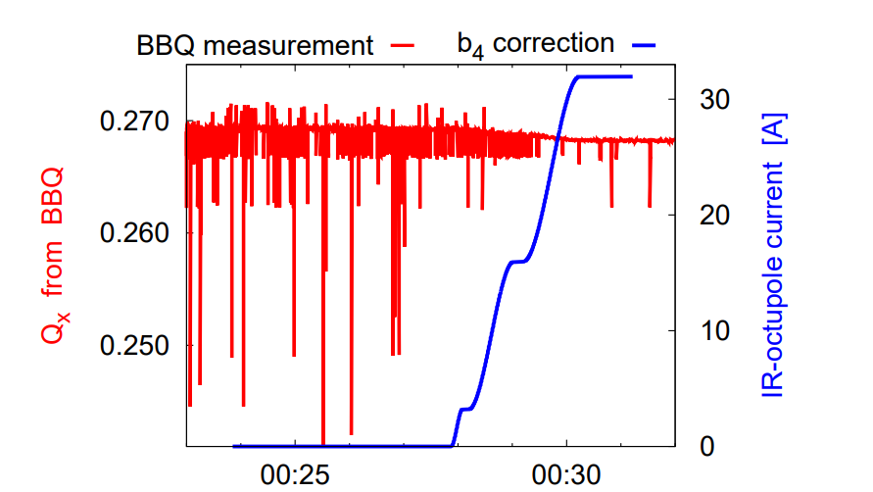
All b4 (MCOX) (2)
The correction also important for the BBQ tune signal
  Crucial for K-modulation
Strong nonlinearities also prevent us from reaching high kick amplitudes with AC-dipole
Mitigation: Change the MO and potentially the MCOX in IR8 powering depending on β* and beam
E. Maclean

Slide 11
Do we have enough strength in the MO at 30 cm?
310 A is needed to correct the IR nonlinearities at 30 cm with 160urad
Max powering is 550A* that gives us 240A
  That gives us equivalent of ~400A at flattop thanks to the increased ATS factor at 30 cm
In 2022 we were operating at 295 A at flattop (no collisions ) and no instabilities were observed, see N. Mounet talk in JAPW
  Have to study the exact terms but looks promising
*The correct number is 590A which was pointed out during the presentation (this is now also updated in the MAD-X sequence.)

Slide 12
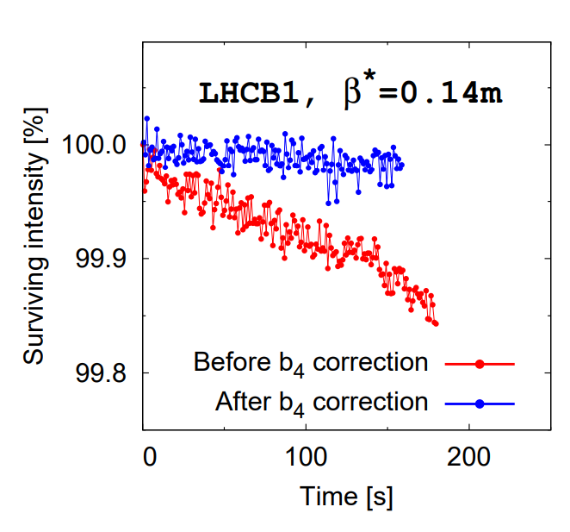
MCOX (octupole correctors, b4)
At very low β* the corrections start having significant impact on DA
The impact on DA at 30cm with nominal configuration is planed to be measured in 2023
  Compensate with the MO (settings need to be calculated)
E. Maclean

Slide 13
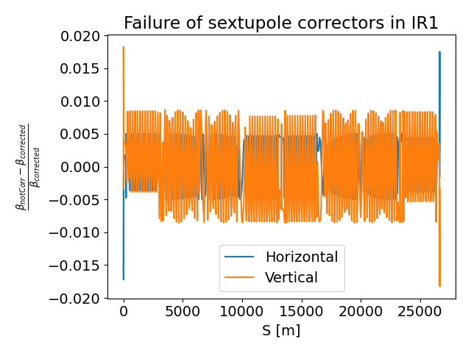
MCSSX and MCSX (sextupole corrector, a3 and b3)
IR5 correctors remains below the expected damage limit for 500^{-fb}
  Strength similar between the correctors for the two IRs (slightly stronger IR5)
  Main difference is that depending on the crossing plane the feed-down is either to β-beat or coupling
For IP1 we can expect from simulation:
  |C-| = 2-3*10⁻³ if the b3 corrector stop working
  β-beat in the range of 2%
Mitigation: Correct the feed-down to coupling and potentially β-beat

Slide 14
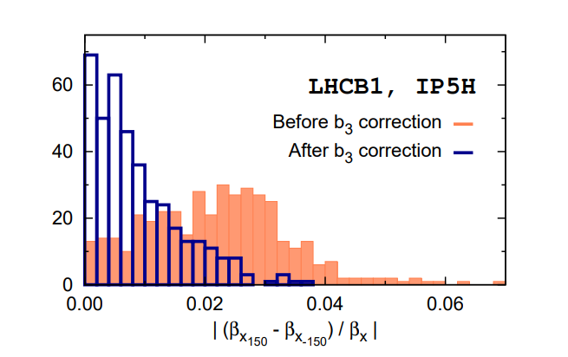
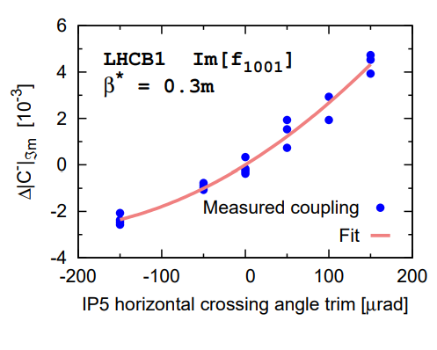
MCSSX and MCSX (sextupole corrector, a3 and b3)
In case we would start with crossing angle levelling then there will be an impact of the change in crossing angle on β-beat in coupling
Not limiting but additional operational work
E. Maclean

Slide 15
Summary
a3, b3 failure: Correct the coupling feed-down and β-beat if needed
a4 failure: Correct the feed-down to transverse coupling
b4 Single IR failure:
  Compensate with other b4 correctors in the other IR
b4 Multiple IR failure:
  Compensate with the MO and MCOX in IR8
    The 2022 experience indicates that we have enough MO strength
    Powering will have to be adjusted per β* step and beam
b6 failure: No mitigation method needed
Open points:
  The impact from the RP optics has not been studied and the errors might be also be different
  The impact of losing the correctors for DA has not been studied for a4, b4, a3, b3 at β* = 30cm has not been studied.
    Plan to do this year as end of fill MD, also valuable input for the HL

Slide 16

Backup

Slide 17
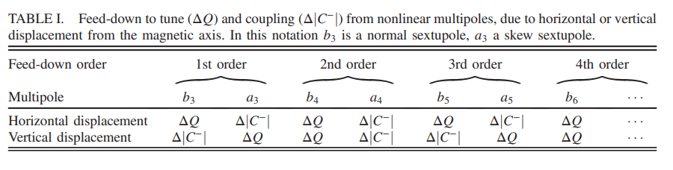

Slide 18
