Slide 1




Integrated radiation dose in IR8
in the HL era
Alessia Ciccotelli
Francesco Cerutti
10th Meeting of the LHC Triplet Task Force 2023 March 24th

Slide 2
NEW REFERENCES
“The current final focus magnets of the LHC can withstand an integrated luminosity of about 1.5 ab^-1 (inverse attobarns) before experiencing significant radiation damage and degradation.
This corresponds to approximately 1500 trillion proton-proton collisions.”
[https://chat.openai.com/chat]
Not really.
Can we go up to 1’500 fb^-1 ?!
which by the way corresponds to approximately 150’000 trillion proton-proton collisions.

Slide 3
NEW REFERENCES [II]
But reliability can still be found:
“Gianluigi Arduini is a physicist who has been working in the beam department at CERN for many years. He is known for his contributions to the development and optimization of the beam performance in the LHC and other particle accelerators.
Arduini has played a key role in the design and commissioning of the LHC's beam optics, which involves the precise control and manipulation of the particle beams to achieve the desired collision conditions. He has also been involved in the development of new techniques for measuring and controlling the beam's properties, such as beam instrumentation and feedback systems.
In addition to his work on the LHC, Arduini has been involved in several other accelerator projects, including the design and construction of the Large Electron-Positron collider (LEP) at CERN. He has also published numerous research papers on accelerator physics and beam dynamics.”
[https://chat.openai.com/chat]

Slide 4
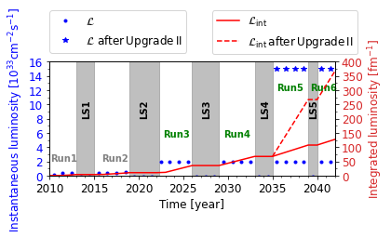
ALTERNATIVE LUMI PROSPECTS

Slide 5
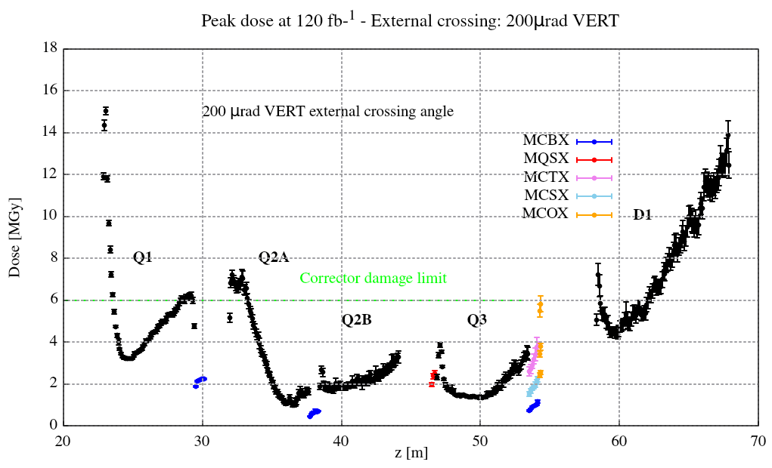
NO UPGRADE II:
PEAK DOSE PROFILE FROM 2023 ONWARDS
Right side, where the Q1 is more exposed
Assuming same (half) lumi for either LHCb spectrometer polarity
Former (Run 1 to 2022) contribution to be added

Slide 6
IN SUMMARY: MAIN QUADRUPOLES AND D1
 | no upgrade II
MAIN QUADRUPOLE / SEPARATION DIPOLE | PEAK DOSE [MGy]
 | after 130 fb⁻¹
Q1 (R8) | 17
Q2A | 7
Q2B | 3.5
Q3 | 4
D1 | 14
D1 limit to be ascertained

Slide 7
IN SUMMARY: CORRECTORS
 | no upgrade II
CORRECTOR MAGNET | PEAK DOSE [MGy]
 | after 130 fb⁻¹
MCBX1 | 2.5
MCBX2 | 1
MCBX3 | 1
MQSX | 2.5
MCSX3 | 2.5
MCTX3 | 4
MCSSX3 | 2.5
MCOX3 | 4
MCOSX3 | 6

Slide 8
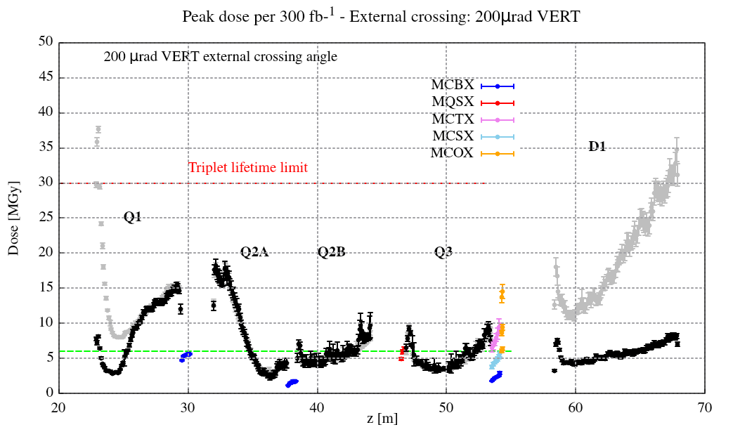
UPGRADE II IN LS4:
PEAK DOSE PROFILE FROM LS4 ONWARDS
Right side, where the Q1 is more exposed
Assuming same (half) lumi for either LHCb spectrometer polarity
Former (Run 1 to LS4) contribution to be added
without due protection measures,
namely ‘TAS’ in the short compensator and D1 inner shielding

Slide 9
IN SUMMARY: MAIN QUADRUPOLES AND D1
 | no upgrade II | with upgrade II in LS4
MAIN QUADRUPOLE / SEPARATION DIPOLE | PEAK DOSE [MGy]
 | after 130 fb⁻¹ | after 370 fb⁻¹
Q1 (R8) | 17 | 19
Q2A | 7 | 22
Q2B | 3.5 | 12
Q3 | 4 | 12
D1 | 14 | 16.5
D1 limit to be ascertained

Slide 10
IN SUMMARY: CORRECTORS
 | no upgrade II | with upgrade II in LS4
CORRECTOR MAGNET | PEAK DOSE [MGy]
 | after 130 fb⁻¹ | after 370 fb⁻¹
MCBX1 | 2.5 | 7
MCBX2 | 1 | 2.5
MCBX3 | 1 | 3.5
MQSX | 2.5 | 7.5
MCSX3 | 2.5 | 7.5
MCTX3 | 4 | 12.5
MCSSX3 | 2.5 | 7.5
MCOX3 | 4 | 11.5
MCOSX3 | 6 | 17.5

Slide 11
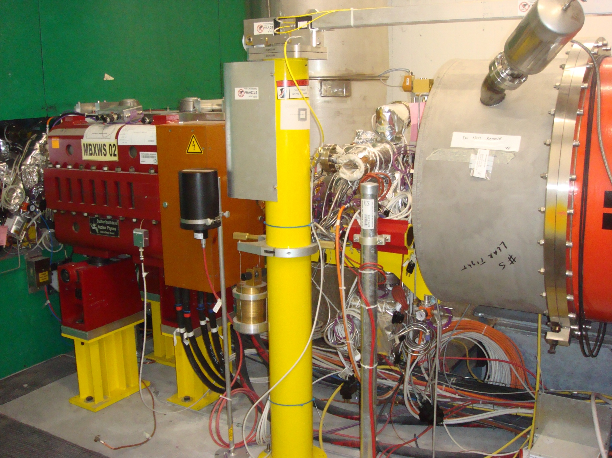
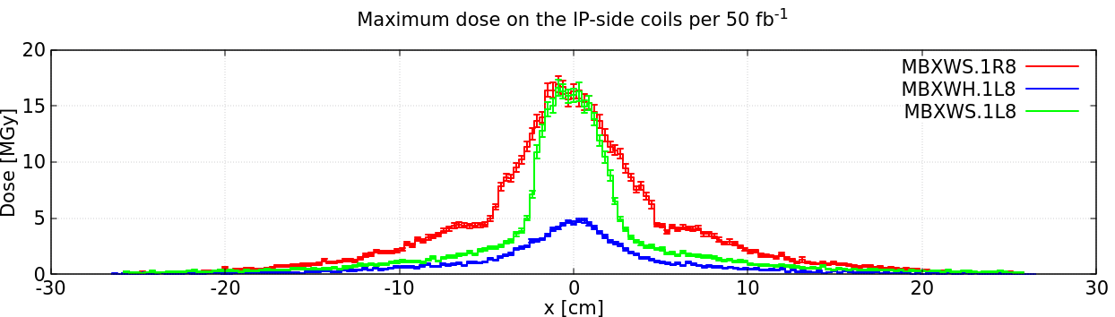
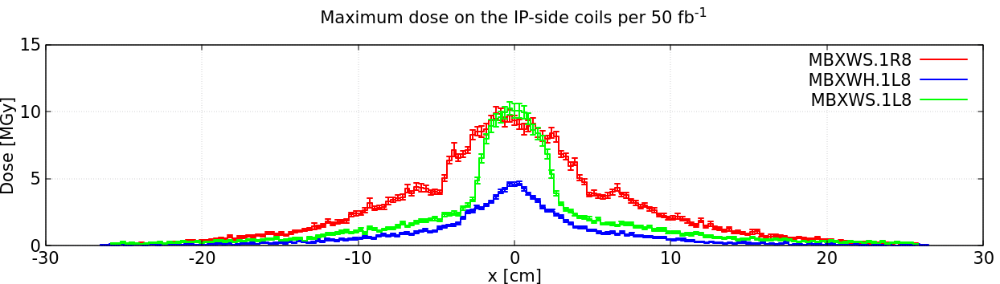
THE COMPENSATORS
R8
UPPER
IP front coils
LOWER
7 TeV beams
+200 μrad V (ext)
 | no upgrade II | with upgrade II in LS4
COMPENSATOR | PEAK DOSE [MGy]
 | after 130 fb⁻¹ | after 370 fb⁻¹
MBXWS | 45 / * 35 | 130 / * 100
MBXWH | 15 | 40
/ * assuming regular inversion
of the external angle polarity

Slide 12
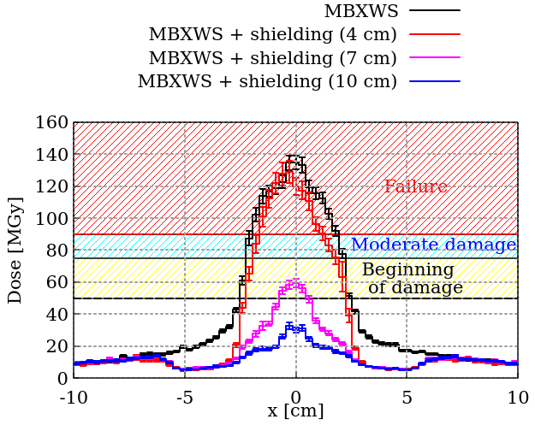
SHORT COMPENSATOR PROTECTION
Normalized to 400 fb⁻¹
Contribution preceding the shielding installation to be added
[A. Ciccotelli et al., doi:10.18429/JACoW-IPAC2022-WEPOST003]

Slide 13
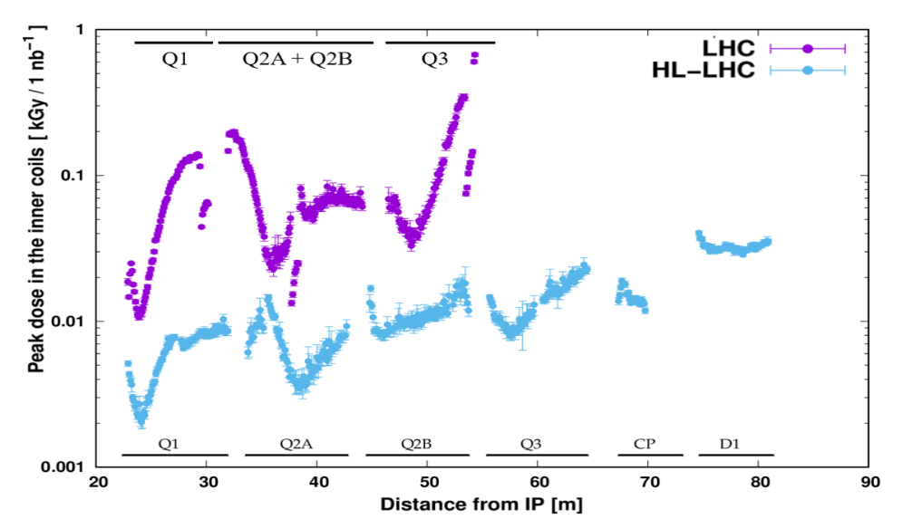
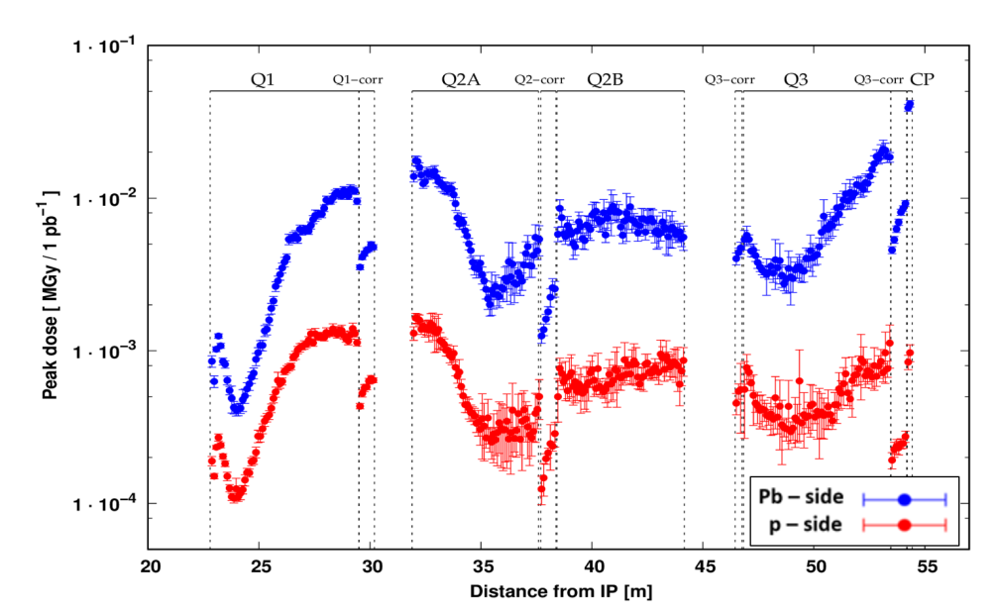
ION OPERATION FOR IR2 EXTRAPOLATIONS
But there is no TAS in IR2
and there are spectrometer and compensators
p-Pb in ATLAS
6.5 Z TeV beams (√s_{NN} = 8.16 TeV)
-140 urad vertical crossing
Pb-Pb in ATLAS
6.37 Z TeV beams (√s_{NN} = 5.02 TeV)
+160 urad vertical crossing
in the coils
[M. Sabaté-Gilarte et al.,
doi:10.18429/JACoW-IPAC2021-WEXA06]

