Slide 1
Non-perturbative de Sitter
Jackiw-Teitelboim Gravity
[Cotler, Jensen to appear]
[Cotler, Jensen 2302.06603]
[Cotler, Strominger 2201.11658]
Jordan Cotler
Harvard Society of Fellows

Slide 2
Pretext

Slide 3
Pretext
So little is known about non-perturbative quantum gravity in dS

Slide 4
Pretext
So little is known about non-perturbative quantum gravity in dS
Goal: Address foundational questions about dS quantum gravity in the simplest possible setting

Slide 5
Pretext
So little is known about non-perturbative quantum gravity in dS
Goal: Address foundational questions about dS quantum gravity in the simplest possible setting
We solve dS JT gravity non-perturbatively, providing the first exactly solvable model of dS quantum gravity

Slide 6
A brief history of this work

Slide 7
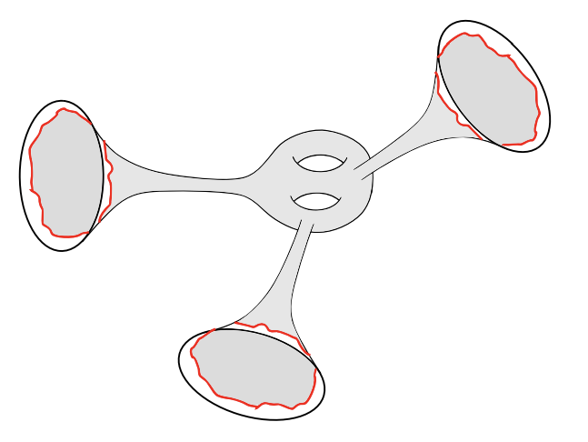
A brief history of this work
[Saad, Shenker, Stanford ‘19]
Solved AdS JT gravity,

Slide 8
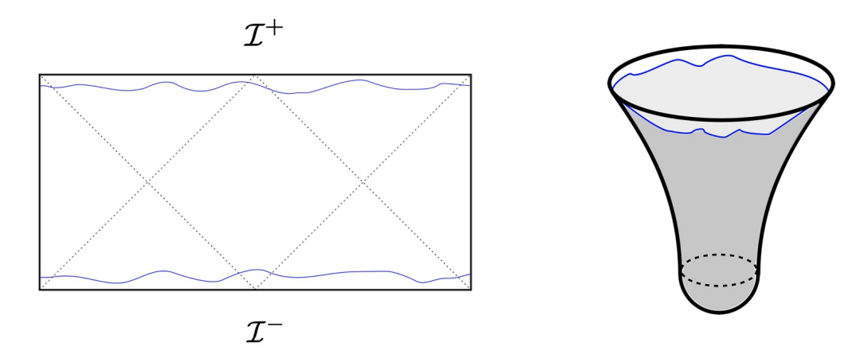
A brief history of this work
[Saad, Shenker, Stanford ‘19]
Solved AdS JT gravity,
[Maldacena, Turiaci, Yang ‘19]
[Cotler, Jensen, Maloney ‘19]
Hartle-Hawking wavefunction
Global dS amplitude
Proposal for genus expansion
Proposal for relation to AdS setting

Slide 9
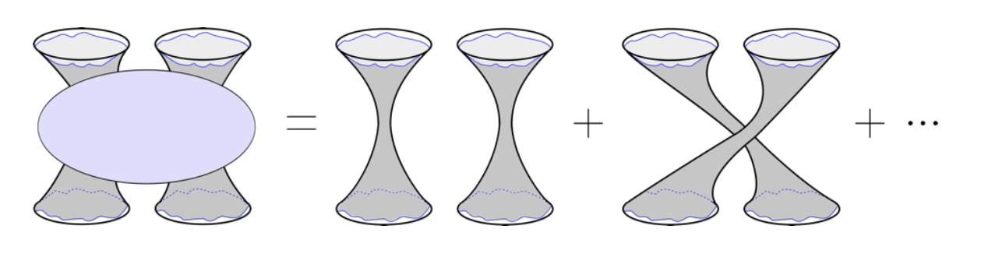
A brief history of this work
[Saad, Shenker, Stanford ‘19]
Solved AdS JT gravity,
[Maldacena, Turiaci, Yang ‘19]
[Cotler, Jensen, Maloney ‘19]
Hartle-Hawking wavefunction
Global dS amplitude
Proposal for genus expansion
Proposal for relation to AdS setting
[Cotler, Jensen ‘19]
Inner product on asymptotic states, S-matrix
Hartle-Hawking state is non-normalizable

Slide 10
A brief history of this work
[Saad, Shenker, Stanford ‘19]
Solved AdS JT gravity,
[Maldacena, Turiaci, Yang ‘19]
[Cotler, Jensen, Maloney ‘19]
Hartle-Hawking wavefunction
Global dS amplitude
Proposal for genus expansion
Proposal for relation to AdS setting
[Cotler, Jensen ‘19]
Inner product on asymptotic states, S-matrix
Hartle-Hawking state is non-normalizable
[Cotler, Jensen ‘23]
Global dS JT amplitude is isometric

Slide 11
A brief history of this work
[Saad, Shenker, Stanford ‘19]
Solved AdS JT gravity,
[Maldacena, Turiaci, Yang ‘19]
[Cotler, Jensen, Maloney ‘19]
Hartle-Hawking wavefunction
Global dS amplitude
Proposal for genus expansion
Proposal for relation to AdS setting
[Cotler, Jensen ‘19]
Inner product on asymptotic states, S-matrix
Hartle-Hawking state in non-normalizable
[Cotler, Jensen ‘23]
Global dS JT amplitude is isometric
(See also [Cotler, Strominger ‘22] )

Slide 12
Summary of results

Slide 13
Summary of results
Carefully treat the dS JT path integral measure

Slide 14
Summary of results
Carefully treat the dS JT path integral measure
dS JT can be viewed as a subtle continuation of AdS JT

Slide 15
Summary of results
Carefully treat the dS JT path integral measure
dS JT can be viewed as a subtle continuation of AdS JT
Continuation of ’s

Slide 16
Summary of results
Carefully treat the dS JT path integral measure
dS JT can be viewed as a subtle continuation of AdS JT
Continuation of ’s
Holographically dual matrix integral with

Slide 17
Three Parts
Part I
Review of dS JT gravity
Part II
Genus expansion
Part III
Discussion

Slide 18
Review of dS JT gravity
Part I

Slide 19
[Maldacena, Turiaci, Yang ‘19]
[Cotler, Jensen, Maloney ‘19]
[Cotler, Jensen ‘19]
dS JT gravity

Slide 20
[Maldacena, Turiaci, Yang ‘19]
[Cotler, Jensen, Maloney ‘19]
[Cotler, Jensen ‘19]
dS JT gravity

Slide 21
[Maldacena, Turiaci, Yang ‘19]
[Cotler, Jensen, Maloney ‘19]
[Cotler, Jensen ‘19]
dS JT gravity
Global dS₂ geometries:

Slide 22
[Maldacena, Turiaci, Yang ‘19]
[Cotler, Jensen, Maloney ‘19]
[Cotler, Jensen ‘19]
dS JT gravity
Global dS₂ geometries:

Slide 23
[Maldacena, Turiaci, Yang ‘19]
[Cotler, Jensen, Maloney ‘19]
[Cotler, Jensen ‘19]
dS JT gravity
Global dS₂ geometries:
No propagating degrees of freedom
Boundary gravitons (Schwarzian modes)
Moduli space

Slide 24
[Cotler, Jensen, Maloney ‘19]
[Cotler, Jensen ‘19]
[Cotler, Jensen ‘23]
dS JT gravity

Slide 25
[Cotler, Jensen, Maloney ‘19]
[Cotler, Jensen ‘19]
[Cotler, Jensen ‘23]
dS JT gravity
Boundary conditions in the far future:

Slide 26
[Cotler, Jensen, Maloney ‘19]
[Cotler, Jensen ‘19]
[Cotler, Jensen ‘23]
dS JT gravity
Boundary conditions in the far future:

Slide 27
[Cotler, Jensen, Maloney ‘19]
[Cotler, Jensen ‘19]
[Cotler, Jensen ‘23]
dS JT gravity
Boundary conditions in the far future:

Slide 28
[Cotler, Jensen, Maloney ‘19]
[Cotler, Jensen ‘19]
[Cotler, Jensen ‘23]
dS JT gravity
Boundary conditions in the far future:

Slide 29
[Cotler, Jensen, Maloney ‘19]
[Cotler, Jensen ‘19]
[Cotler, Jensen ‘23]
dS JT gravity
Boundary conditions in the far future:

Slide 30
[Cotler, Jensen, Maloney ‘19]
[Cotler, Jensen ‘19]
[Cotler, Jensen ‘23]
dS JT gravity
Boundary conditions in the far future:

Slide 31
[Cotler, Jensen, Maloney ‘19]
[Cotler, Jensen ‘19]
[Cotler, Jensen ‘23]
dS JT gravity
Boundary conditions in the far future:

Slide 32
[Cotler, Jensen, Maloney ‘19]
[Cotler, Jensen ‘19]
[Cotler, Jensen ‘23]
dS JT gravity
Boundary conditions in the far future:

Slide 33
[Cotler, Jensen, Maloney ‘19]
[Cotler, Jensen ‘19]
[Cotler, Jensen ‘23]
dS JT amplitudes

Slide 34
[Cotler, Jensen, Maloney ‘19]
[Cotler, Jensen ‘19]
[Cotler, Jensen ‘23]
dS JT amplitudes
Meta-observables are S-matrix elements:

Slide 35
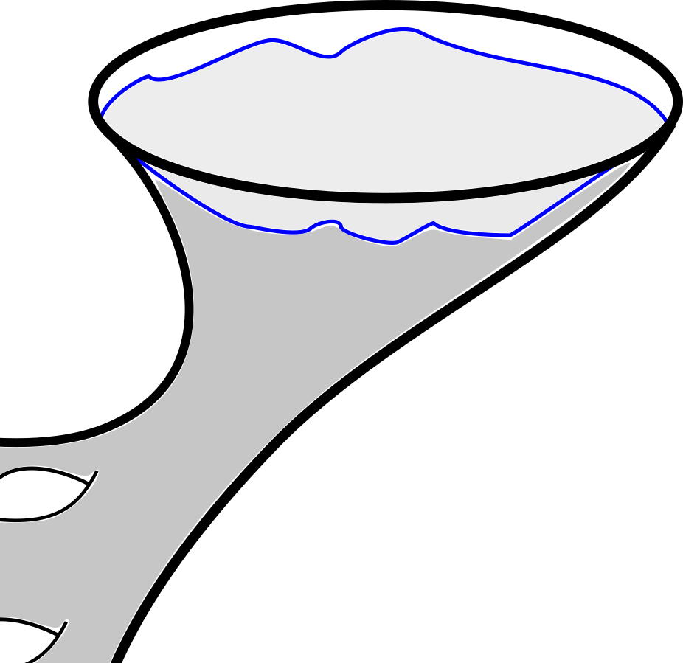
[Cotler, Jensen, Maloney ‘19]
[Cotler, Jensen ‘19]
[Cotler, Jensen ‘23]
dS JT amplitudes
Meta-observables are S-matrix elements:

Slide 36
[Cotler, Jensen, Maloney ‘19]
[Cotler, Jensen ‘19]
[Cotler, Jensen ‘23]
dS JT amplitudes

Slide 37
[Cotler, Jensen, Maloney ‘19]
[Cotler, Jensen ‘19]
[Cotler, Jensen ‘23]
dS JT amplitudes
Sphere:

Slide 38
[Cotler, Jensen, Maloney ‘19]
[Cotler, Jensen ‘19]
[Cotler, Jensen ‘23]
dS JT amplitudes
Sphere:

Slide 39
[Cotler, Jensen, Maloney ‘19]
[Cotler, Jensen ‘19]
[Cotler, Jensen ‘23]
dS JT amplitudes
Sphere:
Disk:

Slide 40
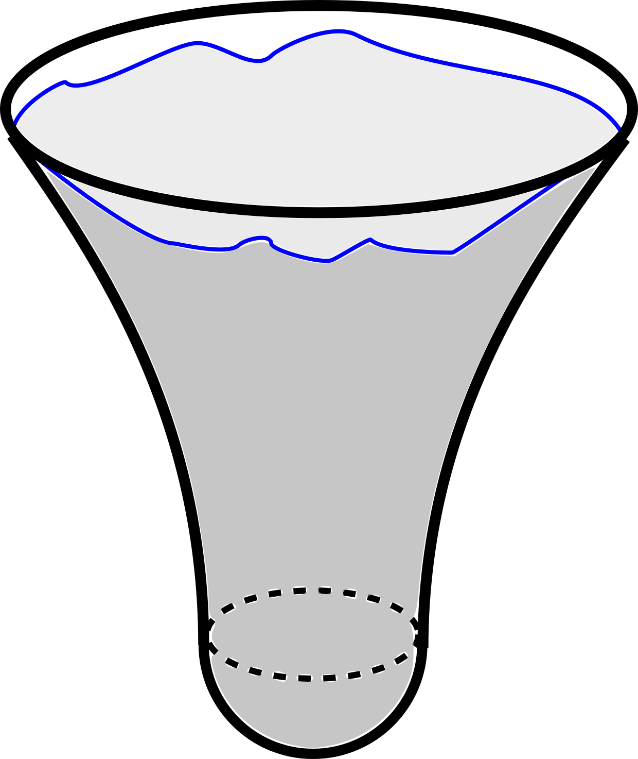
[Cotler, Jensen, Maloney ‘19]
[Cotler, Jensen ‘19]
[Cotler, Jensen ‘23]
dS JT amplitudes
Sphere:
Disk:

Slide 41
[Cotler, Jensen, Maloney ‘19]
[Cotler, Jensen ‘19]
[Cotler, Jensen ‘23]
dS JT amplitudes
Sphere:
Disk:
Cylinder:

Slide 42
[Cotler, Jensen, Maloney ‘19]
[Cotler, Jensen ‘19]
[Cotler, Jensen ‘23]
dS JT amplitudes
Sphere:
Disk:
Cylinder:

Slide 43
[Cotler, Jensen, Maloney ‘19]
[Cotler, Jensen ‘19]
[Cotler, Jensen ‘23]
dS JT amplitudes
Sphere:
Disk:
Cylinder:
pole corresponds to global dS₂ saddle

Slide 44
[Cotler, Jensen, Maloney ‘19]
[Cotler, Jensen ‘19]
[Cotler, Jensen ‘23]
dS JT amplitudes
Sphere:
Disk:
Cylinder:
for convergence of moduli integral
pole corresponds to global dS₂ saddle

Slide 45
[Cotler, Jensen, Maloney ‘19]
[Cotler, Jensen ‘19]
[Cotler, Jensen ‘23]
dS JT amplitudes
Sphere:
Inner product:
Disk:
Cylinder:
for convergence of moduli integral
pole corresponds to global dS₂ saddle

Slide 46
[Cotler, Jensen, Maloney ‘19]
[Cotler, Jensen ‘19]
[Cotler, Jensen ‘23]
dS JT amplitudes
Sphere:
Inner product:
Disk:
Cylinder:
for convergence of moduli integral
pole corresponds to global dS₂ saddle

Slide 47
[Cotler, Jensen, Maloney ‘19]
[Cotler, Jensen ‘19]
[Cotler, Jensen ‘23]
dS JT amplitudes
Sphere:
Inner product:
Disk:
Cylinder:
for convergence of moduli integral
pole corresponds to global dS₂ saddle

Slide 48
[Cotler, Jensen ‘19]
[Cotler, Jensen ‘23]
Some features

Slide 49
[Cotler, Jensen ‘19]
[Cotler, Jensen ‘23]
Some features

Slide 50
[Cotler, Jensen ‘19]
[Cotler, Jensen ‘23]
Some features
In dS JT gravity, the 1-to-1 S-matrix is a projector (!)

Slide 51
[Cotler, Jensen ‘19]
[Cotler, Jensen ‘23]
Some features
In dS JT gravity, the 1-to-1 S-matrix is a projector (!)
Can understand this by decomposing time evolution

Slide 52
[Cotler, Jensen ‘19]
[Cotler, Jensen ‘23]
Some features
In dS JT gravity, the 1-to-1 S-matrix is a projector (!)
Can understand this by decomposing time evolution

Slide 53
[Cotler, Jensen ‘19]
[Cotler, Jensen ‘23]
Some features
In dS JT gravity, the 1-to-1 S-matrix is a projector (!)
Can understand this by decomposing time evolution

Slide 54
[Cotler, Jensen ‘19]
[Cotler, Jensen ‘23]
Some features
In dS JT gravity, the 1-to-1 S-matrix is a projector (!)
Can understand this by decomposing time evolution
is an isometry

Slide 55
[Cotler, Jensen ‘19]
[Cotler, Jensen ‘23]
Some features
In dS JT gravity, the 1-to-1 S-matrix is a projector (!)
Can understand this by decomposing time evolution
is an isometry
is a co-isometry

Slide 56
[Cotler, Jensen ‘19]
[Cotler, Jensen ‘23]
Some features
In dS JT gravity, the 1-to-1 S-matrix is a projector (!)
Can understand this by decomposing time evolution
is an isometry
is a co-isometry

Slide 57
[Cotler, Jensen ‘19]
[Cotler, Jensen ‘23]
Some features
In dS JT gravity, the 1-to-1 S-matrix is a projector (!)
Can understand this by decomposing time evolution
is an isometry
is a co-isometry
projects out initial and final states leading to singular geometries

Slide 58
[Cotler, Jensen ‘19]
[Cotler, Jensen ‘23]
Some features
In dS JT gravity, the 1-to-1 S-matrix is a projector (!)
Can understand this by decomposing time evolution
is an isometry
is a co-isometry
projects out initial and final states leading to singular geometries

Slide 59
[Cotler, Jensen ‘19]
[Cotler, Jensen ‘23]
Some features
In dS JT gravity, the 1-to-1 S-matrix is a projector (!)
Can understand this by decomposing time evolution
is an isometry
is a co-isometry
projects out initial and final states leading to singular geometries
Anticipated by [Cotler, Strominger ‘22]

Slide 60
dS JT amplitudes
Sphere:
Inner product:
Disk:
Cylinder:

Slide 61
Genus expansion
Part II

Slide 62
A puzzle

Slide 63
A puzzle

Slide 64
A puzzle
imposes

Slide 65
A puzzle
imposes
What metrics do we sum over?

Slide 66
A puzzle
imposes
What metrics do we sum over?
There are no smooth Lorentzian metrics on general

Slide 67
Revisiting the disk amplitude

Slide 68
Revisiting the disk amplitude

Slide 69
Revisiting the disk amplitude

Slide 70
Revisiting the disk amplitude

Slide 71
Revisiting the disk amplitude
Maldacena contour

Slide 72

Revisiting the disk amplitude
$(−,−)$ signature with R = 2
Maldacena contour

Slide 73
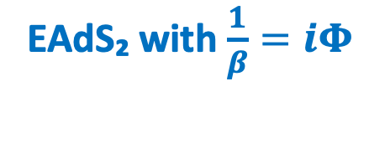
Revisiting the disk amplitude
$(−,−)$ signature with R = 2
EAdS₂ with $\frac{1}{β}=iΦ$
Maldacena contour

Slide 74
Generalization to arbitrary surfaces

Slide 75
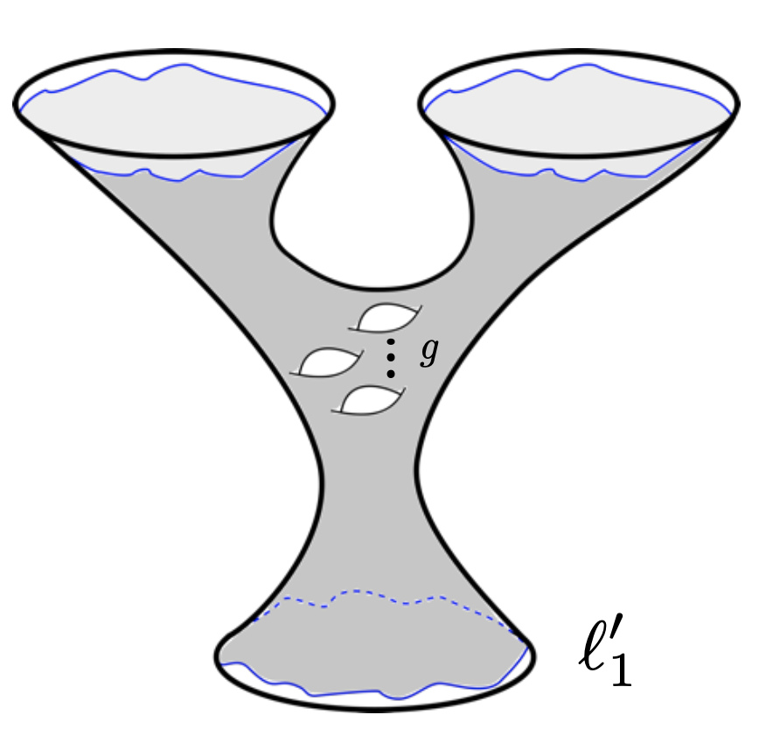

Generalization to arbitrary surfaces
General hyperbolic metrics in $(−,−)$ signature have

Slide 76
Generalization to arbitrary surfaces
General hyperbolic metrics in $(−,−)$ signature have
We find our desired surfaces using these metrics, in conjunction with analytically continuing the dilaton boundary conditions

Slide 77
Path integral computation

Slide 78
Path integral computation
The full picture can be understood with an analysis of the Teichmüller component of BF theory

Slide 79
Path integral computation
The full picture can be understood with an analysis of the Teichmüller component of BF theory
Two ingredients:
Path integral measure induced by
Boundary conditions on circles have:

Slide 80
Path integral computation
The full picture can be understood with an analysis of the Teichmüller component of BF theory
Two ingredients:
Path integral measure induced by
Boundary conditions on circles have:
Note: instructs us to rotate the integration contour of the Schwarzian modes

Slide 81
Path integral computation
The full picture can be understood with an analysis of the Teichmüller component of BF theory
Two ingredients:
Path integral measure induced by
Boundary conditions on circles have:
Note: instructs us to rotate the integration contour of the Schwarzian modes

Slide 82
Topological recursion

Slide 83
Topological recursion
Euclidean AdS JT amplitudes satisfy topological recursion

Slide 84
Topological recursion
Euclidean AdS JT amplitudes satisfy topological recursion
dS JT also satisfies topological recursion with a new spectral curve, corresponding to the density of states

Slide 85
Topological recursion
Euclidean AdS JT amplitudes satisfy topological recursion
dS JT also satisfies topological recursion with a new spectral curve, corresponding to the density of states
Generates analytically continued Weil-Petersson volumes

Slide 86
Topological recursion
Euclidean AdS JT amplitudes satisfy topological recursion
dS JT also satisfies topological recursion with a new spectral curve, corresponding to the density of states
Generates analytically continued Weil-Petersson volumes

Slide 87
Matrix model

Slide 88
Matrix model
dS JT can also be viewed as a continuation of the Euclidean AdS JT matrix model of [Saad, Shenker, Stanford ‘19]

Slide 89
Matrix model
dS JT can also be viewed as a continuation of the Euclidean AdS JT matrix model of [Saad, Shenker, Stanford ‘19]
Two ingredients:
Continuation of genus counting parameter
Parameters in single-trace insertions:

Slide 90
Matrix model
dS JT can also be viewed as a continuation of the Euclidean AdS JT matrix model of [Saad, Shenker, Stanford ‘19]
Two ingredients:
Continuation of genus counting parameter
Parameters in single-trace insertions:
Note: so the effective string coupling is pure imaginary

Slide 91
Matrix model
dS JT can also be viewed as a continuation of the Euclidean AdS JT matrix model of [Saad, Shenker, Stanford ‘19]
Two ingredients:
Continuation of genus counting parameter
Parameters in single-trace insertions:
Note: so the effective string coupling is pure imaginary
Implements

Slide 92
Matrix model
dS JT can also be viewed as a continuation of the Euclidean AdS JT matrix model of [Saad, Shenker, Stanford ‘19]
Two ingredients:
Continuation of genus counting parameter
Parameters in single-trace insertions:
Note: so the effective string coupling is pure imaginary
Implements (c.f. [Anninos, Hartman, Strominger ‘11])

Slide 93
Borel resummation

Slide 94
Borel resummation
leads to alternating signs in genus expansions, which can render them Borel resummable:

Slide 95
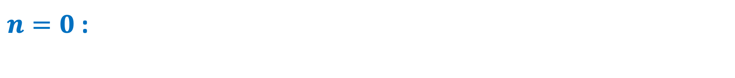
Borel resummation
leads to alternating signs in genus expansions, which can render them Borel resummable:
$n=0$:

Slide 96
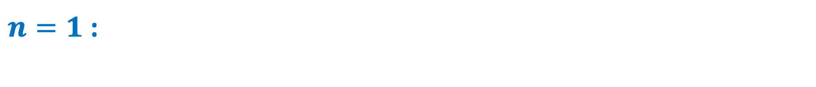
Borel resummation
leads to alternating signs in genus expansions, which can render them Borel resummable:
$n=0$:
$n=1$:

Slide 97
Borel resummation
leads to alternating signs in genus expansions, which can render them Borel resummable:
$n=0$:
$n=1$:
There can be additional doubly non-perturbative effects not captured by resurgence (e.g. eigenvalue instantons)

Slide 98
Another example: double-scaled GUE

Slide 99
Another example: double-scaled GUE
Can apply our continuations:
(which probes )

Slide 100
Another example: double-scaled GUE
Can apply our continuations:
(which probes )
Non-perturbative density of states:

Slide 101
Another example: double-scaled GUE
Can apply our continuations:
(which probes )
Non-perturbative density of states:

Slide 102
Another example: double-scaled GUE
Can apply our continuations:
(which probes )
Non-perturbative density of states:
Flips cut, so it only makes sense to probe model with

Slide 103
Discussion
Part III

Slide 104
Recap of results
Solved dS JT non-perturbatively in the genus expansion
Carefully treated the dS JT path integral measure
dS JT can be viewed as a subtle continuation of AdS JT
Continuation of ’s
Holographically dual matrix integral with

Slide 105
Comments and speculations
dS JT gravity has isometric (and co-isometric) S-matrix evolution at leading order in the genus expansion, but this is broken at higher genus
The theory is UV-complete, but only approximately unitary / isometric
What happens doubly non-perturbatively?
Related to, but different than, the factorization problem in Euclidean AdS
Our analysis uncovers new features of the de Sitter holographic dictionary
More physics to mine out of the model

