Slide 1
Towards a microscopic formulation
of the no-boundary wave function
CERN Cosmo Workshop
Sep 2023
Thomas Hertog
Institute for Theoretical Physics
KU Leuven

Slide 2
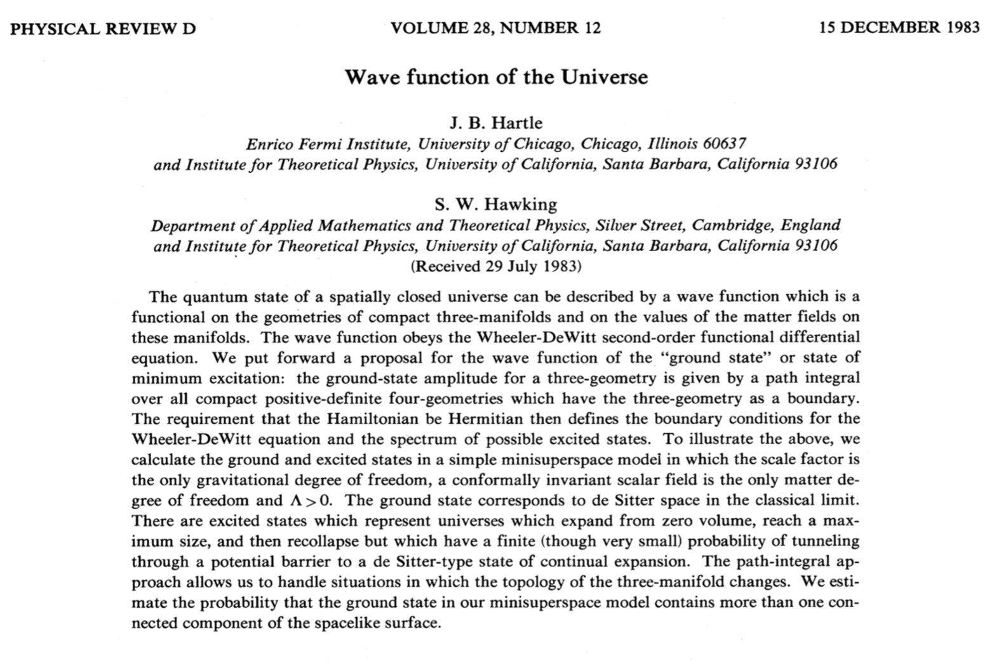

Slide 3
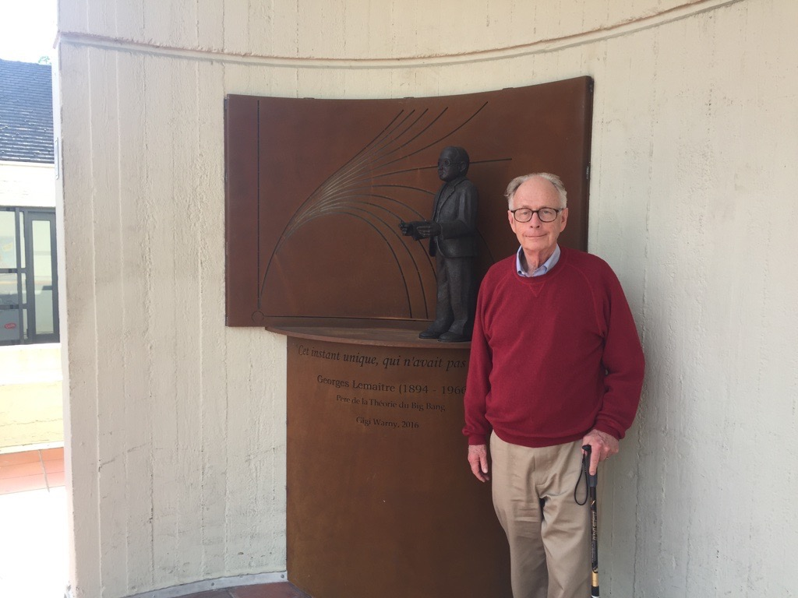

Slide 4
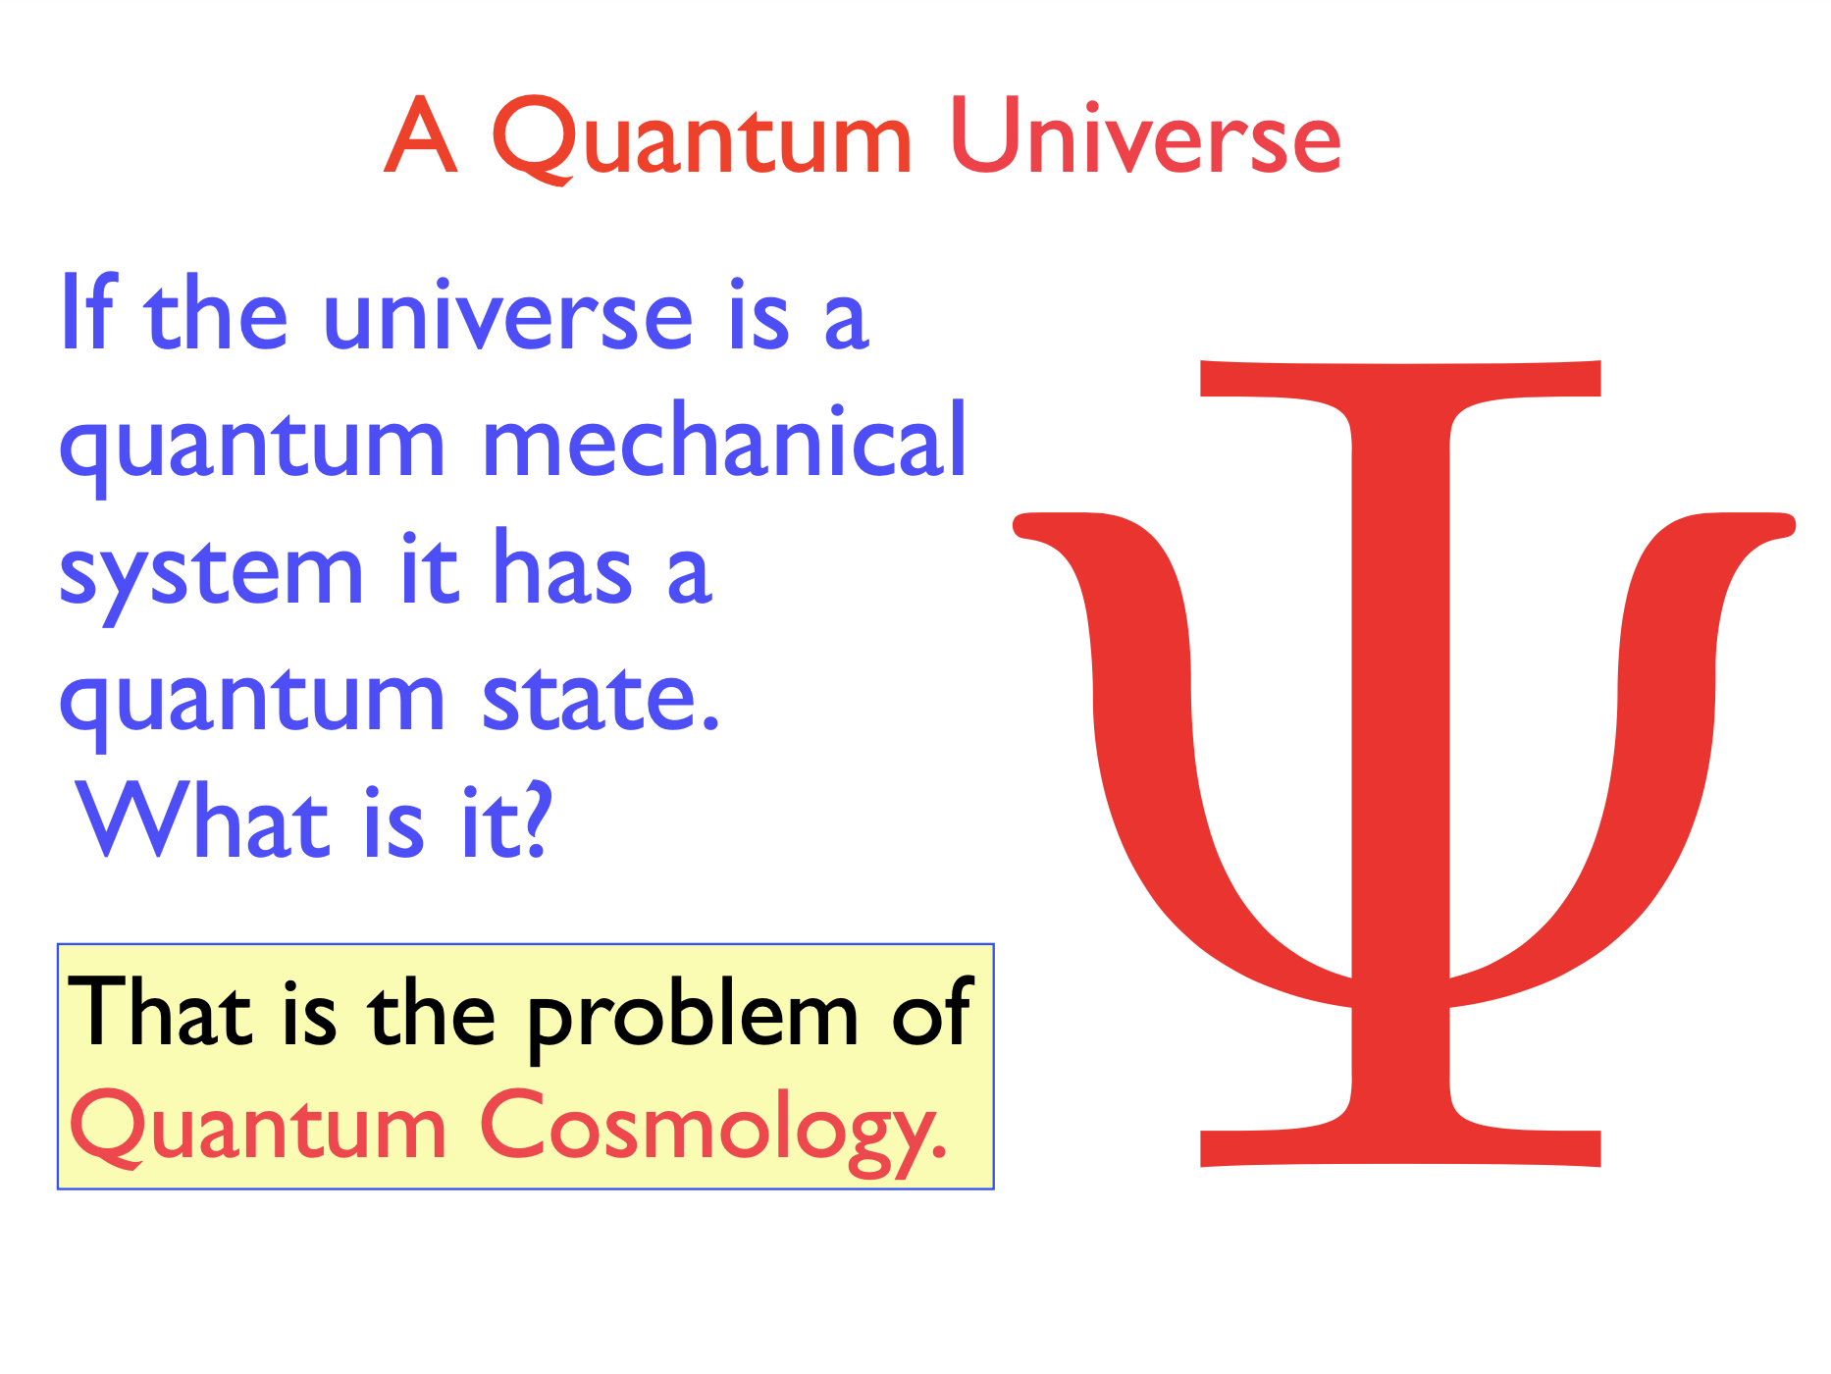
© Hartle

Slide 5
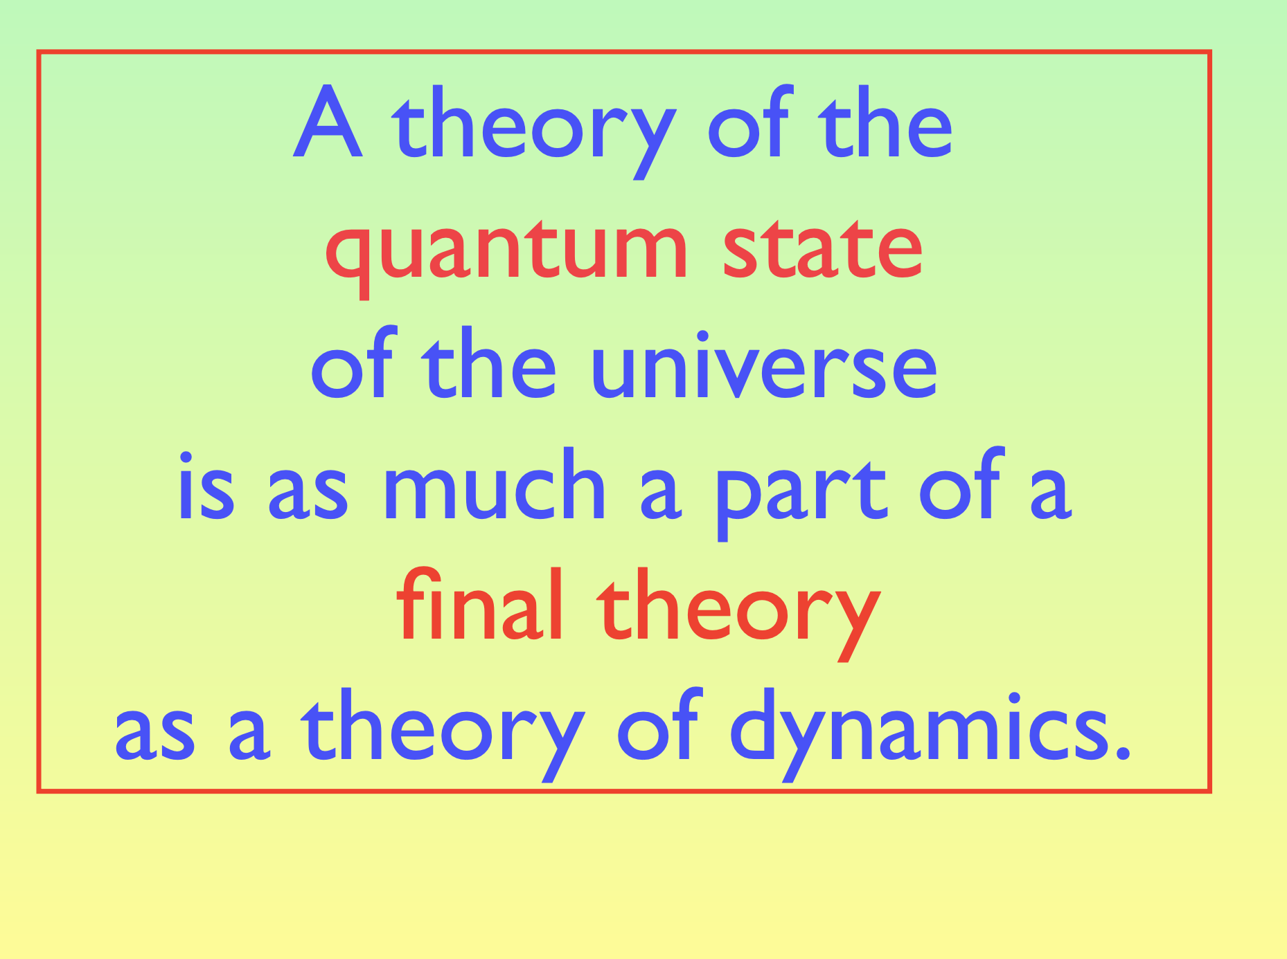
© Hartle

Slide 6
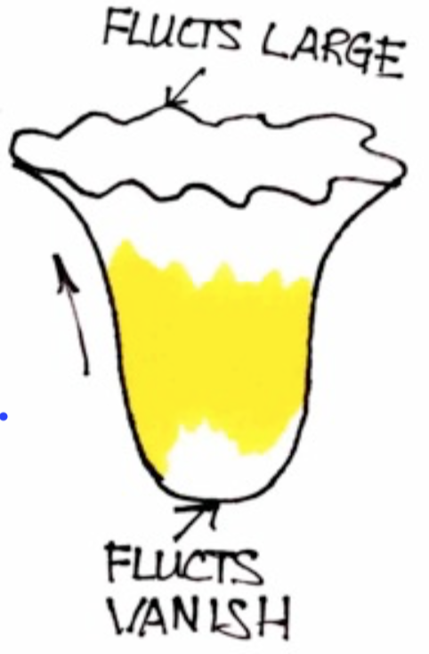
© Hartle

Slide 7
Classical cosmological evolution emerges
through a
dS-like phase
of inflation.
Fluctuations are initially small,
giving rise to a physical arrow of time.
[Hartle, Hawking, TH, 2008]

Slide 8
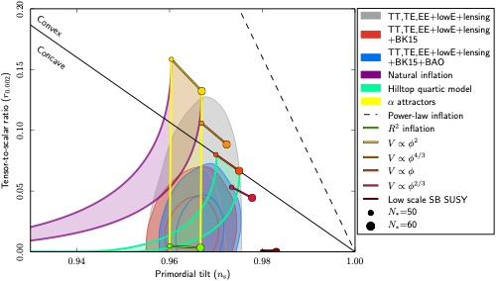
A Prior for Planck?
[Planck 2018 results: Constraints on inflation, 1807.06211]

Slide 9
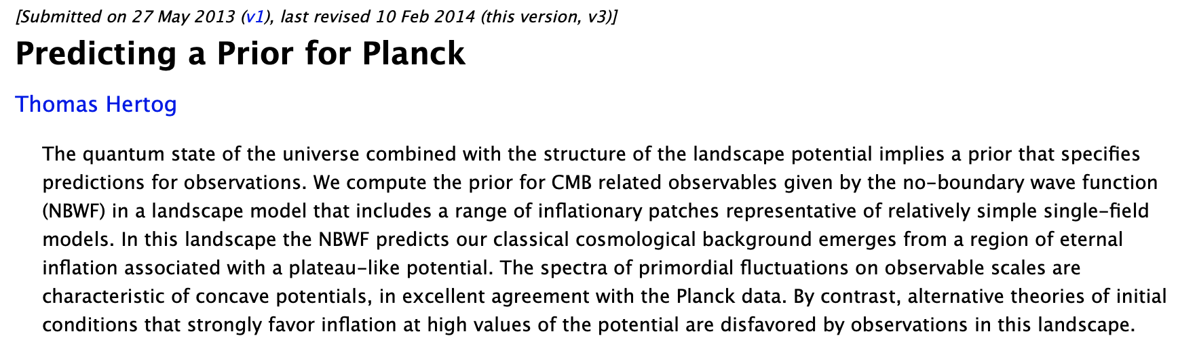
A Prior for Planck?

Slide 10
A Prior for Planck?
From wave function to observables
Observables must be observed
Saddle point form only an approximation

Slide 11
A Prior for Planck?
From wave function to observables
Observables must be observed
Saddle point form only an approximation
→ Can the no-boundary theory be refined -> its predictions strengthened?

Slide 12
Towards a microscopic formulation
of the no-boundary wave function
Allowability -> Saddle selection
Holography -> microscopic dS entropy
Observer -> Page-like transition
hep-th, 2305.15440 [w/ Joel Karlsson, Oliver Janssen]
hep-th, 2211.05907 [w/ N. Bobev, Junho Hong, Joel karlsson, Valentine Reys]
hep-th, 1009.2525 [w/ Hartle, Hawking]

Slide 13

Saddle selection
Kontsevich- Segal: consider only those (complex) saddle backgrounds on which an arbitrary QFT can be defined [2105.10161]
Witten: elevate this to a selection principle of saddles in gravitational path integrals [2111.06514]
Some evidence: the criterion eliminates pathological wormholes but allows e.g. for complexified Kerr

Slide 14
Saddle selection
Kontsevich- Segal: consider only those (complex) saddle backgrounds on which an arbitrary QFT can be defined [2105.10161]
Witten: elevate this to a selection principle of saddles in gravitational path integrals [2111.06514]
Some evidence: the criterion eliminates pathological wormholes but allows e.g. for complexified Kerr
Do all no-boundary saddles that describe
the origin of inflation satisfy the KSW criterion?

Slide 15
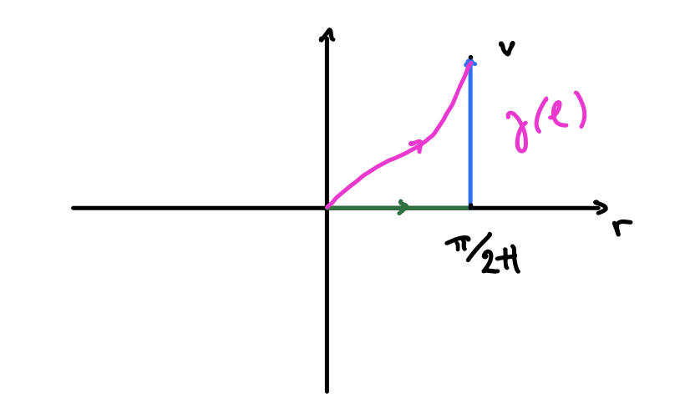
Saddle selection
What can go wrong?

Slide 16
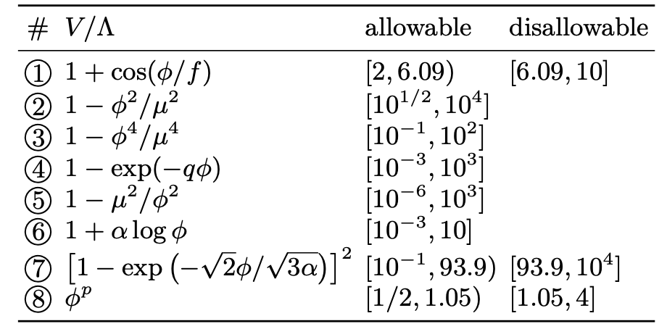
Saddle selection

Slide 17
Saddle selection
What can go wrong?
The KS(W)-criterion selects those no-boundary saddles
in which the universe emerges on a concave patch of the scalar slow-roll potential.

Slide 18
Observational implications

Slide 19
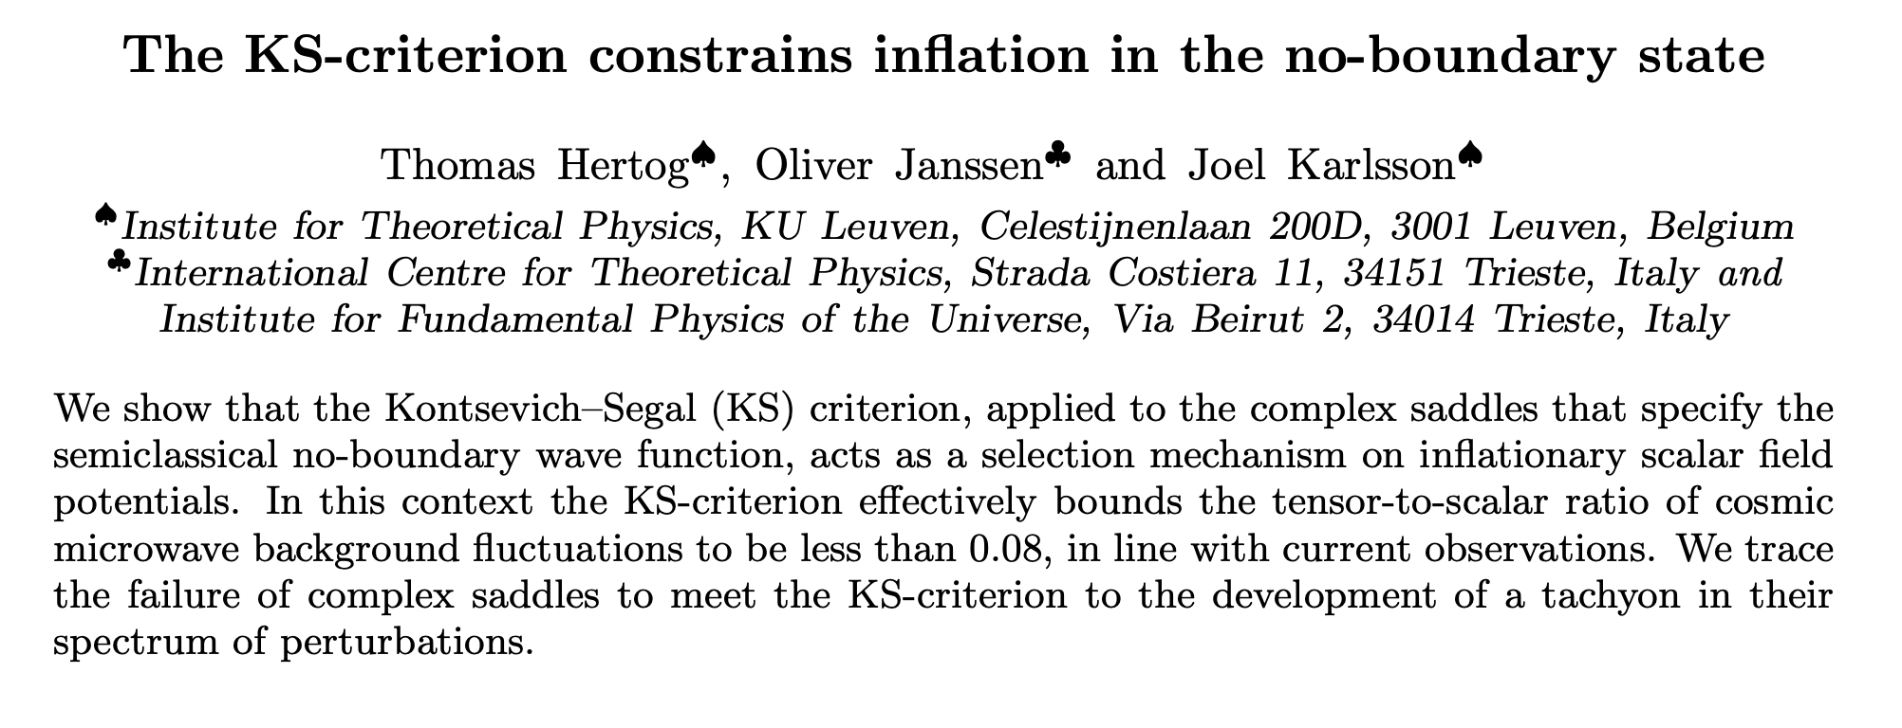
hep-th, 2305.15440

Slide 20
hep-th, 2305.15440
Quid eternal inflation?
This result resonates with swampland mantra..
Quid Quintessence?

Slide 21
Towards a microscopic formulation
of the no-boundary wave function
Allowability -> Saddle selection
Holography -> microscopic dS entropy
Observer -> Page-like transition
hep-th, 2305.15440 [w/ Joel Karlsson, Oliver Janssen]
hep-th, 2211.05907 [w/ N. Bobev, Junho Hong,
Joel Karlsson, Valentine Reys]
hep-th, 1009.2525 [w/ Hartle, Hawking]

Slide 22
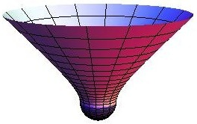
de Sitter saddle
[Hartle, TH ’11; Harlow, Stanford ‘11]
dS
EdS

Slide 23
de Sitter saddle
dS
EdS

Slide 24
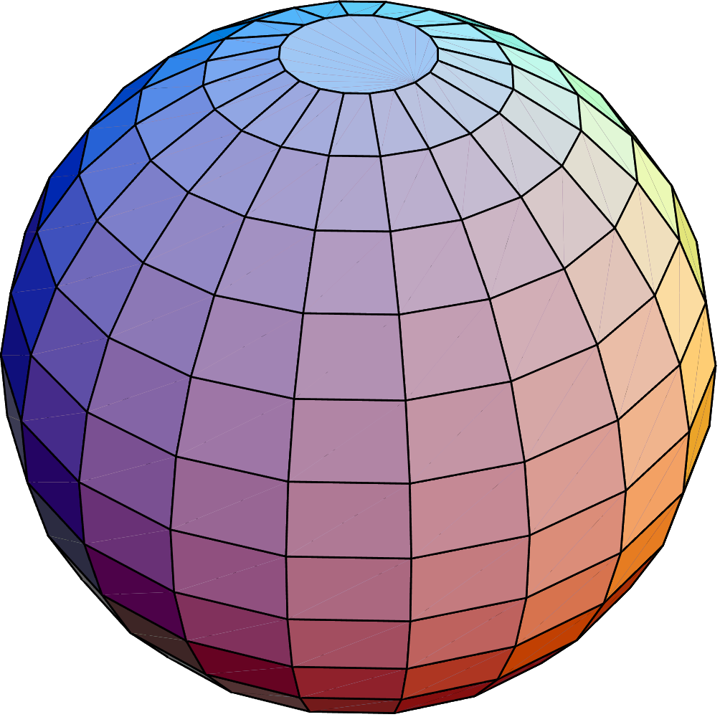
de Sitter entropy
dS
EdS

Slide 25
de Sitter entropy
[Hartle, TH ’11; Harlow, Stanford ‘11]
dS
EdS

Slide 26
de Sitter entropy
-EAdS
dS
-EAdS
EdS

Slide 27

de Sitter entropy

Slide 28
de Sitter entropy

Slide 29
Digression: saddles with sources
[Hartle, TH ’11]
Complex EAdS
domain wall
Lorentzian
inflation
Deformed
sphere
Notes:
AdS/dS link holds at tree level for arbitrary boundary configurations; entire HH proposal can be thought of

Slide 30
de Sitter entropy: microscopics
AdS/CFT EAdS₄ x S⁷ :
Conjecture:

Slide 31
de Sitter entropy: microscopics
AdS/CFT EAdS₄ x S⁷ :
Leading term matches !
Q: What about quantum corrections?

Slide 32
de Sitter entropy: microscopics
AdS/CFT EAdS₄ x S⁷ :
Leading term matches !
Q: What about quantum corrections?
Quid bulk?

Slide 33
de Sitter entropy: microscopics
AdS/CFT EAdS₄ x S⁷ :
Leading term matches !
Q: What about quantum corrections?
Quid bulk?
Leading correction ←→ higher-derivative terms. Match !
Log correction ←→ one-loop det. in 11d Eucl SUGRA on
[Bhattacharyya, Grassi, Marino, Sen ’12]
Notes:
Comment on the minus sign: remember that the EAdS and dS legs enter with different signatures;
But the Euclidean dS action in one signature is minus theEuclidean AdS action in another signature.
That’s the origin of the sign.

Slide 34
`11d quantm supergravity’
[Bhattacharyya, Grassi, Marino, Sen ‘12]
Consider 11d Euclidean SUGRA on
One-loop determinants generate log corrections to the free energy
Odd dimensions: only zero modes contribute
Massless 11d fields: metric, gravitino and three-form
Ghosts are important!
Metric and gravitino have no zero mode because S⁴ is compact.
Logarithmic correction due to a p-form:
→
v
Notes:
This is in perfect and non-trivial agreement with our holographic conjecture for the dS entropy

Slide 35
So.. what does S_{dS} count?

Slide 36
So.. what does S_{dS} count?
Not quite count microstates, since there is no time, no Hamiltonian.
In effect, exp (S_{dS}) not an integer for low (N,k)
But, being given by a (QFT) path integral, the microscopic entropy does represent some sort of measure of degrees of freedom.

Slide 37
So.. what does S_{dS} count?
Not quite count microstates, since there is no time, no Hamiltonian.
In effect, exp (S_{dS}) not an integer for low (N,k)
But, being given by a (QFT) path integral, the microscopic entropy does represent some sort of measure of degrees of freedom.

Slide 38
Quantum cosmology on the (deformed) sphere?
Observables ~
?

Slide 39
Towards a microscopic formulation
of the no-boundary wave function
Allowability -> Saddle selection
Holography -> microscopic dS entropy
Observer -> Page-like transition
hep-th, 2305.15440 [w/ Joel Karlsson, Oliver Janssen]
hep-th, 2211.05907 [w/ N. Bobev, Junho Hong, Joel karlsson, Valentine Reys]
hep-th, 1009.2525 [w/ Hartle, Hawking]

Slide 40
No-boundary prior
→ minimum amount of inflation
Notes:
wave function is strongly tilted towards the low $\phi_0$ saddle points,

Slide 41
No-boundary prior
DATA
DATA
→ minimum amount of inflation
Notes:
wave function is strongly tilted towards the low $\phi_0$ saddle points,

Slide 42
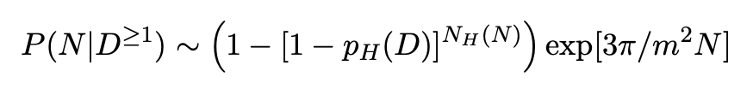
DATA
Conditional probabilities
Consider P(N|D) for given boundary data D, treated quantum
mechanically, i.e. data with a probability p_{H} (D) to occur in any H-volume
Where p_{H} is determined by the wave function itself (for fluctuations).

Slide 43
DATA
Conditional probabilities
Consider P(N|D) for given boundary data D, treated quantum
mechanically, i.e. data with a probability p_{H} (D) to occur in any H-volume
Where p_{H} is determined by the wave function itself (for fluctuations).
Wave function at face value: no data D → low amount of inflation
Conditioned on few data D: → low amount inflation

Slide 44
DATA
Conditional probabilities
Consider P(N|D) for given boundary data D, treated quantum
mechanically, i.e. data with a probability p_{H} (D) to occur in any H-volume
Where p_{H} is determined by the wave function itself (for fluctuations).
Conditioned on lots of data D:
This distribution exhibits a Page-like transition at the threshold of eternal inflation, where a new saddle becomes dominant.
-> large amount of inflation

Slide 45
No-boundary prior
→ minimum amount of inflation
Notes:
wave function is strongly tilted towards the low $\phi_0$ saddle points,

Slide 46
No-boundary prior 2.0

Slide 47

?
Validity saddle pt approximation?
[Hartle, Hawking, TH, 1009.2525]

Slide 48
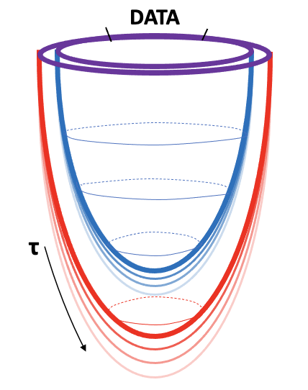
?
Validity saddle pt approximation?
[Hartle, Hawking, TH, 1009.2525]

Slide 49
Towards a microscopic formulation
of the no-boundary wave function
Allowability -> Saddle selection
Holography -> microscopic dS entropy
Observer -> Page-like transition
hep-th, 2305.15440 [w/ Joel Karlsson, Oliver Janssen]
hep-th, 2211.05907 [w/ N. Bobev, Junho Hong, Joel karlsson, Valentine Reys]
hep-th, 1009.2525 [w/ Hartle, Hawking]

