Slide 1

Engineering workflow in vacuum
André Rocha (andre.rocha@cern.ch)
Interlocks, Controls and Monitoring Section, Vacuum Group
TE
Technology Department

Slide 2
Vacuum Control System
Architecture and some numbers
Vacuum Framework
Databases and Configuration Components
Configuration Workflow
From P&ID to a production control system
Conclusions
Key takeaways

Slide 3
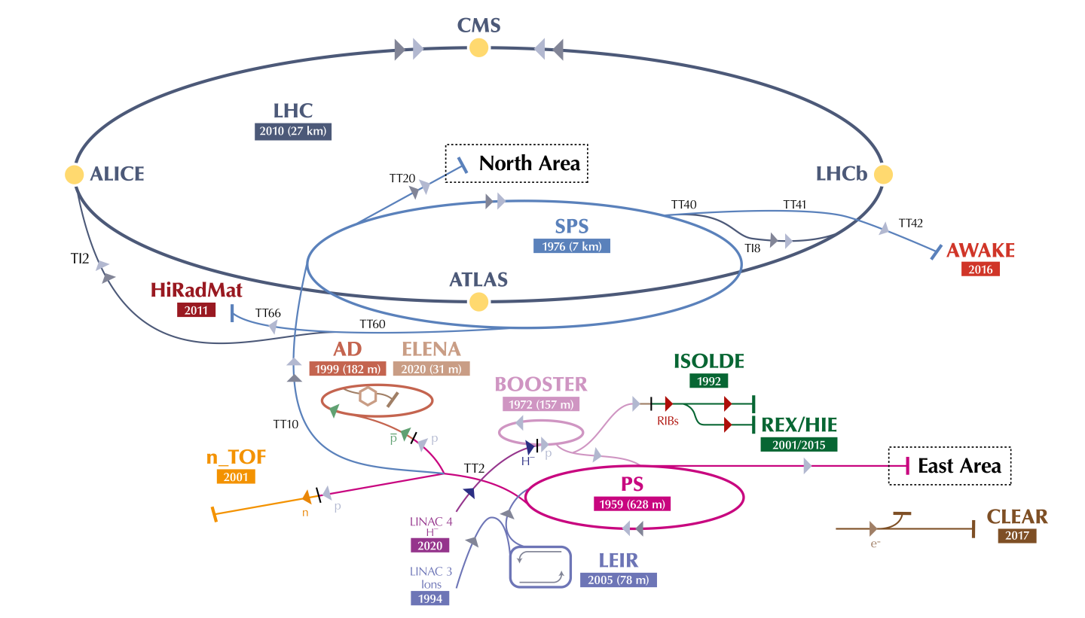

Vacuum at CERN
127 km of lines under vaccum
Pressures between ${10}^{−4}$ and ${10}^{−12}$ mbar
Notes:
No matter the installation, you will always find that the control system is based

Slide 4
Process Equipment numbers
Vacuum is achieved and monitored by over 12000 pieces of control equipment

Slide 5

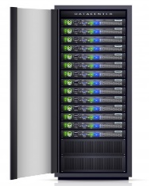
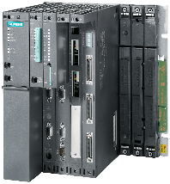
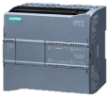
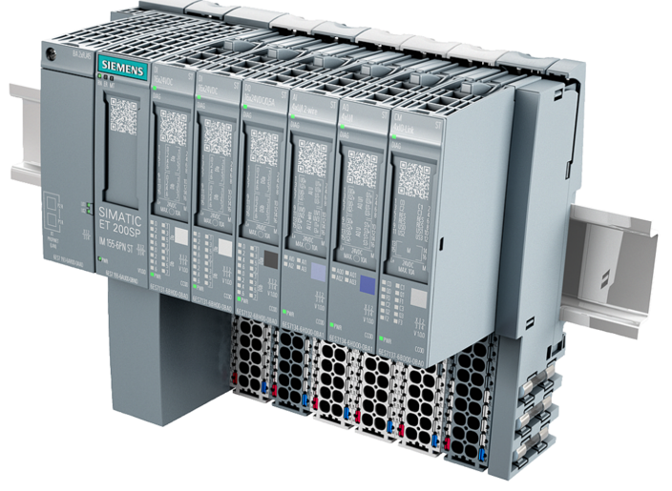
Control System Architecture
SCADA
Servers
WinCC-OA
General Purpose Network
User Terminals
Terminal
Servers
Technical Network
Master PLC
(S7-400 x 35)
LSS Gauge
Reading PLC
(ET200-SP x 18)
Arc Gauge
Reading PLC
(ET200-SP x 16)
VPG PLC
(S7-1200 x 220)
Profibus (mobile)
Profibus (fixed)
Sector Valves
Mobile Devices
Pumping
Group
LSS Insulation Vacuum Gauges
Arc Insulation Vacuum Gauges
Bypass
Valves
NEG + Ion Pumps
LSS Beam Gauges
Penning + Pirani Gauges
Cryogenic
Interlocks
Arc Beam Vacuum Gauges
Cryogenic
Interlocks
( … )
credits R. Ferreira

Slide 6












SCADA Applications
as of 2023
Notes:
No matter the installation, you will always find that the control system is based

Slide 7

Vacuum Framework
vacDB
Developed at TE-VSC-ICM since late 1990s
Used in the largest machines (LHC, SPS, CPS, Deceleration)
WinCC-OA SCADA / Siemens PLC framework
Components:
vacDB – set of ORACLE databases
Vacuum Controls Configurator – vacCC
Vacuum SCADA
Vacuum PLC baseline
Database-driven Configuration Engineering approach
vacCC
Vacuum Framework
vacSCADA
vacPLC

Slide 8
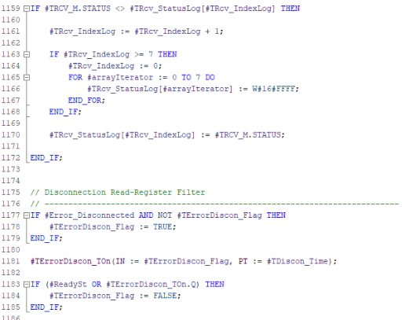

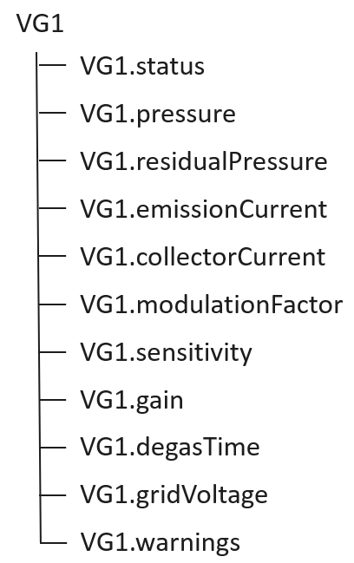
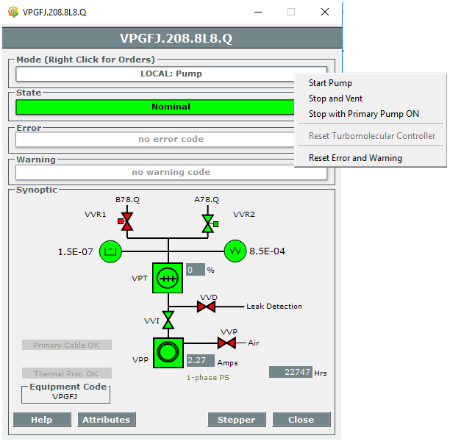
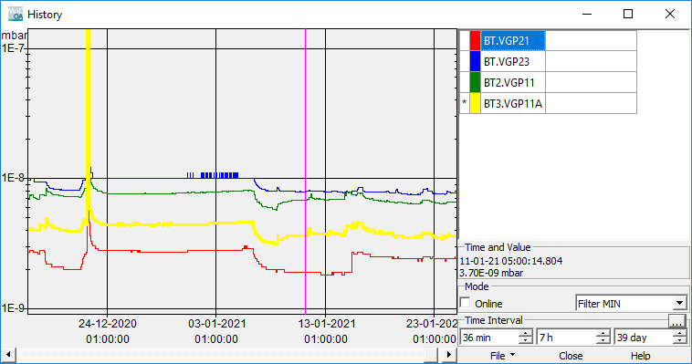
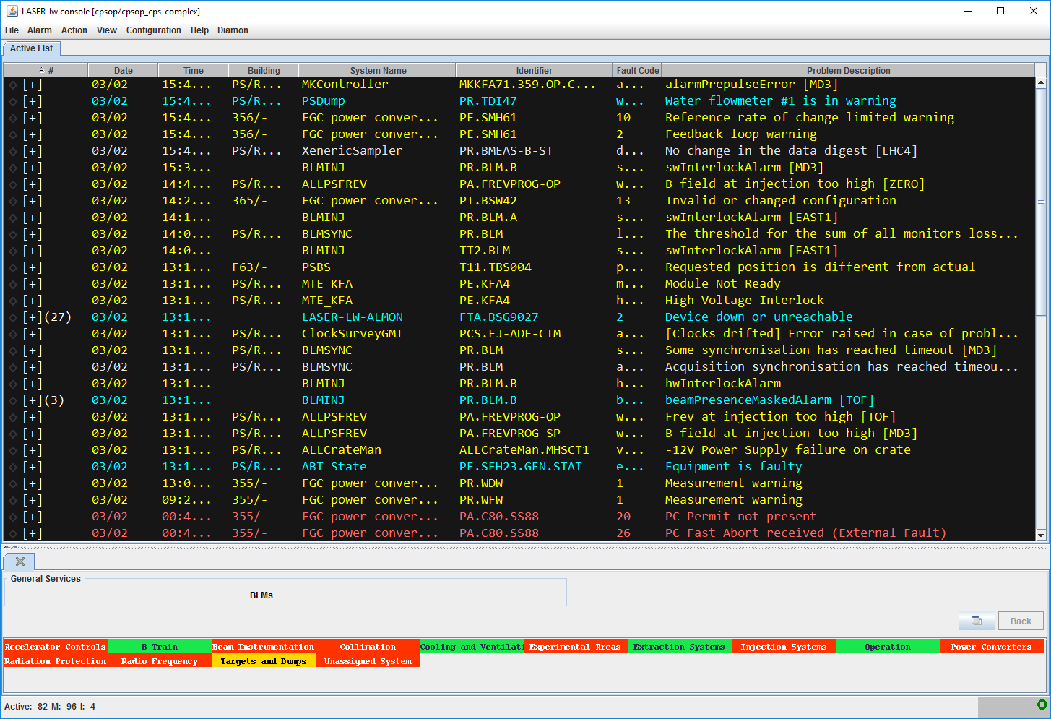
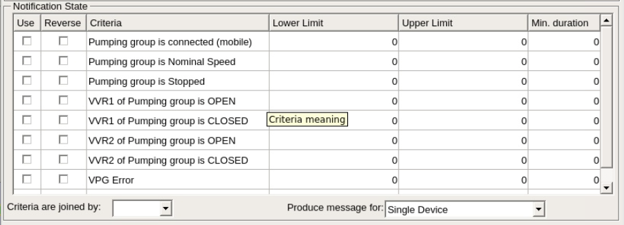
Control Type
SCADA
PLC code
Widget
DP Type
Faceplate
Commands
Archive
Alarms
SMS Notifications
instanceOf
Equipment Instance

Slide 9
Configuration settings numbers
LHC
SPS
CPS
617 632
147 315
100 783

Slide 10
Control Parameters
Attributes required to control devices
Alarms
Archiving
Alarm descriptions
Alarm hierarchies
What to archive. Which archive settings ? Archive duration
vacDB
Communication
Data Sharing
SCADA <-> PLC <-> Device
What to share to other systems ?
Display
The location of equipment in synoptics

Slide 11
Vacuum Databases
Master Database
For each control type:
Definition of Attributes
Definition of Default Attribute values
Definition of Communication block
Definition of SCADA datapoint type
Definition of alarms produced
Master DB
Definition of Control Types
LHC
SPS
CPS
Machine Databases
Instantiation of equipment:
Specification of equipment attributes
Specification of archiving settings
Specification of data sharing
Machine DBs
Instantiation of equipment

Slide 12

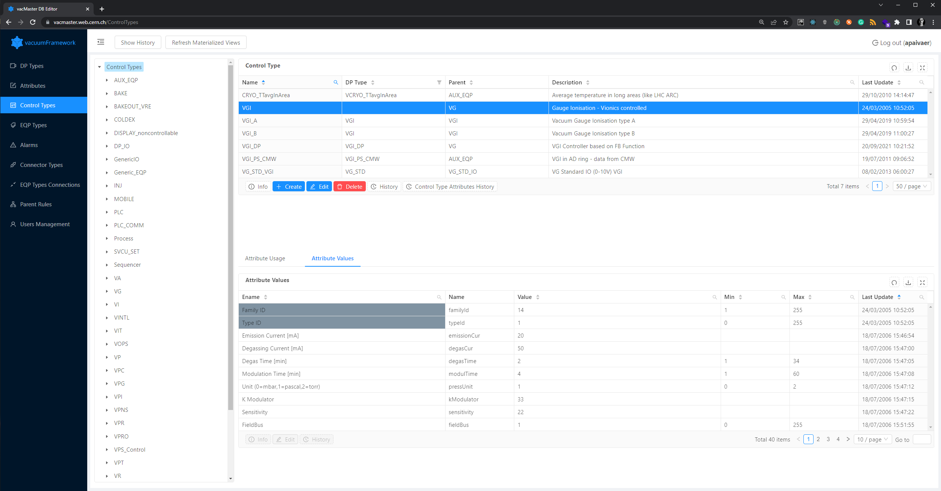
vacCC
Master
Used by SCADA developers
Definition of control types, their attributes, and default values

Slide 13
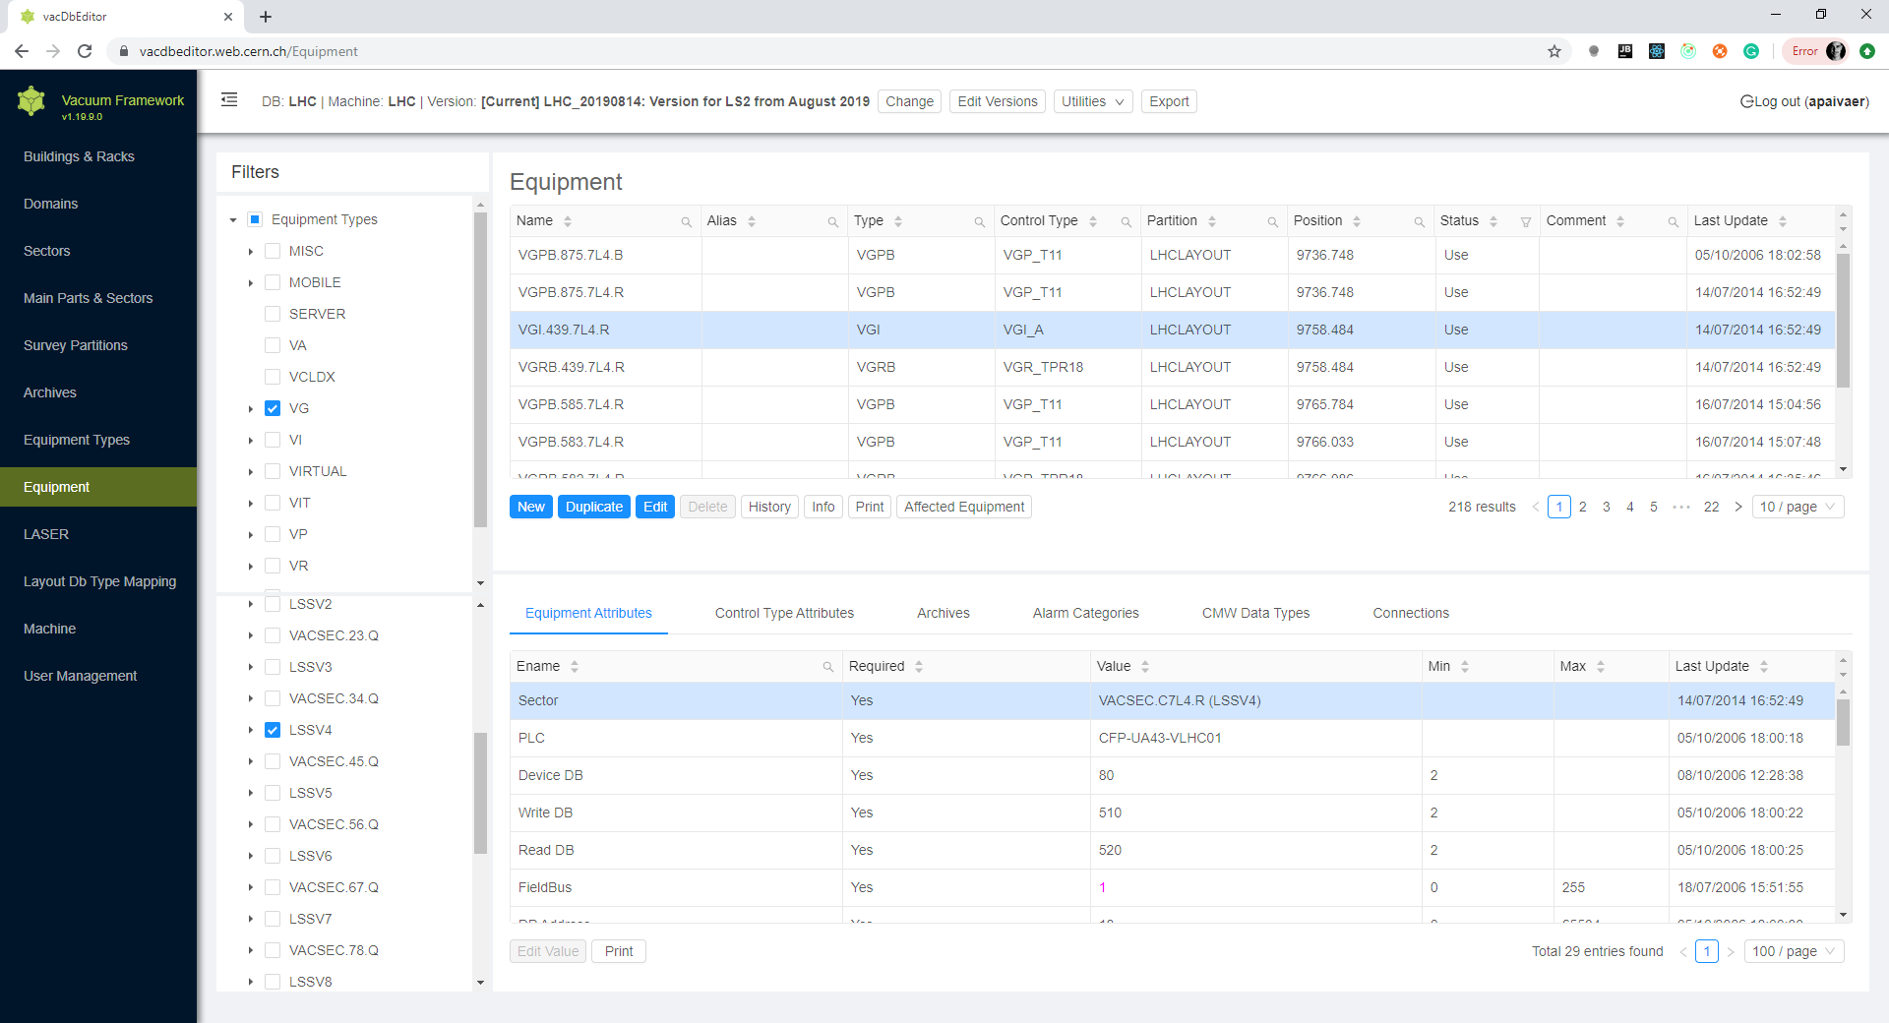
vacCC
Machine
The editor for the machine databases
Allows integration of equipment in the control system by non software experts
Full traceability

Slide 14
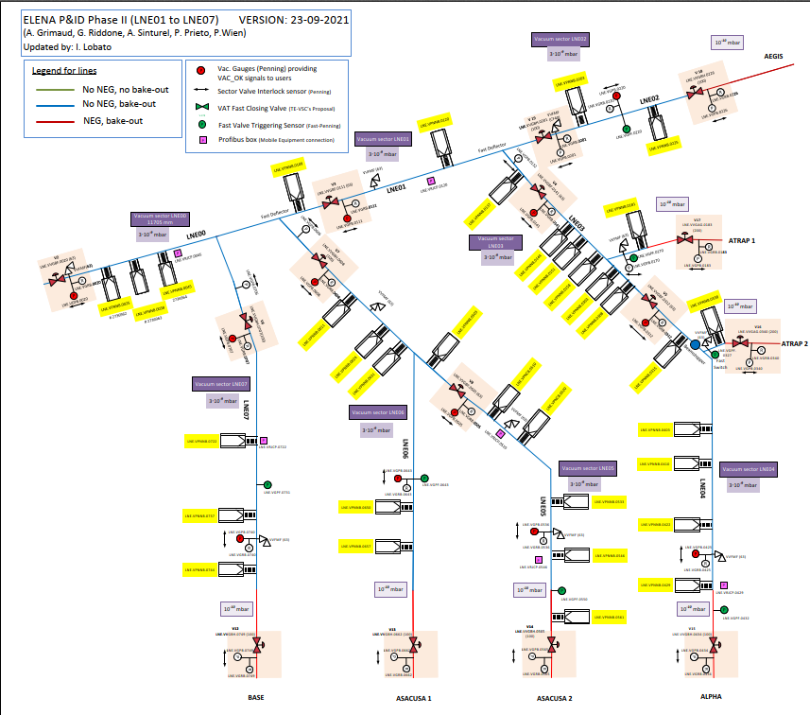

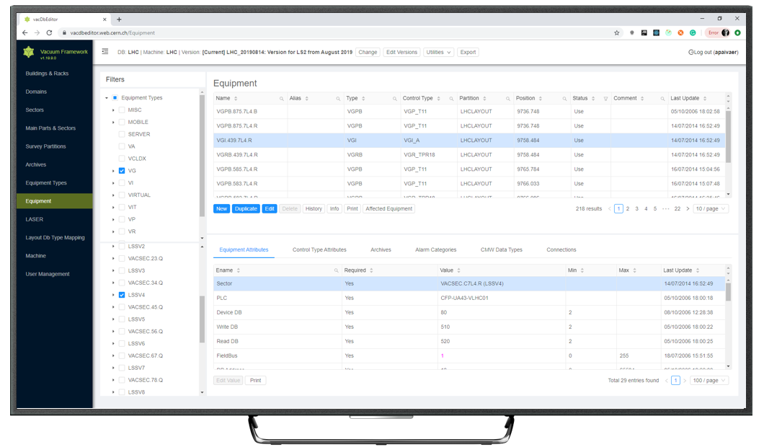

Configuration Workflow
P&ID
vacCC Machine
SCADA Configuration
Test Environment
Production
PLC Code
P&ID approved
Naming Conventions Applied to P&ID
Create/Update machine in vacCC
Configuration
Export
Deploy test SCADA application and PLC code
Commissioning
Deploy prod SCADA application and PLC code
ECR – Engineering Change Request
Typical requests:
New machines
New vacuum lines
New sectorization
Vacuum controls equipment upgrades

Slide 15
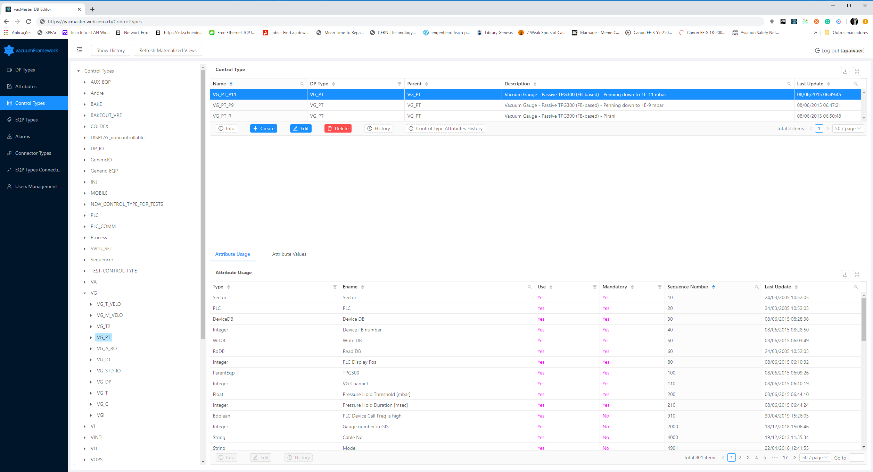
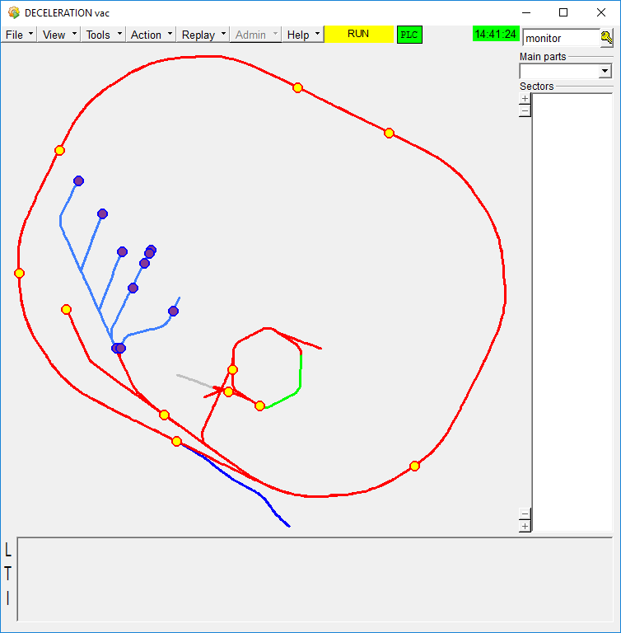
vacCC Master
Configuration
Architecture
MASTER
vacCC Master Backend
Data flow
LHC
SPS
CPS
SCADA
Import
SCADA Configuration
vacCC Machine Backend
Exporter Service
PLC Code
Synchronizer
Service
PLC Baseline
Vacuum Devices
Layout
vacCC Machine
Notes:
All

Slide 16
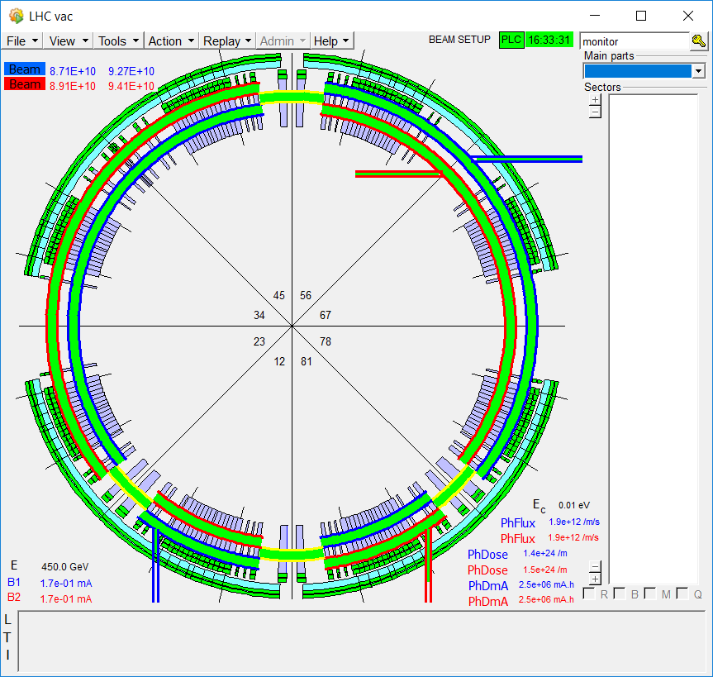
SCADA
User Interface

Slide 17
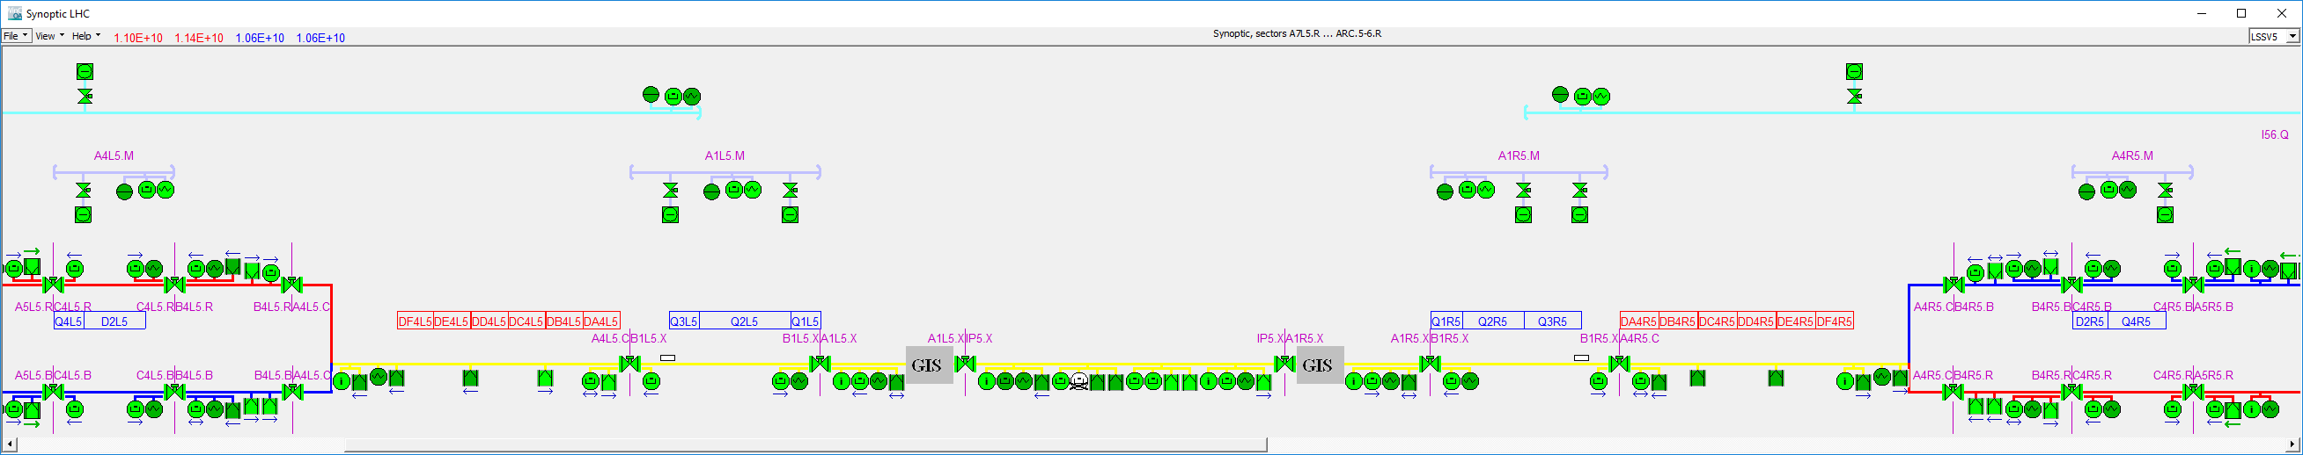
Automatic Synoptic Drawing

Slide 18
Equipment Details Panel

Slide 19
Archiving

Slide 20
Alarms

Slide 21
Advantages of Database-Driven Configuration Engineering Tools
Object oriented-like paradigm
Each equipment instance inherits a default configuration, but the user is free to override configuration
Cross-layer consistency
Changes of parameters are propagated to all relevant layers of the control system
Data integrity
Configuration integrity and consistency done by defining rules for data validation and constraints
Assessibility
Multiple people can work in the configuration of the control system at the same time
Versioning
Have different versions of the control system ready in advance according to the needs of operations
History
Log every change. Know what changed, when it changed and who changed what.

Slide 22
Future Work
Automate SCADA deployment
Objective: minimize human intervention by automating SCADA deployments
Instead of generating configuration files and updating the SCADA manually, generate a new container image of the SCADA application
Deploy to development and production environments with the push of a button
Automate PLC projects build
More on this by R. Ferreira
Conclusion
The vacuum configuration workflow is streamlined through the Vacuum Controls Configurator infrastructure:
Updates to individual equipment and machines are done through vacCC Machine
Default values are managed through vacCC Master
Database-driven Configuration Engineering tools are essential for the management of large-scale control systems

