Slide 2
PS Booster Magnets Task Force
The Challenge
Antony Newborough on behalf of TE/MSC-NCM

Slide 3
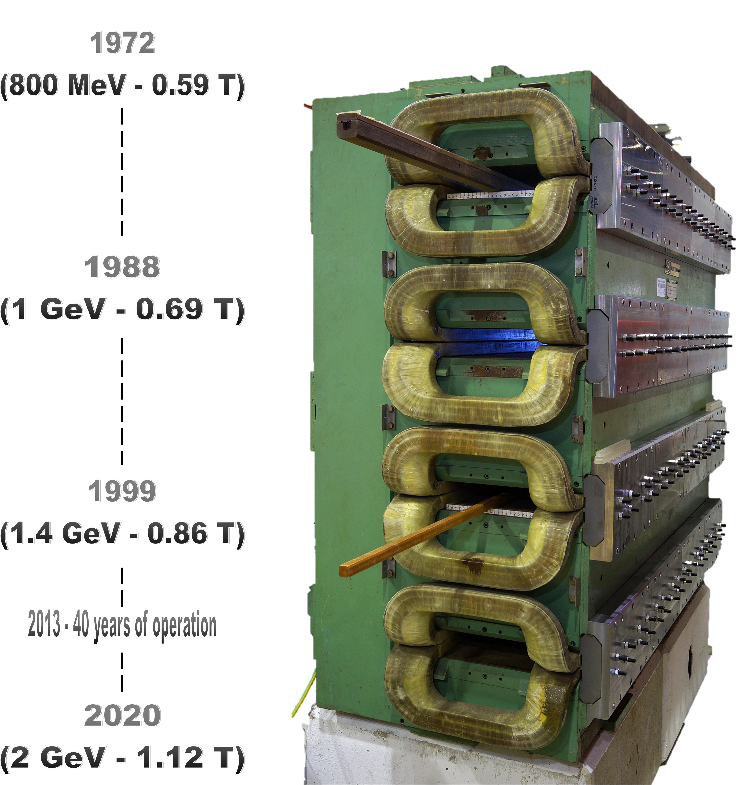
PS Booster Magnets Task Force
The Challenge
Introduction:
  PSB Magnets distribution of magnets by age;
  PSB Main Quadrupole Magnets
    Inventory
    Non-conformities
    Sample analysis
    Repair, mitigation and reconstruction
  PSB Main Bending magnets
    Inventory
    Sample analysis
  Beyond the PSB?
The PSB Upgrades

Slide 4
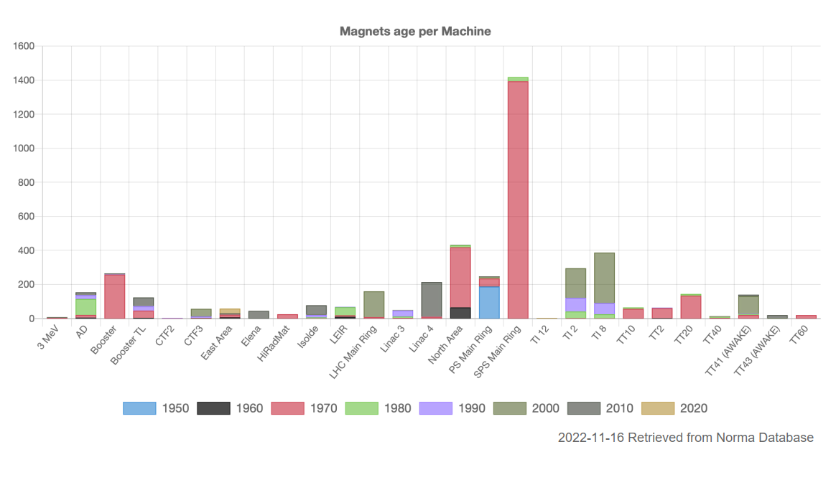
Magnet ageing by machine…
Magnet Production Decade by Machine
Continuous refurbishment of MU
Extremely reliable to date
NA Cons underway
Refurbishment of all MU completed in LS2

Slide 5
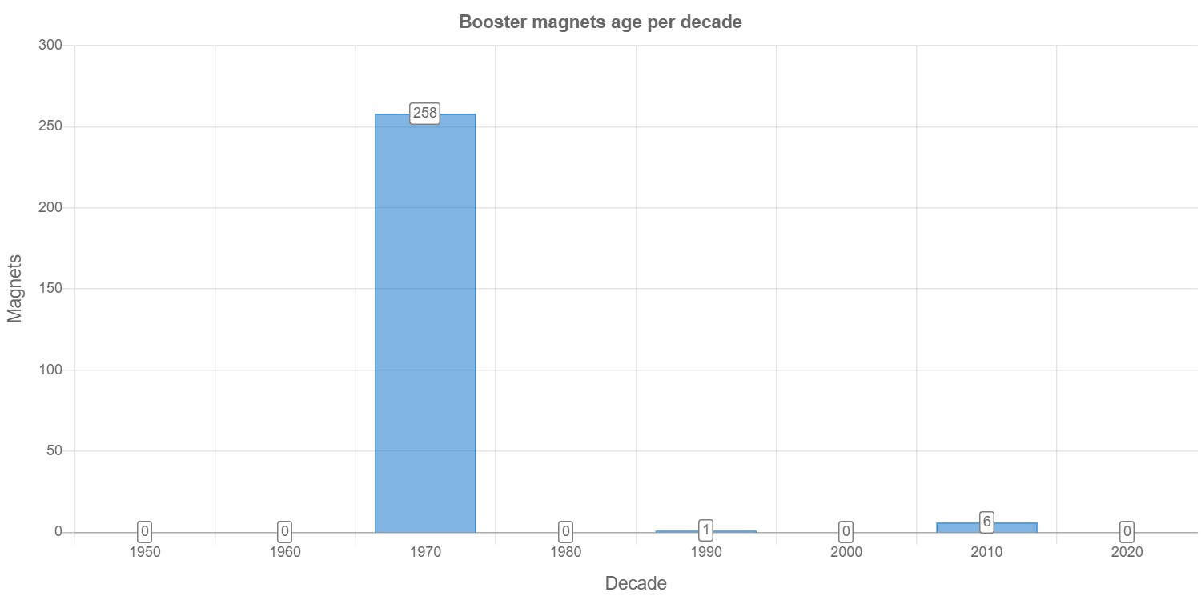
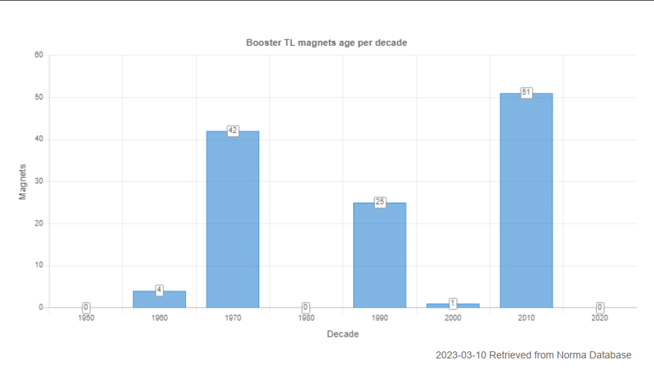
Magnet ageing PSB
PSB Ring Magnet Production by Decade
The ring magnets are predominantly original, the vast majority have never been removed from the machine.
192/260* of the magnet units are water cooled.
* 580/770 when considering multipoles e.g. combined Oct, Sex and Quads etc…
450 – 550 million cycles
26.4 millions with POPS-B
(~20 million @ 2 GeV)
+200 million up to 2040?
(Estimations from EPC & OP)
1950
1960
1970
1980
1990
2000
2010
2020
PSB TL Magnet Production by Decade
From the L4 > PSB > PS & ISOLDE many of the magnets have been exchanged during various upgrades. The majority of the remaining original magnets are air-cooled.
51/123 magnets are water cooled.

Slide 6
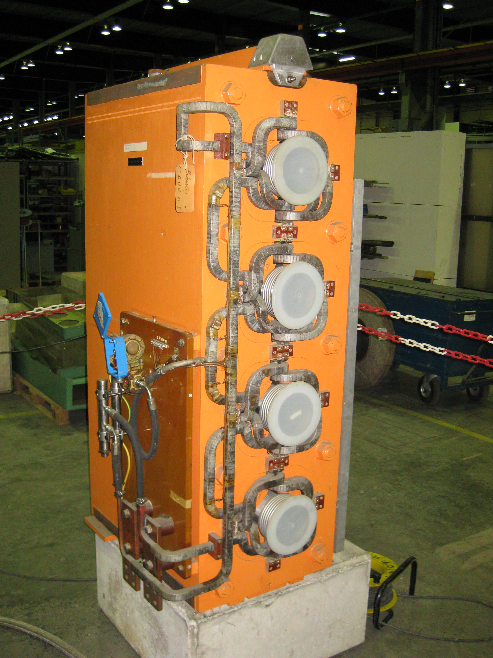
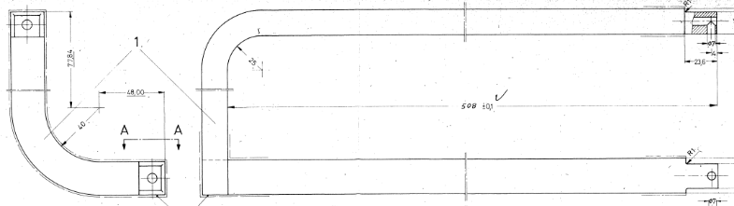
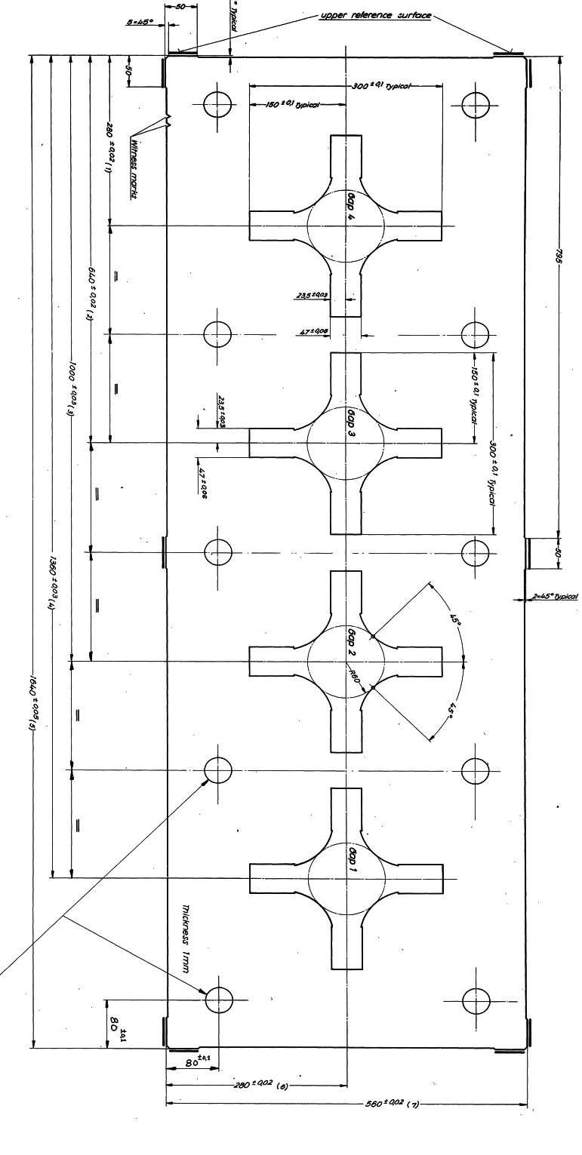
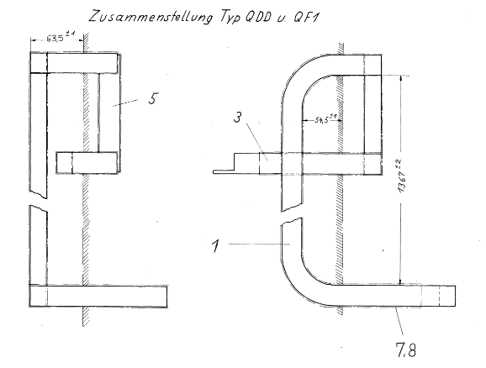
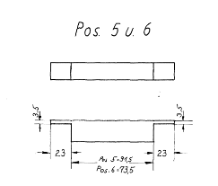
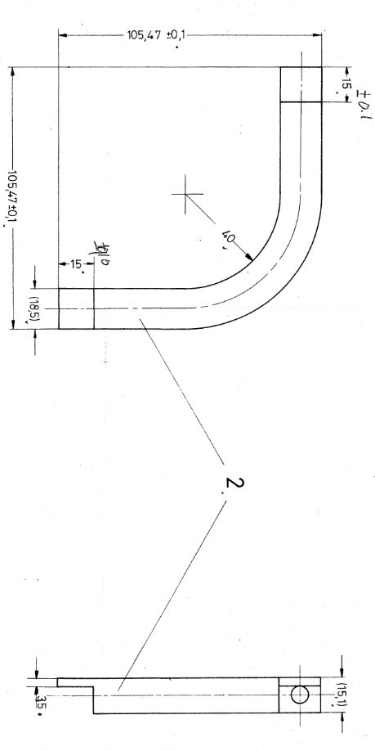
PSB quadrupole magnet ageing
REMINDER: Until 2021 the only PSB quadrupole exchange was due to a vacuum leak!
A Unique Construction!
Single lamination (no means to open the magnet)
Coil built-up turn by turn (~76 brazed connections per magnet, ~3650 in operation)**
Mica/glass fiber insulation tape with the whole magnet resin impregnated (true VPI method which CERN is not equipped)
ZERO LEAKS UNTIL 2021 AND FIVE SINCE!
** Additional undocumented brazed joints are being discovered
Design Code | Old Code | Installed | Spare | Comment
PXMQNEC4WP | QFO LEFT | 16 | 2* | Removed from the ring during the YETS 21/22 #17 repaired (only where it leaked!) and certified #30 repaired (only where it leaked!) and certified but has since had additional sample cut and requires additional repair
PXMQNED4WP | QFO RIGHT | 16 | 1* | NC Removed from the ring during the YETS 22/23, sample extracted
PXMQNFA4WP | QDE left | 8 | 1* | NC Removed from the ring during the YETS 22/23, sample extracted
PXMQNFJ4WP | QDE right | 8 | 1* | NC Removed from the ring during the YETS 22/23, sample extracted
 |  | 48 | 5
PSB Quadrupole status
*Non-conformity reports:
https://edms.cern.ch/document/2664838
https://edms.cern.ch/document/2603476
https://edms.cern.ch/document/2779972
https://edms.cern.ch/document/2812055
https://edms.cern.ch/document/2812056

Slide 7
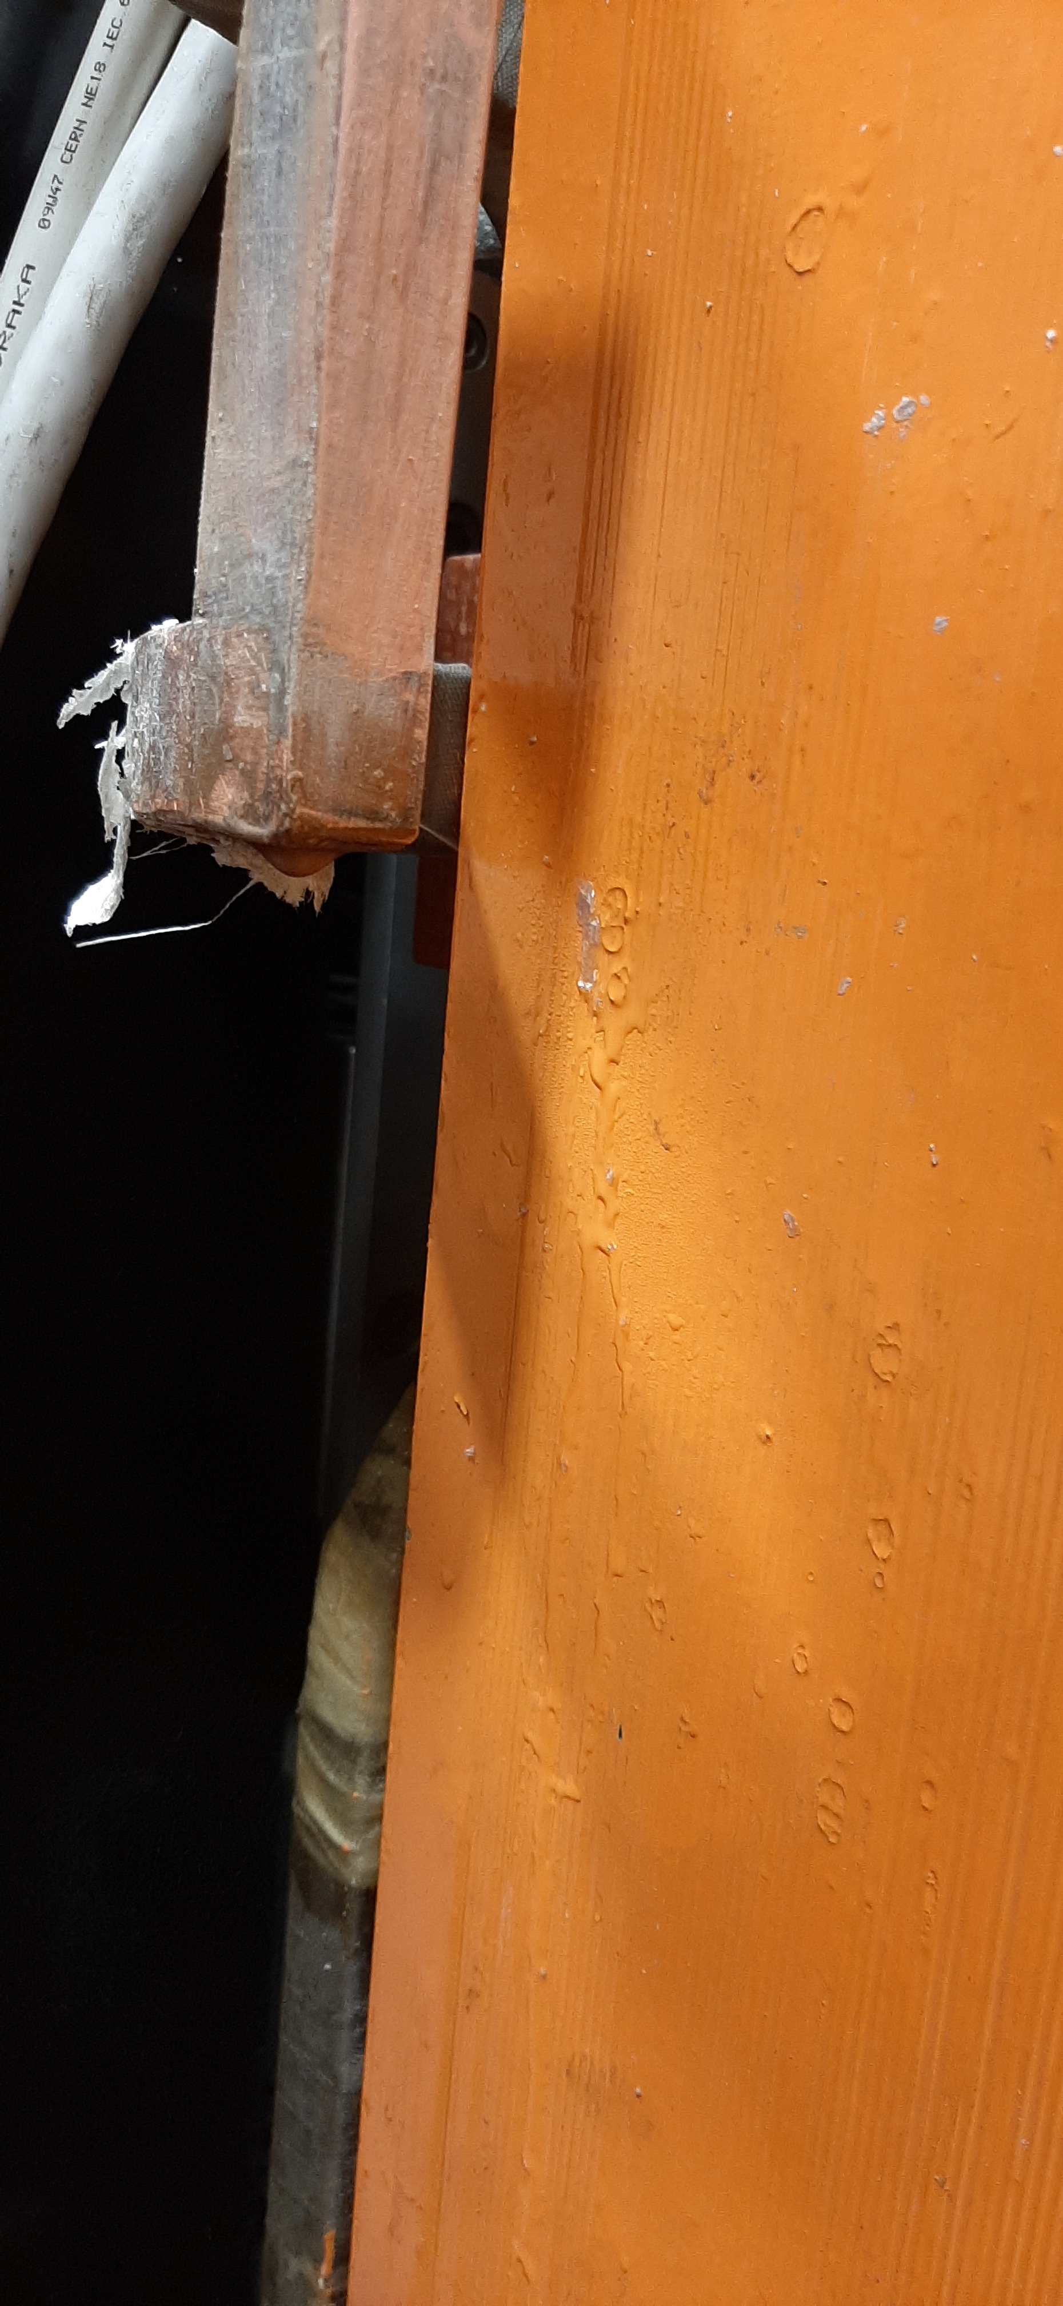
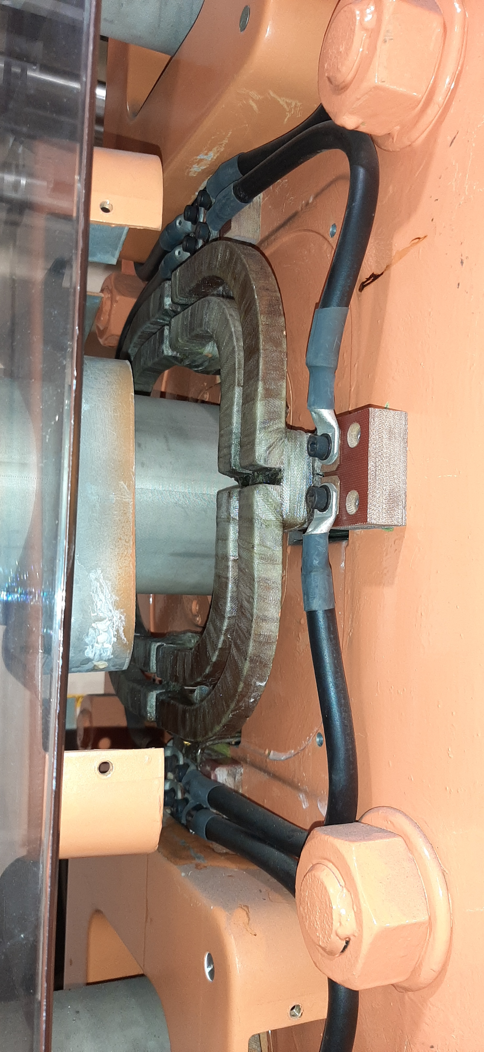
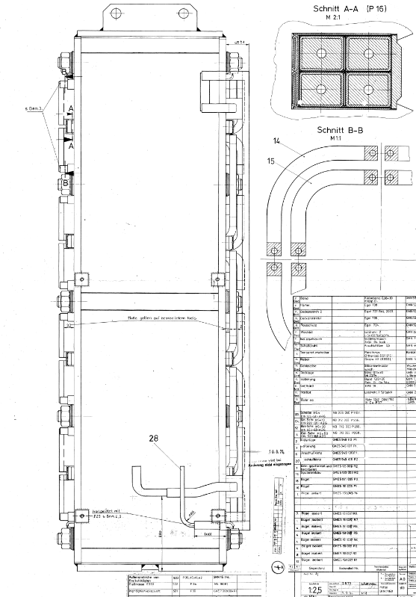
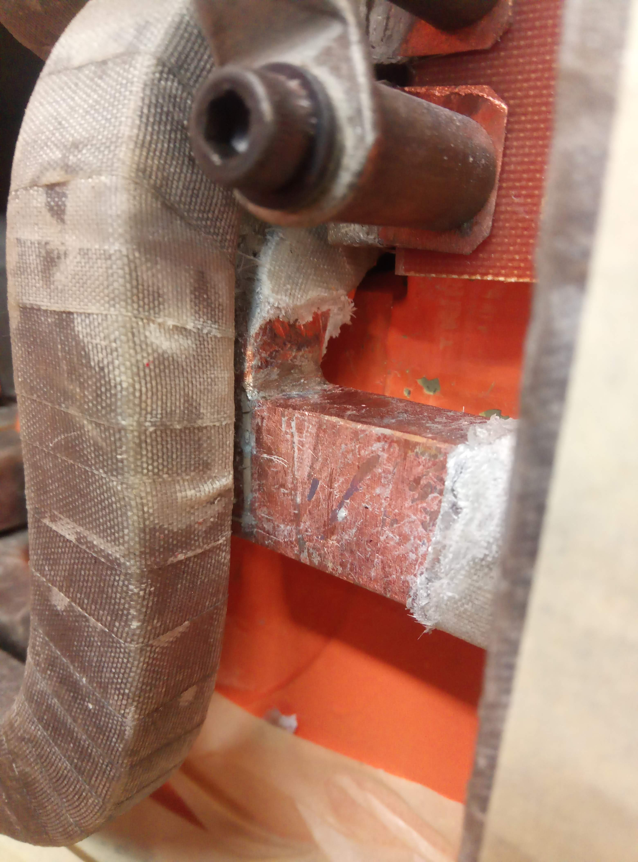
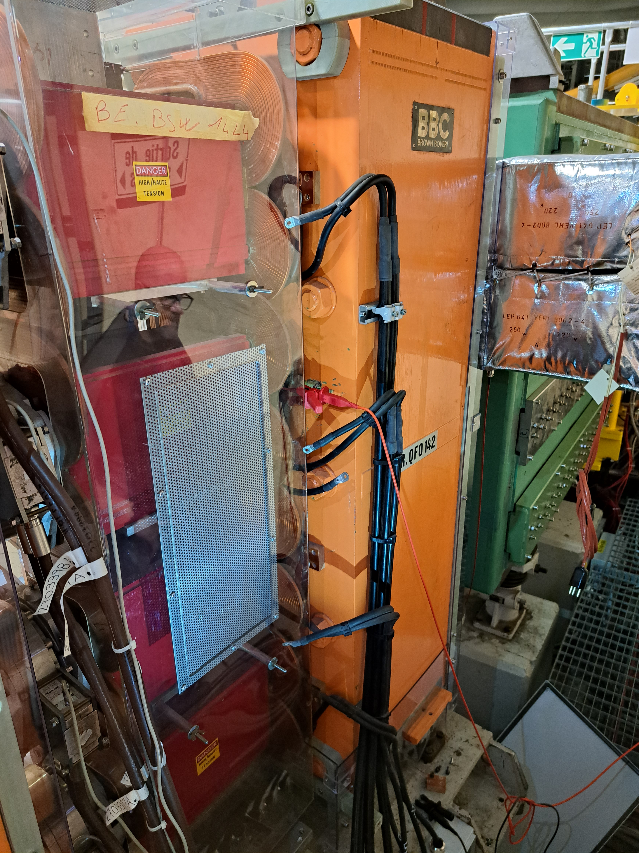
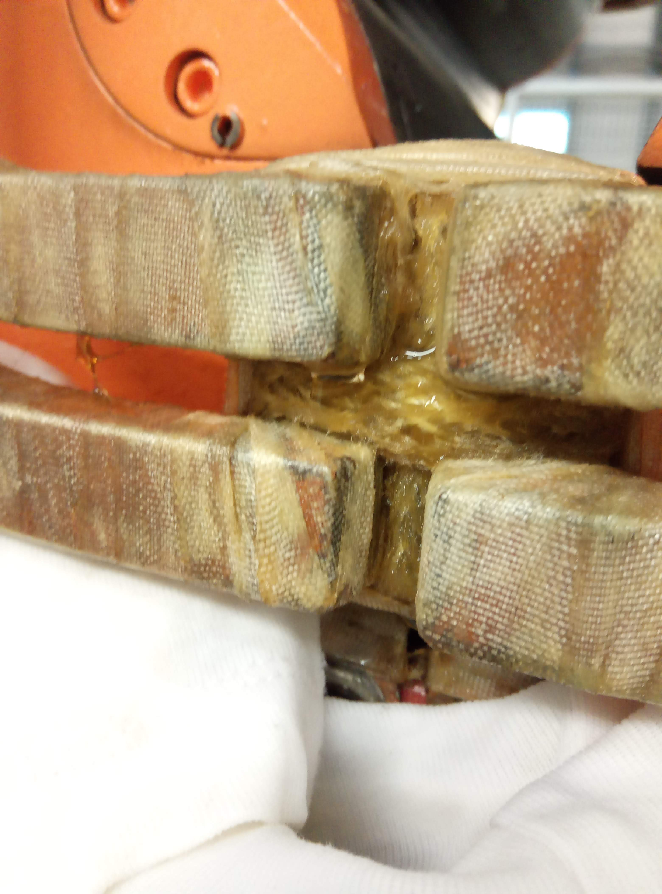
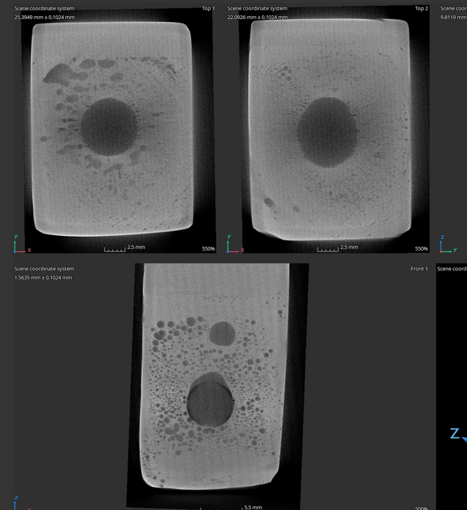
PSB quadrupole - Brazing NC Location
09/22
QDE5
“brazed end” R3
06/21
QFO161
“busbar”
11/22
QFO142
“brazed end” R3
12/22
QDE11
“Aperture link” R2-R3
11/21
QFO91
“brazed end” R2
Location possibly linked to
original brazing quality?

Slide 8
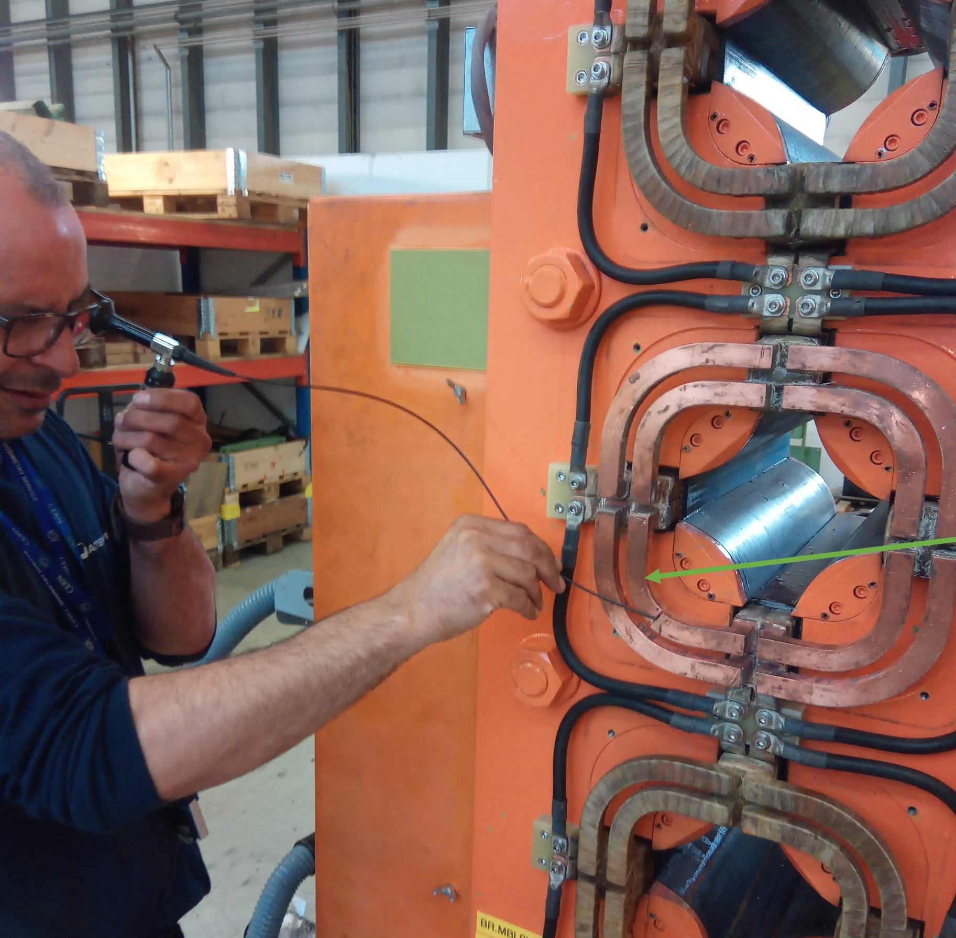
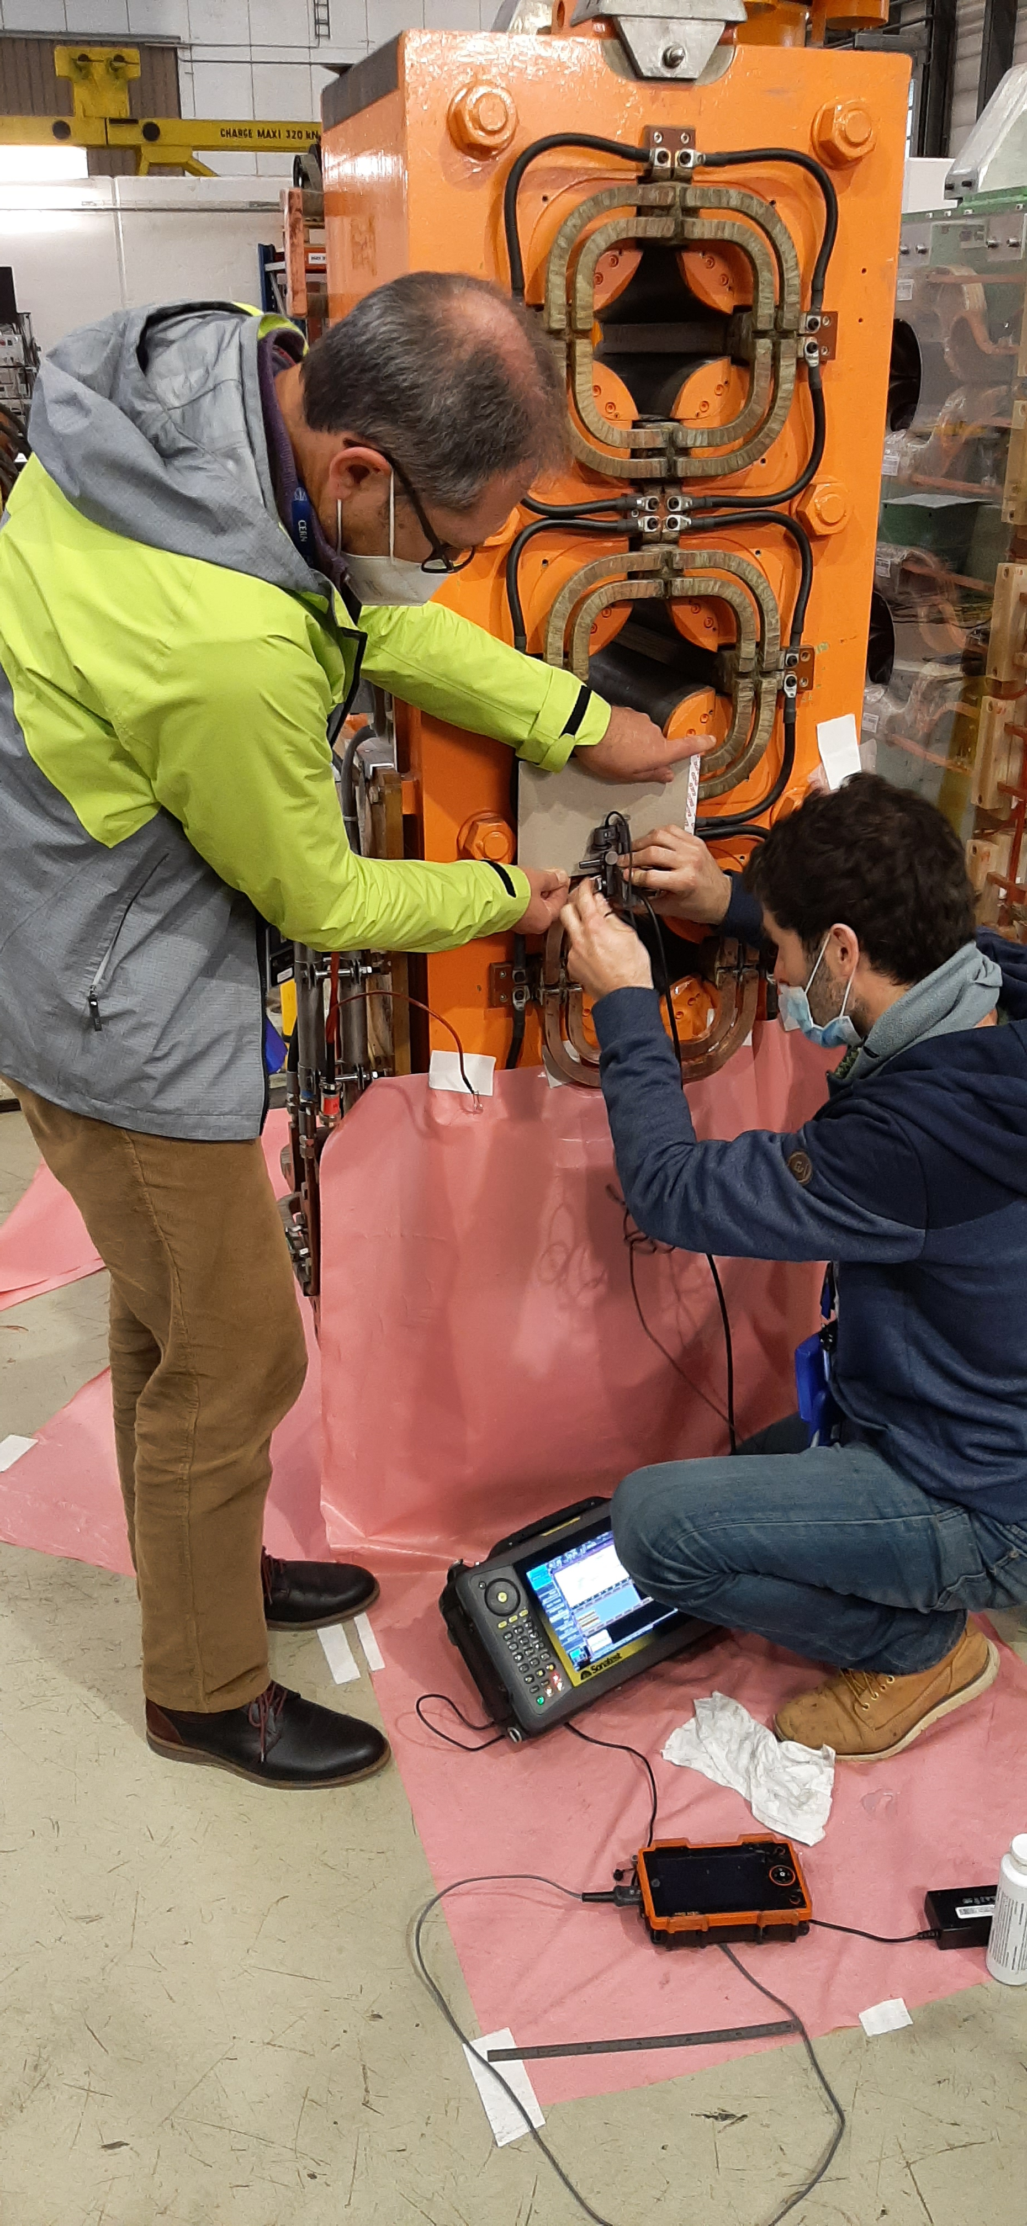
Brazing Analysis
January 22
  Ultrasonic inspection with MME. Voids in the brazed joints ‘visible’ but inconclusive as to the origin.
  Endoscope inspection MSC, nothing conclusive

Slide 9
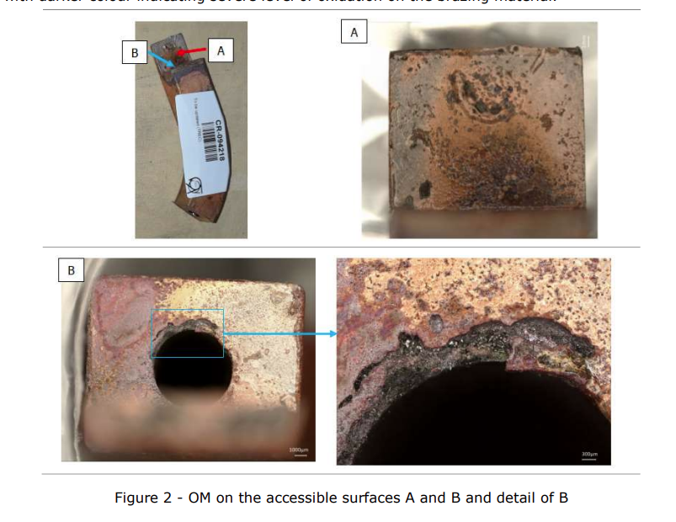
Brazing Analysis
October 22
  Initial microscopic examination of the ‘debrazed’ sample by MME.
  (https://edms.cern.ch/document/2808077/2). First confirmation of the filler material (Sil-Fos) and signs of corrosion.

Slide 10
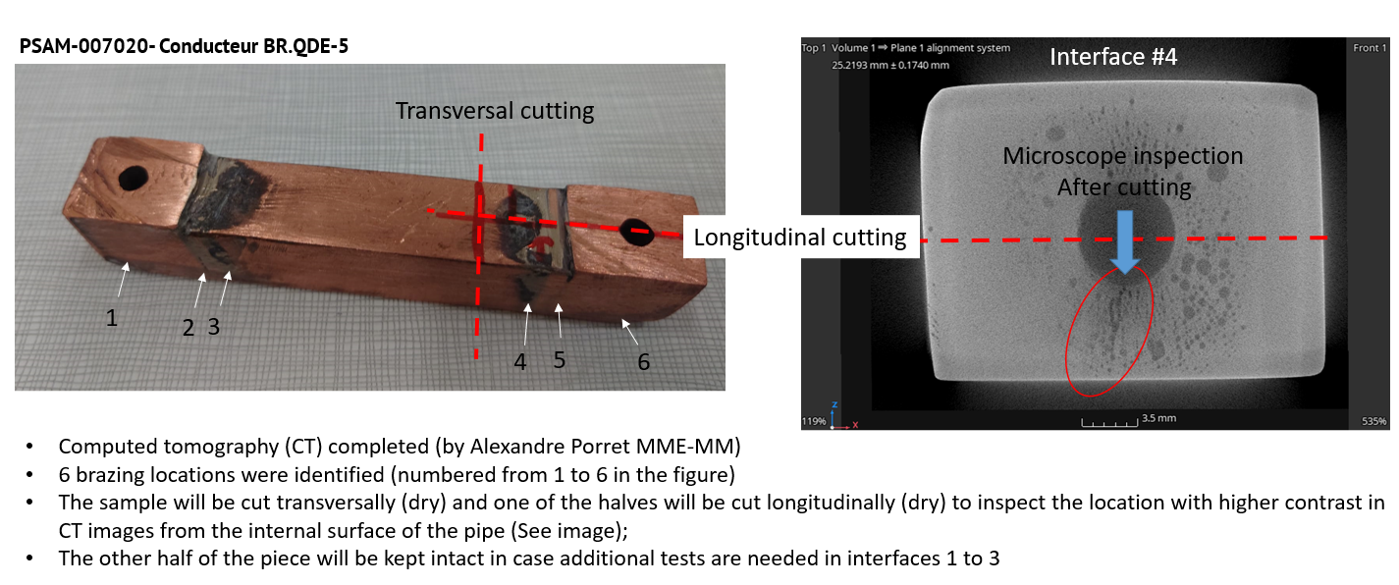
Brazing Analysis
January 23
  CT and further microscopic analysis (MME) of a ‘cut’ sample taken from the PXMQNFJ4WP-B2000005 magnet which failed 09/22 and was exchanged during YETS22/23.
  Identification of corrosion and Sulphur as detailed in https://edms.cern.ch/document/2817755/1

Slide 11
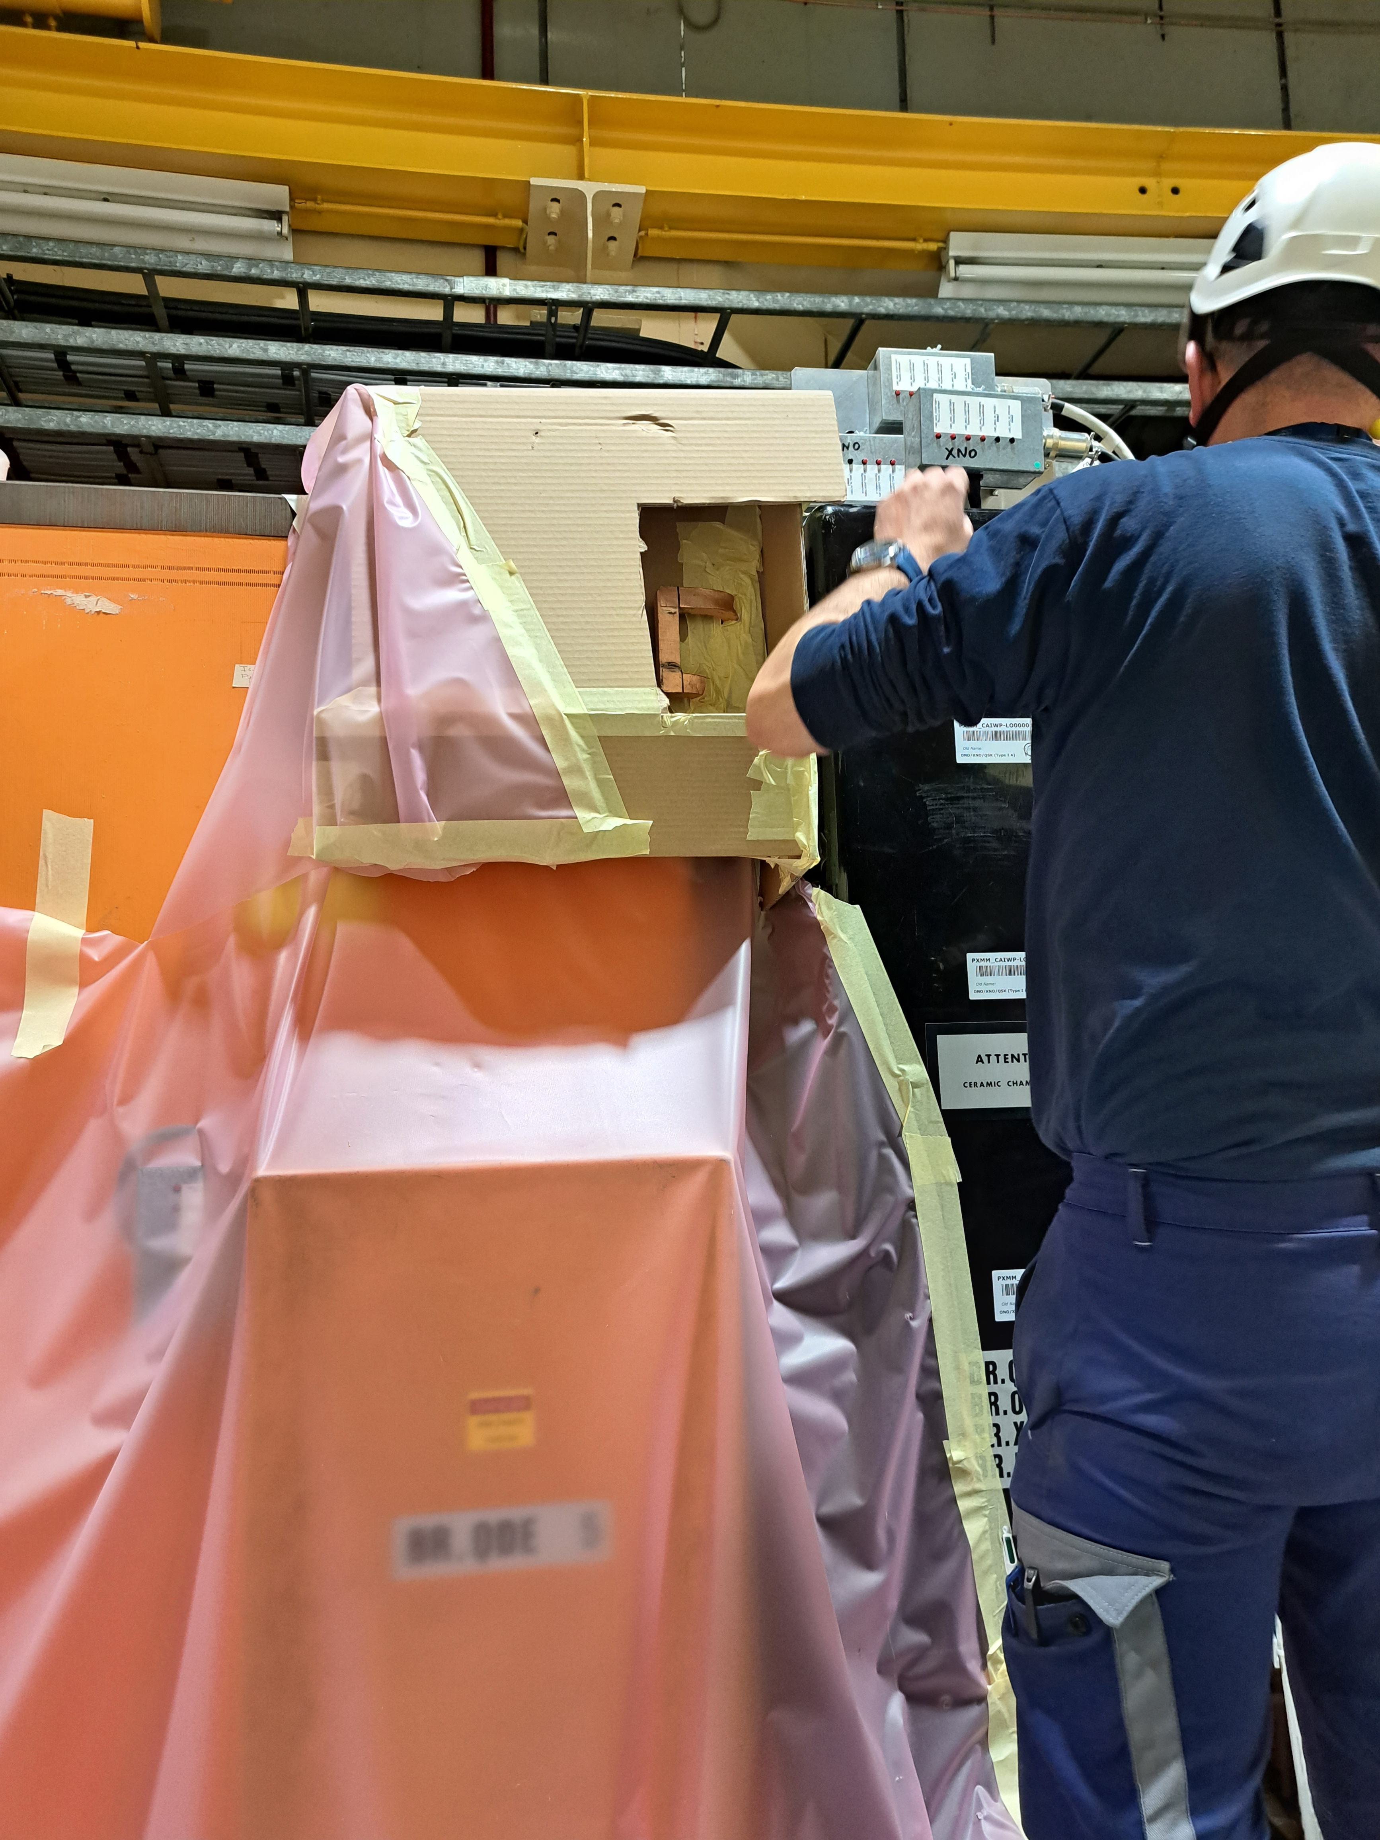
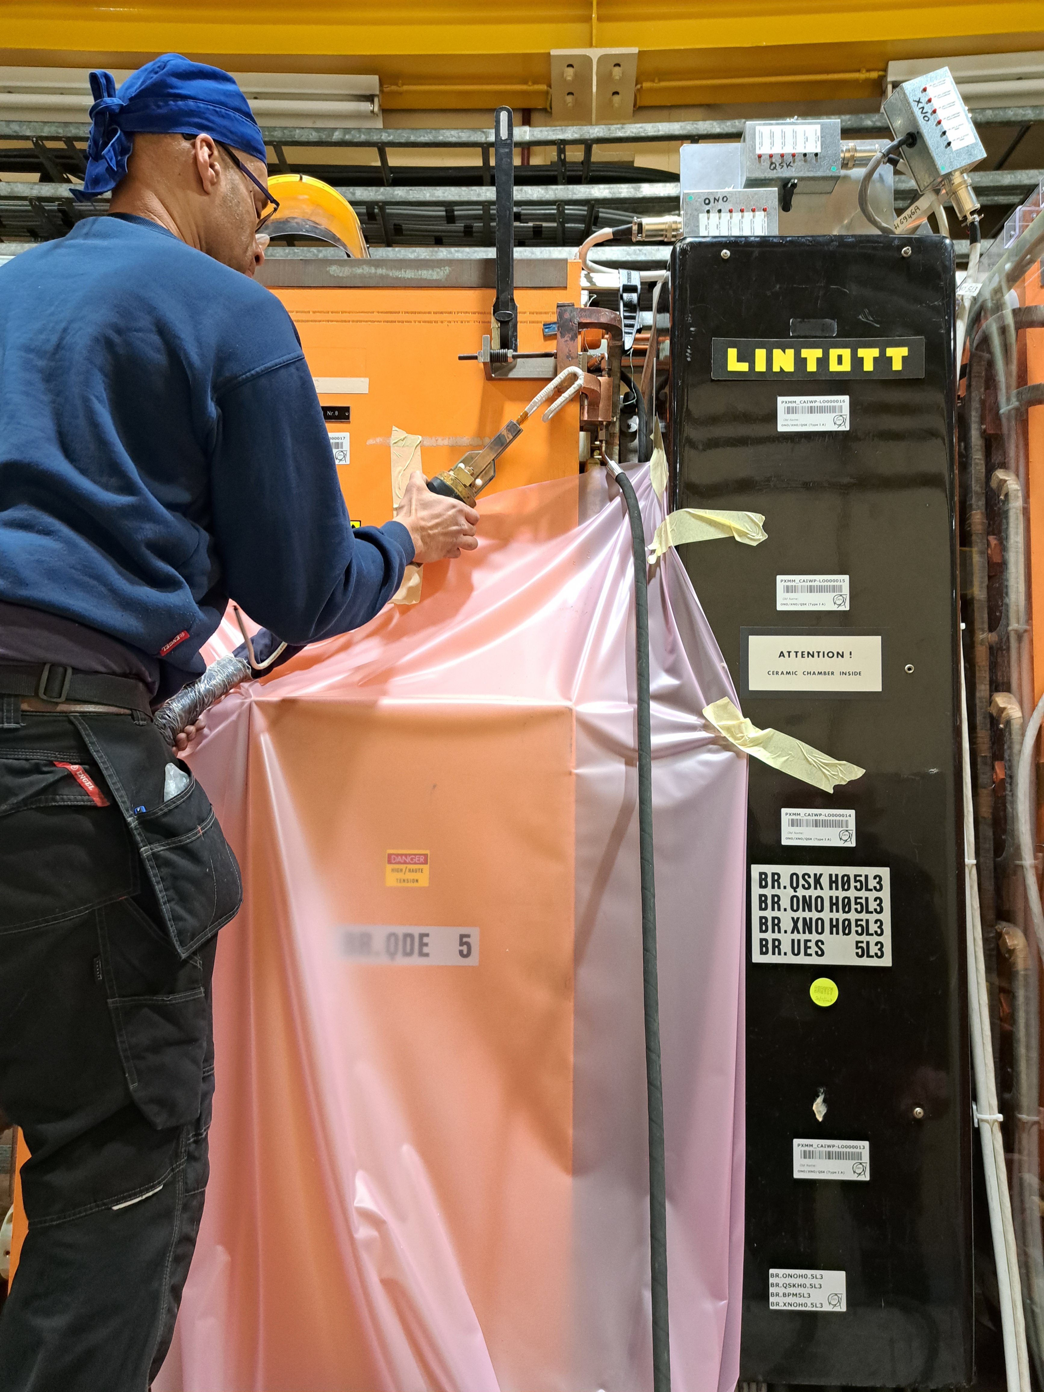
Brazing Analysis
February/March 23
  CT and further microscopic analysis (MME) of a ‘cut’ sample taken from the PXMQNFJ4WP-B2000017 in the machine (unused spare magnet installed during YETS 22/23)
  Early stage of corrosion and small quantities of Sulphur discovered, https://edms.cern.ch/document/2855110/1 & https://edms.cern.ch/document/2824484/1

Slide 12
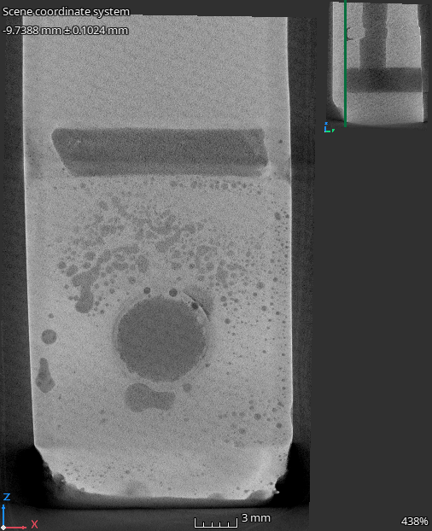
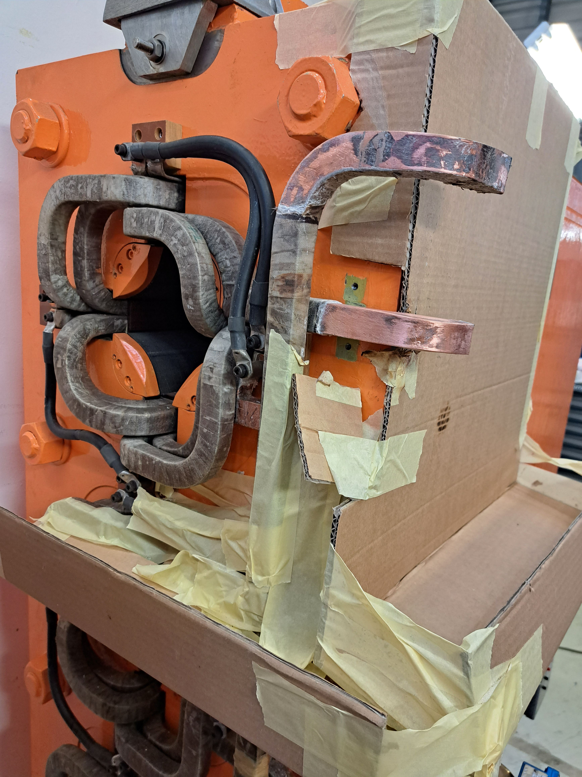
Brazing Analysis
March 23
  CT (MME) of ‘cut’ samples taken from the PXMQNEC4WP-B2000017, PXMQNFA4WP-B2000011 & PXMQNED4WP-B2000027 (all magnets which have seen water leaks after 50 years of operation). https://edms.cern.ch/document/2847250/1
  Sample preparation for microscopic analysis underway.

Slide 13

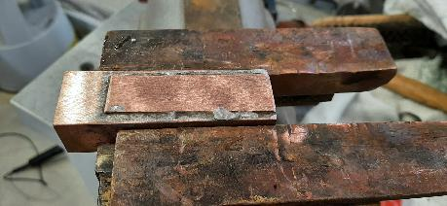
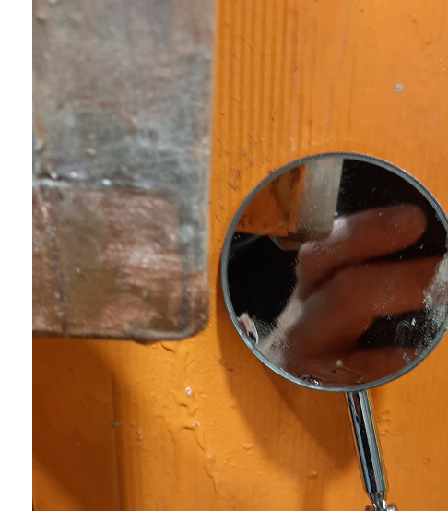
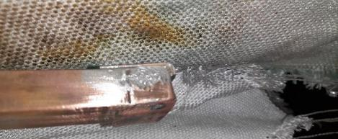
Brazing patching QFO161
Leak discovered during the run (06/21), an in-situ repair was made using ‘soft’ solder, finally the magnet was exchanged during the following YETS.

Slide 14
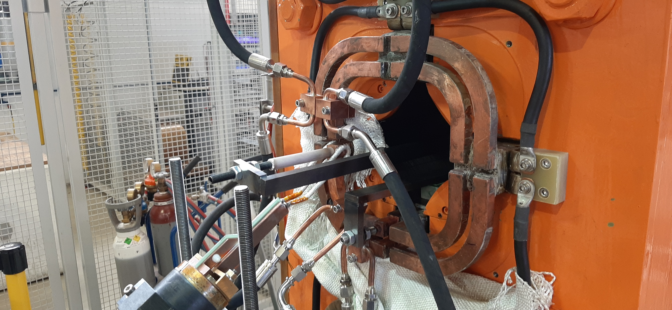
Brazing repair
Water cooling to avoid damaging insulation
Induction brazing head
Induction Brazing repair of the PSB QFO91 Quadrupole in TE workshop summer 22.

Slide 15
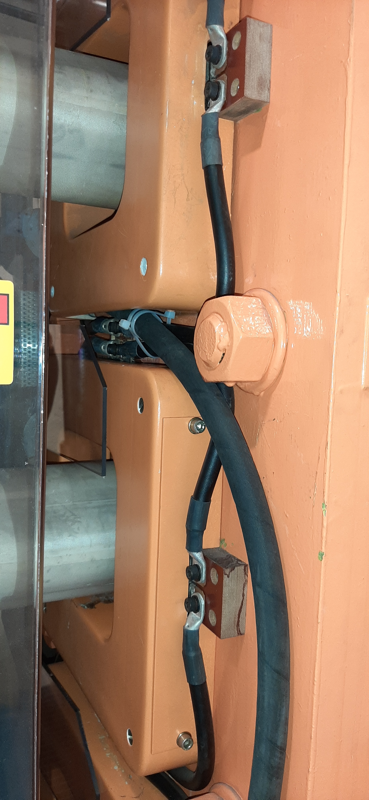
Brazing failure mitigation…
BR.QDE 5, Oct 22
Diversion of the leak to the booster tunnel floor until the magnet could be exchange in the YETS 22/23

Slide 16
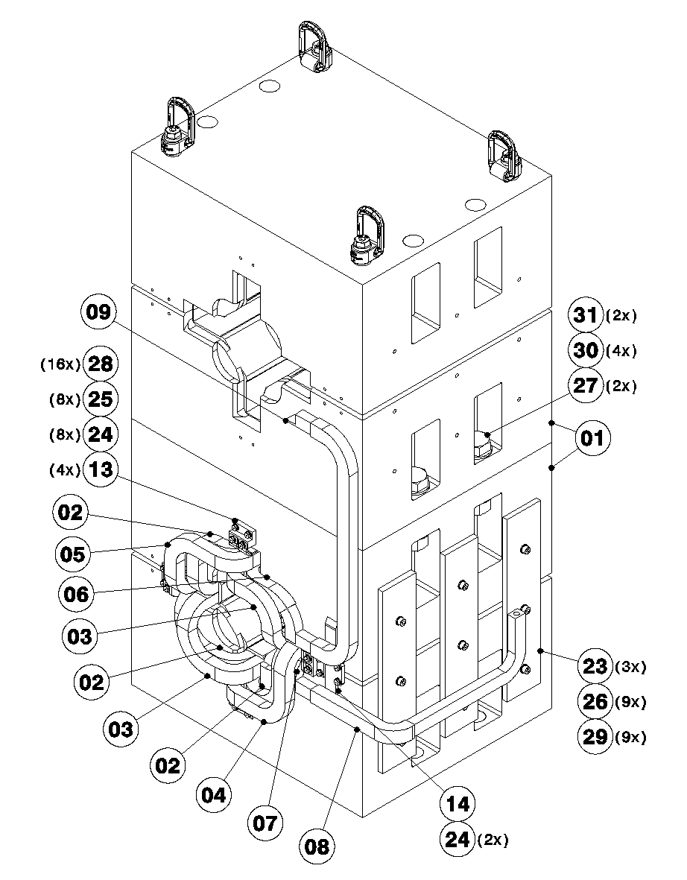
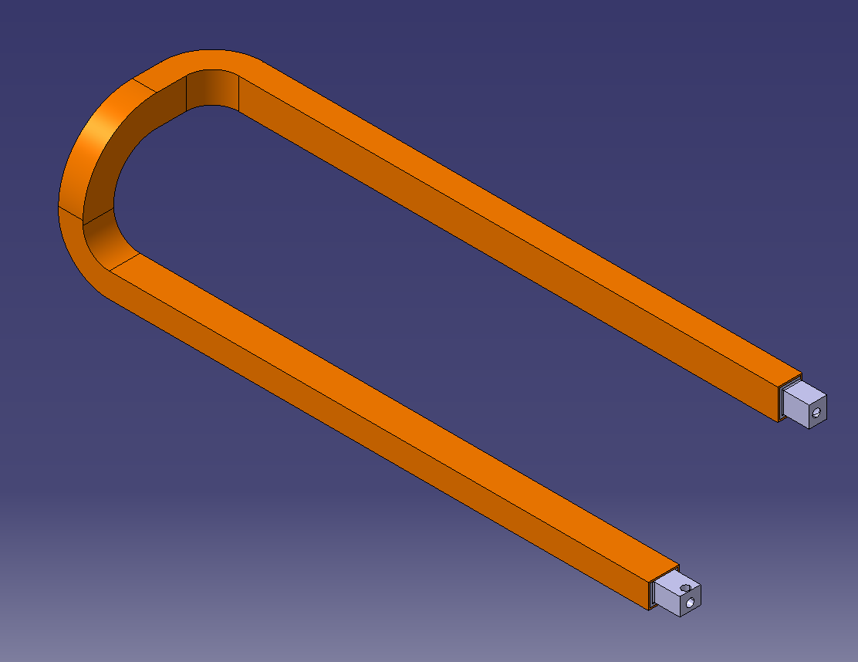
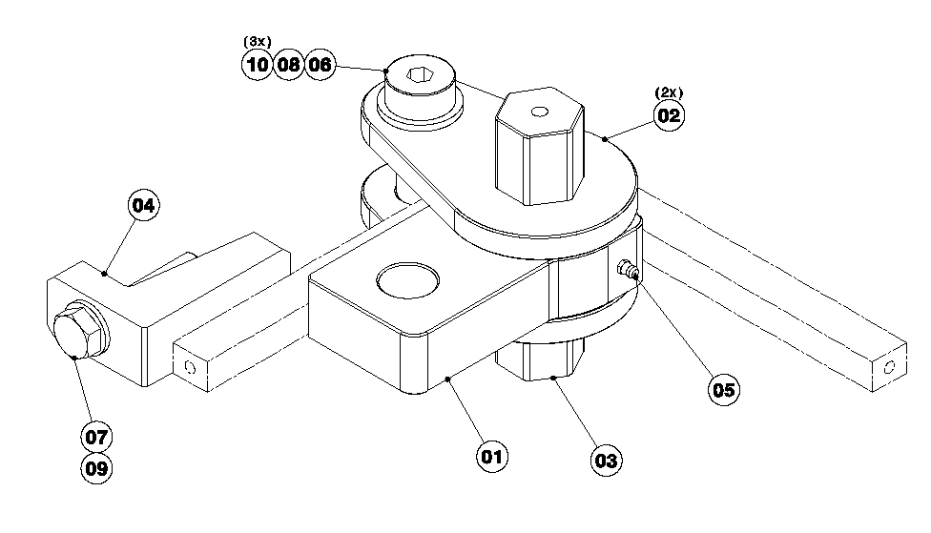
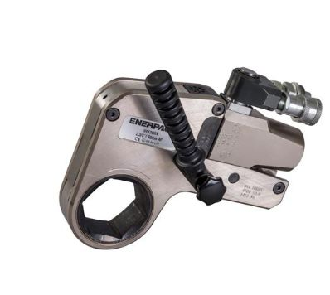
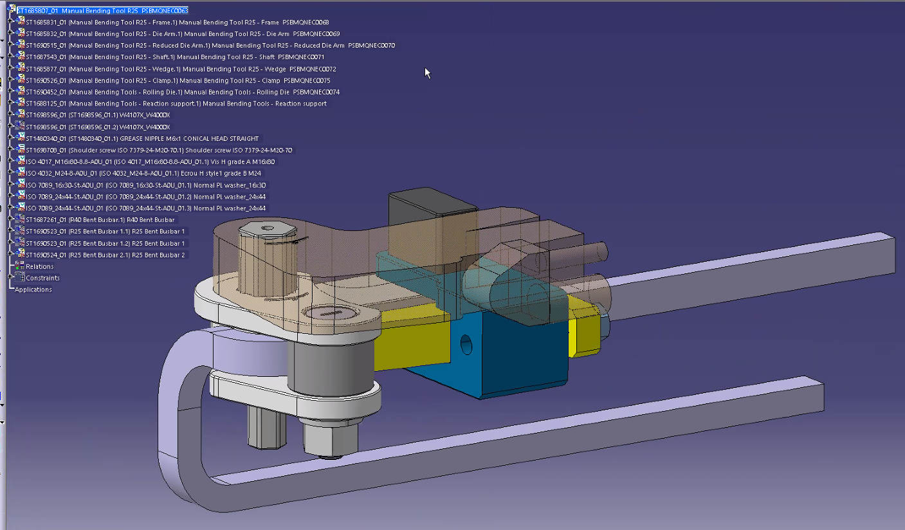
Magnet reconstruction…
  Study current method and alternative method of impregnation;
  Order of raw material for dummy trials and to refurbish at least 6 magnets;
  Perform dummy assembly;
  By end of 2023, process validation and submission of full consolidation request
Courtesy of I. Aguirrebeitia EN/MME

Slide 17
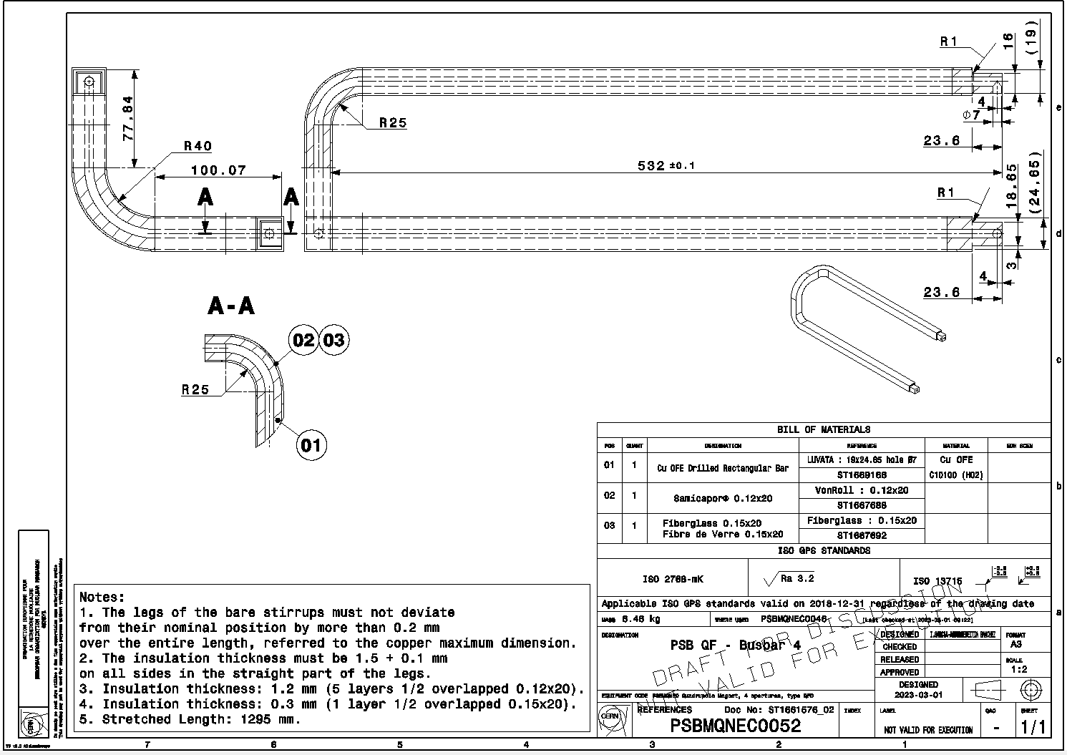

Magnet reconstruction…

Slide 18
Magnet reconstruction…

Slide 19
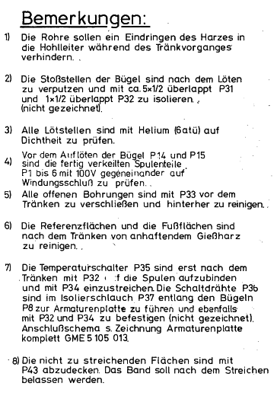
Magnet reconstruction…
ite 1) Remarks: The tubes should prevent the resin from penetrating into the conductor during the impregnation process.
2 ) The joints of the brackets are to be plastered after soldering and insulated with approx . 5x1/2 overlapping P31 (0.12 mm (1.2 mm) Mica) and 1x1/2 overlapping P32 (0.15 mm (0.3 mm). , (not shown) .
3 ) All soldered joints are to be checked for leaks with helium ( 6 atm ) .
4) Before soldering on the brackets P14 and P15, the already wedged coil parts P1 to 6 must be checked against each other with 100V for interturn short circuits.
5 ) All open holes must be sealed with P33 before impregnation and cleaned afterwards .
6 ) The reference surfaces and the foot surfaces are to be cleaned after impregnation of adhering cast resin ..
7 ) The temperature switches P35 are only after impregnation with P32 . f untie the bobbins and coat them with P34. The switching wires P36 are to be routed in the insulating hose P37 along the brackets P8 to the dashboard and also to be fastened with P32 and P34 (not shown). Connection diagram s. Drawing of dashboard complete GME 5 105 013
8) The areas not to be painted are to be covered with P43. The tape is intended to be left in place after painting. se

Slide 20
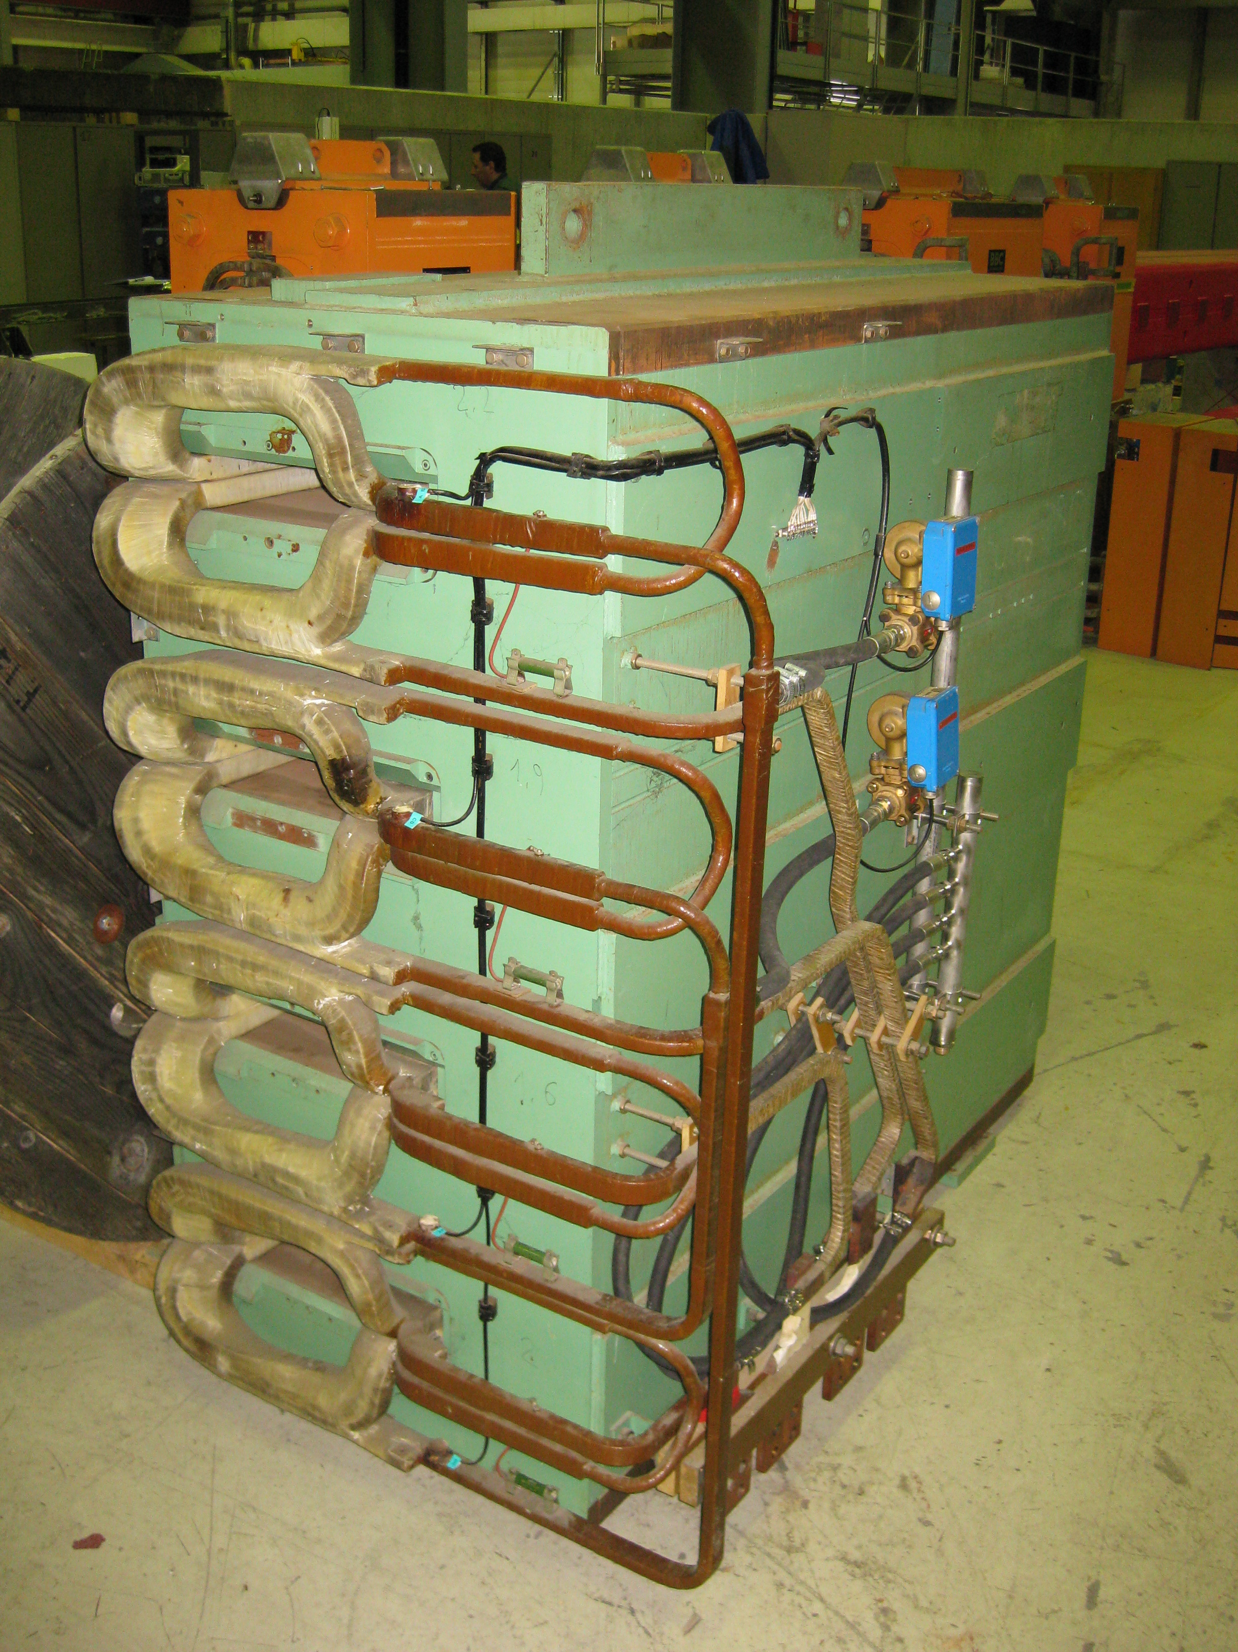
PSB Bending magnets
Design Code | Old Code | Installed | Spare | Comment
PXMBHGC4WP | BHZ | 30+1 | 1 | 30 ‘normal’ main bending magnet + 1 reference magnet + 1 spare + 1 complete set of coils
PXMBHGE4WP | BHZ INJ | 1 | 1 | ‘Special’ injection magnet + 1 spare (Coils were upgraded for 2 GeV)
PXMBHGD4WP | BHZ EXT | 1 | 1 | ‘Special’ extraction magnet + 1 spare (Coils were upgraded for 2 GeV)
PSB bending magnet status
Very reliable magnet with no real downtime in 50 years of operation!
Single lamination, upgraded with new closing plates to reduce saturation for 2 GeV operations, at the same time taking the advantage of improving the coil shimming;
Includes ~35 hydraulic brazing (Silver/Phosphorous based) per magnet and more than 1100 in operation!
  except for 1 internal brazing, all repairs could in theory be completed in-situ.
Other than an issue with the new special injection and extraction trim coils, all other issues have been minor and are kept under control with regular maintenance work (revision of interlocks, changes of hoses etc.)
If multipole failures did occur, we could soon use our ‘original’ spare coil stock and it may be prudent to consider ordering additional spares now that we have reached 50 years of operation, 1 - 2 years lead time.

Slide 21
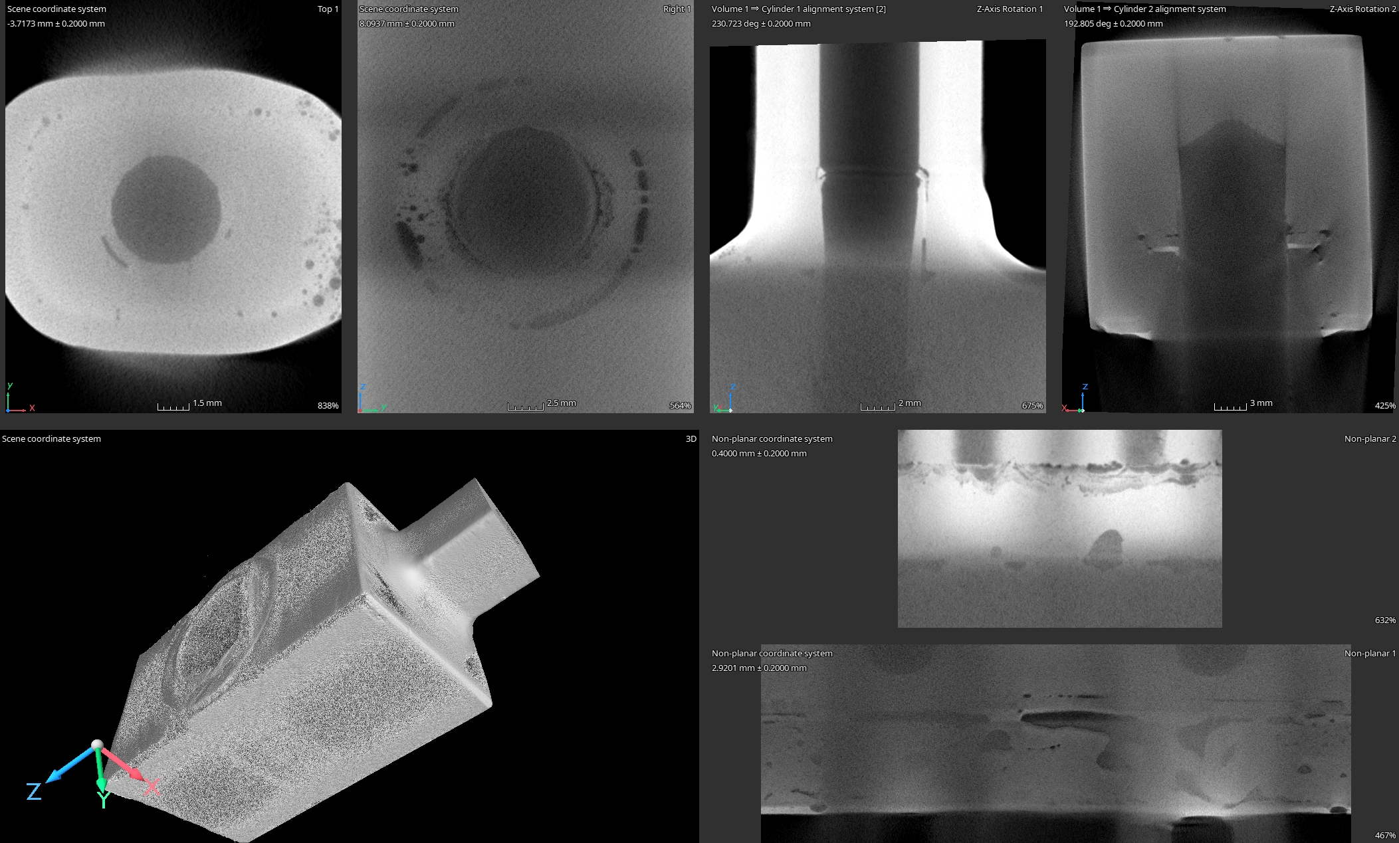
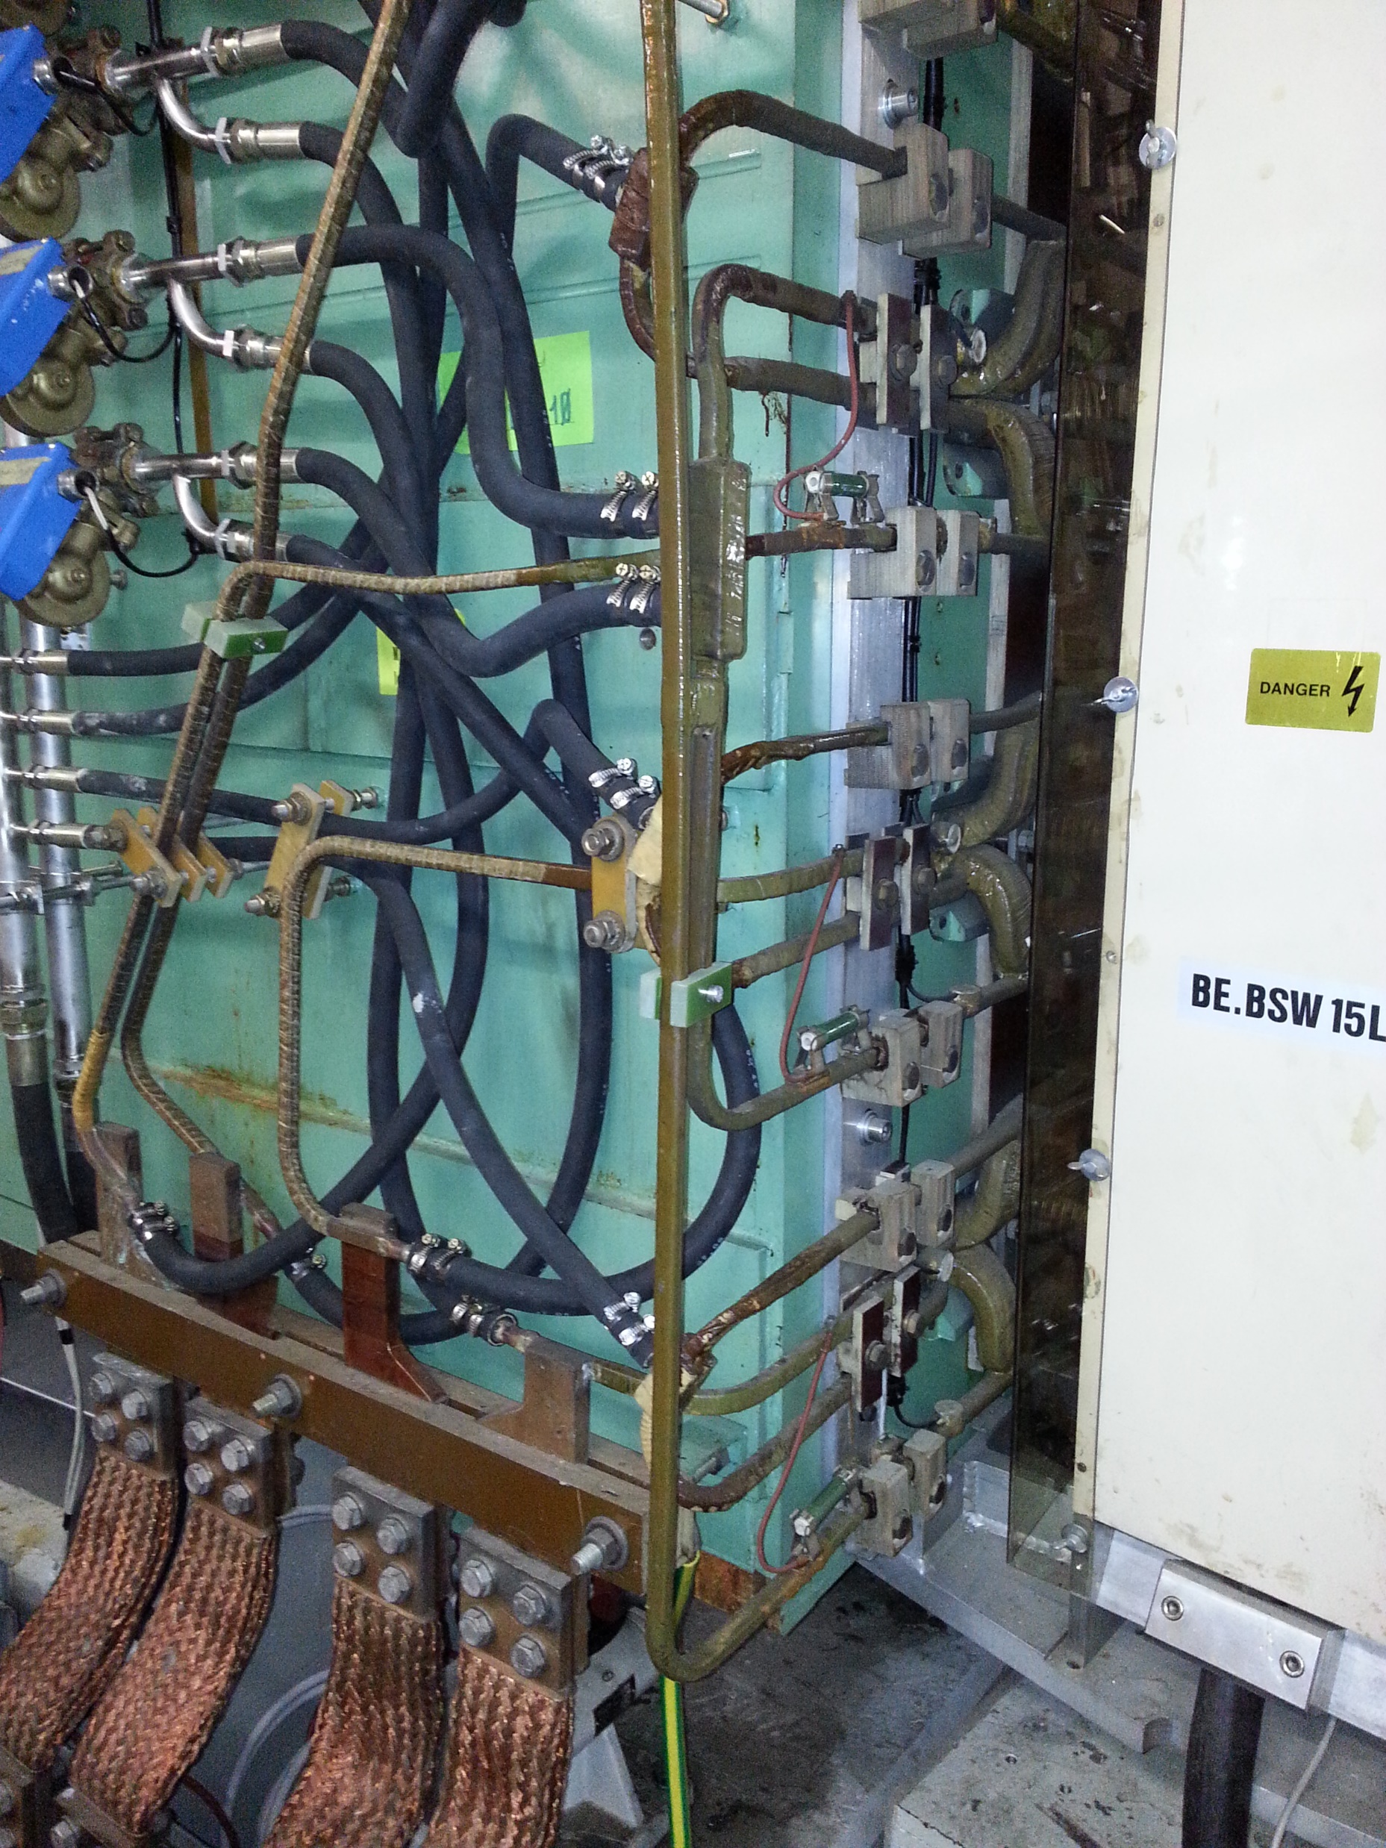
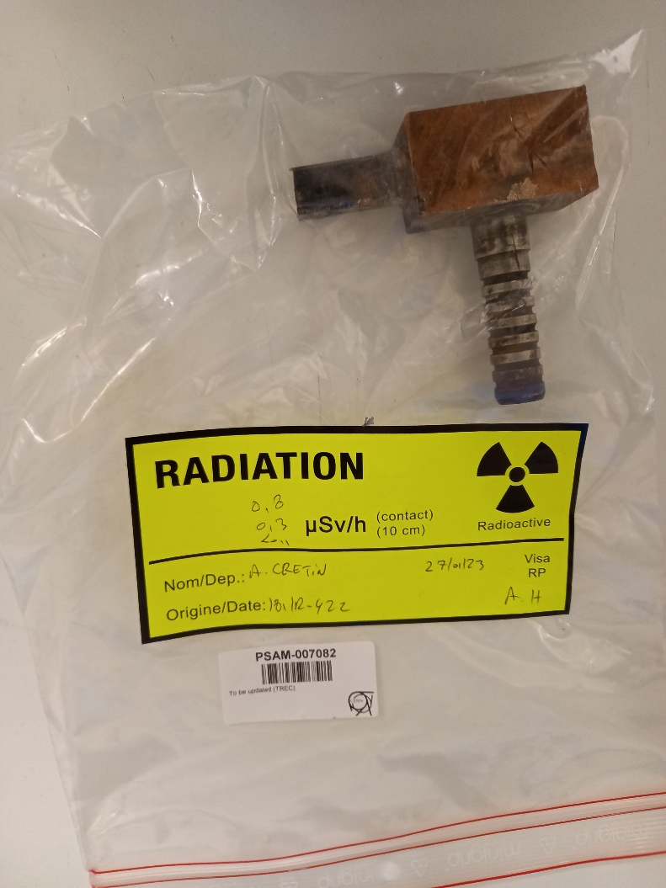
PSB Bending - Brazing Analysis
February 23
  CT and further microscopic analysis (MME) of a ‘cut’ sample taken from bending magnet PXMBHGE4WP-01000001 which was removed the machine during LS2.
  (https://edms.cern.ch/document/2825737/1 & Pending

Slide 22
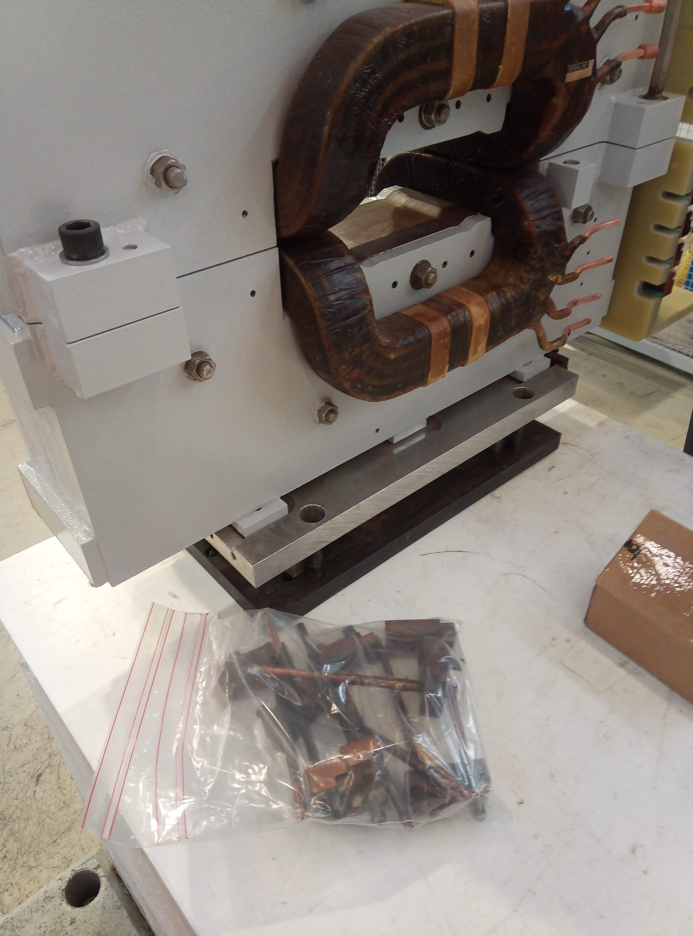
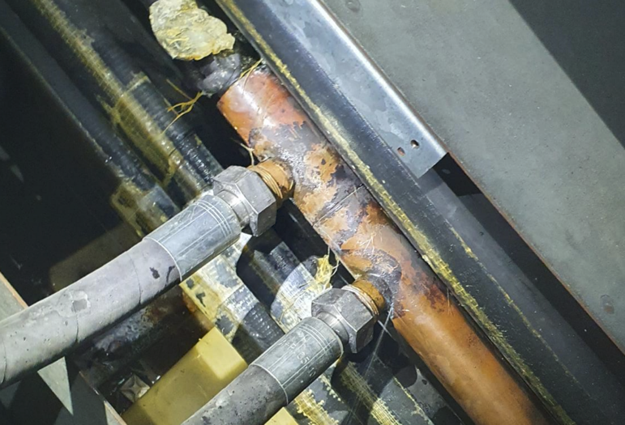
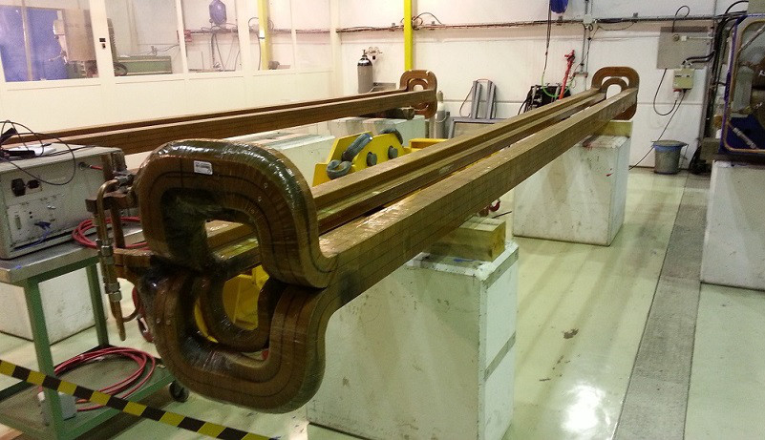
Beyond the PSB?
SPS – Main Quadrupole busbar Feb 2023?
PS – 205 Bumper magnet May 22?
SPS – Main Bending magnets?

Slide 24
SPARE SLIDES

Slide 25
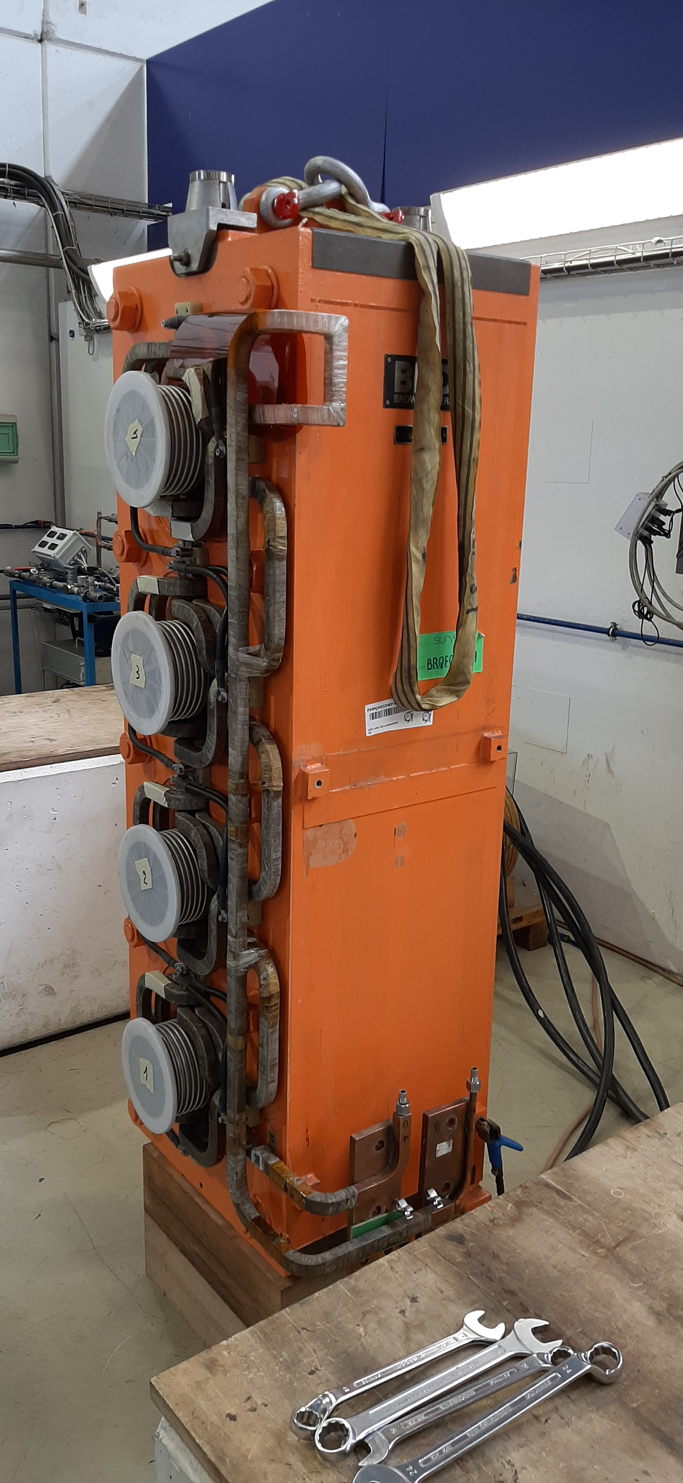
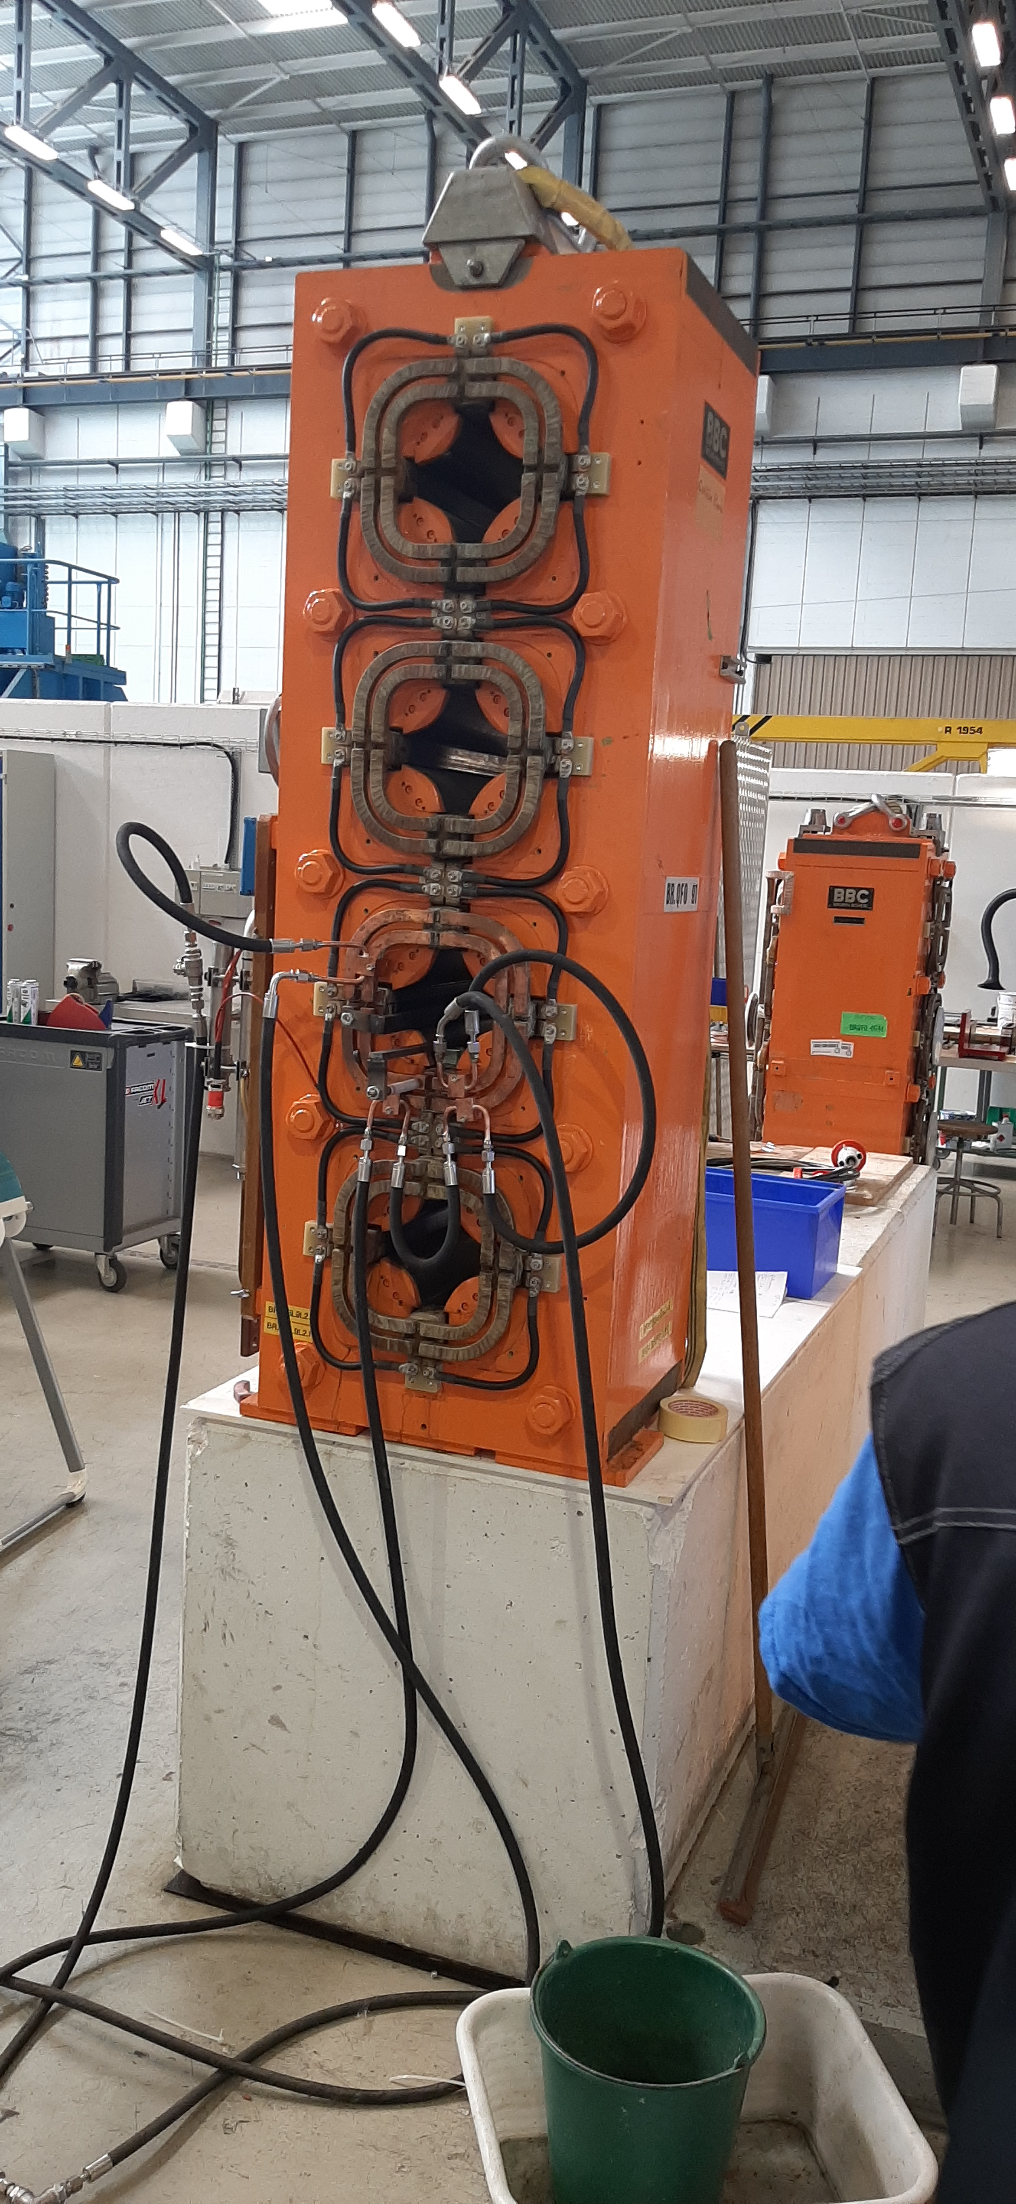
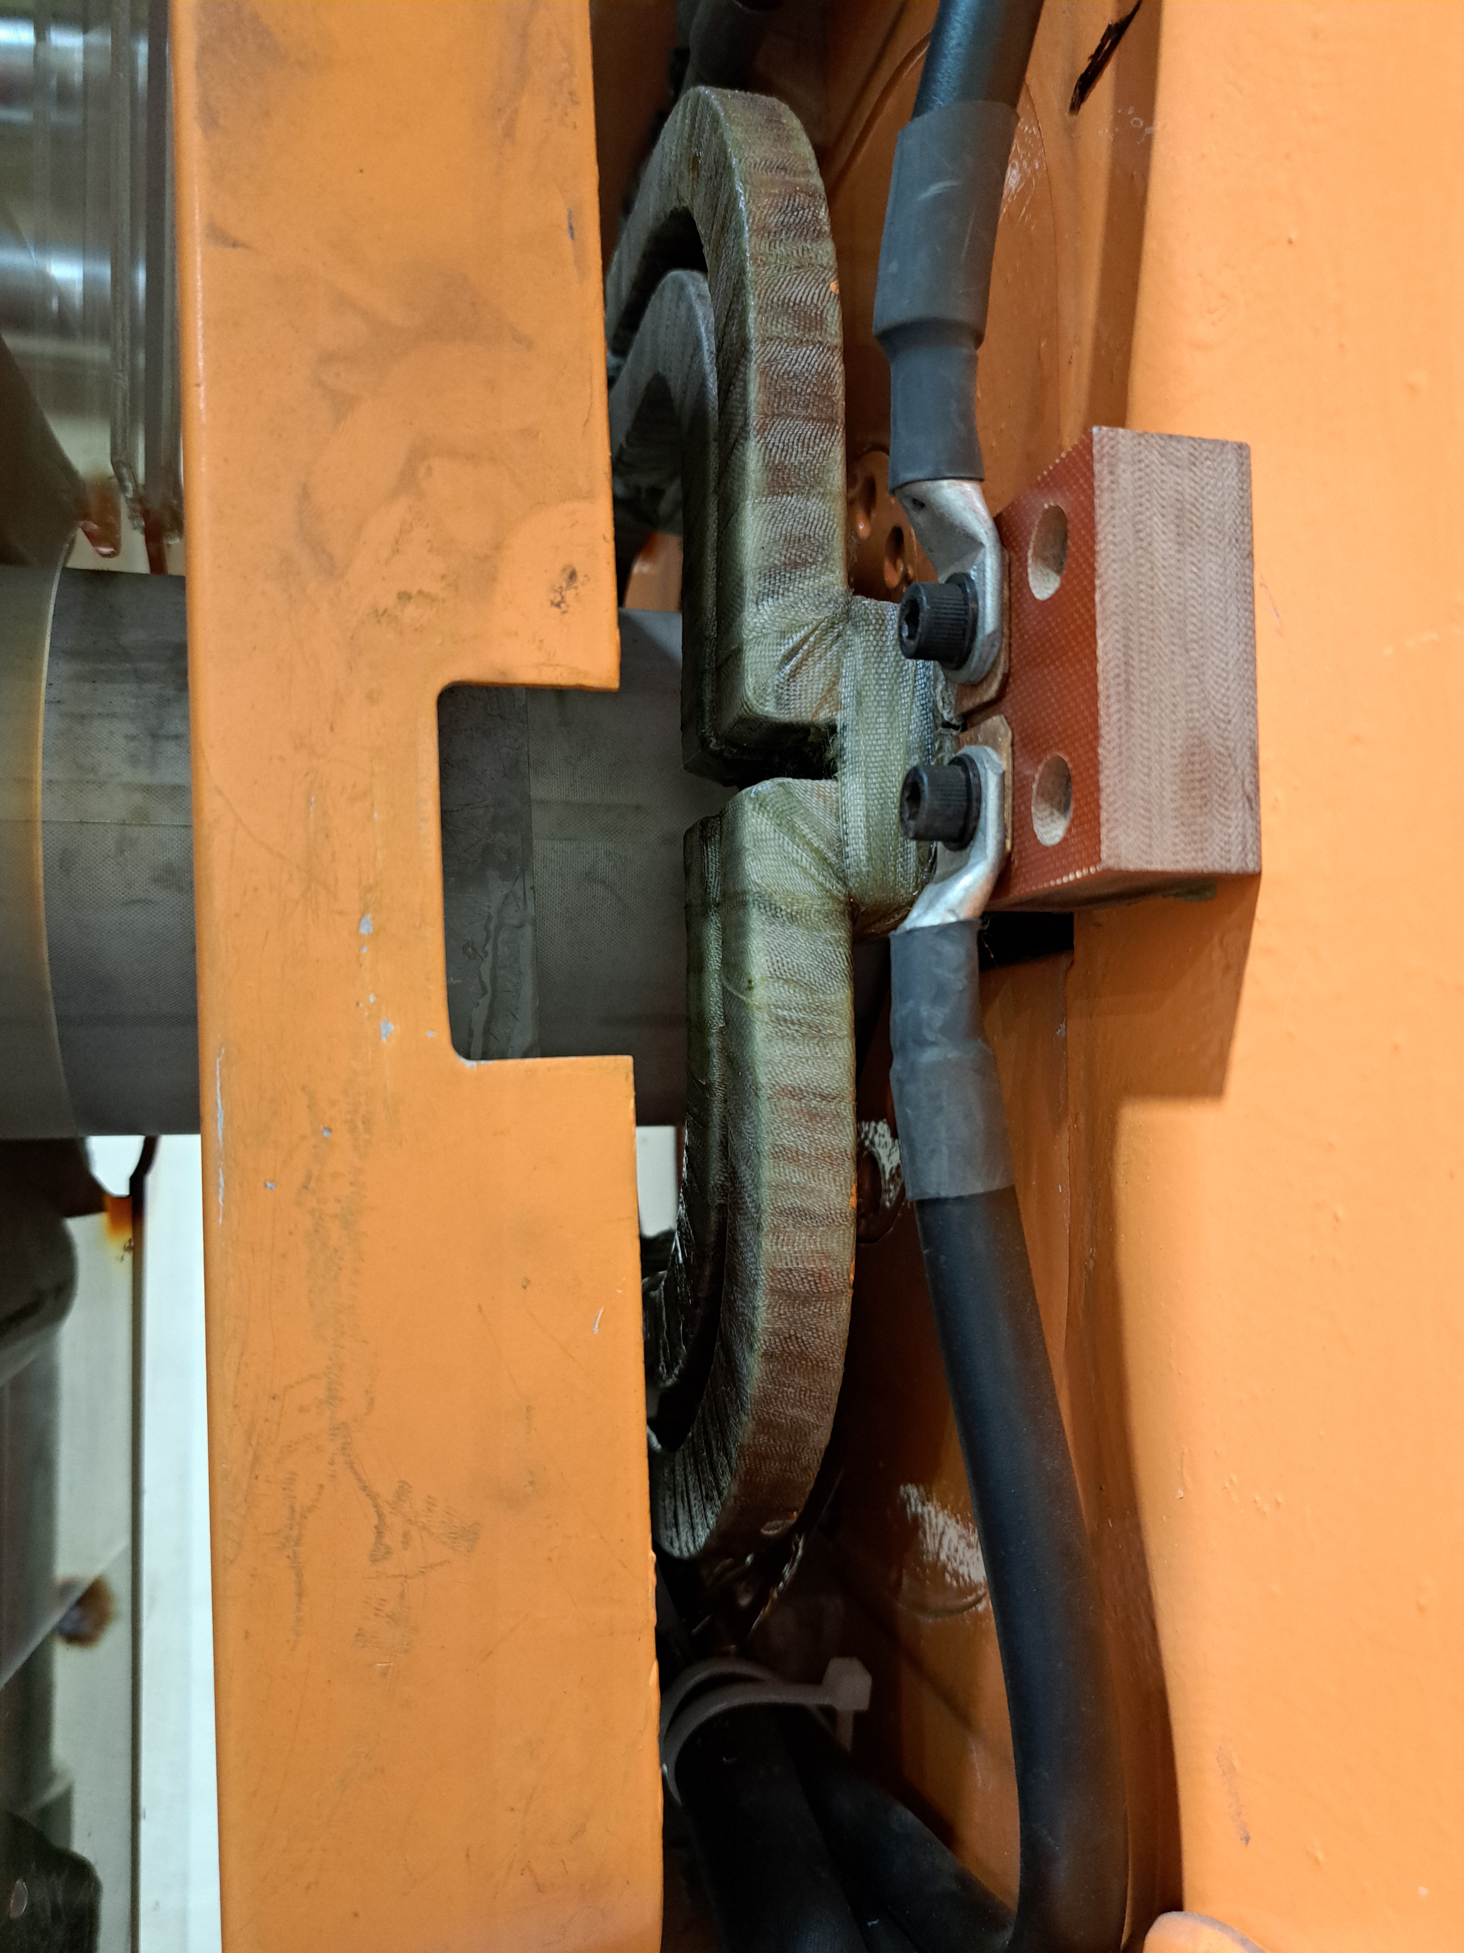
    Evolution of the faults over the past 2 years
BR.QFO161 PXMQNEC4WP-B2000030 – 06/21
BR.QFO91 PXMQNEC4WP-B2000017 – 11/21
https://edms.cern.ch/document/2603476
Leaking brazed joint temporarily repaired in the machine with a soft brazing.
Removed from the machine in YETS 21/22.
Hard brazing replaced in the NCM workshop
Weak insulation to ground ~ 50 MΩ requiring further repair!
Vacuum bag impregnation to be studied.
https://edms.cern.ch/document/2664838
Leaking brazed joint discovered during the High Voltage test during the YETS 21/22.
Removed from the machine in YETS 21/22.
Repair has been completed and the magnet is now operational
BR.QDE5 PXMQNFJ4WP-B2000005 – 09/22
https://edms.cern.ch/document/2779972/1
Leak brazed joint similar to BR.QFO91
Operation has continued diverting the water to the tunnel floor
Magnet exchange planned during YETS22/23

Slide 26
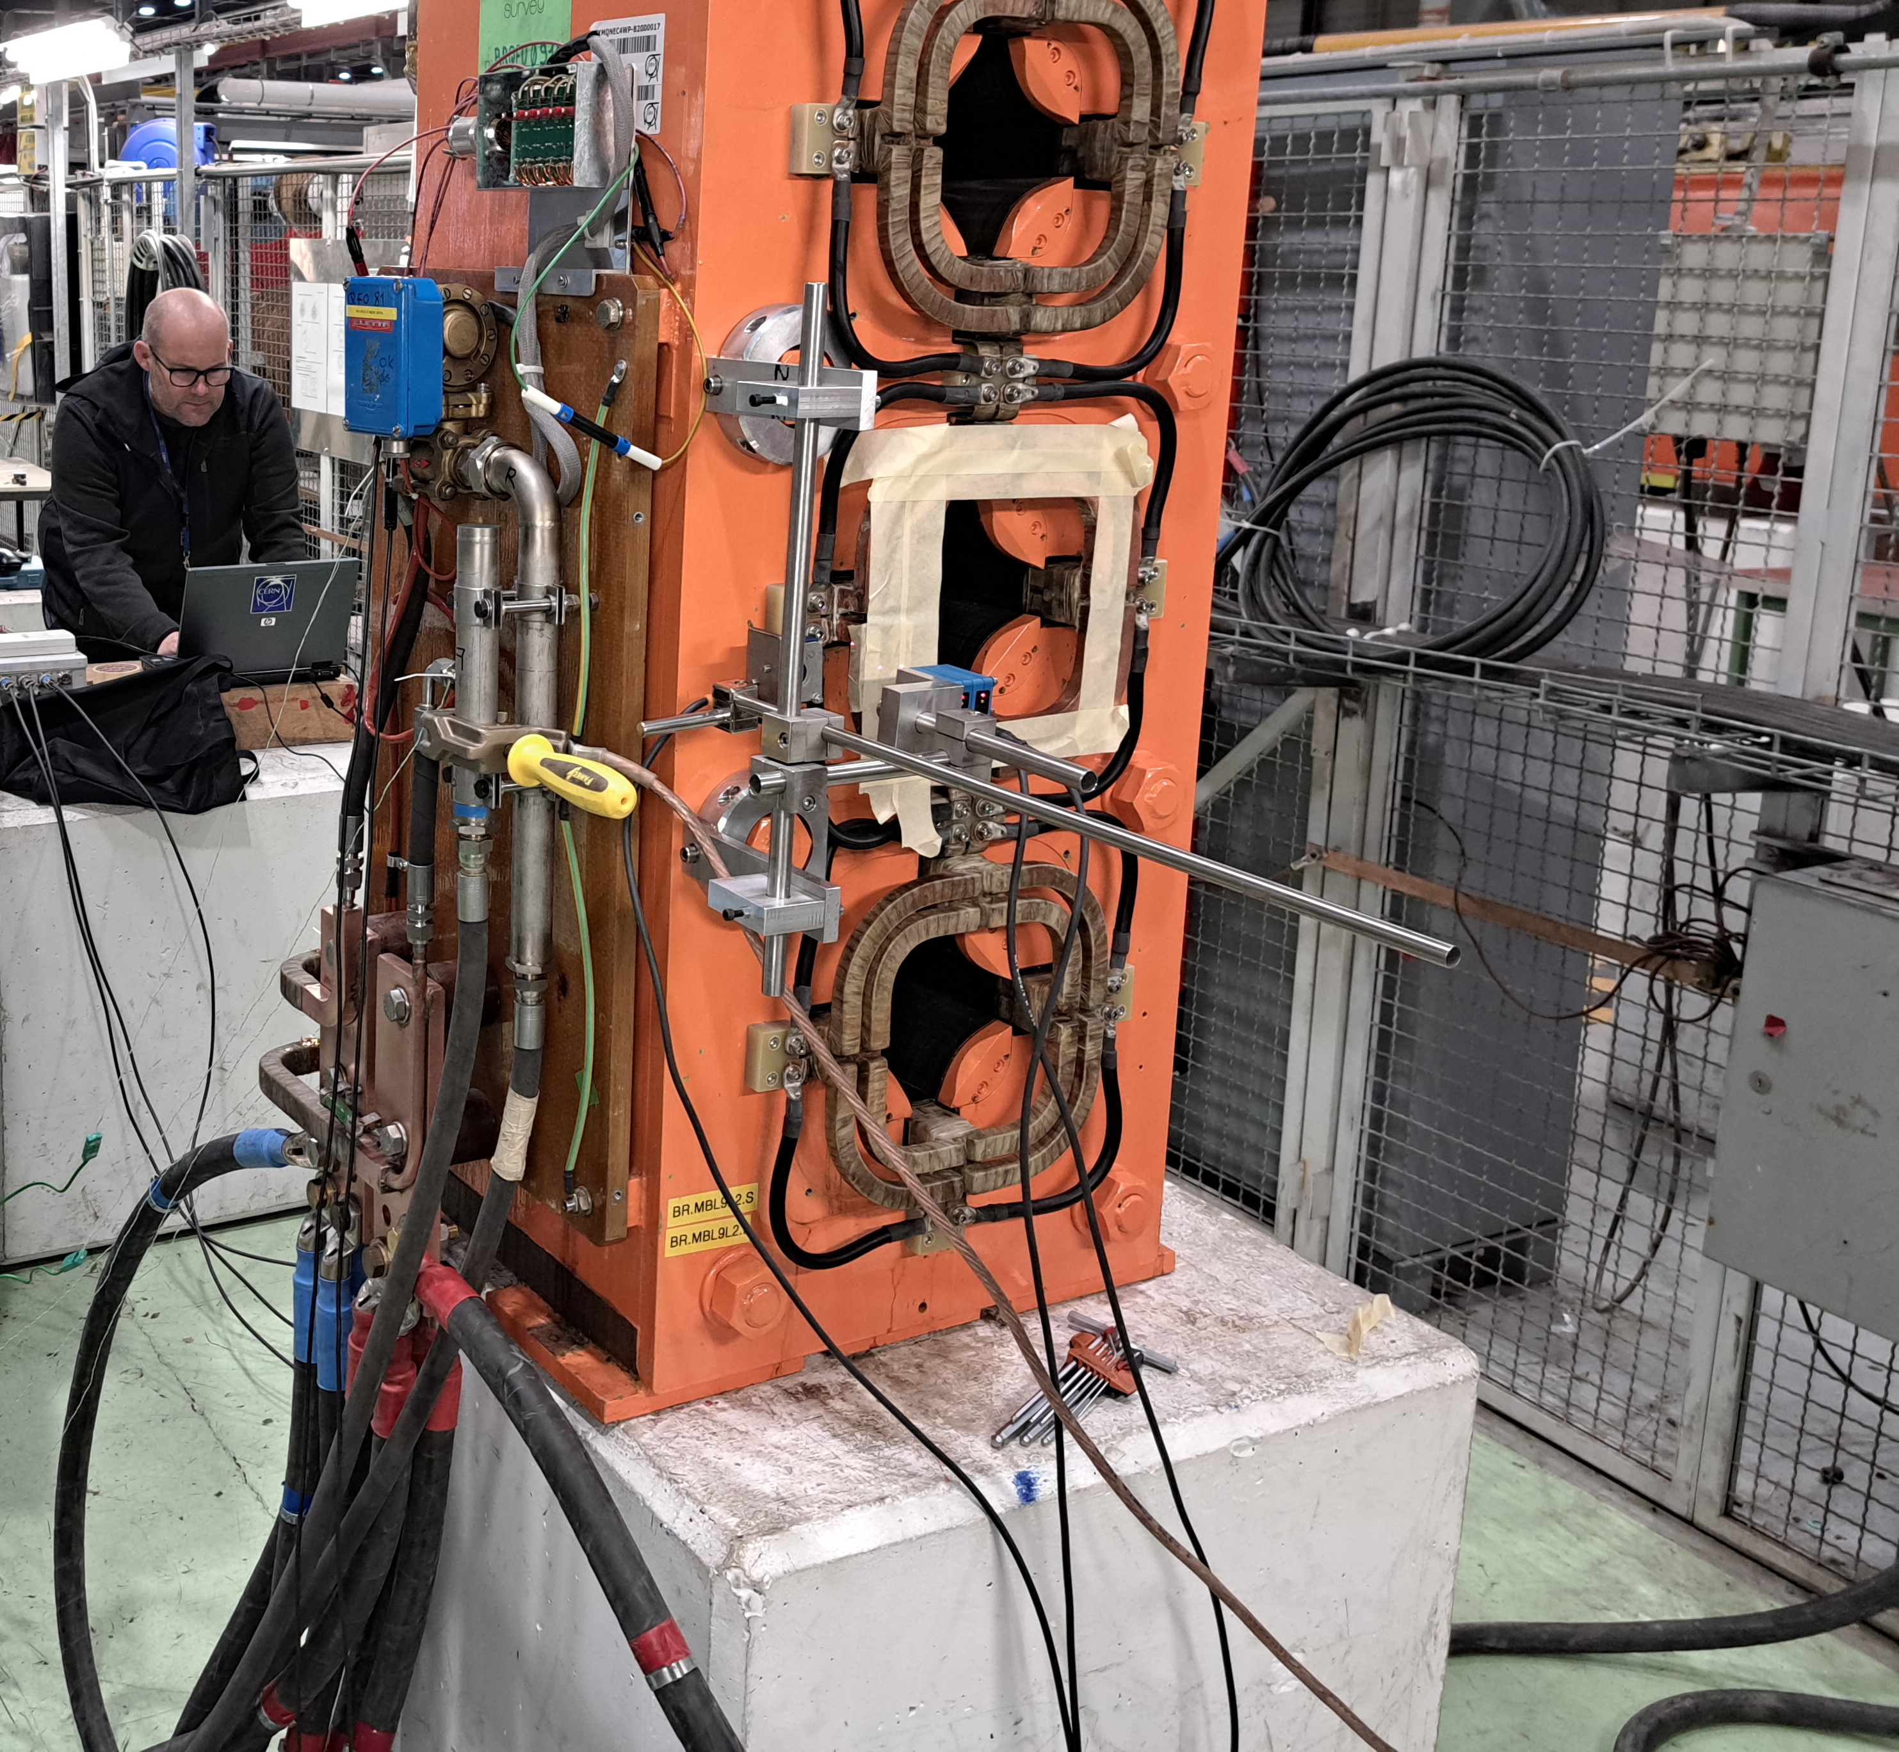
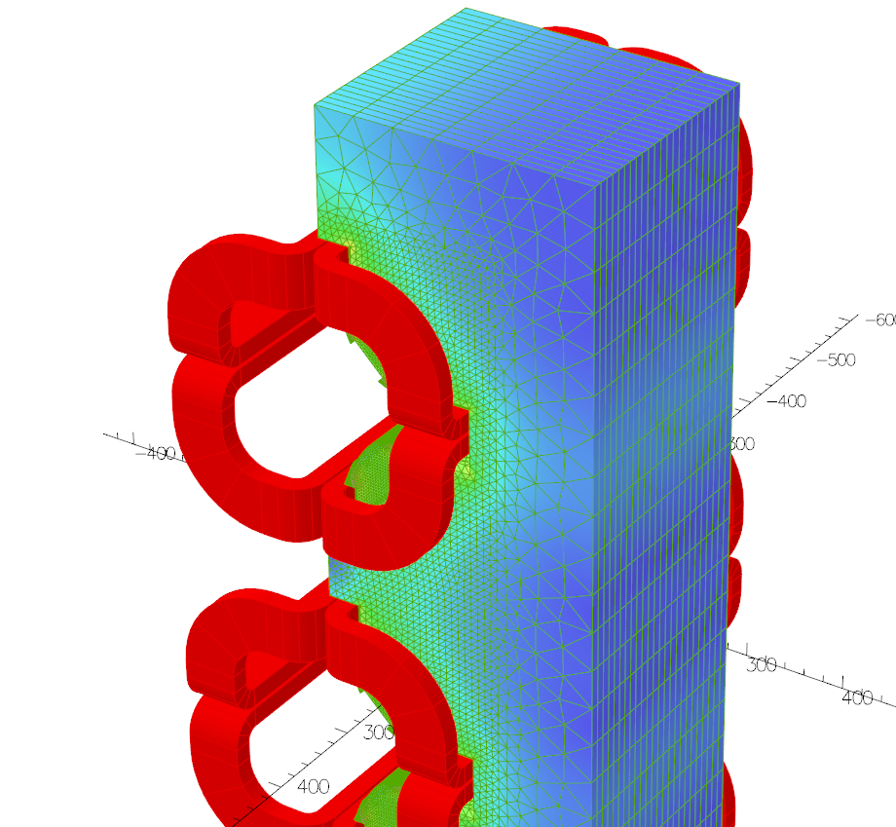
Is the origin of the faults understood?
Ultrasound (EN/MME) and endoscope (TE/MSC) inspections have not identified any erosion of the cooling channel or original brazed joints in either case, further checks will be made on the QDE5 magnet once removed from the machine.
SEM analysis (EN/MME) of the brazing confirms a Copper / Silver / Phosphorus brazing including traces of Cadmium* material (which is a typical brazing filler to avoid flux).
Simulations show a modest force (~250 N) on the coil and brazed joint, measurements on the spare (repaired QFO91) magnet show no movement during the magnetic cycle.
Investigation will continue with the QDE5, but clear priority is to make the magnet operational.
Inspections, measurements and simulations of the PSB Quadrupole Magnets
07/12/22
JAPW - TE/MSC-NCM

Slide 27
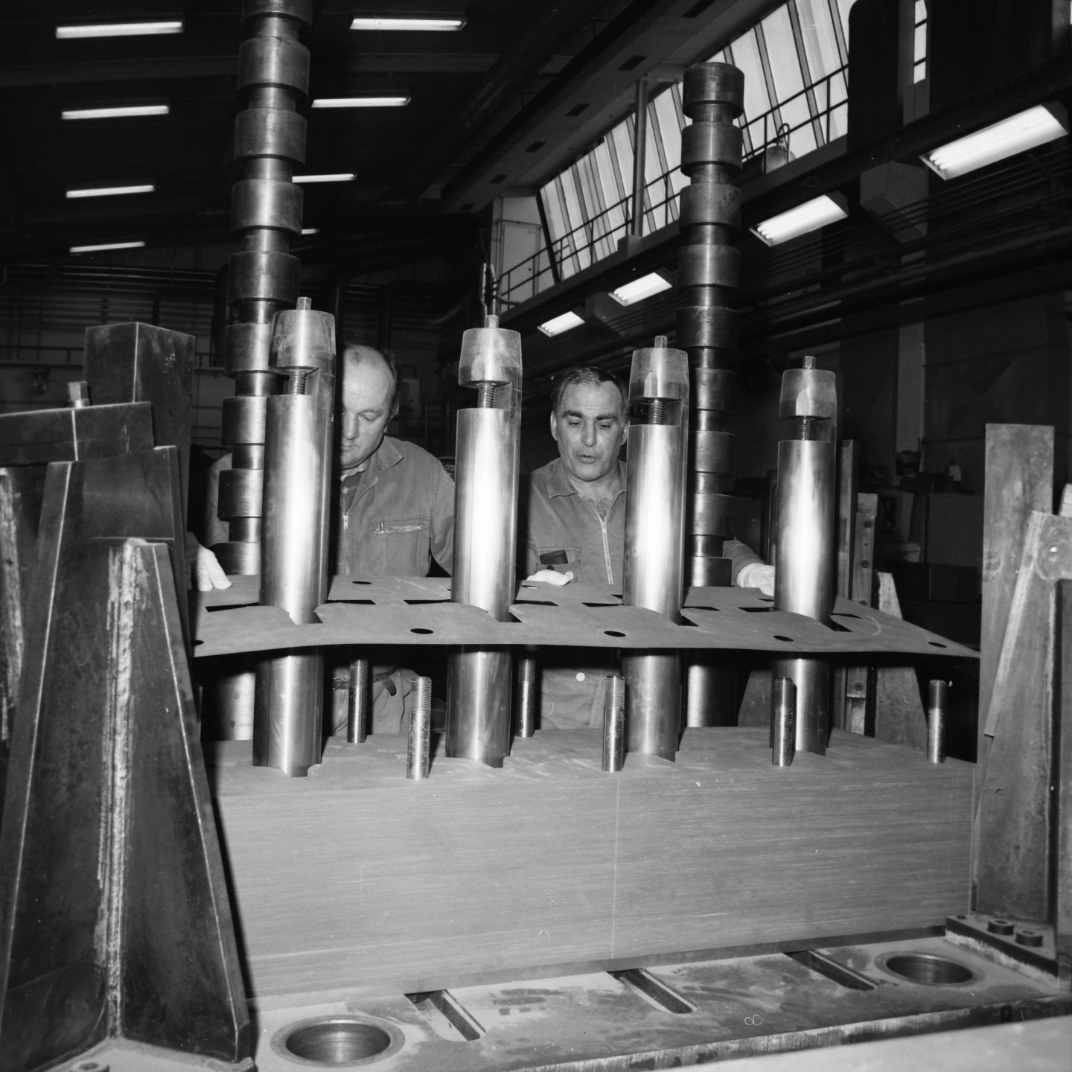

Photo Achieves:
Details about the yoke construction - https://cds.cern.ch/record/2799949
Still searching for the coil assembly ☹

Slide 28


Presence of resin ‘drips’ from the VPI process

Slide 29

Presence of resin ‘drips’ from the VPI process

Slide 30

Trim terminal blocks replaced during 1975 – see https://edms.cern.ch/ui/file/1425477/2/MPS-Int_BR-75-11.pdf
Many of the screws were broken during the exchange due to the fact they had been glued in place during the VPI

Slide 31

Future Actions – Be Prepared!
In anticipation that future repairs are unsuccessful or not possible (ground or interturn shorts etc..), or the failure rate increases, it is proposed to already study and prepare to completely rebuild the magnets.
For this we propose a two-stage approach followed by the eventual renovation campaign:
Stage 1 – Study and dummy trials (~1 year & 170 kCHF)
  Study current method and alternative method of impregnation;
  Order of raw material for dummy trials and to refurbish at least 6 magnets;
  Perform dummy assembly;
  By end of 2023, process validation and submission of full consolidation request.
Stage 2 – Consolidation request including series tooling and infrastructure (~1 year & 420 kCHF)
  Final definition and production of tooling;
  Part production;
  Infrastructure
    VPI system
    Curing oven
Renovation campaign of 6 magnets (~360 kCHF):
  FSU (0.6 per magnet)
Typical VPI System

Slide 32
Future Actions – Be Prepared!
 | Estimated Cost (kCHF) | Estimated Date | Comment
STAGE 1
Design office study | 15 | 12/22 – 2/23 | Operation Budget
Copper for 3 QD / 3 QF | 54 | 06/23 | “ ”
Copper forming (Dummy) | 15 | 06/23 -09/23 | “ ”
Insulation + Resin (3QD + 3 QF) | 20 | 06/23 | “ ”
Dummy ½ Yoke (2 apertures) | 16 | 06/23 | “ ”
Dummy Assembly (FSU) | 30 | 09/23 – 12/23 | “ ”
Impregnation of Dummy with industrial partner + validation | 20 | 09/23 – 12/23 | “ ”
Total | 170
STAGE 2
Design Office, series tooling etc… | 20 | 01/24 - 04/24 | CONS Budget
Series tooling | 30 | from 01/24 | “ ”
Copper forming (3 QD & 3 QF) | 55 | from 01/24 | “ ”
Additional material for 6 magnets (Qstrip copper, shimming etc…) | 30 | from 01/24 | “ ”
Infrastructure
VPI System | 250 | Depending on Study | CONS Budget
Oven | 40 | Depending on Study | “ ”
Total | 420
Renovation Campaign of 6 magnets
FSU (0.6 per magnet) | 360 | Depending on Study | Operation Budget
STAGE 1 + STAGE 2 + Renovation Campaign of 6 magnets* | 948
*Does not include the cost of exchanging the magnets in the machine, for example vacuum/transport/survey works.
In addition, other magnets such as the orbit correctors (PXMCCAAWAP) may need to be exchanged with the quadrupoles as is the case this YETS during the QDE5 replacement. A set of coils for each stack costs ~60 kCHF, for which our stock will soon be depleted.

Slide 33
Future Actions – Be Prepared!
If the faults are indeed linked to a Cadmium ageing of the brazing, then the situation may be much more critical than we first imagined. We could soon face the situation where multiple failures can no longer be covered by the current spare situation or initial proposal to replace and renovate the magnets.
Along with the complete renovation campaign of the existing magnets, 0.6 MCHF + 0.6 FTE per magnet (stripping down the existing magnets and replacing the coils). Two more drastic solutions could be imagined:
  We propose to build 12 additional spares ~ 2.4* MCHF (4 of each QF left and right and 2 of each QD left and right). These magnets would need to be integrated into the machine as new designs and would probably need separate trim circuits to compensate the differences between the old and new yokes. A coffee discussion with OP has confirmed that this could be feasible but would need to be discuss with all involved. Eventually we will still need to rebuild all/most of the radioactive original magnets (0.3** FTE plus 25 kCHF per magnet) ~ 5.3 MCHF with the risk of significant downtime
  Maintaining the current magnets until say LS3, while in parallel building a complete new set of quadrupoles (32 QF and 16 QD plus 4 spares) ~10* MCHF
* Rough estimate of 200 kCHF per magnet
** One would assume that after the initial learning curve the renovation campaign would be optimized to ~3-4 months or less.
The eventual vacuum, transport work remains the same and is not considered above.

Slide 34
Magnet Ageing - Conclusions
Every year the heart of the accelerator complex is getting older. With no magical cream or elixir of life this isn’t going to stop!
PSB Magnet Ageing:
The PSB is one of the most solicitated machines in terms of magnetic cycles, ~500 million to date. Another 200+ million are needed to get to 2040.
The magnets has been running without major faults for nearly 50 years, until the last 2 years where we have now seen 3 leaks on brazed connections.
Even a small increase in failures (1 - 2% of 3650) could require to exchange/repair of all the quadrupole magnets in the machine!
In the case that we run out of spares we could have to live with leaks for up to 2 years or suffer downtime.
A study to be able to completely rebuild the quadrupole magnets is proposed, with stage 1 already underway. The total to refurbish 6 quadrupole magnets is estimated at ~1 MCHF.
Notes:
“we have repaired the spare where it leaked??”

