Slide 1

PS Booster magnets Task Force
Topic discussion - Draft work plan of ST-2
Progress of the running inspections
Planned tests – short term
Draft work plan – medium term
Meeting 2 – 29.03.2023 – ST-2: Analysis and understanding of the failure modes
Stefano Sgobba and Ana Teresa Perez
EDMS_2866091

Slide 2
First outcomes, commonalty of phenomena
Selective corrosion of the Cu at the interface with the braze metal
As above, of the Cu-rich phases within the braze metal
Galvanic effects, crevice corrosion phenomena
Effect of the filler
Aggravating factors: sulphide-induced events?
Poor quality of the brazed joints
Next steps:
Three additional non-leaking samples from main quadrupole already inspected by CT;
Cutting and microscopic inspection will follow with identical procedure to gain understanding of the corrosion mechanism and have more statistics about the joints state

Slide 3
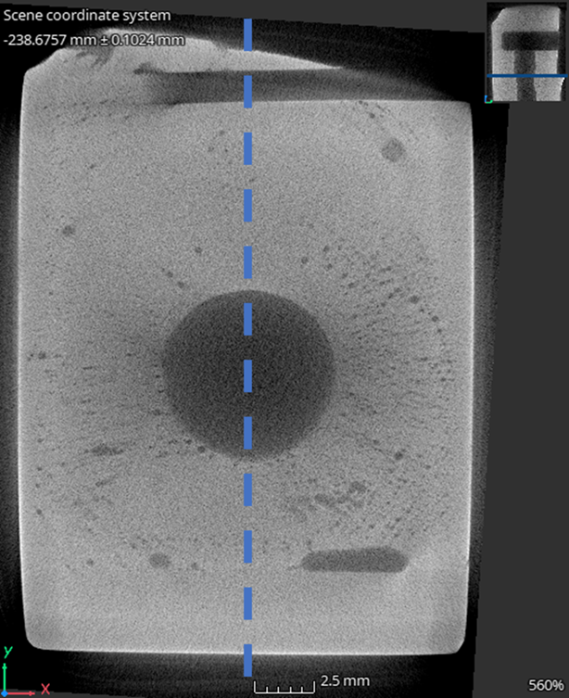
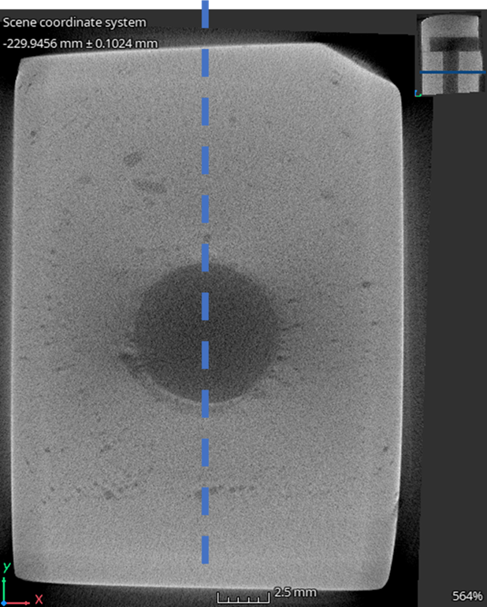
 | Sample #1 | Sample #2 | Sample #3 | Additional samples
Sample from | PSB main quadrupole | PSB main quadrupole | PSB bending dipole | PSB main quadrupole
Time in service | 50 years | 2 weeks | Until LS2 | Until LS2 ??
Status | Non-leaking
Interface aspect | Bulk Cu selectively attacked |  |  | -
Sulphur content | Up to 5.5 wt. % | Below 1 wt. % | Up to 5.5 wt. % | -
CT reports | 2817755 | 2824484 | 2825737 | 2847250
Microscopy reports |  | 2855110 | Under preparation | -
Additional samples (cuts ongoing):
PSAM-007337 (left), PSAM-007338 (middle) &
PSAM-007339 (right)

Slide 4
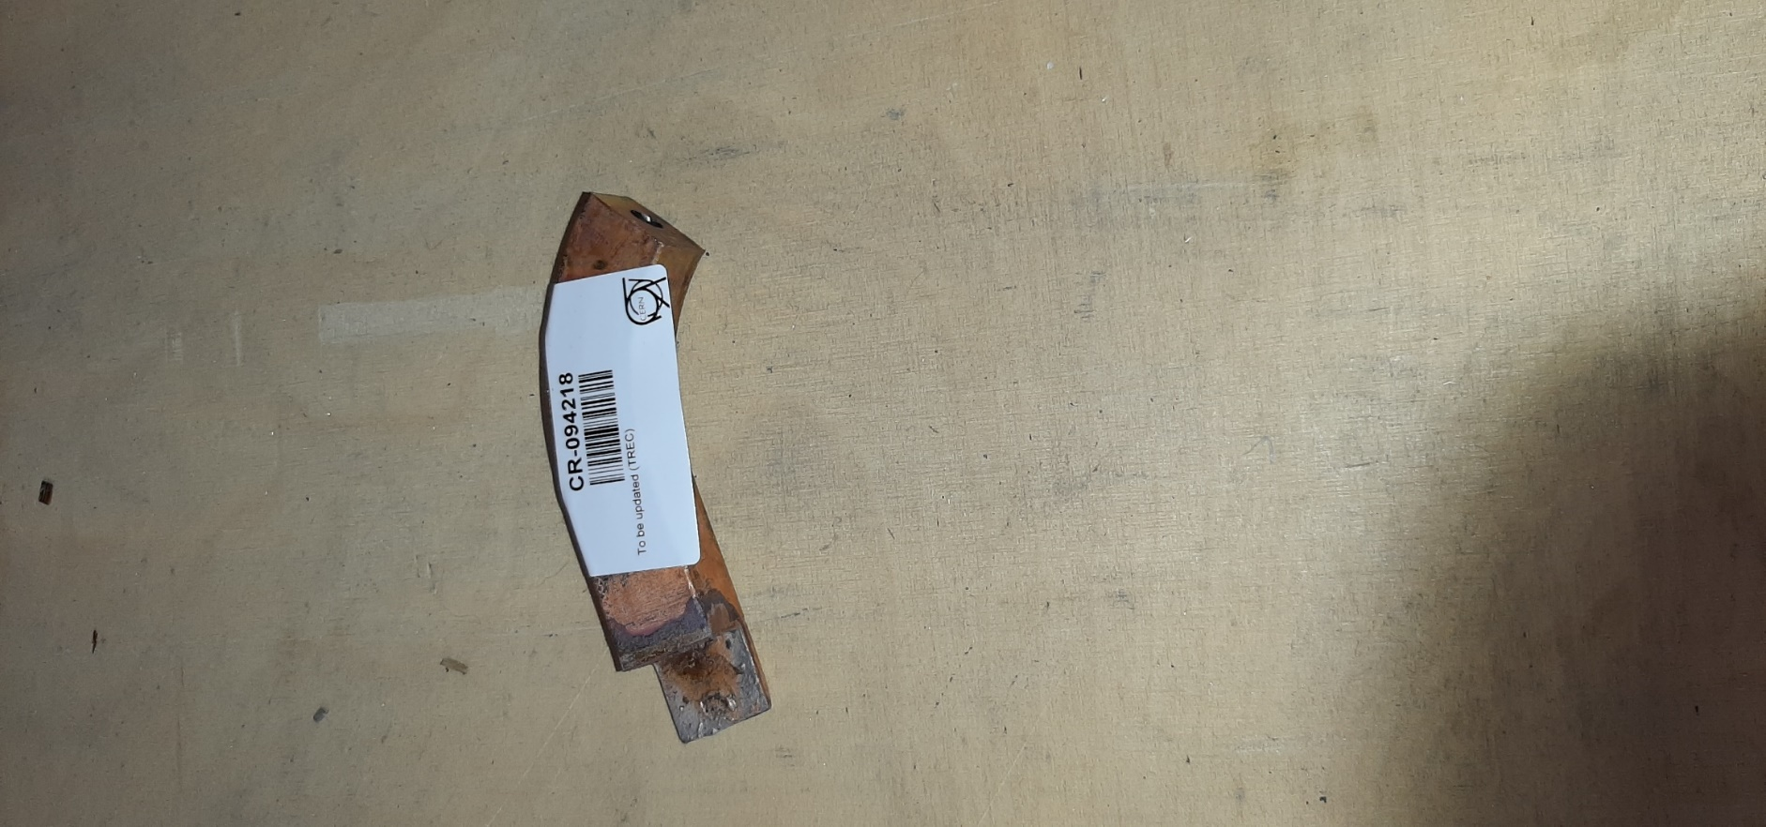
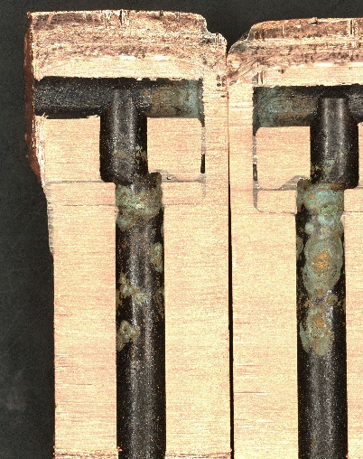
Planned tests – short term: additional tests by TE-VSC
Meeting with TE-VSC experts on 23.03.23 (M. Taborelli, M. Himmerlich, B. Teissandier). Envisaged tests:
  Water from PSB cooling circuit (IR + XRF) → To confirm + estimate the presence of S on the water
    Similar analysis was performed on demineralized water from LHC Point #4 in 2022 → https://edms.cern.ch/document/2718759/2
    Minimum volume required → ≈ 1L
    Validation by RP (N. Conan) and CV (contact person?)
XPS
  Braze bead analysis and overflow of the braze alloy on the inner surface of the tube (XPS) → To investigate the possible presence of Cd on the brazing alloy Cu-Ag-P and traces of S
    Maximum thickness → 10 mm x 10 mm x 8 mm → It is easy to cut a specimen form the de-brazed sample (activated) in the image
    Additional XPS sample will be prepared from a non de-brazed sample
  Other analyses (ICP), following chemical dissolution of other elements except Cd?
  γ-spectroscopy analysis (contact with Nabil Menaa / HSE-RP) → radioanalytical techniques could help via the quantification of Cd-109 even though it is challenging as the 88 keV gamma line intensity is only 3.6%
ICP

Slide 5
Draft work plan – medium term
1) Identify all magnet cooling circuits (⇒ TE/MSC)
    Copper based
    Including soldered, brazed and/or braze welded joints
  2) For the above circuits
    Provide history of operation (demineralized water, maintenance – dry periods)
    Information about parent and filler metal grades, if available
    Availability of unoperated or shortly operated spares, for comparison (⇒TE/MSC)
    Sampling and analysis of the water (S residues)
    Historical analyses of the water if available (⇒EN/CV)
    3) On selected cooling circuit joints (based on relevance, accessibility, availability for removals…)
    Perform similar analyses as for PSB (⇒EN/MME)

Slide 6
Draft work plan – medium term_2
4) Start envisaging applicable repair/rebuilding solutions (⇒ ST-3)
    By soldering (?), brazing and/or braze welding
    Improved geometry, avoid recesses, increase ligament length…
    Qualification of repair/rebuilding processes: assess the achievable quality, to be improved compared to the past state of the art
    Accelerated corrosion tests
    5) General recommendations
    Avoid S contamination, how?
    Purging and inert gas shielding of the circuits when non-operated, identify solutions

